Slide 1
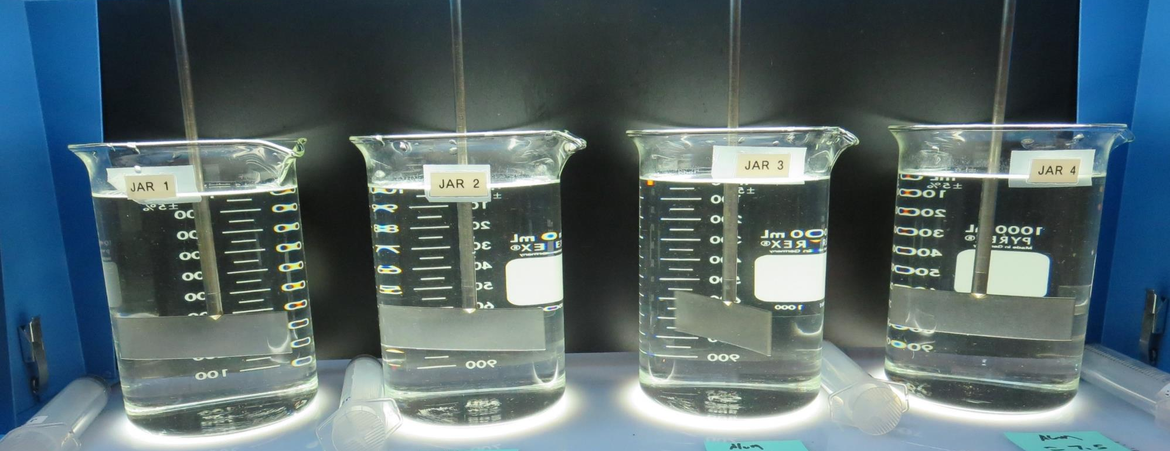
South Feather Water & Power Agency (SFWPA) CA0410006 Butte County Jar Test
by Guy Schott, P.E
June 4, 2020

Slide 2
Source Water: Miners Ranch Reservoir Treatment: Trident Clarifiers followed by Multi-Media Filtration
Source Water Characteristics
Turbidity: 0.83 NTU
pH: 7.55
UVT: 95.6%, UVA: 0.019/cm
Filtrate Plant Water
Coagulant Dose, Alum: 7.7 mg/L
Turbidity: 0.09 NTU
UVT: 98.3%, UVA: 0.007/cm
UVA Reduction: 63.2%

Slide 3
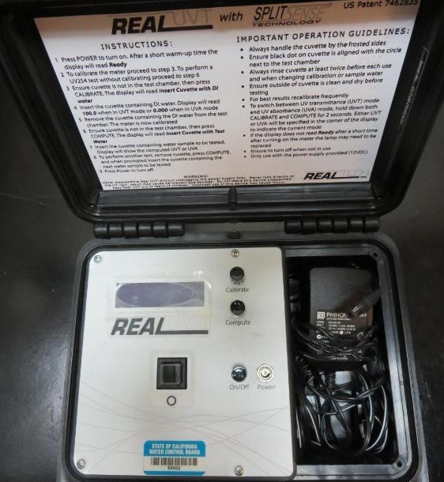
UVT/UVA, pathlength 10 mm
UV transmittance (UVT) is a measurement of the amount of ultraviolet light (commonly at 254 nm due to its germicidal effect) that passes through a water sample compared to the amount of light that passes through a pure water sample. The measurement is expressed as a percentage, % UVT.
%UVT = 10^{(-UVA)} x 100%
UV absorbance (UVA) is calculated as a relative measure of the amount of light absorbed by a water sample compared with the amount of light absorbed by a pure water sample.
UVA = -log(%UVT/100)

Slide 4
Applied Coagulants for Jar Testing
Pro Pac 9810 (NTU Technologies)
45-50% Aluminum Chlorohydrate (ACH)
45-50% Water
5% Proprietary
SG = 1.25 - 1.34
Aluminum Sulfate
48.25% Alum
SG = 1.34
Advanced Coagulant
12.55% Al₂O₃
6.64% Al
66.4% Basicity
SG = 1.3

Slide 5
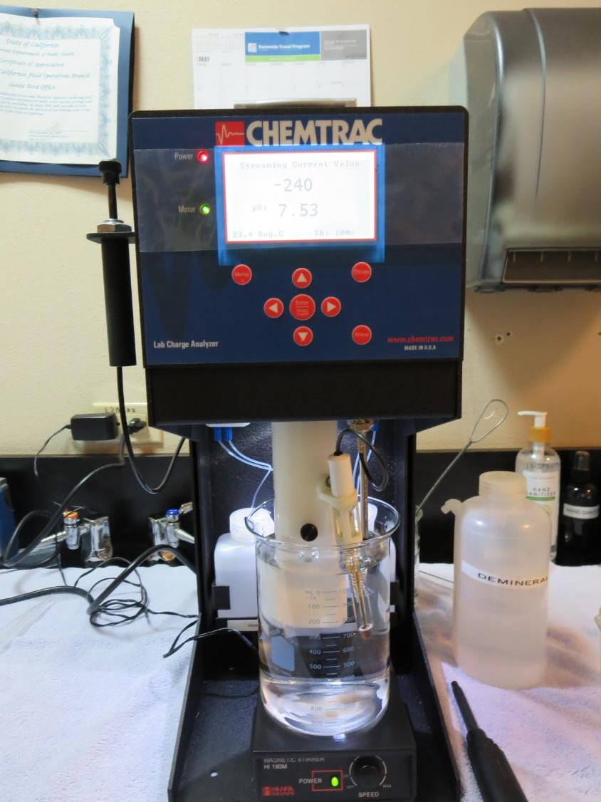
Laboratory Charge Analyzer
LCA: Used to determine coagulant demand of a source water entering the treatment plant.
Source pH: 7.55
LCA #1:
Alum: 4.5 mg/L as product
pH adjusted to 6.7 w/acetic acid solution
LCA #2:
9810: 3.3 mg/L as product
(no pH adjustment)

Slide 6
Coagulant Information
Unless stated otherwise, all coagulant doses are reported as Product (100% strength). Aluminum sulfate is reported as Alum.
Preparation of coagulant stock solutions are generally 1.0 and/or 0.1 percent strength using 100 and/or 200 mL volumetric flasks.
Finnpipette F2 variable volume pipette, capacity 100-1000 micro liters is used for stock solution preparation and coagulant aid jar test dosing.
Finnpipette F2 variable volume pipette, capacity 0.5-5 mL is used for primary coagulant jar test dosing.

Slide 7
Filterability and %UVT/UVA Analysis
For all jars, 25 mL were sampled immediately at the end of flocculation duration for filterability and %UVT/UVA.

Slide 8
SFWPA : Jar Test 1-8 Results 25 mL sampled at end of floc duration.
Jar # | 200 RPM Flash Mix Seconds | RPM Floc Duration 5 min | Alum mg/L | Filtrate NTU | Filtrate %UVT | Filtrate UVA/cm | %UVA Reduction
J1 | 30 | 30 | 4.0 | 0.15 | 96.7 | 0.014 | 26.3
J2 | 30 | 30 | 4.5 | 0.11 | 96.7 | 0.014 | 26.3
J3 | 30 | 30 | 5.0 | 0.11 | 96.8 | 0.013 | 31.6
J4 | 30 | 30 | 5.5 | 0.09 | 96.8 | 0.013 | 31.6
J5 | 30 | 30 | 6.0 | 0.11 | 97.3 | 0.011 | 42.1
J6 | 30 | 30 | 6.5 | 0.09 | 97.5 | 0.011 | 42.1
J7 | 30 | 30 | 7.0 | 0.07 | 97.7 | 0.010 | 47.4
J8 | 30 | 30 | 7.5 | 0.09 | 97.5 | 0.010 | 47.4

Slide 9
SFWPA : Jar Test 9-16 Results 25 mL sampled at end of floc duration.
Jar # | 200 RPM Flash Mix Seconds | RPM Floc Duration 5 min | 9810 mg/L | Filtrate NTU | Filtrate %UVT | Filtrate UVA/cm | %UVA Reduction
J9 | 30 | 30 | 3.0 | 0.16 | 97.7 | 0.010 | 47.4
J10 | 30 | 30 | 3.3 | 0.10 | 98.0 | 0.008 | 57.9
J11 | 30 | 30 | 3.6 | 0.10 | 98.2 | 0.007 | 63.2
J12 | 30 | 30 | 3.9 | 0.07 | 98.3 | 0.007 | 63.2
J13 | 30 | 30 | 4.2 | 0.14 | 97.5 | 0.011 | 42.1
J14 | 30 | 30 | 4.5 | 0.08 | 98.1 | 0.008 | 57.9
J15 | 30 | 30 | 4.8 | 0.17 | 97.8 | 0.009 | 52.6
J16 | 30 | 30 | 5.1 | 0.20 | 97.8 | 0.009 | 52.6

Slide 10
SFWPA : Jar Test 17-24 Results 25 mL sampled at end of floc duration.
Jar # | 200 RPM Flash Mix Seconds | RPM Floc Duration 5 min | Adv Coag. mg/L | Filtrate NTU | Filtrate %UVT | Filtrate UVA/cm | %UVA Reduction
J17 | 30 | 30 | 4.0 | 0.17 | 96.7 | 0.014 | 26.3
J18 | 30 | 30 | 5.0 | 0.12 | 97.0 | 0.013 | 31.6
J19 | 30 | 30 | 6.0 | 0.14 | 96.7 | 0.014 | 26.3
J20 | 30 | 30 | 7.0 | 0.12 | 97.0 | 0.013 | 31.6
J21 | 30 | 30 | 8.0 | 0.11 | 97.5 | 0.011 | 42.1
J22 | 30 | 30 | 9.0 | 0.09 | 97.5 | 0.010 | 47.4
J23 | 30 | 30 | 10.0 | 0.08 | 97.6 | 0.010 | 47.4
J24 | 30 | 30 | 11.0 | 0.09 | 97.6 | 0.010 | 47.4

Slide 11
SFWPA : Jar Test 25-28 Results 25 mL sampled at end of floc duration.
Jar # | 200 RPM Flash Mix Seconds | RPM Floc Duration 5 min | Alum mg/L | Filtrate NTU | Filtrate %UVT | Filtrate UVA/cm | %UVA Reduction
J25 | 30 | 30 | 7.0 | 0.11 | 97.5 | 0.010 | 47.4
J26 | 30 | 30 | 7.5 | 0.10 | 97.7 | 0.010 | 47.4
J27 | 30 | 30 | 8.0 | 0.11 | 97.6 | 0.010 | 47.4
J28 | 30 | 30 | 8.5 | 0.07 | 97.8 | 0.009 | 52.6

Slide 12
Jars 1-4 Test Flash Mix 30 Sec (200 RPM) Floc Mix 5 min (30 RPM) 25 mL sampled end of Floc Applied Coagulant Aluminum Sulfate

Slide 13
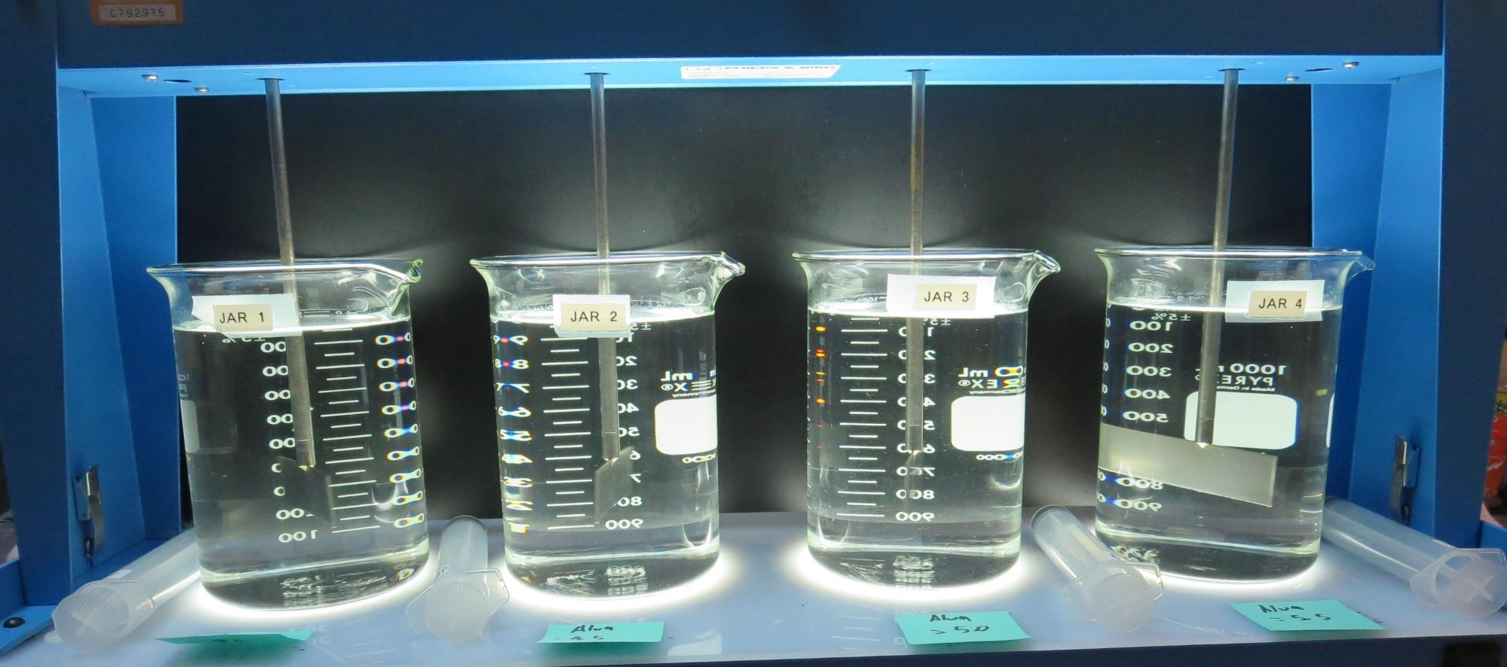
Jars 1-4: At End of Floc Duration, 25 mL is syringed for filterability and %UVT/UVA.
4.0 mg/L Alum
Filtrate 0.15 NTU
UVT: 96.7%
UVA: 0.014/cm
UVA Reduction 26.3%
4.5 mg/L Alum
Filtrate 0.11 NTU
UVT: 96.7%
UVA: 0.014/cm
UVA Reduction 26.3%
5.0 mg/L Alum
Filtrate 0.11 NTU
UVT: 96.8%
UVA: 0.013/cm
UVA Reduction 31.6%
5.5 mg/L Alum
Filtrate 0.09 NTU
UVT: 96.8%
UVA: 0.013/cm
UVA Reduction 31.6%

Slide 14
Jars 5-8 Test Flash Mix 30 Sec (200 RPM) Floc Mix 5 min (30 RPM) 25 mL sampled end of Floc Applied Coagulant Aluminum Sulfate

Slide 15
Jars 5-8: At End of Floc Duration, 25 mL is syringed for filterability and %UVT/UVA.
6.0 mg/L Alum
Filtrate 0.11 NTU
UVT: 97.3%
UVA: 0.011/cm
UVA Reduction 42.1%
6.5 mg/L Alum
Filtrate 0.09 NTU
UVT: 97.5%
UVA: 0.011/cm
UVA Reduction 42.1%
7.0 mg/L Alum
Filtrate 0.07 NTU
UVT: 97.7%
UVA: 0.010/cm
UVA Reduction 47.4%
7.5 mg/L Alum
Filtrate 0.09 NTU
UVT: 97.5%
UVA: 0.013/cm
UVA Reduction 47.4%

Slide 16
Jars 9-12 Test Flash Mix 30 Sec (200 RPM) Floc Mix 5 min (30 RPM) 25 mL sampled end of Floc Applied Coagulant 9810

Slide 17
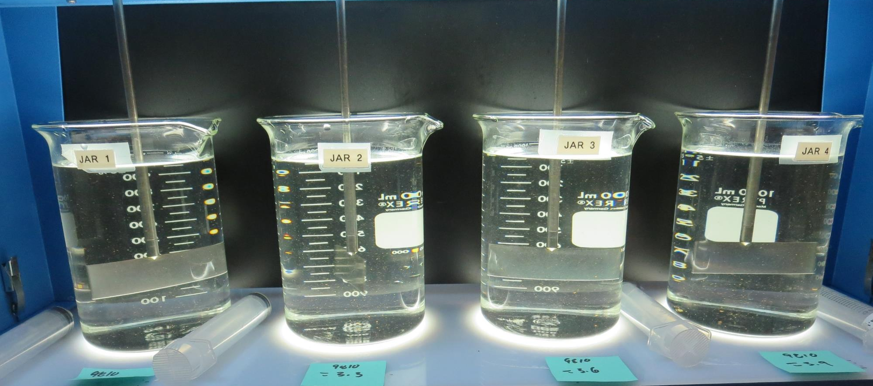
Jars 9-12: At End of Floc Duration, 25 mL is syringed for filterability and %UVT/UVA.
3.0 mg/L 9810
Filtrate 0.16 NTU
UVT: 97.7%
UVA: 0.010/cm
UVA Reduction 47.4%
3.3 mg/L 9810
Filtrate 0.10 NTU
UVT: 98.0%
UVA: 0.008/cm
UVA Reduction 57.9%
3.6 mg/L 9810
Filtrate 0.10 NTU
UVT: 98.2%
UVA: 0.007/cm
UVA Reduction 63.2%
3.9 mg/L 9810
Filtrate 0.07 NTU
UVT: 98.3%
UVA: 0.007/cm
UVA Reduction 63.2%

Slide 18
Jars 13-16 Test Flash Mix 30 Sec (200 RPM) Floc Mix 5 min (30 RPM) 25 mL sampled end of Floc Applied Coagulant 9810

Slide 19
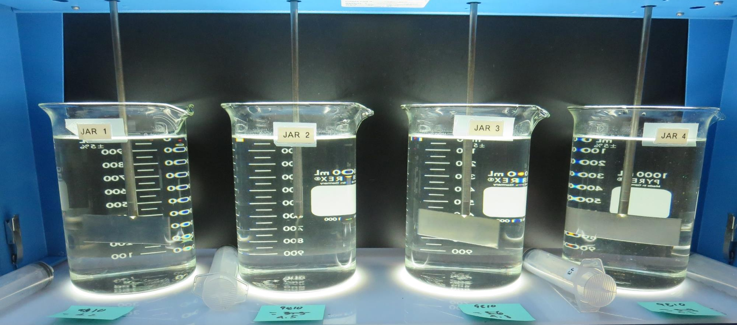
Jars 13-16: At End of Floc Duration, 25 mL is syringed for filterability and %UVT/UVA.
4.2 mg/L 9810
Filtrate 0.14 NTU
UVT: 97.5%
UVA: 0.011/cm
UVA Reduction 42.1%
4.5 mg/L 9810
Filtrate 0.08 NTU
UVT: 98.1%
UVA: 0.008/cm
UVA Reduction 57.9%
4.8 mg/L 9810
Filtrate 0.17 NTU
UVT: 97.8%
UVA: 0.009/cm
UVA Reduction 52.6%
5.1 mg/L 9810
Filtrate 0.20 NTU
UVT: 97.8%
UVA: 0.009/cm
UVA Reduction 52.6%

Slide 20
Jars 17-20 Test Flash Mix 30 Sec (200 RPM) Floc Mix 5 min (30 RPM) 25 mL sampled end of Floc Applied Coagulant Advanced Coagulant

Slide 21
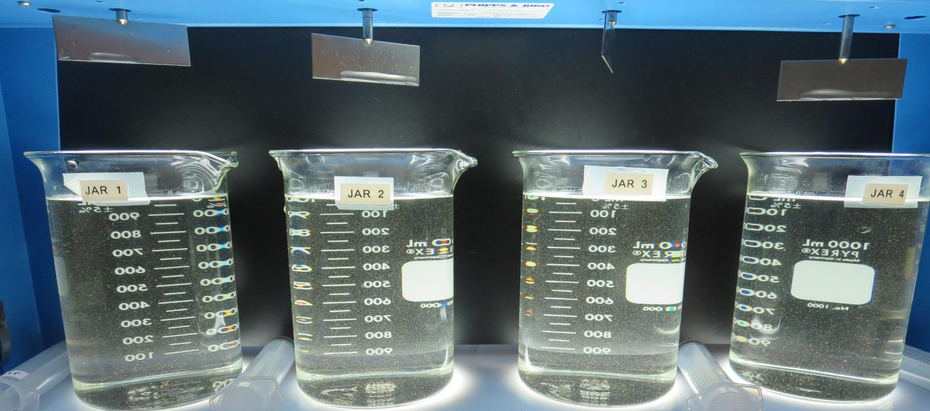
Jars 17-20: At End of Floc Duration, 25 mL is syringed for filterability and %UVT/UVA.
4.0 mg/L Adv Coag.
Filtrate 0.17 NTU
UVT: 96.7%
UVA: 0.014/cm
UVA Reduction 26.3%
5.0 mg/L Adv Coag.
Filtrate 0.12 NTU
UVT: 97.0%
UVA: 0.013/cm
UVA Reduction 31.6%
6.0 mg/L Adv Coag.
Filtrate 0.14 NTU
UVT: 96.7%
UVA: 0.014/cm
UVA Reduction 26.3%
7.0 mg/L Adv Coag.
Filtrate 0.12 NTU
UVT: 97.0%
UVA: 0.013/cm
UVA Reduction 31.6%

Slide 22
Jars 21-24 Test Flash Mix 30 Sec (200 RPM) Floc Mix 5 min (30 RPM) 25 mL sampled end of Floc Applied Coagulant Advanced Coagulant

Slide 23
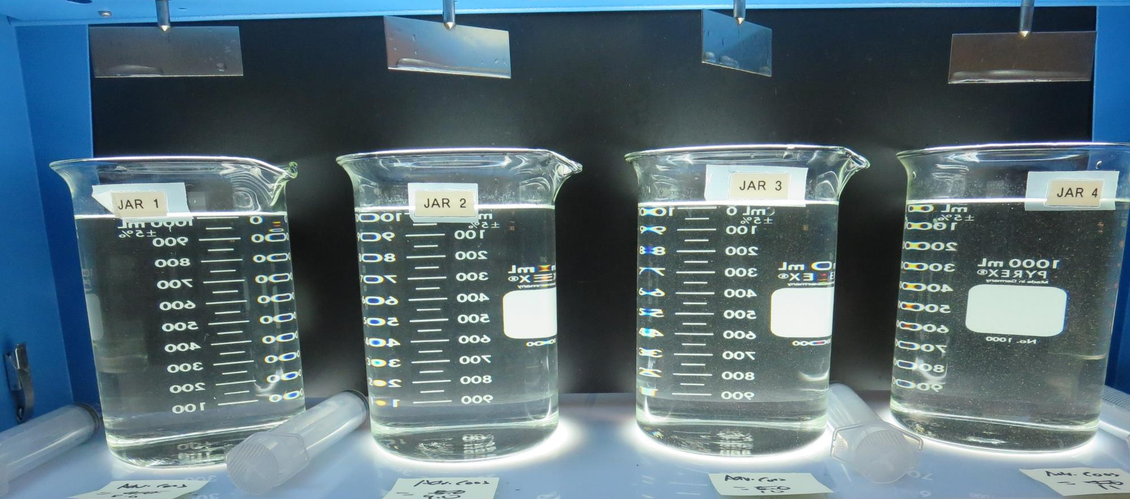
Jars 21-24: At End of Floc Duration, 25 mL is syringed for filterability and %UVT/UVA.
8.0 mg/L Adv Coag.
Filtrate 0.11 NTU
UVT: 97.5%
UVA: 0.011/cm
UVA Reduction 42.1%
9.0 mg/L Adv Coag.
Filtrate 0.09 NTU
UVT: 97.5%
UVA: 0.010/cm
UVA Reduction 47.4%
10.0 mg/L Adv Coag.
Filtrate 0.08 NTU
UVT: 97.6%
UVA: 0.010/cm
UVA Reduction 47.4%
11.0 mg/L Adv Coag.
Filtrate 0.09 NTU
UVT: 97.6%
UVA: 0.010/cm
UVA Reduction 47.4%

Slide 24
Jars 25-28 Test Flash Mix 30 Sec (200 RPM) Floc Mix 5 min (30 RPM) 25 mL sampled end of Floc Applied Coagulant Aluminum Sulfate

Slide 25
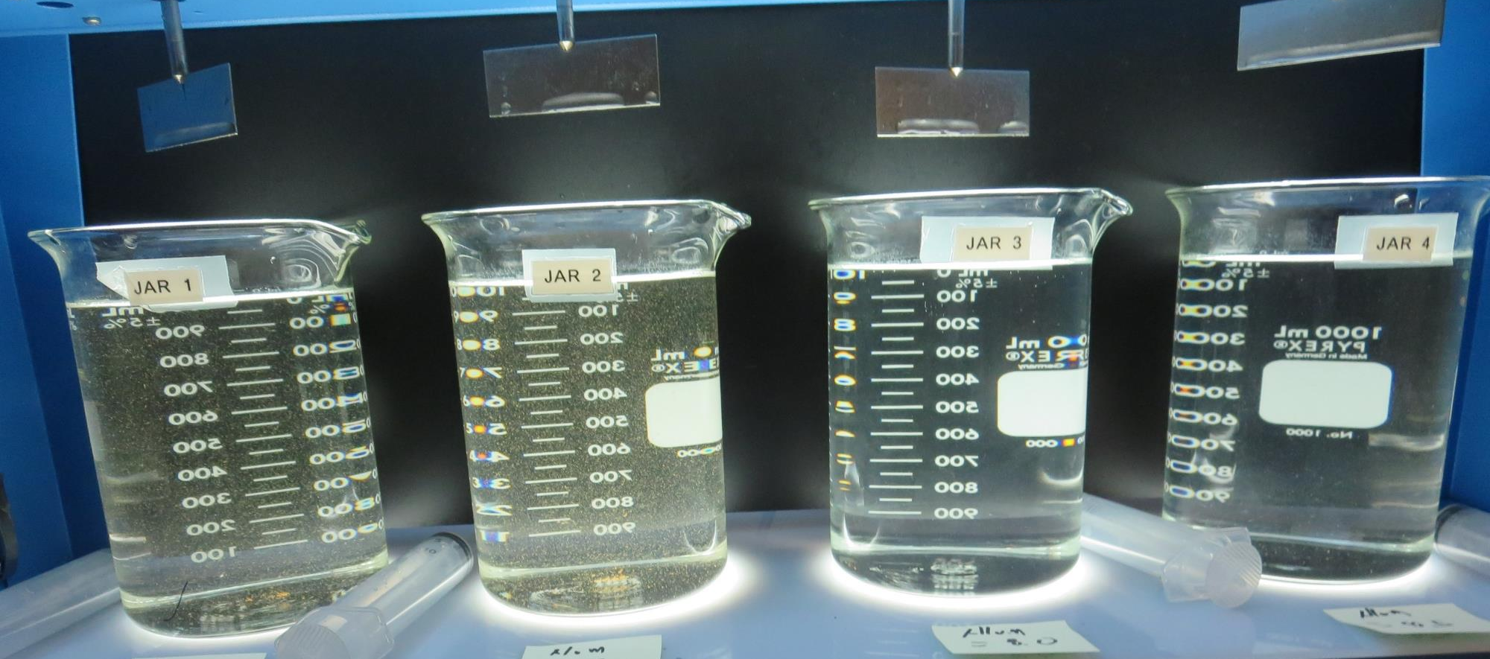
Jars 25-28: At End of Floc Duration, 25 mL is syringed for filterability and %UVT/UVA.
7.0 mg/L Alum
Filtrate 0.11 NTU
UVT: 97.5%
UVA: 0.010/cm
UVA Reduction 47.4%
7.5 mg/L Alum
Filtrate 0.10 NTU
UVT: 97.7%
UVA: 0.010/cm
UVA Reduction 47.4%
8.0 mg/L Alum
Filtrate 0.11 NTU
UVT: 97.6%
UVA: 0.010/cm
UVA Reduction 47.4%
8.5 mg/L Alum
Filtrate 0.07 NTU
UVT: 97.8%
UVA: 0.009/cm
UVA Reduction 52.6%

Slide 26
Jar Testing for 1-Liter Jars: Procedures for Most Treatment Plants
Fill jars with source water prior to coagulant injection and set paddle speed at 30 rpm
Add chemicals (i.e., NaOCl, primary coagulant, coagulant aid) to each jar
Flash mix for 15-60 seconds (200 rpm)
Slow mix for 5 minutes (20-30 rpm)
Settled for 5 minutes. Syringe 25 mL from each jar taken 1-inch below surface (25 mL/12 sec rate). For this study, sample was taken immediately at the end of flocculation process.
Filtered through 1.2 um isopore membrane into cuvette drip rate, 15 mL/(50-90 sec)
Measure filtrate turbidity, chlorine residual and %UVT/UVA
Measure settled water turbidity after 25 minutes of total setting
Record all data

Slide 27
Jar Test Filterability Test Equipment
Turbidity Instrument
Syringe w/Luer-Lock Tip, 30 cc
(part#: 2225800, by Hach)
Swinnex Filter Holder, 25 mm (part#: SX0002500)
Isopore Membrane Filter, 1.2 um absolute
pore size,
Φ= 25 mm , thickness: 24 um,
hydrophilic polycarbonate membrane
(part #: RTTP02500)
Go to Sigma-Aldrich for laboratory supplies http://www.sigmaaldrich.com/united-states.html

Slide 28
Isopore Membrane Information
Categories | Information
trade name | Isopore
filter color | White
chemistry | Polycarbonate (PC)
water flow rate | Avg. 175 mL/min x cm² (typical results @ 10 psi)
media | Isopore®
wettability | Hydrophilic
porosity | 14.7%
pore size | 1.2 µm
bubble point at 23 °C | 1.0 bar, air with water
thickness | 24 µm
filter diameter (ø) | 25 mm
material size | polycarbonate, Hydrophilic, 1.2 µm, 25 mm, white, plain, 100

Slide 29
Isopore Membrane Background Information
The Isopore membrane is a polycarbonate, track-etched screen filter recommended for all analyses in which the sample is viewed on the surface of the membrane. The Isopore membrane is composed of polycarbonate film, which has a smooth, glass-like surface for clearer sample observation. The unique manufacturing process of the membrane ensures a precise pore diameter and a consistent pore size for accurate separation of samples by size. Matched-weight filters are not usually required because of low, constant tar and ash weights. Features & Benefits: Membrane structure retains particles on the surface, simplifying counting and analysis

Slide 30
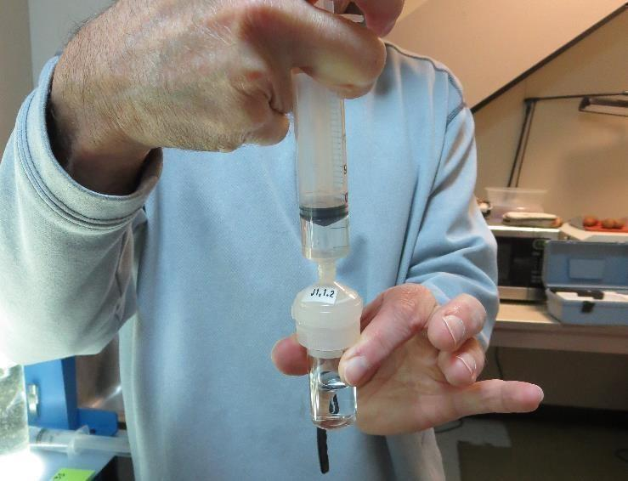
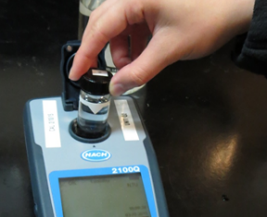
Jar Test - Filterability Test
Syringe ~ 25 mL from jar (after 5-minutes of settling)
Filter-to-waste 3-5 mL
Filter directly into clean cuvette
Measure turbidity
Note: Take several readings before recording final NTU results. Micro bubbles can adhere to glass causing false NTU readings. To remove bubbles, tilt cuvette up to 90 degrees.

Slide 31
Contact
Guy Schott, P.E.
State Water Resources Control Board
Division of Drinking Water
Santa Rosa, CA
Go to Stock Solution/Dose calculations/Jar Test Results for tools to download
www.waterboards.ca.gov/drinking_water/programs/districts/mendocino_district.html
Email: Guy Schott - Guy.Schott@waterboards.ca.gov
Office Number: 707-576-2732

