Slide 1
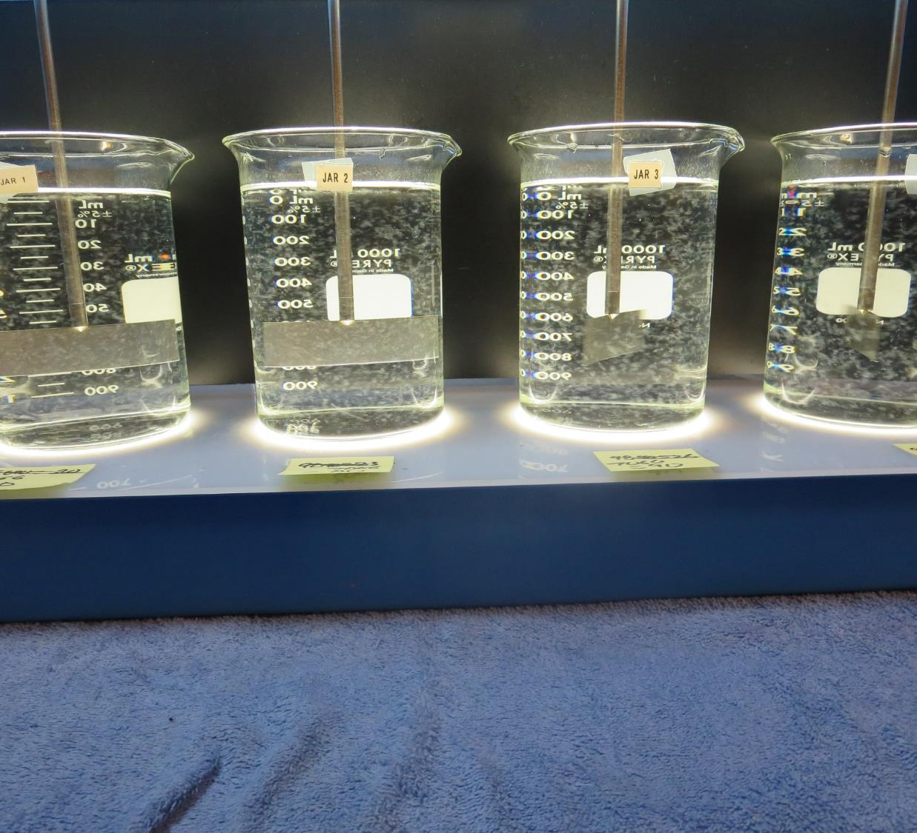
Kettleman City CSD CA1610009 Kings County Jar Test
by Guy Schott, P.E.
November 5, 2019

Slide 2
Source Water: California Aqueduct
Source Water Charateristic
Turbidity: 0.98 NTU
pH: 8.05, Alkalinity: 70 mg/L as CaCO₃
UVT: 83.9%,
UVA: 0.076/cm
0.4 um Source Filtered
UVT: 84.9%,
UVA: 0.071/cm
Conventional Treatment w/Membrane Filtration

Slide 3
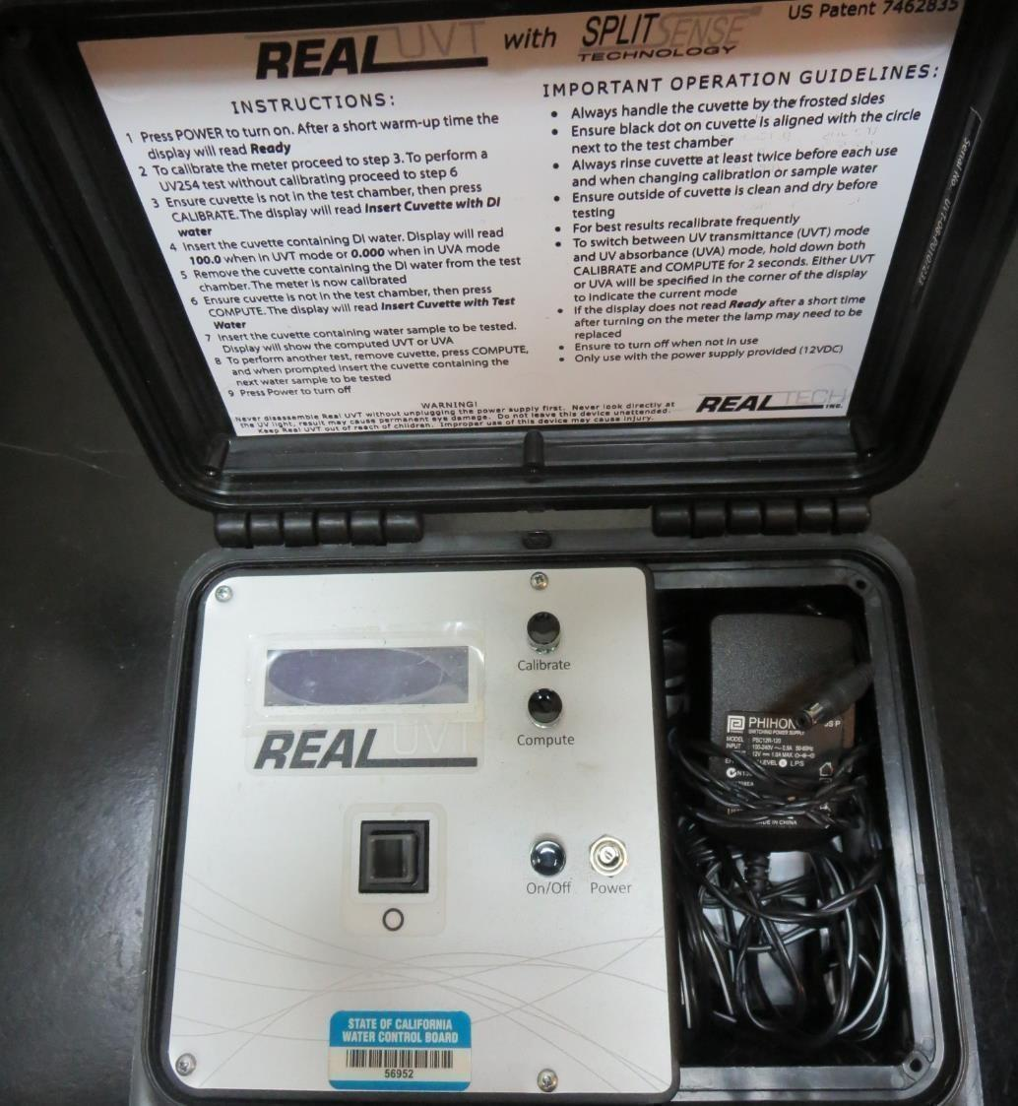
UVT/UVA
UV transmittance (UVT) is a measurement of the amount of ultraviolet light (commonly at 254 nm due to its germicidal effect) that passes through a water sample compared to the amount of light that passes through a pure water sample. The measurement is expressed as a percentage, % UVT.
%UVT = 10^{(-UVA)} x 100%
UV absorbance (UVA) is calculated as a relative measure of the amount of light absorbed by a water sample compared with the amount of light absorbed by a pure water sample.
UVA = -log(%UVT/100)

Slide 4
Coagulant Used for Jar Testing
Pro Pac 9800 (NTU Technologies)
50% Aluminum Chlorohydrate
50% Water
5% Proprietary
SG = 1.34
Pro Pac 9890 (NTU Technologies)
35-45% Aluminum Chlorohydrate
35-45% Water
20% Proprietary
SG = 1.25-1.34
Aluminum Sulfate (Alum)
48.24% Alum, 8.2% Al₂O₃
SG = 1.34
7066 (Garratt Callahan)
10 – 30% Poly Aluminum Hydroxychloride Sulfate
SG = 1.2

Slide 5
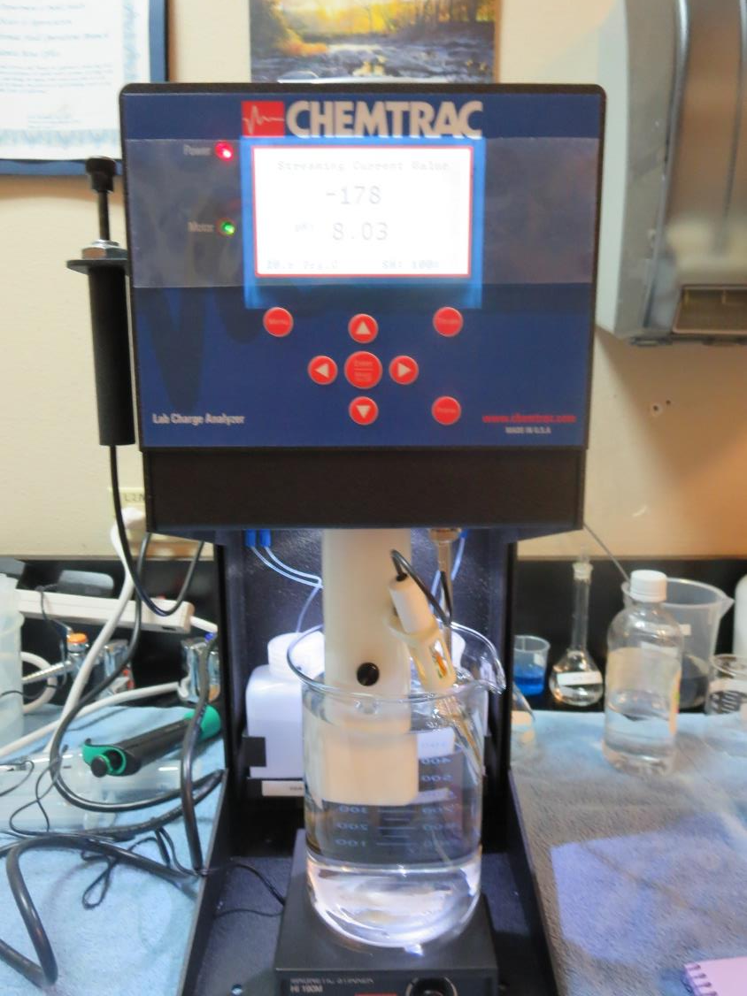
Laboratory Charge Analyzer
LCA: Used to determine coagulant demand of a source water entering the treatment plant.
Source pH: 8.03
LCA #1:
9800: 22 mg/L as product
pH adjusted to 7.5 with acetic acid
LCA #2:
Alum: 35 mg/L as product
pH adjusted to 6.75 with acetic acid

Slide 6
Coagulant Information
Unless stated otherwise, all coagulant doses are reported as Product (100% strength). Aluminum Sulfate is reported at Alum
Preparation of coagulant stock solutions are generally 1.0 or 0.1 percent strength using 100 and/or 200 mL volumetric flasks.
Finnpipette F2 variable volume pipette, capacity 100-1000 micro liters is used for stock solution preparation and coagulant aid jar test dosing.
Finnpipette F2 variable volume pipette, capacity 0.5-5 mL is used for primary coagulant jar test dosing.

Slide 7
Kettleman City CSD: Jar Test 1-8 Results
Jar # | 200 RPM Flash Mix seconds | 30 RPM Floc Duration minutes | Alum mg/L | 9800 mg/L | Filtrate NTU | Filtrate %UVT | Filtrate UVA/cm | Settle NTU 25 min
J1 | 15 | 5 | 32 | 0 | 0.08 | 91.0 | 0.041 | 0.49
J2 | 15 | 5 | 35 | 0 | 0.07 | 91.5 | 0.039 | 0.46
J3 | 15 | 5 | 38 | 0 | 0.08 | 91.9 | 0.037 | 0.41
J4 | 15 | 5 | 41 | 0 | 0.07 | 92.1 | 0.036 | 0.42
J5 | 15 | 5 | 32 | 3.2 | 0.07 | 91.8 | 0.037 | 0.37
J6 | 15 | 5 | 35 | 3.5 | 0.08 | 91.8 | 0.037 | 0.36
J7 | 15 | 5 | 38 | 3.8 | 0.08 | 92.2 | 0.035 | 0.48
J8 | 15 | 5 | 41 | 4.1 | 0.08 | 92.5 | 0.034 | 0.43

Slide 8
Kettleman City CSD: Jar Test 9-16 Results
Jar # | 200 RPM Flash Mix seconds | 30 RPM Floc Duration minutes | 9890 mg/L | 7066 mg/L | Filtrate NTU | Filtrate %UVT | Filtrate UVA/cm | Settle NTU 25 min
J9 | 15 | 5 | 20 | 0 | n/a | 89.5 | 0.048 | 0.45
J10 | 15 | 5 | 23 | 0 | 0.07 | 91.4 | 0.039 | 0.41
J11 | 15 | 5 | 26 | 0 | 0.07 | 91.6 | 0.038 | 0.37
J12 | 15 | 5 | 29 | 0 | 0.07 | 91.8 | 0.037 | 0.40
J13 | 15 | 5 | 0 | 70 | 0.09 | 90.9 | 0.041 | 0.27
J14 | 15 | 5 | 0 | 80 | 0.08 | 91.2 | 0.040 | 0.28
J15 | 15 | 5 | 0 | 90 | 0.07 | 91.8 | 0.037 | 0.30
J16 | 15 | 5 | 0 | 100 | 0.07 | 92.1 | 0.036 | 0.22

Slide 9
Kettleman City CSD: Jar Test 17-20 Results
Jar # | 200 RPM Flash Mix seconds | 30 RPM Floc Duration minutes | 9800 mg/L | Filtrate NTU | Filtrate %UVT | Filtrate UVA/cm | Settle NTU 25 min
J17 | 15 | 5 | 22 | 0.08 | 91.2 | 0.040 | 0.36
J18 | 15 | 5 | 25 | 0.08 | 91.5 | 0.039 | 0.38
J19 | 15 | 5 | 28 | 0.08 | 91.7 | 0.038 | 0.40
J20 | 15 | 5 | 31 | 0.07 | 92.0 | 0.036 | 0.31

Slide 10
Jars 1-4 Test Flash Mix 15 Sec (200 RPM) Floc Mix 5 min (30 RPM) Applied Coagulant Aluminum Sulfate

Slide 11
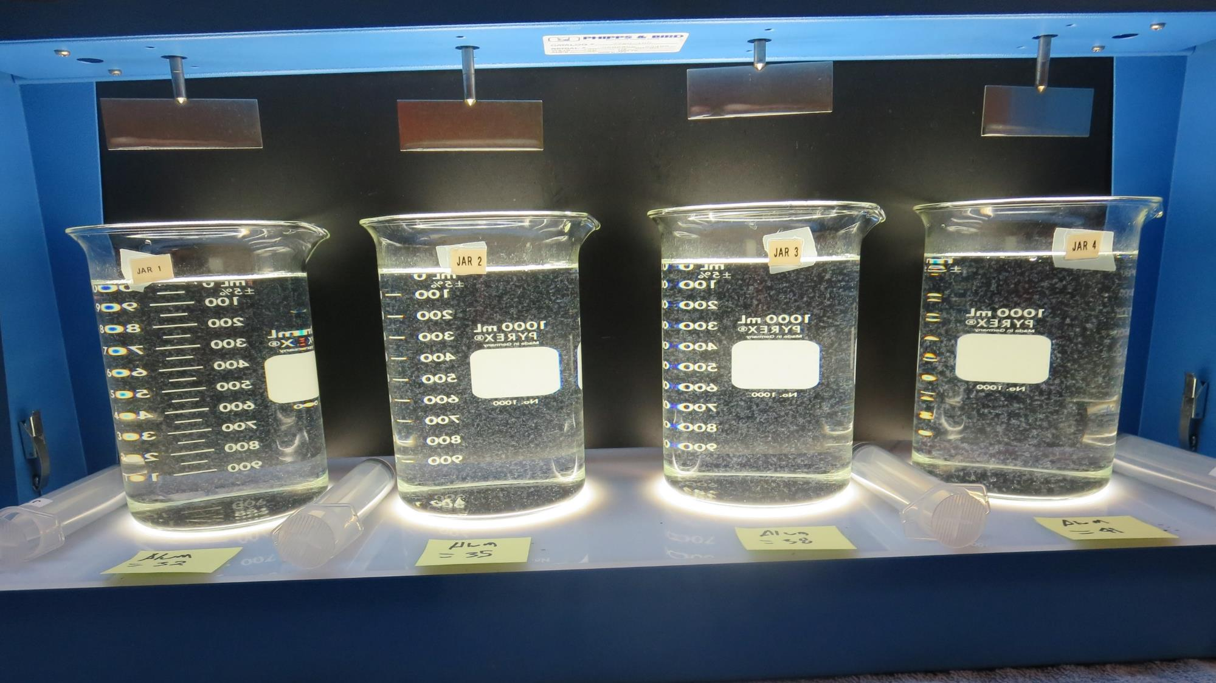
Jars 1-4: End of 5-minute flocculation (30 RPM) duration.
32 mg/L Alum
Filtrate 0.08 NTU
UVT: 91.0%
UVA: 0.041/cm
Settled: 0.49 NTU
35 mg/L Alum
Filtrate 0.07 NTU
UVT: 91.5%
UVA: 0.039/cm
Settled: 0.46 NTU
38 mg/L Alum
Filtrate 0.08 NTU
UVT: 91.9%
UVA: 0.037/cm
Settled: 0.41 NTU
41 mg/L Alum
Filtrate 0.07 NTU
UVT: 92.1%
UVA: 0.036/cm
Settled: 0.42 NTU

Slide 12
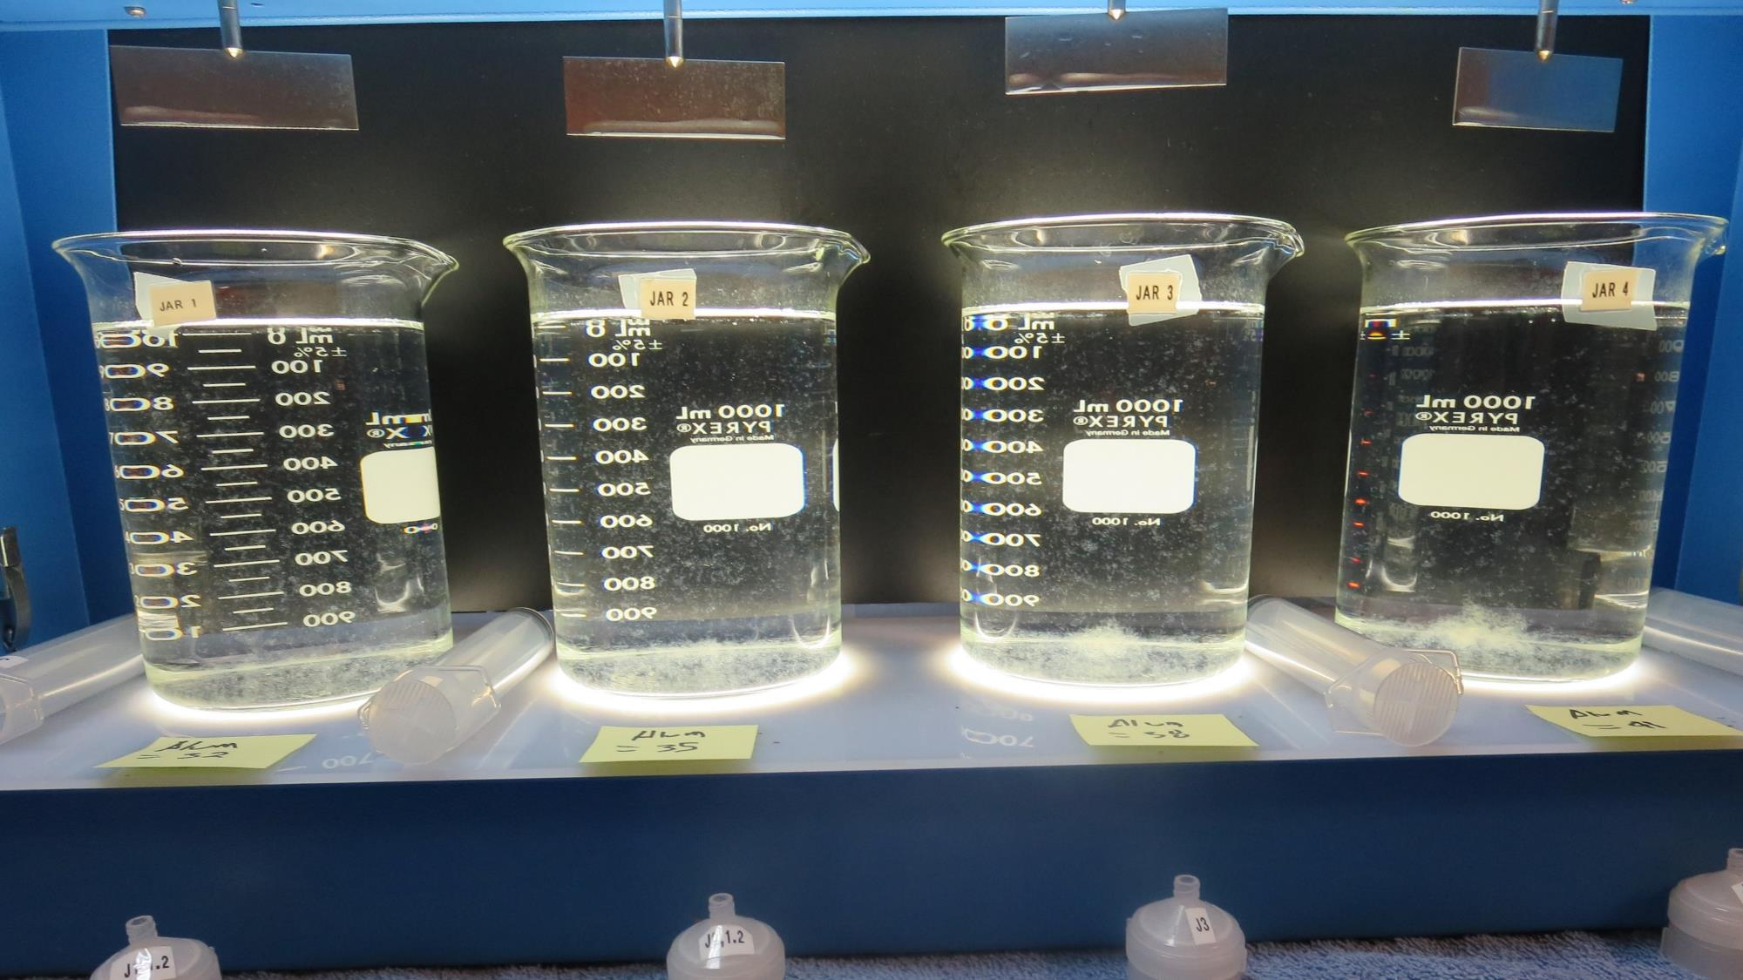
Jars 1-4: After 5 min of settling, 25 mL is syringed for filterability and %UVT/UVA.

Slide 13
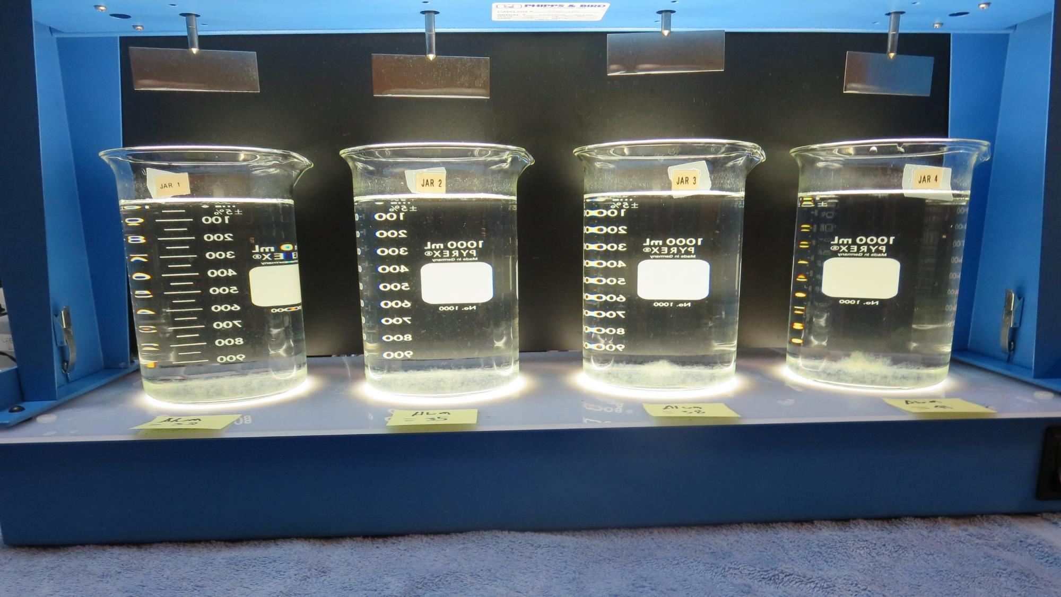
Jars 1-4: After 25-minutes of settling, settled water turbidity is taken.
32 mg/L Alum
Filtrate 0.08 NTU
UVT: 91.0%
UVA: 0.041/cm
Settled: 0.49 NTU
35 mg/L Alum
Filtrate 0.07 NTU
UVT: 91.5%
UVA: 0.039/cm
Settled: 0.46 NTU
38 mg/L Alum
Filtrate 0.08 NTU
UVT: 91.9%
UVA: 0.037/cm
Settled: 0.41 NTU
41 mg/L Alum
Filtrate 0.07 NTU
UVT: 92.1%
UVA: 0.036/cm
Settled: 0.42 NTU

Slide 14
Jars 5-8 Test Flash Mix 15 Sec (200 RPM) Floc Mix 5 min (30 RPM) Applied Coagulants Aluminum Sulfate 9800

Slide 15
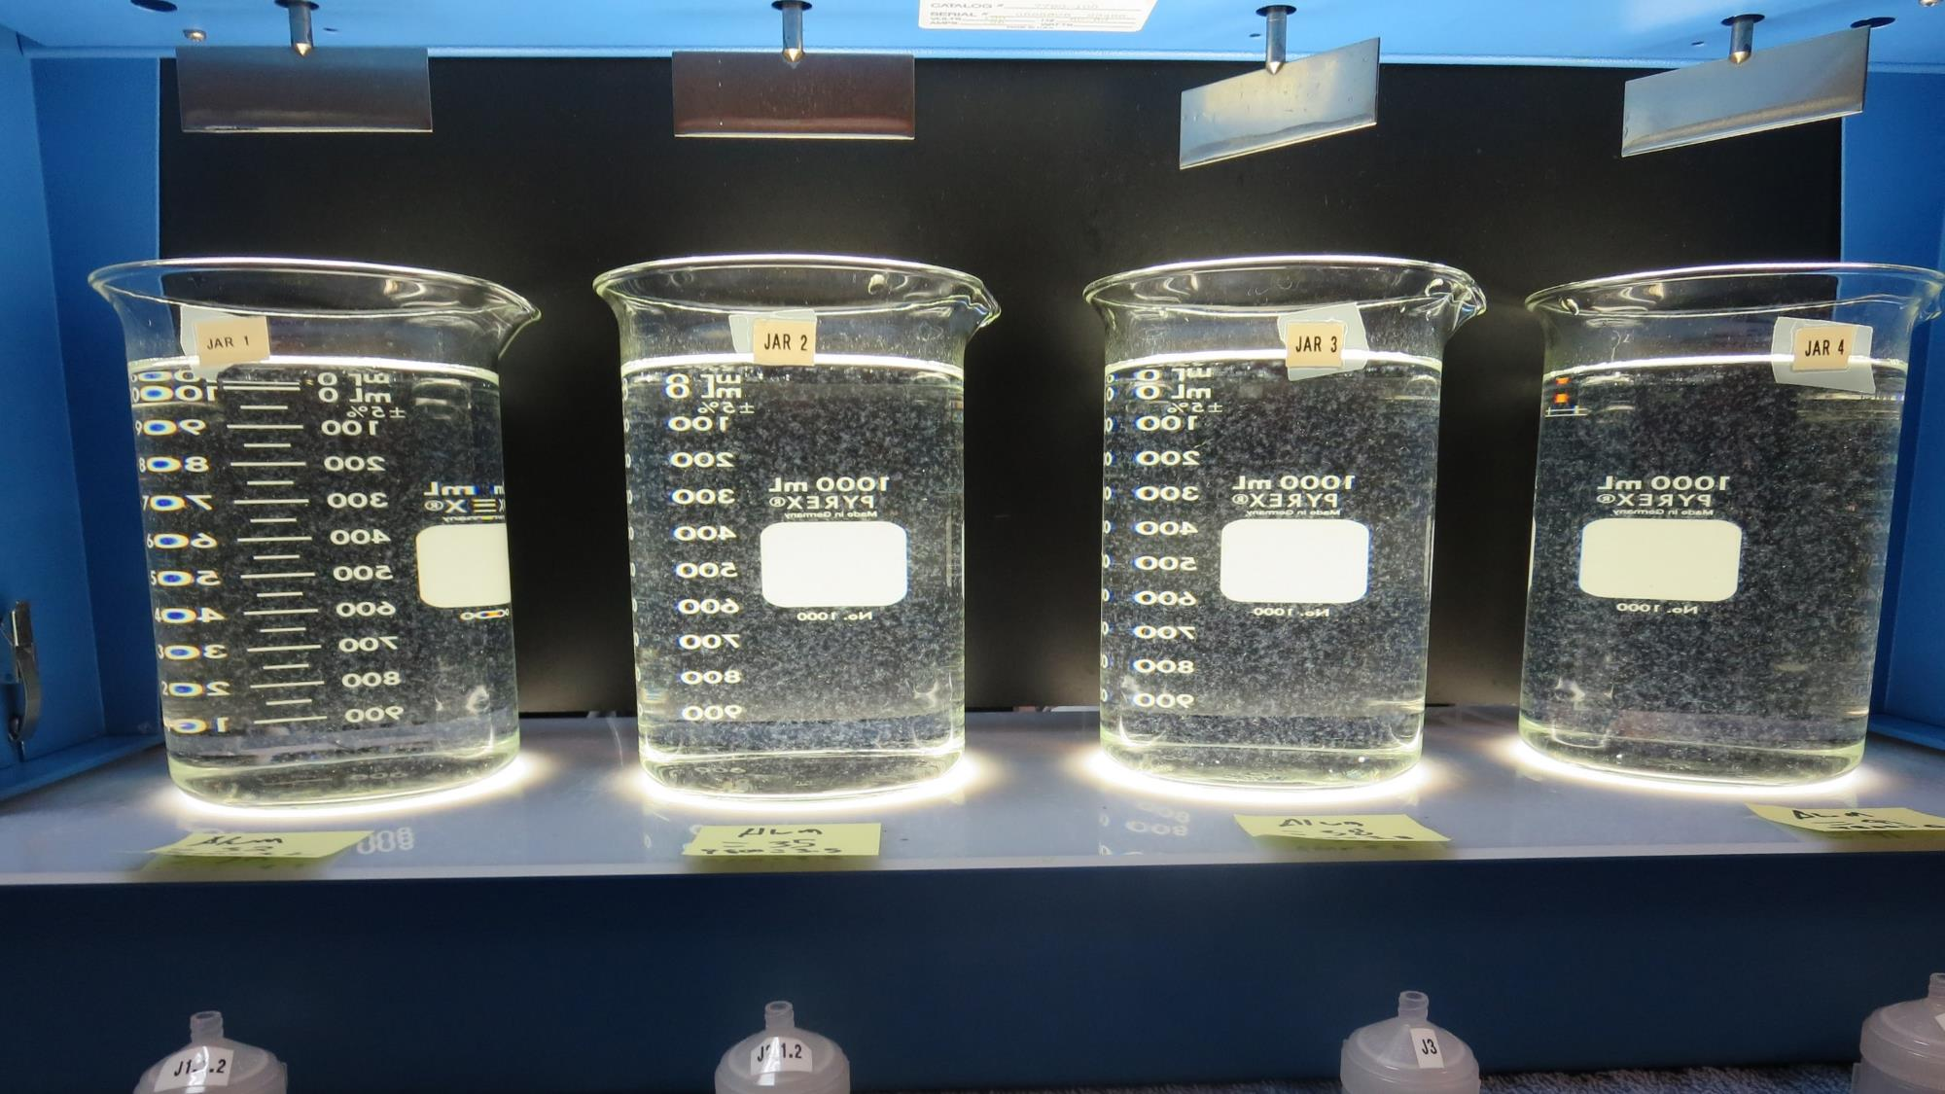
Jars 5-8: End of 5-minute flocculation (30 RPM) duration.
32 mg/L Alum
3.2 mg/L 9800
Filtrate 0.07 NTU
UVT: 91.8%
UVA: 0.037/cm
Settled: 0.37 NTU
35 mg/L Alum
3.5 mg/L 9800
Filtrate 0.08 NTU
UVT: 91.8%
UVA: 0.037/cm
Settled: 0.36 NTU
38 mg/L Alum
3.8 mg/L 9800
Filtrate 0.08 NTU
UVT: 92.2%
UVA: 0.035/cm
Settled: 0.48 NTU
41 mg/L Alum
4.1 mg/L 9800
Filtrate 0.08 NTU
UVT: 92.5%
UVA: 0.034/cm
Settled: 0.43 NTU

Slide 16
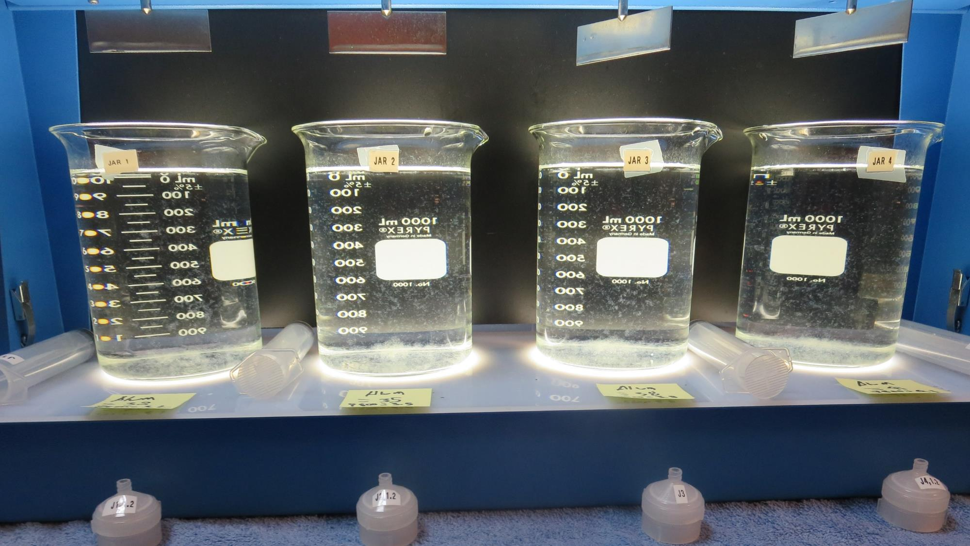
Jars 5-8: After 5 min of settling, 25 mL is syringed for filterability and %UVT/UVA.

Slide 17
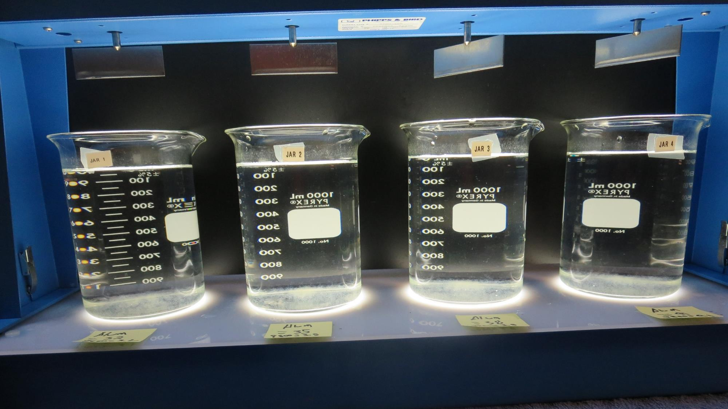
Jars 5-8: After 25-minutes of settling, settled water turbidity is taken.
32 mg/L Alum
3.2 mg/L 9800
Filtrate 0.07 NTU
UVT: 91.8%
UVA: 0.037/cm
Settled: 0.37 NTU
35 mg/L Alum
3.5 mg/L 9800
Filtrate 0.08 NTU
UVT: 91.8%
UVA: 0.037/cm
Settled: 0.36 NTU
38 mg/L Alum
3.8 mg/L 9800
Filtrate 0.08 NTU
UVT: 92.2%
UVA: 0.035/cm
Settled: 0.48 NTU
41 mg/L Alum
4.1 mg/L 9800
Filtrate 0.08 NTU
UVT: 92.5%
UVA: 0.034/cm
Settled: 0.43 NTU

Slide 18
Jars 9-12 Test Flash Mix 15 Sec (200 RPM) Floc Mix 5 min (30 RPM) Applied Coagulant 9890

Slide 19
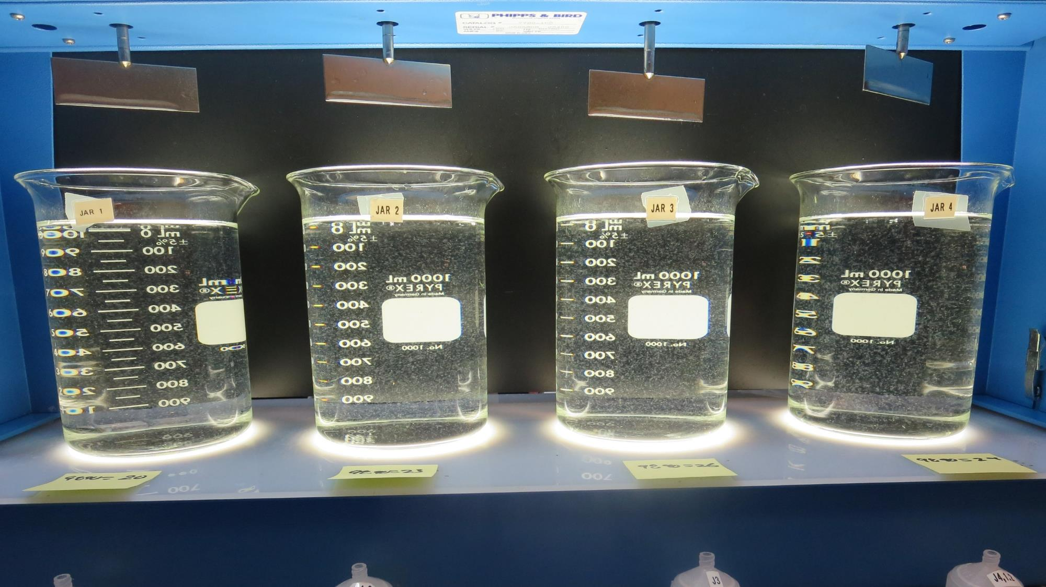
Jars 9-12: End of 5-minute flocculation (30 RPM) duration.
20 mg/L 9890
Filtrate n/a NTU
UVT: 89.5%
UVA: 0.048/cm
Settled: 0.45 NTU
23 mg/L 9890
Filtrate 0.07 NTU
UVT: 91.4%
UVA: 0.039/cm
Settled: 0.41 NTU
26 mg/L 9890
Filtrate 0.07 NTU
UVT: 91.6%
UVA: 0.038/cm
Settled: 0.37 NTU
29 mg/L 9890
Filtrate 0.07 NTU
UVT: 91.8%
UVA: 0.037/cm
Settled: 0.40 NTU

Slide 20
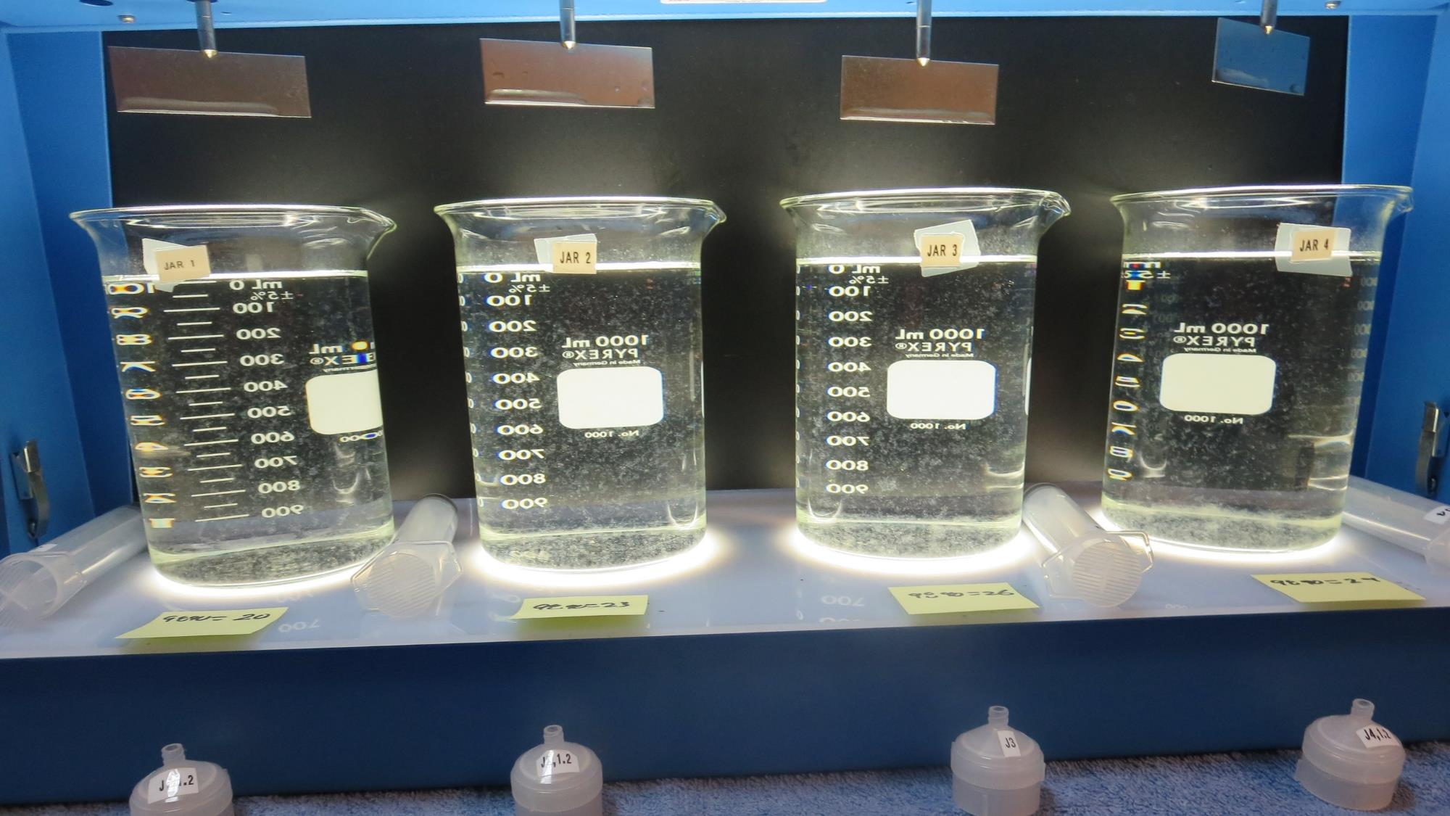
Jars 9-12: After 5 min of settling, 25 mL is syringed for filterability and %UVT/UVA.

Slide 21
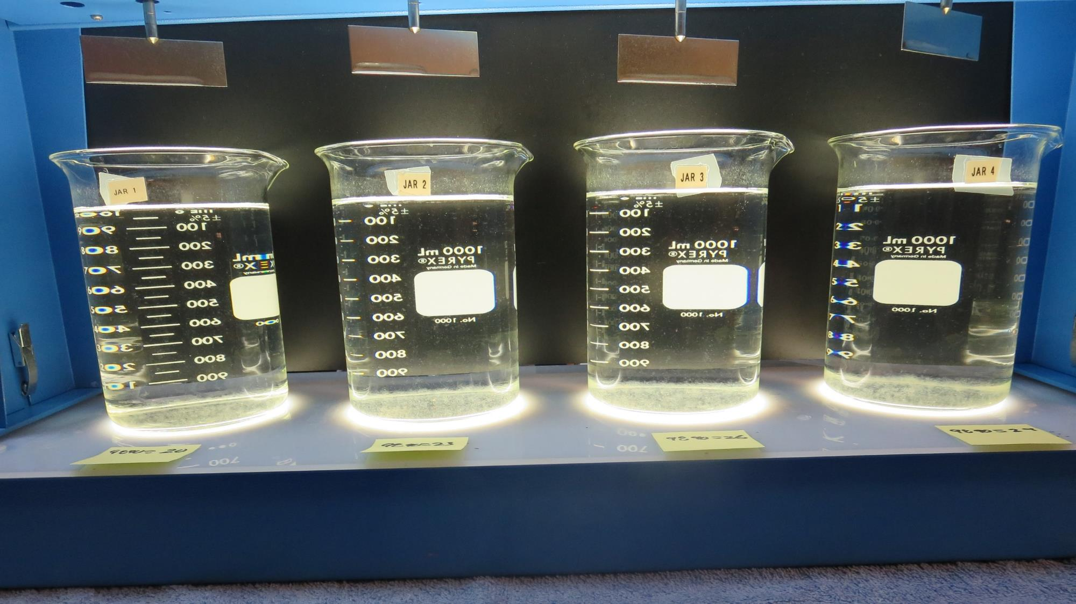
Jars 9-12: After 25-minutes of settling, settled water turbidity is taken.
20 mg/L 9890
Filtrate 0.36 NTU
UVT: 89.5%
UVA: 0.048/cm
Settled: 0.45 NTU
23 mg/L 9890
Filtrate 0.07 NTU
UVT: 91.4%
UVA: 0.039/cm
Settled: 0.41 NTU
26 mg/L 9890
Filtrate 0.07 NTU
UVT: 91.6%
UVA: 0.038/cm
Settled: 0.37 NTU
29 mg/L 9890
Filtrate 0.07 NTU
UVT: 91.8%
UVA: 0.037/cm
Settled: 0.40 NTU

Slide 22
Jars 13-16 Test Flash Mix 15 Sec (200 RPM) Floc Mix 5 min (30 RPM) Applied Coagulant 7066

Slide 23
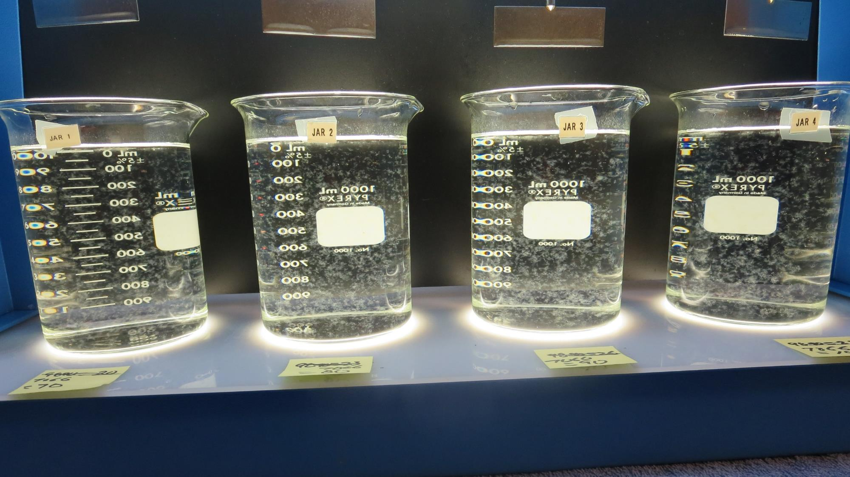
Jars 13-16: End of 5-minute flocculation (30 RPM) duration.
70 mg/L 7066
Filtrate 0.09 NTU
UVT: 90.9%
UVA: 0.041/cm
Settled: 0.27 NTU
80 mg/L 7066
Filtrate 0.08 NTU
UVT: 91.2%
UVA: 0.040/cm
Settled: 0.28 NTU
90 mg/L 7066
Filtrate 0.07 NTU
UVT: 91.8%
UVA: 0.037/cm
Settled: 0.30 NTU
100 mg/L 7066
Filtrate 0.07 NTU
UVT: 92.1%
UVA: 0.036/cm
Settled: 0.22 NTU

Slide 24
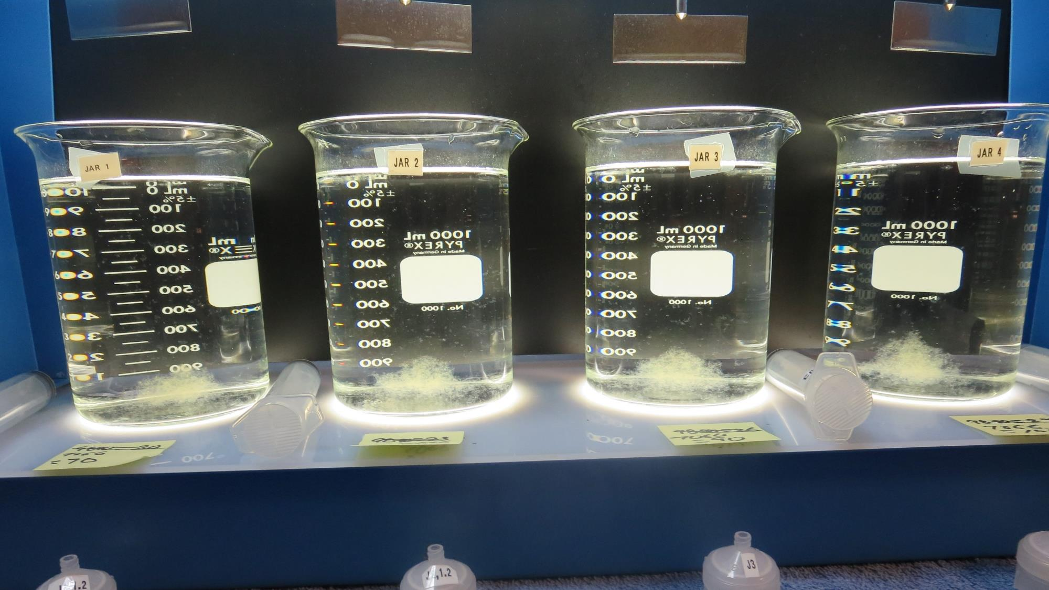
Jars 13-18: After 5 min of settling, 25 mL is syringed for filterability and %UVT/UVA.

Slide 25
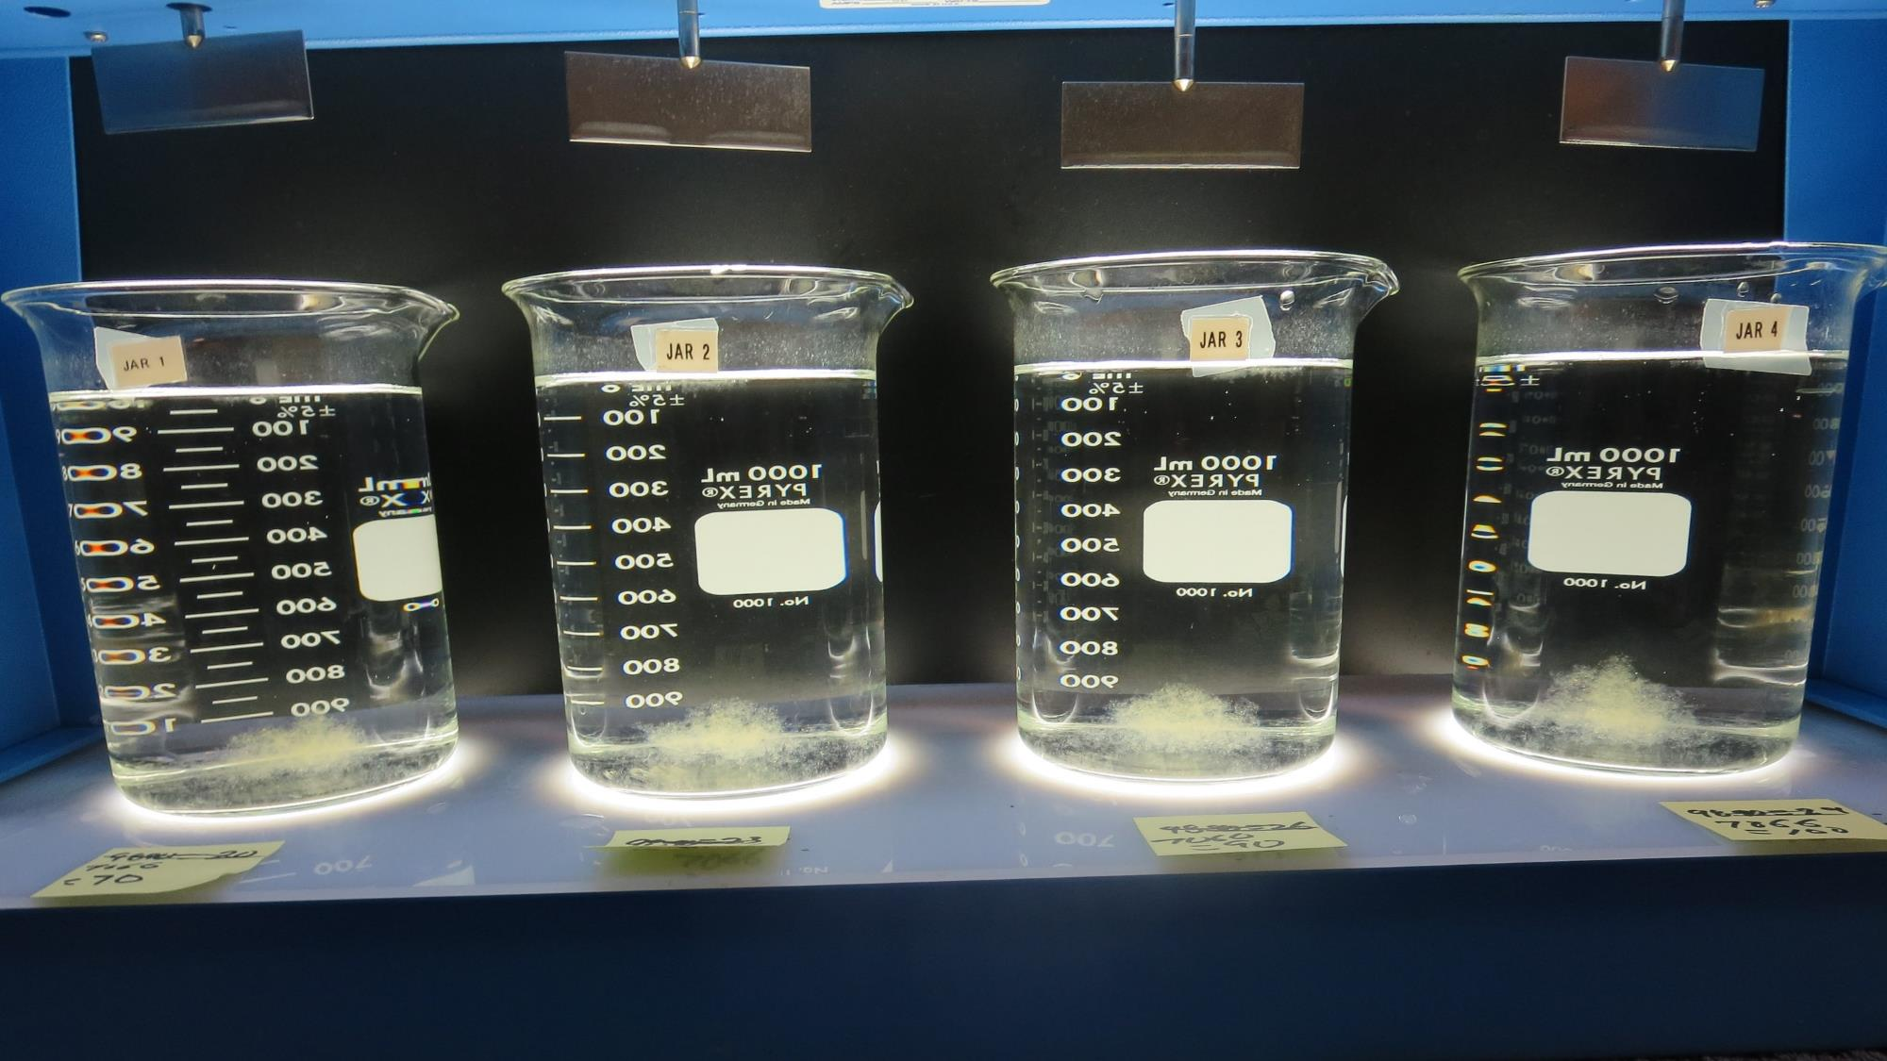
Jars 13-16: After 25-minutes of settling, settled water turbidity is taken.
70 mg/L 7066
Filtrate 0.09 NTU
UVT: 90.9%
UVA: 0.041/cm
Settled: 0.27 NTU
80 mg/L 7066
Filtrate 0.08 NTU
UVT: 91.2%
UVA: 0.040/cm
Settled: 0.28 NTU
90 mg/L 7066
Filtrate 0.07 NTU
UVT: 91.8%
UVA: 0.037/cm
Settled: 0.30 NTU
100 mg/L 7066
Filtrate 0.07 NTU
UVT: 92.1%
UVA: 0.036/cm
Settled: 0.22 NTU

Slide 26
Jars 17-20 Test Flash Mix 15 Sec (200 RPM) Floc Mix 5 min (30 RPM) Applied Coagulant 9800

Slide 27
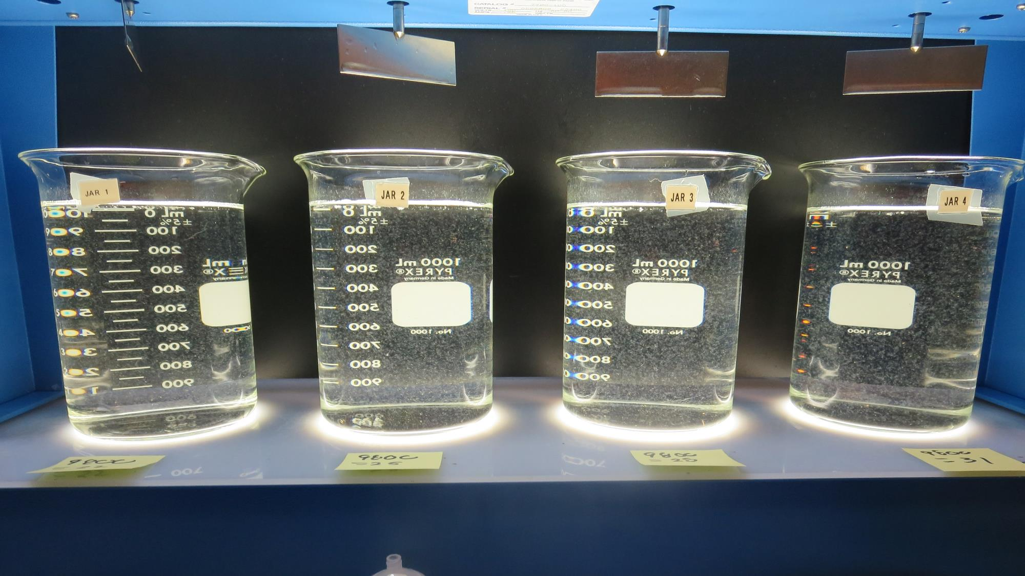
Jars 17-20: End of 5-minute flocculation (30 RPM) duration.
22 mg/L 9800
Filtrate 0.08 NTU
UVT: 91.2%
UVA: 0.040/cm
Settled: 0.36 NTU
25 mg/L 9800
Filtrate 0.08 NTU
UVT: 91.5%
UVA: 0.039/cm
Settled: 0.38 NTU
28 mg/L 9800
Filtrate 0.08 NTU
UVT: 91.7%
UVA: 0.038/cm
Settled: 0.40 NTU
31 mg/L 9800
Filtrate 0.07 NTU
UVT: 92.0%
UVA: 0.036/cm
Settled: 0.31 NTU

Slide 28
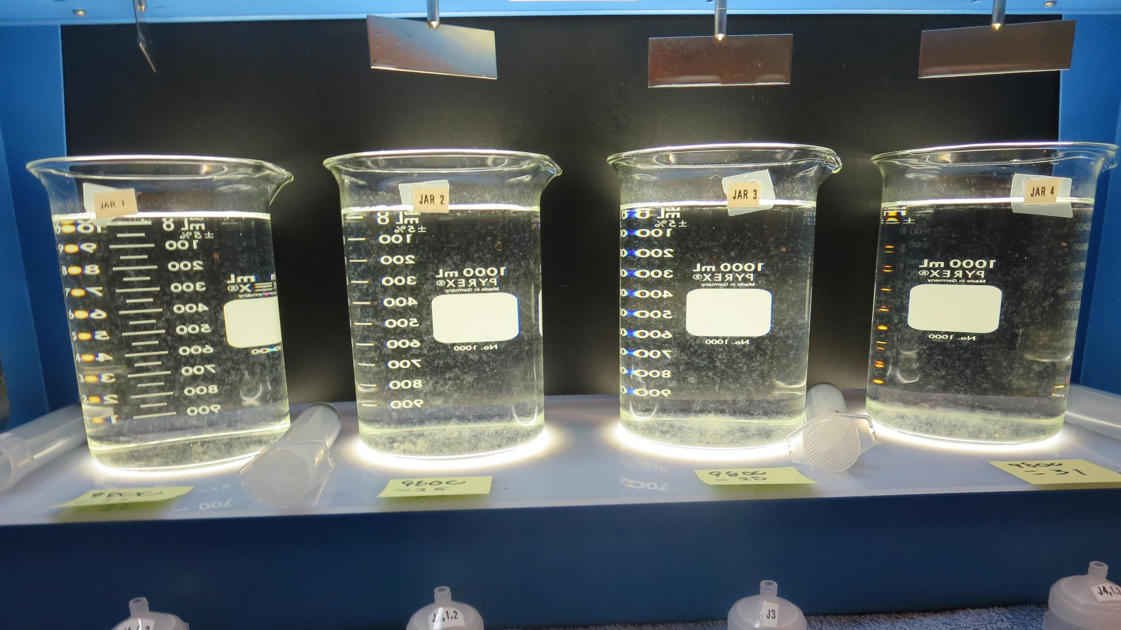
Jars 17-20: After 5 min of settling, 25 mL is syringed for filterability and %UVT/UVA.

Slide 29
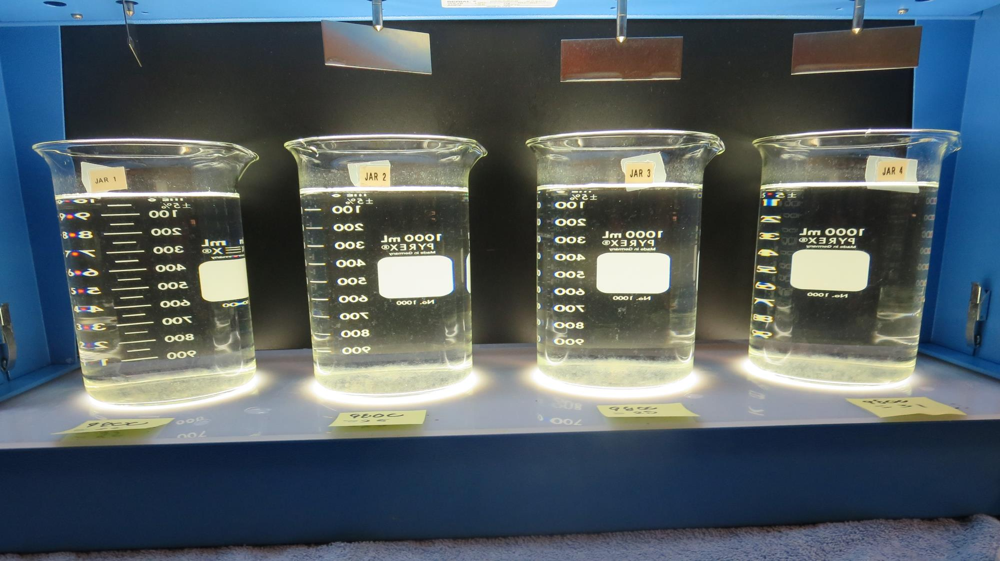
Jars 17-20: After 25-minutes of settling, settled water turbidity is taken.
22 mg/L 9800
Filtrate 0.08 NTU
UVT: 91.2%
UVA: 0.040/cm
Settled: 0.36 NTU
25 mg/L 9800
Filtrate 0.08 NTU
UVT: 91.5%
UVA: 0.039/cm
Settled: 0.38 NTU
28 mg/L 9800
Filtrate 0.08 NTU
UVT: 91.7%
UVA: 0.038/cm
Settled: 0.40 NTU
31 mg/L 9800
Filtrate 0.07 NTU
UVT: 92.0%
UVA: 0.036/cm
Settled: 0.31 NTU

Slide 30
Jar Testing for 1-Liter Jars: Procedures for Most Treatment Plants
Fill jars with source water prior to coagulant injection and set paddle speed at 30 rpm
Add chemicals (i.e., NaOCl, primary coagulant, coagulant aid) to each jar
Flash mix for 15-60 seconds (200 rpm)
Slow mix for 5 minutes (20-30 rpm)
Settled for 5 minutes. Syringe 25 mL from each jar taken 1-inch below surface (25 mL/12 sec rate)
Filtered through 1.2 um isopore membrane into cuvette drip rate, 15 mL/(50-90 sec)
Measure filtrate turbidity, chlorine residual and %UVT/UVA
Measure settled water turbidity after 25 minutes of total setting
Record all data

Slide 31
Jar Test Filterability Test Equipment
Turbidity Instrument
Syringe w/Luer-Lock Tip, 30 cc
(part#: 2225800, by Hach)
Swinnex Filter Holder, 25 mm (part#: SX0002500)
Isopore Membrane Filter, 1.2 um absolute
pore size,
Φ= 25 mm , thickness: 24 um,
hydrophilic polycarbonate membrane
(part #: RTTP02500)
Go to Sigma-Aldrich for laboratory supplies http://www.sigmaaldrich.com/united-states.html

Slide 32
Isopore Membrane Information
Categories | Information
trade name | Isopore
filter color | White
chemistry | Polycarbonate (PC)
water flow rate | Avg. 175 mL/min x cm² (typical results @ 10 psi)
media | Isopore®
wettability | Hydrophilic
porosity | 14.7%
pore size | 1.2 µm
bubble point at 23 °C | 1.0 bar, air with water
thickness | 24 µm
filter diameter (ø) | 25 mm
material size | polycarbonate, Hydrophilic, 1.2 µm, 25 mm, white, plain, 100

Slide 33
Isopore Membrane Background Information
The Isopore membrane is a polycarbonate, track-etched screen filter recommended for all analyses in which the sample is viewed on the surface of the membrane. The Isopore membrane is composed of polycarbonate film, which has a smooth, glass-like surface for clearer sample observation. The unique manufacturing process of the membrane ensures a precise pore diameter and a consistent pore size for accurate separation of samples by size. Matched-weight filters are not usually required because of low, constant tar and ash weights. Features & Benefits: Membrane structure retains particles on the surface, simplifying counting and analysis

Slide 34
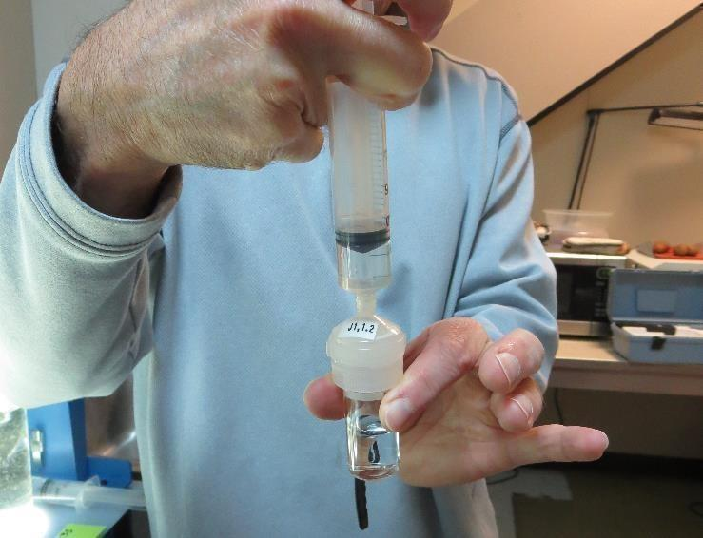
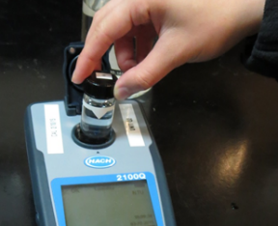
Jar Test - Filterability Test
Syringe ~ 25 mL from jar (after 5-minutes of settling)
Filter-to-waste 3-5 mL
Filter directly into clean cuvette
Measure turbidity
Note: Take several readings before recording final NTU results. Micro bubbles can adhere to glass causing false NTU readings. To remove bubbles, tilt cuvette up to 90 degrees.

Slide 35
Contact
Guy Schott, P.E.
State Water Resources Control Board
Division of Drinking Water
Santa Rosa, CA
Go to Stock Solution/Dose calculations/Jar Test Results for tools to download
www.waterboards.ca.gov/drinking_water/programs/districts/mendocino_district.html
Email: Guy Schott - Guy.Schott@waterboards.ca.gov
Office Number: 707-576-2732

