Slide 1
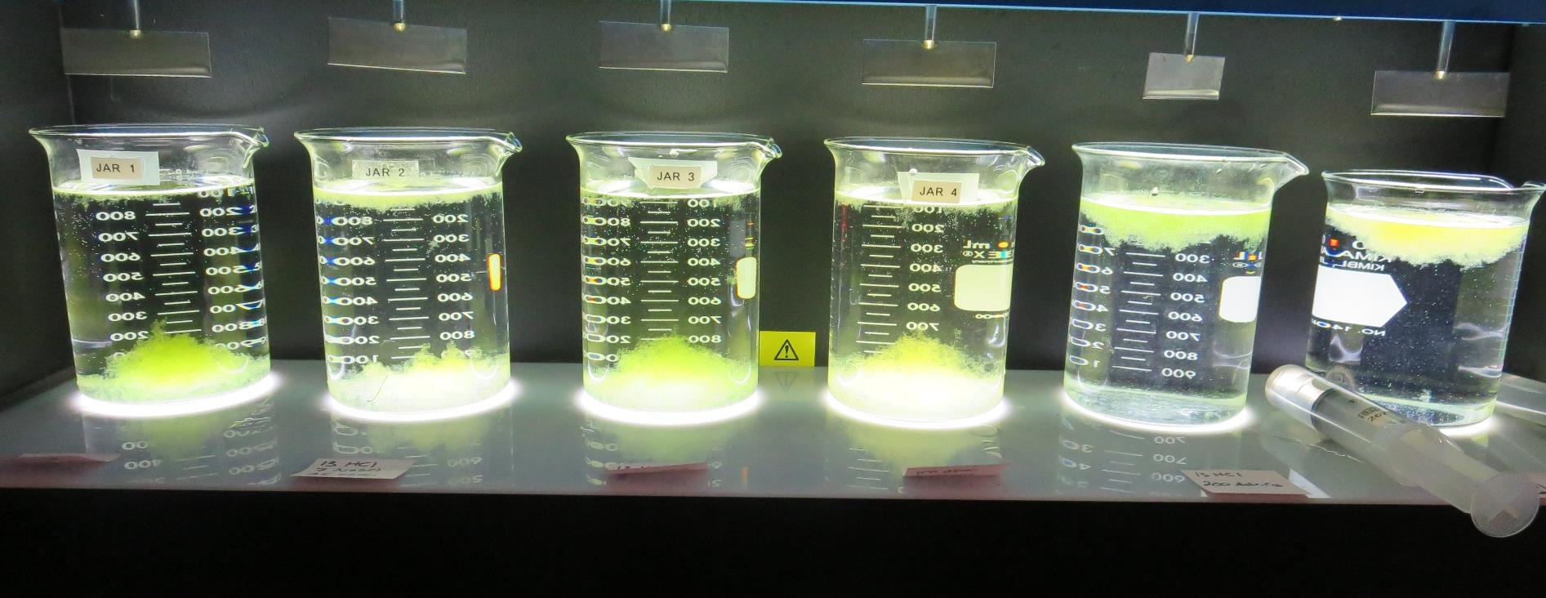
Konocti County Water District CA1710006, Lake County, Jar Test
by Guy Schott, P.E. October 5, 2020

Slide 2
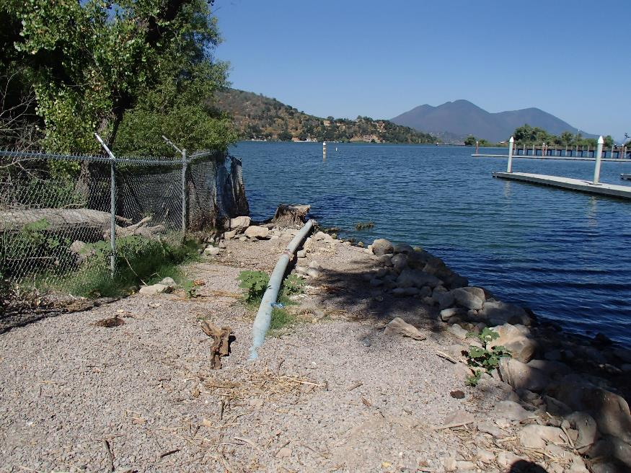
Konocti County Water District Source Water: Clear Lake Conventional Treatment

Slide 3
Konocti CWD, October 5, 2020 Source Water Characteristics
Source (morning), Post Oxidation
pH: 8.97
Turbidity: 12.6 NTU
UVT: 66.18%
UVA: 0.1793/cm
0.4 um Filtered
Turbidity: 3.7 NTU
UVT: 75.71%
UVA: 0.1208/cm
Using the P300 UVT/UVA analyzer; calibrated with DI water.
Source (afternoon), Post Oxidation
Turbidity: 15.5 NTU
UVT: 74.4%
UVA: 0.1803/cm
0.4 um Filtered
Turbidity: 1.2 NTU
UVT: 85.74%
UVA: 0.0668/cm
Using the P300 UVT/UVA analyzer; calibrated with DI water.

Slide 4
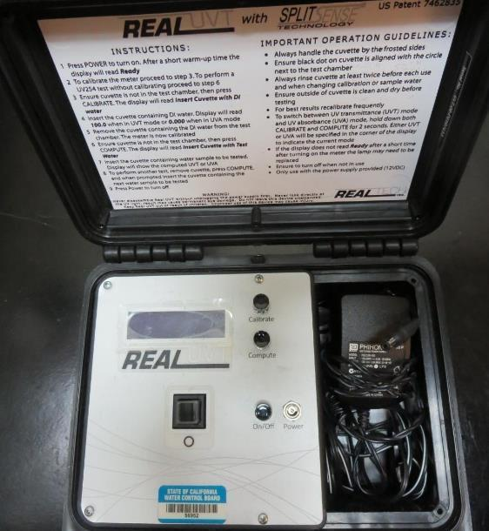
UVT/UVA, pathlength 40 mm
UV transmittance (UVT) is a measurement of the amount of ultraviolet light (commonly at 254 nm due to its germicidal effect) that passes through a water sample compared to the amount of light that passes through a pure water sample. The measurement is expressed as a percentage, % UVT.
%UVT = 10^{(-UVA)} x 100%
UV absorbance (UVA) is calculated as a relative measure of the amount of light absorbed by a water sample compared with the amount of light absorbed by a pure water sample.
UVA = -log(%UVT/100)

Slide 5
Applied Coagulants for Jar Testing
Pro Pac 9800 (NTU Technologies)
50% Aluminum Chlorohydrate
50% Water
23.62% Al₂O₃
83% Basicity
SG = 1.34
Pro Pac 9890 (NTU Technologies)
35-45% Aluminum Chlorohydrate
20% Trade Secret
35-45% Water
SG = 1.25-1.34
BWS, Inc.
Advanced Coagulant
AdvFloc-CTC-00011
12.55% Al₂O₃
64.9% Basicity
SG = 1.299

Slide 6
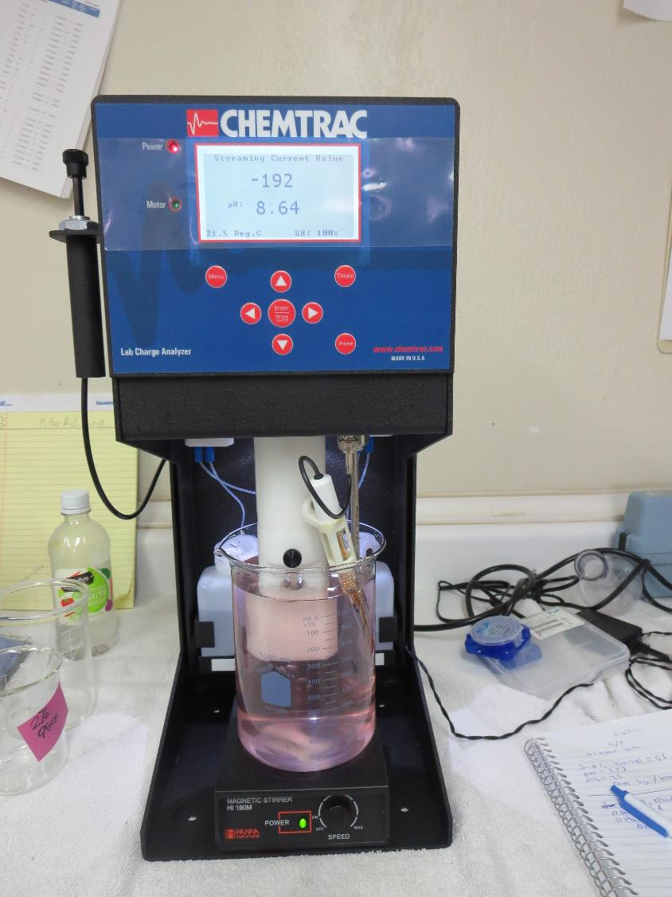
Laboratory Charge Analyzer
LCA: Used to determine coagulant demand of a source water entering the treatment plant.
All pH adjusted to 7.5 w/acetic acid solution
LCA #1:
Post ozone sample
Source pH: 8.97
9800: 53 mg/L as product
LCA #2:
Pre-ozone sample
Source pH: 8.64
9800: 59 mg/L as product
LCA #3:
Post ozone sample
9890: 40 mgL as product

Slide 7
Coagulant Information
Unless stated otherwise, all coagulant doses are reported as Product (100% strength).
Preparation of coagulant stock solutions are generally 1.0 and/or 0.1 percent strength using 100 and/or 200 mL volumetric flasks.
Finnpipette F2 variable volume pipette, capacity 100-1000 micro liters is used for stock solution preparation and coagulant aid jar test dosing.
Finnpipette F2 variable volume pipette, capacity 0.5-5 mL is used for primary coagulant jar test dosing.

Slide 8
Water Source – Post Oxidation
Unless stated otherwise, all water jar testing is post oxidation (KMnO₄ and O₃).

Slide 9
Konocti CWD: Jar Test 1-4 Results Clear Lake Source Water (10/5/20, morning) Flash Mix 200 RPM (30 sec); Floc Mix 30 RPM (5 minutes) 13 mg/L HCl added to each jar.
Jar # | NaOCl mg/L | 9800 mg/L | 9890 mg/L | Filtrate NTU | Filtrate %UVT | Filtrate UVA/cm | %UVA Reduction | Settle NTU 25 min
J1 | 0 | 0 | 45 | 0.14 | 91.03 | 0.0409 | 66.1 | 0.24
J2 | 7 | 0 | 45 | 0.16 | 90.05 | 0.0455 | 62.3 | 1.71
J3 | 0 | 100 | 0 | 0.14 | 91.56 | 0.0383 | 68.3 | 0.49
J4 | 7 | 100 | 0 | 0.14 | 90.44 | 0.0437 | 63.8 | 1.65

Slide 10
Konocti CWD: Jar Test 5-6 Results Clear Lake Source Water (10/5/20, morning) Flash Mix 200 RPM (30 sec); Floc Mix 30 RPM (5 minutes)
Jar # | HCl mg/L | NaOCl mg/L | Adv Coag mg/L | Filtrate NTU | Filtrate %UVT | Filtrate UVA/cm | %UVA Reduction | Settle NTU 25 min
J5 | 13 | 0 | 200 | 0.23 | 91.11 | 0.0405 | 66.5 | 12.6
J6 | 13 | 7 | 200 | 0.30 | 90.45 | 0.0436 | 63.9 | 16.4

Slide 11
Jars 7-12
After 25 minutes of settling, there were no settled flocs that floated to the surface. However, after 40-45, most of the settled flocs floated to the surface except for Jar 7. Jar 7 source water was taken before ozonation. All other jars sources were post ozonation.

Slide 12
Konocti CWD: Jar Test 5-6 Results Clear Lake Source Water (10/5/20, afternoon) Flash Mix 200 RPM (30 sec); Floc Mix 30 RPM (5 minutes) Jar 7: Pre-ozone sample Jars 8-12: Post ozone samples
Jar # | HCl mg/L | 9800 mg/L | 9890 mg/L | Filtrate NTU | Filtrate %UVT | Filtrate UVA/cm | %UVA Reduction | Settle NTU 25 min
J7 | 13 | 56 | 5.6 | 0.12 | 89.64 | 0.0475 | 28.9 | 0.37
J8 | 13 | 50 | 5.0 | 0.12 | 90.91 | 0.0414 | 38.0 | 0.92
J9 | 13 | 55 | 5.5 | 0.13 | 91.38 | 0.0392 | 41.3 | 0.58
J10 | 13 | 60 | 6.0 | 0.12 | 90.99 | 0.0410 | 38.6 | 0.33
J11 | 13 | 65 | 6.5 | 0.11 | 91.14 | 0.0403 | 39.7 | 0.28
J12 | 13 | 55 | 0 | 0.12 | 90.73 | 0.0423 | 36.7 | 0.24

Slide 13
Jars 1-6 Test Flash Mix 30 Sec (200 RPM) Floc Mix 5 min (30 RPM) 10/5/20 (morning source) Applied Coagulants 9800/9890/Adv Coag.

Slide 14
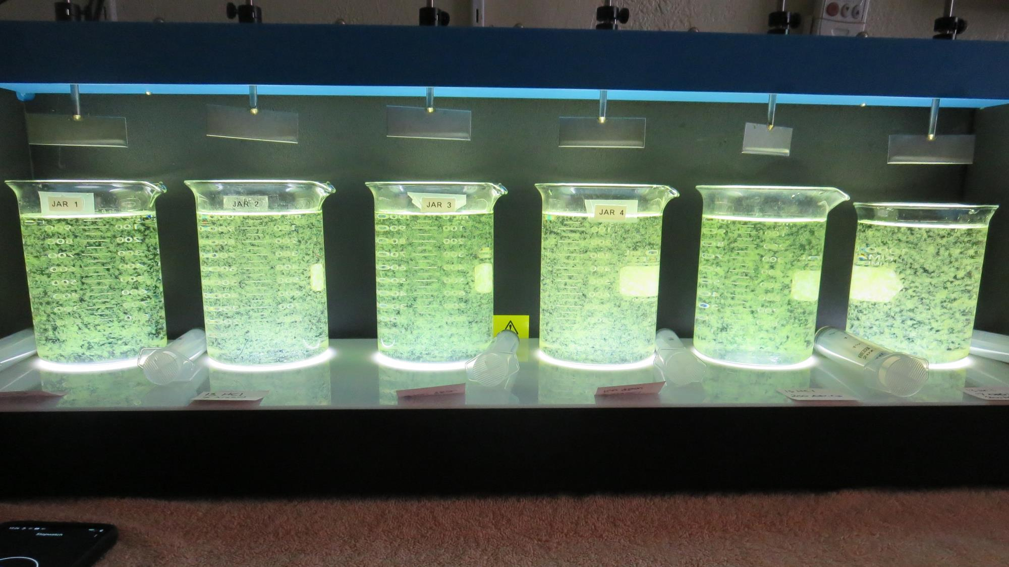
Jars 1-6: End of 5-minute flocculation (30 RPM) duration.
13 mg/L HCL
45 mg/L 9890
Filtrate 0.14 NTU
UVT: 91.03%
UVA: 0.0409/cm
UVA Reduction: 66.1%
Settled: 0.24 NTU
13 mg/L HCL
7 mg/L NaOCl
45 mg/L 9890
Filtrate 0.16 NTU
UVT: 90.05%
UVA: 0.0455/cm
UVA Reduction: 62.3%
Settled: 1.71 NTU
13 mg/L HCL
100 mg/L 9800
Filtrate 0.14 NTU
UVT: 91.56%
UVA: 0.0383/cm
UVA Reduction: 68.3%
Settled: 0.49 NTU
13 mg/L HCL
7 mg/L NaOCl
100 mg/L 9800
Filtrate 0.14 NTU
UVT: 90.44%
UVA: 0.0437/cm
UVA Reduction: 63.8%
Settled: 1.65 NTU
13 mg/L HCL
200 mg/L Adv Coag.
Filtrate 0.23 NTU
UVT: 91.11%
UVA: 0.0405/cm
UVA Reduction: 66.5%
Settled: 12.6 NTU
13 mg/L HCL
7 mg/L NaOCl
200 mg/L Adv Coag.
Filtrate 0.30 NTU
UVT: 90.45%
UVA: 0.0436/cm
UVA Reduction: 63.9%
Settled: 16.4 NTU

Slide 15
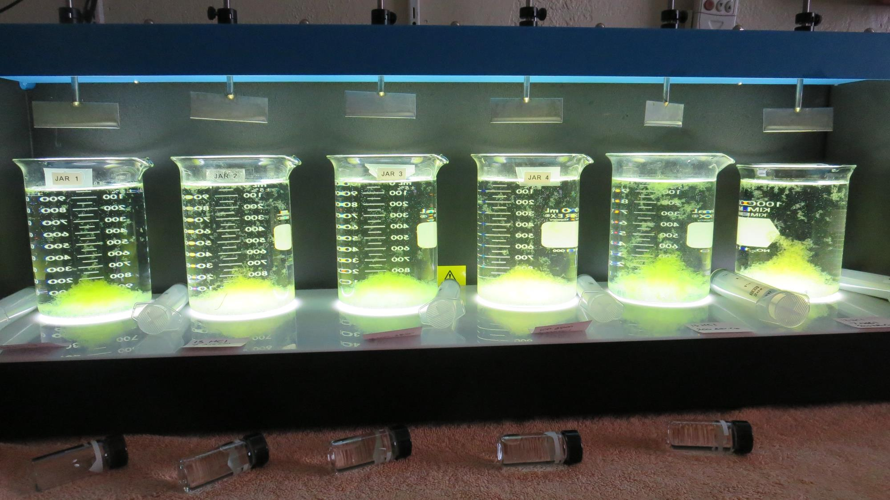
Jars 1-6: After 5 min of settling, 25 mL is syringed for filterability and %UVT/UVA.

Slide 16
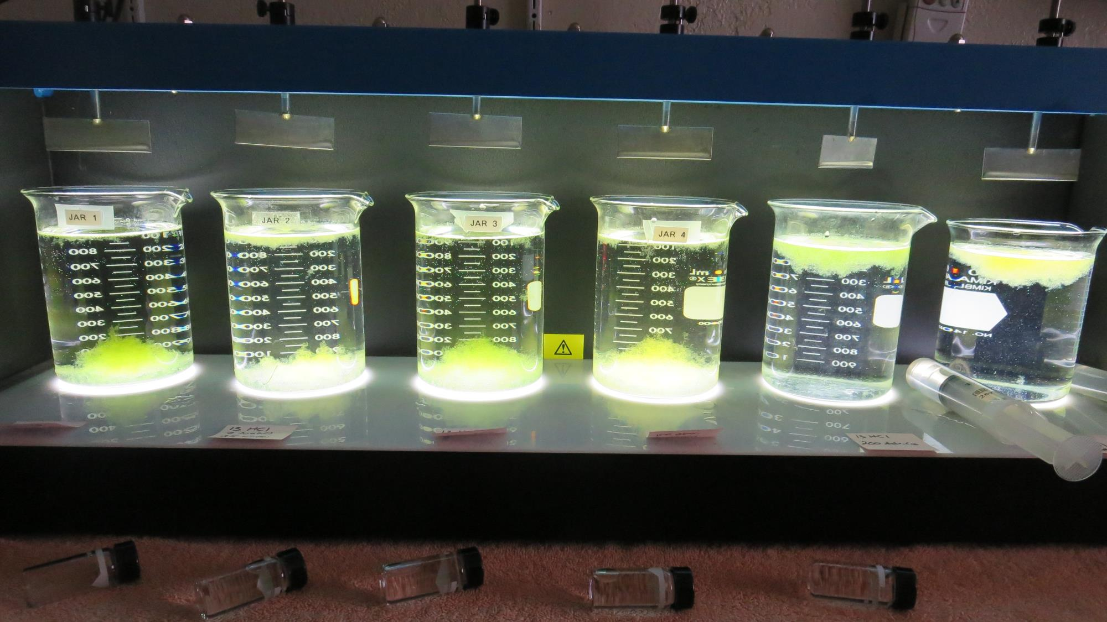
Jars 1-6: After 25-minutes of settling, settled water turbidity is taken.
13 mg/L HCL
45 mg/L 9890
Filtrate 0.14 NTU
UVT: 91.03%
UVA: 0.0409/cm
UVA Reduction: 66.1%
Settled: 0.24 NTU
13 mg/L HCL
7 mg/L NaOCl
45 mg/L 9890
Filtrate 0.16 NTU
UVT: 90.05%
UVA: 0.0455/cm
UVA Reduction: 62.3%
Settled: 1.71 NTU
13 mg/L HCL
100 mg/L 9800
Filtrate 0.14 NTU
UVT: 91.56%
UVA: 0.0383/cm
UVA Reduction: 68.3%
Settled: 0.49 NTU
13 mg/L HCL
7 mg/L NaOCl
100 mg/L 9800
Filtrate 0.14 NTU
UVT: 90.44%
UVA: 0.0437/cm
UVA Reduction: 63.8%
Settled: 1.65 NTU
13 mg/L HCL
200 mg/L Adv Coag.
Filtrate 0.23 NTU
UVT: 91.11%
UVA: 0.0405/cm
UVA Reduction: 66.5%
Settled: 12.6 NTU
13 mg/L HCL
7 mg/L NaOCl
200 mg/L Adv Coag.
Filtrate 0.30 NTU
UVT: 90.45%
UVA: 0.0436/cm
UVA Reduction: 63.9%
Settled: 16.4 NTU

Slide 17
Jars 7-12 Test Flash Mix 30 Sec (200 RPM) Floc Mix 5 min (30 RPM) 10/5/20 (afternoon source) Applied Coagulants 9800/9890

Slide 18
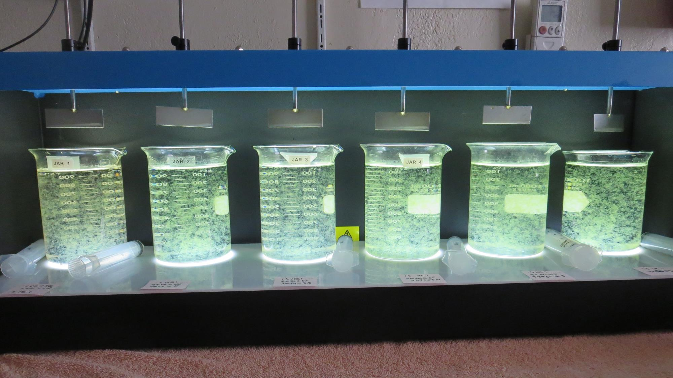
Jars 7-12: End of 5-minute flocculation (30 RPM) duration.
Pre-ozone water
13 mg/L HCL
56 mg/L 9800
5.6 mg/L 9890
Filtrate 0.12 NTU
UVT: 89.64%
UVA: 0.0475/cm
UVA Reduction: 28.9%
Settled: 0.37 NTU
13 mg/L HCL
50 mg/L 9800
5.0 mg/L 9890
Filtrate 0.12 NTU
UVT: 90.91%
UVA: 0.0414/cm
UVA Reduction: 38.0%
Settled: 0.92 NTU
13 mg/L HCL
55 mg/L 9800
5.5 mg/L 9890
Filtrate 0.13 NTU
UVT: 91.38%
UVA: 0.0392/cm
UVA Reduction: 41.3%
Settled: 0.58 NTU
13 mg/L HCL
60 mg/L 9800
6.0 mg/L 9890
Filtrate 0.12 NTU
UVT: 90.99%
UVA: 0.0410/cm
UVA Reduction: 38.6%
Settled: 0.33 NTU
13 mg/L HCL
65 mg/L 9800
6.5 mg/L 9890
Filtrate 0.11 NTU
UVT: 91.14%
UVA: 0.0403/cm
UVA Reduction: 39.7%
Settled: 0.28 NTU
13 mg/L HCL
55 mg/L 9800
0 mg/L 9890
Filtrate 0.12 NTU
UVT: 90.73%
UVA: 0.0423/cm
UVA Reduction: 36.7%
Settled: 0.24 NTU

Slide 19
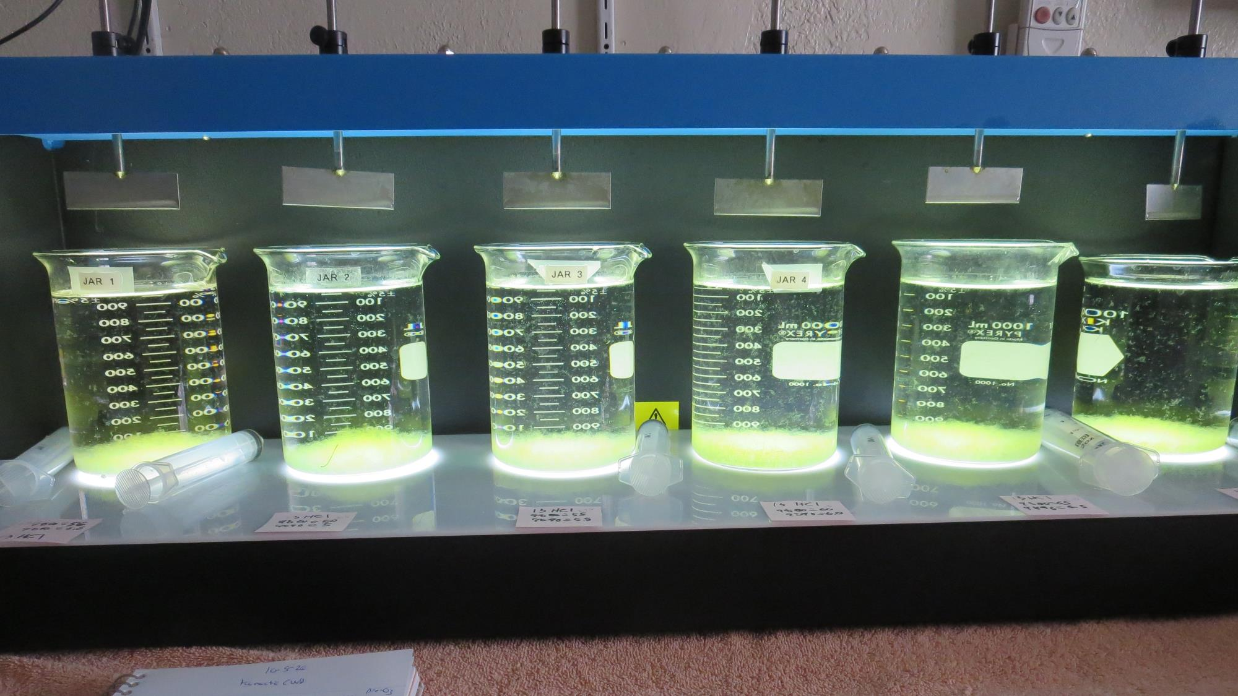
Jars 5-8: After 5 min of settling, 25 mL is syringed for filterability and %UVT/UVA.

Slide 20
Jars 7-12: After 25-minutes of settling, settled water turbidity is taken.
Pre-ozone water
13 mg/L HCL
56 mg/L 9800
5.6 mg/L 9890
Filtrate 0.12 NTU
UVT: 89.64%
UVA: 0.0475/cm
UVA Reduction: 28.9%
Settled: 0.37 NTU
13 mg/L HCL
50 mg/L 9800
5.0 mg/L 9890
Filtrate 0.12 NTU
UVT: 90.91%
UVA: 0.0414/cm
UVA Reduction: 38.0%
Settled: 0.92 NTU
13 mg/L HCL
55 mg/L 9800
5.5 mg/L 9890
Filtrate 0.13 NTU
UVT: 91.38%
UVA: 0.0392/cm
UVA Reduction: 41.3%
Settled: 0.58 NTU
13 mg/L HCL
60 mg/L 9800
6.0 mg/L 9890
Filtrate 0.12 NTU
UVT: 90.99%
UVA: 0.0410/cm
UVA Reduction: 38.6%
Settled: 0.33 NTU
13 mg/L HCL
65 mg/L 9800
6.5 mg/L 9890
Filtrate 0.11 NTU
UVT: 91.14%
UVA: 0.0403/cm
UVA Reduction: 39.7%
Settled: 0.28 NTU
13 mg/L HCL
55 mg/L 9800
0 mg/L 9890
Filtrate 0.12 NTU
UVT: 90.73%
UVA: 0.0423/cm
UVA Reduction: 36.7%
Settled: 0.24 NTU

Slide 21
Jar Testing for 1-Liter Jars: Procedures for Most Treatment Plants
Fill jars with source water prior to coagulant injection and set paddle speed at 30 rpm
Add chemicals (i.e., NaOCl, primary coagulant, coagulant aid) to each jar
Flash mix for 15-30 seconds (200 rpm)
Slow mix for 5 minutes (20-30 rpm)
Settled for 5 minutes. Syringe 25 mL from each jar taken 1-inch below surface (25 mL/12 sec rate).
Filtered through 1.2 um isopore membrane into cuvette drip rate, 15 mL/(50-90 sec)
Measure filtrate turbidity, chlorine residual and %UVT/UVA
Measure settled water turbidity after 25 minutes of total setting
Record all data

Slide 22
Jar Test Filterability Test Equipment
Turbidity Instrument
Syringe w/Luer-Lock Tip, 30 cc
(part#: 2225800, by Hach)
Swinnex Filter Holder, 25 mm (part#: SX0002500)
Isopore Membrane Filter, 1.2 um absolute
pore size,
Φ= 25 mm , thickness: 24 um,
hydrophilic polycarbonate membrane
(part #: RTTP02500)
Go to Sigma-Aldrich for laboratory supplies http://www.sigmaaldrich.com/united-states.html

Slide 23
Isopore Membrane Information
Categories | Information
trade name | Isopore
filter color | White
chemistry | Polycarbonate (PC)
water flow rate | Avg. 175 mL/min x cm² (typical results @ 10 psi)
media | Isopore®
wettability | Hydrophilic
porosity | 14.7%
pore size | 1.2 µm
bubble point at 23 °C | 1.0 bar, air with water
thickness | 24 µm
filter diameter (ø) | 25 mm
material size | polycarbonate, Hydrophilic, 1.2 µm, 25 mm, white, plain, 100

Slide 24
Isopore Membrane Background Information
The Isopore membrane is a polycarbonate, track-etched screen filter recommended for all analyses in which the sample is viewed on the surface of the membrane. The Isopore membrane is composed of polycarbonate film, which has a smooth, glass-like surface for clearer sample observation. The unique manufacturing process of the membrane ensures a precise pore diameter and a consistent pore size for accurate separation of samples by size. Matched-weight filters are not usually required because of low, constant tar and ash weights. Features & Benefits: Membrane structure retains particles on the surface, simplifying counting and analysis

Slide 25
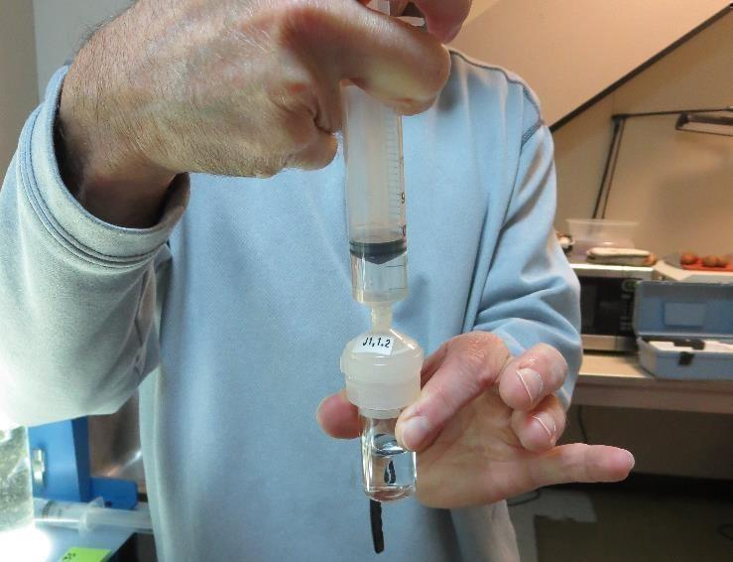
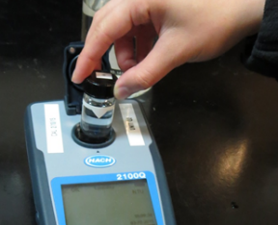
Jar Test - Filterability Test
Syringe ~ 25 mL from jar (after 5-minutes of settling)
Filter-to-waste 3-5 mL
Filter directly into clean cuvette
Measure turbidity
Note: Take several readings before recording final NTU results. Micro bubbles can adhere to glass causing false NTU readings. To remove bubbles, tilt cuvette up to 90 degrees.

Slide 26
Contact
Guy Schott, P.E.
State Water Resources Control Board
Division of Drinking Water
Santa Rosa, CA
Go to Stock Solution/Dose calculations/Jar Test Results for tools to download
www.waterboards.ca.gov/drinking_water/programs/districts/mendocino_district.html
Email: Guy Schott - Guy.Schott@waterboards.ca.gov
Office Number: 707-576-2732

