Slide 1
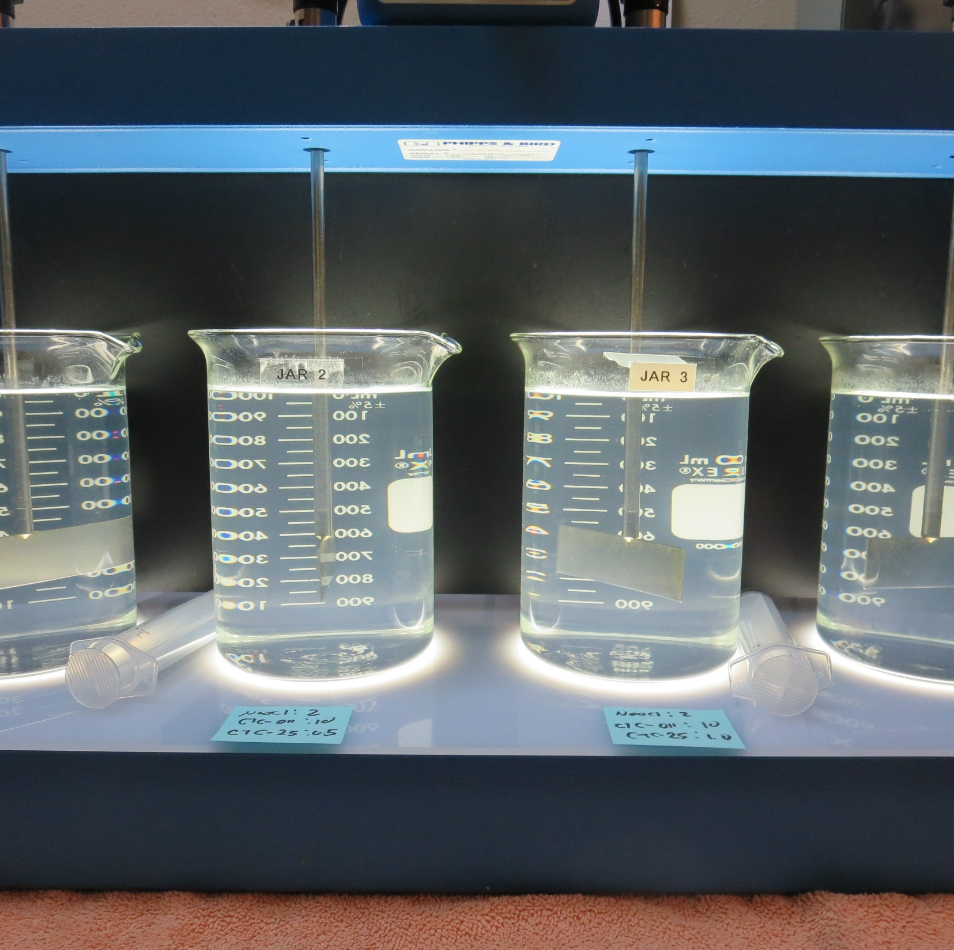
Cobb Area – Branding Iron CA1710012, Lake County, Jar Test, Fe Removal
by Guy Schott, P.E.
May 4, 2021

Slide 2
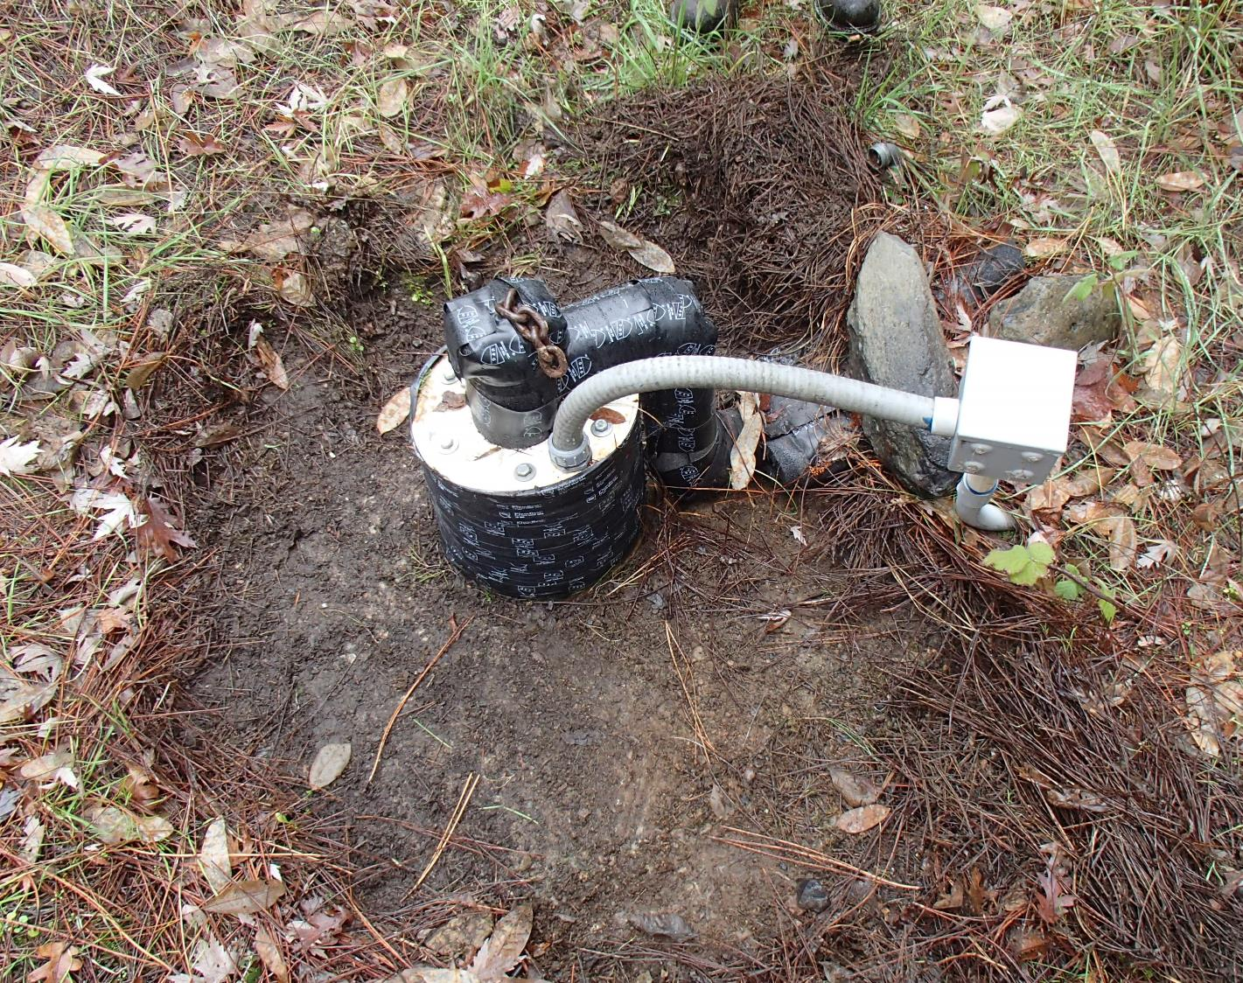
Cobb Area – Branding Iron Well 01 Source: Fe: 1.029 mg/L

Slide 3
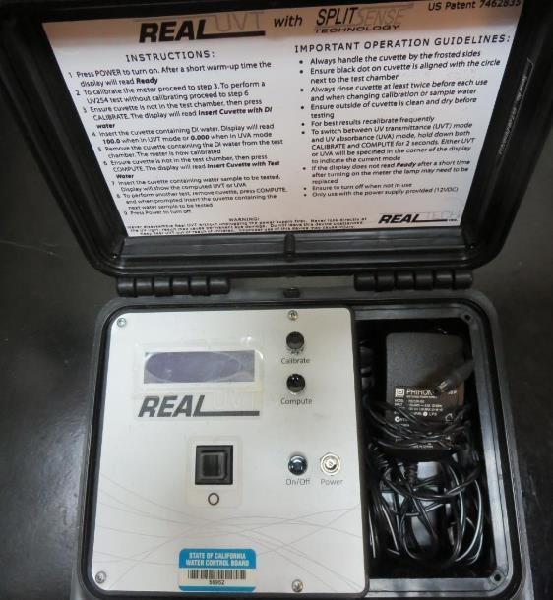
UVT/UVA, pathlength 10 mm
UV transmittance (UVT) is a measurement of the amount of ultraviolet light (commonly at 254 nm due to its germicidal effect) that passes through a water sample compared to the amount of light that passes through a pure water sample. The measurement is expressed as a percentage, % UVT.
%UVT = 10^{(-UVA)} x 100%
UV absorbance (UVA) is calculated as a relative measure of the amount of light absorbed by a water sample compared with the amount of light absorbed by a pure water sample.
UVA = -log(%UVT/100)

Slide 4
Applied Coagulants for Jar Testing (1)
BWS, Inc.
AdvFloc-CTC-00011
Polyaluminum Hydroxy Chlorosulfate
12.55% Al₂O₃
6.64% Al
64.9% Basicity
SG = 1.299
NSF limit: 250 mg/L as Product
20 mg/L (0.583 mL/min for 10 gpm plant flow)
Gregory F. Nieckarz, Ph.D.
Principal Consultant
SWS Consulting, LLC.
+1.541.953.5112
gregn.swsc@gmail.com
7066 (Garratt Callahan)
10 – 30% Poly Aluminum Hydroxychloride Sulfate
50% Basicity
SG = 1.2
NSF limit: 450 mg/L as Product

Slide 5
Applied Coagulants for Jar Testing (2)
Polydyne Incorporated
Clarifloc C-308P
SG = 1.0 – 1.2
Viscosity: 80-180 centipoise
pDADMAC (20% active, 80% H₂O)
NSF limit: 50 mg/L (product)
Product dose 5 mg/L = 1 mg/L pDADMAC active
Polydyne Incorporated
Clarifloc C-378
SG = 1.0 – 1.2
Viscosity: 800-1000 centipoise
pDADMAC (20% active, 80% H₂O)
NSF limit: 50 mg/L (product)
Product dose 5 mg/L = 1 mg/L pDADMAC active

Slide 6
Applied Coagulants for Jar Testing (3)
Pro Pac 9800 (NTU Technologies)
50% Aluminum Chlorohydrate
50% Water
23.62% Al₂O₃
12.5% Al
83% Basicity
SG = 1.25-1.34
NSF limit: 250 mg/L as Product

Slide 7
Branding Iron: Jar Test 1-4 Results, Well 01 Flash Mix 200 RPM (20 sec); Floc Mix 20 RPM (2 minutes)
Jar # | NaOCl mg/L | CTC-00011 mg/L | CTC-00025 mg/L | Filtrate NTU | Filtrate %UVT | Filtrate UVA/cm | Fe mg/L | %Fe Reduction | Free Cl₂ Residual mg/L
J1 | 2.0 | 10 | 0.0 | 0.09 | 98.8 | 0.004 | 0.012 | 98.8 | 0.70
J2 | 2.0 | 10 | 0.5 | 0.16 | 98.3 | 0.007 | 0.002 | 99.8 | 0.85
J3 | 2.0 | 10 | 1.0 | 0.33 | 97.4 | 0.011 | 0.071 | 93.1 | 0.87
J4 | 2.0 | 10 | 1.5 | 0.56 | 96.1 | 0.016 | 0.167 | 83.8 | 0.76

Slide 8
Branding Iron: Jar Test 5-8 Results, Well 01 Flash Mix 200 RPM (20 sec); Floc Mix 20 RPM (2 minutes)
Jar # | NaOCl mg/L | CTC-00011 mg/L | Clarifloc C-378 mg/L | Filtrate NTU | Filtrate %UVT | Filtrate UVA/cm | Fe mg/L | %Fe Reduction | Free Cl₂ Residual mg/L
J5 | 2.0 | 10 | 0.0 | 0.10 | 98.8 | 0.005 | 0.026 | 97.5 | 0.68
J6 | 2.0 | 10 | 0.5 | 0.22 | 98.3 | 0.007 | 0.054 | 94.8 | 0.89
J7 | 2.0 | 10 | 1.0 | 0.31 | 97.5 | 0.010 | 0.078 | 92.4 | 0.92
J8 | 2.0 | 10 | 1.5 | 0.51 | 96.8 | 0.014 | 0.150 | 85.4 | 0.90

Slide 9
Branding Iron: Jar Test 9-12 Results, Well 01 Flash Mix 200 RPM (20 sec); Floc Mix 20 RPM (2 minutes)
Jar # | NaOCl mg/L | 9800 mg/L | Filtrate NTU | Filtrate %UVT | Filtrate UVA/cm | Fe mg/L | %Fe Reduction | Free Cl₂ Residual mg/L
J9 | 2.0 | 2 | 1.19 | 93.3 | 0.029 | - | - | 0.87
J10 | 2.0 | 4 | 1.33 | 92.8 | 0.032 | - | - | 0.91
J11 | 2.0 | 6 | 1.29 | 92.6 | 0.033 | - | - | 0.92
J12 | 2.0 | 8 | 1.14 | 92.6 | 0.033 | 0.403 | 60.8 | 0.89

Slide 10
Branding Iron: Jar Test 13-20 Results, Well 01 Flash Mix 200 RPM (20 sec); Floc Mix 20 RPM (2 minutes)
Jar # | NaOCl mg/L | CTC-00011 mg/L | Filtrate NTU | Filtrate %UVT | Filtrate UVA/cm | Fe mg/L | %Fe Reduction | Free Cl₂ Residual mg/L
J13 | 2.0 | 6 | 0.61 | 95.5 | 0.019 | 0.255 | 75.2 | 0.92
J14 | 2.0 | 8 | 0.69 | 95.1 | 0.021 | 0.228 | 77.8 | 0.86
J15 | 2.0 | 10 | 0.58 | 95.8 | 0.018 | 0.189 | 81.6 | 0.92
J16 | 2.0 | 12 | 0.31 | 97.5 | 0.010 | 0.057 | 94.5 | 0.48
J17 | 2.0 | 14 | 0.11 | 98.6 | 0.005 | 0.031 | 97.0 | 0.80
J18 | 2.0 | 16 | 0.09 | 98.8 | 0.004 | 0.003 | 99.7 | 0.69
J19 | 2.0 | 18 | 0.08 | 99.0 | 0.004 | 0.020 | 98.1 | 0.75
J20 | 2.0 | 20 | 0.20 | 98.3 | 0.007 | 0.045 | 95.6 | 0.89

Slide 11
Branding Iron: Jar Test 21-24 Results, Well 01 Flash Mix 200 RPM (20 sec); Floc Mix 20 RPM (2 minutes)
Jar # | NaOCl mg/L | 7066 mg/L | Filtrate NTU | Filtrate %UVT | Filtrate UVA/cm | Fe mg/L | %Fe Reduction | Free Cl₂ Residual mg/L
J21 | 2.0 | 16 | 0.18 | 98.2 | 0.007 | 0.049 | 95.2 | 0.56
J22 | 2.0 | 18 | 0.16 | 98.4 | 0.007 | 0.043 | 95.8 | 0.88
J23 | 2.0 | 20 | 0.15 | 98.5 | 0.006 | 0.040 | 96.1 | 0.61
J24 | 2.0 | 22 | 0.15 | 98.3 | 0.007 | 0.051 | 95.0 | 0.94

Slide 12
Branding Iron: Jar Test 25-31 Results, Well 01 Flash Mix 200 RPM (20 sec); Floc Mix 20 RPM (2 minutes)
Jar # | NaOCl mg/L | CTC-00011 mg/L | Filtrate NTU | Filtrate %UVT | Filtrate UVA/cm | Fe mg/L | %Fe Reduction | Free Cl₂ Residual mg/L
J25 | 2.0 | 10 | 0.45 | 97.1 | 0.012 | - | - | 0.77
J26 | 2.0 | 14 | 0.22 | 98.1 | 0.008 | 0.056 | 94.6 | 0.29
J27 | 2.0 | 18 | 0.14 | 98.4 | 0.006 | 0.026 | 97.5 | 0.92
J28 | 2.0 | 20 | 0.13 | 98.5 | 0.006 | 0.032 | 96.9 | 0.92
J29 | 2.0 | 18 | 0.15 | 98.5 | 0.006 | 0.033 | 96.8 | 0.88
J30 | 2.0 | 22 | 0.09 | 98.9 | 0.004 | 0.023 | 97.8 | 0.87
J31 | 2.0 | 26 | 0.10 | 98.8 | 0.005 | 0.016 | 98.4 | 0.88

Slide 13
Jar Testing for 1-Liter Jars: Procedures for Iron Removal
Fill jars with source water prior to coagulant injection and set paddle speed at 30 rpm
Add chemicals (i.e., NaOCl, primary coagulant, coagulant aid) to each jar
Flash mix for 20 seconds (200 rpm)
Slow mix for 2 minutes (20 rpm).
Syringe 25 mL from each jar taken 1-inch below surface (25 mL/12 sec rate).
Filtered through 1.2 um isopore membrane into cuvette drip rate, 15 mL/(50-90 sec).
Measure filtrate turbidity, %UVT/UVA and Fe.
Dip cuvette into jar and measure chlorine residual.
Record all data.

Slide 14
Jar Test Filterability Test Equipment
Turbidity Instrument
Syringe w/Luer-Lock Tip, 30 cc
(part#: 2225800, by Hach)
Swinnex Filter Holder, 25 mm (part#: SX0002500)
Isopore Membrane Filter, 1.2 um absolute
pore size,
Φ= 25 mm , thickness: 24 um,
hydrophilic polycarbonate membrane
(part #: RTTP02500)
Go to Sigma-Aldrich for laboratory supplies http://www.sigmaaldrich.com/united-states.html

Slide 15
Isopore Membrane Information
Categories | Information
trade name | Isopore
filter color | White
chemistry | Polycarbonate (PC)
water flow rate | Avg. 175 mL/min x cm² (typical results @ 10 psi)
media | Isopore®
wettability | Hydrophilic
porosity | 14.7%
pore size | 1.2 µm
bubble point at 23 °C | 1.0 bar, air with water
thickness | 24 µm
filter diameter (ø) | 25 mm
material size | polycarbonate, Hydrophilic, 1.2 µm, 25 mm, white, plain, 100

Slide 16
Isopore Membrane Background Information
The Isopore membrane is a polycarbonate, track-etched screen filter recommended for all analyses in which the sample is viewed on the surface of the membrane. The Isopore membrane is composed of polycarbonate film, which has a smooth, glass-like surface for clearer sample observation. The unique manufacturing process of the membrane ensures a precise pore diameter and a consistent pore size for accurate separation of samples by size. Matched-weight filters are not usually required because of low, constant tar and ash weights. Features & Benefits: Membrane structure retains particles on the surface, simplifying counting and analysis

Slide 17
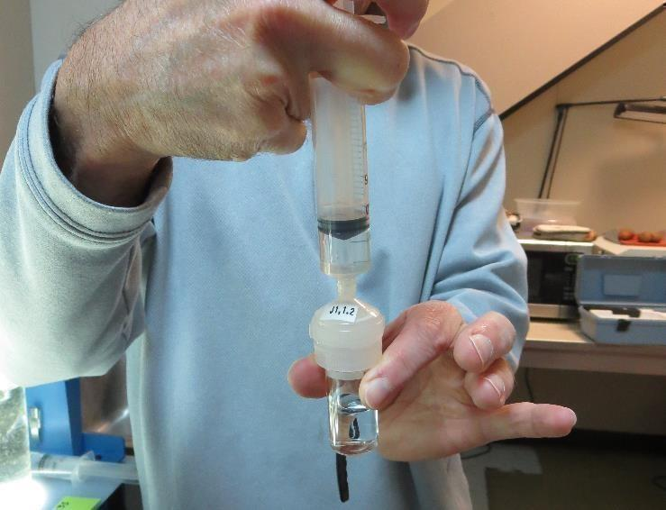
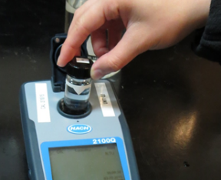
Jar Test - Filterability Test
Syringe ~ 25 mL from jar (after 5-minutes of settling)
Filter-to-waste 3-5 mL
Filter directly into clean cuvette
Measure turbidity
Note: Take several readings before recording final NTU results. Micro bubbles can adhere to glass causing false NTU readings. To remove bubbles, tilt cuvette up to 90 degrees.

Slide 18
Contact
Guy Schott, P.E.
State Water Resources Control Board
Division of Drinking Water
Santa Rosa, CA
Go to Stock Solution/Dose calculations/Jar Test Results for tools to download
www.waterboards.ca.gov/drinking_water/programs/districts/mendocino_district.html
Email: Guy Schott - Guy.Schott@waterboards.ca.gov
Office Number: 707-576-2732

