Slide 1
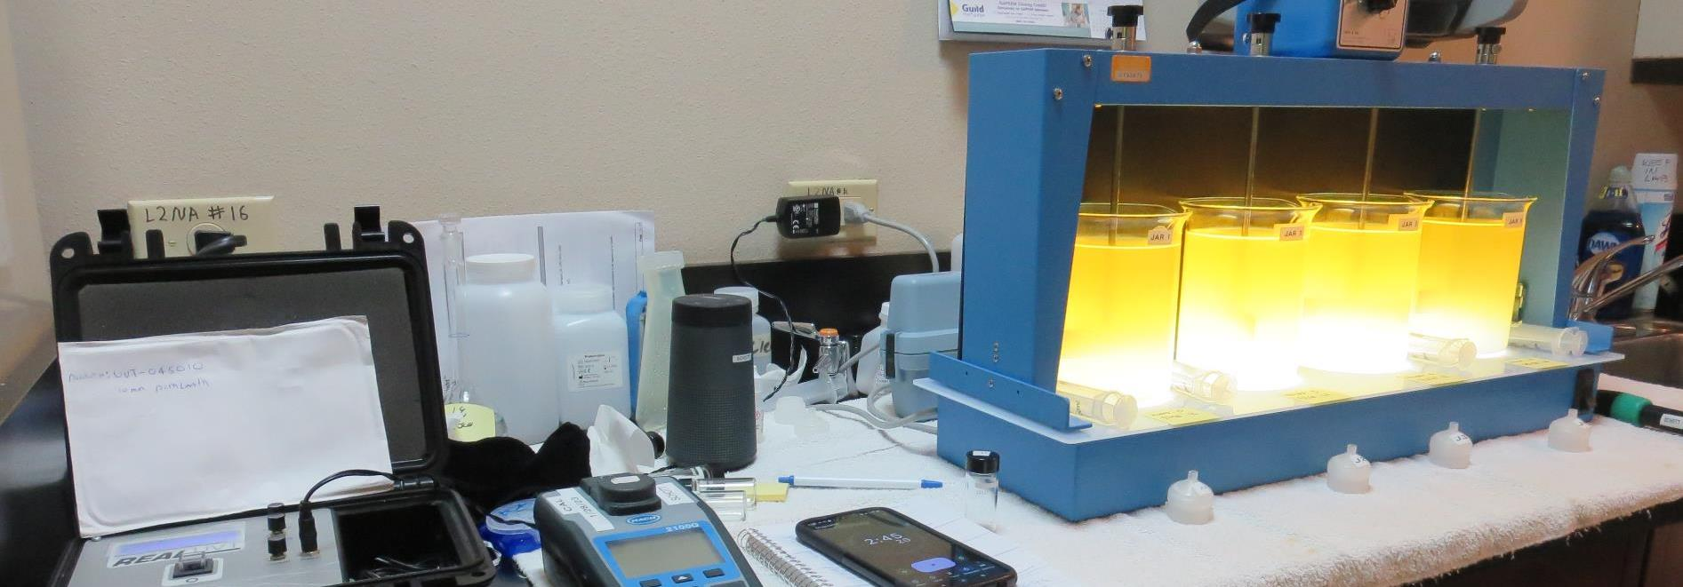
CSP-MacKerricher State Park CA2310301, Mendocino County Jar Test
by Guy Schott, P.E.
January 27, 2023

Slide 2
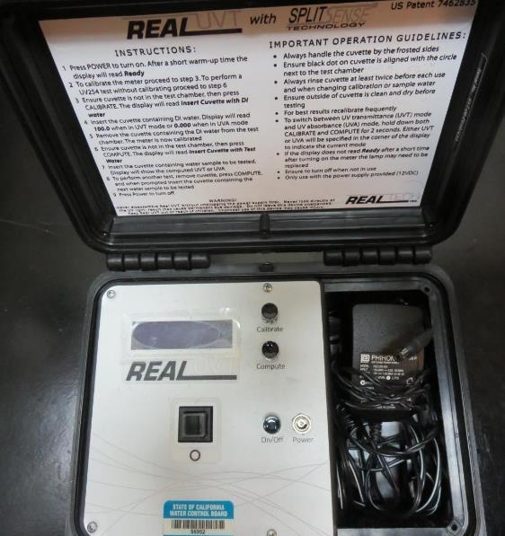
UVT/UVA, pathlength 10 mm
UV transmittance (UVT) is a measurement of the amount of ultraviolet light (254 nm) that passes through a water sample compared to the amount of light that passes through a pure water sample. The measurement is expressed as % UVT.
%UVT = 10^{(-UVA)} x 100%
UV absorbance (UVA) is calculated as a relative measure of the amount of light absorbed by a water sample compared with the amount of light absorbed by a pure water sample.
UVA = -log(%UVT/100)

Slide 3
CSP-MacKerricher State Park Source & Treated Water Characteristics, January 27, 2023
Source – Mill Creek
pH: 6.50
Alkalinity: 44 mg/L as CaCO₃
Turbidity: 101 NTU
UVT: 19.7%,
UVA: 0.704/cm
0.4 um Filtered
Turbidity: 6.7 NTU
UVT: 53.9%,
UVA: 0.267/cm
Source – Iron Concentration
Fe: 11.48 mg/L
0.4 um Filtered
Fe: 1.58 mg/L

Slide 4
Applied Coagulants for Jar Testing (1)
Pro Pac 9800 (NTU Technologies)
50% Aluminum Chlorohydrate
50% Water
23.62% Al₂O₃
12.5% Al
83% Basicity
SG = 1.25-1.34
NSF limit: 250 mg/L as Product
10 mg/L as 9800 = Reduction 1.18 mg/L as CaCO₃
Pro Pac 9890 (NTU Technologies)
35-45% Aluminum Chlorohydrate
35-45% Water
~18.9% Al₂O₃
~10.5% Al
83% Basicity
20% polyamine (50% water, 50% active polyamines)
SG = 1.25-1.34
NSF limit: 50 mg/L as Product;
Product dose 10 mg/L = 1 mg/L polyamines active

Slide 5
Applied Coagulants for Jar Testing (2)
960 (NTU Technologies)
33% Polyaluminum Hydroxychlorosulfate
67% Water
SG = 1.29
NSF limit: 250 mg/L as Product
961 (NTU Technologies)
35% Polyaluminum Hydroxychlorosulfate
2% pDADMAC
65% Water
SG = 1.29
NSF limit: 255 mg/L as Product

Slide 6
Applied Coagulants for Jar Testing (3)
Aluminum Sulfate (Product)
Al₂(SO₄)₃*14.3H₂0 (Liquid)
48% Aluminum Sulfate
52% Water
8.2% Al₂O₃
4.3% Al
0% Basicity
SG = 1.32
NSF limit: 400 mg/L (product)
As hydrated Al₂(SO₄)₃*14.3H₂0
17% Al₂O₃
Ferric Chloride
42.4% FeCl₃
SG = 1.44
NSF limit: 250 mg/L as Product;

Slide 7
Applied Coagulants for Jar Testing (4)
BWS, Inc.
Greg Nieckarz, Ph.D.
Greg.niekarz@bws.works
541-953-5112
AdvFloc-CTC-00011
Polyaluminum Hydroxy Chlorosulfate
12.55% Al₂O₃
6.64% Al
64.9% Basicity
SG = 1.299
NSF limit: 250 mg/L as Product

Slide 8
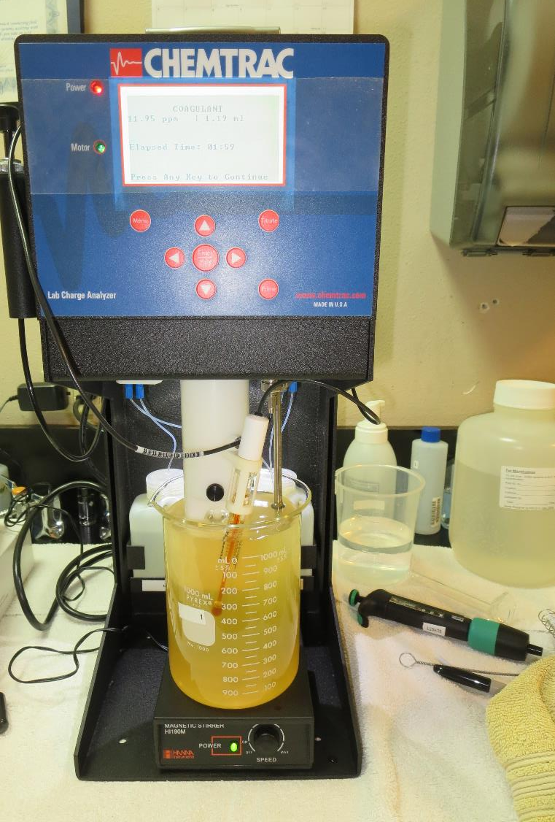
Laboratory Charge Analyzer
LCA: Used to determine coagulant demand of a source water entering the treatment plant.
Source pH: 6.50
LCA #1: 9800: 11.9 mg/L

Slide 9
Coagulant Information
Unless stated otherwise, all coagulant doses are reported as Product (100% strength).
Aluminum Sulfate doses are reported as hydrated Al₂(SO₄)₃*14.3H₂0.
Ferric Chloride doses are reported as FeCl₃.
Preparation of coagulant stock solutions are generally 1.0 and/or 0.1 percent strength using 100 and/or 200 mL volumetric flasks.
Finnpipette F2 variable volume pipette, capacity 100-1000 micro liters is used for stock solution preparation and coagulant aid jar test dosing.
Finnpipette F2 variable volume pipette, capacity 0.5-5 mL is used for primary coagulant jar test dosing.

Slide 10
Coagulants – Alkalinity Consumption
Coagulant | Chemical Dose, mg/L | Alkalinity Consumed mg/L as CaCO₃
Ferric Chloride | 10 | 9.25
Aluminum Sulfate | 10 | 5.0
CTC-00011 | 10 | 1.3
960 | 10 | ~1.3
961 | 10 | ~1.3
9800 | 10 | 1.18
9890 | 10 | 0.95

Slide 11
CSP-MacKerricher State Park; Jar Test 1 - 8 Results Flash Mix 200 RPM (20 sec); Floc Mix 30 RPM (5 min)
Jar# | NaOCl mg/L | 9800 mg/L | Filtrate NTU | Filtrate %UVT | Filtrate UVA/cm | Settle NTU 25 min | %UVA Reduction
J1 | 5 | 3 | 9.94 | 67.7 | 0.169 | 111 | 36.7
J2 | 5 | 6 | 8.82 | 74.4 | 0.128 | 93.5 | 52.1
J3 | 5 | 9 | 1.6 | 84.9 | 0.070 | 48.0 | 73.8
J4 | 5 | 12 | 5.36 | 81.0 | 0.091 | 34.2 | 65.9
J5 | 10 | 9 | 1.40 | 87.2 | 0.059 | 42.3 | 77.9
J6 | 10 | 10 | 0.92 | 88.0 | 0.055 | 45.9 | 79.4
J7 | 10 | 11 | 0.86 | 88.5 | 0.052 | 37.8 | 80.5
J8 | 10 | 12 | 0.55 | 89.5 | 0.047 | 40.7 | 82.4

Slide 12
CSP-MacKerricher State Park; Jar Test 9 - 12 Results Flash Mix 200 RPM (20 sec); Floc Mix 30 RPM (5 min)
Jar# | NaOCl mg/L | 9800 mg/L | Filtrate NTU | Filtrate %UVT | Filtrate UVA/cm | Settle NTU 25 min | %UVA Reduction
J9 | 15 | 12 | 1.23 | 87.5 | 0.057 | 38.8 | 78.7
J10 | 15 | 13 | 0.58 | 88.9 | 0.050 | 39.8 | 81.3
J11 | 15 | 14 | 0.91 | 88.9 | 0.050 | 38.7 | 81.3
J12 | 15 | 15 | 2.18 | 88.5 | 0.052 | 36.6 | 80.5

Slide 13
CSP-MacKerricher State Park; Jar Test 13 - 20 Results Flash Mix 200 RPM (20 sec); Floc Mix 30 RPM (5 min)
Jar# | NaOCl mg/L | 9890 mg/L | Filtrate NTU | Filtrate %UVT | Filtrate UVA/cm | %UVA Reduction | Settle NTU 25 min | Filtrate Fe, mg/L
J13 | 10 | 9 | 0.18 | 90.0 | 0.045 | 83.1 | 42.6 | -
J14 | 10 | 11 | 1.61 | 88.2 | 0.054 | 78.7 | 36.4 | -
J15 | 10 | 13 | 0.16 | 91.2 | 0.039 | 85.4 | 43.2 | -
J16 | 10 | 15 | 0.07 | 92.8 | 0.032 | 88.0 | 53.8 | -
J17 | 10 | 15 | 0.06 | 92.2 | 0.035 | 86.9 | 80.2 | 0.000
J18 | 10 | 17 | 0.06 | 91.6 | 0.037 | 86.1 | 97.0 | 0.000
J19 | 10 | 19 | 0.08 | 92.2 | 0.034 | 87.3 | 91.0 | 0.015
J20 | 10 | 21 | 0.14 | 92.5 | 0.032 | 88.0 | 101 | 0.000

Slide 14
CSP-MacKerricher State Park; Jar Test 21 - 24 Results Flash Mix 200 RPM (20 sec); Floc Mix 30 RPM (5 min)
Jar# | NaOCl mg/L | 9890 mg/L | Filtrate NTU | Filtrate %UVT | Filtrate UVA/cm | %UVA Reduction | Settle NTU 25 min | Filtrate Fe mg/L
J21 | 0 | 16 | 0.07 | 92.3 | 0.036 | 87.3 | 98.0 | 0.005
J22 | 3 | 16 | 0.05 | 91.2 | 0.039 | 85.4 | 98.0 | 0.000
J23 | 6 | 16 | 0.05 | 91.0 | 0.041 | 84.6 | 94.2 | 0.005
J24 | 10 | 16 | 0.05 | 93.6 | 0.028 | 89.5 | 94.3 | -

Slide 15
CSP-MacKerricher State Park; Jar Test 25 - 32 Results Flash Mix 200 RPM (20 sec); Floc Mix 30 RPM (5 min)
Jar# | CTC-00011 mg/L | Filtrate NTU | Filtrate %UVT | Filtrate UVA/cm | %UVA Reduction | Settle NTU 25 min | Filtrate Fe mg/L
J25 | 20 | 2.13 | 89.0 | 0.050 | 81.3 | 28.8 | -
J26 | 30 | 0.28 | 90.7 | 0.042 | 84.3 | 18.9 | -
J27 | 40 | 0.50 | 90.5 | 0.042 | 84.3 | 17.6 | -
J28 | 50 | 0.06 | 91.7 | 0.037 | 86.1 | 16.5 | 0.002
J29 | 50 | 0.06 | 92.1 | 0.035 | 86.9 | 14.2 | -
J30 | 60 | 0.05 | 92.9 | 0.031 | 88.4 | 11.6 | -
J31 | 70 | 0.05 | 93.1 | 0.030 | 88.8 | 10.4 | -
J32 | 80 | 0.04 | 93.2 | 0.030 | 88.8 | 10.0 | -

Slide 16
CSP-MacKerricher State Park; Jar Test 33 - 36 Results Flash Mix 200 RPM (20 sec); Floc Mix 30 RPM (5 min)
Jar# | FeCl₃ mg/L | Filtrate NTU | Filtrate %UVT | Filtrate UVA/cm | %UVA Reduction | Settle NTU 25 min | Filtrate Fe mg/L
J33 | 20 | 0.93 | 87.9 | 0.055 | 79.4 | 50.6 | -
J34 | 30 | 0.88 | 88.4 | 0.053 | 80.1 | 27.2 | -
J35 | 40 | 0.33 | 90.0 | 0.045 | 83.1 | 20.5 | -
J36 | 50 | 0.07 | 92.7 | 0.032 | 88.0 | 13.2 | 0.005

Slide 17
CSP-MacKerricher State Park; Jar Test 37 - 40 Results Flash Mix 200 RPM (20 sec); Floc Mix 30 RPM (5 min)
Jar# | Alum mg/L | Filtrate NTU | Filtrate %UVT | Filtrate UVA/cm | %UVA Reduction | Settle NTU 25 min | Filtrate Fe mg/L
J37 | 30 | 0.77 | 90.3 | 0.044 | 83.5 | 75.8 | -
J38 | 40 | 0.64 | 91.3 | 0.039 | 85.4 | 91.3 | -
J39 | 50 | 0.05 | 93.0 | 0.031 | 88.4 | 92.4 | 0.001
J40 | 60 | 0.16 | 93.6 | 0.028 | 89.5 | 93.6 | -

Slide 18
CSP-MacKerricher State Park; Jar Test 41 - 44 Results Flash Mix 200 RPM (20 sec); Floc Mix 30 RPM (5 min)
Jar# | 960 mg/L | Filtrate NTU | Filtrate %UVT | Filtrate UVA/cm | %UVA Reduction | Settle NTU 25 min | Filtrate Fe mg/L
J41 | 30 | 0.07 | 91.7 | 0.037 | 86.1 | 15.5 | 0.004
J42 | 40 | 0.05 | 91.9 | 0.036 | 86.5 | 15.5 | -
J43 | 50 | 0.05 | 92.3 | 0.034 | 87.3 | 16.5 | -
J44 | 60 | 0.05 | 93.7 | 0.028 | 89.5 | 13.4 | -

Slide 19
CSP-MacKerricher State Park; Jar Test 45 - 48 Results Flash Mix 200 RPM (20 sec); Floc Mix 30 RPM (5 min)
Jar# | 961 mg/L | Filtrate NTU | Filtrate %UVT | Filtrate UVA/cm | %UVA Reduction | Settle NTU 25 min
J45 | 20 | 0.34 | 90.9 | 0.041 | 84.6 | 46.4
J46 | 30 | 0.90 | 92.0 | 0.036 | 86.5 | 67.6
J47 | 40 | 1.97 | 86.4 | 0.063 | 76.4 | 65.1
J48 | 50 | 11.7 | 64.2 | 0.191 | 28.5 | 64.5

Slide 20
Jars 1-4 Test Flash Mix 200 RPM, 20 Sec Floc Mix 30 RPM, 5 min 25 mL sampled 5 minutes at end of Floc period Applied Coagulant 9800

Slide 21
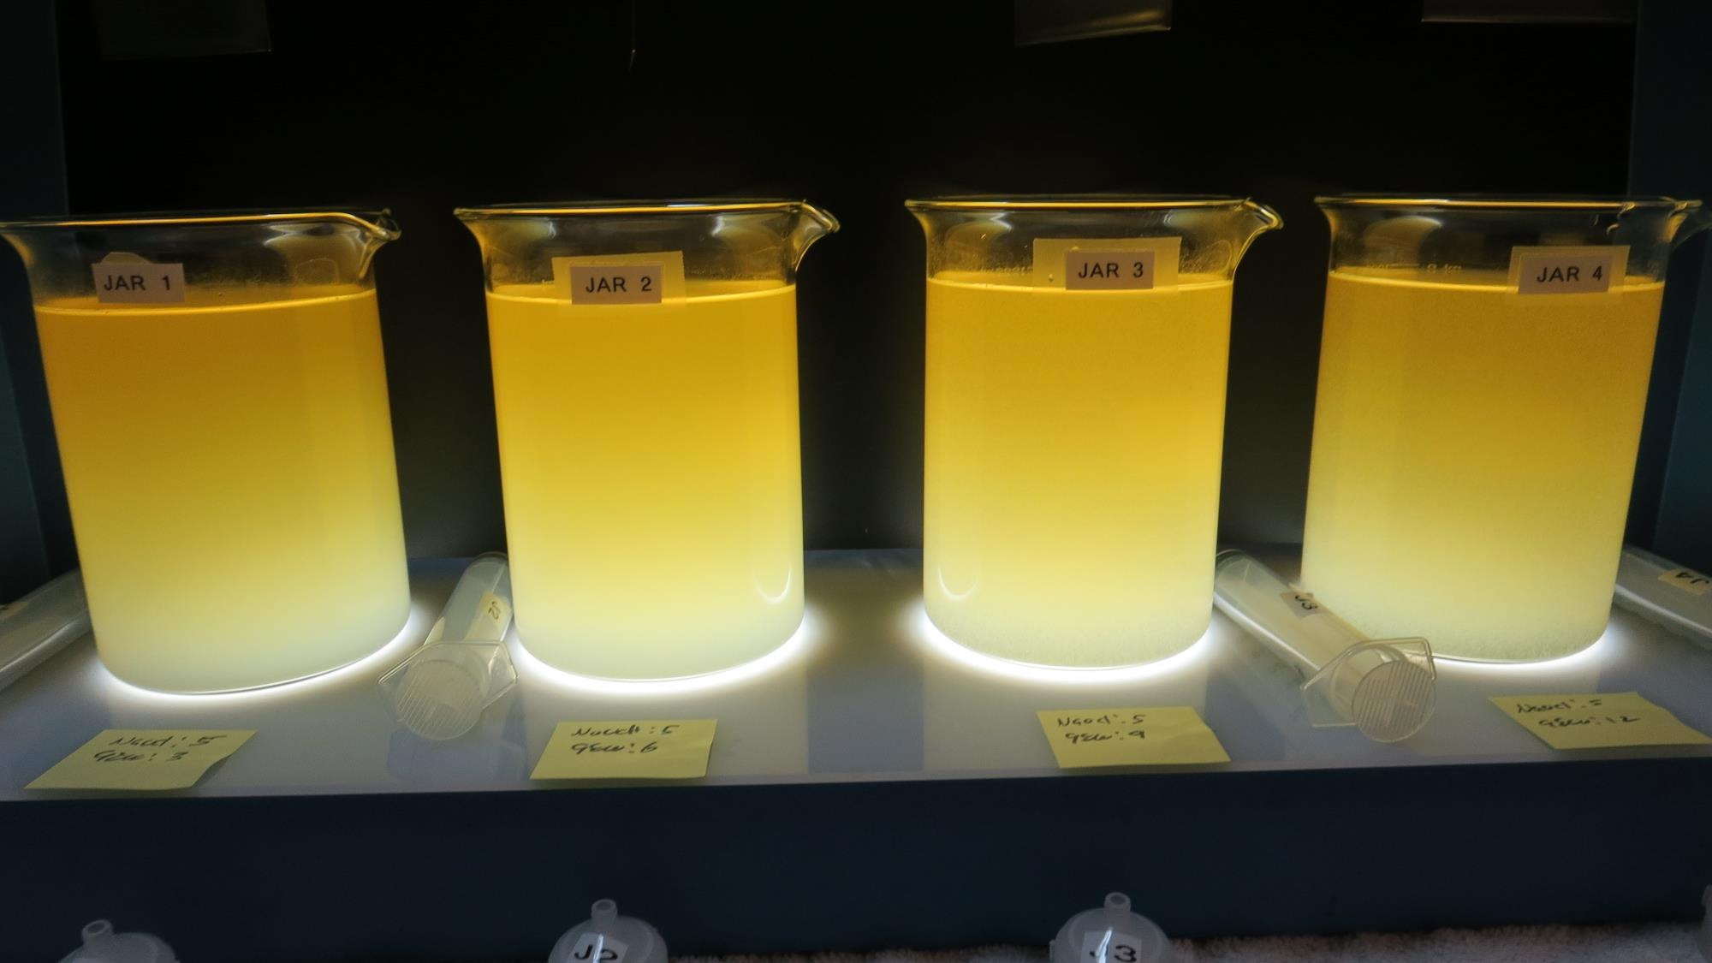
Jars 1-4: End of Floc Duration, 25 mL is syringed for filterability and %UVT/UVA.
5 mg/L NaOCl
3 mg/L 9800
Filtrate: 9.91 NTU
UVT: 67.7%
UVA: 0.169/cm
UVA Reduction: 36.7%
Settled: 111 NTU
5 mg/L NaOCl
6 mg/L 9800
Filtrate: 8.82 NTU
UVT: 74.4%
UVA: 0.128/cm
UVA Reduction: 52.1%
Settled: 93.5 NTU
5 mg/L NaOCl
9 mg/L 9800
Filtrate: 1.60 NTU
UVT: 84.9%
UVA: 0.070/cm
UVA Reduction: 73.8%
Settled: 48.0 NTU
5 mg/L NaOCl
12 mg/L 9800
Filtrate: 5.36 NTU
UVT: 81.0%
UVA: 0.091/cm
UVA Reduction: 65.9%
Settled: 34.2 NTU

Slide 22
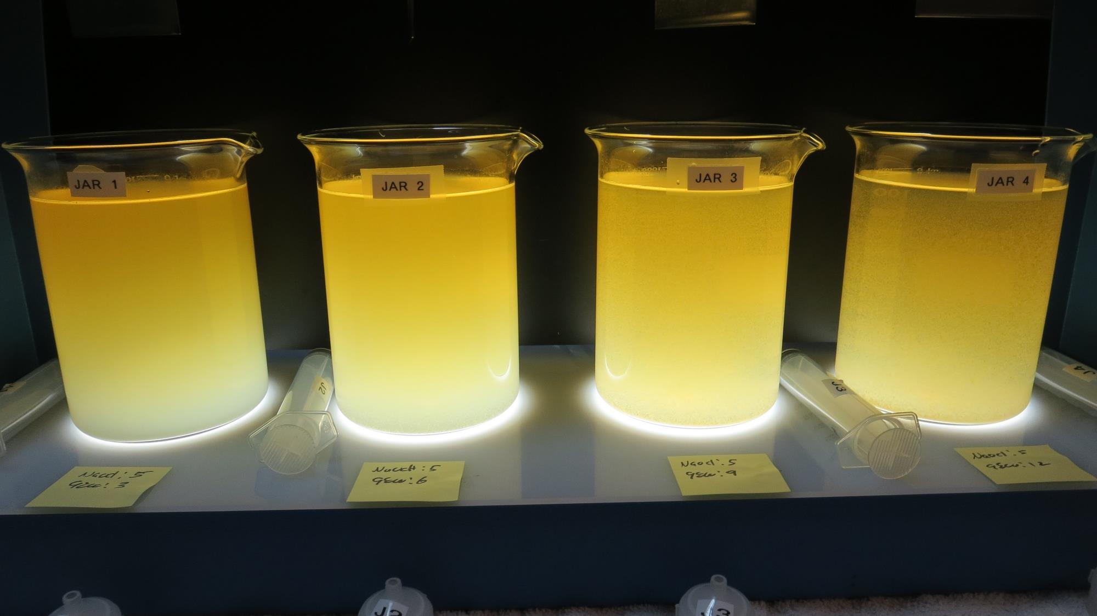
Jars 1-4: After 5 min of settling, 25 mL is syringed for filterability and %UVT/UVA.

Slide 23
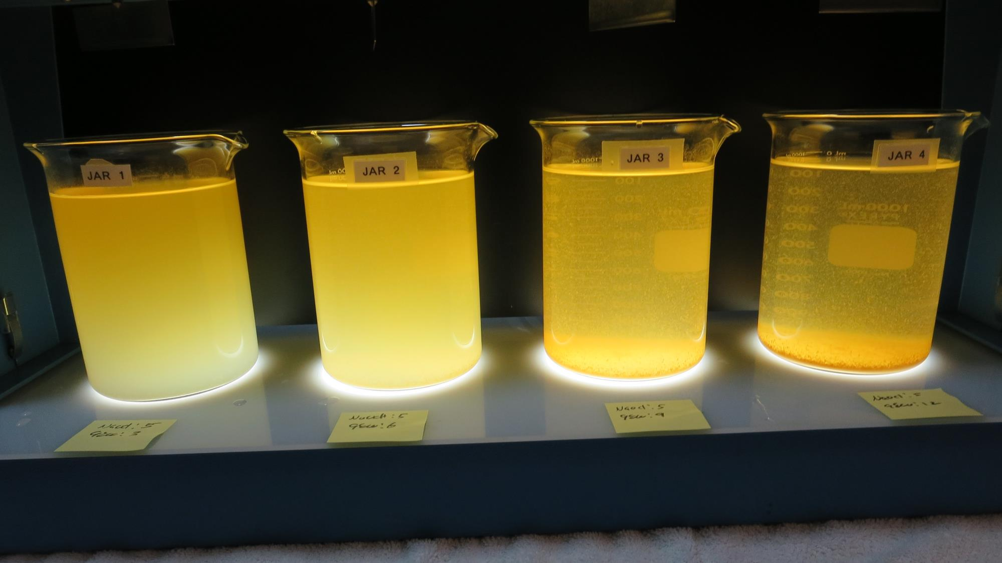
Jars 1-4: After 25-minutes of settling, settled water turbidity is taken.
5 mg/L NaOCl
3 mg/L 9800
Filtrate: 9.91 NTU
UVT: 67.7%
UVA: 0.169/cm
UVA Reduction: 36.7%
Settled: 111 NTU
5 mg/L NaOCl
6 mg/L 9800
Filtrate: 8.82 NTU
UVT: 74.4%
UVA: 0.128/cm
UVA Reduction: 52.1%
Settled: 93.5 NTU
5 mg/L NaOCl
9 mg/L 9800
Filtrate: 1.60 NTU
UVT: 84.9%
UVA: 0.070/cm
UVA Reduction: 73.8%
Settled: 48.0 NTU
5 mg/L NaOCl
12 mg/L 9800
Filtrate: 5.36 NTU
UVT: 81.0%
UVA: 0.091/cm
UVA Reduction: 65.9%
Settled: 34.2 NTU

Slide 24
Jars 5-8 Test Flash Mix 200 RPM, 20 Sec Floc Mix 30 RPM, 5 min 25 mL sampled 5 minutes at end of Floc period Applied Coagulant 9800

Slide 25
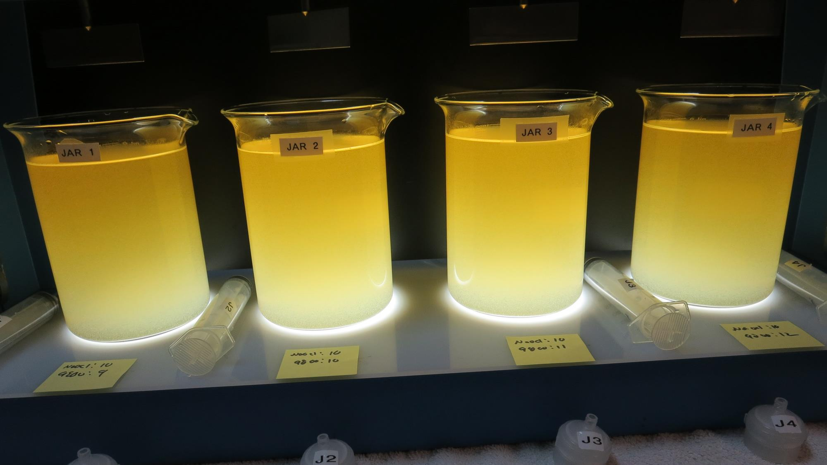
Jars 5-8: End of Floc Duration, 25 mL is syringed for filterability and %UVT/UVA.
10 mg/L NaOCl
9 mg/L 9800
Filtrate: 1.40 NTU
UVT: 87.2%
UVA: 0.059/cm
UVA Reduction: 77.9%
Settled: 42.3 NTU
10 mg/L NaOCl
10 mg/L 9800
Filtrate: 0.92 NTU
UVT: 88.0%
UVA: 0.055/cm
UVA Reduction: 79.4%
Settled: 45.9 NTU
10 mg/L NaOCl
11 mg/L 9800
Filtrate: 0.86 NTU
UVT: 88.5%
UVA: 0.052/cm
UVA Reduction: 80.5%
Settled: 37.8 NTU
10 mg/L NaOCl
12 mg/L 9800
Filtrate: 0.55 NTU
UVT: 89.5%
UVA: 0.047/cm
UVA Reduction: 82.5%
Settled: 40.7 NTU

Slide 26
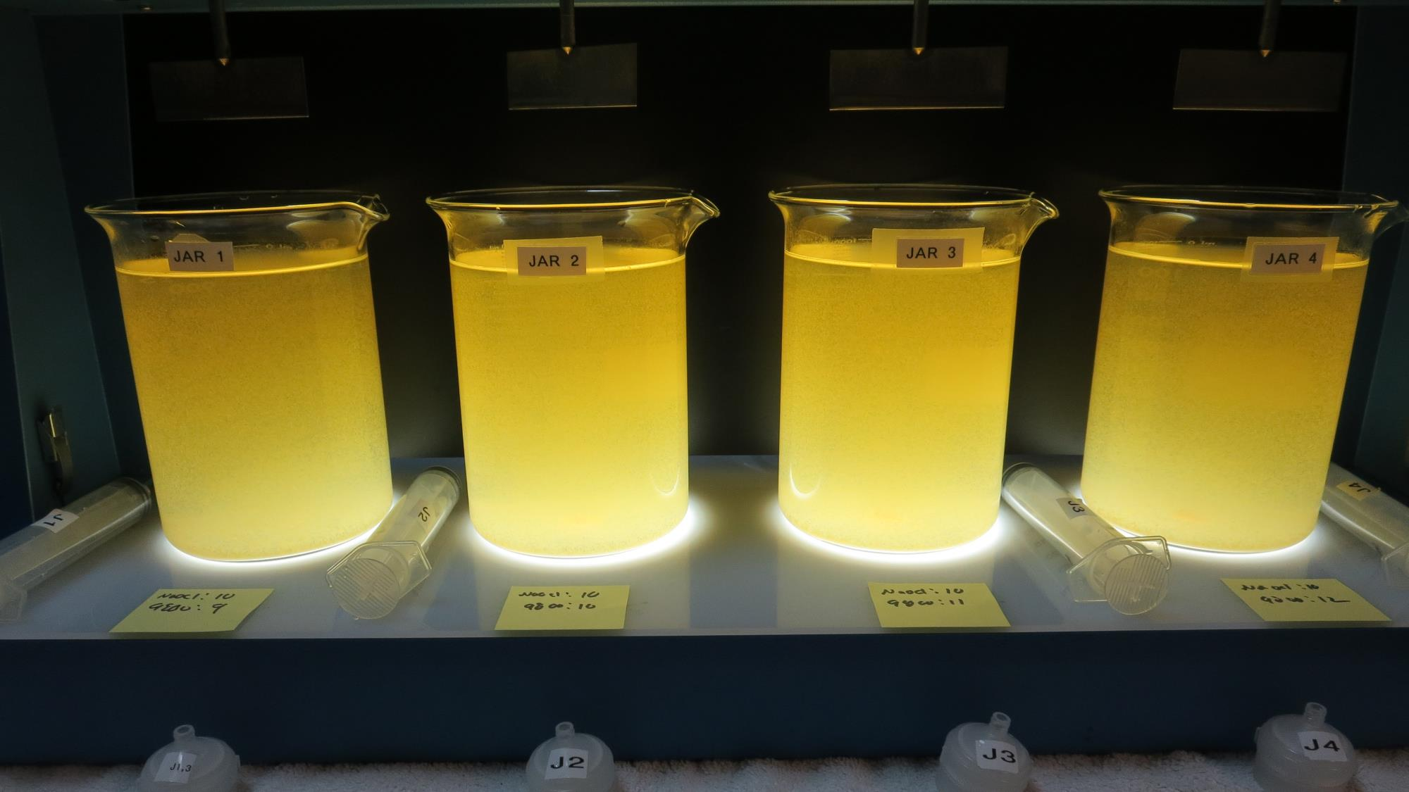
Jars 5-8: After 5 min of settling, 25 mL is syringed for filterability and %UVT/UVA.

Slide 27
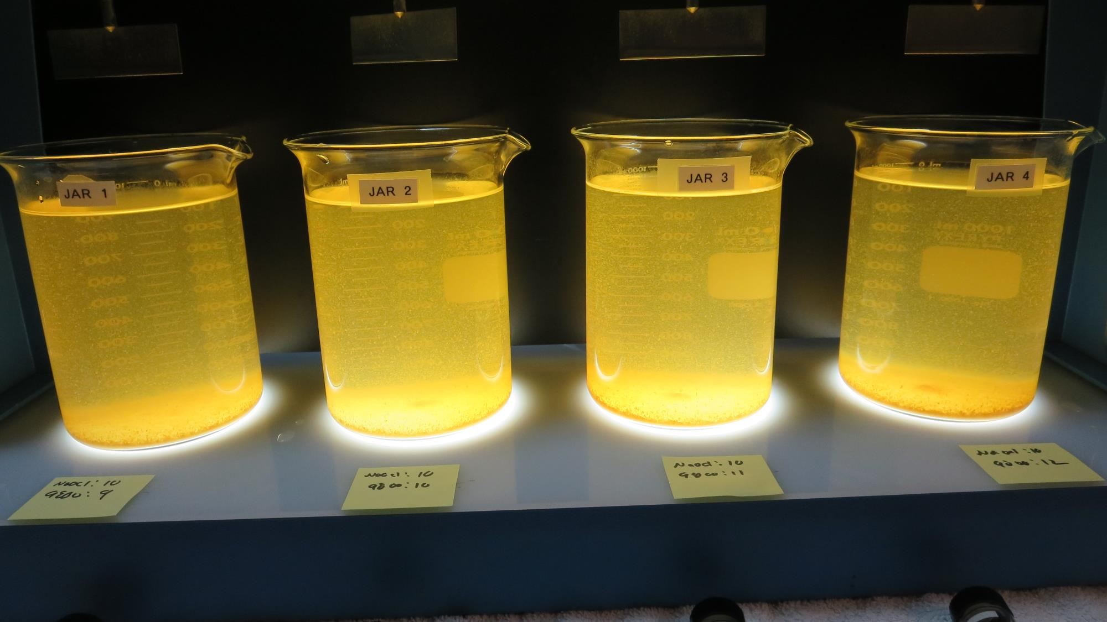
Jars 5-8: After 25-minutes of settling, settled water turbidity is taken.
10 mg/L NaOCl
9 mg/L 9800
Filtrate: 1.40 NTU
UVT: 87.2%
UVA: 0.059/cm
UVA Reduction: 77.9%
Settled: 42.3 NTU
10 mg/L NaOCl
10 mg/L 9800
Filtrate: 0.92 NTU
UVT: 88.0%
UVA: 0.055/cm
UVA Reduction: 79.4%
Settled: 45.9 NTU
10 mg/L NaOCl
11 mg/L 9800
Filtrate: 0.86 NTU
UVT: 88.5%
UVA: 0.052/cm
UVA Reduction: 80.5%
Settled: 37.8 NTU
10 mg/L NaOCl
12 mg/L 9800
Filtrate: 0.55 NTU
UVT: 89.5%
UVA: 0.047/cm
UVA Reduction: 82.5%
Settled: 40.7 NTU

Slide 28
Jars 9-12 Test Flash Mix 200 RPM, 20 Sec Floc Mix 30 RPM, 5 min 25 mL sampled 5 minutes at end of Floc period Applied Coagulant 9800

Slide 29
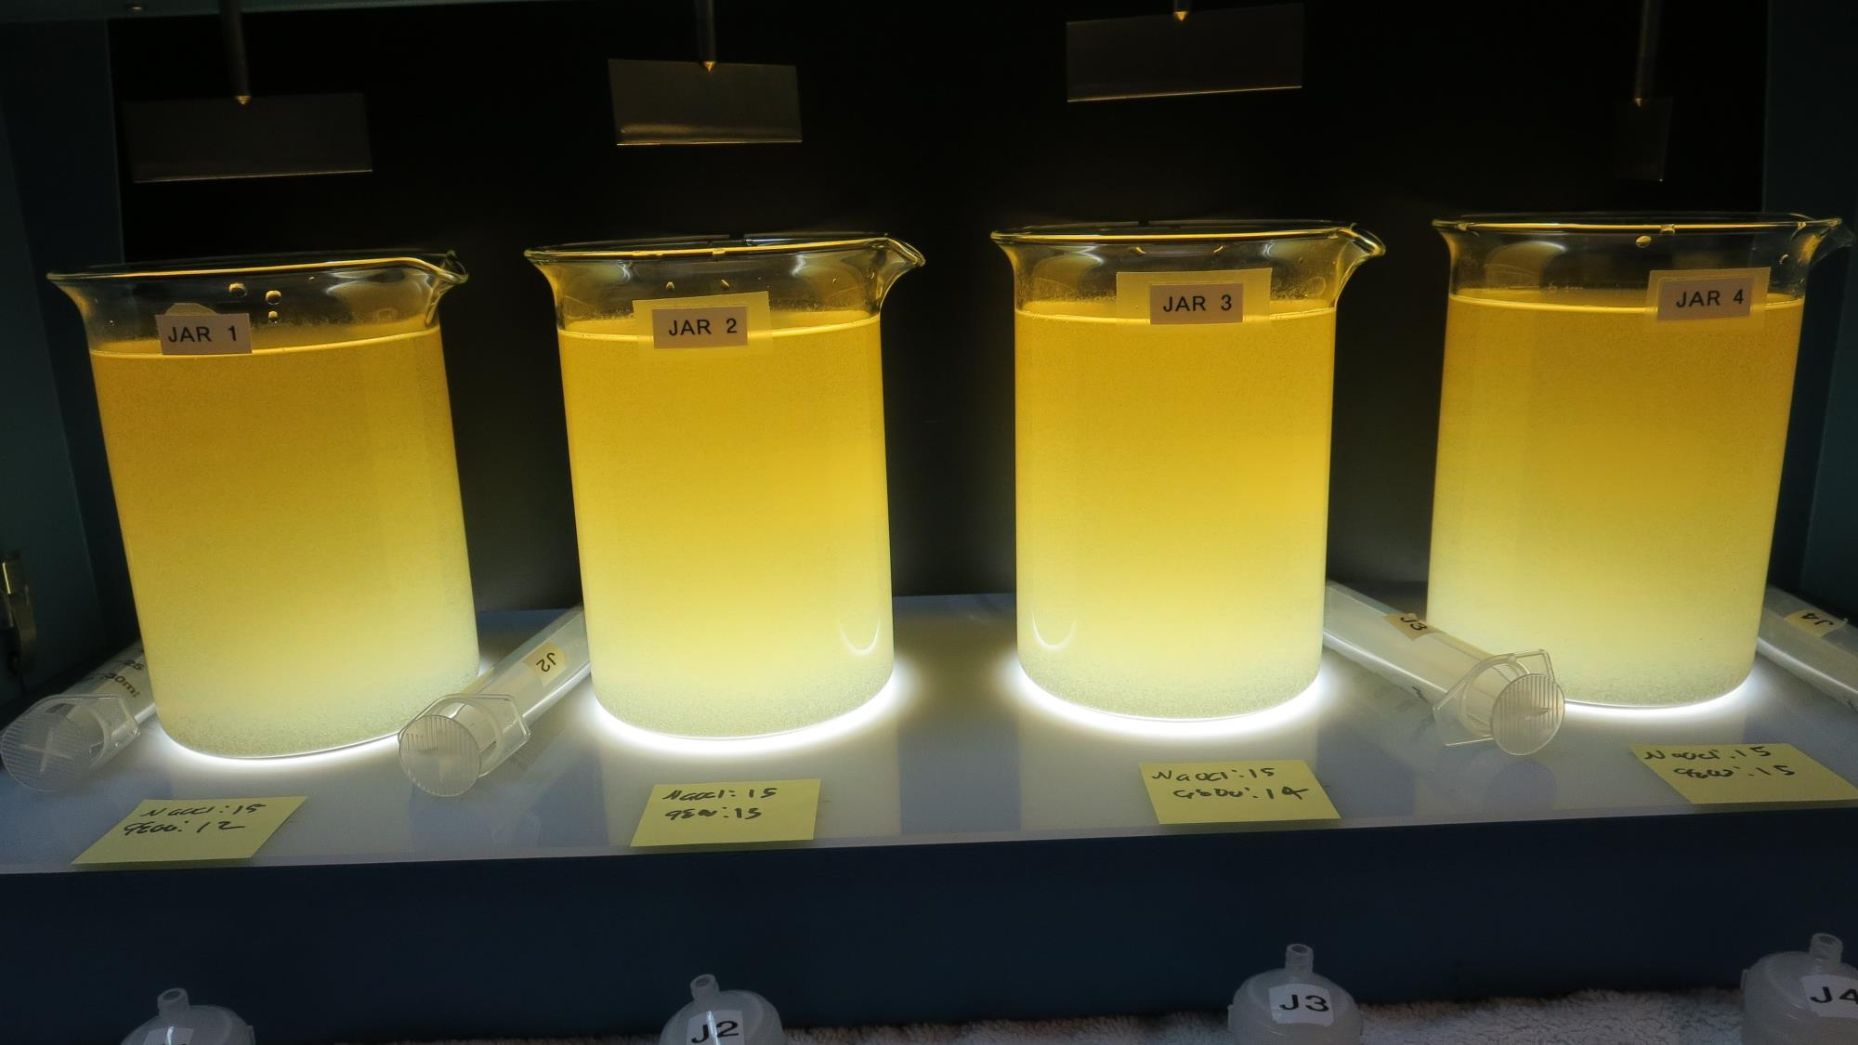
Jars 9-12: End of Floc Duration, 25 mL is syringed for filterability and %UVT/UVA.
15 mg/L NaOCl
12 mg/L 9800
Filtrate: 1.23 NTU
UVT: 87.5%
UVA: 0.057/cm
UVA Reduction: 78.7%
Settled: 38.8 NTU
15 mg/L NaOCl
13 mg/L 9800
Filtrate: 0.58 NTU
UVT: 88.9%
UVA: 0.050/cm
UVA Reduction: 81.3%
Settled: 39.8 NTU
15 mg/L NaOCl
14 mg/L 9800
Filtrate: 0.91 NTU
UVT: 88.9%
UVA: 0.050/cm
UVA Reduction: 81.3%
Settled: 38.7 NTU
15 mg/L NaOCl
15 mg/L 9800
Filtrate: 2.18 NTU
UVT: 88.5%
UVA: 0.052/cm
UVA Reduction: 80.5%
Settled: 36.6 NTU

Slide 30
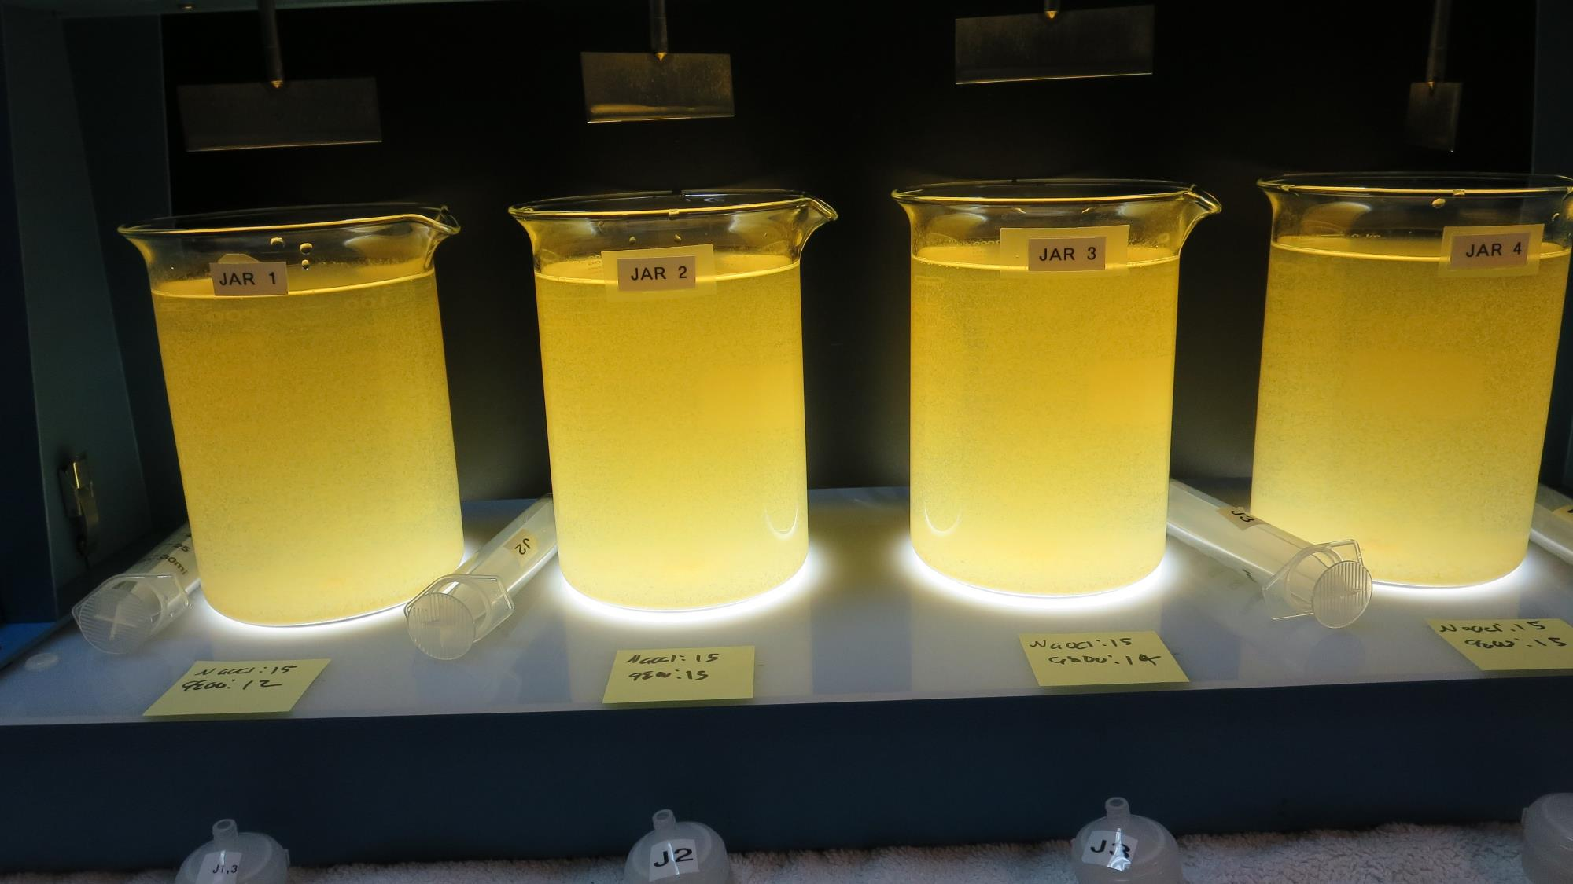
Jars 9-12: After 5 min of settling, 25 mL is syringed for filterability and %UVT/UVA.

Slide 31
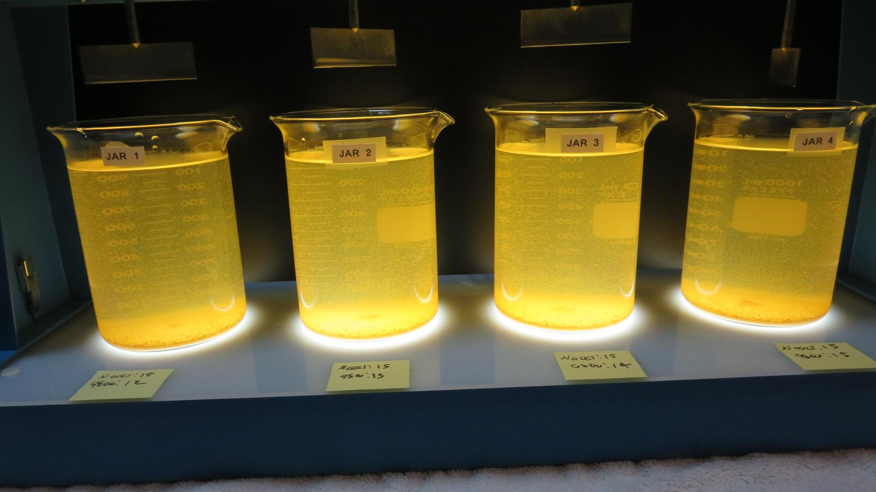
Jars 9-12: After 25-minutes of settling, settled water turbidity is taken.
15 mg/L NaOCl
12 mg/L 9800
Filtrate: 1.23 NTU
UVT: 87.5%
UVA: 0.057/cm
UVA Reduction: 78.7%
Settled: 38.8 NTU
15 mg/L NaOCl
13 mg/L 9800
Filtrate: 0.58 NTU
UVT: 88.9%
UVA: 0.050/cm
UVA Reduction: 81.3%
Settled: 39.8 NTU
15 mg/L NaOCl
14 mg/L 9800
Filtrate: 0.91 NTU
UVT: 88.9%
UVA: 0.050/cm
UVA Reduction: 81.3%
Settled: 38.7 NTU
15 mg/L NaOCl
15 mg/L 9800
Filtrate: 2.18 NTU
UVT: 88.5%
UVA: 0.052/cm
UVA Reduction: 80.5%
Settled: 36.6 NTU

Slide 32
Jars 13-16 Test Flash Mix 200 RPM, 20 Sec Floc Mix 30 RPM, 5 min 25 mL sampled 5 minutes at end of Floc period Applied Coagulant 9890

Slide 33
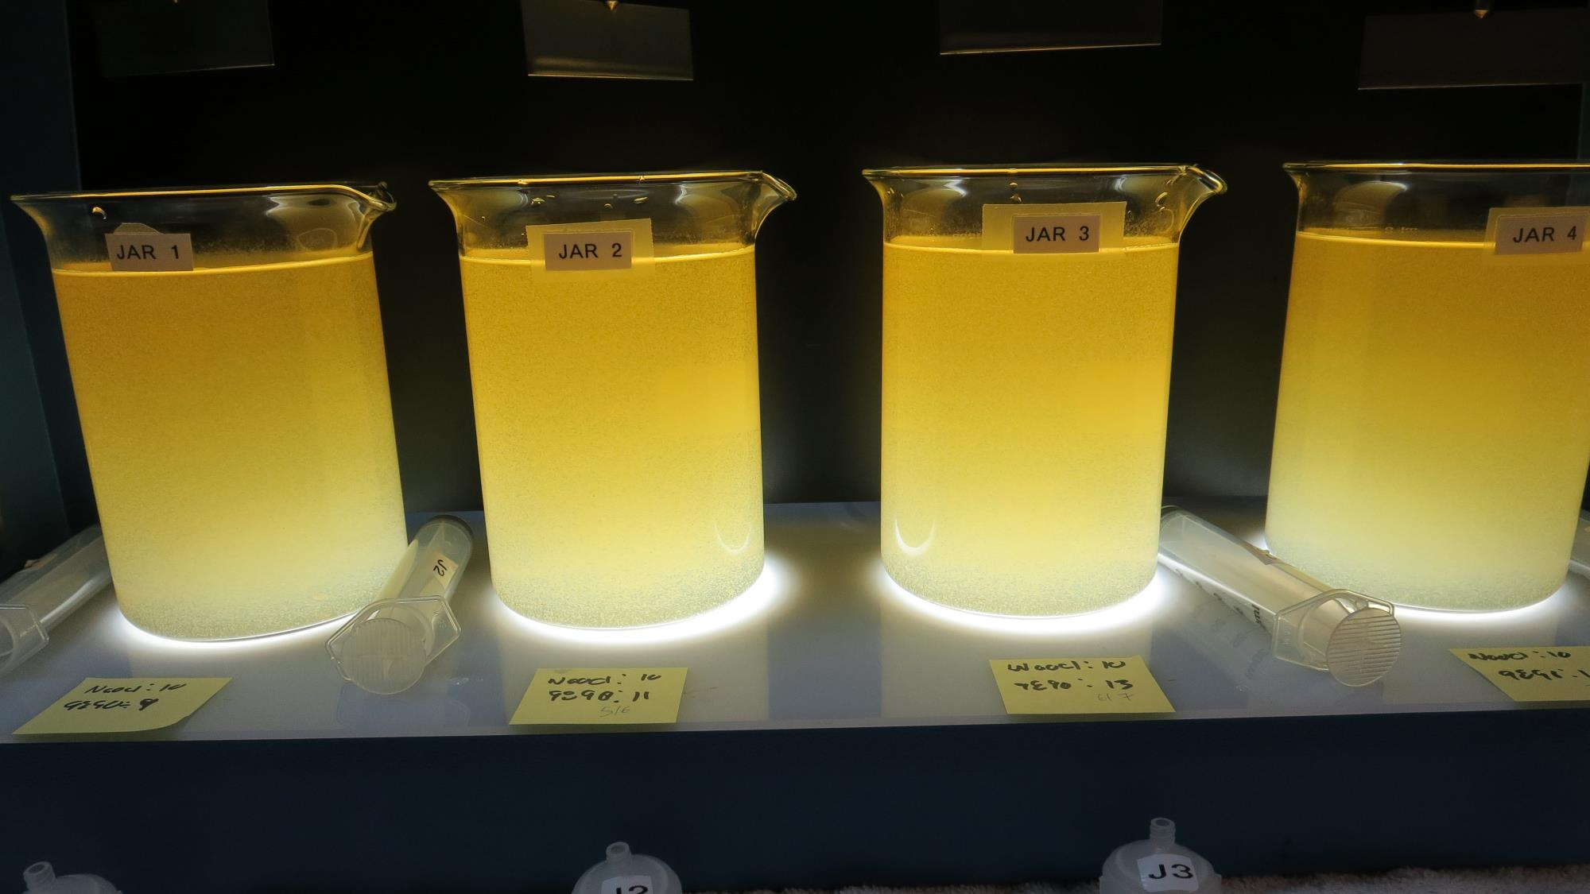
Jars 13-16: End of Floc Duration, 25 mL is syringed for filterability and %UVT/UVA.
10 mg/L NaOCl
9 mg/L 9890
Filtrate: 0.18 NTU
UVT: 90.0%
UVA: 0.045/cm
UVA Reduction: 83.1%
Settled: 42.6 NTU
10 mg/L NaOCl
11 mg/L 9890
Filtrate: 1.61 NTU
UVT: 88.2%
UVA: 0.054/cm
UVA Reduction: 78.7%
Settled: 36.4 NTU
10 mg/L NaOCl
13 mg/L 9890
Filtrate: 0.16 NTU
UVT: 91.2%
UVA: 0.039/cm
UVA Reduction: 85.4%
Settled: 43.2 NTU
10 mg/L NaOCl
15 mg/L 9890
Filtrate: 0.07 NTU
UVT: 92.8%
UVA: 0.032/cm
UVA Reduction: 88.0%
Settled: 53.8 NTU

Slide 34
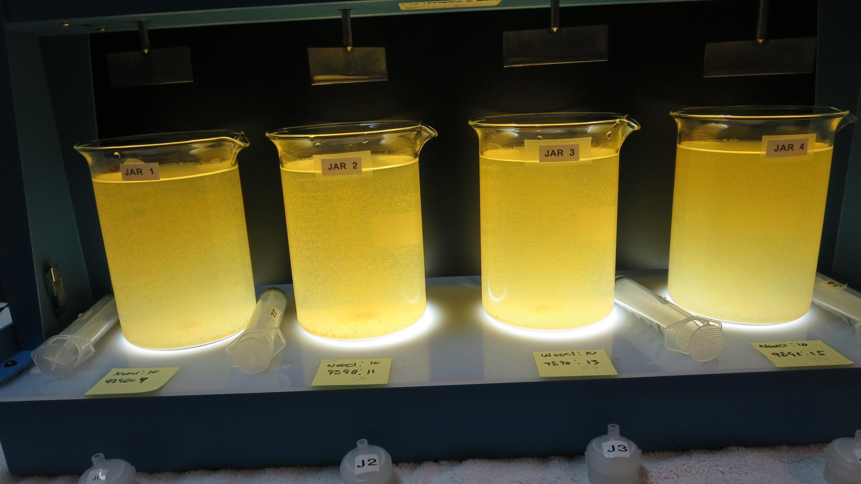
Jars 13-16: After 5 min of settling, 25 mL is syringed for filterability and %UVT/UVA.

Slide 35
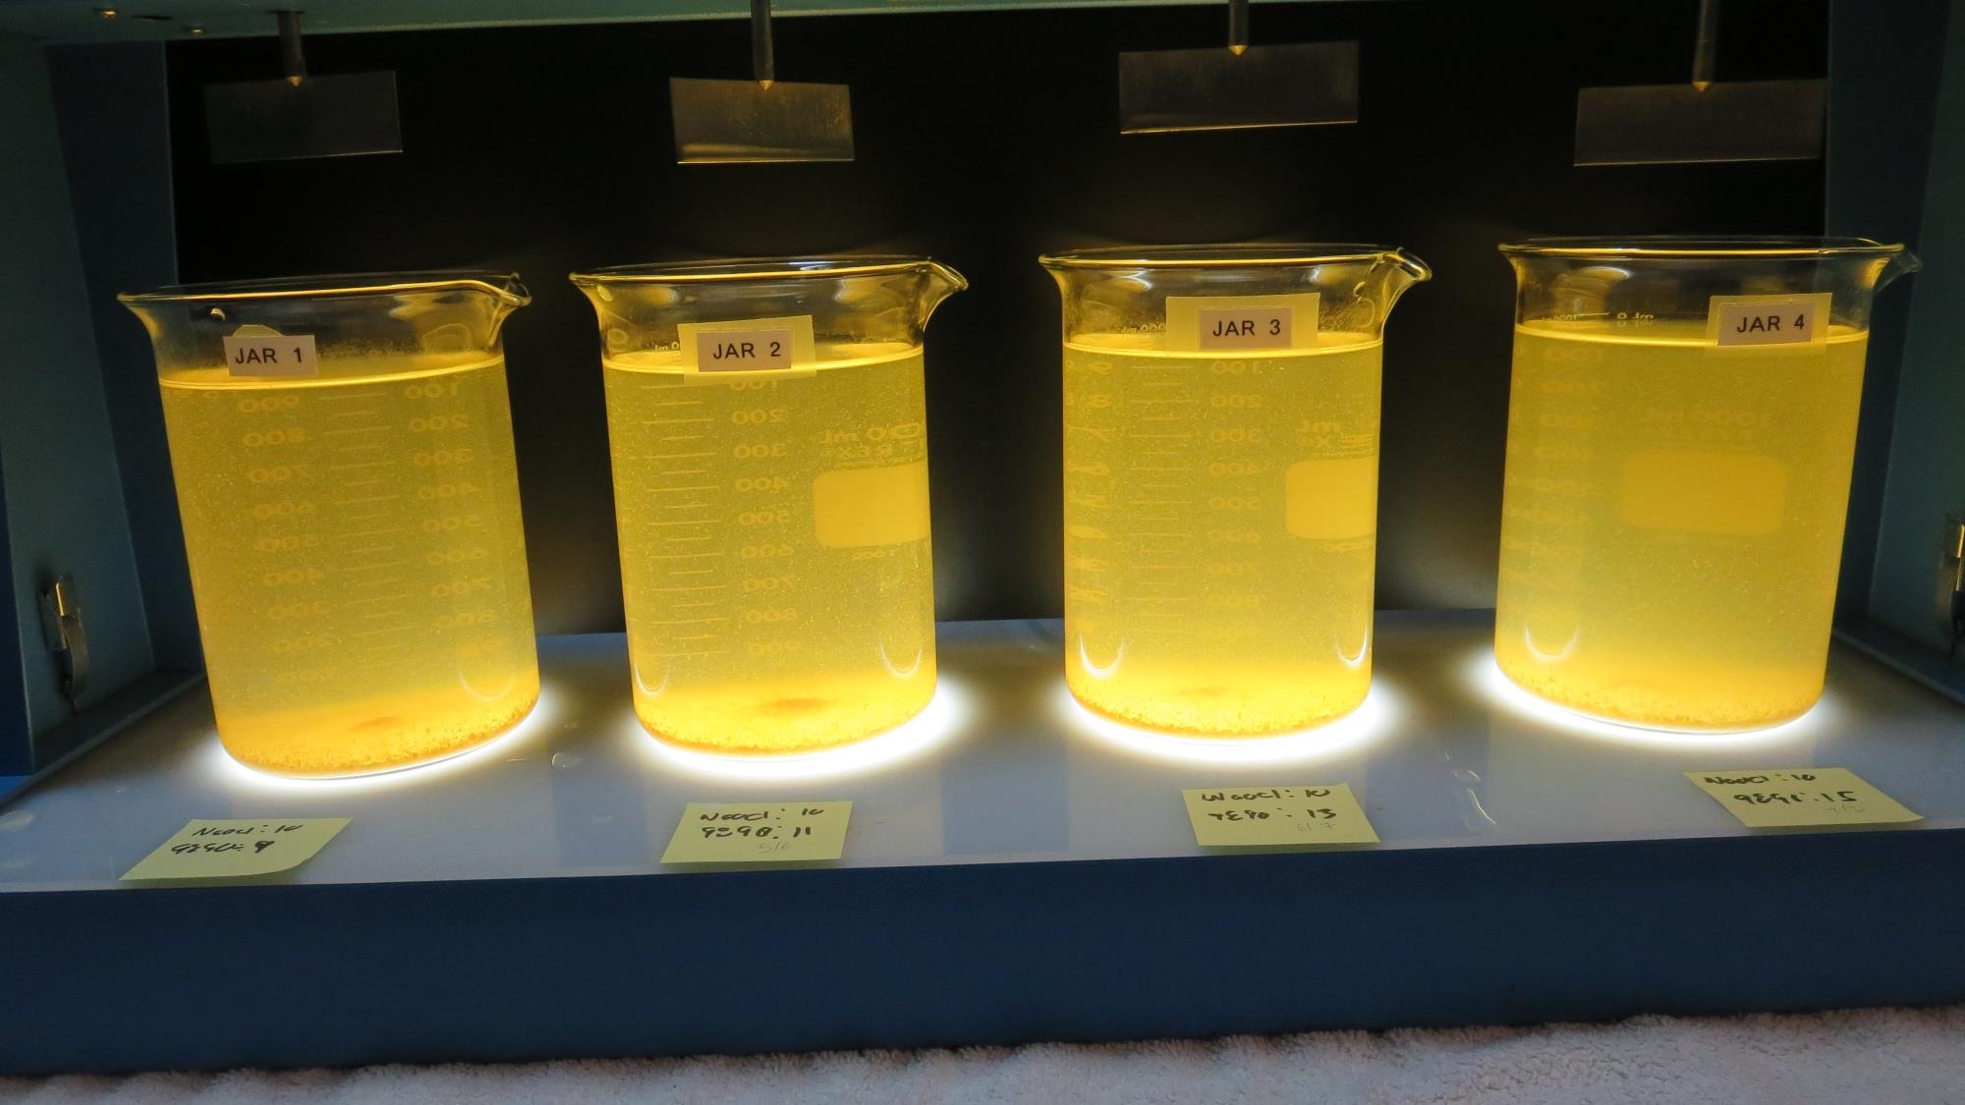
Jars 13-16: After 25-minutes of settling, settled water turbidity is taken.
10 mg/L NaOCl
9 mg/L 9890
Filtrate: 0.18 NTU
UVT: 90.0%
UVA: 0.045/cm
UVA Reduction: 83.1%
Settled: 42.6 NTU
10 mg/L NaOCl
11 mg/L 9890
Filtrate: 1.61 NTU
UVT: 88.2%
UVA: 0.054/cm
UVA Reduction: 78.7%
Settled: 36.4 NTU
10 mg/L NaOCl
13 mg/L 9890
Filtrate: 0.16 NTU
UVT: 91.2%
UVA: 0.039/cm
UVA Reduction: 85.4%
Settled: 43.2 NTU
10 mg/L NaOCl
15 mg/L 9890
Filtrate: 0.07 NTU
UVT: 92.8%
UVA: 0.032/cm
UVA Reduction: 88.0%
Settled: 53.8 NTU

Slide 36
Jars 17-20 Test Flash Mix 200 RPM, 20 Sec Floc Mix 30 RPM, 5 min 25 mL sampled 5 minutes at end of Floc period Applied Coagulant 9890

Slide 37
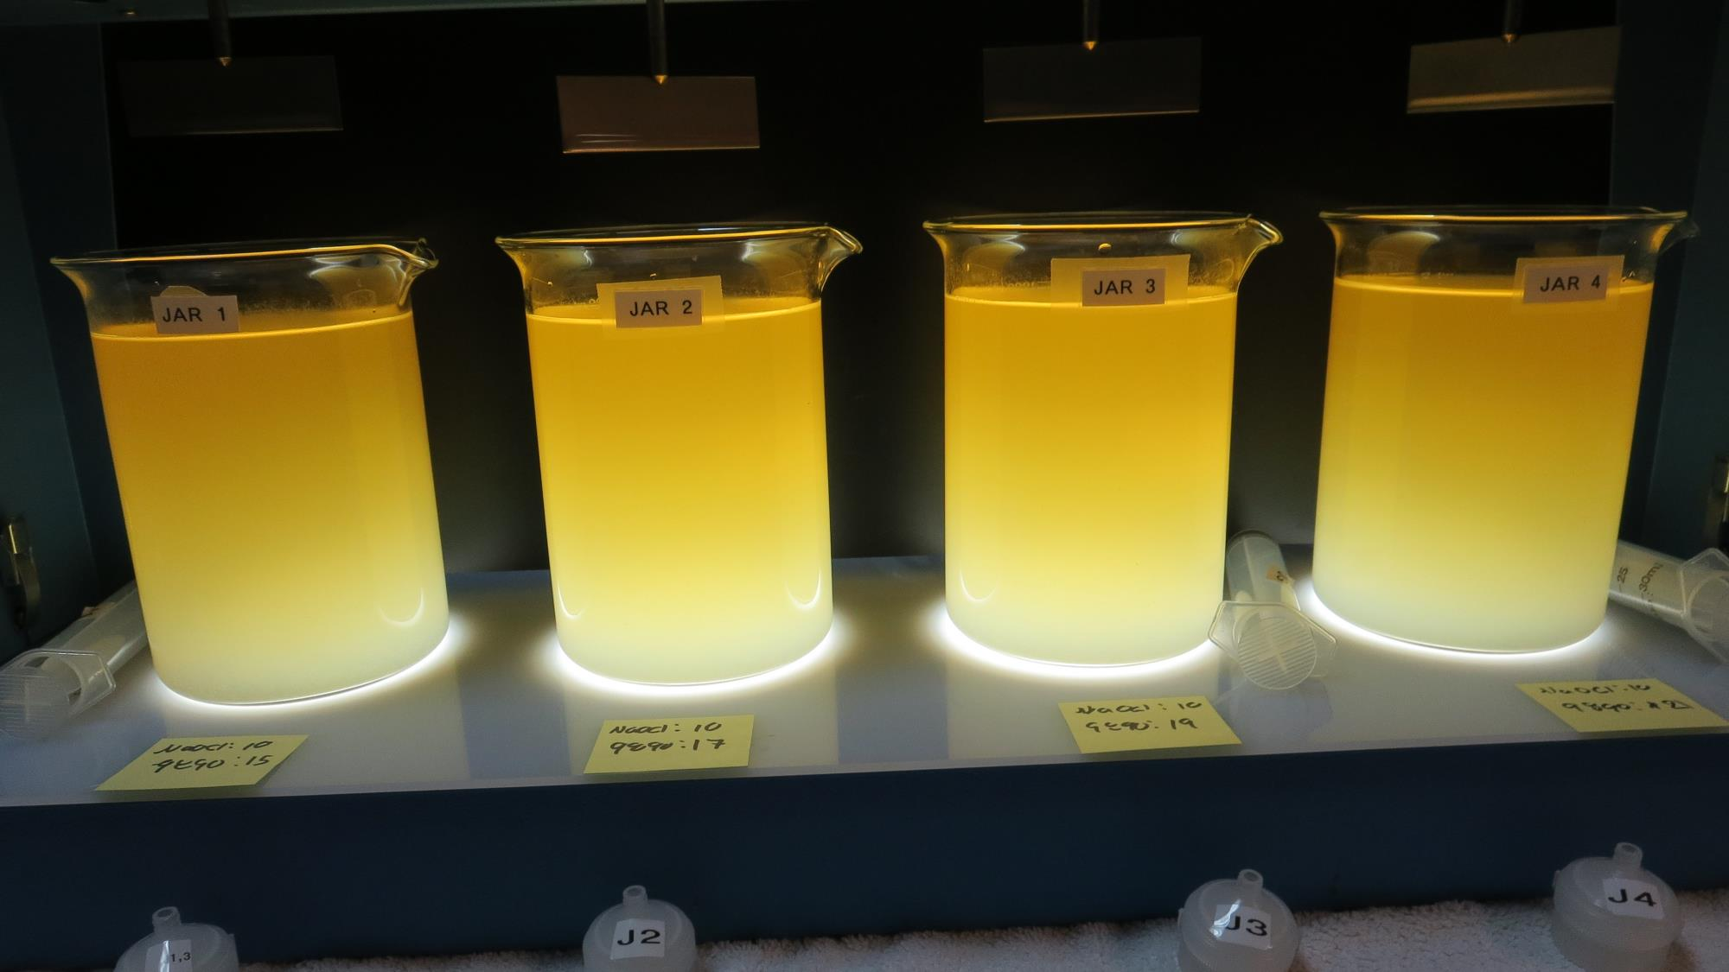
Jars 17-20: End of Floc Duration, 25 mL is syringed for filterability and %UVT/UVA.
10 mg/L NaOCl
15 mg/L 9890
Filtrate: 0.06 NTU
UVT: 92.2%
UVA: 0.035/cm
UVA Reduction: 86.9%
Settled: 80.2 NTU
Filtrate Fe: 0.000 mg/L
10 mg/L NaOCl
17 mg/L 9890
Filtrate: 0.06 NTU
UVT: 91.6%
UVA: 0.037/cm
UVA Reduction: 86.1%
Settled: 97.0 NTU
Filtrate Fe: 0.000 mg/L
10 mg/L NaOCl
19 mg/L 9890
Filtrate: 0.08 NTU
UVT: 92.2%
UVA: 0.034/cm
UVA Reduction: 87.3%
Settled: 91.0 NTU
Filtrate Fe: 0.015 mg/L
10 mg/L NaOCl
21 mg/L 9890
Filtrate: 0.14 NTU
UVT: 92.7%
UVA: 0.032/cm
UVA Reduction: 88.0%
Settled: 101 NTU
Filtrate Fe: 0.000 mg/L

Slide 38
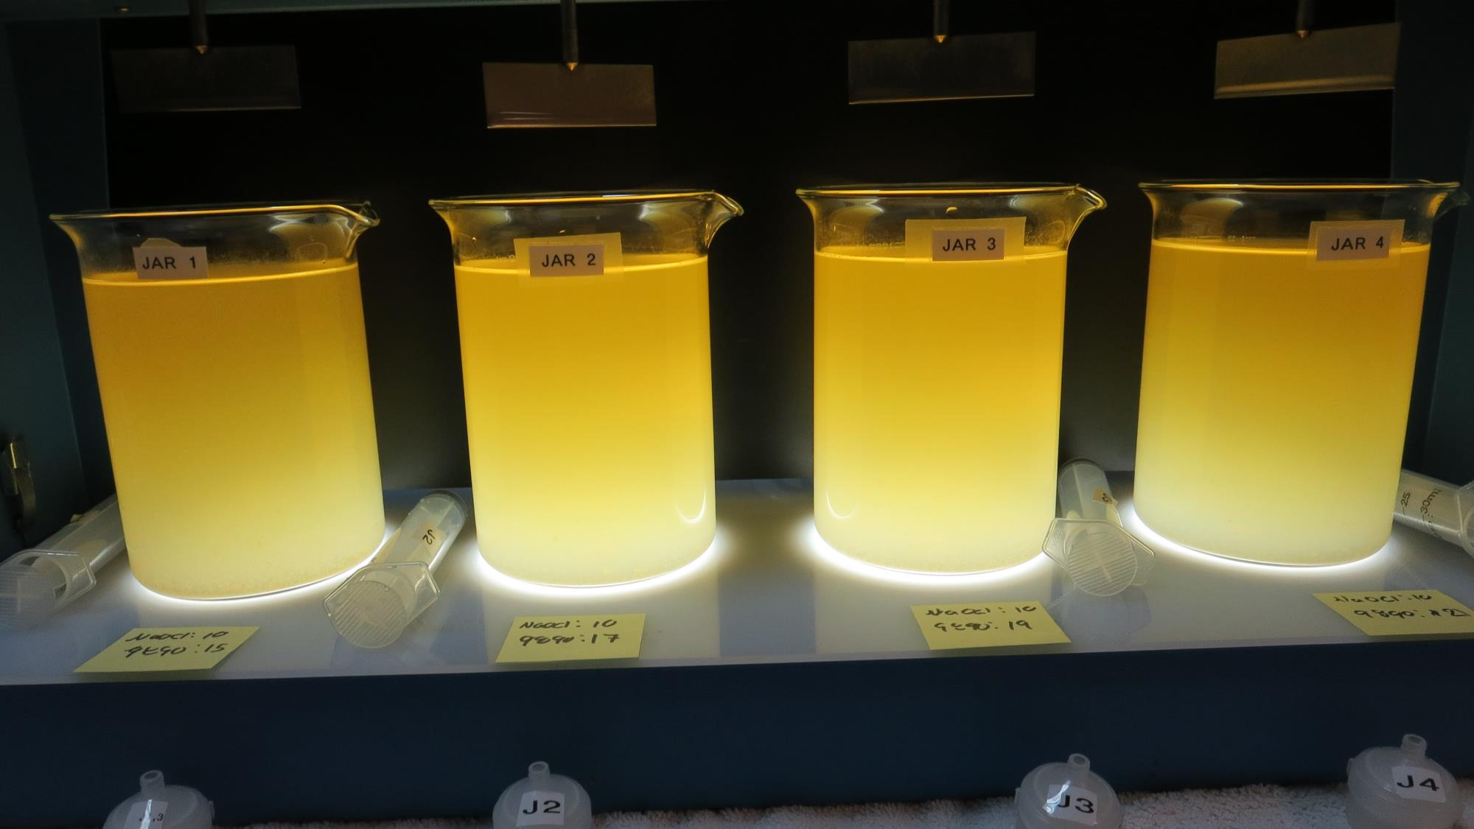
Jars 17-20: After 5 min of settling, 25 mL is syringed for filterability and %UVT/UVA.

Slide 39
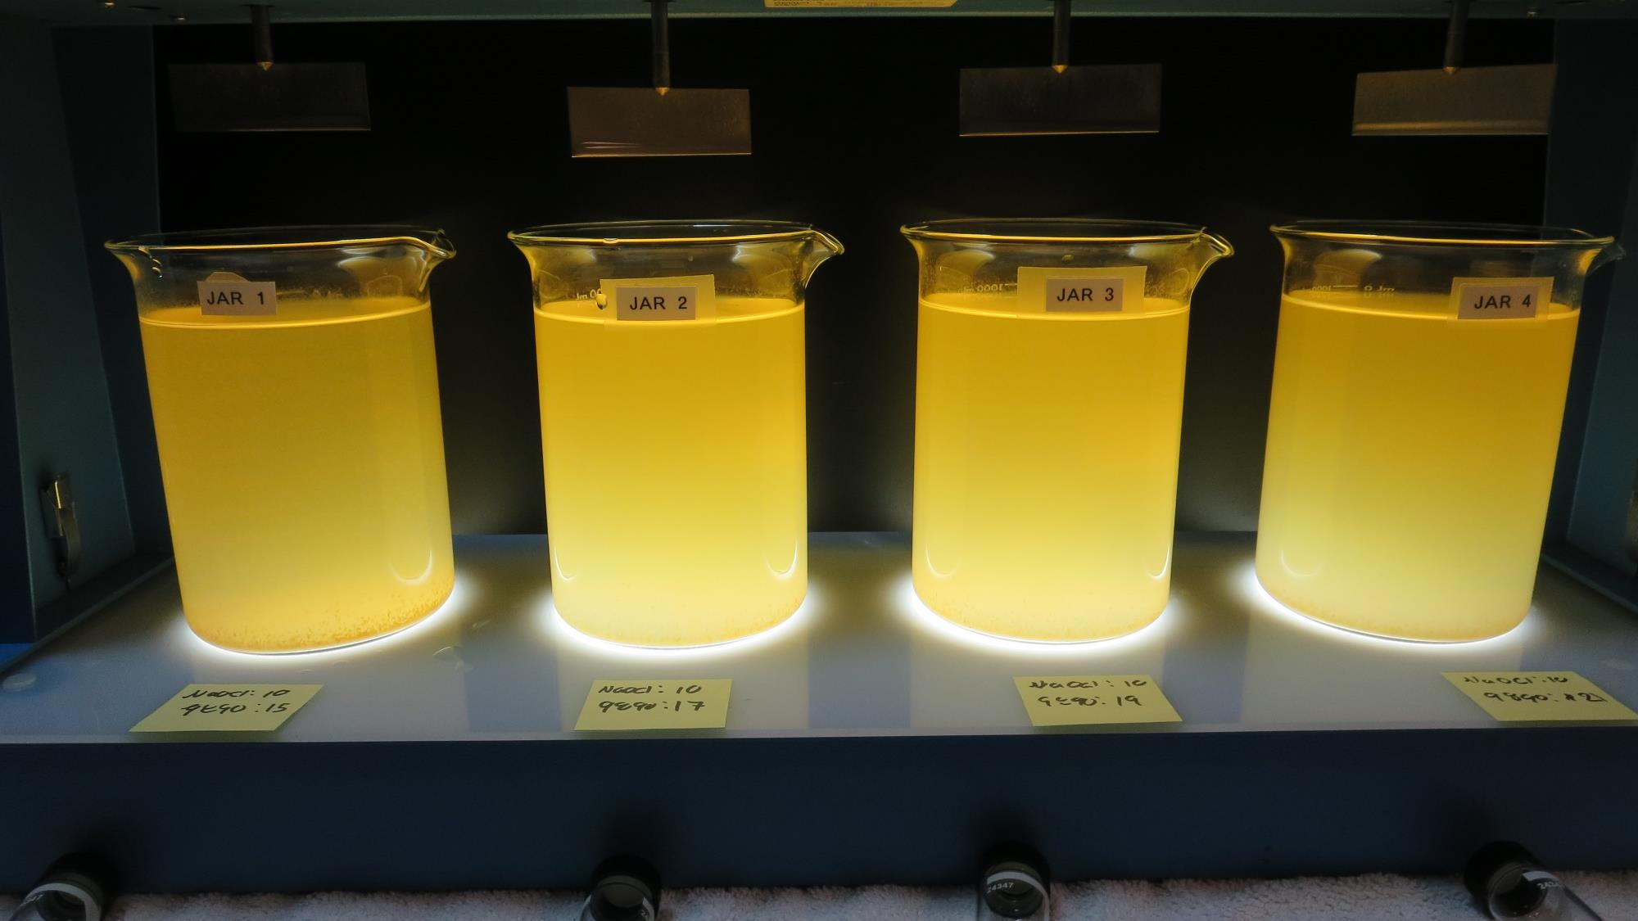
Jars 17-20: After 25-minutes of settling, settled water turbidity is taken.
10 mg/L NaOCl
15 mg/L 9890
Filtrate: 0.06 NTU
UVT: 92.2%
UVA: 0.035/cm
UVA Reduction: 86.9%
Settled: 80.2 NTU
Filtrate Fe: 0.000 mg/L
10 mg/L NaOCl
17 mg/L 9890
Filtrate: 0.06 NTU
UVT: 91.6%
UVA: 0.037/cm
UVA Reduction: 86.1%
Settled: 97.0 NTU
Filtrate Fe: 0.000 mg/L
10 mg/L NaOCl
19 mg/L 9890
Filtrate: 0.08 NTU
UVT: 92.2%
UVA: 0.034/cm
UVA Reduction: 87.3%
Settled: 91.0 NTU
Filtrate Fe: 0.015 mg/L
10 mg/L NaOCl
21 mg/L 9890
Filtrate: 0.14 NTU
UVT: 92.7%
UVA: 0.032/cm
UVA Reduction: 88.0%
Settled: 101 NTU
Filtrate Fe: 0.000 mg/L

Slide 40
Jars 21-24 Test Flash Mix 200 RPM, 20 Sec Floc Mix 30 RPM, 5 min 25 mL sampled 5 minutes at end of Floc period Applied Coagulant 9890

Slide 41
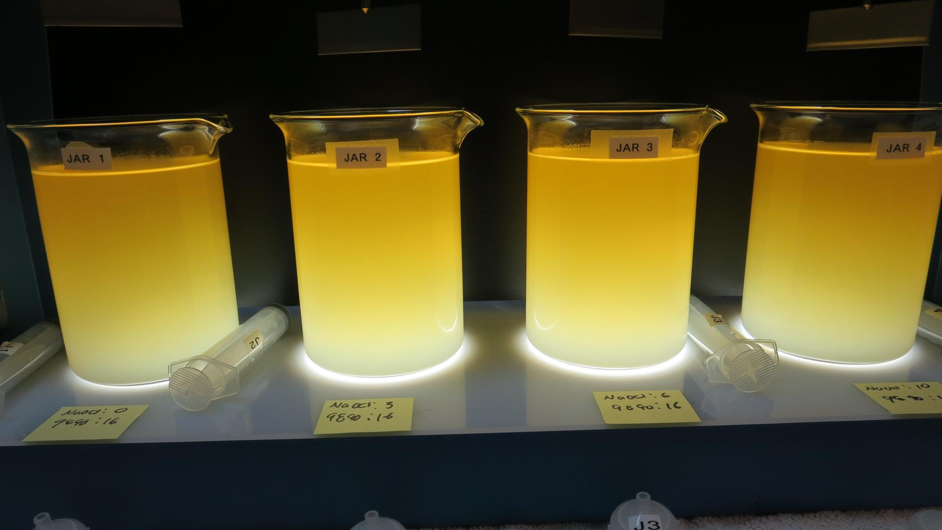
Jars 21-24: End of Floc Duration, 25 mL is syringed for filterability and %UVT/UVA.
0 mg/L NaOCl
16 mg/L 9890
Filtrate: 0.07 NTU
UVT: 92.3%
UVA: 0.034/cm
UVA Reduction: 87.3%
Settled: 98.0 NTU
Filtrate Fe: 0.005 mg/L
3.0 mg/L NaOCl
16 mg/L 9890
Filtrate: 0.05 NTU
UVT: 91.2%
UVA: 0.039/cm
UVA Reduction: 85.4%
Settled: 98.0 NTU
Filtrate Fe: 0.000 mg/L
6.0 mg/L NaOCl
16 mg/L 9890
Filtrate: 0.05 NTU
UVT: 91.0%
UVA: 0.041/cm
UVA Reduction: 84.6%
Settled: 94.2 NTU
Filtrate Fe: 0.005 mg/L
10 mg/L NaOCl
16 mg/L 9890
Filtrate: 0.05 NTU
UVT: 93.6%
UVA: 0.028/cm
UVA Reduction: 89.5%
Settled: 94.3 NTU

Slide 42
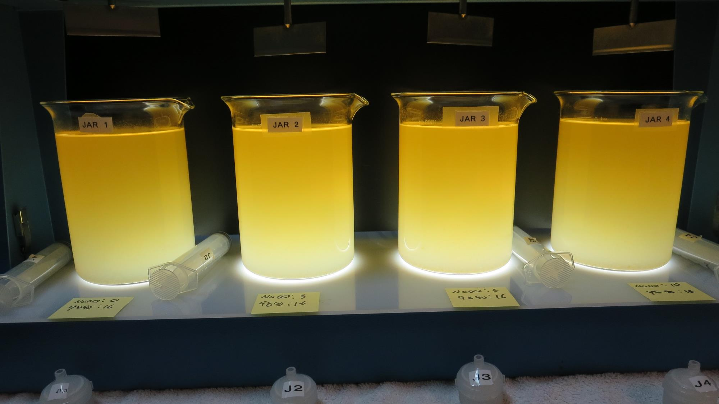
Jars 21-24: After 5 min of settling, 25 mL is syringed for filterability and %UVT/UVA.

Slide 43
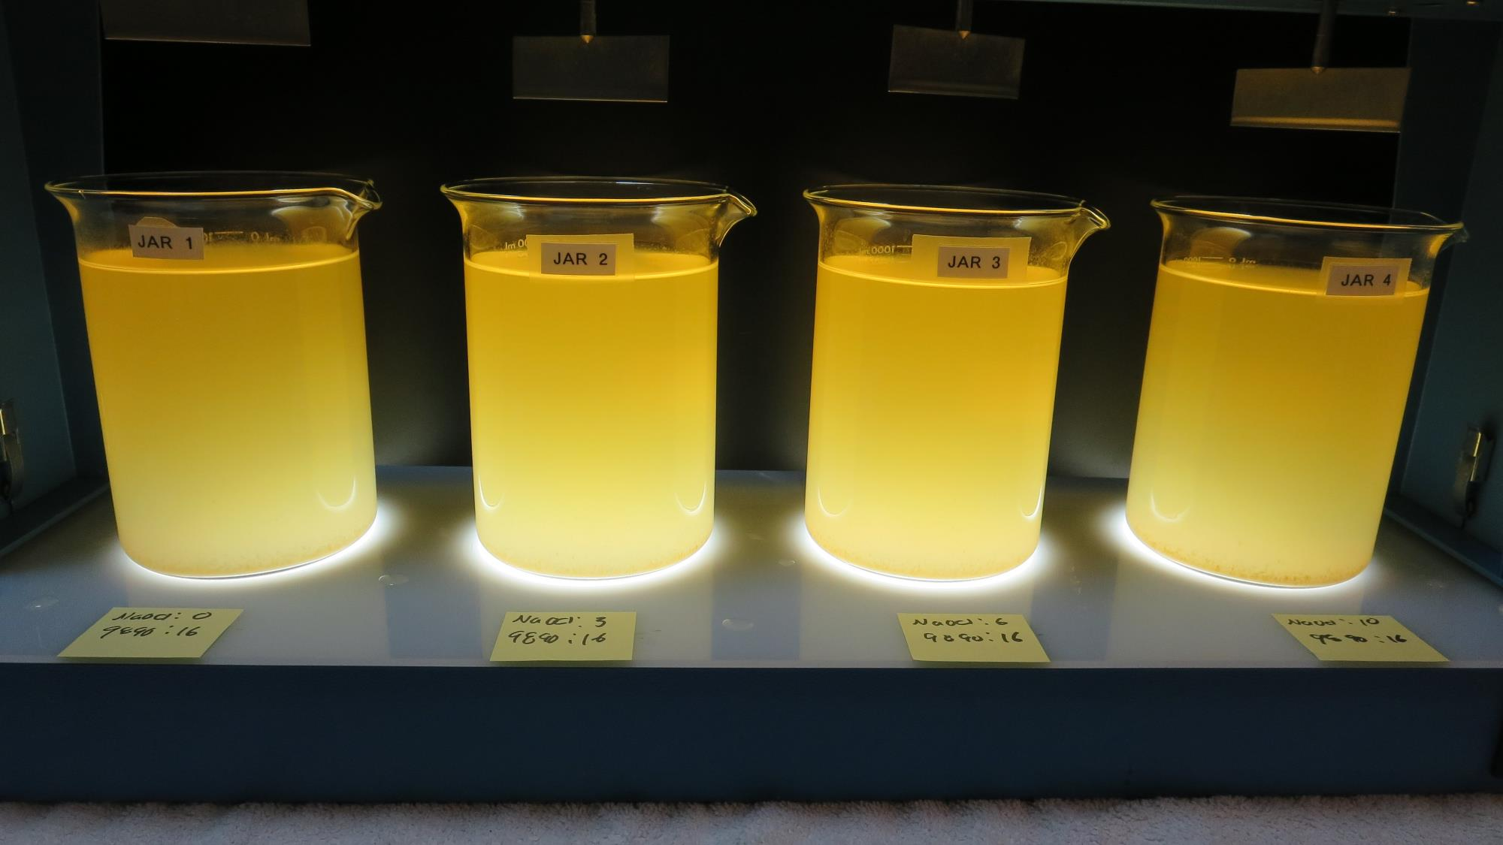
Jars 21-24: After 25-minutes of settling, settled water turbidity is taken.
0 mg/L NaOCl
16 mg/L 9890
Filtrate: 0.07 NTU
UVT: 92.3%
UVA: 0.034/cm
UVA Reduction: 87.3%
Settled: 98.0 NTU
Filtrate Fe: 0.005 mg/L
3.0 mg/L NaOCl
16 mg/L 9890
Filtrate: 0.05 NTU
UVT: 91.2%
UVA: 0.039/cm
UVA Reduction: 85.4%
Settled: 98.0 NTU
Filtrate Fe: 0.000 mg/L
6.0 mg/L NaOCl
16 mg/L 9890
Filtrate: 0.05 NTU
UVT: 91.0%
UVA: 0.041/cm
UVA Reduction: 84.6%
Settled: 94.2 NTU
Filtrate Fe: 0.005 mg/L
10 mg/L NaOCl
16 mg/L 9890
Filtrate: 0.05 NTU
UVT: 93.6%
UVA: 0.028/cm
UVA Reduction: 89.5%
Settled: 94.3 NTU

Slide 44
Jars 25-28 Test Flash Mix 200 RPM, 20 Sec Floc Mix 30 RPM, 5 min 25 mL sampled 5 minutes at end of Floc period Applied Coagulant AdvFloc CTC-00011 Polyaluminum Hydroxy Chlorosulfate

Slide 45
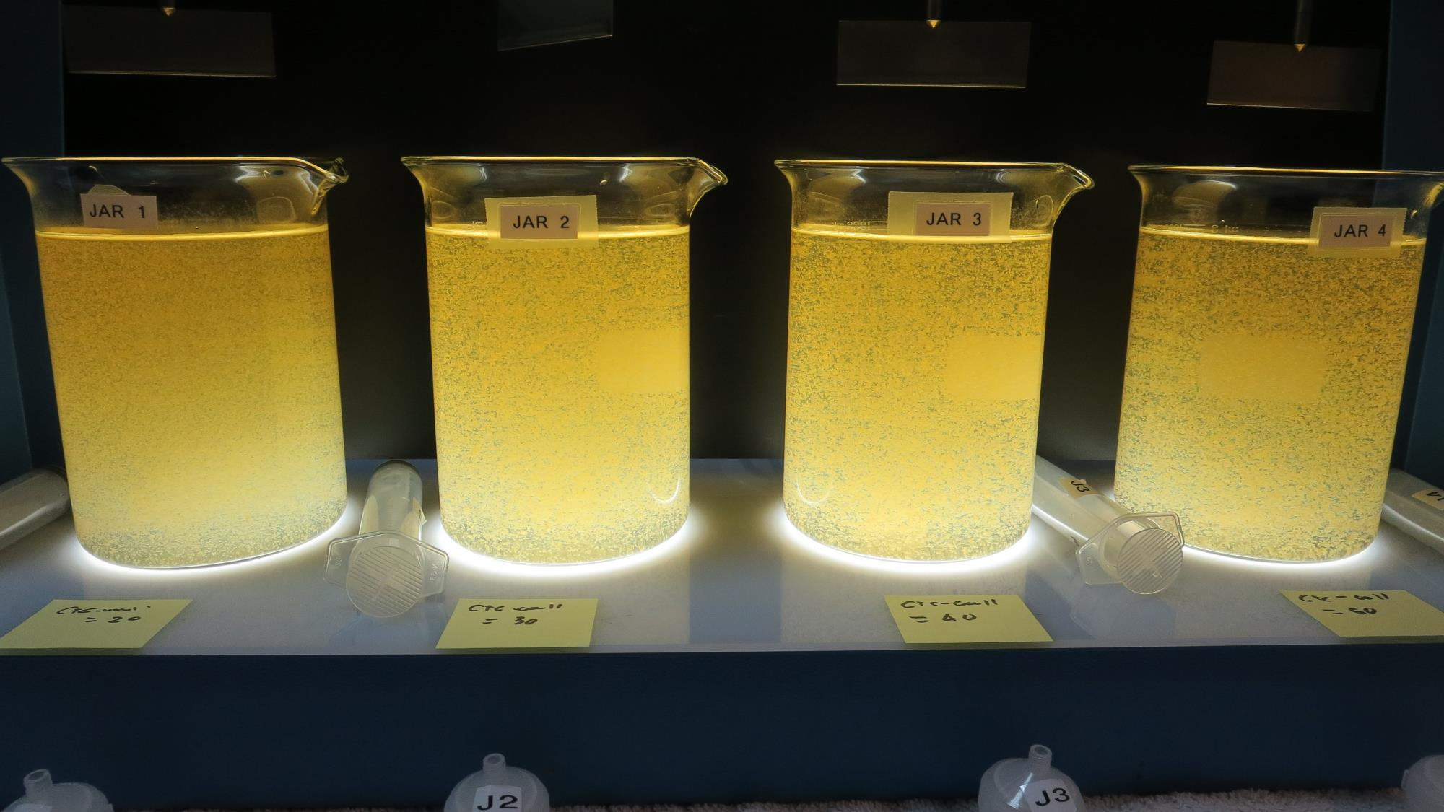
Jars 25-28: End of Floc Duration, 25 mL is syringed for filterability and %UVT/UVA.
20 mg/L CTC-00011
Filtrate: 2.13 NTU
UVT: 89.0%
UVA: 0.050/cm
UVA Reduction: 81.3%
Settled: 28.8 NTU
30 mg/L CTC-00011
Filtrate: 0.28 NTU
UVT: 90.7%
UVA: 0.042/cm
UVA Reduction: 84.3%
Settled: 18.9 NTU
40 mg/L CTC-00011
Filtrate: 0.50 NTU
UVT: 90.5%
UVA: 0.042/cm
UVA Reduction: 84.3%
Settled: 17.6 NTU
50 mg/L CTC-00011
Filtrate: 0.06 NTU
UVT: 91.7%
UVA: 0.037/cm
UVA Reduction: 86.1%
Settled: 16.5 NTU
Filtrate Fe: 0.002 mg/L

Slide 46
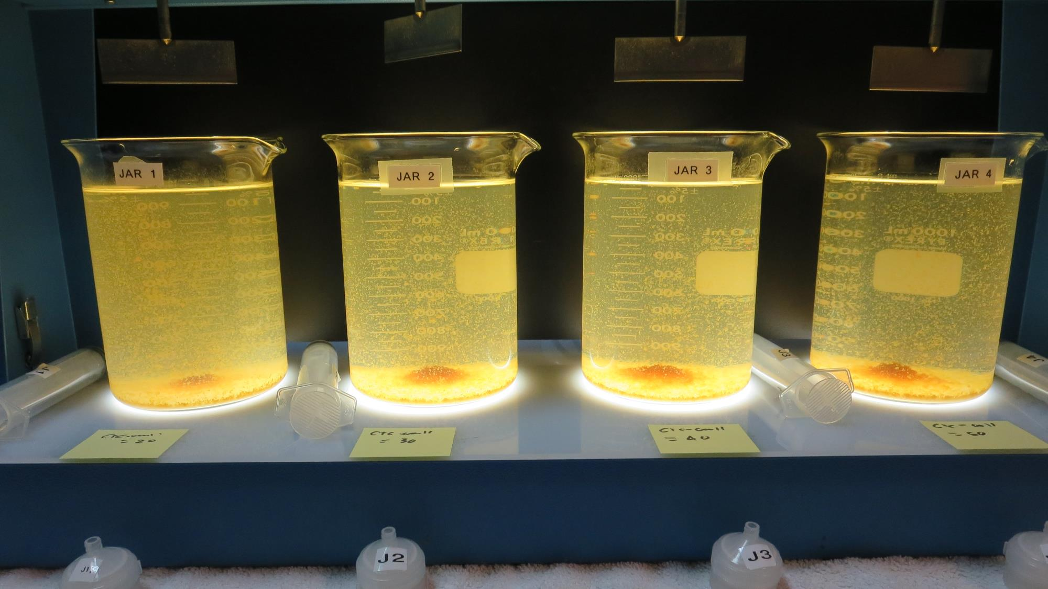
Jars 25-28: After 5 min of settling, 25 mL is syringed for filterability and %UVT/UVA.

Slide 47
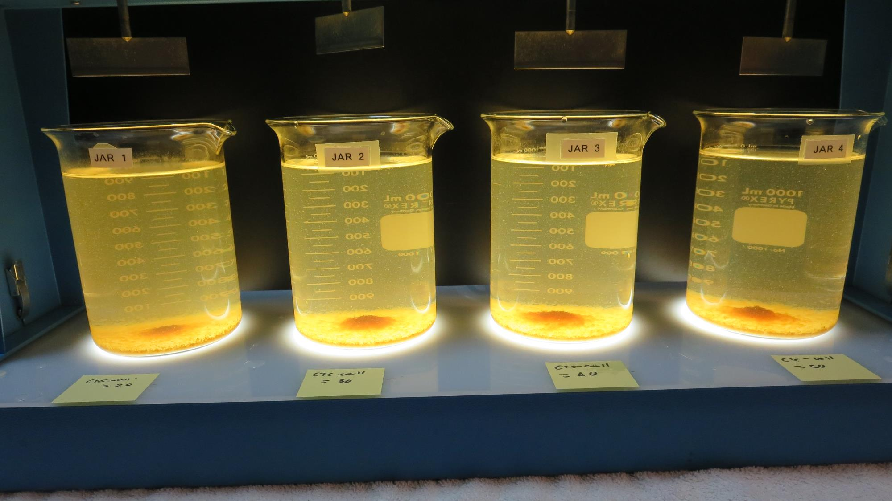
Jars 25-28: After 25-minutes of settling, settled water turbidity is taken.
20 mg/L CTC-00011
Filtrate: 2.13 NTU
UVT: 89.0%
UVA: 0.050/cm
UVA Reduction: 81.3%
Settled: 28.8 NTU
30 mg/L CTC-00011
Filtrate: 0.28 NTU
UVT: 90.7%
UVA: 0.042/cm
UVA Reduction: 84.3%
Settled: 18.9 NTU
40 mg/L CTC-00011
Filtrate: 0.50 NTU
UVT: 90.5%
UVA: 0.042/cm
UVA Reduction: 84.3%
Settled: 17.6 NTU
50 mg/L CTC-00011
Filtrate: 0.06 NTU
UVT: 91.7%
UVA: 0.037/cm
UVA Reduction: 86.1%
Settled: 16.5 NTU
Filtrate Fe: 0.002 mg/L

Slide 48
Jars 29-32 Test Flash Mix 200 RPM, 20 Sec Floc Mix 30 RPM, 5 min 25 mL sampled 5 minutes at end of Floc period Applied Coagulant AdvFloc CTC-00011 Polyaluminum Hydroxy Chlorosulfate

Slide 49
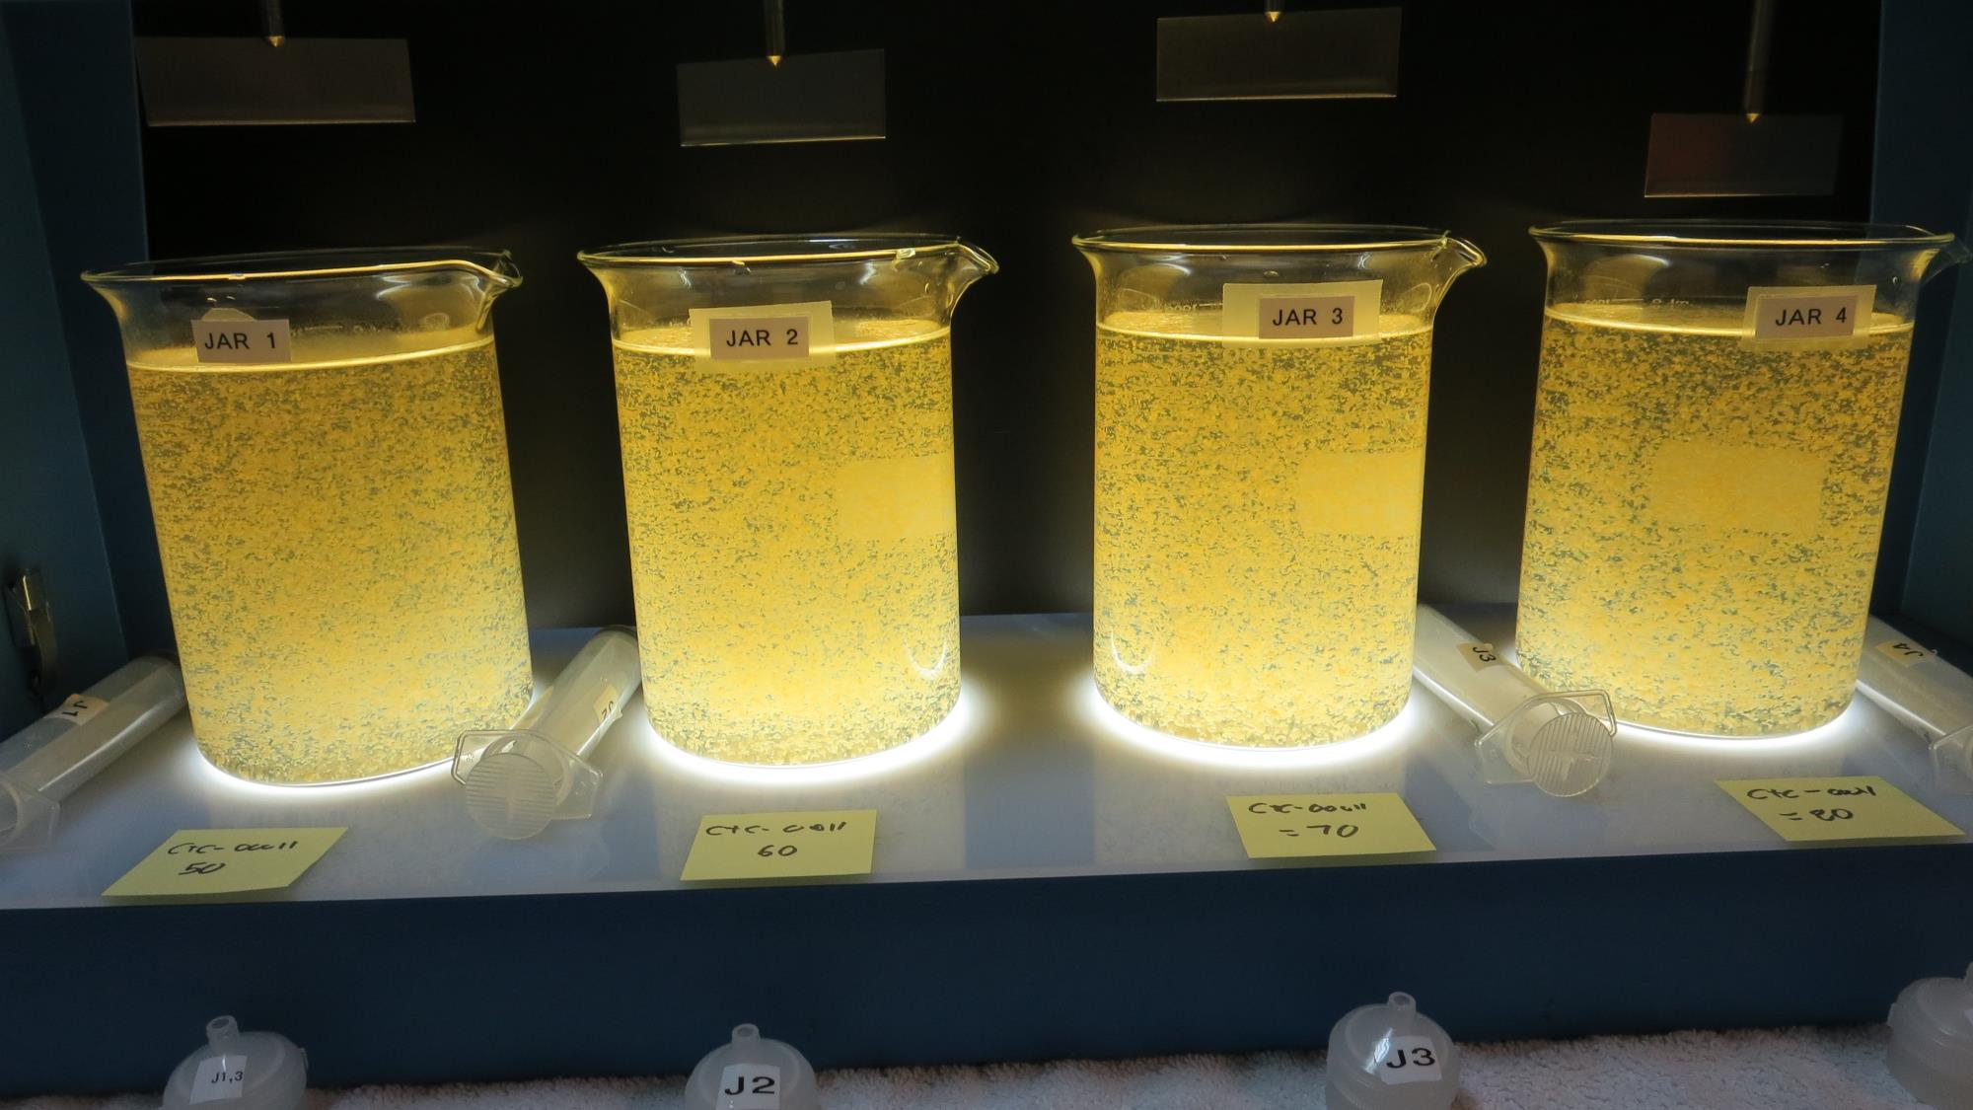
Jars 29-32: End of Floc Duration, 25 mL is syringed for filterability and %UVT/UVA.
50 mg/L CTC-00011
Filtrate: 0.06 NTU
UVT: 92.1%
UVA: 0.035/cm
UVA Reduction: 86.9%
Settled: 14.2 NTU
60 mg/L CTC-00011
Filtrate: 0.05 NTU
UVT: 92.9%
UVA: 0.031/cm
UVA Reduction: 88.4%
Settled: 11.6 NTU
70 mg/L CTC-00011
Filtrate: 0.05 NTU
UVT: 93.1%
UVA: 0.030/cm
UVA Reduction: 88.8%
Settled: 10.4 NTU
80 mg/L CTC-00011
Filtrate: 0.04 NTU
UVT: 93.2%
UVA: 0.030/cm
UVA Reduction: 88.8%
Settled: 10.0 NTU

Slide 50
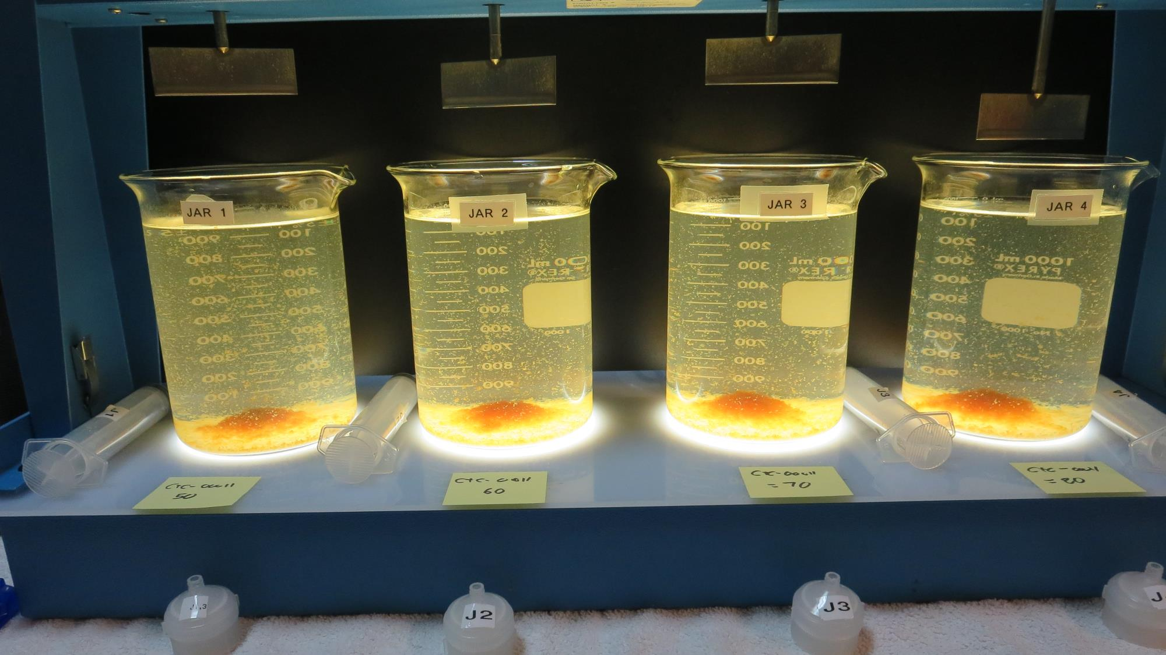
Jars 29-32: After 5 min of settling, 25 mL is syringed for filterability and %UVT/UVA.

Slide 51
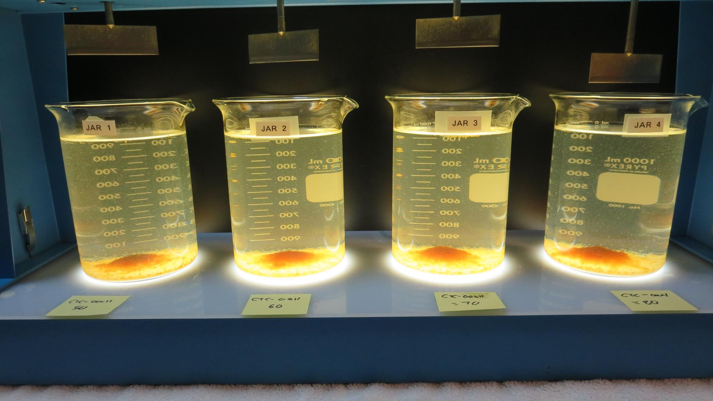
Jars 29-32: After 25-minutes of settling, settled water turbidity is taken.
50 mg/L CTC-00011
Filtrate: 0.06 NTU
UVT: 92.1%
UVA: 0.035/cm
UVA Reduction: 86.9%
Settled: 14.2 NTU
60 mg/L CTC-00011
Filtrate: 0.05 NTU
UVT: 92.9%
UVA: 0.031/cm
UVA Reduction: 88.4%
Settled: 11.6 NTU
70 mg/L CTC-00011
Filtrate: 0.05 NTU
UVT: 93.1%
UVA: 0.030/cm
UVA Reduction: 88.8%
Settled: 10.4 NTU
80 mg/L CTC-00011
Filtrate: 0.04 NTU
UVT: 93.2%
UVA: 0.030/cm
UVA Reduction: 88.8%
Settled: 10.0 NTU

Slide 52
Jars 33-36 Test Flash Mix 200 RPM, 20 Sec Floc Mix 30 RPM, 5 min 25 mL sampled 5 minutes at end of Floc period Applied Coagulant Ferric Chloride

Slide 53
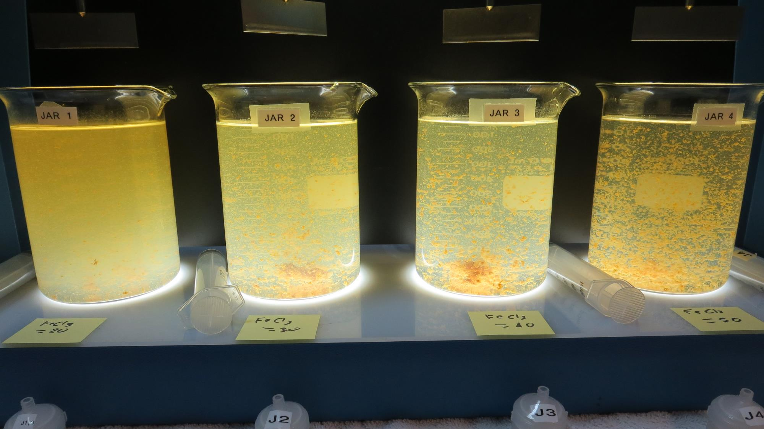
Jars 33-36: End of Floc Duration, 25 mL is syringed for filterability and %UVT/UVA.
20 mg/L FeCl₃
Filtrate: 0.93 NTU
UVT: 87.9%
UVA: 0.055/cm
UVA Reduction: 87.9%
Settled: 50.6 NTU
30 mg/L FeCl₃
Filtrate: 0.88 NTU
UVT: 88.4%
UVA: 0.053/cm
UVA Reduction: 80.1%
Settled: 27.2 NTU
40 mg/L FeCl₃
Filtrate: 0.33 NTU
UVT: 90.0%
UVA: 0.045/cm
UVA Reduction: 83.1%
Settled: 20.5 NTU
50 mg/L FeCl₃
Filtrate: 0.07 NTU
UVT: 92.7%
UVA: 0.032/cm
UVA Reduction: 88.0%
Settled: 13.2 NTU
Filtrate Fe: 0.005 mg/L

Slide 54
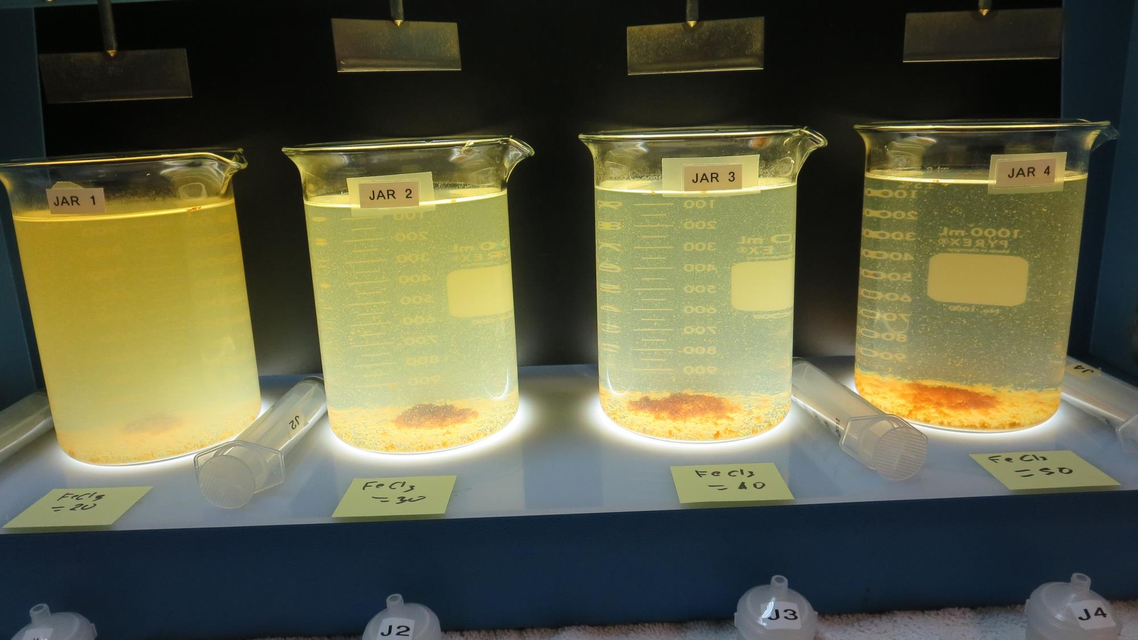
Jars 33-36: After 5 min of settling, 25 mL is syringed for filterability and %UVT/UVA.

Slide 55
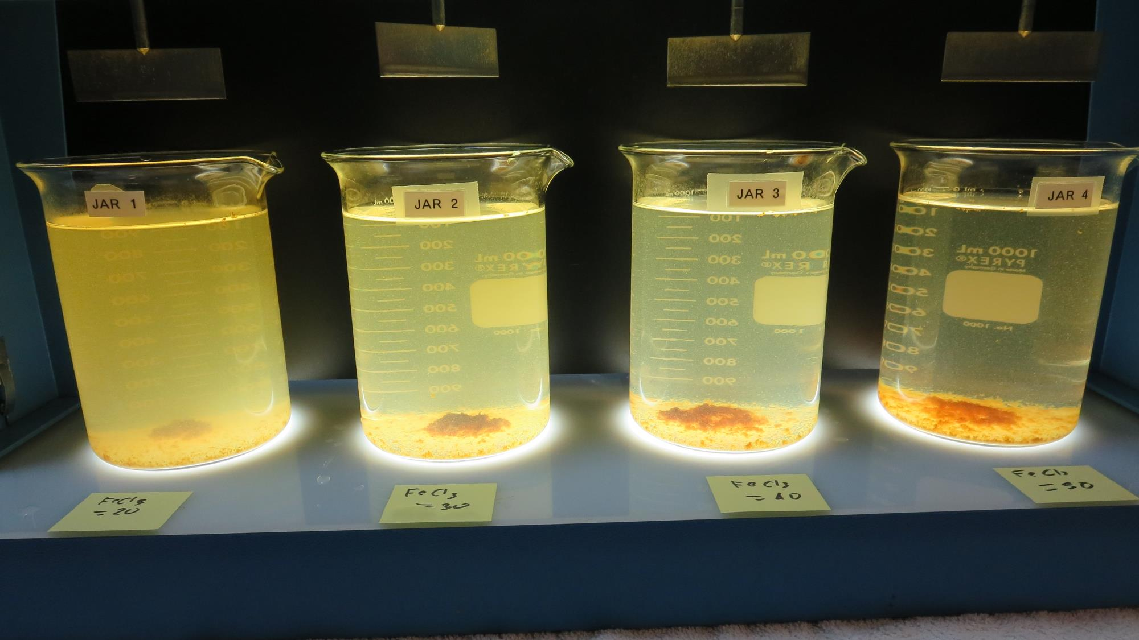
Jars 33-36: After 25-minutes of settling, settled water turbidity is taken.
20 mg/L FeCl₃
Filtrate: 0.93 NTU
UVT: 87.9%
UVA: 0.055/cm
UVA Reduction: 87.9%
Settled: 50.6 NTU
30 mg/L FeCl₃
Filtrate: 0.88 NTU
UVT: 88.4%
UVA: 0.053/cm
UVA Reduction: 80.1%
Settled: 27.2 NTU
40 mg/L FeCl₃
Filtrate: 0.33 NTU
UVT: 90.0%
UVA: 0.045/cm
UVA Reduction: 83.1%
Settled: 20.5 NTU
50 mg/L FeCl₃
Filtrate: 0.07 NTU
UVT: 92.7%
UVA: 0.032/cm
UVA Reduction: 88.0%
Settled: 13.2 NTU
Filtrate Fe: 0.005 mg/L

Slide 56
Jars 37-40 Test Flash Mix 200 RPM, 20 Sec Floc Mix 30 RPM, 5 min 25 mL sampled 5 minutes at end of Floc period Applied Coagulant Alum

Slide 57
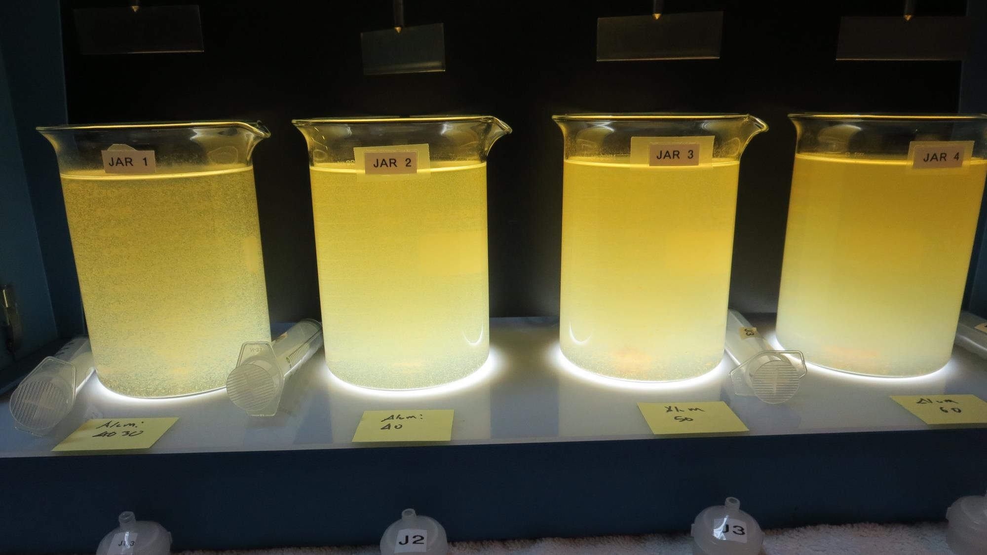
Jars 37-40: End of Floc Duration, 25 mL is syringed for filterability and %UVT/UVA.
30 mg/L Alum
Filtrate: 0.77 NTU
UVT: 90.3%
UVA: 0.044/cm
UVA Reduction: 83.5%
Settled: 75.8 NTU
40 mg/L Alum
Filtrate: 0.64 NTU
UVT: 91.3%
UVA: 0.039/cm
UVA Reduction: 85.4%
Settled: 35.5 NTU
50 mg/L Alum
Filtrate: 0.06 NTU
UVT: 92.4%
UVA: 0.034/cm
UVA Reduction: 88.4%
Settled: 54.6 NTU
60 mg/L Alum
Filtrate: 0.16 NTU
UVT: 93.6%
UVA: 0.028/cm
UVA Reduction: 89.5%
Settled: 25.8 NTU

Slide 58
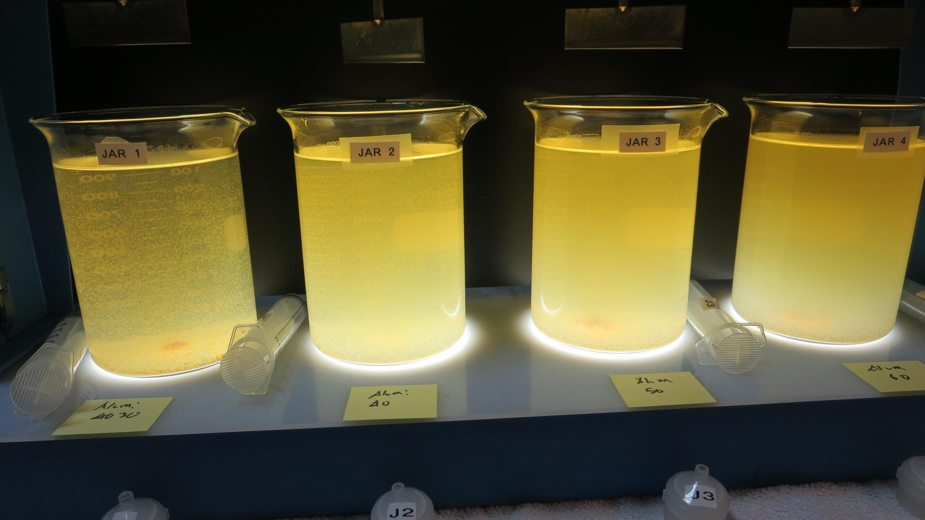
Jars 37-40: After 5 min of settling, 25 mL is syringed for filterability and %UVT/UVA.

Slide 59
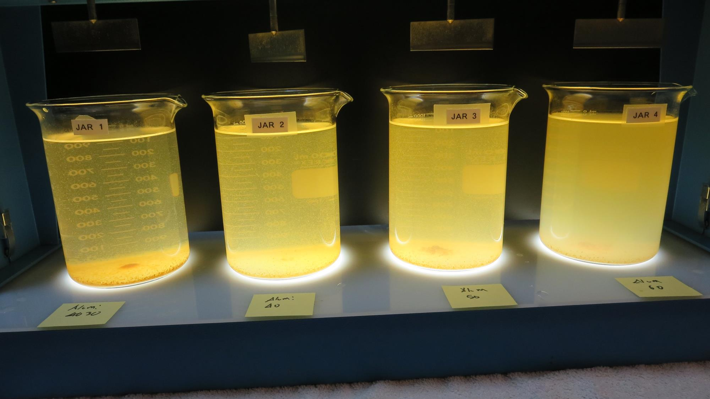
Jars 37-40: After 25-minutes of settling, settled water turbidity is taken.
30 mg/L Alum
Filtrate: 0.77 NTU
UVT: 90.3%
UVA: 0.044/cm
UVA Reduction: 83.5%
Settled: 75.8 NTU
40 mg/L Alum
Filtrate: 0.64 NTU
UVT: 91.3%
UVA: 0.039/cm
UVA Reduction: 85.4%
Settled: 35.5 NTU
50 mg/L Alum
Filtrate: 0.06 NTU
UVT: 92.4%
UVA: 0.034/cm
UVA Reduction: 88.4%
Settled: 54.6 NTU
60 mg/L Alum
Filtrate: 0.16 NTU
UVT: 93.6%
UVA: 0.028/cm
UVA Reduction: 89.5%
Settled: 25.8 NTU

Slide 60
Jars 41-44 Test Flash Mix 200 RPM, 20 Sec Floc Mix 30 RPM, 5 min 25 mL sampled 5 minutes at end of Floc period Applied Coagulant 960 Polyaluminum Hydroxychlorosulfate

Slide 61
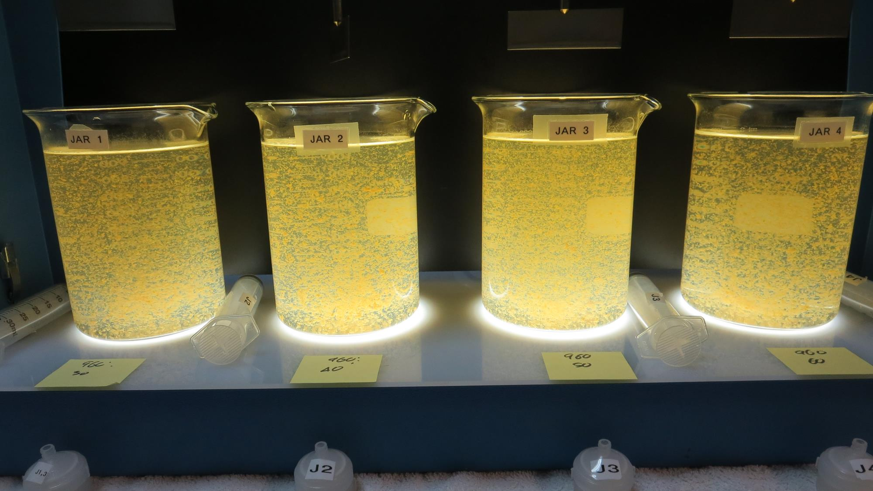
Jars 41-44: End of Floc Duration, 25 mL is syringed for filterability and %UVT/UVA.
30 mg/L 960
Filtrate: 0.07 NTU
UVT: 91.7%
UVA: 0.037/cm
UVA Reduction: 86.1%
Settled: 15.5 NTU
40 mg/L 960
Filtrate: 0.05 NTU
UVT: 91.9%
UVA: 0.036/cm
UVA Reduction: 86.5%
Settled: 15.5 NTU
50 mg/L 960
Filtrate: 0.05 NTU
UVT: 92.3%
UVA: 0.034/cm
UVA Reduction: 87.3%
Settled: 16.5 NTU
60 mg/L 960
Filtrate: 0.05 NTU
UVT: 93.7%
UVA: 0.028/cm
UVA Reduction: 89.5%
Settled: 13.4 NTU

Slide 62
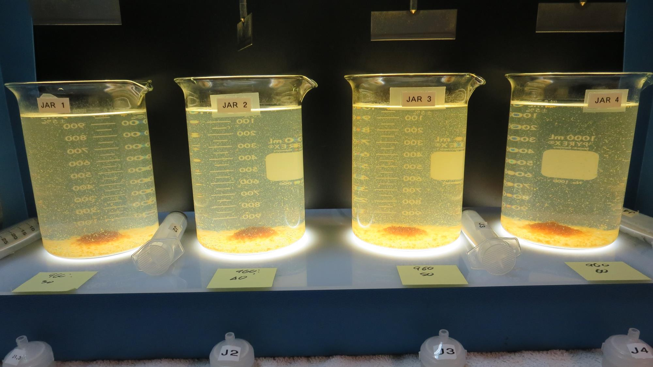
Jars 41-44: After 5 min of settling, 25 mL is syringed for filterability and %UVT/UVA.

Slide 63
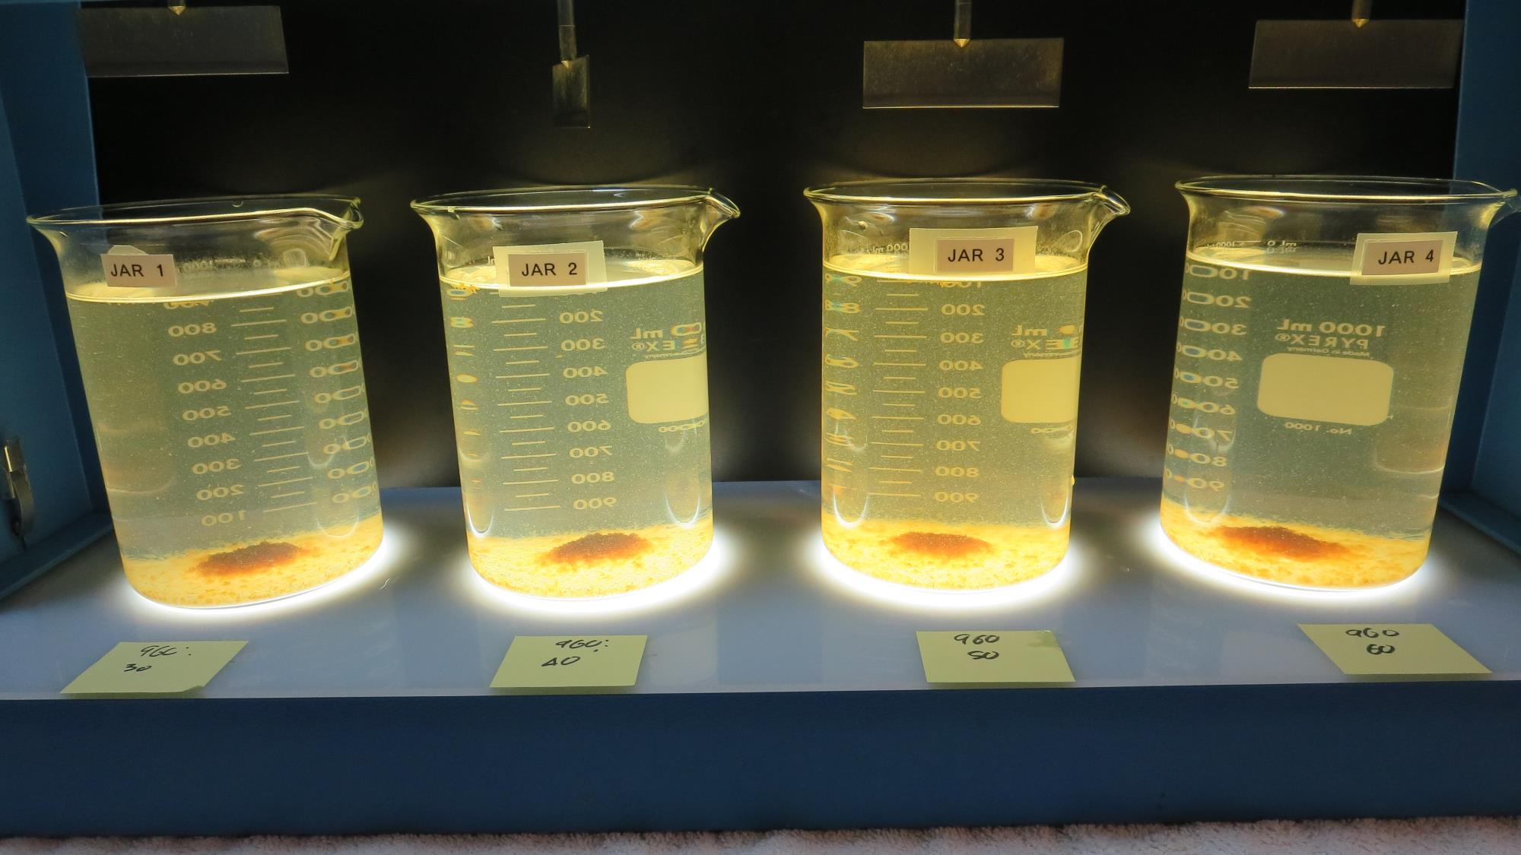
Jars 41-44: After 25-minutes of settling, settled water turbidity is taken.
30 mg/L 960
Filtrate: 0.07 NTU
UVT: 91.7%
UVA: 0.037/cm
UVA Reduction: 86.1%
Settled: 15.5 NTU
40 mg/L 960
Filtrate: 0.05 NTU
UVT: 91.9%
UVA: 0.036/cm
UVA Reduction: 86.5%
Settled: 15.5 NTU
50 mg/L 960
Filtrate: 0.05 NTU
UVT: 92.3%
UVA: 0.034/cm
UVA Reduction: 87.3%
Settled: 16.5 NTU
60 mg/L 960
Filtrate: 0.05 NTU
UVT: 93.7%
UVA: 0.028/cm
UVA Reduction: 89.5%
Settled: 13.4 NTU

Slide 64
Jars 45-48 Test Flash Mix 200 RPM, 20 Sec Floc Mix 30 RPM, 5 min 25 mL sampled 5 minutes at end of Floc period Applied Coagulant 961 No photos available

Slide 65
Jar Testing for 1-Liter Jars: Procedures for Most Treatment Plants
Fill jars with source water prior to coagulant injection and set paddle speed at 30 rpm
Add chemicals (i.e., NaOCl, primary coagulant, coagulant aid) to each jar
Flash mix for 15-30 seconds (200 rpm)
Slow mix for 5 minutes (20-30 rpm)
Settled for 5 minutes. Syringe 25 mL from each jar taken 1-inch below surface (25 mL/12 sec rate)
Filtered through 1.2 um isopore membrane into cuvette drip rate, 15 mL/(50-90 sec)
Measure filtrate turbidity, chlorine residual and %UVT/UVA
Measure settled water turbidity after 25 minutes of total setting
Record all data

Slide 66
Jar Test Filterability Test Equipment
Turbidity Instrument
Syringe w/Luer-Lock Tip, 30 cc
(part#: 2225800, by Hach)
Swinnex Filter Holder, 25 mm (part#: SX0002500)
Isopore Membrane Filter, 1.2 um absolute
pore size,
Φ= 25 mm , thickness: 24 um,
hydrophilic polycarbonate membrane
(part #: RTTP02500)
Go to Sigma-Aldrich for laboratory supplies http://www.sigmaaldrich.com/united-states.html

Slide 67
Isopore Membrane Information
Categories | Information
trade name | Isopore
filter color | White
chemistry | Polycarbonate (PC)
water flow rate | Avg. 175 mL/min x cm² (typical results @ 10 psi)
media | Isopore®
wettability | Hydrophilic
porosity | 14.7%
pore size | 1.2 µm
bubble point at 23 °C | 1.0 bar, air with water
thickness | 24 µm
filter diameter (ø) | 25 mm
material size | polycarbonate, Hydrophilic, 1.2 µm, 25 mm, white, plain, 100

Slide 68
Isopore Membrane Background Information
The Isopore membrane is a polycarbonate, track-etched screen filter recommended for all analyses in which the sample is viewed on the surface of the membrane. The Isopore membrane is composed of polycarbonate film, which has a smooth, glass-like surface for clearer sample observation. The unique manufacturing process of the membrane ensures a precise pore diameter and a consistent pore size for accurate separation of samples by size. Matched-weight filters are not usually required because of low, constant tar and ash weights. Features & Benefits: Membrane structure retains particles on the surface, simplifying counting and analysis

Slide 69
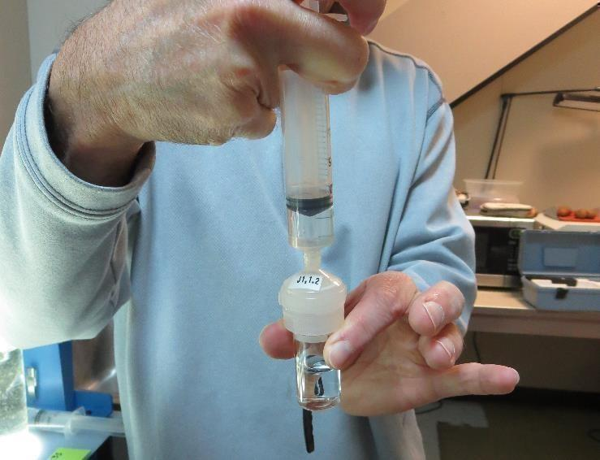
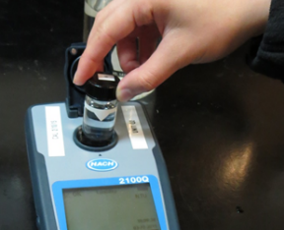
Jar Test - Filterability Test
Syringe ~ 25 mL from jar (after 5-minutes of settling)
Filter-to-waste 3-5 mL
Filter directly into clean cuvette
Measure turbidity
Note: Take several readings before recording final NTU results. Micro bubbles can adhere to glass causing false NTU readings. To remove bubbles, tilt cuvette up to 90 degrees.

Slide 70
Contact
Guy Schott, P.E.
State Water Resources Control Board
Division of Drinking Water
Santa Rosa, CA
Go to Stock Solution/Dose calculations/Jar Test Results for tools to download
www.waterboards.ca.gov/drinking_water/programs/districts/mendocino_district.html
Jar Testing Done Right training video: https://www.youtube.com/watch?v=aGByyxhelkI
Email: Guy Schott - Guy.Schott@waterboards.ca.gov
Office Number: 707-576-2732

