Slide 1
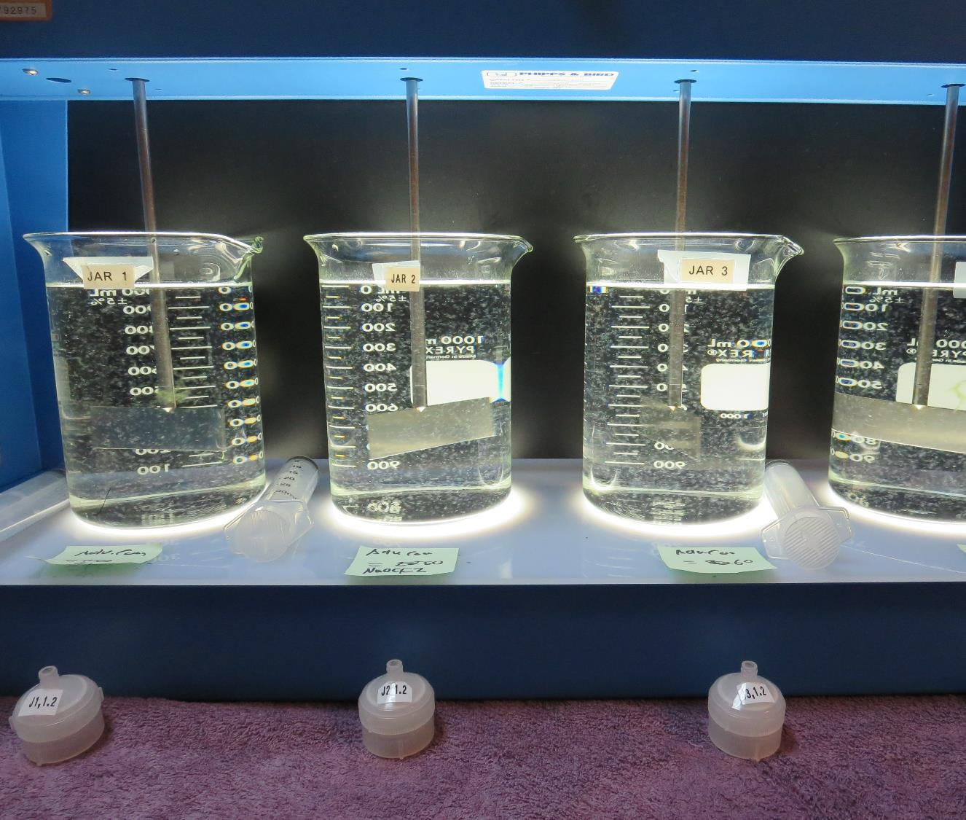
Cement Hill Water Plant CA4810005 Solano County Jar Test
by Guy Schott, P.E.
July 28, 2020

Slide 2
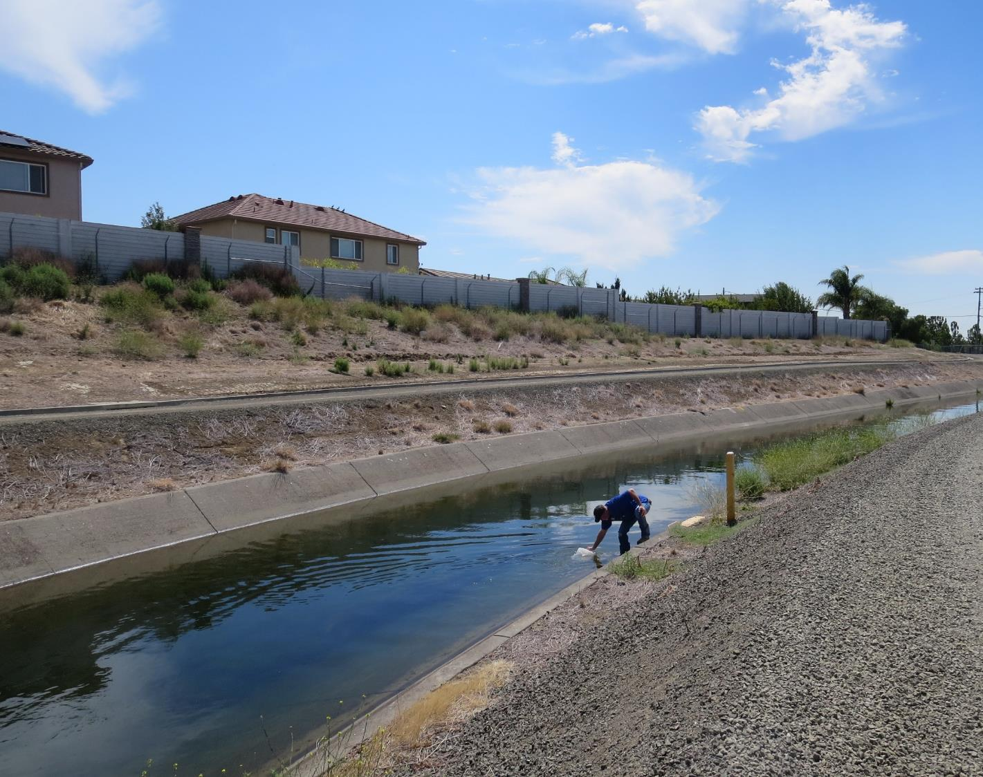
Cement Hill WTP Source Water: Putah South Canal Conventional Treatment

Slide 3
Cement Hill WTP, July 28, 2020 Source Water Characteristics
Source
pH: 8.46
Turbidity: 0.87 NTU
UVT: 87%
UVA: 0.060/cm
0.4 um Filtered
Turbidity: 0.17 NTU
UVT: 87.1%
UVA: 0.059/cm
Plant CFE
Turbidity: 0.08 NTU
UVT: 91.9%
UVA: 0.036/cm
UVA Reduction: 39.0%
Plant Treatment Chemicals
Pre-chlorination: Dose?
Coagulant: 932 = 3.42 mg/L
Filter Aid: 9890 = 3.14 mg/L

Slide 4
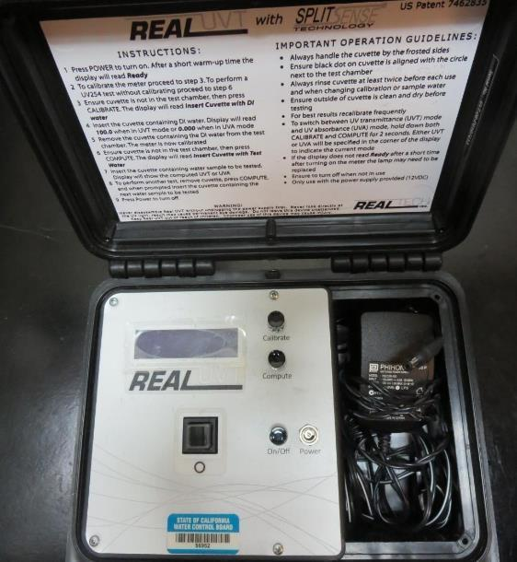
UVT/UVA, pathlength 10 mm
UV transmittance (UVT) is a measurement of the amount of ultraviolet light (commonly at 254 nm due to its germicidal effect) that passes through a water sample compared to the amount of light that passes through a pure water sample. The measurement is expressed as a percentage, % UVT.
%UVT = 10^{(-UVA)} x 100%
UV absorbance (UVA) is calculated as a relative measure of the amount of light absorbed by a water sample compared with the amount of light absorbed by a pure water sample.
UVA = -log(%UVT/100)

Slide 5
Applied Coagulants for Jar Testing
Pro Pac 9890 (NTU Technologies)
35-45% Aluminum Chlorohydrate
35-45% Water
SG = 1.25-1.34
Pro Pac 932 (NTU Technologies)
Contains water soluble Aluminum compound
SG = 1.3
Advanced Coagulant
12.55% Al₂O₃
6.64% Al
66.4% Basicity
SG = 1.3

Slide 6
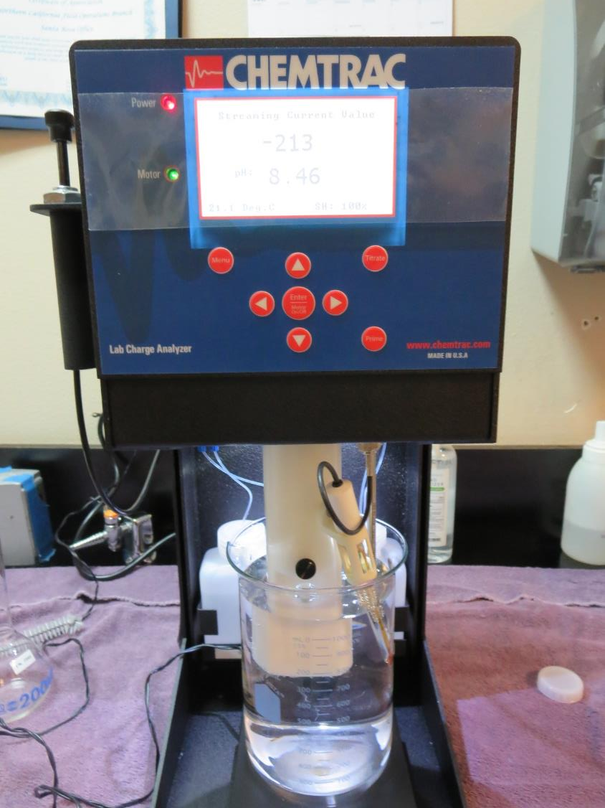
Laboratory Charge Analyzer
LCA: Used to determine coagulant demand of a source water entering the treatment plant.
Source pH: 8.48
LCA #1:
932: 21.8 mg/L as product
pH adjusted to 7.5 w/acetic acid solution
LCA #2:
9890: 9-10 mg/L as product
pH adjusted to 7.5 w/acetic acid solution

Slide 7
Coagulant Information
Unless stated otherwise, all coagulant doses are reported as Product (100% strength).
Preparation of coagulant stock solutions are generally 1.0 and/or 0.1 percent strength using 100 and/or 200 mL volumetric flasks.
Finnpipette F2 variable volume pipette, capacity 100-1000 micro liters is used for stock solution preparation and coagulant aid jar test dosing.
Finnpipette F2 variable volume pipette, capacity 0.5-5 mL is used for primary coagulant jar test dosing.

Slide 8
NaOCl Pre-Oxidation
Note: For a given coagulant dose, there will be an increase in %UVT or decrease in UVA when NaOCl is added. It is believed that some of the DOC is converted to disinfection by-products giving a false indication of improved DOC reduction via coagulation. There are jars that compare the same coagulant dose with one jar injected with NaOCl. The sense of improvement with the jar with chlorine is due to the chlorine reaction with DOC that results in increase in %UVT or decrease in UVA.

Slide 9
Cement Hill WTP: Jar Test 1-4 Results Putah South Canal Source Water Flash Mix 200 RPM (30 sec); Floc Mix 30 RPM (5 min)
Jar # | NaOCl mg/L | 932 mg/L | 9890 mg/L | Filtrate NTU | Filtrate %UVT | Filtrate UVA/cm | %UVA Reduction | Settle NTU 25 min
J1 | 0 | 3.42 | 3.02 | 0.23 | 89.1 | 0.050 | 15.3 | 1.06
J2 | 2.0 | 3.42 | 3.02 | 0.13 | 91.0 | 0.040 | 19.0 | 1.26
J3 | 0 | 22 | 0 | 0.08 | 91.6 | 0.038 | 35.6 | 0.72
J4 | 0 | 0 | 8.7 | 0.11 | 90.8 | 0.041 | 30.5 | 1.07

Slide 10
Cement Hill WTP : Jar Test 5-12 Results Putah South Canal Source Water; Flash Mix 200 RPM (30 sec)
Jar # | 30 RPM Floc Duration min | NaOCl mg/L | Adv Coag. mg/L | Filtrate NTU | Filtrate %UVT | Filtrate UVA/cm | %UVA Reduction | Settle NTU 25 min
J5 | 5 | 0 | 10 | 0.28 | 88.2 | 0.054 | 8.5 | 0.77
J6 | 5 | 0 | 20 | 0.15 | 89.1 | 0.050 | 15.3 | 0.88
J7 | 5 | 0 | 30 | 0.12 | 89.5 | 0.048 | 18.6 | 0.59
J8 | 5 | 0 | 40 | 0.10 | 90.5 | 0.043 | 27.1 | 0.37
J9 | 5 | 0 | 50 | 0.10 | 91.3 | 0.039 | 33.9 | 0.30
J10 | 5 | 2.0 | 50 | 0.09 | 93.1 | 0.030 | 49.2 | 0.34
J11 | 5 | 0 | 60 | 0.10 | 91.8 | 0.036 | 39.0 | 0.33
J12 | 5 | 2.0 | 60 | 0.09 | 94.3 | 0.025 | 57.6 | 0.27

Slide 11
Cement Hill WTP: Jar Test 13-18 Results Putah South Canal Source Water Flash Mix 200 RPM (30 sec); Floc Mix 30 RPM (5 min)
Jar # | NaOCl mg/L | 932 mg/L | 9890 mg/L | Filtrate NTU | Filtrate %UVT | Filtrate UVA/cm | %UVA Reduction | Settle NTU 25 min
J13 | 2.0 | 3.42 | 3.14 | 0.24 | 91.0 | 0.040 | 32.2 | 1.20
J14 | 2.0 | 7.0 | 3.14 | 0.18 | 91.8 | 0.037 | 37.3 | 1.19
J15 | 2.0 | 10 | 3.14 | 0.15 | 92.1 | 0.035 | 40.7 | 1.13
J16 | 2.0 | 13 | 3.14 | 0.12 | 92.5 | 0.033 | 44.1 | 0.79
J17 | 2.0 | 22 | 2.2 | 0.16 | 93.0 | 0.031 | 47.5 | 0.54
J18 | 0 | 22 | 2.2 | 0.18 | 92.0 | 0.035 | 40.7 | 0.66

Slide 12
Jars 1-4 Test Flash Mix 30 Sec (200 RPM) Floc Mix 5 min (30 RPM) Applied Coagulants 932/9890

Slide 13
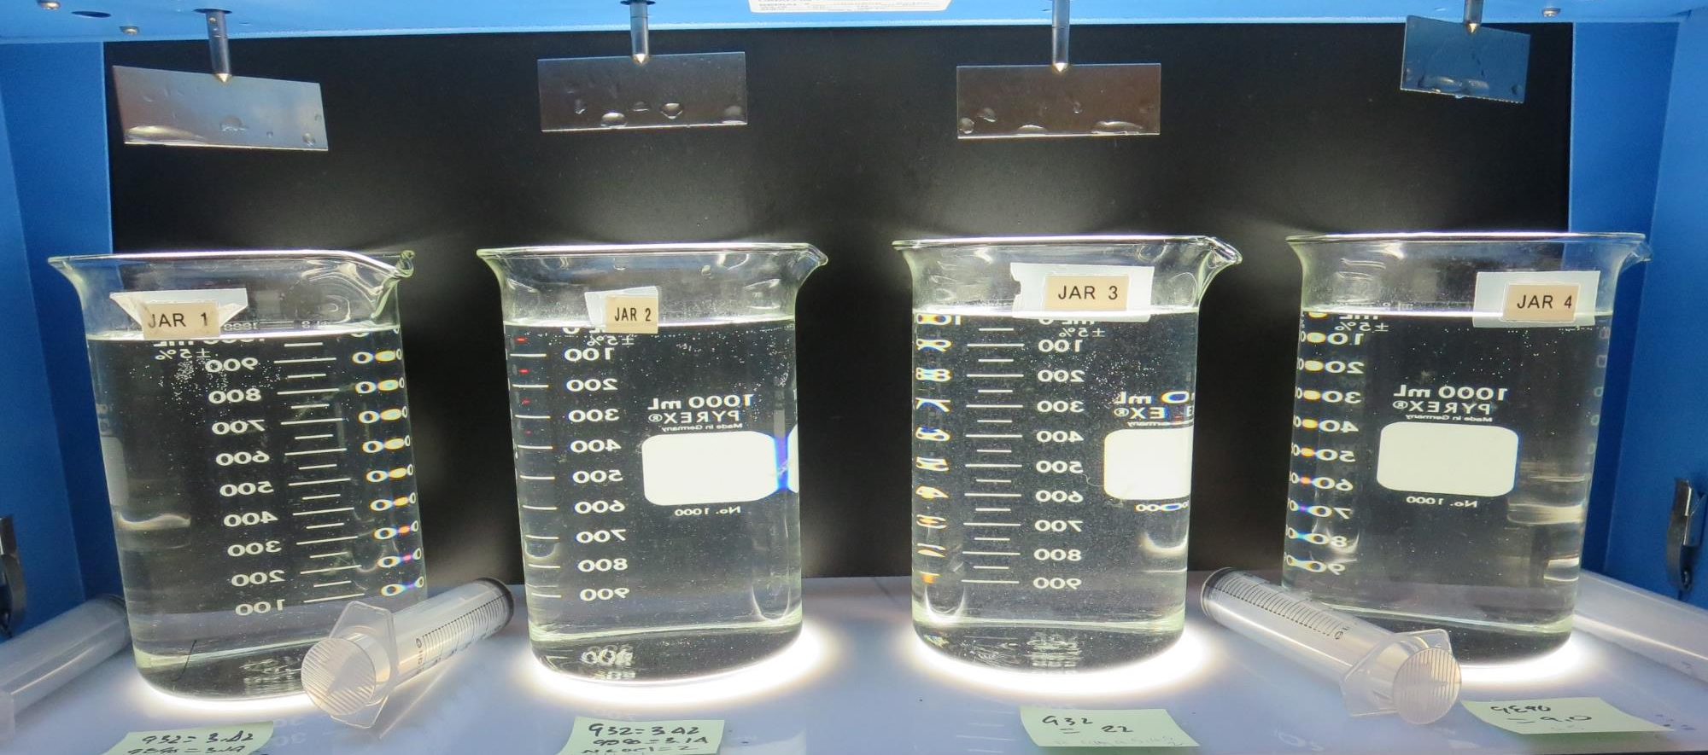
Jars 1-4: End of 5-minute flocculation (30 RPM) duration.
0 mg/L NaOCl
3.42 mg/L 932
3.14 mg/L 9890
Filtrate 0.23 NTU
UVT: 88.9%
UVA: 0.050/cm
UVA Reduction: 15.3%
Settled: 1.06 NTU
2.0 mg/L NaOCl
3.42 mg/L 932
3.14 mg/L 9890
Filtrate 0.13 NTU
UVT: 91.0%
UVA: 0.040/cm
UVA Reduction: 19.0%
Settled: 1.26 NTU
22 mg/L 932
Filtrate 0.08 NTU
UVT: 91.6%
UVA: 0.038/cm
UVA Reduction: 35.6%
Settled: 0.72 NTU
9 mg/L 9890
Filtrate 0.11 NTU
UVT: 90.8%
UVA: 0.041/cm
UVA Reduction: 15.3%
Settled: 1.07 NTU

Slide 14
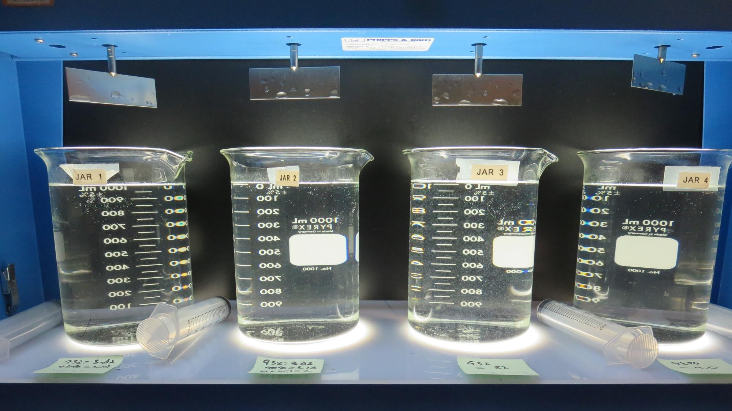
Jars 1-4: After 5 min of settling, 25 mL is syringed for filterability and %UVT/UVA.

Slide 15
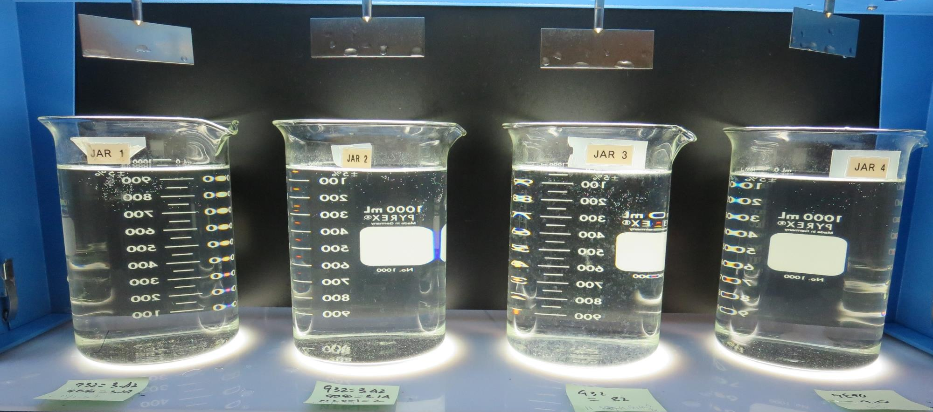
Jars 1-4: After 25-minutes of settling, settled water turbidity is taken.
0 mg/L NaOCl
3.42 mg/L 932
3.14 mg/L 9890
Filtrate 0.23 NTU
UVT: 88.9%
UVA: 0.050/cm
UVA Reduction: 15.3%
Settled: 1.06 NTU
2.0 mg/L NaOCl
3.42 mg/L 932
3.14 mg/L 9890
Filtrate 0.13 NTU
UVT: 91.0%
UVA: 0.040/cm
UVA Reduction: 19.0%
Settled: 1.26 NTU
22 mg/L 932
Filtrate 0.08 NTU
UVT: 91.6%
UVA: 0.038/cm
UVA Reduction: 35.6%
Settled: 0.72 NTU
9 mg/L 9890
Filtrate 0.11 NTU
UVT: 90.8%
UVA: 0.041/cm
UVA Reduction: 15.3%
Settled: 1.07 NTU

Slide 16
Jars 5-8 Test Flash Mix 30 Sec (200 RPM) Floc Mix 5 min (30 RPM) Applied Coagulant Advanced Coagulant

Slide 17
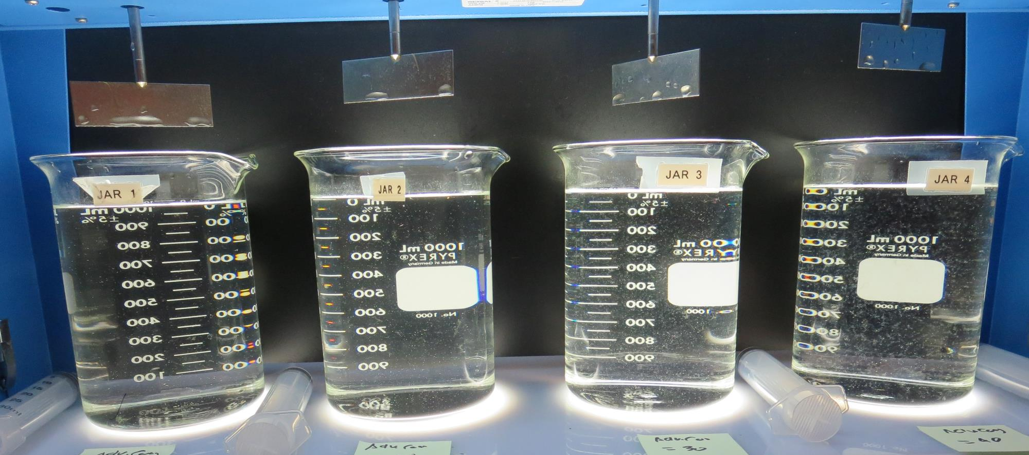
Jars 5-8: End of 5-minute flocculation (30 RPM) duration.
10 mg/L Adv Coag.
Filtrate 0.28 NTU
UVT: 88.2%
UVA: 0.054/cm
UVA Reduction: 8.5%
Settled: 0.77 NTU
20 mg/L Adv Coag.
Filtrate 0.15 NTU
UVT: 89.1%
UVA: 0.050/cm
UVA Reduction: 15.3%
Settled: 0.88 NTU
30 mg/L Adv Coag.
Filtrate 0.12 NTU
UVT: 89.5%
UVA: 0.048/cm
UVA Reduction: 18.6%
Settled: 0.59 NTU
40 mg/L Adv Coag.
Filtrate 0.10 NTU
UVT: 90.5%
UVA: 0.043/cm
UVA Reduction: 27.1%
Settled: 0.37 NTU

Slide 18
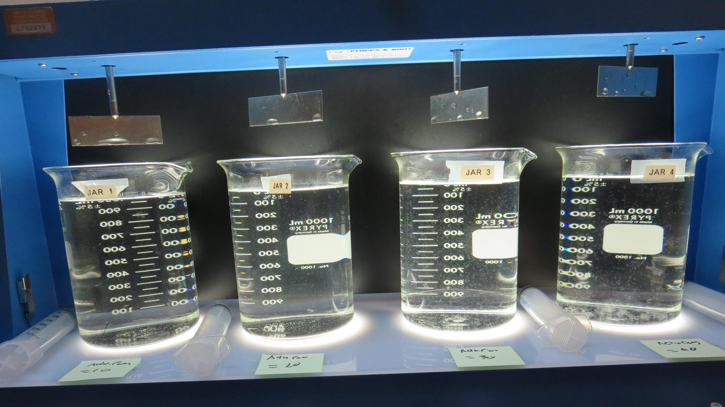
Jars 5-8: After 5 min of settling, 25 mL is syringed for filterability and %UVT/UVA.

Slide 19
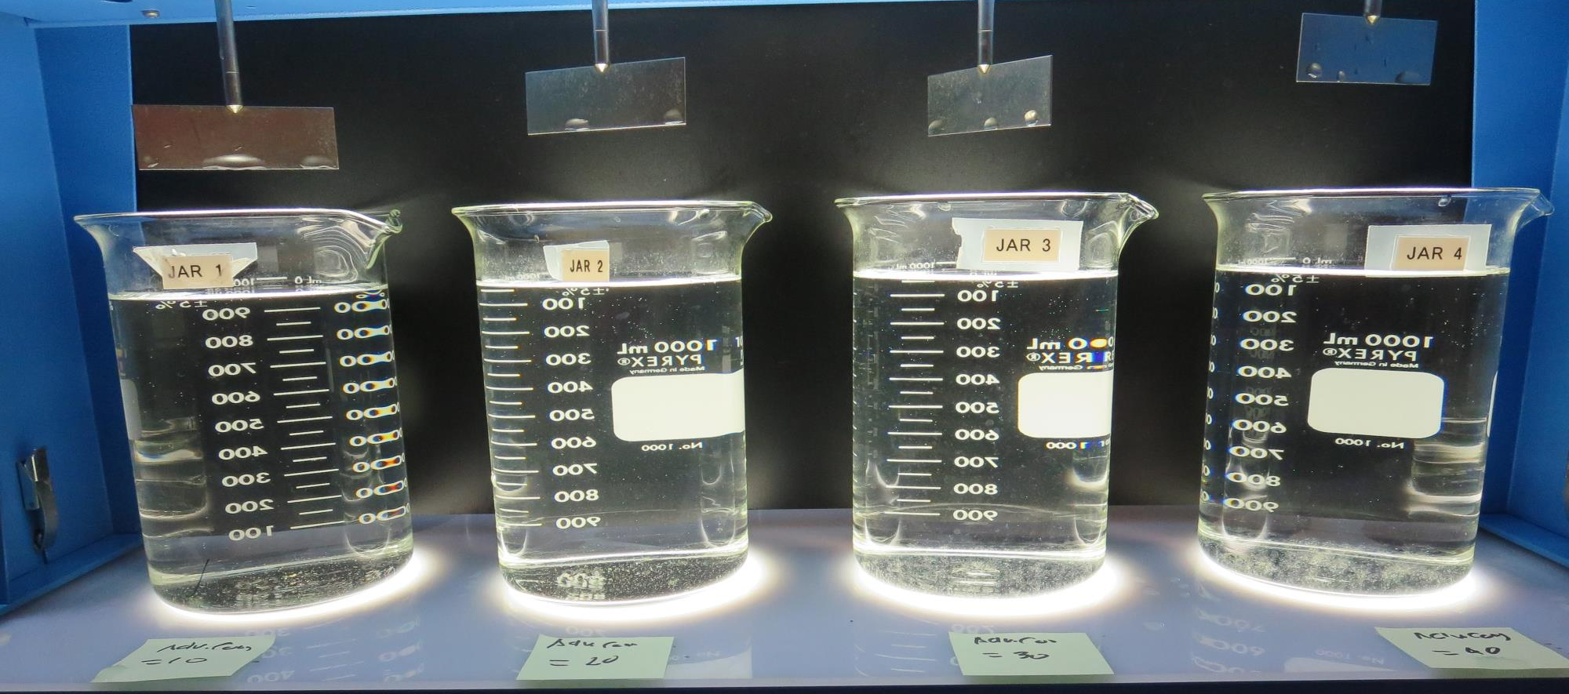
Jars 5-8: After 25-minutes of settling, settled water turbidity is taken.
10 mg/L Adv Coag.
Filtrate 0.28 NTU
UVT: 88.2%
UVA: 0.054/cm
UVA Reduction: 8.5%
Settled: 0.77 NTU
20 mg/L Adv Coag.
Filtrate 0.15 NTU
UVT: 89.1%
UVA: 0.050/cm
UVA Reduction: 15.3%
Settled: 0.88 NTU
30 mg/L Adv Coag.
Filtrate 0.12 NTU
UVT: 89.5%
UVA: 0.048/cm
UVA Reduction: 18.6%
Settled: 0.59 NTU
40 mg/L Adv Coag.
Filtrate 0.10 NTU
UVT: 90.5%
UVA: 0.043/cm
UVA Reduction: 27.1%
Settled: 0.37 NTU

Slide 20
Jars 9 -12 Test Flash Mix 30 Sec (200 RPM) Floc Mix 5 min (30 RPM) Applied Coagulant Advanced Coagulant

Slide 21
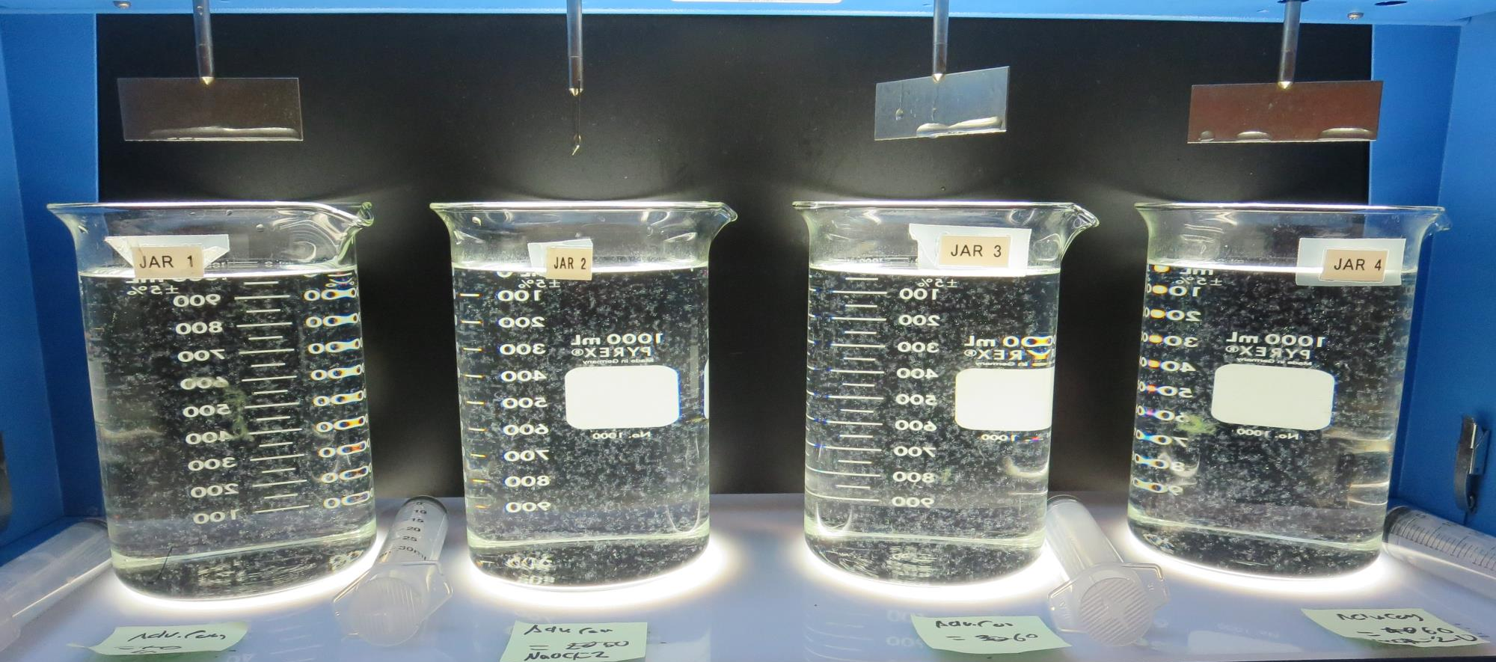
Jars 9-12: End of 5-minute flocculation (30 RPM) duration.
0 mg/L NaOCl
50 mg/L Adv Coag.
Filtrate 0.10 NTU
UVT: 91.3%
UVA: 0.039/cm
UVA Reduction: 33.9%
Settled: 0.30 NTU
2.0 mg/L NaOCl
50 mg/L Adv Coag.
Filtrate 0.09 NTU
UVT: 93.1%
UVA: 0.039/cm
UVA Reduction: 49.2%
Settled: 0.30 NTU
0 mg/L NaOCl
60 mg/L Adv Coag.
Filtrate 0.10 NTU
UVT: 91.8%
UVA: 0.036/cm
UVA Reduction: 39.0%
Settled: 0.33 NTU
2.0 mg/L NaOCl
60 mg/L Adv Coag.
Filtrate 0.09 NTU
UVT: 94.3%
UVA: 0.025/cm
UVA Reduction: 57.6%
Settled: 0.25 NTU

Slide 22
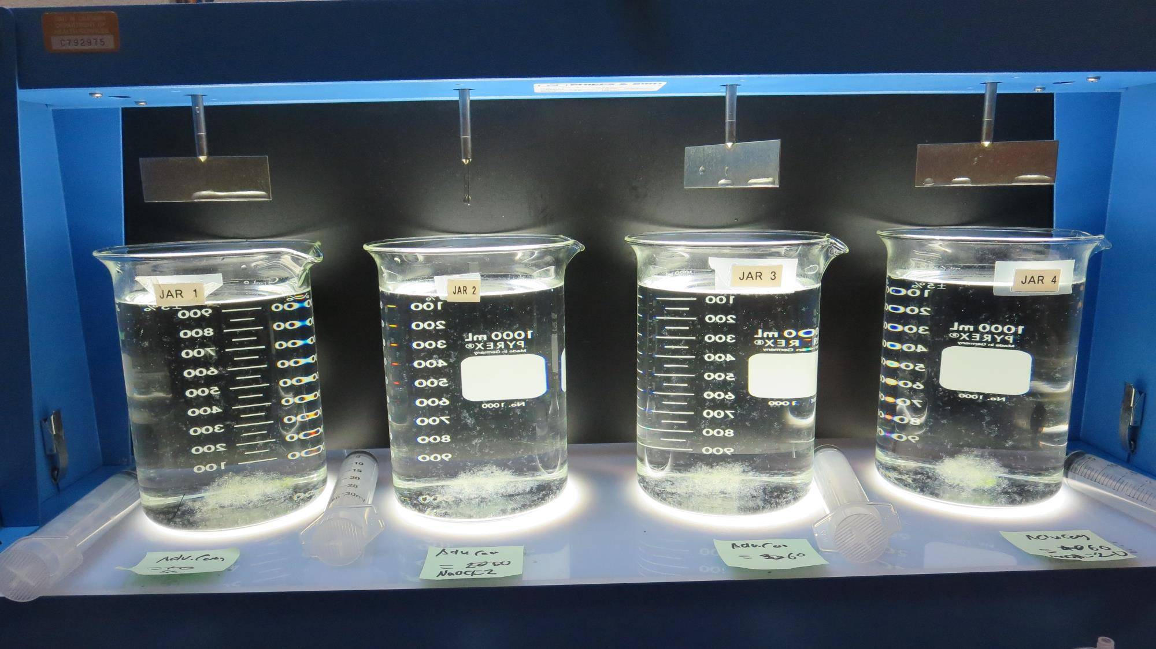
Jars 9-12: After 5 min of settling, 25 mL is syringed for filterability and %UVT/UVA.

Slide 23
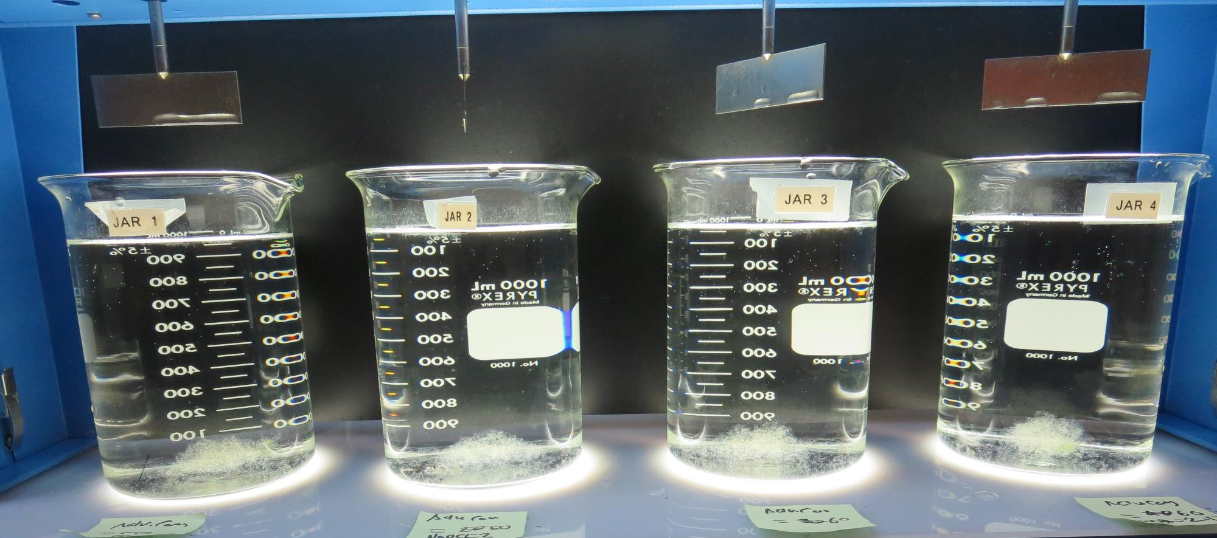
Jars 9-12: After 25-minutes of settling, settled water turbidity is taken.
0 mg/L NaOCl
50 mg/L Adv Coag.
Filtrate 0.10 NTU
UVT: 91.3%
UVA: 0.039/cm
UVA Reduction: 33.9%
Settled: 0.30 NTU
2.0 mg/L NaOCl
50 mg/L Adv Coag.
Filtrate 0.09 NTU
UVT: 93.1%
UVA: 0.039/cm
UVA Reduction: 49.2%
Settled: 0.30 NTU
0 mg/L NaOCl
60 mg/L Adv Coag.
Filtrate 0.10 NTU
UVT: 91.8%
UVA: 0.036/cm
UVA Reduction: 39.0%
Settled: 0.33 NTU
2.0 mg/L NaOCl
60 mg/L Adv Coag.
Filtrate 0.09 NTU
UVT: 94.3%
UVA: 0.025/cm
UVA Reduction: 57.6%
Settled: 0.25 NTU

Slide 24
Jars 13-16 Test Flash Mix 30 Sec (200 RPM) Floc Mix 5 min (30 RPM) Applied Coagulants 932/9890

Slide 25
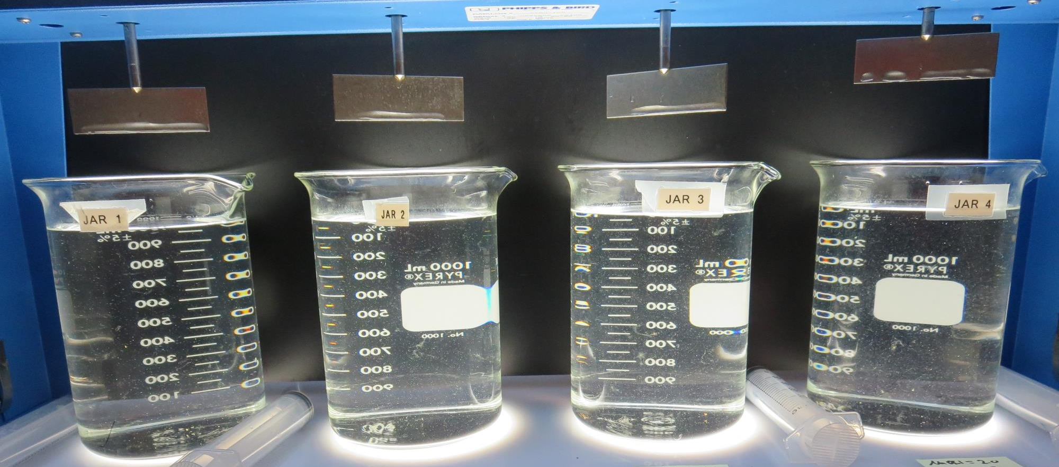
Jars 13-16: End of 5-minute flocculation (30 RPM) duration.
2.0 mg/L NaOCl
3.42 mg/L 932
3.14 mg/L 9890
Filtrate 0.24 NTU
UVT: 91.0%
UVA: 0.040/cm
UVA Reduction: 32.2%
Settled: 1.20 NTU
2.0 mg/L NaOCl
7.0 mg/L 932
3.14 mg/L 9890
Filtrate 0.18 NTU
UVT: 91.8%
UVA: 0.037/cm
UVA Reduction: 37.3%
Settled: 1.19 NTU
2.0 mg/L NaOCl
10 mg/L 932
3.14 mg/L 9890
Filtrate 0.15 NTU
UVT: 92.1%
UVA: 0.035/cm
UVA Reduction: 40.7%
Settled: 1.13 NTU
2.0 mg/L NaOCl
13 mg/L 932
3.14 mg/L 9890
Filtrate 0.12 NTU
UVT: 92.5%
UVA: 0.033/cm
UVA Reduction: 44.1%
Settled: 0.79 NTU

Slide 26
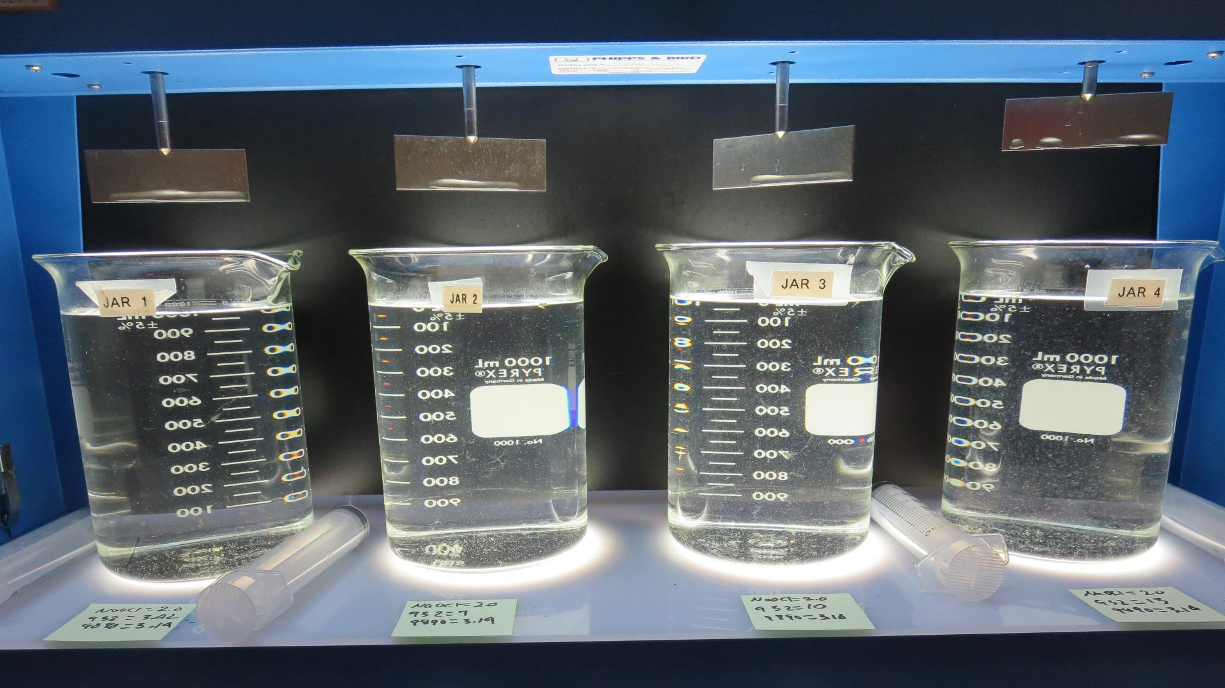
Jars 13-16: After 5 min of settling, 25 mL is syringed for filterability and %UVT/UVA.

Slide 27
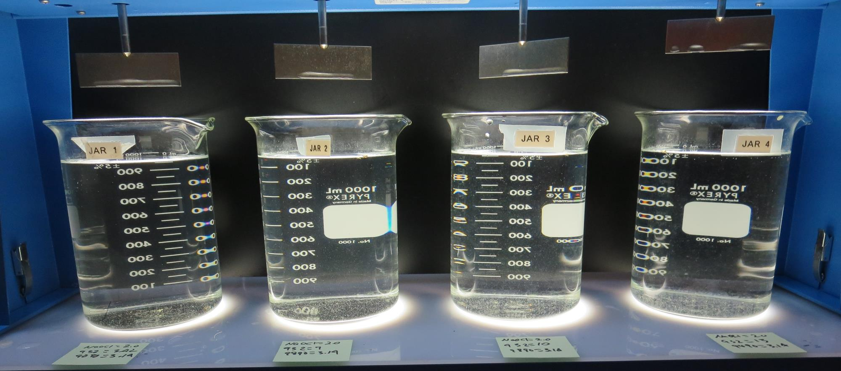
Jars 13-16: After 25-minutes of settling, settled water turbidity is taken.
2.0 mg/L NaOCl
3.42 mg/L 932
3.14 mg/L 9890
Filtrate 0.24 NTU
UVT: 91.0%
UVA: 0.040/cm
UVA Reduction: 32.2%
Settled: 1.20 NTU
2.0 mg/L NaOCl
7.0 mg/L 932
3.14 mg/L 9890
Filtrate 0.18 NTU
UVT: 91.8%
UVA: 0.037/cm
UVA Reduction: 37.3%
Settled: 1.19 NTU
2.0 mg/L NaOCl
10 mg/L 932
3.14 mg/L 9890
Filtrate 0.15 NTU
UVT: 92.1%
UVA: 0.035/cm
UVA Reduction: 40.7%
Settled: 1.13 NTU
2.0 mg/L NaOCl
13 mg/L 932
3.14 mg/L 9890
Filtrate 0.12 NTU
UVT: 92.5%
UVA: 0.033/cm
UVA Reduction: 44.1%
Settled: 0.79 NTU

Slide 28
Jars 17-18 Test Flash Mix 30 Sec (200 RPM) Floc Mix 5 min (30 RPM) Applied Coagulants 932/9890

Slide 29
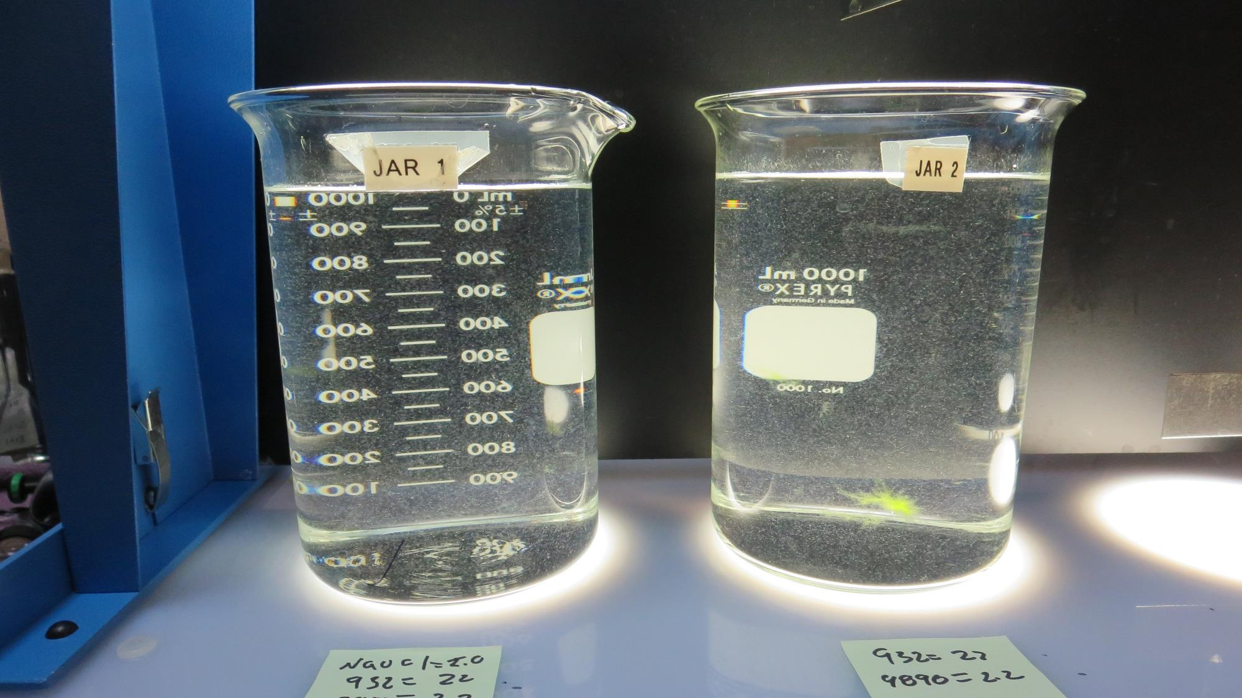
Jars 17-18: End of 5-minute flocculation (30 RPM) duration.
2.0 mg/L NaOCl
22 mg/L 932
2.2 mg/L 9890
Filtrate 0.16 NTU
UVT: 93.0%
UVA: 0.031/cm
UVA Reduction: 47.5%
Settled: 0.54 NTU
0 mg/L NaOCl
22 mg/L 932
2.2 mg/L 9890
Filtrate 0.18 NTU
UVT: 92.0%
UVA: 0.035/cm
UVA Reduction: 40.7%
Settled: 0.66 NTU

Slide 30
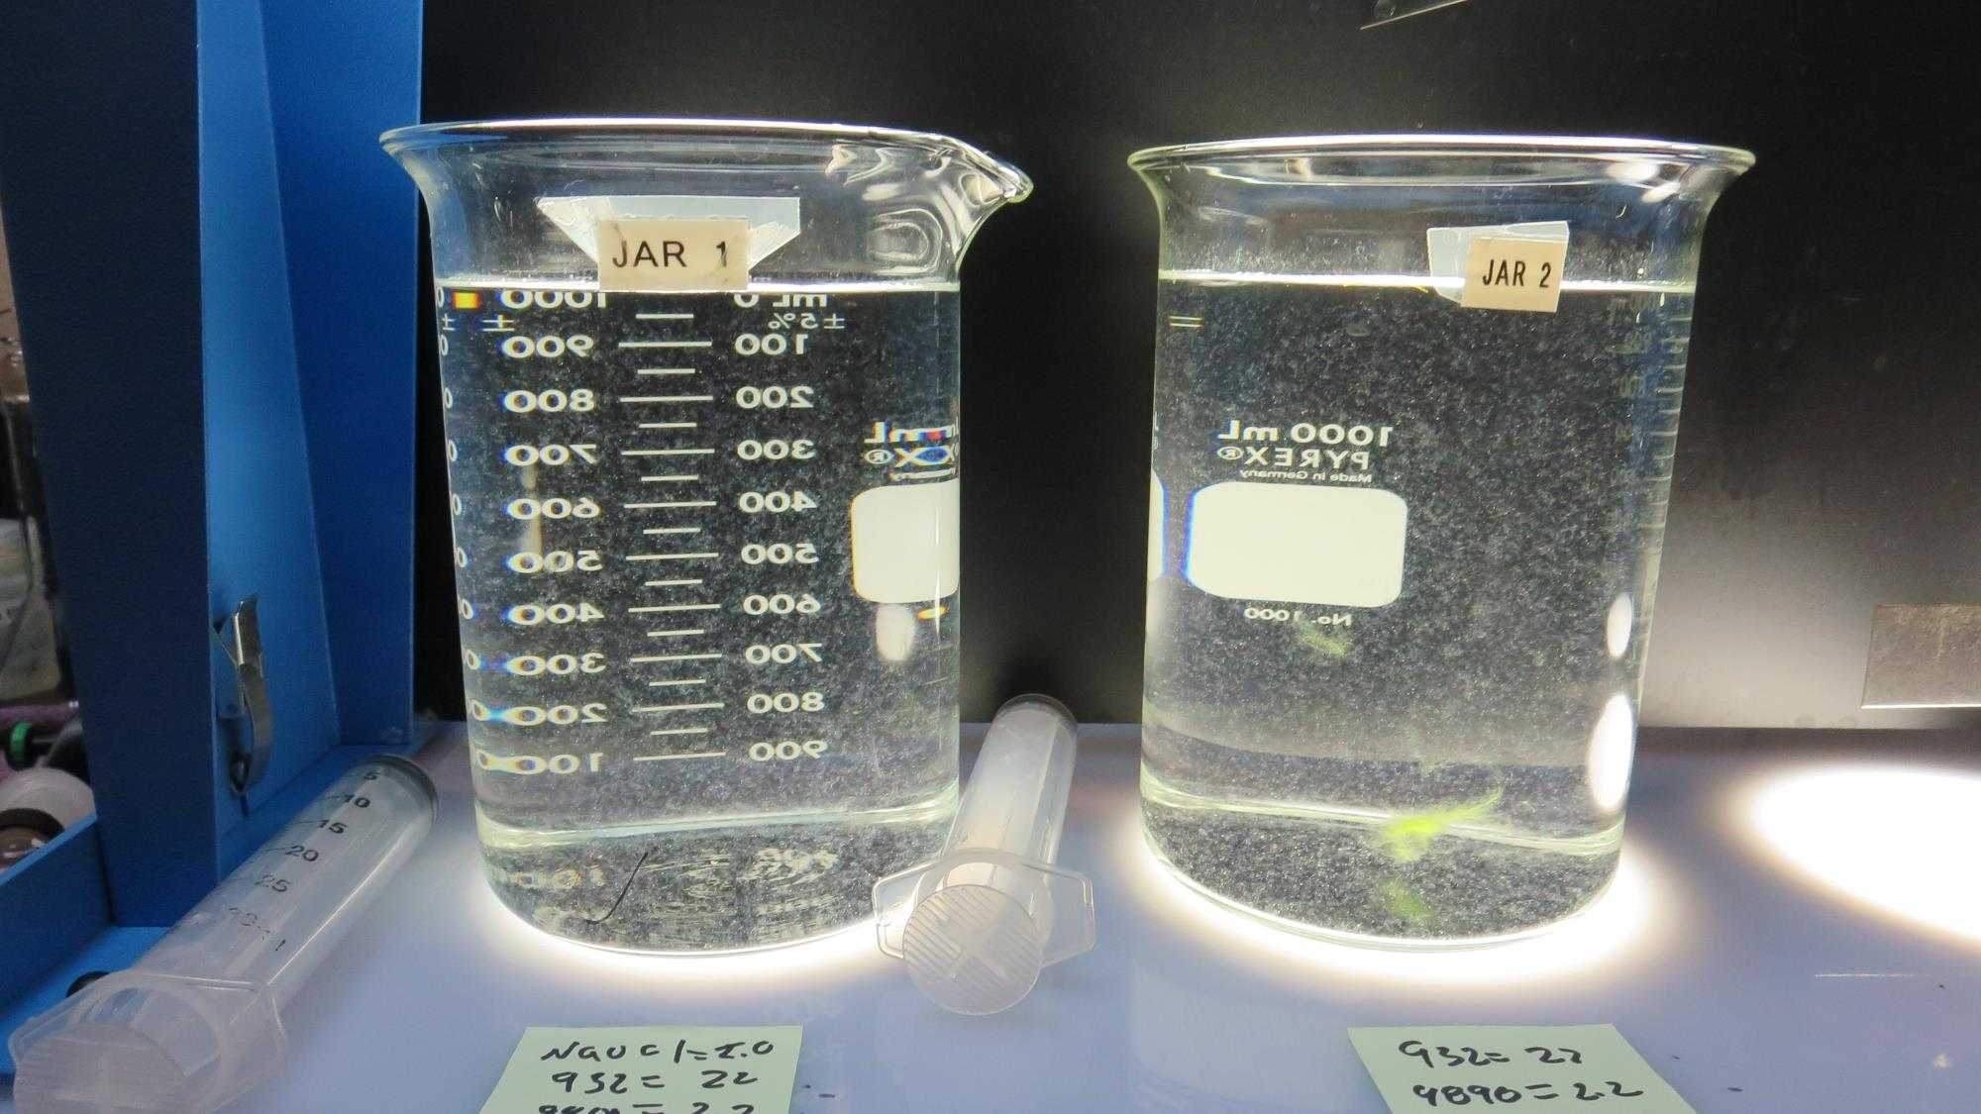
Jars 17-18: After 5 min of settling, 25 mL is syringed for filterability and %UVT/UVA.

Slide 31
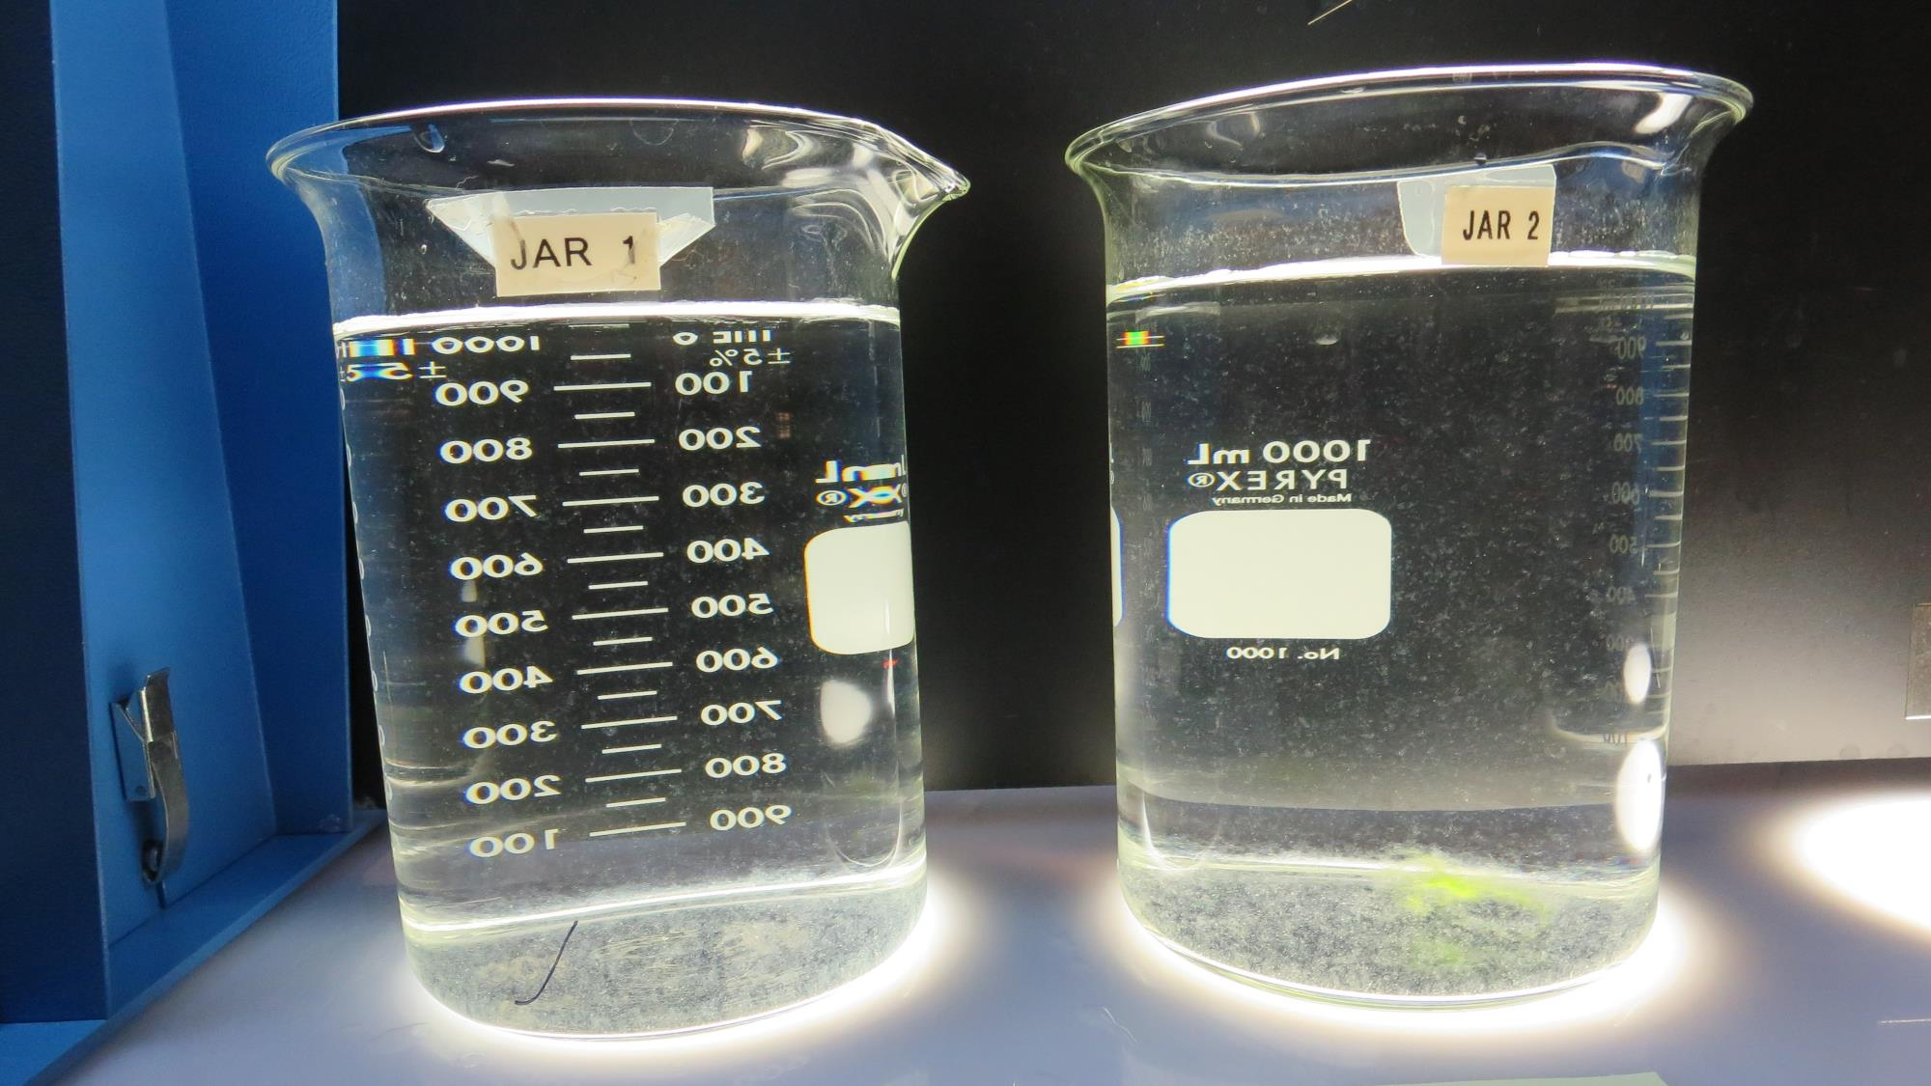
Jars 17-18: After 25-minutes of settling, settled water turbidity is taken.
2.0 mg/L NaOCl
22 mg/L 932
2.2 mg/L 9890
Filtrate 0.16 NTU
UVT: 93.0%
UVA: 0.031/cm
UVA Reduction: 47.5%
Settled: 0.54 NTU
0 mg/L NaOCl
22 mg/L 932
2.2 mg/L 9890
Filtrate 0.18 NTU
UVT: 92.0%
UVA: 0.035/cm
UVA Reduction: 40.7%
Settled: 0.66 NTU

Slide 32
Jar Testing for 1-Liter Jars: Procedures for Most Treatment Plants
Fill jars with source water prior to coagulant injection and set paddle speed at 30 rpm
Add chemicals (i.e., NaOCl, primary coagulant, coagulant aid) to each jar
Flash mix for 15-30 seconds (200 rpm)
Slow mix for 5 minutes (20-30 rpm)
Settled for 5 minutes. Syringe 25 mL from each jar taken 1-inch below surface (25 mL/12 sec rate).
Filtered through 1.2 um isopore membrane into cuvette drip rate, 15 mL/(50-90 sec)
Measure filtrate turbidity, chlorine residual and %UVT/UVA
Measure settled water turbidity after 25 minutes of total setting
Record all data

Slide 33
Jar Test Filterability Test Equipment
Turbidity Instrument
Syringe w/Luer-Lock Tip, 30 cc
(part#: 2225800, by Hach)
Swinnex Filter Holder, 25 mm (part#: SX0002500)
Isopore Membrane Filter, 1.2 um absolute
pore size,
Φ= 25 mm , thickness: 24 um,
hydrophilic polycarbonate membrane
(part #: RTTP02500)
Go to Sigma-Aldrich for laboratory supplies http://www.sigmaaldrich.com/united-states.html

Slide 34
Isopore Membrane Information
Categories | Information
trade name | Isopore
filter color | White
chemistry | Polycarbonate (PC)
water flow rate | Avg. 175 mL/min x cm² (typical results @ 10 psi)
media | Isopore®
wettability | Hydrophilic
porosity | 14.7%
pore size | 1.2 µm
bubble point at 23 °C | 1.0 bar, air with water
thickness | 24 µm
filter diameter (ø) | 25 mm
material size | polycarbonate, Hydrophilic, 1.2 µm, 25 mm, white, plain, 100

Slide 35
Isopore Membrane Background Information
The Isopore membrane is a polycarbonate, track-etched screen filter recommended for all analyses in which the sample is viewed on the surface of the membrane. The Isopore membrane is composed of polycarbonate film, which has a smooth, glass-like surface for clearer sample observation. The unique manufacturing process of the membrane ensures a precise pore diameter and a consistent pore size for accurate separation of samples by size. Matched-weight filters are not usually required because of low, constant tar and ash weights. Features & Benefits: Membrane structure retains particles on the surface, simplifying counting and analysis

Slide 36
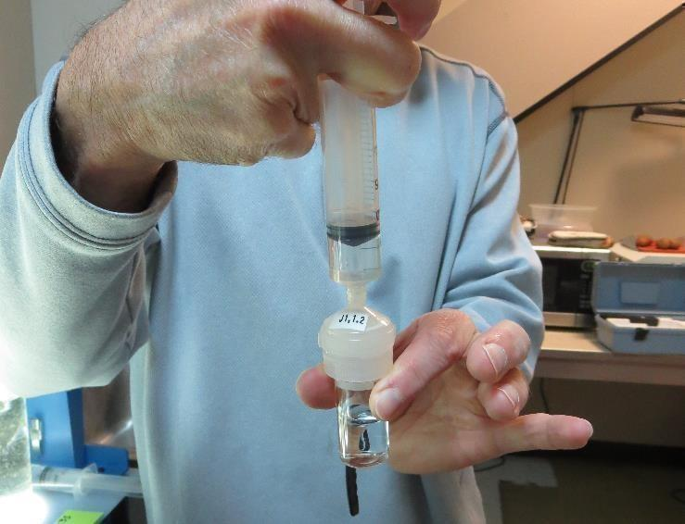
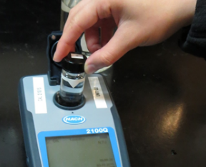
Jar Test - Filterability Test
Syringe ~ 25 mL from jar (after 5-minutes of settling)
Filter-to-waste 3-5 mL
Filter directly into clean cuvette
Measure turbidity
Note: Take several readings before recording final NTU results. Micro bubbles can adhere to glass causing false NTU readings. To remove bubbles, tilt cuvette up to 90 degrees.

Slide 37
Contact
Guy Schott, P.E.
State Water Resources Control Board
Division of Drinking Water
Santa Rosa, CA
Go to Stock Solution/Dose calculations/Jar Test Results for tools to download
www.waterboards.ca.gov/drinking_water/programs/districts/mendocino_district.html
Email: Guy Schott - Guy.Schott@waterboards.ca.gov
Office Number: 707-576-2732

