Slide 1
Voluntary Diversion Reduction Program Among In-Delta Riparian Water Rights Claimants
Michael Patrick George, Delta Watermaster
Lauren Barva, Communications & Outreach Specialist
State Water Resources Control Board
May 3, 2016

Slide 2
Program Background
April 2015: Facing a 4th year of drought, threat of curtailments, minimal snowpack, Governor Brown extended emergency drought proclamation
Central and South Delta farmers proposed a voluntary program to reduce their surface water diversions during the summer months – June through September
Goal: reduce 2015 agricultural irrigation diversions by 25% vs. 2013 baseline in order to reduce stress on the water system
SWRCB agreed, in return, to refrain from enforcing deeper curtailments against riparians, if ordered later in the season

Slide 3
Program Terms
Participation was voluntary
Enrollment was offered only to riparian water right claimants within the Delta
Participants were required to file their plans for reducing diversions by 25% on or before June 1
Reduction strategies were kept flexible to accommodate the variety of circumstances
Plan implementation was subject to verification inspections during the program period
Participants were required to file an “after-action” report on plan implementation in November 2015.

Slide 4
Diversion Reduction Program Report Issued on March 11
Headlines:
217 Plans Prepared, Covering 2/3 of the Central and South Delta: 180,000 acres (and portion of CCCo)
Program Overachieved Target: 32% Reduction Reported
Flexibility and Voluntary Nature of the Program Incentivized Creativity and Micro-response
Likely Helped to Avert Riparian Curtailment
Great Example of Voluntary Action to Address a Common Problem
Achieved Results without Waiving Cherished Rights, Going to Court, or Triggering Regulation
Report Posted on Watermaster Website http://waterboards.ca.gov/water_issues/programs/delta_watermaster/docs/diversion_reduction15.pdf

Slide 5
Methods for Reducing Diversions
Fallowing
Rotating to less water intensive crops
Reducing irrigation frequency
Employing more efficient irrigation equipment and/or techniques
Field reconfiguration

Slide 6
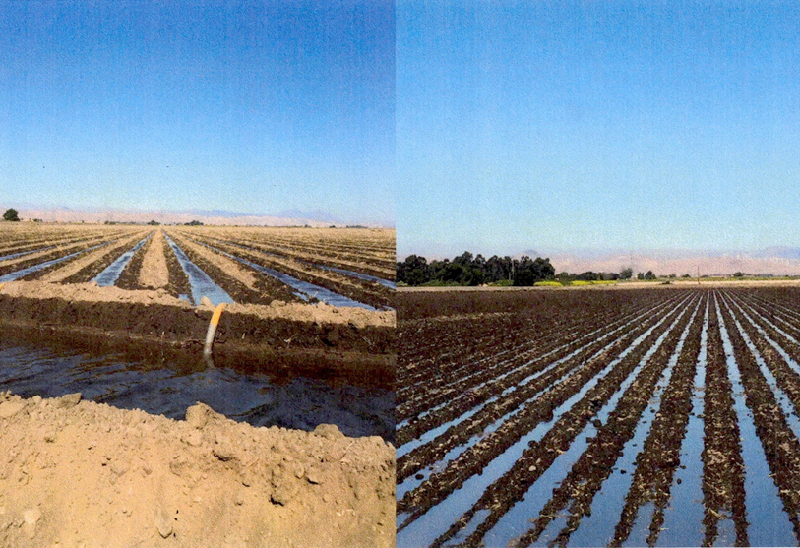
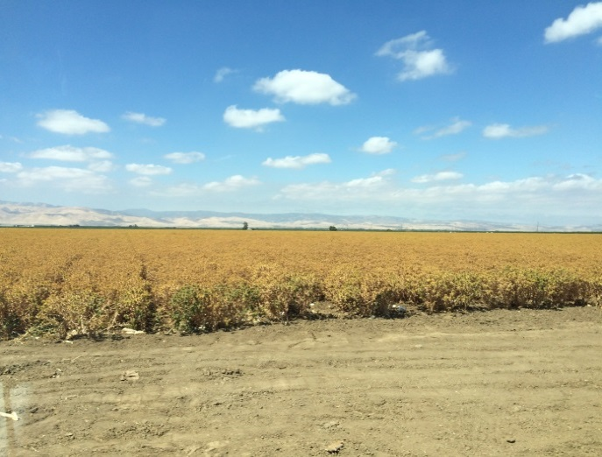
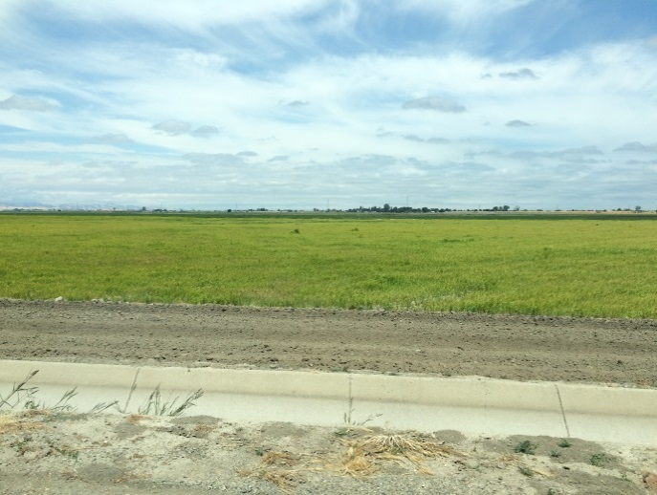
Examples
Irrigation with 60” beds
Irrigating with 30” beds
Crop Rotation
Safflower
Sudan

Slide 7
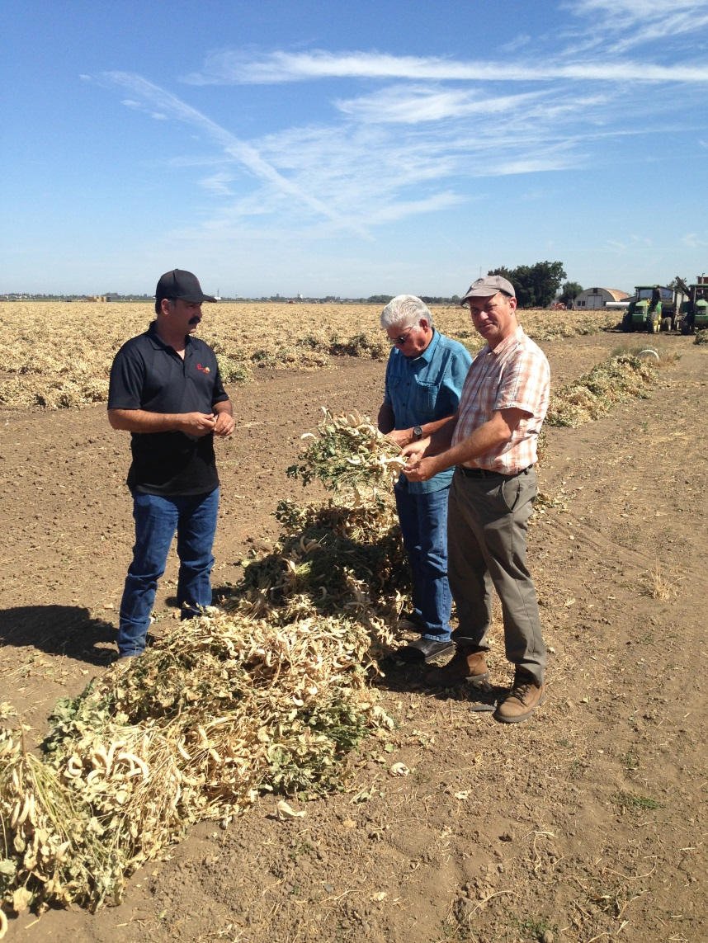
Verification Inspections
1st prioritized the larger plans in terms of total acreage
2nd visited smaller family owned and operated farms, often without much professional support
Findings:
Even a lawyer can learn a lot riding in a pickup with a farmer
Participants in the program operated to exceed the 25% target for reduced diversion
Peer relationships were supportive of success in the program
Farmers took pride in contributing to drought amelioration

Slide 8
Statistical Overview
Total acres in Central and South Delta: 268,000
Total acres enrolled in the diversion reduction program: 180,119¹
Number of conservation plans submitted: 217
Acre-feet reported as diverted in summer 2013: 486,754
Acre-feet reported as diverted in summer 2015: 333,082
Reductions in diversions reported from program implementation: 153,672
Percent of reduced diversions reported: 32%
Acre-feet diverted per acre of irrigated land in summer 2013: 2.70
Acre-feet diverted per acre of irrigated land in summer 2015: 1.91
Disclaimer: The data compiled and summarized in the report are based on filings prepared by program participants and their advisors. The vast majority of in-Delta diversions are not measured, so water diversion and use are estimated with a variety of techniques at varying levels of accuracy.
¹ A total of 15,005 acres enrolled in the program are located in Contra Costa County, outside the Central and South Delta Water Agencies boundaries.

Slide 9
Observations from the Program
Cooperative agreements produced results and reduced conflict
No verification of water rights
Riparian curtailments were narrowly avoided
Apparent influence on Delta outflow
Long-term concerns over salt build-up
Need for improved measurement of diversions
Managing conflicting riparian and priority systems in extreme shortage exposed fissures in our water system

Slide 10
Questions?

