Slide 1
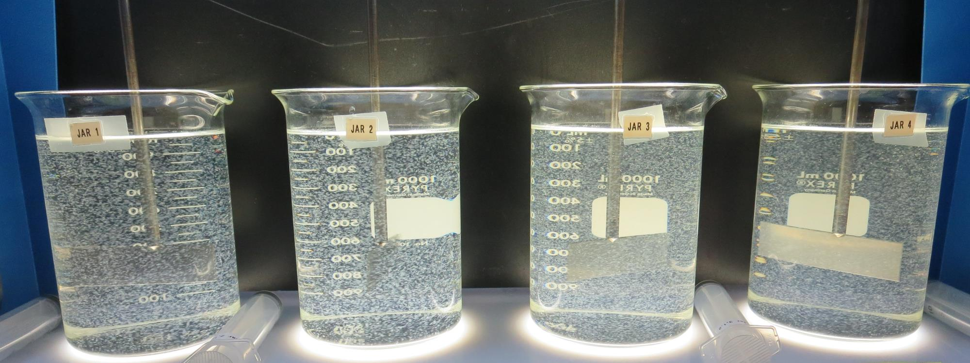
Veterans Home Roberts Filtration Treatment Plant CA2810008 Napa County Jar Test
by Guy Schott, P.E.
March 19, 2019

Slide 2
Rector Reservoir Water Characteristics March 19, 2019
Source
Turbidity: 8.8 NTU
UVT: 71.6%
UVA: 0.145/cm
0.4 um Filtered
UVT: 73.5%
UVA: 0.134/cm

Slide 3
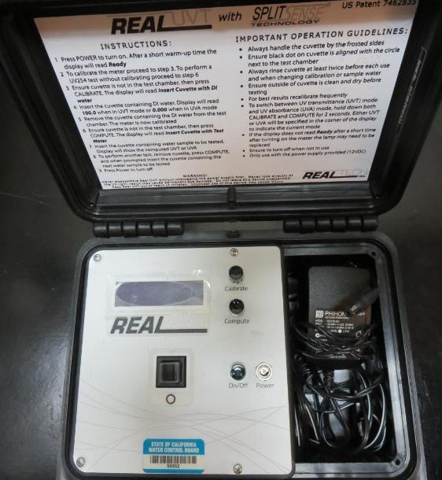
UVT/UVA
UV transmittance (UVT) is a measurement of the amount of ultraviolet light (commonly at 254 nm due to its germicidal effect) that passes through a water sample compared to the amount of light that passes through a pure water sample. The measurement is expressed as a percentage, % UVT.
%UVT = 10^{(-UVA)} x 100%
UV absorbance (UVA) is calculated as a relative measure of the amount of light absorbed by a water sample compared with the amount of light absorbed by a pure water sample.
UVA = -log(%UVT/100)

Slide 4
Applied Coagulants for Jar Testing
AH-710 (Garratt Callahan)
ACH/1,2-Ethanediamine, Polymer w/(Chloromethlyl) Oxirane & N-Methylmethanamine (Epichlorohydrin Dimethylamine Copolymer)
SG-1.31
ULTRION 8157 (Nalco Co.)
10-30% Calcium Chloride
10-30% Aluminum Hydroxychloride
1-5% Aluminum Phosphate
SG = 1.27
7066 (Garratt Callahan)
10 – 30% Poly Aluminum Hydroxychloride Sulfate
50% Basicity
SG = 1.2
Pro Pac 9800 (NTU Technologies)
50% Aluminum Chlorohydrate (ACH)
50% Water
SG = 1.34
CAT-FLOC 8108 PLUS (Nalco Co.)
SG = 1.018 – 1.058

Slide 5
Coagulant Information
Unless stated otherwise, all coagulant doses are reported as Product (100% strength). Aluminum sulfate is reported as Alum.
Preparation of coagulant stock solutions are generally 1.0 and/or 0.1 percent strength using 100 and/or 200 mL volumetric flasks.
Finnpipette F2 variable volume pipette, capacity 100-1000 micro liters is used for stock solution preparation and coagulant aid jar test dosing.
Finnpipette F2 variable volume pipette, capacity 0.5-5 mL is used for primary coagulant jar test dosing.

Slide 6
Veterans Home: Jar Test 1-8 Results
Jar # | 200 RPM Flash Mix seconds | 30 RPM Floc Duration minutes | 9800 mg/L | AH-710 mg/L | Filtrate NTU | Filtrate %UVT | Filtrate UVA/cm
J1 | 60 | 10 | 9.3 | 0 | 1.5 | 88.6 | 0.053
J2 | 60 | 10 | 12 | 0 | 0.55 | 92.5 | 0.034
J3 | 60 | 10 | 15 | 0 | 1.14 | 91.9 | 0.037
J4 | 60 | 10 | 18 | 0 | 0.08 | 95.1 | 0.022
J5 | 60 | 10 | 0 | 9 | 1.52 | 88.9 | 0.051
J6 | 60 | 10 | 0 | 12 | 0.80 | 92.9 | 0.032
J7 | 60 | 10 | 0 | 15 | 0.70 | 93.5 | 0.029
J8 | 60 | 10 | 0 | 18 | 0.08 | 95.1 | 0.022

Slide 7
Veterans Home: Jar Test 9-16 Results
Jar # | 200 RPM Flash Mix seconds | 30 RPM Floc Duration minutes | 9800 mg/L | AH-710 mg/L | Filtrate NTU | Filtrate %UVT | Filtrate UVA/cm
J9 | 60 | 10 | 9 | 0.9 | 1.8 | 89.5 | 0.048
J10 | 60 | 10 | 12 | 1.2 | 1.6 | 90.9 | 0.041
J11 | 60 | 10 | 15 | 1.5 | 0.32 | 94.6 | 0.024
J12 | 60 | 10 | 18 | 1.8 | 0.79 | 94.0 | 0.027
J13 | 60 | 10 | 12 | 0 | 0.27 | 93.6 | 0.029
J14 | 60 | 10 | 15 | 0 | 0.56 | 93.6 | 0.029
J15 | 60 | 10 | 18 | 0 | 0.74 | 94.0 | 0.027
J16 | 60 | 10 | 21 | 0 | 0.07 | 96.1 | 0.017

Slide 8
Veterans Home: Jar Test 17-20 Results
Jar # | 200 RPM Flash Mix seconds | 30 RPM Floc Duration minutes | 9800 mg/L | AH-710 mg/L | Filtrate NTU | Filtrate %UVT | Filtrate UVA/cm
J17 | 60 | 10 | 0 | 18 | 0.98 | 93.6 | 0.029
J18 | 60 | 10 | 0 | 21 | 2.3 | n/a | n/a
J19 | 60 | 10 | 21 | 0 | 3.9 | 86.8 | 0.061
J20 | 60 | 10 | 24 | 0 | 0.46 | 95.3 | 0.021

Slide 9
Veterans Home: Jar Test 21-28 Results
Jar # | 200 RPM Flash Mix seconds | 30 RPM Floc Duration minutes | ULTRION 8157 mg/L | Filtrate NTU | Filtrate %UVT | Filtrate UVA/cm | Settle NTU 25 min
J21 | 60 | 10 | 18 | 3.5 | 83.4 | 0.079 | 9.1
J22 | 60 | 10 | 21 | 1.2 | 87.9 | 0.056 | 8.6
J23 | 60 | 10 | 24 | 1.2 | 88.3 | 0.054 | 6.5
J24 | 60 | 10 | 27 | 0.82 | 89.1 | 0.050 | 4.0
J25 | 60 | 10 | 31 | 0.47 | 90.5 | 0.043 | 2.6
J26 | 60 | 10 | 34 | 0.16 | 91.7 | 0.038 | 2.3
J27 | 60 | 10 | 37 | 0.31 | 91.6 | 0.038 | 2.3
J28 | 60 | 10 | 40 | 0.23 | 92.2 | 0.035 | 2.3

Slide 10
Veterans Home: Jar Test 29-32 Results
Jar # | 200 RPM Flash Mix seconds | 30 RPM Floc Duration minutes | ULTRION 8157 mg/L | Filtrate NTU | Filtrate %UVT | Filtrate UVA/cm | Settle NTU 25 min
J29 | 60 | 10 | 43 | 0.12 | 92.7 | 0.033 | 1.7
J30 | 60 | 10 | 46 | 0.07 | 92.8 | 0.032 | 1.6
J31 | 60 | 10 | 49 | 0.21 | 93.0 | 0.032 | 1.5
J32 | 60 | 10 | 52 | 0.22 | 92.9 | 0.032 | 1.9

Slide 11
Veterans Home: Jar Test 33-34 Results
Jar # | 200 RPM Flash Mix seconds | 30 RPM Floc Duration minutes | NaOCl mg/L | ULTRION 8157 mg/L | Filtrate NTU | Filtrate %UVT | Filtrate UVA/cm | Settle NTU 25 min
J33 | 60 | 10 | 2 | 43 | 0.29 | 92.3 | 0.035 | 1.7
J34 | 60 | 10 | 2 | 46 | 0.10 | 92.9 | 0.032 | 1.6

Slide 12
Veterans Home: Jar Test 35-37 Results
Jar # | 200 RPM Flash Mix seconds | 30 RPM Floc Duration minutes | CAT-FLOC 8108 mg/L | ULTRION 8157 mg/L | Filtrate NTU | Filtrate %UVT | Filtrate UVA/cm | Settle NTU 25 min
J35 | 60 | 10 | 3 | 43 | 0.16 | 93.2 | 0.031 | 2.9
J36 | 60 | 10 | 3 | 46 | 0.17 | 93.4 | 0.030 | 3.7
J37 | 60 | 5 | - | 46 | 0.09 | 93.0 | 0.032 | 3.1

Slide 13
Jars 1-4 Test Flash Mix 60 Sec (200 RPM) Floc Mix 10 min (30 RPM) Applied Coagulant 9800

Slide 14
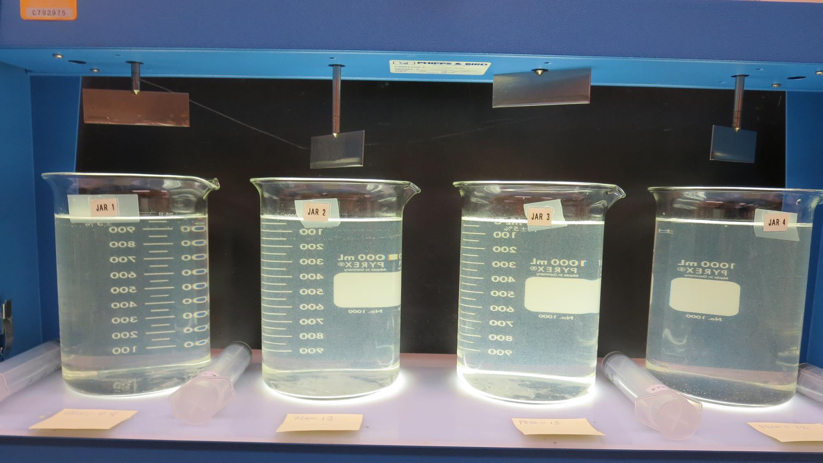
Jars 1-4: End of 10-minute flocculation (30 RPM) duration.
9.3 mg/L 9800
Filtrate 1.5 NTU
UVT: 88.6%
UVA: 0.053/cm
12 mg/L 9800
Filtrate 0.55 NTU
UVT: 92.5%
UVA: 0.034/cm
15 mg/L 9800
Filtrate 1.14 NTU
UVT: 91.9%
UVA: 0.037/cm
18 mg/L 9800
Filtrate 0.08 NTU
UVT: 95.1%
UVA: 0.022/cm

Slide 15
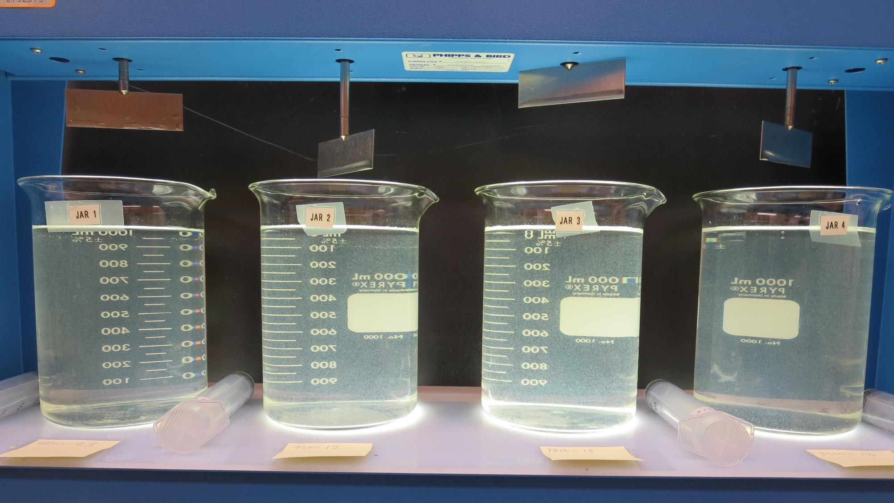
Jars 1-4: After 5 min of settling, 25 mL is syringed for filterability and %UVT/UVA

Slide 16
Jars 5-8 Test Flash Mix 60 Sec (200 RPM) Floc Mix 10 min (30 RPM) Applied Coagulant AH-710

Slide 17
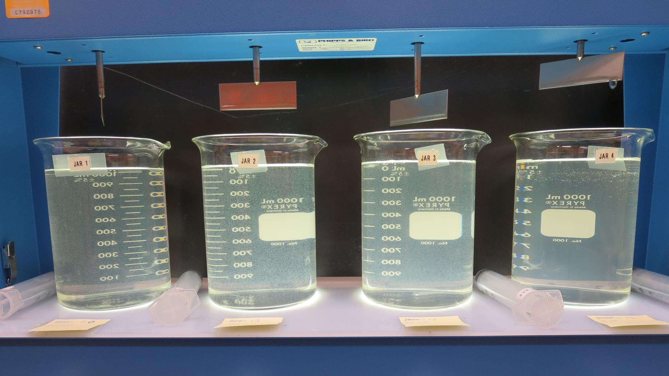
Jars 5-8: End of 10-minute flocculation (30 RPM) duration.
9 mg/L AH 710
Filtrate 1.5 NTU
UVT: 88.9%
UVA: 0.051/cm
12 mg/L AH 710
Filtrate 0.8 NTU
UVT: 92.9%
UVA: 0.032/cm
15 mg/L AH 710
Filtrate 0.7 NTU
UVT: 93.5%
UVA: 0.029/cm
18 mg/L AH 710
Filtrate 0.08 NTU
UVT: 95.1%
UVA: 0.022/cm

Slide 18
Jars 9-12 Test Flash Mix 60 Sec (200 RPM) Floc Mix 10 min (30 RPM) Applied Coagulants 9800/AH-710

Slide 19
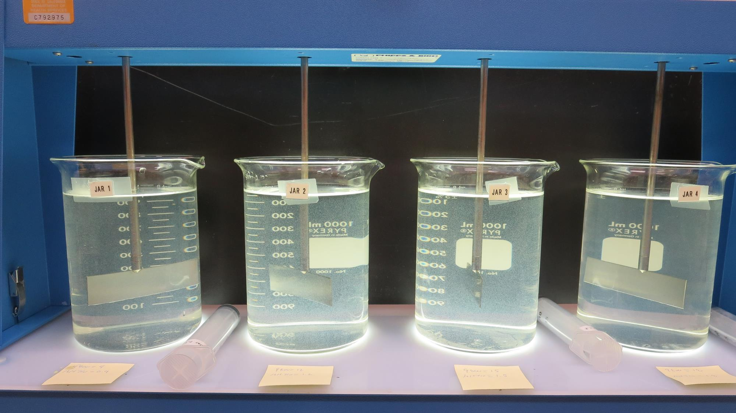
Jars 9-12: End of 10-minute flocculation (30 RPM) duration.
9 mg/L 9800
0.9 mg/L AH 710
Filtrate 1.8 NTU
UVT: 89.5%
UVA: 0.048/cm
12 mg/L 9800
1.2 mg/L AH 710
Filtrate 1.6 NTU
UVT: 90.9%
UVA: 0.041/cm
15 mg/L 9800
1.5 mg/L AH 710
Filtrate 0.32 NTU
UVT: 94.6%
UVA: 0.024/cm
18 mg/L 9800
1.8 mg/L AH 710
Filtrate 0.79 NTU
UVT: 94.0%
UVA: 0.027/cm

Slide 20
Jars 13-16 Test Flash Mix 60 Sec (200 RPM) Floc Mix 10 min (30 RPM) Applied Coagulant 7016

Slide 21
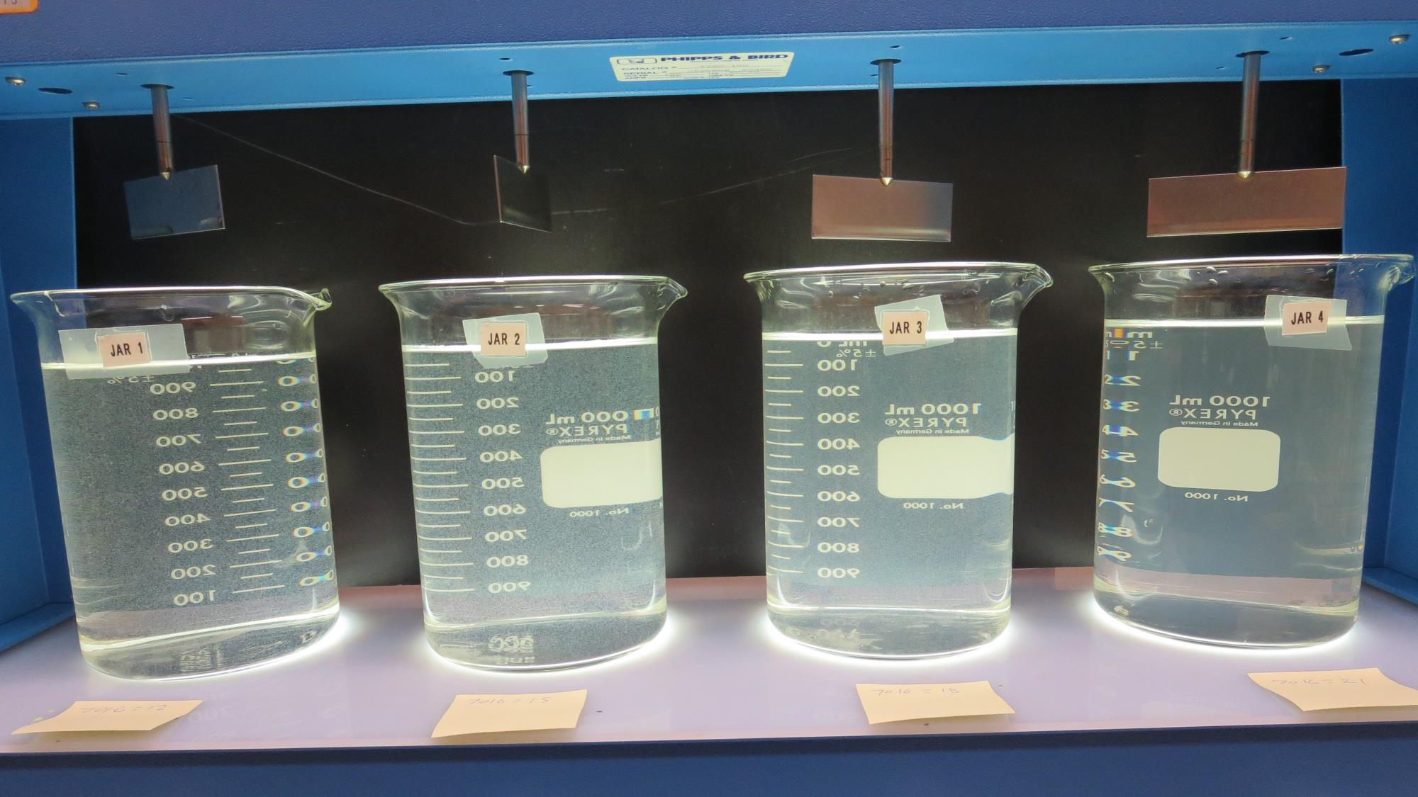
Jars 13-16: End of 10-minute flocculation (30 RPM) duration.
12 mg/L 7016
Filtrate 0.27 NTU
UVT: 93.6%
UVA: 0.029/cm
15 mg/L 7016
Filtrate 0.56 NTU
UVT: 93.6%
UVA: 0.029/cm
18 mg/L 7016
Filtrate 0.74 NTU
UVT: 94.0%
UVA: 0.027/cm
21 mg/L 7016
Filtrate 0.07 NTU
UVT: 96.1%
UVA: 0.017/cm

Slide 22
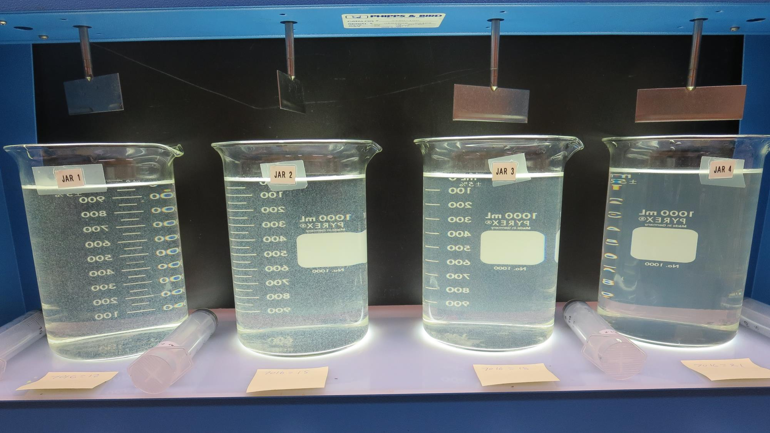
Jars 13-16: After 5 min of settling, 25 mL is syringed for filterability and %UVT/UVA
12 mg/L 7016
Filtrate 0.27 NTU
UVT: 93.6%
UVA: 0.029/cm
15 mg/L 7016
Filtrate 0.56 NTU
UVT: 93.6%
UVA: 0.029/cm
18 mg/L 7016
Filtrate 0.74 NTU
UVT: 94.0%
UVA: 0.027/cm
21 mg/L 7016
Filtrate 0.07 NTU
UVT: 96.1%
UVA: 0.017/cm

Slide 23
Jars 17-20 Test Flash Mix 60 Sec (200 RPM) Floc Mix 10 min (30 RPM) Applied Coagulants AH-710 7016

Slide 24
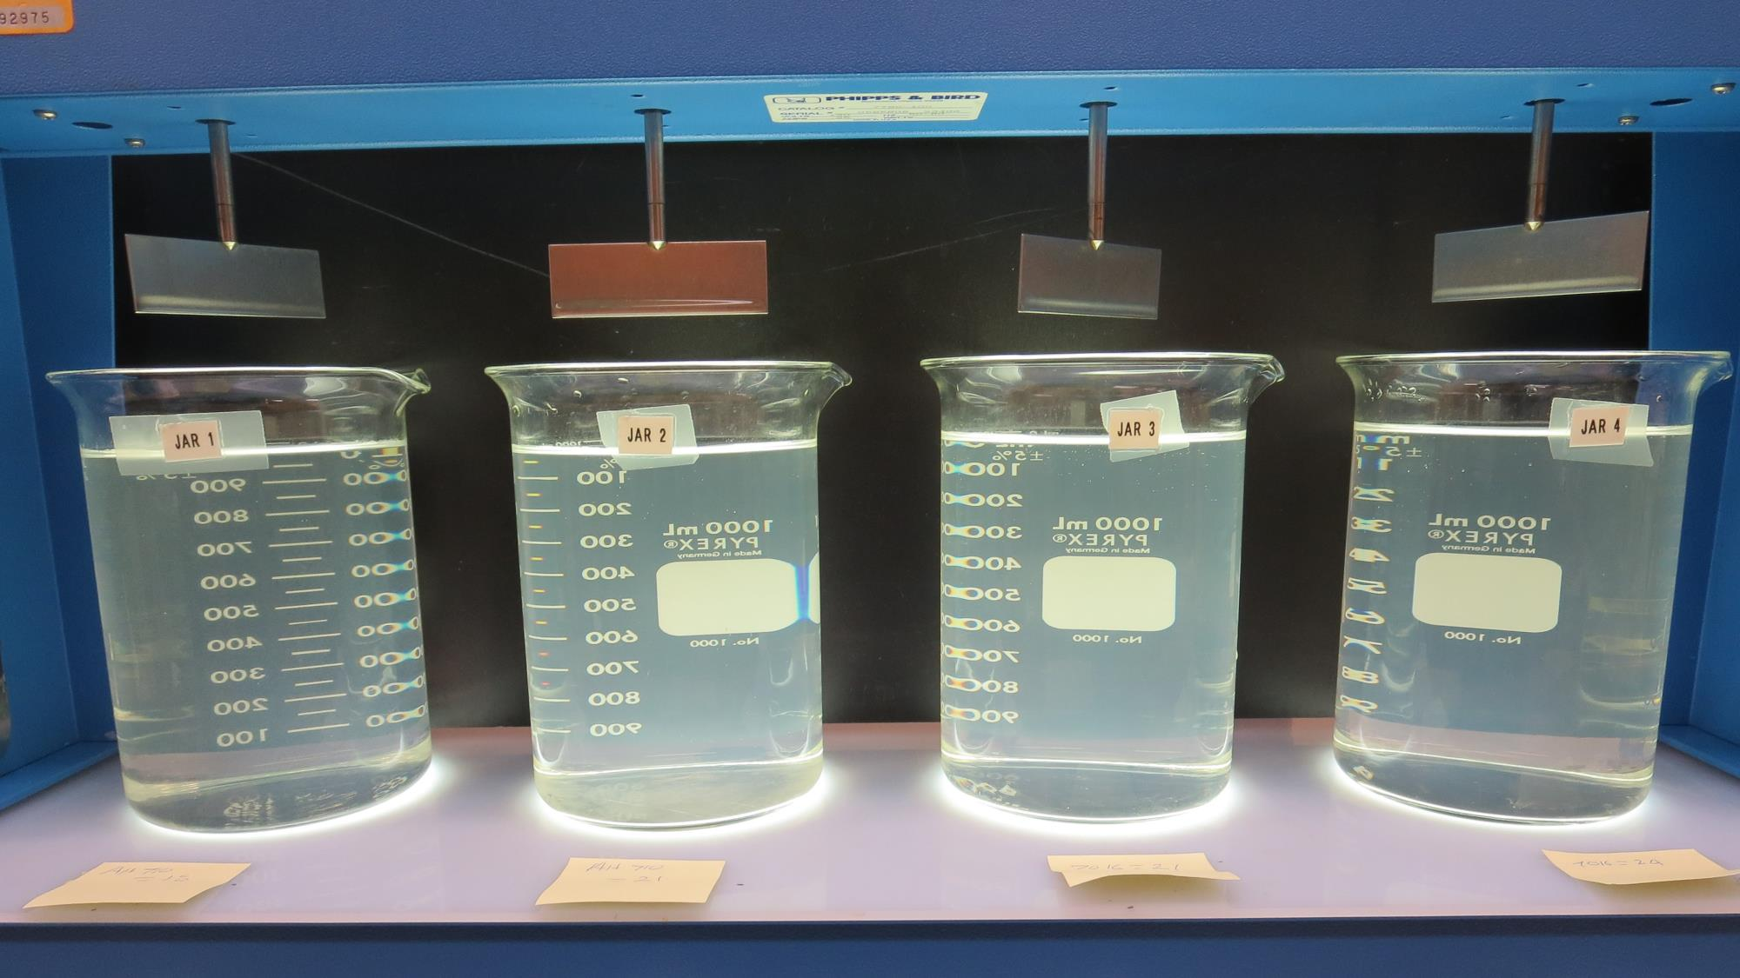
Jars 17-20: End of 10-minute flocculation (30 RPM) duration.
18 mg/L AH 710
Filtrate 0.98 NTU
UVT: 93.6%
UVA: 0.029/cm
21 mg/L AH 710
Filtrate 2.3 NTU
UVT: -%
UVA: -/cm
21 mg/L 7016
Filtrate 3.9 NTU
UVT: 86.8%
UVA: 0.061/cm
24 mg/L 7016
Filtrate 0.46 NTU
UVT: 95.3%
UVA: 0.021/cm

Slide 25
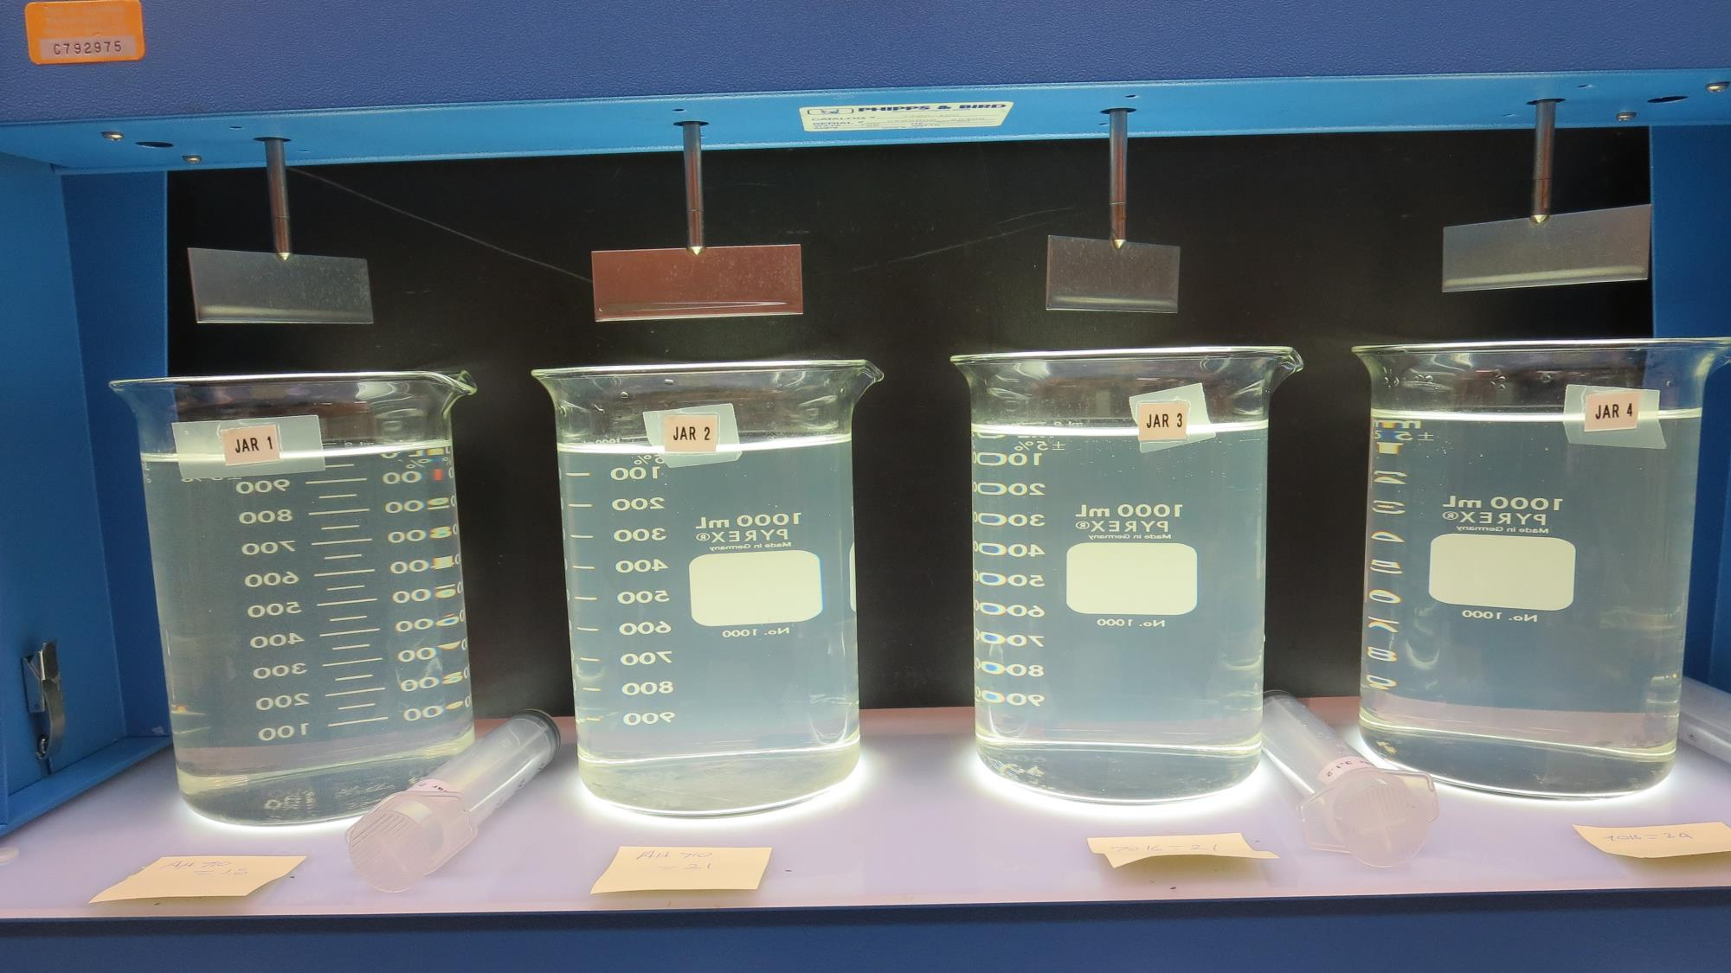
Jars 17-20: After 5 min of settling, 25 mL is syringed for filterability and %UVT/UVA
18 mg/L AH 18
Filtrate 0.98 NTU
UVT: 93.6%
UVA: 0.029/cm
21 mg/L AH 18
Filtrate 2.3 NTU
UVT: -%
UVA: -/cm
21 mg/L 7016
Filtrate 3.9 NTU
UVT: 86.8%
UVA: 0.061/cm
24 mg/L 7016
Filtrate 0.46 NTU
UVT: 95.3%
UVA: 0.021/cm

Slide 26
Jars 21-24 Test Flash Mix 60 Sec (200 RPM) Floc Mix 10 min (30 RPM) Applied Coagulant ULTRION 8157

Slide 27
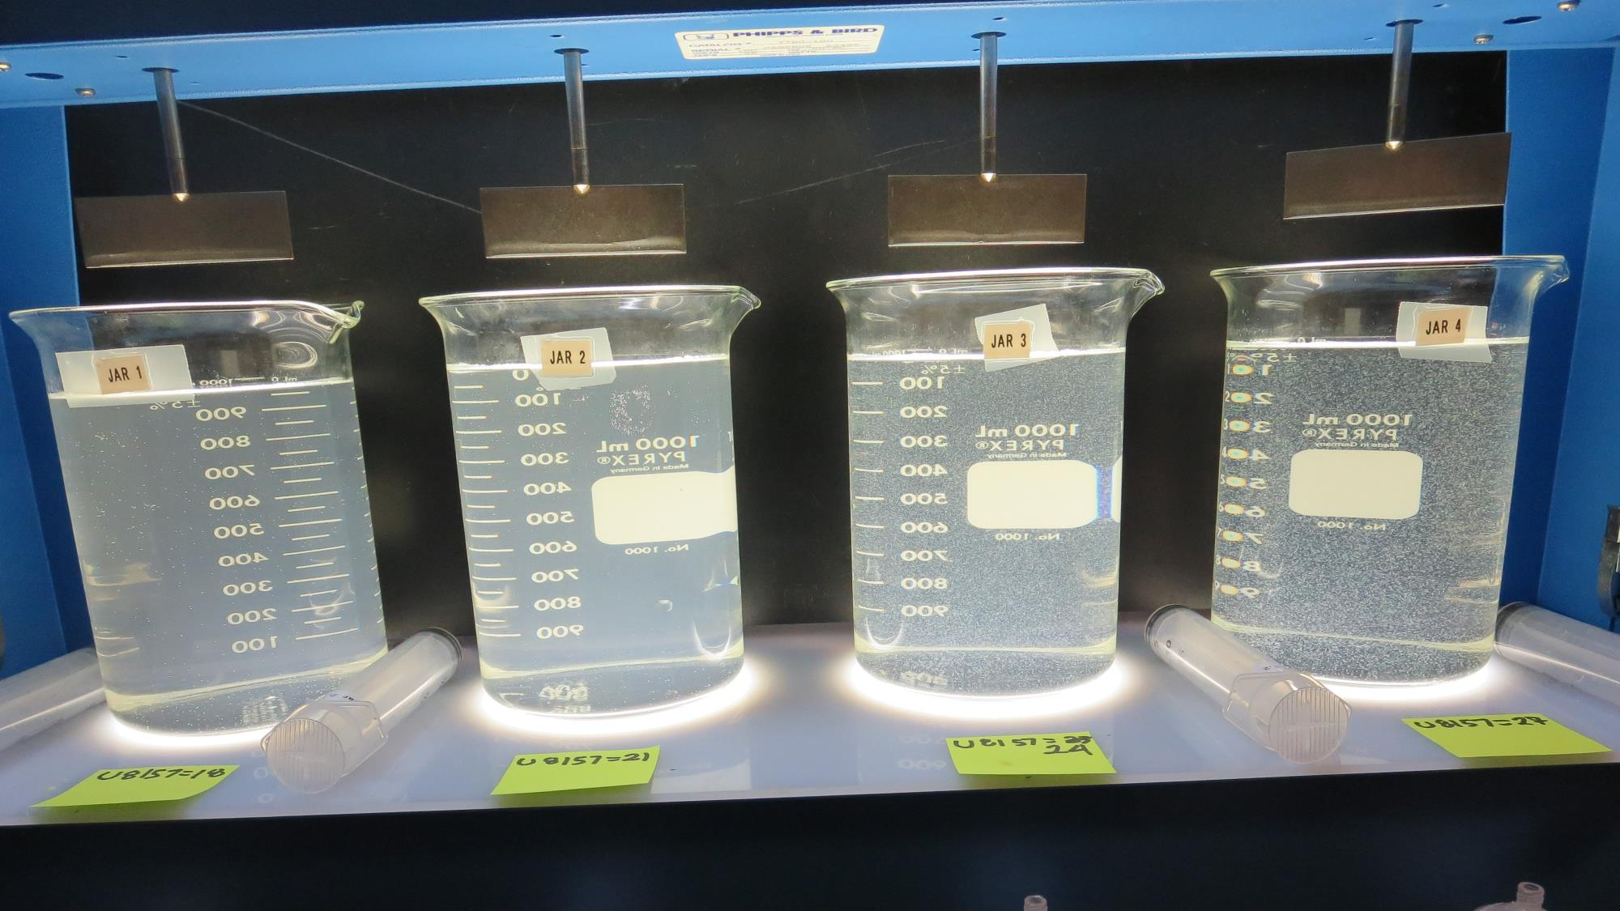
Jars 21-24: End of 10-minute flocculation (30 RPM) duration.
18 mg/L ULTRION 8157
Filtrate 3.5 NTU
UVT: 83.4%
UVA: 0.079/cm
Settled: 9.1 NTU
21 mg/L ULTRION 8157
Filtrate 1.2 NTU
UVT: 87.9%
UVA: 0.056/cm
Settled: 8.6 NTU
24 mg/L ULTRION 8157
Filtrate 1.2 NTU
UVT: 88.3%
UVA: 0.054/cm
Settled: 6.5 NTU
27 mg/L ULTRION 8157
Filtrate 0.82 NTU
UVT: 89.1%
UVA: 0.050/cm
Settled: 4 NTU

Slide 28
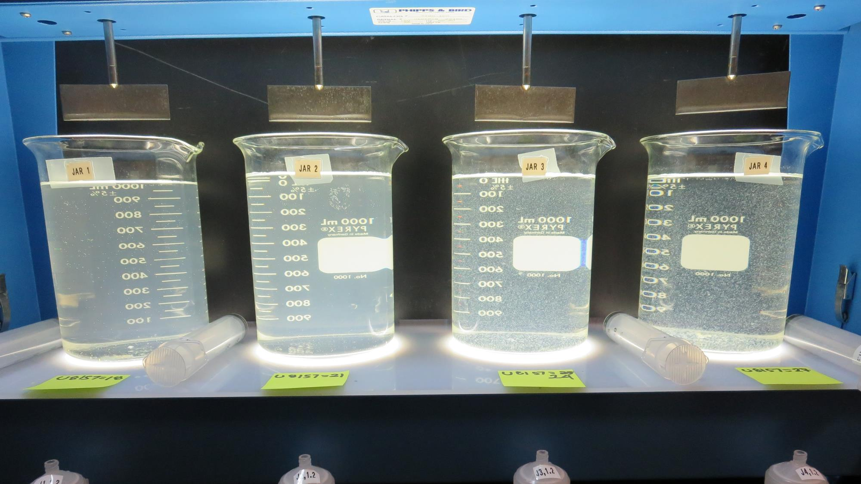
Jars 21-24: After 5 min of settling, 25 mL is syringed for filterability and %UVT/UVA

Slide 29
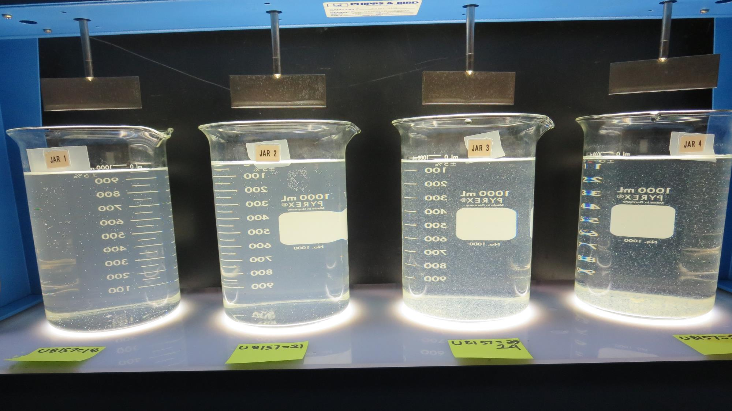
Jars 21-24: After 25-minutes of settling, settled water turbidity is taken.
18 mg/L ULTRION 8157
Filtrate 3.5 NTU
UVT: 83.4%
UVA: 0.079/cm
Settled: 9.1 NTU
21 mg/L ULTRION 8157
Filtrate 1.2 NTU
UVT: 87.9%
UVA: 0.056/cm
Settled: 8.6 NTU
24 mg/L ULTRION 8157
Filtrate 1.2 NTU
UVT: 88.3%
UVA: 0.054/cm
Settled: 6.5 NTU
27 mg/L ULTRION 8157
Filtrate 0.82 NTU
UVT: 89.1%
UVA: 0.050/cm
Settled: 4 NTU

Slide 30
Jars 25-28 Test Flash Mix 60 Sec (200 RPM) Floc Mix 10 min (30 RPM) Applied Coagulant ULTRION 8157

Slide 31
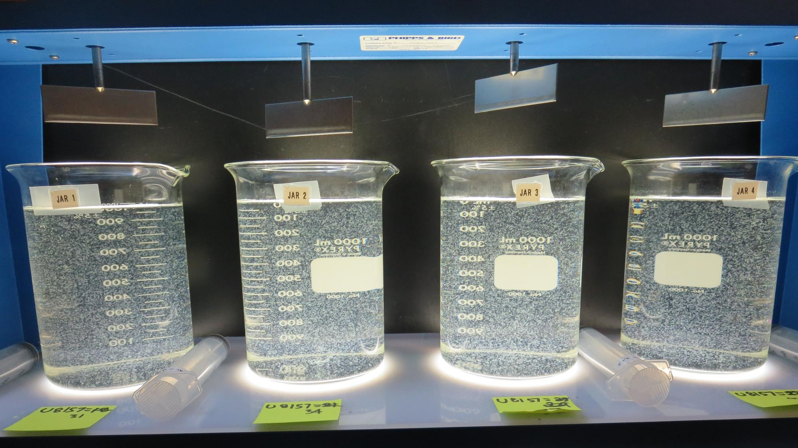
Jars 25-28: End of 10-minute flocculation (30 RPM) duration.
31 mg/L ULTRION 8157
Filtrate 0.47 NTU
UVT: 90.5%
UVA: 0.043/cm
Settled: 2.6 NTU
34 mg/L ULTRION 8157
Filtrate 0.16 NTU
UVT: 91.7%
UVA: 0.038/cm
Settled: 2.3 NTU
37 mg/L ULTRION 8157
Filtrate 0.31 NTU
UVT: 91.6%
UVA: 0.038/cm
Settled: 2.3 NTU
40 mg/L ULTRION 8157
Filtrate 0.23 NTU
UVT: 92.2%
UVA: 0.035/cm
Settled: 2.3 NTU

Slide 32
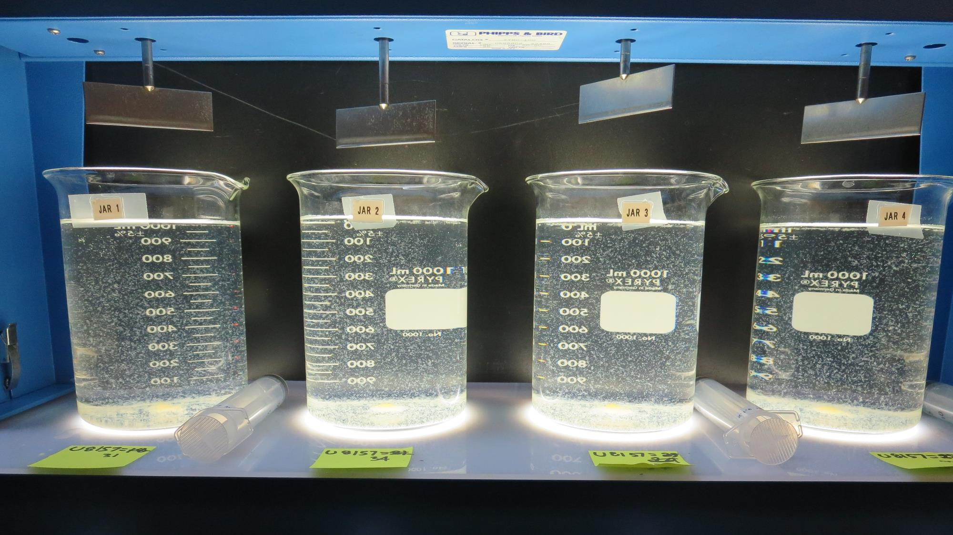
Jars 25-28: After 5 min of settling, 25 mL is syringed for filterability and %UVT/UVA

Slide 33
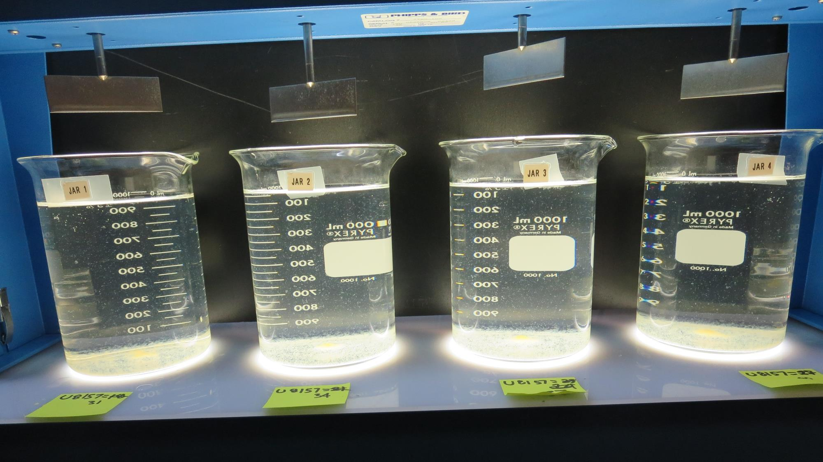
Jars 25-28: After 25-minutes of settling, settled water turbidity is taken.
31 mg/L ULTRION 8157
Filtrate 0.47 NTU
UVT: 90.5%
UVA: 0.043/cm
Settled: 2.6 NTU
34 mg/L ULTRION 8157
Filtrate 0.16 NTU
UVT: 91.7%
UVA: 0.038/cm
Settled: 2.3 NTU
37 mg/L ULTRION 8157
Filtrate 0.31 NTU
UVT: 91.6%
UVA: 0.038/cm
Settled: 2.3 NTU
40 mg/L ULTRION 8157
Filtrate 0.23 NTU
UVT: 92.2%
UVA: 0.035/cm
Settled: 2.3 NTU

Slide 34
Jars 29-32 Test Flash Mix 60 Sec (200 RPM) Floc Mix 10 min (30 RPM) Applied Coagulant ULTRION 8157

Slide 35
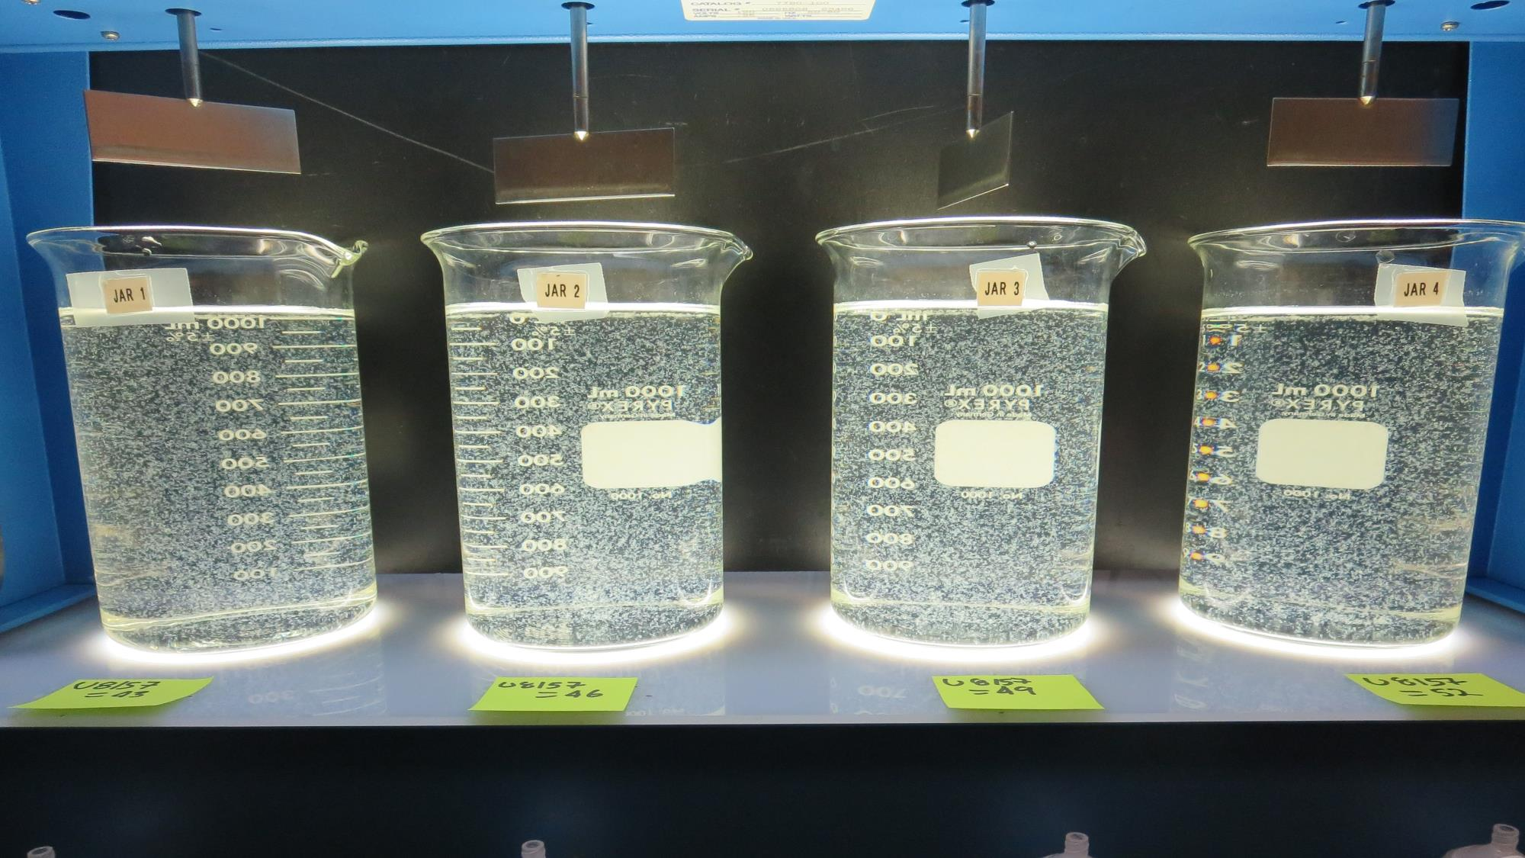
Jars 29-32: End of 10-minute flocculation (30 RPM) duration.
43 mg/L ULTRION 8157
Filtrate 0.12 NTU
UVT: 92.7%
UVA: 0.033/cm
Settled: 1.6 NTU
46 mg/L ULTRION 8157
Filtrate 0.07 NTU
UVT: 92.8%
UVA: 0.032/cm
Settled: 1.6 NTU
49 mg/L ULTRION 8157
Filtrate 0.21 NTU
UVT: 93.0%
UVA: 0.032/cm
Settled: 1.5 NTU
52 mg/L ULTRION 8157
Filtrate 0.22 NTU
UVT: 92.2%
UVA: 0.032/cm
Settled: 1.9 NTU

Slide 36
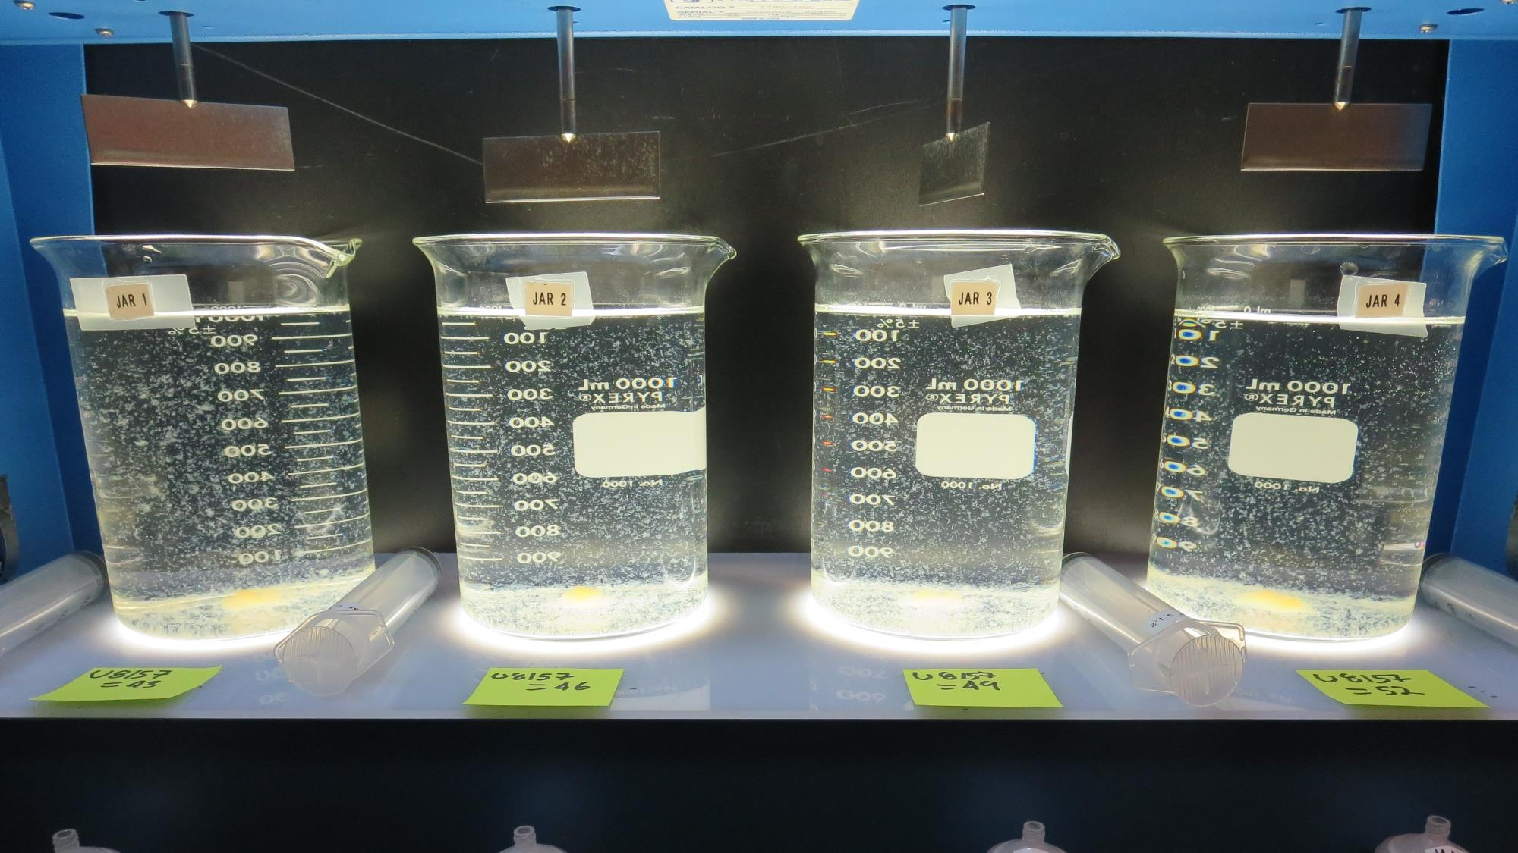
Jars 29-32: After 5 min of settling, 25 mL is syringed for filterability and %UVT/UVA

Slide 37
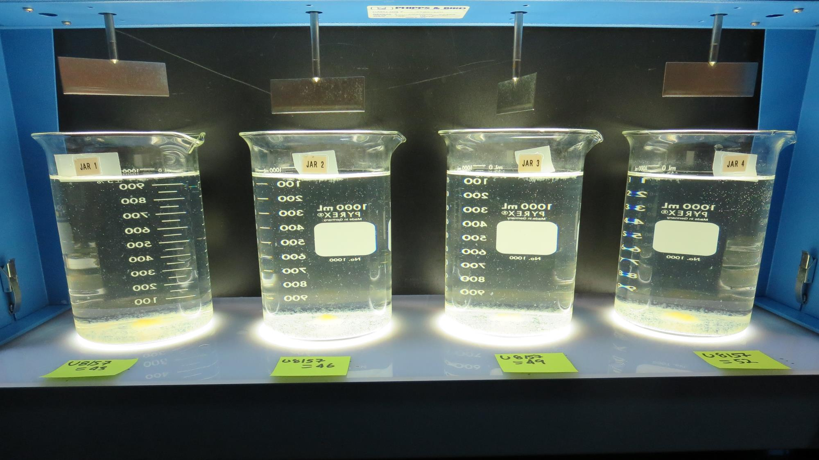
Jars 29-32: After 25-minutes of settling, settled water turbidity is taken.
43 mg/L ULTRION 8157
Filtrate 0.12 NTU
UVT: 92.7%
UVA: 0.033/cm
Settled: 1.6 NTU
46 mg/L ULTRION 8157
Filtrate 0.07 NTU
UVT: 92.8%
UVA: 0.032/cm
Settled: 1.6 NTU
49 mg/L ULTRION 8157
Filtrate 0.21 NTU
UVT: 93.0%
UVA: 0.032/cm
Settled: 1.5 NTU
52 mg/L ULTRION 8157
Filtrate 0.22 NTU
UVT: 92.2%
UVA: 0.032/cm
Settled: 1.9 NTU

Slide 38
Jars 33-36 Test Flash Mix 60 Sec (200 RPM) Floc Mix 10 min (30 RPM) Applied Coagulant ULTRION 8157 CAT-FLOC 8108 w/NaOCl

Slide 39
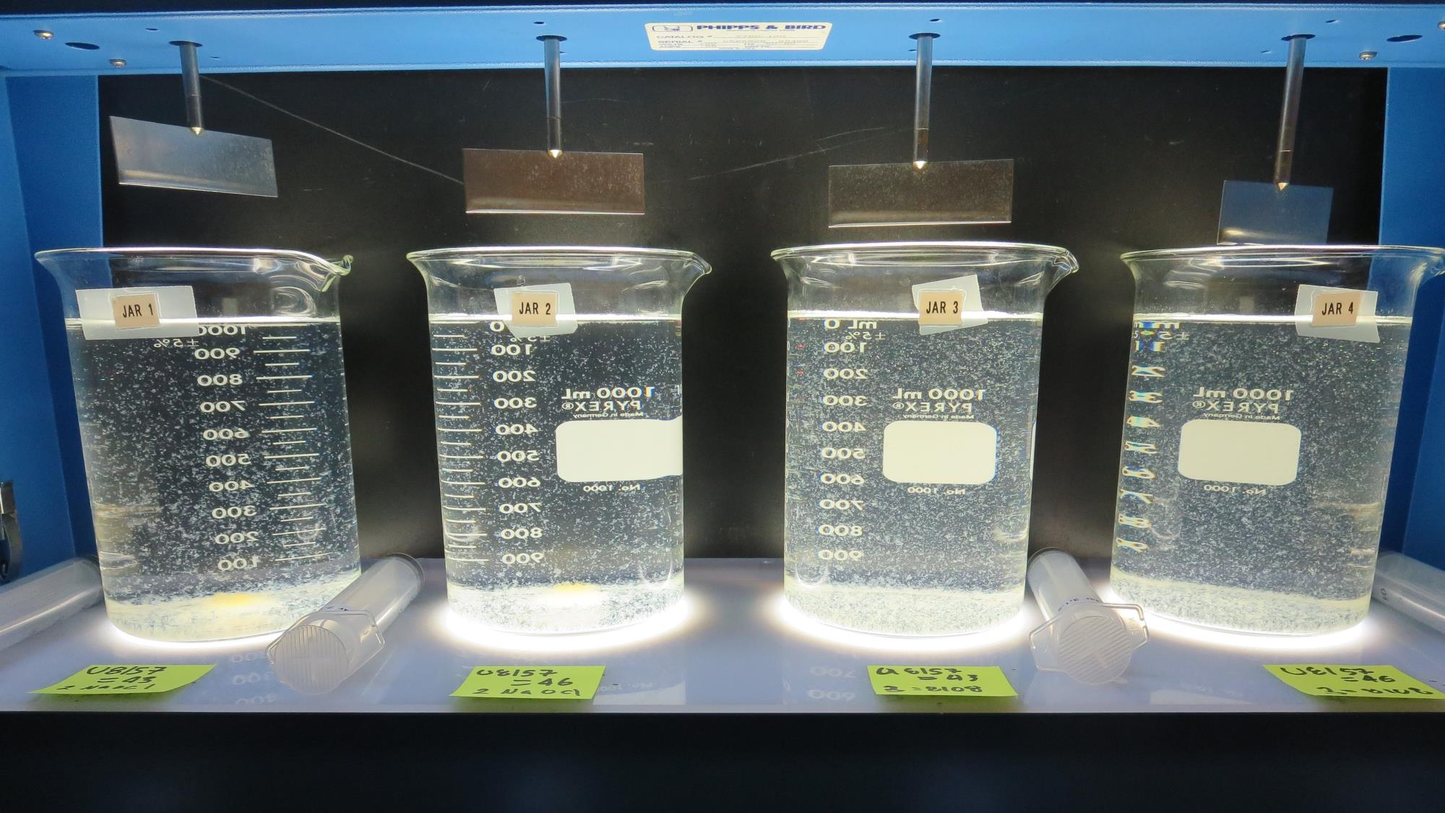
Jars 33-36: After 5 min of settling, 25 mL is syringed for filterability and %UVT/UVA

Slide 40
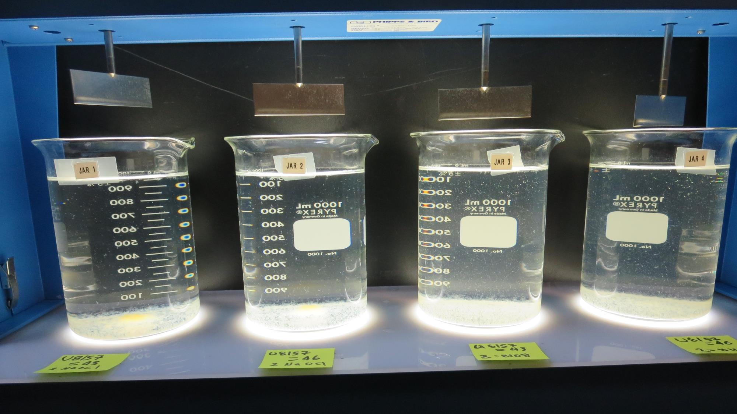
Jars 33-36: After 25-minutes of settling, settled water turbidity is taken.
2 mg/L NaOCl
43 mg/L ULTRION 8157
Filtrate 0.29 NTU
UVT: 92.3%
UVA: 0.035/cm
Settled: 1.7 NTU
2 mg/L NaOCl
46 mg/L ULTRION 8157
Filtrate 0.10 NTU
UVT: 92.9%
UVA: 0.032/cm
Settled: 1.6 NTU
43 mg/L ULTRION 8157
3 mg/L Cat-Floc 8108
Filtrate 0.16 NTU
UVT: 93.2%
UVA: 0.031/cm
Settled: 2.9 NTU
46 mg/L ULTRION 8157
3 mg/L Cat-Floc 8108
Filtrate 0.17 NTU
UVT: 93.4%
UVA: 0.030/cm
Settled: 3.7 NTU

Slide 41
Jars 37 Test Flash Mix 60 Sec (200 RPM) Floc Mix 5 min (30 RPM) Applied Coagulant ULTRION 8157

Slide 42
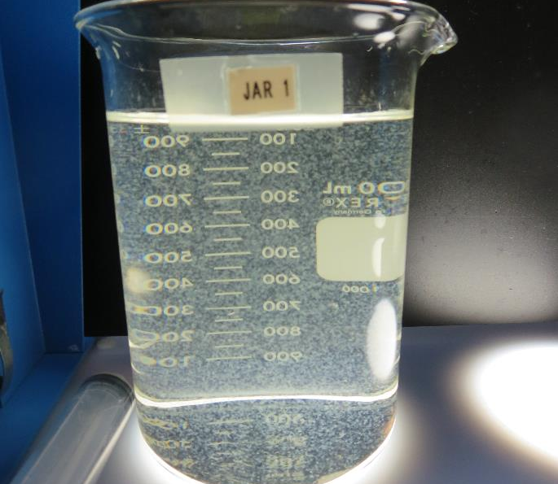
Jars 37: End of 10-minute flocculation (30 RPM) duration.
46 mg/L ULTRION 8157
Filtrate 0.09 NTU
UVT: 93.0%
UVA: 0.032/cm
Settled: 3.1 NTU

Slide 43
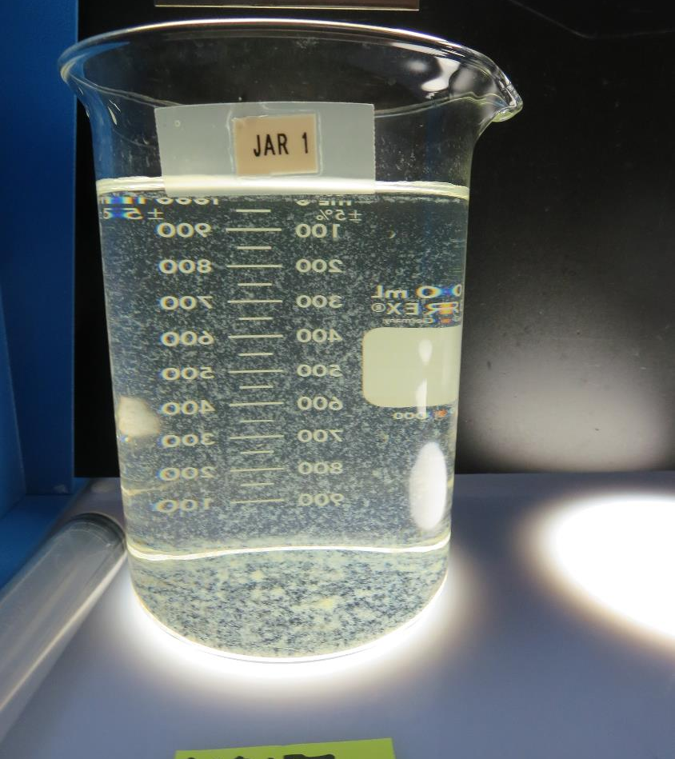
Jars 37: After 5 min of settling, 25 mL is syringed for filterability and %UVT/UVA

Slide 44
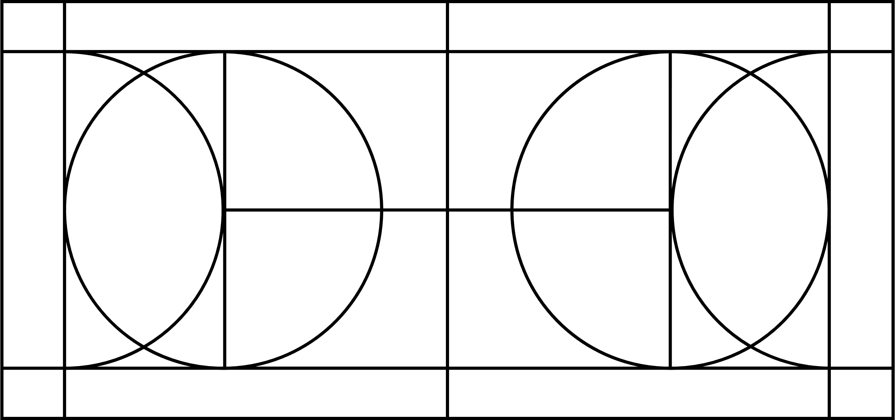
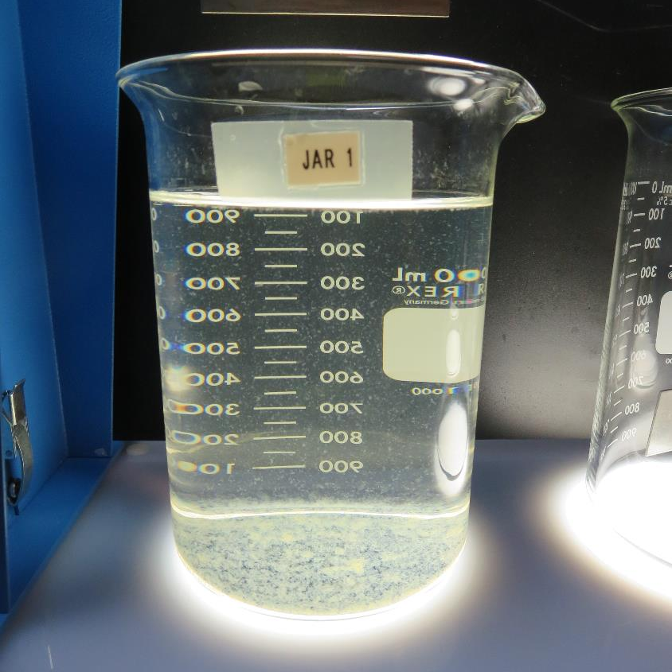
Jars 37: After 25-minutes of settling, settled water turbidity is taken.
46 mg/L ULTRION 8157
Filtrate 0.09 NTU
UVT: 93.0%
UVA: 0.032/cm
Settled: 3.1 NTU

Slide 45
Jar Testing for 1-Liter Jars: Procedures for Most Treatment Plants
Fill jars with source water prior to coagulant injection and set paddle speed at 30 rpm
Add chemicals (i.e., NaOCl, primary coagulant, coagulant aid) to each jar
Flash mix for 15-60 seconds (200 rpm)
Slow mix for 5 minutes (20-30 rpm)
Settled for 5 minutes. Syringe 25 mL from each jar taken 1-inch below surface (25 mL/12 sec rate)
Filtered through 1.2 um isopore membrane into cuvette drip rate, 15 mL/(50-90 sec)
Measure filtrate turbidity, chlorine residual and %UVT/UVA
Measure settled water turbidity after 25 minutes of total setting
Record all data

Slide 46
Jar Test Filterability Test Equipment
Turbidity Instrument
Syringe w/Luer-Lock Tip, 30 cc
(part#: 2225800, by Hach)
Swinnex Filter Holder, 25 mm (part#: SX0002500)
Isopore Membrane Filter, 1.2 um absolute
pore size,
Φ= 25 mm , thickness: 24 um,
hydrophilic polycarbonate membrane
(part #: RTTP02500)
Go to Sigma-Aldrich for laboratory supplies http://www.sigmaaldrich.com/united-states.html

Slide 47
Isopore Membrane Information
Categories | Information
trade name | Isopore
filter color | White
chemistry | Polycarbonate (PC)
water flow rate | Avg. 175 mL/min x cm² (typical results @ 10 psi)
media | Isopore®
wettability | Hydrophilic
porosity | 14.7%
pore size | 1.2 µm
bubble point at 23 °C | 1.0 bar, air with water
thickness | 24 µm
filter diameter (ø) | 25 mm
material size | polycarbonate, Hydrophilic, 1.2 µm, 25 mm, white, plain, 100

Slide 48
Isopore Membrane Background Information
The Isopore membrane is a polycarbonate, track-etched screen filter recommended for all analyses in which the sample is viewed on the surface of the membrane. The Isopore membrane is composed of polycarbonate film, which has a smooth, glass-like surface for clearer sample observation. The unique manufacturing process of the membrane ensures a precise pore diameter and a consistent pore size for accurate separation of samples by size. Matched-weight filters are not usually required because of low, constant tar and ash weights. Features & Benefits: Membrane structure retains particles on the surface, simplifying counting and analysis

Slide 49
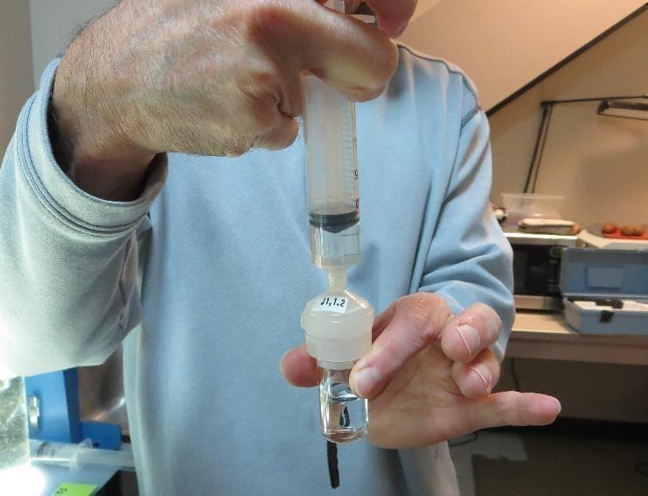
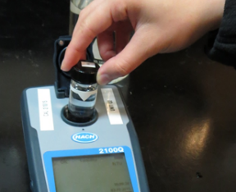
Jar Test - Filterability Test
Syringe ~ 25 mL from jar (after 5-minutes of settling)
Filter-to-waste 3-5 mL
Filter directly into clean cuvette
Measure turbidity
Note: Take several readings before recording final NTU results. Micro bubbles can adhere to glass causing false NTU readings. To remove bubbles, tilt cuvette up to 90 degrees.

Slide 50
Contact
Guy Schott, P.E.
State Water Resources Control Board
Division of Drinking Water
Santa Rosa, CA
Go to Stock Solution/Dose calculations/Jar Test Results for tools to download
www.waterboards.ca.gov/drinking_water/programs/districts/mendocino_district.html
Email: Guy Schott - Guy.Schott@waterboards.ca.gov
Office Number: 707-576-2732

