Slide 1
Jar Testing – Simple and Effective
Jar Testing – Simple and Effective
10/19/22
By Guy Schott, P.E.
CA State Water Resources Control Board
Division of Drinking Water

Slide 2
Presentation Overview
Jar Testing – Application
Lab Equipment/Materials
Analysis (Filterability, Filtrate UVT/UVA & Settleability)
Case Studies – Jar Testing
Coagulant overdosing (Filtrate NTU issues)
Kenya (Tenwek Hospital) – New Surface Water Treatment Facility – Jar Testing/Training for Plant Optimization

Slide 3
Applied Jar Testing - California
Conventional Treatment Plants
with
Media Filtration &
Membrane Filtration
Direct Filtration Plants
with
Media Filtration &
Membrane Filtration
Dissolved Air Flotation (DAF) with
Media Filtration &
Membrane Filtration
Trident & Roberts
Absorption/Contact
Media Filtration
Actiflo
(ballast sand)
with
Media Filtration
Alternative Technologies Roughing Contact Clarifier/Media Filtration &
Inline Filtration

Slide 4
Jar Testing - What’s Important
Simple and effective that provides supporting data - Don’t make it complicated
One set of procedures, methods and analysis that can be applied to most treatment plant technologies
Results that clearly reveal which pre-oxidant, coagulant(s) and dose that provides supporting data on
Filterability (floc strength, turbidity, and perceived head loss)
Dissolved organic carbon reduction (UVA surrogate)
Settleability (turbidity)
Confidence in your jar testing data that is transferable to full-scale plant operations

Slide 5
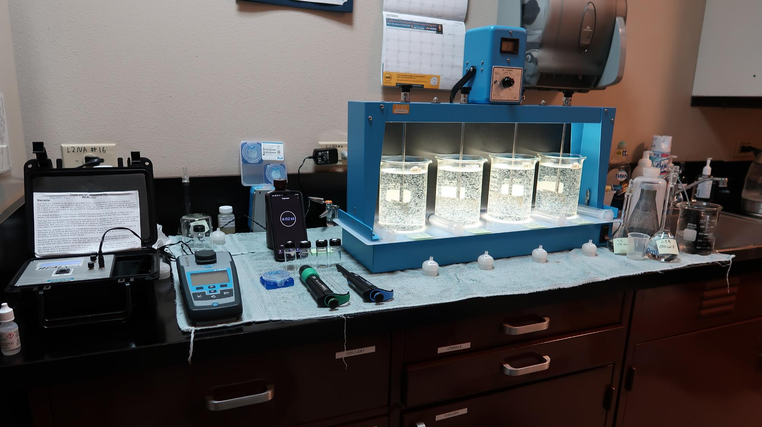
Lab
4-Jar Tester
Cuvettes
UVA/%UVT
Syringes
Stock
Solutions
Filters
(1.2 um absolute
Isopore membrane)
Pipettes
Turbidity

Slide 6
1. Filterability Analysis
Technique and analysis for predicting full-scale media filtration
Materials:
30 mL Syringe w/Luer-Lock Tip
Filter holder
1.2 um absolute Isopore membrane filter
Samples collected at end of flocculation period (post 0-5 minutes) to assess floc strength
Filtration and Analysis: 4 minutes per Jar to complete and record

Slide 7
2. UV-Absorption (UVA) Analysis
Surrogate for predicting indirect DOC reduction
Compares different jar testing coagulants and doses for best filtrate UVA
Systems with DBP issues, UVA measurements are critical for determining optimum coagulant and dose
Filtrate UVA Analysis: 1 minute per Jar to complete and record

Slide 8
3. Settleability Analysis
Relative performance measurement between jars based on coagulant type, dose and flocculation duration
Samples are collected 25 minutes from the end of the flocculation period for a 4-jar tester
Settleability Analysis: 1 minute per Jar to sample, complete and record
Note: Do not use settleability as the sole source of data to determine optimum coagulant/dose
No supporting data on filterability and DOC reduction

Slide 9
Sensitivity Performance Analysis Plant ID: HRCSD; Plant dose (Alum: 35 mg/L, pDADMAC: 6.0 mg/L)
Jar# | Alum (dry) mg/L | pDADMAC mg/L | Filtrate NTU | Floc Strength | Filtrate UVA/cm | Settle NTU
J1 | 35 | 0 | 1.06 | Very Weak | 0.084 | 13.3
J2 | 45 | 0 | 0.66 | Very Weak | 0.075 | 11.4
J3 | 55 | 0 | 0.27 | Weak | 0.059 | 8.7
J4 | 65 | 0 | 0.26 | Weak | 0.052 | 3.8
J5 | 35 | 6.0 | 0.10 | Good | 0.061 | 3.2
J6 | 45 | 6.0 | 0.05 | Strong | 0.049 | 2.7
J7 | 55 | 6.0 | 0.04 | Strong | 0.044 | 3.9
J8 | 65 | 6.0 | 0.05 | Strong | 0.041 | 3.6

Slide 10
UVA Application – Plant ID: NWC
90 ug/L TTHMs
63 ug/L HAA5
Filtrate: 0.04 NTU
Filtrate UVA: 0.046/cm
Settled: 2.0 NTU
59 ug/L TTHMs
40 ug/L HAA5
Filtrate: 0.04 NTU
Filtrate UVA: 0.030/cm
Settled: 2.0 NTU
35% UVA
Reduction

Slide 11
Audience Engagement Slide
Filterability and UVA analysis in jar testing provides information on
Coagulant underdosing
Coagulant overdosing
Floc strength
DOC reduction (UVA surrogate)
Potential disinfection by-product issues
All above
Answer (F) – All above

Slide 12
Jar Testing Procedures and Analysis
35 minutes to complete jar testing and analysis
Flash Mix, 200 RPM (20-30 sec) | 2. Flocculation, 20-30 RPM (5 min) | 3. Filterability & Filtrate UVA Analysis | 4. Settleability Analysis
Set 20-30 RPM Pipette coagulant(s) into each jar Start flash mix. | *Floc for 5 minutes. Lift paddles and lock | Sample at end of flocculation period for plants w/out settling. Wait 5 minutes for plants w/settling. | After 25 minutes of settling, sample and measure settled water turbidity.
*Note: Floc mixing duration longer than 5 minutes has no significant impact on filterability and filtrate UVA results.

Slide 13
Case Studies
Coagulant overdosing (Filtrate NTU issues)
Kenya (Tenwek Hospital) – New Surface Water Treatment Facility – Jar Testing/Training for Plant Optimization

Slide 14
Case 1: Filterability Analysis Coagulant Overdosing – Storm Event
50% of plant off-line for filter media change out
Source turbidity: 126 NTU, storm event
Operator doubles coagulant dose from 55 mg/L to: 110 mg/L
Plant settled water turbidity > 11 NTU
Plant filtrate turbidity: 0.20 - 0.26 NTU
Filter backwashing once per hour
Operator overwhelmed/not enough sleep

Slide 15
Case 1: Jar Test Results vs Plant
Jar # | ACH Product mg/L | Filtrate NTU | Settled NTU
J1 | 45 | 0.50 | 2.2
J2 | 55 | 0.35 | 1.9
J3 | 65 | 0.18 | 2.4
J4 | 75 | 0.05 | 2.8
J5 | 85 | 0.14 | 3.2
J6 | 110 | 0.20 | 7.0
Plant Operations before Jar Testing:
Coagulant dose: 110 mg/L
Filtrate turbidity: 0.20 - 0.26 NTU
Settled water turbidity: >11 NTU
Plant Operations after Jar Testing:
Coagulant dose: 75 mg/L
Filtrate turbidity: 0.05 NTU
Settled water turbidity: 2 NTU

Slide 16
Kenya, Tenwek Hospital - Surface Water Treatment Plant
Case 2:
Mission:
Optimize the chemical and operations of the new surface water treatment facility.
Train and work with the operators

Slide 17
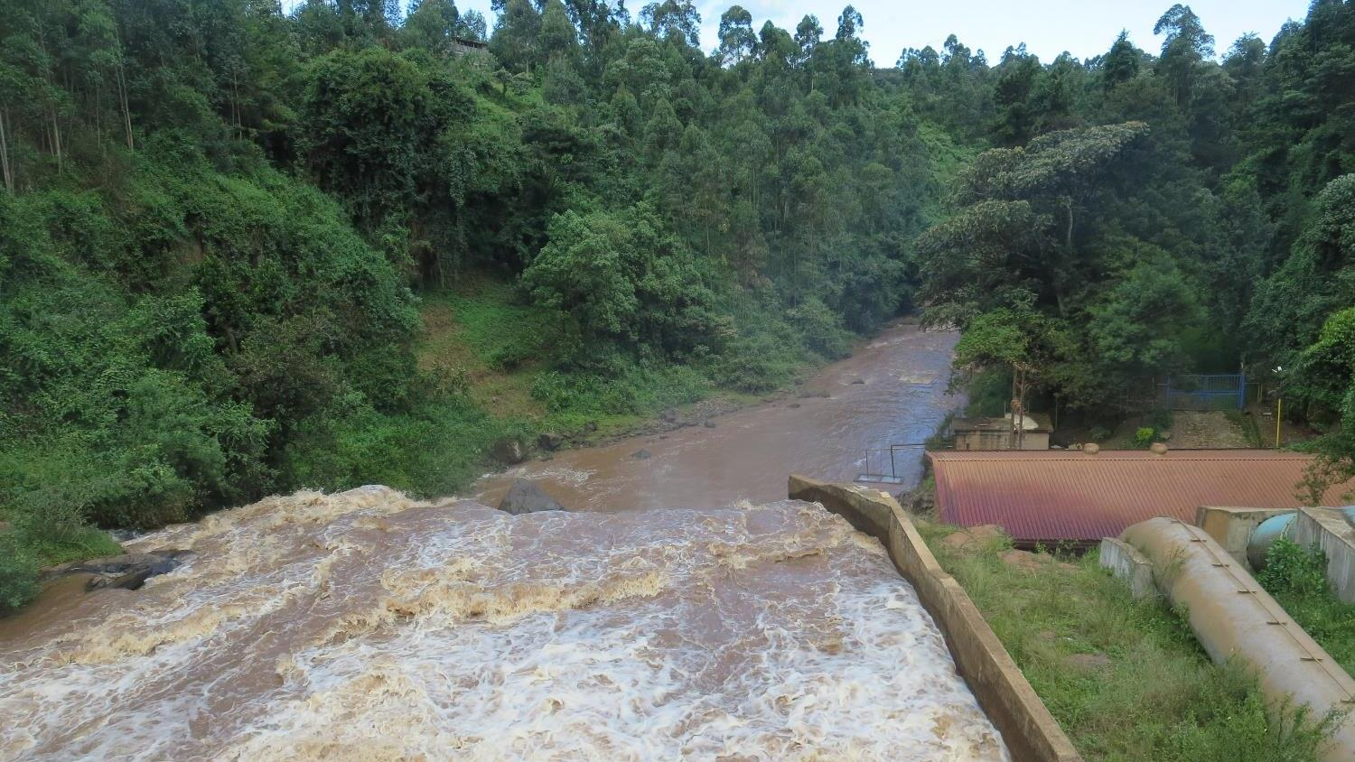
River Mara
Source Water
River Mara
Alkalinity: 12 mg/L CaCO₃
Turbidity: 100 – 800 NTU
Source 0.4 um Filtered:
UVA: 0.170/cm
UVT: 67.6 %
Available Chemicals
Dry Alum
Dry Soda Ash
Dry Calcium Hypochlorite

Slide 18
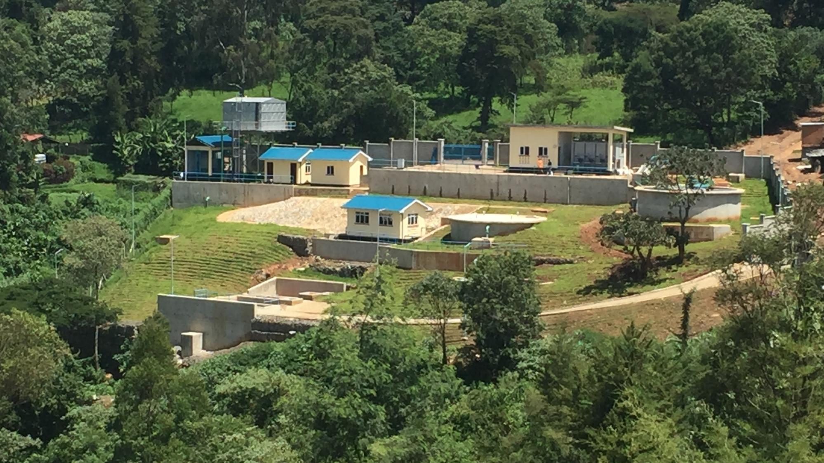
Treatment Plan
Clean Water
Backwash Tank
Booster
Pump
Bld
Mix
Chemical
Solutions
Clearwell
Chemical
Storage
Bld
Clarifier
& Filter
Gravity
Chemical
Feeders
Lab
Bld
Office
Bld
Sludge
Drying Beds
Backwash Lagoon/
Filter-to-waste/
Clarifier Desludging

Slide 19
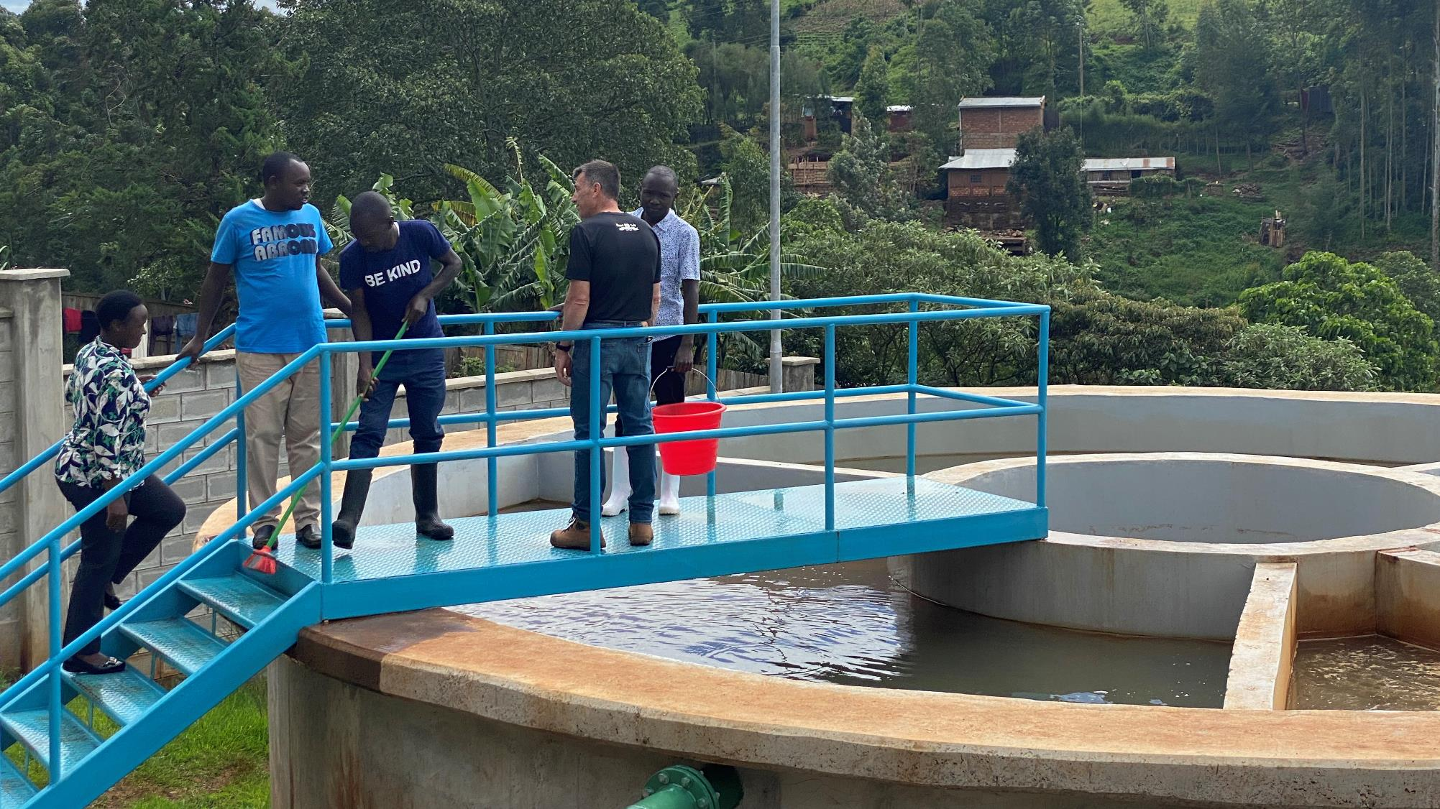
Clarifier/Filter
Sand
Filter

Slide 20
Case 2. Jar Testing/Training for New Treatment Plant in Kenya (Tenwek Hospital)
Upon arrival (April 2022) at Tenwek Hospital
Alum/Soda Ash added at front of treatment plant
Filtrate turbidity >1 NTUs; Kenya’s turbidity standard: <=5 NTUs
Jar testing results showed Na₂CO₃ had negative impact on filterability
Moved Na₂CO₃ to post filtration
Optimized Alum dose via jar testing
Results:
Filtrate turbidity <0.1 NTU
Filtrate UVA: 0.008/cm
Filtrate UVT: 98%

Slide 21
Kenya, Tenwek Hospital, Jar Testing for Optimization

Slide 22
Thank you for attending! Contact and Links
Guy Schott, P.E.
State Water Resources Control Board
Division of Drinking Water, Santa Rosa, CA
Go to Jar Test Results/Procedures for tools to download
www.waterboards.ca.gov/drinking_water/programs/districts/mendocino_district.html
Jar Testing Done Right video training https://youtu.be/aGByyxhelkI
Email: Guy Schott - Guy.Schott@waterboards.ca.gov

