Slide 1

Item #17: Board Workshop
Alamitos Bay and Los Cerritos Channel
Watershed Management Area
Watershed Management
Program Approach
October 9, 2014

Slide 2
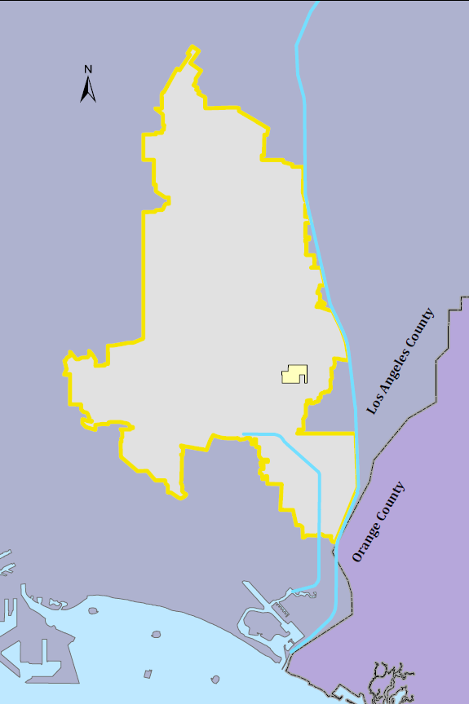
Unincorporated
County Island
San Gabriel River
Located in Los Cerritos Channel Watershed
Landlocked by the City of Long Beach
95 acres
Los Cerritos Channel

Slide 3
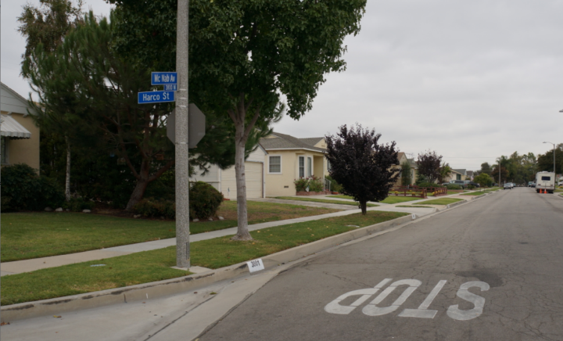
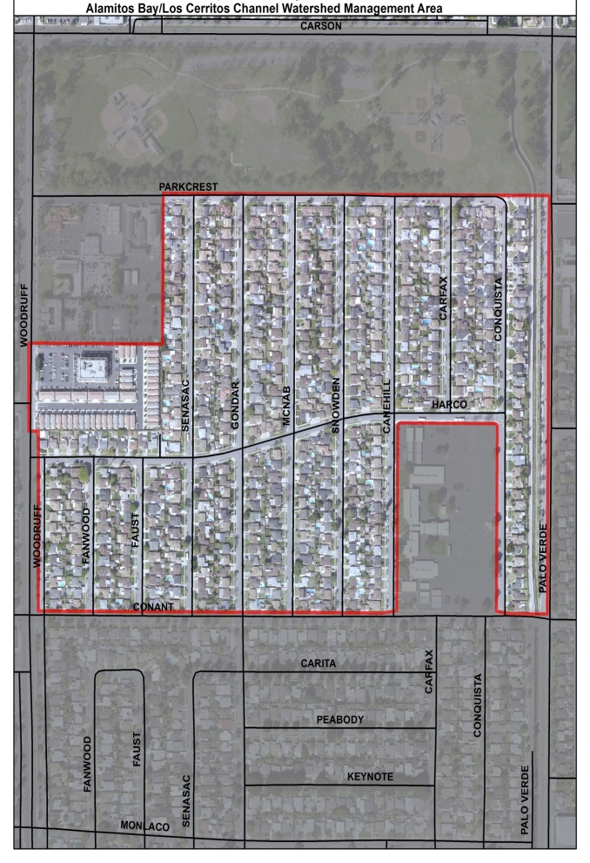
Unincorporated County Island
Predominately single family residential neighborhood
3 catch basins

Slide 4
Water Quality Priorities
County Island
Los Cerritos Channel Metals TMDL
Greater Harbors Toxics TMDL
Waterbody | Category 1 (Highest Priority) |  | Category 2 (High Priority) | Category 3 (Medium Priority) | Low Priority Pollutants
 | Pollutant | TMDL
Los Cerritos Channel | Copper (wet and dry) | LCC Metals | Ammonia | MBAS | Cadmium (wet)
 | Lead | LCC Metals/DC Toxics | Bis(2ethylhexyl) phthalate (DEHP) | Enterococcus | Chlorpyrifos (wet)
 | Zinc | LCC Metals/DC Toxics | Chlordane (Sediment) |  | Chromium (wet)
 | DDT (fish tissue) | DC Toxics | Coliform Bacteria |  | Diazinon (wet and dry)
 | PCBs (fish tissue) | DC Toxics | Trash |  | Dissolved Silver (wet)
 | Chlordane (fish tissue) | DC Toxics | pH
 | PAHs (sediment) | DC Toxics
 | Toxicity (sediment) | DC Toxics

Slide 5
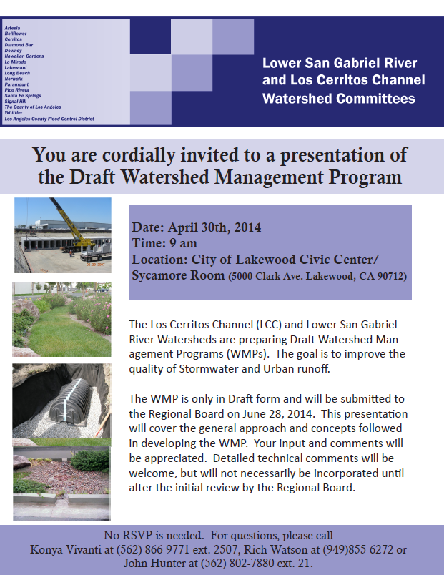
Outreach and Stakeholder Input
Partnered with other WMP groups for a Stakeholder Outreach meeting on April 30th, 2014.
Received positive remarks from Stakeholders.

Slide 6
Pollutant Reduction Strategy
Computer modeling shows a 72% reduction in zinc is needed by 2026
June 28, 2014
WMP/CIMP Submitted
July 2017
In compliance:
Continue implementing previous WCMs and monitoring
Implement Watershed Control Measures (WCMs)
July 2015
Monitor 2 Downstream Locations
July 2017
If exceedances are found:
Implement County Island Specific Monitoring
July 2019
If exceedances are found:
Implement Additional Watershed Control Measures
Final Compliance Dates:
2023: Los Cerritos Channel Metals TMDL- Dry Weather
2026: Los Cerritos Channel Metals TMDL- Wet Weather
2032: Harbors Toxics TMDL

Slide 7
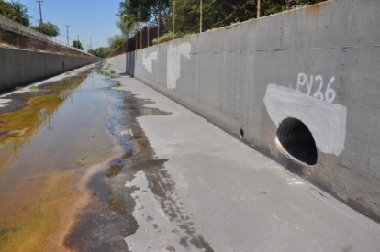
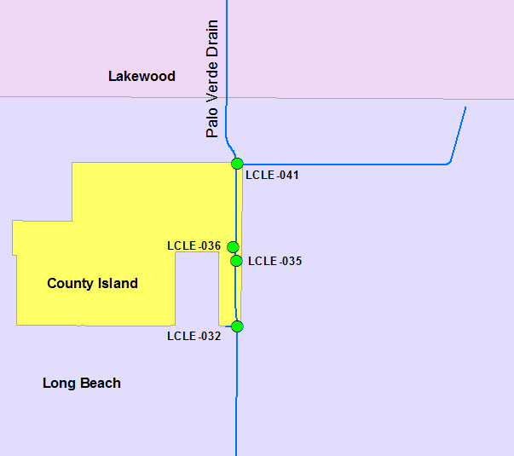
Non-Storm Water Outfall Based Monitoring
County Island has 4 outfalls into Palos Verde Drain
2 screenings have been conducted so far
No significant flow

Slide 8
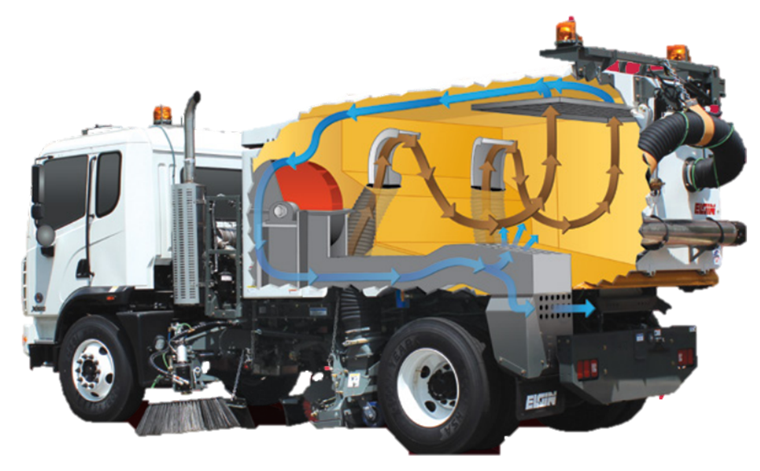
Selected Watershed Control Measures
  Enhanced Street Sweeping
  Vacuum sweepers capture fine sediments that metals are bound to
*Image courtesy of Elgin Sweepers

Slide 9
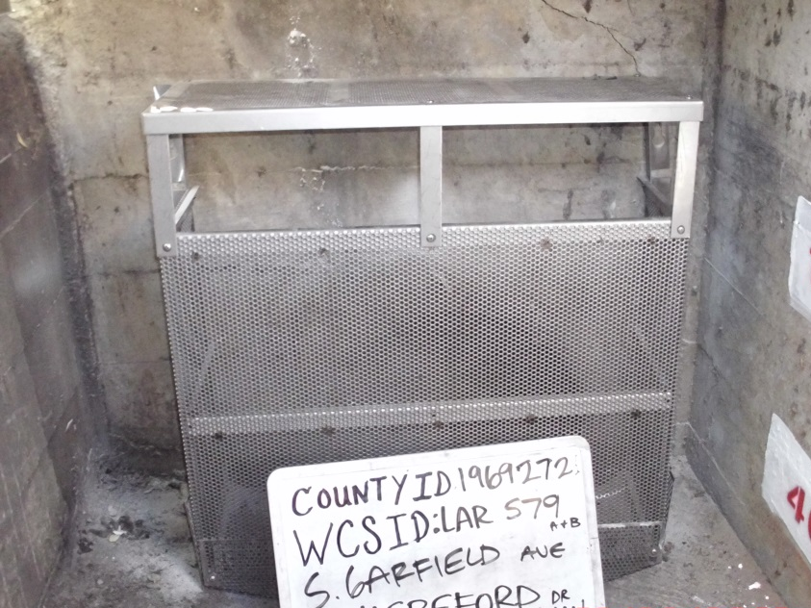
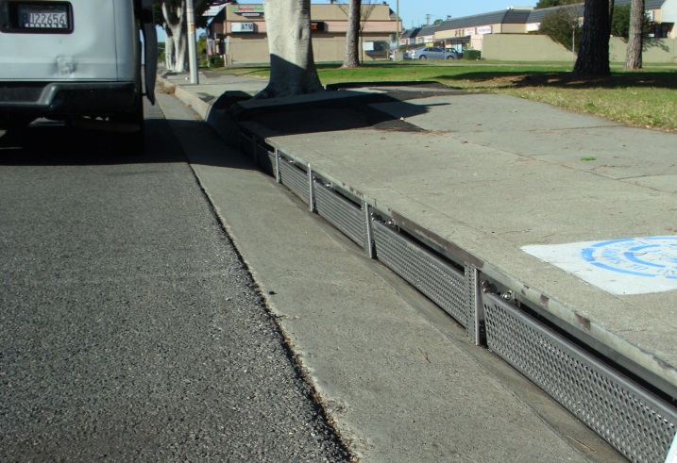
Selected Watershed Control Measures
  Full capture devices and automatic retractable screens
  Reduce trash and sediment from entering storm drain system
  Increased catch basin cleanout

Slide 10
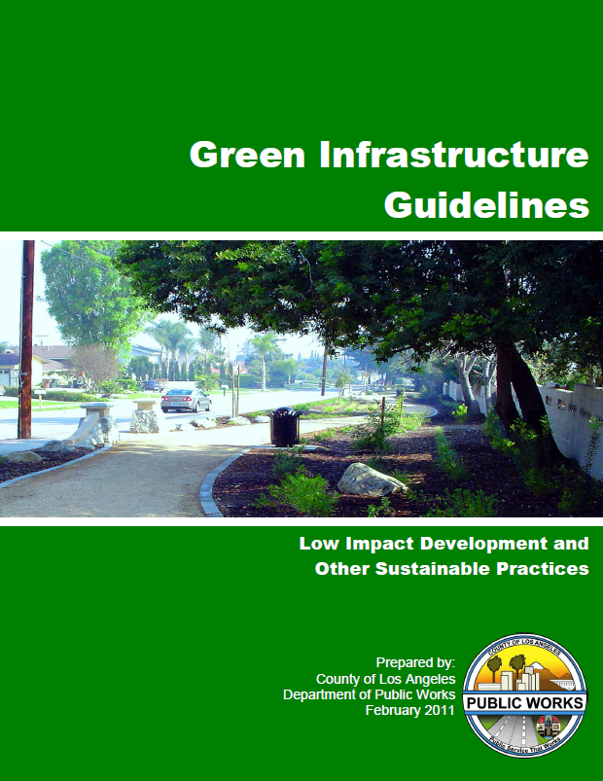
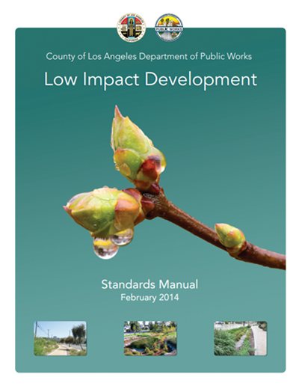
Selected Watershed Control Measures
  Green Streets Policy/Green Infrastructure Guidelines are in place
  Low Impact Development Ordinance is in place

Slide 11
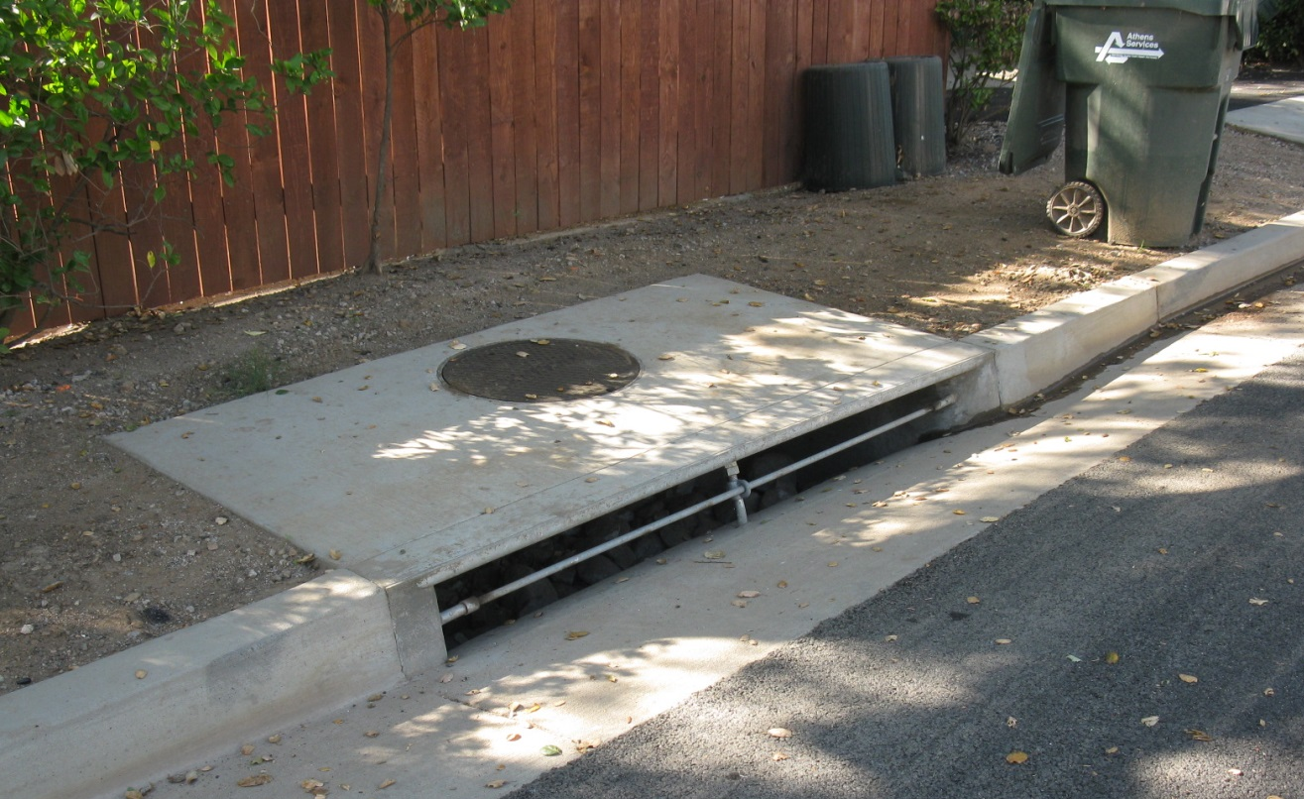
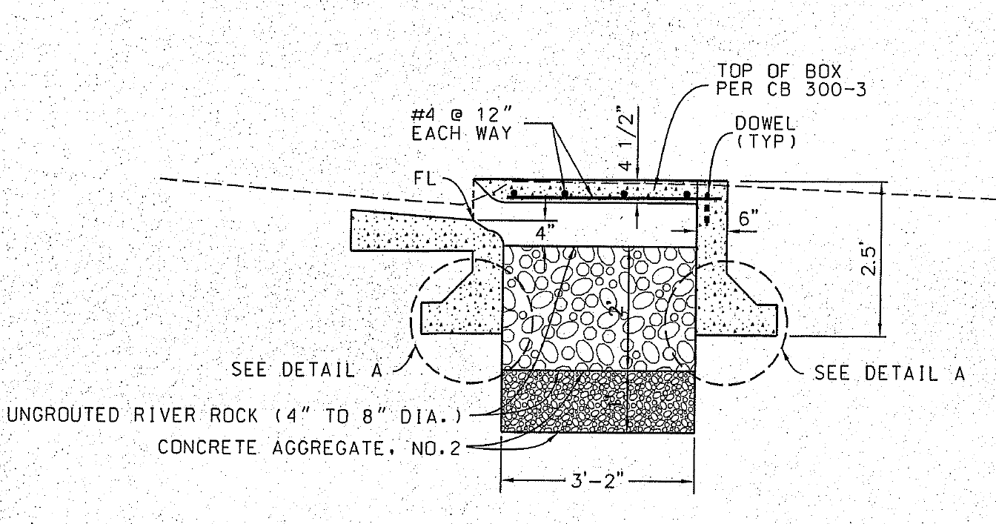
Potential Watershed Control Measures
  Pervious Catch Basins

Slide 12
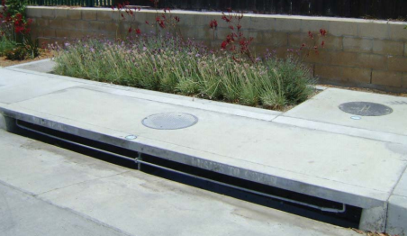
Potential Watershed Control Measures
  Modular Wetlands

Slide 13
Next Steps
  Implement identified WCMs
  Monitoring efforts have begun
  Evaluate monitoring data
  Implement additional WCMs to meet water quality priorities

Slide 14
County of Los Angeles
Department of Public Works
dpw.lacounty.gov
BILL JOHNSON, P.E.
Watershed Management Division
(626) 458-4319
wjohnson@dpw.lacounty.gov

Slide 15
Bullpen Slides

Slide 16
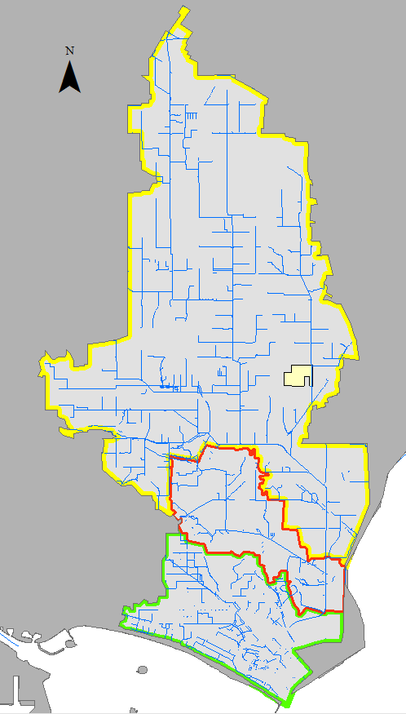
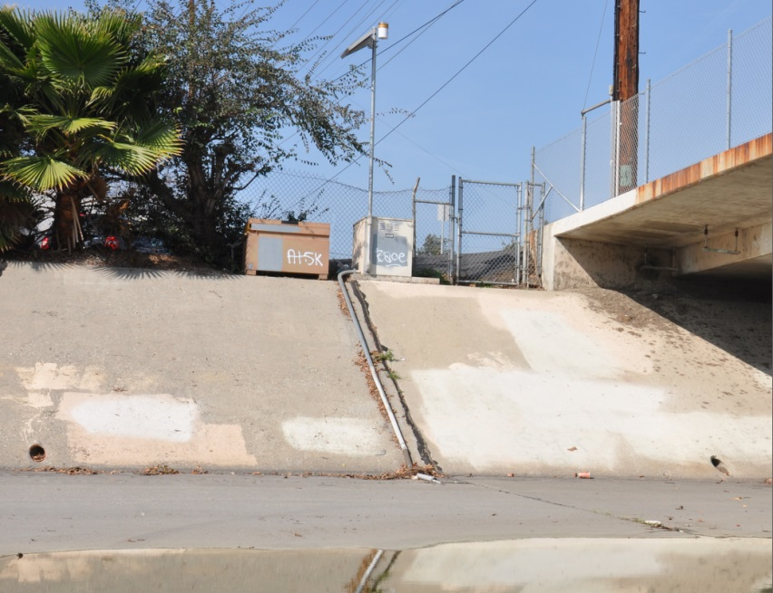
Receiving Water/LCC Metals TMDL Monitoring Site
LACFCD and County to partner with Los Cerritos Channel Group for Receiving Water/LCC Metals TMDL site.
Existing City of Long Beach Mass Emission Site at Stearns Street.
Site has been operational since 2000.

Slide 17
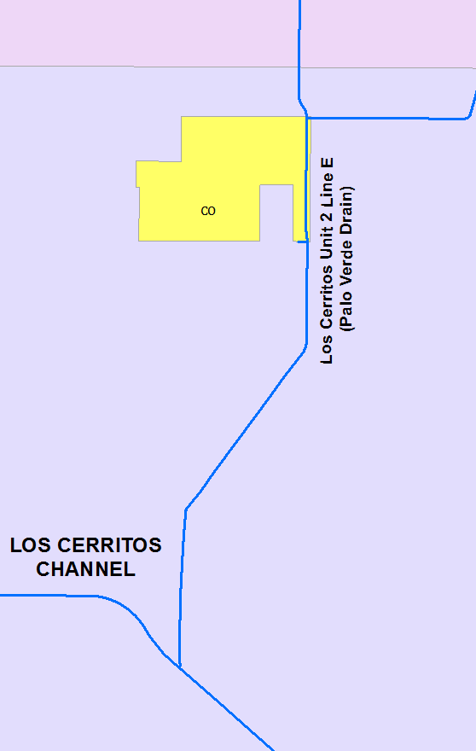
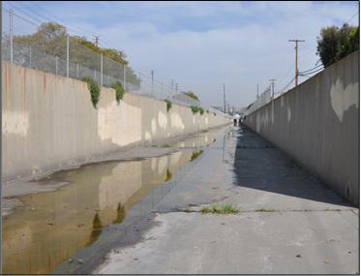
Storm Water Outfall/LCC Metals TMDL
Lakewood
Group to partner with LCC Group for a new site SB10
TMDL site along Palo Verde Drain.
Adjacent to invert access ramp.
An autosampler to be installed.
Long Beach
SB10

Slide 18
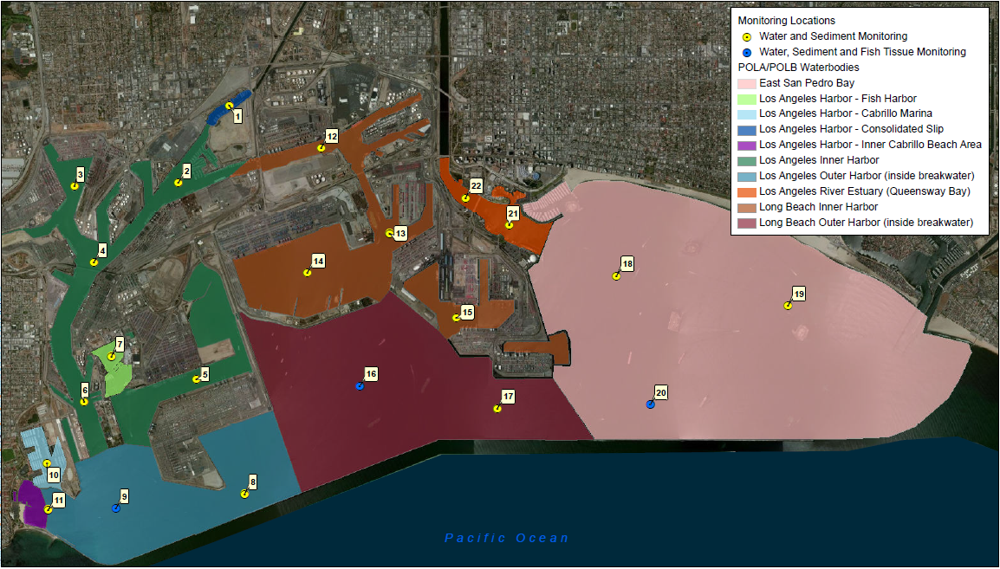
Receiving Water TMDL Site: Dominguez Channel and Greater Los Angeles/Long Beach Harbors Toxics TMDL
County and LACFCD are both partners with the Greater Harbors Regional Monitoring Coalition

Slide 19
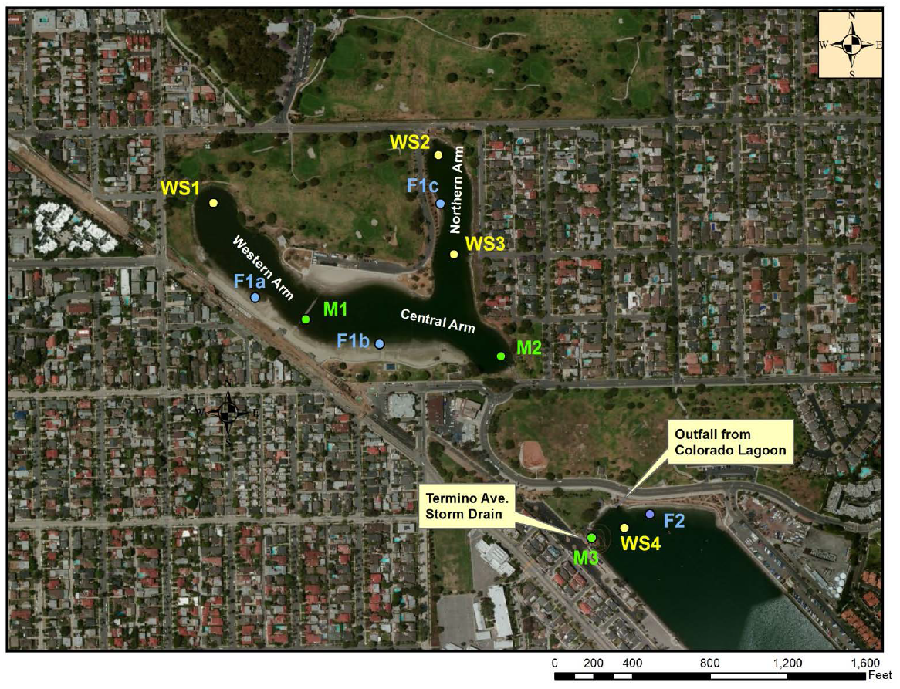
Receiving Water TMDL Site: Colorado Lagoon Toxics TMDL
WS1 -4: Water Quality Sites
F1-2: Fish Sampling Sites
M1-3: Mussel Collection Sites
LACFCD partnering with City of Long Beach on Colorado Lagoon Toxics TMDL plan preparation and monitoring.

