Slide 1




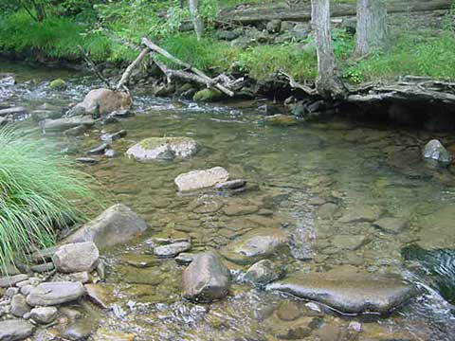
Implementation Workshop on the Statewide NPDES Permit
for
Drinking Water System Discharges
To Surface Waters
Renan Jauregui
Water Resource Control Engineer
Division of Water Quality

Slide 2



What is an
NPDES Permit?
An NPDES permit is an authorization to discharge
There is no right to a permit and it can be revoked
5-year lifecycle
Report of Waste Discharge or NOI is needed to apply
Issued as an individual or general permit

Slide 3
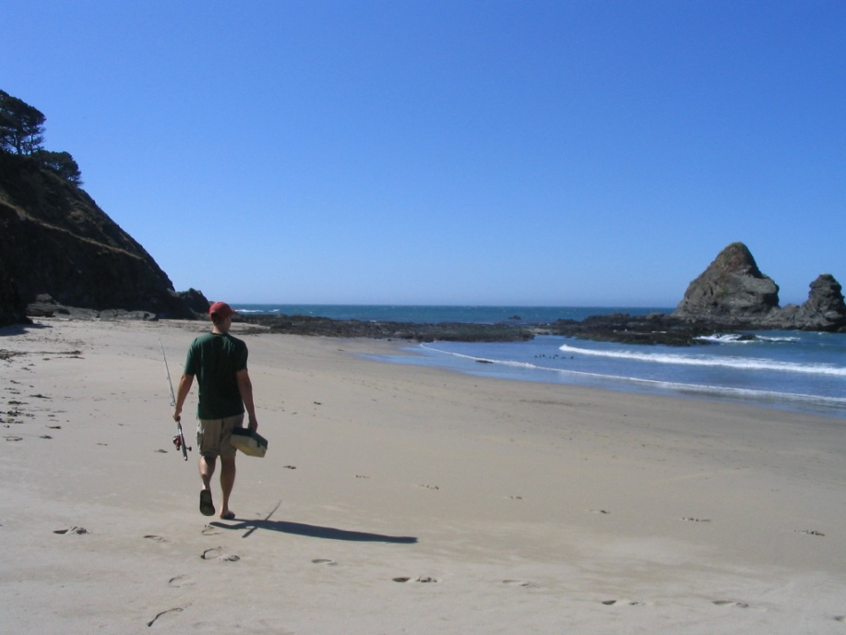
NPDES Permit Policy – Our Tool Box
California Toxics Rule
  126 priority pollutants criteria
California Ocean Plan
  Implementation
  Objectives
California Thermal Plan
State Implementation Policy for priority pollutants
  Implementation
Basin Plans
  Beneficial uses
  Water quality objectives
  Implementation

Slide 4
NPDES Permit Nuts and Bolts
Major Permit Requirements:
  Federal Standard Provisions
  Effluent Limits
    Technology Based Effluent Limits
      40 CFR 405-499
    Water Quality Based Effluent Limits
      WQ Criteria/Objectives (Beneficial Uses)
  Self Monitoring Requirements
  Applicable Pretreatment, Sludge, and management requirements, and special studies.

Slide 5
How do beneficial uses relate to standards and limitations
If MUN applicable:
  Protect it for drinking water standards (MCLs, CTR human health)
If REC-1 applicable:
  Protect it for pathogens (total coliform standards, and CTR human health as well)
If AGR applicable:
  Protect it for AG goals and Pathogens if direct consumption
If COLD or WARM applicable:
  Protect it for toxic pollutants (CTR aquatic toxicity for metals and pesticides), chlorine and ammonia toxicity, dissolved oxygen, temperature, pH, etc.

Slide 6
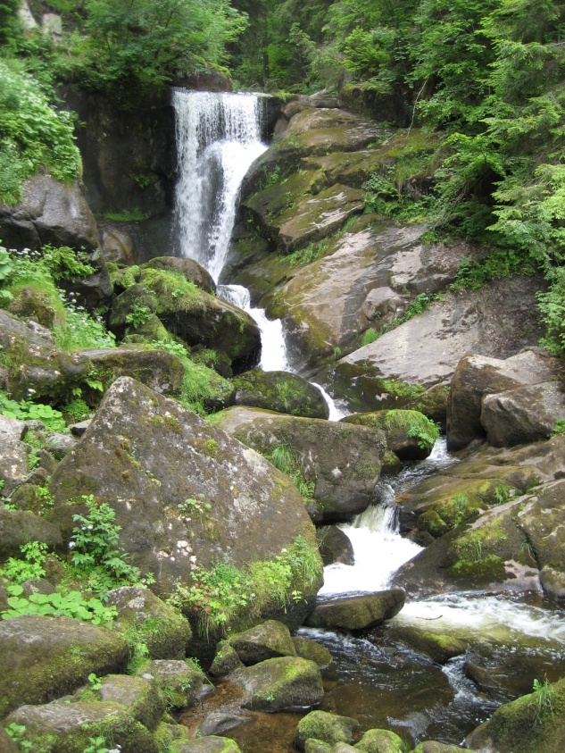
Effluent limitations are needed …
…where there is a “reasonable potential” for the discharge to cause or contribute to an excursion above water quality standards.
We have a three-trigger reasonable potential test.
Effluent limitations could be for:
Individual constituents
Whole effluent toxicity
Effluent limitations can result in …
Increased monitoring & reporting costs $
Special studies (dilution, tox evaluation) $$
Penalties & liability $$
Additional controls or advanced treatment $$$

Slide 7




Carl Henriet - SWRCB
Intake
Supply
Reasonable Potential Analysis
Ambient
B
Limit if: Max Eff Conc ≥ Criteria
Limit if: Max B > Criteria and detected in effluent
Limit possible if: impaired, fish tissue, compliance problems, etc.
DISCHARGER
Criteria
Effluent
C
1
2
3
4
5
6
7
5
Concentration

Slide 8
DWS NPDES Permit Enrollment
    Who is required to enroll
      Water Purveyors that are Community Drinking Water Systems (CDWS) with 1000 connections or more
      Wholesalers regardless of the number of connections
    Who would not be required to enroll
      Community Drinking Water System with less than 1000 connections.
      Transient, non-transient and non-community drinking water systems.
      CDWS that are also MS4 Permittees.
      CDWS that have an established MS4 local agreement and approved by their local Regional Board.
      CDWS whose discharges do not enter a water of the U.S.
      CDWS whose system-specific or water-body specific discharges require an individual Regional Board NPDES permit due to a TMDL or because the discharge falls outside the scope of the statewide permit.

Slide 9
DWS NPDES Permit Authorized Discharges
    Type of Discharges Authorized (sample list)
      Planned
        Groundwater supply well flushing or pump to waste
        Groundwater well development, rehabilitation and testing
        Transmission system installation
        Distribution system storage tank or reservoir releases
        Distribution system dewatering, flushing, pressure testing
        Fire hydrant flushing, meter testing, automated water quality analyzers operations.
        Water Treatment plant operations (excluding backwash filter that discharges to a water of the U.S.)
        Discharges due to activities undertaken to comply with mandates of the Federal Drinking Water Act and Ca Health and Safety Code
      Emergency and Unplanned
        Drinking water system failures, including repairs on transmission or distributions system failures
        Trench dewatering due to a system failure or emergency failure
        Operation errors and discharges due to catastrophic events.

Slide 10
DWS NPDES Permit Effluent Requirements
    Effluent Requirements/Limitations for discharges that enter a water of the U.S.
      Establish Best Management Practices (BMPs) to:
        Prevent aquatic toxicity of chlorine by dechlorination
        Prevent erosion and hydromodification by erosion control and prevention measures
        Minimize Sediment discharge and turbidity impacts through sediment, turbidity, and erosion controls
        Prevent water quality impacts from groundwater supply well operations such as well development and rehabilitation by complying with a turbidity action level of 100 NTU or less in the discharge, and change or enhance BMPs when turbidity levels are greater than 100 NTU
        Applicable to all planned discharges that enter a water of the U.S.
      Comply with the following effluent limitations:
        A total chlorine residual maximum of 0.019 mg/L (inland waters, enclosed bays and estuaries) or 0.08 mg/L (ocean) with compliance assessed by a field meter monitoring result of <0.1 mg/L (non-detect)
        Only applicable to superchlorinated discharges, direct discharges, or discharges within 300 ft from a water of the U.S.

Slide 11
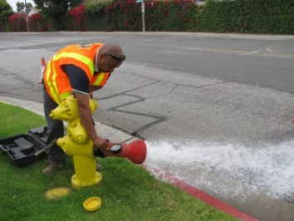
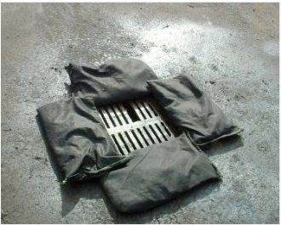
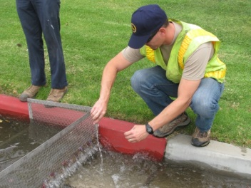
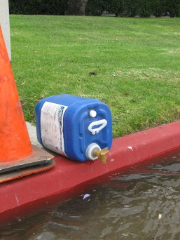
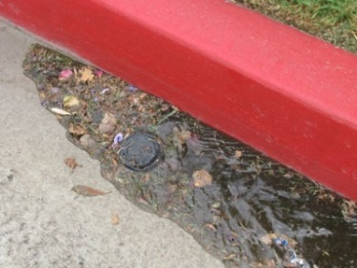
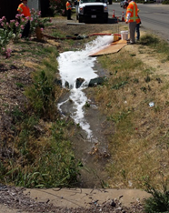
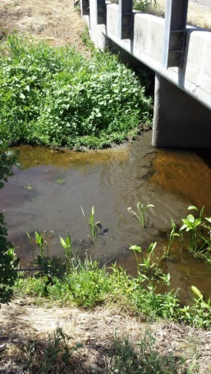
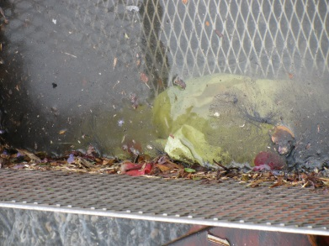
DWS NPDES Permit Effluent Requirements
Types of BMPs are left to the discretion of the CDWS (include but not limited to those established by AWWA)
Emphasis on BMPs to be the primary control of toxicity, solids, trash, erosion, scour and hydromodification
BMPs listed in Attachment C of the permit are examples

Slide 12
DWS NPDES Permit Monitoring Requirements
    Monitoring requirements.
      Event effluent monitoring: (per event)
        Superchlorinated discharges (volume, chlorine, pH, and visual turbidity)
        High volume discharges (1ac-ft or larger) (volume, chlorine, visual turbidity)
        Well development /rehabilitation (volume, chlorine, and metered turbidity),
        If discharge <20 min then one sample during first 10 min
        If discharge between 20 to 60 min then one sample first 10 min and second sample during last 10 min.
        If discharge >60 min then one sample first 10 min, second within 50 min and last one within last 10 min of discharge or close to end of discharge as feasible.
      Representative effluent monitoring: (annual- chlorine, volume, visual turbidity)
        All other types of discharges that represent same general water source, same water treatment, and same type of implemented BMPs.
        Same frequency as event monitoring dependent on duration of discharge.
      Receiving water monitoring:
        Visual monitoring (erosion, discoloration, suspended matter, aquatic life impact, visible films, sheens, potential nuisance conditions)
        Only applicable when direct planned discharges do not comply with permit requirements. (not applicable for emergency discharges).

Slide 13
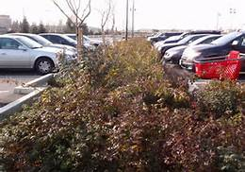
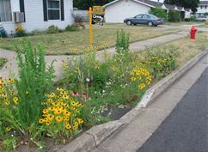
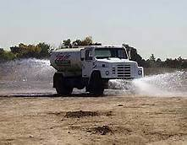
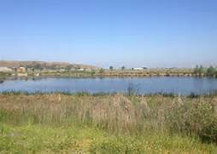
Emphasis on Beneficial Use or Reuse
No monitoring is required if water is put to a beneficial reuse such as:
  Using the water that would otherwise be discharged for irrigation or other uses (e.g dust control)
  Putting the water that would otherwise be discharged to land disposal for ground water infiltration and recharge

Slide 14
DWS NPDES Permit Reporting Requirements
    Notification/Reporting requirements.
      Notification of emergency or noncompliant discharges
        Notify Regional Board within 24 hrs and in writing within 5 days
        Notify Stormwater System Operator with 24 hrs.
      Pre-Notification of large planned discharges >1acre-ft:
        Notify Regional Board and Stormwater System Operator 3 days prior to initiating discharge or retroactively within 24 hrs after the Discharger is informed to initiate a large volume discharge
      Reporting to State Water Board by March 1 of every year:
        All non-compliant discharge monitoring information
        A record of the number of direct discharges that are >50,000 gal for the year
        An estimate of the total volume discharged to waters of the U.S. during the year.
        An estimate of the total volume of discharged water that was put to a beneficial reuse instead of discharging to a water of the U.S.

Slide 15
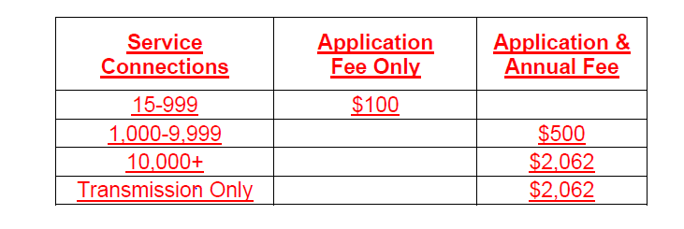
NPDES Permit Application Checklist
    Notice of Intent form completed and signed
    Application fee payable to the
    SWRCB included
    Site information provided
        Option of providing general location of the facilities or the boundaries of the service area(s)
        Need only to show the named receiving waters and the major named downstream waters
        For discharges within 300 feet of a water body, the Discharger is only expected to submit the representative distance of 300 feet on both sides of the named water bodies or indicate the entire service area is within 300 feet from a water body.
    TMDL Waterbody information completed and submitted
      2 samples’ laboratory analysis for parameters listed in Table F-2 for each applicable TMDL waterbody
      The estimated minimum and maximum discharge volume per discharge event and estimated average annual discharge volume going to the TMDL waterbody.
      Description of TMDL specific BMPs if any.

Slide 16
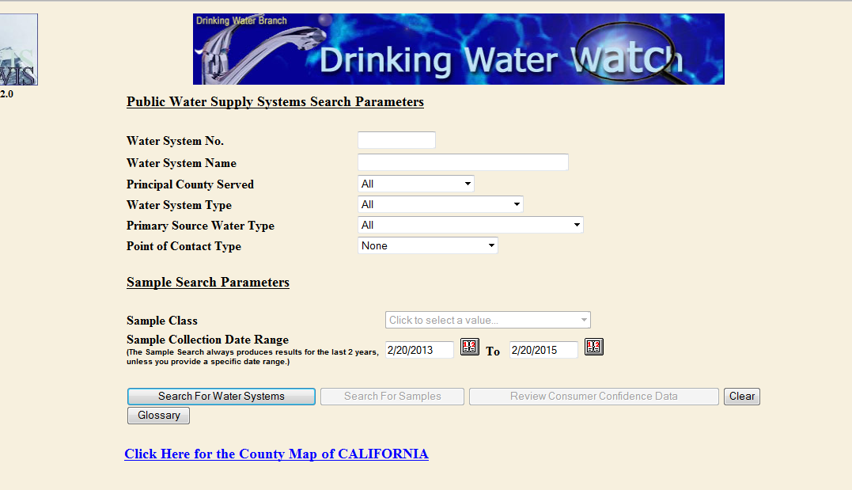
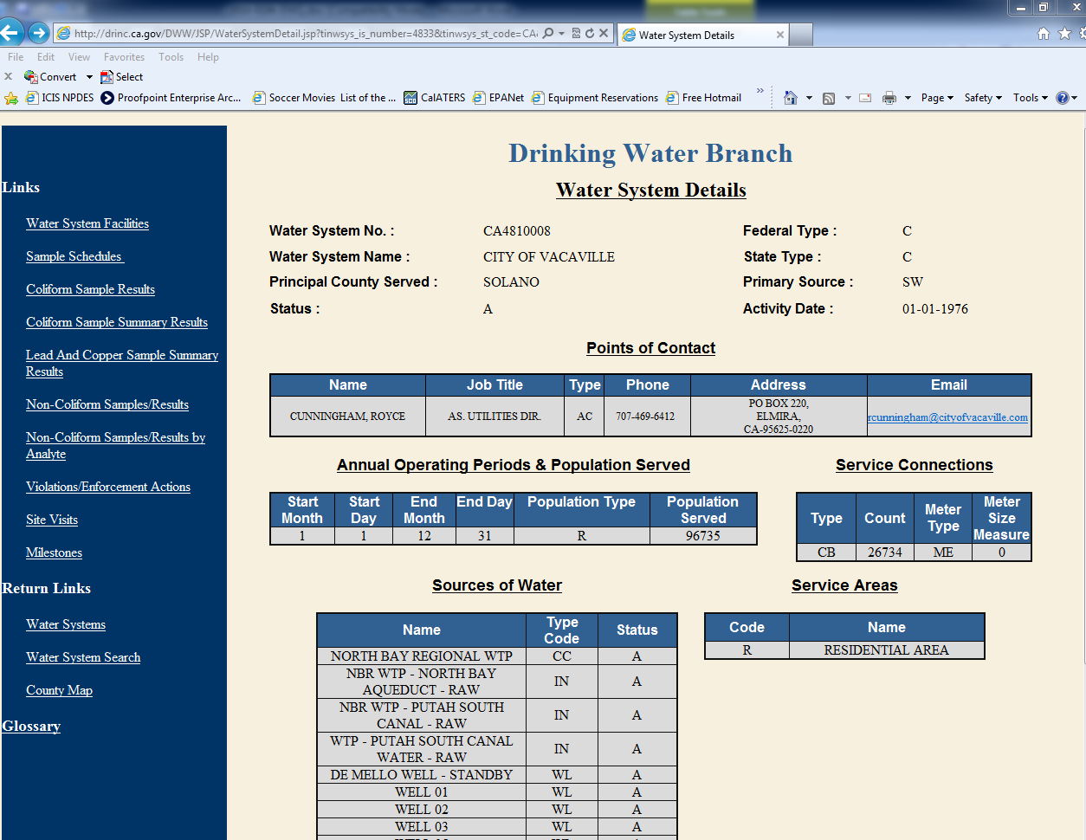
NOI Example
Water Watch Website http://drinc.ca.gov/DWW/index.jsp

Slide 17
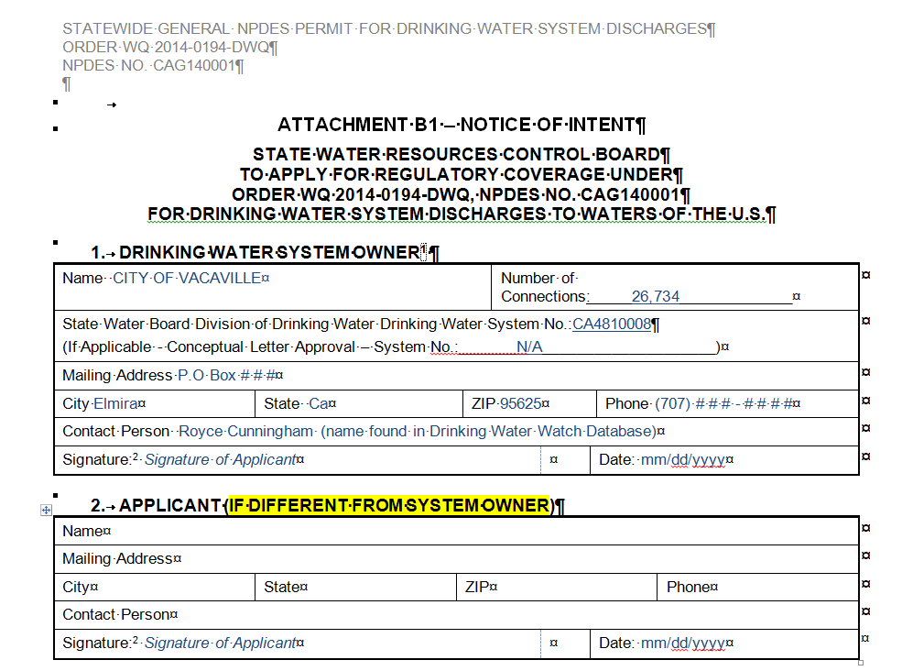
NOI Example
Sections 1, 2

Slide 18
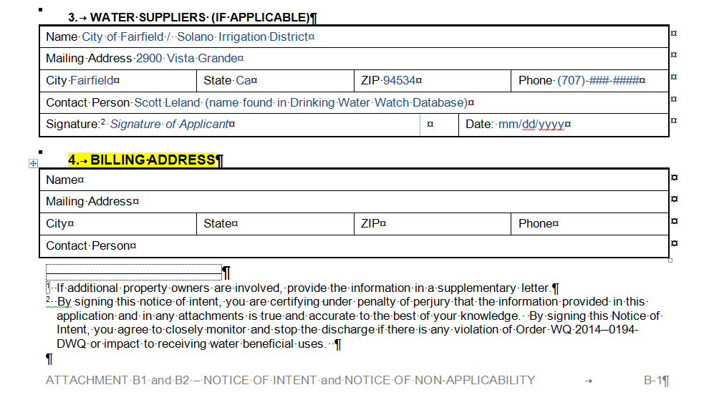
NOI Example
Sections 3, 4

Slide 19
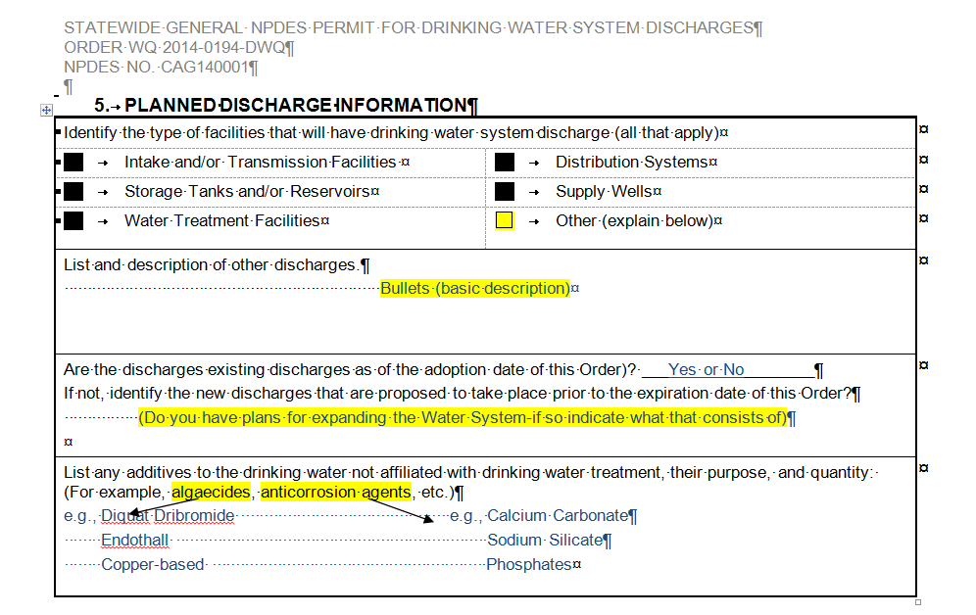
NOI Example
Section 5

Slide 20
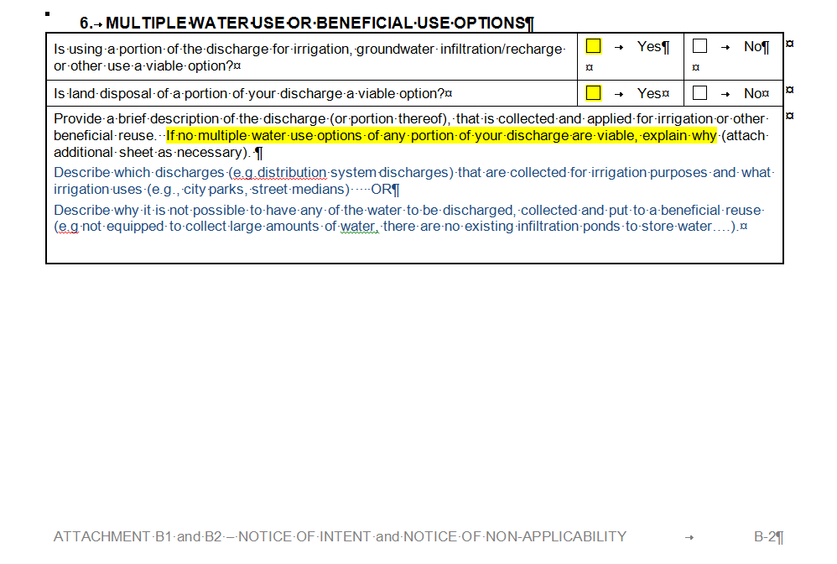
NOI Example
Section 6

Slide 21
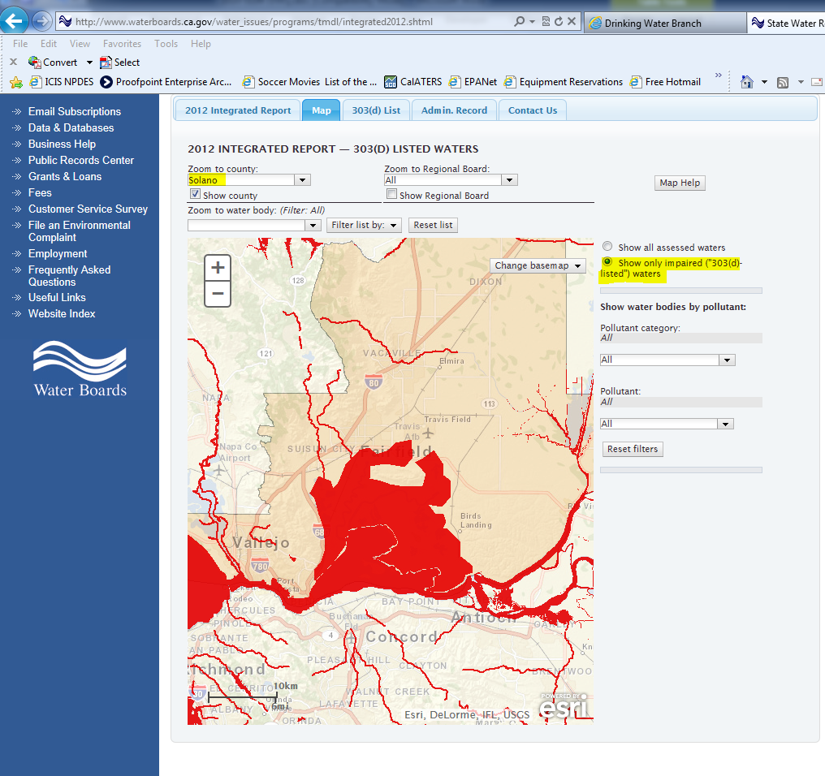
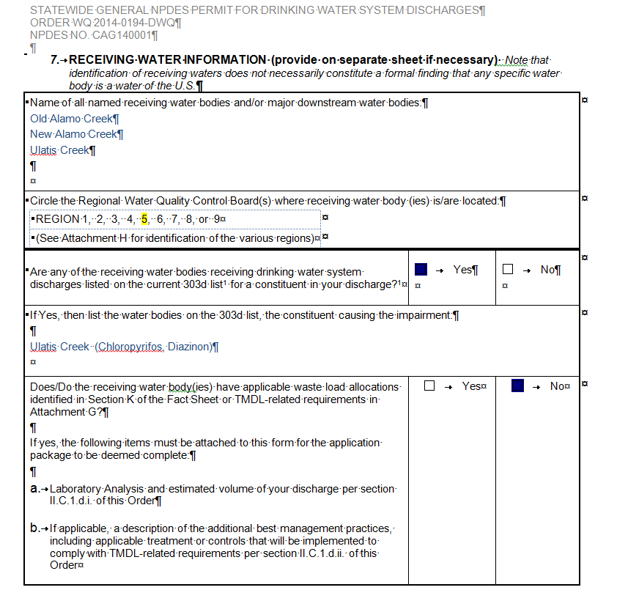
NOI Example
Section 7 http://www.waterboards.ca.gov/water_issues/programs/tmdl/integrated2012.shtml

Slide 22
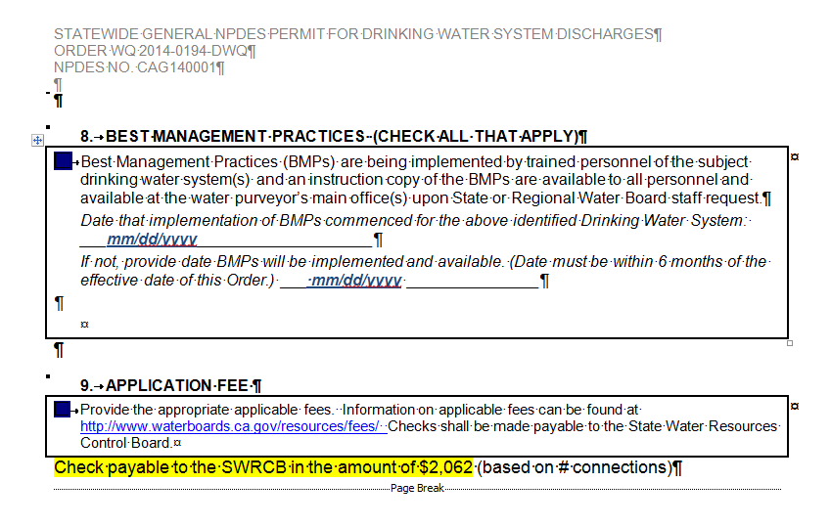
NOI Example
Section 8

Slide 23
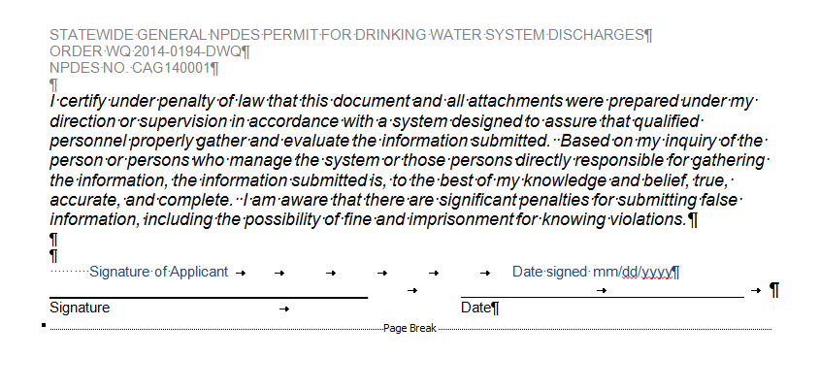
NOI Example
Certification/Signature

Slide 24
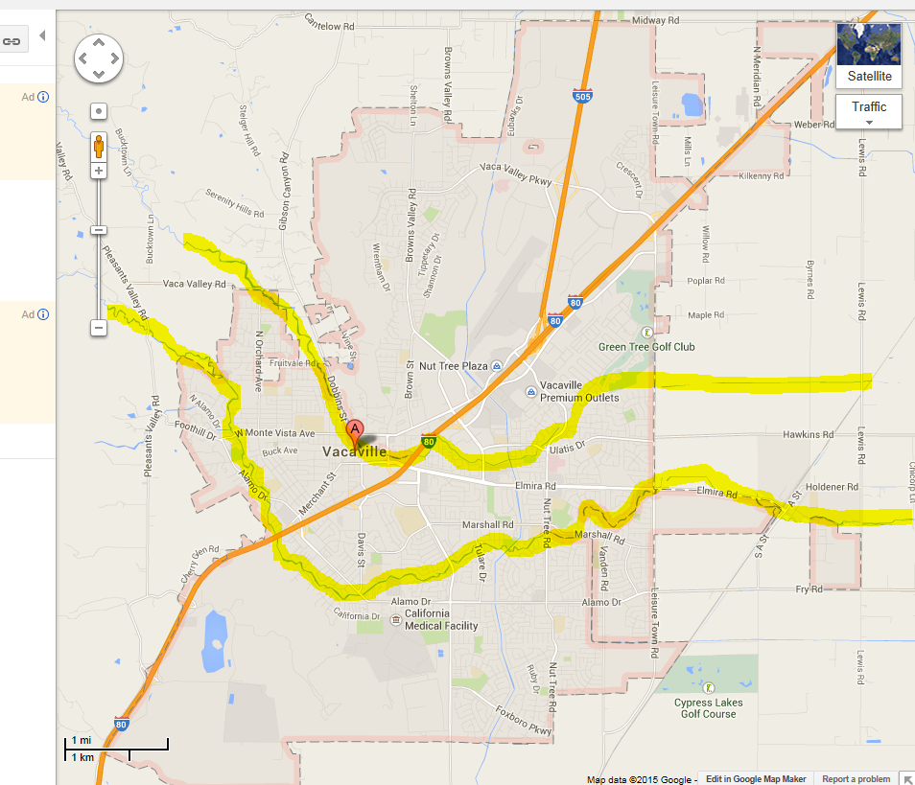
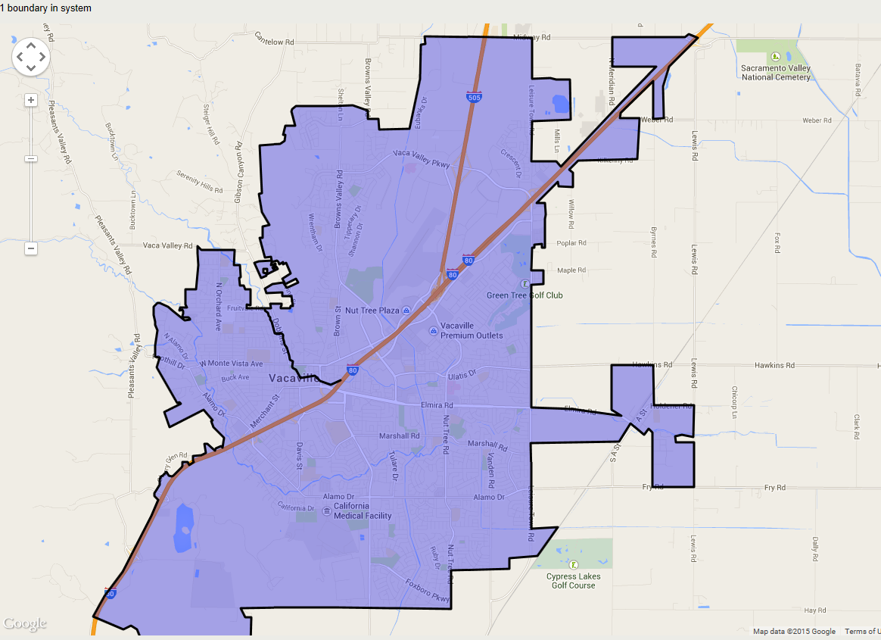
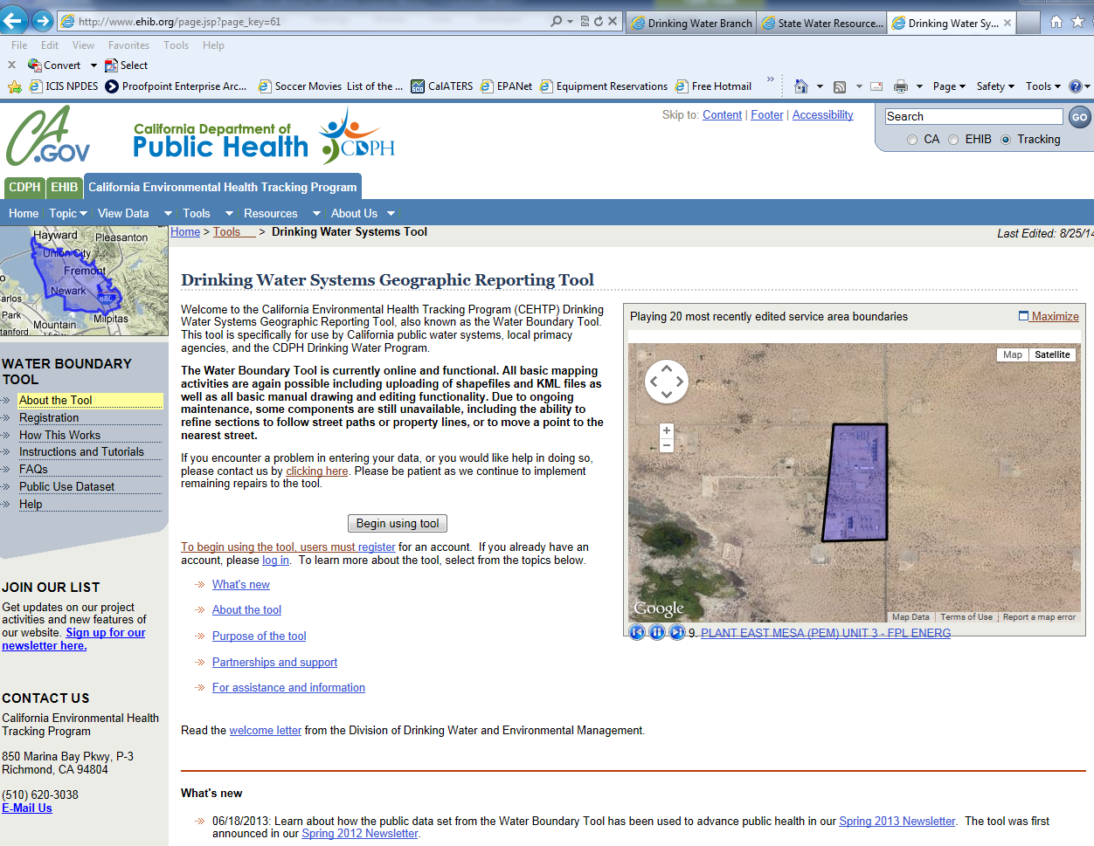
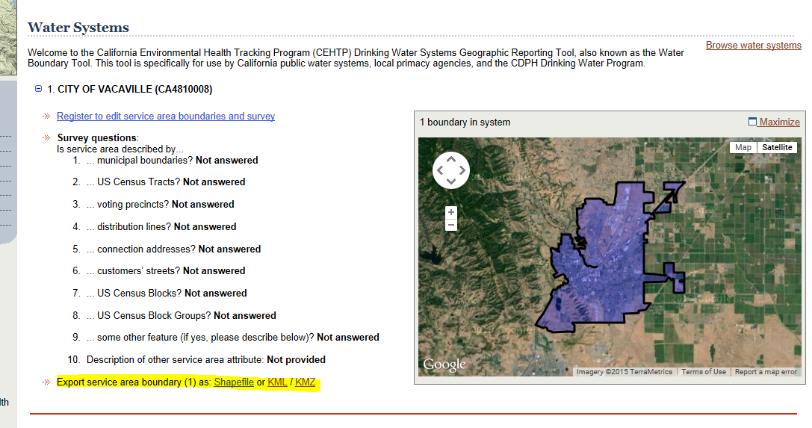
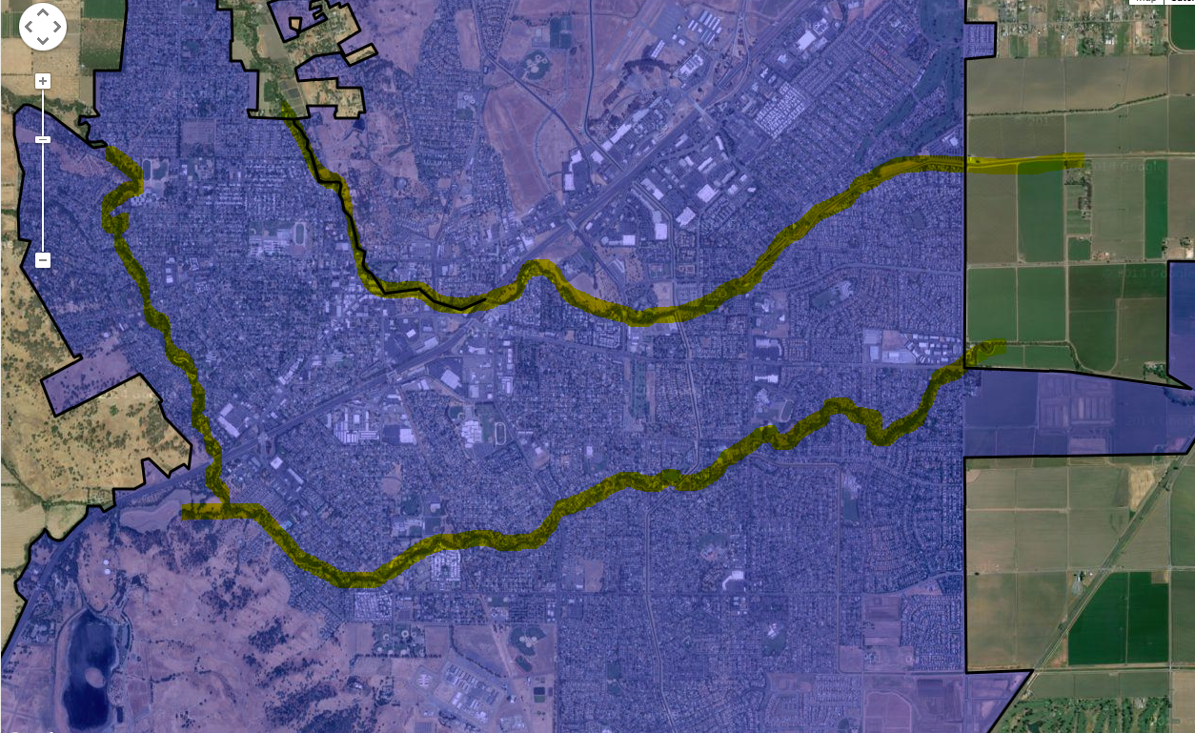
Mapping Requirements
DWS Geographic Tool http://www.ehib.org/page.jsp?page_key=61

Slide 25
Notice of Non-Applicability
    Discharges from the drinking water system solely enter a water of the U.S. via a municipal separate storm sewer system (MS4) and there is a local agreement established with the MS4 Permittee and approved by the local Regional Water Board.
    The drinking water system is owned or operated by the MS4 Permittee and all discharges enter a water of the U.S. via the permitted MS4 system.
    The drinking water system is regulated under an existing individual Regional Water Board Permit due to threat to water quality above the low-threat scope of the statewide permit, or due to the need to address TMDL-specific requirements.
    The drinking water system does not discharge to a water of the U.S. or a conveyance that drains to a water of the U.S.

Slide 26
Notice of Non-Applicability submittal Checklist
    Notice of Non-Applicability form completed and signed
    Regional Board Order and NPDES number included if reason for NONA is that the discharge falls outside the scope of the statewide permit.
    Copy of local agreement with an MS4 permittee and acknowledgement by the Regional Board is included if reason for NONA is that the discharge is covered under a local agreement with MS4 permittee.
    Regional Board Order and NPDES number is included if reason for NONA is that the discharger is owned and operated by an MS4 permittee or co-permittee which is named in the MS4 permit.
    Description how discharges are managed if reason for NONA is that no discharge enters a water of the U.S.

Slide 27
Questions?
Questions?

