Slide 1
Item No. 13 Recommendation to the State Water Resources Control Board Regarding the Section 303(d) List
Lahontan Water Board
June 19, 2014
Carly Nilson & Mary Fiore-Wagner
Environmental Scientists
Notes:
Good Morning Board Chair and Members of the Board. I’m Mary Fiore-Wagner, an Environmental Scientist in your South Lake Tahoe Office in the TMDL and Basin Planning Unit. Together with Carly Nilson, also an environmental scientist in the Tahoe Office, we’ll be presenting Item No. 13 in your Agenda Packet.

Slide 2
Presentation Roadmap
Process
Data & Evaluation
Results
Public Comments & Staff Responses
Recommendation
Notes:
Here’s a roadmap for today’s presentation.
We’ll start by presenting information about the assessment process, then we’ll introduce the data used in the 2012 evaluation and the results of the evaluation, and we’ll introduce the list of impaired water bodies for our region.
Then we’ll discuss comments we received and our responses to those comments. Finally, we’ll present our recommendation to the Board.

Slide 3
Process
Federal CWA
Integrated Report = 305(b) + 303(d)
Assessment
List
Notes:
I’m going to start by defining the Integrated Report.
Under the Clean Water Act (CWA) States are given the primary responsibility of protecting and restoring surface water quality.
To fulfill this responsibility, States produce two reports required by USEPA: a 305(b) Report, which is considered a Water Quality Assessment Report where we assess waterbody-pollutant combinations, and a 303(d) List of Impaired Waters.
California has integrated the 305(b) Report and the 303(d) List into a single report referred to as the Integrated Report, which satisfies the requirements of both CWA Sections.

Slide 4
Section 305(b) Assessment
Process
Requires States to assess and report on overall quality of all the waters of the State
Consider data and information
Assign beneficial use support ratings:
Fully Supporting (Categories 1 & 2 No action)
Not Supporting (Categories 4 & 5 Must address)
Insufficient Information (Category 3 Collect data)
Notes:
CWA Section 305(b) requires States to complete an assessment of all its surface waters and report on their overall quality.
To assist the Water Boards with the Integrated Report Process and make this task more manageable, in 2007, EPA funded and created a the web-based interface known as California Water Quality Assessment (CalWQA) database.
CalWQA stores data, also referred to as Lines of Evidence. State and Regional Board staff consider these lines of evidence and make decisions about the quality of the waterbodies within their respective regions.
The assessment process also involves assigning ratings evaluating beneficial use support. The database uses these ratings to place water body-pollutant combinations in one of five categories. Categories characterize whether beneficial uses are fully supported in which case a waterbody would be classified in
Categories 1 &2 include waters that meet standards
Categories 4 & 5, water body is impaired and standards are not meet
Category 3 information alone is not enough to support an assessment. For reasons that may include
monitoring data have poor quality assurance,
not enough samples in a dataset,
no existing numerical objective or evaluation criteria.

Slide 5
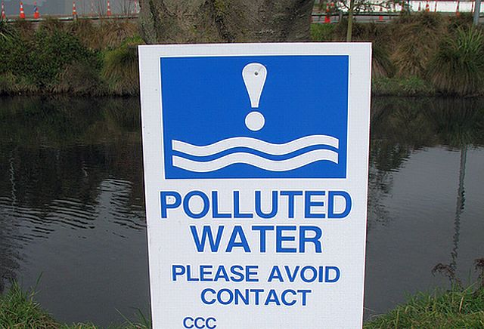
Process
Section 303(d) Assessment
States identify and submit list of surface waters not meeting standards due to pollutants
List commonly referred to as 303(d) list or “List of Impaired Water Bodies”
Pollutant levels exceed standards then water body is placed on 303(d) List of Impaired Water Bodies
Notes:
As staff completes its assessment, waterbodies that do not support their designated beneficial uses fall into categories 4 or 5. These waterbodies that fall into categories 4&5 comprise the 303(d) list.
For Cat 4 and 5 waterbodies, staff has determined that pollutant levels measured in the water do not meet the protective water quality standards develop to maintain the designated beneficial use, whether it be domestic supply or cold freshwater habitat for example.
Placement of a water body pollutant combination on the 303(d) List, helps staff identify which waterbodies are falling short and require some attention to address their impairment.

Slide 6
Lahontan Water Board Action
Process
Proposed Board action covers Section 303(d) list recommendations to State Water Board
Board staff entered Section 305(b) assessment data into online database
Public comment period (Apr. 4 – May 19) on both Section 303(d) list and Section 305(b) assessment
Notes:
The Proposed Action for your consideration today is a subset of 305(b) Water Quality Assessment process. Our assessment rates the overall water quality of all our surface waters. Your action involves approving (or not) those waterbodies, which through our assessment, do not fully support beneficial uses, and as such are being recommended for inclusion on the 303(d) List of Impaired Waterbodies.
As I mentioned earlier CalWQA was created to support the Integrated Report Process. The data and conclusions we make about the overall water quality of our surface waters are housed within CalWQA and this information can be exported to the EPA at the end of each assessment cycle.
Our combined 303(d) List and the 305(b) Assessment along with an associated staff report were circulated for a 45 day public comment period.
Carly will be discussing comments received and our responses later in this presentation.

Slide 7
Approval Process
Process
Lahontan Water Board
State Water Board
U.S. EPA (final 303(d) List)
Notes:
The first step in the approval process is consideration at the Regional Board level.
Following adoption by Regional Board, the 2012 Integrated Report will be transmitted to State Board, and upon State Board approval it’s submitted to EPA where 303(d) list is final with the agency’s approval.
The opportunity for public participation is provided at both the Regional and State Board levels.
[The USEPA then compiles the 305(b) assessments into their biennial “National Water Quality Inventory Report” to Congress.]
Up until this year, the IR was meant to be completed every two years. EPA and SB worked on a strategy moving forward to create a more efficient and successful IR Process. The strategy agreed upon includes dividing CA into thirds by Regional Water Board and submitting an IR for 3 RBs per listing cycle.
For the current water quality assessment cycle, State Board plans to prepare an “Integrated Report” for Regional Boards 1, 6, and 7.
2012 IR: North Coast (Region 1), Lahontan (Region 6), and Colorado River Basin (Region 7) Water Boards.
2014 IR: Central Coast (Region 3), Central Valley (Region 5), and San Diego (Region 9) Water Boards .
2016 IR: SF Bay (Region 2), LA (Region 4), and Santa Ana (Region 8) Water Boards.
The Lahontan Water Board will develop its next Integrated Report update for 2018.
Though we will not be going through this formal process again until 2018, the
Process does allow Regional Water Boards that are “off cycle” to still examine high priority
data and make decisions related directly to listings and delistings and submit them for inclusion into the current listing cycle as appropriate.

Slide 8
Data Evaluation
Data & Evaluation
Surface Water Ambient Monitoring Program (SWAMP)
Data submitted by stakeholders
Notes:
So where does the IR Process begin. Well, it starts with a public solicitation for data. For the 2012 cycle, the State Board formally solicited for data in 2010 and all data submitted by August 2010 was considered for this Listing cycle.
I do want to acknowledge that this assessment cycle was a lot more intensive than last listing cycle based on the volume of data submitted, which then needed to be evaluated.
For the Lahontan Region, data submitted included information provided by the State Board’s Surface Water Ambient Monitoring Program (SWAMP) for monitoring initiated at both the statewide and regional levels.
SWAMP:
carefully designed, often externally reviewed monitoring programs
produce high-quality information.
Stakeholders
LADWP, STPUD, Heavenly Valley Ski Area all submitted data associated with permits we’ve issued to these dischargers which require monitoring and reporting.
We also received turbidity data from our sister agency, the CA DWR.

Slide 9
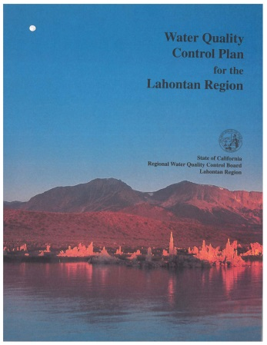
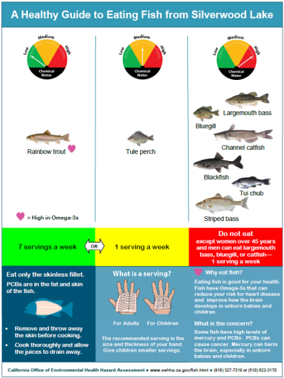
Standards and Criteria
Data & Evaluation
Process
Water Quality Objectives (any B.U.)
Drinking Water Maximum or Secondary Contaminant Levels (MCLs or SMCLs) (MUN)
California Toxic Rule (COLD and WARM)
State and federal evaluation guidelines (COMM)
Fish consumption advisories (OEHHA).
Notes:
So now that we have all this data, the next step in the assessment process is to compare the measured pollutant levels to standards or criteria established to protect beneficial uses.
Standards and criteria we use in our assessment come from State and Federal Plans and Policies.
The Basin Plan that contains regulatory limits water quality objectives that apply to all surface waters, or hydrologic units and site-specific objectives for individual waterbodies.
•To determine if municipal drinking water supplies (MUN) are protected we compare available data to Drinking water standards-Maximum Contaminant Levels established to protect human health.
California Toxics Rule establishes standards for toxic chemicals. These CTR standards along with water quality criteria developed by EPA are often used to determine if the waterbody can support its COLD and WARM freshwater habitat.
State and Federal evaluation guidelines and Fish consumption advisories issued by OEHHA used to evaluate the Commercial beneficial use which includes the consumption of fish. Particularly useful to support the Littlerock and Silverwood Lake listings for Hg and PCBs. Hg from legacy mercury and gold mining, local and global emissions, and erosion of soils naturally high in HG. PCBs are persistent chemicals that are now banned, but were commonly used in electrical, industrial applications.
Determining the exceedances of water quality standards, objectives, criteria, and guidelines forms the basis of the water quality assessments for Sections 303(d) and 305(b).
Whether or not water quality objectives are exceeded determines a water body’s ability to support its designated beneficial uses and also determines whether to list, or not list, the water body as impaired.

Slide 10
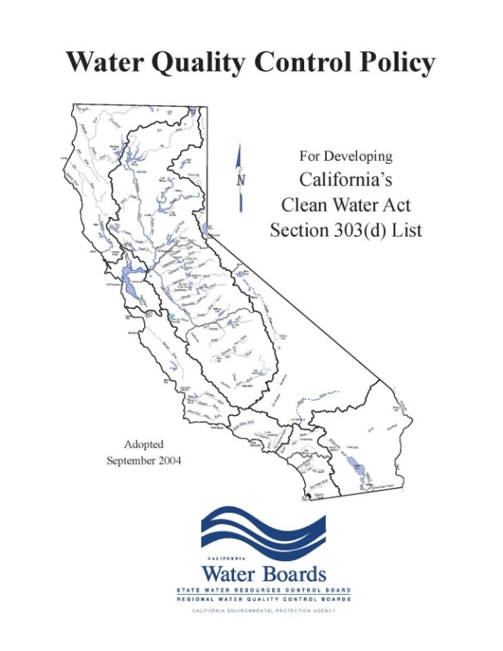
Listing Policy
Data & Evaluation
State Water Board adopted the “Listing Policy” in 2004
Policy prescribes sample numbers and number of exceedances of standards or criteria needed for listing and delisting
conventional pollutants
toxicant pollutants
Policy allows Regional Board discretion to “not list”
Notes:
To assist Regional Boards in the assessment and decision making process, the State Water Board’s developed the 2004 Listing Policy
provides a standardized approach for developing California’s section 303(d) list,
establishes requirements for data quality, data quantity
provides standard rules for making listing or delisting decisions based on binomial statistics.
State Board recognizes that Regional Boards have more familiarity with their waterbodies, which is why Regional Board’s make final listing decision that is provided for State Board approval.
Binomial distribution: a mathematical distribution that describes the probabilities associated with the possible number of times particular outcomes will occur in series of observation (i.e., samples). Each observation may have only one of two possible results (standard is exceeded or not).
Listing Policy Concerns on next page:
As Carly and I journeyed through this assessment cycle, and we applied the Listing Policy, we recognized that there were certain Constraints with the Listing Policy.
For one it’s Easy to List and Difficult to de-list waterbodies. More samples and fewer exceedances are required to delist a water body.
Especially challenging in the Lahontan Region when some of our WQO were set at background levels instead of levels needed to protect beneficial uses.
So rather than rely on the quantitative approach, using a weight of evidence, which combines a quatitative and qualitative approach provides more flexibility in choosing not to list or making a case to delist a water body.
Staff recommends more exploration and more flexibility in use of the weight-of-evidence approach.
Staff doesn’t always rely on the quantitative approach and you will see this later when Carly goes over waterbodies not recommended for listing, against the Listing Policy.

Slide 11
Results
Results
Assessment results shown in CalWQA database entries and database reports
1698 Lines of Evidence (LOEs)
2328 Water Body Fact Sheets
186 Water Bodies or segments assessed
Notes:
Data is reviewed within the California Water Quality Assessment database, commonly known as CalWQA. As Mary stated earlier, this data comes directly from the Surface Water Ambient Monitoring Program and data submitted from stakeholders. For future assessments, data will only be assessed directly from the California Environmental Data Exchange Network, commonly known as CEDEN. This is to ensure that the data used for evaluation of impairments is of merit and includes a quality assurance plan.
Staff evaluated over fifteen hundred new data sets, which are recorded as lines of evidence within the CalWQA database. These lines of evidence are evaluated with past listing cycle datasets to make listing decisions. The listing decisions are described within water body fact sheets and are available for public viewing on our webpage as Appendix I of the Staff Report. There were roughly double the amount of fact sheets developed this listing cycle in comparison to last cycle.
Backup: 2010 Listing Cycle: 1,739 LOEs generated, 1,264 water body fact sheet generated, 186 water bodies or segments assessed

Slide 12
Section 303(d) Recommendations
Results
27 new Section 303(d) listings
2 delistings
2 listings added to Category 4b (addressed by actions other than TMDLs)
Total new and existing listings = 148
(Appendix A of Staff Report – pg. 13-27)
12 category changes for Lake Tahoe tributaries
Notes:
Staff recommends 27 new Section 303(d) listings. I will go over this in more detail in the next slide.
We recommend two delistings: Clearwater Creek for sedimentation/siltation and the Amargosa River (Willow Creek confluence to Badwater segment) for arsenic as they were incorrectly listed in past listing cycles. This information is reflected in Appendix B of the Staff Report.
Backup: Clearwater Creek is recommended for delisting based on a bioassessment study by Dave Herbst in 1195 and Clearwater Creek Surveys by Tetra Tech in 2003. The Amargosa River is being recommended for delisting as the original listing was based on insufficient information and there is federal aquatic life criteria to assess whether aquatic saline habitat is being supported or is impaired by arsenic.
Staff recommends that two listings are added to Category 4b (addressed by action other than TMDLs): Snowshoe Thompson ditch for both phosphorus and nitrogen. These two impairments are being addressed by the South Tahoe Public Utility District’s waste discharge requirements.
Backup: This is a ditch that is tributary to the W. Fork Carson River. Under BOARD ORDER NO. R6T-2004-0010 WDID NO. 6A095900700, STPUD is prohibited from discharging any deleterious material to the W. Fork the Carson River. STPUD is not required to sample this ditch as part of their permit, but are required to sample the receiving water. Any impairments to the ditch are addressed by the permit in lieu of a TMDL.
According to the permit, STPUD is required to sample SW-01 (W. Fork Carson River at lower end of Crystal Springs Rd.) and SW-02 (Indian Creek 100 yards above diversion) monthly (March-November) for TP. These sampling locations show water quality upstream and downstream of Snowshoe Thompson ditch. In section XII, A, "For every item where the requirements are not met, the discharger shall submit a statement of the actions undertaken or proposed which will bring the discharge into full compliance with requirements at the earliest time, and shall submit a timetable for correction."
Irrigation Ditches at Carson River Road, Alpine County
WDRs and MRP (RB6-2004-0010, WDID6A095900700) for South Tahoe Public Utility District, requires STPUD to conduct additional surface water (including this irrigation ditch) and groundwater monitoring. On an annual basis, STPUD must report corrective actions taken or planned, if any, which may be needed to bring the discharge into full compliance with the waste discharge requirements.
Although not considered new listings, staff want to highlight Lake Tahoe tributaries that have previously been identified as impaired for sediment, nitrogen, or phosphorus are recommended for a category change as “List on 303(d) list (being addressed by USEPA TMDL)”. The implementation measures that are necessary to address these impairments are the same measures outlined in the Lake Tahoe TMDL; therefore additional implementation efforts are not necessary to address these impairments.
Backup:
Blackwood Creek: phosphorus, nitrogen
Heavenly Valley Creek (source to USFS boundary): phosphorus
Heavenly Valley Creek (USFS to Trout Creek): sediment
Trout Creek (above HWY 50): nitrogen, phosphorus
Trout Creek (below HWY 50): nitrogen, phosphorus
Truckee River (above Christmas Valley): phosphorus
Truckee River (below Christmas Valley): phosphorus
Ward Creek: nitrogen, phosphorus, sedimentation/siltation

Slide 13
Bijou Park Creek
West Fork of the Carson River
Snowshoe Thompson ditch
Indian Creek
Indian Creek Reservoir
Donner Lake
Littlerock Reservoir
Silverwood Lake
Lake Gregory
Lake Arrowhead
Notes:
This map is to provide spatial understanding of the Section 303(d) recommendations. The water bodies highlighted in green are proposed for listing. In the far right corner, it includes Littlerock Reservoir, Silverwood Lake, Lake Gregory, and Lake Arrowhead, for mercury impairment.
The top two maps include the other proposed listings in green, and include:
1) Bijou Park Creek for iron, oil and grease
2) West Fork of the Carson River (Headwaters to Woodfords segment): chloride, sulfates, total dissolved solids, and turbidity
3) West Fork of the Carson River (Woodfords to Paynesville segment): chloride, nitrate, sulfates, total dissolved solids, and turbidity
4) Indian Creek: chloride, dissolved oxygen
5) Donner Lake: chlordane, arsenic
The water bodies highlighted in yellow are proposed new listings but addressed by a USEPA approved TMDL and include:
Bijou Park Creek for phosphorus, total nitrogen as N, and turbidity (which is being addressed by the Lake Tahoe TMDL)
Indian Creek Reservoir for dissolved oxygen (which is being addressed by the Indian Creek Reservoir TMDL)
As stated in the previous slide, the Snowshoe Thompson ditch is proposed for new listings, but being addressed by an action other than a TMDL and is highlighted in purple in the top, right map.

Slide 14
Listings Not Recommended
Results
11 water body-pollutant combinations exceed standards and meet Listing Policy’s numerical requirements for listing but are not recommended for listing (Appendix C, pg. 13-34)
Policy permits not listing for:
inadequate temporal representation of pollutant levels
poor quality assurance
no appropriate numerical criteria or evaluation guideline
Notes:
As Mary stated earlier, staff relies on the 2004 Listing Policy to make listing decisions to be consistent within the state. In some cases, staff does not recommend listing based on inadequate temporal representation, poor quality assurance, or inappropriate numerical criteria or evaluation guideline to evaluate if the water body is impaired for the pollutant. This list is included in Appendix C and details can be found in the fact sheets located in Appendix I of the Staff Report.
Backup: List of the 11 water body-pollutant combinations:
Hidden Valley Creek: total phosphorus
Tahoe Keys Sailing Lagoon: pH
Carson River, East Fork: Boron, total phosphorus, sulfates
Carson River, West Fork (Woodfords to Paynesville): Boron
Dressler ditch: turbidity
West Walker River: Boron, Chloride
Upper Twin Lake (East Walker River HU): mercury
Amargosa River (Willow Creek confluence to Badwater segment): Copper
The Listing Policy states that samples should be representative of the critical timing that the pollutant is expected to impact the water body. In general, samples should be available from two or more seasons or from two or more events when effects or water quality objective exceedances would be expected to be clearly manifested.

Slide 15
Addressing Impairments
Results
All Category 5 listings include an estimated completion date to address impairments
2012 Listings addressed by 2025
Development of a TMDL
Alternative remedial program
Changes in water quality objectives
Notes:
As Mary described earlier, the Section 305(b) assessment is comprised of 5 separate categories. For Category 5, evidence shows at least one use is not supported for a water body-pollutant combination. A water body-pollutant combination that falls into Category 5 this listing cycle must have the impairment addressed by 2025, as water bodies placed on the list of impaired water bodies are assigned a 13 year period to address the impairment. The methods of addressing an impairment include the development of a TMDL, an alterative remedial program (for example the Bridgeport Grazing Waiver), or changes in water quality objectives.

Slide 16
Written Public Comments (Appendix M, pg. 13-42)
Comments & Responses
Truckee River Watershed Council
Support current listing
TRWC collected bioassessment data and sediment deposition surveys
Validate current listing
Impaired beneficial uses
Notes:
Staff received three comment letters within the public notice timeframe. The comment letters and staff responses are located in Appendix M of the Staff Report.
The Truckee River Watershed Council’s comment letter was in support of staff recommendations to not propose delisting of the Truckee River for sedimentation/siltation. No new data was assessed this listing cycle for the suspended sediment in the Truckee River and staff was not confident based on the existing data to delist at this time. The Truckee River Watershed Council shared their monitoring efforts since 2010 and agree that de-listing is premature.
Backup: At one time, in discussions with State Board, our staff indicated we would consider delisting the Truckee River. When staff began its evaluation of the data associated with this assessment cycle, it was evident that the Truckee River was not ripe for de-listing. Additionally, recent data collected by the TRWC through bioassessments and sediment deposition surveys indicates impaired beneficial uses still exist within the Truckee River.

Slide 17
Written Public Comments (Appendix M, pg. 13-64)
Comments & Responses
City of South Lake Tahoe
Bijou Park Creek – iron : No changes
Bijou Park Creek – phosphorus, nitrogen, turbidity: Changes
Tallac and Trout Creeks – bacteria: No changes
Notes:
Staff also received a comment letter from the City of South Lake Tahoe. They proposed that Bijou Park Creek not be listed as impaired for iron. Given that the data supported listing based on our Basin Plan objective, Bijou Park Creek is still recommended for listing as impaired for iron.
The City also proposed that Bijou Park Creek have a final listing change for phosphorus, nitrogen, and turbidity. Staff originally proposed that it should be “List on 303(d) list(TMDL required list)” and agrees with the City that it more appropriately should be “List on 303(d) list (being addressed by USEPA TMDL).” The Lake Tahoe TMDL implementation measures will address these impairments at Bijou Park Creek and a site specific TMDL is not warranted.
The City was also concerned that Tallac and Trout Creeks should no longer be listed for pathogens as historic grazing is most likely the source. Historical data showed impairment and until new data is evaluated to demonstrates improvements in water quality, these water bodies remain listed as impaired. Internally, staff have been evaluating bacteria levels at Trout Creek and Tallac Creek since 2010. This data has been entered into CEDEN and will be evaluated next listing cycle to determine if these water bodies are no longer impaired for bacteria.

Slide 18
Written Public Comments (Appendix M, pg. 13-73)
Comments & Responses
Region 2 Water Board
Fish tissue mercury
Re-evaluate data based on individual fish samples rather than composites
Staff Report changes where appropriate
Notes:
The Statewide Lakes Sportfish Contamination study of 2007-2008 data was evaluated this listing cycle. Originally, this data was assessed as per State Board direction to composite samples as the Listing Policy defers to them not being independent if collected on the same day at the same location. The Region 2 Water Board recommended that all regional boards re-assess this data as fish are not stagnant and move throughout a lake and accumulate mercury over time; therefore the fish should be assessed independently. Lahontan staff agreed, re-assessed the data, and made necessary changes to the Staff Report. This included the addition of Lake Gregory and Lake Arrowhead recommended for listing for mercury.

Slide 19
Recommendation
Recommendation
Adopt Resolution R6T-2014-PROPOSED, transmitting recommendations for the Section 303(d) List to the State Water Board
Notes:
Staff recommends that the Board adopt Resolution R6T-2014-Proposed and that it be submitted to State Board for consideration.

