Slide 1
Water quality
DWR-8 Errata Page 1

Slide 2
Overview of testimony
DRW-8 Errata:2
CWF effects on harmful algal blooms (HABs) and water quality at City of Sacramento water treatment plant (WTP) intakes (Exhibit DWR-651)
CWF effects on HABs in the Delta (Exhibit DWR-653)
CWF effects on HABs and water quality at City of Stockton WTP intake on the San Joaquin River (Exhibit DWR-652)

Slide 3
CWF Effects at
City of Sacramento WTP Intakes
Opinions presented regarding:
  Harmful algal blooms (HABs)
    Effects of river velocity
    Effects of river temperature
  Disinfection byproduct formation potential
    Effects of river temperature
  Water Quality
    Dissolved metals concentrations
    Dissolved organic carbon

Slide 4
Primary factors affecting Microcystis
Abiotic Factors:
  Water temperatures >19°C (66.2°F)
  Low flows and channel velocities resulting in low turbulence/mixing and long residence times
  Water column irradiance and clarity >50 μmoles/m2/s
  Sufficient nutrient availability (nitrogen and phosphorus)
Biotic Factors:
  Competition with other algae
  Grazing by zooplankton

Slide 5
Opinion 1
  Lower Sacramento River HABs
  The effects of the CWF on lower Sacramento River flow velocity and water temperatures would not be sufficient to change the frequency or magnitude of cyanobacteria blooms that could potentially occur in the river upstream of the Sacramento River WTP intake, relative to the NAA.

Slide 6
HABs
River Velocity Analysis (Cont.)
Flow velocity in range of 0.1 to 1.3 ft/s disrupts Microcystis blooms (Mitrovic et al. 2003, Zhang et al. 2007, Long et al. 2011, as cited in Zhang et al. 2015, Mitrovic et al. 2011, Li et al. 2013).
Velocities of 0.2 to 1.0 ft/s disrupted Microcystis blooms and shifted the dominant phytoplankton to green algae and diatoms (Li et al. 2013, Zhang et al. 2015).
Velocities above 1.0 ft/s quickly disrupted an established cyanobacteria bloom in Darling River, Australia (Mitrovic et al. 2011)
Channel velocities above about 0.2 ft/s become increasing less favorable for cyanobacteria, including Microcystis.

Slide 7
Lower Sacramento River Velocity
Probability of exceedance of daily maximum velocity in the lower Sacramento River at RM 58 for August (1976–1991 period of record modeled).

Slide 8
Lower Sacramento River Velocity
Probability of exceedance of 15-minute velocity in the lower Sacramento River at RM 58 for August (1976–1991 period of record modeled).

Slide 9
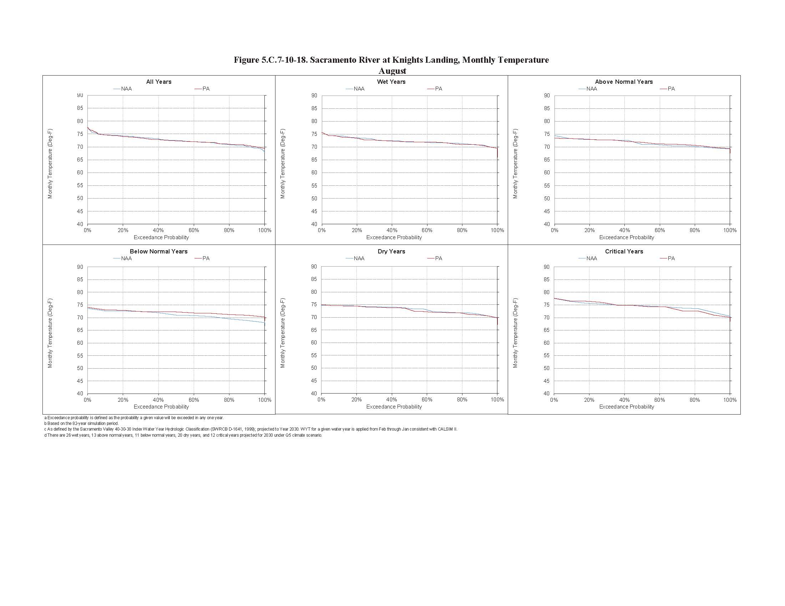
Lower Sacramento River Temperature
Probability of exceedance of temperature for August at Knights Landing (1922 – 2003 period of record modeled).

Slide 10
Opinion 2
  Lower American River HABs:
The effects of the CWF on lower American River flows (and associated channel turbulence, mixing, and residence time) and water temperatures would not be sufficient to substantially change the frequency or magnitude of cyanobacteria blooms that could potentially occur in the river upstream of the E.A. Fairbairn WTP intake, relative to the NAA.

Slide 11
Opinion 3
  DBPs at City of Sacramento WTPs:
The CWF would not cause increases in temperature or organic carbon in the lower Sacramento River or lower American River of frequency and magnitude that would cause substantial adverse impacts to DBP formation potential at the City’s WTPs.

Slide 12
Temperature and
DBP Formation Potential
Lower Sacramento River
Lower American River
CWF Max annual average temperature increase = 0.1°F
Max potential TTHM increase (5 models):
0.4%
CWF Max annual average temperature increase = 0.5°F
Max potential TTHM increase (5 models):
1.6%

Slide 13
DWR-9
IMPACT OF TEMPERATURE INCREASE (1^{O} F) ON TTHM AND HAA5 FORMATION
Douglas M. Owen, P.E., BCEE, ENV SP: President, Owen Water Consulting LLC
Page 1

Slide 14
Conclusions
DWR-9
A temperature difference of 1º F is very small in terms of affecting TTHM and HAA5 formation. This temperature change alone would not result in a DBP compliance issue for the City of Sacramento’s WTPs under current regulatory requirements.
Operators at potable WTPs may observe discernable differences in DBP concentrations over increments of 5º C, which corresponds to 9º F.
Increases in water temperature affect the water treatment process. Conventional processes, as well as disinfection become more efficient as temperature increases.
Page 2

Slide 15
Analytical approach
DWR-9
Applied industry-accepted TTHM and HAA5 formation equations to assess impact of increase in temperature
  Used by USEPA in DBP regulatory development
Parameter | Temperature (ºF)
 | 59 increased to 60 | 76 increased to 77
Total Trihalomethanes | 2.3 percent | 1.4 percent
Sum of Five Haloacetic Acids | 1.3 percent | 0.8 percent
Page 3

Slide 16
Organic Carbon and
DBP Formation Potential
Cyanobacteria:
  Would not change notably in either river between the CWF and the NAA, and thus would not contribute to higher DOC in river
Reservoir Storage:
  No relationship between storage and river organic carbon concentrations, as claimed
  Potential additional exposed Folsom Reservoir shoreline in fall months <0.01% of watershed

Slide 17
Shasta Reservoir Storage vs. River
Dissolved Organic Carbon (DOC)
Dissolved organic carbon (DOC) concentration in the lower Sacramento River at Balls Ferry versus end-of-month Shasta Reservoir storage for 2005–2016.
Conclusion: DOC in river does not go up as storage goes down

Slide 18
Folsom Reservoir Storage vs. River
Dissolved Organic Carbon (DOC)
Dissolved organic carbon (DOC) concentration in the lower American River at E.A. Fairbairn WTP versus end-of-month Folsom Reservoir storage for 1994–2016.
Conclusion: DOC in river does not go up as storage goes down

Slide 19
Opinion 4
Reservoir Storage and Dissolved Metals in Rivers:
The discharge from reservoirs having somewhat lower summer and fall storage for the CWF, relative to the NAA, would not cause increased dissolved metals in rivers and thus would not cause additional treatment requirements at either WTP

Slide 20
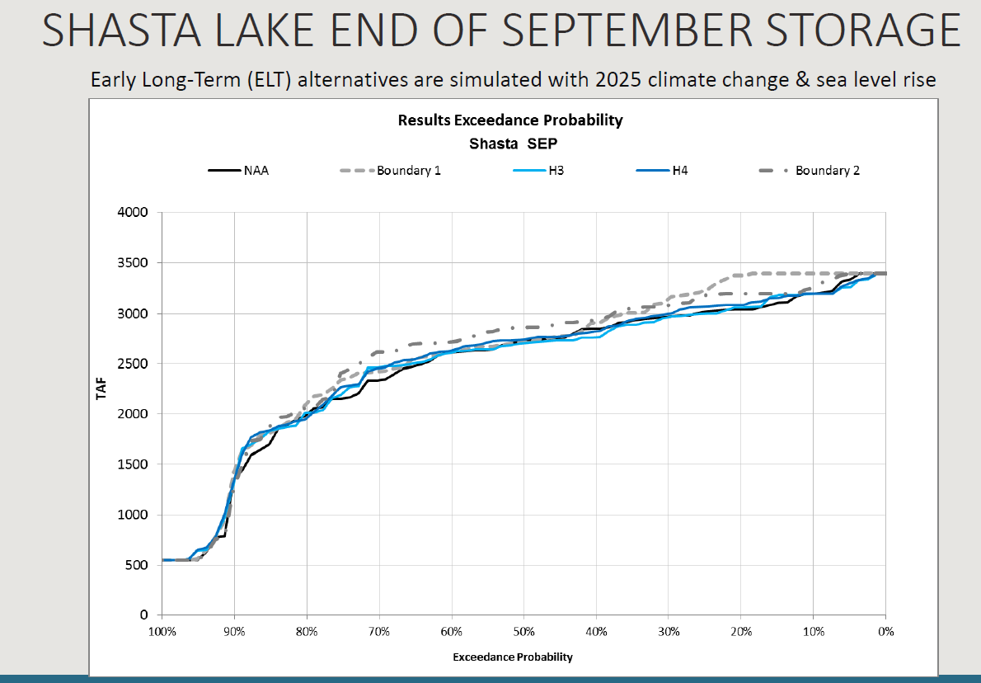
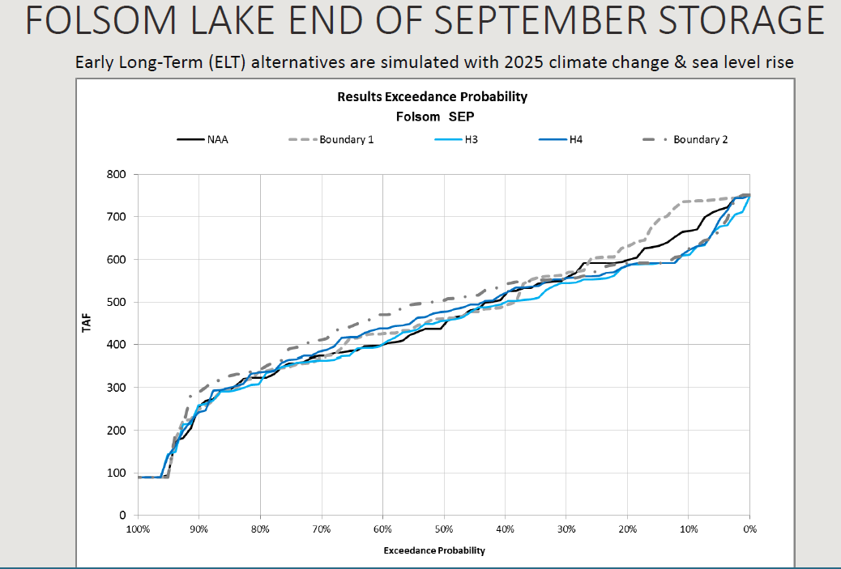
No significant change in storage
Figures from DWR Exhibit 5 (Errata) pp. 47 and 48

Slide 21
Reservoir Storage vs. River
Dissolved Iron Conc.
Dissolved iron concentration in the lower Sacramento River at Balls Ferry versus end-of-month Shasta Reservoir storage for 2004–2016.
Conclusion: Lower storage may be weakly related to lower metals, not higher

Slide 22
CWF Effects on
Delta HABs
Opinions presented regarding CWF effects on HABs in the Delta as affected by:
  Flow and associated velocity and residence time
  Temperature
  Turbidity
  Nutrients
Exhibit DWR-XXX

Slide 23
Opinion 5
Delta Flows and HABs:
Although Microcystis blooms are expected to occur at certain Delta locations in the future, as they have historically, channel velocities at various Delta locations would not be altered to a degree that would make hydrodynamic conditions substantially more conducive to Microcystis blooms for the CWF, relative to that which would occur for the NAA.

Slide 24
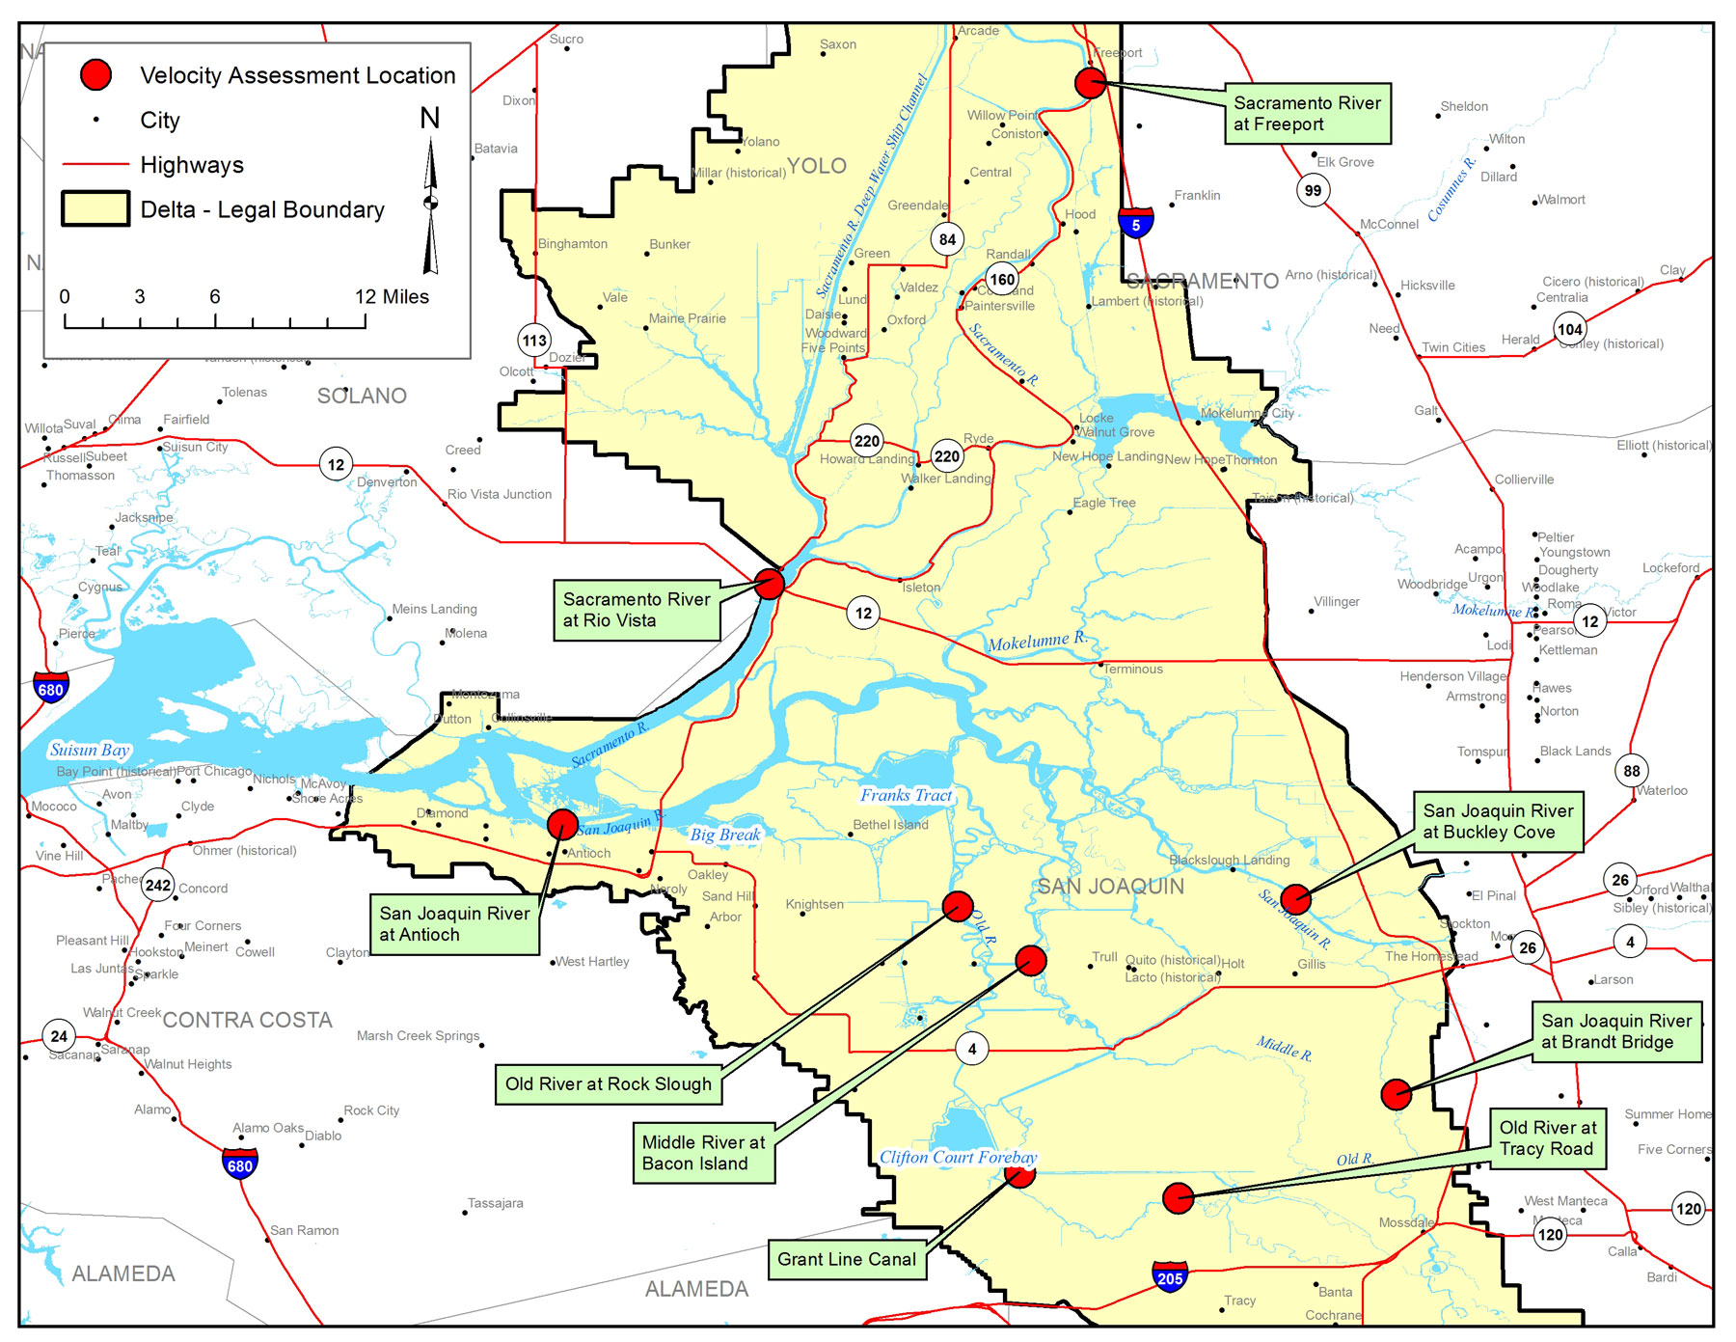
Delta Flow Velocity Effects Analysis

Slide 25
Daily Max Velocity:
Old River at Rock Slough
Probability of exceedance of daily maximum velocity for the 1976–1991 period of record modeled.

Slide 26
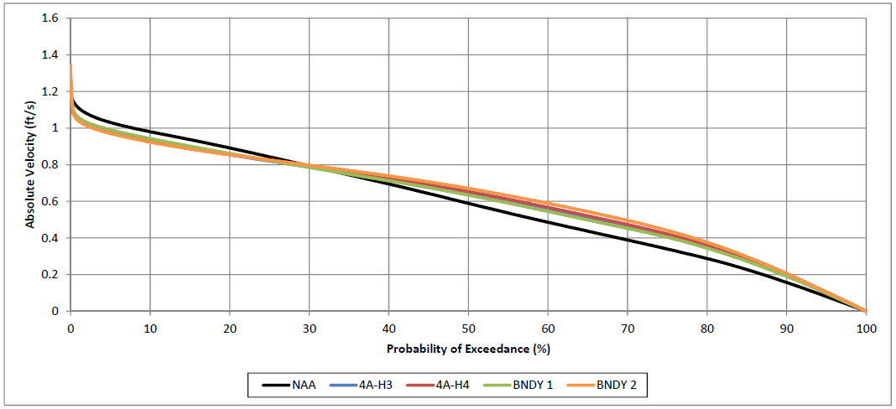
15-minute Velocity
Old River at Rock Slough
Probability of exceedance of absolute values of daily velocities, on a 15-minute time-step, for the June through November period (1976–1991 period of record modeled).

Slide 27
Opinion 6
Delta Residence Time and HABs:
Increased residence time alone does not equate with increased Microcystis bloom frequency or magnitude. Based on current science, it is uncertain how cyanoHABs would react to the CWF-driven changes in residence time.

Slide 28
Residence Time
Channel velocity is the driver of:
  Residence time
  Channel turbulence and mixing (which affects competition with other algae for resources)
  In-channel turbidity
Because these and other factors interact in a complex fashion to affect cyanoHABs, increased or “long” residence times do not always result in bloom occurrence or increased bloom magnitude.

Slide 29
Opinion 7
Delta Temperature and HABs:
The small differences in water temperature between the CWF and NAA scenarios modeled for various locations across the Delta would not substantially increase the frequency or magnitude of cyanobacteria blooms within the Delta.

Slide 30
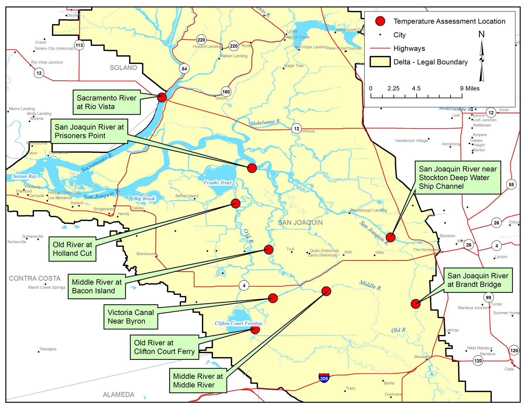
Delta Temperature Effects Analysis

Slide 31
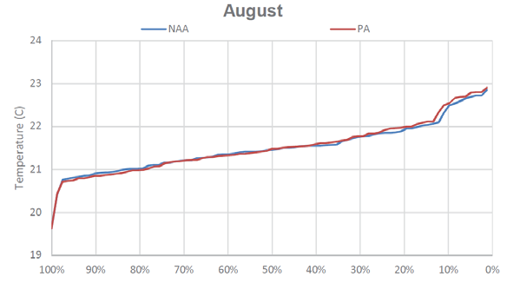
Delta Temperature:
SJR at Prisoner’s Point
Probability of exceedance of temperatures for August for the 1922–2003 period of record modeled. Source: Biological Assessment, Appendix 5B, Figure 5.B.5.41‐1.

Slide 32
Opinion 8
Delta Turbidity and HABs:
Any minor change in turbidity that may occur from the CWF would not have a substantial effect on the frequency or magnitude of HABs in the Delta.

Slide 33
Delta Turbidity Effects Analysis
Final EIR/EIS, Chapter 8, p. 8-971 to 8-972 states: the CWF operations is expected to have a minimal effect on total suspended solids (TSS) and turbidity levels in the Delta, relative to the NAA
In drought year 2014, when Microcystis blooms were large in magnitude and duration, light levels in the euphotic zone were no greater than they were in previous years during the peak of the bloom (Lehman et al. 2017)
Delta turbidity in 2014 did not differ significantly from other years

Slide 34
Opinion 9
Delta Nutrients and HABs:
Relatively small increases in nutrients due to the CWF would not be expected to increase the frequency, magnitude, or duration of cyanoHAB in the Delta, relative to that which would occur for the NAA.

Slide 35
Delta Nutrients
Berg and Sutula (2015) found that nutrient concentrations and N:P ratios do not change sufficiently among years to explain inter-annual variation in Microcystis biomass or occurrence.
They further stated: “Therefore, the initiation of Microcystis blooms and other cyanoHABs are probably not associated with changes in nutrient concentrations or their ratios in the Delta.”
Total N and orthophosphate (SRP) concentrations were well in excess during the Microcystis bloom in 2014 and the N:P ratio was not correlated with Microcystis biovolume (Lehman et al. 2017).

Slide 36
Opinion 10
Water Quality at City of Stockton WTP Intake:
The CWF would not alter water quality at the City of Stockton’s WTP intake location in a manner that would cause adverse impacts to the municipal and industrial supply beneficial uses at this river location.

Slide 37
CWF Effects at
City of Stockton WTP Intake
City of Stockton concerns:
  Bromide
  Chloride
  Electrical Conductivity
  Organic Carbon
  Nitrate / Nitrite
  Pesticides
  Other Toxins
  Water Temperature
  Cyanobacteria (e.g., Microcystis)

Slide 38
CWF Effects on
Bromide at Stockton Intake
Box-and-whisker and probability of exceedance plots for monthly average bromide concentrations in the San Joaquin River at the City of Stockton’s drinking water diversion location for all water years (1976–1991)

Slide 39
Questions

