Slide 1
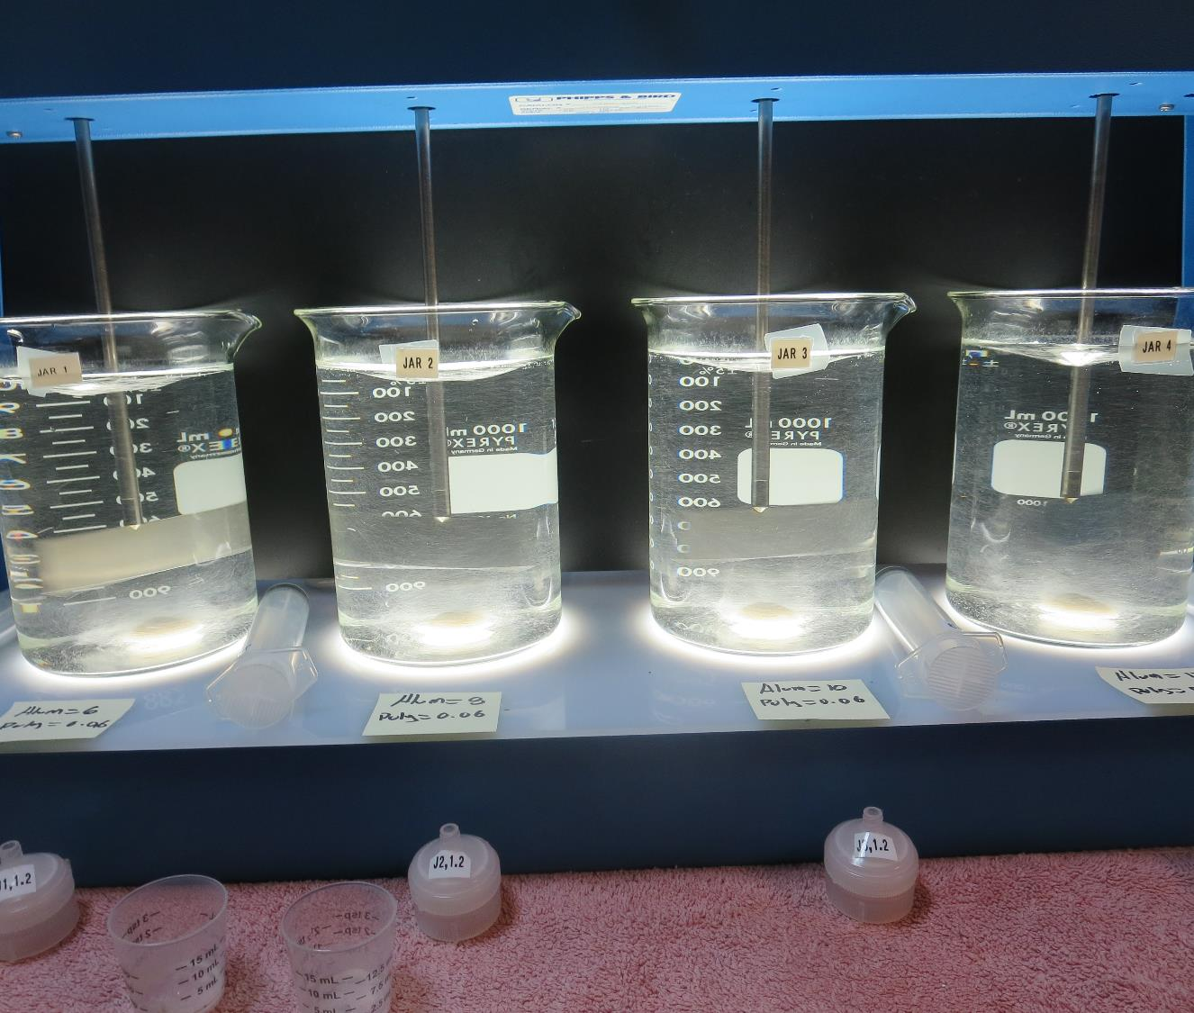
City of Fresno CA1010007 Fresno County Jar Test Actiflo
by Guy Schott, P.E.
January 7, 2020

Slide 2
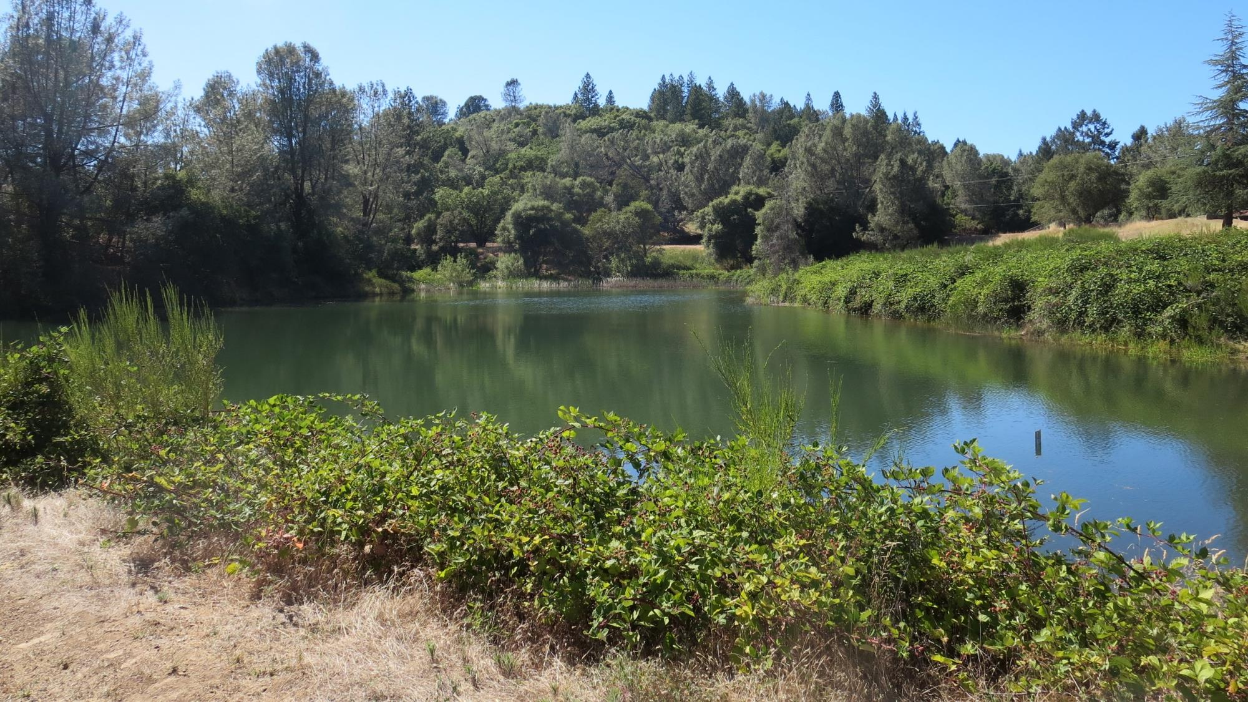
Kings River

Slide 3
City of Fresno Kings River Water Characteristics January 7, 2020
Source
Turbidity: 0.45 NTU
pH: 7.32
UVT: 91.7% (unfiltered)
UVA/cm: 0.038

Slide 4
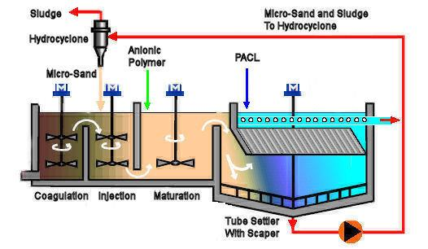
Actiflo Microsand Ballasted Clarification Treatment
Alum

Slide 5
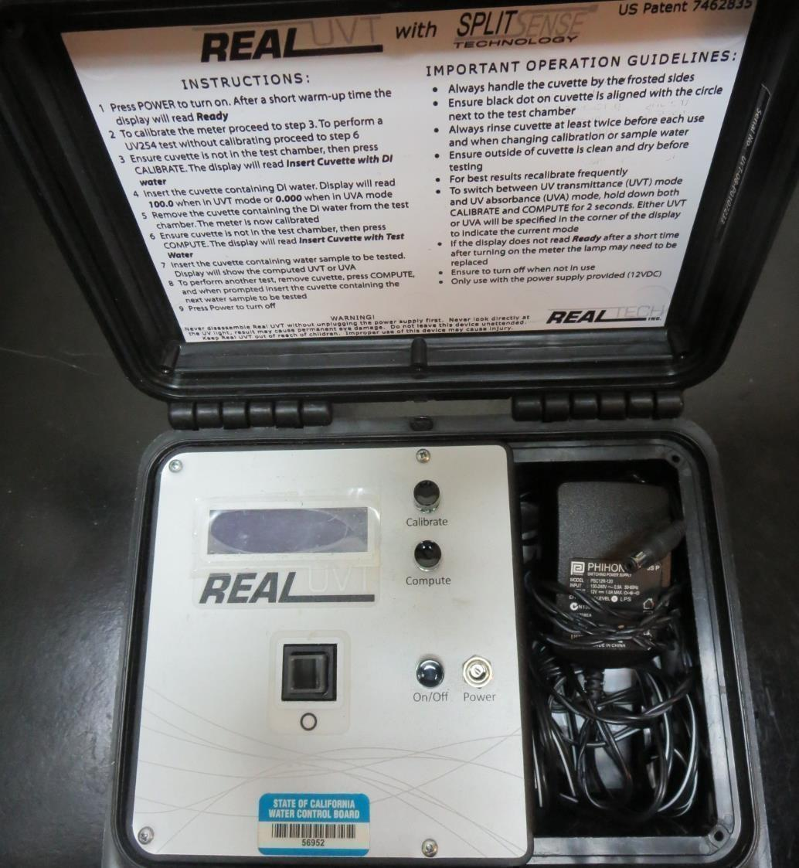
UVT/UVA
UV transmittance (UVT) is a measurement of the amount of ultraviolet light (commonly at 254 nm due to its germicidal effect) that passes through a water sample compared to the amount of light that passes through a pure water sample. The measurement is expressed as a percentage, % UVT.
%UVT = 10^{(-UVA)} x 100%
UV absorbance (UVA) is calculated as a relative measure of the amount of light absorbed by a water sample compared with the amount of light absorbed by a pure water sample.
UVA = -log(%UVT/100)

Slide 6
Coagulant Used for Jar Testing
Pro Pac 9800 (NTU Technologies)
50% Aluminum Chlorohydrate (ACH)
50% Water
SG = 1.34
Aluminum Sulfate
48.24% Aluminum Sulfate
8.2% Al₂O₃
SG = 1.34
Nalco – Optimer 8110 PULV
Polyacrylamide
Dry
Max use 1 mg/L

Slide 7
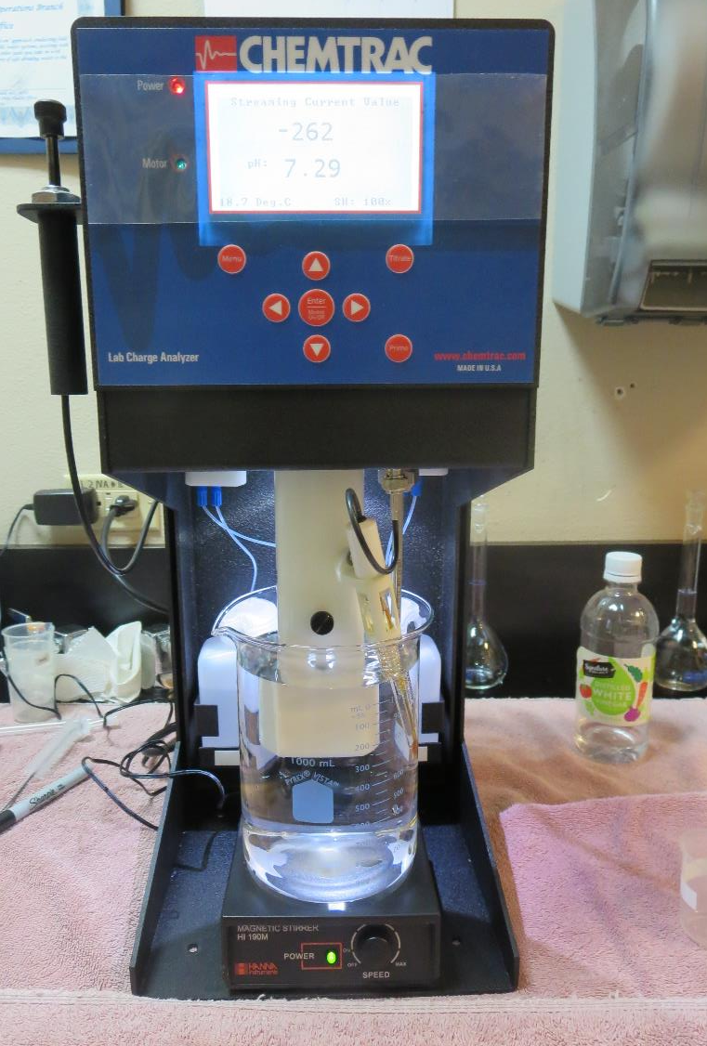
Laboratory Charge Analyzer
LCA: Used to determine coagulant demand of a source water entering the treatment plant.
Source pH: 7.32
LCA #1:
Optimer 8110: 0.06 mg/L as product
Alum: 6.29 mg/L as product
pH adjusted to 6.8 with acetic acid.

Slide 8
City of Fresno – Northeast Plant, Jar Test 1-8 Results Flash Mix 200 RPM (30 sec), MR (Maturation)
Jar # | Alum mg/L | 110 RPM Mix min | Ballast Sand | 8110 PULV mg/L | 60 RPM MR min | Filtrate NTU | Filtrate %UVT | Filtrate UVA/cm | Settle NTU 5 min
J1 | 6 | 2 | ½ Tsp | 0.06 | 3 | 0.15 | 95.1 | 0.021 | 1.0
J2 | 8 | 2 | ½ Tsp | 0.06 | 3 | 0.09 | 95.8 | 0.019 | 0.81
J3 | 10 | 2 | ½ Tsp | 0.06 | 3 | 0.08 | 96.1 | 0.017 | 0.82
J4 | 12 | 2 | ½ Tsp | 0.06 | 3 | 0.08 | 96.3 | 0.016 | 0.96
J5 | 12 | 2 | ½ Tsp | 0.06 | 3 | 0.08 | 96.3 | 0.016 | 0.74
J6 | 14 | 2 | ½ Tsp | 0.06 | 3 | 0.07 | 96.3 | 0.016 | 0.74
J7 | 16 | 2 | ½ Tsp | 0.06 | 3 | 0.06 | 96.9 | 0.014 | 0.76
J8 | 18 | 2 | ½ Tsp | 0.06 | 3 | 0.10 | 96.7 | 0.015 | 0.76

Slide 9
City of Fresno – Northeast Plant, Jar Test 9-16 Results Flash Mix 200 RPM (30 sec), MR (Maturation)
Jar # | Alum mg/L | 110 RPM Mix min | Ballast Sand | 8110 PULV mg/L | 60 RPM MR min | Filtrate NTU | Filtrate %UVT | Filtrate UVA/cm | Settle NTU 5 min
J9 | 12 | 2 | ½ Tsp | 1.0 | 3 | 0.08 | 96.3 | 0.016 | 0.77
J10 | 14 | 2 | ½ Tsp | 1.0 | 3 | 0.07 | 96.7 | 0.015 | 0.89
J11 | 16 | 2 | ½ Tsp | 1.0 | 3 | 0.06 | 96.7 | 0.015 | 0.75
J12 | 18 | 2 | ½ Tsp | 1.0 | 3 | 0.10 | 96.6 | 0.015 | 0.65
J13 | 12 | 2 | ½ Tsp | 0 | 3 | 0.12 | 96.1 | 0.017 | 0.71
J14 | 14 | 2 | ½ Tsp | 0 | 3 | 0.09 | 96.2 | 0.017 | 1.07
J15 | 16 | 2 | ½ Tsp | 0 | 3 | 0.13 | 96.0 | 0.018 | 0.78
J16 | 18 | 2 | ½ Tsp | 0 | 3 | 0.10 | 96.3 | 0.016 | 0.66

Slide 10
City of Fresno – Northeast Plant, Jar Test 17-24 Results Flash Mix 200 RPM (30 sec), MR (Maturation)
Jar # | Alum mg/L | 110 RPM Mix min | Ballast Sand | 8110 PULV mg/L | 60 RPM MR min | Filtrate NTU | Filtrate %UVT | Filtrate UVA/cm | Settle NTU 5 min
J17 | 12 | 2 | 0 | 0.06 | 3 | 0.12 | 96.2 | 0.017 | 0.63
J18 | 14 | 2 | 0 | 0.06 | 3 | 0.11 | 96.4 | 0.016 | 0.65
J19 | 16 | 2 | 0 | 0.06 | 3 | 0.11 | 96.8 | 0.014 | 0.63
J20 | 18 | 2 | 0 | 0.06 | 3 | 0.09 | 96.7 | 0.015 | 0.57
J21 | 12 | 2 | 1/4 Tsp | 0.06 | 3 | 0.12 | 96.4 | 0.016 | 0.74
J22 | 14 | 2 | $1/4$ Tsp | 0.06 | 3 | 0.11 | 96.4 | 0.016 | 0.72
J23 | 16 | 2 | 1/4 Tsp | 0.06 | 3 | 0.08 | 96.5 | 0.015 | 0.87
J24 | 18 | 2 | 1/4 Tsp | 0.06 | 3 | 0.08 | 96.7 | 0.015 | 0.79

Slide 11
City of Fresno – Northeast Plant, Jar Test 25-28 Results Flash Mix 200 RPM (30 sec), MR (Maturation)
Jar # | 9800 mg/L | 110 RPM Mix min | Ballast Sand | 8110 PULV mg/L | 60 RPM MR min | Filtrate NTU | Filtrate %UVT | Filtrate UVA/cm | Settle NTU 5 min
J25 | 7.0 | 2 | ½ Tsp | 0.06 | 3 | 0.08 | 96.4 | 0.016 | 0.73
J26 | 8.5 | 2 | ½ Tsp | 0.06 | 3 | 0.11 | 96.4 | 0.016 | 0.72
J27 | 10 | 2 | ½ Tsp | 0.06 | 3 | 0.10 | 96.6 | 0.015 | 0.80
J28 | 11.5 | 2 | ½ Tsp | 0.06 | 3 | 0.10 | 96.7 | 0.015 | 0.62

Slide 12
Jar Testing – Procedures for Actiflo 1-Liter Jars
Fill jars with source water prior to coagulant injection; set paddle speed at 30 rpm
Add primary coagulant to each jar
Flash mix for 15-60 seconds (200 rpm for 1-liter jars)
Reduce paddled speed to (110 rpm for 1-liter jars)
Add ballast sand (1/2 tsp/liter)
Hold paddle speed for 2-minutes
Reduce paddle speed to (60 rpm for 1-liter jars)
Add polymer

Slide 13
Jar Testing – Procedures for Actiflo 1-Liter Jars - continue
Hold paddle speed for 3-minutes (maturation basin)
Turn paddles off; raise paddles out of water; settled for 1 minute
Syringe 25 mL from each jar taken 1-inch below surface (25 mL/12 sec rate)
Filtered through 1.2 um Isopore membrane into cuvette (drip rate, 15 mL/90 sec)
Measure filtrate turbidity, chlorine residual and %UVT or UVA
Measure settled water turbidity after 5 minutes of total setting
Record all data

Slide 14
Jar Test Filterability Test Equipment
Turbidity Instrument
Syringe w/Luer-Lock Tip, 30 cc
(part#: 2225800, by Hach)
Swinnex Filter Holder, 25 mm (part#: SX0002500)
Isopore Membrane Filter, 1.2 um absolute
pore size,
Φ= 25 mm , thickness: 24 um,
hydrophilic polycarbonate membrane
(part #: RTTP02500)
Go to Sigma-Aldrich for laboratory supplies http://www.sigmaaldrich.com/united-states.html

Slide 15
Isopore Membrane Information
Categories | Information
trade name | Isopore
filter color | White
chemistry | Polycarbonate (PC)
water flow rate | Avg. 175 mL/min x cm² (typical results @ 10 psi)
media | Isopore®
wettability | Hydrophilic
porosity | 14.7%
pore size | 1.2 µm
bubble point at 23 °C | 1.0 bar, air with water
thickness | 24 µm
filter diameter (ø) | 25 mm
material size | polycarbonate, Hydrophilic, 1.2 µm, 25 mm, white, plain, 100

Slide 16
Isopore Membrane Background Information
The Isopore membrane is a polycarbonate, track-etched screen filter recommended for all analyses in which the sample is viewed on the surface of the membrane. The Isopore membrane is composed of polycarbonate film, which has a smooth, glass-like surface for clearer sample observation. The unique manufacturing process of the membrane ensures a precise pore diameter and a consistent pore size for accurate separation of samples by size. Matched-weight filters are not usually required because of low, constant tar and ash weights. Features & Benefits: Membrane structure retains particles on the surface, simplifying counting and analysis

Slide 17
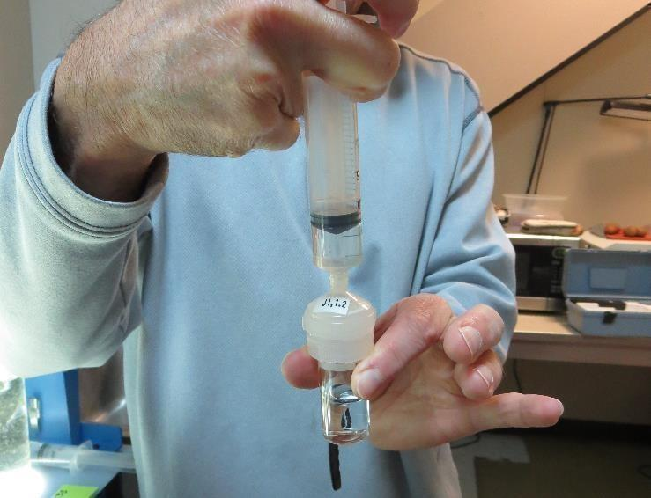
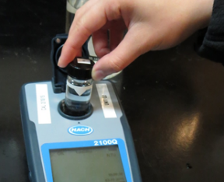
Jar Test - Filterability Test
Syringe ~ 25 mL from jar (after 5-minutes of settling)
Filter-to-waste 3-5 mL
Filter directly into clean cuvette
Measure turbidity
Note: Take several readings before recording final NTU results. Micro bubbles can adhere to glass causing false NTU readings. To remove bubbles, tilt cuvette up to 90 degrees.

Slide 18
Contact
Guy Schott, P.E.
State Water Resources Control Board
Division of Drinking Water
Santa Rosa, CA
Go to Stock Solution/Dose calculations/Jar Test Results for tools to download
www.waterboards.ca.gov/drinking_water/programs/districts/mendocino_district.html
Email: Guy Schott - Guy.Schott@waterboards.ca.gov
Office Number: 707-576-2732

