Slide 1
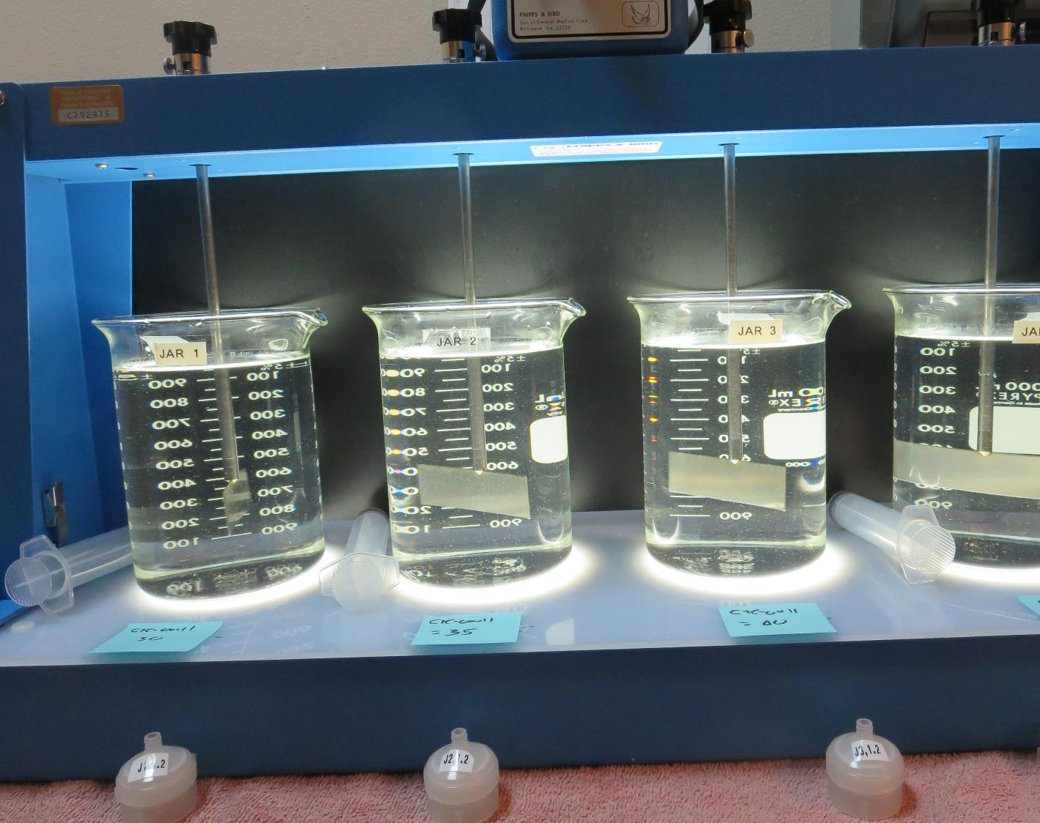
Bass Lake Water Company CA2010003 Madera County Jar Test
by Guy Schott, P.E.
July 9, 2021

Slide 2
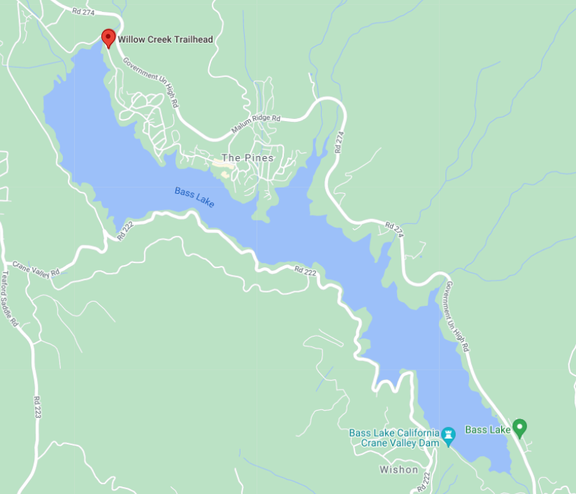
Source: Willow Creek

Slide 3
Trident
Inline Filtration System
Static Mixer, 350-gallon contact tank, and Anthracite/Sand Filtration

Slide 4
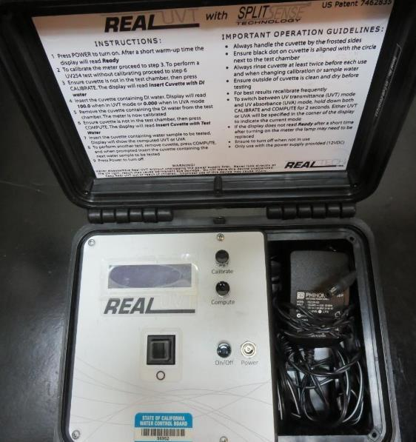
UVT/UVA, pathlength 10 mm
UV transmittance (UVT) is a measurement of the amount of ultraviolet light (254 nm) that passes through a water sample compared to the amount of light that passes through a pure water sample. The measurement is expressed as % UVT.
%UVT = 10^{(-UVA)} x 100%
UV absorbance (UVA) is calculated as a relative measure of the amount of light absorbed by a water sample compared with the amount of light absorbed by a pure water sample.
UVA = -log(%UVT/100)

Slide 5
Willow Creek Source and Plant Filtrate Water Characteristics, July 9, 2021
Source
pH: 7.53
Alkalinity: 17-21 mg/L as CaCO₃ (State Database, 2021)
Turbidity: 0.42 NTU
UVT: 88.3%,
UVA: 0.053/cm
0.4 um Filtered
Turbidity: 0.11 NTU
UVT: 89.9%,
UVA: 0.046/cm
Plant Filtrate Water (before-chlorination
Turbidity: 0.07 NTU
UVT: 95.7%,
UVA: 0.019/cm
UVA Reduction: 58.7%

Slide 6
Applied Coagulants for Jar Testing (1)
Nalco, ULTRION 8157
10-30% Aluminum Hydroxychlorite
1-5% Aluminum Phosphate
10-30% Calcium Chloride
5% Polyquaternary amine chloride
SG = 1.27
Viscosity: 14 centipoise
NSF limit: 200 mg/L (product)
Product dose 40 mg/L = 1.0 mg/L polyamines active
AdvFloc-CTC-00011
Polyaluminum Hydroxy Chlorosulfate
12.55% Al₂O₃
6.64% Al
64.9% Basicity
SG = 1.299
NSF limit: 250 mg/L as Product
BWS, Inc.
Greg Nieckarz, Ph.D.
Greg.niekarz@bws.works
541-953-5112

Slide 7
Applied Coagulants for Jar Testing (2)
Nalco, Nalcolyte 8105
SG = 1.14 – 1.18
Viscosity: 125-400 centipoise
Polyquaternary amine chloride
NSF limit: 10 mg/L (product)
Product dose 2 mg/L = 1 mg/L polyamine active
Nalco, CAT-FLOC 8103
SG = 1.018 – 1.058
Viscosity: <1,050 centipoise
pDADMAC
NSF limit: 57 mg/L (product)

Slide 8
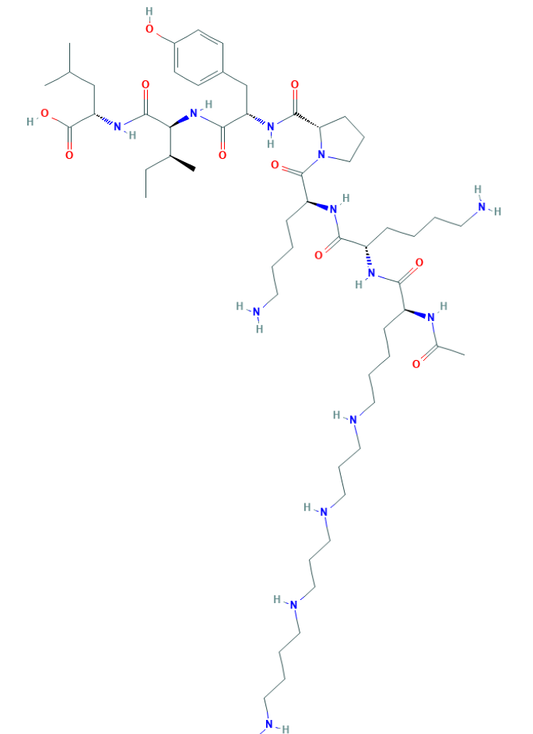
Polyamine C₅₉H₁₀₈N₁₄O₁₀ MW: 1,173.6 g/mol

Slide 9
Diallyldimethylammonium chloride or N-allyl-N,N-dimethylprop-2-en-1-aminium chloride pDADMAC C₈H₁₆ClN MW: 161.67 g/mol
CH₃
CH₂
CH₂
CH
N
+
CH
CH₂
CH₂
CH₃
Cl⁻

Slide 10
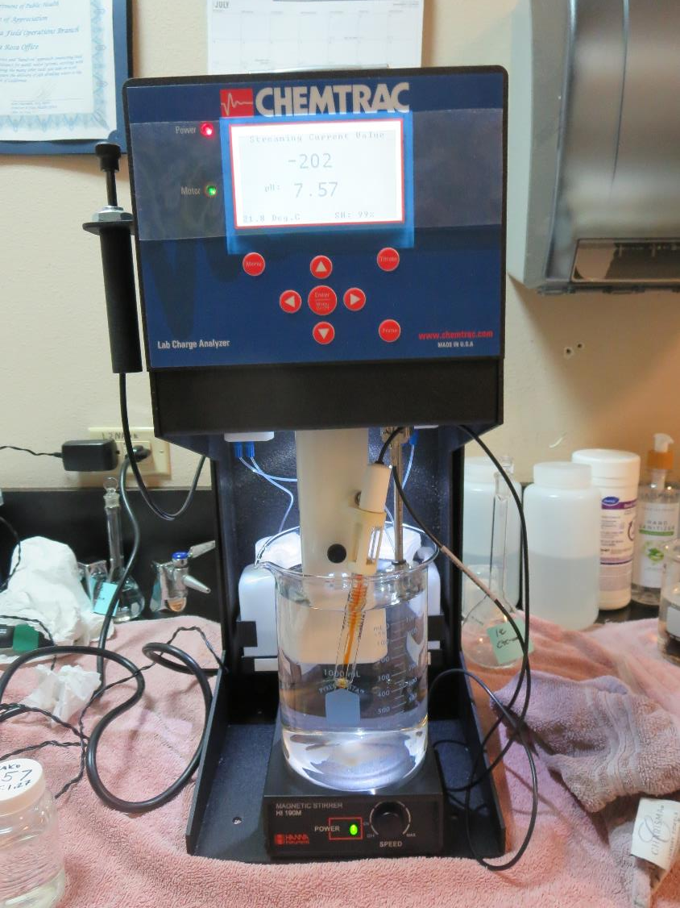
Laboratory Charge Analyzer
LCA: Used to determine coagulant demand of a source water entering the treatment plant.
Source pH: 7.53 – 7.57
LCA #1: Nalco 8157: 24 mg/L
LCA #2: Nalco 8105: 1 mg/L (manually dosed)
Nalco 8157: 7.5 mg/L
LCA #3: Nalco 8103: 1 mg/L (manually dosed)
Nalco 8157: 22.6 mg/L
LCA #4: AdvFloc CTC-00011: 41 mg/L
LCA #5: Nalco 8105: 1 mg/L (manually dosed)
AdvFloc CTC-00011: 15.1 mg/L

Slide 11
Coagulant Information
Unless stated otherwise, all coagulant doses are reported as Product (100% strength).
Aluminum Sulfate doses are reported as hydrated Al₂(SO₄)₃*14.3H₂0.
Preparation of coagulant stock solutions are generally 1.0 and/or 0.1 percent strength using 100 and/or 200 mL volumetric flasks.
Finnpipette F2 variable volume pipette, capacity 100-1000 micro liters is used for stock solution preparation and coagulant aid jar test dosing.
Finnpipette F2 variable volume pipette, capacity 0.5-5 mL is used for primary coagulant jar test dosing.

Slide 12
Bass Lake Water Company: Source: Willow Creek Summary of Source Post Membrane vs. Optimum Dose and Coagulants Filtrate Jars
Jar# | CTC- 00011 mg/L | ULTRION 8157 mg/L | Nalcolyte 8105 polyamines mg/L | Cat-Floc 8105 pDADMAC mg/L | Filtrate NTU | Filtrate %UVT | Filtrate UVA/cm | %UVA Reduction
A | 0 | 0 | 0 | 0 | 0.05 | 90.8 | 0.041 | 10.9
B | 7.5 | 0 | 1.5 | 0 | 0.04 | 95.9 | 0.018 | 60.9
C | 10 | 0 | 1.2 | 0 | 0.03 | 95.8 | 0.018 | 60.9
D | 10 | 0 | 0 | 1.2 | 0.04 | 95.1 | 0.021 | 54.3
E | 40 | 0 | 0 | 0 | 0.04 | 96.5 | 0.015 | 67.4
F | 0 | 24 | 0 | 0 | 0.05 | 96.2 | 0.016 | 65.2
G | 0 | 5 | 0 | 1.5 | 0.06 | 95.1 | 0.021 | 54.3
Note: Jar A –water filtered through a 0.2 um absolute Isopore membrane. All other jars were filtered through 1.2 um absolute Isopore membranes used for the filterability and UVT/UVA analysis.

Slide 13
Jar Test – Filtrate Water Spiked with 2.0 mg/L NaOCl Membrane Filtrate Water vs. Filtrate Optimum Coagulant/Dose
TTHM: 45 ug/L,
HAA5: 34 ug/L
TTHM: 80 ug/L,
HAA5: 73 ug/L

Slide 14
Bass Lake Water Company: TTHMs/HAA5s Laboratory Results NaOCl dose after filtration: 2.0 mg/L (Hold Time 4.2 days)
Jar # | CTC-0001 mg/L | Nalcolyte 8105 mg/L | Filtrate %UVT | Filtrate UVA/cm | %UVA Reduction | TTHM ug/L | HAA5 ug/L | Cl2 Residual mg/L
1 | 0 | 0 | 90.8 | 0.041 | 10.9 | 80 | 73 | 0.05
2 | 7.5 | 1.5 | 95.6 | 0.019 | 58.7 | 45 | 34 | 0.82
End of 4.2 days:
Jar #1: UVT: 93.7%, UVA: 0.027/cm; (additional UVA reduction: 41.3%)
Jar #2: UVT: 97.2%, UVA: 0.012/cm; (additional UVA reduction: 15.2%)

Slide 15
Source: Willow Creek; Jar Test 1 - 8 Results Flash Mix 200 RPM (20 sec); Floc Mix 20 RPM (1 min)
Jar# | ULTRION 8157 mg/L | Nalcolyte 8105 mg/L | Filtrate NTU | Filtrate %UVT | Filtrate UVA/cm | %UVA Reduction
J1 | 3.85 | 1.45 | 0.41 | 92.6 | 0.033 | 28.3
J2 | 10 | 1.45 | 0.22 | 93.9 | 0.027 | 41.3
J3 | 15 | 1.45 | 0.33 | 93.0 | 0.031 | 32.6
J4 | 20 | 1.45 | 0.31 | 93.5 | 0.028 | 39.1
J5 | 24 | 0 | 0.05 | 96.2 | 0.016 | 65.2
J6 | 30 | 0 | 0.07 | 95.8 | 0.018 | 60.9
J7 | 35 | 0 | 0.06 | 96.1 | 0.017 | 63.0
J8 | 40 | 0 | 0.04 | 96.7 | 0.014 | 69.6

Slide 16
Source: Willow Creek; Jar Test 9 - 16 Results Flash Mix 200 RPM (20 sec); Floc Mix 20 RPM (1 min)
Jar# | ULTRION 8157 mg/L | Cat-Floc 8103 mg/L | Filtrate NTU | Filtrate %UVT | Filtrate UVA/cm | %UVA Reduction
J9 | 10 | 0 | 0.23 | 92.1 | 0.035 | 23.9
J10 | 15 | 0 | 0.24 | 92.7 | 0.032 | 30.4
J11 | 20 | 0 | 0.15 | 94.2 | 0.025 | 43.5
J12 | 24 | 0 | 0.09 | 95.1 | 0.022 | 52.2
J13 | 10 | 1.0 | 0.05 | 95.2 | 0.021 | 54.3
J14 | 10 | 2.0 | 0.07 | 95.7 | 0.018 | 60.9
J15 | 10 | 4.0 | 0.33 | 91.0 | 0.040 | 13.0
J16 | 10 | 6.0 | 0.38 | 90.0 | 0.045 | 2.2

Slide 17
Source: Willow Creek; Jar Test 17 - 20 Results Flash Mix 200 RPM (20 sec); Floc Mix 20 RPM (1 min)
Jar# | ULTRION 8157 mg/L | Cat-Floc 8103 mg/L | Filtrate NTU | Filtrate %UVT | Filtrate UVA/cm | %UVA Reduction
J17 | 5 | 0.5 | 0.25 | 92.3 | 0.034 | 26.1
J18 | 5 | 1.0 | 0.07 | 95.0 | 0.022 | 52.2
J19 | 5 | 1.5 | 0.06 | 95.1 | 0.021 | 54.3
J20 | 5 | 2.0 | 0.11 | 95.3 | 0.020 | 56.5

Slide 18
Source: Willow Creek; Jar Test 21 - 28 Results Flash Mix 200 RPM (20 sec); Floc Mix 20 RPM (1 min)
Jar# | CTC-00011 mg/L | Cat-Floc 8103 mg/L | Filtrate NTU | Filtrate %UVT | Filtrate UVA/cm | %UVA Reduction
J21 | 30 | 0 | 0.06 | 95.9 | 0.017 | 63.0
J22 | 35 | 0 | 0.05 | 96.5 | 0.015 | 67.4
J23 | 40 | 0 | 0.04 | 96.5 | 0.015 | 67.4
J24 | 45 | 0 | 0.05 | 96.4 | 0.015 | 67.4
J25 | 10 | 0 | 0.23 | 91.4 | 0.038 | 17.4
J26 | 10 | 1.0 | 0.08 | 95.1 | 0.021 | 54.3
J27 | 15 | 0 | 0.09 | 94.4 | 0.024 | 47.8
J28 | 15 | 1.0 | 0.06 | 95.5 | 0.019 | 58.7

Slide 19
Source: Willow Creek; Jar Test 29 - 36 Results Flash Mix 200 RPM (20 sec); Floc Mix 20 RPM (1 min)
Jar# | ULTRION 8157 mg/L | Cat-Floc 8103 mg/L | Nalcolyte8105 mg/L | Filtrate NTU | Filtrate %UVT | Filtrate UVA/cm | %UVA Reduction
J29 | 5.5 | 0 | 1.0 | 0.32 | 92.9 | 0.031 | 32.6
J30 | 6.5 | 0 | 1.0 | 0.25 | 93.3 | 0.030 | 34.8
J31 | 7.5 | 0 | 1.0 | 0.24 | 93.5 | 0.028 | 39.1
J32 | 8.5 | 0 | 1.0 | 0.21 | 93.9 | 0.027 | 41.3
J33 | 5.5 | 1.0 | 0 | 0.22 | 91.0 | 0.040 | 13.0
J34 | 6.5 | 1.0 | 0 | 0.26 | 91.3 | 0.039 | 15.2
J35 | 7.5 | 1.0 | 0 | 0.22 | 91.7 | 0.037 | 19.6
J36 | 8.5 | 1.0 | 0 | 0.21 | 92.1 | 0.035 | 23.9

Slide 20
Source: Willow Creek; Jar Test 37 - 40 Results Flash Mix 200 RPM (20 sec); Floc Mix 20 RPM (1 min)
Jar# | CTC-00011 mg/L | Nalcolyte 8105 mg/L | Filtrate NTU | Filtrate %UVT | Filtrate UVA/cm | %UVA Reduction
J37 | 5.0 | 1.5 | 0.20 | 93.9 | 0.027 | 41.3
J38 | 7.5 | 1.5 | 0.04 | 95.9 | 0.018 | 60.9
J39 | 10 | 1.5 | 0.10 | 95.2 | 0.021 | 54.3
J40 | 12.5 | 1.5 | 0.08 | 95.7 | 0.019 | 58.7

Slide 21
Source: Willow Creek; Jar Test 41 - 44 Results Flash Mix 200 RPM (20 sec); Floc Mix 20 RPM (1 min)
Jar# | ULTRION 8157 mg/L | Nalcolyte 8105 mg/L | Filtrate NTU | Filtrate %UVT | Filtrate UVA/cm | %UVA Reduction
J41 | 5.0 | 0.5 | 0.23 | 90.0 | 0.045 | 2.2
J42 | 5.0 | 1.0 | 0.25 | 90.6 | 0.042 | 8.7
J43 | 5.0 | 1.5 | 0.23 | 91.7 | 0.037 | 19.6
J44 | 5.0 | 2.0 | 0.14 | 93.3 | 0.029 | 37.0

Slide 22
Source: Willow Creek; Jar Test 45 - 50 Results Flash Mix 200 RPM (20 sec); Floc Mix 20 RPM (1 min)
Jar# | CTC-00011 mg/L | Cat-Floc 8103 mg/L | Nalcolyte 8105 mg/L | Filtrate NTU | Filtrate %UVT | Filtrate UVA/cm | %UVA Reduction
J45 | 7.5 | 1.5 | 0 | 0.13 | 93.6 | 0.028 | 39.1
J46 | 7.5 | 0 | 1.5 | 0.10 | 95.2 | 0.021 | 54.3
J47 | 10 | 1.2 | 0 | 0.04 | 95.1 | 0.021 | 54.3
J48 | 10 | 0 | 1.2 | 0.03 | 95.8 | 0.018 | 60.9
J49 | 7.5 | 0 | 1.5 | 0.11 | 95.6 | 0.019 | 58.7
J50 | 10 | 0 | 1.2 | 0.09 | 95.6 | 0.019 | 58.7

Slide 23
Jar Testing for 1-Liter Jars: Procedures for Inline Treatment Plants
Fill jars with source water prior to coagulant injection and set paddle speed at 30 rpm
Add chemicals (i.e., NaOCl, primary coagulant, coagulant aid) to each jar
Flash mix for 15-30 seconds (200 rpm)
Slow mix for 1 minute (20 rpm)
Syringe 25 mL from each jar taken 1-inch below surface (20 mL/12 sec rate)
Filtered through 1.2 um isopore membrane into cuvette drip rate, 15 mL/(50-90 sec)
Measure filtrate turbidity, chlorine residual and %UVT/UVA
Record all data

Slide 24
Jar Test Filterability Test Equipment
Turbidity Instrument
Syringe w/Luer-Lock Tip, 30 cc
(part#: 2225800, by Hach)
Swinnex Filter Holder, 25 mm (part#: SX0002500)
Isopore Membrane Filter, 1.2 um absolute
pore size,
Φ= 25 mm , thickness: 24 um,
hydrophilic polycarbonate membrane
(part #: RTTP02500)
Go to Sigma-Aldrich for laboratory supplies http://www.sigmaaldrich.com/united-states.html

Slide 25
Isopore Membrane Information
Categories | Information
trade name | Isopore
filter color | White
chemistry | Polycarbonate (PC)
water flow rate | Avg. 175 mL/min x cm² (typical results @ 10 psi)
media | Isopore®
wettability | Hydrophilic
porosity | 14.7%
pore size | 1.2 µm
bubble point at 23 °C | 1.0 bar, air with water
thickness | 24 µm
filter diameter (ø) | 25 mm
material size | polycarbonate, Hydrophilic, 1.2 µm, 25 mm, white, plain, 100

Slide 26
Isopore Membrane Background Information
The Isopore membrane is a polycarbonate, track-etched screen filter recommended for all analyses in which the sample is viewed on the surface of the membrane. The Isopore membrane is composed of polycarbonate film, which has a smooth, glass-like surface for clearer sample observation. The unique manufacturing process of the membrane ensures a precise pore diameter and a consistent pore size for accurate separation of samples by size. Matched-weight filters are not usually required because of low, constant tar and ash weights. Features & Benefits: Membrane structure retains particles on the surface, simplifying counting and analysis

Slide 27
Jar Test - Filterability Test
Syringe ~ 25 mL from jar (after 5-minutes of settling)
Filter-to-waste 3-5 mL
Filter directly into clean cuvette
Measure turbidity
Note: Take several readings before recording final NTU results. Micro bubbles can adhere to glass causing false NTU readings. To remove bubbles, tilt cuvette up to 90 degrees.

Slide 28
Contact
Guy Schott, P.E.
State Water Resources Control Board
Division of Drinking Water
Santa Rosa, CA
Go to Stock Solution/Dose calculations/Jar Test Results for tools to download
www.waterboards.ca.gov/drinking_water/programs/districts/mendocino_district.html
Email: Guy Schott - Guy.Schott@waterboards.ca.gov
Office Number: 707-576-2732

