Slide 1

1,2,3-Trichloropropane (1,2,3-TCP) Maximum Contaminant Level (MCL)
State Water Resources Control Board (State Water Board)
Division of Drinking Water (DDW)
Public Hearing
April 19, 2017

Slide 2
Public Hearing
State Water Board is not taking action on the regulations today
Public Hearing in accordance with Administrative Procedure Act requirements
  Intent is to receive public comments
  State Water Board will respond to public comments in the Final Statement of Reasons
  Written public comments must be submitted to State Water Board by Friday, April 21, at 5:00 p.m.

Slide 3
Schedule
Focused Stakeholder Meetings: May 2016
Public Workshops: July 2016
Public Comment Period: March 4 – April 21, 2017, 5:00 pm
Public Hearing: April 19, 2017
Anticipated Board Adoption: late spring/summer 2017
Effective Date of Regulations: July 1, 2017 or later

Slide 4
Presentation Outline
Overview of 1,2,3-Trichloropropane (1,2,3-TCP)
Proposed Regulations
  Maximum Contaminant Level (MCL)
  Detection Limit for purposes of Reporting (DLR)
  Best Available Technology (BAT)
  Public Notification & Consumer Confidence Report
  “Grandfathering”
Public Comments

Slide 5
1,2,3-TCP - History and Background
1,2,3-TCP:
Was used as industrial solvent and for degreasing
Was an ingredient in soil fumigants widely used for many decades
Moves to groundwater aquifer w/little soil adsorption

Slide 6
1,2,3-TCP Occurrence Data
2001-2015 Occurrence Data:
  471 wells with confirmed detections above 5 parts per trillion (ppt)
  Range of Detections: 5 ppt to >10,000 ppt
(Proposed DLR is 5 ppt)
Vast majority in groundwater

Slide 7
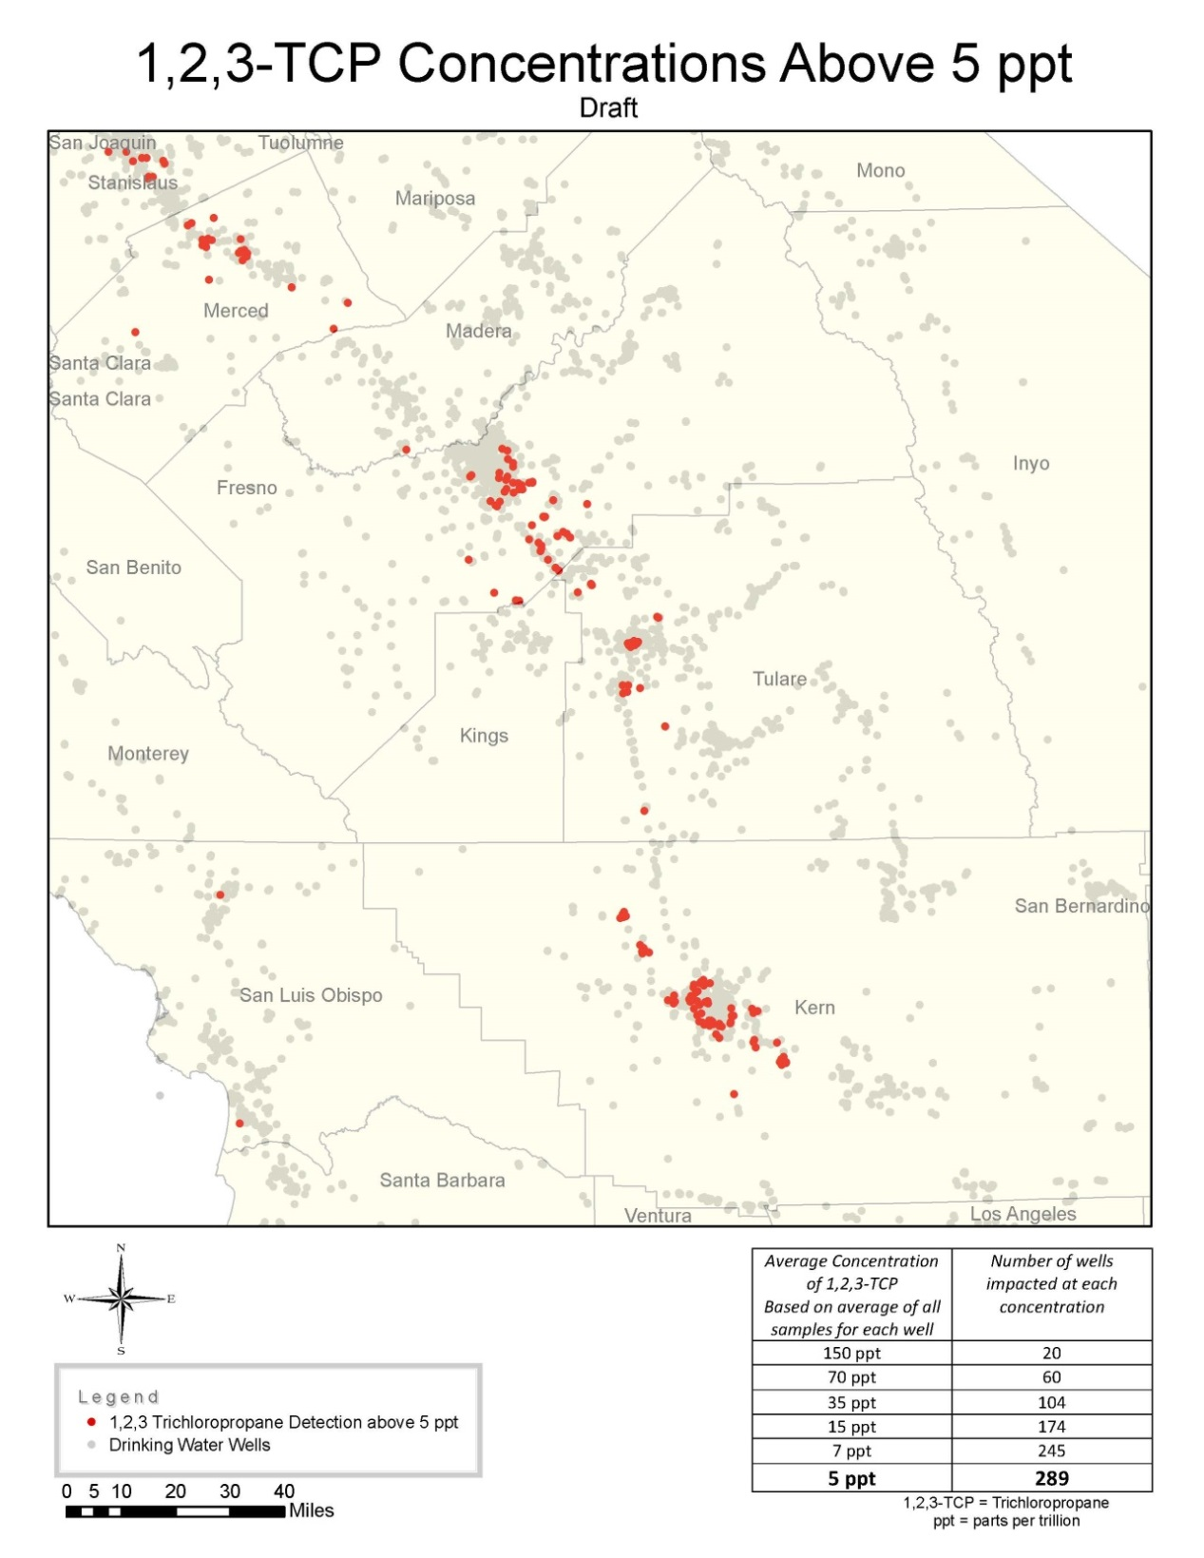
Central Valley Sources with Average
1,2,3-TCP Concentration above 5 ppt
(2001-2015)

Slide 8
1,2,3-TCP Health Effects
1,2,3-TCP is considered carcinogenic
Exposure routes: Drinking water
  – Body absorbs much or all of 1,2,3-TCP in the drinking water
Exposure routes: Inhalation
  – Body absorbs some of the trace levels of 1,2,3-TCP that can be found in homes receiving contaminated water.

Slide 9
Public Health Goal (PHG)
The PHG of 0.7 ppt is based on chronic (long-term) exposure:
  drinking 2 liters of water per day over a lifetime (70 years)
  breathing air containing 1,2,3-TCP over a lifetime
PHGs are not regulatory requirements and can be set lower than detection limits or treatment capability

Slide 10
1,2,3-TCP MCL Development Process
Health and Safety Code Section 116365:
State Water Board must set the MCL at a level that is as close as feasible to the corresponding public health goal placing primary emphasis on the protection of public health, and that, to the extent technologically and economically feasible…

Slide 11
PHG Published
Data Collection
DLR Determination
Major Steps in MCL Development Process for 1,2,3-TCP
Identify Range of MCLs for Evaluation
Calculate Costs (Treatment, Laboratory, and Monitoring)
Identify Impacted Population
Determine BAT
Determine Health Benefits
Evaluation
BAT – Best Available Treatment Technology
DLR – Detection Limit for Purposes of Reporting
MCL – Maximum Contaminant Level
PHG – Public Health Goal
MCL Selected

Slide 12
1,2,3-TCP MCL Development –
Additional Requirements for Rulemaking
External Scientific Peer Review
  Health and Safety Code 57004
  http://www.waterboards.ca.gov/water_issues/programs/peer_review/
Compliance with CEQA
Major Regulations Analysis
  State Administrative Procedure Act requirement for any proposed regulation with economic impact > $50 million
  http://www.dof.ca.gov/Forecasting/Economics/Major_Regulations/Major_Regulations_Table/

Slide 13
1,2,3-TCP MCL – Proposed Regulation
Proposed MCL of 5 ppt is based on the following considerations:
Technical Feasibility:
  ELAP-Certified Laboratories – Analytical Detection Limit of 5 ppt
  The standard treatment for 1,2,3-TCP (Granular Activated Carbon) is proven, cost-effective and reliable down to 5 ppt
Economic Feasibility
Protection of Public Health:
  5 ppt would result in a theoretical cancer risk of less than 1/100,000
  GAC reduces inhalation exposure (not addressed by bottled water)

Slide 14
1,2,3-TCP MCL – Proposed Regulation
Existing Regulations
Compliance
  Based on Running Annual Average (RAA)
  May be out of compliance before collecting 4 quarterly samples
Monitoring
  Initial quarterly monitoring for 1 year – starts January 2018

Slide 15
1,2,3-TCP MCL – Proposed Regulation
Monitoring (continued)
  Initial quarterly monitoring
  Subsequent routine monitoring (every 1 or 3 years)
  If 1,2,3-TCP is detected at or above the MCL
    More frequent monitoring is then required to determine compliance with MCL
Consistent with existing regulations for Synthetic Organic Chemicals

Slide 16
1,2,3-TCP DLR – Proposed Regulation
Proposed DLR of 5 ppt
Provides a consistent definition of “non-detect” when monitoring for 1,2,3-TCP
Analytical methods have been in use for over a decade
More than 20 CA ELAP-certified laboratories using the methods
  List of laboratories on the State Water Board website

Slide 17
1,2,3-TCP BAT – Proposed Regulation
The proposed BAT is Granular Activated Carbon (GAC)
  Already in use for 1,2,3-TCP treatment
  Removes 1,2,3-TCP to less than the proposed DLR
  Readily available and reliable technology
BAT designation does not prevent permitting of alternative technologies capable of removing 1,2,3-TCP.

Slide 18
1,2,3-TCP MCL – Treatment Options
Options for a well that is out of compliance:
  Provide treatment (GAC or other District-approved treatment)
  Drill new well
  Remove the well from use
  Purchase water from a nearby utility
  Consolidate with a nearby larger water system
  Blend contaminated water with a clean source to reduce overall concentrations of 1,2,3-TCP to below MCL

Slide 19
1,2,3-TCP Public Notification & Consumer Confidence Report – Proposed Regulation
Public Notification & Consumer Confidence Report
  New language for 1,2,3-TCP health effects
  New language for sources of 1,2,3-TCP contamination

Slide 20
Proposed “Grandfathering” Regulations
  Addition to Organic Chemical Initial Monitoring regulations
  Allows samples collected prior to MCL effective date to be substituted for initial monitoring samples
    Requests must be made in writing to applicable District Office
    Can only substitute samples in like calendar quarters (e.g. Q2 2016 for Q2 2018)
    Can only substitute three of the four quarterly samples – must collect at least one sample during initial monitoring
    Will also apply to future organic chemical MCLs

Slide 21
Additional Information
1,2,3-TCP information website
  http://www.waterboards.ca.gov/drinking_water/certlic/drinkingwater/123TCP.shtml
  Or search for “SWRCB 123”
1,2,3-TCP proposed regulation website
  http://www.waterboards.ca.gov/drinking_water/certlic/drinkingwater/123TCP_SBDDW-17-001.shtml

