Slide 1

3rd PRELIMINARY DRAFT REGULATIONS
WORKSHOP

Slide 2

Safety
In the event of an emergency we will follow site specific evacuation procedures

Slide 3
Introductions
Christine Sotelo
  ELAP Chief
Jacob Oaxaca
  Senior Environmental Scientist, Supervisor
Katlin Bloom
  Environmental Scientist
Andrew Hamilton
  Environmental Scientist

Slide 4
Opening Remarks
ELAP is an essential program to the Water Board and various environmental/public health regulatory agencies
Adopting new accreditation standards and updating regulations are transformative initiatives recommended by the Expert Review Panel
This has been a collaborative process with extensive stakeholder input from the entire laboratory community and ELTAC members
Thank you for your attendance and participation, your comments are incredibly valuable

Slide 5
Workshop Agenda
Draft Regulations Development and The Rulemaking Process
Responding to Comments
3rd Preliminary Draft Overview and Open Comment Period
Next Steps

Slide 6
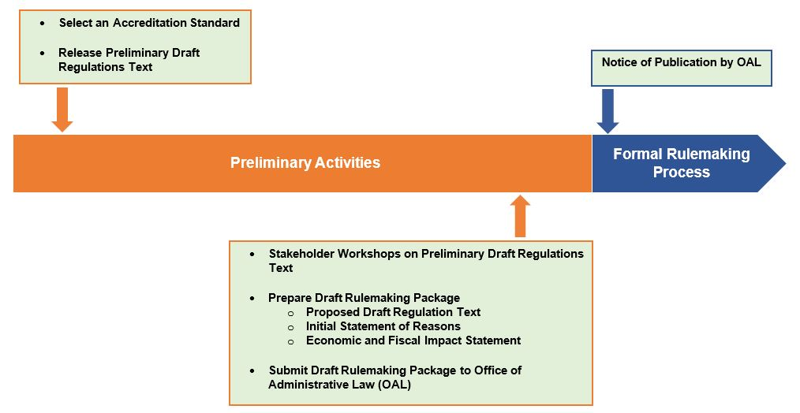
Draft Regulations Development

Slide 7
Draft Regulations Development
First Preliminary Draft
  Released to the entire laboratory community
  We accepted approximately 75% of comments
Second Preliminary Draft
  Released to members of ELTAC
  We accepted approximately 60% of comments
Third Preliminary Draft
  Released to the entire laboratory community
  Applicable comments and suggestions will be incorporated into the Proposed Draft Regulations Text, which will go out as part of the full regulatory package for public comment

Slide 8
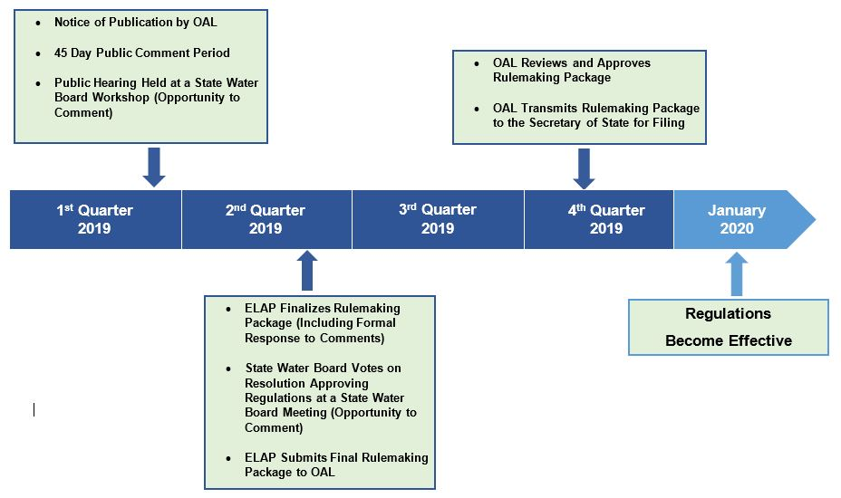
Rulemaking Process (Dates Subject to Change)

Slide 9
Responding to Comments
Comments from each of the preliminary drafts are being used as a development tool to prepare the Proposed Draft Regulations Text
The Final Rulemaking Package will include a formal Response to Comments made during the formal rulemaking process

Slide 10
Workshop Format
The purpose of this workshop is to listen to comments
ELAP will summarize each section of the regulation text and then open the floor to comments
When commenting, please identify your name, organization, and the specific section of the text that you are commenting on

Slide 11
Article 1 – Definitions
§64801 Definitions
  Definitions used differently or that do not exist in 2016 TNI Standard – Rev 2.1, Volume 1
    Assessment Agency – means ELAP, or any entity that is approved by ELAP to conduct laboratory assessments for ELAP

Slide 12
Comments on Article 1

Slide 13
Article 2 – Accreditation Requirements
§64802.00 Accreditation Criteria
  Criteria a laboratory must meet to obtain accreditation from ELAP
§64802.05 Application Package
  Items a laboratory must submit with an application package
§64802.10 Quality Systems
  Minimum requirements a laboratory must meet to ensure data of known quality
    Selection of 2016 TNI Standard (with two exceptions) is supported by the Expert Review Panel, State Agency partners, and the State Board
    Allows for a three year implementation period from date of adoption

Slide 14
Article 2 – Accreditation Requirements (Continued)
§64802.15 Field(s) of Accreditation
  How the FOA’s are determined and where the list of FOA’s will be located
§64802.20 Proficiency Testing
  The requirements and frequency for testing PT samples, including required action for failing to achieve acceptable scores
§64802.25 On-Site Assessment
  The requirements and frequency for on-site assessments
    OSA’s frequency will be every 2 years

Slide 15
Comments on Article 2

Slide 16
Article 3 – Types of Accreditation
§64808.00 Initial Accreditation
  Requirements to obtain initial accreditation
§64808.05 Renewal Accreditation
  Requirements to renew accreditation, including deadline for submitting renewal applications and penalties for late submittals
    Renewal applications due 90 days prior to expiration date
§64808.10 Reciprocity Accreditation
  Requirements and conditions for accreditation by reciprocity
§64808.15 Amendment Accreditation
  Requirements associated with the various ways to amend accreditation

Slide 17
Comments on Article 3

Slide 18
Article 4 – Types of Laboratories
§64810.00 Main Laboratory
  Description of main laboratory
§64810.05 Satellite Laboratory
  Description of and requirements for satellite laboratories
    Removed distance criteria
§64810.10 Mobile Laboratory
  Description of and requirements for mobile laboratories

Slide 19
Comments on Article 4

Slide 20
Article 5 – Laboratory Personnel, Facilities and Equipment
§64812.00 Laboratory Personnel
  Credential requirements for management and analysts in a laboratory
    Removed “minimum certificate grade” table and aligned requirements with facility’s permit requirements
§64812.05 Laboratory Facilities and Equipment
  Requirements for how a laboratory facility shall be arranged and operated

Slide 21
Comments on Article 5

Slide 22
Article 6 – Notification, Reporting, Control of Records, Change of Technical Manager or Ownership, and Trade Secrets
§64814.00 Notification, Reporting and Records Retention
  Requirements for drinking water sample notification, subcontracting work, reporting results, and control of records
§64814.05 Notification of Change of Technical Manager or Change of Ownership
  Required action when there is a change of technical manager or laboratory ownership, including timeline for notifying ELAP
§64814.10 Trade Secrets
  Describes when ELAP can release information designated as a trade secret

Slide 23
Comments on Article 6

Slide 24
Article 7 – Reasons for Denial, Citation, Suspension, or Revocation
§64816.00 Denial of Accreditation
  Laboratory actions that can lead to denial of accreditation.
§64816.05 Issuance of a Citation
  Laboratory actions that can lead to the issuance of a citation.
§64816.10 Suspension or Revocation of Accreditation
  Laboratory actions that can lead to suspension or revocation of accreditation.

Slide 25
Comments on Article 7

Slide 26
Comments on Article 1 through 7

Slide 27
Next Steps
Following close of this public comment period (January 18, 2019 February 8, 2019) ELAP will prepare the Draft Rulemaking Package
  Proposed Draft Regulations Text
  Initial Statement of Reasons
  Economic and Fiscal Impact Statement
We expect to enter the formal rulemaking process in the first quarter of 2019
Future information regarding the rulemaking process will be communicated through the email subscription, announcements section of the ELAP website, and the ELAP regulations home page

Slide 28
Rulemaking Process (Dates Subject to Change)

Slide 29
Thank you for your attendance and participation, your comments have been incredibly valuable

