Slide 1
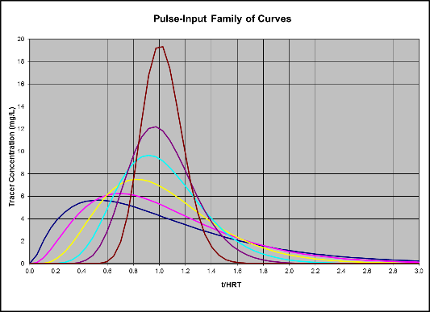
Tracer Studies
And Disinfection
Guy Schott, P.E.
Presented to
AWWA – Sacramento, CA
March 27, 2019

Slide 2

Learning Objectives
Purpose of a tracer study
Water age distribution
Disinfection exposure time
CT disinfection (pathogen delivered dose)
Log inactivation
Baffling Factor (BF)
Tracer test preparation
Hydraulic efficiencies for different reactors
Discussion

Slide 3
Purpose of a
Tracer Study
To determine the hydraulic or disinfectant exposure time of water through one or more reactors.
Performed by the addition of a nonreactive chemical (tracer, marker).

Slide 4
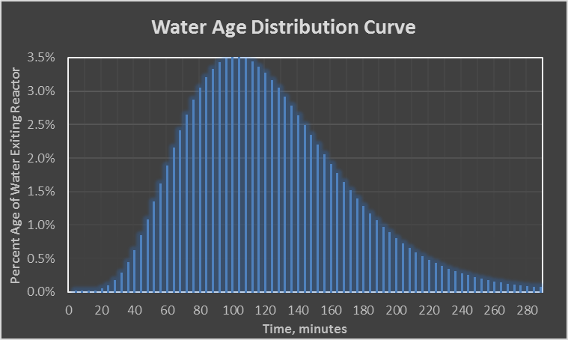
40%
60% of water age is 100 min or more
10%
90% of water age is 62 min or more

Slide 5
Disinfection
Exposure Time (t₁₀)
Based on the time it takes for 10% of the total water entering a reactor to be the first to exit the reactor. Determined via tracer study.

Slide 6
Disinfectant Exposure Time
Related to:
  Reactor configuration
  (inlet/outlet, baffles, L:W)
  Water Depth
  Working volume
  Flow rate
  Temperature gradient
  Hydraulic mixing

Slide 7
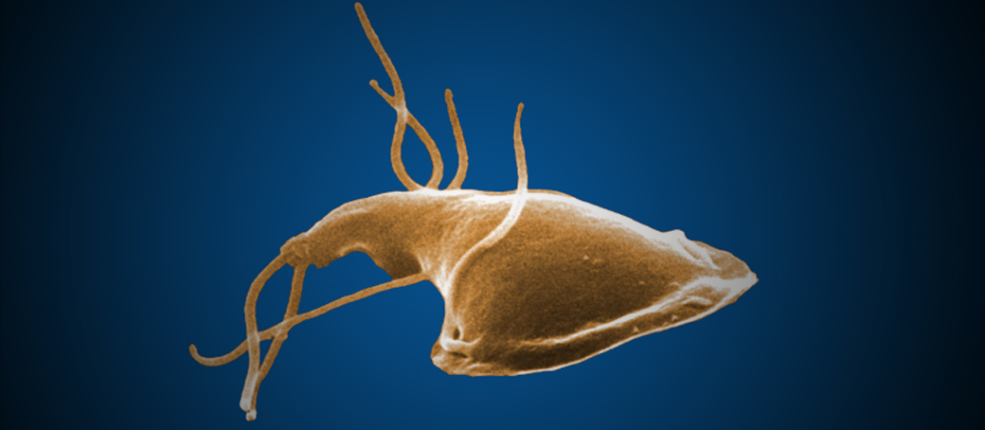
Delivered Dose to Pathogen
(Ct)
Cl₂
Delivered Dose, “Ct”
  “C” is the disinfectant residual (mg/L)
  “t” is the disinfectant exposure or contact time (minutes)
C x t = mg/L * min, delivered dose
Cl₂
Cl₂
Cl₂
Cl₂

Slide 8
Disinfection
Log Inactivation
Giardia cyst log inactivation is based on the Delivered Dose, “Ct” and associated
^{pH}
^{Disinfectant residual}
^{Temperature}
Virus log inactivation is based on the Delivered Dose, “Ct” and associated
^{Disinfectant residual}
^{Temperature}
Parameters are looked up in EPA Ct tables to determine the log inactivation.

Slide 9
Baffling
Factor (BF)
Generated from Tracer Study:
t₁₀ = disinfectant exposure time
HRT = hydraulic residence time = Volume/flow
Baffling Factor (BF) = t₁₀ / HRT
0 < BF < 1
BF is applied to the disinfection contact basin’s operational HRT to determine contact time (t₁₀, minutes).
Calculated daily treatment plant disinfectant exposure time:
t_{10_cal} = BF x HRT

Slide 10
Tracer Test Preparation
Reactor Process to Evaluate
Tracer methods
Tracer material
Tracer dosage
Test flows and reactor operating level
Test duration
Chemical feed pump
Sample locations
Sample frequency
Communication between parties involved

Slide 11
1. Tracer Methods
A continuous tracer feed added throughout test.
Adding the entire amount of tracer at the beginning of test.

Slide 12

Tracer Test
Methods
Step-Dose Method
A continuous tracer feed added throughout test.
Slug-Dose Method
Adding the entire amount of tracer at the beginning of test.
Tracer
Q₁
Cl₂
Cl₂
Q₂
Chlorine Contact Basin
t_{i…..}
Tracer

Slide 13
Model Step-Dose Curve

Slide 14
Model Slug-Dose Curve

Slide 15
Actual Slug-Dose Curve

Slide 16
2. Tracer Material
Fluoride (F)
  Liquid (H₂SiF₆ Hydrofluorosilicic Acid)
  Dry (NaF)
    15 gal NaF mix solution : 1 gal H₂SiF₆
Lithium Chloride (Li)
Others (NaCl, CaCl₂), dry or liquid
Tracer should be non-reactive

Slide 17
3. Dosage
Step-Dose
  Fluoride: 2 to 4.0 mg/L as F
  Lithium: 0.5 mg/L
  Chloride/Na/Ca: Dependent on background constituents and any secondary standards

Slide 18
Slug-Dose Test
How Much Tracer to Add
t₁₀/HRT (BF) | Calculated Dispersion Concentration in Basin | Tracer Study Peak Concentration (estimated)
0.24 | 1.35 | 1.0
0.34 | 1.23 | 1.0
0.42 | 1.12 | 1.0
0.51 | 0.95 | 1.0
0.61 | 0.76 | 1.0
0.70 | 0.58 | 1.0
  Estimate BF
  Calculate amount of tracer mass needed for associated dispersion concentration.
  For lower or higher peak concentration, apply factor to dispersion concentration.
.

Slide 19
4A. Test Flows and Operating Level
One Test: Normal operating flow and clearwell level.
Two Tests: Summer/winter flows and clearwell levels.
Three Tests: High/mid/low flows and normal operating clearwell levels.
Notes:
Think of an in-line motionless static mixer. The higher the flow, greater mixing.

Slide 20
4B. Test Flows and Operating Level
Baffle tanks –
  Higher flow, results in greater mixing (>Reynolds number & BF)
  At a given flow, increase tank volume (<Reynolds number & BF)
Non-baffled tanks -
  Less predicable
  Temperature gradient can result in less mixing (<BF), greater short-circuiting.
  At a given flow, increase/decrease in tank volume (? Increase/decrease in BF)
Notes:
Think of an in-line motionless static mixer. The higher the flow, greater mixing.

Slide 21
5A. Test Duration
May vary from < 1 HRT to 4 HRT (site specific & predicted BF)
For full tracer recovery (slug-dose) and steady-state tracer (step-dose)
  2.5 - 4 HRT duration

Slide 22
5B. Test Duration - When HRT is very long
Modified the Step-Dose method
Test is completed in less than 1 HRT
Measurements of tracer inlet and outlet
Inlet measurements:
  Flow into 5-gallon bucket over several minutes to ensure average applied tracer dosage is measured. Take sample out of bucket.
  Dump bucket and start over with next sample
  Average inlet sample results to determine applied dosage
Outlet measurements:
  Sample duration < HRT
Notes:
If inlet to reactor cannot be measured, then physical chemical drawdown is required. Modified Slug-dose could be acceptable.

Slide 23

Modified Step-Dose Method
Clearwell
Inlet
Sampling
Outlet
Sampling
Tracer
All sampling is conducted to 1 x HRT or less

Slide 24
Actual Modified Step-Dose Test Curve

Slide 25
6. Chemical Feed Pump
Select chemical feed pump capacity based on plant flow and mL/min dosage range.
Before tracer test, prime and test feed pump to ensure it works and stays on during duration of test.
For slug-dose test, may be appropriate to temporarily shut down treatment plant for 2-5 minutes to inject tracer material and then start plant (site-specific).

Slide 26
7. Sample Frequency
Sample distribution frequency is depended on baffling factor resolution goal around critical sampling region.
Example:
    Goal – e.g., measure to the nearest 0.02 baffling factor (BF).
    HRT = 150 minutes
    Sample Frequency Critical Region
    0.02 • HRT = 0.02 • 150 min = 3 minutes
Critical region – is the area under curve where t₁₀ occurs for a Step-Dose curve.

Slide 27
8. Sample Locations
Reactor outlet
Modified Step-Dose, inlet/outlet
  Use 5 gallon bucket for inlet sampling to obtain average inlet tracer dosage
  Take sample out of bucket
  Dump bucket and start over

Slide 28
9. Communications
Plant personnel
Regulatory agency
Firm doing the tracer study
By phone, email and/or written report

Slide 29
When flows are not at steady-state
Variable outlet flow
  Modified step-dose method
  Take cumulative treated water volume (V₁₀, gallons) from time zero (t_{o}) to t₁₀
  Divide cumulative volume (V₁₀) by average working volume (V₁₀/V) = BF
BF= V₁₀/V from tracer test (based on volume)
  V₁₀: The volume of water that has exited the reactor from t_{o} to t₁₀ when 10% of the tracer mass has exited the reactor.
  V: Average operating Clearwell volume of water during tracer test from t_{o} to t₁₀.

Slide 30
Reactors – Chlorine Contactors
BF (0.05-0.2)
BF (0.3-0.4), L:W = 12
Top View
Circular
Tanks
BF (0.4-0.45), L:W = 16
BF (0.6-0.7), L:W = 52
Rectangular Tanks,
Serpentine Flow
BF is depended on reactor design, volume, water depth, flow and temperature gradient
L:W is the total travel length of water divided by channel width or pipe diameter.

Slide 31
Determining L:W ratio
Inlet
Length is longest flow path (red line).
Width is the average channel width for each flow path.
Outlet

Slide 32
Determining L:W ratio
Inlet
Length is longest flow path (red line).
Width is the average channel width for each flow path.
Outlet

Slide 34

Contact
Guy Schott, P.E.
State Water Resources Control Board
Division of Drinking Water
Santa Rosa, CA
For Tracer Study Database and/or Results:
https://www.waterboards.ca.gov/drinking_water/programs/districts/mendocino_district.html
Guy.Schott@waterboards.ca.gov
707-576-2732

