Slide 1
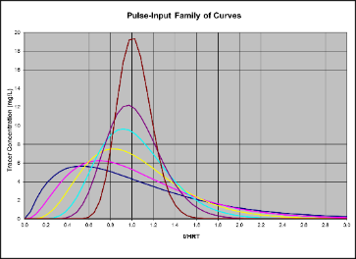
Tracer Studies and
Delivered Dose (450 CT)
Disinfected Tertiary Recycled Water
Guy Schott, P.E.
Presented to
AWWA – Sacramento, CA
March 27, 2019

Slide 2
Learning Objectives
Purpose of a tracer study
Water age distribution
Modal contact time (disinfection exposure time)
CT Disinfection requirement, 450 mg/L-min (what it means)
Tracer methods – Slug/Pulse-Input & Step Dose
Modal baffling factor (BF_{mod})
Tracer materials
Sample frequency
Handling non-steady state flows during tracer test
Case study
Discussion

Slide 3
Purpose a Tracer Study?
To determine the hydraulic or disinfectant exposure time of water through one or more reactors.
The addition of a nonreactive chemical (tracer, marker) is added in the form of a pulse-input (slug) or step-input at inlet to reactor and monitored at outlet.

Slide 4
Water Age Distribution Profile
Fluid Elements
60% of water age is 100 min or more
Notes:
Fluid elements moving at different velocities through reactor having unique residence times.

Slide 5
Water Age or Disinfection Exposure Time
Related to:
  Reactor configuration (inlet/outlet, baffles, L:W)
  Reactor working volume
  Water Depth
  Flow rate
  Temperature gradient
  Hydraulic mixing

Slide 6
Modal Contact Time
(Disinfection Exposure Time of Interest)
Notes:
Notice that the time at peak curve is less than the HRT. Discuss exposure time to right of T.

Slide 7
Modal Contact Time
Title 22 §60301.600. Modal contact time.
"Modal contact time" means the amount of time elapsed between the time that a tracer, such as salt or dye, is injected into the influent at the entrance to a chamber and the time that the highest concentration of the tracer is observed in the effluent from the chamber.
  Modal Contact Time
  “T”
  (Disinfection Exposure Time)

Slide 8
Disinfected tertiary recycled water
Title 22 §60301.230. Disinfected tertiary recycled water.
"Disinfected tertiary recycled water" means a filtered and subsequently disinfected wastewater that meets the following criteria:
(a) The filtered wastewater has been disinfected by:
(1) A chlorine disinfection process following filtration that provides a CT (the product of total chlorine residual and modal contact time measured at the same point) value of not less than 450 milligram-minutes per liter at all times with a modal contact time of at least 90 minutes, based on peak dry weather design flow.

Slide 9
CT (450 mg/L-min)
  “C” is the disinfectant chlorine residual (mg/L)
  “T” is the exposure/contact time (minutes)
  T ≥ 90 minutes (modal contact time)
  Multiply them:
C • T = mg/L • min (delivered dose to pathogen)
CT value ≥ 450 mg/L • min
Title 22 §60301.230. Disinfected tertiary recycled water

Slide 10
Chlorine Contact Basin
Cl₂
Q₁
Q₂
mg/L
(disinfectant, C)
The disinfectant residual (C, mg/L) multiplied by its exposure time
(T, minutes) provides a CT value (mg/L•min) that is associated to pathogen inactivation.

Slide 11
Tracer Tests for
Finding the Disinfection Exposure Time
Slug-Dose or Pulse-Input Method – adding the entire amount tracer at the beginning of test.
      Direct test for finding the modal contact time.
Step-Dose Method – a continuous tracer feed added throughout test.
      Indirect test for finding the modal contact time.

Slide 12

Slug-Dose Tracer Method
Slug-Dose or Pulse-Input Method – adding the entire amount tracer at the beginning of test.
Tracer
t₀
Chlorine Contact Basin
Q₁
Cl₂
Cl₂
Q₂
Tracer
t_{i…..}

Slide 13
Modal Contact Time
Peak of Slug-Input Curve
Modal contact time (T) should be:
T ≤ Hydraulic Residence Time (HRT)
HRT = V/Q = minutes
V = Reactor Working Volume (gallons)
Q = Flow through Reactor (gpm)

Slide 14
What if T is less than 90 minutes
Outlet chlorine residual (C) = 6.0 mg/L.
Exposure modal contact time (T) = 80 minutes
  CT= (6)(80) = 480 mg/L • min (delivered dose)
  which is > 450 mg/L • min
  Is the recycled water system in compliance with CT?
  Title 22 §60301.230. Disinfected tertiary recycled water.
  The system is out-of-compliance, T is <90 minutes

Slide 15
Recap of Chlorine Exposure Times
Disinfected Tertiary Recycled Water
  Modal Contact Time (T) is the water age of interest.
  T or T_{mod} ≥90 min
  T is that time when the curve is at its peak (Slug-Dose test or convert Step-Dose curve).
  C is outlet chlorine residual, mg/L
  CT ≥ 450 mg/L ∙ min (delivered dose)

Slide 16
Modal Contact Time
For Range of Flows
Once modal contact time (T) is determined via tracer test for a single flow, how is T determined for seasonal flows?
Apply a hydraulic efficiency factor (BF_{mod}) to daily operating HRT.

Slide 17
Modal Baffling Factor (BF_{mod})
BF_{mod}= T/HRT from tracer test
The modal contact time (T) divided by hydraulic residence
time (HRT).
0 < BF_{mod} < 1
Represents the chlorine contactor basin’s hydraulic efficiency.
BF_{mod} is applied to chlorine contact basin’s operational HRT to determine modal contact time (T, minutes).

Slide 18
Modal Baffling Factor - Application
Example Calculation for applying BF_{mod}
  BF_{mod} =T/HRT = 0.85 based on tracer study
Example:
Q = 100 gpm
Contactor Volume (V) = 12,000 gallons
HRT = V/Q = 120 min
T_{calc} = HRT ∙ BF_{mod}
T_{calc} = 120 min ∙ 0.85 = 102 minutes (modal contact time)
To achieve a CT of 450 mg/L • min;
C = 450/ T_{calc} = 450/102 = 4.4 mg/L Cl₂

Slide 19
Operating Parameters
Based on Tracer Test
Example

Slide 20
Reactors – Chlorine Contactors
BF_{mod} (0.1-0.2)
BF_{mod} (0.3-0.5), L:W = 12
Top View
Circular
Tanks
BF_{mod} (0.4-0.8), L:W = 16
BF_{mod} (0.6-0.9), L:W = 52
Rectangular Tanks,
Serpentine Flow
Pipelines
BF_{mod} (0.3-0.8), L:D = 57
BF_{mod} (0.6-0.95), L:D = 454
BF_{mod} is depended on reactor design, volume, water depth, flow and temperature gradient
L:W or L:D is the total travel length of water divided by channel width or pipe diameter.

Slide 21
Tracer Selection
Fluoride (F)
  Liquid (H₂SiF₆ Hydrofluorosilicic Acid)
  Dry (NaF)
    15 gal NaF mix solution : 1 gal H₂SiF₆
Rhodamine B Dye
  Degrades in the present of chlorine and sunlight
Lithium Chloride (Li)
Others (NaCl, CaCl₂), dry or liquid
Tracer shall be non-reactive
Tracer should be non-reactive
Chlorine is reactive– may be suited to verify historical tracer test.

Slide 22
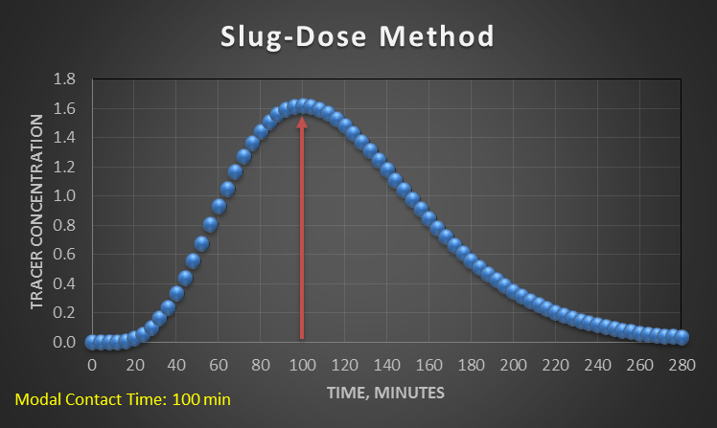
Sample Frequency
Sample frequency greatest around predicted modal contact time (critical region).
Segment 2
Segment 1
Segment 3
Critical Region
HRT: 120 min

Slide 23
Tracer Mass Recovery
For determining Modal Contact Time (T), mass recovery of tracer is not necessary.
Determining tracer mass recovery should be an option and only if practical.
Practical – when test can be completed within 6 hours and for other hydraulic evaluations (i.e., t₁₀).
Impractical – when test can take up to 24 hours for full tracer recovery.

Slide 24
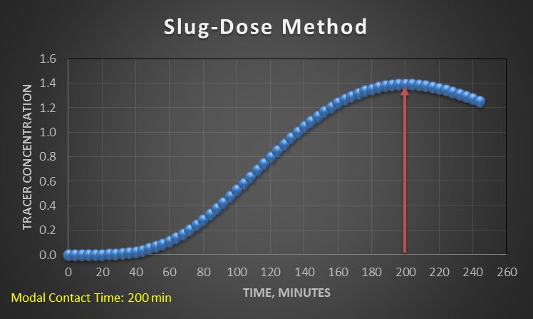
Tracer Test Duration
HRT: 240 min

Slide 25
HRT & Modal Baffling Factor for
Non-Steady-State Flows
Method 1:
  Take weighted flow average from time zero (t_{o}) to modal contact time (T)
  Divide average working volume by weighted flow to calculate average hydraulic residence time (HRT).
  BF_{mod} = T/HRT
Method 2:
  Take cumulative treated water volume (V_{mod}, gallons) from time zero (t_{o}) to modal contact (T)
  Divide cumulative volume (V_{mod},) by average working volume (V_{mod}/V) = BF_{mod}

Slide 26
Prepping for a Tracer Study
Objectives (t₁₀ or T_{mod})
Reactor type
Tracer method
Tracer material
Tracer mass input
Injection point
Test flow (inlet/outlet)
Operating tank level
Sample location
Sample frequency
Plant interruptions
Tracer test analysis preparation
Sample bottle preparation
Data form
Spreadsheet to process data
Schematic of reactor (details)
Personnel (duties)
Communication between parties involved

Slide 27
Case Study
Case 1: Underground chlorine contact pipeline
  Issue: Very low Modal Contact Time compared to HRT
  Discuss reason and corrective solution

Slide 28
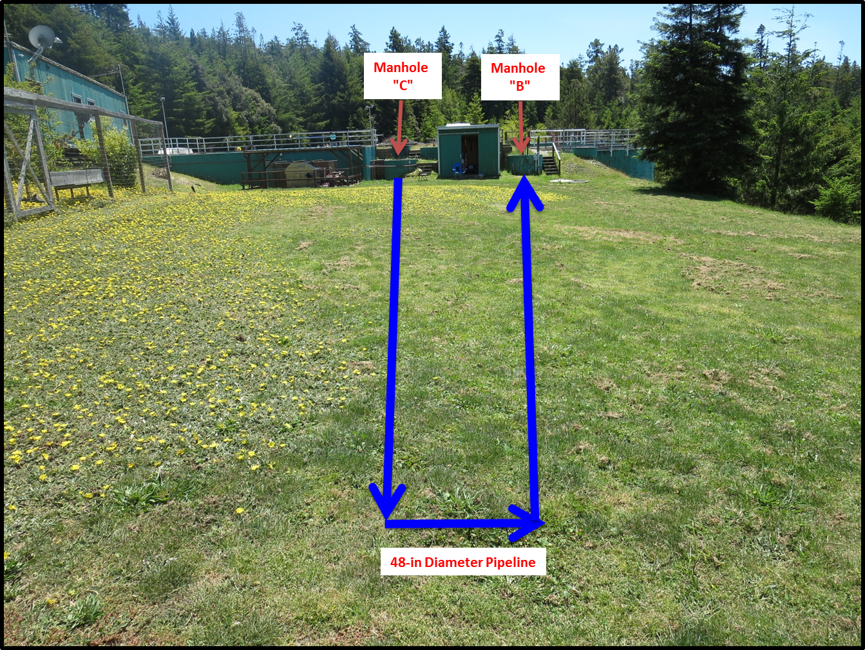
Chlorine Contact – Pipeline – Case Study 1
Added
Tracer
Tracer
Sampling
21,500 gallons
229 ft length
58 gpm weighted flow
HRT = 370 min; T = 90 min; BF_{mod} = 0.24

Slide 29
Chlorine Contact – Pipeline
Case Study 1
Pipeline volume: 21,500 gallons
Pipeline diameter: 48-inches (4 feet)
Pipeline length: 229 feet
Material: concrete (buried)
L:D ratio: 57
Treated water flows from: Sea Ranch and Gualala
Flow: 20-140 gpm (58 gpm weighted avg)
HRT = 370 min; T = 90 min; BF_{mod} = 0.24

Slide 30
Channeling
Manhole
“C”
Manhole
“B”
Flow: 58 gpm weighted average
18ºC
18ºC
<18ºC
48-in Pipeline
Temperature gradient issue
Notes:
Fluid elements moving at different velocities.

Slide 31
Chlorine Contact - Pipeline
Pipeline volume: 21,500 gallons
Pipeline diameter: 48-inches (4 feet)
Pipeline length: 229 feet
Material: concrete (buried)
L:D ratio: 57
Treated water flows from: Sea Ranch and Gualala
Flow: 20-140 gpm (63 gpm weighted avg)
Orifice Pipeline: 1.5” PVC, 80-ft, 1/8” holes spaced 18 inches
HRT = 340 min; T = 210 min; BF_{mod} = 0.62

Slide 32

Contact
Guy Schott, P.E.
State Water Resources Control Board
Division of Drinking Water
Santa Rosa, CA
For Tracer Study Database and/or Results:
https://www.waterboards.ca.gov/drinking_water/programs/districts/mendocino_district.html
Guy.Schott@waterboards.ca.gov
707-576-2732

Slide 33
Questions
References
Levenspiel, O. (1972) Chemical Reaction Engineering, 2nd ed., John Wiley & Sons, New York
Levenspiel, O. (1998) Chemical Reaction Engineering, 3rd ed., John Wiley & Sons, New York
Grady, C. P. & Lim, Henry C. (1980) Biological Wastewater Treatment, Theory and Applications, Marcel Dekker, Inc., New York and Basel
Tracer Studies in Water Treatment Facilities: A Protocol and Case Studies, American Water Works Association Research Foundation
https://www.waterboards.ca.gov/drinking_water/programs/districts/mendocino_district.html
Guy Schott, P.E.
guy.schott@waterboards.ca.gov
707-576-2732

