Slide 1
4-Log Virus Treatment under the
Groundwater Rule
Guy Schott, P.E.
State Water Resources Control Board
August 17, 2017

Slide 2
Topics
Groundwater Rule
Source Waters
Log Inactivation
Types of Disinfectants
Ct Basics
Baffling Factor
Ct & Log Inactivation Calculation Example Problems

Slide 3
Groundwater Rule
Regulatory Requirements
Groundwater Rule: Groundwater systems (GWS) that do not provide disinfection or do disinfect but do not get virus inactivation credit must conduct source water monitoring (E. coli) whenever they are notified of a total coliform positive (TC+) routing sample (Total Coliform Rule).
As a result of the above rule, GWS may choose to provide 4-log virus treatment to forgo triggered source water E. coil monitoring due to a routine positive bacteriological distribution sample.
Groundwater systems with significant deficiencies may be required to disinfect to achieve 4-log inactivation of viruses.
  Fecal/E.coli
  Inadequate construction
  Near surface water source (possible influence)

Slide 4
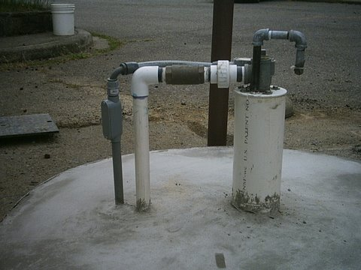
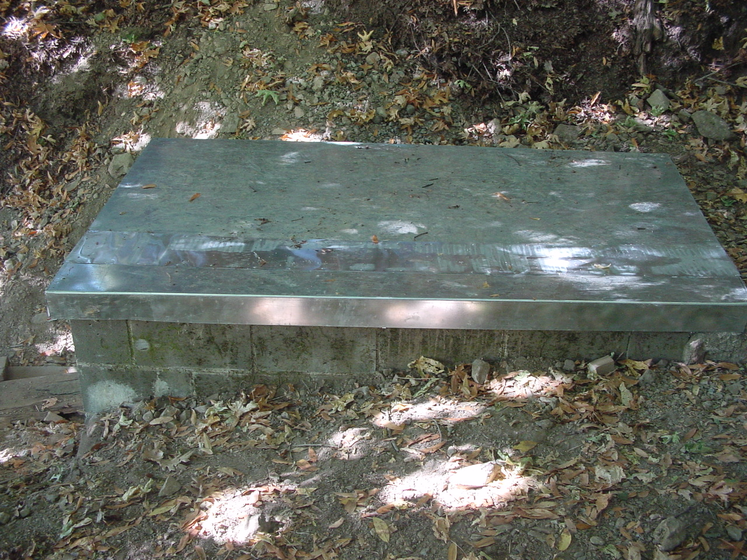
Source Waters
Vertical and Horizontal Wells
Springs

Slide 5
Log Inactivation
Understanding 4-Log Virus Treatment
Virus treatment means virus removal and/or inactivation.
Removal/inactivation of microorganisms, including viruses, generally is measured on logarithmic scale.
Log inactivation of viruses relates to % inactivation of viruses.
  1-log inactivation = 9 out of 10 = 90% inactivation
  2-log inactivation = 99 out of 100 = 99% inactivation
  3-log inactivation = 999 out of 1,000 = 99.9% inactivation
  4-log inactivation = 9,999 out of 10,000 = 99.99% inactivation

Slide 6
Type of Disinfectants
Chlorine
Ozone
Ultraviolet Radiation (UV)
Chlorine Dioxide
Chloramines
Most common for small water systems

Slide 7
Ct Basics
- Log inactivation is based on the Delivered Dose, “Ct”
  “C” is the disinfectant residual (mg/L)
  “t” is the exposure or contact time (minutes)
  Multiply them:
C • t = mg/L • min (delivered dose)
The calculated Ct value is looked up in EPA Ct tables to determine the log inactivation based on specific monitoring parameters (pH, disinfectant residual and/or temperature).
Ct value

Slide 8
Ct Table – Inactivation of Viruses by Free Chlorine, pH 6.0-9.0
Inactivation (log) | Temperature (ºC) 4 6 8 10 12 14 16 18 20 22 24
2 | 4.4 | 3.8 | 3.4 | 3.0 | 2.6 | 2.2 | 1.8 | 1.4 | 1.0 | 1.0 | 1.0
3 | 6.7 | 5.6 | 4.8 | 4.0 | 3.6 | 3.2 | 2.8 | 2.4 | 2.0 | 1.6 | 1.2
4 | 8.9 | 7.6 | 6.8 | 6.0 | 5.2 | 4.4 | 3.8 | 3.4 | 3.0 | 2.6 | 2.2
Calculated Ct is 4.5 mg/L*min
Temperature: 10ºC
From Ct Table: The log inactivation is somewhere between 3 and 4.

Slide 9
Ct Basics
Disinfectant concentration “C” is measured before the first customer or outlet of water system.
Exposure or contact time “t” is difficult of quantify. Theoretically, “Ƭ” is calculated as
V
Q

Slide 10
Baffling Factor (BF)
Baffling factor or short-circuiting factor (0.05 – 1):
  Determined from tracer study or estimated
  BF = t₁₀/ Ƭ from tracer study.
Q₁
V₁
mg/L (disinfectant, C)
Cl₂
Ct = mg/L ∙ min
Ƭ = V₁/Q₂
Q₂
t = BF ∙ Ƭ

Slide 11
The Ct value is Analogous to
UV Dose (It)
It is the product of UV light intensity and exposure time
“I” is in mW/cm² (UV light Intensity)
“t” is in seconds (exposure time)
I • t = mW/cm² • seconds = mJ/cm² (delivered dose)
It value

Slide 12
Calculating Ct and Log Inactivation
Pipeline Contactor
Pressure Tank
Well
Distribution
System
NaOCl
Cl₂
Daily grab (≤ 3,300 people)
Continuous (> 3,330 people)

Slide 13
Pipeline Contactor
Calculating Ct and Log Inactivation
Pipeline Length (L): 520 feet
Pipeline Diameter (D): 2-in = 0.167-ft
Well Flow: 30 gpm
Pipeline Volume (Vol):
Baffling Factor (BF) for Pipeline: 1.0 (assume plug flow)
Pipeline Contact Time: (Vol•BF)/flow = (85 gal•1)/(30 gal/min) = 2.8 minutes
Measured Chlorine Residual: 1.6 mg/L at water temperature of 14ºC
Calculated Ct: 1.6 mg/L • 2.8 minutes = 4.5 mg/L • minutes (Delivered Dose)

Slide 14
Ct Table – Inactivation of Viruses by Free Chlorine, pH 6.0-9.0
Inactivation (log) | Temperature (ºC) 4 6 8 10 12 14 16 18 20 22 24
2 | 4.4 | 3.8 | 3.4 | 3.0 | 2.6 | 2.2 | 1.8 | 1.4 | 1.0 | 1.0 | 1.0
3 | 6.7 | 5.6 | 4.8 | 4.0 | 3.6 | 3.2 | 2.8 | 2.4 | 2.0 | 1.6 | 1.2
4 | 8.9 | 7.6 | 6.8 | 6.0 | 5.2 | 4.4 | 3.8 | 3.4 | 3.0 | 2.6 | 2.2
Pipeline:
Calculated Ct is 4.5 mg/L*min
4.4 mg/L*min (EPA Table) for temperature at 14ºC at 4 log virus inactivation
4.5 > 4.4, therefore the water system is meeting at least 4 log virus inactivation.

Slide 15
Alternative Treatment
UV Disinfection, 4-Log Virus
Pressure Tank
Well
UV
Distribution
System
Install UV Reactor that can achieve 4-log virus inactivation.
UV Reactor must be validated in accordance with the
2006 USEPA UV Disinfection Guidance Manual (UVDGM).
Contact: Anthony Oosterveld (519) 763-1032 or (519) 317-0428
aoosterveld@viqua.com , viqua.com

Slide 16
Storage Tank Contactor
Calculating Ct and Log Inactivation
Storage
Tank
Well
Distribution
System
NaOCl
Cl₂
Daily grab (≤ 3,300 people)
Continuous (> 3,330 people)

Slide 17
Storage Tank Contactor
Calculating Ct and Log Inactivation
Operating Tank Volume (Vol): 6,000 gallons
Well Flow: 30 gpm
Tank Flow: 80 gpm
Baffling Factor (BF) for Tank: 0.1
Tank Contact Time: (Vol•BF)/flow = (6,000 gal•0.1)/(80 gal/min) = 7.5 minutes
Measured Chlorine Residual: 0.8 mg/L at water temperature of 12ºC
Calculated Ct: 0.8 mg/L • 7.5 minutes = 6.0 mg/L • minutes (Delivered Dose)

Slide 18
Ct Table – Inactivation of Viruses by Free Chlorine, pH 6.0-9.0
Inactivation (log) | Temperature (ºC) 4 6 8 10 12 14 16 18 20 22 24
2 | 4.4 | 3.8 | 3.4 | 3.0 | 2.6 | 2.2 | 1.8 | 1.4 | 1.0 | 1.0 | 1.0
3 | 6.7 | 5.6 | 4.8 | 4.0 | 3.6 | 3.2 | 2.8 | 2.4 | 2.0 | 1.6 | 1.2
4 | 8.9 | 7.6 | 6.8 | 6.0 | 5.2 | 4.4 | 3.8 | 3.4 | 3.0 | 2.6 | 2.2
Storage Tank:
Calculated Ct is 6.0 mg/L*min
5.2 mg/L*min (EPA Table) for temperature at 12ºC at 4 log virus inactivation
6.0 > 5.2, therefore the water system is meeting at least 4 log virus inactivation.

Slide 19
Ozone Disinfection
Calculating Ct & Log Inactivation
Ozone
Contactor
Storage
Tank
Well
Distribution
System
O₃
O₃
Daily grab (≤ 3,300 people)
Continuous (> 3,330 people)

Slide 20
Ozone Disinfection
Calculating Ct & Log Inactivation
Operating Ozone Tank Volume (Vol): 1,000 gallons
Well Flow: 30 gpm
Baffling Factor (BF) for Tank: 0.4
Ozone Contact Time: (Vol•BF)/flow = (600 gal•0.4)/(30 gal/min) = 8.0 minutes
Measured Ozone Residual: 0.2 mg/L at water temperature of 10ºC
Calculated Ct: 0.2 mg/L • 8.0 minutes = 1.6 mg/L • minutes (Delivered Dose)

Slide 21
Ct Table – Inactivation of Viruses by Ozone
Inactivation (log) | Temperature (ºC) 4 6 8 10 12 14 16 18 20 22 24
2 | 0.68 | 0.58 | 0.54 | 0.50 | 0.42 | 0.34 | 0.29 | 0.27 | 0.25 | 0.21 | 0.17
3 | 1.03 | 0.88 | 0.84 | 0.80 | 0.68 | 0.56 | 0.48 | 0.44 | 0.40 | 0.34 | 0.28
4 | 1.35 | 1.16 | 1.08 | 1.00 | 0.84 | 0.68 | 0.58 | 0.54 | 0.50 | 0.42 | 0.34
Ozone Tank:
Calculated Ct is 1.6 mg/L*min
1.0 mg/L*min (EPA Table) for temperature at 10ºC at 4 log virus inactivation
1.6 > 1.0, therefore the water system is meeting at least 4 log virus inactivation.

Slide 22
Log Inactivation
Ct Comparisons (Delivered Dose)
¹Disinfectant | Delivered Dose mg/L • min | Virus Log | Giardia cyst Log | Cryptosporidium Log
Ozone | 1.0 | 4.0 | 2.0 | 0.09
²Chlorine | 6.3 | 4.0 | ³0.09 – 0.24 | -
⁴Chlorine Dioxide | 26.4 | 4.0 | 3.4 | 0.09
²Chloramines | 1,560 | 4.0 | 2.4 | -
¹Temperature at 9ºC;
²MRDL: = 4.0 mg/L as Cl₂
³pH: 6-9;
⁴MRDL = 0.8 mg/L as ClO₂

Slide 23
UV Log Inactivation
Disinfectant | Delivered Dose mW/cm² • sec (mJ/cm²) | Virus Log | Giardia cyst Log | Cryptosporidium Log
Ultraviolet Radiation (UV) | 186 | 4.0 | 4.0 | 4.0

Slide 24
Website
https://www.waterboards.ca.gov/
  Drinking Water
  Drinking Water Field Operations Branch Districts
  Mendocino – District 03
  CT Spreadsheets
  CT Presentations

