Slide 1
Airport-Larkfield-Wikiup Sanitation
Sonoma County, CA
Modal Contact Time
Tracer Study
August 23, 2015
by Guy Schott, P.E.
Water Resources Control Board,
Division of Drinking Water
Guy.schott@waterboards.ca.gov
707-576-2732

Slide 2
Chlorine Contact Basin
6.5-ft Channel width & baffle opening, typical.
130-ft Channel length; Basin L:W – 42:1
82,170 gallons/basin, 6.5-ft water depth
Influent channel
width: 2.5-ft
Influent weir width: 3.5-ft

Slide 3
Final Results
Test Date: August 23, 2016
Test by: Water Resources Control Board, Division of Drinking Water
Average Plant Flow: 1,566 gpm
Modal Contact Time: 145 minutes
Modal Baffling Factor: 0.87

Slide 4
Tracer Study – Overview 1
A tracer study was conducted at the Airport-Larkfield-Wikiup Sanitation to determine the “Modal” contact time for 3 of the 4 operating open channel serpentine disinfection contact basins operated in parallel. Modal contact time was determined for each basin and the combined effluent of each basins. Modal time is that time when a tracer curve is at its peak for the Slug-Dose or Pulse-Input method.

Slide 5
Tracer Study – Overview 2
Tracer Method – Slug Dose
Injection Point – Influent Channel
Number of Basins – 3 identical serpentine open channel basins operated in parallel
Sample Points – End of each contact basin and collection pump basin of all three open channel basins
Tracer Analysis – Ion Selective Fluoride Probe

Slide 6
Tracer Material Overview
Tracer – Hydrofluorosillicic Acid (H₂SiF₆)
Tracer Buck Density – 10.13 lbs/gal
Tracer Product Strength – 24.07% as H₂SiF₆
Molecular Weight – 144.09 g/mole (H₂SiF₆)
Fluoride Concentration – 79.11% (144 g/mole)
H₂SiF₆ Tracer Volume Added – 5.23 gal
Tracer Mass Added – 4,580 g as F (10.09 lbs)
Method of Injection: Poured into inlet channel within 10 seconds.

Slide 7
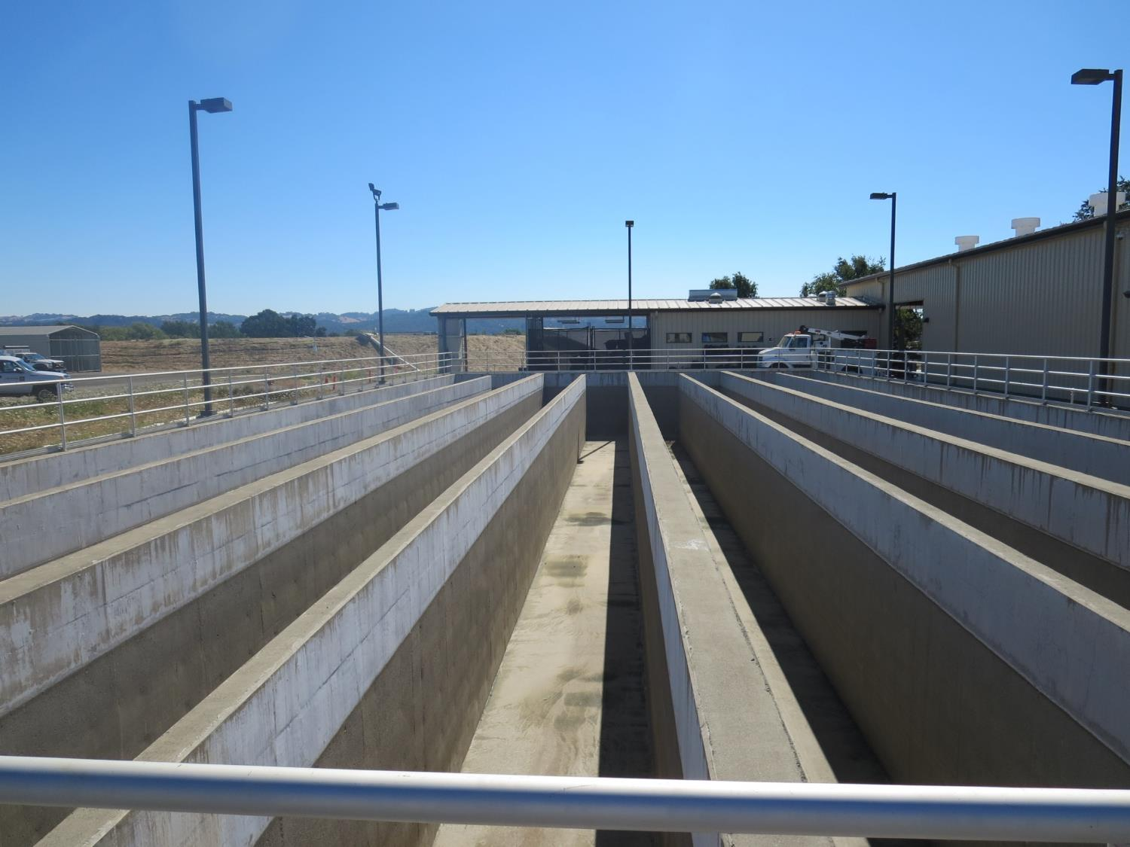
Chlorine Contact Chambers
251,000 Gal Max Capacity
1
2
3
4
Basin 2
Basin 2

Slide 8
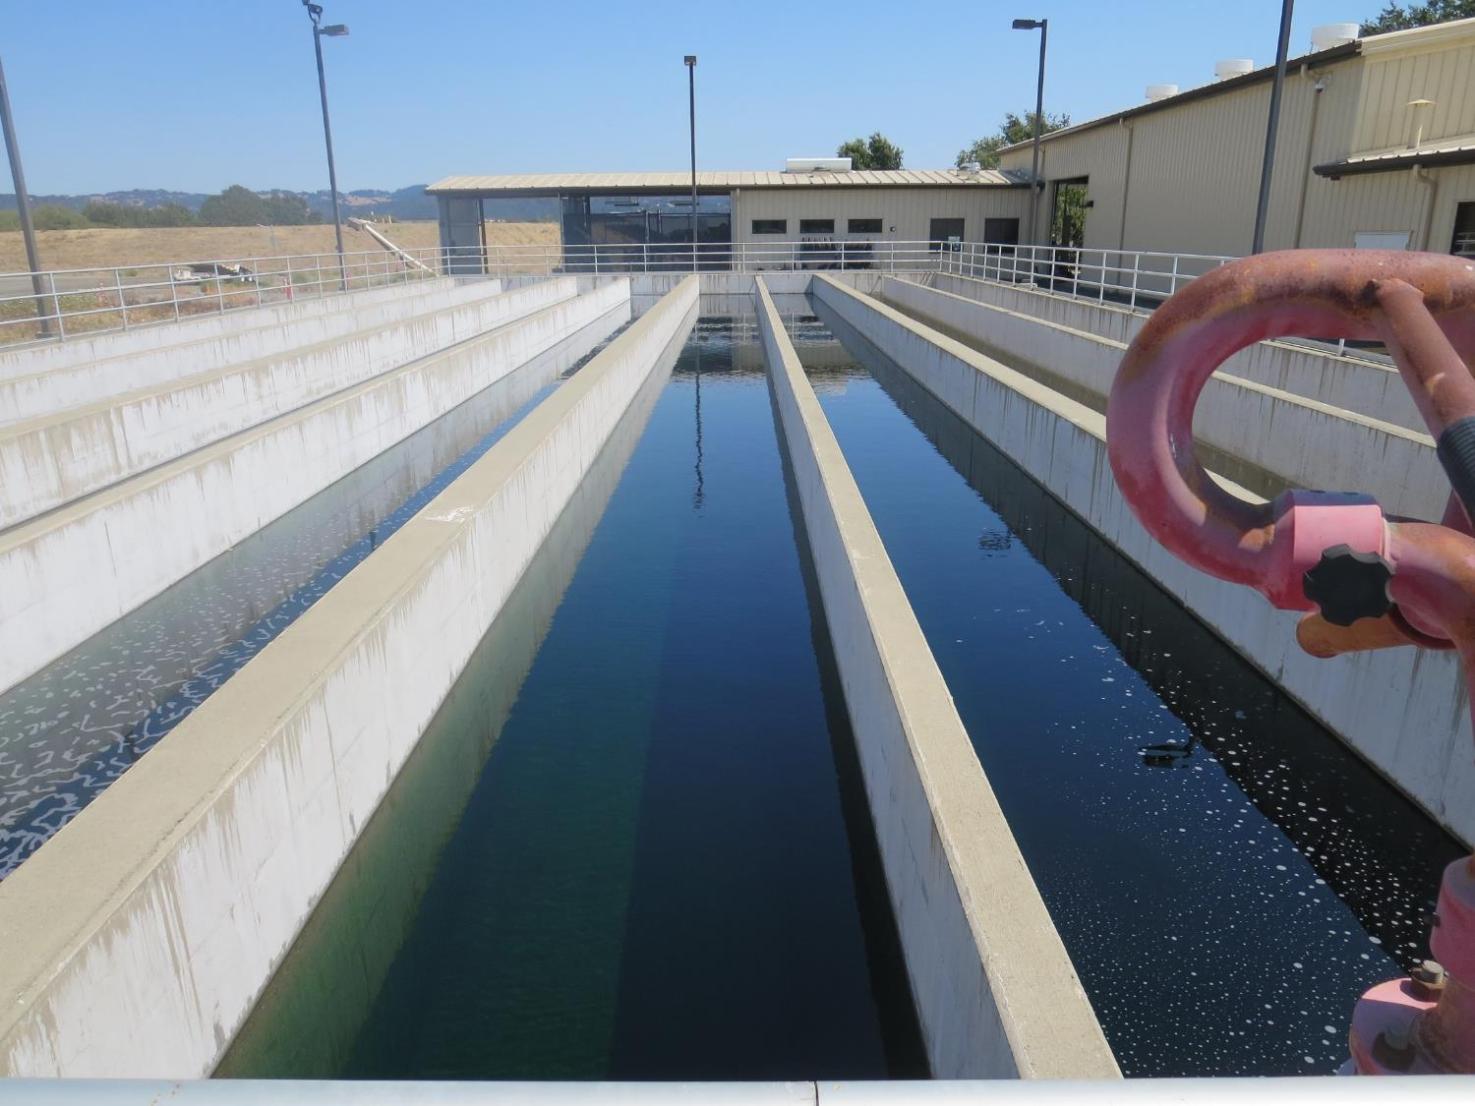
Chlorine Contact Chambers
251,800 Gal Max Capacity
Chlorine Contact Chambers
251,000 Gal Max Capacity
Basin 4
Empty
Basin 1
Basin 2
Basin 2
Basin 3
Basin 3

Slide 9
Chlorine Contact Basins
Design/Operating Parameters
Name | Water Depth ft | Channel Width ft | Total Travel Length ft | Basin Volume (gallons) | Influent Channel Per Basin (gallons)
Basin #1 | 6.5 | 6.5 | 260 | 82,170 | 560
Basin #2 | 6.5 | 6.5 | 260 | 82,170 | 1,120
Basin #3 | 6.5 | 6.5 | 260 | 82,170 | 1,680
Combined (Basins 1-3) |  |  |  | 246,520 | Total: 3,360
Influent Channel: 2.5 ft wide x 2 ft depth
Channel (basin 1) influent length: 15
Channel (basin 2) influent length: 30
Channel (basin 3) influent length: 45

Slide 10
Tracer Test Results for
Chlorine Contact Basins
Name | ¹Volume (gallons) | Average Flow (gpm) | HRT (minutes) | Modal Contact time (minutes) | Modal Baffling Factor
Basin #1 | 82,700 | *498 | 166 | 130 | 0.78
Basin #2 | 83,300 | *500 | 167 | 135 | 0.81
Basin #3 | 83,800 | *505 | 168 | 155 | 0.93
Combined (Basins 1-3) | 251,800 | 1,516 | 166 | 145 | 0.87
*Note: the average flow for each basin is the total average flow from time (zero) to the modal contact time for each individual basin divided by 3 (3 basins in service). This calculation assumes even flow between each basin. Based on Modal Contact Time results for each basin, it appears that Basin 1 has the highest flow and Basin 3 with the lower flow.
¹Each basin volume includes channel volume.

Slide 11
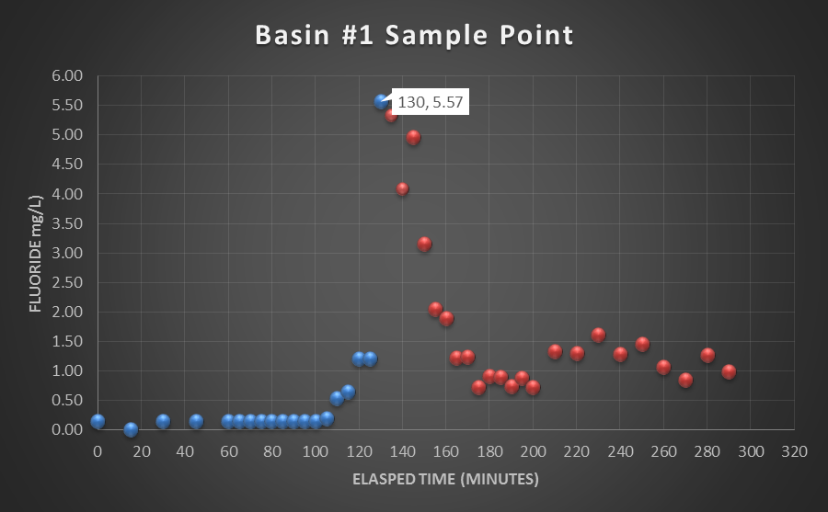
Modal Contact Time: 130 minutes
Basin Volume + Inlet Volume: 82,700 gallons
Average Flow: 498 gpm
HRT: 166 minutes
Baffling factor 0.78 (t_{modal}/HRT)

Slide 12
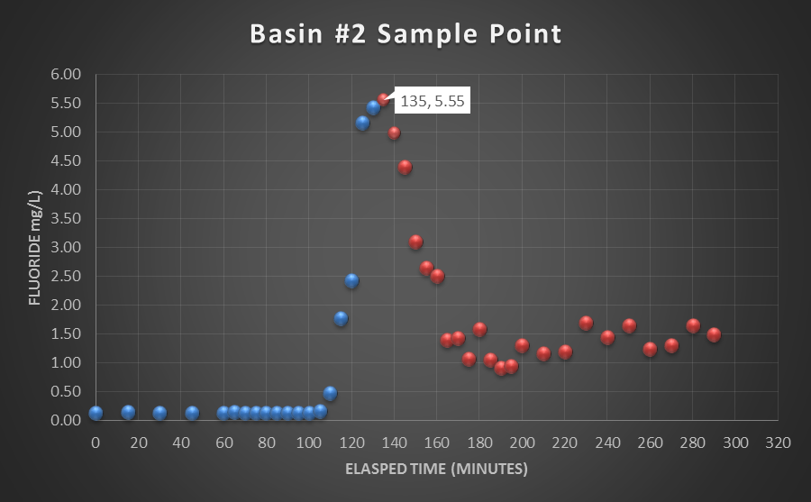
Modal Contact Time: 135 minutes
Basin Volume + Inlet Volume: 83,300 gallons
Average Flow: 500 gpm
HRT: 167 minutes
Baffling factor 0.81 (t_{modal}/HRT)

Slide 13
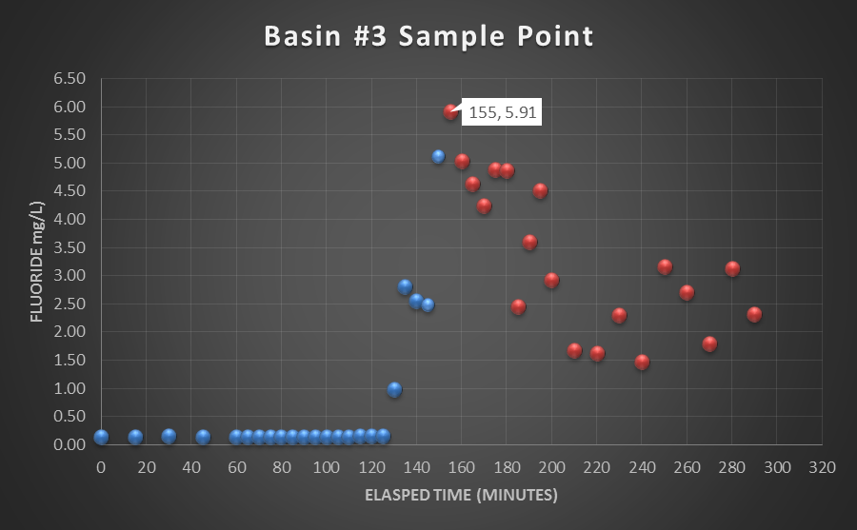
Modal Contact Time: 155 minutes
Basin Volume + Inlet Volume: 83,800 gallons
Average Flow: 505 gpm
HRT: 168 minutes
Baffling factor 0.93 (t_{modal}/T)

Slide 14
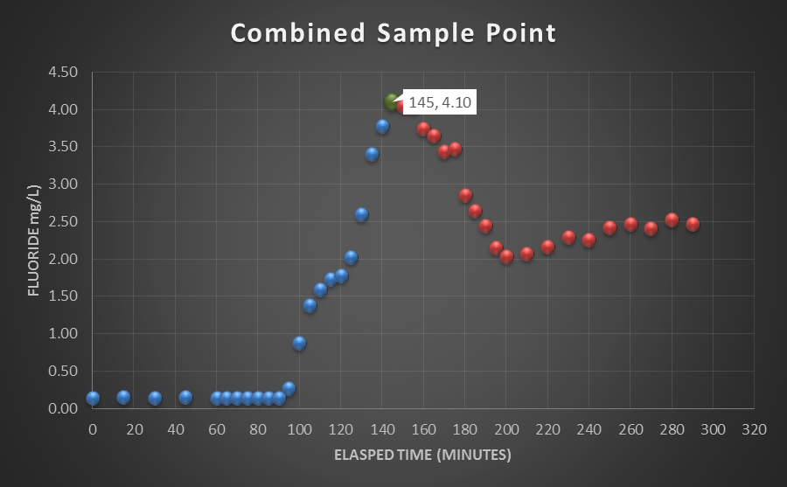
Modal Contact Time: 145 minutes
Basin Volume + Inlet Volume: 251,800 gallons
Average Flow: 1,516 gpm
HRT: 166 minutes
Baffling factor 0.87 (t_{modal}/T)

Slide 15
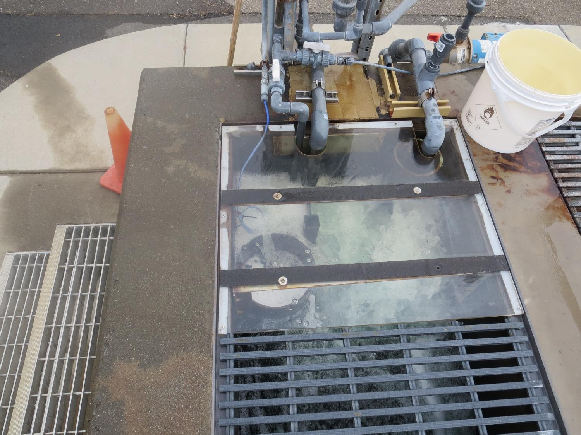
Channel Influent &
Fluoride Injection

Slide 16
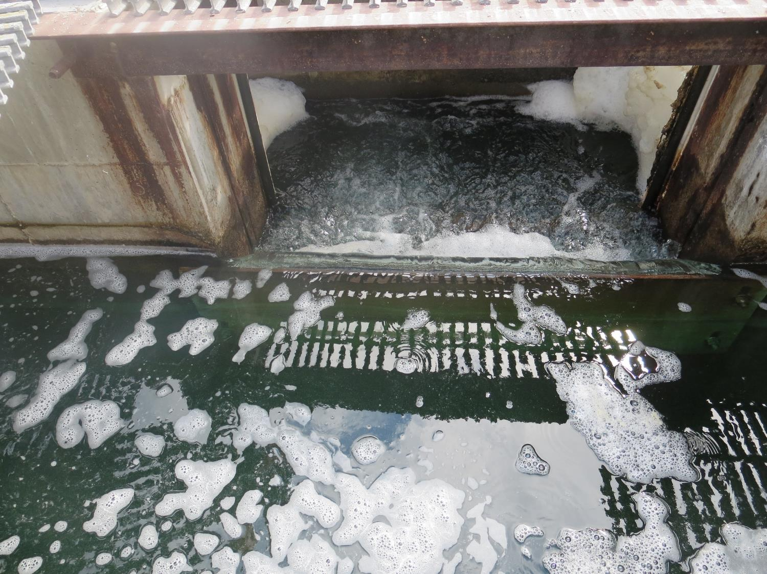
Influent Weir Opening to Basin, 3.5-ft
(typical)

Slide 17
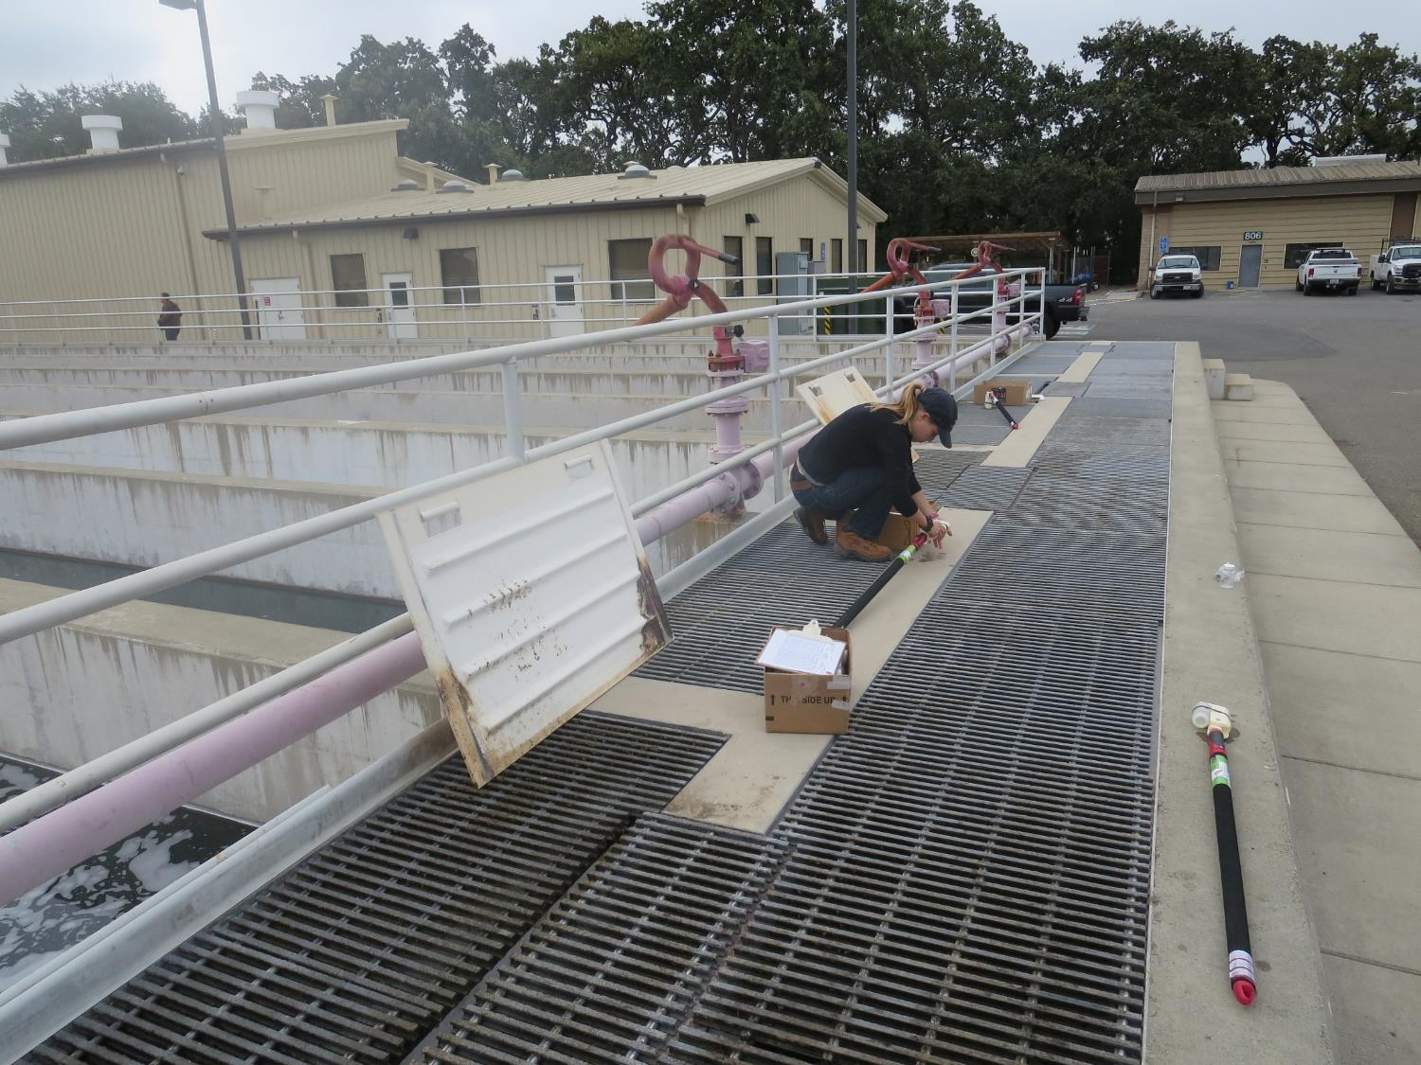
Sampling Pole

Slide 18
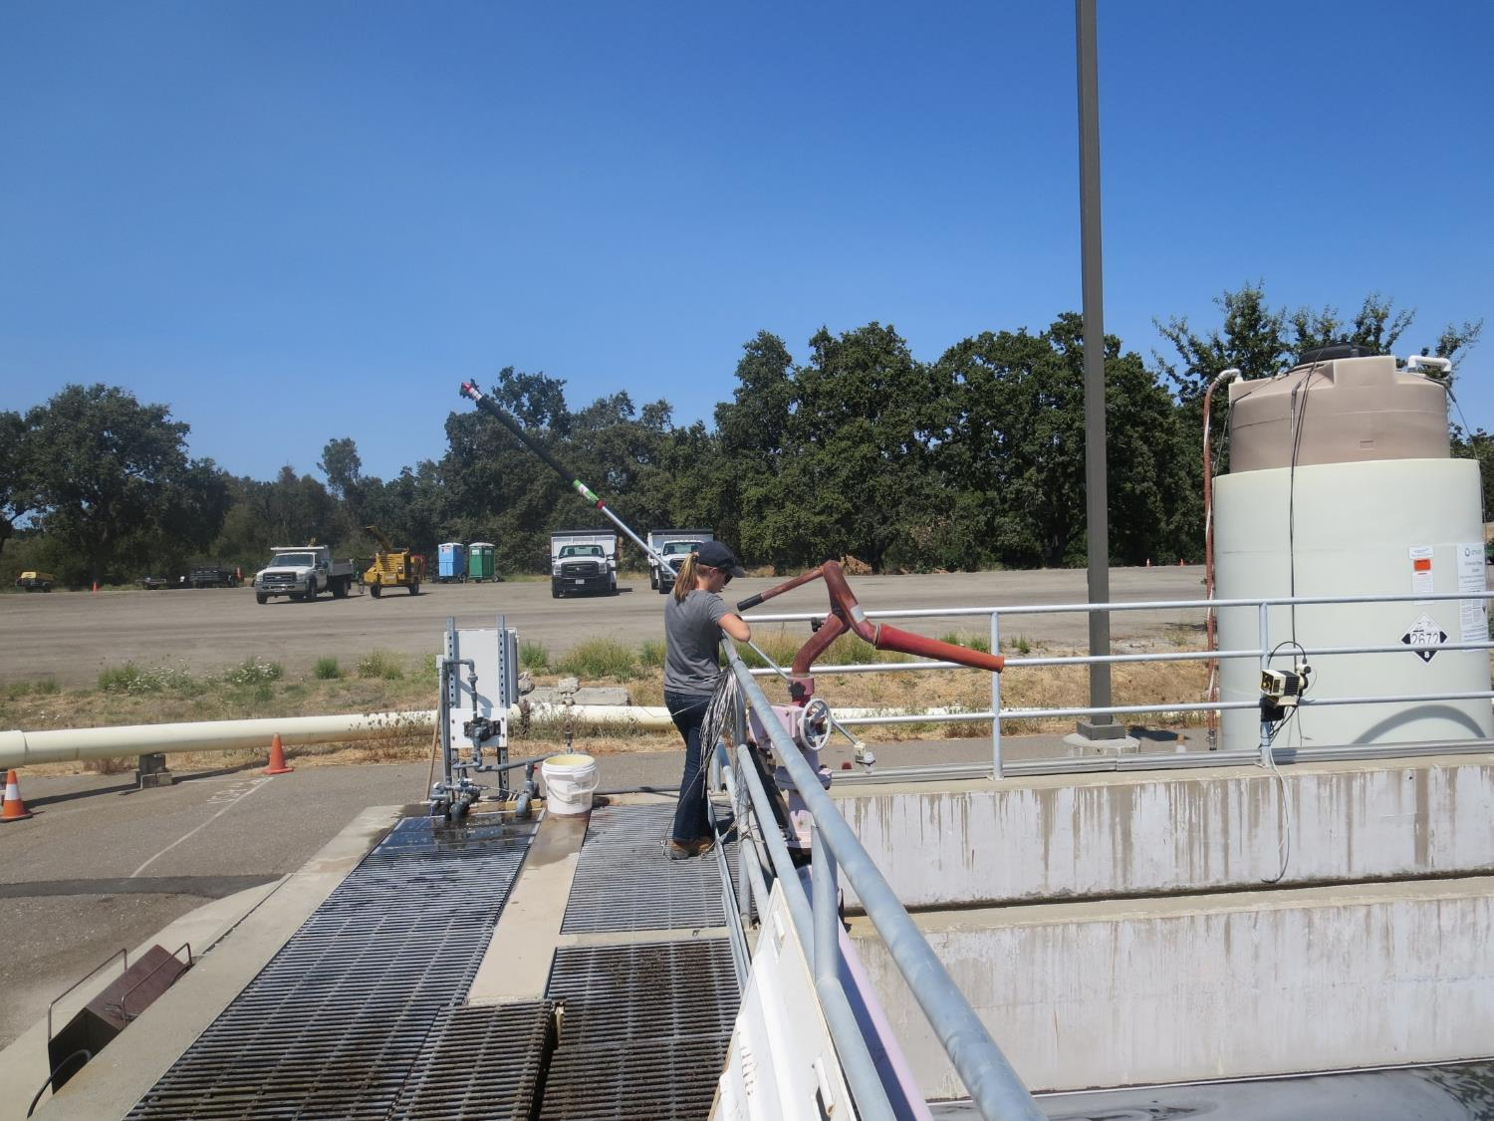

Slide 19
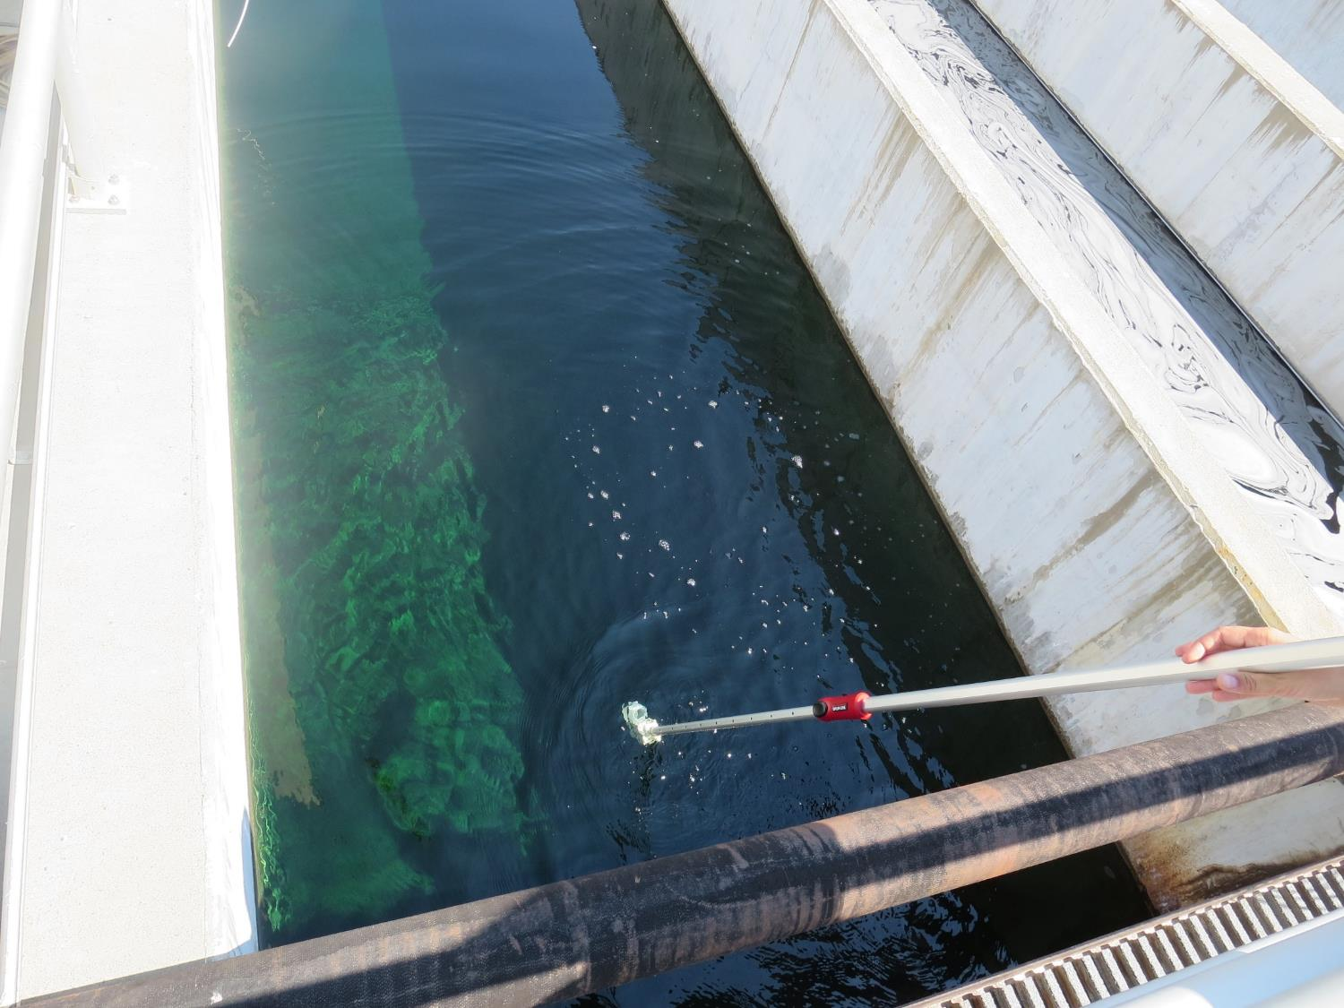

Slide 20
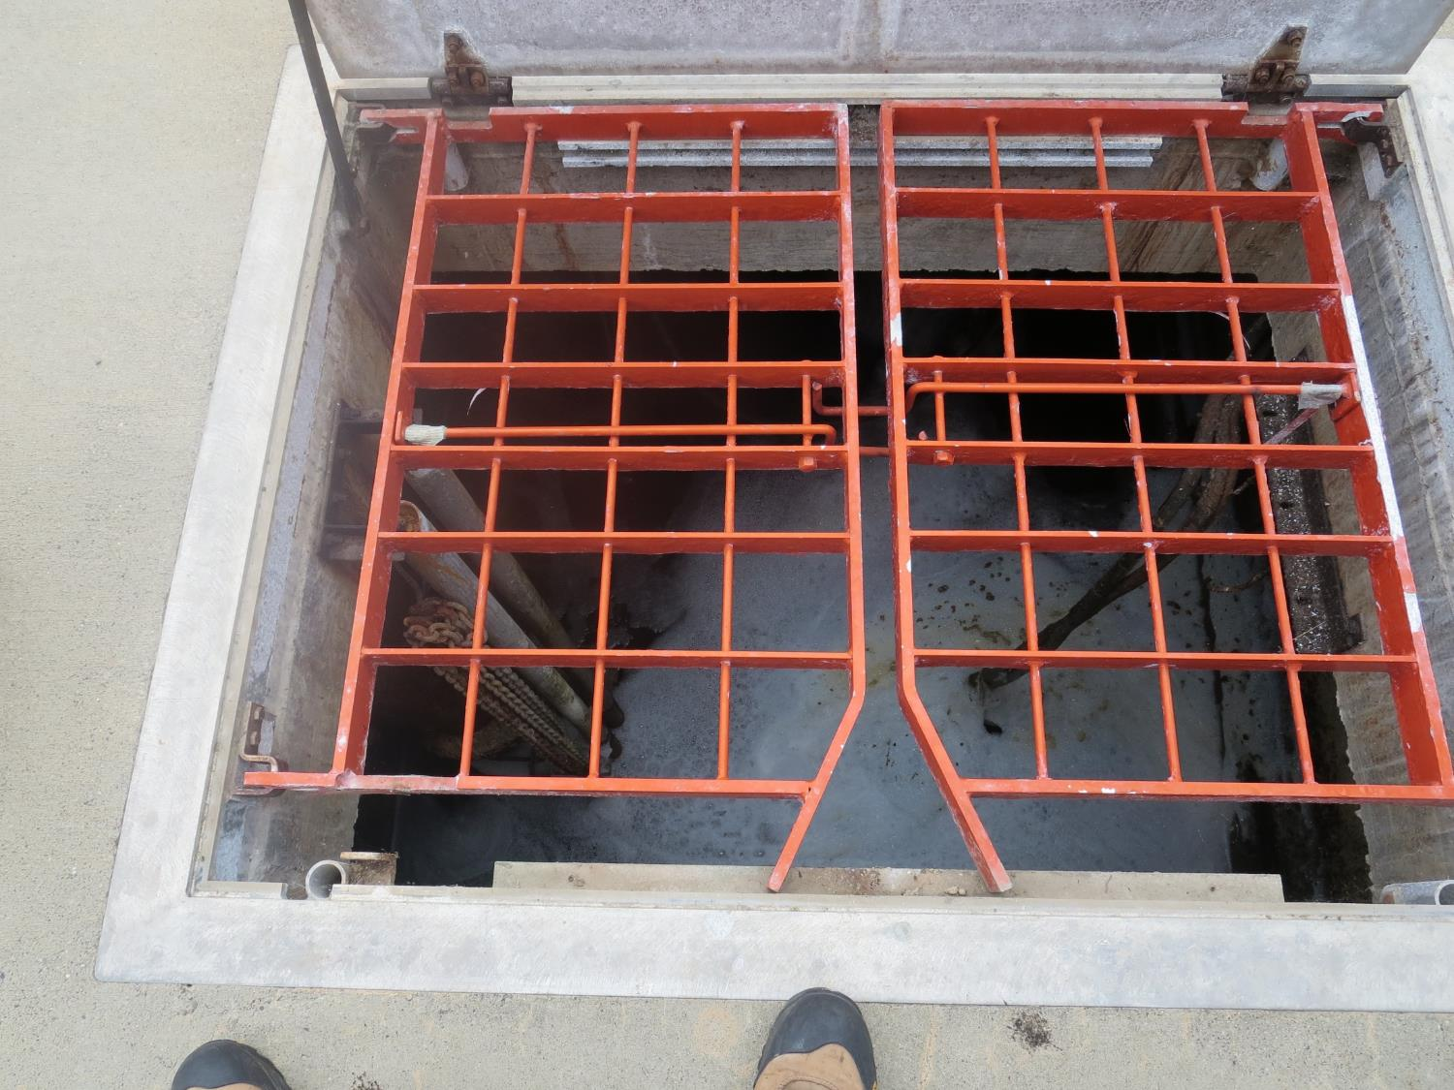
Collection Basin (Combined Basins 1-3)

Slide 21
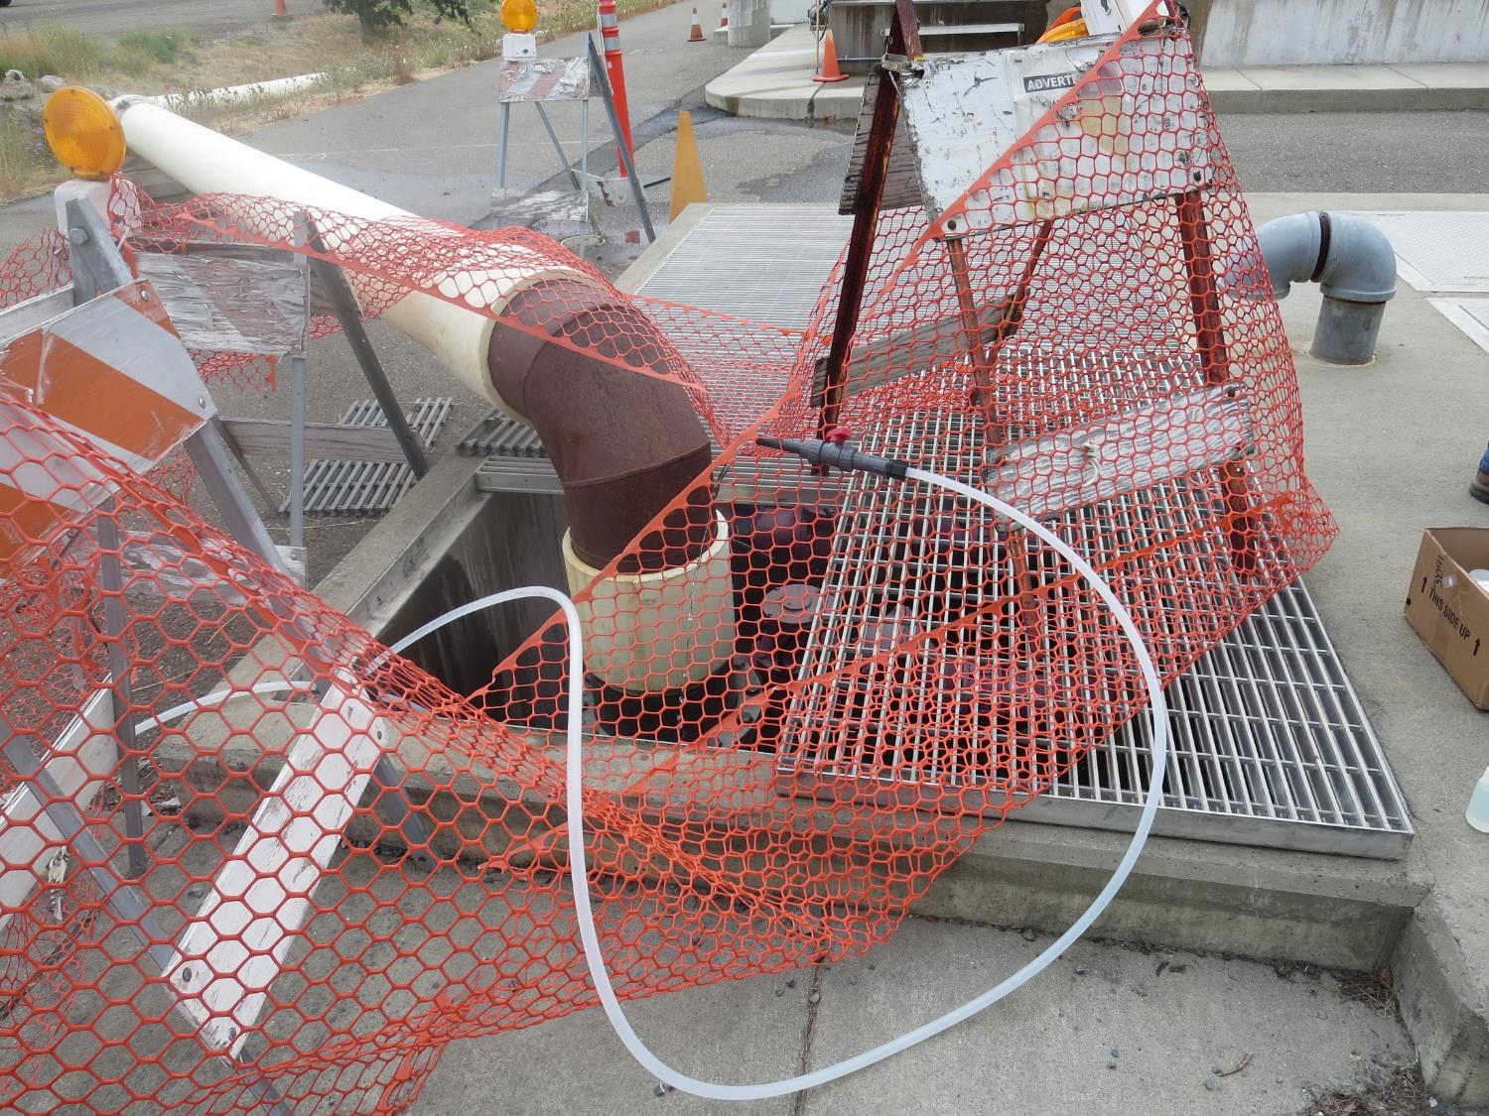
Combined Fluoride Sampling Point

