Slide 1
Buckingham Park Water District
Tracer Study
2/10/16
By Guy Schott

Slide 2
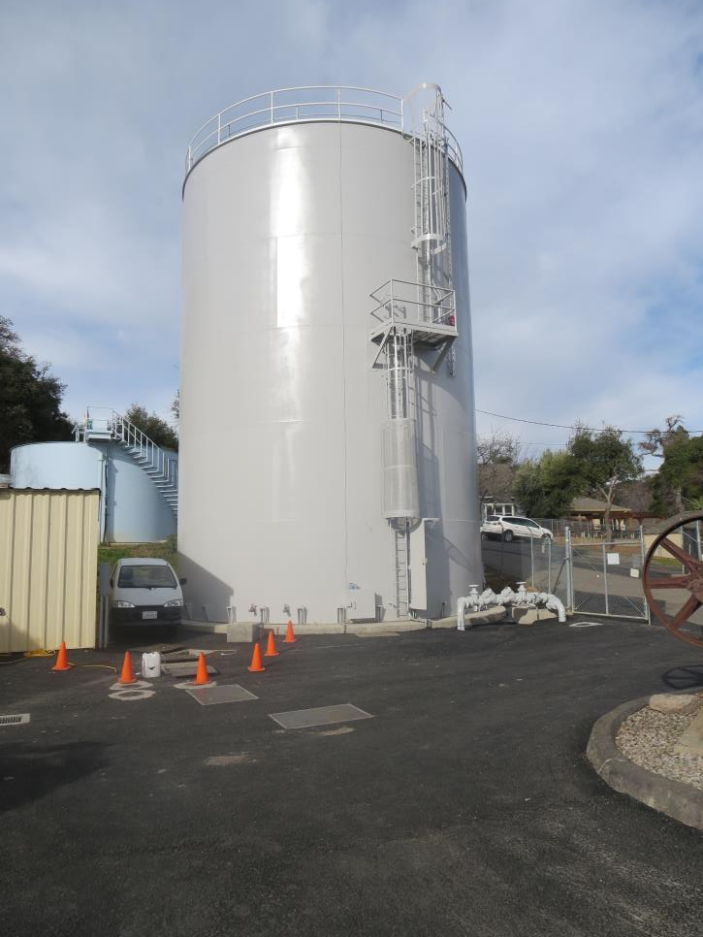
200K Clearwell
30-ft Diameter; 37.8 ft. Baffle Height

Slide 4
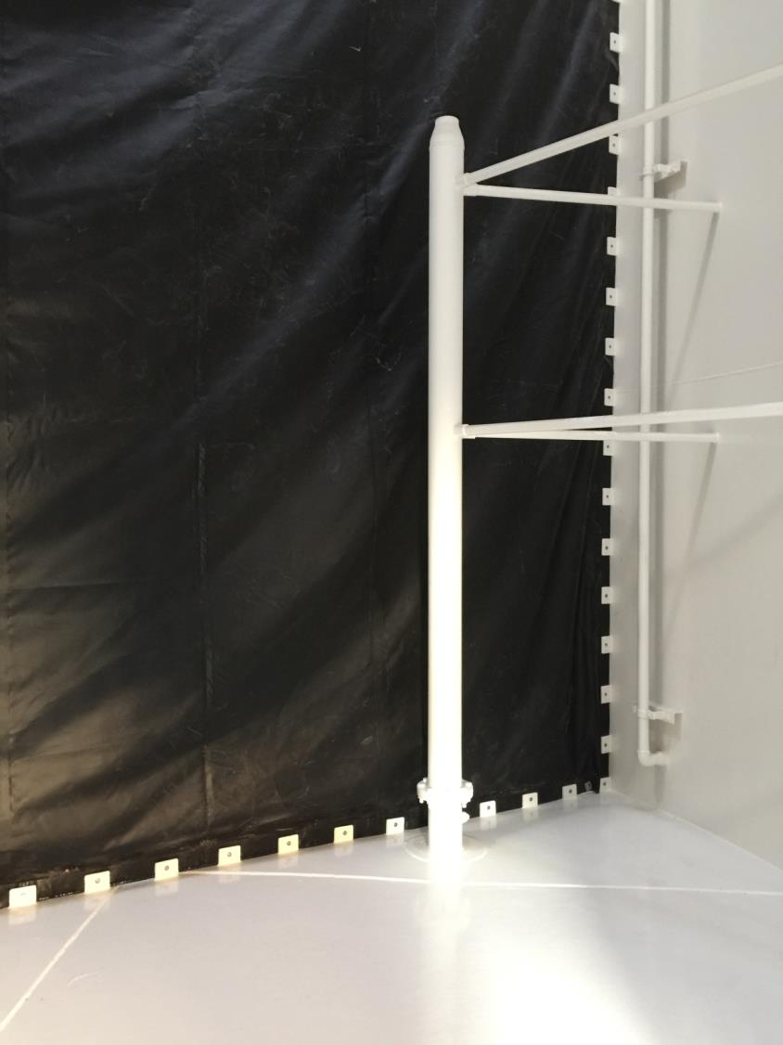
Nozzle Velocity:
5.1 ft/sec
Baffle Curtain
Inlet Riser
12 ft Ht.
6” x 4” Reducer

Slide 5
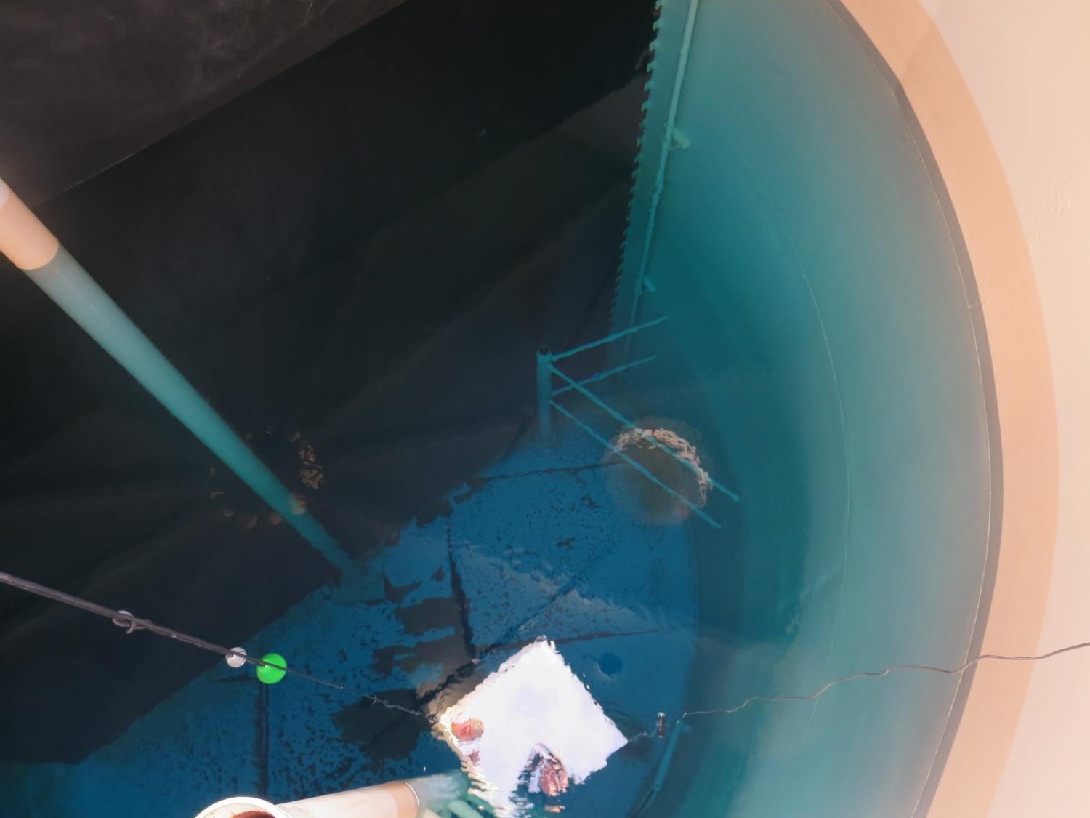
Inlet Side of Clearwell

Slide 6
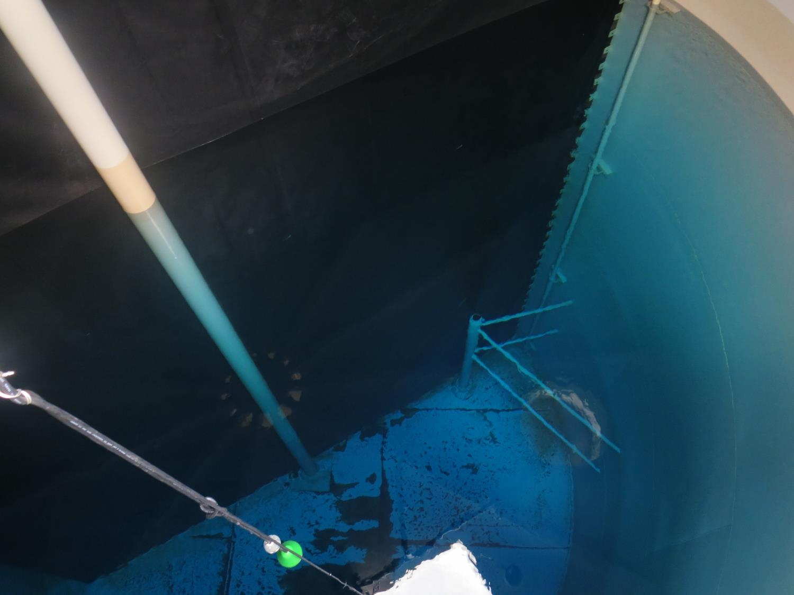
Baffle Curtain
Inlet Side of Clearwell

Slide 7
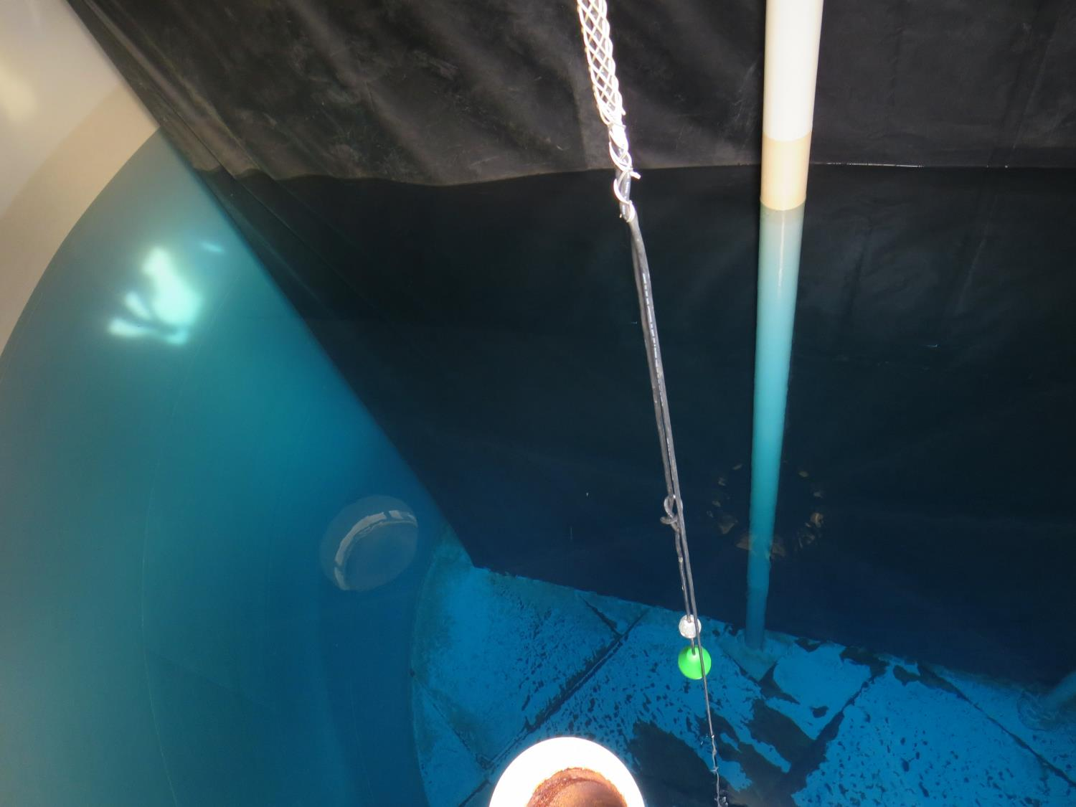
Flow

Slide 8
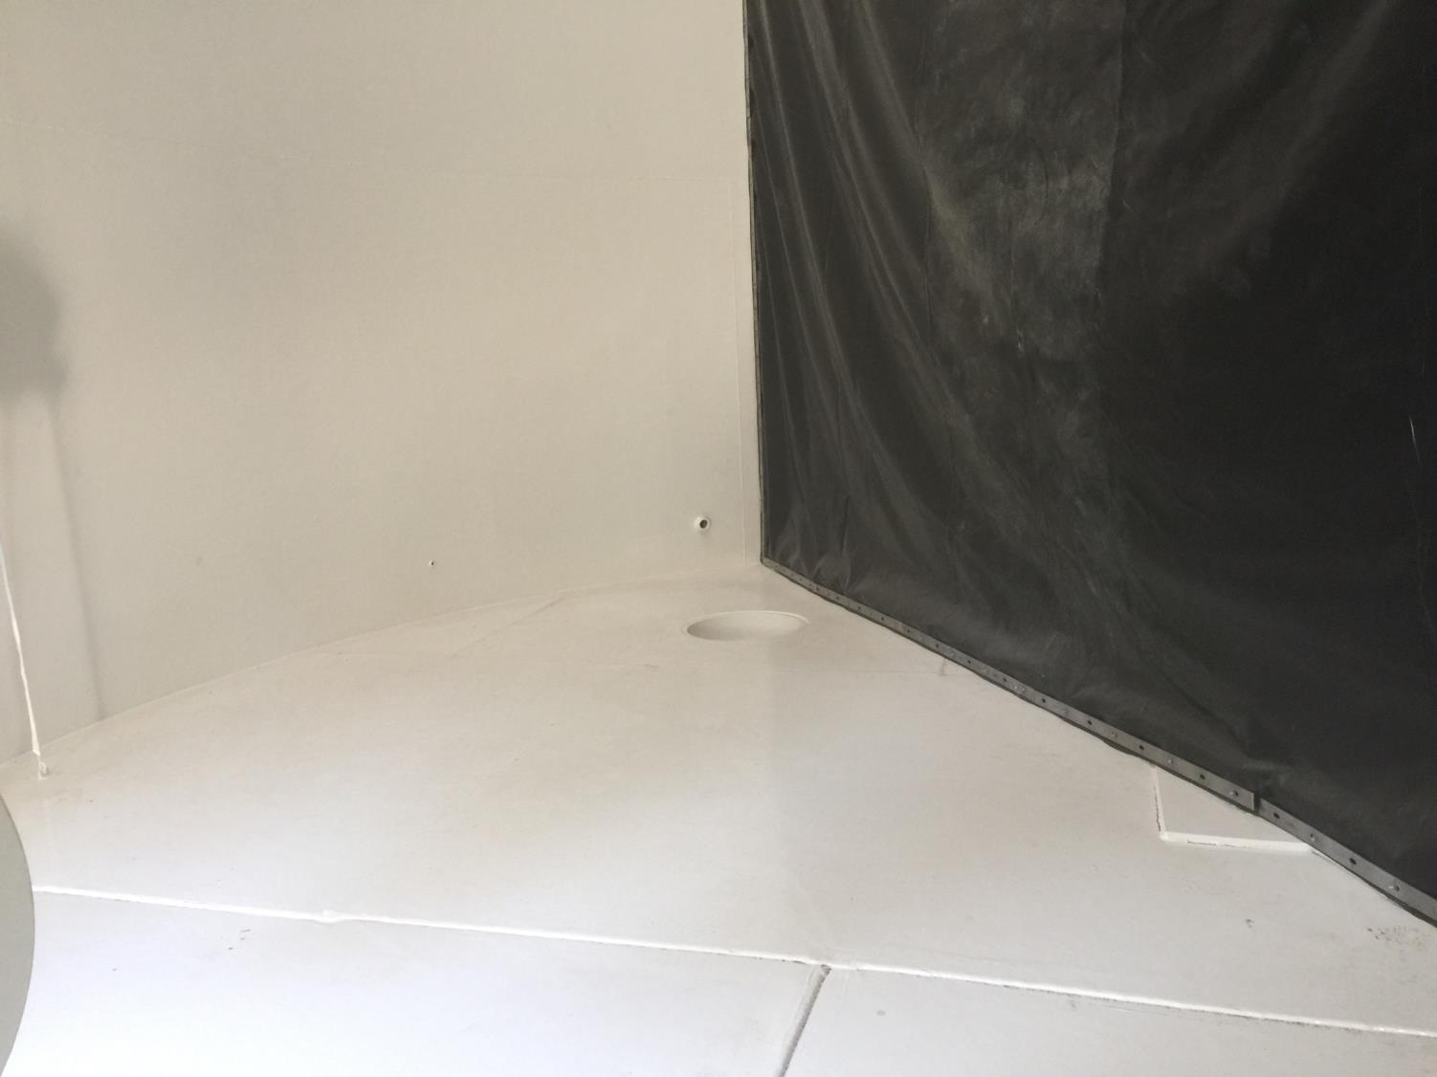
Outlet

Slide 9
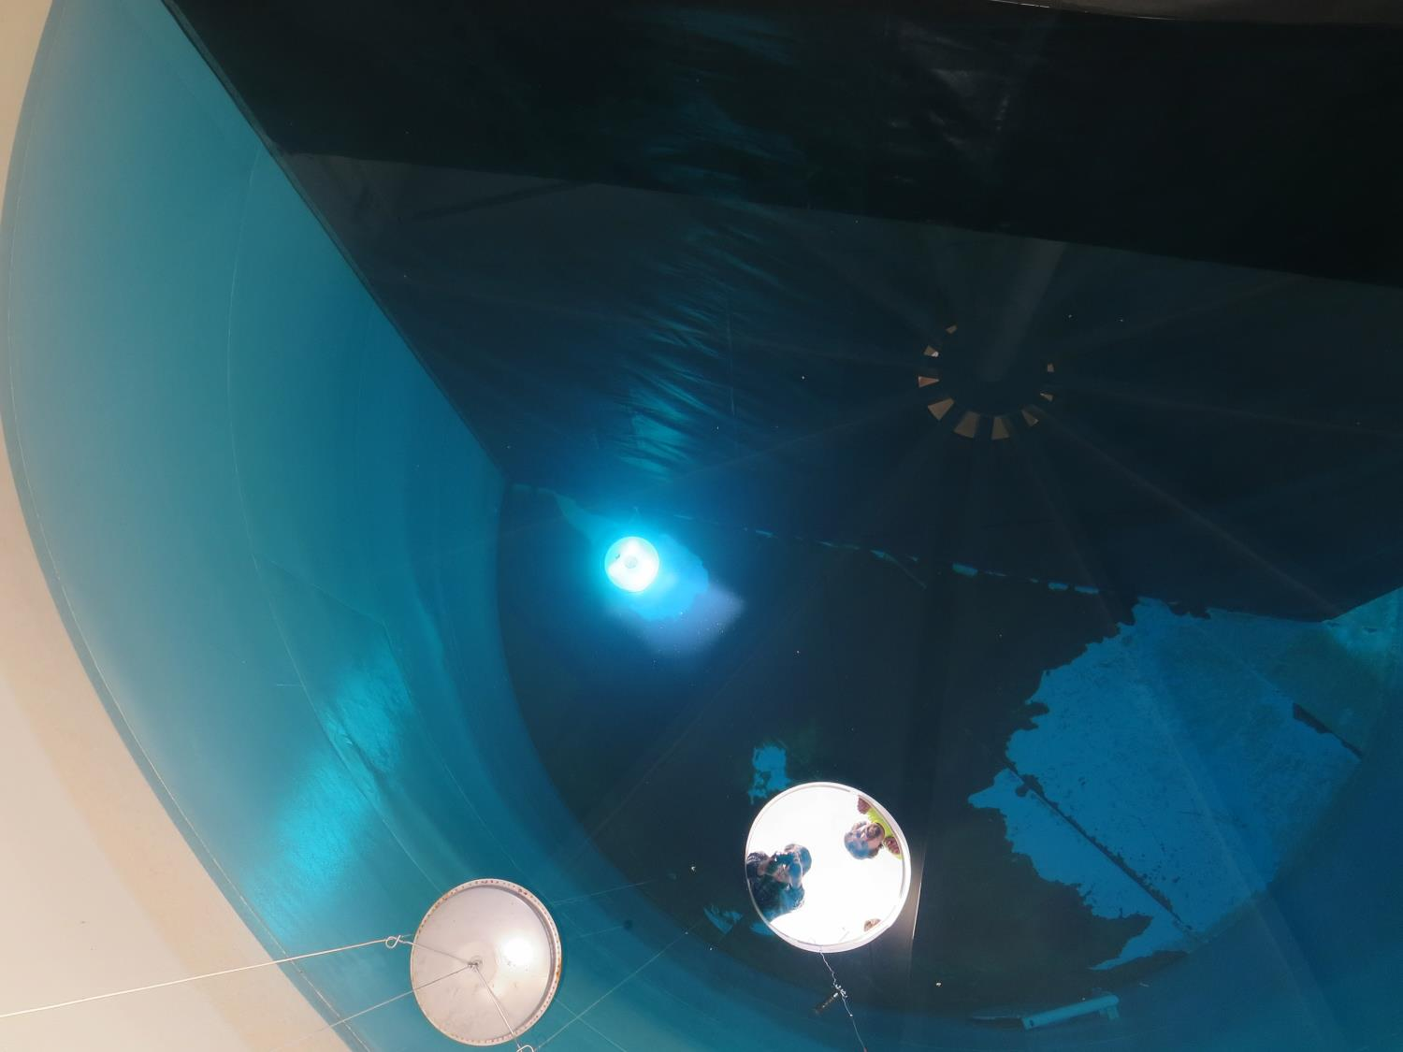
Outlet Side of Clearwell
Leaking baffle

Slide 10
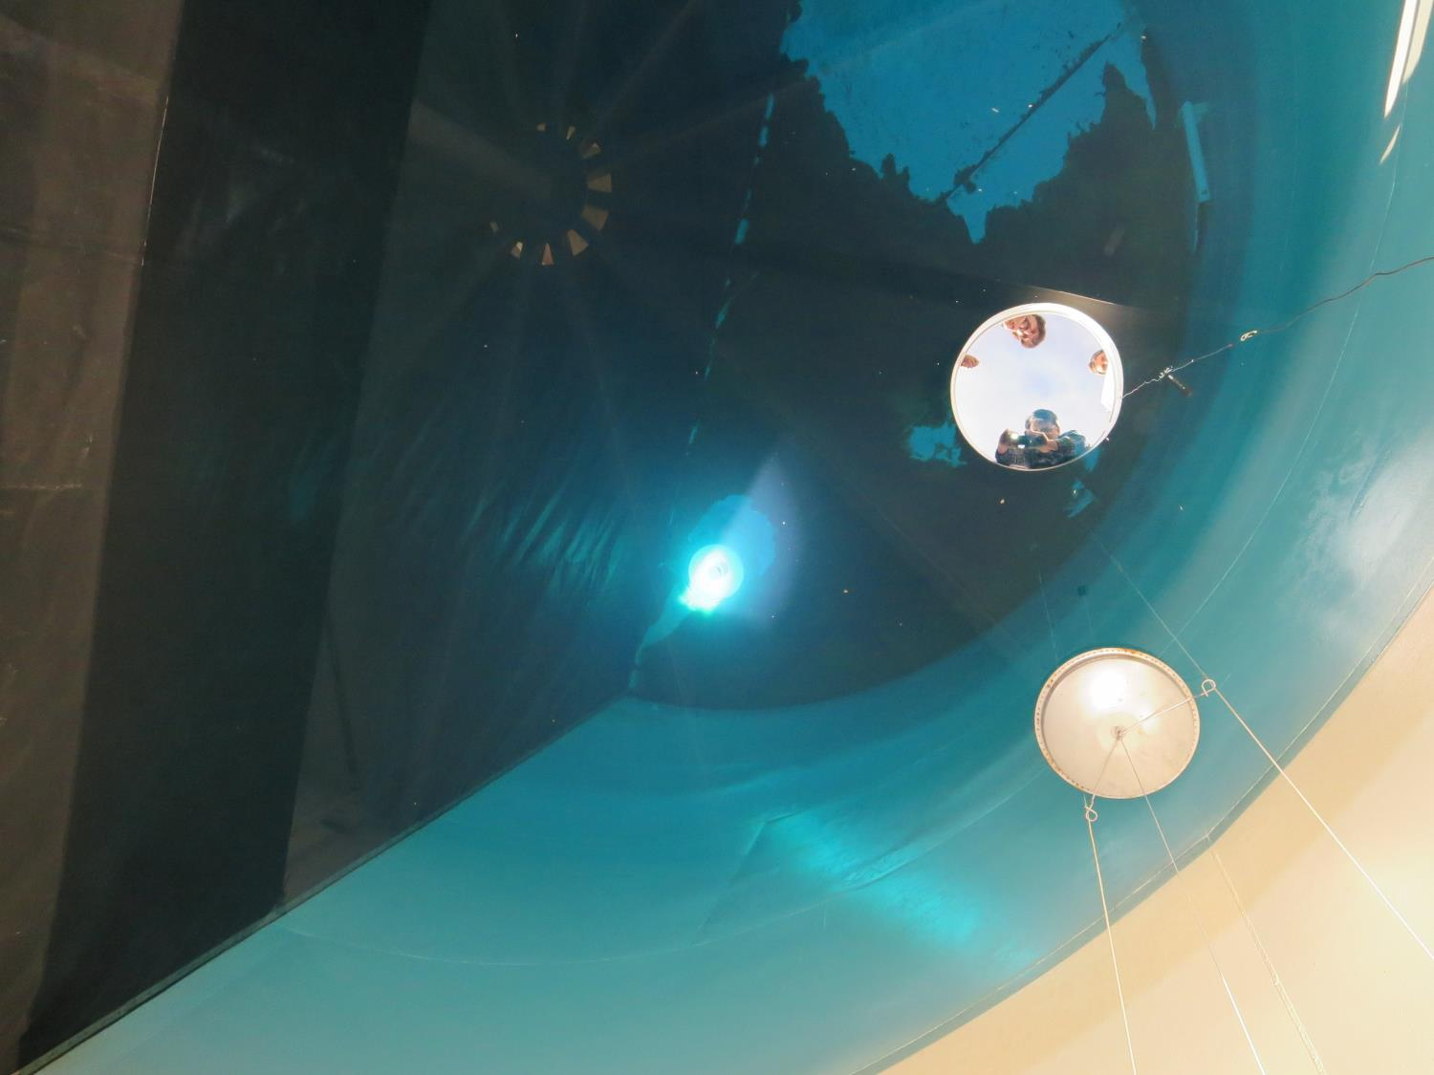
Outlet
Leaking baffle

Slide 11
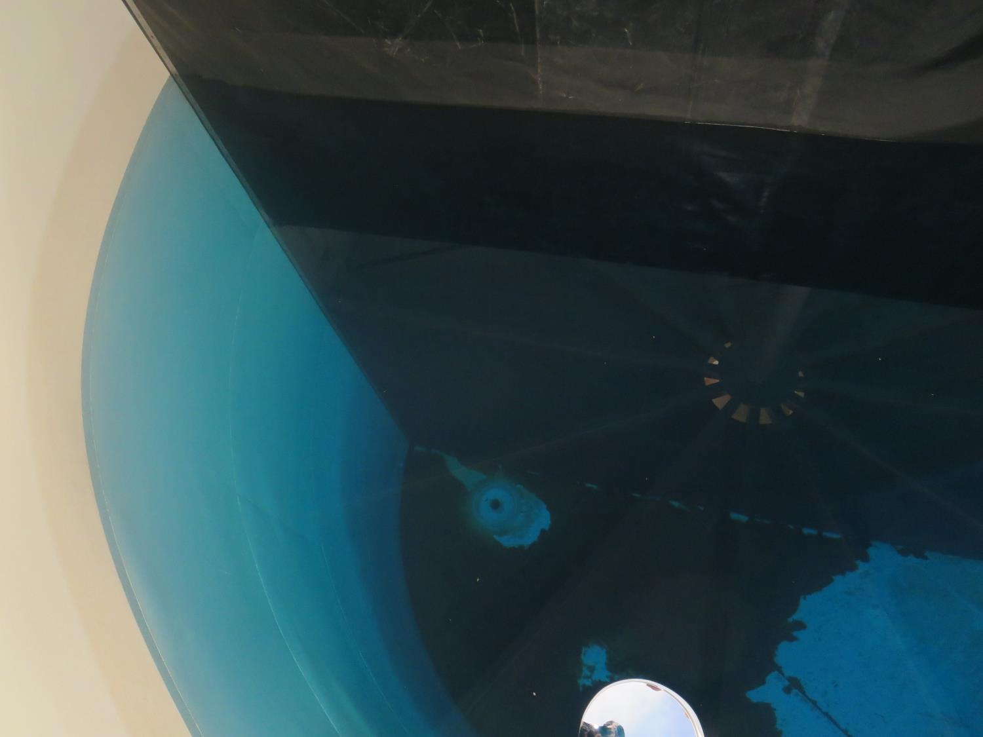
Outlet

Slide 12
Baffling Factor: 0.13
Flow (inlet/outlet): 200 gpm; HRT: 867 minutes (14.4 hrs)

Slide 13
Depth
Clearwell
Chlorine Residual
Operating Tank
Level: 31.8 ft.
31 ft
1.82 mg/L
1.81 mg/L
16.5 ft
1.81 mg/L
1.73 mg/L
1.5 ft
1.73 mg/L
1.86 mg/L
Inlet Side
Outlet Side

