Slide 1
Buckingham Park Water District
Tracer Study #2
2/2/17
By Karen Stufkosky

Slide 2
Background and Purpose
This tracer study is the second tracer study done for this tank since its installation. The first study (2/10/16) provided a lower baffling factor (0.13) than expected. Upon investigation, the tank appeared to be short-circuiting from observation of the sediment on the bottom of the tank.
The tank was dove in September 2016 for its one-year, post-construction inspection. The divers photograph a gap between the curtain and the tank bottom and side wall. The divers filled in the gaps with NSF approved Aquatapoxy to potentially decrease any short-circuiting.
This second study (2/2/17) was performed to determine if the baffling factor had improved with the above mentioned repairs.

Slide 3
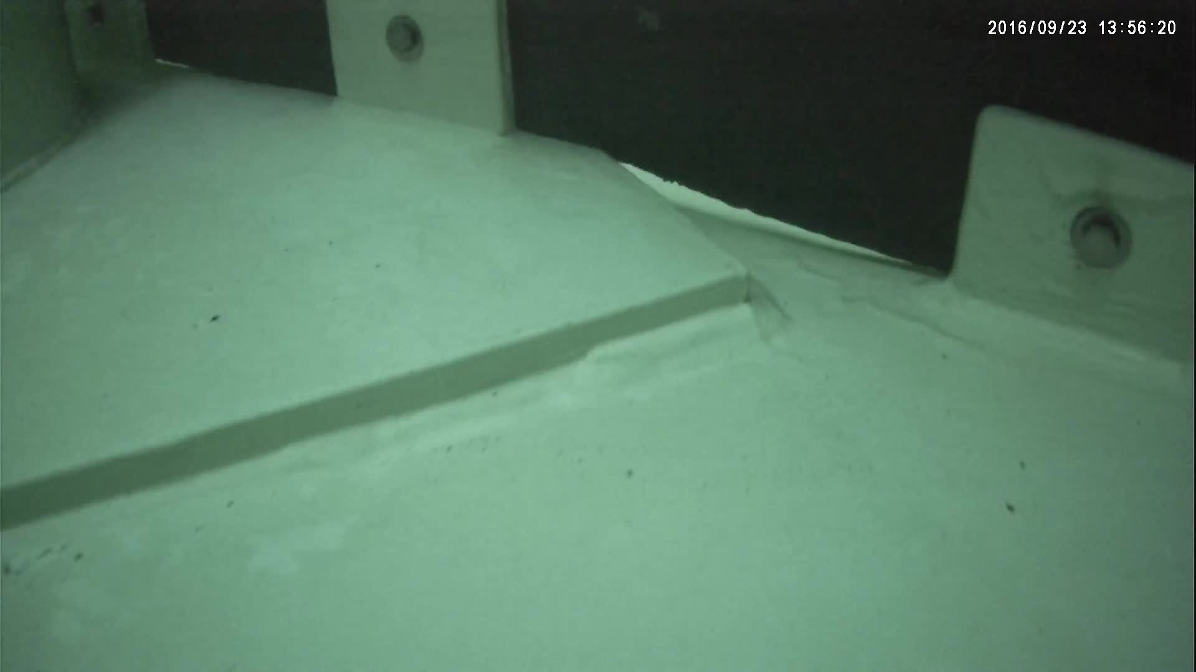
Gap – one of many

Slide 4
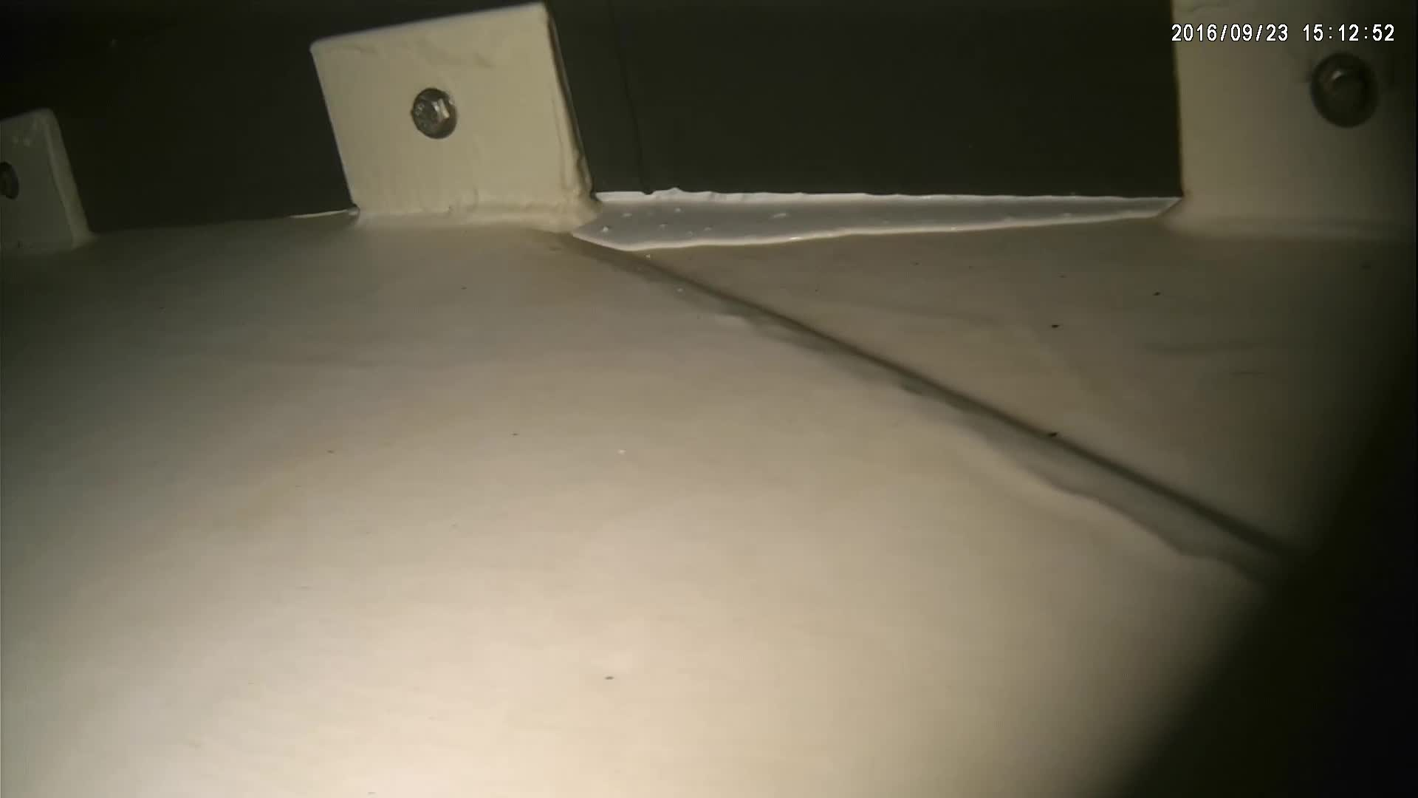
Gap repair – one of many

Slide 5
Tracer Study #1 Results Study 2/10/16
Operating Tank
Level: 31.8 ft.
Baffling Factor: 0.13
Flow (inlet/outlet): 200 gpm; HRT: 867 minutes (14.4 hrs)

Slide 6
Tracer Study #2 Results Study 2/2/17
Operating Tank
Level: 33.0-33.8 ft.
Time (min) | Tracer F (mg/L) | t/T
0 | 0.00 | 0.00
30 | 0.04 | 0.03
60 | 0.18 | 0.07
70 | 0.17 | 0.08
80 | 0.17 | 0.09
90 | 0.21 | 0.10
100 | 0.27 | 0.11
110 | 0.31 | 0.13
120 | 0.33 | 0.14
130 | 0.33 | 0.15
140 | 0.31 | 0.16
160 | 0.34 | 0.18
180 | 0.40 | 0.21
Measured Dose: 3.3 mg/L F
Flow: average 203 gpm
HRT: 871 minutes (14.5 hrs)
Baffling Factor: 0.14

Slide 7
Results
The results of this study gave a baffling factor of 0.14, similar to the first study with a 0.13 baffling factor.
The cause for the low baffling factor is unknown.
The epoxy applied to the baffling current may have broken loose.
Unknown flow pattern (investigate with NSF dye in tank or a Computational Fluid Dynamics software)
As-built drawings were reviewed to ensure the tank is not being by-passed. There is no piping or valving that allows the tank to be by-passed, ruling out any short-circuiting or cross-connections.

Slide 8
Conclusions
The results of this tracer study gave a baffling factor of 0.14 for this tank.
Repairs to the current wall were expected to increase the baffling factor and prevent short-circuiting.
The tank should be inspected again to ensure the epoxy is still in place.
The tank flow patterns should be further investigated through a study with dye and through flow modeling software.
List of NSF 61 approved dyes:
http://info.nsf.org/Certified/PwsChemicals/Listings.asp?CompanyName=&TradeName=&ChemicalName=&ProductFunction=Tracer+Dye&PlantState=&PlantCountry=&PlantRegion=

Slide 9
Appendix 1 - Tank Configuration

Slide 10
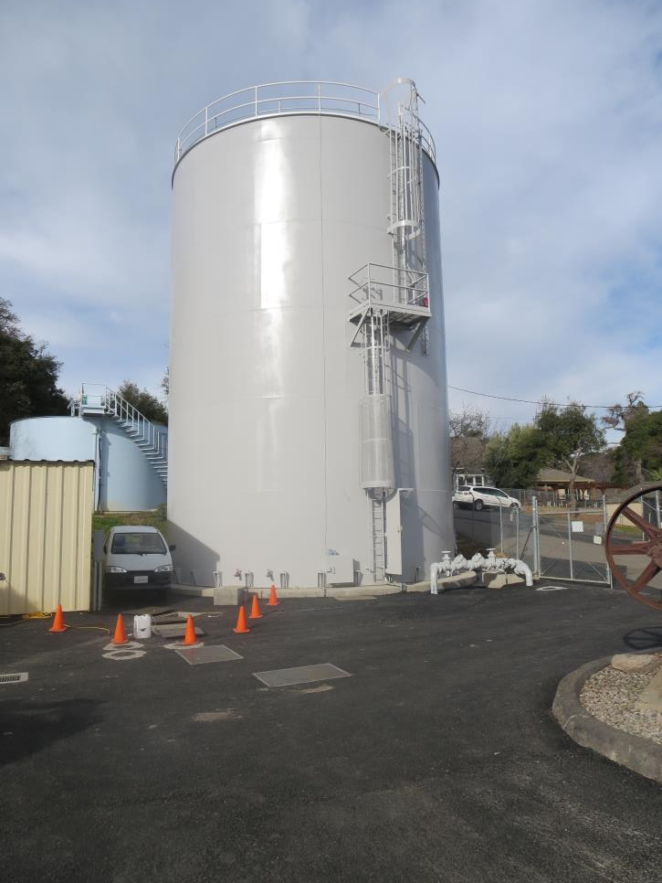
200K Clearwell
30-ft Diameter; 37.8 ft. Baffle Height

Slide 12
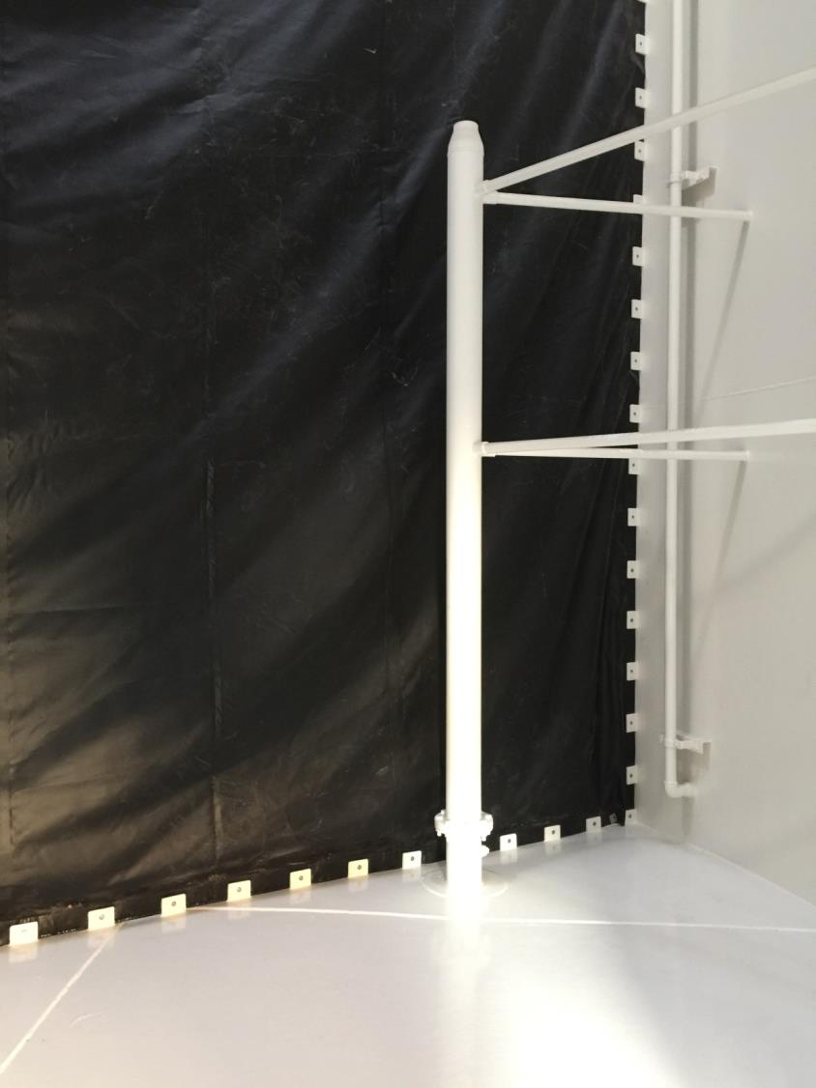
Nozzle Velocity:
5.1 ft/sec
Baffle Curtain
Inlet Riser
12 ft Ht.
6” x 4” Reducer

Slide 13
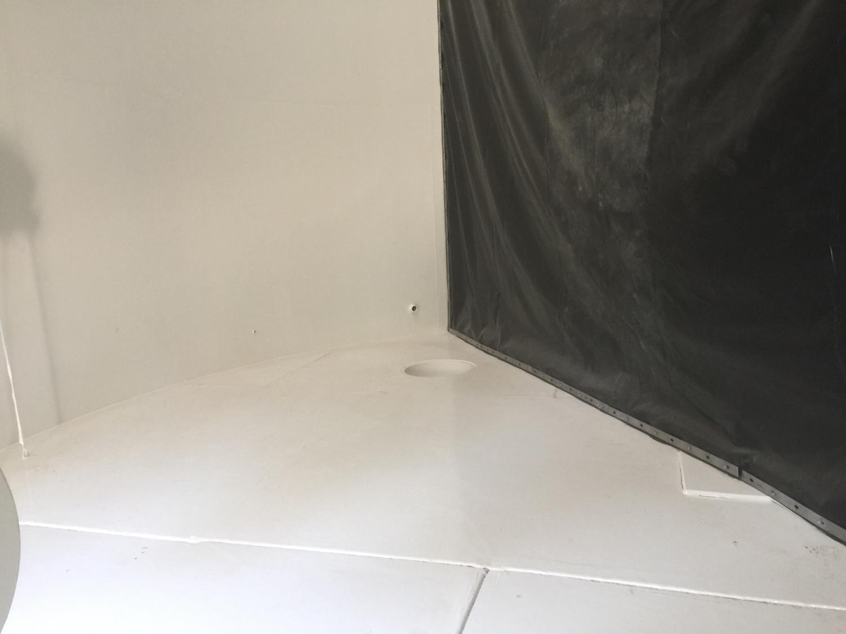
Outlet

