Slide 1
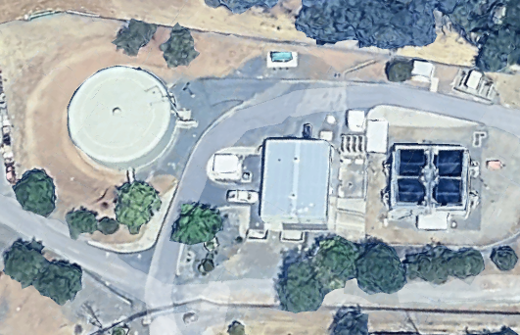
1
Cal-Water Service Co. - Oroville
Tracer Studies
September 17, 2025
November 20, 2025
CA0400019

Slide 2
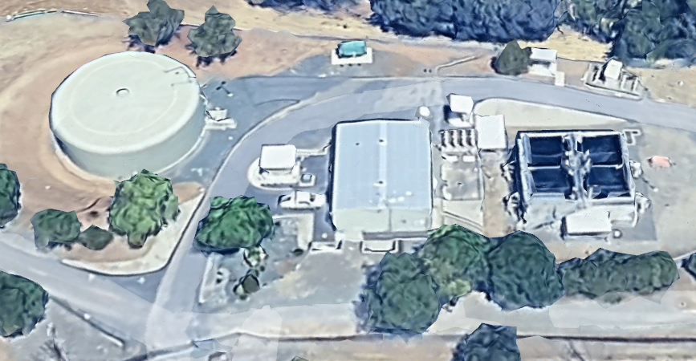
Segment 1 (47,000-gal Concrete sump/pump Tank)
Segment 2 (1,744-gal Pipeline)
Segment 3 (450,000-gal Clearwell)
24,800 gal/ft
0.45 MG Clearwell
Concrete Tank
(47,000 gal)
3
Pipeline, 1,744 gal
Gravity Filters
2
1
Gravity
Flow
Disinfection
Tracer

Slide 3
Summary of Tracer Results
Tracer Date | Reactor(s) | Average Operating Volume, gal | t₁₀ min | HRT min | Baffling Factor
September 17, 2025 | Concrete Sump/Pump Tank | 47,284 | 10.1 | 26.7 | 0.38
November 20, 2025 | Concrete Sump/Pump Tank | 41,500 | 9.1 | 23.3 | 0.39
September 17, 2025 | Concrete + Pipeline + Clearwell | 515,000 | 54 | 349 | 0.15
November 20, 2025 | Concrete + Pipeline + Clearwell | 482,026 | 65 | 368 | 0.17
Notes:
On September 17, 2025, the flow through concrete (sump/pump) tank was operated to tank overflow; sump pump operated continuous at 1,770 gpm (no interruptions). Clearwell exit flow average 1,345 gpm.
On November 20, 2025, the entry flow was 1,000 gpm to the concrete (sump/pump) tank with an exit flow of 1,770 gpm. The sump/pump cycled on/off due to draining and filling. Clearwell exit flow average 1,187 gpm.

Slide 4
Summary of Tracer Procedures (2 of 2)
Two tracer studies were conducted on the combined concrete tank, transmission line, and 450K clearwell operated in serries. Disinfection begins with post filtrate chlorinated water entering the 47K concrete tank. This water is transferred via sump pump through a 1.7K transmission line to the 450K Clearwell. Water exits the Clearwell via gravity. CT compliance sampling is at the Clearwell discharge line.

Slide 5
Summary of Tracer Procedures (1 of 2)
Hydrofluosilicic Acid (H₂SiF₆) was added as the tracer at the chlorine injection point upstream of the 47,000-gallon concrete sump/pump tank.
Sampling were conducted at two stations
  Station 1: Outlet of 47K concrete tank. The tracer method was the “Step-Dose” method to confirm fluoride dose (mg/L).
  Station 2: Outlet of 450K Clearwell. The tracer method was the “Modified Step-Dose” method which the durations is less than the hydraulic residence time (HRT).

Slide 6
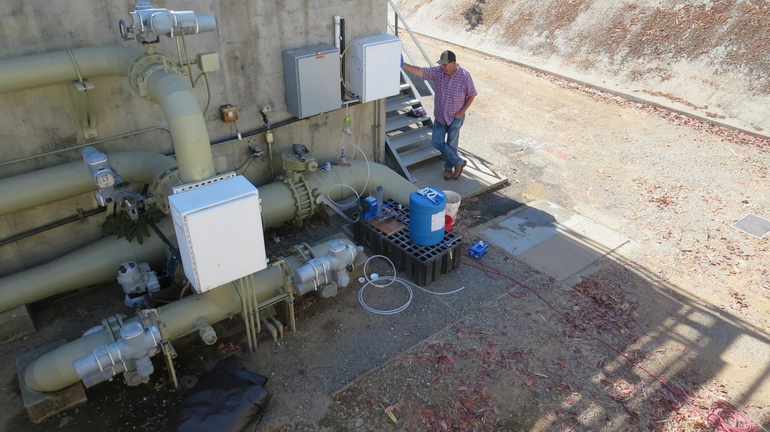
2
Fluoride Setup
and Injection Point
Chlorine Injection
Point in Vault

Slide 7
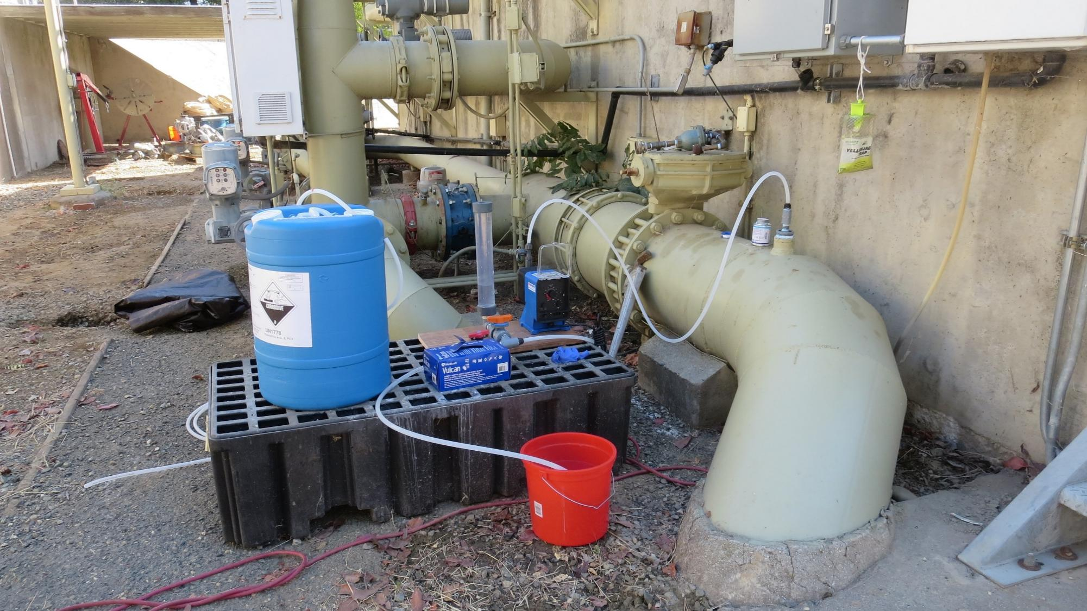
3
Fluoride
Injection Point

Slide 8
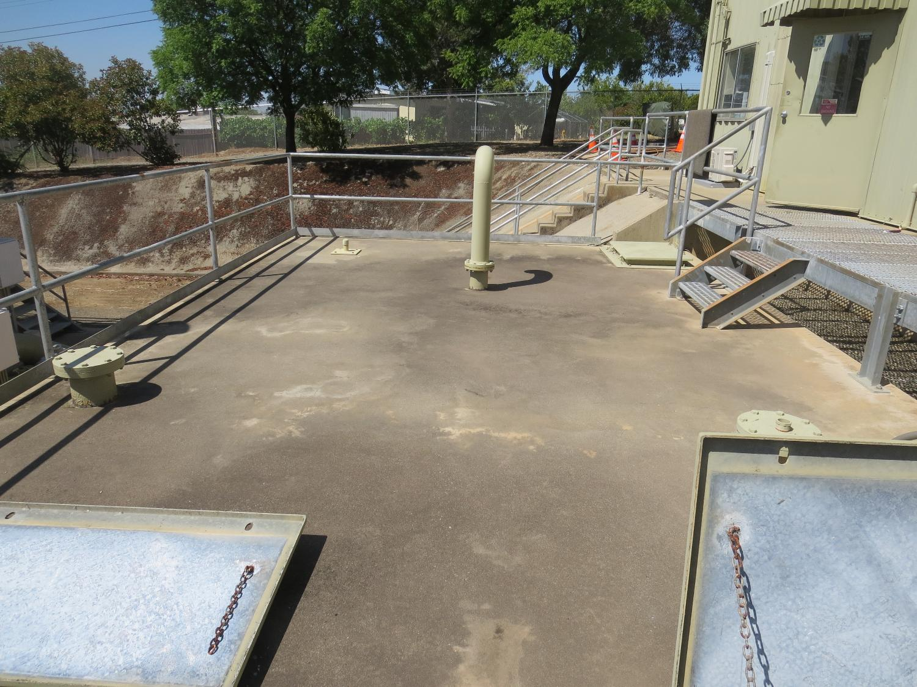
4
Post Treatment Sump/Pumps
40,000 gallons (average operating level)

Slide 9
5

Slide 10
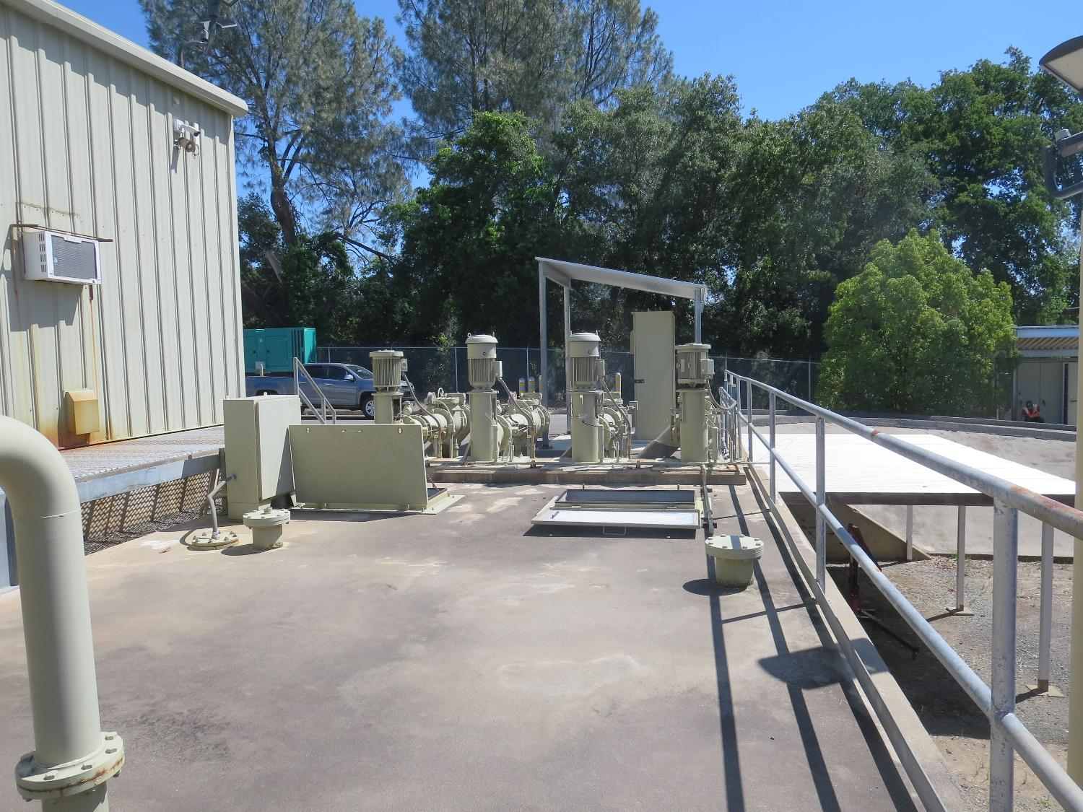
6
Post Treatment Sump/Pumps
47,000 gallons
Tracer sampling
Step-Dose Curve
To verify tracer dose
1,770 gpm
Per pump

Slide 11
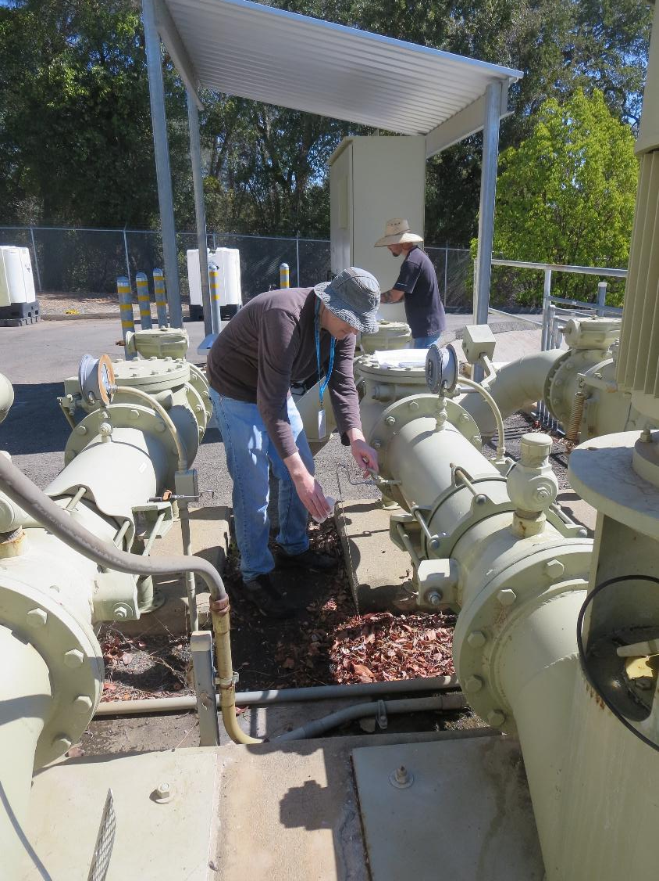
7
Post Treatment Sump/Pumps
47,000 concrete
Sampling point

Slide 12
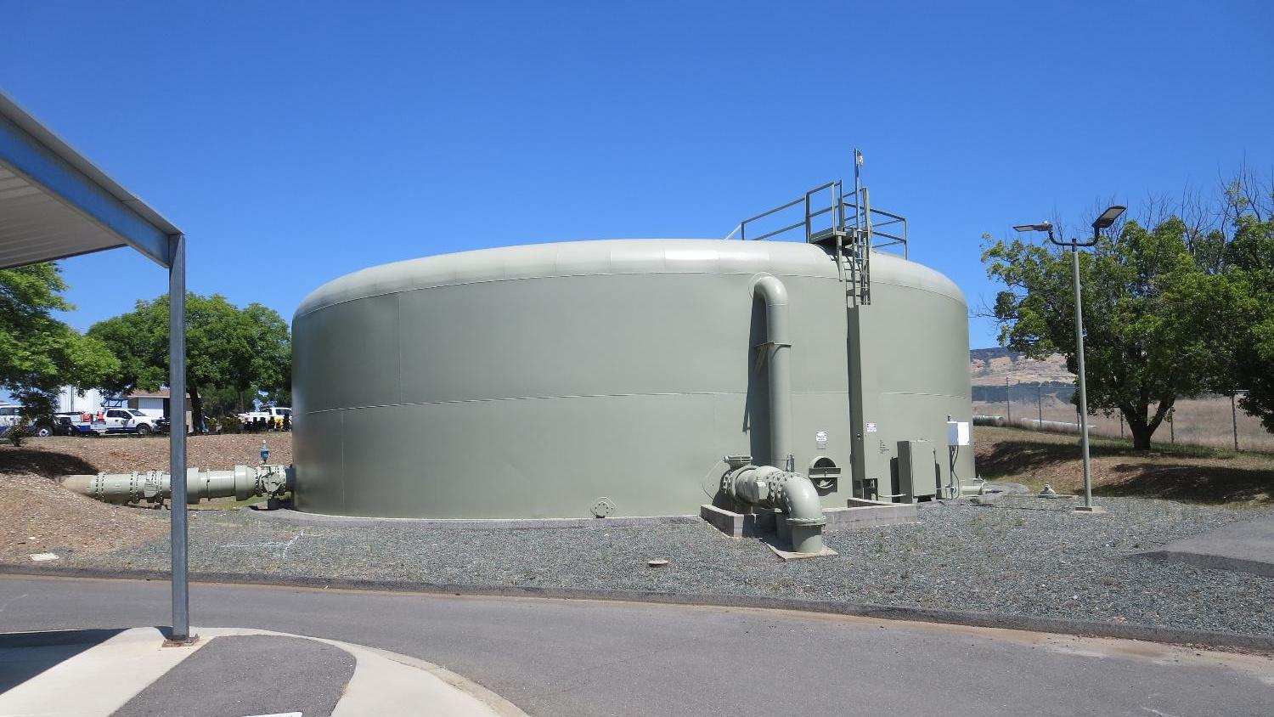
8
24-in outlet
450,000 Gallons
18-in inlet
pipe nozzle

Slide 13
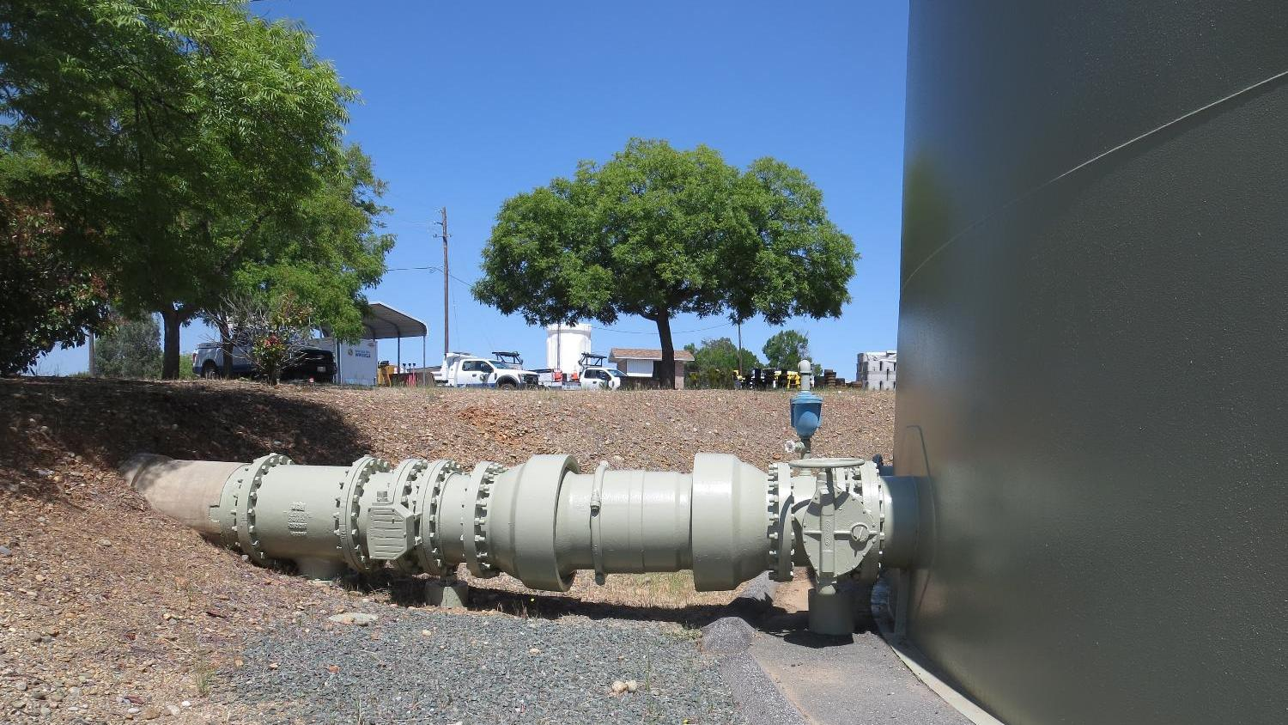
9
Tracer
monitoring
24-in outlet

Slide 14
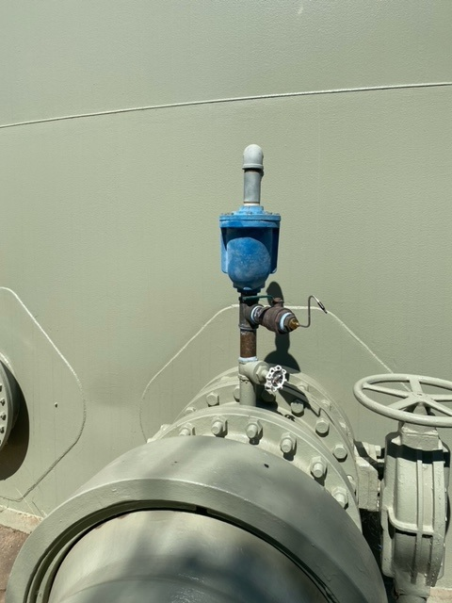
10
450,000 Gallon Clearwell
Outlet Sample Tap

Slide 15
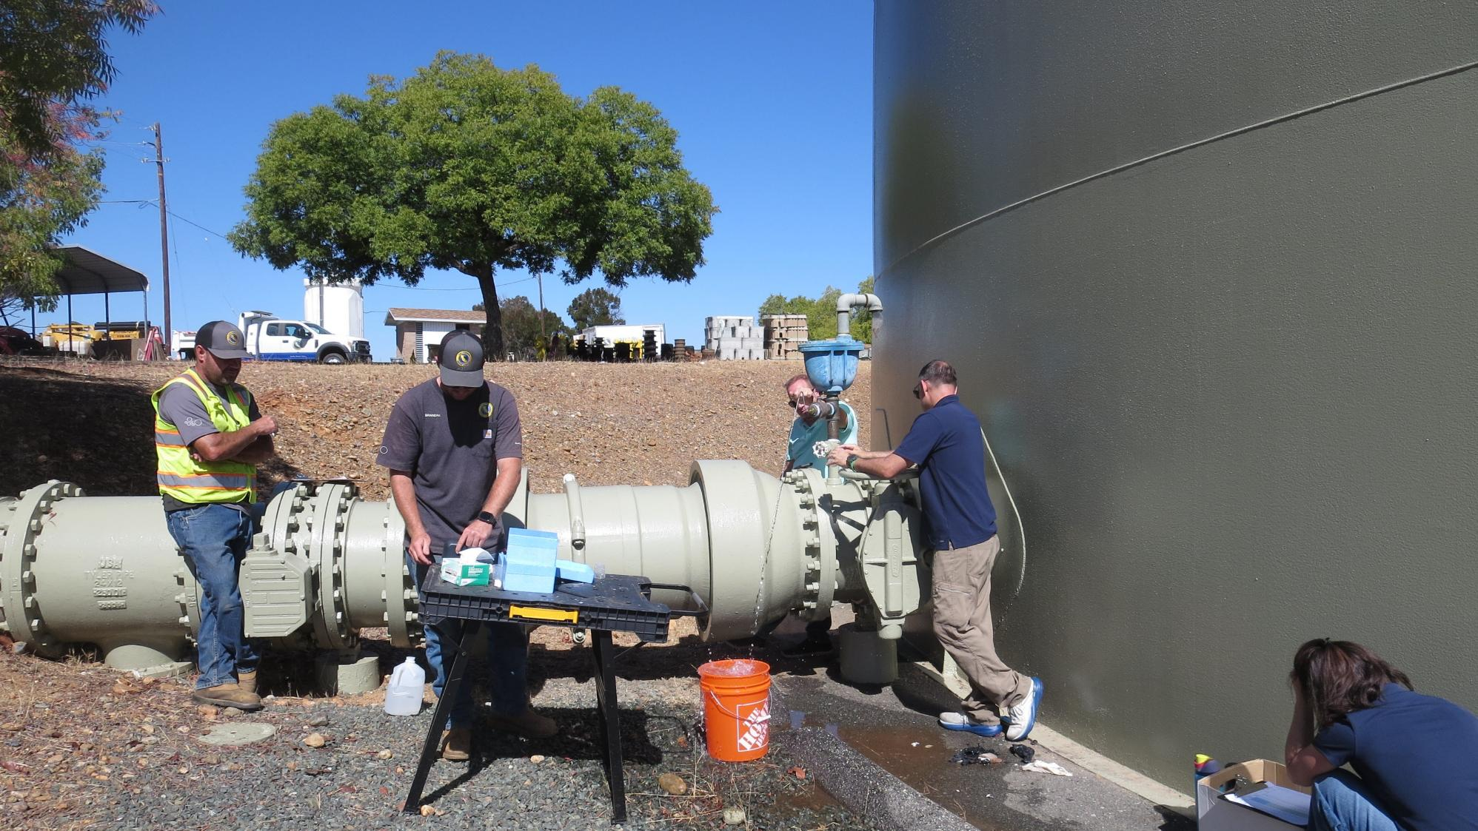
11
Post 450K
Clearwell
Sampling point

Slide 16
12
450K
Clearwell

Slide 17
Test 1: Tracer Fluoride Dose, Inlet to Clearwell
Elapsed Time minutes | *Tracer Fluoride Dose mg/L
66 | 0.75
September 17, 2025
*Excludes background fluoride of 0.1.03 mg/L

Slide 18
13
Tracer Test 1 Tabulated Results
Concrete Tank
9/17/2025

Slide 19
14
September 17, 2025
Dose: 0.80 mg/L (inlet monitoring)
0.08 mg/L at t₁₀ (outlet monitoring)
T₁₀: 53.58 min
HRT: 349 min
BF: 0.15 (T₁₀/HRT)

Slide 20
15
September 17, 2025
Dose: 0.80 mg/L (inlet monitoring)
0.08 mg/L at t₁₀ (outlet monitoring)
T₁₀: 53.58 min
HRT: 349 min
BF: 0.15 (T₁₀/HRT)

Slide 21
16
Tracer Test 1 Tabulated Results
Clearwell
9/17/2025

Slide 22
Test 2: Tracer Fluoride Dose, Inlet to Clearwell
November 20, 2025
Elapsed Time minutes | *Tracer Fluoride Dose mg/L
99 | 2.92
107 | 2.97
111 | 2.99
123 | 3.02
131 | 2.96
135 | 2.90
*Excludes background fluoride of 0.032 mg/L

Slide 23
17
Tracer Test 2 Tabulated Results
Concrete Tank
11/20/2025

Slide 24
18
Dose: 2.96 mg/L (inlet monitoring)
0.296 mg/L at t₁₀ (outlet monitoring)
T₁₀: 65 min
HRT: 368 min
BF: 0.17 (T₁₀/HRT)

Slide 25
19
Dose: 2.96 mg/L (inlet monitoring)
0.296 mg/L at t₁₀ (outlet monitoring)
T₁₀: 65 min
HRT: 368 min
BF: 0.17 (T₁₀/HRT)

Slide 26
20
Tracer Test 2 Tabulated Results
Clearwell
11/20/2025

Slide 27
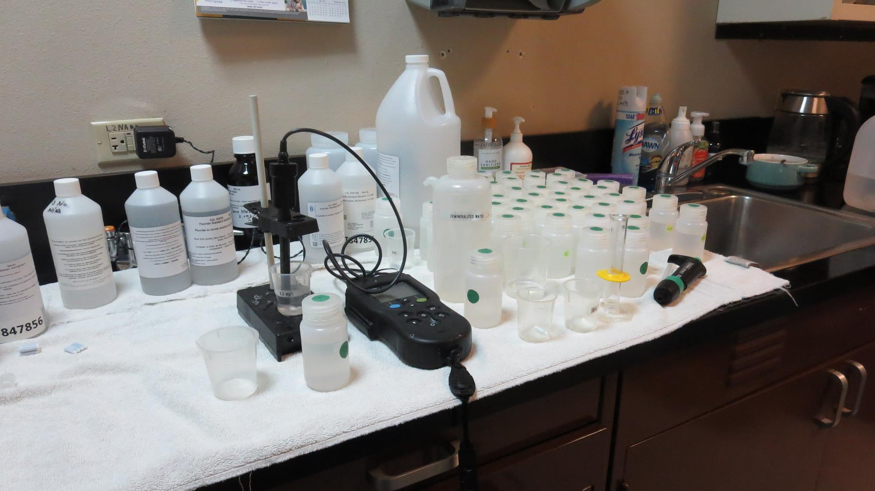
21
Fluoride Analysis
IntelliCAL Fluoride ISE Probe
Standards: 0.2 & 2.0 mg/L
Ionic Strength Adjustor (ISA)

Slide 28
Purpose of a Tracer Study
To determine the hydraulic efficiency or disinfectant exposure time of water through one or more reactors.
The addition of known quantities of a nonreactive chemical (tracer) is added in the form of a pulse (slug) or step-dose input.
The time of travel or disinfectant exposure time through the reactor is impacted by:
  Flow rate
  Water Depth
  Volume
  Configuration
  Hydraulic mixing
  Temperature

Slide 29
Disinfection Exposure Time of Fluid in Vessel for Determining Ct₁₀
C” - disinfectant residual (mg/L) at the point of inactivation compliance.
Disinfection exposure time of water used for Ct₁₀ calculation is the time (t₁₀) it takes for the first 10 percent of the water entering the reactor to exit the reactor.
To determine this, a nonreactive tracer is introduced into the water and is monitored leaving the reactor.
Example: 1.5 mg/L of tracer is continuously dose during testing; t₁₀ is that time when 0.15 mg/L of tracer concentration (10% of dose) has exited the reactor.

Slide 30
Ct₁₀ Value
Log inactivation is based on the Delivered Dose, “Ct₁₀”
  “C” is the disinfectant residual (mg/L)
  “t₁₀” is the exposure or contact time (minutes)
  Multiply them:
C • t₁₀ = mg/L • min (delivered dose to pathogens)
The calculated Ct₁₀ value is looked up in EPA Ct tables to determine the log inactivation based on specific monitoring parameters (pH, disinfectant residual and temperature).

Slide 31
Baffling Factor (BF)
Baffling factor or short-circuiting factor:
  Determined from tracer study or estimated
  BF = t₁₀/ HRT from tracer study
  HRT (hydraulic residence time) = operating volume divided by reactor flow
BF is determined and applied to daily operations of the reactor for determining the disinfectant exposure time.
Example:
  Concrete Tank, Pipeline + Clearwell: Total operating volume: 450,000 gallons
  Exit flow: 1,400 gpm (2.016 MGD)
  BF: 0.15, from tracer study (combined Concrete Tank, Pipeline and Clearwell)
  Calculated contact or disinfection exposure time:
    450,000 gal ÷ 1,400 gpm × 0.15 = 48.2 minutes = t₁₀

Slide 32
Test Method
Modified Step-Dose Method
It is a continue feed of tracer injected before the reactor at constant rate with plant flow. The “Step-Dose” test has a duration of 3-4 HRT to achieve reactor outlet steady-state tracer concentration. The time “t₁₀” is determined when 10% of the tracer dose concentration has exist the reactor. The “Modified Step-Dose” test allows the test to be completed in less than 1 HRT by physical measurements of the tracer to the inlet of the reactor.

Slide 33
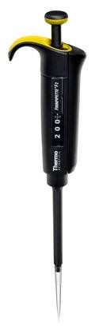
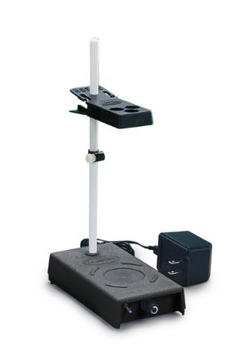
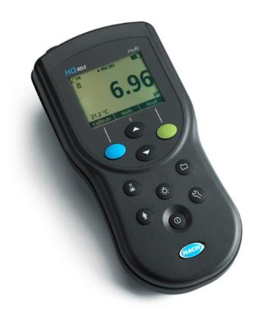
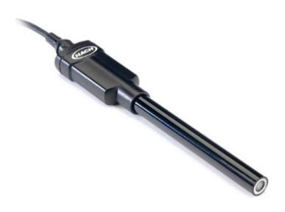
Method of Analysis and Equipment
Intellical™ ISEF121 Fluoride (F⁻) Ion Selective Electrode (ISE)
HQ40d Portable ISE Multi-Parameter Meter
Fluoride Ionic Strength Adjustor (ISA)
Fluoride Standards (0.2 & 2.0 mg/L)
25 mL graduated cylinder
Finnpipette F2 variable volume pipette, capacity 0.5 - 5 mL
Electrode stirrer stand
50 mL beakers
Stir Bar, Magnetic, Polygon

Slide 34

Contact
Guy Schott, P.E.
State Water Resources Control Board
Division of Drinking Water
Santa Rosa, CA
Go to Tracer Test Results for review
www.waterboards.ca.gov/drinking_water/programs/districts/mendocino_district.html
Email: Guy Schott - Guy.Schott@waterboards.ca.gov
Office Number: 707-576-2732

