Slide 1
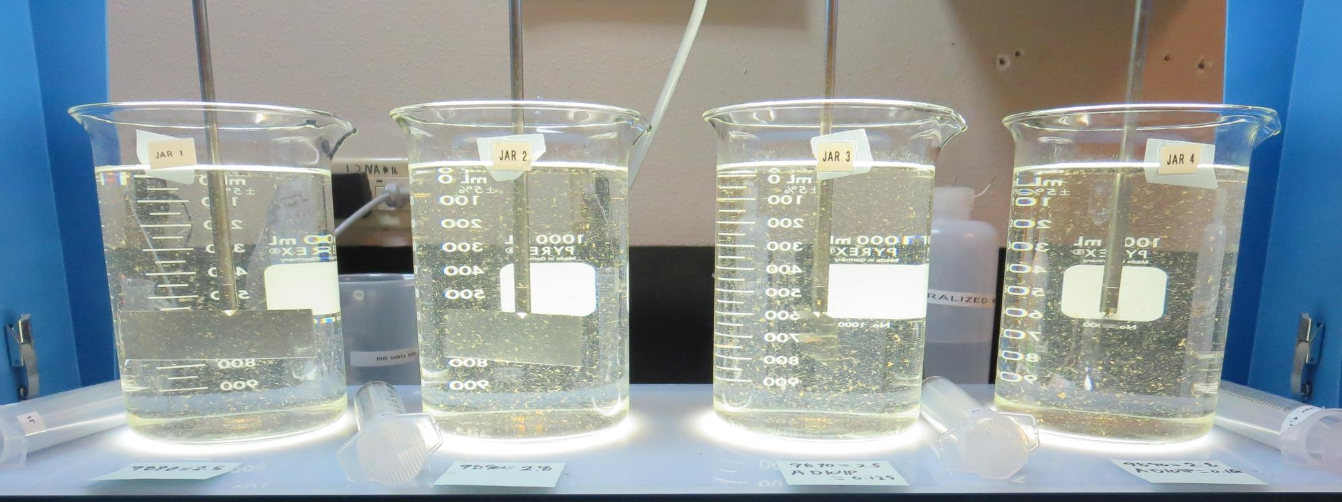
Georgetown Divide PUD
CA0910013
El Dorado County
Jar Test
by Guy Schott, P.E.
July 12, 2019

Slide 2
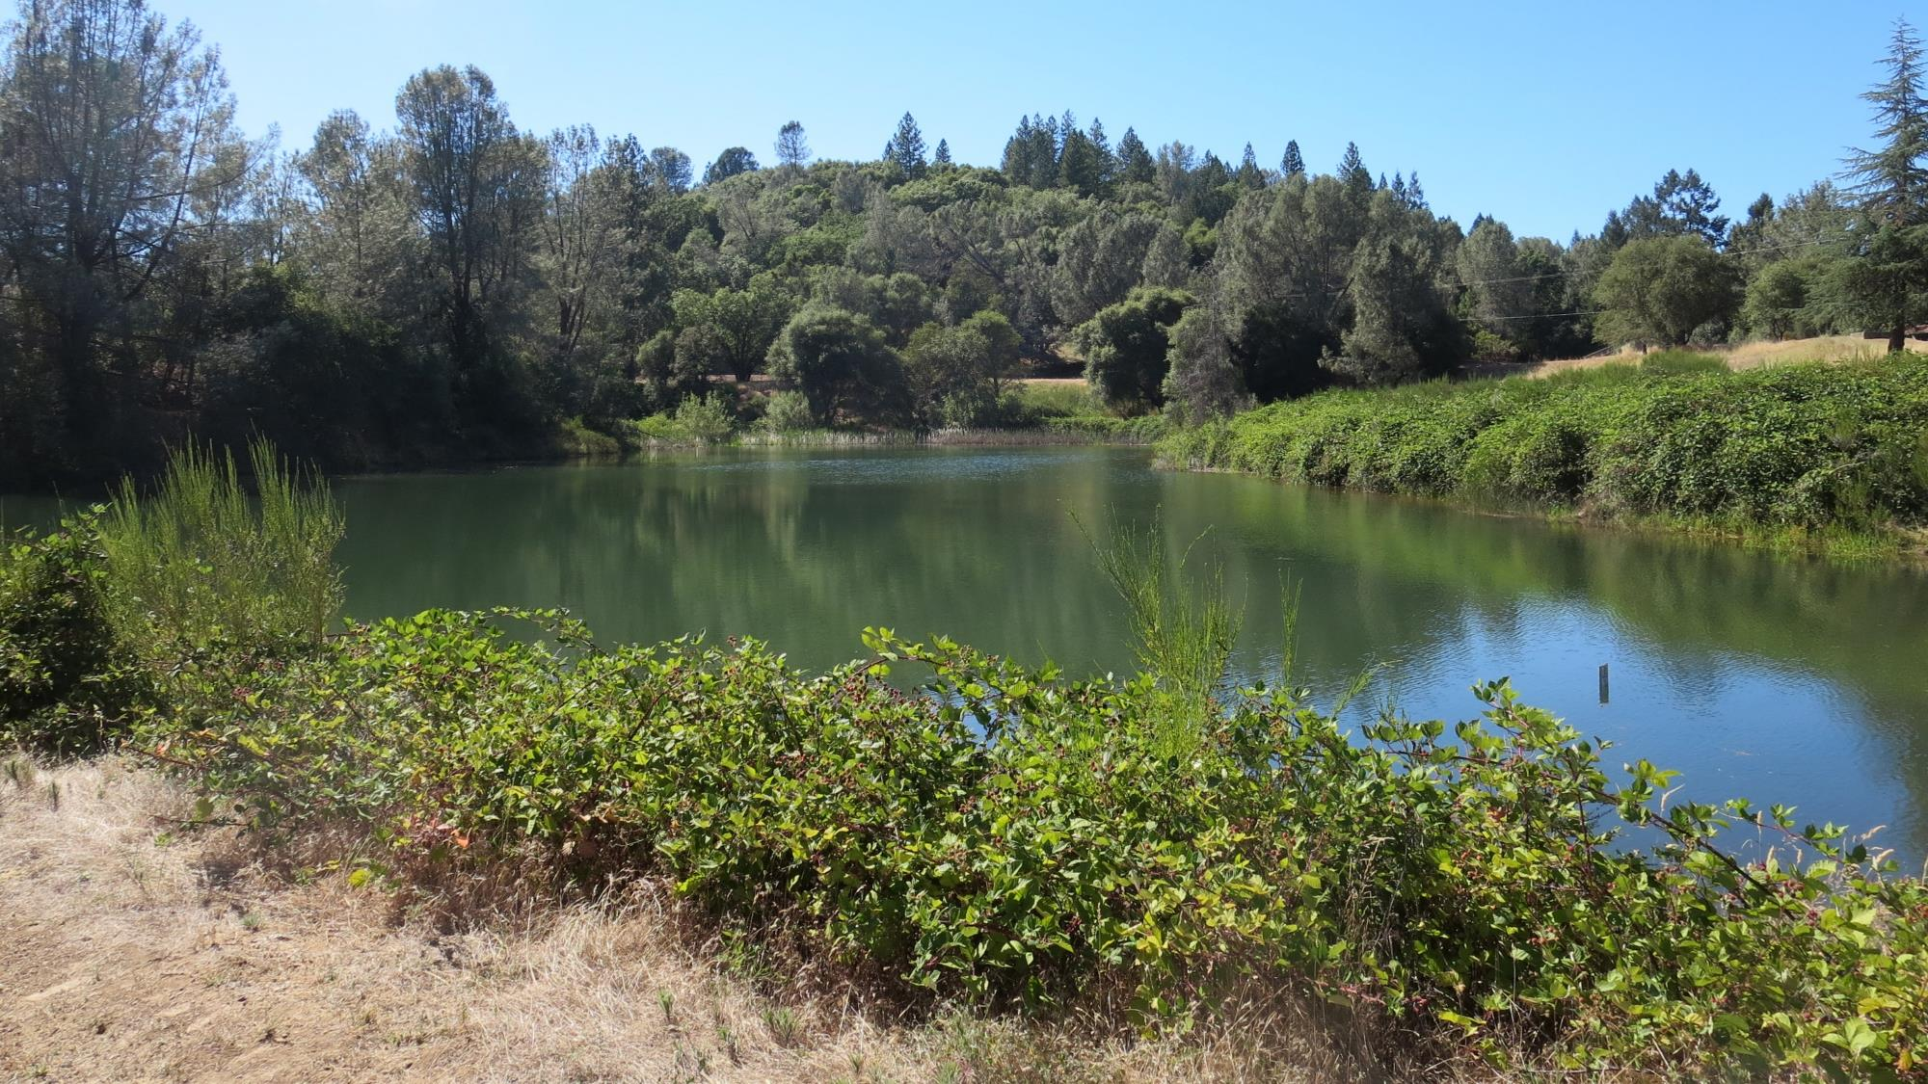
Walton Lake

Slide 3
Walton Lake Source Water Characteristics
Source (July 12, 2019)
Turbidity: 3.4 NTU
pH: 7.33
UVT: 93.9% (unfiltered)
UVA: 0.027/cm
Raw filtered (0.4 um absolute filter)
UVT: 95.6%
UVA: 0.020/cm
Raw filtered (1.2 um absolute filter)
Turbidity: 0.34 NTU
UVT: 96.1%
UVA: 0.017/cm

Slide 4
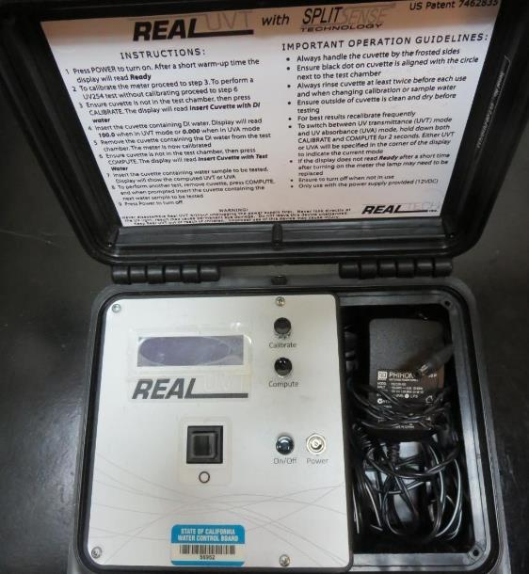
UVT/UVA
UV transmittance (UVT) is a measurement of the amount of ultraviolet light (commonly at 254 nm due to its germicidal effect) that passes through a water sample compared to the amount of light that passes through a pure water sample. The measurement is expressed as a percentage, % UVT.
%UVT = 10^{(-UVA)} x 100%
UV absorbance (UVA) is calculated as a relative measure of the amount of light absorbed by a water sample compared with the amount of light absorbed by a pure water sample.
UVA = -log(%UVT/100)

Slide 5
Applied Coagulants for Jar Testing Set 1
Pro Pac 9800 (NTU Technologies)
50% Aluminum Chlorohydrate (ACH)
50% Water
SG = 1.34
Pro Pac 9800 (NTU Technologies)
35-45% ACH
35-45% Water
20% Proprietary
SG = 1.25 – 1.34
7066 (Garratt Callahan)
10 – 30% Poly Aluminum Hydroxychloride Sulfate
50% Basicity
SG = 1.2
AD-101P (NTU Technologies)
0.25% Polyacrylamide
SG = 1.0

Slide 6
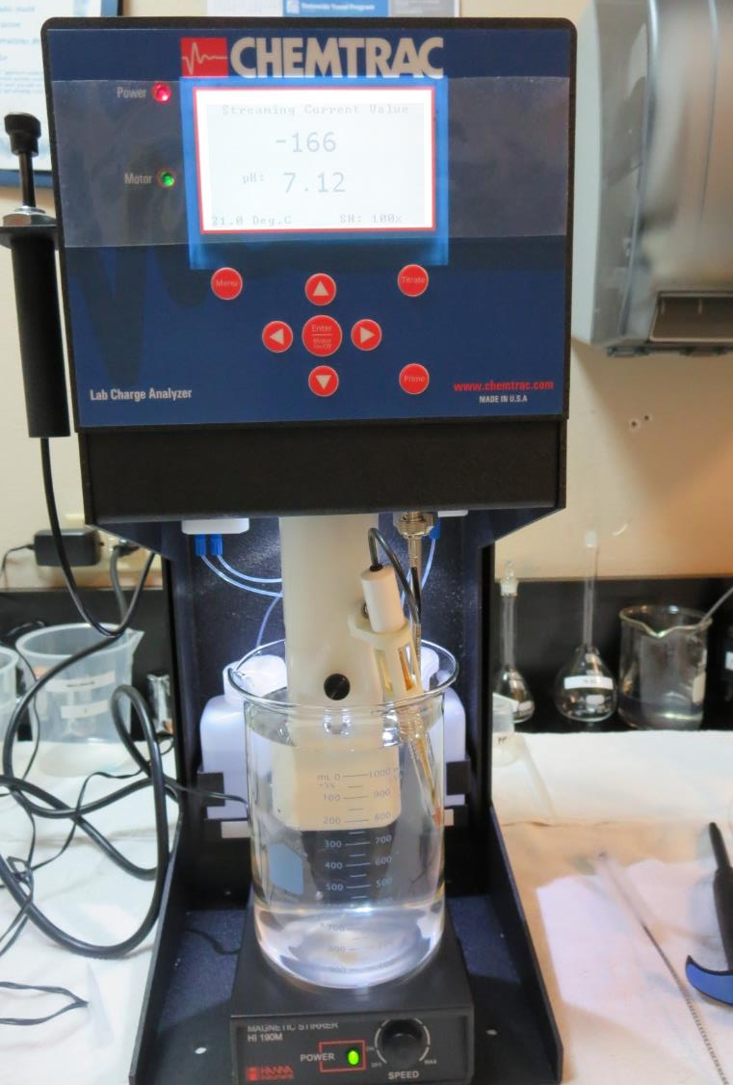
Laboratory Charge Analyzer
LCA: Used to determine coagulant demand of a source water entering the treatment plant.
Source pH: 7.34
LCA #1:
9890: 1.6 mg/L as product (no pH adjustment)
LCA #2:
9800: 2.6 mg/L as product (no pH adjustment)
LCA #3:
7076: 13.85 mg/L as product (no pH adjustment)

Slide 7
Coagulant Information
Unless stated otherwise, all coagulant doses are reported as Product (100% strength).
Preparation of coagulant stock solutions are generally 1.0 or 0.1 percent strength using 100 and/or 200 mL volumetric flasks.
Finnpipette F2 variable volume pipette, capacity 100-1000 micro liters is used for stock solution preparation and coagulant aid jar test dosing.
Finnpipette F2 variable volume pipette, capacity 0.5-5 mL is used for primary coagulant jar test dosing.

Slide 8
Georgetown Divide PUD:
Jar Test 1-8 Results
Jar | 200 RPM Flash Mix seconds | 30 RPM Floc Duration minutes | 9890 mg/L | Filtrate NTU | Filtrate %UVT | Filtrate UVA/cm | Settle NTU 25 min | Sludge Lbs./MG
J1 | 60 | 5 | 1.0 | 0.25 | 96.5 | 0.015 | 1.52 | 45
J2 | 60 | 5 | 1.5 | 0.08 | 97.2 | 0.012 | 1.43 | 47
J3 | 60 | 5 | 2.0 | 0.11 | 97.5 | 0.011 | 1.47 | 50
J4 | 60 | 5 | 2.5 | 0.08 | 97.7 | 0.010 | 1.72 | 52
J5 | 0 | 5 | 1.0 | 0.10 | 98.1 | 0.008 | 2.06 | 45
J6 | 0 | 5 | 1.5 | 0.11 | 97.8 | 0.010 | 1.84 | 47
J7 | 0 | 5 | 2.0 | 0.12 | 97.6 | 0.011 | 1.86 | 50
J8 | 0 | 5 | 2.5 | 0.12 | 98.1 | 0.008 | 1.75 | 52

Slide 9
Georgetown Divide PUD:
Jar Test 9-16 Results
Jar | 200 RPM Flash Mix seconds | 30 RPM Floc Duration minutes | 7076 mg/L | Filtrate NTU | Filtrate %UVT | Filtrate UVA/cm | Settle NTU 25 min | Sludge Lbs./MG
J9 | 60 | 5 | 10 | 0.05 | 97.9 | 0.009 | 1.35 | 80
J10 | 60 | 5 | 12 | 0.05 | 98.0 | 0.009 | 1.45 | 88
J11 | 60 | 5 | 14 | 0.05 | 97.9 | 0.009 | 1.35 | 97
J12 | 60 | 5 | 16 | 0.06 | 98.1 | 0.008 | 1.22 | 105
J13 | 60 | 5 | 6 | 0.07 | 97.9 | 0.009 | 1.33 | 64
J14 | 60 | 5 | 8 | 0.07 | 97.8 | 0.010 | 1.39 | 72
J15 | 60 | 5 | 10 | 0.06 | 97.8 | 0.010 | 1.34 | 80
J16 | 60 | 5 | 12 | 0.04 | 98.0 | 0.009 | 1.36 | 88

Slide 10
Georgetown Divide PUD:
Jar Test 17-20 Results
Jar | 200 RPM Flash Mix seconds | 30 RPM Floc Duration minutes | 9800 mg/L | Filtrate NTU | Filtrate %UVT | Filtrate UVA/cm | Settle NTU 25 min | Sludge Lbs./MG
J17 | 60 | 5 | 2.2 | 0.09 | 97.8 | 0.010 | 1.84 | 51
J18 | 60 | 5 | 2.4 | 0.09 | 97.7 | 0.010 | 1.52 | 52
J19 | 60 | 5 | 2.6 | 0.09 | 97.8 | 0.010 | 1.59 | 53
J20 | 60 | 5 | 2.8 | 0.06 | 98.1 | 0.008 | 1.70 | 54

Slide 11
Georgetown Divide PUD:
Jar Test 21-24 Results, Flash Mix 60 sec (200 RPM)
Jar | 30 RPM Floc Duration minutes | 9890 mg/L | AD101P mg/L | Filtrate NTU | Filtrate %UVT | Filtrate UVA/cm | Settle NTU 25 min | Sludge Lbs./MG
J21 | 5 | 2.5 | 0 | 0.10 | 97.7 | 0.010 | 2.0 | 52
J22 | 5 | 2.8 | 0 | 0.11 | 97.9 | 0.009 | 1.8 | 54
J23 | 5 | 2.5 | 0.125 | 0.08 | 98.0 | 0.009 | 2.1 | 52
J24 | 5 | 2.8 | 0.140 | 0.09 | 98.0 | 0.009 | 1.7 | 54

Slide 12
Jars 1-4 Test
Flash Mix 60 Sec (200 RPM)
Floc Mix 5 min (30 RPM)
Applied Coagulant
9890

Slide 13
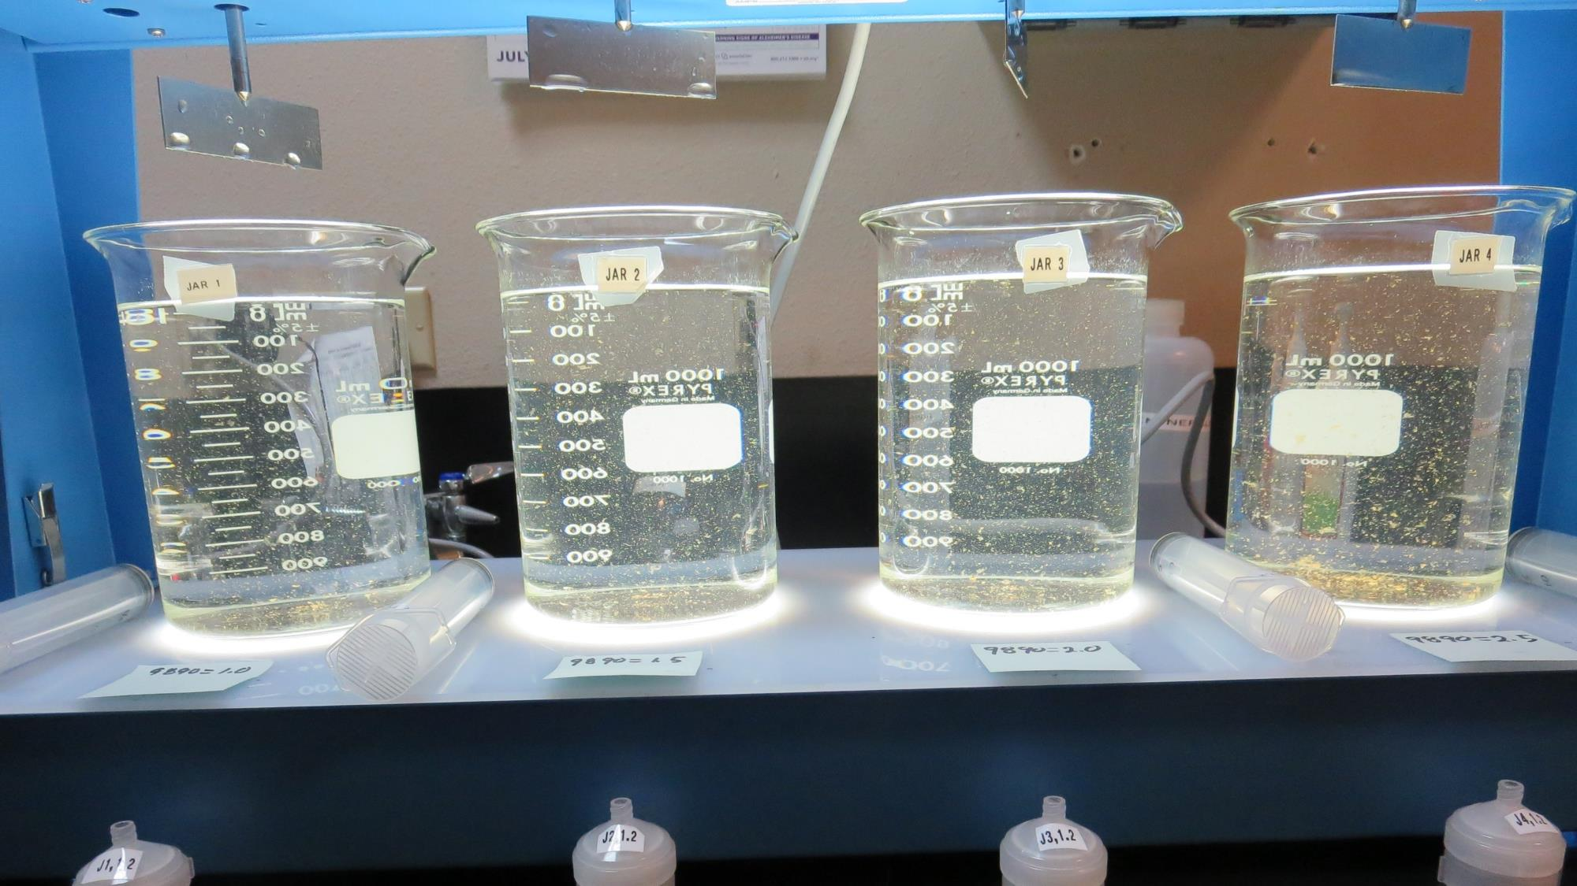
Jars 1-4: End of 5-minute flocculation (30 RPM) duration.
1.0 mg/L 9890
Filtrate 0.25 NTU
UVT: 96.5%
UVA: 0.015/cm
Settled: 1.52 NTU
1.5 mg/L 9890
Filtrate 0.08 NTU
UVT: 97.2%
UVA: 0.012/cm
Settled: 1.43 NTU
2.0 mg/L 9890
Filtrate 0.11 NTU
UVT: 97.5%
UVA: 0.011/cm
Settled: 1.47 NTU
2.5 mg/L 9890
Filtrate 0.08 NTU
UVT: 97.7%
UVA: 0.010/cm
Settled: 1.72 NTU

Slide 14
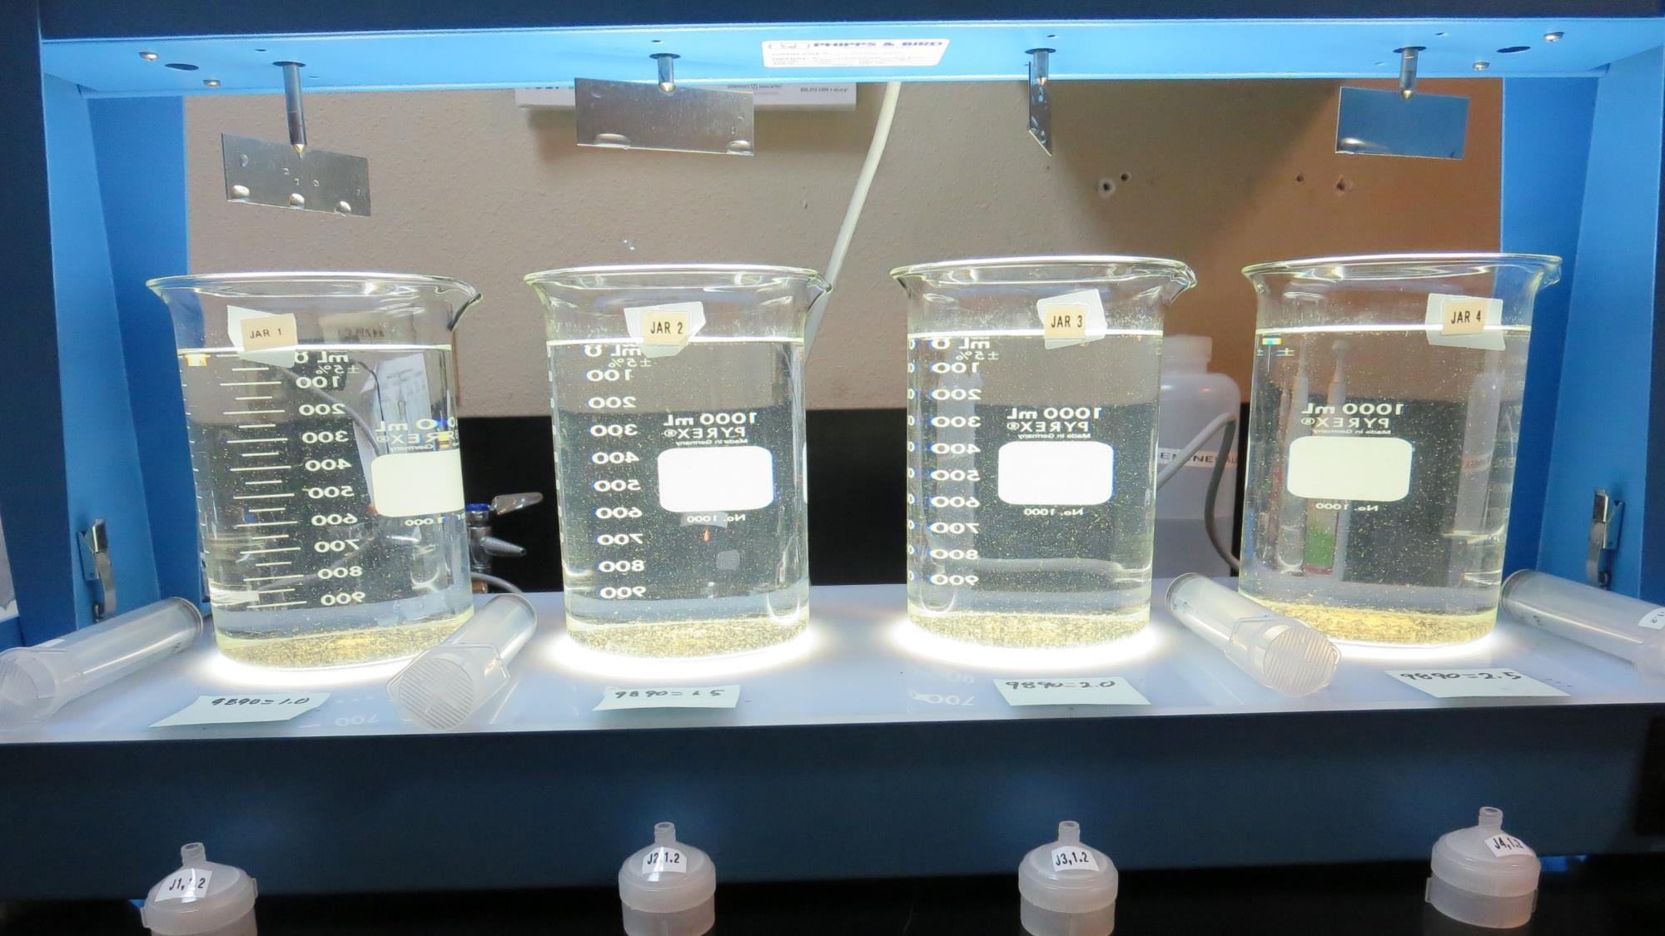
Jars 1-4: After 5 min of settling, 25 mL is syringed for filterability and %UVT/UVA.

Slide 15
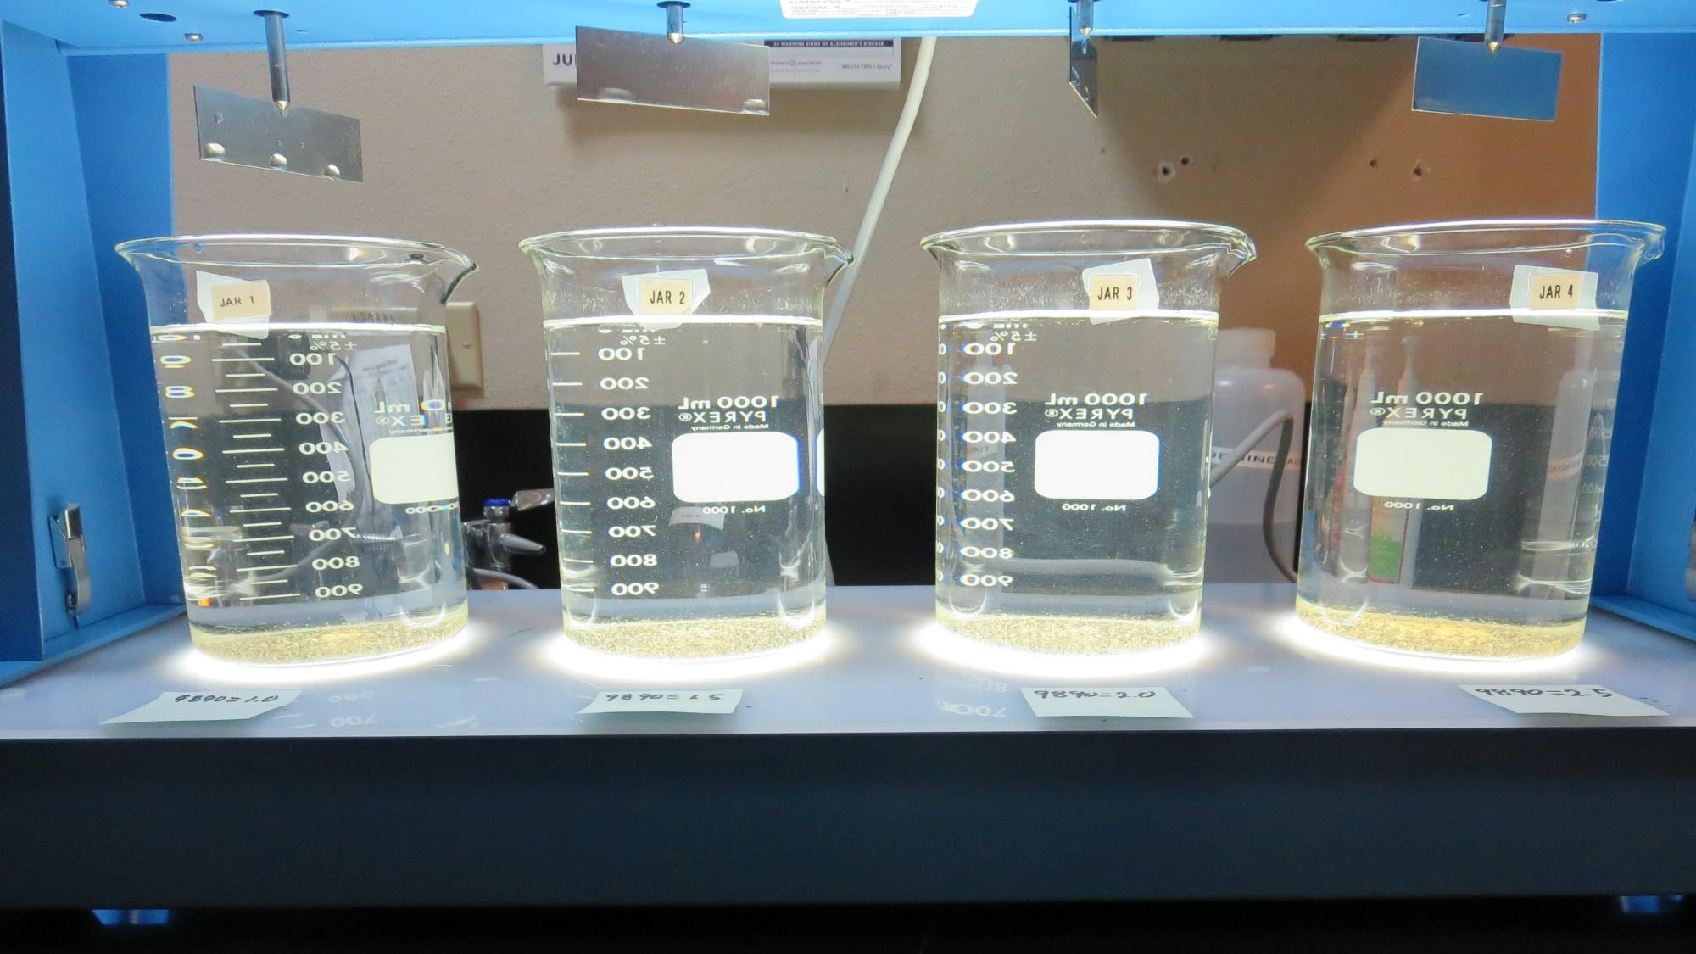
Jars 1-4: After 25-minutes of settling, settled water turbidity is taken.
1.0 mg/L 9890
Filtrate 0.25 NTU
UVT: 96.5%
UVA: 0.015/cm
Settled: 1.52 NTU
1.5 mg/L 9890
Filtrate 0.08 NTU
UVT: 97.2%
UVA: 0.012/cm
Settled: 1.43 NTU
2.0 mg/L 9890
Filtrate 0.11 NTU
UVT: 97.5%
UVA: 0.011/cm
Settled: 1.47 NTU
2.5 mg/L 9890
Filtrate 0.08 NTU
UVT: 97.7%
UVA: 0.010/cm
Settled: 1.72 NTU

Slide 16
Jars 5-8 Test
No Flash Mix
Floc Mix 5 min (30 RPM)
Applied Coagulant
9890

Slide 17
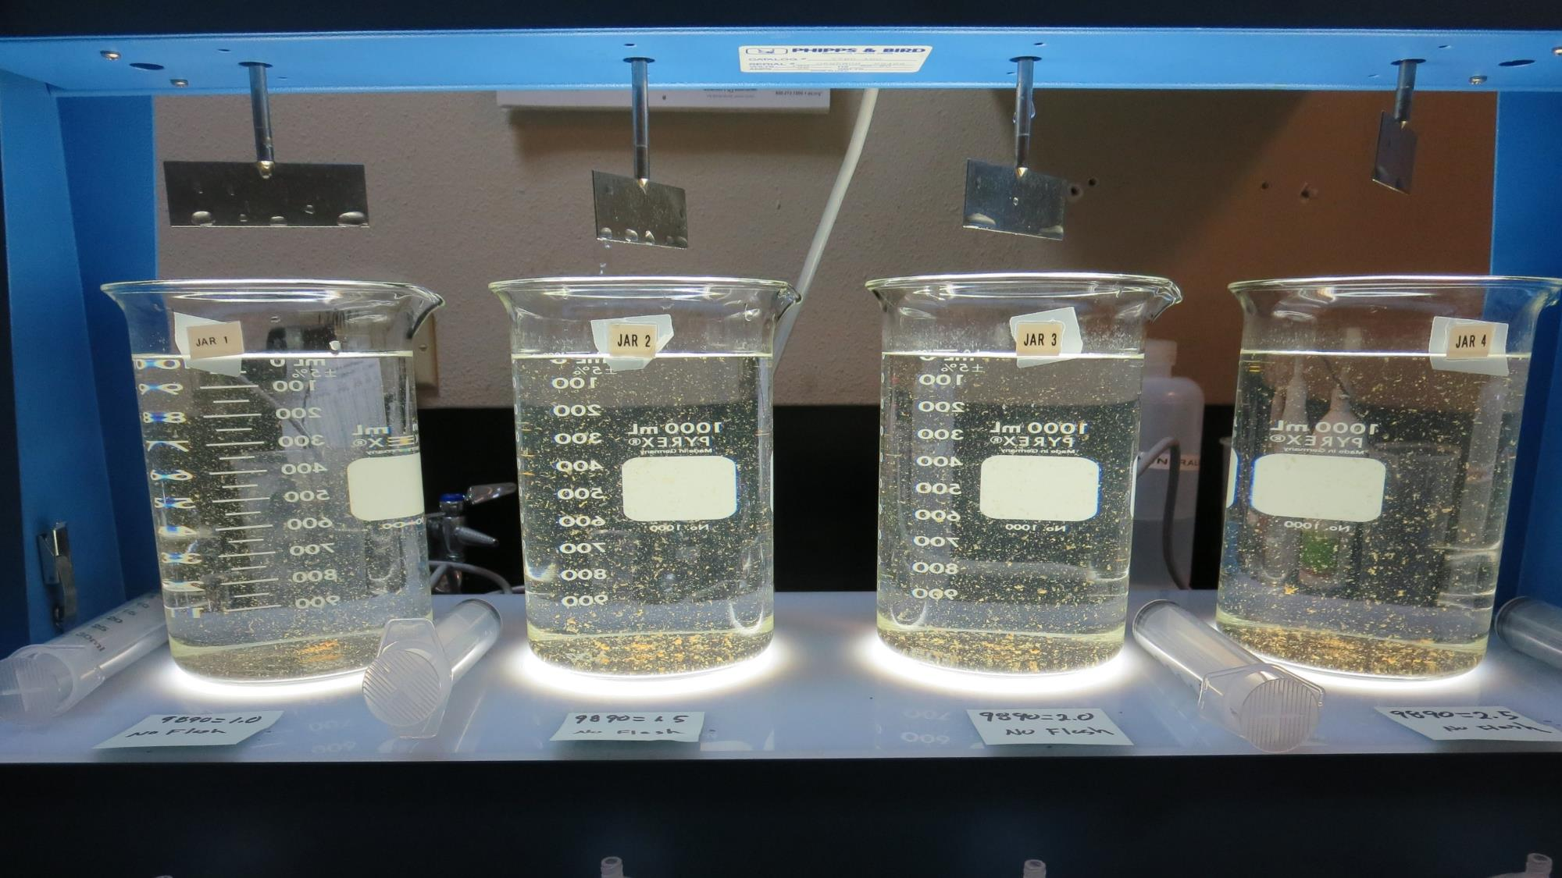
Jars 5-8: End of 5-minute flocculation (30 RPM) duration.
1.0 mg/L 9890
Filtrate 0.10 NTU
UVT: 98.1%
UVA: 0.008/cm
Settled: 2.06 NTU
1.5 mg/L 9890
Filtrate 0.11 NTU
UVT: 97.8%
UVA: 0.010/cm
Settled: 1.84 NTU
2.0 mg/L 9890
Filtrate 0.12 NTU
UVT: 97.6%
UVA: 0.011/cm
Settled: 1.86 NTU
2.5 mg/L 9890
Filtrate 0.12 NTU
UVT: 98.1%
UVA: 0.008/cm
Settled: 1.75 NTU

Slide 18
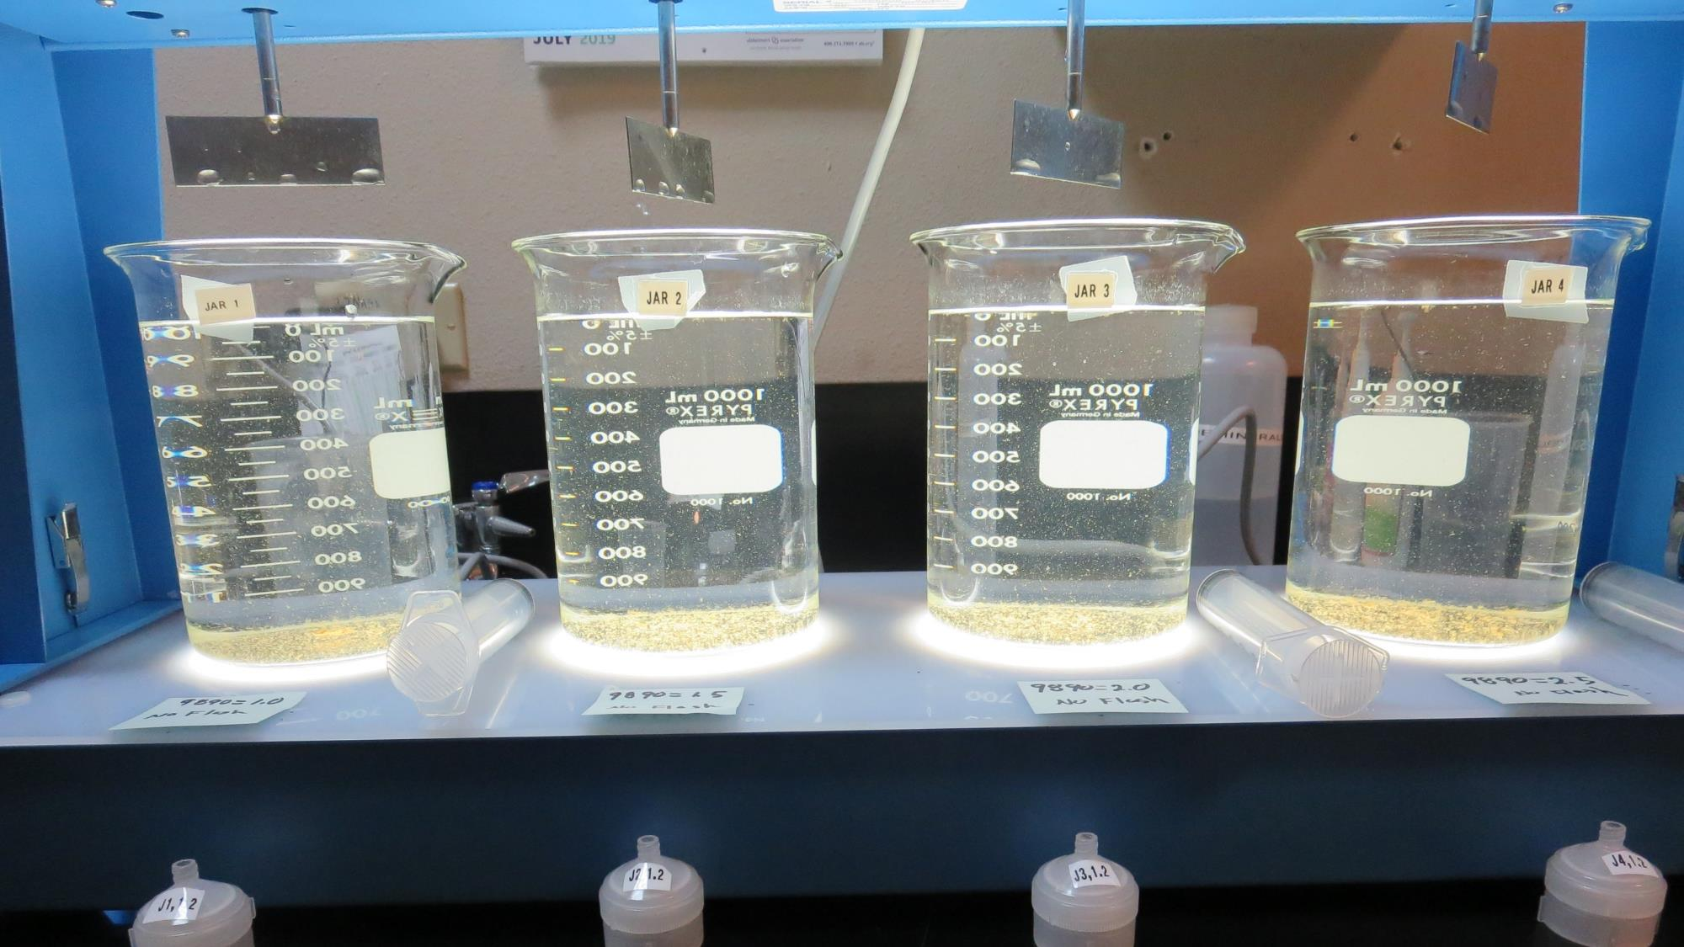
Jars 5-8: After 5 min of settling, 25 mL is syringed for filterability and %UVT/UVA.

Slide 19
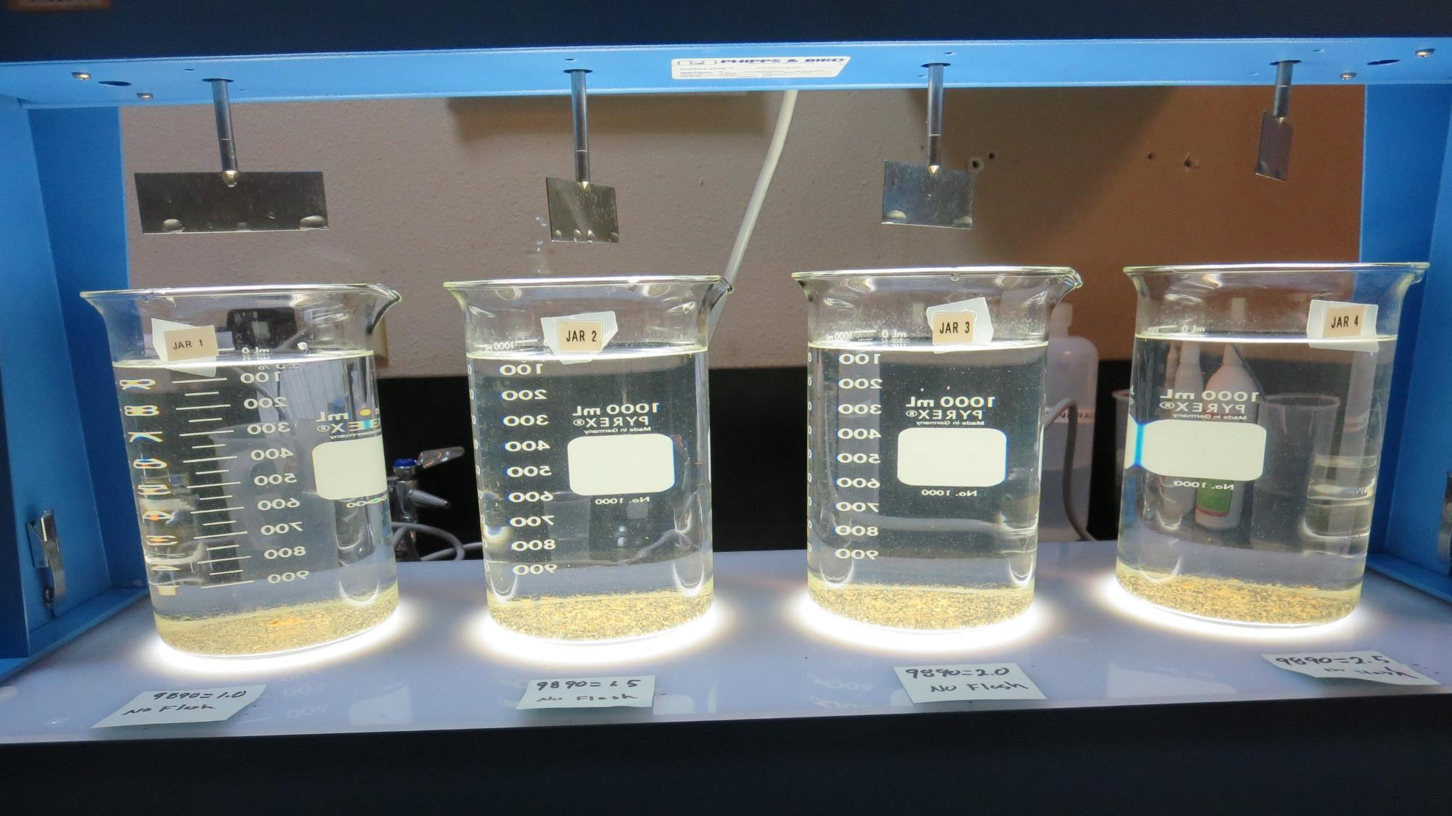
Jars 5-8: After 25-minutes of settling, settled water turbidity is taken.
1.0 mg/L 9890
Filtrate 0.10 NTU
UVT: 98.1%
UVA: 0.008/cm
Settled: 2.06 NTU
1.5 mg/L 9890
Filtrate 0.11 NTU
UVT: 97.8%
UVA: 0.010/cm
Settled: 1.84 NTU
2.0 mg/L 9890
Filtrate 0.12 NTU
UVT: 97.6%
UVA: 0.011/cm
Settled: 1.86 NTU
2.5 mg/L 9890
Filtrate 0.12 NTU
UVT: 98.1%
UVA: 0.008/cm
Settled: 1.75 NTU

Slide 20
Jars 9-12 Test
Flash Mix 60 Sec (200 RPM)
Floc Mix 5 min (30 RPM)
Applied Coagulant
7066

Slide 21
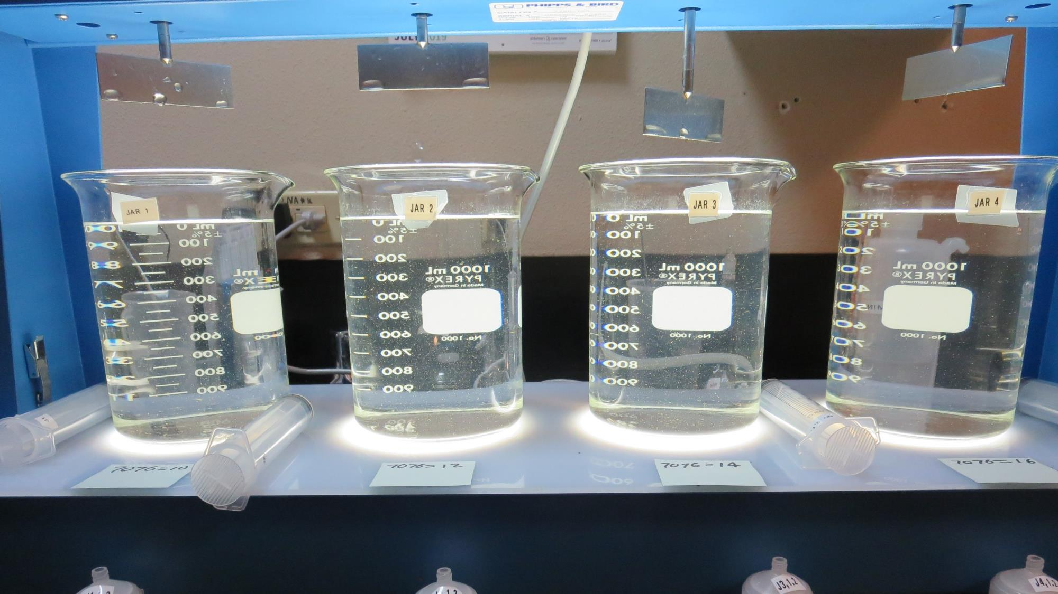
Jars 9-12: End of 5-minute flocculation (30 RPM) duration.
10 mg/L 7076
Filtrate 0.05 NTU
UVT: 97.9%
UVA: 0.009/cm
Settled: 1.35 NTU
12 mg/L 7076
Filtrate 0.05 NTU
UVT: 98.0%
UVA: 0.009/cm
Settled: 1.45 NTU
14 mg/L 7076
Filtrate 0.05 NTU
UVT: 97.9%
UVA: 0.009/cm
Settled: 1.35 NTU
16 mg/L 7076
Filtrate 0.06 NTU
UVT: 98.1%
UVA: 0.008/cm
Settled: 1.22 NTU

Slide 22
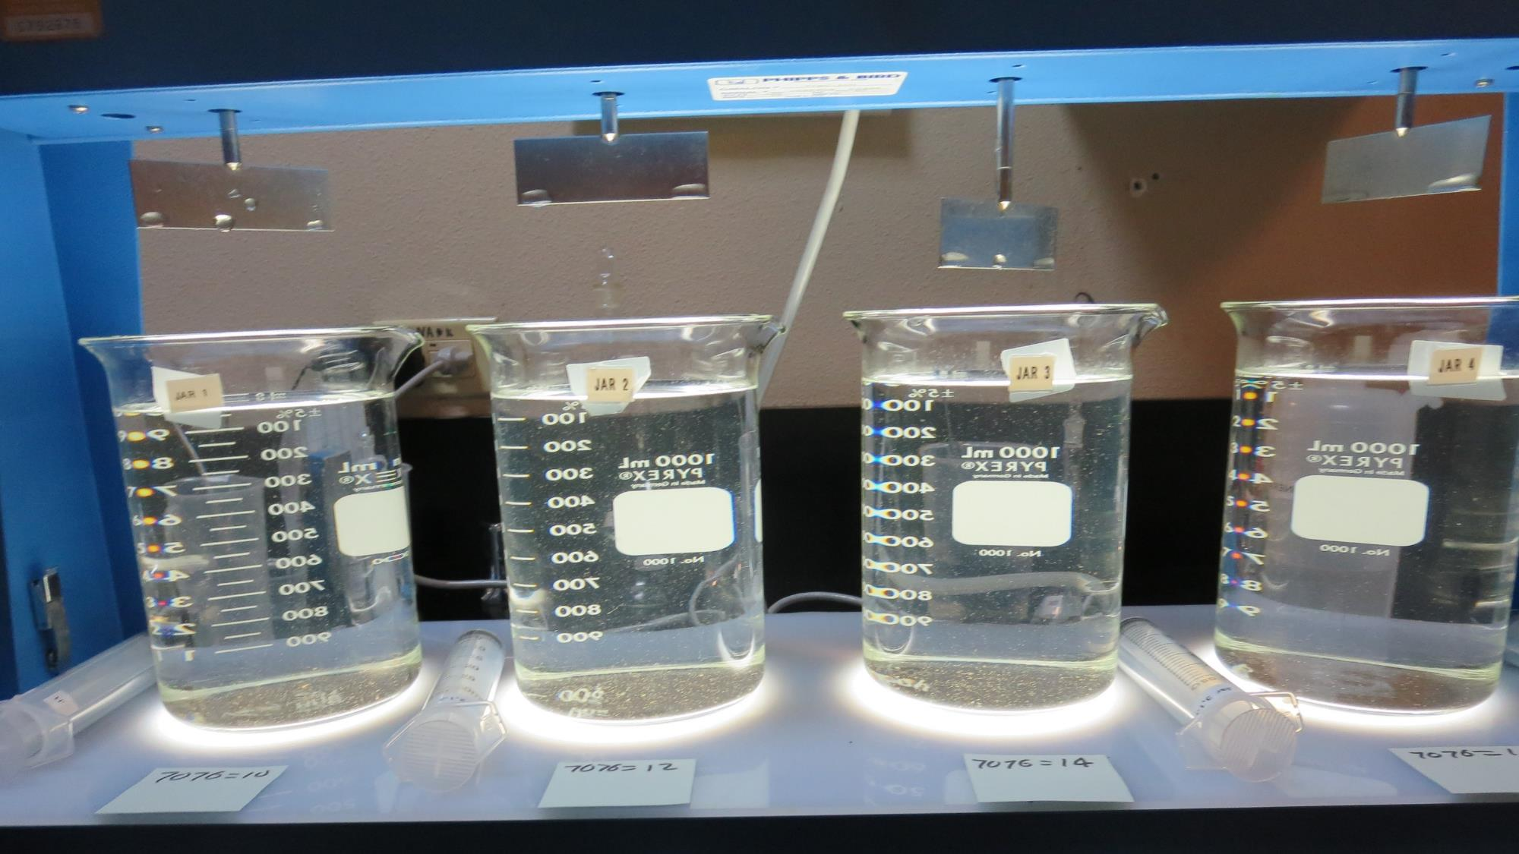
Jars 9-12: After 5 min of settling, 25 mL is syringed for filterability and %UVT/UVA.

Slide 23
Jars 9-12: After 25-minutes of settling, settled water turbidity is taken.
10 mg/L 7076
Filtrate 0.05 NTU
UVT: 97.9%
UVA: 0.009/cm
Settled: 1.35 NTU
12 mg/L 7076
Filtrate 0.05 NTU
UVT: 98.0%
UVA: 0.009/cm
Settled: 1.45 NTU
14 mg/L 7076
Filtrate 0.05 NTU
UVT: 97.9%
UVA: 0.009/cm
Settled: 1.35 NTU
16 mg/L 7076
Filtrate 0.06 NTU
UVT: 98.1%
UVA: 0.008/cm
Settled: 1.22 NTU

Slide 24
Jars 13-16 Test
Flash Mix 60 Sec (200 RPM)
Floc Mix 5 min (30 RPM)
Applied Coagulant
7066

Slide 25
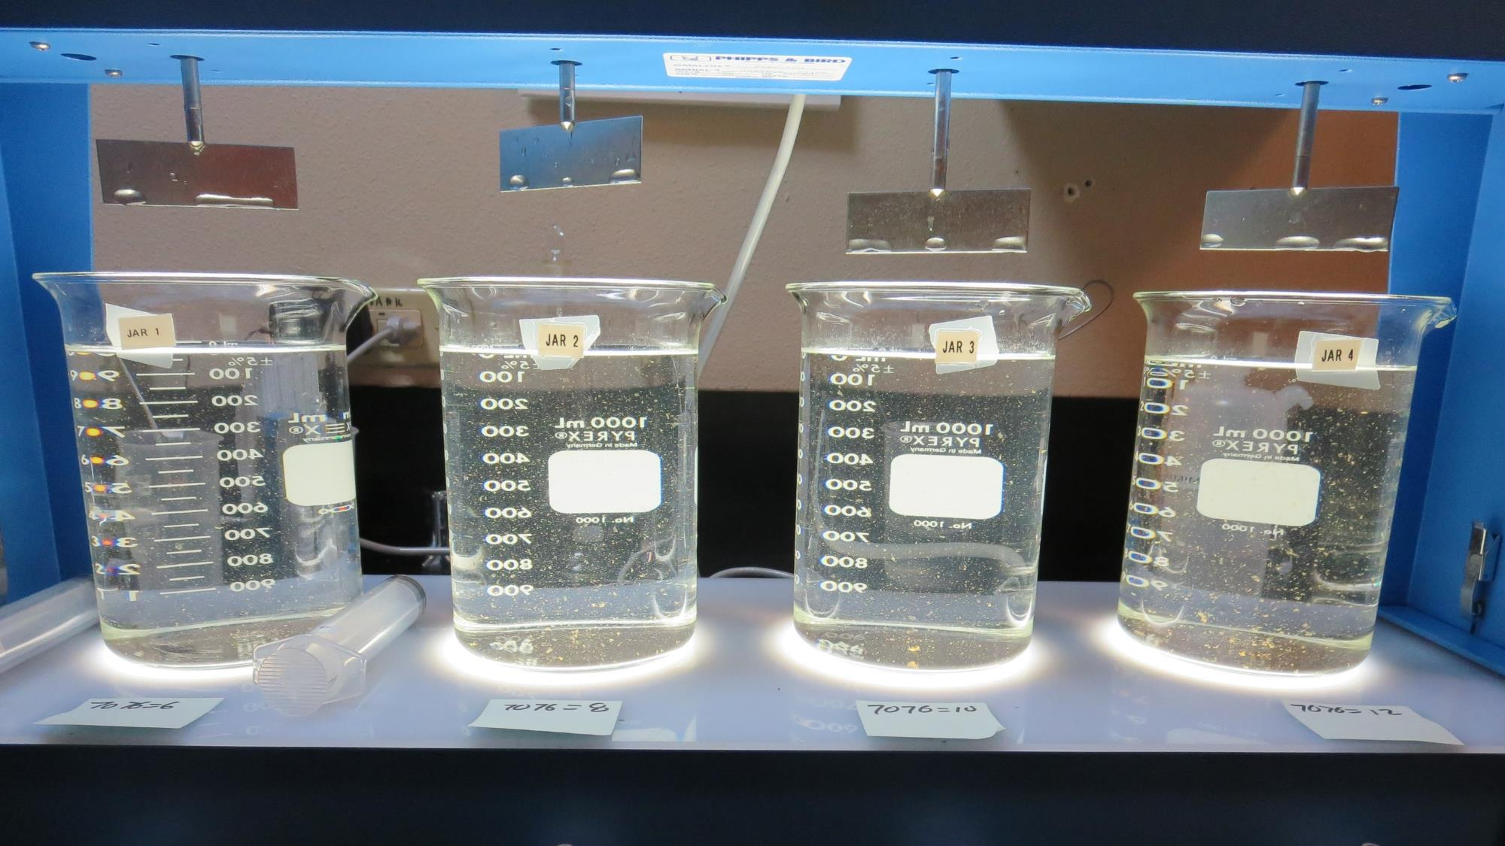
Jars 13-16: End of 5-minute flocculation (30 RPM) duration.
6 mg/L 7076
Filtrate 0.07 NTU
UVT: 97.9%
UVA: 0.009/cm
Settled: 1.33 NTU
8 mg/L 7076
Filtrate 0.07 NTU
UVT: 97.8%
UVA: 0.010/cm
Settled: 1.39 NTU
10 mg/L 7076
Filtrate 0.06 NTU
UVT: 97.8%
UVA: 0.010/cm
Settled: 1.34 NTU
12 mg/L 7076
Filtrate 0.04 NTU
UVT: 98.0%
UVA: 0.009/cm
Settled: 1.36 NTU

Slide 26
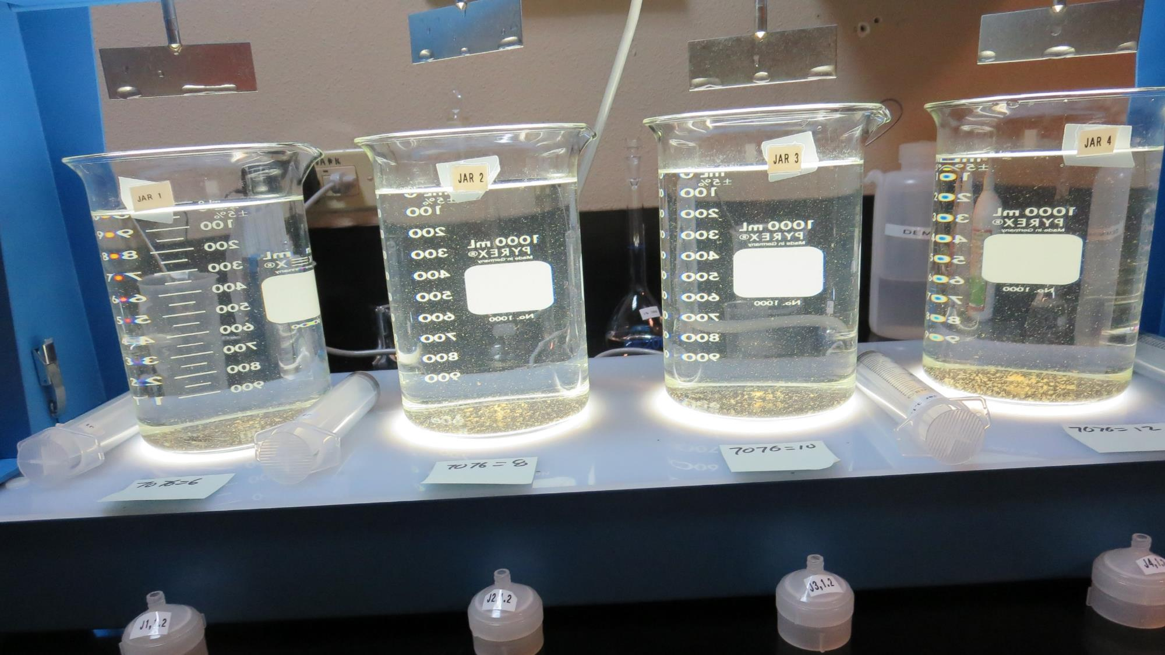
Jars 13-16: After 5 min of settling, 25 mL is syringed for filterability and %UVT/UVA.

Slide 27
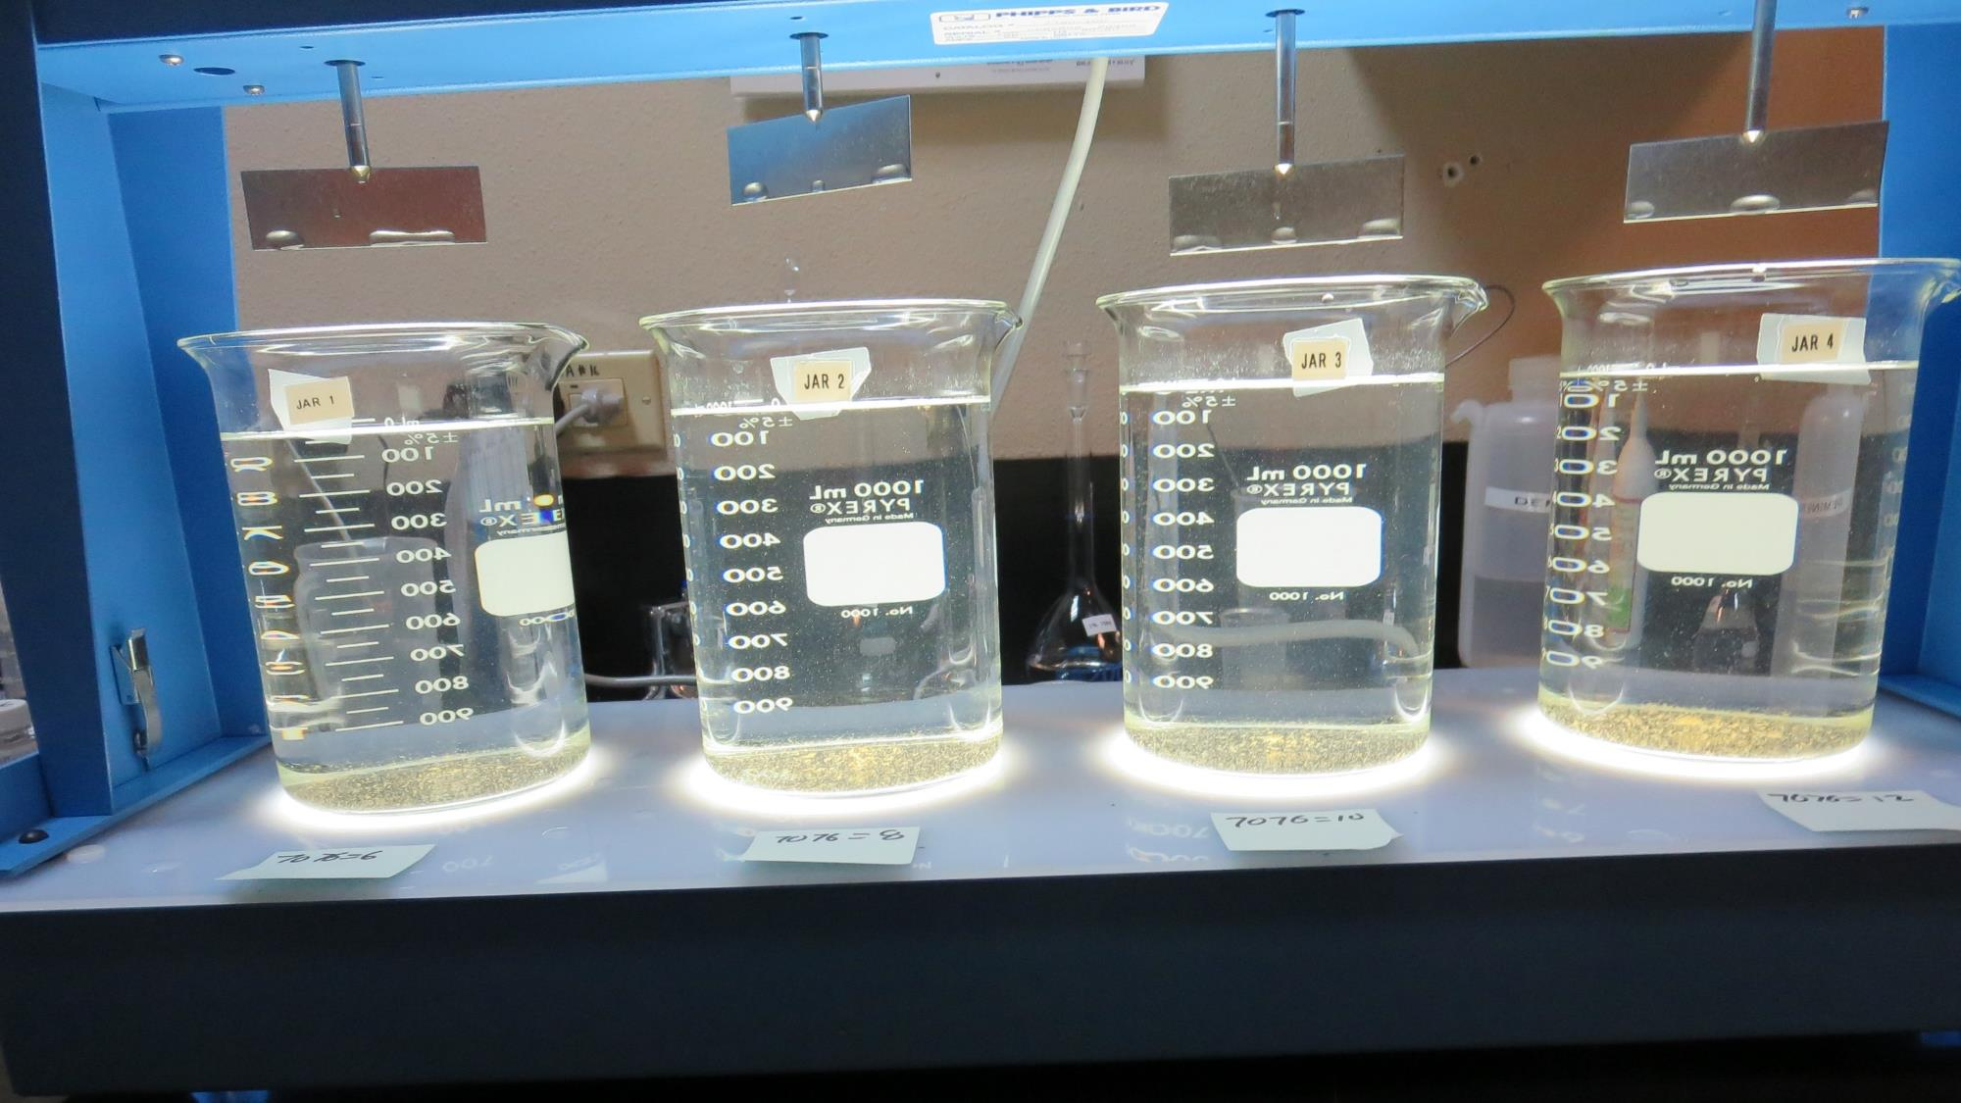
Jars 13-16: After 25-minutes of settling, settled water turbidity is taken.
6 mg/L 7076
Filtrate 0.07 NTU
UVT: 97.9%
UVA: 0.009/cm
Settled: 1.33 NTU
8 mg/L 7076
Filtrate 0.07 NTU
UVT: 97.8%
UVA: 0.010/cm
Settled: 1.39 NTU
10 mg/L 7076
Filtrate 0.06 NTU
UVT: 97.8%
UVA: 0.010/cm
Settled: 1.34 NTU
12 mg/L 7076
Filtrate 0.04 NTU
UVT: 98.0%
UVA: 0.009/cm
Settled: 1.36 NTU

Slide 28
Jars 17-20 Test
Flash Mix 60 Sec (200 RPM)
Floc Mix 5 min (30 RPM)
Applied Coagulant
9800

Slide 29
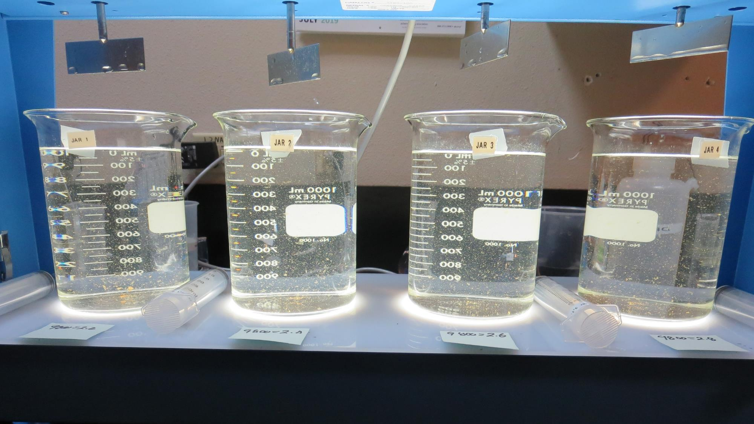
Jars 17-20: End of 5-minute flocculation (30 RPM) duration.
2.2 mg/L 9800
Filtrate 0.09 NTU
UVT: 97.8%
UVA: 0.010/cm
Settled: 1.84 NTU
2.4 mg/L 9800
Filtrate 0.09 NTU
UVT: 97.7%
UVA: 0.010/cm
Settled: 1.52 NTU
2.6 mg/L 9800
Filtrate 0.09 NTU
UVT: 97.8%
UVA: 0.010/cm
Settled: 1.59 NTU
2.8 mg/L 9800
Filtrate 0.06 NTU
UVT: 98.1%
UVA: 0.008/cm
Settled: 1.70 NTU

Slide 30
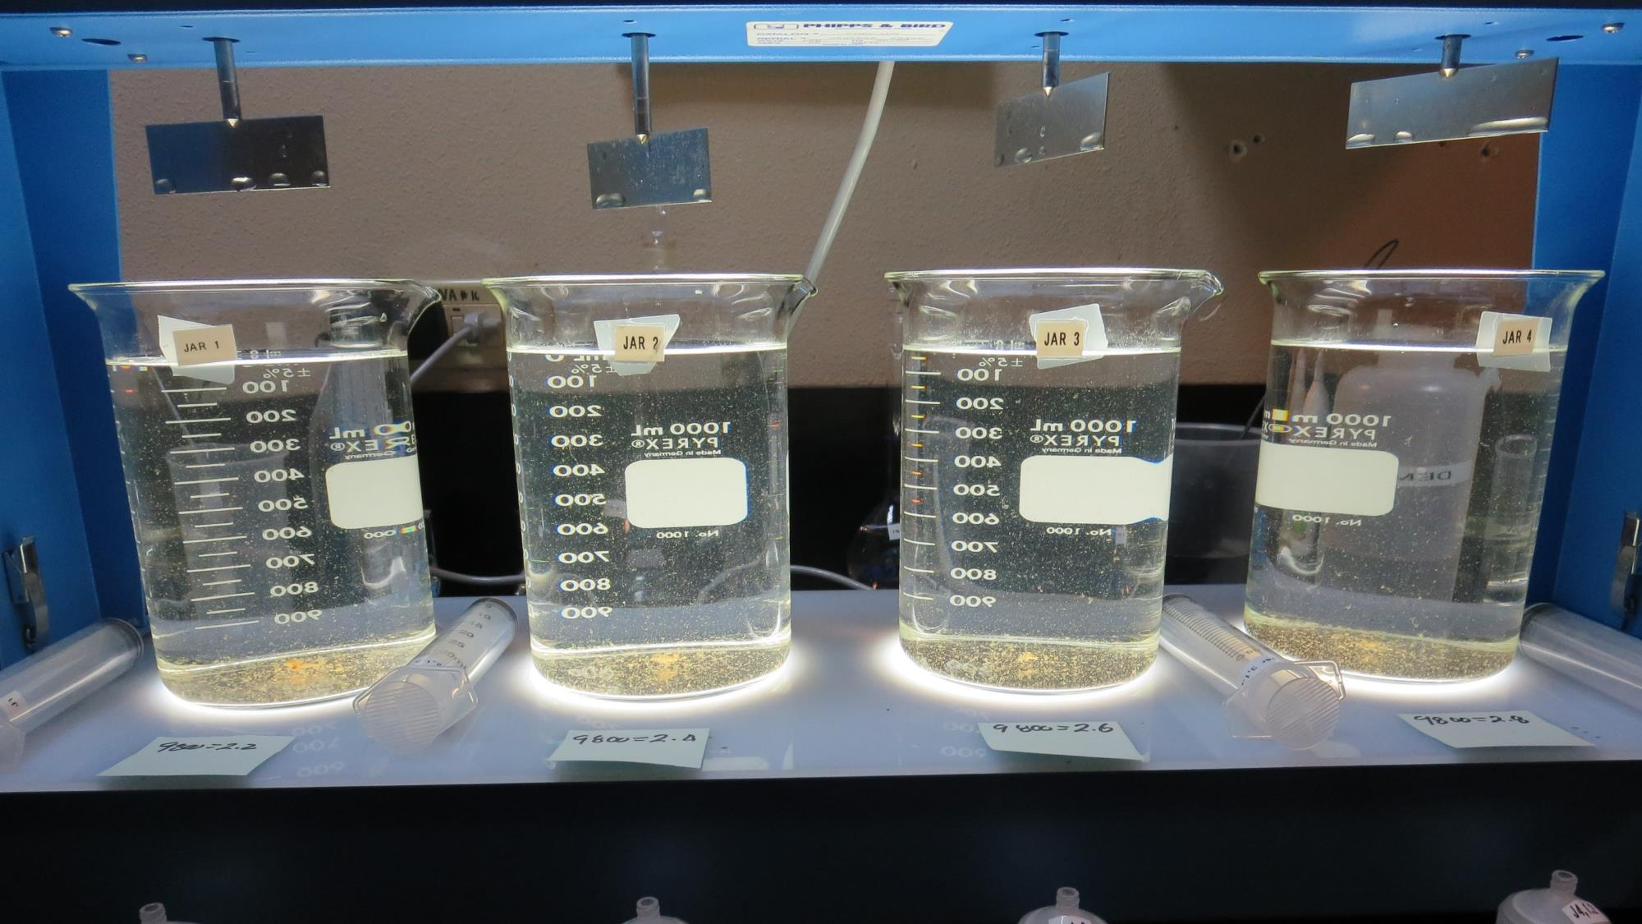
Jars 17-20: After 5 min of settling, 25 mL is syringed for filterability and %UVT/UVA.

Slide 31
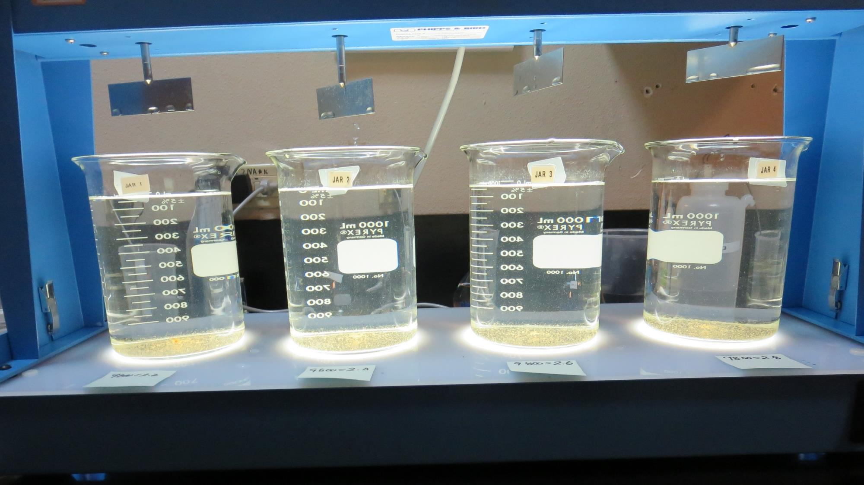
Jars 17-20: After 25-minutes of settling, settled water turbidity is taken.
2.2 mg/L 9800
Filtrate 0.09 NTU
UVT: 97.8%
UVA: 0.010/cm
Settled: 1.84 NTU
2.4 mg/L 9800
Filtrate 0.09 NTU
UVT: 97.7%
UVA: 0.010/cm
Settled: 1.52 NTU
2.6 mg/L 9800
Filtrate 0.09 NTU
UVT: 97.8%
UVA: 0.010/cm
Settled: 1.59 NTU
2.8 mg/L 9800
Filtrate 0.06 NTU
UVT: 98.1%
UVA: 0.008/cm
Settled: 1.70 NTU

Slide 32
Jars 21-24 Test
Flash Mix 60 Sec (200 RPM)
Floc Mix 5 min (30 RPM)
Applied Coagulants
9890/AD-101P

Slide 33
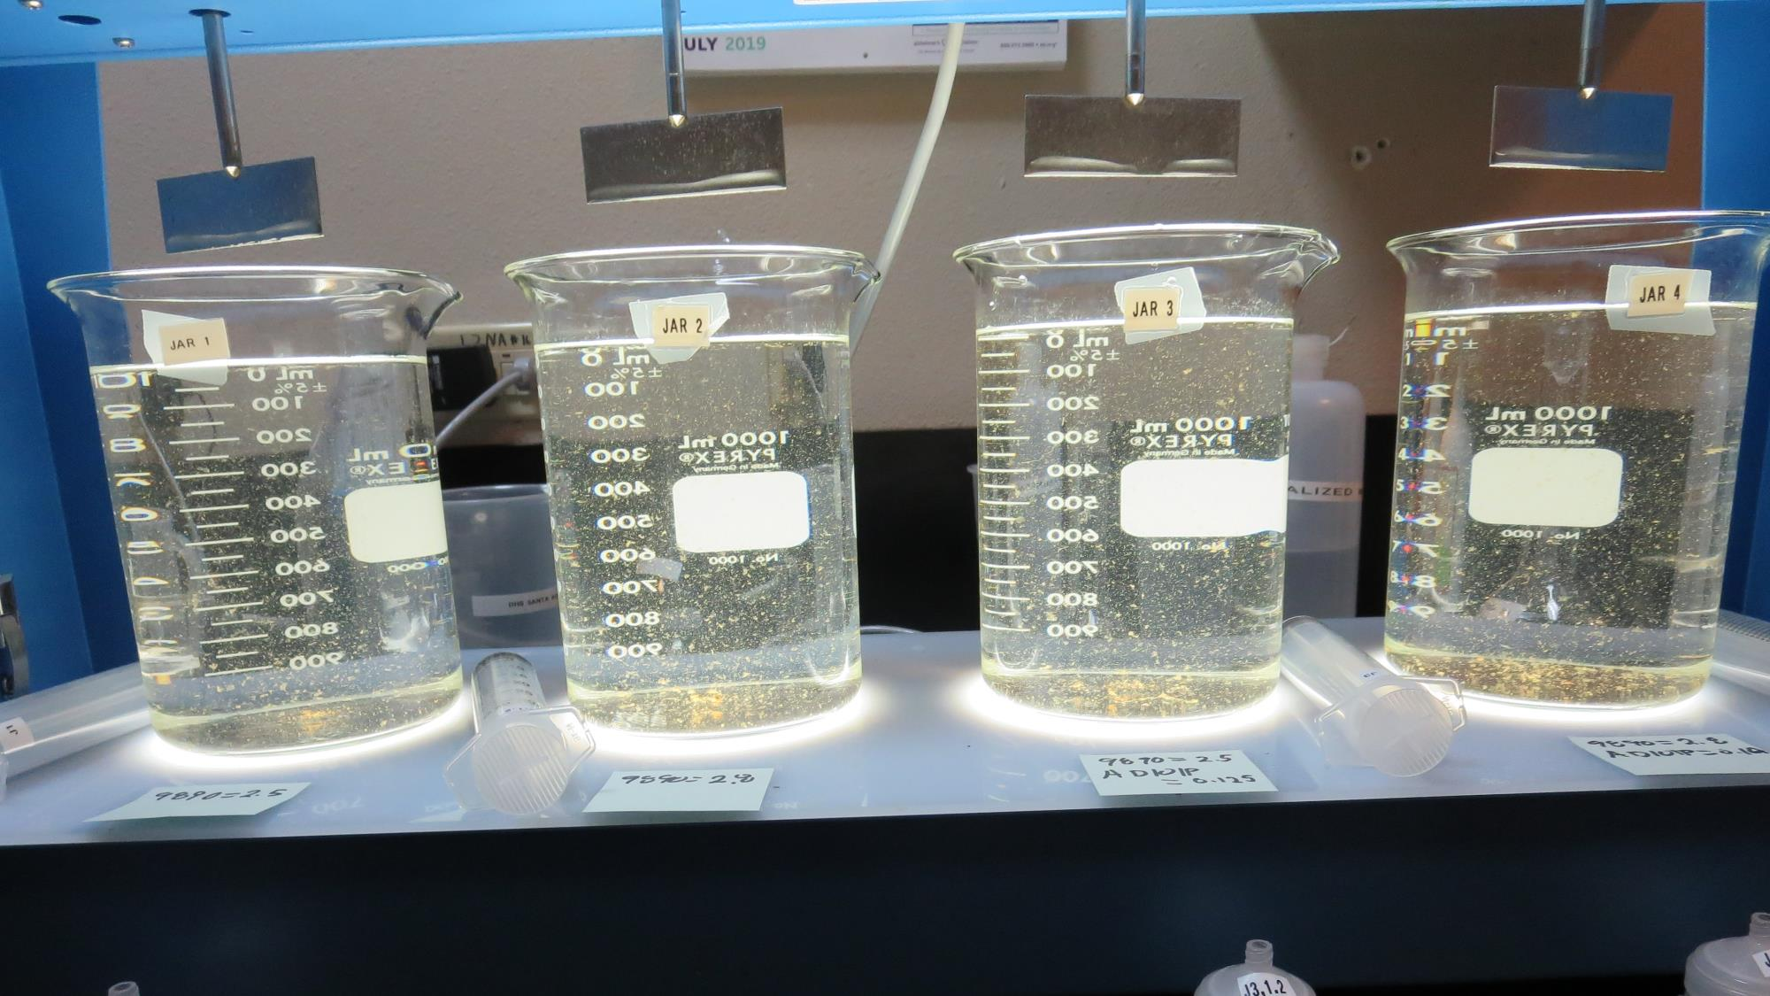
Jars 21-24: End of 5-minute flocculation (30 RPM) duration.
2.5 mg/L 9890
0 mg/L AD 101P
Filtrate 0.10 NTU
UVT: 97.7%
UVA: 0.010/cm
Settled: 2.0 NTU
2.8 mg/L 9890
0 mg/L AD 101P
Filtrate 0.11 NTU
UVT: 97.9%
UVA: 0.009/cm
Settled: 1.8 NTU
2.5 mg/L 9890
0.125 mg/L AD 101P
Filtrate 0.08 NTU
UVT: 98.0%
UVA: 0.009/cm
Settled: 2.1 NTU
2.8 mg/L 9890
0.14 mg/L AD 101P
Filtrate 0.09 NTU
UVT: 98.0%
UVA: 0.009/cm
Settled: 1.7 NTU

Slide 34
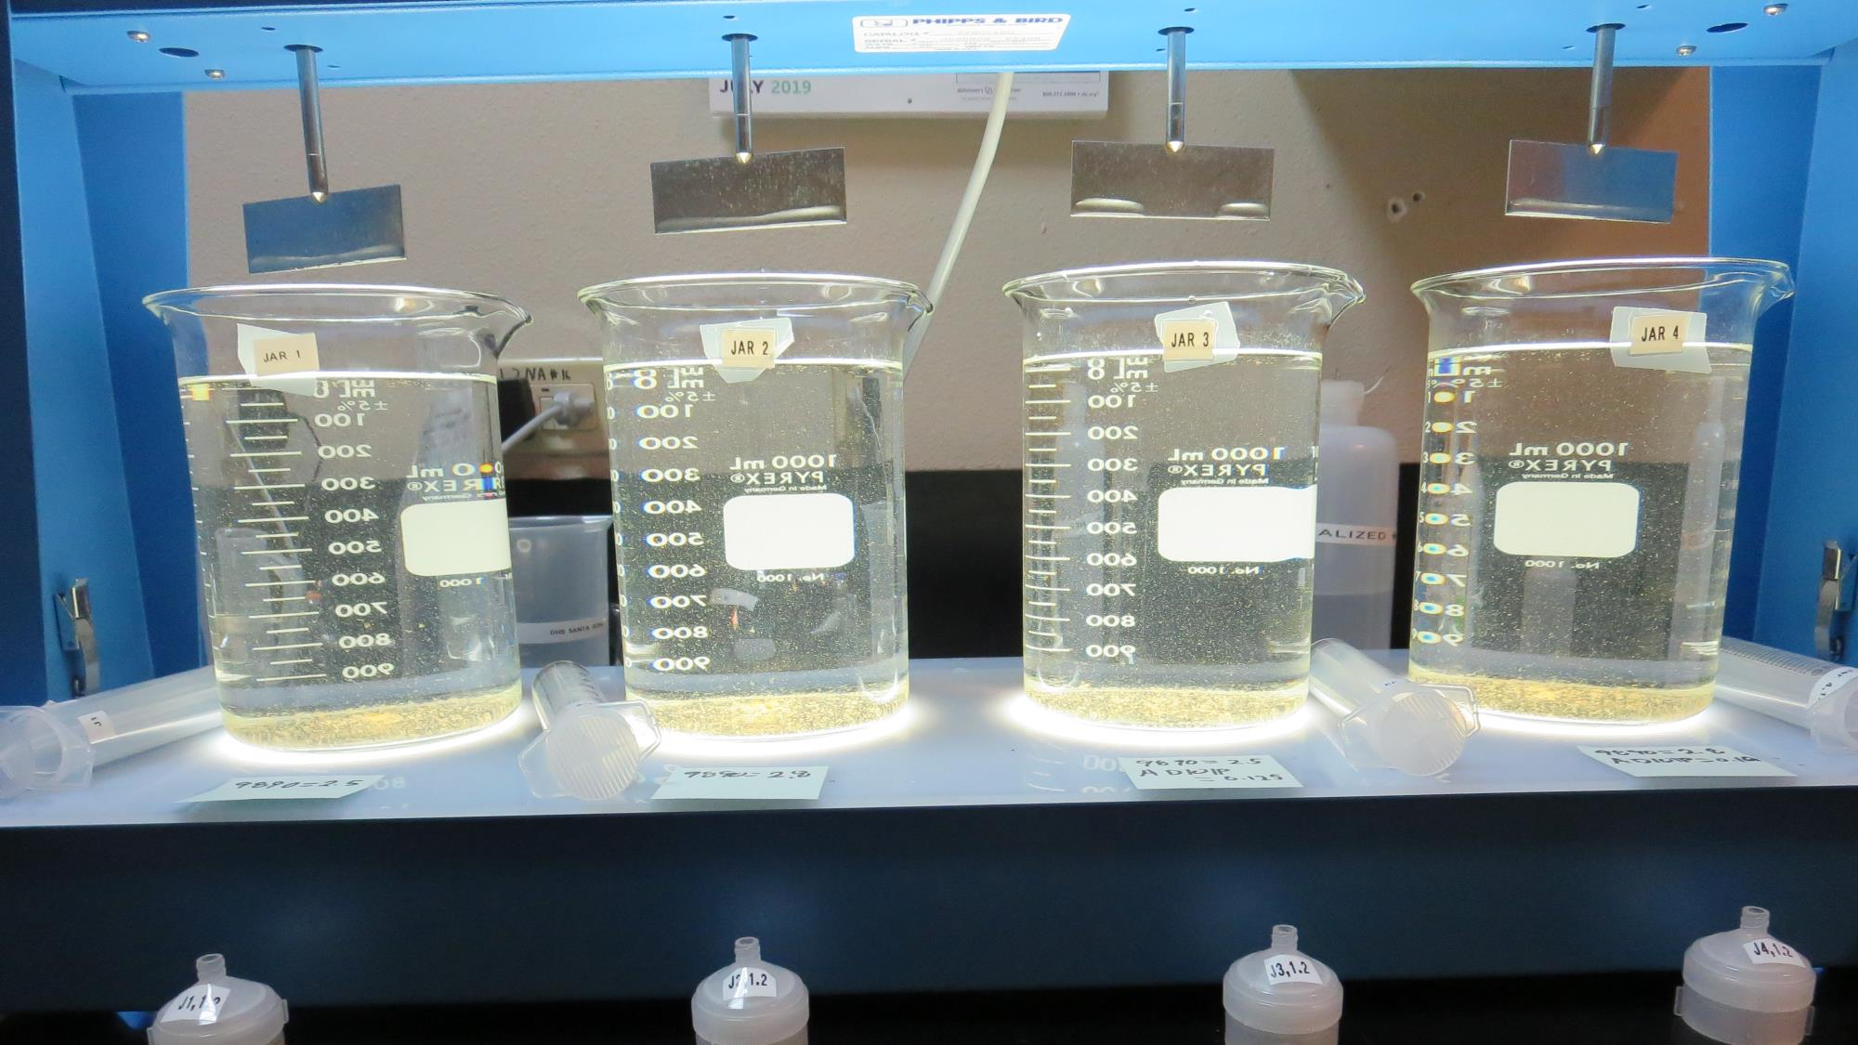
Jars 21-24: After 5 min of settling, 25 mL is syringed for filterability and %UVT/UVA.

Slide 35
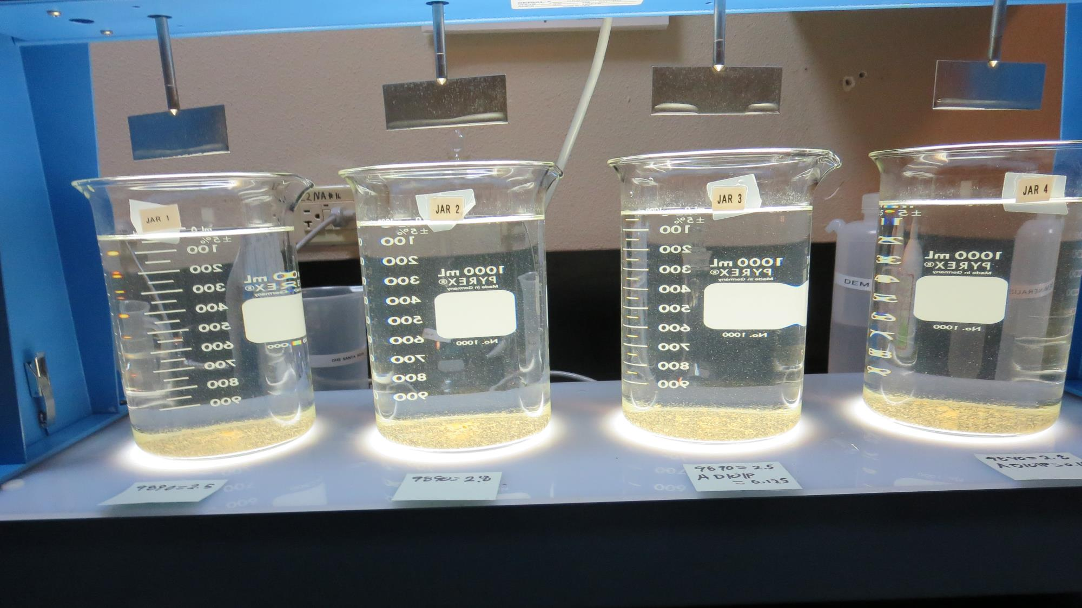
Jars 21-24: After 25-minutes of settling, settled water turbidity is taken.
2.5 mg/L 9890
0 mg/L AD 101P
Filtrate 0.10 NTU
UVT: 97.7%
UVA: 0.010/cm
Settled: 2.0 NTU
2.8 mg/L 9890
0 mg/L AD 101P
Filtrate 0.11 NTU
UVT: 97.9%
UVA: 0.009/cm
Settled: 1.8 NTU
2.5 mg/L 9890
0.125 mg/L AD 101P
Filtrate 0.08 NTU
UVT: 98.0%
UVA: 0.009/cm
Settled: 2.1 NTU
2.8 mg/L 9890
0.14 mg/L AD 101P
Filtrate 0.09 NTU
UVT: 98.0%
UVA: 0.009/cm
Settled: 1.7 NTU

Slide 36
Jar Testing for 1-Liter Jars:
Procedures for Most Treatment Plants
Fill jars with source water prior to coagulant injection and set paddle speed at 30 rpm
Add chemicals (i.e., NaOCl, primary coagulant, coagulant aid) to each jar
Flash mix for 15-60 seconds (200 rpm)
Slow mix for 5 minutes (20-30 rpm)
Settled for 5 minutes. Syringe 25 mL from each jar taken 1-inch below surface (25 mL/12 sec rate). For this study, sample was taken immediately at the end of flocculation process.
Filtered through 1.2 um isopore membrane into cuvette drip rate, 15 mL/(50-90 sec)
Measure filtrate turbidity, chlorine residual and %UVT/UVA
Measure settled water turbidity after 25 minutes of total setting
Record all data

Slide 37

Jar Test
Filterability Test Equipment
Turbidity Instrument
Syringe w/Luer-Lock Tip, 30 cc
(part#: 2225800, by Hach)
Swinnex Filter Holder, 25 mm (part#: SX0002500)
Isopore Membrane Filter, 1.2 um absolute
pore size,
Φ= 25 mm , thickness: 24 um,
hydrophilic polycarbonate membrane
(part #: RTTP02500)
Go to Sigma-Aldrich for laboratory supplies http://www.sigmaaldrich.com/united-states.html

Slide 38
Isopore Membrane Information
Categories | Information
trade name | Isopore
filter color | White
chemistry | Polycarbonate (PC)
water flow rate | Avg. 175 mL/min x cm² (typical results @ 10 psi)
media | Isopore®
wettability | Hydrophilic
porosity | 14.7%
pore size | 1.2 µm
bubble point at 23 °C | 1.0 bar, air with water
thickness | 24 µm
filter diameter (ø) | 25 mm
material size | polycarbonate, Hydrophilic, 1.2 µm, 25 mm, white, plain, 100

Slide 39
Isopore Membrane Background Information
The Isopore membrane is a polycarbonate, track-etched screen filter recommended for all analyses in which the sample is viewed on the surface of the membrane. The Isopore membrane is composed of polycarbonate film, which has a smooth, glass-like surface for clearer sample observation. The unique manufacturing process of the membrane ensures a precise pore diameter and a consistent pore size for accurate separation of samples by size. Matched-weight filters are not usually required because of low, constant tar and ash weights.
Features & Benefits:
Membrane structure retains particles on the surface, simplifying counting and analysis

Slide 40
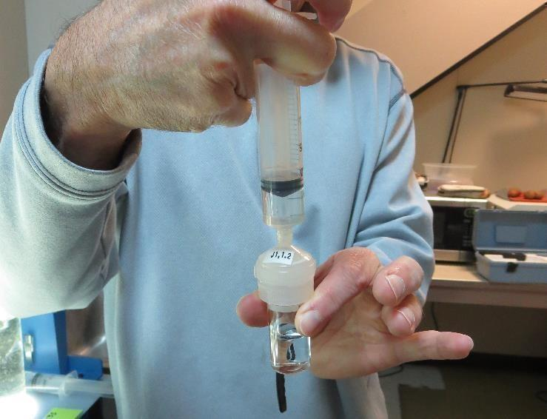

Jar Test - Filterability Test
Syringe ~ 25 mL from jar (after 5-minutes of settling)
Filter-to-waste 3-5 mL
Filter directly into clean cuvette
Measure turbidity
Note: Take several readings before recording final NTU results. Micro bubbles can adhere to glass causing false NTU readings. To remove bubbles, tilt cuvette up to 90 degrees.

Slide 41

Contact
Guy Schott, P.E.
State Water Resources Control Board
Division of Drinking Water
Santa Rosa, CA
Go to Stock Solution/Dose calculations/Jar Test Results for tools to download
www.waterboards.ca.gov/drinking_water/programs/districts/mendocino_district.html
Email: Guy Schott - Guy.Schott@waterboards.ca.gov
Office Number: 707-576-2732

