Slide 1
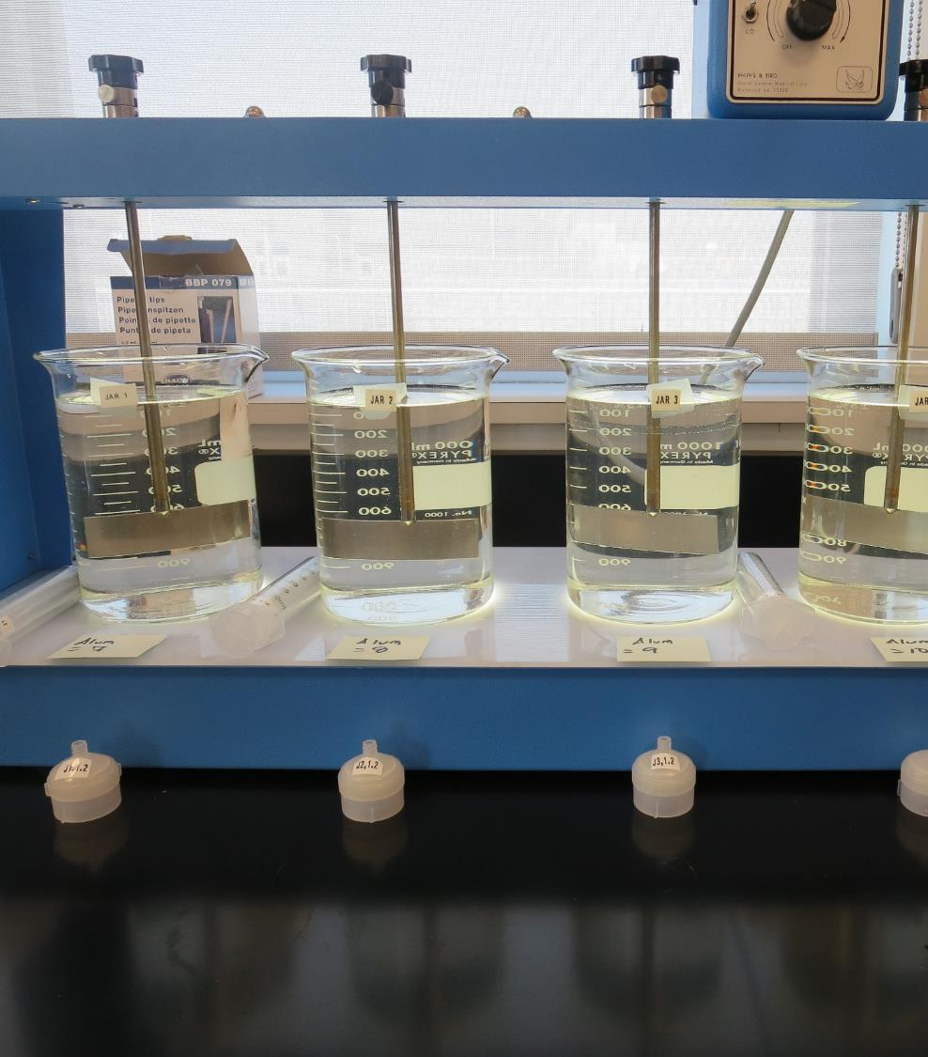
City of Fresno CA1010007 Fresno County Jar Test
by Guy Schott, P.E.
July 31, 2019

Slide 2
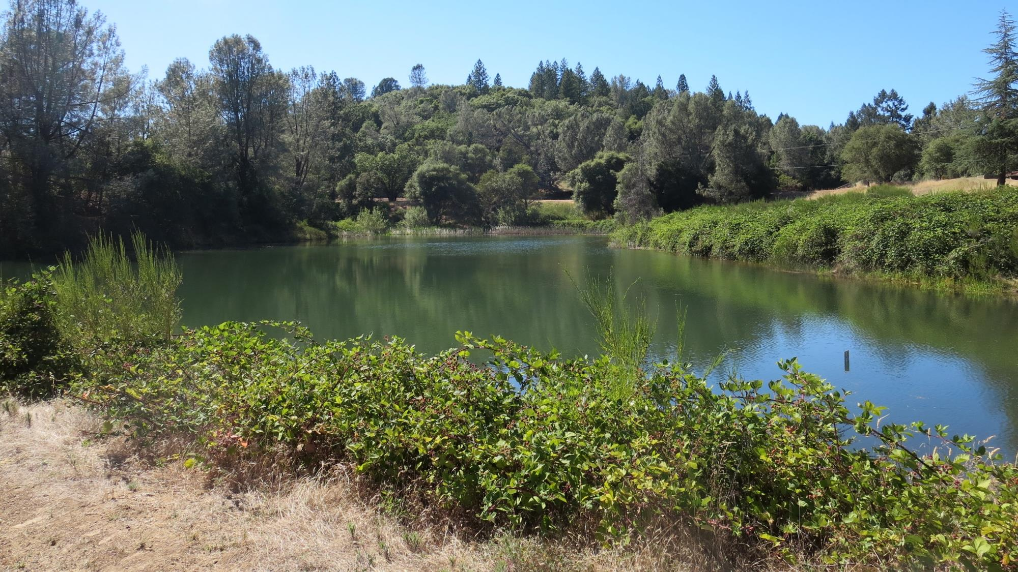
Kings River

Slide 3
City of Fresno Kings River Water Characteristics July 29-31, 2019
Source
Turbidity: 1 – 1.1 NTU
pH: 7.13 - 7.33
UVT: 87.6% (unfiltered)
UVA/cm: 0.057

Slide 4
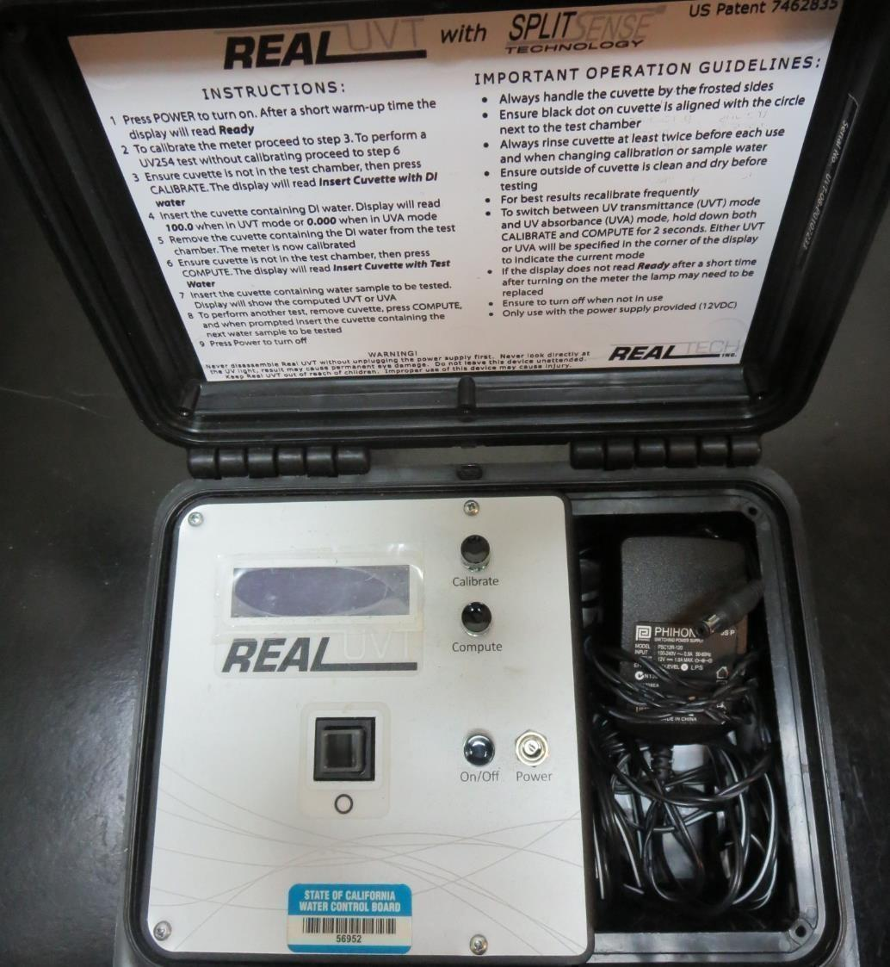
UVT/UVA
UV transmittance (UVT) is a measurement of the amount of ultraviolet light (commonly at 254 nm due to its germicidal effect) that passes through a water sample compared to the amount of light that passes through a pure water sample. The measurement is expressed as a percentage, % UVT.
%UVT = 10^{(-UVA)} x 100%
UV absorbance (UVA) is calculated as a relative measure of the amount of light absorbed by a water sample compared with the amount of light absorbed by a pure water sample.
UVA = -log(%UVT/100)

Slide 5
Coagulant Used for Jar Testing
Pro Pac 9800 (NTU Technologies)
50% Aluminum Chlorohydrate (ACH)
50% Water
SG = 1.34
Aluminum Sulfate
48.24% Aluminum Sulfate
8.2% Al₂O₃
SG = 1.34
7066 (Garratt Callahan)
10 – 30% Poly Aluminum Hydroxychloride Sulfate
SG = 1.2

Slide 6
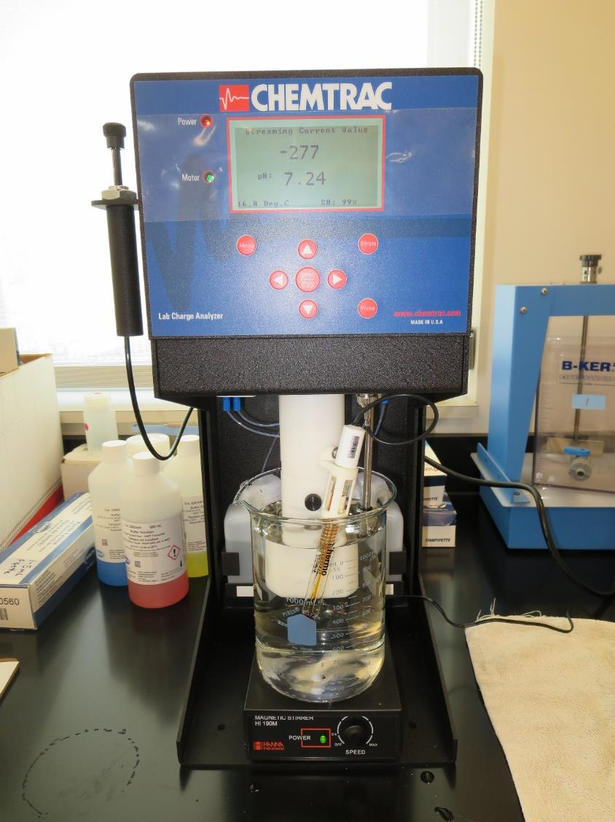
Laboratory Charge Analyzer
LCA: Used to determine coagulant demand of a source water entering the treatment plant.
Source pH: 7.24
LCA #1:
Alum: 8.7 mg/L as product
pH adjusted to 6.8 with acetic acid.
LCA #2:
9800: 7.5 mg/L as product (no pH adjustment)
LCA #3:
7076: 20.7 mg/L as product (no pH adjustment)

Slide 7
Coagulant Information
Unless stated otherwise, all coagulant doses are reported as Product (100% strength). Aluminum Sulfate is reported as Alum.
Preparation of coagulant stock solutions are generally 1.0 and/or 0.1 percent strength using 100 and/or 200 mL volumetric flasks.
Finnpipette F2 variable volume pipette, capacity 100-1000 micro liters is used for stock solution preparation and coagulant aid jar test dosing.
Finnpipette F2 variable volume pipette, capacity 0.5-5 mL is used for primary coagulant jar test dosing.

Slide 8
City of Fresno – South Plant: Jar Test 1-4 Results
Jar | 200 RPM Flash Mix seconds | 30 RPM Floc Duration minutes | Alum mg/L | Filtrate NTU | Filtrate %UVT | Filtrate UVA/cm | Settle NTU 25 min
J1 | 60 | 5 | 7.0 | 0.40 | 94.8 | 0.023 | 1.55
J2 | 60 | 5 | 8.0 | 0.06 | 96.1 | 0.017 | 1.72
J3 | 60 | 5 | 9.0 | 0.05 | 96.9 | 0.014 | 1.81
J4 | 60 | 5 | 10 | 0.06 | 96.9 | 0.014 | 1.74

Slide 9
City of Fresno – South Plant: Jar Test 5-10 Results
Jar | 200 RPM Flash Mix seconds | 30 RPM Floc Duration minutes | Alum mg/L | Filtrate NTU | Filtrate %UVT | Filtrate UVA/cm | Settle NTU 25 min
J5 | 0 | 5 | 11 | 0.06 | 96.6 | 0.015 | 1.85
J6 | 0 | 5 | 7.0 | 0.67 | 91.7 | 0.038 | 1.56
J7 | 0 | 5 | 8.0 | 0.25 | 94.6 | 0.024 | n/a
J8 | 0 | 5 | 9.0 | 0.13 | 95.7 | 0.019 | n/a
J9 | 0 | 5 | 10 | 0.14 | 95.5 | 0.020 | n/a
J10 | 0 | 5 | 11 | 0.20 | 95.1 | 0.023 | n/a

Slide 10
City of Fresno – South Plant : Jar Test 11-15 Results
Jar | 200 RPM Flash Mix seconds | 30 RPM Floc Duration minutes | 9800 mg/L | Filtrate NTU | Filtrate %UVT | Filtrate UVA/cm | Settle NTU 25 min
J11 | 60 | 5 | 5.0 | 0.18 | 94.5 | 0.025 | 1.36
J12 | 60 | 5 | 6.0 | 0.34 | 94.4 | 0.025 | 1.46
J13 | 60 | 5 | 7.0 | 0.13 | 95.8 | 0.019 | 1.55
J14 | 60 | 5 | 8.0 | 0.22 | 95.7 | 0.019 | 1.53
J15 | 60 | 5 | 9.0 | 0.35 | 94.7 | 0.024 | 1.58

Slide 11
City of Fresno – South Plant : Jar Test 16-20 Results
Jar | 200 RPM Flash Mix seconds | 30 RPM Floc Duration minutes | 7076 mg/L | Filtrate NTU | Filtrate %UVT | Filtrate UVA/cm | Settle NTU 25 min
J16 | 60 | 5 | 20 | 0.12 | 95.9 | 0.018 | 1.43
J17 | 60 | 5 | 22 | 0.07 | 96.8 | 0.014 | 1.45
J18 | 60 | 5 | 24 | 0.10 | 96.5 | 0.015 | 1.35
J19 | 60 | 5 | 26 | 0.09 | 96.6 | 0.015 | 1.50
J20 | 60 | 5 | 28 | 0.08 | 97.3 | 0.012 | 1.42

Slide 12
Jar Testing for 1-Liter Jars: Procedures for Most Treatment Plants
Fill jars with source water prior to coagulant injection and set paddle speed at 30 rpm
Add chemicals (i.e., NaOCl, primary coagulant, coagulant aid) to each jar
Flash mix for 15-60 seconds (200 rpm)
Slow mix for 5 minutes (20-30 rpm)
Settled for 5 minutes. Syringe 25 mL from each jar taken 1-inch below surface (25 mL/12 sec rate).
Filtered through 1.2 um isopore membrane into cuvette drip rate, 15 mL/(50-90 sec)
Measure filtrate turbidity, chlorine residual and %UVT/UVA
Measure settled water turbidity after 25 minutes of total setting
Record all data

Slide 13
Jar Test Filterability Test Equipment
Turbidity Instrument
Syringe w/Luer-Lock Tip, 30 cc
(part#: 2225800, by Hach)
Swinnex Filter Holder, 25 mm (part#: SX0002500)
Isopore Membrane Filter, 1.2 um absolute
pore size,
Φ= 25 mm , thickness: 24 um,
hydrophilic polycarbonate membrane
(part #: RTTP02500)
Go to Sigma-Aldrich for laboratory supplies http://www.sigmaaldrich.com/united-states.html

Slide 14
Isopore Membrane Information
Categories | Information
trade name | Isopore
filter color | White
chemistry | Polycarbonate (PC)
water flow rate | Avg. 175 mL/min x cm² (typical results @ 10 psi)
media | Isopore®
wettability | Hydrophilic
porosity | 14.7%
pore size | 1.2 µm
bubble point at 23 °C | 1.0 bar, air with water
thickness | 24 µm
filter diameter (ø) | 25 mm
material size | polycarbonate, Hydrophilic, 1.2 µm, 25 mm, white, plain, 100

Slide 15
Isopore Membrane Background Information
The Isopore membrane is a polycarbonate, track-etched screen filter recommended for all analyses in which the sample is viewed on the surface of the membrane. The Isopore membrane is composed of polycarbonate film, which has a smooth, glass-like surface for clearer sample observation. The unique manufacturing process of the membrane ensures a precise pore diameter and a consistent pore size for accurate separation of samples by size. Matched-weight filters are not usually required because of low, constant tar and ash weights. Features & Benefits: Membrane structure retains particles on the surface, simplifying counting and analysis

Slide 16
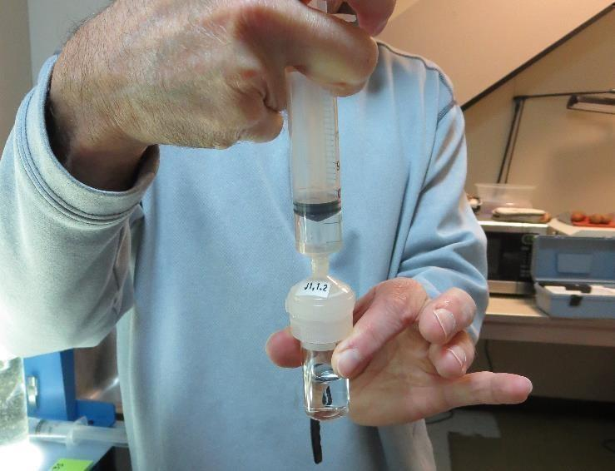
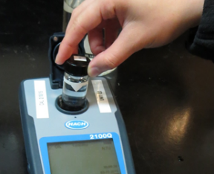
Jar Test - Filterability Test
Syringe ~ 25 mL from jar (after 5-minutes of settling)
Filter-to-waste 3-5 mL
Filter directly into clean cuvette
Measure turbidity
Note: Take several readings before recording final NTU results. Micro bubbles can adhere to glass causing false NTU readings. To remove bubbles, tilt cuvette up to 90 degrees.

Slide 17
Contact
Guy Schott, P.E.
State Water Resources Control Board
Division of Drinking Water
Santa Rosa, CA
Go to Stock Solution/Dose calculations/Jar Test Results for tools to download
www.waterboards.ca.gov/drinking_water/programs/districts/mendocino_district.html
Email: Guy Schott - Guy.Schott@waterboards.ca.gov
Office Number: 707-576-2732

