Slide 1
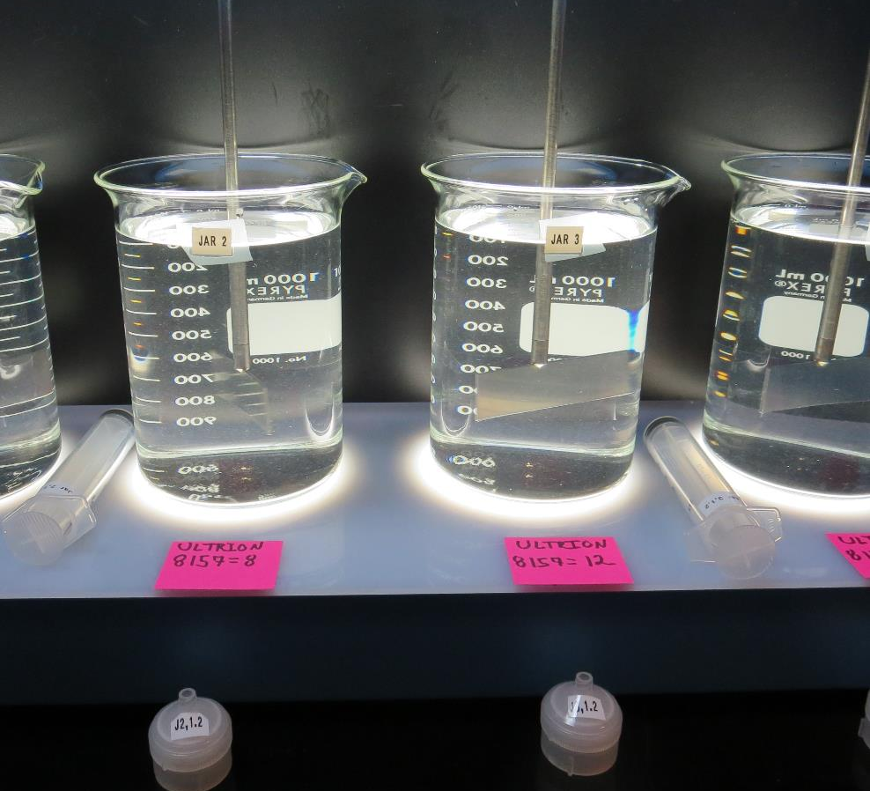
Garberville
Sanitary District
CA1210008
Humboldt County
Jar Test
by Guy Schott, P.E.
February 4, 2019

Slide 2
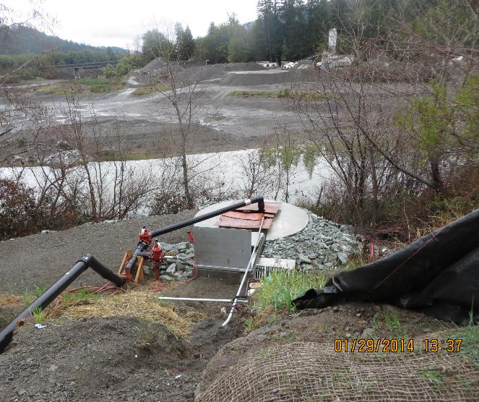
Garberville Sanitary District
Water Characteristics
February 4, 2019
Source
Particle Counts > 2 um = 6,347
PPB = 3,172
Turbidity: 1.6 NTU
pH: 7.9
UVT: 94.5%
UVA: 0.025

Slide 3
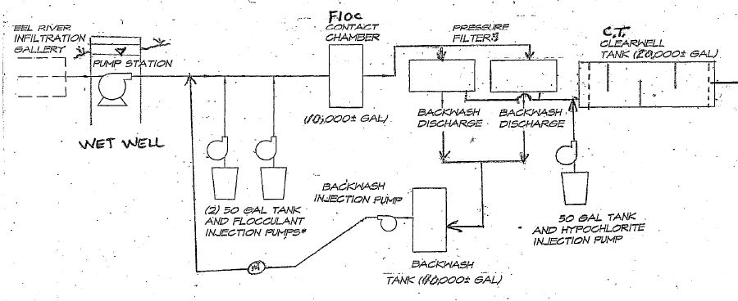
Direct Filtration Plant

Slide 4
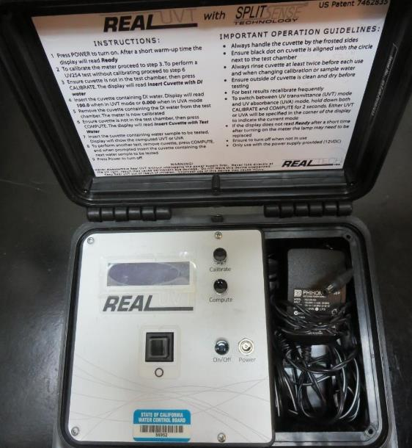
UVT/UVA
UV transmittance (UVT) is a measurement of the amount of ultraviolet light (commonly at 254 nm due to its germicidal effect) that passes through a water sample compared to the amount of light that passes through a pure water sample. The measurement is expressed as a percentage, % UVT.
%UVT = 10^{(-UVA)} x 100%
UV absorbance (UVA) is calculated as a relative measure of the amount of light absorbed by a water sample compared with the amount of light absorbed by a pure water sample.
UVA = -log(%UVT/100)

Slide 5
Applied Coagulants for Jar Testing
Pro Pac 9800 (NTU Technologies)
50% Aluminum Chlorohydrate (ACH)
50% Water
SG = 1.34
ULTRION 8157 (Nalco Company)
10-30% Calcium Chloride
10-30% Aluminum Hydroxychloride
1-5% Aluminum Phosphate
SG = 1.27

Slide 6
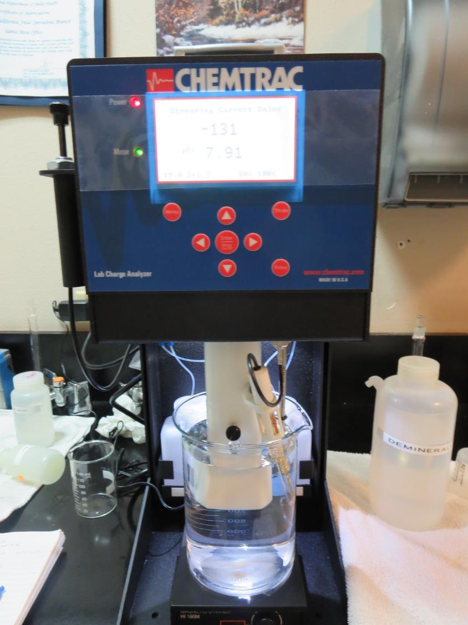
Laboratory Charge Analyzer
LCA: Used to determine coagulant demand of a source water entering the treatment plant.
Source pH: 7.9
LCA #1: ACH (9800): 5.5 mg/L as product
pH adjusted to 7.5 w/acetic acid
LCA #2: ULTRION 8157
14.5 mg/L as product, no pH adjustment
LCA #3: ULTRION 8157
12.3 mg/L as product
pH adjustment to 7.5 w/acetic acid

Slide 7
Coagulant Information
Unless stated otherwise, all coagulant doses are reported as Product (100% strength). Aluminum sulfate is reported as Alum.
Preparation of coagulant stock solutions are generally 1.0 and/or 0.1 percent strength using 100 and/or 200 mL volumetric flasks.
Finnpipette F2 variable volume pipette, capacity 100-1000 micro liters is used for stock solution preparation and coagulant aid jar test dosing.
Finnpipette F2 variable volume pipette, capacity 0.5-5 mL is used for primary coagulant jar test dosing.

Slide 8
Garberville Sanitary District : Jar Test 1-8 Results
Jar # | 200 RPM Flash Mix seconds | 30 RPM Floc Duration minutes | 9800 mg/L | ULTRION 8157 mg/L | Filtrate NTU | Filtrate %UVT | Filtrate UVA/cm | Settle NTU 25 min
J1 | 60 | 5 | 3.5 | 0 | 0.12 | 96.2 | 0.017 | 1.7
J2 | 60 | 5 | 5.5 | 0 | 0.07 | 96.7 | 0.015 | 1.8
J3 | 60 | 5 | 7.5 | 0 | 0.06 | 97.2 | 0.012 | 1.6
J4 | 60 | 5 | 9.5 | 0 | 0.14 | 97.1 | 0.013 | 1.8
J5 | 60 | 5 | 0 | 4 | 0.09 | 96.0 | 0.018 | 1.4
J6 | 60 | 5 | 0 | 8 | 0.08 | 96.0 | 0.018 | 1.7
J7 | 60 | 5 | 0 | 12 | 0.08 | 96.1 | 0.017 | 1.7
J8 | 60 | 5 | 0 | 16 | 0.07 | 96.8 | 0.014 | 1.7

Slide 9
Jars 1-4 Test
Flash Mix 60 Sec (200 RPM)
Floc Mix 5 min (30 RPM)
Applied Coagulant
9800

Slide 10
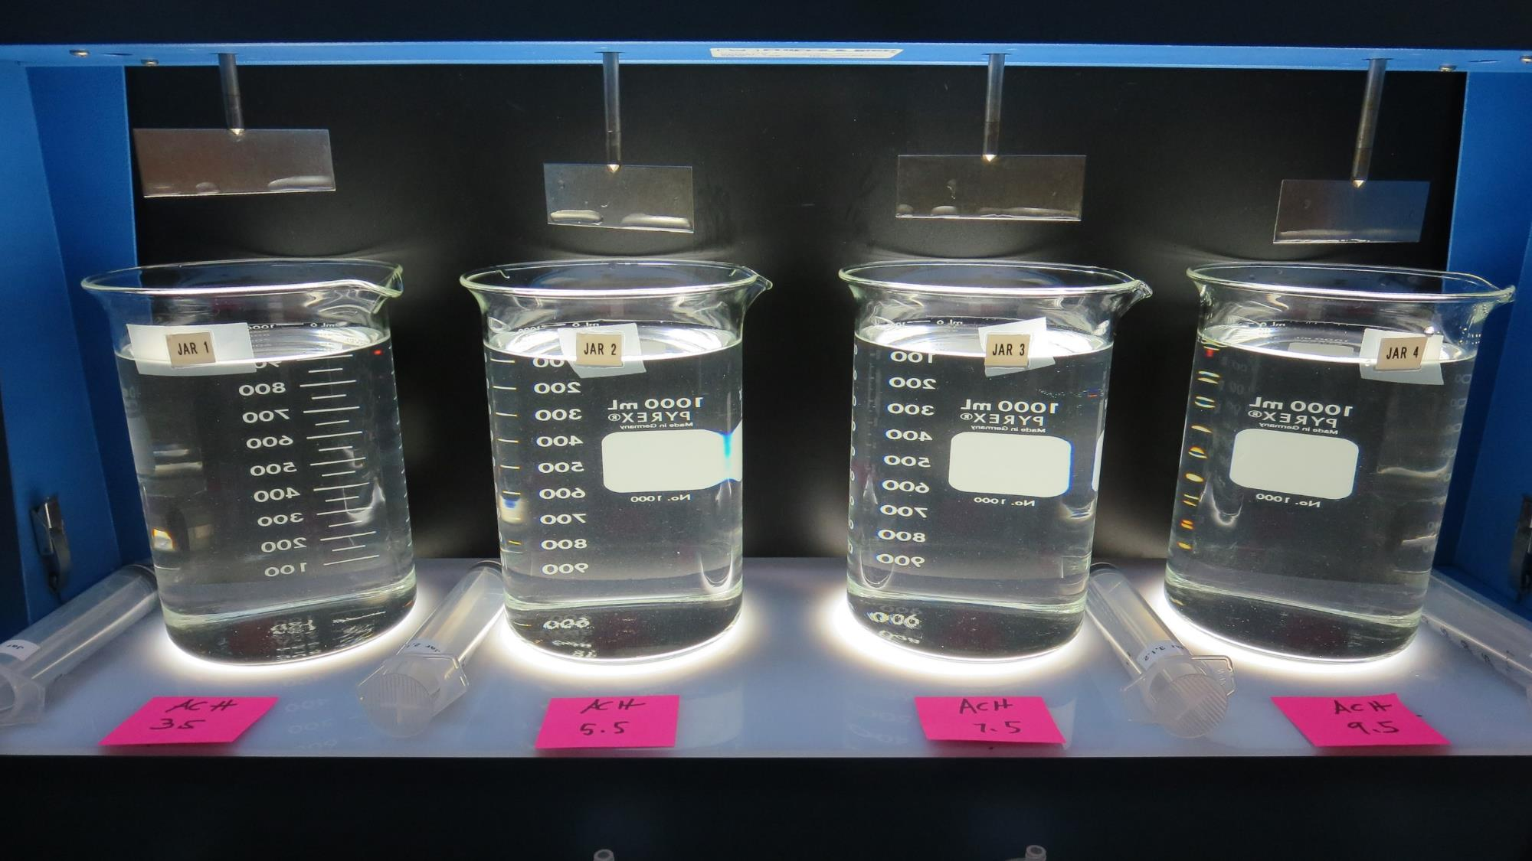
Jars 1-4: End of 5-minute flocculation (30 RPM) duration.
3.5 mg/L 9800
Filtrate 0.12 NTU
UVT: 96.2%
UVA: 0.017/cm
Settled: 1.7 NTU
5.5 mg/L 9800
Filtrate 0.07 NTU
UVT: 96.7%
UVA: 0.015/cm
Settled: 1.8 NTU
7.5 mg/L 9800
Filtrate 0.06 NTU
UVT: 97.2%
UVA: 0.012/cm
Settled: 1.6 NTU
9.5 mg/L 9800
Filtrate 0.14 NTU
UVT: 97.1%
UVA: 0.013/cm
Settled: 1.8 NTU

Slide 11
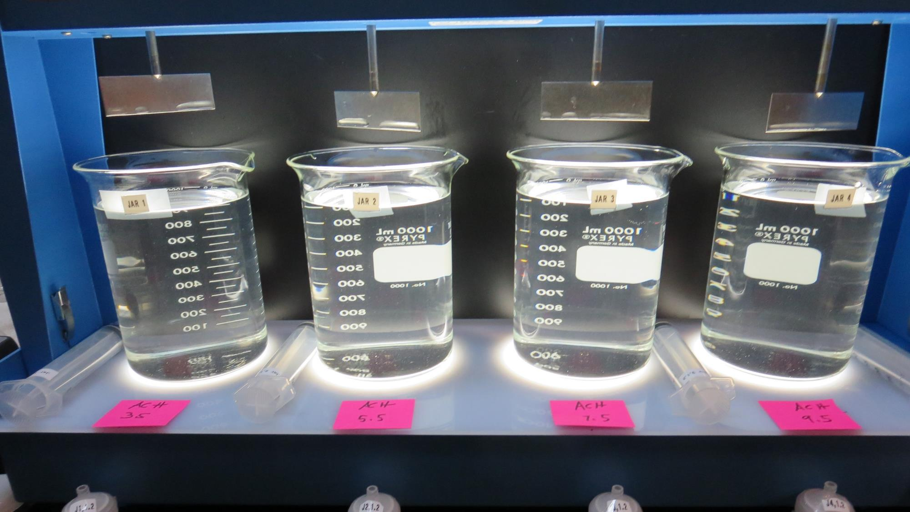
Jars 1-4: After 5 min of settling, 25 mL is syringed for filterability and %UVT/UVA.

Slide 12
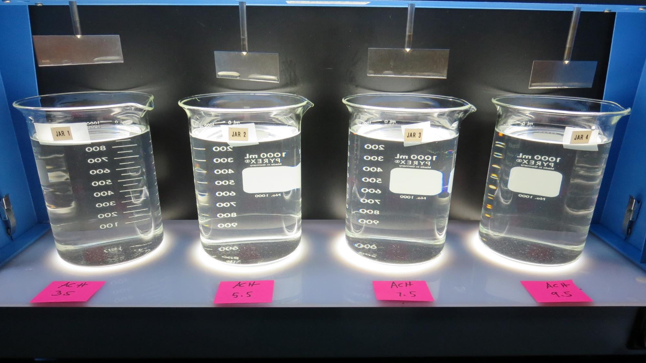
Jars 1-4: After 25-minutes of settling, settled water turbidity is taken.
3.5 mg/L 9800
Filtrate 0.12 NTU
UVT: 96.2%
UVA: 0.017/cm
Settled: 1.7 NTU
5.5 mg/L 9800
Filtrate 0.07 NTU
UVT: 96.7%
UVA: 0.015/cm
Settled: 1.8 NTU
7.5 mg/L 9800
Filtrate 0.06 NTU
UVT: 97.2%
UVA: 0.012/cm
Settled: 1.6 NTU
9.5 mg/L 9800
Filtrate 0.14 NTU
UVT: 97.1%
UVA: 0.013/cm
Settled: 1.8 NTU

Slide 13
Jars 5-8 Test
Flash Mix 60 Sec (200 RPM)
Floc Mix 5 min (30 RPM)
Applied Coagulant
ULTRION 8157

Slide 14
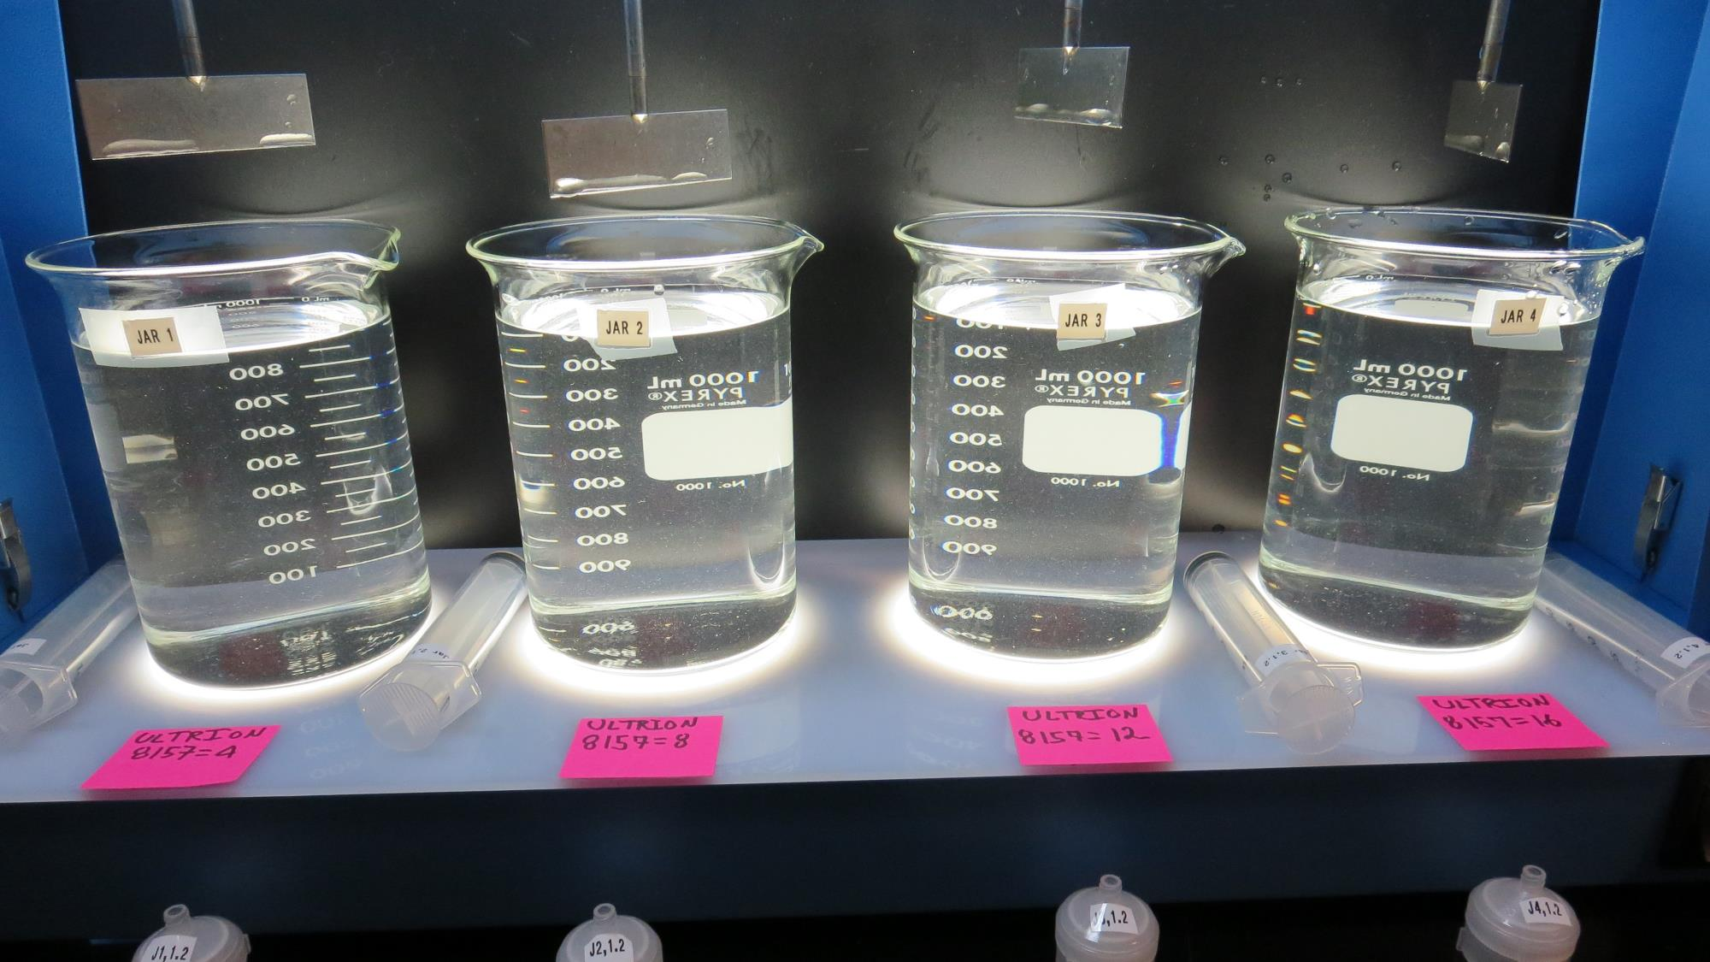
Jars 5-8: End of 5-minute flocculation (30 RPM) duration.
4 mg/L 8157
Filtrate 0.09 NTU
UVT: 96.0%
UVA: 0.018/cm
Settled: 1.4 NTU
8 mg/L 8157
Filtrate 0.08 NTU
UVT: 96.0%
UVA: 0.018/cm
Settled: 1.7 NTU
12 mg/L 8157
Filtrate 0.08 NTU
UVT: 96.0%
UVA: 0.017/cm
Settled: 1.7 NTU
16 mg/L 8157
Filtrate 0.07 NTU
UVT: 96.8%
UVA: 0.014/cm
Settled: 1.7 NTU

Slide 15
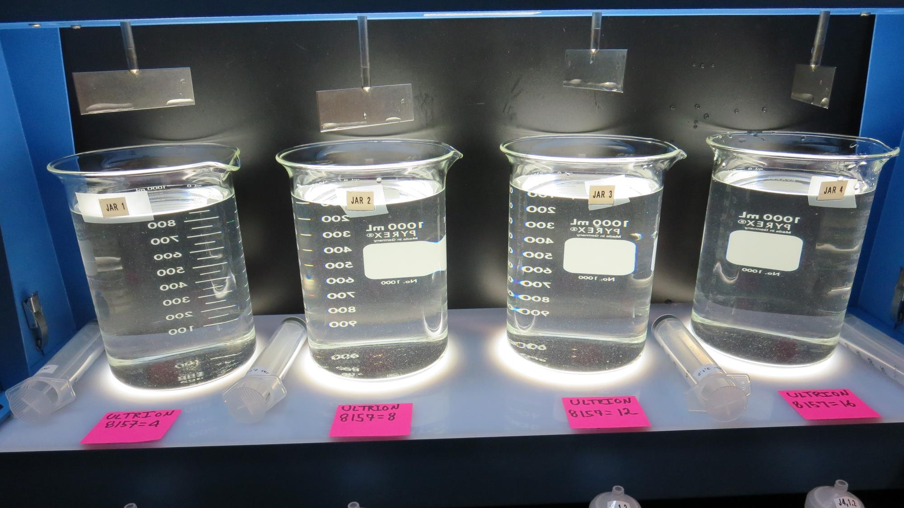
Jars 5-8: After 5 min of settling, 25 mL is syringed for filterability and %UVT/UVA.

Slide 16
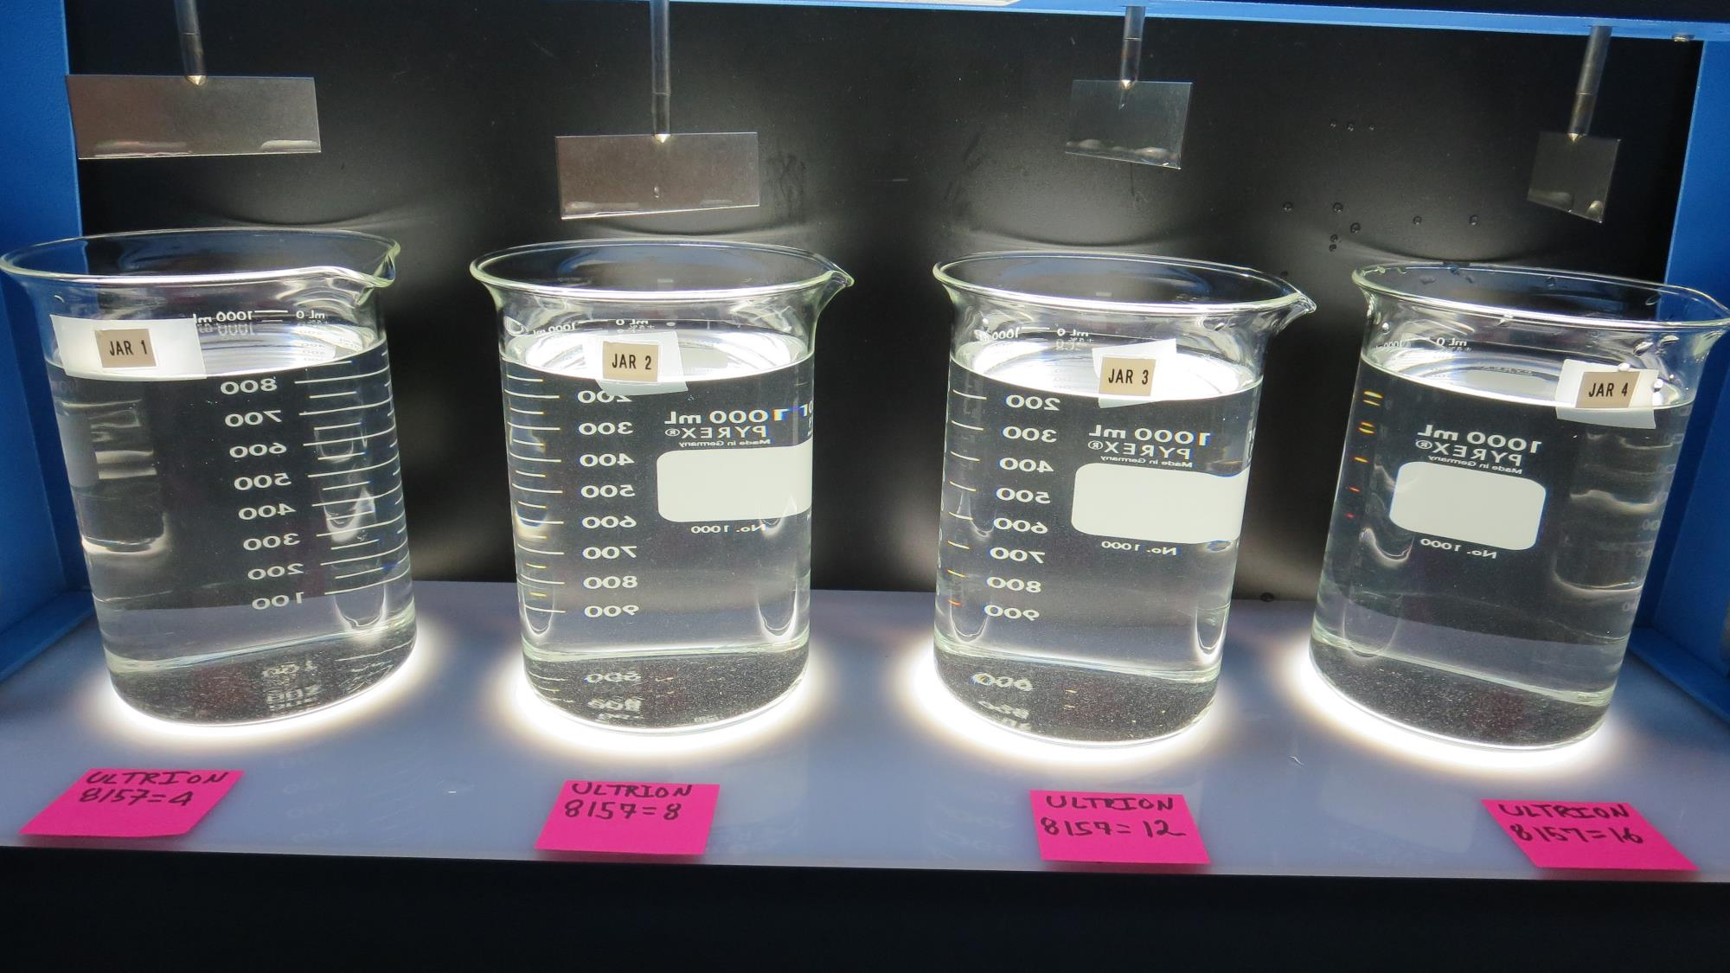
Jars 5-8: After 25-minutes of settling, settled water turbidity is taken.
4 mg/L 8157
Filtrate 0.09 NTU
UVT: 96.0%
UVA: 0.018/cm
Settled: 1.4 NTU
8 mg/L 8157
Filtrate 0.08 NTU
UVT: 96.0%
UVA: 0.018/cm
Settled: 1.7 NTU
12 mg/L 8157
Filtrate 0.08 NTU
UVT: 96.0%
UVA: 0.017/cm
Settled: 1.7 NTU
16 mg/L 8157
Filtrate 0.07 NTU
UVT: 96.8%
UVA: 0.014/cm
Settled: 1.7 NTU

Slide 17
Jar Testing for 1-Liter Jars:
Procedures for Most Treatment Plants
Fill jars with source water prior to coagulant injection and set paddle speed at 30 rpm
Add chemicals (i.e., NaOCl, primary coagulant, coagulant aid) to each jar
Flash mix for 15-60 seconds (200 rpm)
Slow mix for 5 minutes (20-30 rpm)
Settled for 5 minutes. Syringe 25 mL from each jar taken 1-inch below surface (25 mL/12 sec rate)
Filtered through 1.2 um isopore membrane into cuvette drip rate, 15 mL/(50-90 sec)
Measure filtrate turbidity, chlorine residual and %UVT/UVA
Measure settled water turbidity after 25 minutes of total setting
Record all data

Slide 18

Jar Test
Filterability Test Equipment
Turbidity Instrument
Syringe w/Luer-Lock Tip, 30 cc
(part#: 2225800, by Hach)
Swinnex Filter Holder, 25 mm (part#: SX0002500)
Isopore Membrane Filter, 1.2 um absolute
pore size,
Φ= 25 mm , thickness: 24 um,
hydrophilic polycarbonate membrane
(part #: RTTP02500)
Go to Sigma-Aldrich for laboratory supplies http://www.sigmaaldrich.com/united-states.html

Slide 19
Isopore Membrane Information
Categories | Information
trade name | Isopore
filter color | White
chemistry | Polycarbonate (PC)
water flow rate | Avg. 175 mL/min x cm² (typical results @ 10 psi)
media | Isopore®
wettability | Hydrophilic
porosity | 14.7%
pore size | 1.2 µm
bubble point at 23 °C | 1.0 bar, air with water
thickness | 24 µm
filter diameter (ø) | 25 mm
material size | polycarbonate, Hydrophilic, 1.2 µm, 25 mm, white, plain, 100

Slide 20
Isopore Membrane Background Information
The Isopore membrane is a polycarbonate, track-etched screen filter recommended for all analyses in which the sample is viewed on the surface of the membrane. The Isopore membrane is composed of polycarbonate film, which has a smooth, glass-like surface for clearer sample observation. The unique manufacturing process of the membrane ensures a precise pore diameter and a consistent pore size for accurate separation of samples by size. Matched-weight filters are not usually required because of low, constant tar and ash weights.
Features & Benefits:
Membrane structure retains particles on the surface, simplifying counting and analysis

Slide 21
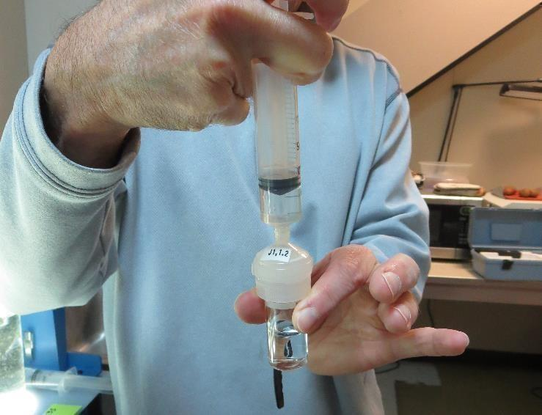

Jar Test - Filterability Test
Syringe ~ 25 mL from jar (after 5-minutes of settling)
Filter-to-waste 3-5 mL
Filter directly into clean cuvette
Measure turbidity
Note: Take several readings before recording final NTU results. Micro bubbles can adhere to glass causing false NTU readings. To remove bubbles, tilt cuvette up to 90 degrees.

Slide 22

Contact
Guy Schott, P.E.
State Water Resources Control Board
Division of Drinking Water
Santa Rosa, CA
Go to Stock Solution/Dose calculations/Jar Test Results for tools to download
www.waterboards.ca.gov/drinking_water/programs/districts/mendocino_district.html
Email: Guy Schott - Guy.Schott@waterboards.ca.gov
Office Number: 707-576-2732

