Slide 1
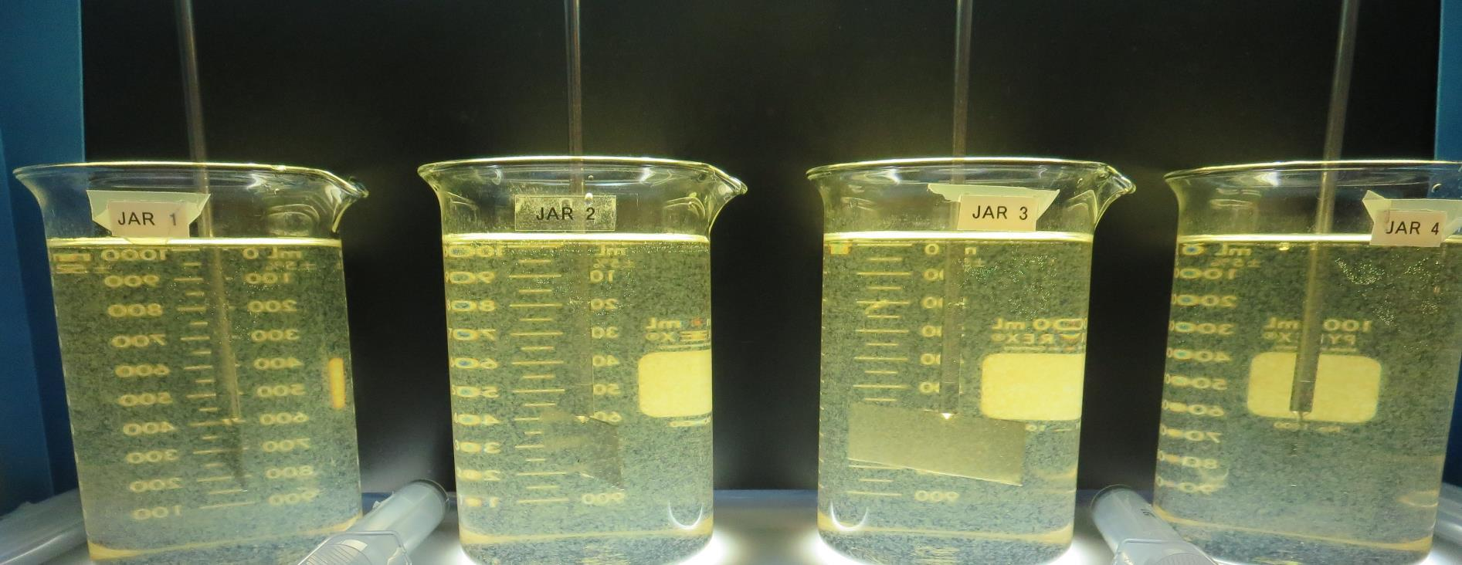
Westhaven C.S.D. CA1210024, Humboldt County, Jar Test
by Guy Schott, P.E. January 28, 2021

Slide 2
Westhaven C.S.D., January 28, 2021 Source Water Characteristics
Source: Streams
pH: 6.9 – 7.1
Alkalinity: 15 mg/L as CaCO₃
Turbidity: 2.46 NTU
UVT: 22.3%
UVA: 0.650/cm
0.4 um Filtered
Turbidity: 0.32 NTU
UVT: 23.6%
UVA: 0.626/cm
Using the P200 UVT/UVA analyzer; calibrated with organic free water.

Slide 3
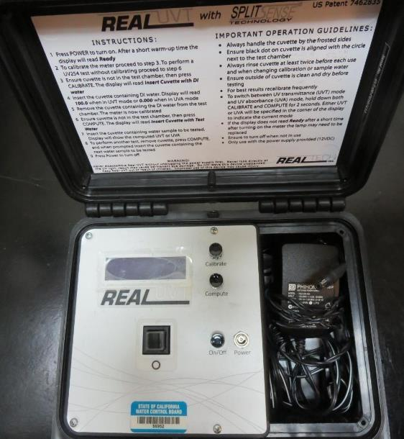
UVT/UVA, pathlength 10 mm
UV transmittance (UVT) is a measurement of the amount of ultraviolet light (commonly at 254 nm due to its germicidal effect) that passes through a water sample compared to the amount of light that passes through a pure water sample. The measurement is expressed as a percentage, % UVT.
%UVT = 10^{(-UVA)} x 100%
UV absorbance (UVA) is calculated as a relative measure of the amount of light absorbed by a water sample compared with the amount of light absorbed by a pure water sample.
UVA = -log(%UVT/100)

Slide 4
Applied Coagulants for Jar Testing (1)
BWS, Inc.
Advanced Coagulant
AdvFloc-CTC-00011
Polyaluminum Hydroxy Chlorosulfate
12.55% Al₂O₃
64.9% Basicity
SG = 1.299
Max dose: 250 mg/L as product
Gregory F. Nieckarz, Ph.D.
Principal Consultant
SWS Consulting, LLC.
+1.541.953.5112
gregn.swsc@gmail.com
NTU Technologies
Zeta Floc PA 50
50% polyamines
50% water
SG = 1.1-1.2
NSF limit: 10 mg/L as Product;
Product dose 2 mg/L = 1 mg/L polyamines active

Slide 5
Applied Coagulants for Jar Testing (2)
Pro Pac 9810 (NTU Technologies)
45-50% Aluminum Chlorohydrate
45-50% Water
~22.4% Al₂O₃
~11.9% Al
83% Basicity
5% polyamine (50% water, 50% active polyamines)
SG = 1.25-1.34
NSF limit: 200 mg/L as Product;
Product dose 40 mg/L = 1 mg/L polyamines active
7066 (Garratt Callahan)
10 – 30% Poly Aluminum Hydroxychloride Sulfate
SG = 1.2
NSF limit: 450 mg/L as Product

Slide 6
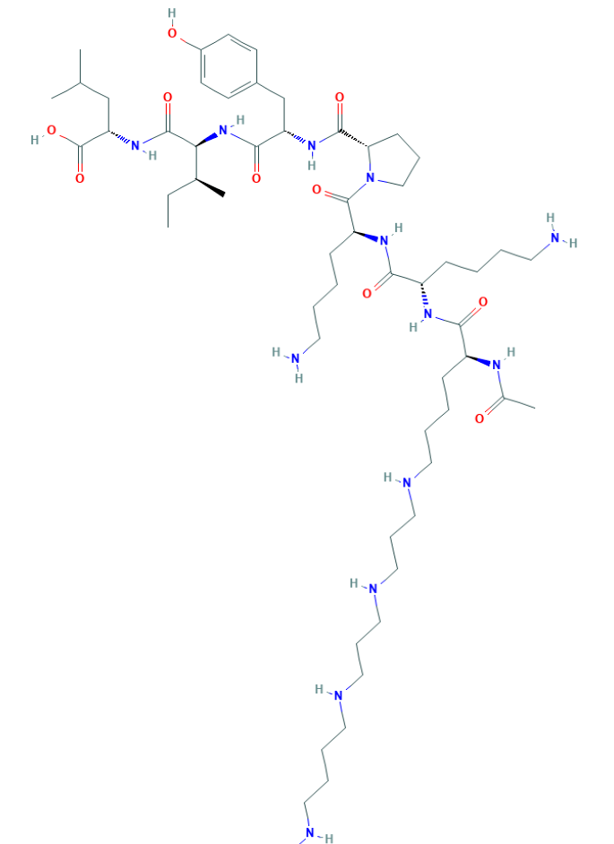
Polyamine C₅₉H₁₀₈N₁₄O₁₀ MW: 1,173.6 g/mol

Slide 7
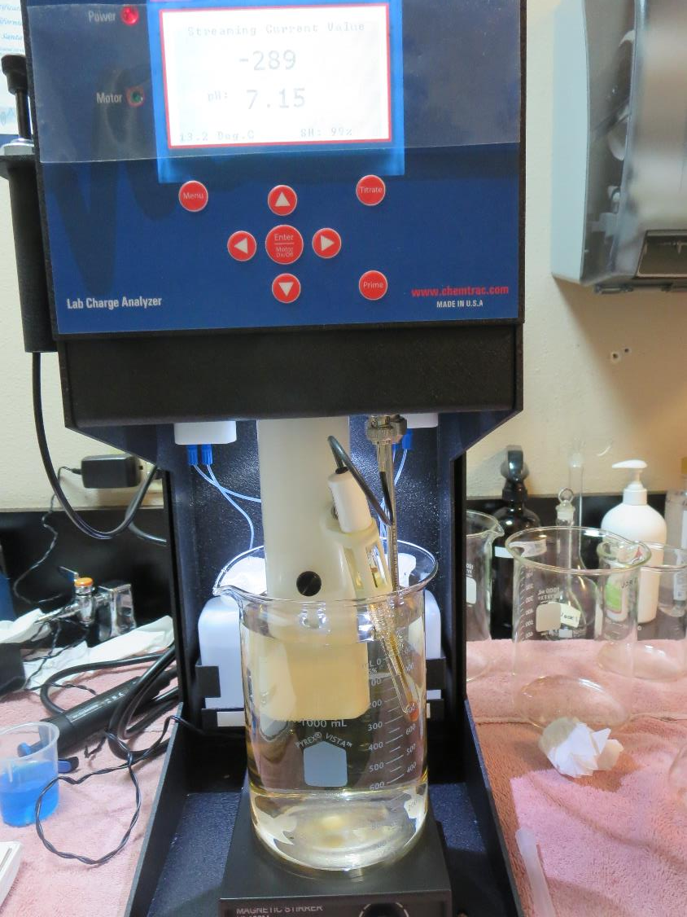
Laboratory Charge Analyzer
LCA: Used to determine coagulant demand of a source water entering the treatment plant.
LCA #1:
pH: 6.90
AdvFloc-CTC-00011:
112 mg/L as product
LCA #2:
9810: 64 mg/L as product

Slide 8
Coagulant Information
Unless stated otherwise, all coagulant doses are reported as Product (100% strength).
Preparation of coagulant stock solutions are generally 1.0 and/or 0.1 percent strength using 100 and/or 200 mL volumetric flasks.
Finnpipette F2 variable volume pipette, capacity 100-1000 micro liters is used for stock solution preparation and coagulant aid jar test dosing.
Finnpipette F2 variable volume pipette, capacity 0.5-5 mL is used for primary coagulant jar test dosing.

Slide 9
Westhaven CSD: Jar Test 1-8 Results Flash Mix 200 RPM (20 sec); Source: Stream Sources
Jar # | 20 RPM Floc Duration minutes | Adv Floc mg/L | Filtrate NTU | Filtrate %UVT | Filtrate UVA/cm | %UVA Reduction
J1 | 5 | 70 | 6.2 | 22.0 | .657 | 0
J2 | 5 | 85 | 4.7 | 35.6 | .448 | 28.4
J3 | 5 | 100 | 0.45 | 82.4 | 0.084 | 86.6
J4 | 5 | 115 | 0.59 | 84.6 | 0.072 | 88.5
J5 | 5 | 110 | 0.42 | 85.4 | 0.068 | 89.1
J6 | 5 | 120 | 0.35 | 88.0 | 0.055 | 91.2
J7 | 5 | 130 | 0.17 | 91.7 | 0.037 | 94.1
J8 | 5 | 140 | 0.34 | 89.9 | 0.045 | 92.8

Slide 10
Westhaven CSD: Jar Test 9-12 Results Flash Mix 200 RPM (20 sec); Source: Stream Sources
Jar # | 20 RPM Floc Duration minutes | 9810 mg/L | Filtrate NTU | Filtrate %UVT | Filtrate UVA/cm | %UVA Reduction
J9 | 5 | 65 | 0.13 | 90.9 | 0.041 | 93.5
J10 | 5 | 70 | 1.23 | 77.9 | 0.108 | 82.7
J11 | 5 | 75 | 1.66 | 74.4 | 0.128 | 79.6
J12 | 5 | 80 | 4.83 | 42.5 | 0.370 | 40.9

Slide 11
Westhaven CSD: Jar Test 13-20 Results Flash Mix 200 RPM (20 sec); Source: Stream Sources
Jar # | 20 RPM Floc Duration minutes | NaOH mg/L | Adv Floc mg/L | PA 50 mg/L | Filtrate NTU | Filtrate %UVT | Filtrate UVA/cm | %UVA Reduction
J13 | 5 | 0 | 130 | 0 | 0.34 | 90.0 | 0.045 | 92.8
J14 | 5 | 5 | 130 | 0 | 0.36 | 89.4 | 0.048 | 92.3
J15 | 5 | 10 | 130 | 0 | 0.34 | 90.5 | 0.043 | 93.1
J16 | 5 | 15 | 130 | 0 | 0.22 | 90.9 | 0.041 | 93.5
J17 | 5 | 20 | 130 | 1 | 0.21 | 91.9 | 0.036 | 94.2
J18 | 5 | 20 | 130 | 3 | 0.13 | 93.8 | 0.027 | 95.7
J19 | 5 | 20 | 150 | 1 | 0.19 | 93.0 | 0.031 | 95.0
J20 | 5 | 20 | 150 | 3 | 0.31 | 91.4 | 0.034 | 94.6

Slide 12
Westhaven CSD: Jar Test 21-28 Results Flash Mix 200 RPM (20 sec); Source: Stream Sources
Jar # | 20 RPM Floc Duration minutes | NaOH mg/L | 7076 mg/L | PA 50 mg/L | Filtrate NTU | Filtrate %UVT | Filtrate UVA/cm | %UVA Reduction
J21 | 5 | 30 | 180 | 0 | 0.86 | 80.7 | 0.092 | 85.3
J22 | 5 | 30 | 200 | 0 | 0.11 | 93.7 | 0.028 | 95.5
J23 | 5 | 30 | 220 | 0 | 2.55 | 68.1 | 0.166 | 73.5
J24 | 5 | 30 | 240 | 0 | 5.77 | 42.0 | 0.376 | 39.9
J25 | 5 | 30 | 200 | 0 | 0.73 | 85.0 | 0.070 | 88.8
J26 | 5 | 30 | 200 | 2 | 1.97 | 71.4 | 0.146 | 76.7
J27 | 5 | 30 | 200 | 4 | 3.45 | 56.0 | 0.251 | 59.9
J28 | 5 | 30 | 200 | 6 | 2.73 | 56.5 | 0.248 | 60.4

Slide 13
Westhaven CSD: Jar Test 29-32 Results Flash Mix 200 RPM (20 sec); Source: Stream Sources
Jar # | 20 RPM Floc Duration minutes | 7076 mg/L | Filtrate NTU | Filtrate %UVT | Filtrate UVA/cm | %UVA Reduction
J29 | 5 | 140 | 0.16 | 90.5 | 0.043 | 93.1
J30 | 5 | 150 | 0.21 | 90.5 | 0.043 | 93.1
J31 | 5 | 160 | 0.23 | 90.7 | 0.042 | 93.3
J32 | 5 | 170 | 0.45 | 86.7 | 0.061 | 90.3

Slide 14
Jars 1-4 Test Flash Mix 20 Sec (200 RPM) Floc Mix 5 min (20 RPM) Applied Coagulant AdvFloc-CTC-00011

Slide 15
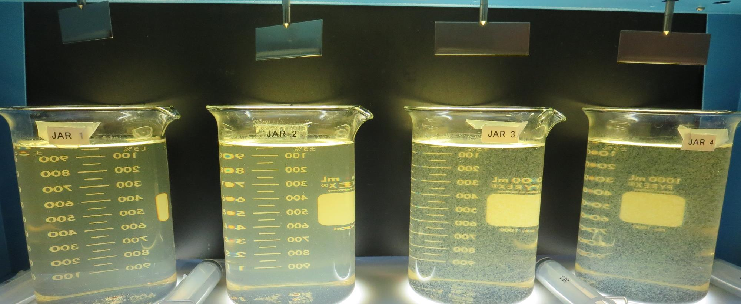
Jars 1-4: End of 5-minute flocculation (20 RPM) duration. 25 mL is syringed for filterability and %UVT/UVA.
70 mg/L Adv Floc
Filtrate 6.2 NTU
UVT: 22%
UVA: 0.657/cm
UVA Reduction: 0%
85 mg/L Adv Floc
Filtrate 4.7 NTU
UVT: 35.6%
UVA: 0.448/cm
UVA Reduction: 28.4%
100 mg/L Adv Floc
Filtrate 0.45 NTU
UVT: 35.6%
UVA: 0.084/cm
UVA Reduction: 86.6%
115 mg/L Adv Floc
Filtrate 0.59 NTU
UVT: 84.6%
UVA: 0.072/cm
UVA Reduction: 88.5%

Slide 16
Jars 5-8 Test Flash Mix 20 Sec (200 RPM) Floc Mix 5 min (20 RPM) Applied Coagulant AdvFloc-CTC-00011

Slide 17
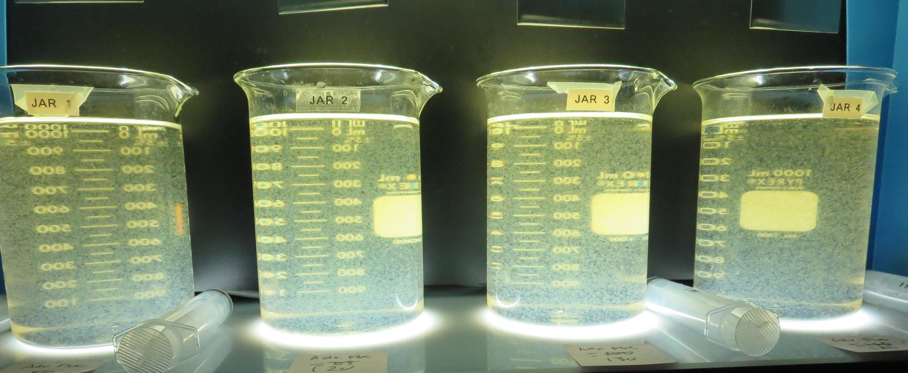
Jars 5-8: End of 5-minute flocculation (20 RPM) duration. 25 mL is syringed for filterability and %UVT/UVA.
110 mg/L Adv Floc
Filtrate 0.42 NTU
UVT: 85.4%
UVA: 0.068/cm
UVA Reduction: 89.1%
120 mg/L Adv Floc
Filtrate 0.35 NTU
UVT: 88.0%
UVA: 0.055/cm
UVA Reduction: 91.2%
130 mg/L Adv Floc
Filtrate 0.17 NTU
UVT: 91.7%
UVA: 0.037/cm
UVA Reduction: 94.1%
140 mg/L Adv Floc
Filtrate 0.34 NTU
UVT: 89.9%
UVA: 0.045/cm
UVA Reduction: 92.8%

Slide 18
Jars 9-12 Test Flash Mix 20 Sec (200 RPM) Floc Mix 5 min (20 RPM) Applied Coagulant 9810

Slide 19
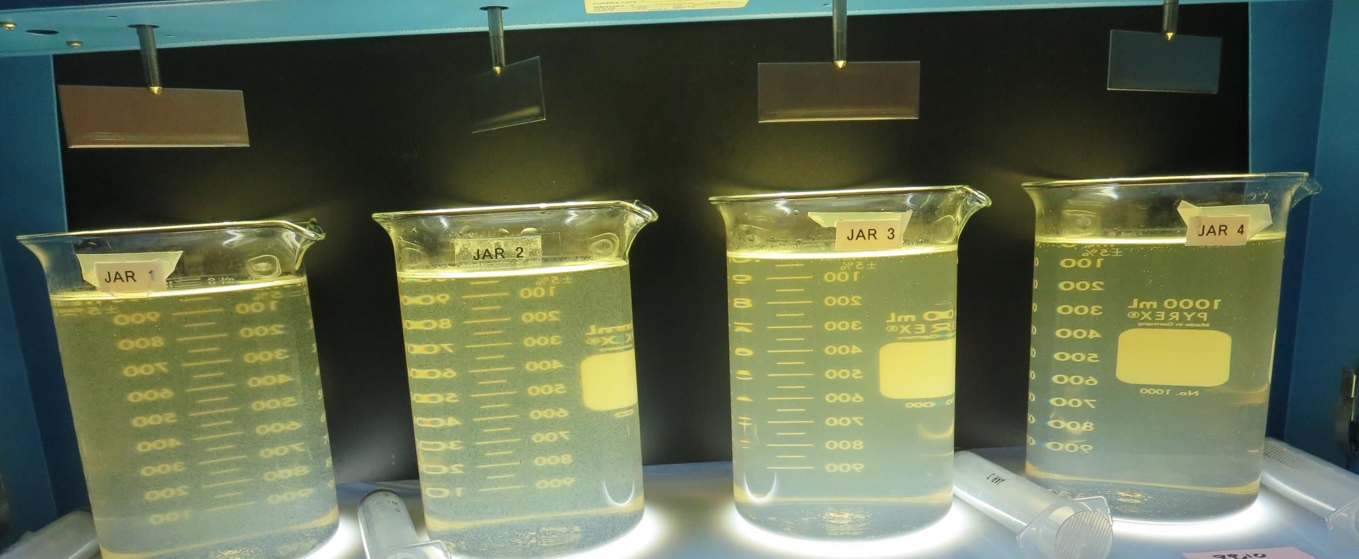
Jars 9-12: End of 5-minute flocculation (20 RPM) duration. 25 mL is syringed for filterability and %UVT/UVA.
65 mg/L 9810
Filtrate 0.13 NTU
UVT: 90.9%
UVA: 0.041/cm
UVA Reduction: 93.5%
70 mg/L 9810
Filtrate 1.23 NTU
UVT: 77.9%
UVA: 0.108/cm
UVA Reduction: 82.7%
75 mg/L 9810
Filtrate 1.66 NTU
UVT: 74.4%
UVA: 0.128/cm
UVA Reduction: 79.6%
80 mg/L 9810
Filtrate 4.83 NTU
UVT: 42.5%
UVA: 0.370/cm
UVA Reduction: 40.9%

Slide 20
Jars 13-16 Test Flash Mix 20 Sec (200 RPM) Floc Mix 5 min (20 RPM) Applied Coagulant AdvFloc-CTC-00011

Slide 21
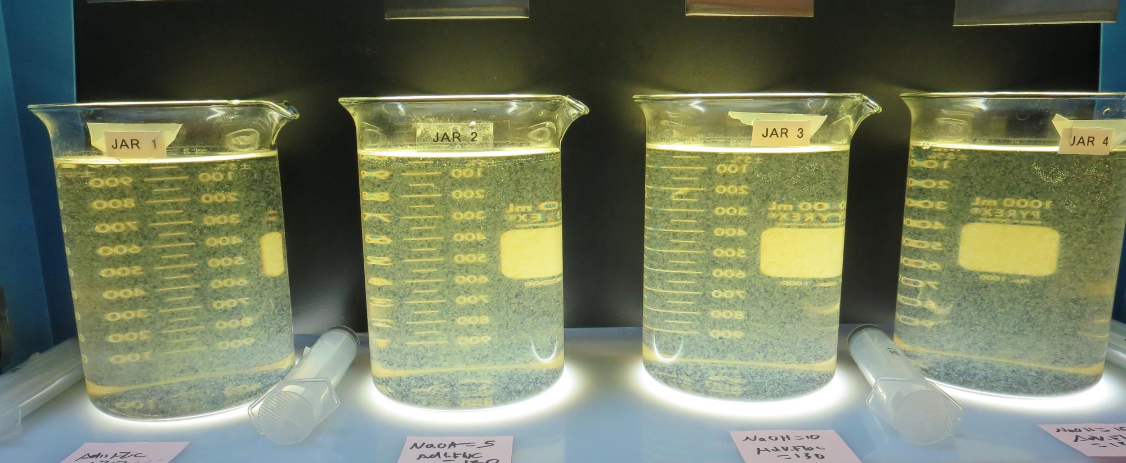
Jars 13-16: End of 5-minute flocculation (20 RPM) duration. 25 mL is syringed for filterability and %UVT/UVA.
0 mg/L NaOH
130 mg/L Adv Floc
Filtrate 0.34 NTU
UVT: 90.0%
UVA: 0.045/cm
UVA Reduction: 92.8%
5 mg/L NaOH
130 mg/L Adv Floc
Filtrate 0.36 NTU
UVT: 89.4%
UVA: 0.048/cm
UVA Reduction: 92.3%
10 mg/L NaOH
130 mg/L Adv Floc
Filtrate 0.34 NTU
UVT: 90.4%
UVA: 0.043/cm
UVA Reduction: 93.1%
15 mg/L NaOH
130 mg/L Adv Floc
Filtrate 0.22 NTU
UVT: 90.9%
UVA: 0.041/cm
UVA Reduction: 93.5%

Slide 22
Jars 17-20 Test Flash Mix 20 Sec (200 RPM) Floc Mix 5 min (20 RPM) Applied Coagulant AdvFloc-CTC-00011

Slide 23
Jars 17-20: End of 5-minute flocculation (20 RPM) duration. 25 mL is syringed for filterability and %UVT/UVA.
20 mg/L NaOH
130 mg/L Adv Floc
1 mg/L PA 50
Filtrate 0.21 NTU
UVT: 91.9%
UVA: 0.036/cm
UVA Reduction: 94.2%
20 mg/L NaOH
130 mg/L Adv Floc
3 mg/L PA 50
Filtrate 0.13 NTU
UVT: 93.8%
UVA: 0.027/cm
UVA Reduction: 95.7%
20 mg/L NaOH
150 mg/L Adv Floc
1 mg/L PA 50
Filtrate 0.19 NTU
UVT: 93.0%
UVA: 0.031/cm
UVA Reduction: 95.0%
20 mg/L NaOH
150 mg/L Adv Floc
3 mg/L PA 50
Filtrate 0.31 NTU
UVT: 92.4%
UVA: 0.034/cm
UVA Reduction: 94.6%

Slide 24
Jars 21-24 Test Flash Mix 20 Sec (200 RPM) Floc Mix 5 min (20 RPM) Applied Coagulant 7066

Slide 25
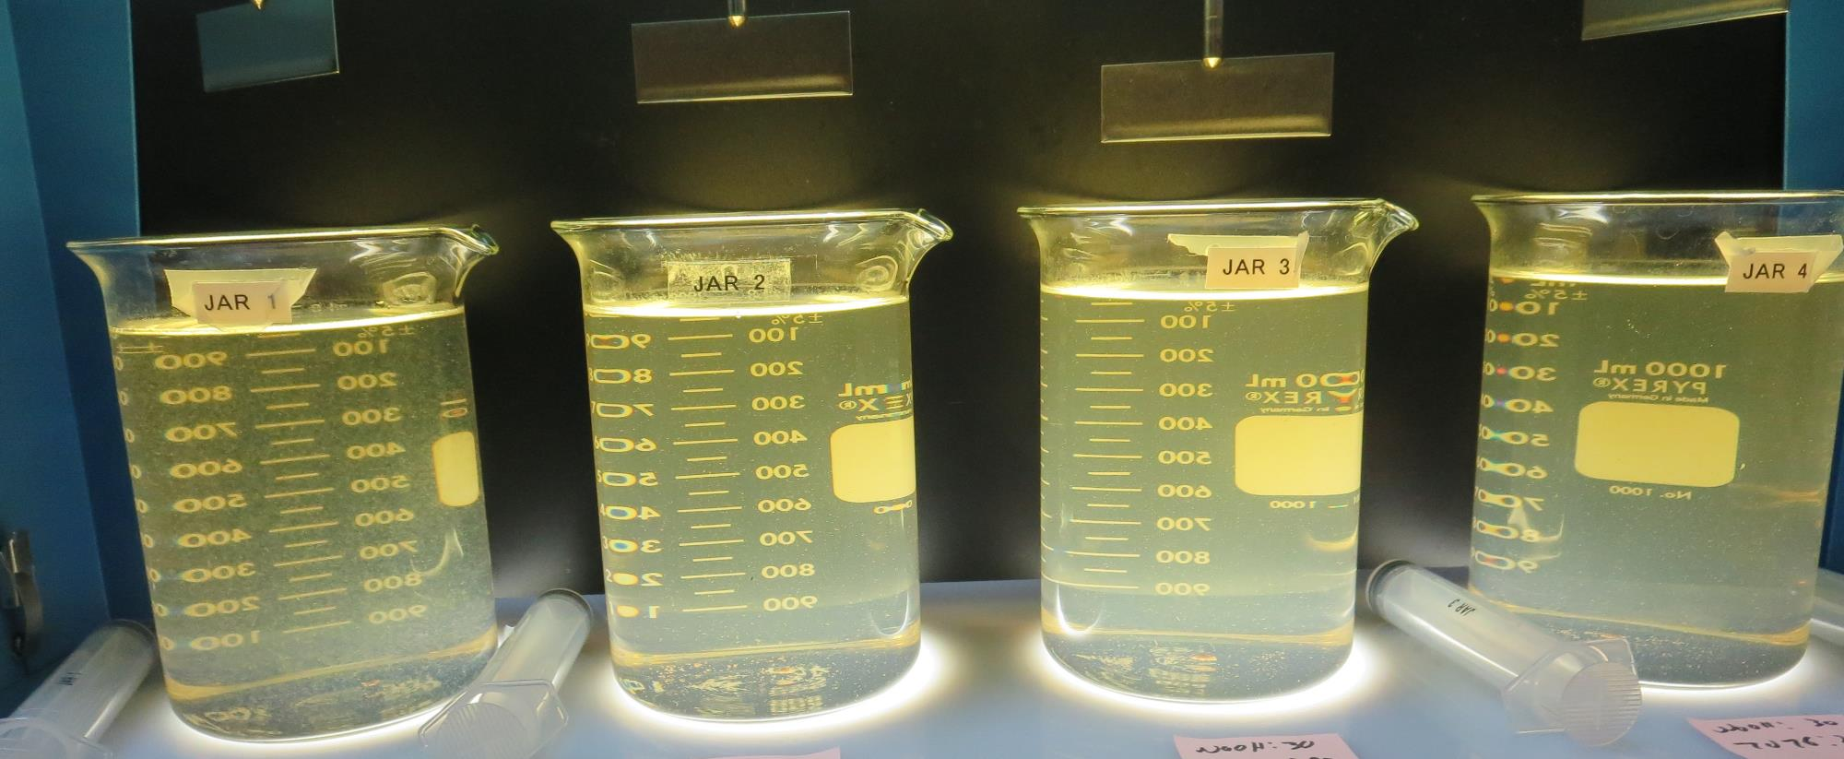
Jars 21-24: End of 5-minute flocculation (20 RPM) duration. 25 mL is syringed for filterability and %UVT/UVA.
30 mg/L NaOH
180 mg/L 7076
Filtrate 0.86 NTU
UVT: 80.7%
UVA: 0.092/cm
UVA Reduction: 85.3%
30 mg/L NaOH
200 mg/L 7066
Filtrate 0.11 NTU
UVT: 93.7%
UVA: 0.028/cm
UVA Reduction: 95.5%
30 mg/L NaOH
220 mg/L 7076
Filtrate 2.55 NTU
UVT: 68.1%
UVA: 0.166/cm
UVA Reduction: 73.5%
30 mg/L NaOH
240 mg/L 7076
Filtrate 5.77 NTU
UVT: 42.0%
UVA: 0.376/cm
UVA Reduction: 39.9%

Slide 26
Jars 25-28 Test Flash Mix 20 Sec (200 RPM) Floc Mix 5 min (20 RPM) Applied Coagulant 7066

Slide 27
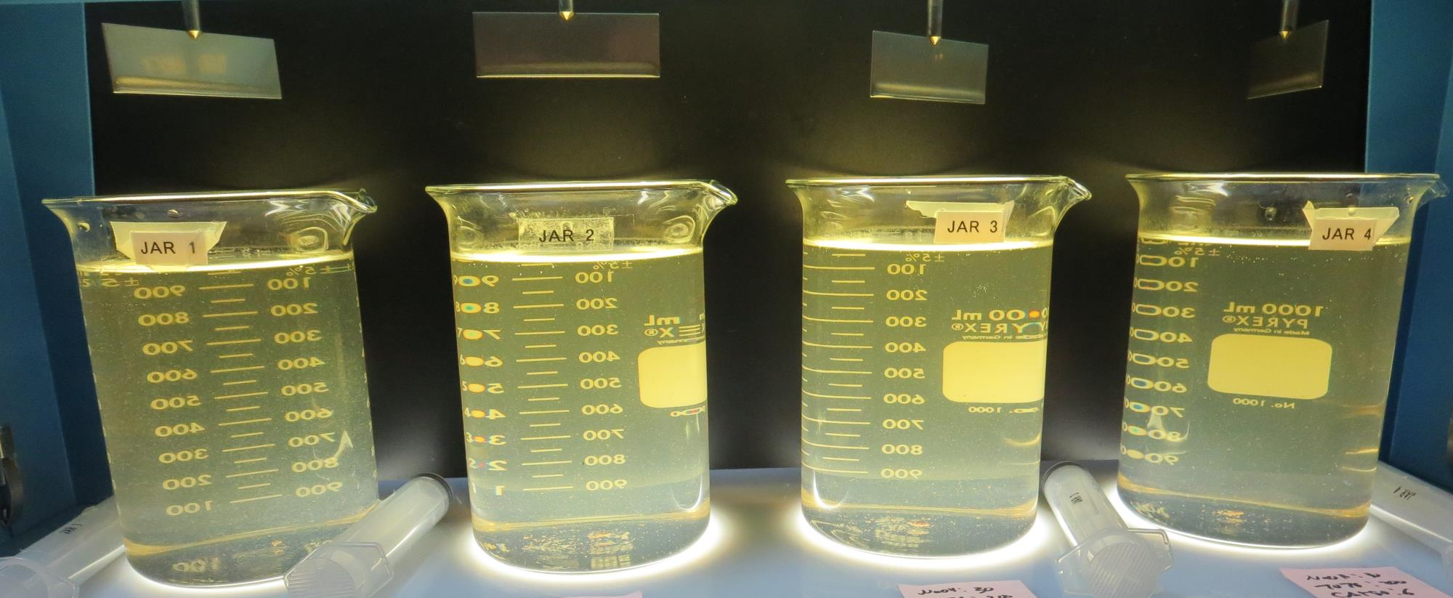
Jars 25-28: End of 5-minute flocculation (20 RPM) duration. 25 mL is syringed for filterability and %UVT/UVA.
30 mg/L NaOH
200 mg/L 7076
0 mg/L PA 50
Filtrate 0.73 NTU
UVT: 85.0%
UVA: 0.070/cm
UVA Reduction: 88.8%
30 mg/L NaOH
200 mg/L 7066
2 mg/L PA 50
Filtrate 1.97 NTU
UVT: 71.4%
UVA: 0.146/cm
UVA Reduction: 76.7%
30 mg/L NaOH
220 mg/L 7076
4 mg/L PA 50
Filtrate 3.45 NTU
UVT: 56.0%
UVA: 0.251/cm
UVA Reduction: 59.9%
30 mg/L NaOH
240 mg/L 7076
6 mg/L PA 50
Filtrate 2.73 NTU
UVT: 56.5%
UVA: 0.248/cm
UVA Reduction: 60.4%

Slide 28
Jars 29-32 Test Flash Mix 20 Sec (200 RPM) Floc Mix 5 min (20 RPM) Applied Coagulant 7066

Slide 29
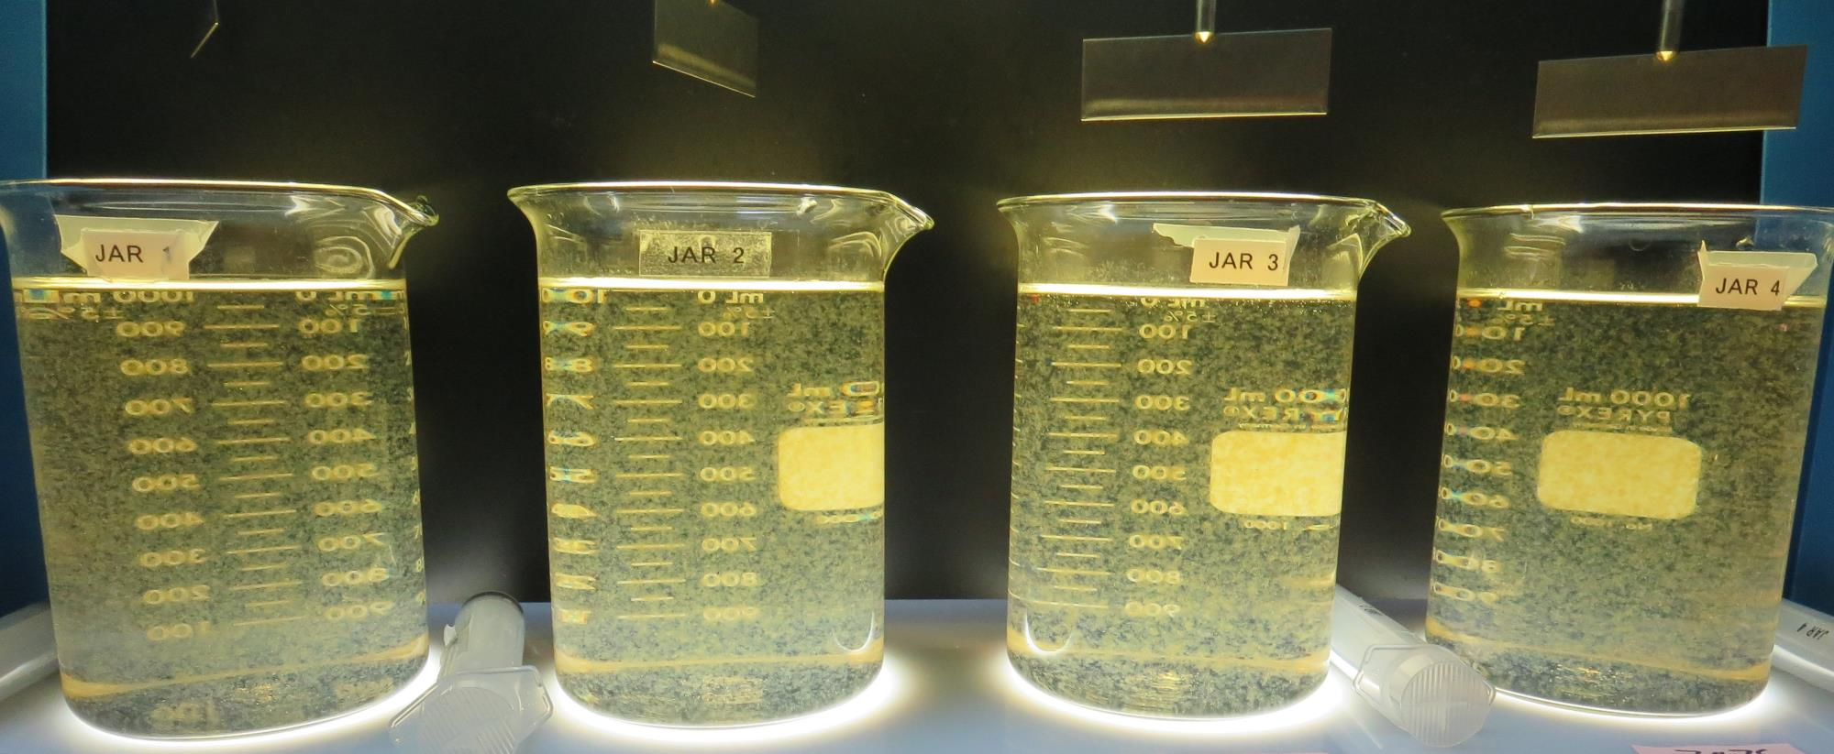
Jars 29-32: End of 5-minute flocculation (20 RPM) duration. 25 mL is syringed for filterability and %UVT/UVA.
140 mg/L 7076
Filtrate 0.16 NTU
UVT: 90.5%
UVA: 0.043/cm
UVA Reduction: 93.1%
150 mg/L 7076
Filtrate 0.21 NTU
UVT: 90.5%
UVA: 0.043/cm
UVA Reduction: 93.1%
160 mg/L 7076
Filtrate 0.23 NTU
UVT: 90.7%
UVA: 0.042/cm
UVA Reduction: 93.3%
170 mg/L 7076
Filtrate 0.45 NTU
UVT: 86.7%
UVA: 0.061/cm
UVA Reduction: 90.3%

Slide 30
Jar Testing for 1-Liter Jars: Procedures for Most Treatment Plants
Fill jars with source water prior to coagulant injection and set paddle speed at 30 rpm
Add chemicals (i.e., NaOCl, primary coagulant, coagulant aid) to each jar
Flash mix for 15-30 seconds (200 rpm)
Slow mix for 5 minutes (20-30 rpm)
Settled for 5 minutes. Syringe 25 mL from each jar taken 1-inch below surface (25 mL/12 sec rate). For this study, 25 mL was taken at end of floc period.
Filtered through 1.2 um isopore membrane into cuvette drip rate, 15 mL/(50-90 sec)
Measure filtrate turbidity, chlorine residual and %UVT/UVA
Measure settled water turbidity after 25 minutes of total setting
Record all data

Slide 31
Jar Test Filterability Test Equipment
Turbidity Instrument
Syringe w/Luer-Lock Tip, 30 cc
(part#: 2225800, by Hach)
Swinnex Filter Holder, 25 mm (part#: SX0002500)
Isopore Membrane Filter, 1.2 um absolute
pore size,
Φ= 25 mm , thickness: 24 um,
hydrophilic polycarbonate membrane
(part #: RTTP02500)
Go to Sigma-Aldrich for laboratory supplies http://www.sigmaaldrich.com/united-states.html

Slide 32
Isopore Membrane Information
Categories | Information
trade name | Isopore
filter color | White
chemistry | Polycarbonate (PC)
water flow rate | Avg. 175 mL/min x cm² (typical results @ 10 psi)
media | Isopore®
wettability | Hydrophilic
porosity | 14.7%
pore size | 1.2 µm
bubble point at 23 °C | 1.0 bar, air with water
thickness | 24 µm
filter diameter (ø) | 25 mm
material size | polycarbonate, Hydrophilic, 1.2 µm, 25 mm, white, plain, 100

Slide 33
Isopore Membrane Background Information
The Isopore membrane is a polycarbonate, track-etched screen filter recommended for all analyses in which the sample is viewed on the surface of the membrane. The Isopore membrane is composed of polycarbonate film, which has a smooth, glass-like surface for clearer sample observation. The unique manufacturing process of the membrane ensures a precise pore diameter and a consistent pore size for accurate separation of samples by size. Matched-weight filters are not usually required because of low, constant tar and ash weights. Features & Benefits: Membrane structure retains particles on the surface, simplifying counting and analysis

Slide 34
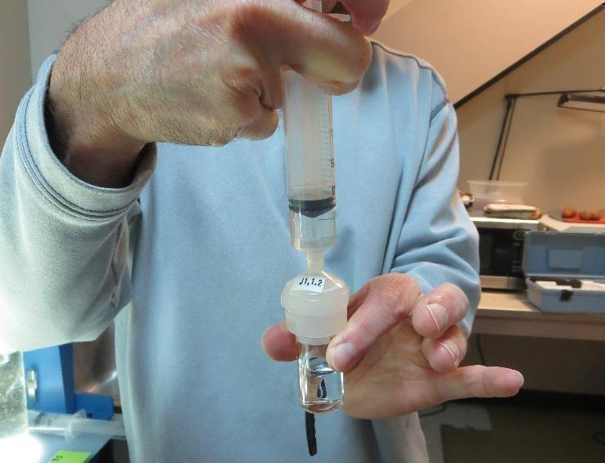
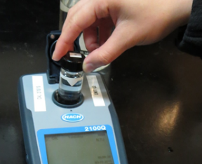
Jar Test - Filterability Test
Syringe ~ 25 mL from jar (after 5-minutes of settling)
Filter-to-waste 3-5 mL
Filter directly into clean cuvette
Measure turbidity
Note: Take several readings before recording final NTU results. Micro bubbles can adhere to glass causing false NTU readings. To remove bubbles, tilt cuvette up to 90 degrees.

Slide 35
Contact
Guy Schott, P.E.
State Water Resources Control Board
Division of Drinking Water
Santa Rosa, CA
Go to Stock Solution/Dose calculations/Jar Test Results for tools to download
www.waterboards.ca.gov/drinking_water/programs/districts/mendocino_district.html
Email: Guy Schott - Guy.Schott@waterboards.ca.gov
Office Number: 707-576-2732

