Slide 1
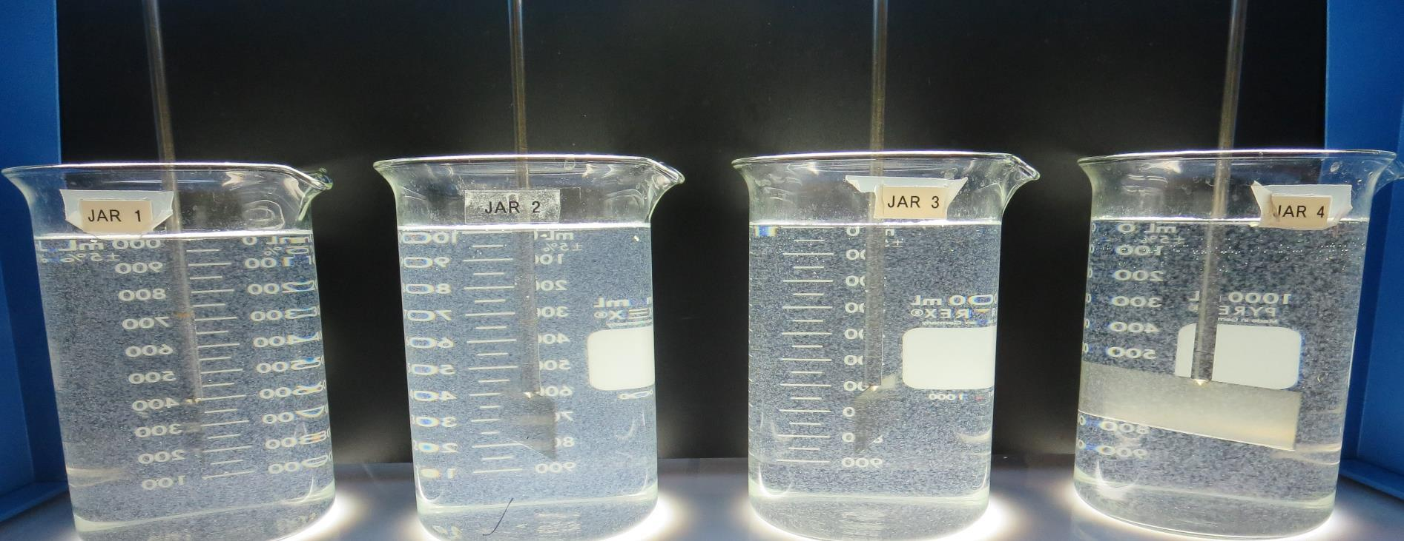
El Centro, City of CA1310004 Imperial County Jar Test
by Guy Schott, P.E.
January 12, 2021

Slide 2
El Centro WTP Source: South Date – Gate 20B

Slide 3
El Centro WTP Water Characteristics January 12, 2021
Source
pH: 8.16 – 8.22
Alkalinity: 142 mg/L as CaCO₃
Turbidity: 3.4 NTU
UVT: 87.1%,
UVA: 0.059/cm
0.4 um Filtered
Turbidity: 0.20 NTU
UVT: 89.4%,
UVA: 0.048/cm
Plant Coagulant Dose:
Alum: 26 mg/L
308P: 2.5 mg/L
Post Filter, before Cl₂ additon:
0.07 NTU
UVT: 94.1%,
UVA: 0.026/cm
UVA Reduction: 45.8%
Clearwell:
0.08 NTU
UVT: 94.0%,
UVA: 0.026/cm
UVA Reduction: 45.8%

Slide 4
Source Water Dose with 2.0 mg/L NaOCl
Time, minutes | %UVT | UVA/cm | %UVA Reduction | Cl₂, mg/L
0 | 87.1 | 0.059 | - | 0
11 | 87.9 | 0.056 | 5.1 | 1.04
22 | 88.3 | 0.053 | 10.2 | 1.00
33 | 88.4 | 0.053 | 10.2 | 0.95
42 | 88.5 | 0.053 | 10.2 | 0.89

Slide 5
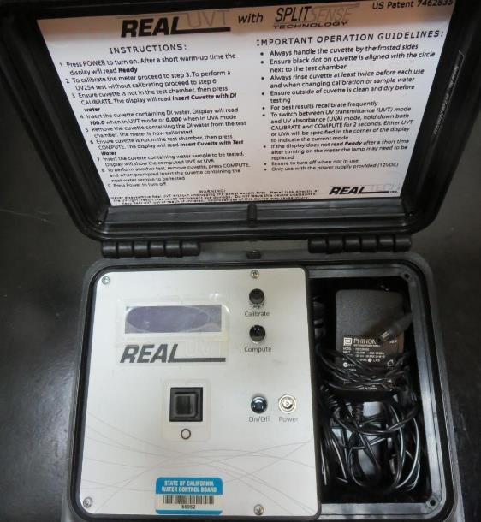
UVT/UVA, pathlength 10 mm
UV transmittance (UVT) is a measurement of the amount of ultraviolet light (commonly at 254 nm due to its germicidal effect) that passes through a water sample compared to the amount of light that passes through a pure water sample. The measurement is expressed as a percentage, % UVT.
%UVT = 10^{(-UVA)} x 100%
UV absorbance (UVA) is calculated as a relative measure of the amount of light absorbed by a water sample compared with the amount of light absorbed by a pure water sample.
UVA = -log(%UVT/100)

Slide 6
Applied Coagulants for Jar Testing (1)
Aluminum Sulfate (Product)
Al₂(SO₄)₃*14.3H₂0 (diluted)
48% Aluminum Sulfate
52% Water
8.2% Al₂O₃
0% Basicity
SG = 1.32
NSF limit: 400 mg/L (product)
As hydrated Al₂(SO₄)₃*14.3H₂0
17% Al₂O₃
Polydyne Incorporated
Clarifloc C-308P
SG = 1.0 – 1.2
pDADMAC (20% active, 80% H₂O)
NSF limit: 50 mg/L (product)
Product dose 5 mg/L = 1 mg/L pDADMAC active

Slide 7
Applied Coagulants for Jar Testing (2)
BWS, Inc.
AdvFloc-CTC-00011
Polyaluminum Hydroxy Chlorosulfate
12.55% Al₂O₃
64.9% Basicity
SG = 1.299
NSF limit: 250 mg/L as Product
Pro Pac 9890 (NTU Technologies)
35-45% Aluminum Chlorohydrate
35-45% Water
20% polyamine (50% water, 50% active polyamines)
SG = 1.25-1.34
NSF limit: 50 mg/L as Product;
Product dose 20 mg/L = 2 mg/L polyamines active

Slide 8
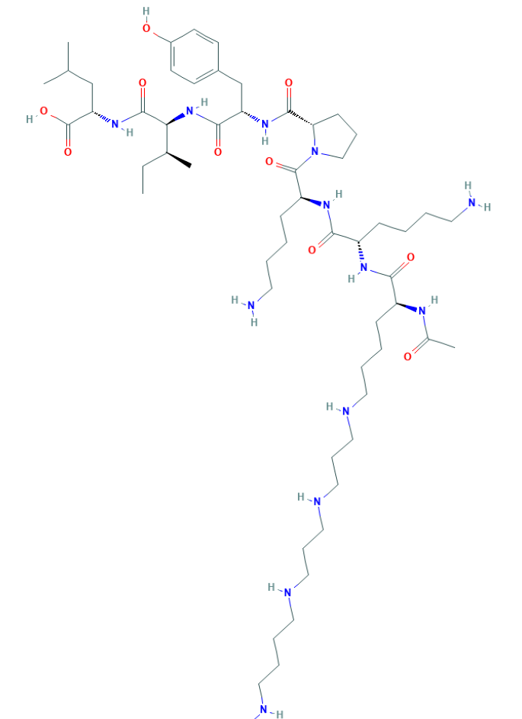
Polyamine C₅₉H₁₀₈N₁₄O₁₀ MW: 1,173.6 g/mol

Slide 9
Diallyldimethylammonium chloride or N-allyl-N,N-dimethylprop-2-en-1-aminium chloride pDADMAC C₈H₁₆ClN MW: 161.67 g/mol
CH₃
CH₂
CH₂
CH
N
+
CH
CH₂
CH₂
CH₃
Cl⁻

Slide 10
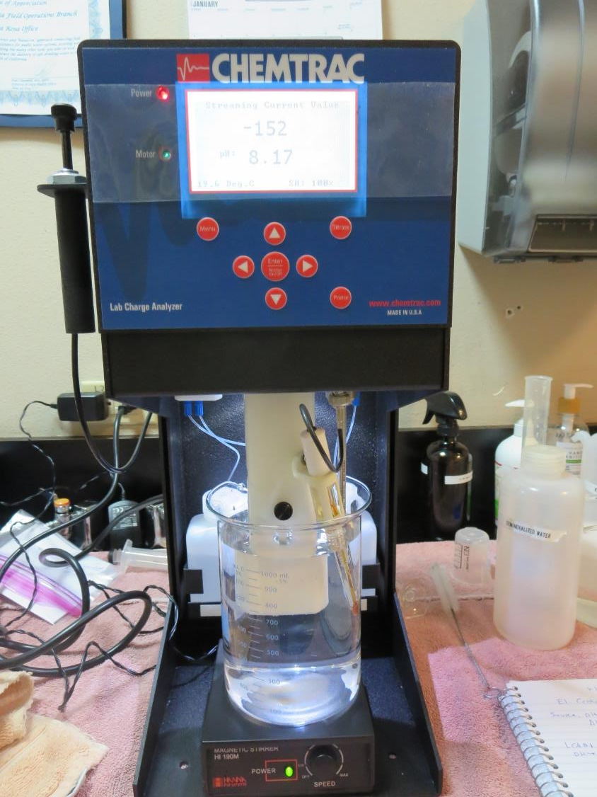
Laboratory Charge Analyzer
LCA: Used to determine coagulant demand of a source water entering the treatment plant.
Source pH: 8.17
LCA #1: Alum: 62 mg/L as dry alum
pH adjusted to 6.6 with acetic acid
LCA #1: 9800: 45 mg/L as product
pH adjusted to 7.5 with acetic acid
LCA #3:
AdvFloc CTC-00011: 220 mg/L
pH adjusted to 7.5 with acetic acid

Slide 11
Coagulant Information
Unless stated otherwise, all coagulant doses are reported as Product (100% strength).
Aluminum Sulfate doses are reported as hydrated Al₂(SO₄)₃*14.3H₂0.
Preparation of coagulant stock solutions are generally 1.0 and/or 0.1 percent strength using 100 and/or 200 mL volumetric flasks.
Finnpipette F2 variable volume pipette, capacity 100-1000 micro liters is used for stock solution preparation and coagulant aid jar test dosing.
Finnpipette F2 variable volume pipette, capacity 0.5-5 mL is used for primary coagulant jar test dosing.

Slide 12
El Centro WTP, Jar Test 1 - 8 Results Flash Mix 200 RPM (30 sec); Floc Mix 30 RPM (5 min)
Jar# | Alum mg/L | C-308P mg/L | CTC-11 mg/L | Filtrate NTU | Filtrate %UVT | Filtrate UVA/cm | %UVA Reduction | Settle NTU 25 min
J1 | 26 | 2.5 | 0 | 0.12 | 91.4 | 0.038 | 20.8 | 2.24
J2 | 32 | 3.2 | 0 | 0.15 | 91.6 | 0.037 | 22.9 | 2.25
J3 | 38 | 3.8 | 0 | 0.16 | 92.3 | 0.034 | 29.9 | 1.83
J4 | 45 | 4.5 | 0 | 0.12 | 92.1 | 0.035 | 27.1 | 1.45
J5 | 51 | 5.1 | 0 | 0.16 | 92.6 | 0.033 | 31.3 | 1.03
J6 | 57 | 5.7 | 0 | 0.13 | 92.8 | 0.032 | 33.3 | 1.56
J7 | 63 | 6.3 | 0 | 0.10 | 93.0 | 0.031 | 35.4 | 1.29
J8 | 0 | 0 | 220 | 0.09 | 94.2 | 0.025 | 47.9 | 0.56

Slide 13
El Centro WTP, Jar Test 9 - 16 Results Flash Mix 200 RPM (30 sec); Floc Mix 30 RPM (5 min)
Jar# | NaOCl mg/L | 9800 mg/L | C-308P mg/L | 9890 mg/L | Filtrate NTU | Filtrate %UVT | Filtrate UVA/cm | %UVA Reduct | Settle NTU 25 min
J9 | 0 | 35 | 0 | 0 | 0.29 | 92.2 | 0.035 | 27.1 | 2.07
J10 | 0 | 40 | 0 | 0 | 0.24 | 92.4 | 0.034 | 29.2 | 1.62
J11 | 0 | 45 | 0 | 0 | 0.26 | 92.6 | 0.033 | 31.3 | 1.64
J12 | 0 | 50 | 0 | 0 | 0.32 | 92.4 | 0.034 | 29.2 | 1.83
J13 | 2.0 | 45 | 0 | 0 | 0.13 | 93.3 | 0.029 | 39.6 | 1.61
J14 | 2.0 | 45 | 1.0 | 0 | 0.14 | 93.4 | 0.029 | 39.6 | 1.75
J15 | 0 | 0 | 0 | 45 | 0.27 | 92.7 | 0.032 | 33.3 | 2.02
J16 | 2.0 | 0 | 0 | 45 | 0.19 | 93.7 | 0.028 | 41.7 | 1.68

Slide 14
El Centro WTP, Jar Test 9 - 16 Results Flash Mix 200 RPM (30 sec); Floc Mix 30 RPM (5 min) 2.0 mg/L NaOCl added to Jars 17-20.
Jar# | 9800 mg/L | C-308P mg/L | 9890 mg/L | Adv. Floc mg/L | Filtrate NTU | Filtrate %UVT | Filtrate UVA/cm | %UVA Reduct | Settle NTU 25 min
J17 | 50 | 0 | 0 | 0 | 0.14 | 93.5 | 0.029 | 39.6 | 1.26
J18 | 50 | 2.0 | 0 | 0 | 0.14 | 93.8 | 0.027 | 43.8 | 1.27
J19 | 0 | 0 | 50 | 0 | 0.10 | 93.7 | 0.027 | 43.8 | 1.48
J20 | 0 | 0 | 0 | 160 | 0.12 | 93.8 | 0.027 | 43.8 | -

Slide 15
Jars 1-4 Test Flash Mix 30 Sec (200 RPM) Floc Mix 5 min (30 RPM) Applied Coagulants Alum/C-308P

Slide 16
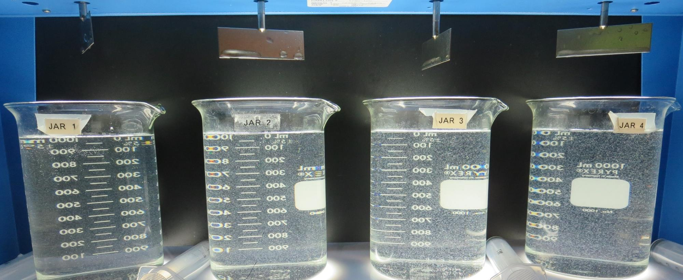
Jars 1-4: End of 5-minute flocculation (30 RPM) duration.
26 mg/L Alum
2.5 mg/L C-308P
Filtrate 0.12 NTU
UVT: 91.4%
UVA: 0.038/cm
UVA Reduction 20.8%
Settled: 2.24 NTU
32 mg/L Alum
3.2 mg/L C-308P
Filtrate 0.15 NTU
UVT: 91.6%
UVA: 0.037/cm
UVA Reduction 22.9%
Settled: 2.25 NTU
38 mg/L Alum
3.8 mg/L C-308P
Filtrate 0.16 NTU
UVT: 92.3%
UVA: 0.034/cm
UVA Reduction 29.2%
Settled: 1.83 NTU
45 mg/L Alum
4.5 mg/L C-308P
Filtrate 0.12 NTU
UVT: 92.1%
UVA: 0.035/cm
UVA Reduction 27.1%
Settled: 1.45 NTU

Slide 17
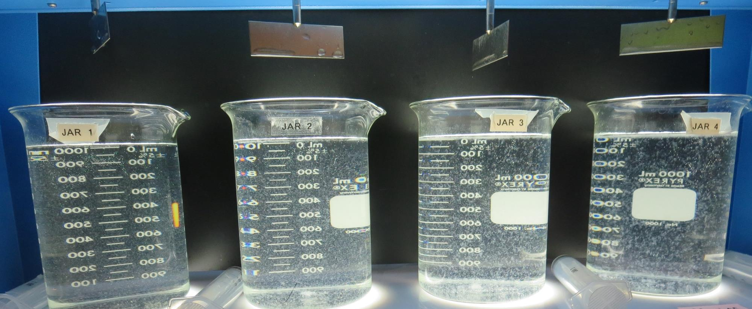
Jars 1-4: After 5 min of settling, 25 mL is syringed for filterability and %UVT/UVA.

Slide 18
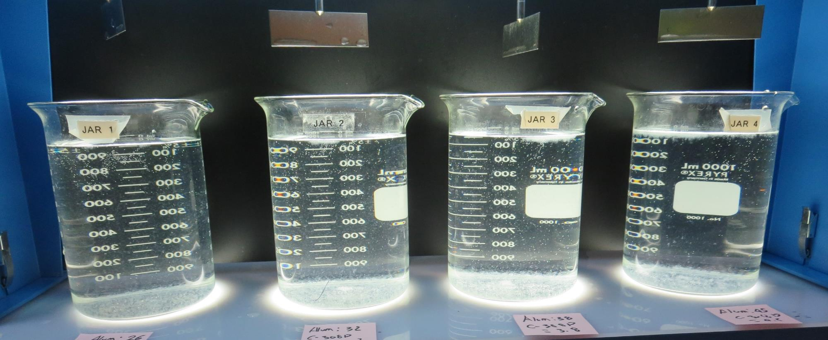
Jars 1-4: After 25-minutes of settling, settled water turbidity is taken.
26 mg/L Alum
2.5 mg/L C-308P
Filtrate 0.12 NTU
UVT: 91.4%
UVA: 0.038/cm
UVA Reduction 20.8%
Settled: 2.24 NTU
32 mg/L Alum
3.2 mg/L C-308P
Filtrate 0.15 NTU
UVT: 91.6%
UVA: 0.037/cm
UVA Reduction 22.9%
Settled: 2.25 NTU
38 mg/L Alum
3.8 mg/L C-308P
Filtrate 0.16 NTU
UVT: 92.3%
UVA: 0.034/cm
UVA Reduction 29.2%
Settled: 1.83 NTU
45 mg/L Alum
4.5 mg/L C-308P
Filtrate 0.12 NTU
UVT: 92.1%
UVA: 0.035/cm
UVA Reduction 27.1%
Settled: 1.45 NTU

Slide 19
Jars 5-8 Test Flash Mix 30 Sec (200 RPM) Floc Mix 5 min (30 RPM) Applied Coagulants Alum/C-308P/CTC-11

Slide 20
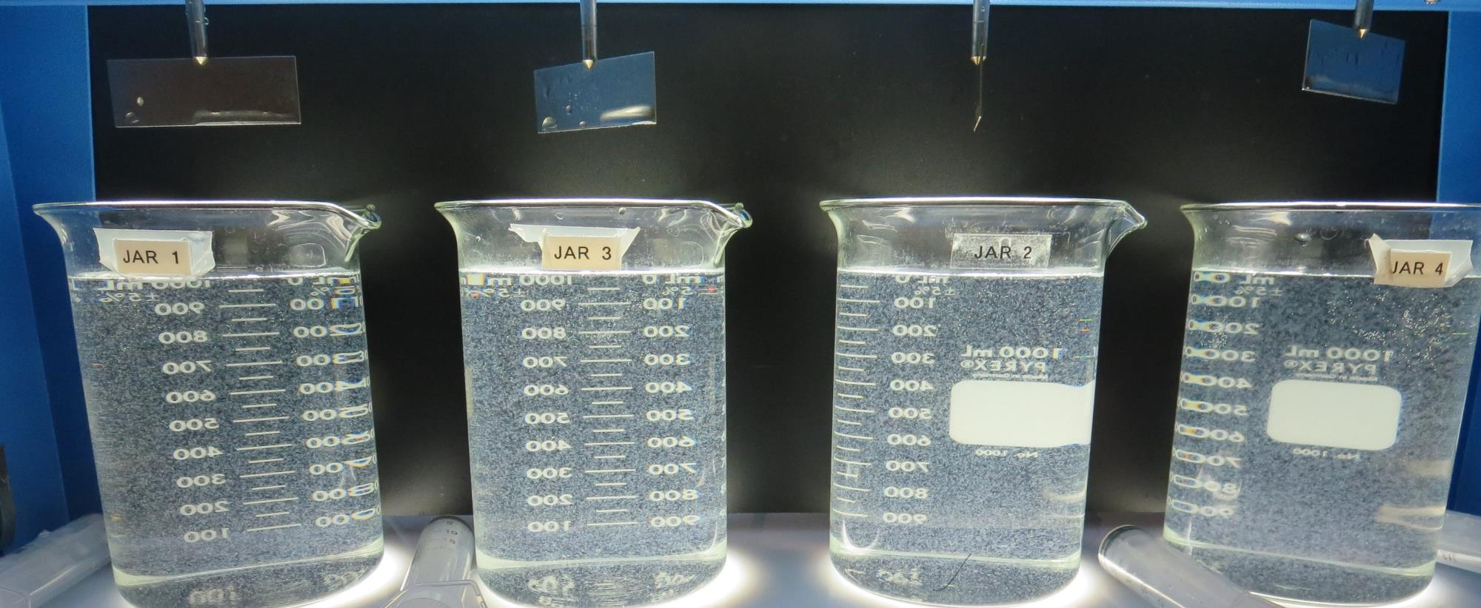
Jars 5-8: End of 5-minute flocculation (30 RPM) duration.
51 mg/L Alum
5.1 mg/L C-308P
Filtrate 0.16 NTU
UVT: 92.6%
UVA: 0.033/cm
UVA Reduction 31.3%
Settled: 1.03 NTU
57 mg/L Alum
5.7 mg/L C-308P
Filtrate 0.13 NTU
UVT: 92.8%
UVA: 0.032/cm
UVA Reduction 33.3%
Settled: 1.56 NTU
63 mg/L Alum
6.3 mg/L C-308P
Filtrate 0.10 NTU
UVT: 93.0%
UVA: 0.031/cm
UVA Reduction 35.4%
Settled: 1.29 NTU
220 mg/L CTC-11
Filtrate 0.09 NTU
UVT: 94.2%
UVA: 0.025/cm
UVA Reduction 47.9%
Settled: 0.56 NTU

Slide 21
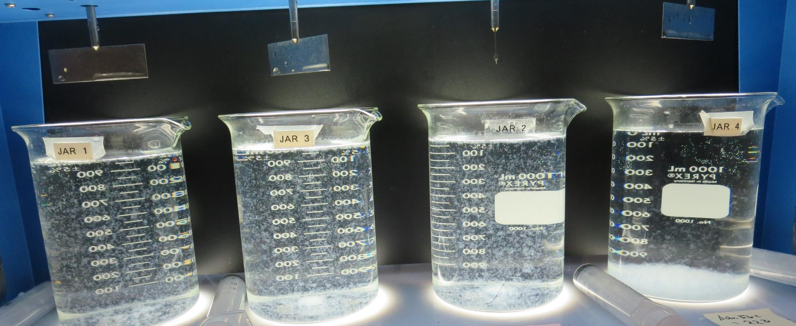
Jars 5-8: After 5 min of settling, 25 mL is syringed for filterability and %UVT/UVA.

Slide 22
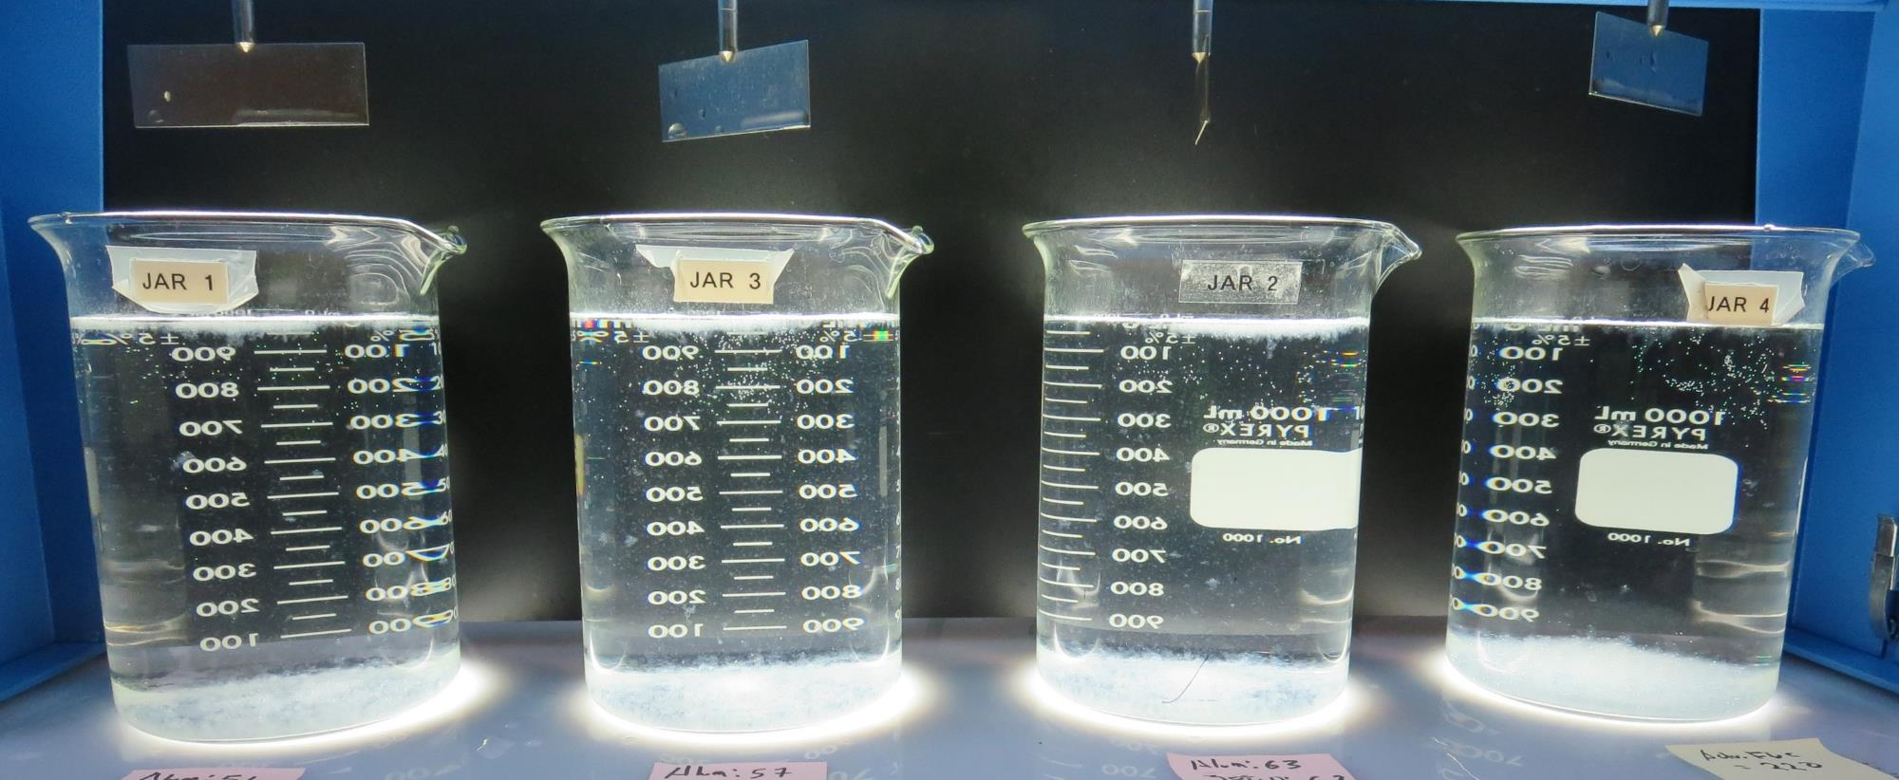
Jars 5-8: After 25-minutes of settling, settled water turbidity is taken.
51 mg/L Alum
5.1 mg/L C-308P
Filtrate 0.16 NTU
UVT: 92.6%
UVA: 0.033/cm
UVA Reduction 31.3%
Settled: 1.03 NTU
57 mg/L Alum
5.7 mg/L C-308P
Filtrate 0.13 NTU
UVT: 92.8%
UVA: 0.032/cm
UVA Reduction 33.3%
Settled: 1.56 NTU
63 mg/L Alum
6.3 mg/L C-308P
Filtrate 0.10 NTU
UVT: 93.0%
UVA: 0.031/cm
UVA Reduction 35.4%
Settled: 1.29 NTU
220 mg/L CTC-11
Filtrate 0.09 NTU
UVT: 94.2%
UVA: 0.025/cm
UVA Reduction 47.9%
Settled: 0.56 NTU

Slide 23
Jars 9-12 Test Flash Mix 30 Sec (200 RPM) Floc Mix 5 min (30 RPM) Applied Coagulant 9800

Slide 24
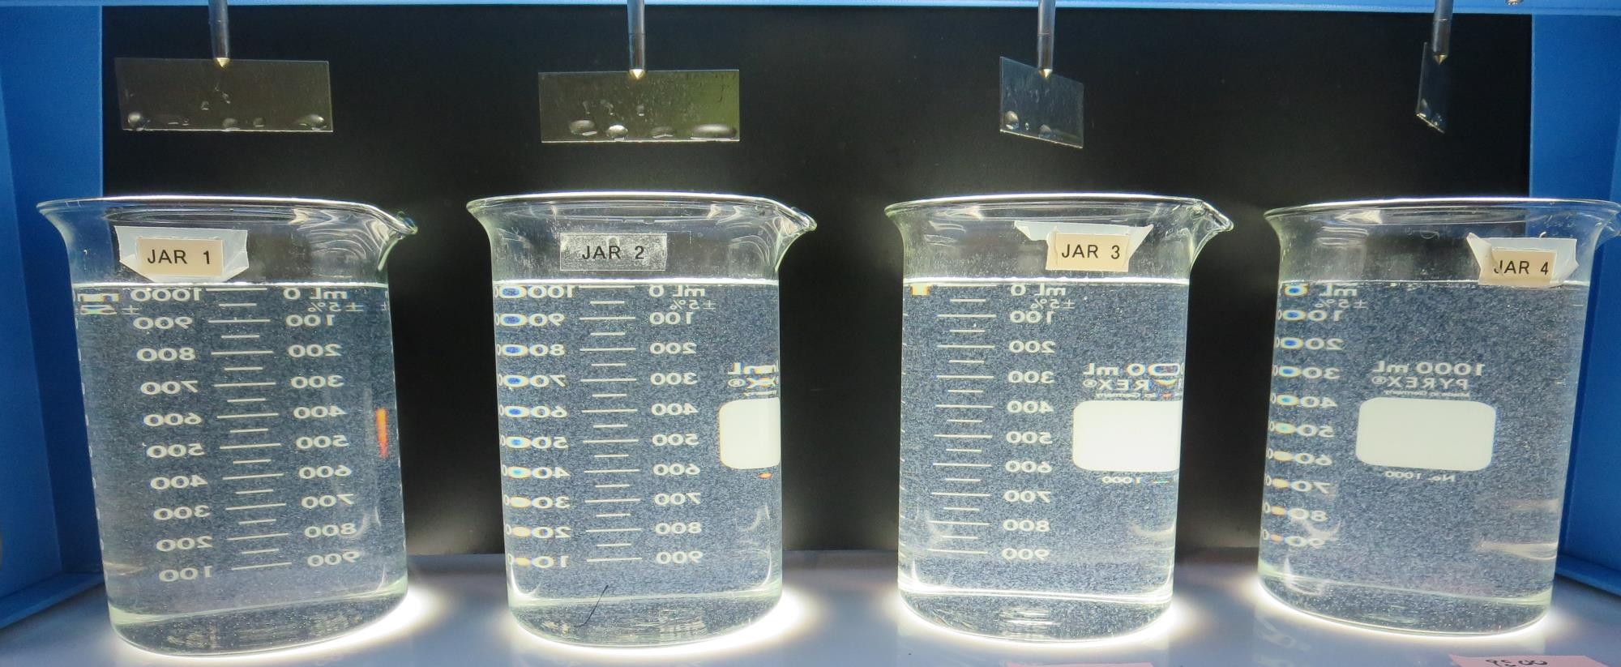
Jars 9-12: End of 5-minute flocculation (30 RPM) duration.
35 mg/L 9800
Filtrate 0.29 NTU
UVT: 92.2%
UVA: 0.035/cm
UVA Reduction 27.1%
Settled: 2.07 NTU
40 mg/L 9800
Filtrate 0.24 NTU
UVT: 92.4%
UVA: 0.035/cm
UVA Reduction 29.2%
Settled: 1.62 NTU
45 mg/L 9800
Filtrate 0.26 NTU
UVT: 92.6%
UVA: 0.033/cm
UVA Reduction 31.3%
Settled: 1.64 NTU
50 mg/L 9800
Filtrate 0.32 NTU
UVT: 92.4%
UVA: 0.034/cm
UVA Reduction 29.2%
Settled: 1.83 NTU

Slide 25
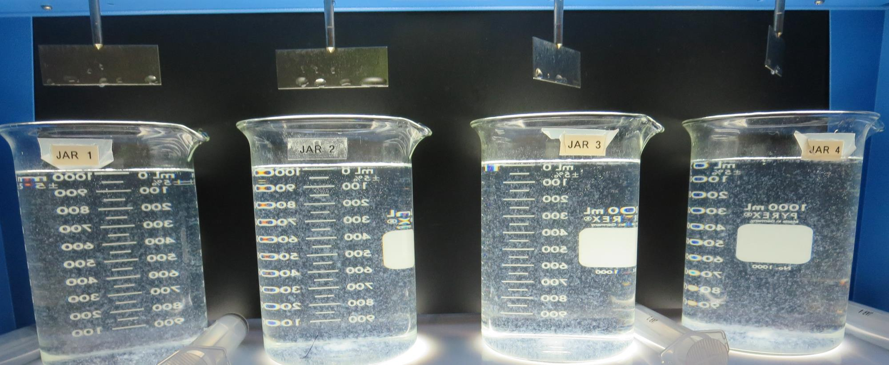
Jars 9-12: After 5 min of settling, 25 mL is syringed for filterability and %UVT/UVA.

Slide 26
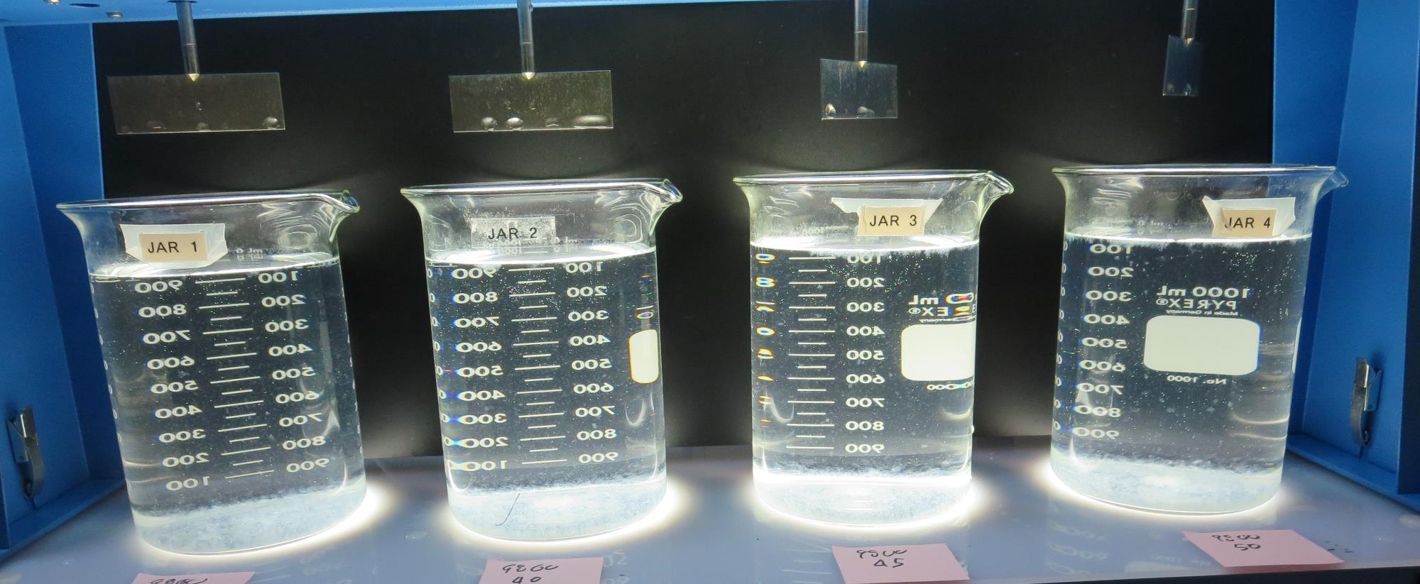
Jars 9-12: After 25-minutes of settling, settled water turbidity is taken.
35 mg/L 9800
Filtrate 0.29 NTU
UVT: 92.2%
UVA: 0.035/cm
UVA Reduction 27.1%
Settled: 2.07 NTU
40 mg/L 9800
Filtrate 0.24 NTU
UVT: 92.4%
UVA: 0.035/cm
UVA Reduction 29.2%
Settled: 1.62 NTU
45 mg/L 9800
Filtrate 0.26 NTU
UVT: 92.6%
UVA: 0.033/cm
UVA Reduction 31.3%
Settled: 1.64 NTU
50 mg/L 9800
Filtrate 0.32 NTU
UVT: 92.4%
UVA: 0.034/cm
UVA Reduction 29.2%
Settled: 1.83 NTU

Slide 27
Jars 13-16 Test Flash Mix 30 Sec (200 RPM) Floc Mix 5 min (30 RPM) Pre-NaOCl Applied Coagulants 9800/9890

Slide 28
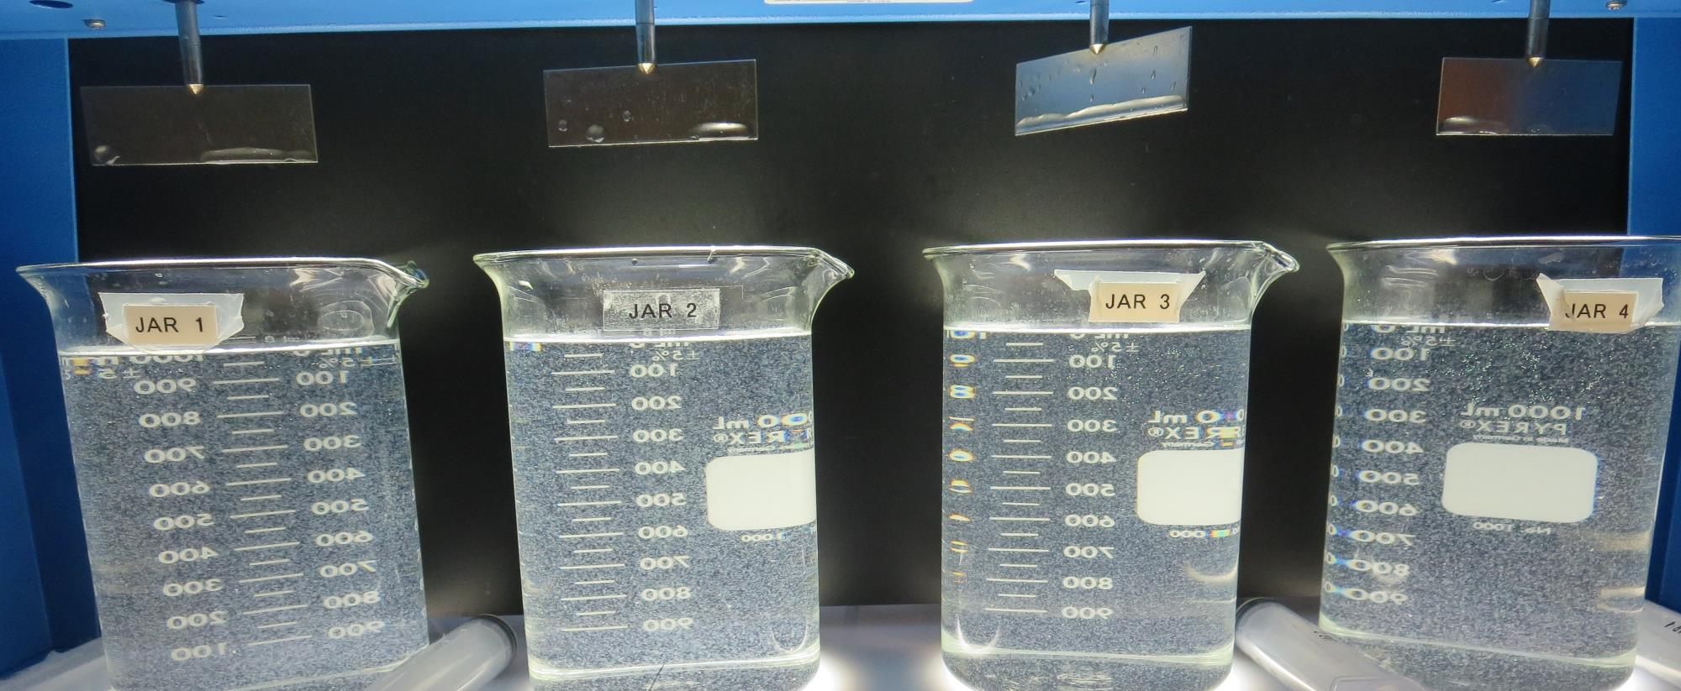
Jars 13-16: End of 5-minute flocculation (30 RPM) duration.
2.0 mg/L NaOCl
45 mg/L 9800
0 mg/L C-308P
Filtrate 0.13 NTU
UVT: 93.3%
UVA: 0.029/cm
UVA Reduction 39.6%
Settled: 1.61 NTU
2.0 mg/L NaOCl
45 mg/L 9800
1.0 mg/L C-308P
Filtrate 0.14 NTU
UVT: 93.4%
UVA: 0.029/cm
UVA Reduction 39.6%
Settled: 1.75 NTU
0 mg/L NaOCl
45 mg/L 9890
Filtrate 0.27 NTU
UVT: 93.4%
UVA: 0.032/cm
UVA Reduction 33.3%
Settled: 2.02 NTU
2.0 mg/L NaOCl
45 mg/L 9890
Filtrate 0.19 NTU
UVT: 93.7%
UVA: 0.028/cm
UVA Reduction 41.7%
Settled: 1.68 NTU

Slide 29
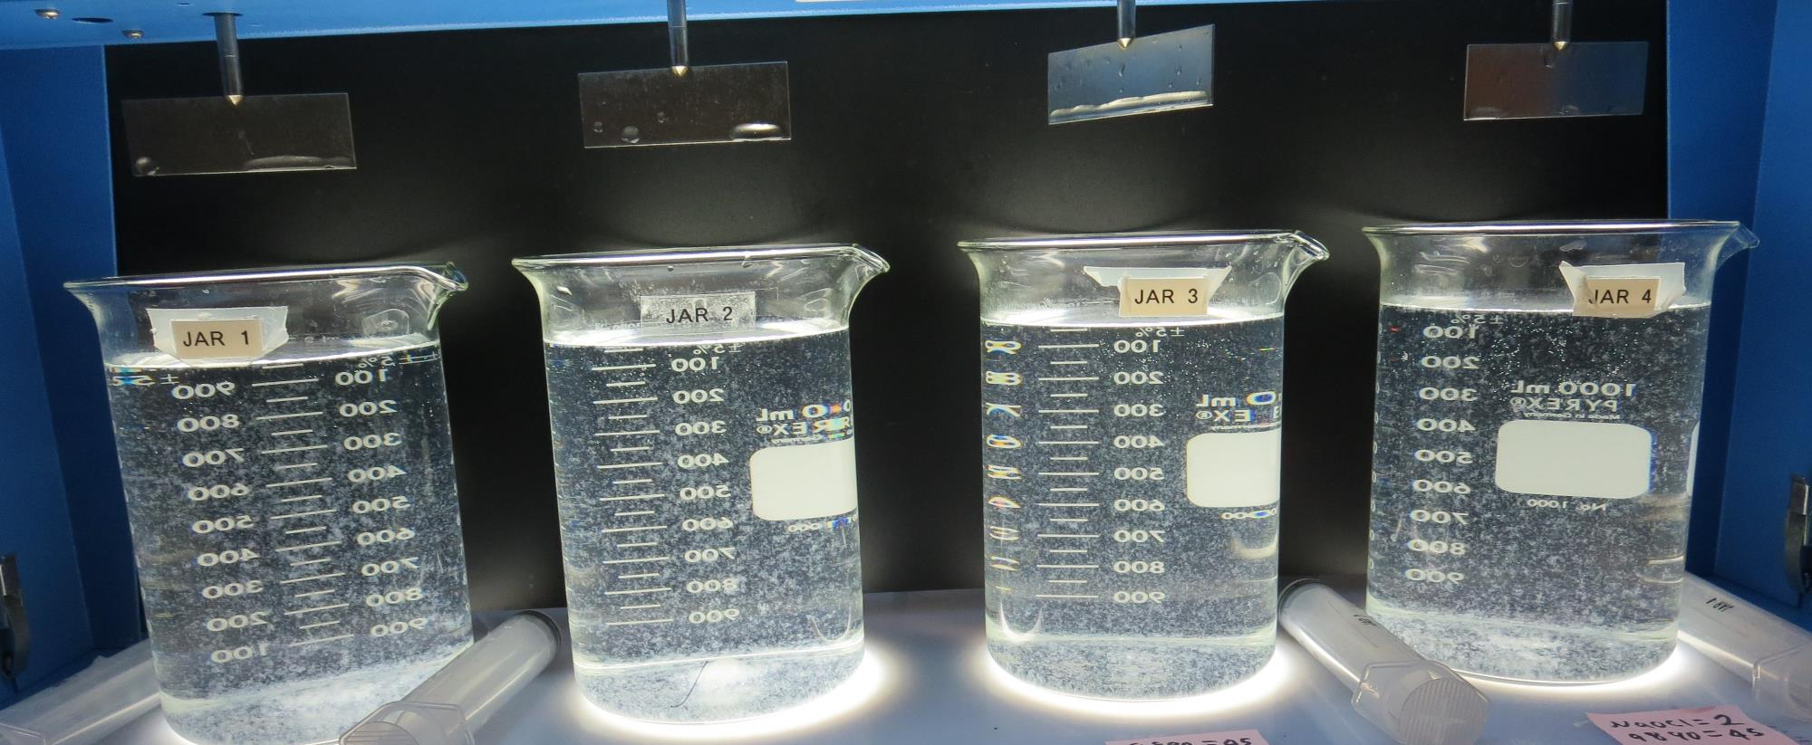
Jars 13-16: After 5 min of settling, 25 mL is syringed for filterability and %UVT/UVA.

Slide 30
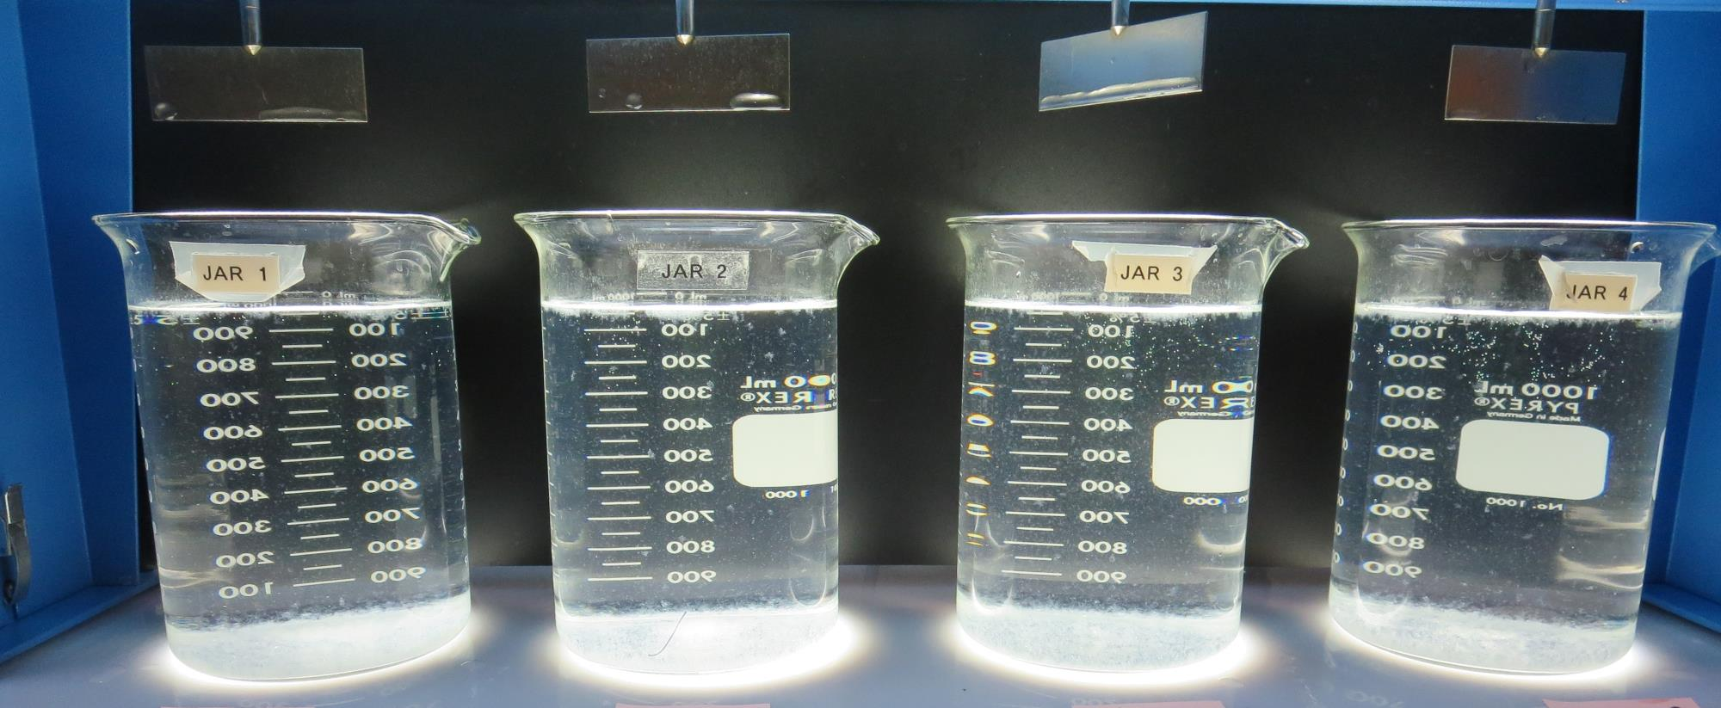
Jars 13-16: After 25-minutes of settling, settled water turbidity is taken.
2.0 mg/L NaOCl
45 mg/L 9800
0 mg/L C-308P
Filtrate 0.13 NTU
UVT: 93.3%
UVA: 0.029/cm
UVA Reduction 39.6%
Settled: 1.61 NTU
2.0 mg/L NaOCl
45 mg/L 9800
1.0 mg/L C-308P
Filtrate 0.14 NTU
UVT: 93.4%
UVA: 0.029/cm
UVA Reduction 39.6%
Settled: 1.75 NTU
0 mg/L NaOCl
45 mg/L 9890
Filtrate 0.27 NTU
UVT: 93.4%
UVA: 0.032/cm
UVA Reduction 33.3%
Settled: 2.02 NTU
2.0 mg/L NaOCl
45 mg/L 9890
Filtrate 0.19 NTU
UVT: 93.7%
UVA: 0.028/cm
UVA Reduction 41.7%
Settled: 1.68 NTU

Slide 31
Jars 17-20 Test Flash Mix 30 Sec (200 RPM) Floc Mix 5 min (30 RPM) Pre-NaOCl Applied Coagulants 9800/C-308P/9890/CTC-11

Slide 32
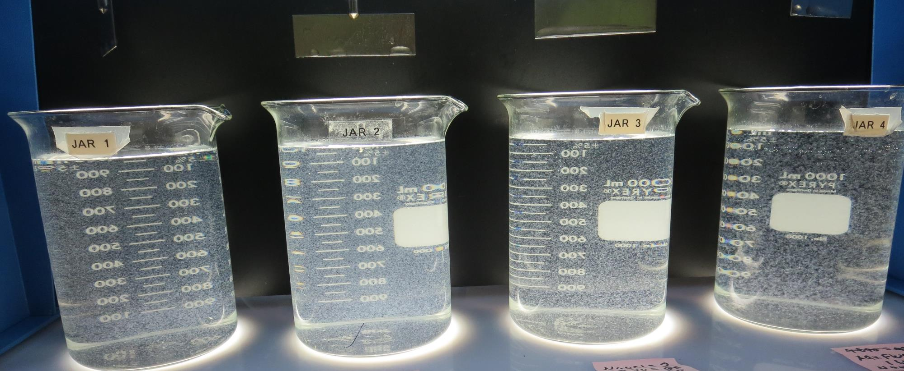
Jars 17-20: End of 5-minute flocculation (30 RPM) duration.
2.0 mg/L NaOCl
50 mg/L 9800
0 mg/L C-308P
Filtrate 0.14 NTU
UVT: 93.5%
UVA: 0.029/cm
UVA Reduction 39.6%
Settled: 1.26 NTU
2.0 mg/L NaOCl
50 mg/L 9800
2.0 mg/L C-308P
Filtrate 0.14 NTU
UVT: 93.8%
UVA: 0.027/cm
UVA Reduction 43.8%
Settled: 1.27 NTU
2.0 mg/L NaOCl
50 mg/L 9890
Filtrate 0.10 NTU
UVT: 93.7%
UVA: 0.027/cm
UVA Reduction 43.8%
Settled: 1.48 NTU
2.0 mg/L NaOCl
160 mg/L CTC-11
Filtrate 0.12 NTU
UVT: 93.8%
UVA: 0.027/cm
UVA Reduction 43.8%
Settled: - NTU

Slide 33
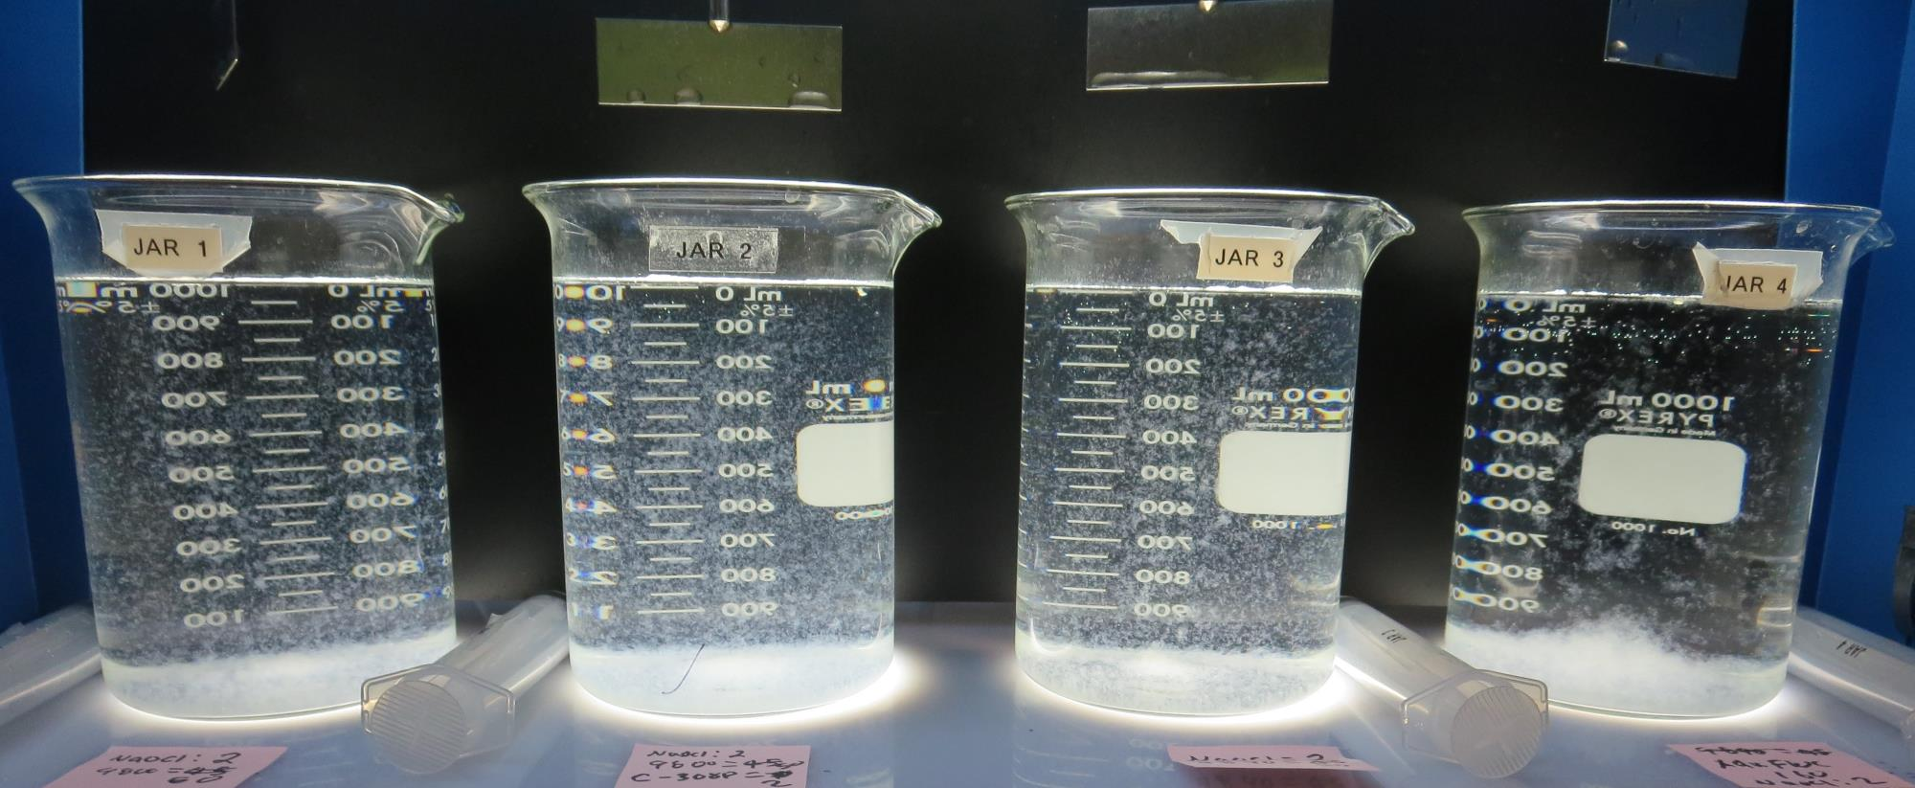
Jars 17-20: After 5 min of settling, 25 mL is syringed for filterability and %UVT/UVA.

Slide 34
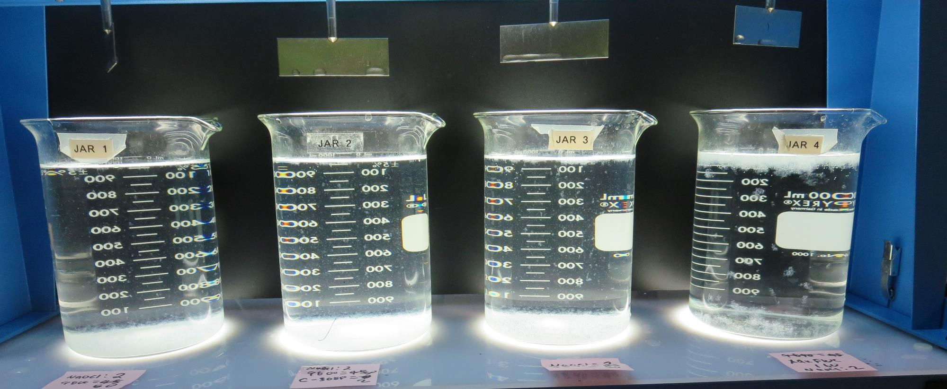
Jars 17-20: After 25-minutes of settling, settled water turbidity is taken.
2.0 mg/L NaOCl
50 mg/L 9800
0 mg/L C-308P
Filtrate 0.14 NTU
UVT: 93.5%
UVA: 0.029/cm
UVA Reduction 39.6%
Settled: 1.26 NTU
2.0 mg/L NaOCl
50 mg/L 9800
2.0 mg/L C-308P
Filtrate 0.14 NTU
UVT: 93.8%
UVA: 0.027/cm
UVA Reduction 43.8%
Settled: 1.27 NTU
2.0 mg/L NaOCl
50 mg/L 9890
Filtrate 0.10 NTU
UVT: 93.7%
UVA: 0.027/cm
UVA Reduction 43.8%
Settled: 1.48 NTU
2.0 mg/L NaOCl
160 mg/L CTC-11
Filtrate 0.12 NTU
UVT: 93.8%
UVA: 0.027/cm
UVA Reduction 43.8%
Settled: - NTU

Slide 35
Jar Testing for 1-Liter Jars: Procedures for Most Treatment Plants
Fill jars with source water prior to coagulant injection and set paddle speed at 30 rpm
Add chemicals (i.e., NaOCl, primary coagulant, coagulant aid) to each jar
Flash mix for 15-30 seconds (200 rpm)
Slow mix for 5 minutes (20-30 rpm)
Settled for 5 minutes. Syringe 25 mL from each jar taken 1-inch below surface (25 mL/12 sec rate)
Filtered through 1.2 um isopore membrane into cuvette drip rate, 15 mL/(50-90 sec)
Measure filtrate turbidity, chlorine residual and %UVT/UVA
Measure settled water turbidity after 25 minutes of total setting
Record all data

Slide 36
Jar Test Filterability Test Equipment
Turbidity Instrument
Syringe w/Luer-Lock Tip, 30 cc
(part#: 2225800, by Hach)
Swinnex Filter Holder, 25 mm (part#: SX0002500)
Isopore Membrane Filter, 1.2 um absolute
pore size,
Φ= 25 mm , thickness: 24 um,
hydrophilic polycarbonate membrane
(part #: RTTP02500)
Go to Sigma-Aldrich for laboratory supplies http://www.sigmaaldrich.com/united-states.html

Slide 37
Isopore Membrane Information
Categories | Information
trade name | Isopore
filter color | White
chemistry | Polycarbonate (PC)
water flow rate | Avg. 175 mL/min x cm² (typical results @ 10 psi)
media | Isopore®
wettability | Hydrophilic
porosity | 14.7%
pore size | 1.2 µm
bubble point at 23 °C | 1.0 bar, air with water
thickness | 24 µm
filter diameter (ø) | 25 mm
material size | polycarbonate, Hydrophilic, 1.2 µm, 25 mm, white, plain, 100

Slide 38
Isopore Membrane Background Information
The Isopore membrane is a polycarbonate, track-etched screen filter recommended for all analyses in which the sample is viewed on the surface of the membrane. The Isopore membrane is composed of polycarbonate film, which has a smooth, glass-like surface for clearer sample observation. The unique manufacturing process of the membrane ensures a precise pore diameter and a consistent pore size for accurate separation of samples by size. Matched-weight filters are not usually required because of low, constant tar and ash weights. Features & Benefits: Membrane structure retains particles on the surface, simplifying counting and analysis

Slide 39
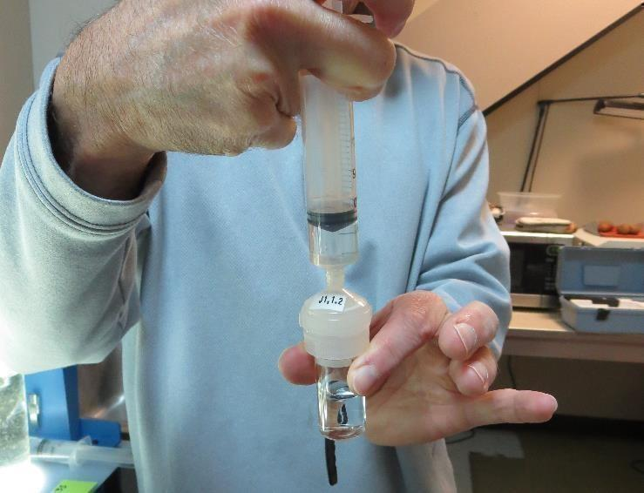
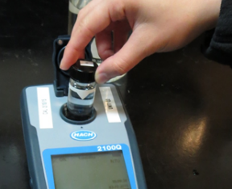
Jar Test - Filterability Test
Syringe ~ 25 mL from jar (after 5-minutes of settling)
Filter-to-waste 3-5 mL
Filter directly into clean cuvette
Measure turbidity
Note: Take several readings before recording final NTU results. Micro bubbles can adhere to glass causing false NTU readings. To remove bubbles, tilt cuvette up to 90 degrees.

Slide 40
Contact
Guy Schott, P.E.
State Water Resources Control Board
Division of Drinking Water
Santa Rosa, CA
Go to Stock Solution/Dose calculations/Jar Test Results for tools to download
www.waterboards.ca.gov/drinking_water/programs/districts/mendocino_district.html
Email: Guy Schott - Guy.Schott@waterboards.ca.gov
Office Number: 707-576-2732

