Slide 1
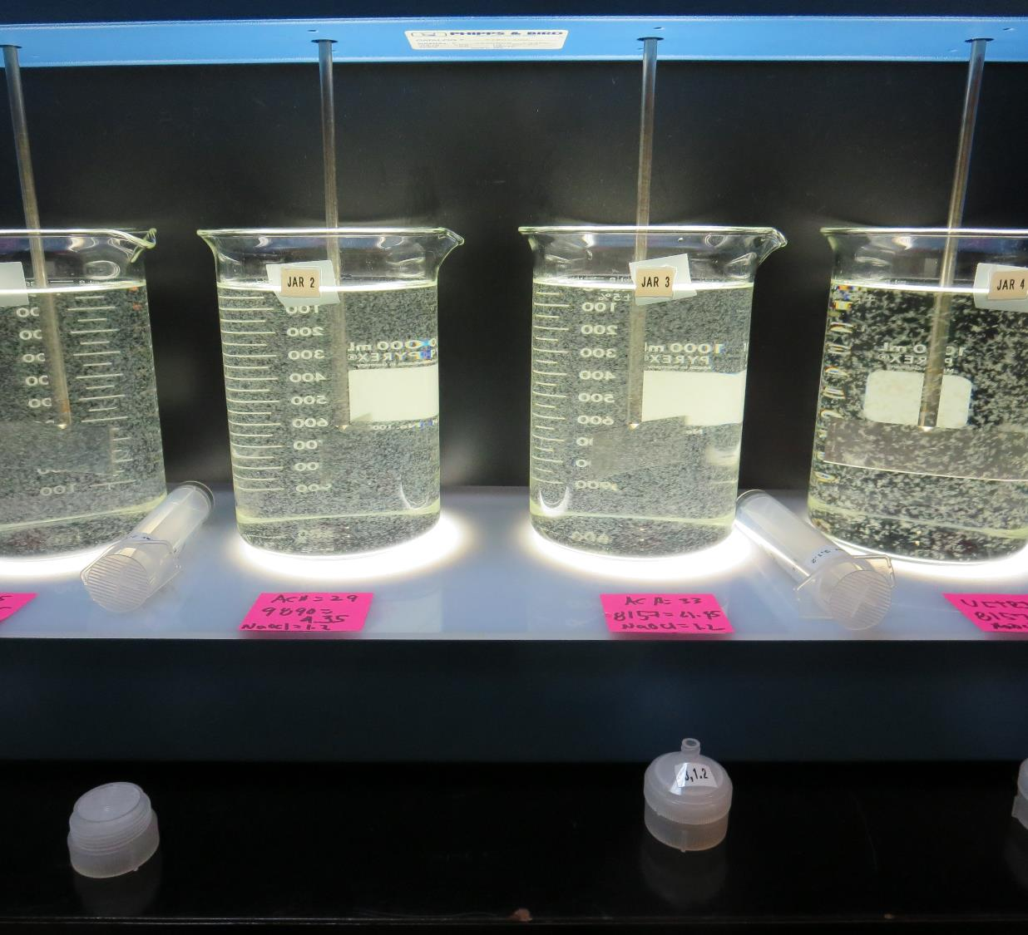
Harbor View Mutual Water Company
CA1700568
Lake County
Jar Test
by Guy Schott, P.E.
February 6, 2019

Slide 2
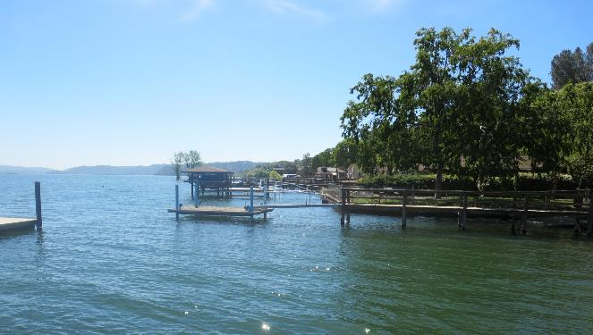
Harbor View MWC
February 6, 2019
Source Water Characteristics
Turbidity: 5.7 NTU
pH: 7.85
UVT: 81.6%
UVA: 0.088/cm

Slide 3
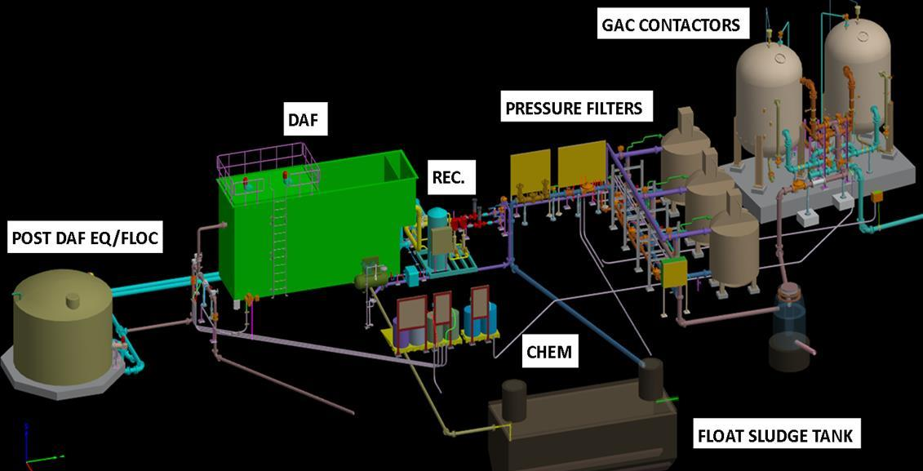
Schematic of Water Treatment Plant

Slide 4
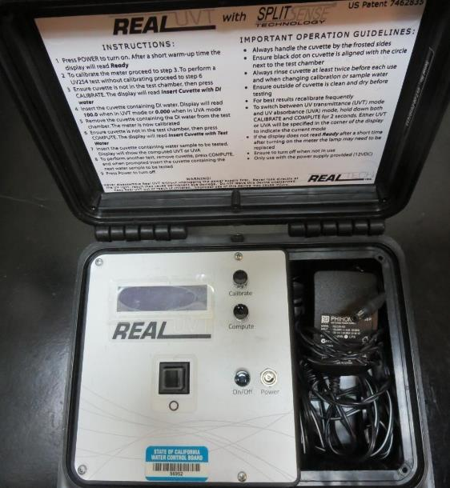
UVT/UVA
UV transmittance (UVT) is a measurement of the amount of ultraviolet light (commonly at 254 nm due to its germicidal effect) that passes through a water sample compared to the amount of light that passes through a pure water sample. The measurement is expressed as a percentage, % UVT.
%UVT = 10^{(-UVA)} x 100%
UV absorbance (UVA) is calculated as a relative measure of the amount of light absorbed by a water sample compared with the amount of light absorbed by a pure water sample.
UVA = -log(%UVT/100)

Slide 5
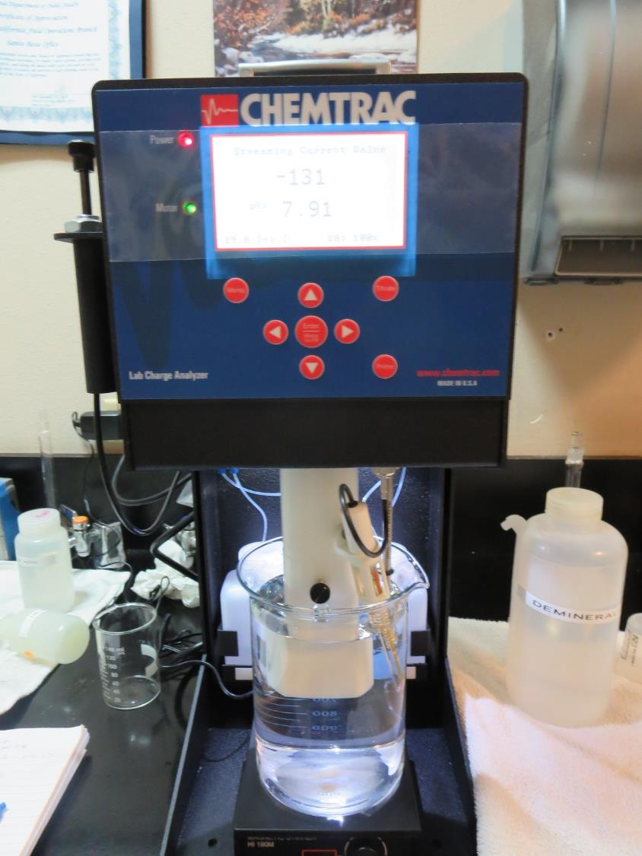
Laboratory Charge Analyzer
LCA: Used to determine coagulant demand of a source water entering the treatment plant.
Source pH: 7.9
LCA #1
ACH (9800): 29 mg/L as product
pH adjusted to 7.5 w/acetic acid
LCA #2:
ULTRION 8157
56.8 mg/L as product
pH adjustment to 7.5 w/acetic acid

Slide 6
Applied Coagulants for Jar Testing
Pro Pac 9800 (NTU Technologies)
50% Aluminum Chlorohydrate
50% Water
SG = 1.34
Pro Pac 9890 (NTU Technologies)
35-45% Aluminum Chlorohydrate
35-45% Water
20% Trade Secret
SG = 1.25-1.34
ULTRION 8157
Nalco Company
10-30% Calcium Chloride
10-30% Aluminum Hydroxychloride
1-5% Aluminum Phosphate
SG = 1.27

Slide 7
Coagulant Information
Unless stated otherwise, all coagulant doses are reported as Product (100% strength). Aluminum sulfate is reported as Alum.
Preparation of coagulant stock solutions are generally 1.0 and/or 0.1 percent strength using 100 and/or 200 mL volumetric flasks.
Finnpipette F2 variable volume pipette, capacity 100-1000 micro liters is used for stock solution preparation and coagulant aid jar test dosing.
Finnpipette F2 variable volume pipette, capacity 0.5-5 mL is used for primary coagulant jar test dosing.

Slide 8
Harbor View MWC: Jar Test 1-8 Results
Jar # | 200 RPM Flash Mix seconds | 30 RPM Floc Duration minutes | 9800 mg/L | ULTRION 8157 mg/L | Filtrate NTU | Filtrate %UVT | Filtrate UVA/cm | Settle NTU 25 min
J1 | 60 | 5 | 25 | 0 | 0.08 | 88.9 | 0.051 | 0.5
J2 | 60 | 5 | 29 | 0 | 0.07 | 89.0 | 0.051 | 0.4
J3 | 60 | 5 | 33 | 0 | 0.07 | 89.4 | 0.049 | 0.5
J4 | 60 | 5 | 37 | 0 | 0.07 | 89.4 | 0.049 | 0.9
J5 | 60 | 5 | 25 | 3.75 | 0.08 | 89.0 | 0.051 | 0.4
J6 | 60 | 5 | 29 | 4.35 | 0.07 | 89.3 | 0.049 | 0.7
J7 | 60 | 5 | 33 | 4.95 | 0.09 | 89.5 | 0.048 | 0.6
J8 | 60 | 5 | 37 | 5.55 | 0.07 | 89.6 | 0.048 | 1.0

Slide 9
Harbor View MWC: Jar Test 9-12 Results
Jar # | 200 RPM Flash Mix seconds | 30 RPM Floc Duration minutes | NaOCl mg/L | 9800 mg/L | Filtrate NTU | Filtrate %UVT | Filtrate UVA/cm | Settle NTU 25 min
J9 | 60 | 5 | 1.2 | 25 | 0.08 | 89.1 | 0.050 | 0.08
J10 | 60 | 5 | 1.2 | 29 | 0.06 | 88.6 | 0.053 | 0.06
J11 | 60 | 5 | 1.2 | 33 | 0.05 | 89.3 | 0.049 | 0.05
J12 | 60 | 5 | 1.2 | 37 | 0.06 | 89.5 | 0.048 | 0.06

Slide 10
Harbor View MWC: Jar Test 13-15 Results
Flash Mix 60 sec (200 RPM)
Jar # | 30 RPM Floc Duration minutes | NaOCl mg/L | 9800 mg/L | 9890 mg/L | Filtrate NTU | Filtrate %UVT | Filtrate UVA/cm | Settle NTU 25 min
J13 | 5 | 1.2 | 25 | 3.75 | 0.06 | 89.9 | 0.046 | 0.3
J14 | 5 | 1.2 | 29 | 4.35 | 0.06 | 90.1 | 0.045 | 0.8
J15 | 5 | 1.2 | 33 | 4.95 | 0.05 | 90.3 | 0.044 | 0.5

Slide 11
Harbor View MWC: Jar Test 16 Results
Jar # | 200 RPM Flash Mix seconds | 30 RPM Floc Duration minutes | NaOCl mg/L | ULTRION 8157 mg/L | Filtrate NTU | Filtrate %UVT | Filtrate UVA/cm | Settle NTU 25 min
J16 | 60 | 5 | 1.2 | 57 | 0.05 | 88.6 | 0.053 | 0.4

Slide 12
Jars 1-12 Test
Pictures of Jars not available

Slide 13
Jars 13-16 Test
Flash Mix 60 Sec (200 RPM)
Floc Mix 5 min (30 RPM)
Applied Coagulants
9800/9890
8157

Slide 14
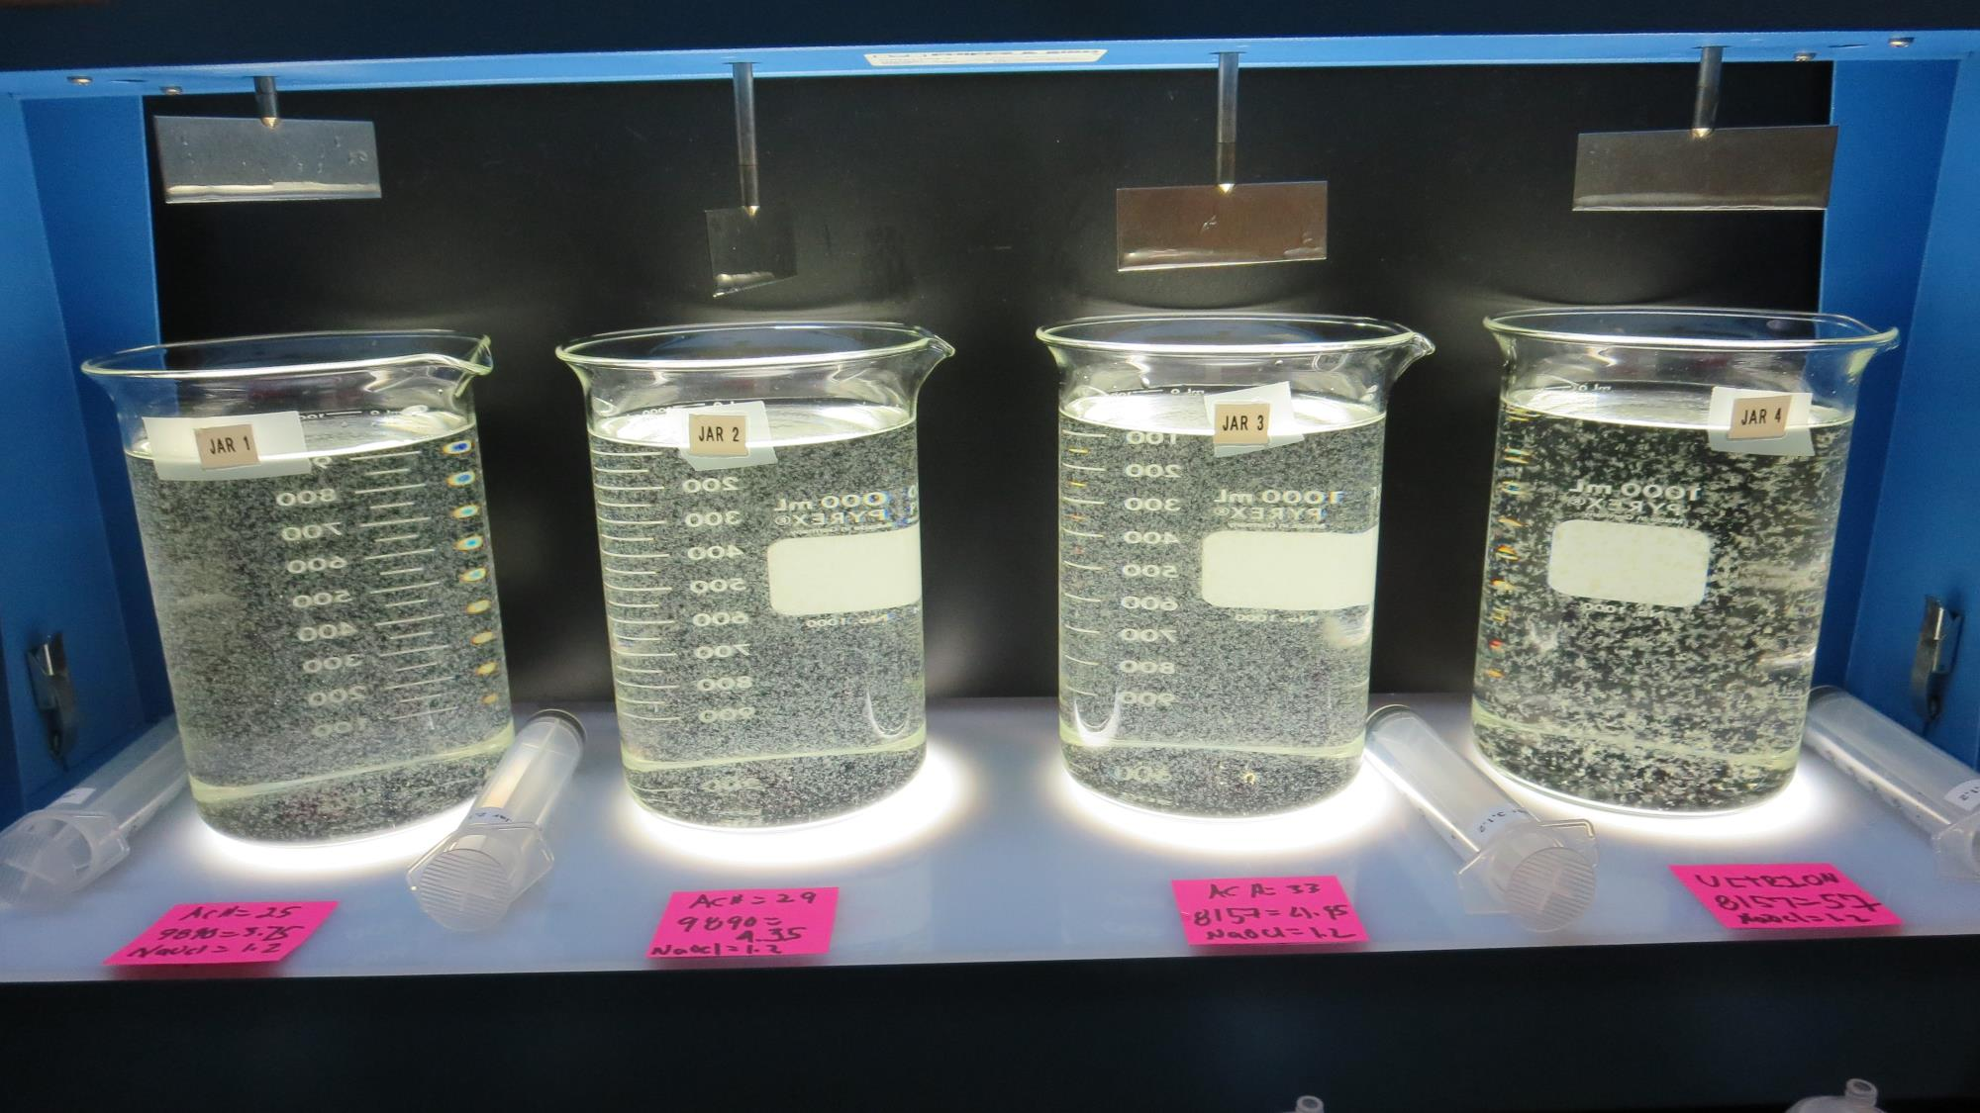
Jars 13-16: End of 5-minute flocculation (30 RPM) duration.
1.2 mg/L NaOCl
3.75 mg/L 9890
25 mg/L 9800
Filtrate 0.06 NTU
UVT: 89.9%
UVA: 0.046/cm
Settled: 0.3 NTU
1.2 mg/L NaOCl
4.35 mg/L 9890
29 mg/L 9800
Filtrate 0.06 NTU
UVT: 90.1%
UVA: 0.045/cm
Settled: 0.8 NTU
1.2 mg/L NaOCl
4.95 mg/L 9890
33 mg/L 9800
Filtrate 0.05 NTU
UVT: 90.3%
UVA: 0.044/cm
Settled: 0.5 NTU
1.2 mg/L NaOCl
57 mg/L 8157
Filtrate 0.05 NTU
UVT: 88.6%
UVA: 0.053/cm
Settled: 0.4 NTU

Slide 15
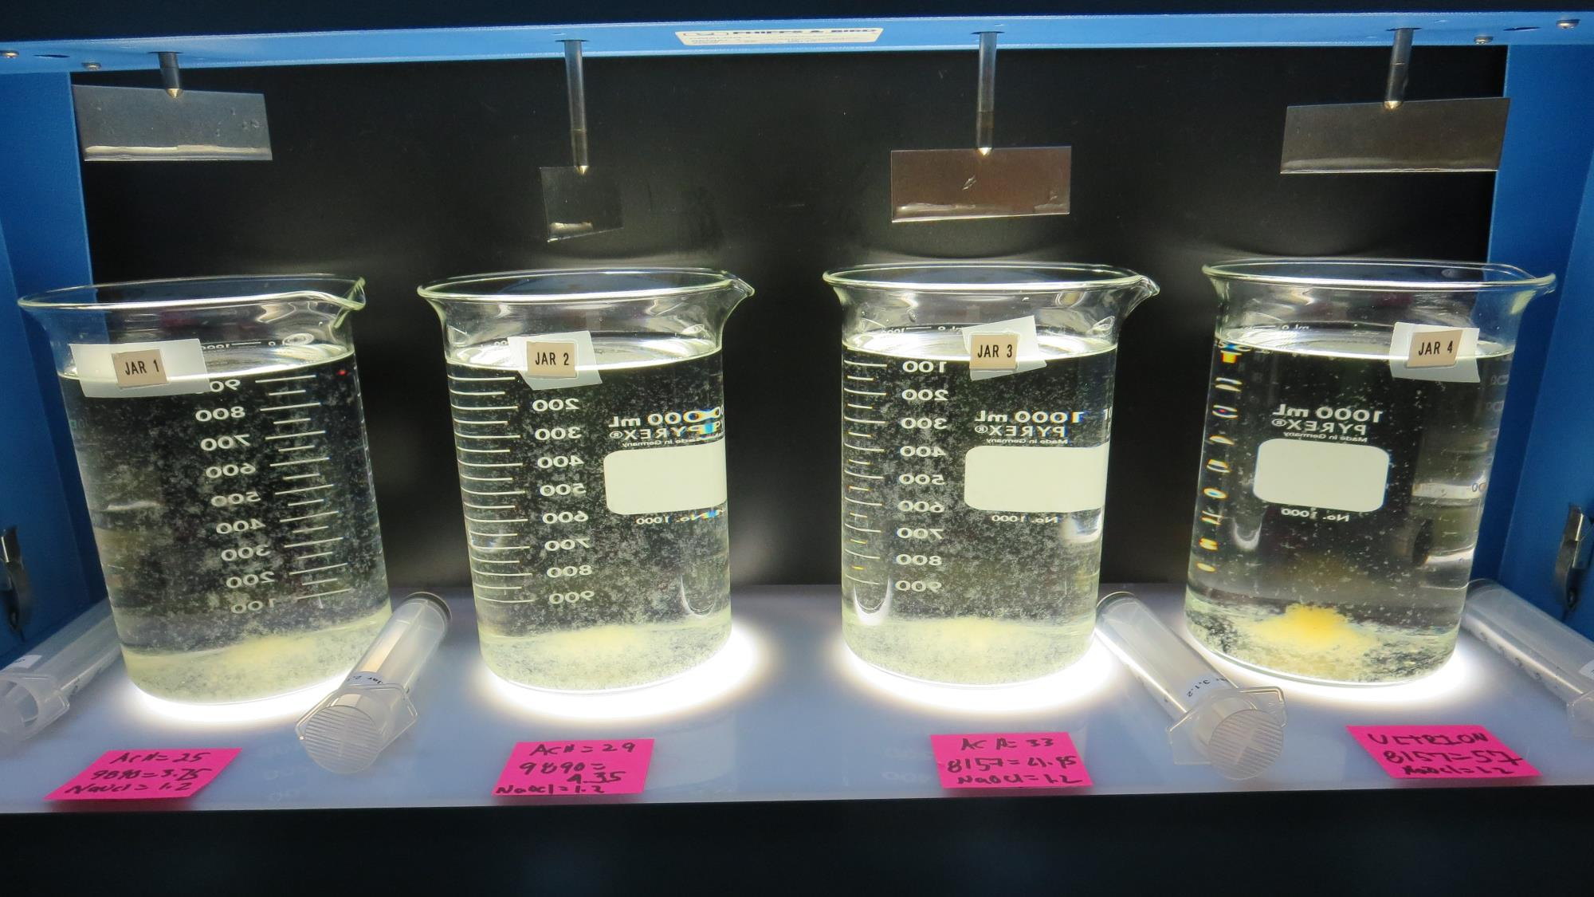
Jars 13-16: After 5 min of settling, 25 mL is syringed for filterability and %UVT/UVA

Slide 16
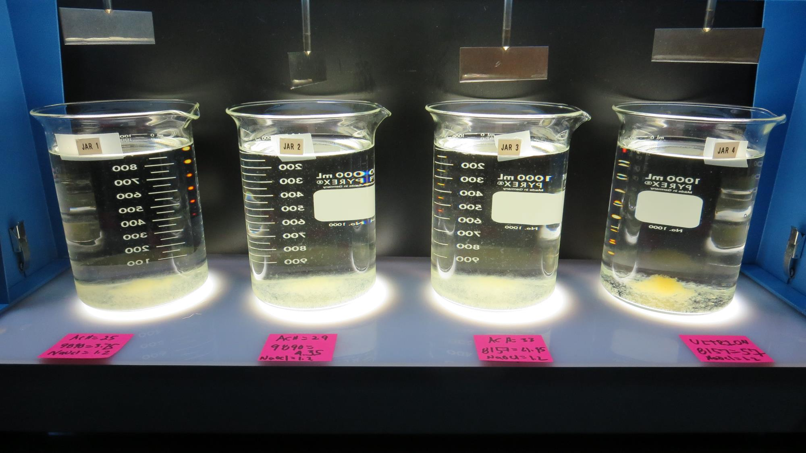
Jars 13-16: After 25-minutes of settling, settled water turbidity is taken.
1.2 mg/L NaOCl
3.75 mg/L 9890
25 mg/L 9800
Filtrate 0.06 NTU
UVT: 89.9%
UVA: 0.046/cm
Settled: 0.3 NTU
1.2 mg/L NaOCl
4.35 mg/L 9890
29 mg/L 9800
Filtrate 0.06 NTU
UVT: 90.1%
UVA: 0.045/cm
Settled: 0.8 NTU
1.2 mg/L NaOCl
4.95 mg/L 9890
33 mg/L 9800
Filtrate 0.05 NTU
UVT: 90.3%
UVA: 0.044/cm
Settled: 0.5 NTU
1.2 mg/L NaOCl
57 mg/L 8157
Filtrate 0.05 NTU
UVT: 88.6%
UVA: 0.053/cm
Settled: 0.4 NTU

Slide 17
Jar Testing for 1-Liter Jars:
Procedures for Most Treatment Plants
Fill jars with source water prior to coagulant injection and set paddle speed at 30 rpm
Add chemicals (i.e., NaOCl, primary coagulant, coagulant aid) to each jar
Flash mix for 15-60 seconds (200 rpm)
Slow mix for 5 minutes (20-30 rpm)
Settled for 5 minutes. Syringe 25 mL from each jar taken 1-inch below surface (25 mL/12 sec rate)
Filtered through 1.2 um isopore membrane into cuvette drip rate, 15 mL/(50-90 sec)
Measure filtrate turbidity, chlorine residual and %UVT/UVA
Measure settled water turbidity after 25 minutes of total setting
Record all data

Slide 18

Jar Test
Filterability Test Equipment
Turbidity Instrument
Syringe w/Luer-Lock Tip, 30 cc
(part#: 2225800, by Hach)
Swinnex Filter Holder, 25 mm (part#: SX0002500)
Isopore Membrane Filter, 1.2 um absolute
pore size,
Φ= 25 mm , thickness: 24 um,
hydrophilic polycarbonate membrane
(part #: RTTP02500)
Go to Sigma-Aldrich for laboratory supplies http://www.sigmaaldrich.com/united-states.html

Slide 19
Isopore Membrane Information
Categories | Information
trade name | Isopore
filter color | White
chemistry | Polycarbonate (PC)
water flow rate | Avg. 175 mL/min x cm² (typical results @ 10 psi)
media | Isopore®
wettability | Hydrophilic
porosity | 14.7%
pore size | 1.2 µm
bubble point at 23 °C | 1.0 bar, air with water
thickness | 24 µm
filter diameter (ø) | 25 mm
material size | polycarbonate, Hydrophilic, 1.2 µm, 25 mm, white, plain, 100

Slide 20
Isopore Membrane Background Information
The Isopore membrane is a polycarbonate, track-etched screen filter recommended for all analyses in which the sample is viewed on the surface of the membrane. The Isopore membrane is composed of polycarbonate film, which has a smooth, glass-like surface for clearer sample observation. The unique manufacturing process of the membrane ensures a precise pore diameter and a consistent pore size for accurate separation of samples by size. Matched-weight filters are not usually required because of low, constant tar and ash weights.
Features & Benefits:
Membrane structure retains particles on the surface, simplifying counting and analysis

Slide 21
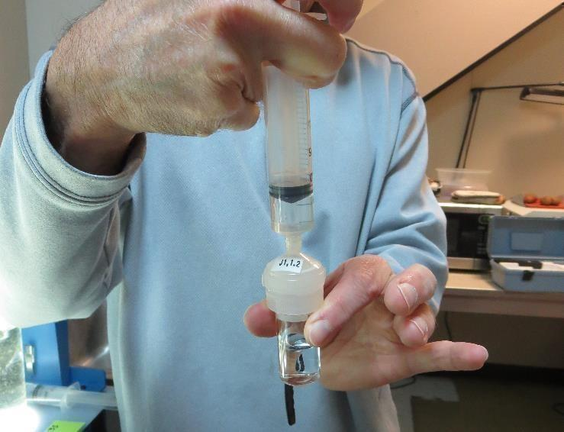

Jar Test - Filterability Test
Syringe ~ 25 mL from jar (after 5-minutes of settling)
Filter-to-waste 3-5 mL
Filter directly into clean cuvette
Measure turbidity
Note: Take several readings before recording final NTU results. Micro bubbles can adhere to glass causing false NTU readings. To remove bubbles, tilt cuvette up to 90 degrees.

Slide 22

Contact
Guy Schott, P.E.
State Water Resources Control Board
Division of Drinking Water
Santa Rosa, CA
Go to Stock Solution/Dose calculations/Jar Test Results for tools to download
www.waterboards.ca.gov/drinking_water/programs/districts/mendocino_district.html
Email: Guy Schott - Guy.Schott@waterboards.ca.gov
Office Number: 707-576-2732

