Slide 1
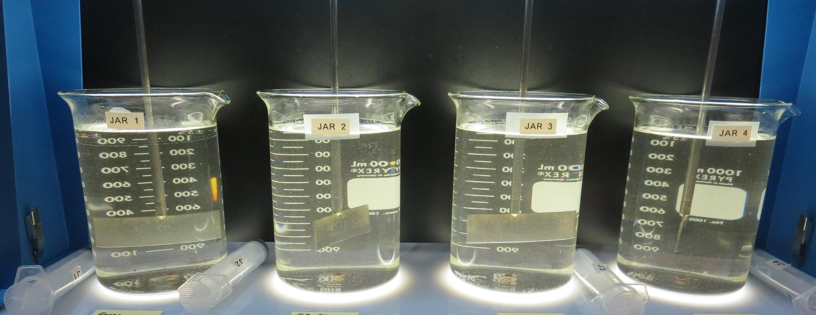
Lazy S Mobile Ranch
CA1700609, Lake County, Jar Test
by Guy Schott, P.E. January 20, 2023

Slide 2
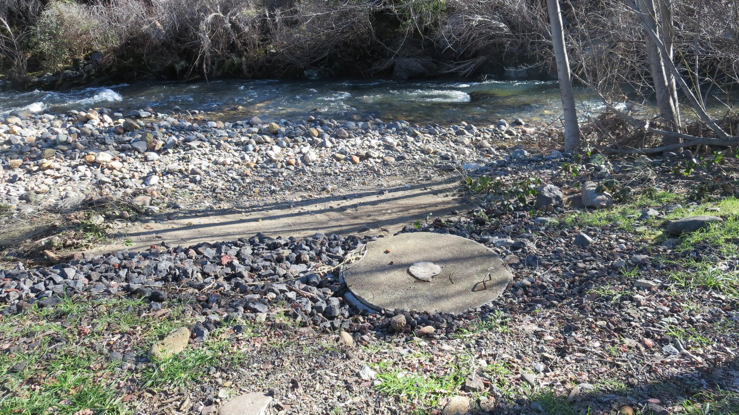
St. Helena Creek/Source

Slide 3
Lazy S Mobile Ranch Source &
Water Characteristics, January 20, 2023
Source – St. Helena Creek
pH: 7.22 -7.48
Alkalinity: 78 mg/L as CaCO₃
Turbidity: 4.47 NTU
UVT: 85.0%,
UVA: 0.070/cm
0.4 um Filtered
Turbidity: 0.17 NTU
UVT: 87.7%,
UVA: 0.056/cm

Slide 4
Applied Coagulants for Jar Testing (1)
Amerfloc 482 (WC1118)
SG = 1.0 – 1.2
pDADMAC (20% active, 80% H₂O)
NSF limit: 50 mg/L (product)
Product dose 5 mg/L = 1 mg/L pDADMAC active
BWS, Inc.
AdvFloc-CTC-00011
Polyaluminum Hydroxy Chlorosulfate
12.55% Al₂O₃
6.64% Al
64.9% Basicity
SG = 1.299
NSF limit: 250 mg/L as Product

Slide 5
Applied Coagulants for Jar Testing (2)
Pro Pac 9800 (NTU Technologies)
50% Aluminum Chlorohydrate
50% Water
23.62% Al₂O₃
12.5% Al
83% Basicity
SG = 1.25-1.34
NSF limit: 250 mg/L as Product
10 mg/L as 9800 = Reduction 1.18 mg/L as CaCO₃

Slide 6
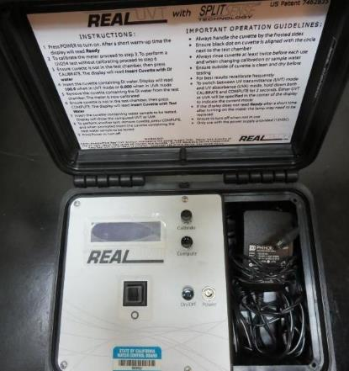
UVT/UVA, pathlength 10 mm
UV transmittance (UVT) is a measurement of the amount of ultraviolet light (254 nm) that passes through a water sample compared to the amount of light that passes through a pure water sample. The measurement is expressed as % UVT.
%UVT = 10^{(-UVA)} x 100%
UV absorbance (UVA) is calculated as a relative measure of the amount of light absorbed by a water sample compared with the amount of light absorbed by a pure water sample.
UVA = -log(%UVT/100)

Slide 7
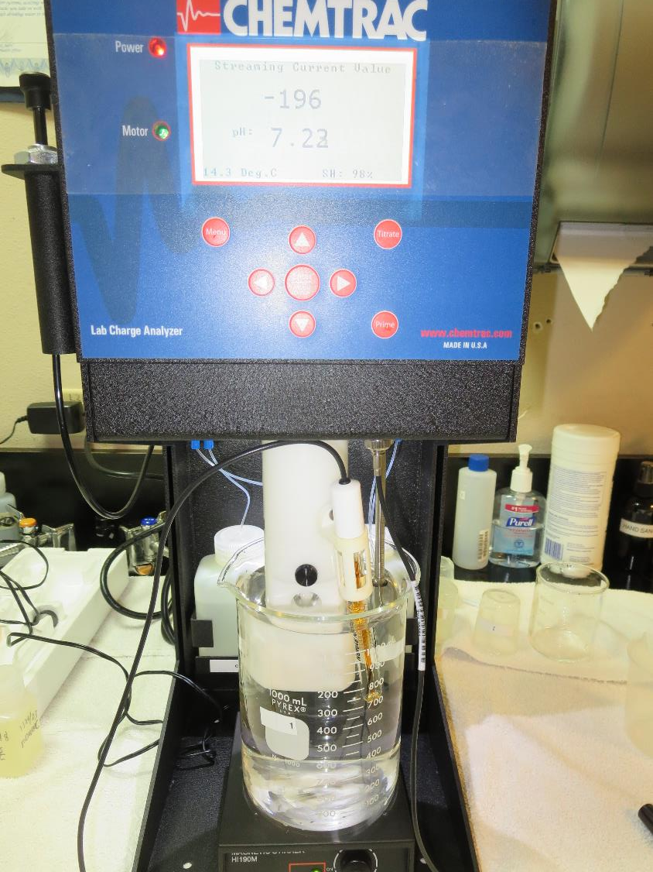
Laboratory Charge Analyzer
LCA: Used to determine coagulant demand of a source water entering the treatment plant.
Source pH: 7.22-7.48
LCA #1:
Amerfloc 482: 8 mg/L as pDADMAC
Note: overdose (>+80 on LCA)

Slide 8
Coagulant Information
Unless stated otherwise, all coagulant doses are reported as Product (100% strength).
Aluminum Sulfate doses are reported as hydrated Al₂(SO₄)₃*14.3H₂0.
Preparation of coagulant stock solutions are generally 1.0 and/or 0.1 percent strength using 100 and/or 200 mL volumetric flasks.
Finnpipette F2 variable volume pipette, capacity 100-1000 micro liters is used for stock solution preparation and coagulant aid jar test dosing.
Finnpipette F2 variable volume pipette, capacity 0.5-5 mL is used for primary coagulant jar test dosing.

Slide 9
Lazy S Mobile Ranch; Jar Test 1 - 8 Results
Flash Mix 200 RPM (20 sec); Floc Mix 20 RPM (5 min)
Jar# | Amerfloc 482 pDADMAC mg/L | CTC-00011 mg/L | Filtrate NTU | Filtrate %UVT | Filtrate UVA/cm | %UVA Reduction | Settle NTU 25 min
J1 | 2.0 | - | 0.57 | 89.5 | 0.048 | 14.3 | 3.28
J2 | 4.0 | - | 0.45 | 91.8 | 0.037 | 33.9 | 5.92
J3 | 6.0 | - | 1.22 | 92.1 | 0.035 | 37.5 | 7.98
J4 | 8.0 | - | 1.55 | 92.0 | 0.036 | 35.7 | 8.67
J5 | - | 16 | 0.11 | 92.6 | 0.033 | 41.1 | 2.98
J6 | - | 22 | 0.10 | 93.0 | 0.031 | 44.6 | 3.29
J7 | - | 28 | 0.07 | 94.9 | 0.022 | 60.7 | 2.1
J8 | - | 34 | 0.08 | 93.9 | 0.027 | 51.8 | 1.97

Slide 10
Lazy S Mobile Ranch; Jar Test 9 - 16 Results
Flash Mix 200 RPM (20 sec); Floc Mix 20 RPM (5 min)
Jar# | 9800 (ACH) mg/L | Filtrate NTU | Filtrate %UVT | Filtrate UVA/cm | %UVA Reduction | Settle NTU 25 min
J9 | 4 | 0.64 | 88.7 | 0.051 | 9.0 | 3.53
J10 | 8 | 0.45 | 91.9 | 0.036 | 35.7 | 3.10
J11 | 12 | 0.15 | 95.6 | 0.019 | 66.1 | 3.68
J12 | 16 | 0.05 | 96.7 | 0.014 | 75.0 | 3.75
J13 | 12 | 0.09 | 95.2 | 0.021 | 62.5 | 4.29
J14 | 14 | 0.08 | 95.4 | 0.020 | 64.3 | 4.29
J15 | 16 | 0.05 | 96.0 | 0.017 | 69.6 | 4.08
J16 | 18 | 0.22 | 93.7 | 0.028 | 50.0 | 4.46

Slide 11
Jars 1-4 Test
Flash Mix 20 Sec (200 RPM)
Floc Mix 5 min (20 RPM)
Applied Coagulant
Amerfloc 486 (pDADMAC)

Slide 12
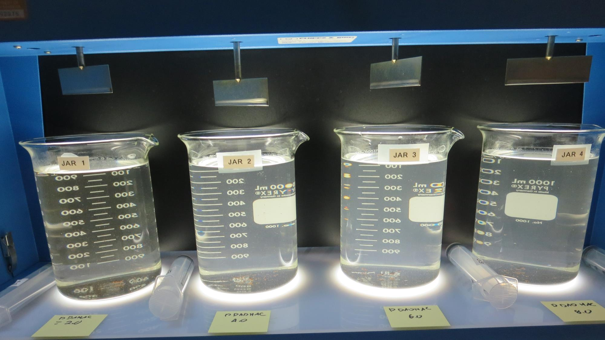
Jars 1-4: End of 5-minute flocculation (20 RPM) duration.
2.0 mg/L pDADMAC
Filtrate: 0.57 NTU
UVT: 89.5%
UVA: 0.048/cm
UVA Reduction: 14.3%
Settled: 3.28 NTU
4.0 mg/L pDADMAC
Filtrate: 0.45 NTU
UVT: 91.8%
UVA: 0.037/cm
UVA Reduction: 33.9%
Settled: 5.92 NTU
6.0 mg/L pDADMAC
Filtrate: 1.22 NTU
UVT: 92.1%
UVA: 0.035/cm
UVA Reduction: 37.5%
Settled: 7.98 NTU
8.0 mg/L pDADMAC
Filtrate: 1.55 NTU
UVT: 92.0%
UVA: 0.036/cm
UVA Reduction: 35.7%
Settled: 8.67 NTU

Slide 13
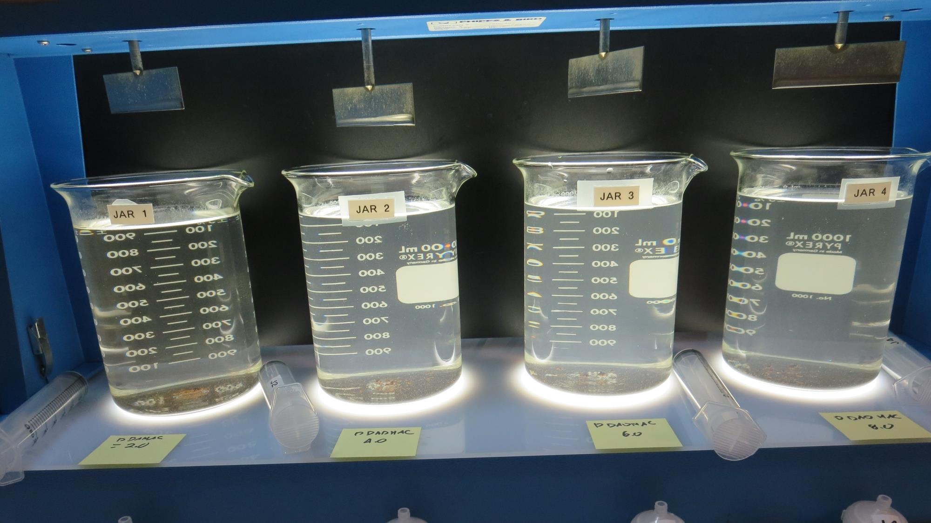
Jars 1-4: After 5 min of settling, 25 mL is syringed for filterability and %UVT/UVA.

Slide 14
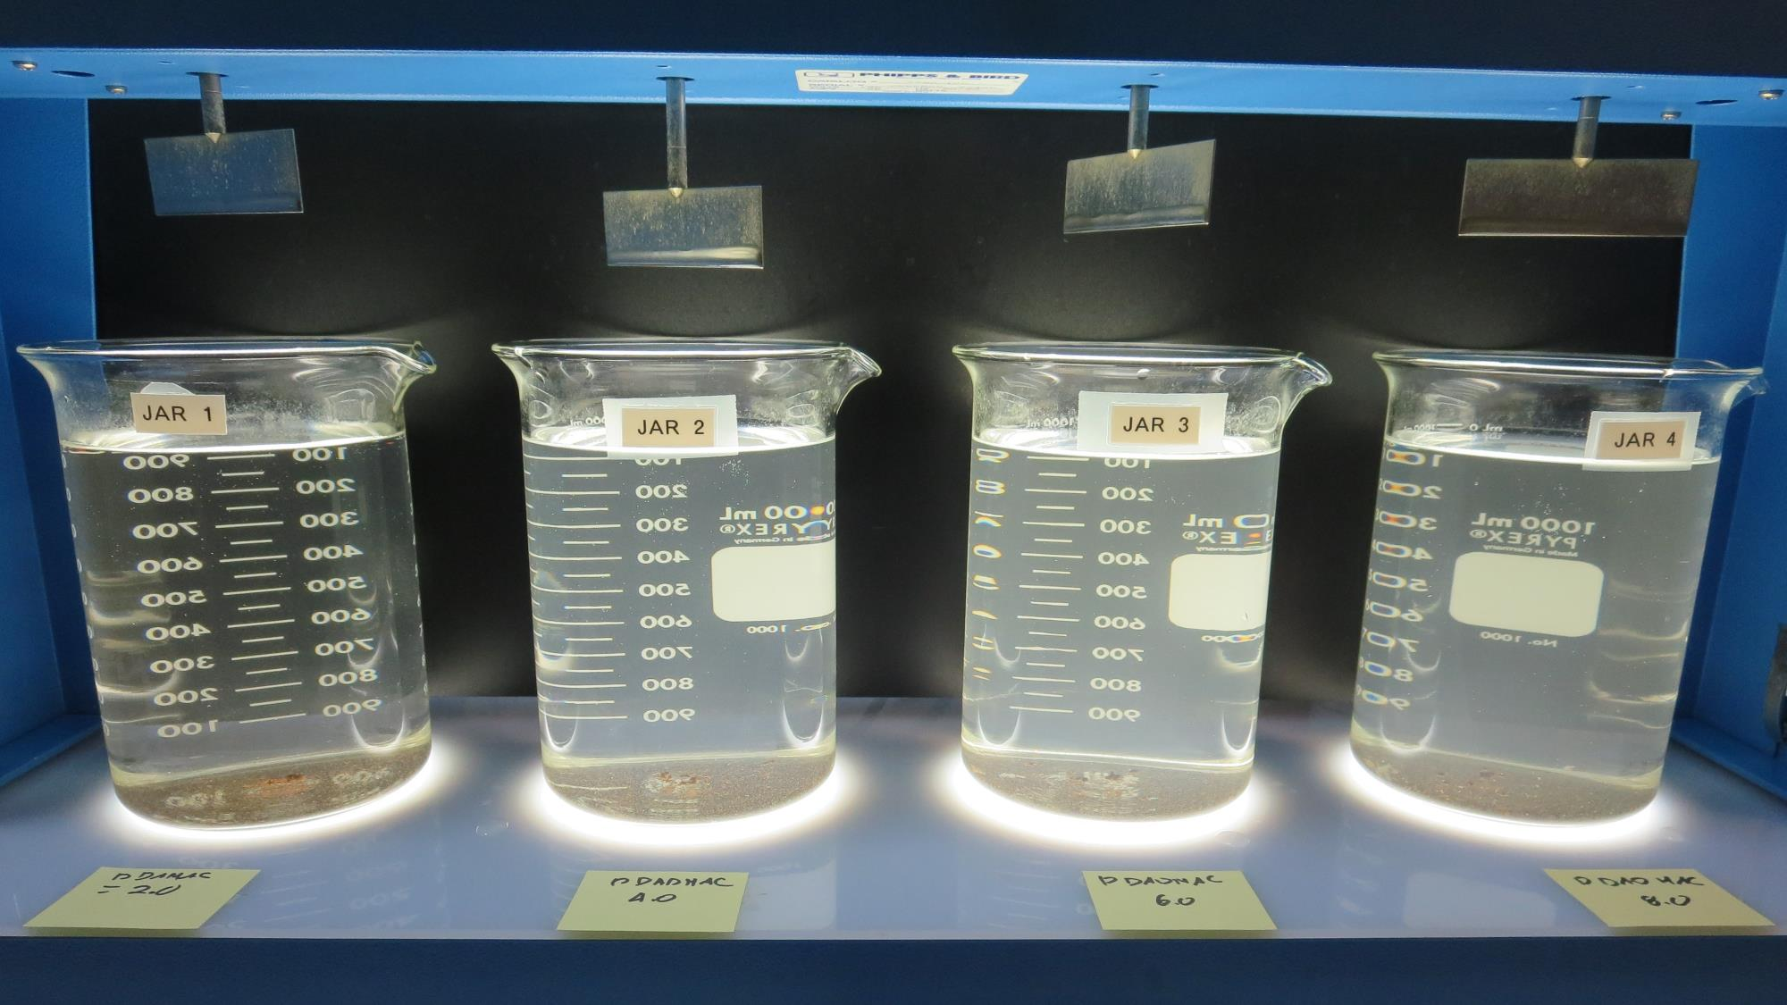
Jars 1-4: After 25-minutes of settling, settled water turbidity is taken.
2.0 mg/L pDADMAC
Filtrate: 0.57 NTU
UVT: 89.5%
UVA: 0.048/cm
UVA Reduction: 14.3%
Settled: 3.28 NTU
4.0 mg/L pDADMAC
Filtrate: 0.45 NTU
UVT: 91.8%
UVA: 0.037/cm
UVA Reduction: 33.9%
Settled: 5.92 NTU
6.0 mg/L pDADMAC
Filtrate: 1.22 NTU
UVT: 92.1%
UVA: 0.035/cm
UVA Reduction: 37.5%
Settled: 7.98 NTU
8.0 mg/L pDADMAC
Filtrate: 1.55 NTU
UVT: 92.0%
UVA: 0.036/cm
UVA Reduction: 35.7%
Settled: 8.67 NTU

Slide 15
Jars 5-8 Test
Flash Mix 20 Sec (200 RPM)
Floc Mix 5 min (20 RPM)
Applied Coagulant
CTC-00011

Slide 16
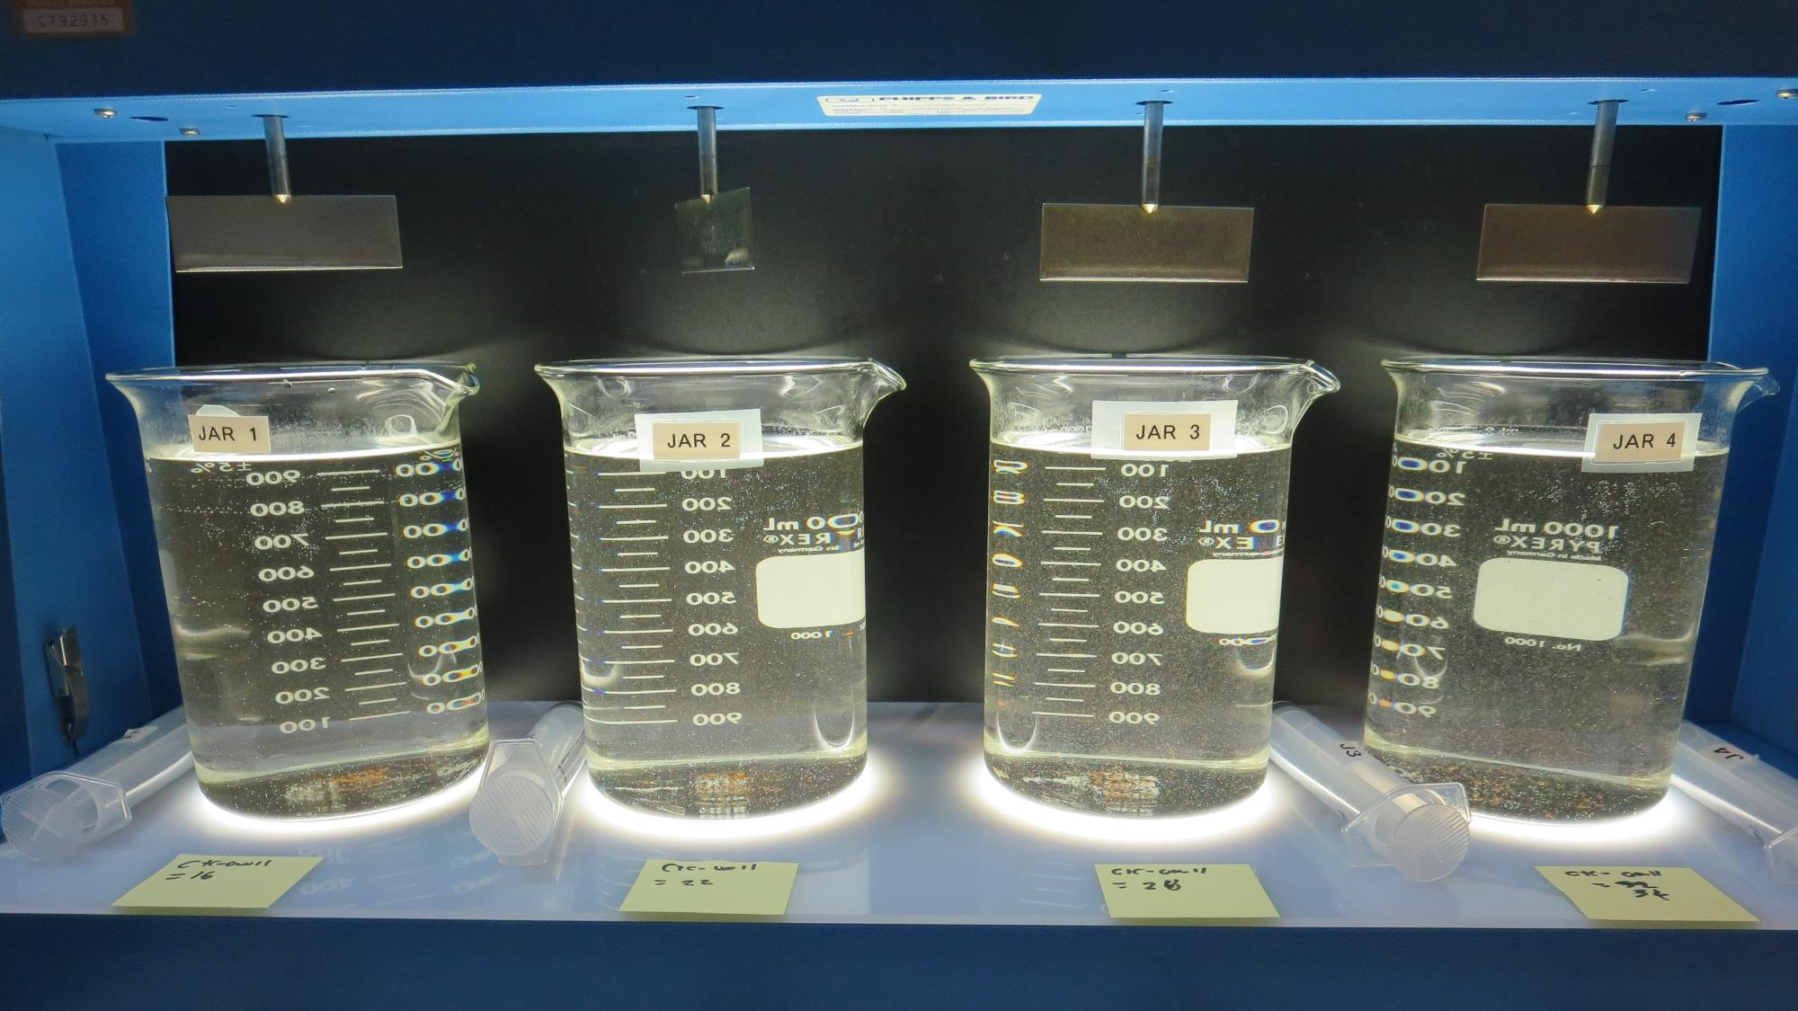
Jars 5-8: End of 5-minute flocculation (20 RPM) duration.
16 mg/L CTC-00011
Filtrate: 0.11 NTU
UVT: 92.6%
UVA: 0.033/cm
UVA Reduction: 41.1%
Settled: 2.98 NTU
22 mg/L CTC-00011
Filtrate: 0.10 NTU
UVT: 93.0%
UVA: 0.031/cm
UVA Reduction: 44.6%
Settled: 3.29 NTU
28 mg/L CTC-00011
Filtrate: 0.07 NTU
UVT: 94.9%
UVA: 0.022/cm
UVA Reduction: 60.7%
Settled: 2.1 NTU
34 mg/L CTC-00011
Filtrate: 0.08 NTU
UVT: 92.9%
UVA: 0.027/cm
UVA Reduction: 51.8%
Settled: 1.97 NTU

Slide 17
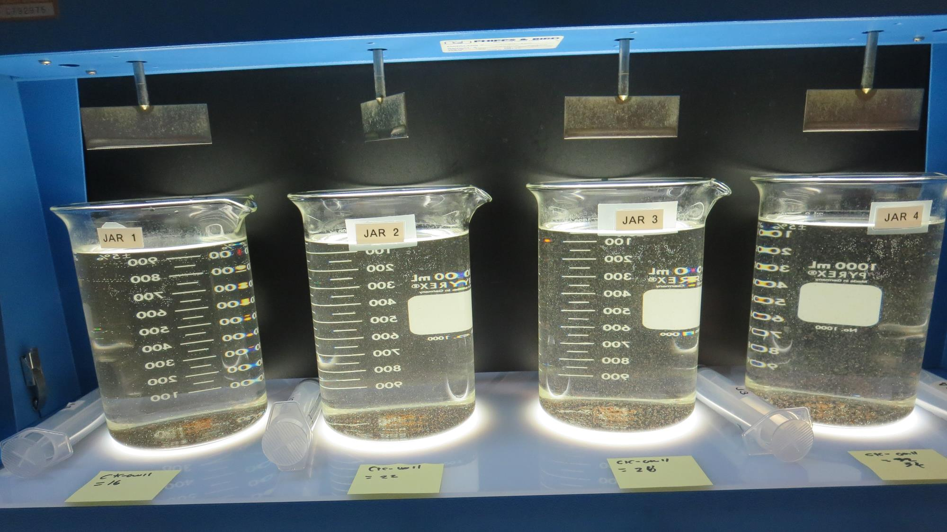
Jars 5-8: After 5 min of settling, 25 mL is syringed for filterability and %UVT/UVA.

Slide 18
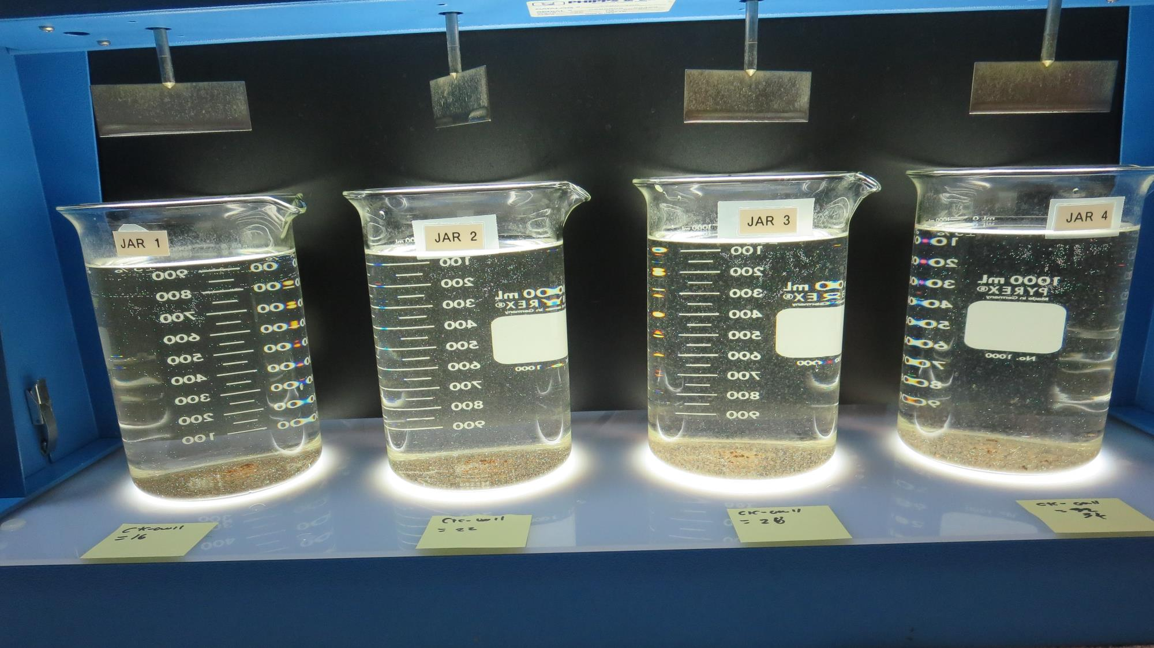
Jars 5-8: After 25-minutes of settling, settled water turbidity is taken.
16 mg/L CTC-00011
Filtrate: 0.11 NTU
UVT: 92.6%
UVA: 0.033/cm
UVA Reduction: 41.1%
Settled: 2.98 NTU
22 mg/L CTC-00011
Filtrate: 0.10 NTU
UVT: 93.0%
UVA: 0.031/cm
UVA Reduction: 44.6%
Settled: 3.29 NTU
28 mg/L CTC-00011
Filtrate: 0.07 NTU
UVT: 94.9%
UVA: 0.022/cm
UVA Reduction: 60.7%
Settled: 2.1 NTU
34 mg/L CTC-00011
Filtrate: 0.08 NTU
UVT: 92.9%
UVA: 0.027/cm
UVA Reduction: 51.8%
Settled: 1.97 NTU

Slide 19
Jars 9-12 Test
Flash Mix 20 Sec (200 RPM)
Floc Mix 5 min (20 RPM)
Applied Coagulant
9800 (ACH)

Slide 20
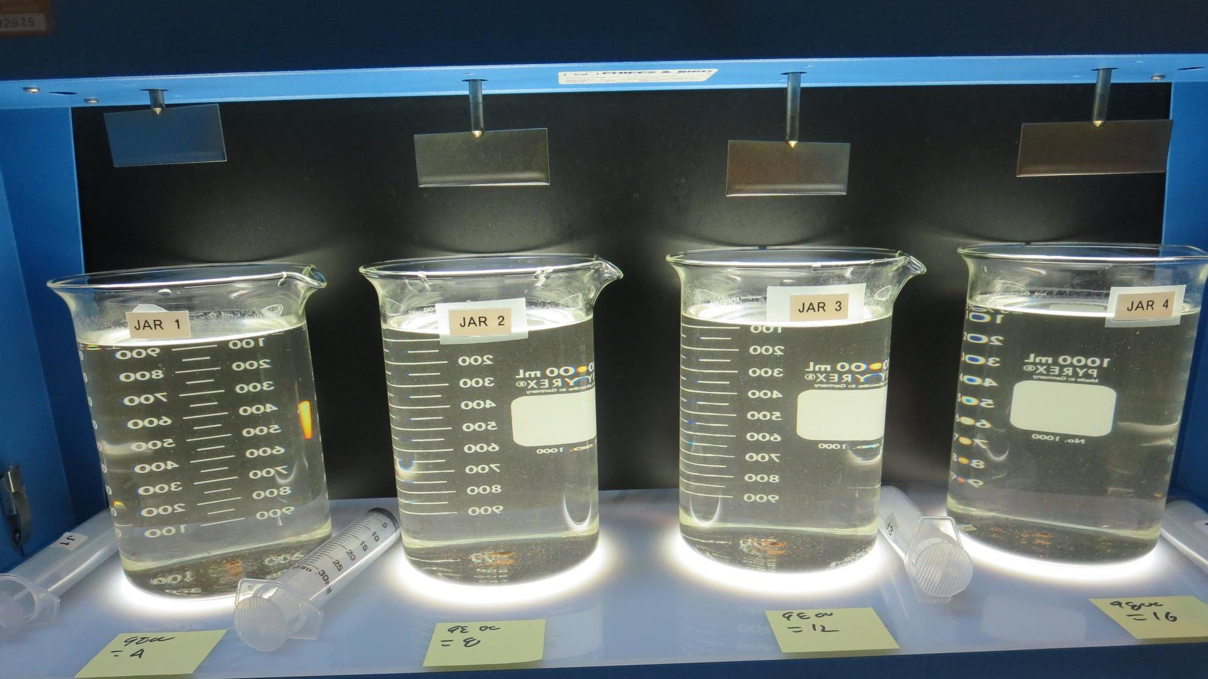
Jars 9-12: End of 5-minute flocculation (20 RPM) duration.
4 mg/L 9800
Filtrate: 0.64 NTU
UVT: 88.7%
UVA: 0.051/cm
UVA Reduction: 9.0%
Settled: 3.53 NTU
8 mg/L 9800
Filtrate: 0.45 NTU
UVT: 91.9%
UVA: 0.036/cm
UVA Reduction: 35.7%
Settled: 3.10 NTU
12 mg/L 9800
Filtrate: 0.15 NTU
UVT: 95.6%
UVA: 0.019/cm
UVA Reduction: 66.1%
Settled: 3.68 NTU
16 mg/L 9800
Filtrate: 0.05 NTU
UVT: 96.7%
UVA: 0.014/cm
UVA Reduction: 75.0%
Settled: 3.75 NTU

Slide 21
Jars 13-16 Test
Flash Mix 20 Sec (200 RPM)
Floc Mix 5 min (20 RPM)
Applied Coagulant
9800 (ACH)

Slide 22
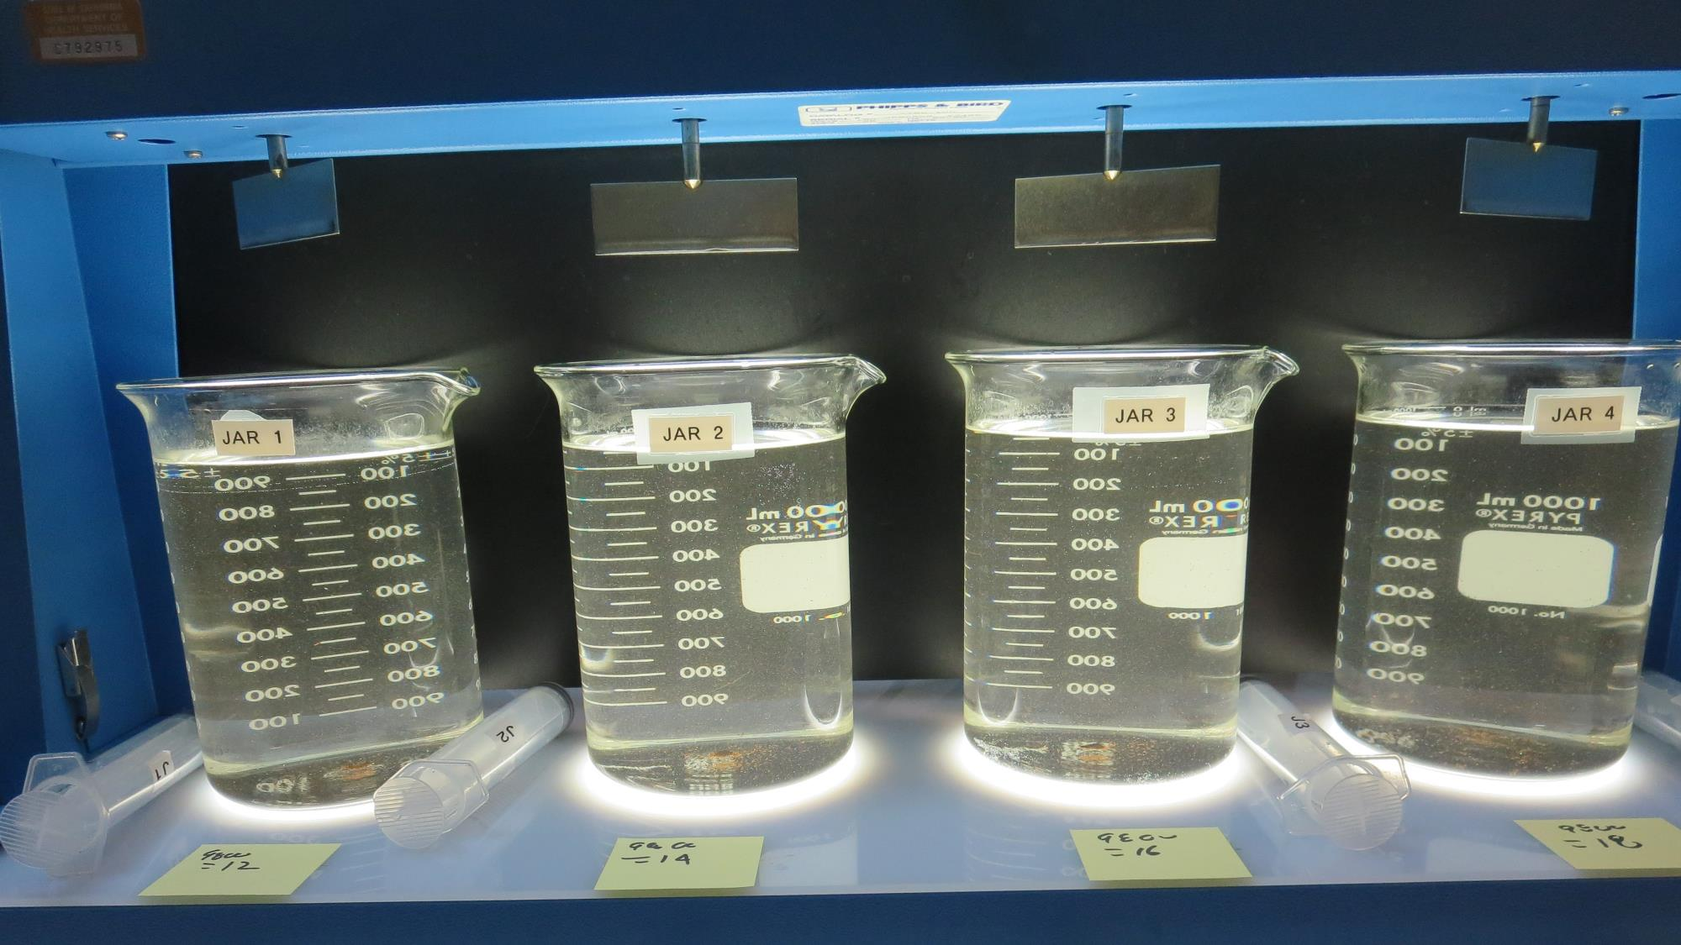
Jars 13-16: End of 5-minute flocculation (20 RPM) duration.
12 mg/L 9800
Filtrate: 0.09 NTU
UVT: 95.2%
UVA: 0.021/cm
UVA Reduction: 62.5%
Settled: 4.29 NTU
14 mg/L 9800
Filtrate: 0.08 NTU
UVT: 95.4%
UVA: 0.020/cm
UVA Reduction: 64.3%
Settled: 4.29 NTU
16 mg/L 9800
Filtrate: 0.05 NTU
UVT: 96.0%
UVA: 0.017/cm
UVA Reduction: 69.6%
Settled: 4.08 NTU
18 mg/L 9800
Filtrate: 0.22 NTU
UVT: 93.7%
UVA: 0.028/cm
UVA Reduction: 50.0%
Settled: 4.46 NTU

Slide 23
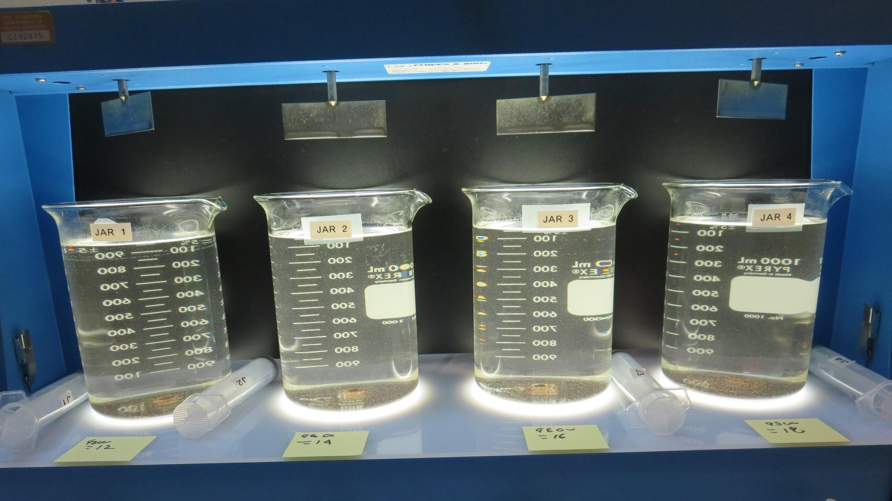
Jars 13-16: After 5 min of settling, 25 mL is syringed for filterability and %UVT/UVA.

Slide 24
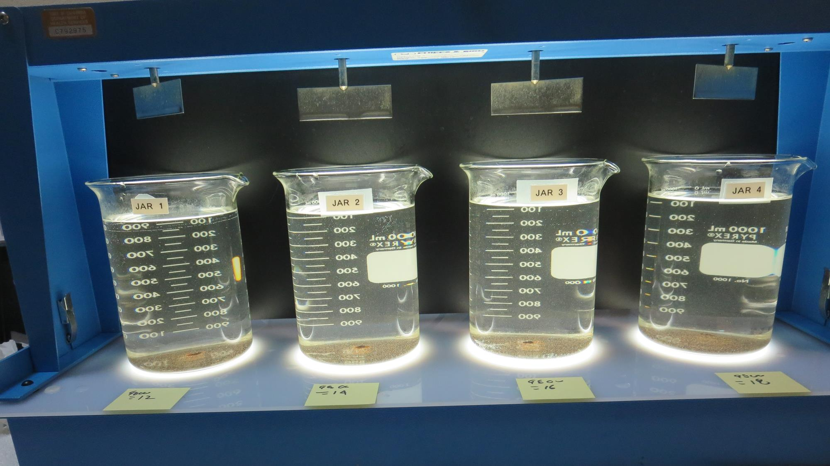
Jars 13-16: After 25-minutes of settling, settled water turbidity is taken.
12 mg/L 9800
Filtrate: 0.09 NTU
UVT: 95.2%
UVA: 0.021/cm
UVA Reduction: 62.5%
Settled: 4.29 NTU
14 mg/L 9800
Filtrate: 0.08 NTU
UVT: 95.4%
UVA: 0.020/cm
UVA Reduction: 64.3%
Settled: 4.29 NTU
16 mg/L 9800
Filtrate: 0.05 NTU
UVT: 96.0%
UVA: 0.017/cm
UVA Reduction: 69.6%
Settled: 4.08 NTU
18 mg/L 9800
Filtrate: 0.22 NTU
UVT: 93.7%
UVA: 0.028/cm
UVA Reduction: 50.0%
Settled: 4.46 NTU

Slide 25
Jar Testing for 1-Liter Jars:
Procedures for Most Treatment Plants
Fill jars with source water prior to coagulant injection and set paddle speed at 20-30 rpm
Add chemicals (i.e., NaOCl, primary coagulant, coagulant aid) to each jar
Flash mix for 15-30 seconds (200 rpm)
Slow mix for 5 minutes (20-30 rpm)
Settled for 5 minutes. Syringe 25 mL from each jar taken 1-inch below surface (25 mL/12 sec rate)
Filtered through 1.2 um isopore membrane into cuvette drip rate, 15 mL/(50-90 sec)
Measure filtrate turbidity, chlorine residual and %UVT/UVA
Measure settled water turbidity after 25 minutes of total setting
Record all data

Slide 26

Jar Test
Filterability Test Equipment
Turbidity Instrument
Syringe w/Luer-Lock Tip, 30 cc
(part#: 2225800, by Hach)
Swinnex Filter Holder, 25 mm (part#: SX0002500)
Isopore Membrane Filter, 1.2 um absolute
pore size,
Φ= 25 mm , thickness: 24 um,
hydrophilic polycarbonate membrane
(part #: RTTP02500)
Go to Sigma-Aldrich for laboratory supplies http://www.sigmaaldrich.com/united-states.html

Slide 27
Isopore Membrane Information
Categories | Information
trade name | Isopore
filter color | White
chemistry | Polycarbonate (PC)
water flow rate | Avg. 175 mL/min x cm² (typical results @ 10 psi)
media | Isopore®
wettability | Hydrophilic
porosity | 14.7%
pore size | 1.2 µm
bubble point at 23 °C | 1.0 bar, air with water
thickness | 24 µm
filter diameter (ø) | 25 mm
material size | polycarbonate, Hydrophilic, 1.2 µm, 25 mm, white, plain, 100

Slide 28
Isopore Membrane Background Information
The Isopore membrane is a polycarbonate, track-etched screen filter recommended for all analyses in which the sample is viewed on the surface of the membrane. The Isopore membrane is composed of polycarbonate film, which has a smooth, glass-like surface for clearer sample observation. The unique manufacturing process of the membrane ensures a precise pore diameter and a consistent pore size for accurate separation of samples by size. Matched-weight filters are not usually required because of low, constant tar and ash weights.
Features & Benefits:
Membrane structure retains particles on the surface, simplifying counting and analysis

Slide 29
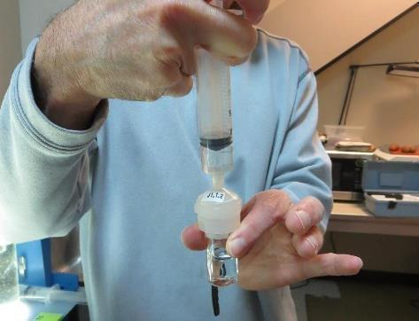

Jar Test - Filterability Test
Syringe ~ 25 mL from jar (after 5-minutes of settling)
Filter-to-waste 3-5 mL
Filter directly into clean cuvette
Measure turbidity
Note: Take several readings before recording final NTU results. Micro bubbles can adhere to glass causing false NTU readings. To remove bubbles, tilt cuvette up to 90 degrees.

Slide 30

Contact
Guy Schott, P.E.
State Water Resources Control Board
Division of Drinking Water
Santa Rosa, CA
Go to Stock Solution/Dose calculations/Jar Test Results for tools to download
www.waterboards.ca.gov/drinking_water/programs/districts/mendocino_district.html
Jar Testing Done Right training video: https://www.youtube.com/watch?v=aGByyxhelkI
Email: Guy Schott - Guy.Schott@waterboards.ca.gov
Office Number: 707-576-2732

