Slide 1
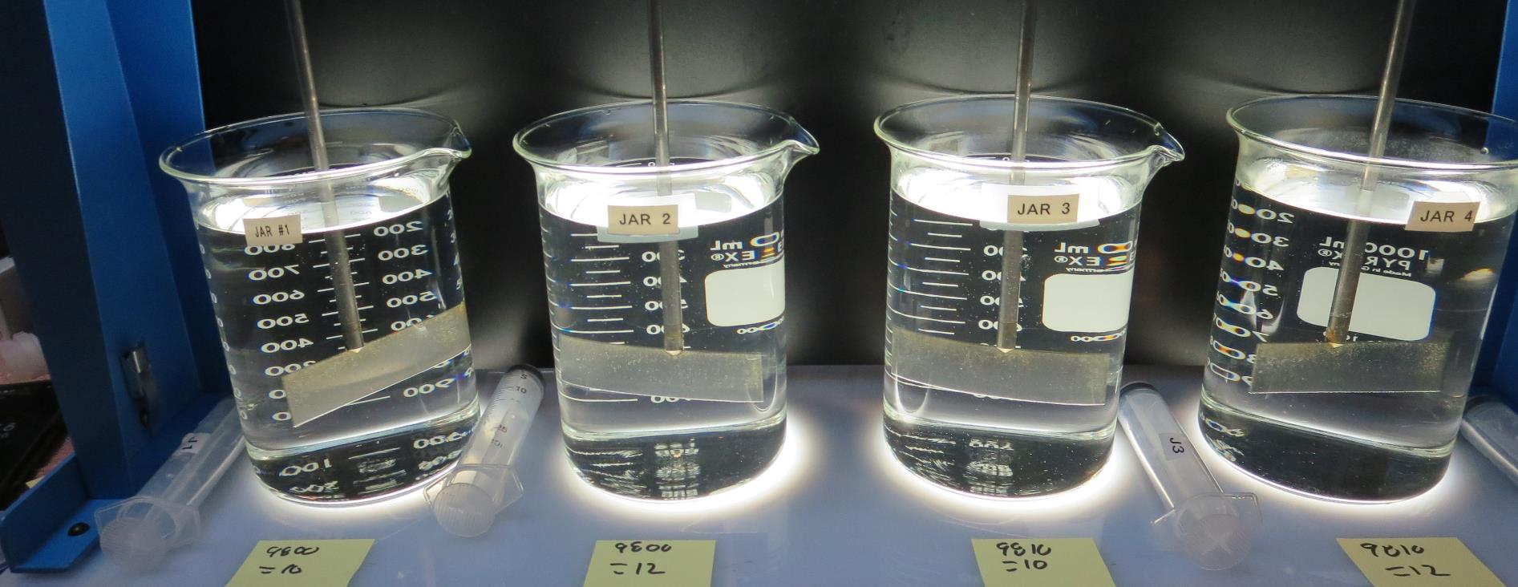
Lazy S Mobile Ranch
CA1700609, Lake County, Jar Test
by Guy Schott, P.E. May 5, 2023

Slide 2
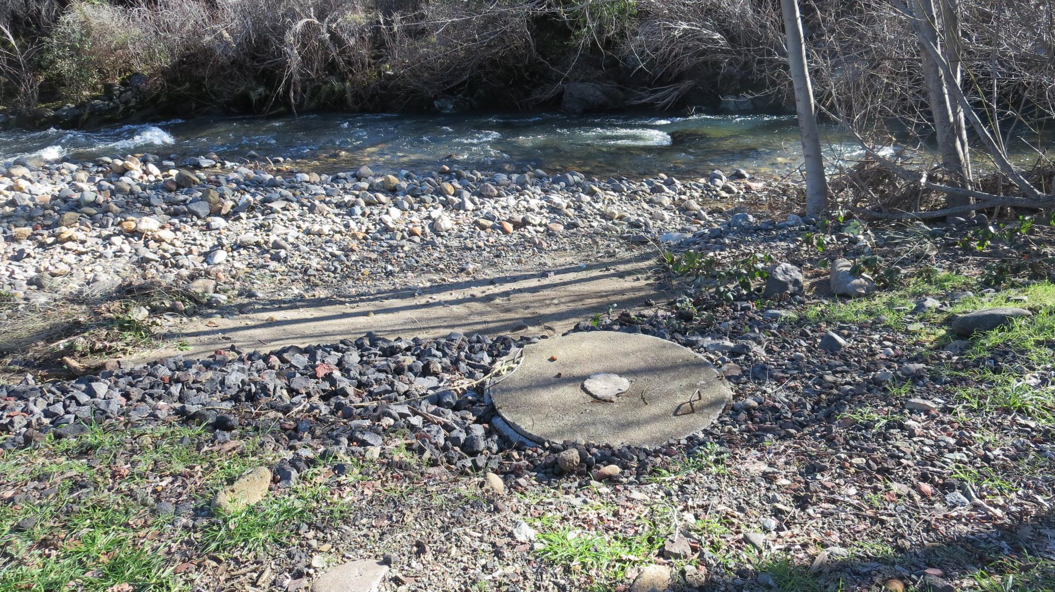
St. Helena Creek/Source

Slide 3
Lazy S Mobile Ranch Source &
Water Characteristics, May 5, 2023
Source – St. Helena Creek
Alkalinity: 96 mg/L as CaCO₃
Turbidity: 0.35 NTU
UVT: 93.2%,
UVA: 0.030/cm
0.4 um Filtered
Turbidity: 0.16 NTU
UVT: 93.3%,
UVA: 0.030/cm
Plant Treatment
Settled Water
Turbidity: 1.55 NTU
Post Multi-Media Filter
Alkalinity: 95 mg/L as CaCO₃
Turbidity: 0.09 NTU
UVT: 98.4%,
UVA: 0.006/cm
Post Membrane/GAC Filters
Turbidity: 0.04 NTU
UVT: 99.4%,
UVA: 0.002/cm

Slide 4
Applied Coagulants for Jar Testing (1)
Pro Pac 9800 (NTU Technologies)
50% Aluminum Chlorohydrate
50% Water
23.62% Al₂O₃
12.5% Al
83% Basicity
SG = 1.25-1.34
NSF limit: 250 mg/L as Product
NTU Technologies
Pro Pac 9810
45-50% Aluminum Chlorohydrate
45-50% Water
~22.4% Al₂O₃
~11.9% Al
83% Basicity
5% polyamine (50% water, 50% active polyamines)
SG = 1.25-1.34
NSF limit: 200 mg/L as Product;
Product dose 10 mg/L = 0.25 mg/L polyamines active

Slide 5
Applied Coagulants for Jar Testing (2)
961 (NTU Technologies)
32% Polyaluminum Hydroxychlorosulfate
2% pDADMAC (blend?)
66% Water
SG = 1.2-1.24
NSF limit: 255 mg/L as Product
Product dose 10 mg/L = 0.1-0.2 mg/L pDADMAC

Slide 6
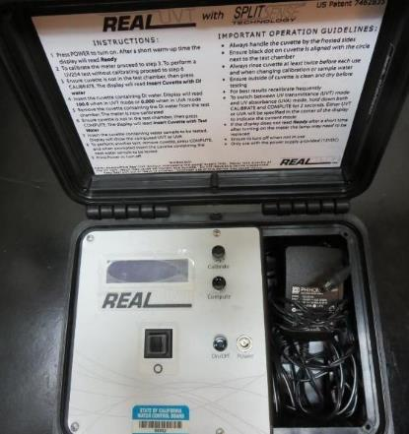
UVT/UVA, pathlength 10 mm
UV transmittance (UVT) is a measurement of the amount of ultraviolet light (254 nm) that passes through a water sample compared to the amount of light that passes through a pure water sample. The measurement is expressed as % UVT.
%UVT = 10^{(-UVA)} x 100%
UV absorbance (UVA) is calculated as a relative measure of the amount of light absorbed by a water sample compared with the amount of light absorbed by a pure water sample.
UVA = -log(%UVT/100)

Slide 7
Coagulant Information
Unless stated otherwise, all coagulant doses are reported as Product (100% strength).
Aluminum Sulfate doses are reported as hydrated Al₂(SO₄)₃*14.3H₂0.
Preparation of coagulant stock solutions are generally 1.0 and/or 0.1 percent strength using 100 and/or 200 mL volumetric flasks.
Finnpipette F2 variable volume pipette, capacity 100-1000 micro liters is used for stock solution preparation and coagulant aid jar test dosing.
Finnpipette F2 variable volume pipette, capacity 0.5-5 mL is used for primary coagulant jar test dosing.

Slide 8
Lazy S Mobile Ranch; Jar Test 1 - 8 Results
Flash Mix 200 RPM (20 sec); Floc Mix 20 RPM (5 min)
Jar# | 9800 mg/L | Filtrate NTU | Filtrate %UVT | Filtrate UVA/cm | %UVA Reduction | Settle NTU 25 min
J1 | 6 | 0.11 | 95.5 | 0.019 | 36.7 | 0.40
J2 | 8 | 0.04 | 98.0 | 0.008 | 73.3 | 0.65
J3 | 12 | 0.04 | 98.2 | 0.007 | 76.7 | 0.70
J4 | 16 | 0.04 | 98.5 | 0.006 | 80.0 | 0.66
J5 | 6 | 0.19 | 96.0 | 0.017 | 43.3 | 0.51
J6 | 8 | 0.19 | 96.4 | 0.015 | 50.0 | 0.62
J7 | 10 | 0.04 | 98.3 | 0.007 | 76.7 | 0.54
J8 | 12 | 0.03 | 98.4 | 0.007 | 76.7 | 0.76

Slide 9
Lazy S Mobile Ranch; Jar Test 9 - 16 Results
Flash Mix 200 RPM (20 sec); Floc Mix 20 RPM (5 min)
Jar# | 9810 mg/L | 961 mg/L | Filtrate NTU | Filtrate %UVT | Filtrate UVA/cm | %UVA Reduction | Settle NTU 25 min
J9 | 6 | - | 0.04 | 97.2 | 0.012 | 60.0 | 0.49
J10 | 8 | - | 0.03 | 97.6 | 0.010 | 66.7 | 0.78
J11 | 10 | - | 0.03 | 98.0 | 0.008 | 73.3 | 0.58
J12 | 12 | - | 0.03 | 98.0 | 0.008 | 73.3 | 0.83
J13 | - | 18 | 0.05 | 96.5 | 0.015 | 50.0 | 0.49
J14 | - | 24 | 0.03 | 97.0 | 0.013 | 56.7 | 0.56
J15 | - | 30 | 0.03 | 97.2 | 0.012 | 60.0 | 0.38
J16 | - | 36 | 0.04 | 97.4 | 0.011 | 63.3 | 0.40

Slide 10
Lazy S Mobile Ranch; Jar Test 17 - 20 Results
Flash Mix 200 RPM (20 sec); Floc Mix 20 RPM (5 min)
Jar# | 9800 mg/L | 9810 mg/L | Filtrate NTU | Filtrate %UVT | Filtrate UVA/cm | %UVA Reduction | Settle NTU 25 min
J17 | 10 | - | 0.05 | 98.3 | 0.007 |  | 0.55
J18 | 12 | - | 0.04 | 98.3 | 0.007 |  | 0.96
J19 | - | 10 | 0.10 | 97.5 | 0.010 |  | 0.63
J20 | - | 12 | 0.11 | 97.6 | 0.010 |  | 0.69

Slide 11
Jar Testing for 1-Liter Jars:
Procedures for Most Treatment Plants
Fill jars with source water prior to coagulant injection and set paddle speed at 20-30 rpm
Add chemicals (i.e., NaOCl, primary coagulant, coagulant aid) to each jar
Flash mix for 15-30 seconds (200 rpm)
Slow mix for 5 minutes (20-30 rpm)
Settled for 5 minutes. Syringe 25 mL from each jar taken 1-inch below surface (25 mL/12 sec rate)
Filtered through 1.2 um isopore membrane into cuvette drip rate, 15 mL/(50-90 sec)
Measure filtrate turbidity, chlorine residual and %UVT/UVA
Measure settled water turbidity after 25 minutes of total setting
Record all data

Slide 12

Jar Test
Filterability Test Equipment
Turbidity Instrument
Syringe w/Luer-Lock Tip, 30 cc
(part#: 2225800, by Hach)
Swinnex Filter Holder, 25 mm (part#: SX0002500)
Isopore Membrane Filter, 1.2 um absolute
pore size,
Φ= 25 mm , thickness: 24 um,
hydrophilic polycarbonate membrane
(part #: RTTP02500)
Go to Sigma-Aldrich for laboratory supplies http://www.sigmaaldrich.com/united-states.html

Slide 13
Isopore Membrane Information
Categories | Information
trade name | Isopore
filter color | White
chemistry | Polycarbonate (PC)
water flow rate | Avg. 175 mL/min x cm² (typical results @ 10 psi)
media | Isopore®
wettability | Hydrophilic
porosity | 14.7%
pore size | 1.2 µm
bubble point at 23 °C | 1.0 bar, air with water
thickness | 24 µm
filter diameter (ø) | 25 mm
material size | polycarbonate, Hydrophilic, 1.2 µm, 25 mm, white, plain, 100

Slide 14
Isopore Membrane Background Information
The Isopore membrane is a polycarbonate, track-etched screen filter recommended for all analyses in which the sample is viewed on the surface of the membrane. The Isopore membrane is composed of polycarbonate film, which has a smooth, glass-like surface for clearer sample observation. The unique manufacturing process of the membrane ensures a precise pore diameter and a consistent pore size for accurate separation of samples by size. Matched-weight filters are not usually required because of low, constant tar and ash weights.
Features & Benefits:
Membrane structure retains particles on the surface, simplifying counting and analysis

Slide 15
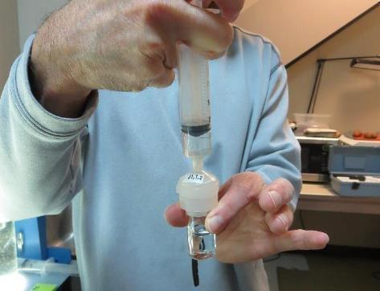

Jar Test - Filterability Test
Syringe ~ 25 mL from jar (after 5-minutes of settling)
Filter-to-waste 3-5 mL
Filter directly into clean cuvette
Measure turbidity
Note: Take several readings before recording final NTU results. Micro bubbles can adhere to glass causing false NTU readings. To remove bubbles, tilt cuvette up to 90 degrees.

Slide 16

Contact
Guy Schott, P.E.
State Water Resources Control Board
Division of Drinking Water
Santa Rosa, CA
Go to Stock Solution/Dose calculations/Jar Test Results for tools to download
www.waterboards.ca.gov/drinking_water/programs/districts/mendocino_district.html
Jar Testing Done Right training video: https://www.youtube.com/watch?v=aGByyxhelkI
Email: Guy Schott - Guy.Schott@waterboards.ca.gov
Office Number: 707-576-2732

