Slide 1
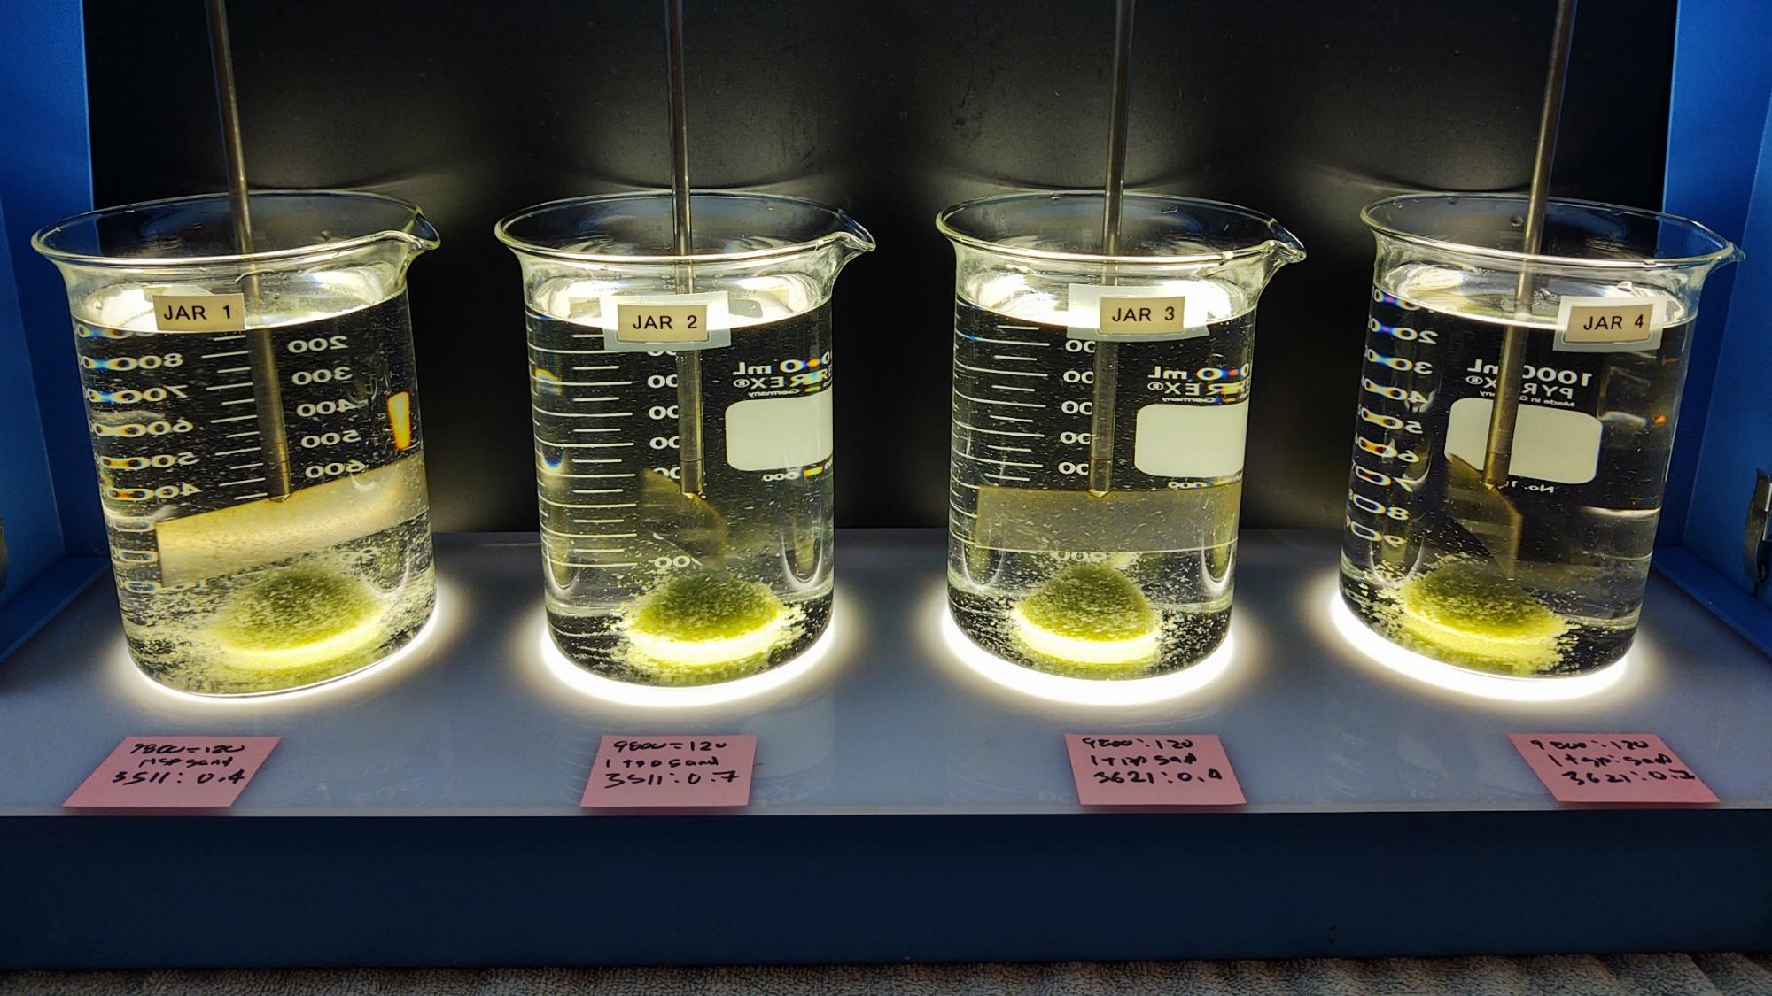
Clearlake Oaks CWD
CA1710001
Lake County
Jar Test
by Guy Schott, P.E.
October 21, 2022

Slide 2
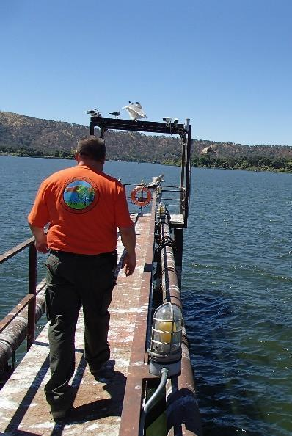
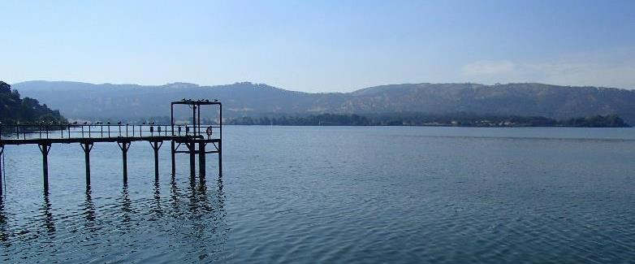
Clearlake Oaks CWD
Source Water: Clear Lake
Conventional Treatment

Slide 3
Clearlake Oaks CWD.:
Source Water Characteristics
October 21, 2022
Source (at Pier) – After Ozonation
pH: x
Turbidity: 7.5 NTU
UVT: 80.2%
UVA: 0.095/cm
0.4 um Filtered
Turbidity: 0.29 NTU
UVT: 85.5%
UVA: 0.067/cm

Slide 4
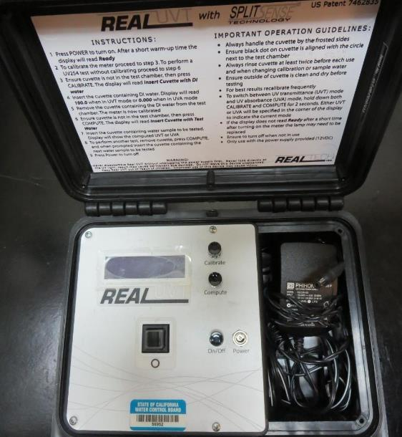
UVT/UVA, pathlength 10 mm
UV transmittance (UVT) is a measurement of the amount of ultraviolet light (commonly at 254 nm due to its germicidal effect) that passes through a water sample compared to the amount of light that passes through a pure water sample. The measurement is expressed as a percentage, % UVT.
%UVT = 10^{(-UVA)} x 100%
UV absorbance (UVA) is calculated as a relative measure of the amount of light absorbed by a water sample compared with the amount of light absorbed by a pure water sample.
UVA = -log(%UVT/100)

Slide 5
Applied Coagulants for Jar Testing (1)
NTU Technologies
Pro Pac 9800
50% Aluminum Chlorohydrate
50% Water
23.62% Al₂O₃
12.5% Al
83% Basicity
SG = 1.25-1.34
NSF limit: 250 mg/L as Product
10 mg/L as 9800 = Reduction 1.18 mg/L as CaCO₃
Veolia Water Solutions
HYDREX 3511
Acrylamide Polymer
Low anionic polymer (dry)
NSF limit: 1.0 mg/L as Product
HYDREX 3621
Acrylamide Polymer
Cationic polymer (dry)
NSF limit: 1.0 mg/L as Product

Slide 6
Applied Coagulants for Jar Testing (2)
NTU Technologies
Pro Pac 9810
45-50% Aluminum Chlorohydrate
45-50% Water
~22.4% Al₂O₃
~11.9% Al
83% Basicity
5% polyamine (50% water, 50% active polyamines)
SG = 1.25-1.34
NSF limit: 200 mg/L as Product;
Product dose 40 mg/L = 1 mg/L polyamines active
NTU Technologies
AD313P
Acrylamide Polymer
Anionic polymer (dry)
NSF limit: 1.0 mg/L as Product
NTU Technologies
CD313P
Acrylamide Polymer
Cationic polymer (dry)
NSF limit: 1.0 mg/L as Product

Slide 7
Coagulant Information
Unless stated otherwise, all coagulant doses are reported as Product (100% strength).
Preparation of coagulant stock solutions are generally 1.0 and/or 0.1 percent strength using 100 and/or 200 mL volumetric flasks.
Finnpipette F2 variable volume pipette, capacity 100-1000 micro liters is used for stock solution preparation and coagulant aid jar test dosing.
Finnpipette F2 variable volume pipette, capacity 0.5-5 mL is used for primary coagulant jar test dosing.

Slide 8
Source: Clear Lake (Pier): Jar Test 1-8 Results
Flash 2 min (200 RPM), Floc1 2 min (110 RPM), Floc2 2 min (60 RPM)
Jar # | O₃ applied | 9800 mg/L | Ballast Sand 110 um | HYDREX 3511 mg/L | Filtrate NTU | Filtrate %UVT | Filtrate UVA/cm | %UVA Reduction | Settle NTU 5 min
J1 | Yes | 100 | 1 tsp | 0.7 | 0.11 | 89.9 | 0.046 | 31.3 | 0.83
J2 | Yes | 110 | 1 tsp | 0.7 | 0.18 | 89.9 | 0.046 | 31.3 | 0.79
J3 | Yes | 120 | 1 tsp | 0.7 | 0.19 | 89.7 | 0.047 | 29.9 | 0.81
J4 | Yes | 130 | 1 tsp | 0.7 | 0.13 | - | - | - | 0.89
J5 | Yes | 80 | 1 tsp | 0.7 | 0.28 | 89.2 | 0.049 | 26.9 | 1.07
J6 | Yes | 90 | 1 tsp | 0.7 | 0.30 | 89.1 | 0.049 | 26.9 | 1.20
J7 | Yes | 160 | 1 tsp | 0.7 | 0.09 | 90.8 | 0.041 | 38.8 | 0.47
J8 | Yes | 170 | 1 tsp | 0.7 | 0.08 | 90.9 | 0.040 | 40.3 | 0.31

Slide 9
Source: Clear Lake (Pier): Jar Test 9-16 Results
Flash 2 min (200 RPM), Floc1 2 min (110 RPM), Floc2 2 min (60 RPM)
Jar # | O₃ applied | 9800 mg/L | Ballast Sand 110 um | HYDREX 3511 mg/L | HYDREX 3621 mg/L | Filtrate NTU | Filtrate %UVT | Filtrate UVA/cm | %UVA Reduction | Settle NTU 5 min
J9 | Yes | 120 | 1 tsp | 0.3 | - | 0.19 | 89.7 | 0.047 | 29.9 | 1.40
J10 | Yes | 120 | 1 tsp | 0.4 | - | 0.21 | 89.6 | 0.047 | 29.9 | 1.31
J11 | Yes | 120 | 1 tsp | 0.5 | - | 0.18 | 89.6 | 0.047 | 29.9 | 1.05
J12 | Yes | 120 | 1 tsp | 0.7 | - | 0.16 | 89.8 | 0.046 | 31.3 | 1.00
J13 | Yes | 120 | 1 tsp | 0.4 | - | 0.11 | 89.8 | 0.046 | 31.3 | 1.00
J14 | Yes | 120 | 1 tsp | 0.7 | - | 0.12 | 90.0 | 0.045 | 32.8 | 0.98
J15 | Yes | 120 | 1 tsp | - | 0.4 | 0.06 | 89.9 | 0.046 | 31.3 | 0.59
J16 | Yes | 120 | 1 tsp | - | 0.7 | 0.06 | 90.3 | 0.044 | 34.3 | 0.49

Slide 10
Source: Clear Lake (Pier): Jar Test 17-24 Results
Flash 20 sec (200 RPM), Floc 5 min (30 RPM)
Jar # | O₃ applied | 9810 mg/L | Filtrate NTU | Filtrate %UVT | Filtrate UVA/cm | %UVA Reduction | Settle NTU 25 min
J17 | Yes | 90 | 0.08 | 90.0 | 0.045 | 32.8 | 0.50
J18 | Yes | 100 | 0.05 | 90.4 | 0.043 | 35.8 | 0.46
J19 | Yes | 110 | 0.06 | 90.6 | 0.042 | 37.3 | 0.35
J20 | Yes | 120 | 0.06 | 90.6 | 0.042 | 37.3 | 0.33
J21 | Yes | 100 | 0.06 | 90.5 | 0.043 | 35.8 | 0.33
J22 | Yes | 110 | 0.05 | 90.3 | 0.044 | 34.3 | 0.32
J23 | Yes | 120 | 0.05 | 90.4 | 0.043 | 35.8 | 0.38
J24 | Yes | 130 | 0.05 | 90.6 | 0.042 | 37.3 | 0.31

Slide 11
Source: Clear Lake (Pier): Jar Test 25-28 Results
Flash 2 min (200 RPM), Floc1 2 min (110 RPM), Floc2 2 min (60 RPM)
Jar # | O₃ applied | 9800 mg/L | Ballast Sand 110 um | HYDREX 3511 mg/L | HYDREX 3611 mg/L | Filtrate NTU | Filtrate %UVT | Filtrate UVA/cm | %UVA Reduction | Settle NTU 5 min
J25 | Yes | 120 | 1 tsp | 0.4 | - | 0.12 | 90.1 | 0.045 | 32.8 | 1.03
J26 | Yes | 120 | 1 tsp | 0.7 | - | 0.15 | 89.9 | 0046 | 31.3 | 0.84
J27 | Yes | 120 | 1 tsp | - | 0.4 | 0.06 | 90.3 | 0.044 | 34.3 | 0.86
J28 | Yes | 120 | 1 tsp | - | 0.7 | 0.06 | 90.2 | 0.044 | 34.3 | 0.66

Slide 12
Source: Clear Lake (Pier): Jar Test 29-36 Results
Flash 2 min (200 RPM), Floc1 2 min (110 RPM), Floc2 2 min (60 RPM)
Jar # | O₃ applied | 9800 mg/L | Ballast Sand 110 um | AD313P mg/L | CD313P mg/L | Filtrate NTU | Filtrate %UVT | Filtrate UVA/cm | %UVA Reduction | Settle NTU 5 min
J29 | Yes | 120 | 1 tsp | 0.15 | - | 0.17 | 90.1 | 0.045 | 32.8 | 0.79
J30 | Yes | 120 | 1 tsp | 0.25 | - | 0.18 | 90.4 | 0.043 | 35.8 | 0.69
J31 | Yes | 120 | 1 tsp | 0.40 | - | 0.13 | 90.2 | 0.044 | 34.3 | 0.66
J32 | Yes | 120 | 1 tsp | 0.50 | - | 0.07 | 90.5 | 0.043 | 35.8 | 0.45
J33 | Yes | 120 | 1 tsp | - | 0.15 | 0.06 | 90.3 | 0.044 | 34.3 | 0.82
J34 | Yes | 120 | 1 tsp | - | 0.25 | 0.06 | 90.1 | 0.045 | 32.8 | 0.76
J35 | Yes | 120 | 1 tsp | - | 0.40 | 0.06 | 90.2 | 0.044 | 34.3 | 0.63
J36 | Yes | 120 | 1 tsp | - | 0.50 | 0.06 | 90.2 | 0.044 | 34.3 | 0.58

Slide 13
Source: Clear Lake (Pier): Jar Test 37-40 Results
Flash 2 min (200 RPM), Floc1 2 min (110 RPM), Floc2 2 min (60 RPM)
Pre-ozone was applied
Jar # | 9800 mg/L | Ballast Sand 110 um | HYDREX 3511 mg/L | HYDREX 3611 mg/L | AD313P mg/L | CD313P mg/L | Filtrate NTU | Filtrate %UVT | Filtrate UVA/cm | %UVA Reduction | Settle NTU 5 min
J37 | 120 | 1 tsp | 0.5 | - | - | - | 0.10 | 90.0 | 0.045 | 32.8 | 0.75
J38 | 120 | 1 tsp | - | 0.5 | - | - | 0.09 | 89.9 | 0.046 | 31.3 | 0.89
J39 | 120 | 1 tsp | - | - | 0.5 | - | 0.14 | 89.9 | 0.046 | 31.3 | 0.74
J40 | 120 | 1 tsp | - | - | - | 0.5 | 0.06 | 90.4 | 0.043 | 35.8 | 0.52

Slide 14
Source: Clear Lake (Pier): Jar Test 41-44 Results
Flash 2 min (200 RPM), Floc1 2 min (110 RPM), Floc2 2 min (60 RPM)
Pre-ozone was applied
Jar # | 9810 mg/L | Ballast Sand 110 um | HYDREX 3511 mg/L | HYDREX 3611 mg/L | AD313P mg/L | CD313P mg/L | Filtrate NTU | Filtrate %UVT | Filtrate UVA/cm | %UVA Reduction | Settle NTU 5 min
J41 | 120 | 1 tsp | 0.5 | - | - | - | 0.16 | 90.4 | 0.043 | 35.8 | 1.50
J42 | 120 | 1 tsp | - | 0.5 | - | - | 0.08 | 89.7 | 0.047 | 29.9 | 1.36
J43 | 120 | 1 tsp | - | - | 0.5 | - | 0.08 | 90.0 | 0.045 | 32.8 | 1.37
J44 | 120 | 1 tsp | - | - | - | 0.5 | 0.07 | 89.9 | 0.046 | 31.3 | 0.94

Slide 15
Jar Testing – Procedures for Actiflo, 1-Liter Jars
Fill jars with source water prior to coagulant injection and set paddle speed at 30 rpm
Add chemicals (i.e., NaOCl, primary coagulant, coagulant aid) to each jar
Jars 1 – 20 (Actiflow only): Start flash mix and hold for 2 minutes (200 rpm)
Add ballast sand and acrylamide polymer during flash mixing
Reduce paddled speed to 110 RPM for 2 minutes
For Jars 21 – 44 (Actiflow only): Flash 200 for 20 sec, then reduce paddle speed to 110 and add sand/polymer
Reduce paddle speed to 60 RPM for 2 minutes
Raise paddles out of water and settled for 1 minute
Syringe 25 mL from each jar taken 1-inch below surface (25 mL/12 sec rate)
Filtered through 1.2 um isopore membrane into cuvette (drip rate, 15 mL/90 sec)
Measure filtrate turbidity, chlorine residual and %UVT or UVA
Measure settled water turbidity after 5 minutes of total setting
Record all data

Slide 16

Jar Test
Filterability Test Equipment
Turbidity Instrument
Syringe w/Luer-Lock Tip, 30 cc
(part#: 2225800, by Hach)
Swinnex Filter Holder, 25 mm (part#: SX0002500)
Isopore Membrane Filter, 1.2 um absolute
pore size,
Φ= 25 mm , thickness: 24 um,
hydrophilic polycarbonate membrane
(part #: RTTP02500)
Go to Sigma-Aldrich for laboratory supplies http://www.sigmaaldrich.com/united-states.html

Slide 17
Isopore Membrane Information
Categories | Information
trade name | Isopore
filter color | White
chemistry | Polycarbonate (PC)
water flow rate | Avg. 175 mL/min x cm² (typical results @ 10 psi)
media | Isopore®
wettability | Hydrophilic
porosity | 14.7%
pore size | 1.2 µm
bubble point at 23 °C | 1.0 bar, air with water
thickness | 24 µm
filter diameter (ø) | 25 mm
material size | polycarbonate, Hydrophilic, 1.2 µm, 25 mm, white, plain, 100

Slide 18
Isopore Membrane Background Information
The Isopore membrane is a polycarbonate, track-etched screen filter recommended for all analyses in which the sample is viewed on the surface of the membrane. The Isopore membrane is composed of polycarbonate film, which has a smooth, glass-like surface for clearer sample observation. The unique manufacturing process of the membrane ensures a precise pore diameter and a consistent pore size for accurate separation of samples by size. Matched-weight filters are not usually required because of low, constant tar and ash weights.
Features & Benefits:
Membrane structure retains particles on the surface, simplifying counting and analysis

Slide 19
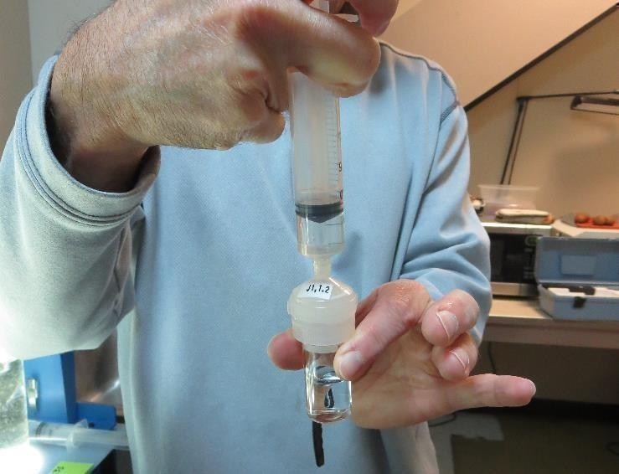

Jar Test - Filterability Test
Syringe ~ 25 mL from jar (after 5-minutes of settling)
Filter-to-waste 3-5 mL
Filter directly into clean cuvette
Measure turbidity
Note: Take several readings before recording final NTU results. Micro bubbles can adhere to glass causing false NTU readings. To remove bubbles, tilt cuvette up to 90 degrees.

Slide 20

Contact
Guy Schott, P.E.
State Water Resources Control Board
Division of Drinking Water
Santa Rosa, CA
Go to Stock Solution/Dose calculations/Jar Test Results for tools to download
www.waterboards.ca.gov/drinking_water/programs/districts/mendocino_district.html
Email: Guy Schott - Guy.Schott@waterboards.ca.gov
Office Number: 707-576-2732

