Slide 1
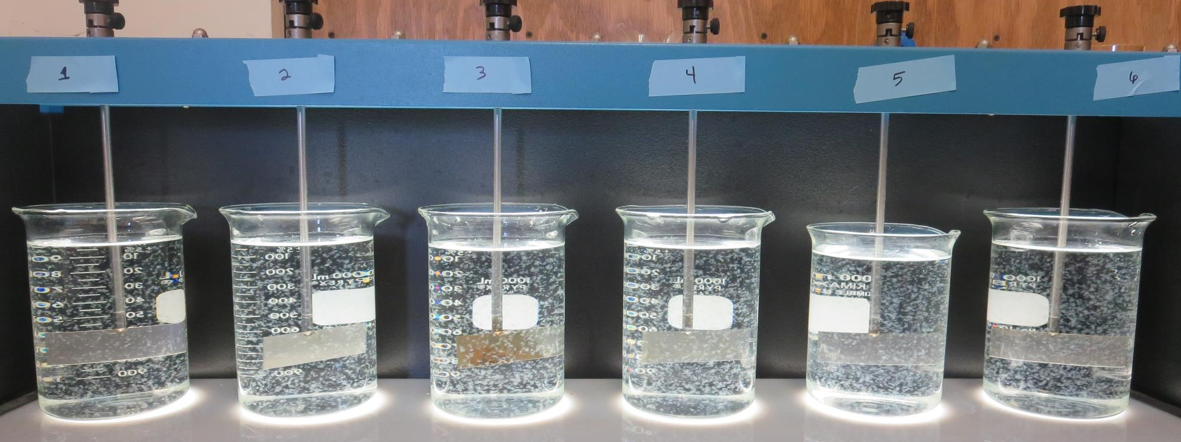
Clearlake Oaks CWD CA1710001 Lake County Jar Test
by Guy Schott, P.E.
May 8, 2019

Slide 2
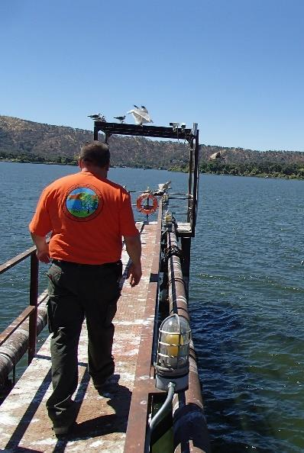
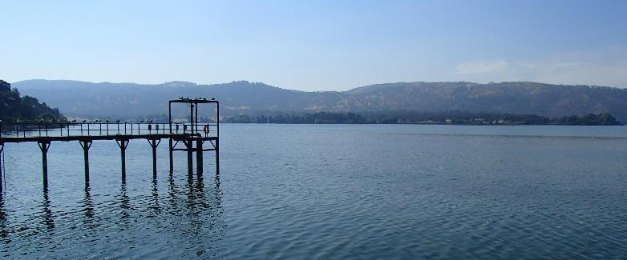
Lucerne Water Co. Source Water: Clear Lake Conventional Treatment

Slide 3
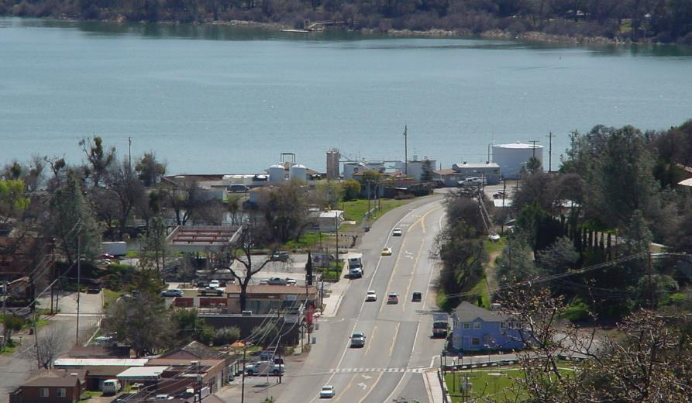
Conventional Treatment Plant

Slide 4
Clearlake Oaks CWD.: Source Water Characteristics March 8, 2019
Source
Post Ozone Sample
Turbidity: 1.35 NTU
UVT: 90%
UVA: 0.046/cm
0.4 um Filtered
UVT: 91.1%
UVA: 0.040/cm

Slide 5
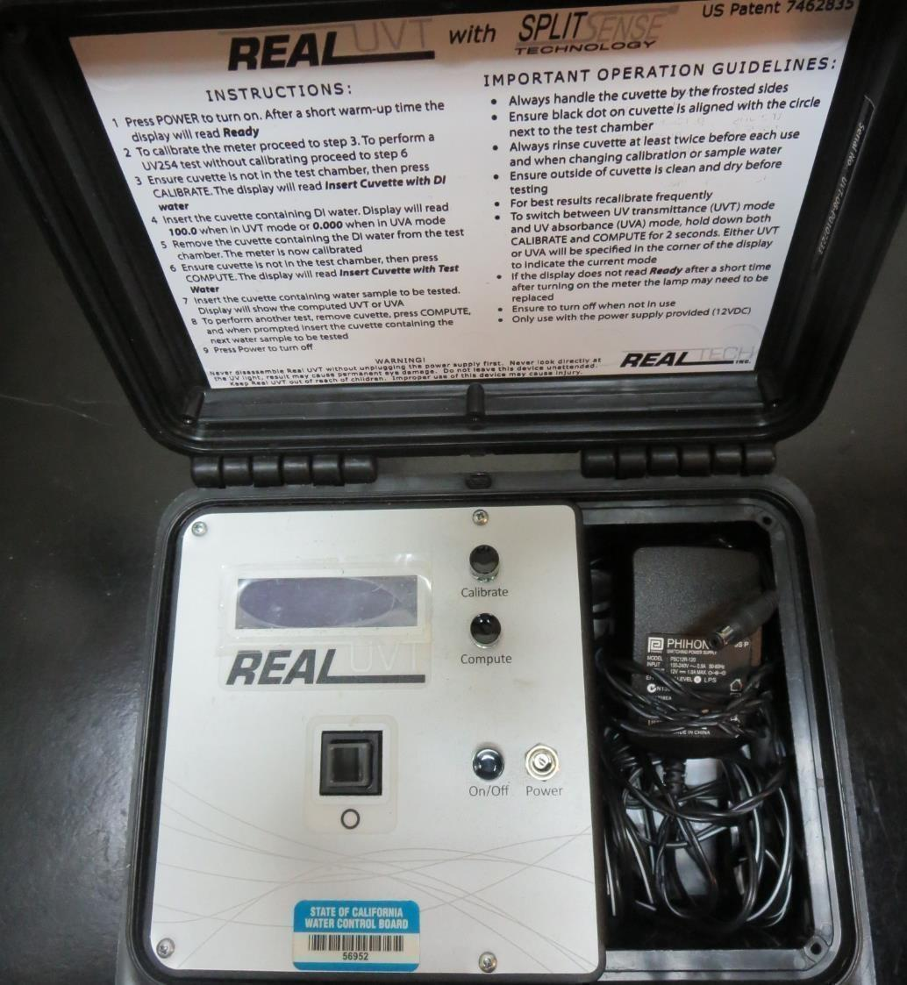
UVT/UVA
UV transmittance (UVT) is a measurement of the amount of ultraviolet light (commonly at 254 nm due to its germicidal effect) that passes through a water sample compared to the amount of light that passes through a pure water sample. The measurement is expressed as a percentage, % UVT.
%UVT = 10^{(-UVA)} x 100%
UV absorbance (UVA) is calculated as a relative measure of the amount of light absorbed by a water sample compared with the amount of light absorbed by a pure water sample.
UVA = -log(%UVT/100)

Slide 6
Applied Coagulants for Jar Testing
Pro Pac 9800 (NTU Technologies)
50% Aluminum Chlorohydrate
50% Water
SG = 1.34
Pro Pac 9890 (NTU Technologies)
35-45% Aluminum Chlorohydrate
35-45% Water
SG = 1.25-1.34
7066 (Garratt Callahan)
10 – 30% Poly Aluminum Hydroxychloride Sulfate
50% Basicity
SG = 1.2
Aluminum Sulfate
48.24% Aluminum Sulfate, 8.2% Al₂O₃
SG = 1.34

Slide 7
Coagulant Information
Unless stated otherwise, all coagulant doses are reported as Product (100% strength). Alum Sulfate is reported as Alum.
Preparation of coagulant stock solutions are generally 1.0 and/or 0.1 percent strength using 100 and/or 200 mL volumetric flasks.
Finnpipette F2 variable volume pipette, capacity 100-1000 micro liters is used for stock solution preparation and coagulant aid jar test dosing.
Finnpipette F2 variable volume pipette, capacity 0.5-5 mL is used for primary coagulant jar test dosing.

Slide 8
Clearlake Oaks CWS: Jar Test 1-6 Results Post-Ozone Source Water
Jar | 200 RPM Flash Mix Seconds | 30 RPM Floc Duration minutes | 7066 mg/L | Filtrate NTU | Filtrate %UVT | Filtrate UVA/cm | Settle NTU 25 min
J1 | 60 | 10 | 30 | 0.10 | 94.1 | 0.026 | 0.65
J2 | 60 | 10 | 40 | 0.14 | 94.6 | 0.024 | 0.60
J3 | 60 | 10 | 50 | 0.18 | 94.0 | 0.027 | 0.48
J4 | 60 | 10 | 60 | 0.13 | 94.4 | 0.025 | 0.42
J5 | 60 | 10 | 70 | 0.13 | 94.9 | 0.023 | 0.31
J6 | 60 | 10 | 80 | 0.12 | 94.9 | 0.023 | 0.31

Slide 9
Clearlake Oaks CWS: Jar Test 7-12 Results Post-Ozone Source Water
Jar | 200 RPM Flash Mix Seconds | 30 RPM Floc Duration minutes | 9800 mg/L | 9890 mg/L | Filtrate NTU | Filtrate %UVT | Filtrate UVA/cm | Settle NTU 25 min
J7 | 60 | 10 | 21 | 1.05 | 0.08 | 95.8 | 0.019 | 0.30
J8 | 60 | 10 | 21 | 2.1 | 0.07 | 95.6 | 0.020 | 0.24
J9 | 60 | 10 | 23 | 1.15 | 0.11 | 95.8 | 0.019 | 0.40
J10 | 60 | 10 | 23 | 2.3 | 0.10 | 95.3 | 0.021 | 0.39
J11 | 60 | 10 | 25 | 1.25 | 0.08 | 95.1 | 0.022 | 0.43
J12 | 60 | 10 | 25 | 2.5 | 0.11 | 95.5 | 0.020 | 0.93

Slide 10
Clearlake Oaks CWS: Jar Test 13-16 Results Post-Ozone Source Water, Flash Mix 60 sec (200 RPM)
Jar | 30 RPM Floc Duration minutes | KMnO₄ mg/L | 9800 mg/L | 9890 mg/L | Filtrate NTU | Filtrate %UVT | Filtrate UVA/cm | Settle NTU 25 min
J13 | 60 | 1.0 | 21 | 1.05 | 0.10 | 94.3 | 0.026 | 0.45
J14 | 60 | 1.0 | 21 | 1.05 | 0.11 | 93.6 | 0.029 | 0.38
J15 | 60 | 2.0 | 23 | 1.15 | 0.07 | 94.3 | 0.026 | 0.23
J16 | 60 | 2.0 | 23 | 1.15 | 0.14 | 93.2 | 0.031 | 0.42

Slide 11
Clearlake Oaks CWS: Jar Test 17-24 Results Post-Ozone Source Water, Flash Mix 60 sec (200 RPM)
Jar | 30 RPM Floc Mix minutes | Alum mg/L | 9800 mg/L | 9890 mg/L | Filtrate NTU | Filtrate %UVT | Filtrate UVA/cm | Settle NTU 25 min
J17 | 5 | 0 | 23 | 1.15 | 0.08 | 94.8 | 0.023 | 0.48
J18 | 10 | 0 | 23 | 1.15 | 0.07 | 94.5 | 0.025 | 0.39
J19 | 20 | 0 | 23 | 1.15 | 0.07 | 94.9 | 0.023 | 0.30
J20 | 40 | 0 | 23 | 1.15 | 0.07 | 94.9 | 0.023 | 0.36
J21 | 5 | 16.8 | 0 | 0 | 0.15 | 92.7 | 0.033 | 1.1
J22 | 10 | 16.8 | 0 | 0 | 0.17 | 92.6 | 0.033 | 0.70
J23 | 20 | 16.8 | 0 | 0 | 0.14 | 92.8 | 0.032 | 0.54
J24 | 45 | 16.8 | 0 | 0 | 0.13 | 92.8 | 0.032 | 0.35

Slide 12
Clearlake Oaks CWS: Jar Test 25-28 Results Post-Ozone Source Water
Jar | 200 RPM Flash Mix Seconds | 30 RPM Floc Duration minutes | 9800 mg/L | 9890 mg/L | Filtrate NTU | Filtrate %UVT | Filtrate UVA/cm | Settle NTU 25 min
J25 | 0 | 5 | 23 | 1.15 | 0.07 | 94.4 | 0.025 | 0.43
J26 | 0 | 10 | 23 | 1.15 | 0.07 | 94.6 | 0.024 | 0.30
J27 | 0 | 20 | 23 | 1.15 | 0.08 | 94.6 | 0.024 | 0.22
J28 | 0 | 40 | 23 | 1.15 | 0.06 | 94.7 | 0.024 | 0.15

Slide 13
Clearlake Oaks CWS: Jar Test 29-36 Results Post-Ozone Source Water
Jar | 200 RPM Flash Mix Seconds | 30 RPM Floc Duration minutes | Alum mg/L | Filtrate NTU | Filtrate %UVT | Filtrate UVA/cm | Settle NTU 25 min
J29 | 0 | 5 | 16.8 | 0.24 | 92.8 | 0.032 | 2.1
J30 | 0 | 10 | 16.8 | 0.17 | 92.8 | 0.032 | 0.95
J31 | 0 | 20 | 16.8 | 0.14 | 93.0 | 0.032 | 0.48
J32 | 0 | 40 | 16.8 | 0.18 | 92.7 | 0.033 | 0.29
J33 | 60 | 10 | 21 | 0.17 | 93.1 | 0.036 | 0.67
J34 | 60 | 10 | 25 | 0.15 | 92.9 | 0.032 | 0.50
J35 | 60 | 10 | 29 | 0.13 | 93.4 | 0.030 | 0.48
J36 | 60 | 10 | 33 | 0.11 | 93.6 | 0.029 | 0.39

Slide 14
Clearlake Oaks CWS: Jar Test 37-40 Results Post-Ozone Source Water, No Flash Mix Applied
Jar | 30 RPM Floc Duration minutes | Alum mg/L | Filtrate NTU | Filtrate %UVT | Filtrate UVA/cm | Settle NTU 15 min | Settle NTU 25 min | Settle NTU 35 min
J37 | 5 | 33 | 0.12 | 93.7 | 0.028 | 1.6 | 1.1 | 0.95
J38 | 10 | 33 | 0.17 | 93.6 | 0.029 | 0.63 | 0.45 | 0.55
J39 | 20 | 33 | 0.12 | 93.6 | 0.029 | 0.58 | 0.36 | 0.38
J40 | 40 | 33 | 0.46 | 93.3 | 0.030 | 0.31 | 0.25 | 0.28

Slide 15
Jars 1-6 Test Flash Mix 60 Sec (200 RPM) Floc Mix 10 min (30 RPM) Applied Coagulant 7066

Slide 16
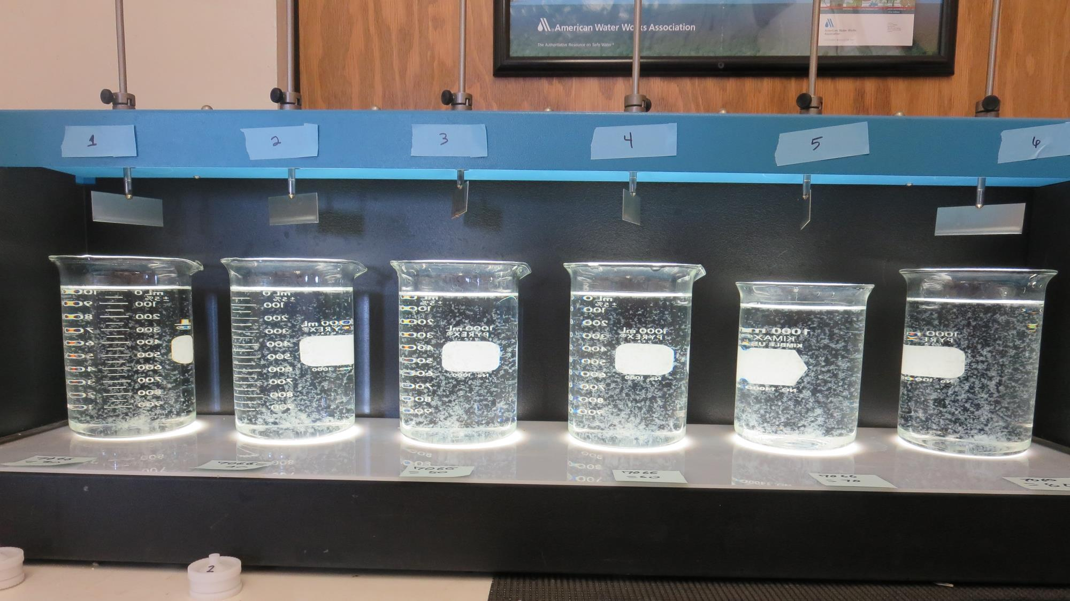
Jars 1-6: End of 10-minute flocculation (30 RPM) duration.
30 mg/L 7066
Filtrate 0.10 NTU
UVT: 94.1%
UVA: 0.026/cm
Settled: 0.65 NTU
40 mg/L 7066
Filtrate 0.14 NTU
UVT: 94.6%
UVA: 0.024/cm
Settled: 0.60 NTU
50 mg/L 7066
Filtrate 0.18 NTU
UVT: 94.0%
UVA: 0.027/cm
Settled: 0.48 NTU
60 mg/L 7066
Filtrate 0.13 NTU
UVT: 94.4%
UVA: 0.025/cm
Settled: 0.42 NTU
70 mg/L 7066
Filtrate 0.13 NTU
UVT: 94.9%
UVA: 0.023/cm
Settled: 0.31 NTU
80 mg/L 7066
Filtrate 0.12 NTU
UVT: 94.9%
UVA: 0.023/cm
Settled: 0.31 NTU

Slide 17
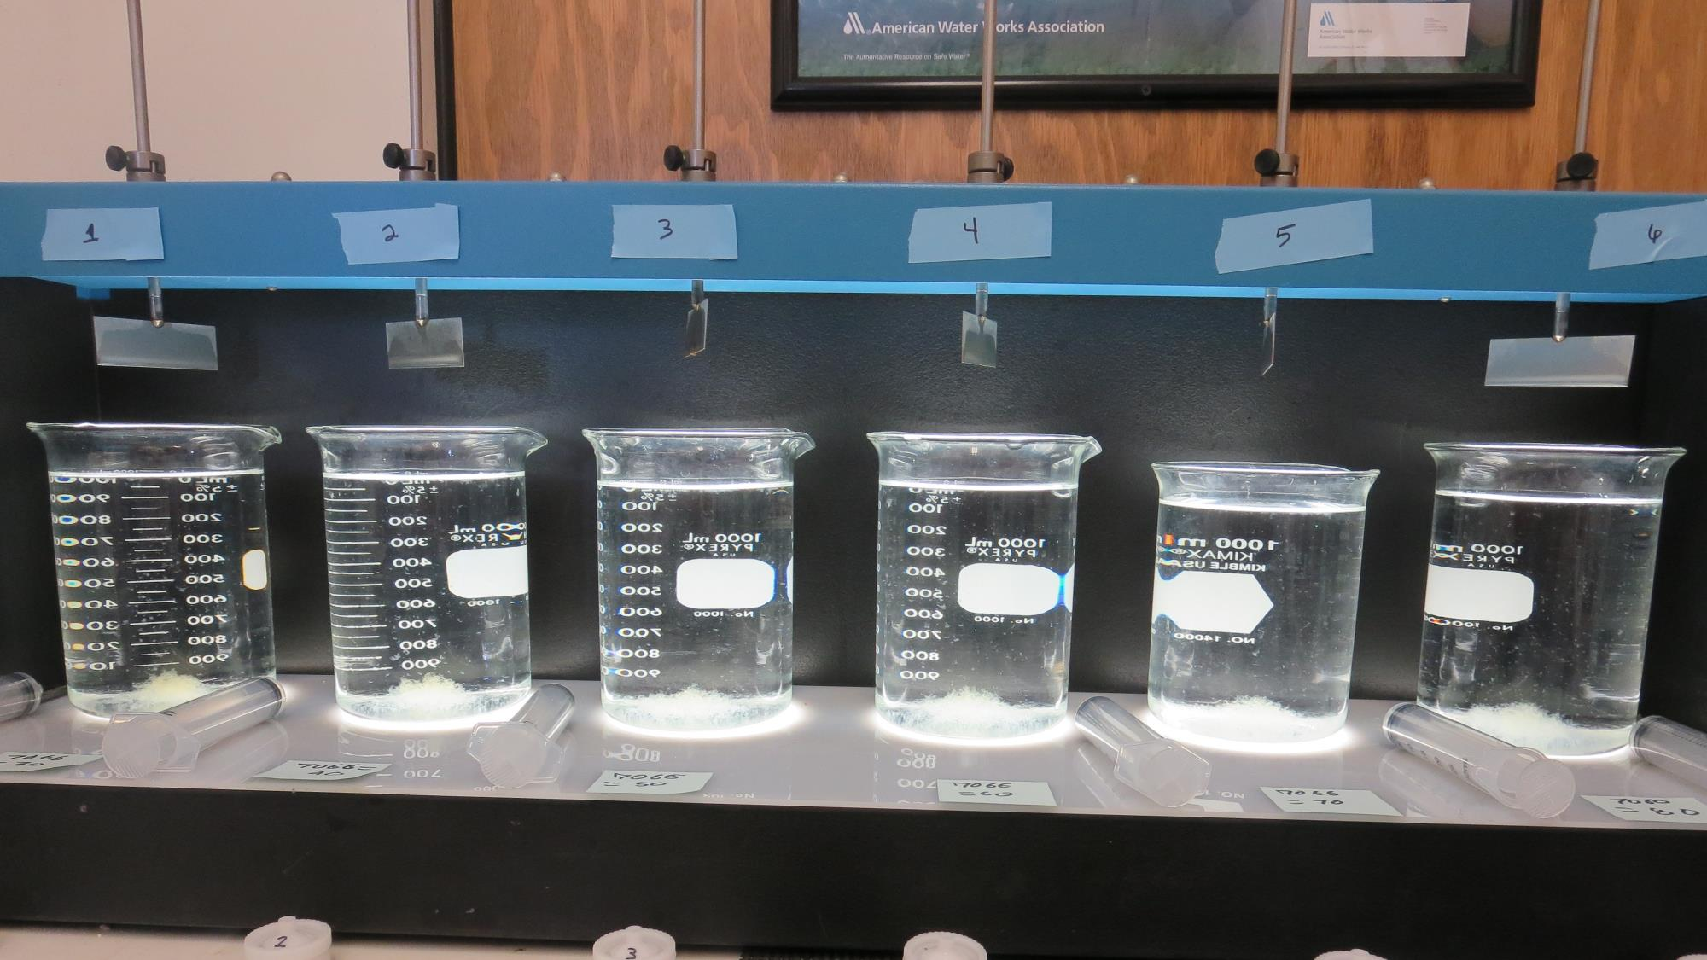
Jars 1-6: After 5 min of settling, 25 mL is syringed for filterability and %UVT/UVA.

Slide 18
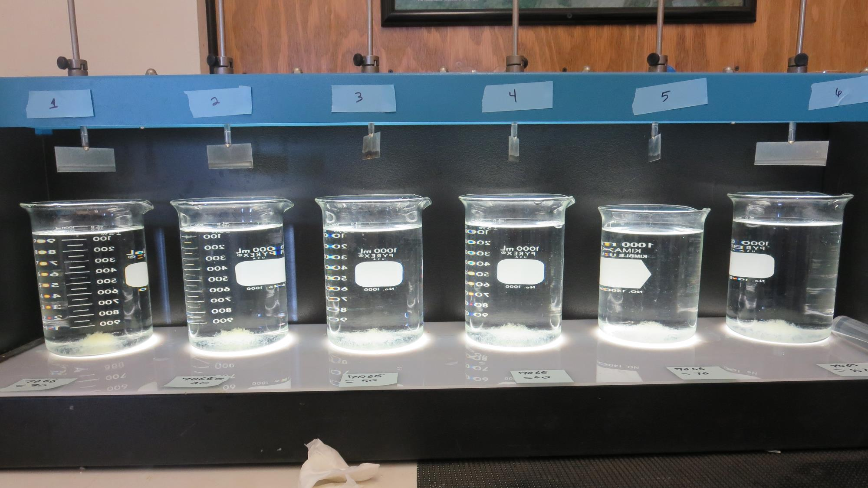
Jars 1-6: After 25-minutes of settling, settled water turbidity is taken.
30 mg/L 7066
Filtrate 0.10 NTU
UVT: 94.1%
UVA: 0.026/cm
Settled: 0.65 NTU
40 mg/L 7066
Filtrate 0.14 NTU
UVT: 94.6%
UVA: 0.024/cm
Settled: 0.60 NTU
50 mg/L 7066
Filtrate 0.18 NTU
UVT: 94.0%
UVA: 0.027/cm
Settled: 0.48 NTU
60 mg/L 7066
Filtrate 0.13 NTU
UVT: 94.4%
UVA: 0.025/cm
Settled: 0.42 NTU
70 mg/L 7066
Filtrate 0.13 NTU
UVT: 94.9%
UVA: 0.023/cm
Settled: 0.31 NTU
80 mg/L 7066
Filtrate 0.12 NTU
UVT: 94.9%
UVA: 0.023/cm
Settled: 0.31 NTU

Slide 19
Jars 7-12 Test Flash Mix 60 Sec (200 RPM) Floc Mix 10 min (30 RPM) Applied Coagulant 9800/9890

Slide 20
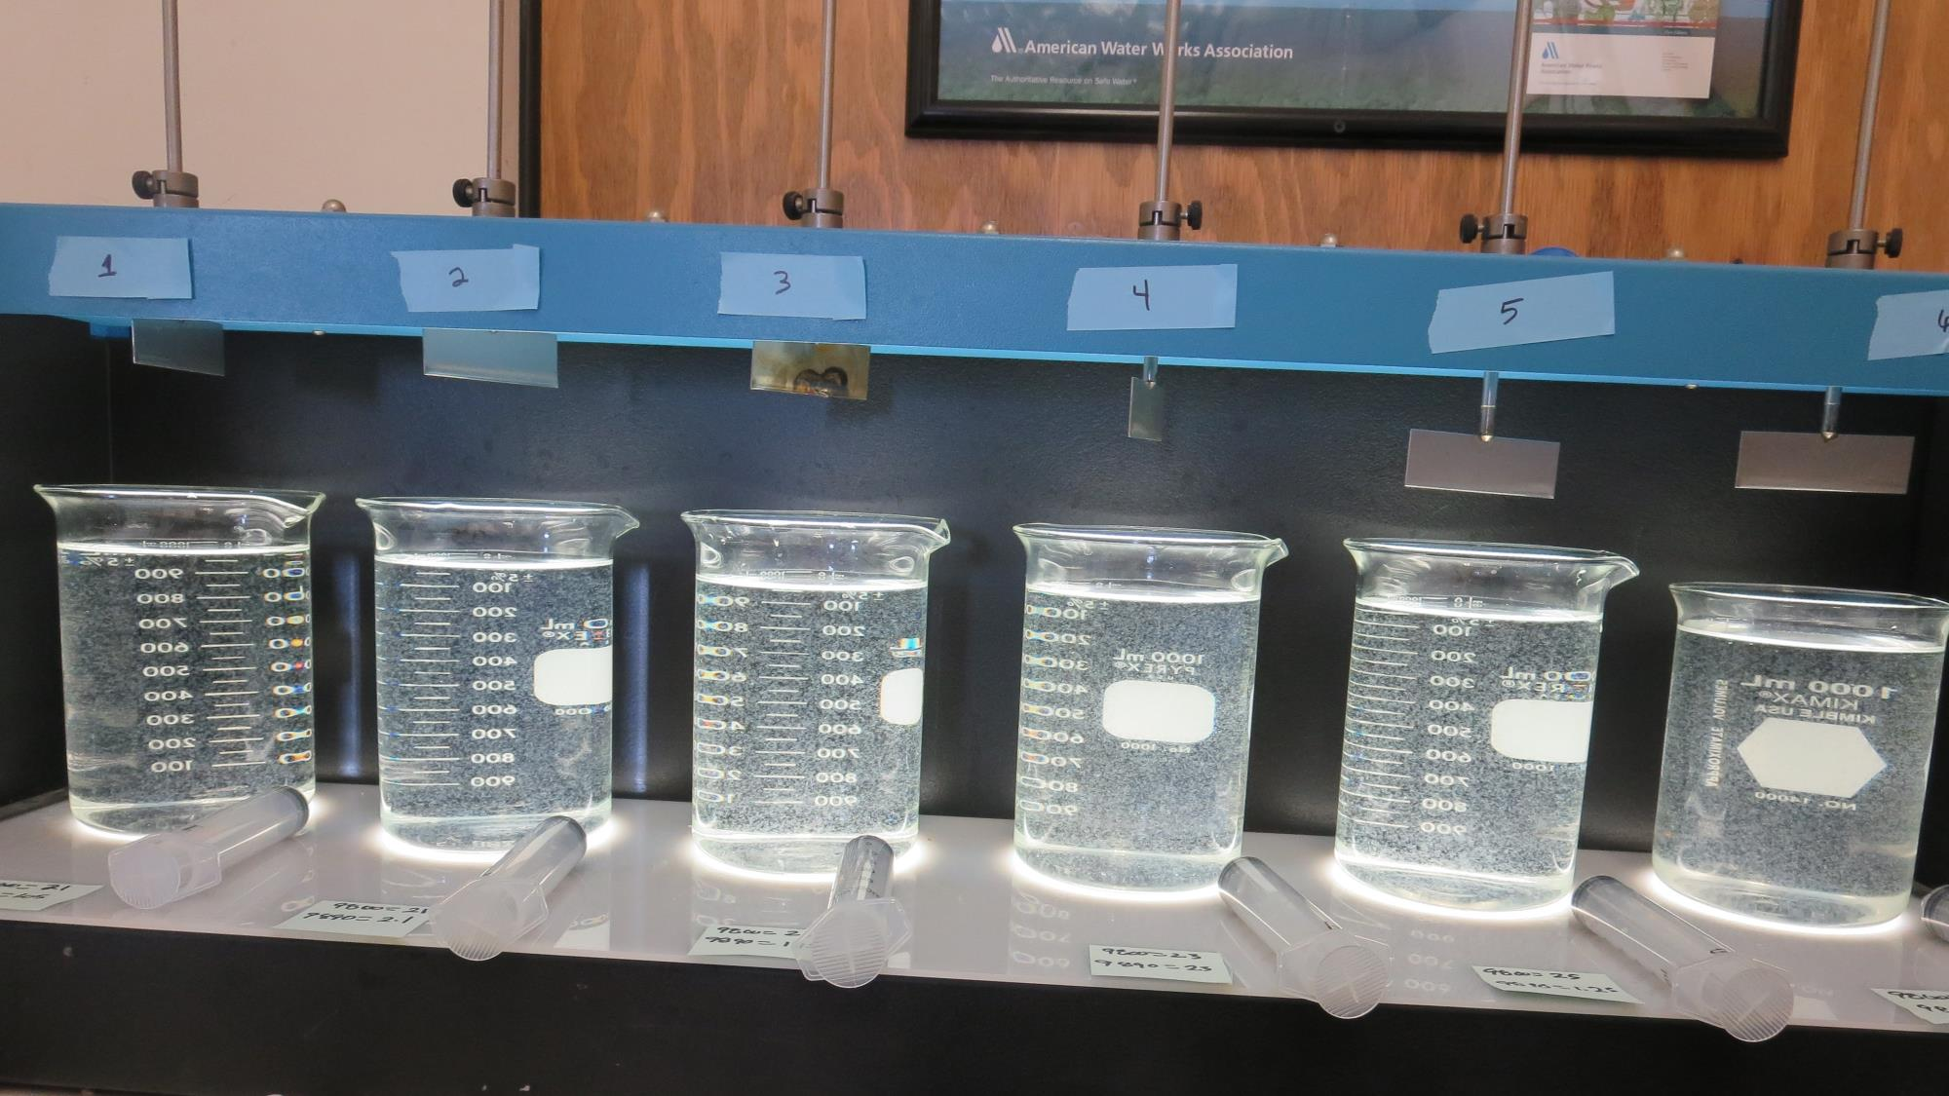
Jars 7-12: End of 10-minute flocculation (30 RPM) duration.
21 mg/L 9800
1.05 mg/L 9890
Filtrate 0.08 NTU
UVT: 95.8%
UVA: 0.019/cm
Settled: 0.30 NTU
21 mg/L 9800
2.1 mg/L 9890
Filtrate 0.07 NTU
UVT: 95.6%
UVA: 0.020/cm
Settled: 0.24 NTU
23 mg/L 9800
1.15 mg/L 9890
Filtrate 0.11 NTU
UVT: 95.8%
UVA: 0.019/cm
Settled: 0.40 NTU
23 mg/L 9800
2.3 mg/L 9890
Filtrate 0.10 NTU
UVT: 95.3%
UVA: 0.021/cm
Settled: 0.39 NTU
25 mg/L 9800
1.25 mg/L 9890
Filtrate 0.08 NTU
UVT: 95.3%
UVA: 0.022/cm
Settled: 0.43 NTU
25 mg/L 9800
2.5 mg/L 9890
Filtrate 0.11 NTU
UVT: 95.5%
UVA: 0.020/cm
Settled: 0.93 NTU

Slide 21
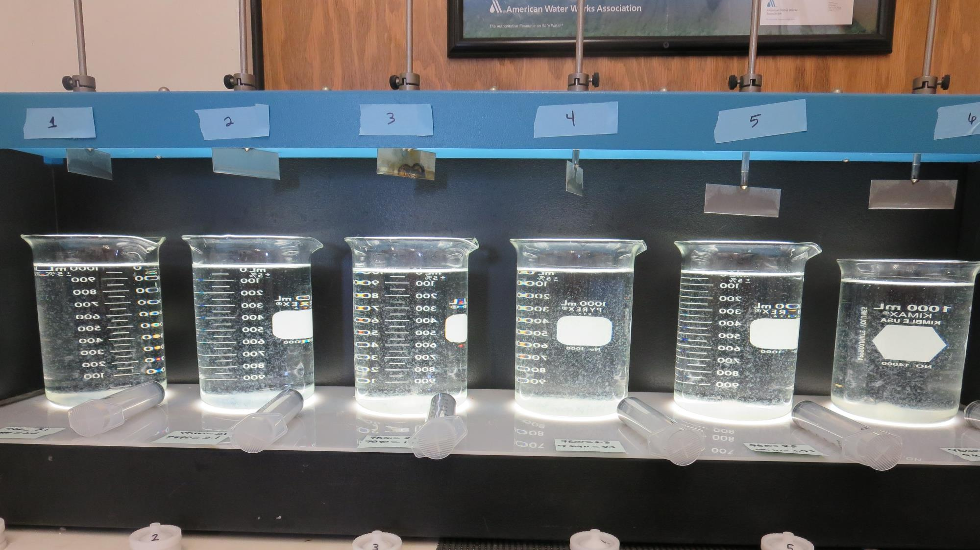
Jars 7-12: After 5 min of settling, 25 mL is syringed for filterability and %UVT/UVA.

Slide 22
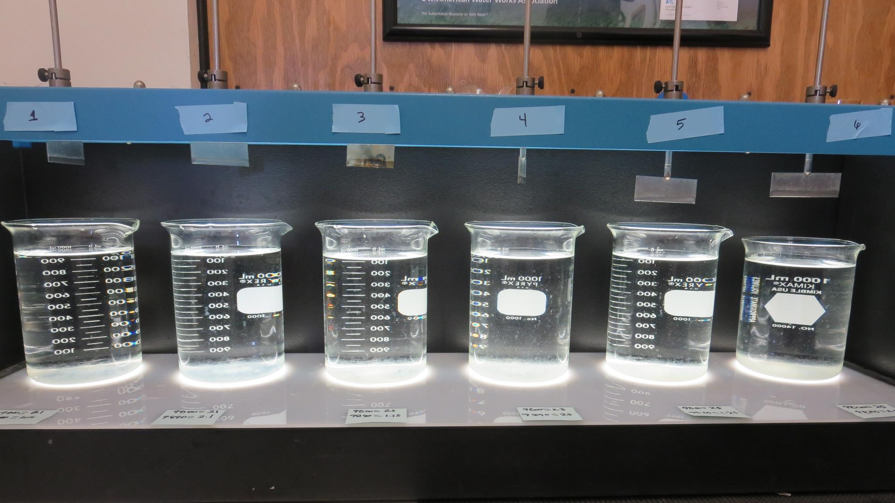
Jars 7-12: After 25-minutes of settling, settled water turbidity is taken.
21 mg/L 9800
1.05 mg/L 9890
Filtrate 0.08 NTU
UVT: 95.8%
UVA: 0.019/cm
Settled: 0.30 NTU
21 mg/L 9800
2.1 mg/L 9890
Filtrate 0.07 NTU
UVT: 95.6%
UVA: 0.020/cm
Settled: 0.24 NTU
23 mg/L 9800
1.15 mg/L 9890
Filtrate 0.11 NTU
UVT: 95.8%
UVA: 0.019/cm
Settled: 0.40 NTU
23 mg/L 9800
2.3 mg/L 9890
Filtrate 0.10 NTU
UVT: 95.3%
UVA: 0.021/cm
Settled: 0.39 NTU
25 mg/L 9800
1.25 mg/L 9890
Filtrate 0.08 NTU
UVT: 95.3%
UVA: 0.022/cm
Settled: 0.43 NTU
25 mg/L 9800
2.5 mg/L 9890
Filtrate 0.11 NTU
UVT: 95.5%
UVA: 0.020/cm
Settled: 0.93 NTU

Slide 23
Jars 13-16 Test Flash Mix 60 Sec (200 RPM) Floc Mix 60 min (30 RPM) Applied Coagulant 9800/9890 w/KMnO₄ Pre-oxidation

Slide 24
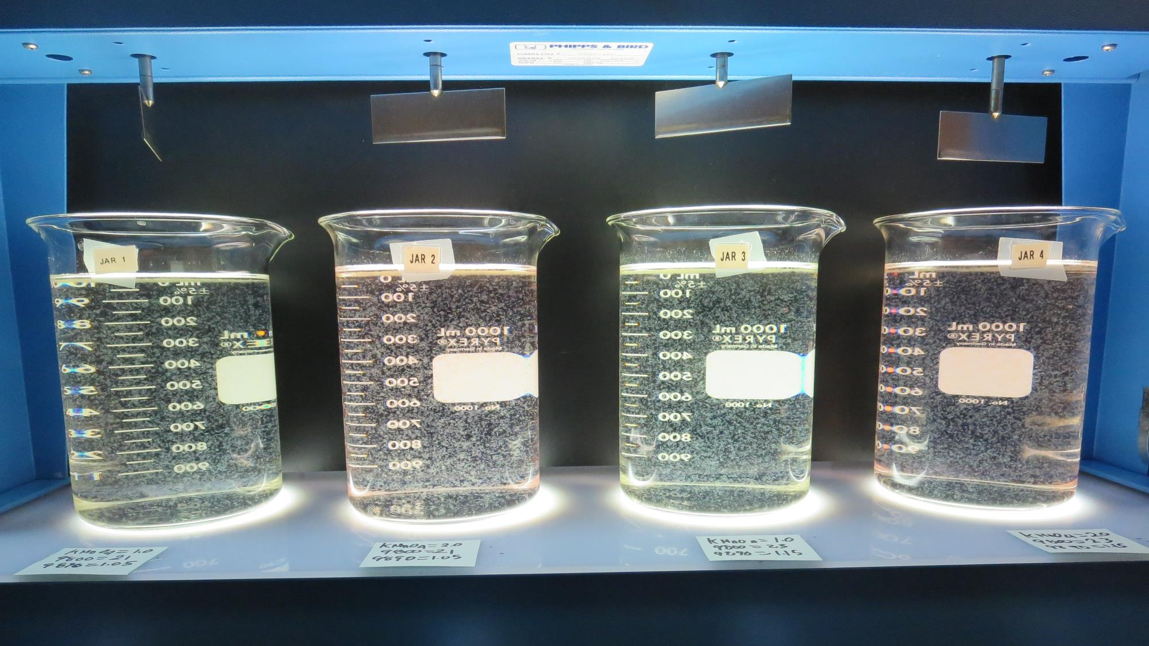
Jars 13-16: End of 60-minute flocculation (30 RPM) duration.
1.0 mg/L KMnO₄
21 mg/L 9800
1.05 mg/L 9890
Filtrate 0.10 NTU
UVT: 94.3%
UVA: 0.026/cm
Settled: 0.45 NTU
2.0 mg/L KMnO₄
21 mg/L 9800
1.05 mg/L 9890
Filtrate 0.11 NTU
UVT: 93.6%
UVA: 0.029/cm
Settled: 0.38 NTU
1.0 mg/L KMnO₄
23 mg/L 9800
1.15 mg/L 9890
Filtrate 0.07 NTU
UVT: 94.3%
UVA: 0.026/cm
Settled: 023 NTU
2.0 mg/L KMnO₄
23 mg/L 9800
1.15 mg/L 9890
Filtrate 0.14 NTU
UVT: 93.2%
UVA: 0.031/cm
Settled: 042 NTU

Slide 25
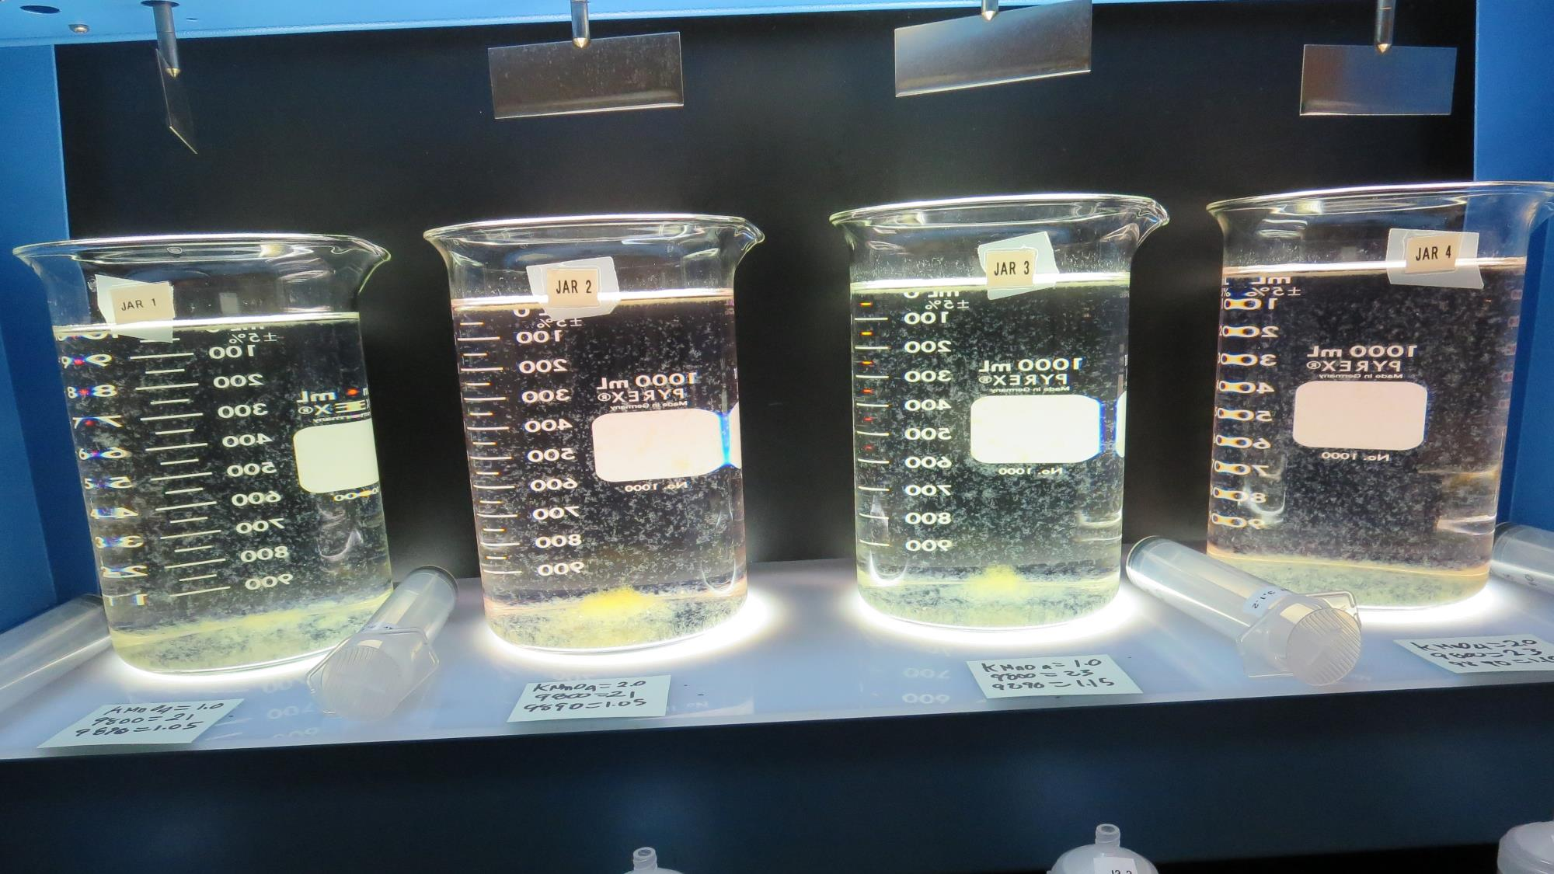
Jars 13-16: After 5 min of settling, 25 mL is syringed for filterability and %UVT/UVA.

Slide 26
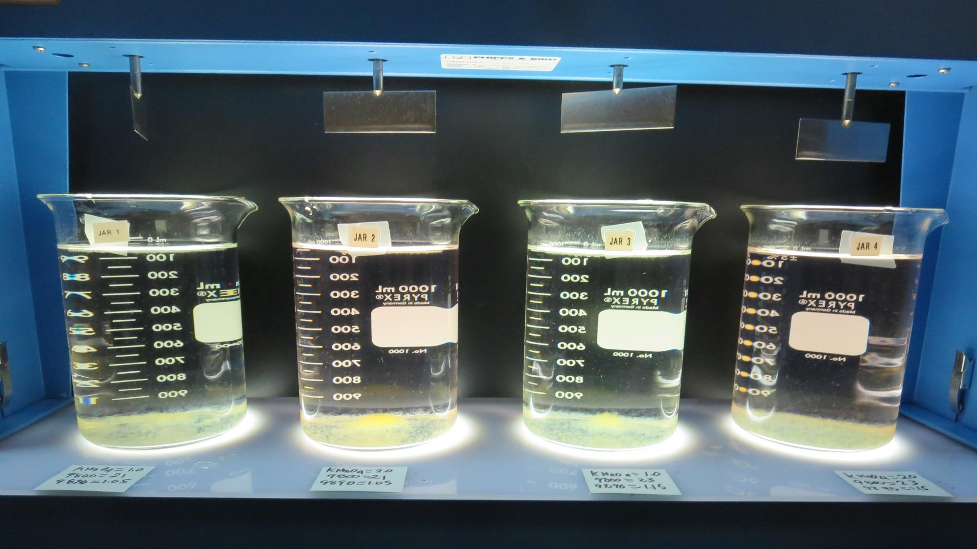
Jars 13-16: After 25-minutes of settling, settled water turbidity is taken.
1.0 mg/L KMnO₄
21 mg/L 9800
1.05 mg/L 9890
Filtrate 0.10 NTU
UVT: 94.3%
UVA: 0.026/cm
Settled: 0.45 NTU
2.0 mg/L KMnO₄
21 mg/L 9800
1.05 mg/L 9890
Filtrate 0.11 NTU
UVT: 93.6%
UVA: 0.029/cm
Settled: 0.38 NTU
1.0 mg/L KMnO₄
23 mg/L 9800
1.15 mg/L 9890
Filtrate 0.07 NTU
UVT: 94.3%
UVA: 0.026/cm
Settled: 023 NTU
2.0 mg/L KMnO₄
23 mg/L 9800
1.15 mg/L 9890
Filtrate 0.14 NTU
UVT: 93.2%
UVA: 0.031/cm
Settled: 042 NTU

Slide 27
Jars 17-20 Test Flash Mix 60 Sec (200 RPM) Floc Mix 5/10/20/40 min (30 RPM) Applied Coagulant 9800/9890

Slide 28
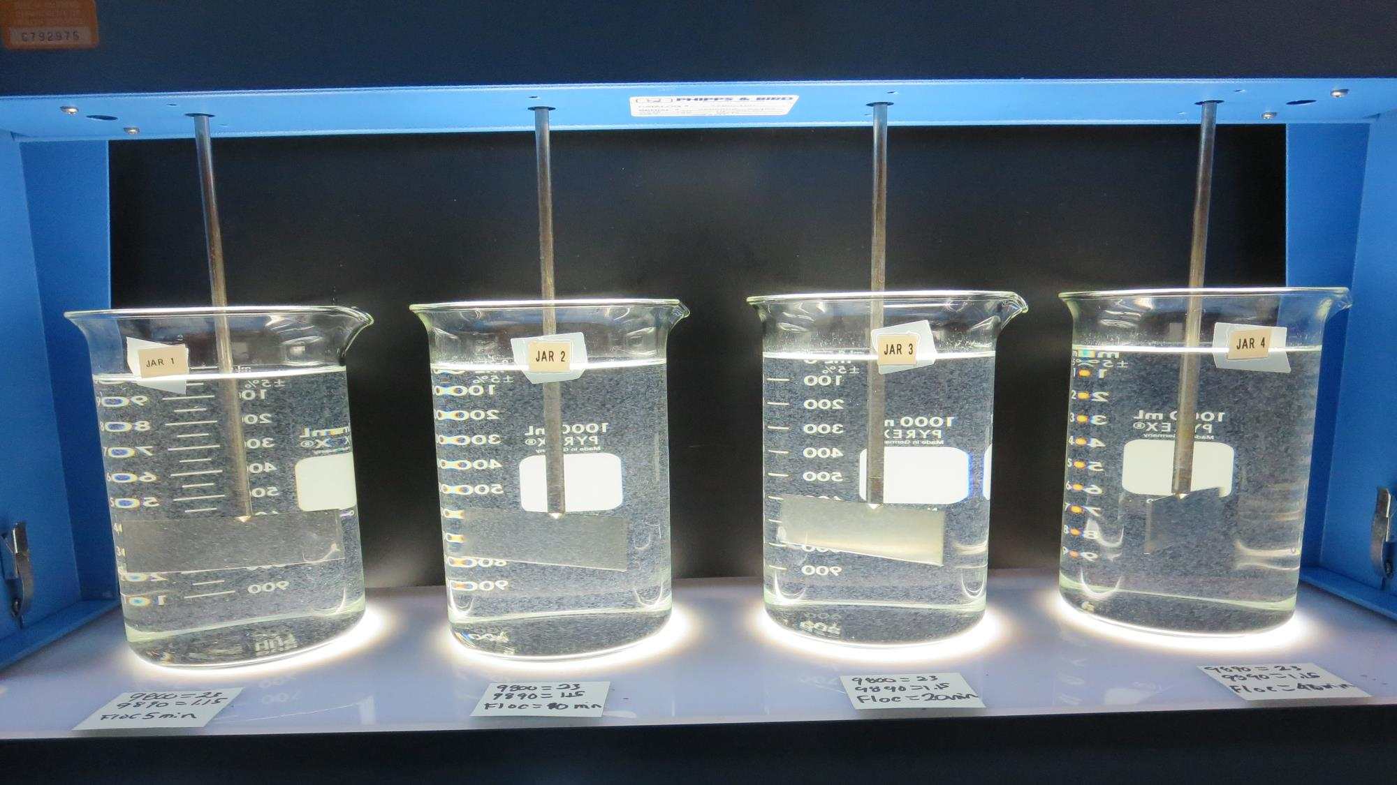
Jars 17: End of 5-minute flocculation (30 RPM) duration.
23 mg/L 9800
1.15 mg/L 9890
Filtrate 0.08 NTU
UVT: 94.8%
UVA: 0.023/cm
Settled: 0.48 NTU

Slide 29
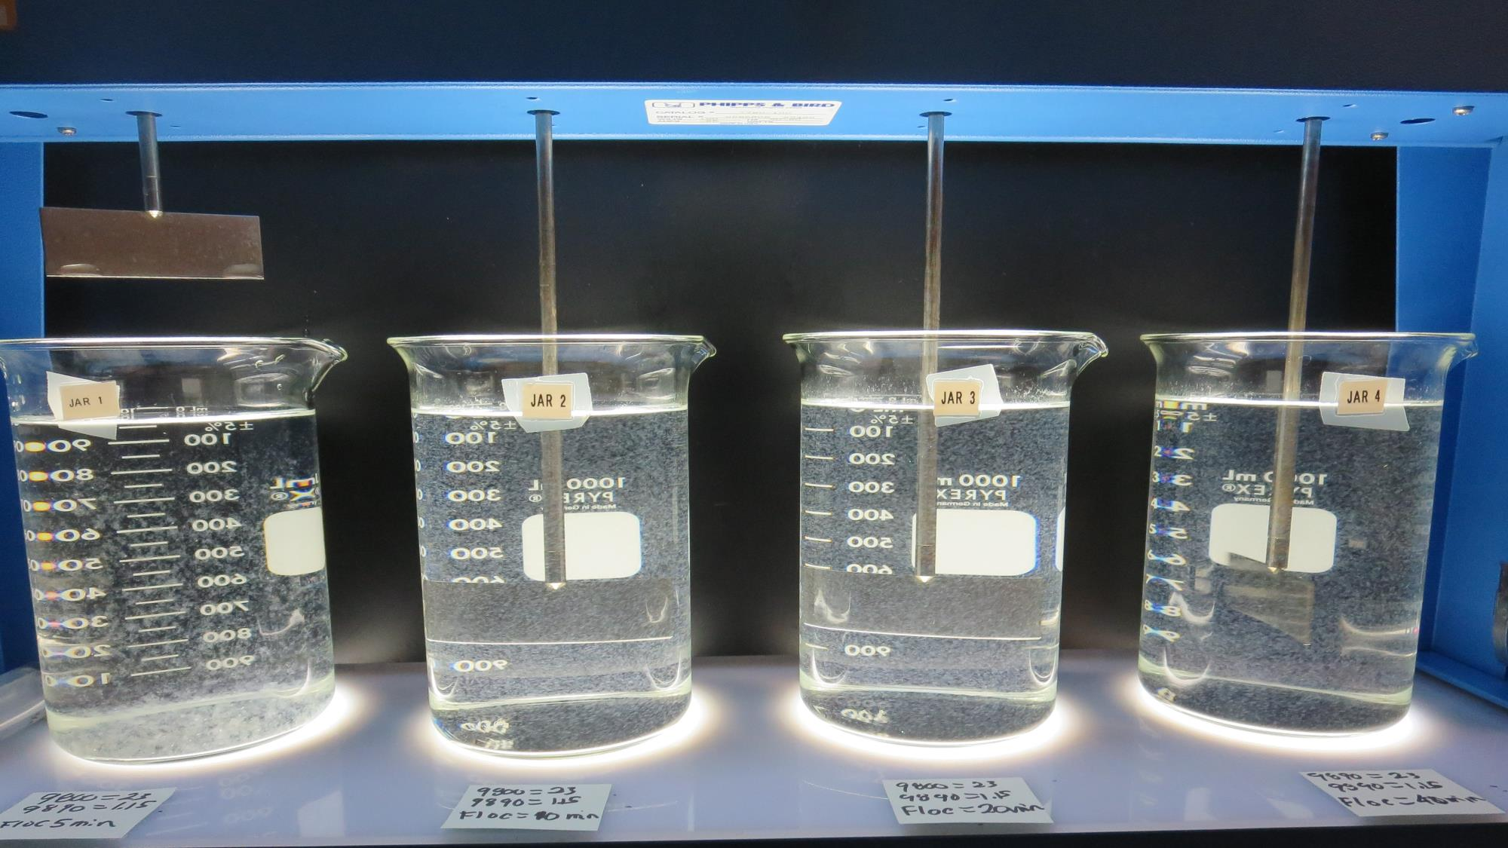
Jars 18: End of 10-minute flocculation (30 RPM) duration.
23 mg/L 9800
1.15 mg/L 9890
Filtrate 0.07 NTU
UVT: 94.5%
UVA: 0.024/cm
Settled: 0.39 NTU

Slide 30
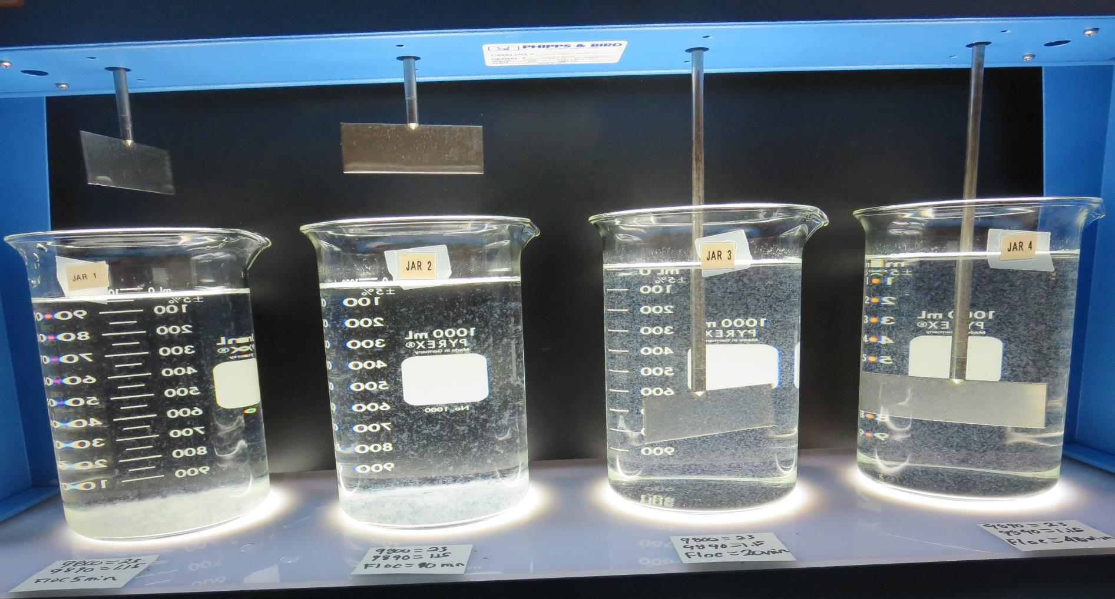
Jars 19: End of 20-minute flocculation (30 RPM) duration.
23 mg/L 9800
1.15 mg/L 9890
Filtrate 0.07 NTU
UVT: 94.9%
UVA: 0.023/cm
Settled: 0.30 NTU

Slide 31
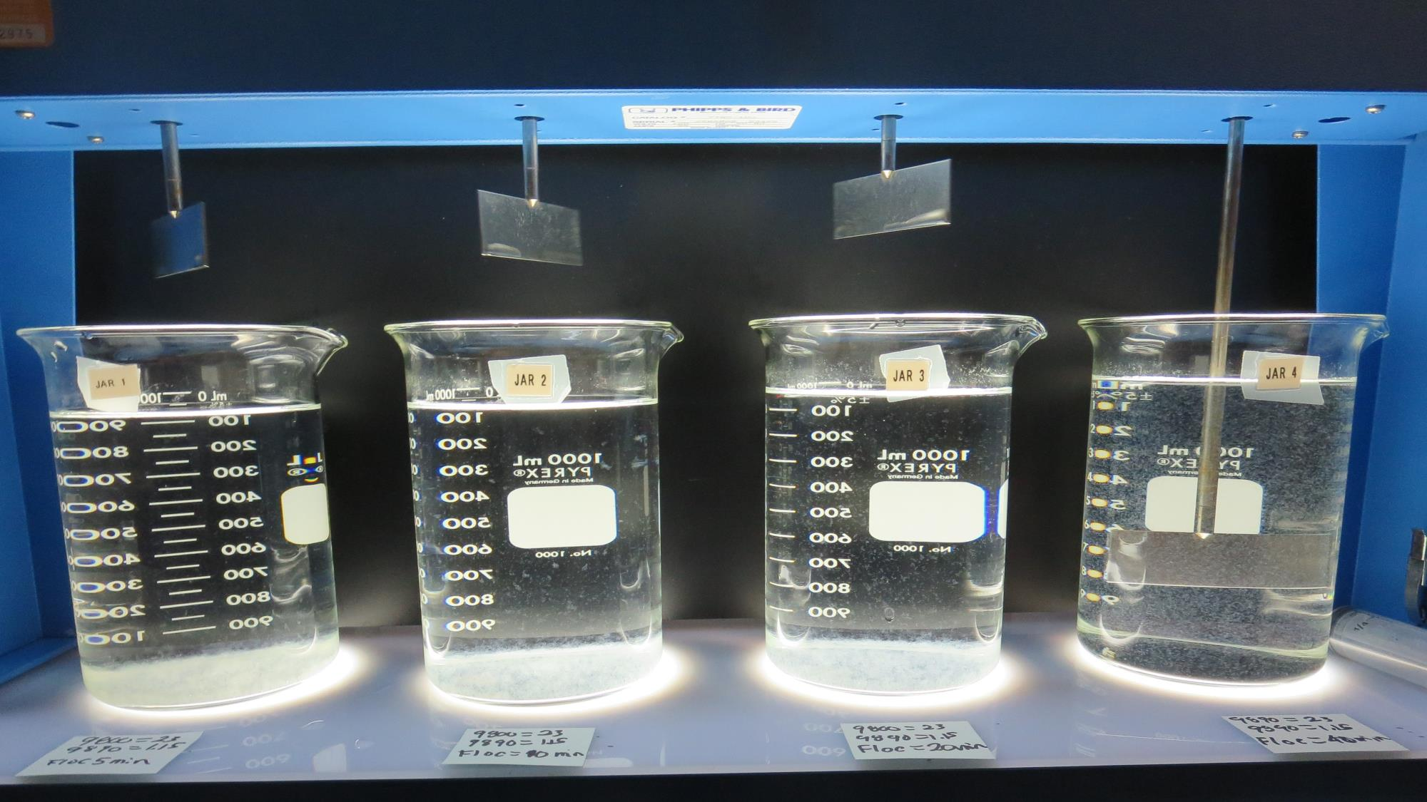
Jars 20: End of 40-minute flocculation (30 RPM) duration.
23 mg/L 9800
1.15 mg/L 9890
Filtrate 0.07 NTU
UVT: 95.1%
UVA: 0.022/cm
Settled: 0.36 NTU

Slide 32
Jars 21-24 Test Flash Mix 60 Sec (200 RPM) Floc Mix 5/10/20/45 min (30 RPM) Applied Coagulant Aluminum Sulfate

Slide 33
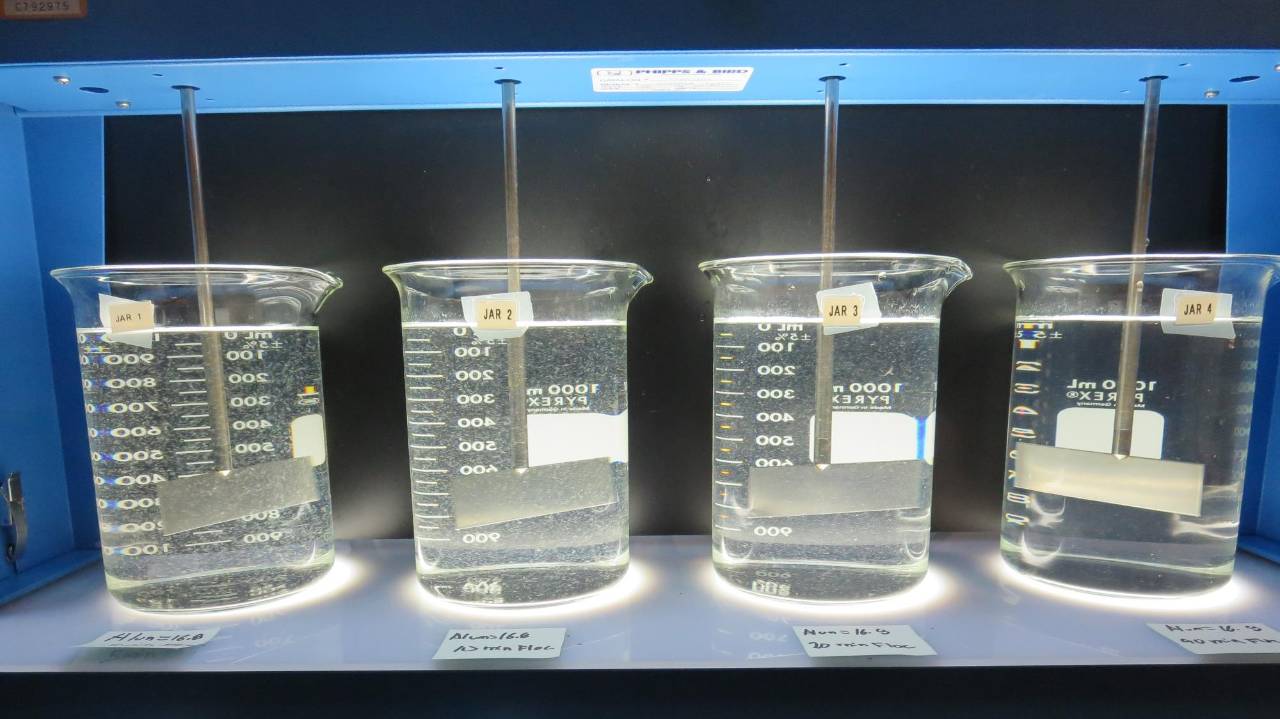
Jars 21: End of 5-minute flocculation (30 RPM) duration.
16.8 mg/L Alum
Filtrate 0.15 NTU
UVT: 92.7%
UVA: 0.033/cm
Settled: 1.1 NTU

Slide 34
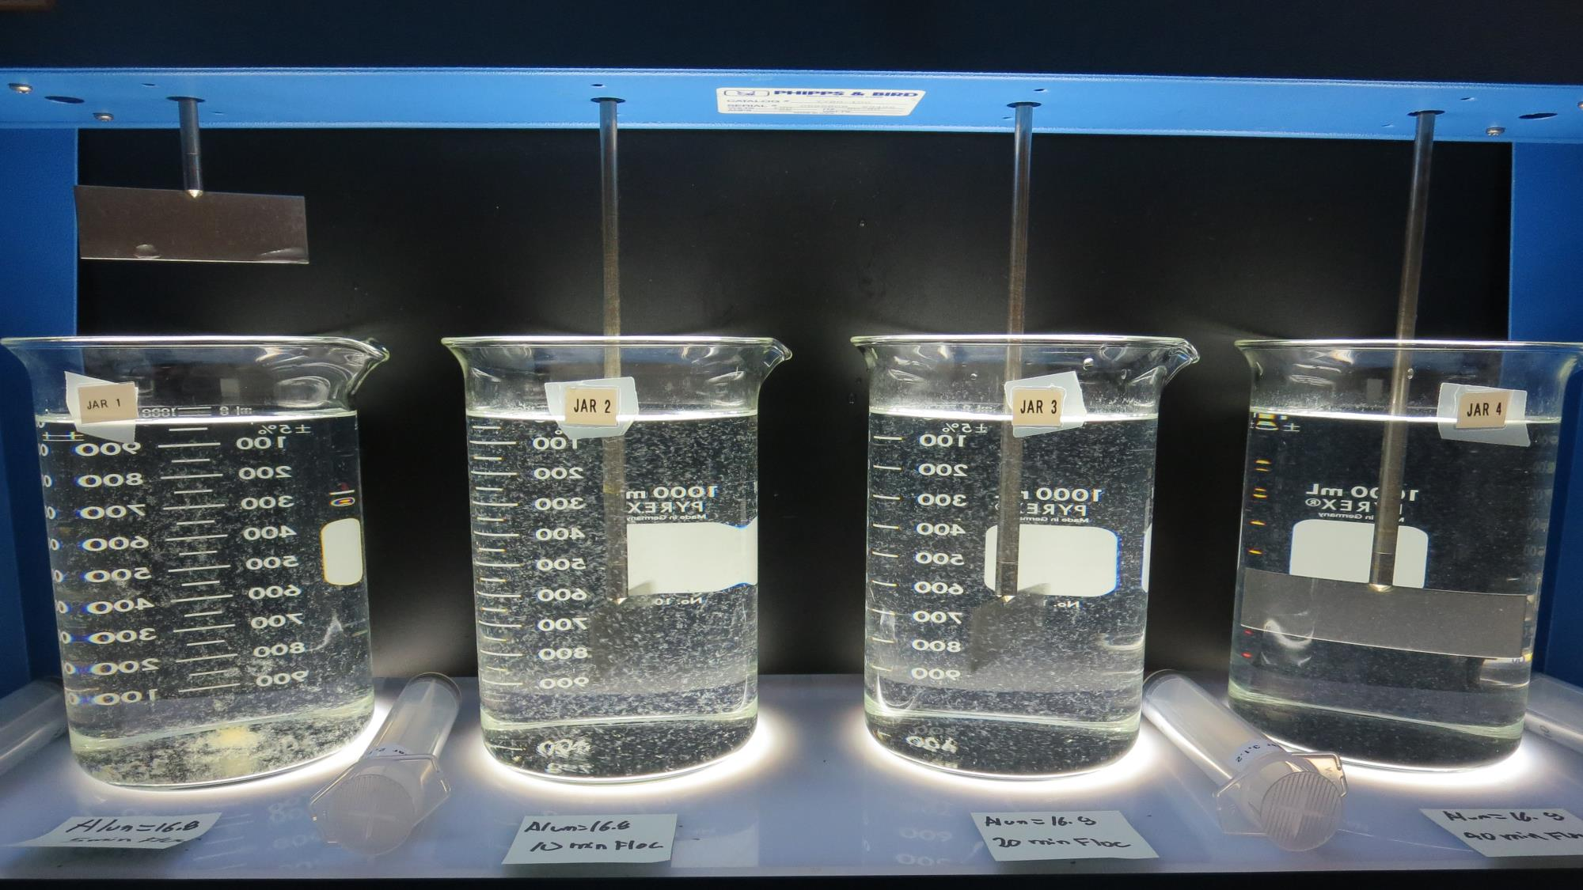
Jars 22: End of 10-minute flocculation (30 RPM) duration.
16.8 mg/L Alum
Filtrate 0.17 NTU
UVT: 92.6%
UVA: 0.033/cm
Settled: 0.70 NTU

Slide 35
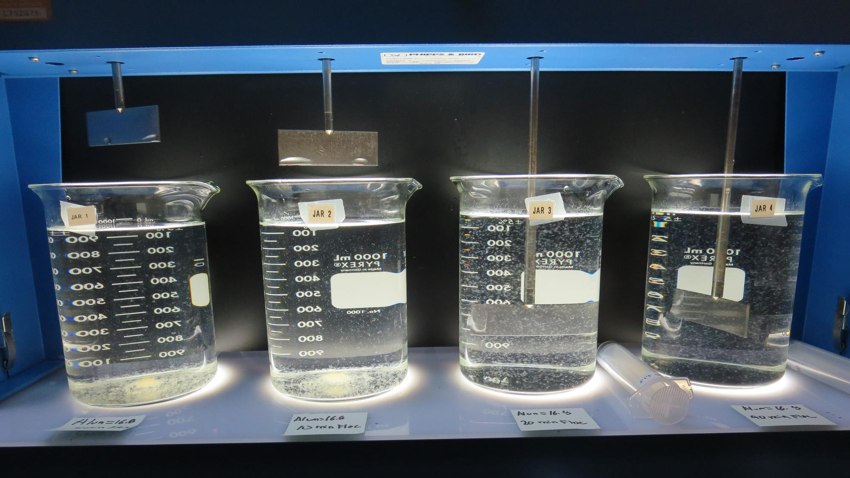
Jars 23: End of 20-minute flocculation (30 RPM) duration.
16.8 mg/L Alum
Filtrate 0.14 NTU
UVT: 92.8%
UVA: 0.032/cm
Settled: 0.54 NTU

Slide 36
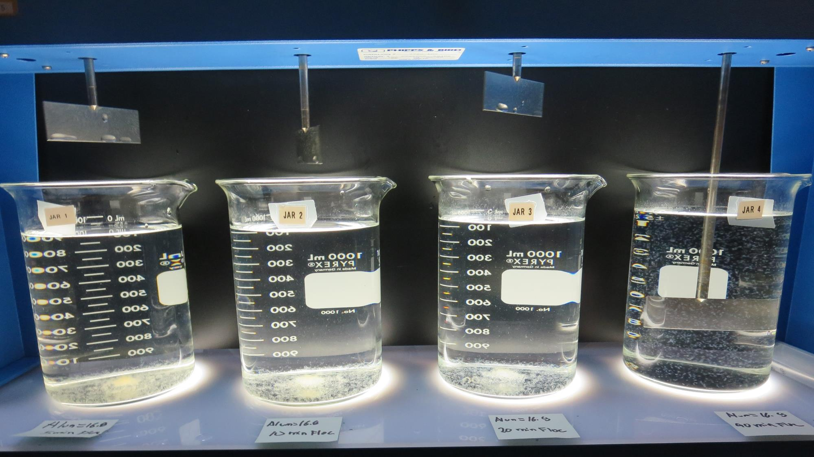
Jars 24: End of 45-minute flocculation (30 RPM) duration.
16.8 mg/L Alum
Filtrate 0.13 NTU
UVT: 92.8%
UVA: 0.032/cm
Settled: 0.35 NTU

Slide 37
Jars 25-28 Test No Flash Mix Floc Mix 5/10/20/40 min (30 RPM) Applied Coagulant 9800/9890

Slide 38
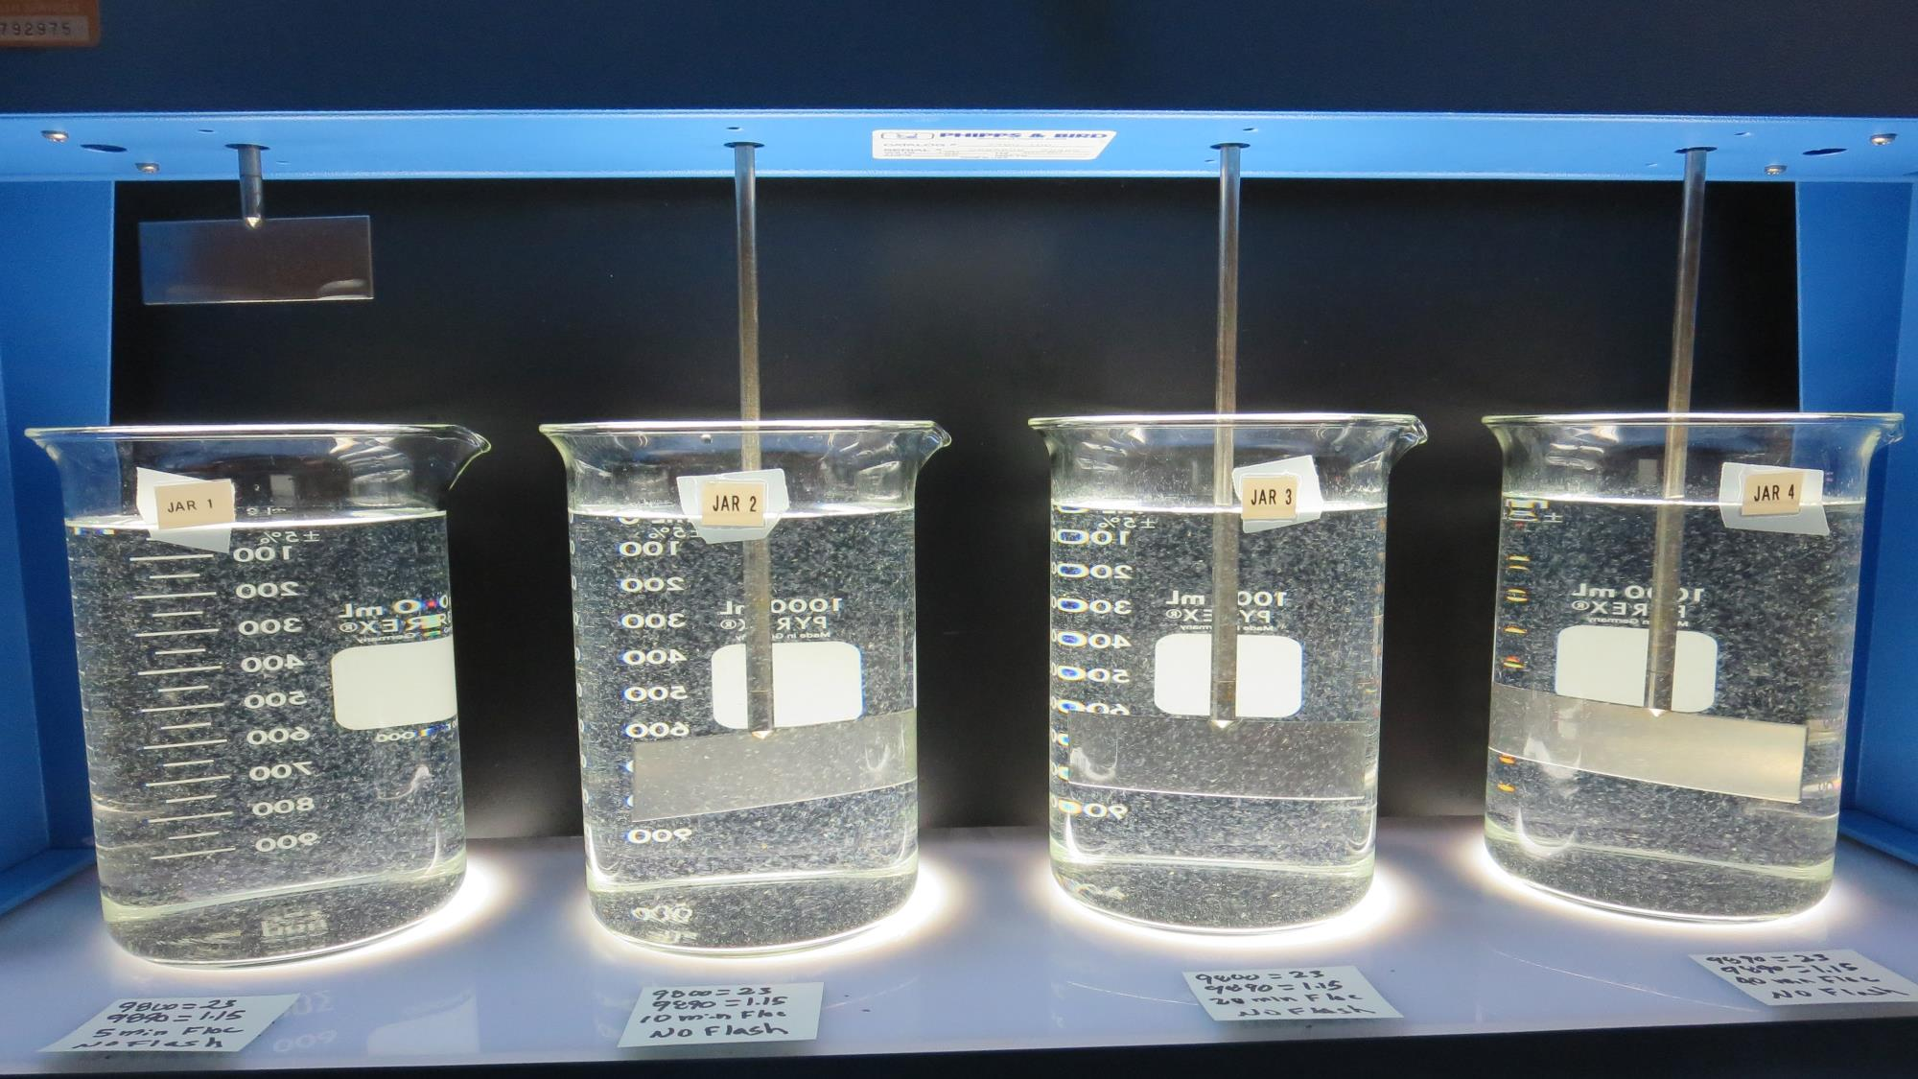
Jars 25: End of 5-minute flocculation (30 RPM) duration.
23 mg/L 9800
1.15 mg/L 9890
Filtrate 0.07 NTU
UVT: 94.4%
UVA: 0.025/cm
Settled: 0.43 NTU

Slide 39
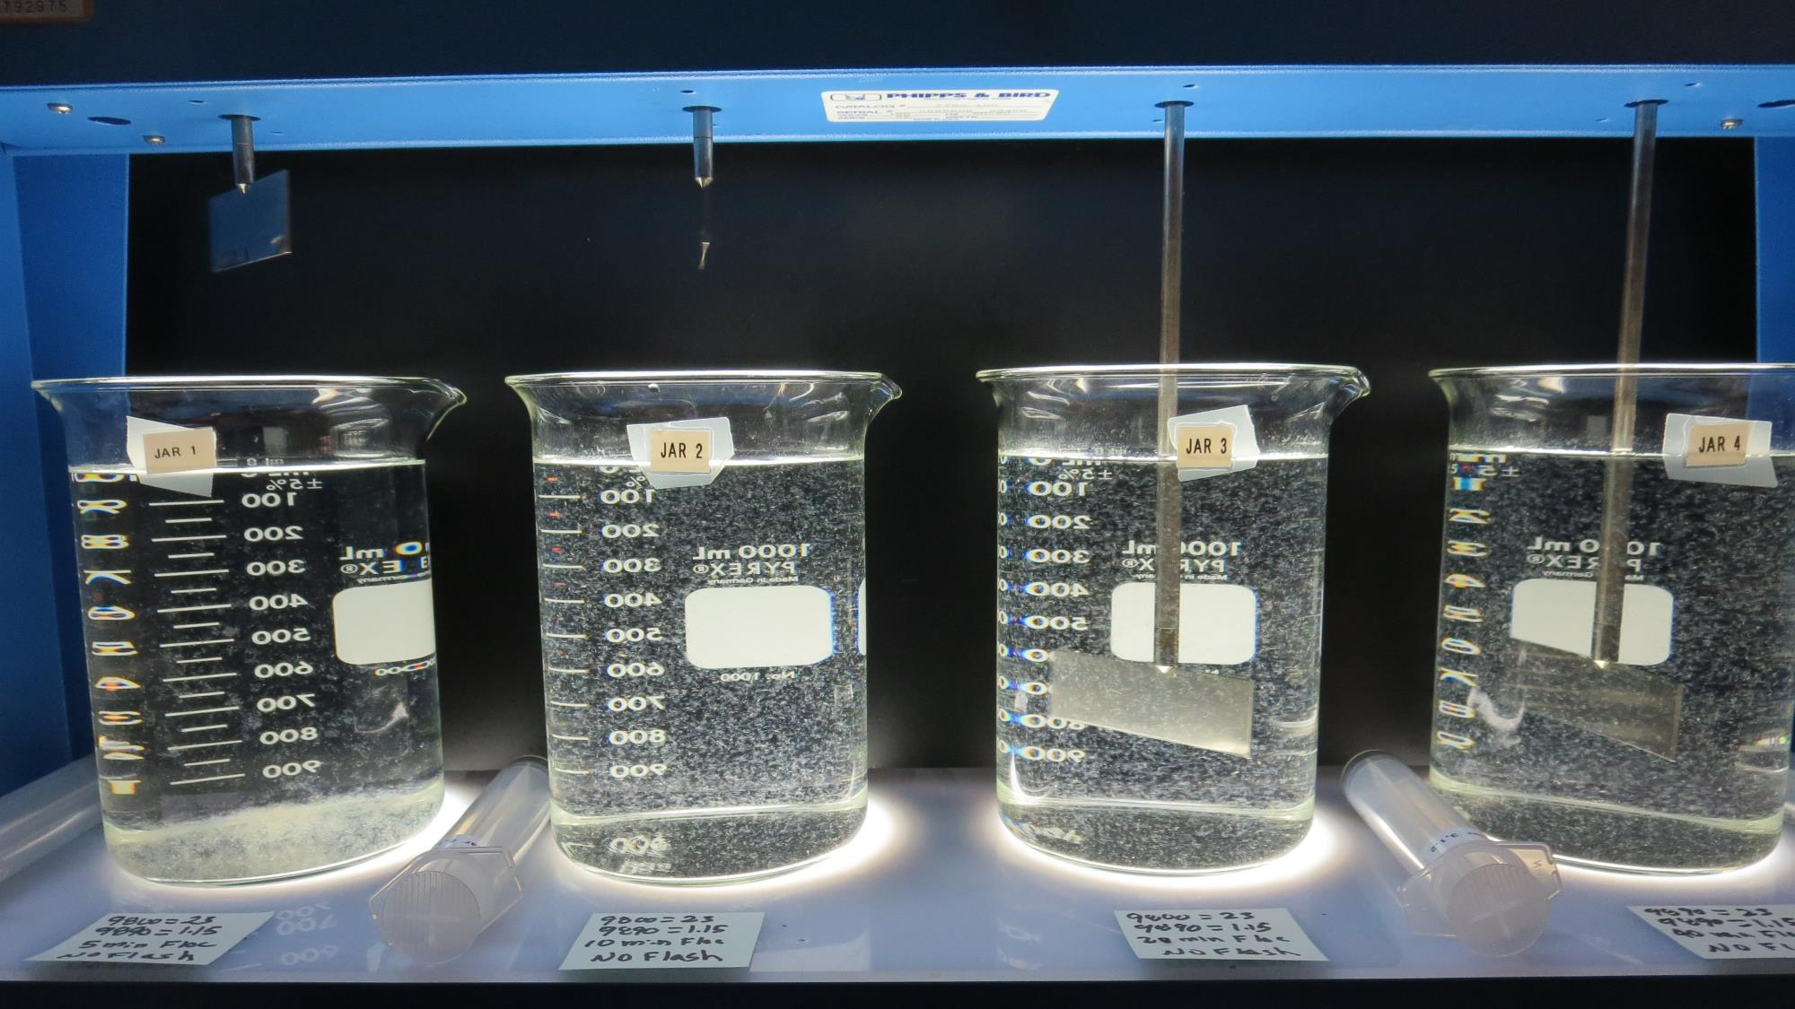
Jars 27: End of 10-minute flocculation (30 RPM) duration.
23 mg/L 9800
1.15 mg/L 9890
Filtrate 0.07 NTU
UVT: 94.6%
UVA: 0.024/cm
Settled: 0.30 NTU

Slide 40
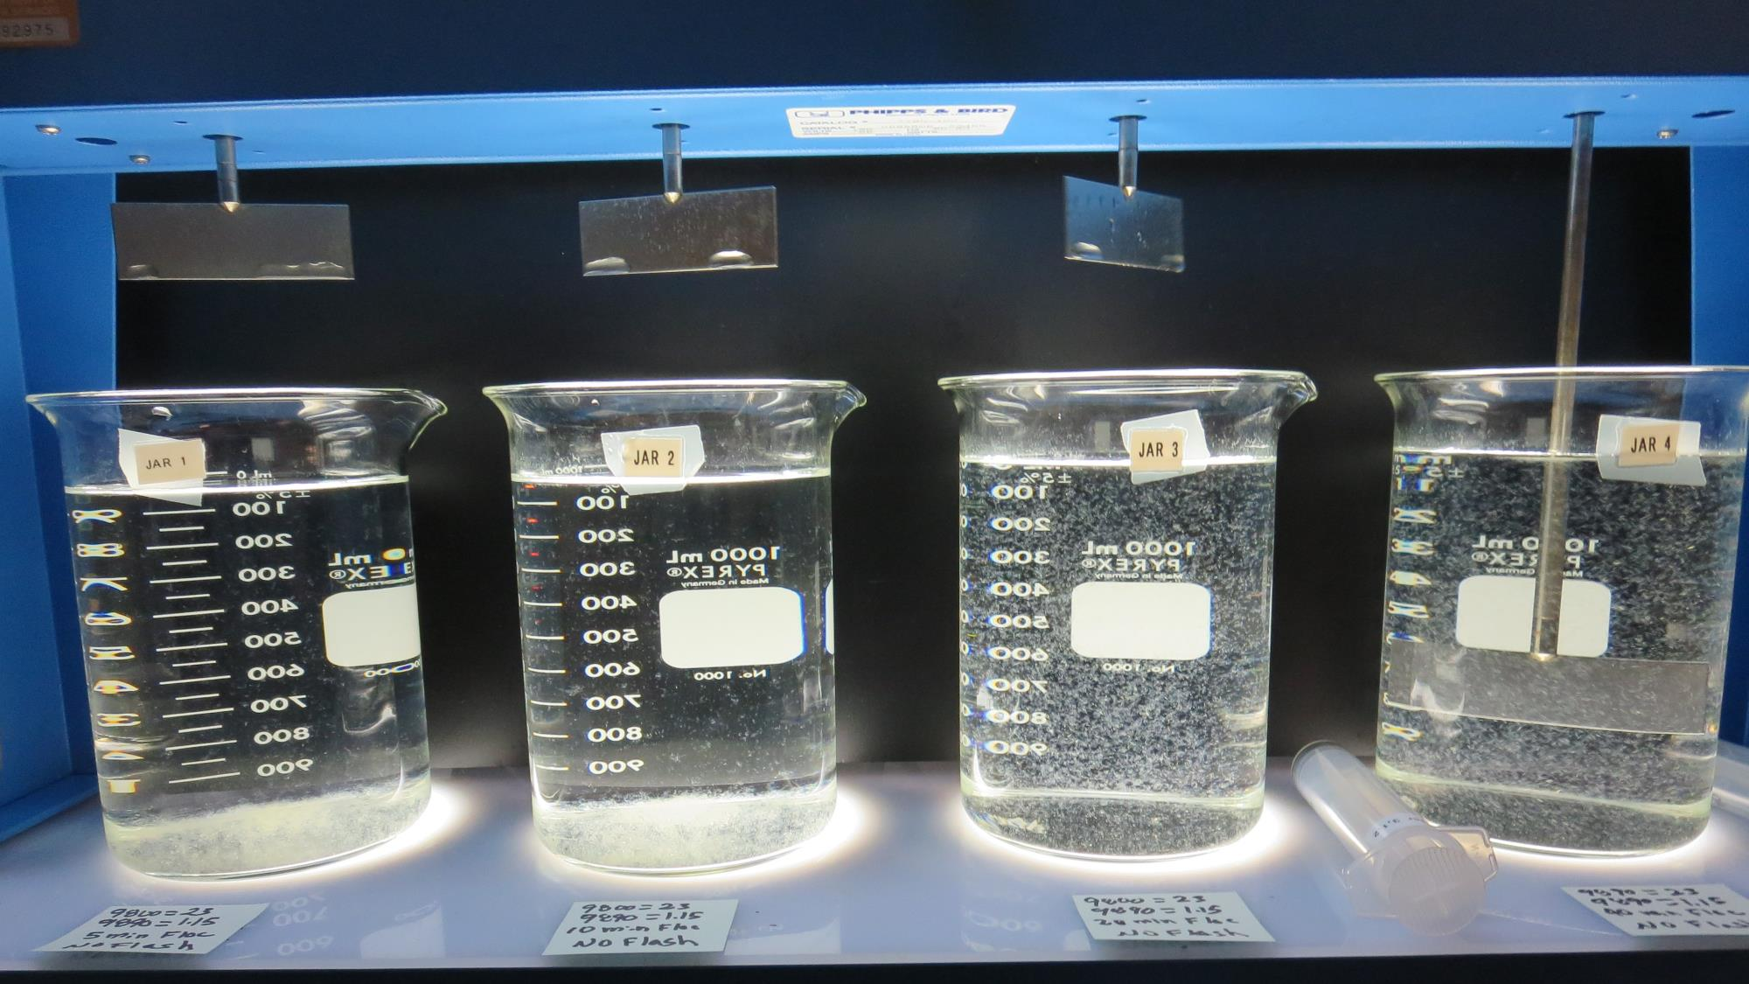
Jars 27: End of 20-minute flocculation (30 RPM) duration.
23 mg/L 9800
1.15 mg/L 9890
Filtrate 0.08 NTU
UVT: 94.6%
UVA: 0.024/cm
Settled: 0.22 NTU

Slide 41
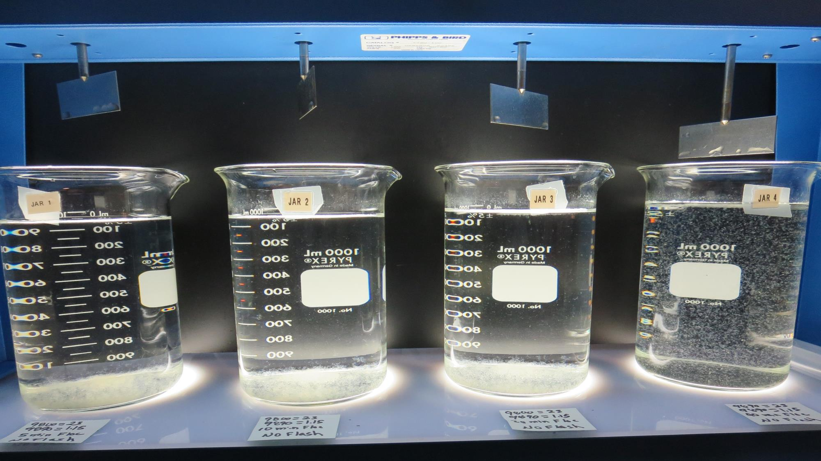
Jars 28: End of 40-minute flocculation (30 RPM) duration.
23 mg/L 9800
1.15 mg/L 9890
Filtrate 0.06 NTU
UVT: 94.7%
UVA: 0.024/cm
Settled: 0.15 NTU

Slide 42
Jars 29-32 Test No Flash Mix Floc Mix 5/10/20/40 min (30 RPM) Applied Coagulant Aluminum Sulfate

Slide 43
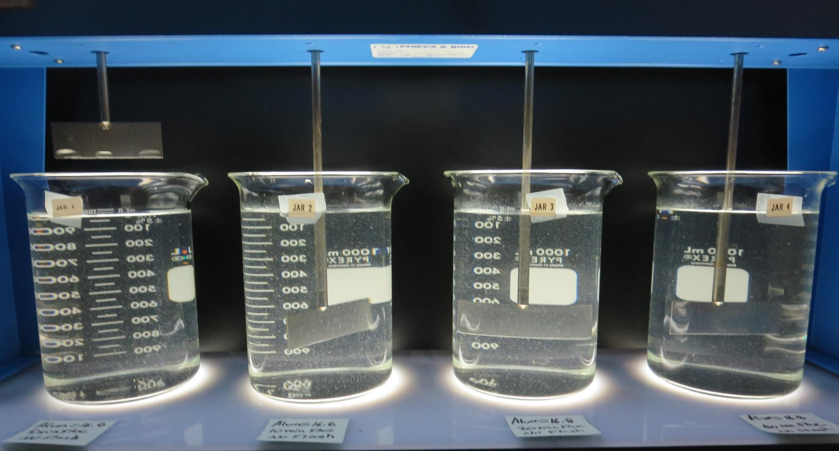
Jars 29: End of 5-minute flocculation (30 RPM) duration.
16.8 mg/L Alum
Filtrate 0.24 NTU
UVT: 92.8%
UVA: 0.032/cm
Settled: 2.1 NTU

Slide 44
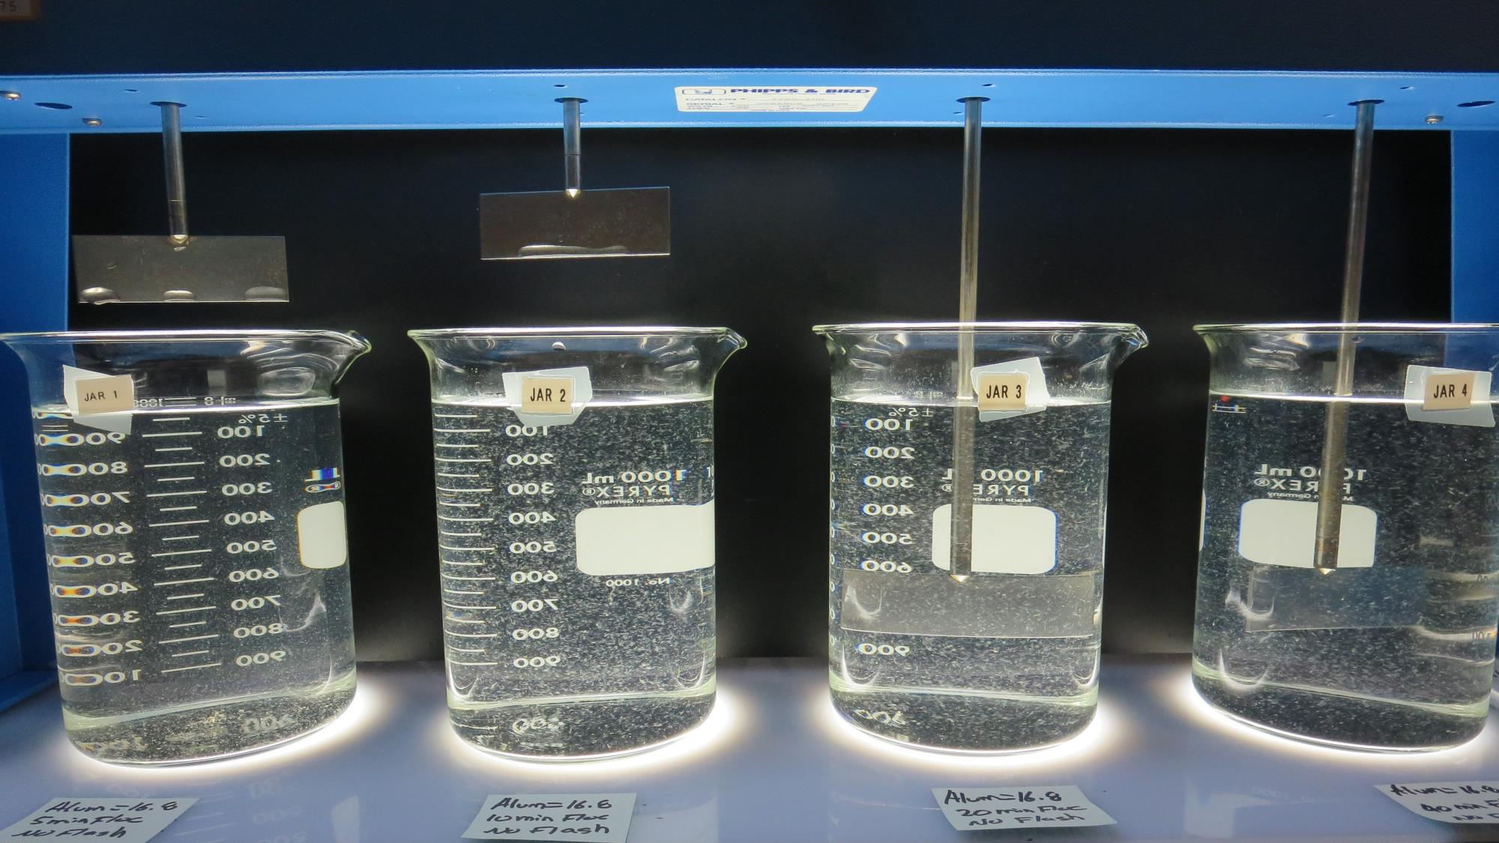
Jars 30: End of 10-minute flocculation (30 RPM) duration.
16.8 mg/L Alum
Filtrate 0.17 NTU
UVT: 92.8%
UVA: 0.032/cm
Settled: 0.95 NTU

Slide 45
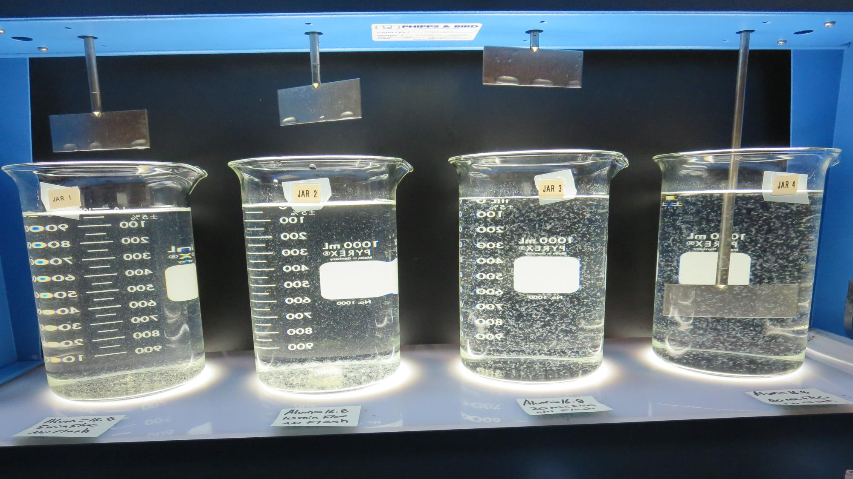
Jars 31: End of 20-minute flocculation (30 RPM) duration.
16.8 mg/L Alum
Filtrate 0.14 NTU
UVT: 93.0%
UVA: 0.032/cm
Settled: 0.48 NTU

Slide 46
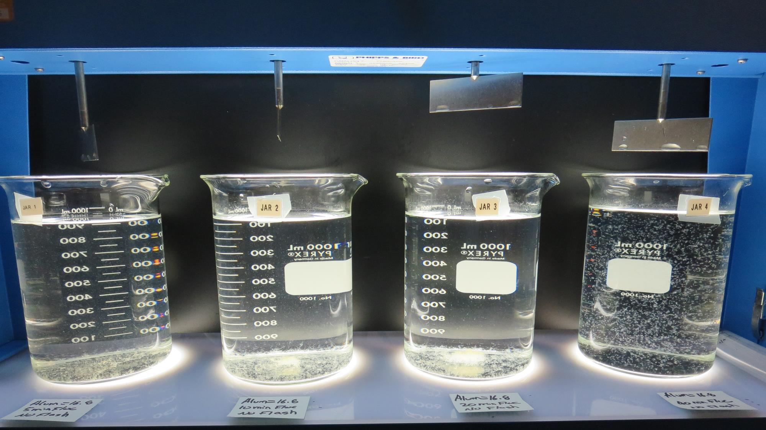
Jars 32: End of 40-minute flocculation (30 RPM) duration.
16.8 mg/L Alum
Filtrate 0.18 NTU
UVT: 92.7%
UVA: 0.033/cm
Settled: 0.29 NTU

Slide 47
Jars 33-36 Test Flash Mix 60 sec (200 RPM) Floc Mix 10 min (30 RPM) Applied Coagulant Aluminum Sulfate

Slide 48
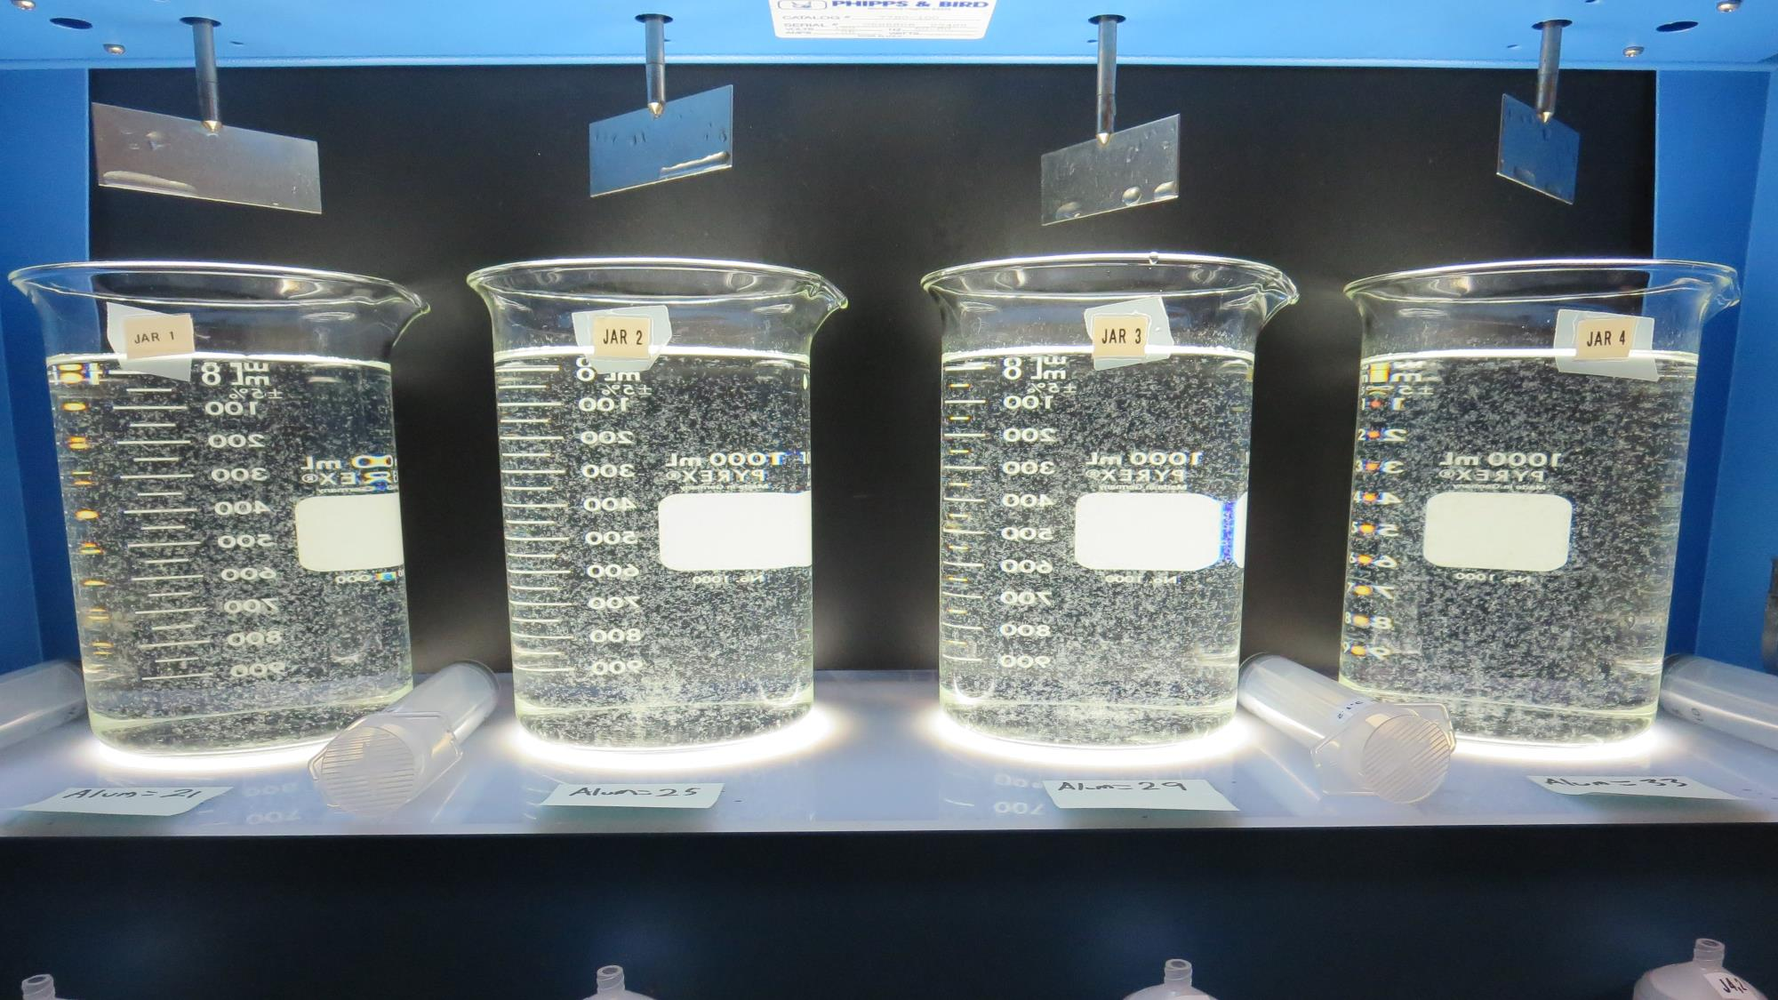
Jars 33-36: End of 10-minute flocculation (30 RPM) duration.
21 mg/L Alum
Filtrate 0.17 NTU
UVT: 93.1%
UVA: 0.036/cm
Settled: 0.67 NTU
25 mg/L Alum
Filtrate 0.15 NTU
UVT: 92.9%
UVA: 0.032/cm
Settled: 0.50 NTU
29 mg/L Alum
Filtrate 0.13 NTU
UVT: 93.4%
UVA: 0.030/cm
Settled: 0.48 NTU
33 mg/L Alum
Filtrate 0.11 NTU
UVT: 93.6%
UVA: 0.030/cm
Settled: 0.39 NTU

Slide 49
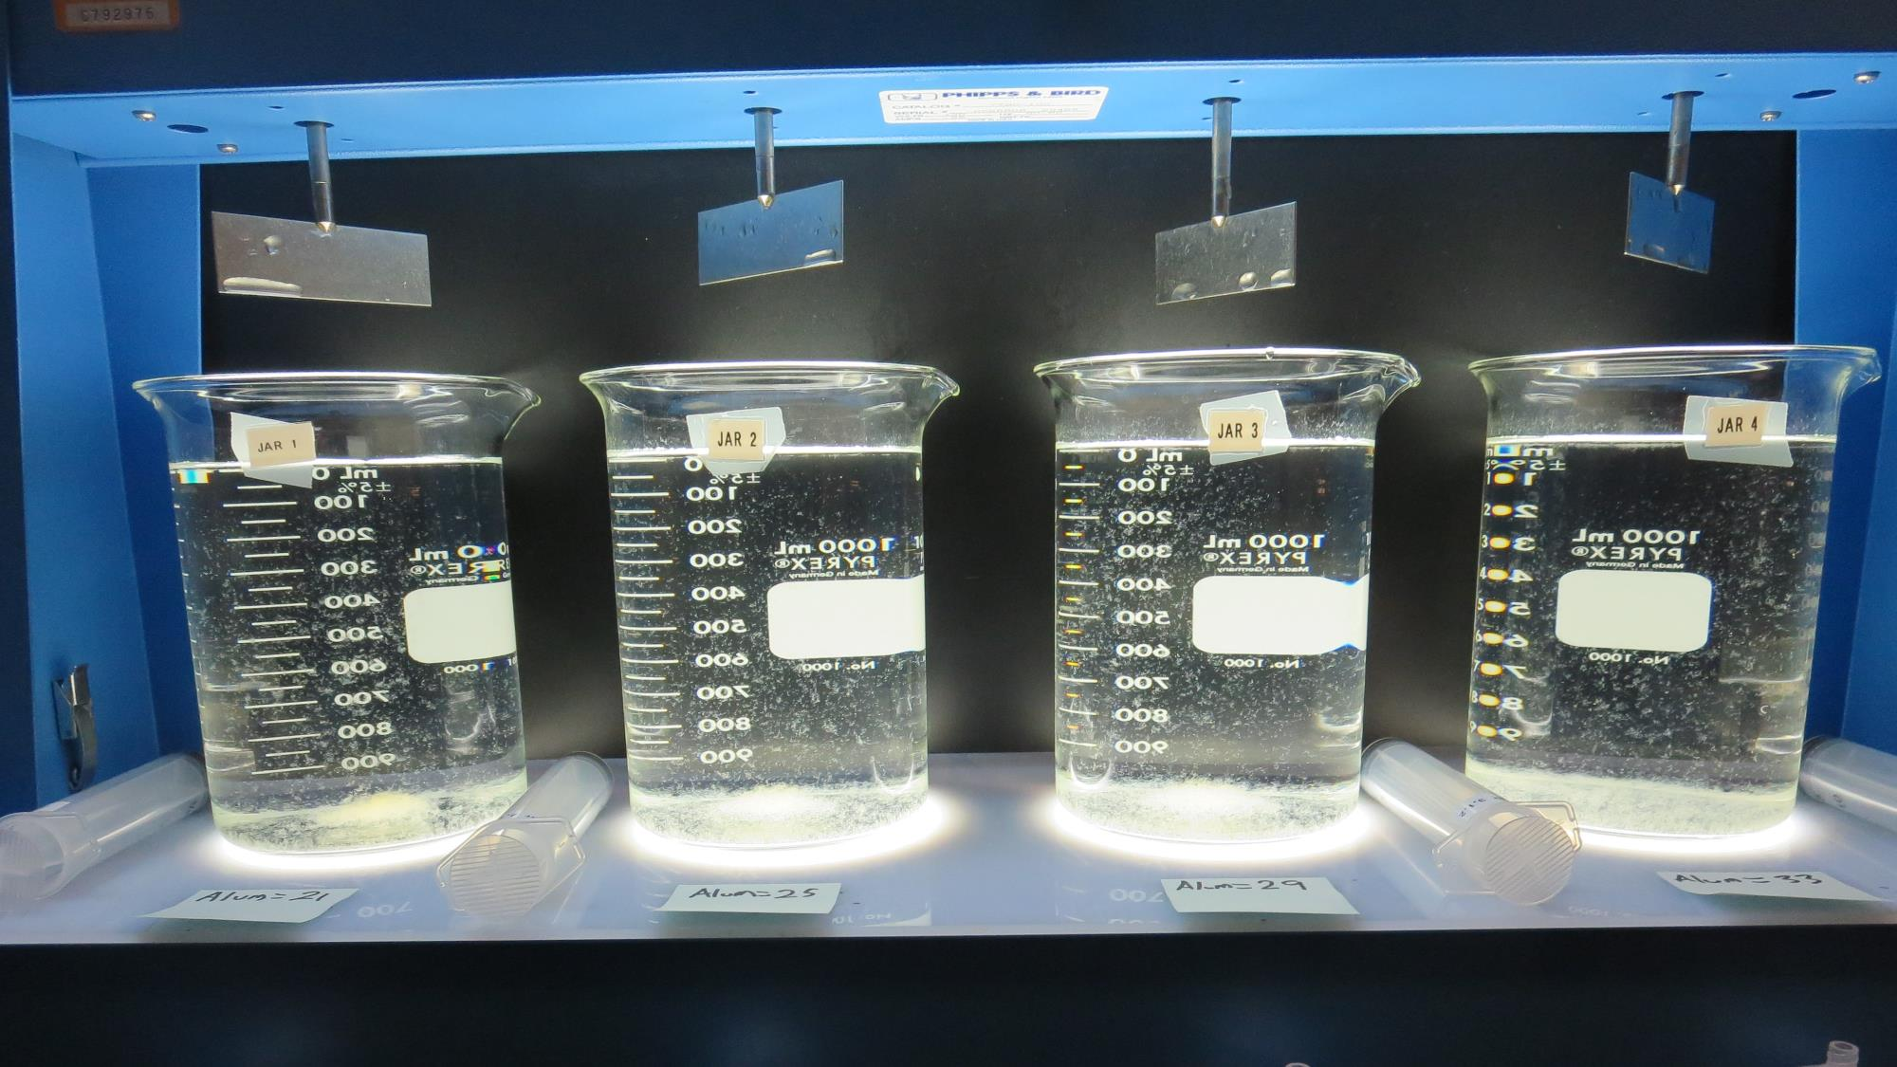
Jars 33-36: After 5 min of settling, 25 mL is syringed for filterability and %UVT/UVA.

Slide 50
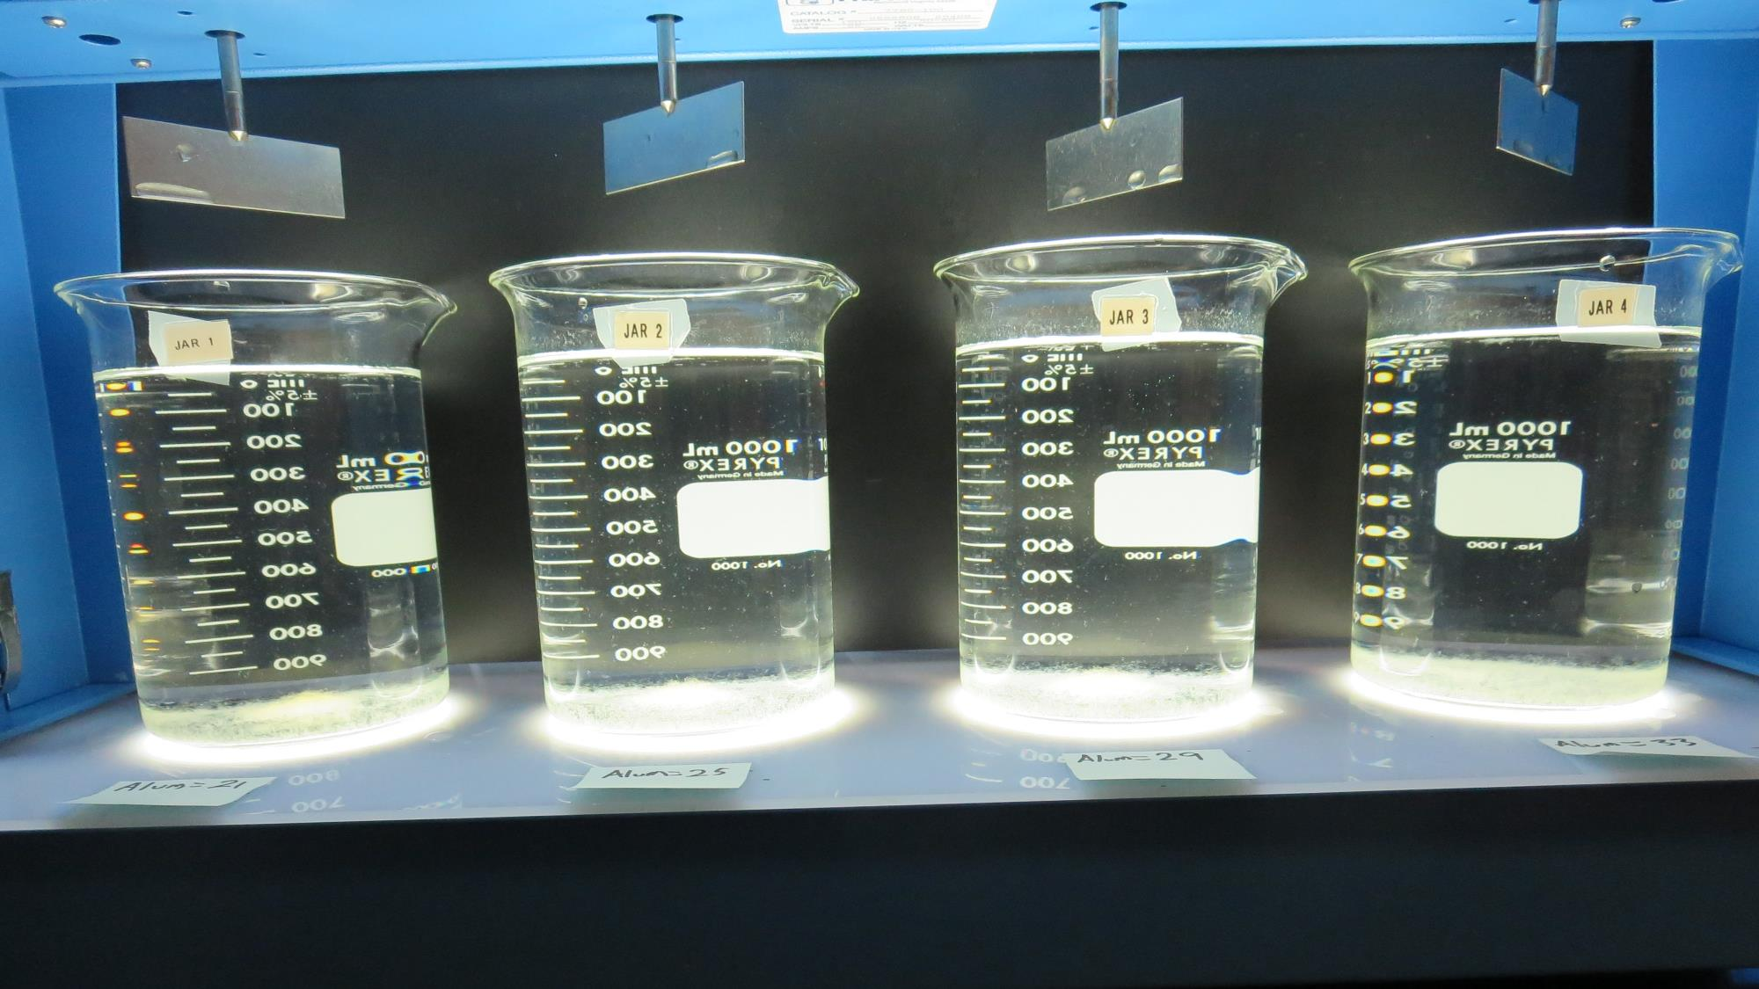
Jars 33-36: After 25-minutes of settling, settled water turbidity is taken.
21 mg/L Alum
Filtrate 0.17 NTU
UVT: 93.1%
UVA: 0.036/cm
Settled: 0.67 NTU
25 mg/L Alum
Filtrate 0.15 NTU
UVT: 92.9%
UVA: 0.032/cm
Settled: 0.50 NTU
29 mg/L Alum
Filtrate 0.13 NTU
UVT: 93.4%
UVA: 0.030/cm
Settled: 0.48 NTU
33 mg/L Alum
Filtrate 0.11 NTU
UVT: 93.6%
UVA: 0.030/cm
Settled: 0.39 NTU

Slide 51
Jars 37-40 Test No Flash Mix Floc Mix 5/10/20/40 min (30 RPM) Applied Coagulant Aluminum Sulfate

Slide 52
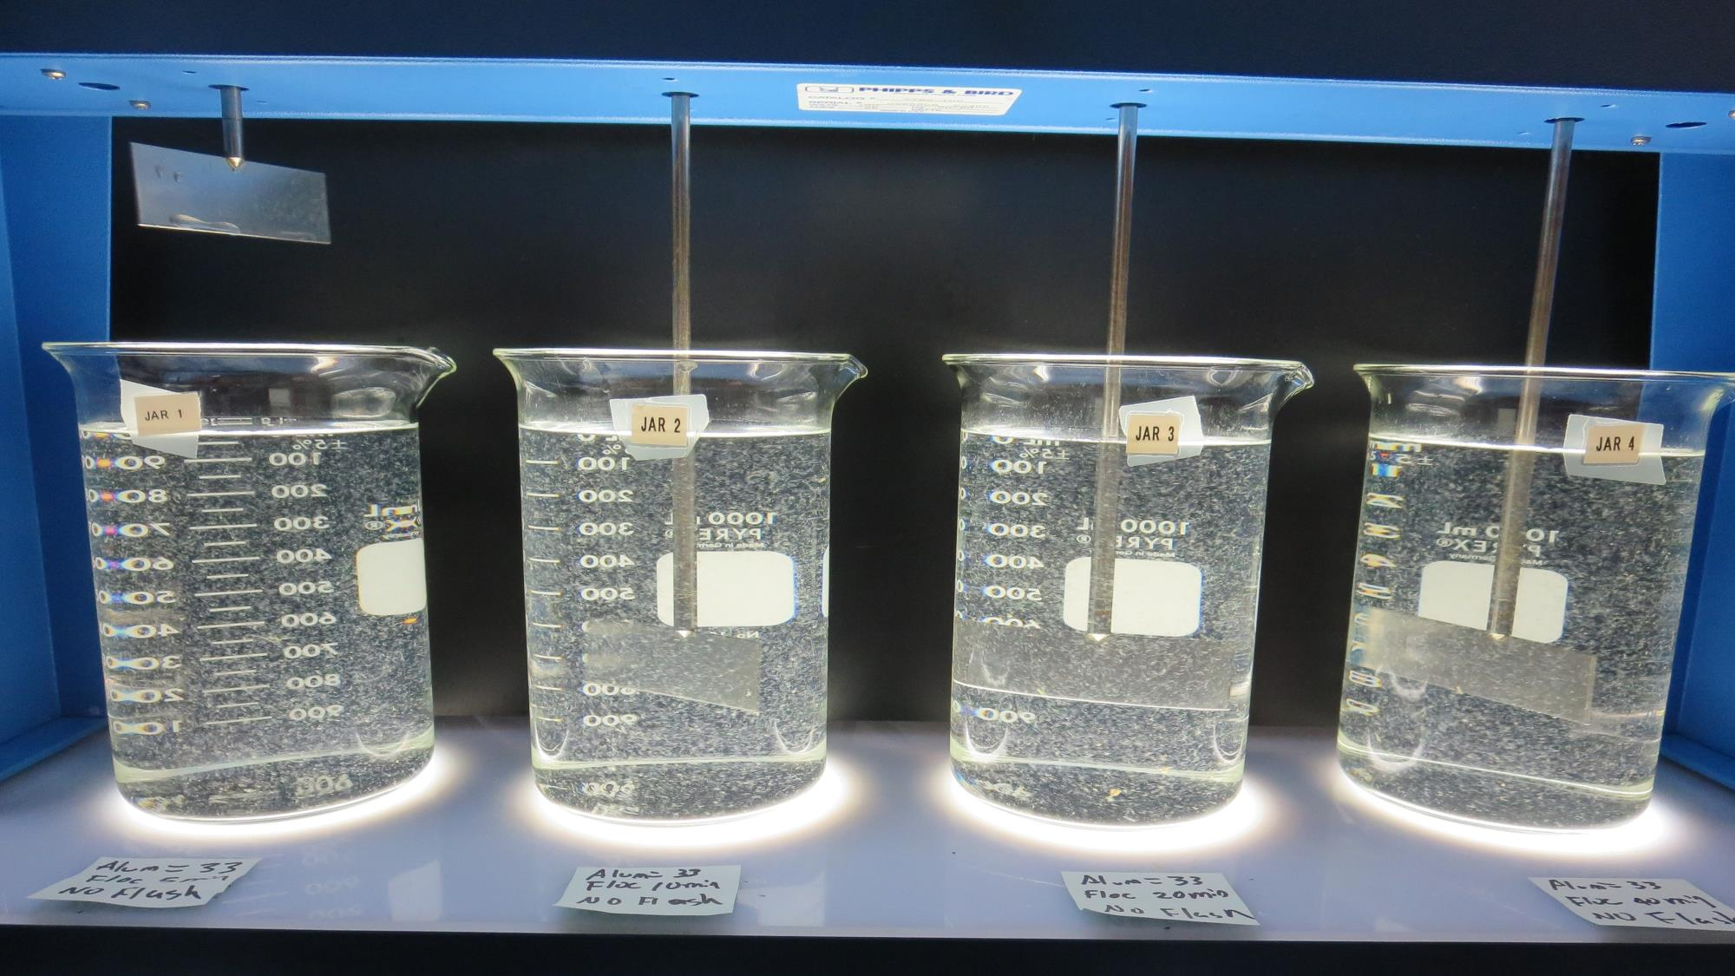
Jars 37: End of 5-minute flocculation (30 RPM) duration.
33 mg/L Alum
Filtrate 0.12 NTU
UVT: 93.7%
UVA: 0.028/cm
Settled: 1.6 NTU (15 min)
Settled: 1.1 NTU (25 min)
Settled: 0.95 NTU (35 min)

Slide 53
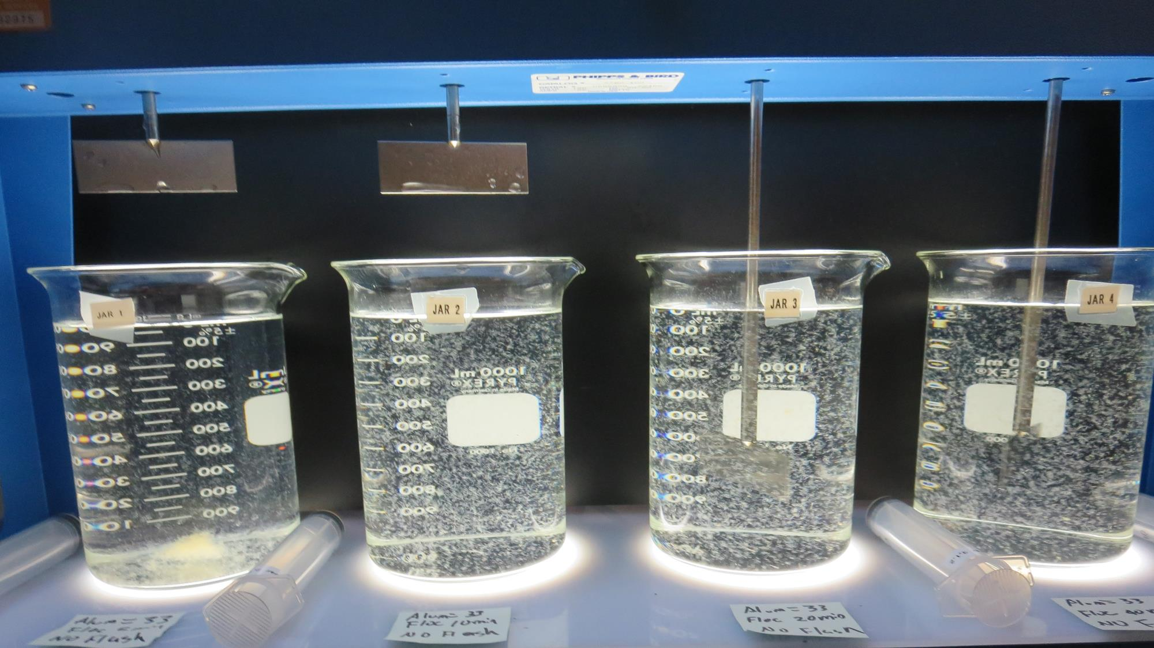
Jars 38: End of 10-minute flocculation (30 RPM) duration.
33 mg/L Alum
Filtrate 0.17 NTU
UVT: 93.6%
UVA: 0.029/cm
Settled: 0.63 NTU (15 min)
Settled: 0.45 NTU (25 min)
Settled: 0.55 NTU (35 min)

Slide 54
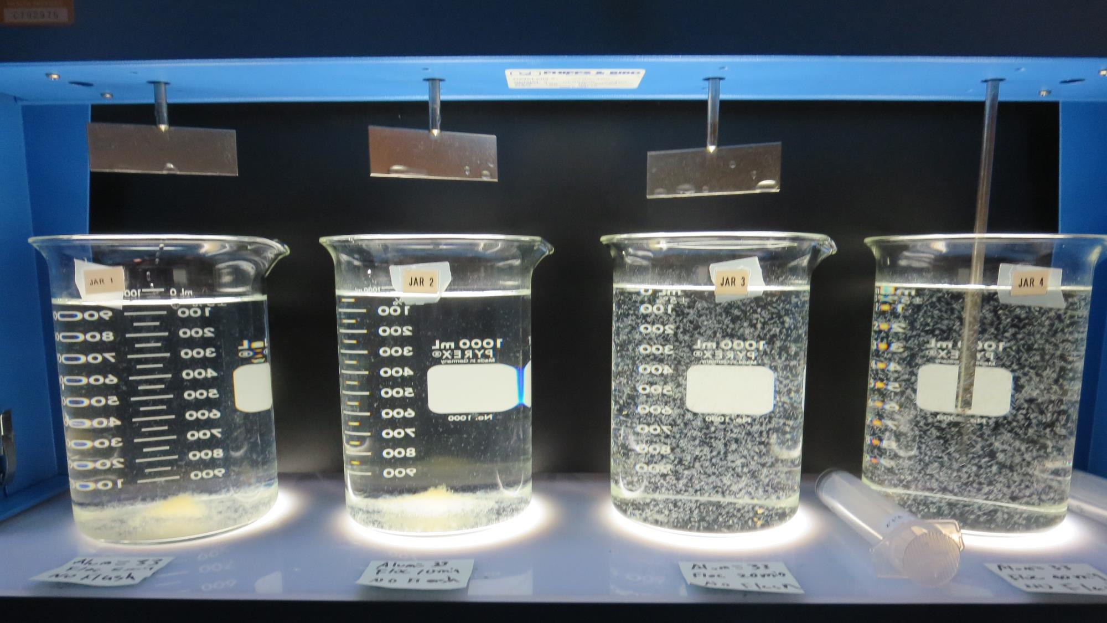
Jars 39: End of 20-minute flocculation (30 RPM) duration.
33 mg/L Alum
Filtrate 0.12 NTU
UVT: 93.6%
UVA: 0.029/cm
Settled: 0.58 NTU (15 min)
Settled: 0.36 NTU (25 min)
Settled: 0.38 NTU (35 min)

Slide 55
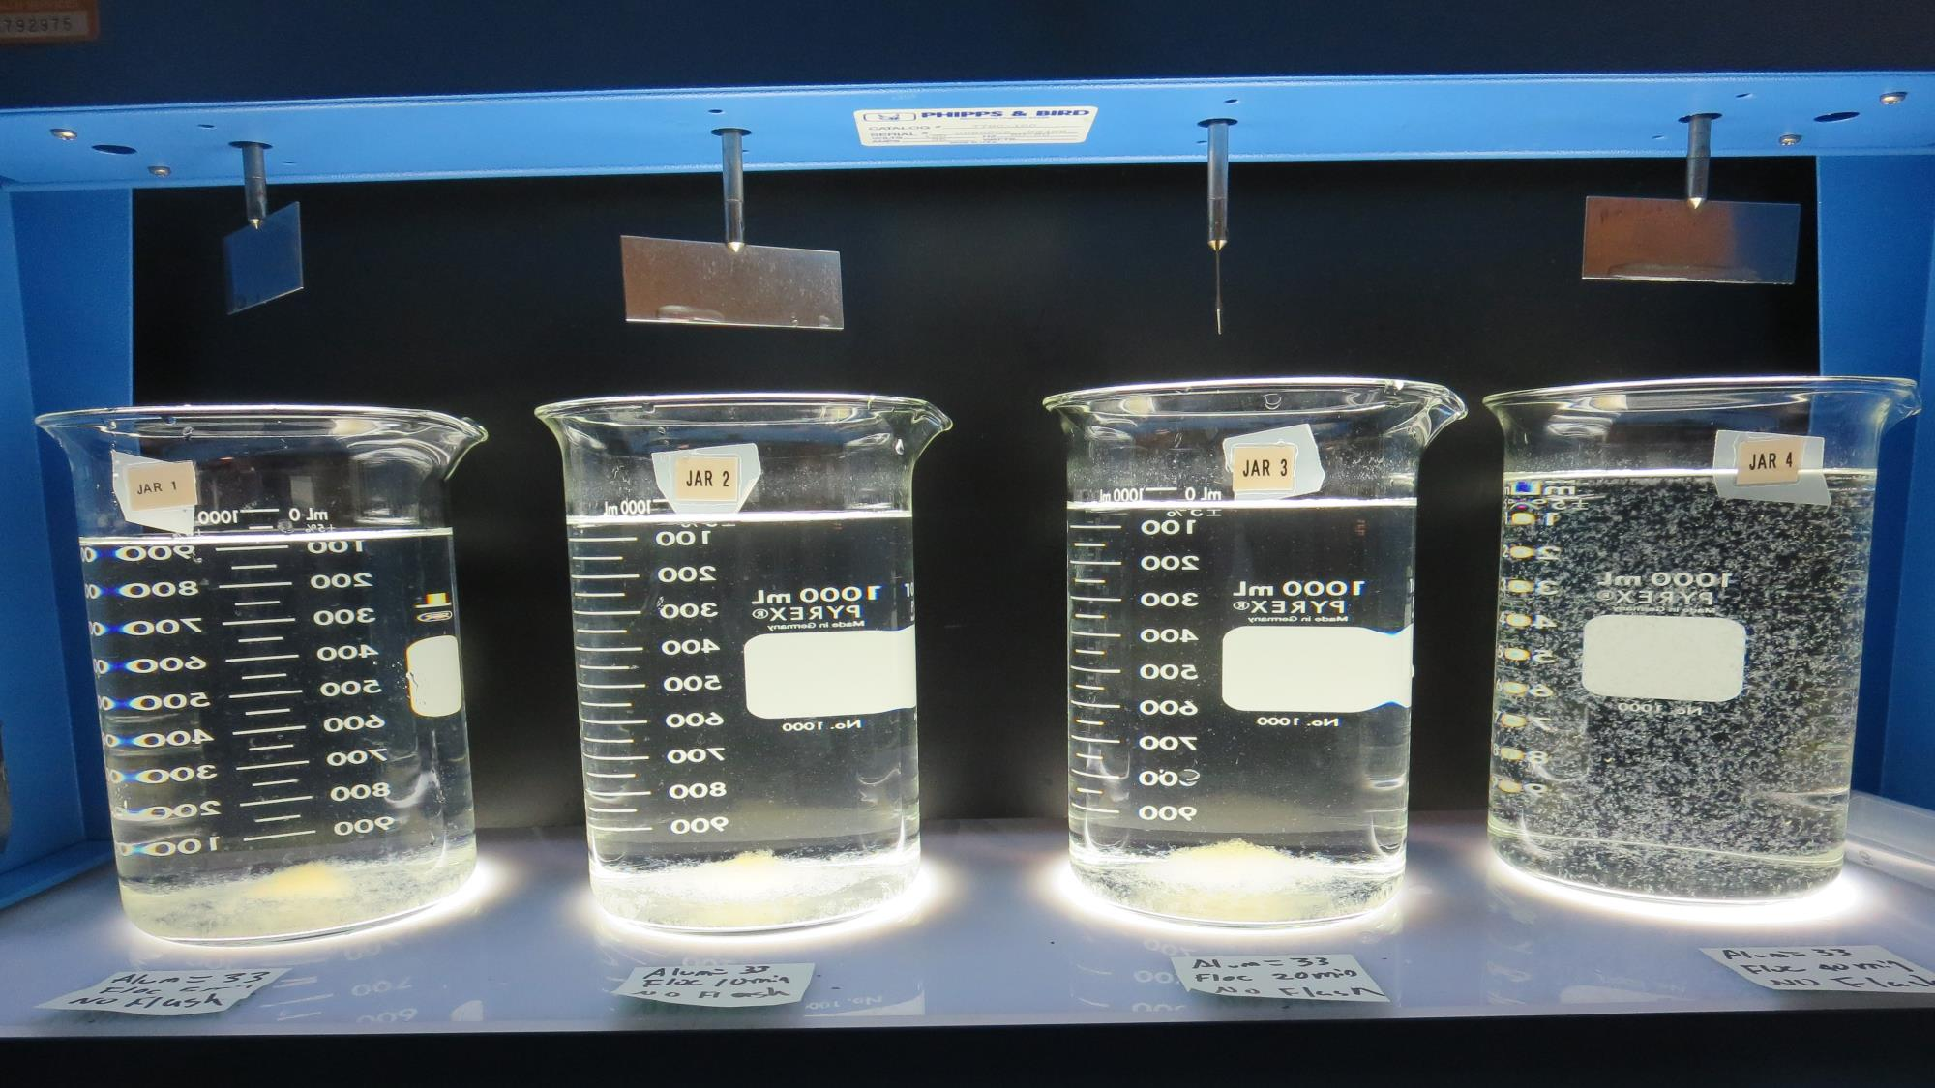
Jars 40: End of 40-minute flocculation (30 RPM) duration.
33 mg/L Alum
Filtrate 0.46 NTU
UVT: 93.3%
UVA: 0.029/cm
Settled: 0.31 NTU (15 min)
Settled: 0.25 NTU (25 min)
Settled: 0.28 NTU (35 min)

Slide 56
Jar Testing for 1-Liter Jars: Procedures for Most Treatment Plants
Fill jars with source water prior to coagulant injection and set paddle speed at 30 rpm
Add chemicals (i.e., NaOCl, primary coagulant, coagulant aid) to each jar
Flash mix for 15-60 seconds (200 rpm)
Slow mix for 5 minutes (20-30 rpm)
Settled for 5 minutes. Syringe 25 mL from each jar taken 1-inch below surface (25 mL/12 sec rate)
Filtered through 1.2 um isopore membrane into cuvette drip rate, 15 mL/(50-90 sec)
Measure filtrate turbidity, chlorine residual and %UVT/UVA
Measure settled water turbidity after 25 minutes of total setting
Record all data

Slide 57
Jar Test Filterability Test Equipment
Turbidity Instrument
Syringe w/Luer-Lock Tip, 30 cc
(part#: 2225800, by Hach)
Swinnex Filter Holder, 25 mm (part#: SX0002500)
Isopore Membrane Filter, 1.2 um absolute
pore size,
Φ= 25 mm , thickness: 24 um,
hydrophilic polycarbonate membrane
(part #: RTTP02500)
Go to Sigma-Aldrich for laboratory supplies http://www.sigmaaldrich.com/united-states.html

Slide 58
Filter Used for This Study
Note: 1.20 um (nominal size), polypropylene hydrophobic membrane was used for this study.
Thickness: 180-250 um, Max flow rate (200 mL/min @ 10 psi)
(Tisch Scientific, Part#: SF14854, www.scienticfilters.com)

Slide 59
Isopore Membrane Information
Categories | Information
trade name | Isopore
filter color | White
chemistry | Polycarbonate (PC)
water flow rate | Avg. 175 mL/min x cm² (typical results @ 10 psi)
media | Isopore®
wettability | Hydrophilic
porosity | 14.7%
pore size | 1.2 µm
bubble point at 23 °C | 1.0 bar, air with water
thickness | 24 µm
filter diameter (ø) | 25 mm
material size | polycarbonate, Hydrophilic, 1.2 µm, 25 mm, white, plain, 100

Slide 60
Isopore Membrane Background Information
The Isopore membrane is a polycarbonate, track-etched screen filter recommended for all analyses in which the sample is viewed on the surface of the membrane. The Isopore membrane is composed of polycarbonate film, which has a smooth, glass-like surface for clearer sample observation. The unique manufacturing process of the membrane ensures a precise pore diameter and a consistent pore size for accurate separation of samples by size. Matched-weight filters are not usually required because of low, constant tar and ash weights. Features & Benefits: Membrane structure retains particles on the surface, simplifying counting and analysis

Slide 61
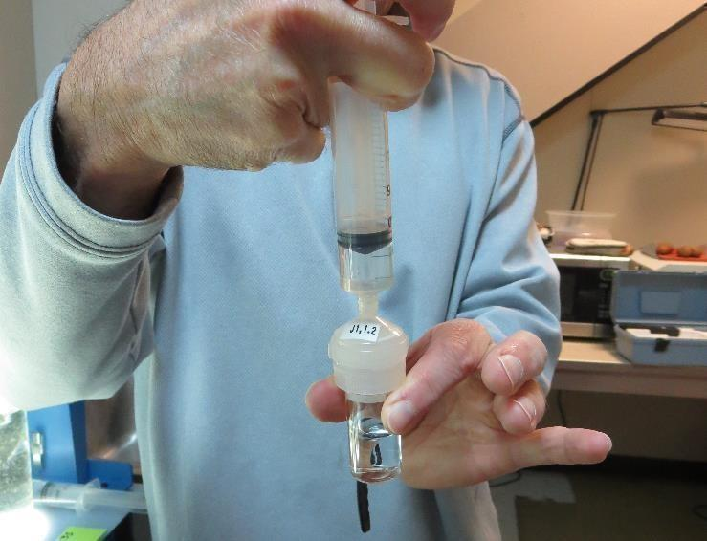
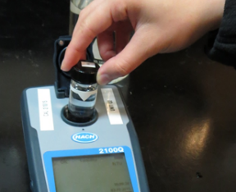
Jar Test - Filterability Test
Syringe ~ 25 mL from jar (after 5-minutes of settling)
Filter-to-waste 3-5 mL
Filter directly into clean cuvette
Measure turbidity
Note: Take several readings before recording final NTU results. Micro bubbles can adhere to glass causing false NTU readings. To remove bubbles, tilt cuvette up to 90 degrees.

Slide 62
Contact
Guy Schott, P.E.
State Water Resources Control Board
Division of Drinking Water
Santa Rosa, CA
Go to Stock Solution/Dose calculations/Jar Test Results for tools to download
www.waterboards.ca.gov/drinking_water/programs/districts/mendocino_district.html
Email: Guy Schott - Guy.Schott@waterboards.ca.gov
Office Number: 707-576-2732

