Slide 1
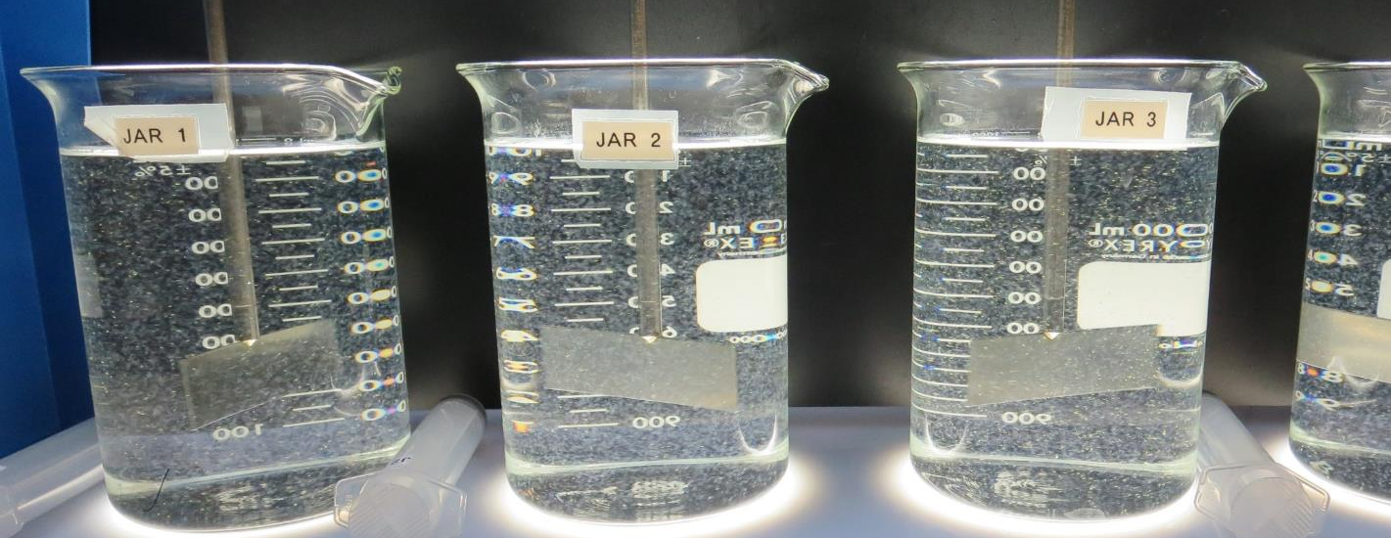
Clearlake Oaks CWD
CA1710001
Lake County
Jar Test
by Guy Schott, P.E.
June 16, 2020

Slide 2
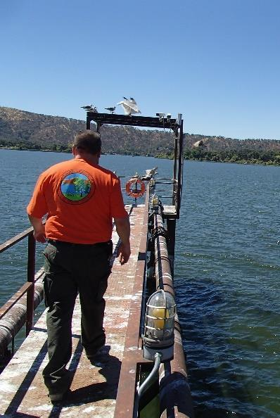
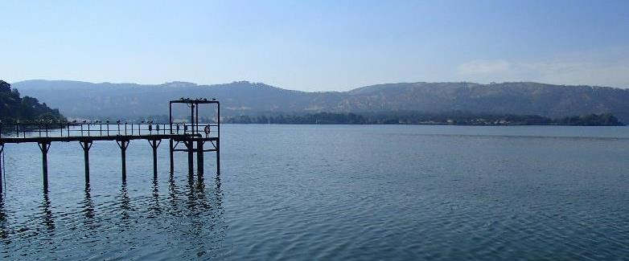
Clearlake Oaks CWD
Source Water: Clear Lake
Conventional Treatment

Slide 3
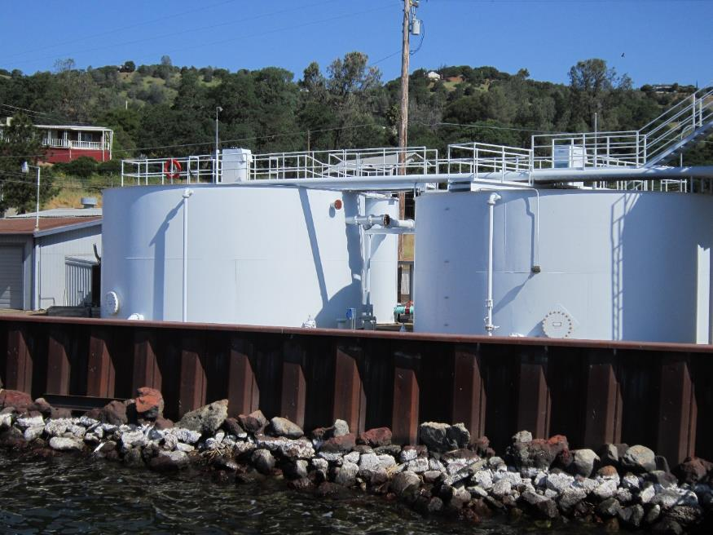
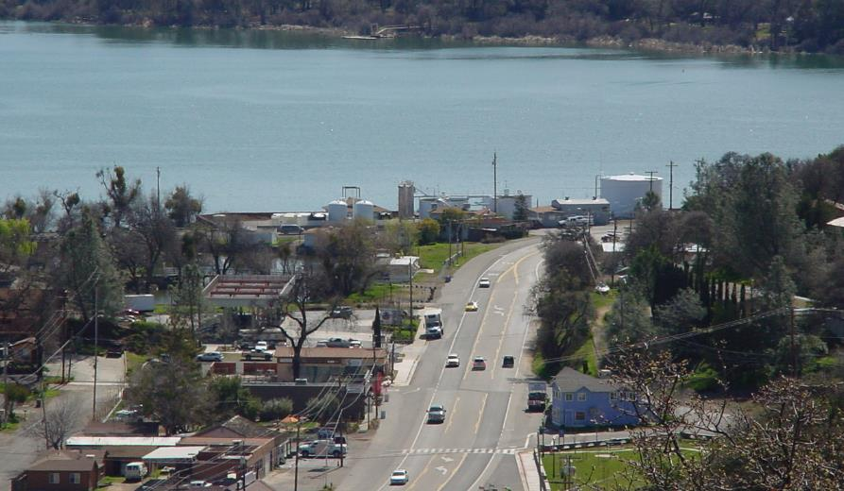
Conventional Treatment Plant

Slide 4
Clearlake Oaks CWD.:
Source Water Characteristics
June 16, 2020
Source
Post Ozone Sample
pH: 8.41
Turbidity: 3.03 NTU
UVT: 89.0%
UVA: 0.050/cm
0.4 um Filtered
Turbidity: 0.26 NTU
UVT: 91.6%
UVA: 0.038/cm
Plant Filtrate
Coagulant Dose: 28 mg/L 9800
Turbidity: 0.10 NTU
UVT: 95.4%
UVA: 0.020/cm
UVA Reduction: 47.4%
GAC Filtrate
Turbidity: 0.07 NTU
UVT: 96.4%
UVA: 0.015/cm
UVA Reduction: 60.5%

Slide 5
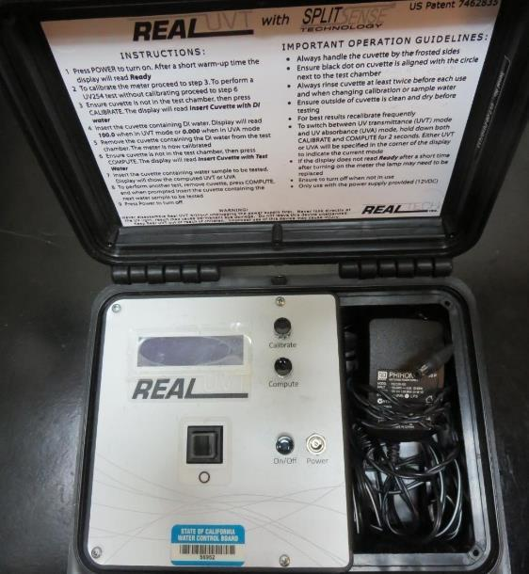
UVT/UVA, pathlength 10 mm
UV transmittance (UVT) is a measurement of the amount of ultraviolet light (commonly at 254 nm due to its germicidal effect) that passes through a water sample compared to the amount of light that passes through a pure water sample. The measurement is expressed as a percentage, % UVT.
%UVT = 10^{(-UVA)} x 100%
UV absorbance (UVA) is calculated as a relative measure of the amount of light absorbed by a water sample compared with the amount of light absorbed by a pure water sample.
UVA = -log(%UVT/100)

Slide 6
Applied Coagulants for Jar Testing
Pro Pac 9800 (NTU Technologies)
50% Aluminum Chlorohydrate
50% Water
83% Basicity
SG = 1.34
Pro Pac 9890 (NTU Technologies)
35-45% Aluminum Chlorohydrate
20% Trade Secret
35-45% Water
SG = 1.25-1.34
Pro Pac 9810 (NTU Technologies)
45% Aluminum Chlorohydrate
5% Trade Secret
45% Water
SG = 1.25-1.34
Advanced Coagulant
12.55% Al₂O₃
6.64% Al
66.4% Basicity
SG = 1.3

Slide 7
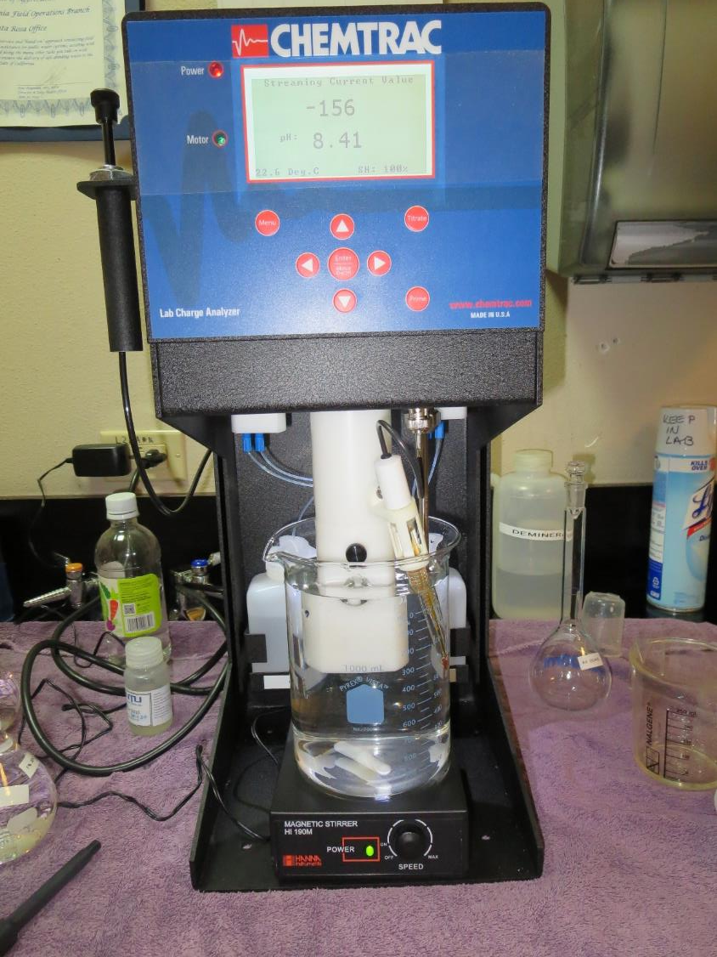
Laboratory Charge Analyzer
LCA: Used to determine coagulant demand of a source water entering the treatment plant.
Source pH: 8.41
LCA #1:
9800: 24.9 mg/L as product
pH adjusted to 7.5 w/acetic acid solution
LCA #2:
Advance Coagulant: 102 mg/L as product
pH adjusted to 7.5 w/acetic acid solution
LCA #3:
9810: Manually added 7 mg/L as product
9800: 14.5 mg/L as product
pH adjusted to 7.5 w/acetic acid solution

Slide 8
Coagulant Information
Unless stated otherwise, all coagulant doses are reported as Product (100% strength). Alum Sulfate is reported as Alum.
Preparation of coagulant stock solutions are generally 1.0 and/or 0.1 percent strength using 100 and/or 200 mL volumetric flasks.
Finnpipette F2 variable volume pipette, capacity 100-1000 micro liters is used for stock solution preparation and coagulant aid jar test dosing.
Finnpipette F2 variable volume pipette, capacity 0.5-5 mL is used for primary coagulant jar test dosing.

Slide 9
Clearlake Oaks CWS: Jar Test 1-4 Results
Post-Ozone Source Water
Jar # | 200 RPM Flash Mix sec | 30 RPM Floc Duration min | 9800 mg/L | Filtrate NTU | Filtrate %UVT | Filtrate UVA/cm | %UVA Reduction | Settle NTU 25 min
J1 | 30 | 5 | 24 | 0.18 | 93.8 | 0.028 | 26.3 | 0.92
J2 | 30 | 5 | 26 | 0.12 | 94.6 | 0.024 | 36.8 | 0.52
J3 | 30 | 5 | 28 | 0.11 | 94.2 | 0.025 | 34.2 | 0.46
J4 | 30 | 5 | 30 | 0.11 | 94.6 | 0.023 | 39.5 | 0.41

Slide 10
Clearlake Oaks CWS: Jar Test 5-8 Results
Post-Ozone Source Water
Jar # | 200 RPM Flash Mix sec | 30 RPM Floc Duration min | 9800 mg/L | Filtrate NTU | Filtrate %UVT | Filtrate UVA/cm | %UVA Reduction | Settle NTU 25 min
J5 | 30 | 5 | 28 | 0.07 | 95.1 | 0.021 | 44.7 | 0.50
J6 | 30 | 5 | 30 | 0.08 | 95.0 | 0.022 | 42.1 | 0.52
J7 | 30 | 5 | 32 | 0.06 | 94.2 | 0.025 | 34.2 | 0.42
J8 | 30 | 5 | 34 | 0.09 | 95.1 | 0.021 | 44.7 | 0.42

Slide 11
Clearlake Oaks CWS: Jar Test 9-10 Results
Post-Ozone Source Water, Flash Mix (200 RPM, 30 sec)
Jar # | 30 RPM Floc Duration minutes | 9810 mg/L | Filtrate NTU | Filtrate %UVT | Filtrate UVA/cm | %UVA Reduction | Settle NTU 25 min
J9 | 5 | 28 | 0.13 | 94.2 | 0.025 | 34.2 | 0.35
J10 | 5 | 30 | 0.11 | 94.3 | 0.025 | 34.2 | 0.32

Slide 12
Clearlake Oaks CWS: Jar Test 11-16 Results
Post-Ozone Source Water, Flash Mix (200 RPM, 30 sec)
Jar # | 30 RPM Floc Duration minutes | 9800 mg/L | 9890 mg/L | Filtrate NTU | Filtrate %UVT | Filtrate UVA/cm | %UVA Reduction | Settle NTU 25 min
J11 | 5 | 21 | 7.0 | 0.11 | 93.9 | 0.027 | 28.9 | 0.40
J12 | 5 | 22.5 | 7.5 | 0.09 | 94.3 | 0.025 | 34.2 | 0.31
J13 | 5 | 22 | 0 | 0.15 | 93.9 | 0.027 | 28.9 | 0.48
J14 | 5 | 24 | 0 | 0.12 | 93.8 | 0.027 | 28.9 | 0.53
J15 | 5 | 26 | 0 | 0.11 | 93.7 | 0.028 | 26.3 | 0.48
J16 | 5 | 28 | 0 | 0.11 | 93.7 | 0.027 | 28.9 | 0.43

Slide 13
Clearlake Oaks CWS: Jar Test 17-20 Results
Post-Ozone Source Water, Flash Mix 200 RPM (30 sec)
Jar # | 30 RPM Floc Duration minutes | Adv Coag. mg/L | Filtrate NTU | Filtrate %UVT | Filtrate UVA/cm | %UVA Reduction | Settle NTU 25 min
J17 | 5 | 70 | 0.15 | 93.7 | 0.028 | 26.3 | 0.40
J18 | 5 | 80 | 0.12 | 93.9 | 0.027 | 28.9 | 0.40
J19 | 5 | 90 | 0.11 | 94.2 | 0.026 | 31.6 | 0.35
J20 | 5 | 100 | 0.08 | 94.4 | 0.025 | 34.2 | 0.29

Slide 14
Clearlake Oaks CWS: Jar Test 21-24 Results
Post-Ozone Source Water, Flash Mix 200 RPM (30 sec)
Jar # | 30 RPM Floc Duration minutes | 9800 mg/L | NaOCl mg/L | Filtrate NTU | Filtrate %UVT | Filtrate UVA/cm | %UVA Reduction | Settle NTU 25 min
J21 | 5 | 26 | 0 | 0.09 | 94.2 | 0.025 | 34.2 | 0.25
J22 | 5 | 28 | 0 | 0.08 | 94.2 | 0.025 | 34.2 | 0.28
J23 | 5 | 26 | 1.0 | 0.10 | 93.1 | 0.031 | 18.4 | 0.32
J24 | 5 | 28 | 1.0 | 0.08 | 93.2 | 0.030 | 21.1 | 0.29

Slide 15
Clearlake Oaks CWS: Jar Test 25-28 Results
Post-Ozone Source Water, Flash Mix 200 RPM (30 sec)
Jar # | 30 RPM Floc Duration minutes | 9800 mg/L | 9890 mg/L | Filtrate NTU | Filtrate %UVT | Filtrate UVA/cm | %UVA Reduction | Settle NTU 25 min
J25 | 5 | 22 | 2.2 | 0.12 | 93.9 | 0.027 | 28.9 | 0.33
J26 | 5 | 24 | 2.4 | 0.08 | 94.0 | 0.026 | 31.6 | 0.30
J27 | 5 | 26 | 2.6 | 0.09 | 94.0 | 0.026 | 31.6 | 0.31
J28 | 5 | 28 | 2.8 | 0.12 | 94.3 | 0.025 | 34.2 | 0.33

Slide 16
Clearlake Oaks CWS: Jar Test 29-36 Results
Post-Ozone Source Water, Flash Mix 200 RPM (30 sec)
Jar # | 30 RPM Floc Duration minutes | 9810 mg/L | Filtrate NTU | Filtrate %UVT | Filtrate UVA/cm | %UVA Reduction | Settle NTU 25 min
J29 | 5 | 26 | 0.10 | 94.6 | 0.024 | 36.8 | 0.31
J30 | 5 | 28 | 0.09 | 94.5 | 0.024 | 36.8 | 0.35
J31 | 5 | 30 | 0.09 | 94.3 | 0.025 | 34.2 | 0.32
J32 | 5 | 32 | 0.09 | 94.6 | 0.024 | 36.8 | 0.30
J33 | 5 | 22 | 0.11 | 94.2 | 0.025 | 34.2 | 0.47
J34 | 5 | 24 | 0.09 | 94.2 | 0.025 | 34.2 | 0.34
J35 | 5 | 26 | 0.09 | 94.5 | 0.024 | 36.8 | 0.32
J36 | 5 | 34 | 0.09 | 94.7 | 0.023 | 39.5 | 0.25

Slide 17
Jars 1-4 Test
Flash Mix 30 Sec (200 RPM)
Floc Mix 5 min (30 RPM)
Applied Coagulant
9800

Slide 18
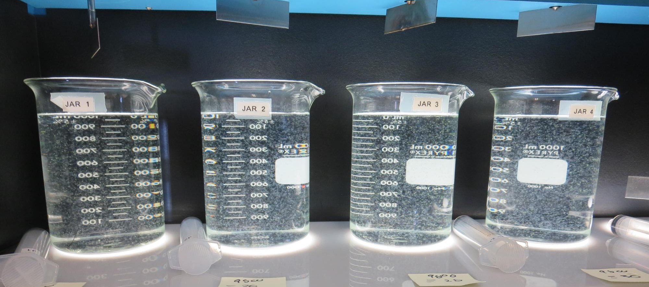
Jars 1-4: End of 5-minute flocculation (30 RPM) duration.
24 mg/L 9800
Filtrate 0.18 NTU
UVT: 93.8%
UVA: 0.028/cm
UVA Reduction: 26.3%
Settled: 0.92 NTU
26 mg/L 9800
Filtrate 0.12 NTU
UVT: 94.6%
UVA: 0.024/cm
UVA Reduction: 36.8%
Settled: 0.52 NTU
28 mg/L 9800
Filtrate 0.11 NTU
UVT: 94.2%
UVA: 0.024/cm
UVA Reduction: 34.2%
Settled: 0.46 NTU
30 mg/L 9800
Filtrate 0.11 NTU
UVT: 94.6%
UVA: 0.023/cm
UVA Reduction: 39.5%
Settled: 0.41 NTU

Slide 19
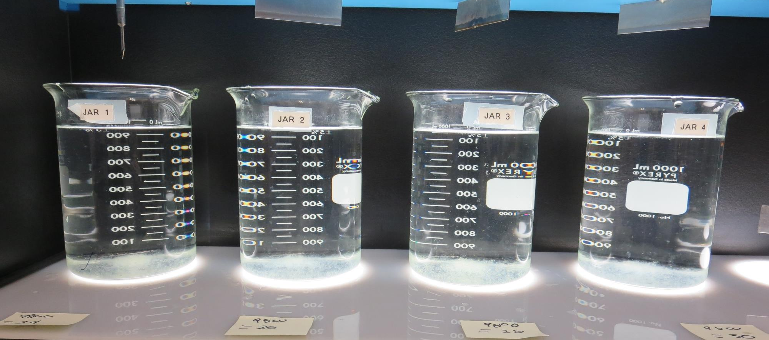
Jars 1-4: After 25-minutes of settling, settled water turbidity is taken.
24 mg/L 9800
Filtrate 0.18 NTU
UVT: 93.8%
UVA: 0.028/cm
UVA Reduction: 26.3%
Settled: 0.92 NTU
26 mg/L 9800
Filtrate 0.12 NTU
UVT: 94.6%
UVA: 0.024/cm
UVA Reduction: 36.8%
Settled: 0.52 NTU
28 mg/L 9800
Filtrate 0.11 NTU
UVT: 94.2%
UVA: 0.024/cm
UVA Reduction: 34.2%
Settled: 0.46 NTU
30 mg/L 9800
Filtrate 0.11 NTU
UVT: 94.6%
UVA: 0.023/cm
UVA Reduction: 39.5%
Settled: 0.41 NTU

Slide 20
Jars 5-8 Test
Flash Mix 30 Sec (200 RPM)
Floc Mix 5 min (30 RPM)
Applied Coagulant
9810

Slide 21
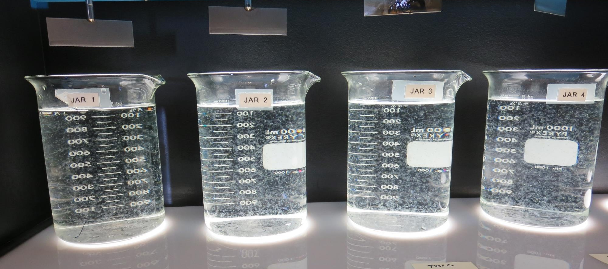
Jars 5-8: End of 5-minute flocculation (30 RPM) duration.
28 mg/L 9810
Filtrate 0.07 NTU
UVT: 95.1%
UVA: 0.021/cm
UVA Reduction: 44.7%
Settled: 0.50 NTU
30 mg/L 9810
Filtrate 0.08 NTU
UVT: 95.0%
UVA: 0.022/cm
UVA Reduction: 42.1%
Settled: 0.52 NTU
32 mg/L 9810
Filtrate 0.06 NTU
UVT: 94.2%
UVA: 0.025/cm
UVA Reduction: 34.2%
Settled: 0.42 NTU
34 mg/L 9810
Filtrate 0.09 NTU
UVT: 95.1%
UVA: 0.021/cm
UVA Reduction: 44.7%
Settled: 0.42 NTU

Slide 22
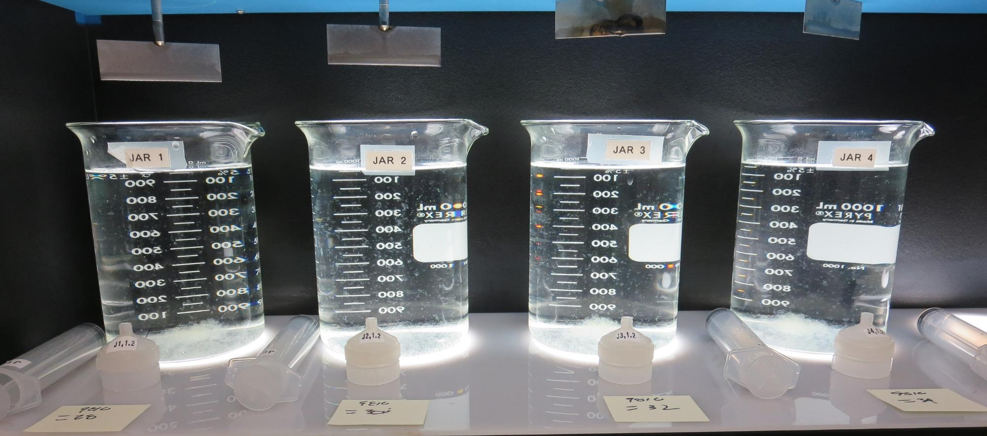
Jars 5-8: After 5 min of settling, 25 mL is syringed for filterability and %UVT/UVA.

Slide 23
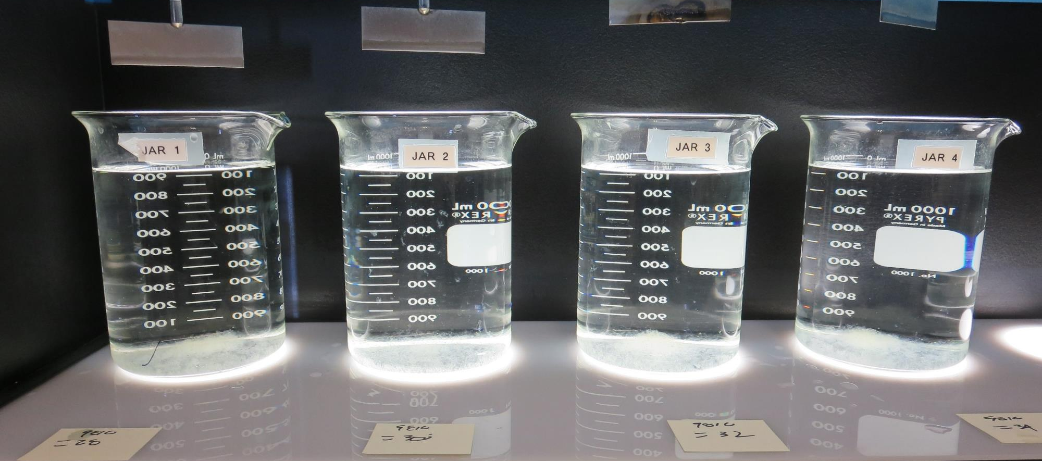
Jars 5-8: After 25-minutes of settling, settled water turbidity is taken.
28 mg/L 9810
Filtrate 0.07 NTU
UVT: 95.1%
UVA: 0.021/cm
UVA Reduction: 44.7%
Settled: 0.50 NTU
30 mg/L 9810
Filtrate 0.08 NTU
UVT: 95.0%
UVA: 0.022/cm
UVA Reduction: 42.1%
Settled: 0.52 NTU
32 mg/L 9810
Filtrate 0.06 NTU
UVT: 94.2%
UVA: 0.025/cm
UVA Reduction: 34.2%
Settled: 0.42 NTU
34 mg/L 9810
Filtrate 0.09 NTU
UVT: 95.1%
UVA: 0.021/cm
UVA Reduction: 44.7%
Settled: 0.42 NTU

Slide 24
Jars 9-12 Test
Flash Mix 30 Sec (200 RPM)
Floc Mix 5 min (30 RPM)
Applied Coagulants
9800/9810/9890

Slide 25
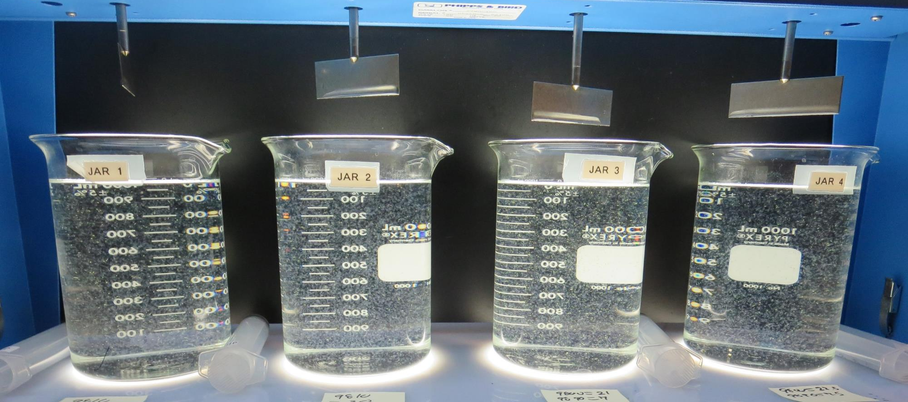
Jars 9-12: End of 5-minute flocculation (30 RPM) duration.
28 mg/L 9810
Filtrate 0.13 NTU
UVT: 94.2%
UVA: 0.025/cm
UVA Reduction: 34.2%
Settled: 0.35 NTU
30 mg/L 9810
Filtrate 0.11 NTU
UVT: 94.3%
UVA: 0.025/cm
UVA Reduction: 34.2%
Settled: 0.32 NTU
21 mg/L 9800
7 mg/L 9890
Filtrate 0.11 NTU
UVT: 93.9%
UVA: 0.027/cm
UVA Reduction: 28.9%
Settled: 0.40 NTU
22.5 mg/L 9800
7.5 mg/L 9890
Filtrate 0.09 NTU
UVT: 94.3%
UVA: 0.025/cm
UVA Reduction: 34.2%
Settled: 0.31 NTU

Slide 26
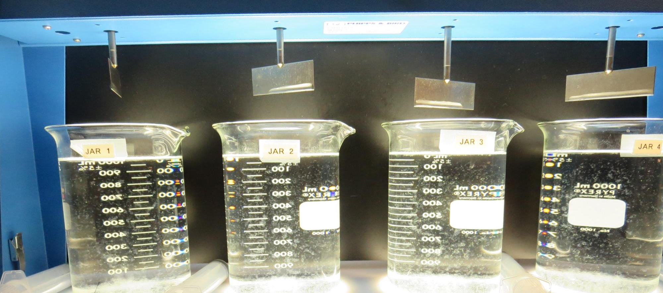
Jars 9-12: After 5 min of settling, 25 mL is syringed for filterability and %UVT/UVA.

Slide 27
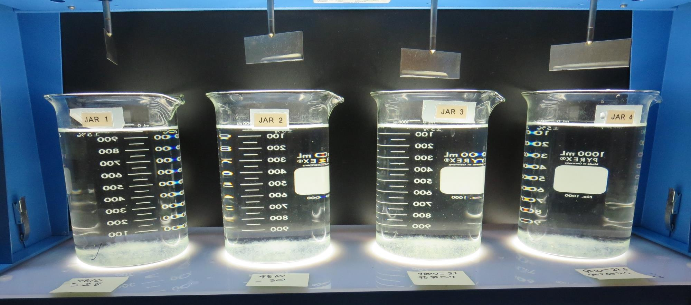
Jars 9-12: After 25-minutes of settling, settled water turbidity is taken.
28 mg/L 9810
Filtrate 0.13 NTU
UVT: 94.2%
UVA: 0.025/cm
UVA Reduction: 34.2%
Settled: 0.35 NTU
30 mg/L 9810
Filtrate 0.11 NTU
UVT: 94.3%
UVA: 0.025/cm
UVA Reduction: 34.2%
Settled: 0.32 NTU
21 mg/L 9800
7 mg/L 9890
Filtrate 0.11 NTU
UVT: 93.9%
UVA: 0.027/cm
UVA Reduction: 28.9%
Settled: 0.40 NTU
22.5 mg/L 9800
7.5 mg/L 9890
Filtrate 0.09 NTU
UVT: 94.3%
UVA: 0.025/cm
UVA Reduction: 34.2%
Settled: 0.31 NTU

Slide 28
Jars 13-16 Test
Flash Mix 30 Sec (200 RPM)
Floc Mix 5 min (30 RPM)
Applied Coagulant
9800

Slide 29
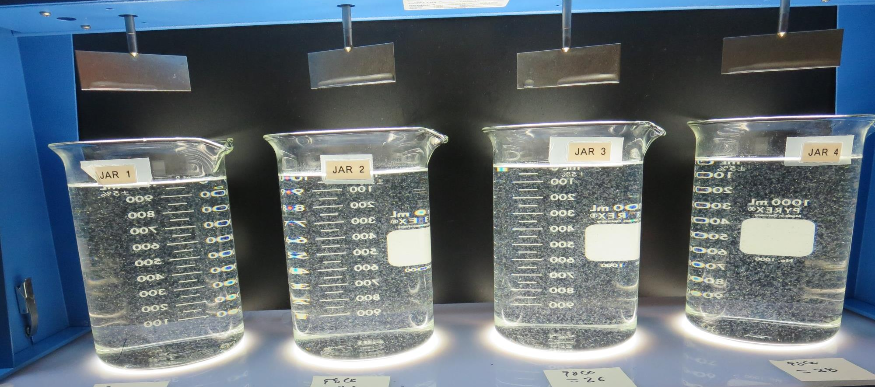
Jars 13-16: End of 5-minute flocculation (30 RPM) duration.
22 mg/L 9800
Filtrate 0.15 NTU
UVT: 93.9%
UVA: 0.027/cm
UVA Reduction: 28.9%
Settled: 0.48 NTU
24 mg/L 9800
Filtrate 0.12 NTU
UVT: 93.8%
UVA: 0.027/cm
UVA Reduction: 28.9%
Settled: 0.53 NTU
26 mg/L 9800
Filtrate 0.11 NTU
UVT: 93.7%
UVA: 0.028/cm
UVA Reduction: 26.3%
Settled: 0.48 NTU
28 mg/L 9800
Filtrate 0.11 NTU
UVT: 93.7%
UVA: 0.027/cm
UVA Reduction: 28.9%
Settled: 0.43 NTU

Slide 30
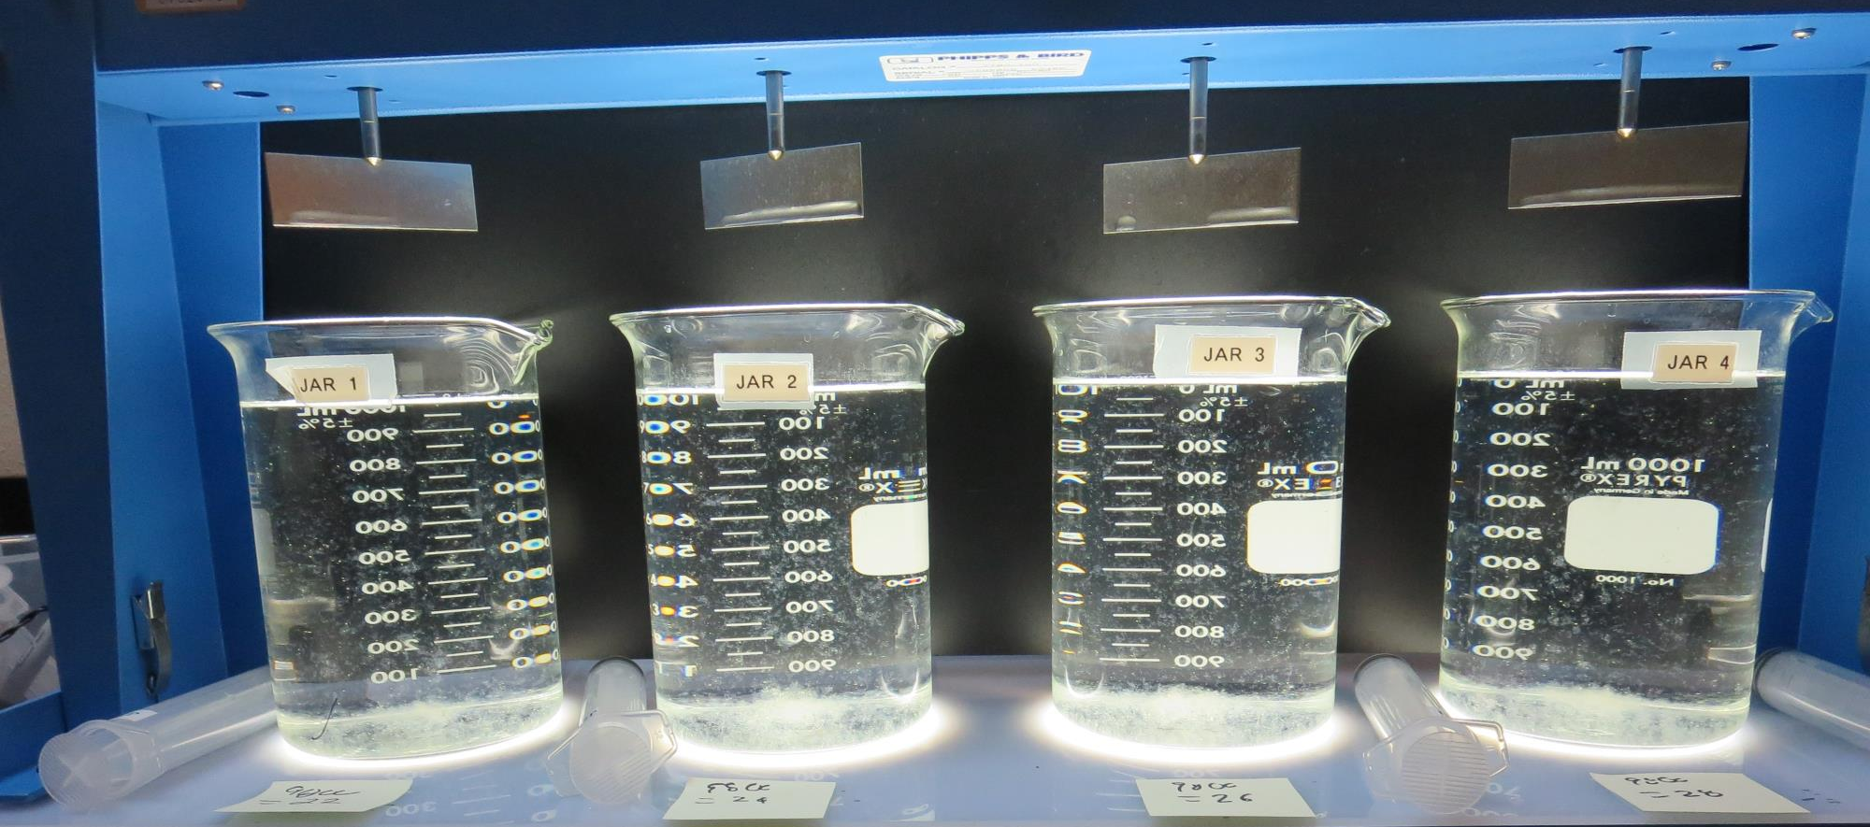
Jars 13-16: After 5 min of settling, 25 mL is syringed for filterability and %UVT/UVA.

Slide 31
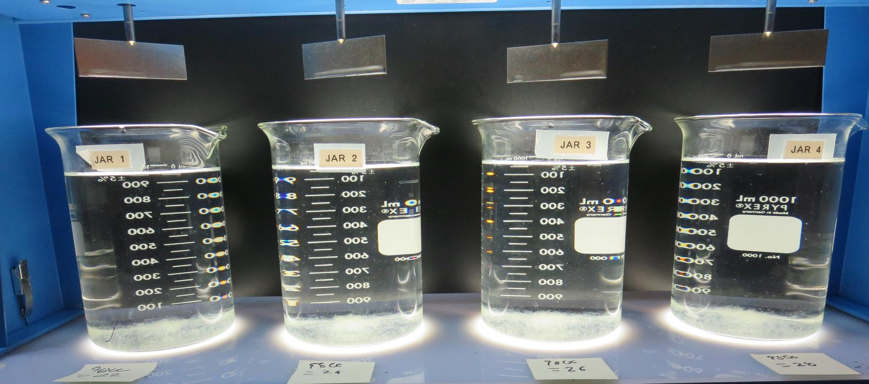
Jars 13-16: After 25-minutes of settling, settled water turbidity is taken.
22 mg/L 9800
Filtrate 0.15 NTU
UVT: 93.9%
UVA: 0.027/cm
UVA Reduction: 28.9%
Settled: 0.48 NTU
24 mg/L 9800
Filtrate 0.12 NTU
UVT: 93.8%
UVA: 0.027/cm
UVA Reduction: 28.9%
Settled: 0.53 NTU
26 mg/L 9800
Filtrate 0.11 NTU
UVT: 93.7%
UVA: 0.028/cm
UVA Reduction: 26.3%
Settled: 0.48 NTU
28 mg/L 9800
Filtrate 0.11 NTU
UVT: 93.7%
UVA: 0.027/cm
UVA Reduction: 28.9%
Settled: 0.43 NTU

Slide 32
Jars 17-20 Test
Flash Mix 30 Sec (200 RPM)
Floc Mix 5 min (30 RPM)
Applied Coagulant
Advanced Coagulant

Slide 33
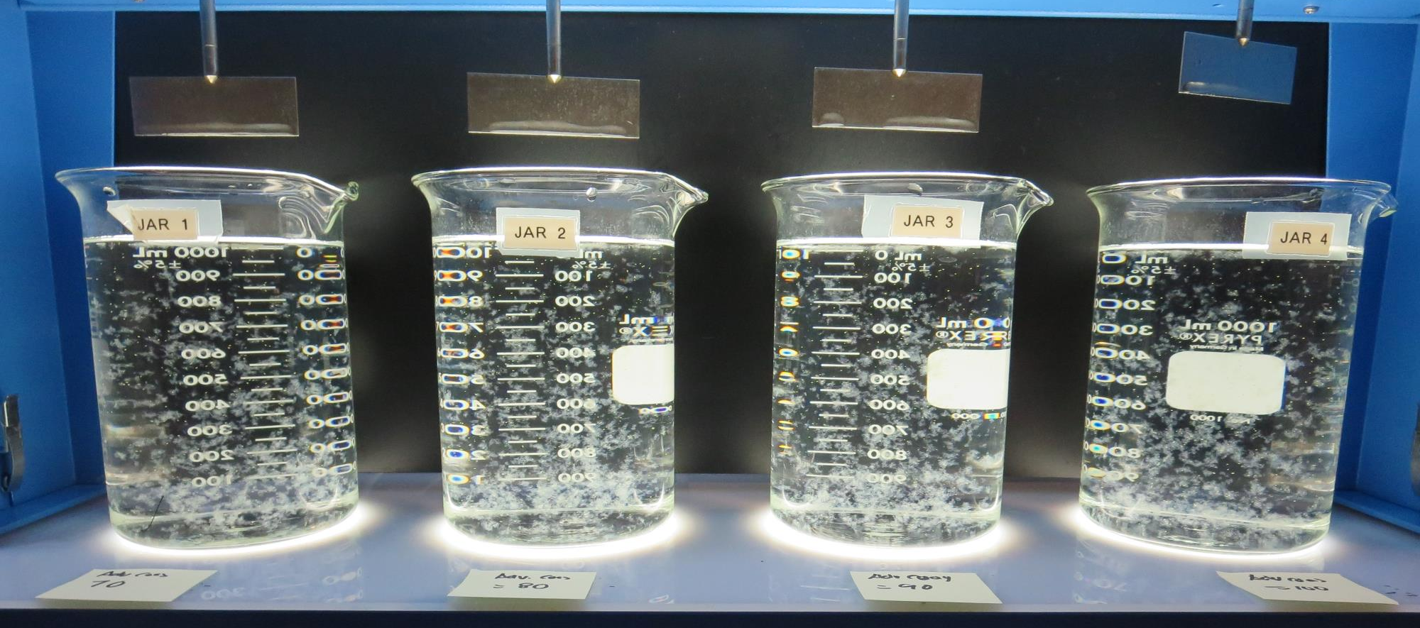
Jars 17-20: End of 5-minute flocculation (30 RPM) duration.
70 mg/L Adv Coag
Filtrate 0.15 NTU
UVT: 93.7%
UVA: 0.028/cm
UVA Reduction: 26.3%
Settled: 0.40 NTU
80 mg/L Adv Coag
Filtrate 0.12 NTU
UVT: 93.9%
UVA: 0.027/cm
UVA Reduction: 28.9%
Settled: 0.40 NTU
90 mg/L Adv Coag
Filtrate 0.11 NTU
UVT: 94.2%
UVA: 0.026/cm
UVA Reduction: 31.6%
Settled: 0.35 NTU
100 mg/L Adv Coag
Filtrate 0.08 NTU
UVT: 94.4%
UVA: 0.025/cm
UVA Reduction: 34.2%
Settled: 0.29 NTU

Slide 34
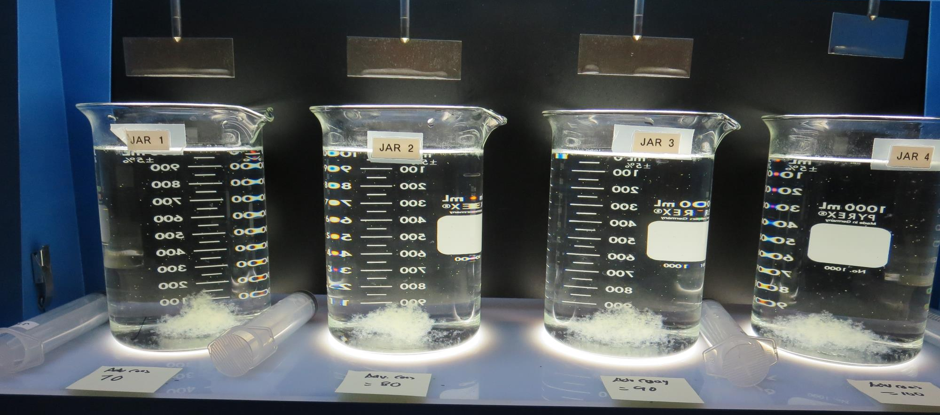
Jars 17-20: After 5 min of settling, 25 mL is syringed for filterability and %UVT/UVA.

Slide 35
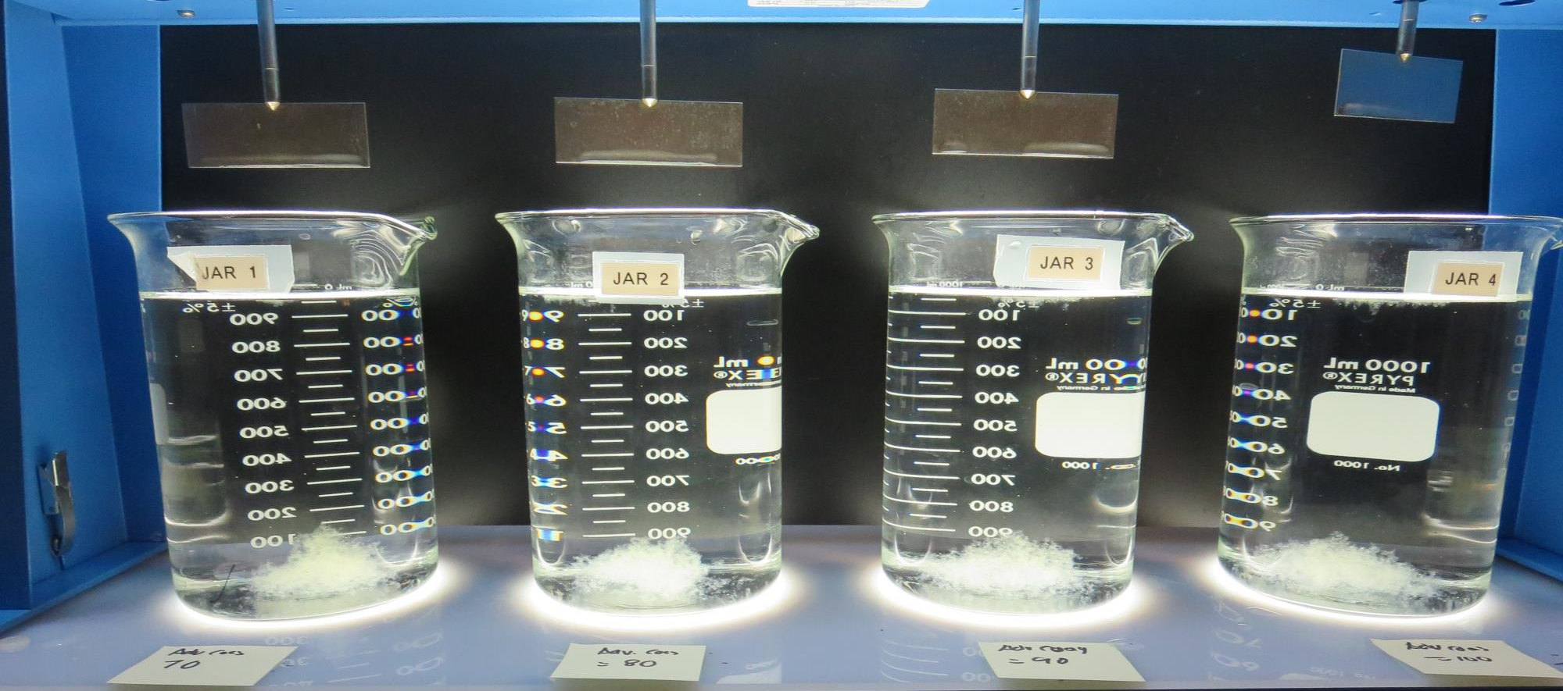
Jars 17-20: After 25-minutes of settling, settled water turbidity is taken.
70 mg/L Adv Coag
Filtrate 0.15 NTU
UVT: 93.7%
UVA: 0.028/cm
UVA Reduction: 26.3%
Settled: 0.40 NTU
80 mg/L Adv Coag
Filtrate 0.12 NTU
UVT: 93.9%
UVA: 0.027/cm
UVA Reduction: 28.9%
Settled: 0.40 NTU
90 mg/L Adv Coag
Filtrate 0.11 NTU
UVT: 94.2%
UVA: 0.026/cm
UVA Reduction: 31.6%
Settled: 0.35 NTU
100 mg/L Adv Coag
Filtrate 0.08 NTU
UVT: 94.4%
UVA: 0.025/cm
UVA Reduction: 34.2%
Settled: 0.29 NTU

Slide 36
Jars 21-24 Test
Flash Mix 30 Sec (200 RPM)
Floc Mix 5 min (30 RPM)
Applied Coagulant
9800 &
Pre-oxidant (NaOCl)

Slide 37
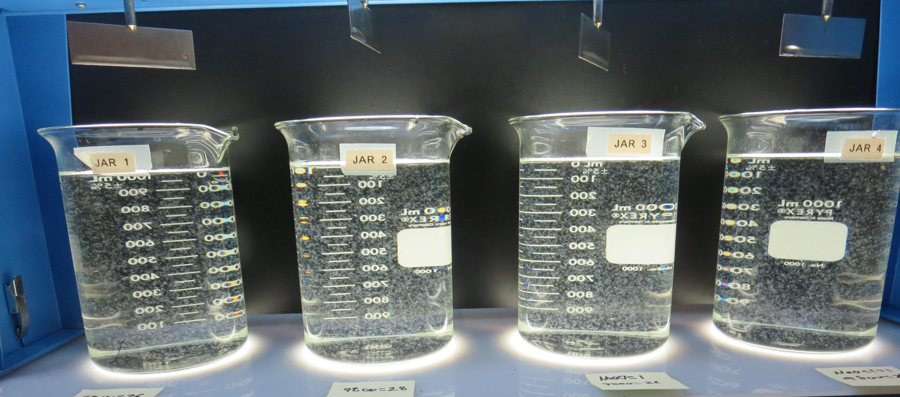
Jars 21-24: End of 5-minute flocculation (30 RPM) duration.
26 mg/L 9800
0 mg/L NaOCl
Filtrate 0.09 NTU
UVT: 94.2%
UVA: 0.025/cm
UVA Reduction: 34.2%
Settled: 0.25 NTU
28 mg/L 9800
0 mg/L NaOCl
Filtrate 0.08 NTU
UVT: 94.2%
UVA: 0.025/cm
UVA Reduction: 34.2%
Settled: 0.28 NTU
26 mg/L 9800
1.0 mg/L NaOCl
Filtrate 0.10 NTU
UVT: 93.1%
UVA: 0.031/cm
UVA Reduction: 18.4%
Settled: 0.32 NTU
28 mg/L 9800
1.0 mg/L NaOCl
Filtrate 0.08 NTU
UVT: 93.2%
UVA: 0.030/cm
UVA Reduction: 21.1%
Settled: 0.29 NTU

Slide 38
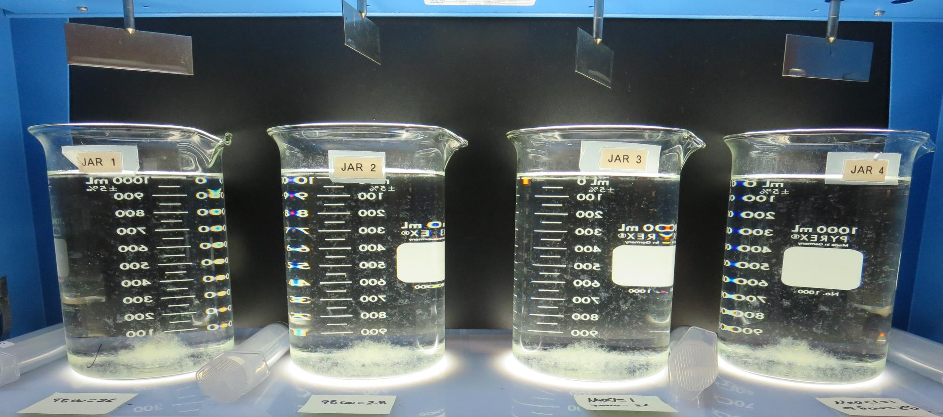
Jars 21-24: After 5 min of settling, 25 mL is syringed for filterability and %UVT/UVA.

Slide 39
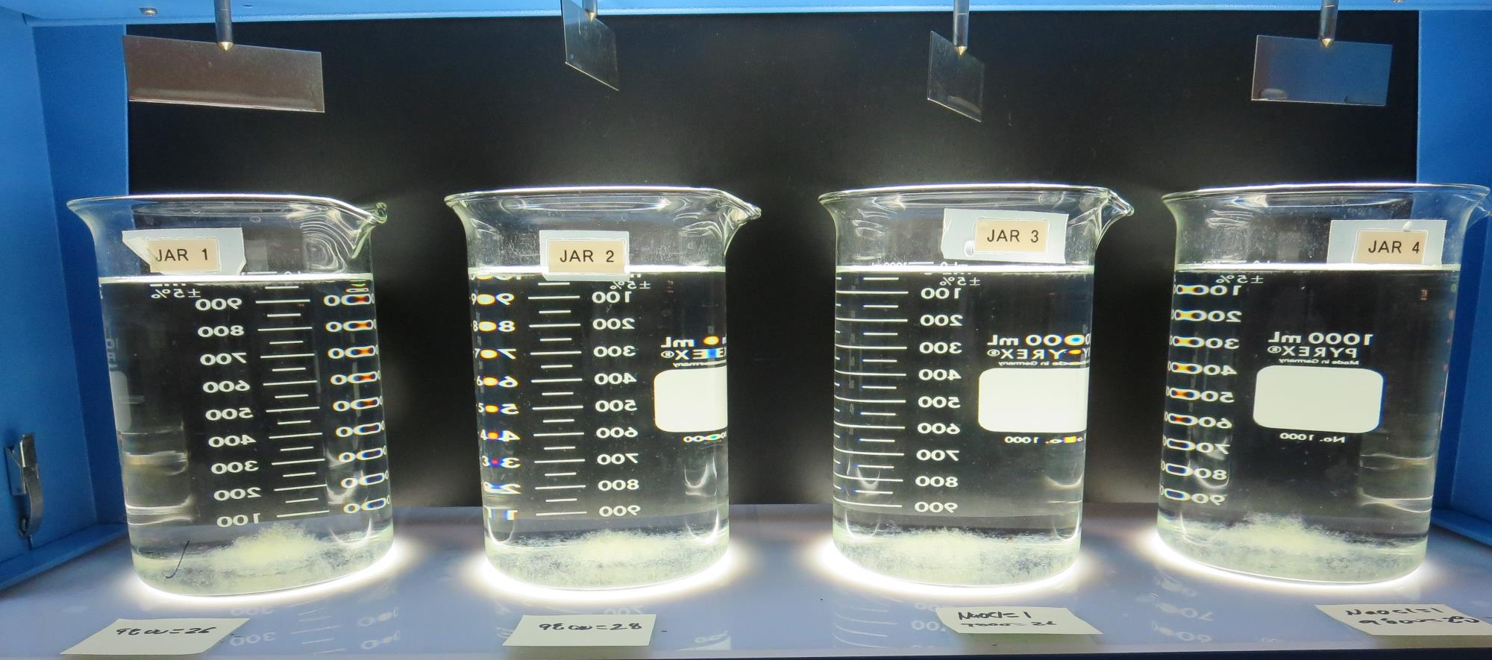
Jars 21-24: After 25-minutes of settling, settled water turbidity is taken.
26 mg/L 9800
0 mg/L NaOCl
Filtrate 0.09 NTU
UVT: 94.2%
UVA: 0.025/cm
UVA Reduction: 34.2%
Settled: 0.25 NTU
28 mg/L 9800
0 mg/L NaOCl
Filtrate 0.08 NTU
UVT: 94.2%
UVA: 0.025/cm
UVA Reduction: 34.2%
Settled: 0.28 NTU
26 mg/L 9800
1.0 mg/L NaOCl
Filtrate 0.10 NTU
UVT: 93.1%
UVA: 0.031/cm
UVA Reduction: 18.4%
Settled: 0.32 NTU
28 mg/L 9800
1.0 mg/L NaOCl
Filtrate 0.08 NTU
UVT: 93.2%
UVA: 0.030/cm
UVA Reduction: 21.1%
Settled: 0.29 NTU

Slide 40
Jars 25-28 Test
Flash Mix 30 Sec (200 RPM)
Floc Mix 5 min (30 RPM)
Applied Coagulants
9800/9890

Slide 41
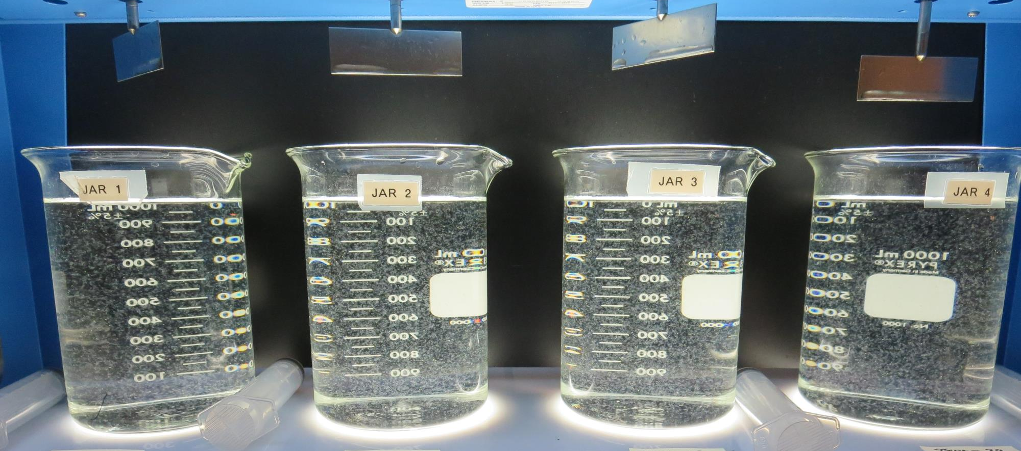
Jars 25-28: End of 5-minute flocculation (30 RPM) duration.
22 mg/L 9800
2.2 mg/L 9890
Filtrate 0.12 NTU
UVT: 93.9%
UVA: 0.027/cm
UVA Reduction: 28.9%
Settled: 0.33 NTU
24 mg/L 9800
2.4 mg/L 9890
Filtrate 0.08 NTU
UVT: 94.0%
UVA: 0.026/cm
UVA Reduction: 31.6%
Settled: 0.30 NTU
26 mg/L 9800
2.6 mg/L 9890
Filtrate 0.09 NTU
UVT: 94.0%
UVA: 0.026/cm
UVA Reduction: 31.6%
Settled: 0.31 NTU
28 mg/L 9800
2.8 mg/L 9890
Filtrate 0.12 NTU
UVT: 94.3%
UVA: 0.025/cm
UVA Reduction: 34.2%
Settled: 0.33 NTU

Slide 42
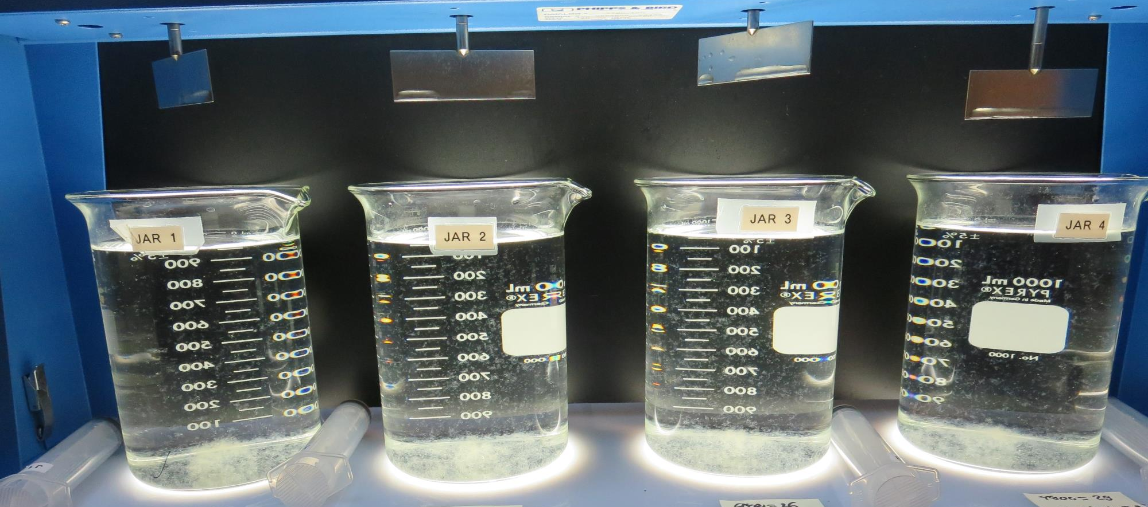
Jars 25-28: After 5 min of settling, 25 mL is syringed for filterability and %UVT/UVA.

Slide 43
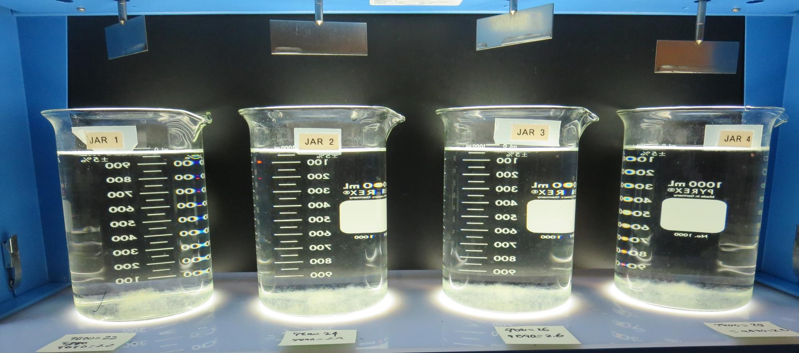
Jars 25-28: After 25-minutes of settling, settled water turbidity is taken.
22 mg/L 9800
2.2 mg/L 9890
Filtrate 0.12 NTU
UVT: 93.9%
UVA: 0.027/cm
UVA Reduction: 28.9%
Settled: 0.33 NTU
24 mg/L 9800
2.4 mg/L 9890
Filtrate 0.08 NTU
UVT: 94.0%
UVA: 0.026/cm
UVA Reduction: 31.6%
Settled: 0.30 NTU
26 mg/L 9800
2.6 mg/L 9890
Filtrate 0.09 NTU
UVT: 94.0%
UVA: 0.026/cm
UVA Reduction: 31.6%
Settled: 0.31 NTU
28 mg/L 9800
2.8 mg/L 9890
Filtrate 0.12 NTU
UVT: 94.3%
UVA: 0.025/cm
UVA Reduction: 34.2%
Settled: 0.33 NTU

Slide 44
Jars 29-32 Test
Flash Mix 30 Sec (200 RPM)
Floc Mix 5 min (30 RPM)
Applied Coagulant
9810

Slide 45
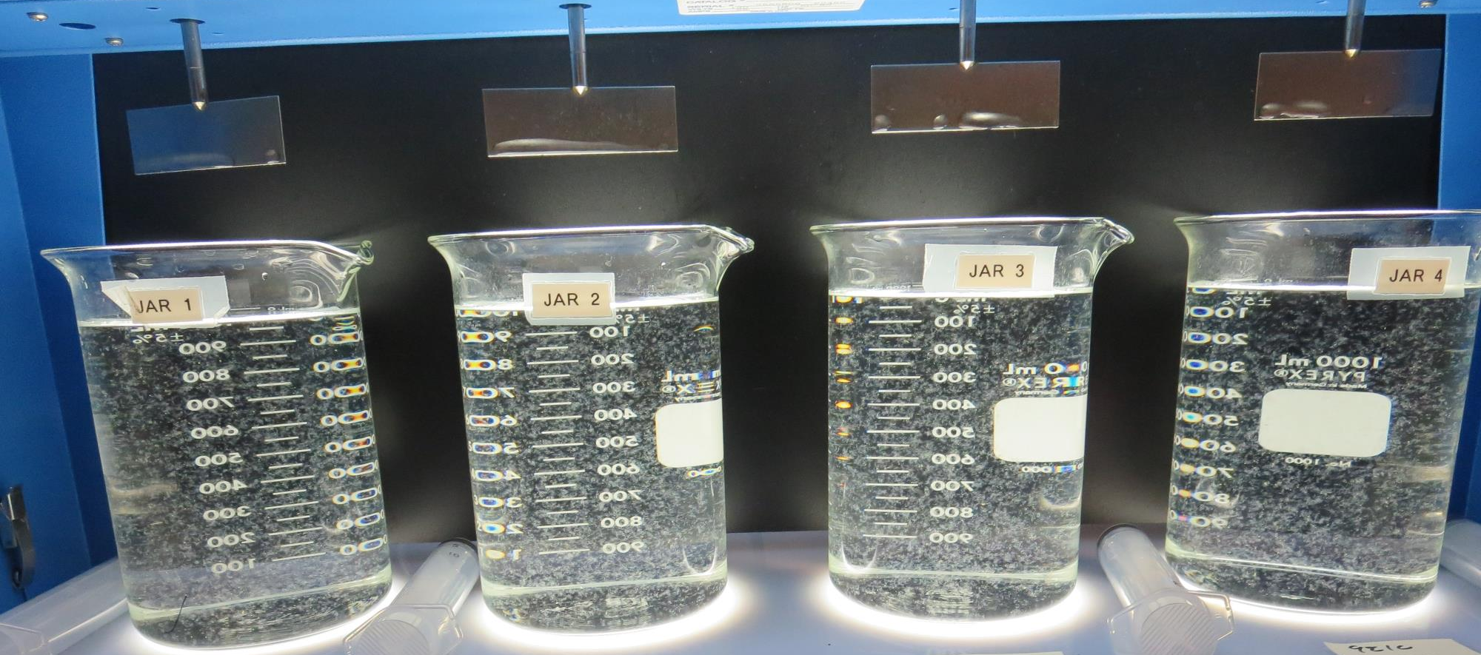
Jars 29-32: End of 5-minute flocculation (30 RPM) duration.
26 mg/L 9810
Filtrate 0.10 NTU
UVT: 94.6%
UVA: 0.024/cm
UVA Reduction: 36.8%
Settled: 0.31 NTU
28 mg/L 9810
Filtrate 0.09 NTU
UVT: 94.5%
UVA: 0.024/cm
UVA Reduction: 36.8%
Settled: 0.35 NTU
30 mg/L 9810
Filtrate 0.09 NTU
UVT: 94.3%
UVA: 0.025/cm
UVA Reduction: 34.2%
Settled: 0.32 NTU
32 mg/L 9810
Filtrate 0.09 NTU
UVT: 94.6%
UVA: 0.024/cm
UVA Reduction: 36.8%
Settled: 0.30 NTU

Slide 46
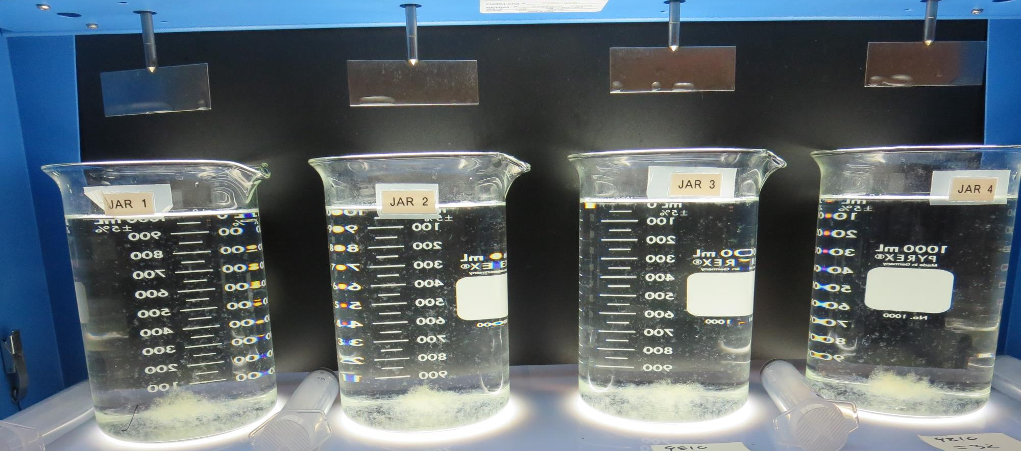
Jars 29-32: After 5 min of settling, 25 mL is syringed for filterability and %UVT/UVA.

Slide 47
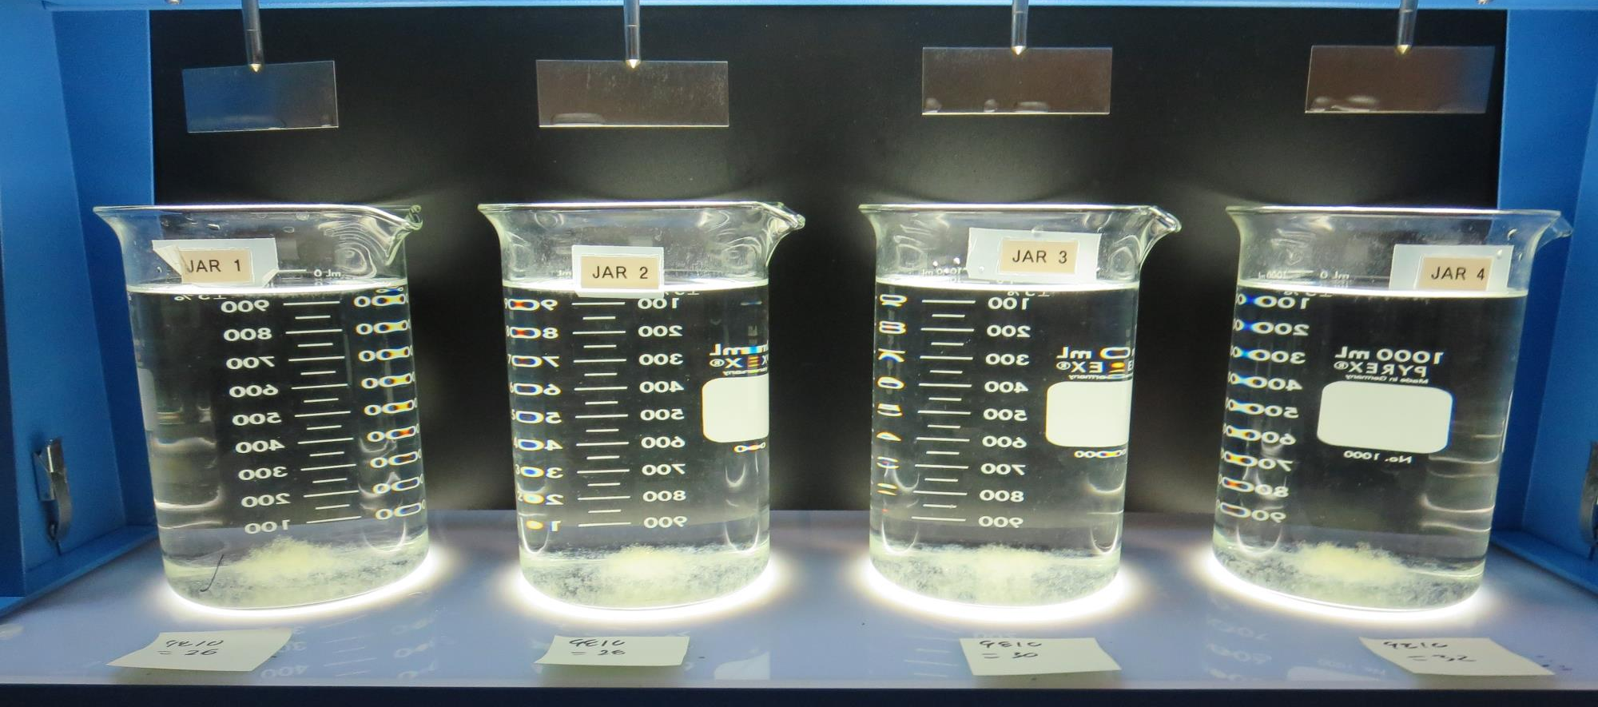
Jars 29-32: After 25-minutes of settling, settled water turbidity is taken.
26 mg/L 9810
Filtrate 0.10 NTU
UVT: 94.6%
UVA: 0.024/cm
UVA Reduction: 36.8%
Settled: 0.31 NTU
28 mg/L 9810
Filtrate 0.09 NTU
UVT: 94.5%
UVA: 0.024/cm
UVA Reduction: 36.8%
Settled: 0.35 NTU
30 mg/L 9810
Filtrate 0.09 NTU
UVT: 94.3%
UVA: 0.025/cm
UVA Reduction: 34.2%
Settled: 0.32 NTU
32 mg/L 9810
Filtrate 0.09 NTU
UVT: 94.6%
UVA: 0.024/cm
UVA Reduction: 36.8%
Settled: 0.30 NTU

Slide 48
Jars 33-36 Test
Flash Mix 30 Sec (200 RPM)
Floc Mix 5 min (30 RPM)
Applied Coagulant
9810

Slide 49
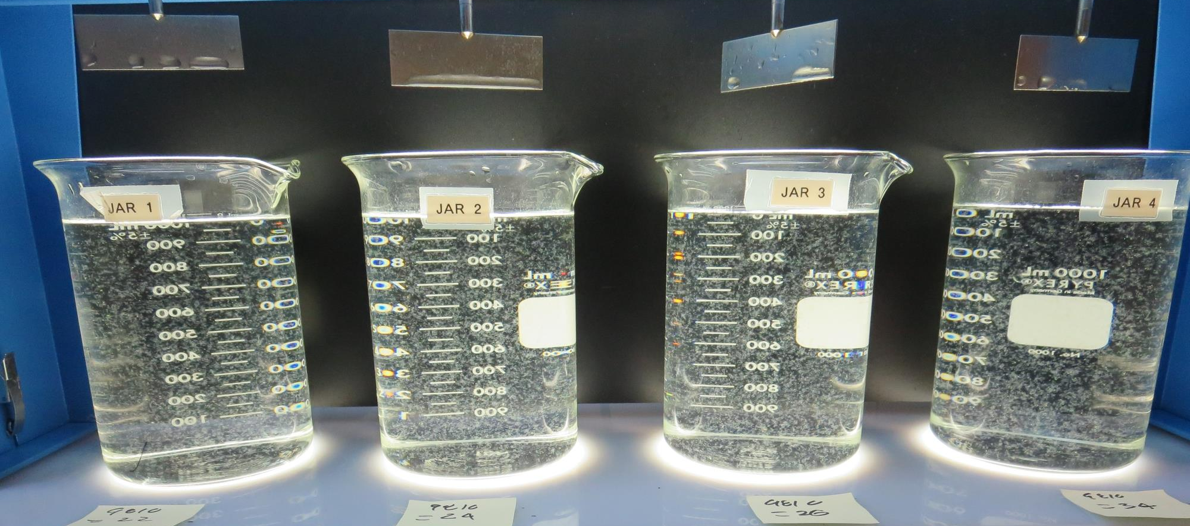
Jars 33-36: End of 5-minute flocculation (30 RPM) duration.
22 mg/L 9810
Filtrate 0.11 NTU
UVT: 94.2%
UVA: 0.025/cm
UVA Reduction: 34.2%
Settled: 0.47 NTU
24 mg/L 9810
Filtrate 0.09 NTU
UVT: 94.2%
UVA: 0.025/cm
UVA Reduction: 34.2%
Settled: 0.34 NTU
26 mg/L 9810
Filtrate 0.09 NTU
UVT: 94.5%
UVA: 0.024/cm
UVA Reduction: 36.8%
Settled: 0.32 NTU
34 mg/L 9810
Filtrate 0.09 NTU
UVT: 94.7%
UVA: 0.023/cm
UVA Reduction: 39.5%
Settled: 0.25 NTU

Slide 50
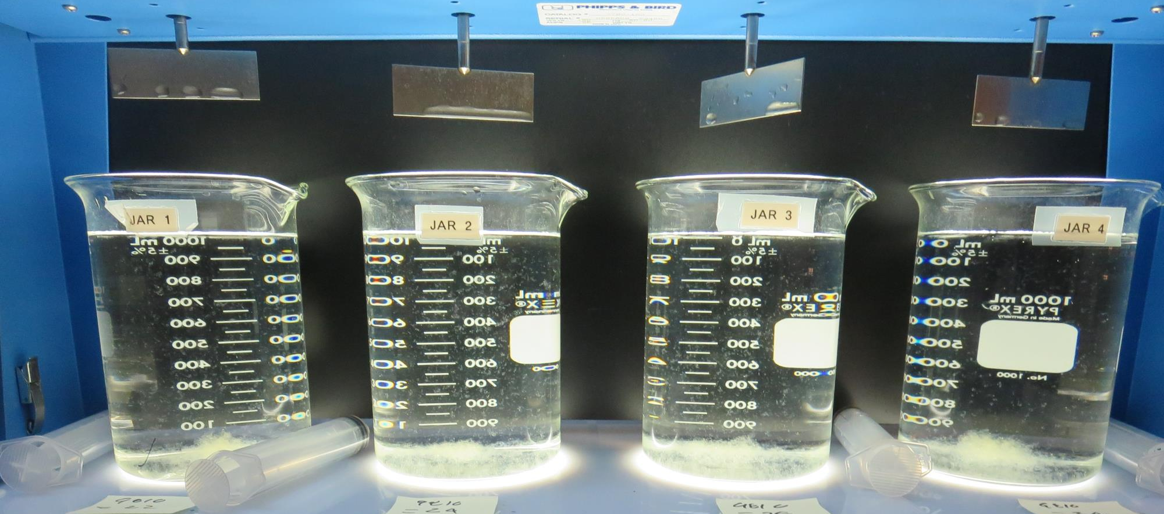
Jars 33-36: After 5 min of settling, 25 mL is syringed for filterability and %UVT/UVA.

Slide 51
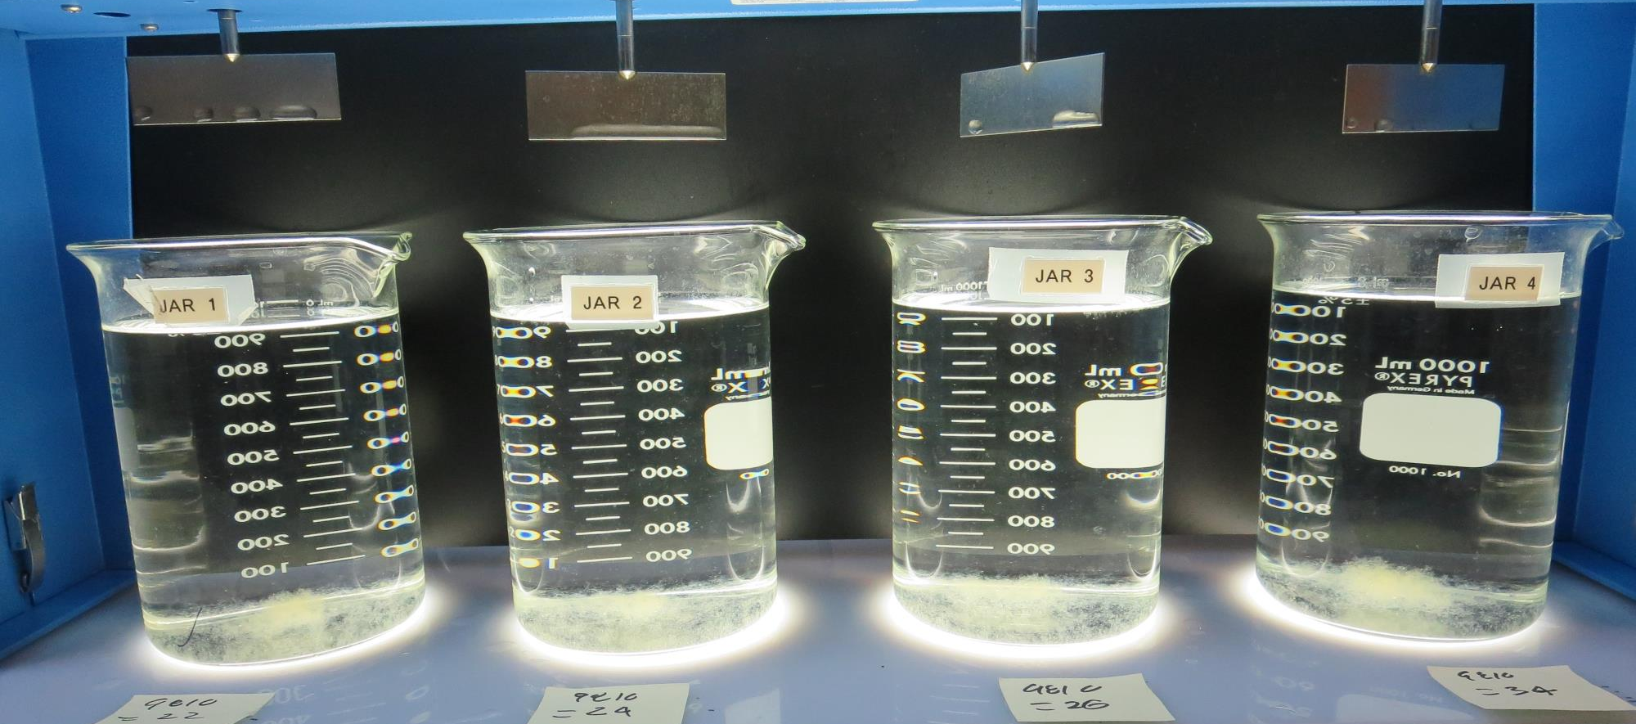
Jars 33-36: After 25-minutes of settling, settled water turbidity is taken.
22 mg/L 9810
Filtrate 0.11 NTU
UVT: 94.2%
UVA: 0.025/cm
UVA Reduction: 34.2%
Settled: 0.47 NTU
24 mg/L 9810
Filtrate 0.09 NTU
UVT: 94.2%
UVA: 0.025/cm
UVA Reduction: 34.2%
Settled: 0.34 NTU
26 mg/L 9810
Filtrate 0.09 NTU
UVT: 94.5%
UVA: 0.024/cm
UVA Reduction: 36.8%
Settled: 0.32 NTU
34 mg/L 9810
Filtrate 0.09 NTU
UVT: 94.7%
UVA: 0.023/cm
UVA Reduction: 39.5%
Settled: 0.25 NTU

Slide 52
Jar Testing for 1-Liter Jars:
Procedures for Most Treatment Plants
Fill jars with source water prior to coagulant injection and set paddle speed at 30 rpm
Add chemicals (i.e., NaOCl, primary coagulant, coagulant aid) to each jar
Flash mix for 15-60 seconds (200 rpm)
Slow mix for 5 minutes (20-30 rpm)
Settled for 5 minutes. Syringe 25 mL from each jar taken 1-inch below surface (25 mL/12 sec rate)
Filtered through 1.2 um isopore membrane into cuvette drip rate, 15 mL/(50-90 sec)
Measure filtrate turbidity, chlorine residual and %UVT/UVA
Measure settled water turbidity after 25 minutes of total setting
Record all data

Slide 53

Jar Test
Filterability Test Equipment
Turbidity Instrument
Syringe w/Luer-Lock Tip, 30 cc
(part#: 2225800, by Hach)
Swinnex Filter Holder, 25 mm (part#: SX0002500)
Isopore Membrane Filter, 1.2 um absolute
pore size,
Φ= 25 mm , thickness: 24 um,
hydrophilic polycarbonate membrane
(part #: RTTP02500)
Go to Sigma-Aldrich for laboratory supplies http://www.sigmaaldrich.com/united-states.html

Slide 54
Isopore Membrane Information
Categories | Information
trade name | Isopore
filter color | White
chemistry | Polycarbonate (PC)
water flow rate | Avg. 175 mL/min x cm² (typical results @ 10 psi)
media | Isopore®
wettability | Hydrophilic
porosity | 14.7%
pore size | 1.2 µm
bubble point at 23 °C | 1.0 bar, air with water
thickness | 24 µm
filter diameter (ø) | 25 mm
material size | polycarbonate, Hydrophilic, 1.2 µm, 25 mm, white, plain, 100

Slide 55
Isopore Membrane Background Information
The Isopore membrane is a polycarbonate, track-etched screen filter recommended for all analyses in which the sample is viewed on the surface of the membrane. The Isopore membrane is composed of polycarbonate film, which has a smooth, glass-like surface for clearer sample observation. The unique manufacturing process of the membrane ensures a precise pore diameter and a consistent pore size for accurate separation of samples by size. Matched-weight filters are not usually required because of low, constant tar and ash weights.
Features & Benefits:
Membrane structure retains particles on the surface, simplifying counting and analysis

Slide 56
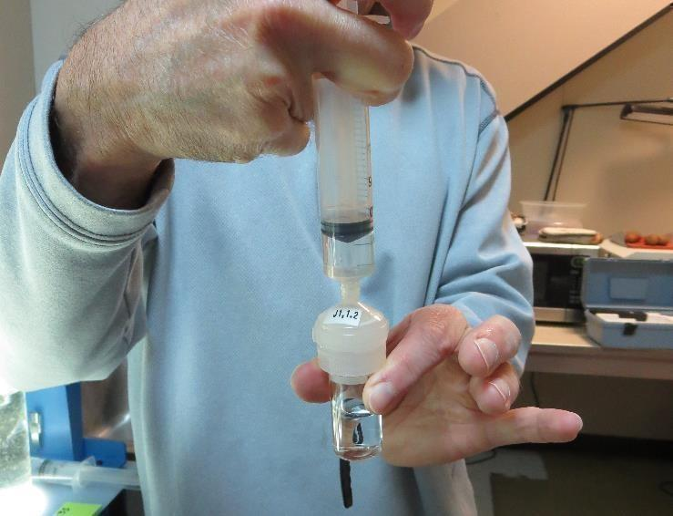

Jar Test - Filterability Test
Syringe ~ 25 mL from jar (after 5-minutes of settling)
Filter-to-waste 3-5 mL
Filter directly into clean cuvette
Measure turbidity
Note: Take several readings before recording final NTU results. Micro bubbles can adhere to glass causing false NTU readings. To remove bubbles, tilt cuvette up to 90 degrees.

Slide 57

Contact
Guy Schott, P.E.
State Water Resources Control Board
Division of Drinking Water
Santa Rosa, CA
Go to Stock Solution/Dose calculations/Jar Test Results for tools to download
www.waterboards.ca.gov/drinking_water/programs/districts/mendocino_district.html
Email: Guy Schott - Guy.Schott@waterboards.ca.gov
Office Number: 707-576-2732

