Slide 1
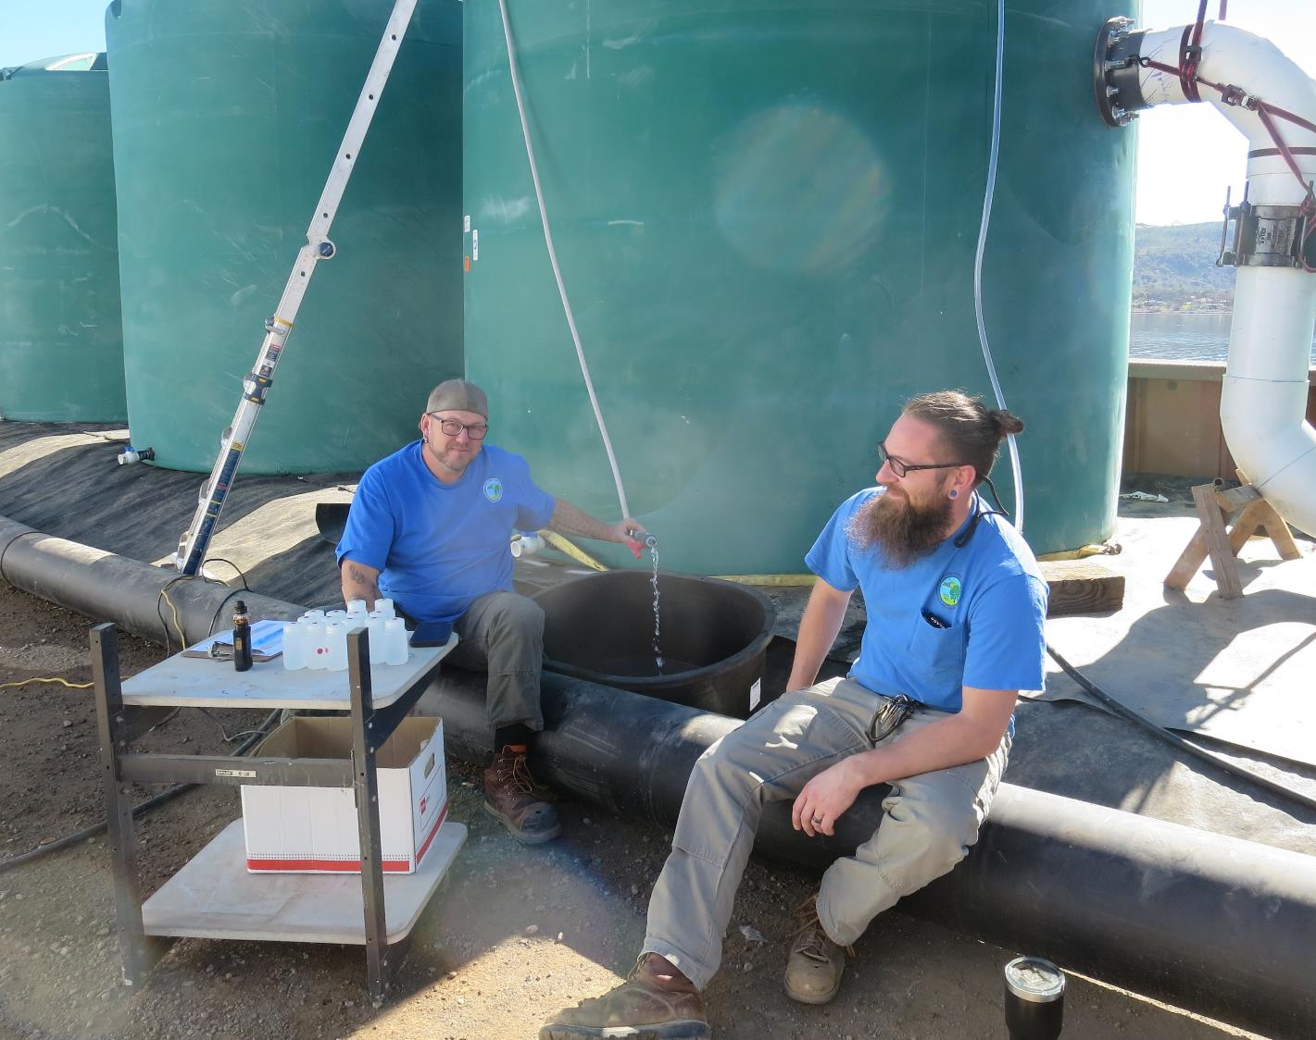
Clearlake Oaks CWD
CA1710001
Tracer Study
Tank Farm
Feb 10, 2022
By Guy Schott, P.E

Slide 2
Table of Contents
Clearwell Design Specifications and Tracer Sampling Points
Summary of Tracer Results and Procedures
Tracer Injection Point
Recorded Tracer Data (Tables)
Graphs: Modified Step-Dose Curves for sample points 2 and 3
And Normalized Modified Step-Dose Curve to F-Curve for sample pts 2 & 3
Purpose of a Tracer Test
Disinfection Exposure Time of Fluid in Vessel for Determining Ct₁₀
Ct₁₀ Value
Baffling Factor (BF), Definition
Tracer Test Method (Modified Step-Dose)
Method of Analysis and Equipment

Slide 3
Pipeline & Tank Design Specifications

Slide 4
Summary of Tracer Procedures
Tracer study was conducted on the temporary installed tank farm that consist of 19 x 10,000-gallon poly tanks operated in series. Liquid fluoride was used as the tracer that was injected at the chlorine injection point upstream of the tank farm.
Sampling were conducted at three stations
  Station 1: Inlet to Tank 1 to determine fluoride dose (mg/L)
  Station 2: Outlet of Tank 5
  Station 3: Downstream of Tank 19 and flow meter near high lift pump
Tank 5 exit flow was 615 gpm
Tank 19 exit flow was 640 gpm

Slide 5
Pipeline & Tanks 1- 5 Configurations

Slide 6
Tracer Test Result Summary –
Transmission Line & Tanks 1 to 5
Modified Step-Dose
Test Date: 2/10/22
Pipe volume from injection point to Tank 1: 1,350 gal
Pipe volume from Tank 4 to Tank 5: 470 gal (~10.3-in Dia)
Tanks 1 - 5 Operating Level: 10-ft
Tank Diameter: 12-ft (846 gal/ft)
Volume of Transmission Line + Tanks: 44,120 gallons
Flow thru Tank 1 - 5: 615 gpm
HRT: 72 minutes (44,120 gal/ 415 gpm)
t₁₀: 39 minutes
Tanks 1 – 5
Baffling Factor (t₁₀/HRT): 0.54

Slide 7
Tracer Test Result Summary –
Transmission Lines + all 19 Tanks
Modified Step-Dose
Test Date: 2/10/22
Pipe volume from injection point to Tank 1: 1,350 gal
Pipe volume from Tank 4 to Tank 5: 470 gal (~10.3-in Dia)
Pipe volume from Tank 19 to high lift pumps: 915 gal (~10.3-in Dia)
Tanks 1 - 5 operating level: 10-ft
Tanks 6 – 19 operating level: 9.5-ft
Tank Diameter: 12-ft (846 gal/ft)
Volume of Transmission Lines + Tanks: 156,638 gallons
Exit Tank 19 Flow: 640 gpm
HRT: 245 minutes (156,638 gal/ 640 gpm)
t₁₀: 150 minutes (minimum)
Tanks 1 – 19
Baffling Factor (t₁₀/HRT): >= 0.6
Note: tracer test wasn’t run long enough to determined actual t₁₀ value.

Slide 8
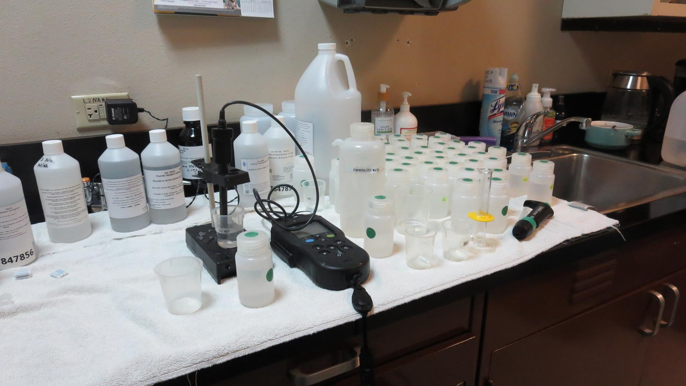
Laboratory

Slide 9
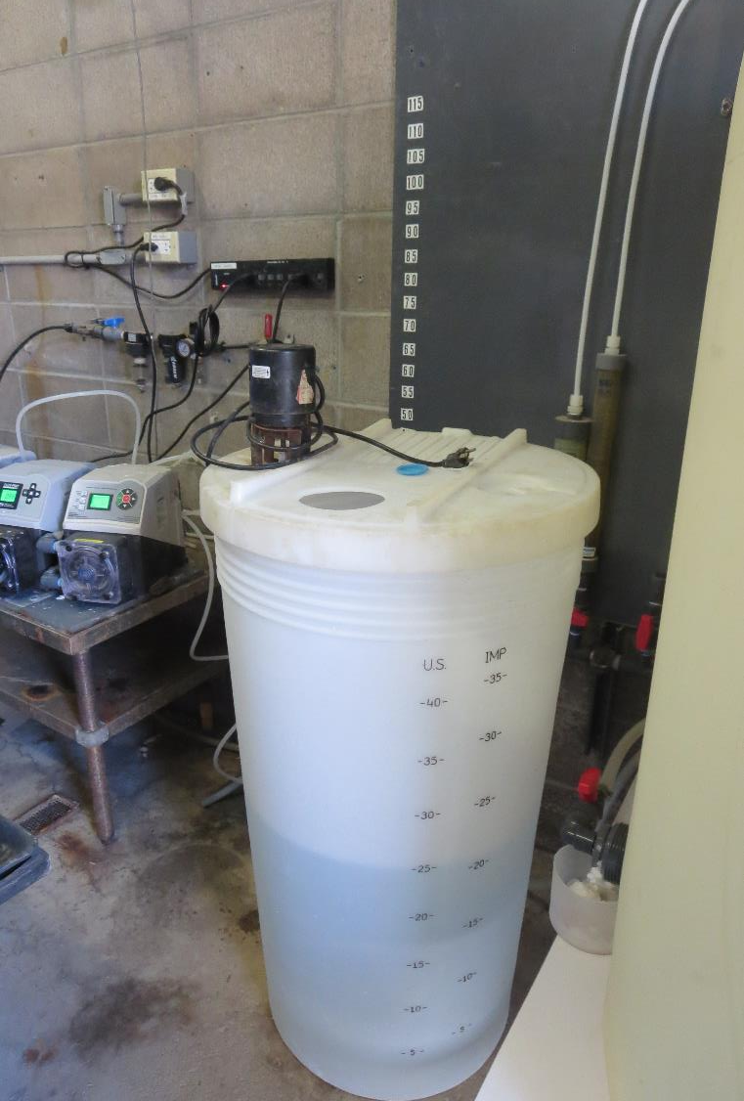
Clearlake Oaks CWS
Tracer and Fluoride injection location
Tracer: H₂SiF₆, Fluoride (F)
Feed pump capacity 17.2 gal/hr set at 50% during test
Background Fluoride: 0.164 mg/L as F
Measured dose: 1.86 mg/L as F (excluding background fluoride)
Fluoride (tracer) was injected into a vault at chlorine injection point.

Slide 10
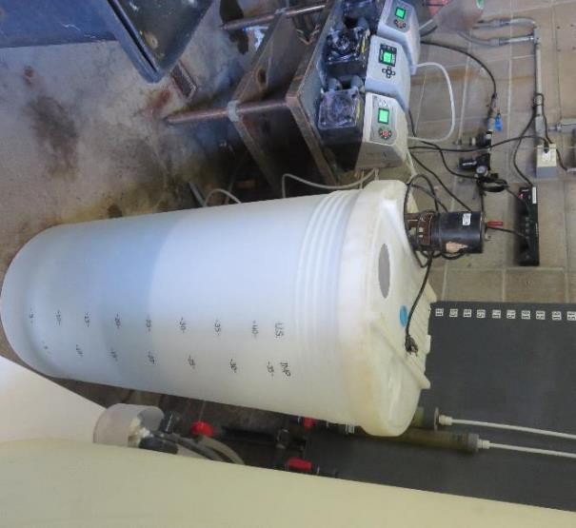
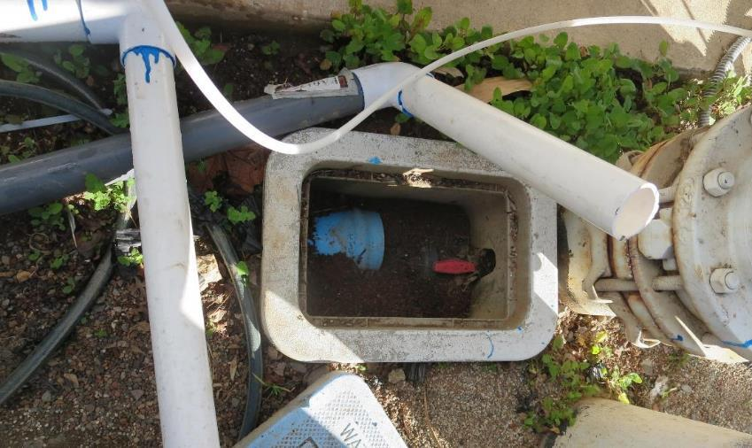
Feed Pump and Tracer Injection
Fluoride chemical crock and pump
Fluoride Injection Point (same location of post NaOCl)

Slide 11
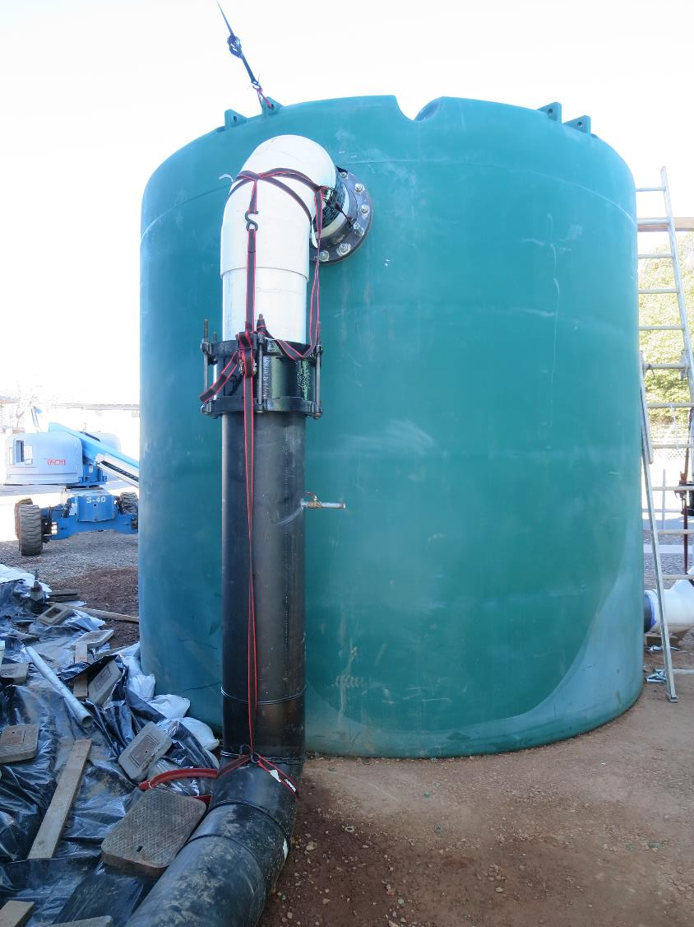
Tank 1
Tank 1
Sample Pt. #1
To determine
Fluoride dose
F Dose: 1.88 mg/L

Slide 12
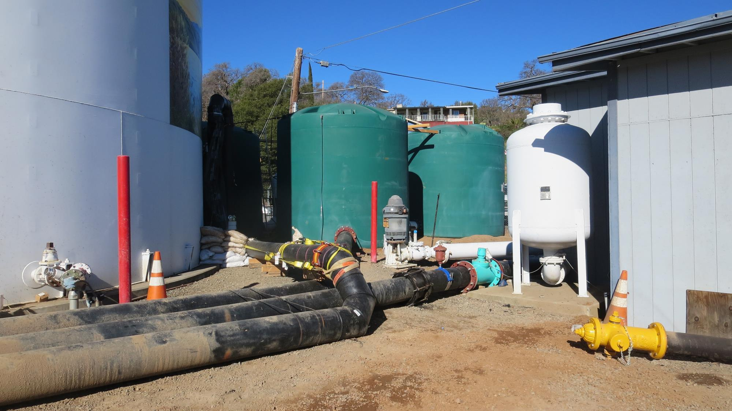
Tanks 2-4
Tanks 2-4
Tank 1
Post Tank 19
Flow Meter

Slide 13
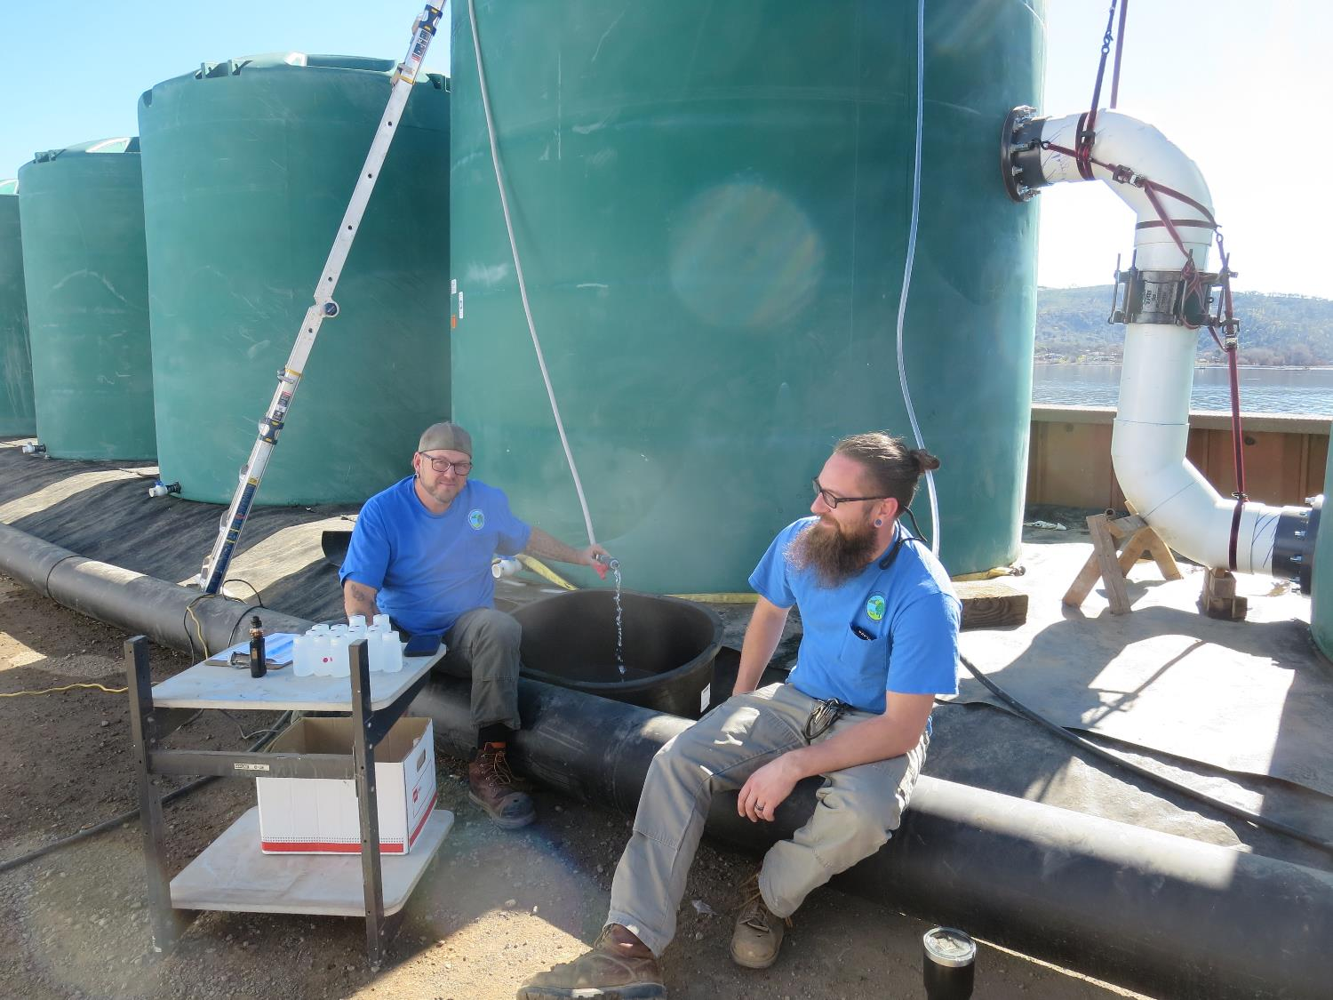
Tank 5 sample pt.
Tank 5
Sample Pt. #2
BF (t₁₀/HRT): 0.54

Slide 14
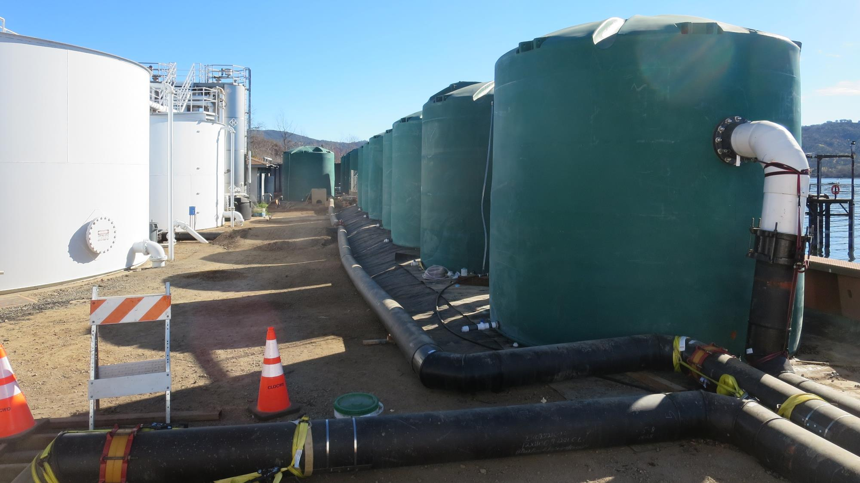
Tank farm
Temporary Tank
Farm (Tanks 5 – 19)

Slide 15
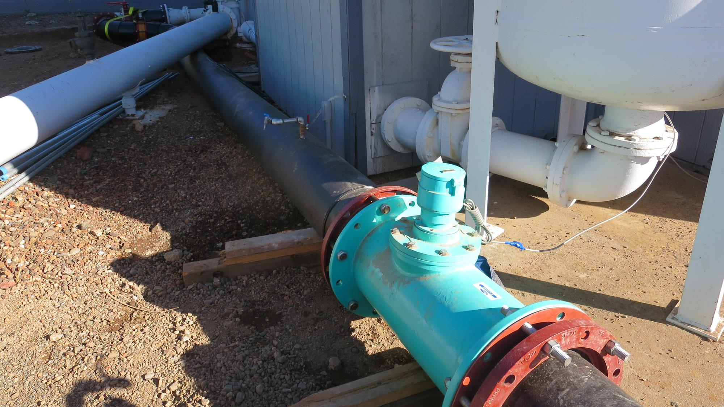
Sample pt 3
Post Tank 19
Sample Pt. #3
BF (t₁₀/HRT): 0.6
Post Tank 19
Flow Meter

Slide 16
Tracer Fluoride Dose, Inlet to Tank 1,
Table 1
Elapsed Time minutes | Tracer Fluoride mg/L | Elapsed Time minutes | Tracer Fluoride mg/L
28 | 1.82 | 69 | 1.89
39 | 1.86 | 78 | 1.88
45 | 1.88 | 84 | 1.92
51 | 1.88 | 90 | 1.92
57 | 1.89 | 96 | 1.91
63 | 1.88 | 102 | 1.91

Slide 17
Tracer Dose and Background Residual
Average background fluoride concentration: 0.164 mg/L as F
Average steady-state measured fluoride concentration exiting pipeline and entering the first tank (steel): 2.046 mg/L as F
Fluoride dose: 2.046 – 0.164 = 1.88 mg/L as F
Results are based on tracer dose of 1.88 mg/L as F
10% of tracer dose is 0.188 mg/L as F

Slide 18
Results 1
Tracer Results for Tanks 1 -5

Slide 19
Step Curve tanks 1-5
Dose: 1.88 mg/L
0.188 mg/L at t₁₀
t₁₀: 39 min
HRT: 72 min
BF: 0.54 (t₁₀/HRT)

Slide 20
Normalized F-Curve, Tanks 1-5
Baffling Factor (BF) = 0.54

Slide 21
Results 2

Slide 22
Step Dose Curve, Tanks 1 - 19
Baffling Factor (BF) >= 0.6

Slide 23
Normazlized F-Curve tanks 1-19

Slide 24
Purpose of a Tracer Study
To determine the hydraulic efficiency or disinfectant exposure time of water through one or more reactors.
The addition of known quantities of a nonreactive chemical (tracer) is added in the form of a pulse (slug) or step-input.
The time of travel or disinfectant exposure time through the reactor is related to:
  Flow rate
  Reactor water volume
  Water Depth
  Reactor configuration
  Hydraulic mixing

Slide 25
Disinfection Exposure Time of Fluid in Vessel for Determining Ct₁₀
C” is the disinfectant residual (mg/L) at the point of inactivation compliance.
The disinfection exposure time of water used for Ct₁₀ calculation is the time (t₁₀) it takes for the first 10 percent of the water entering the reactor to exit the reactor.
To determine this, a marker (nonreactive tracer) is introduced into the water and is monitored leaving the reactor.
Example: 2.7 mg/L of tracer is continuously dose during testing; t₁₀ is that time when 0.27 mg/L of tracer concentration (10% of dose) has exit the reactor.

Slide 26
Ct₁₀ Value
Log inactivation is based on the Delivered Dose, “Ct₁₀”
  “C” is the disinfectant residual (mg/L)
  “t₁₀” is the exposure or contact time (minutes)
  Multiply them:
C • t₁₀ = mg/L • min (delivered dose to pathogens)
The calculated Ct₁₀ value is looked up in EPA Ct tables to determine the log inactivation based on specific monitoring parameters (pH, disinfectant residual and temperature).

Slide 27
Baffling Factor (BF)
Baffling factor or short-circuiting factor:
  Determined from tracer study or estimated
  BF = t₁₀/ HRT from tracer study
  HRT (hydraulic residence time) = reactor volume divided by reactor flow
Once the BF is determined, then it is applied to the operations of the reactor for determining the disinfectant exposure time.
Example:
  Total Clearwell operating volume: 157,000 gallons
  Exit flow: 640 gpm (0.922 MGD)
  BF: 0.6, from tracer study
  Calculated contact or disinfection exposure time:
    157,000 gal ÷ 640 gpm × 0.6 = 147 minutes = t₁₀

Slide 28
Test Method
Modified Step-Dose Method
It is a continue feed of tracer at constant rate and inlet plant flow throughout the duration of the test. The “Step-Dose” test has a duration of 3-4 HRT to achieve reactor outlet steady-state tracer concentration. The time “t₁₀” is determined when 10% of the tracer dose concentration has exist the reactor. The “Modified Step-Dose” test allows the test to be completed in less than 1 HRT by physical measurements of the tracer inlet flow and/or channel basin concentration.

Slide 29
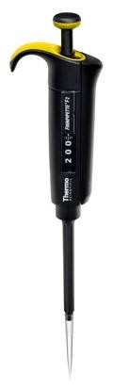
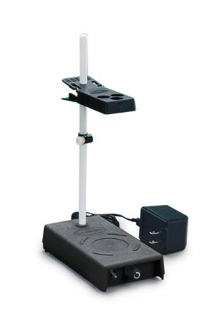
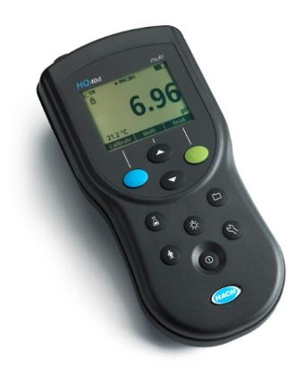
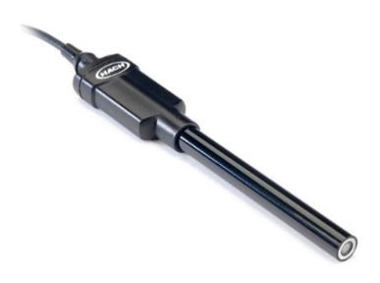
Method of Analysis and Equipment
Intellical™ ISEF121 Fluoride (F⁻) Ion Selective Electrode (ISE)
HQ40d Portable ISE Multi-Parameter Meter
Fluoride Ionic Strength Adjustor (ISA)
Fluoride Standards (0.2 & 2.0 mg/L)
25 mL graduated cylinder
Finnpipette F2 variable volume pipette, capacity 0.5 - 5 mL
Electrode stirrer stand
50 mL beakers
Stir Bar, Magnetic, Polygon

Slide 30

Contact
Guy Schott, P.E.
State Water Resources Control Board
Division of Drinking Water
Santa Rosa, CA
Go to Tracer Test Results for review
www.waterboards.ca.gov/drinking_water/programs/districts/mendocino_district.html
Email: Guy Schott - Guy.Schott@waterboards.ca.gov
Office Number: 707-576-2732

