Slide 1
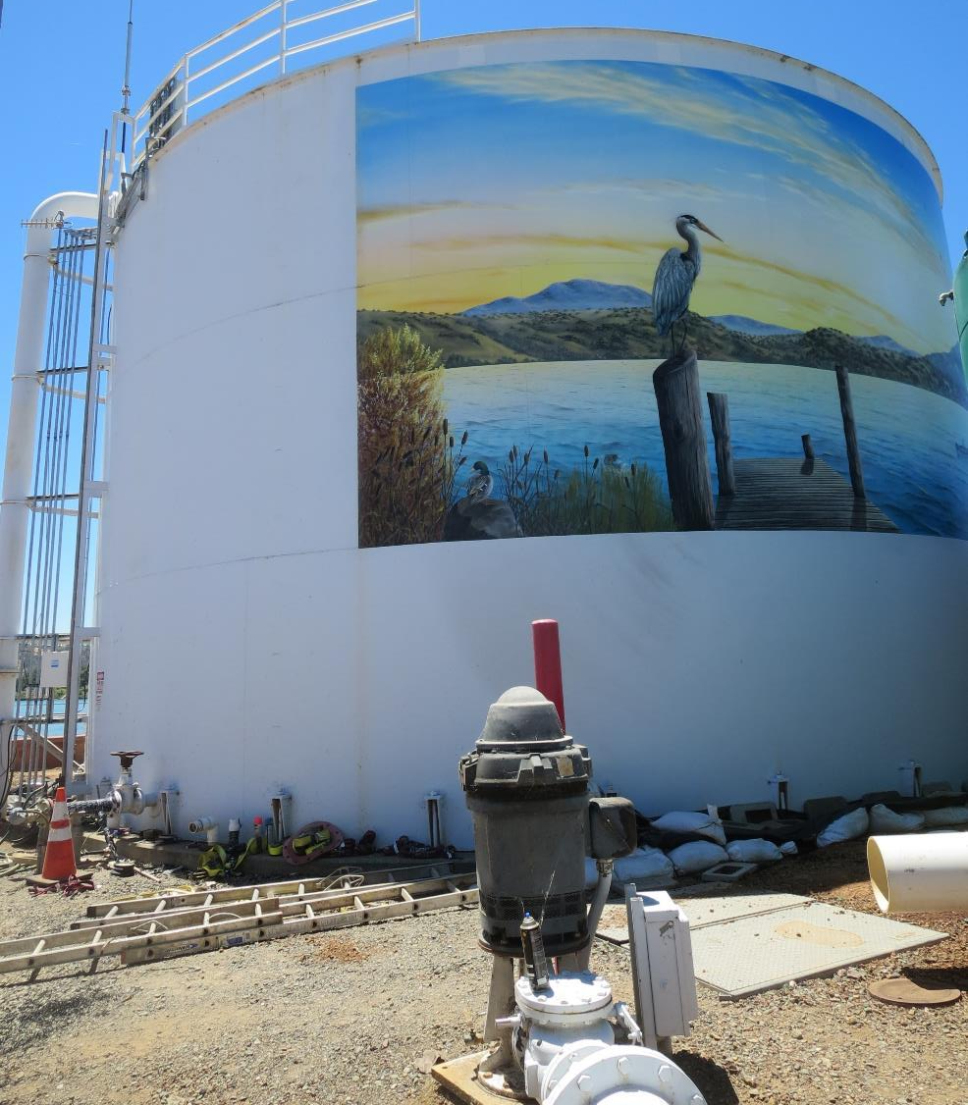
Clearwell
Clearlake Oaks CWD
CA1710001
Tracer Study
Clearwell
July 13, 2022
Performed by:
Guy Schott, P.E
Malia Helms
Amy Santos

Slide 2
Table of Contents
Clearwell Design Specifications and Tracer Sampling Points
Summary of Tracer Results and Procedures
Tracer Injection Point
Recorded Tracer Data (Tables)
Graphs: Modified Step-Dose and Normalized Step-Dose Curve to F-Curve
Purpose of a Tracer Test
Disinfection Exposure Time of Fluid in Vessel for Determining Ct₁₀
Ct₁₀ Value
Baffling Factor (BF), Definition
Tracer Test Method (Modified Step-Dose)
Method of Analysis and Equipment

Slide 3
Pipeline & Tank Design Specifications
PAX Mixer & Surface Water Aeration System were off for this Study

Slide 4
Summary of Tracer Procedures
Tracer study was conducted on the newly rehabilitated 188,000-gallon clearwell installed with a PAX mixer and 2 x surface aeration (~5,000 gpm each) for TTHM reduction. For this test, the PAX mixer and surface aeration systems were off. Liquid fluoride was used as the tracer that was injected at the chlorine injection point upstream of the clearwell.
Sampling were conducted at two stations
  Station 1: Inlet to Tank 1 to determine fluoride dose (mg/L)
  Station 2: Downstream of clearwell and flow meter near high lift pump
Clearwell entry flow was 600 gpm
Clearwell exit flow was 623 gpm

Slide 5
Tracer Test Result Summary –
Transmission Line + Clearwell
Modified Step-Dose
Test Date: 7/13/22
Pipe volume from injection point to Tank 1: 1,350 gal
Clearwell operating level: 18.31-ft
Tank Diameter: 40-ft (9,400 gal/ft)
Volume of Transmission Line + Clearwell: 173,464 gallons
Flow thru Clearwell: 623 gpm
HRT: 278 minutes (173,464 gal/ 623 gpm)
t₁₀: 34.5 minutes
Baffling Factor (t₁₀/HRT): 0.12

Slide 6
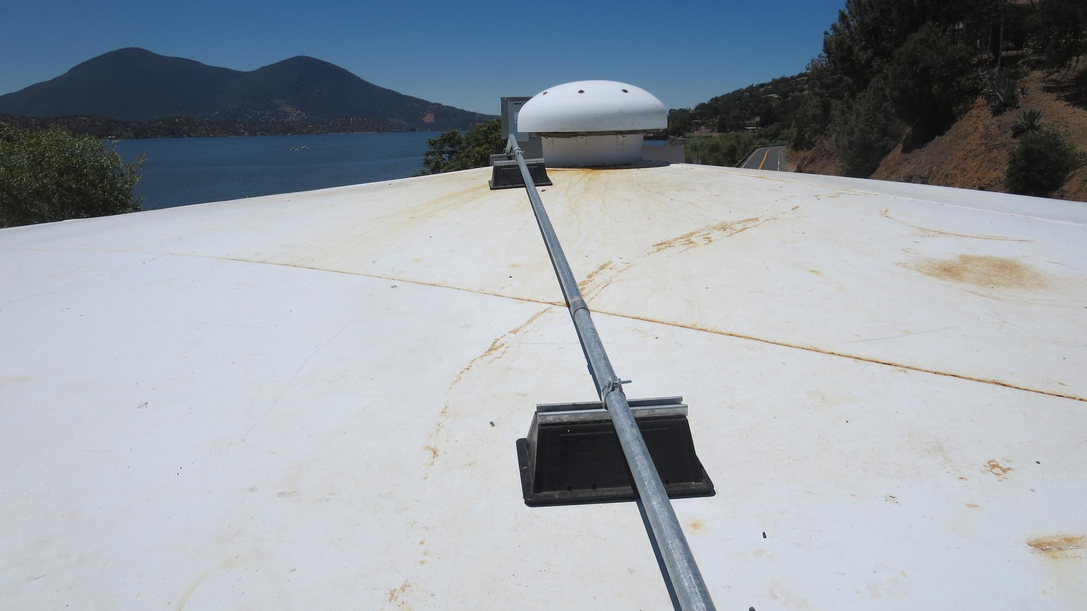
Top of Clearwell
Center Vent

Slide 7
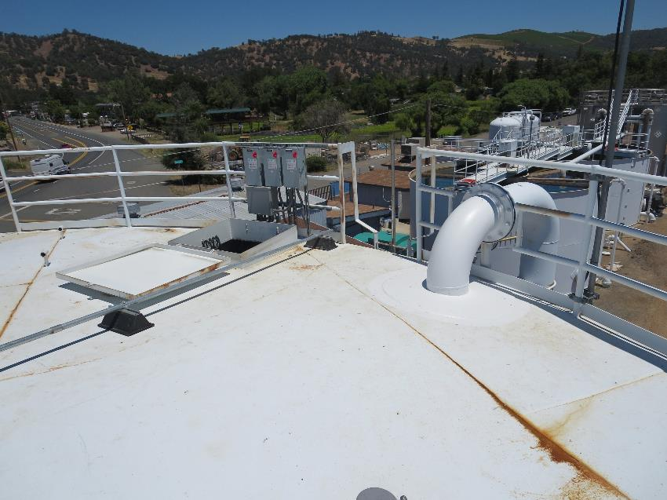
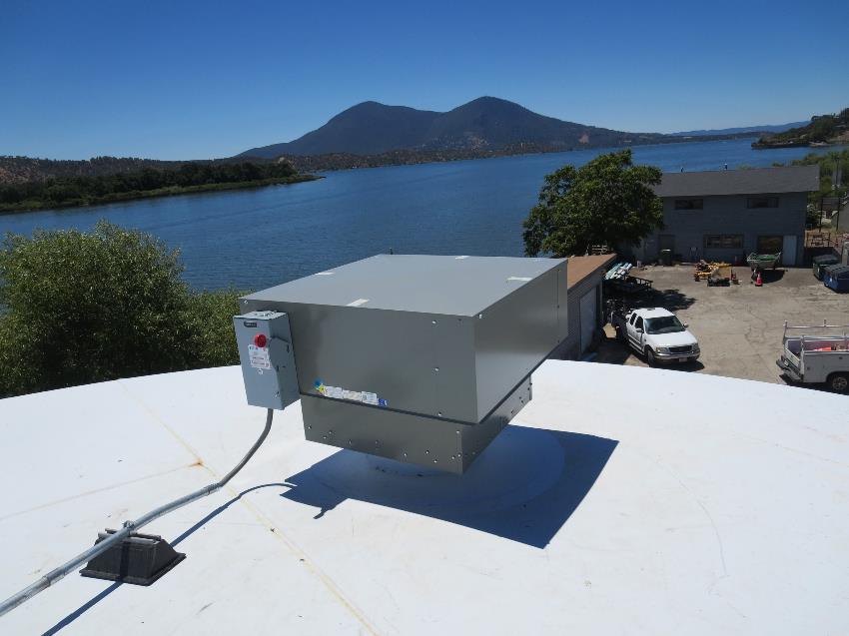
Clearwell Roof – Hatch Entry & Powervent
PAX Powervent headspace
ventilation unit
3,000 CFM
Inlet

Slide 8
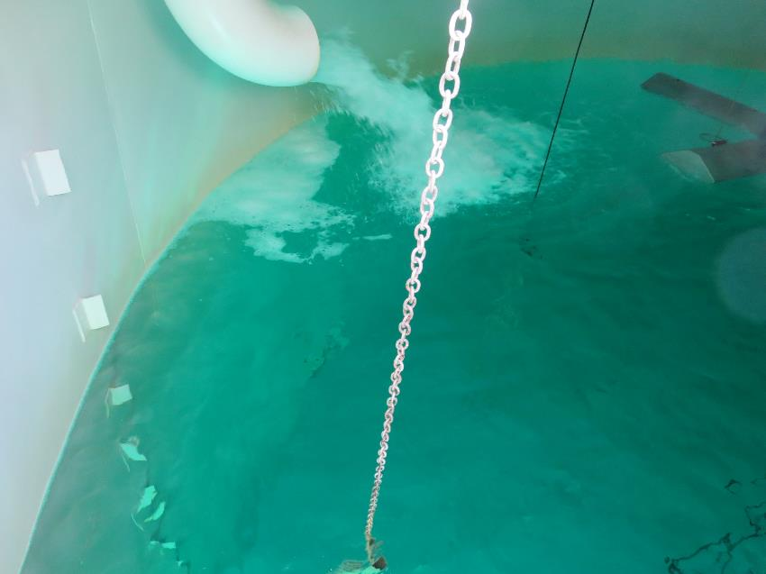
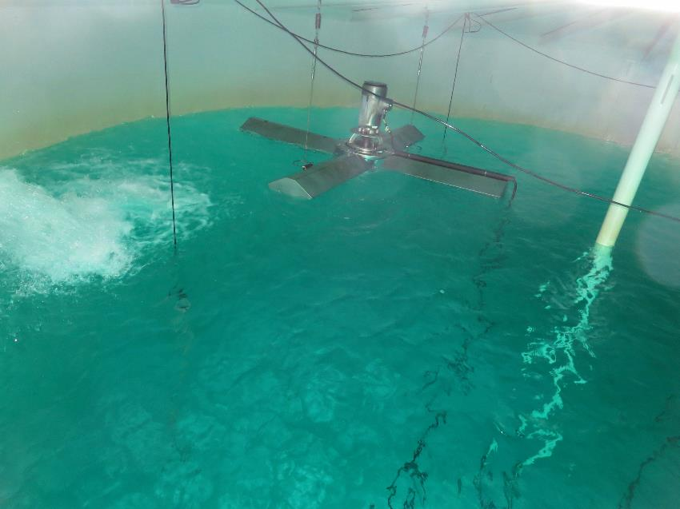
Clearwell Inlet and Surface Aeration (off)

Slide 9
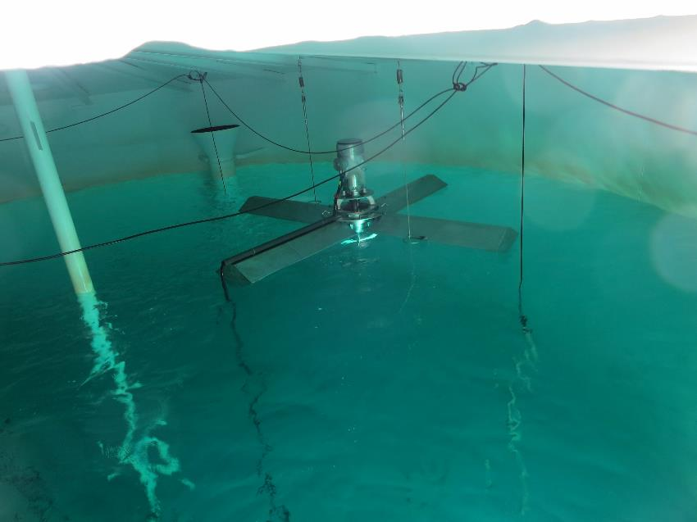
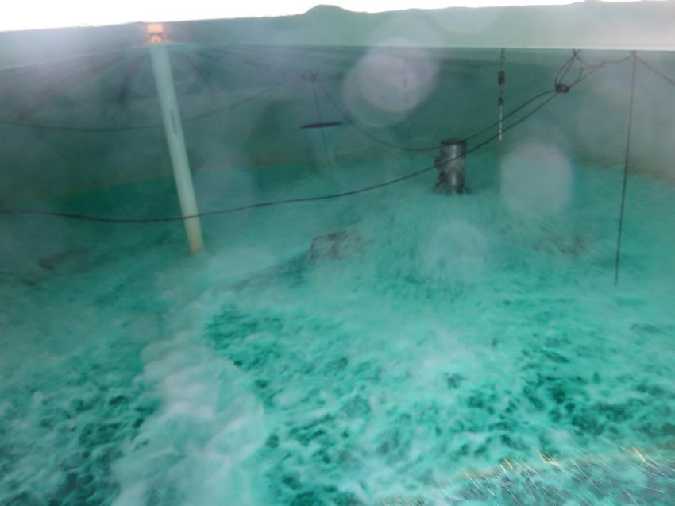
Clearwell Surface Aeration (on/off)

Slide 10
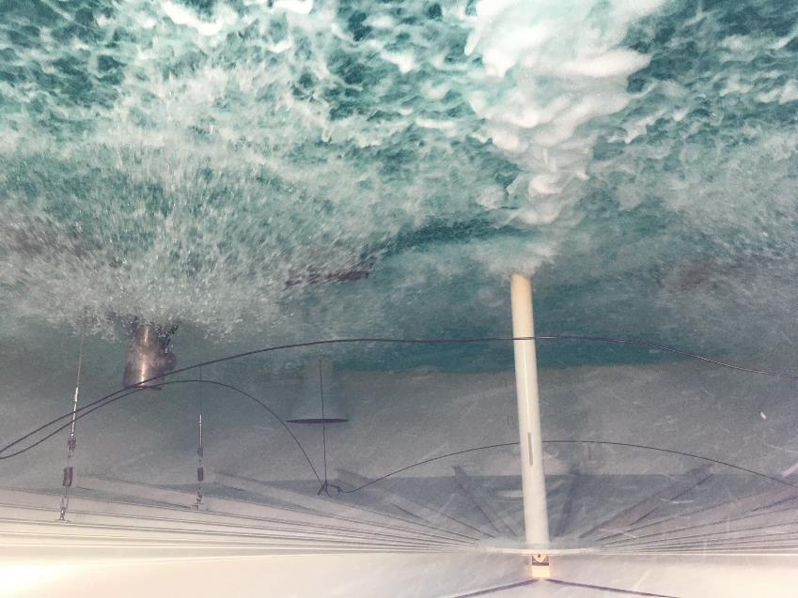
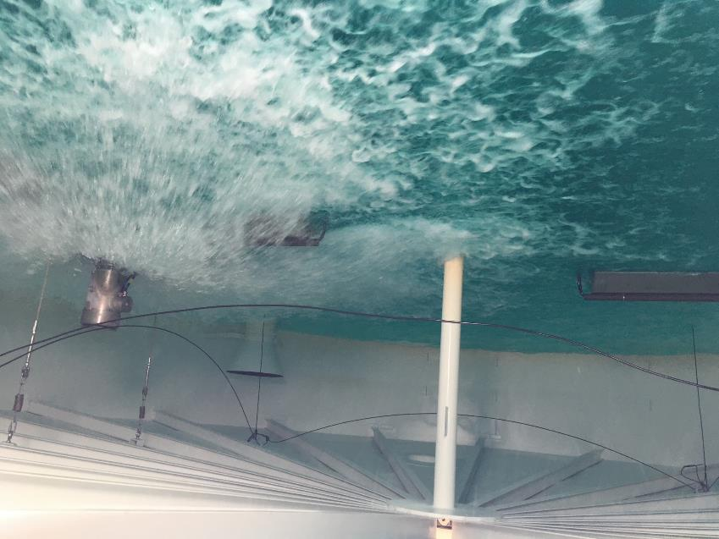
Clearwell Surface Aeration
Note: Surface Aeration was off for this tracer study.

Slide 11
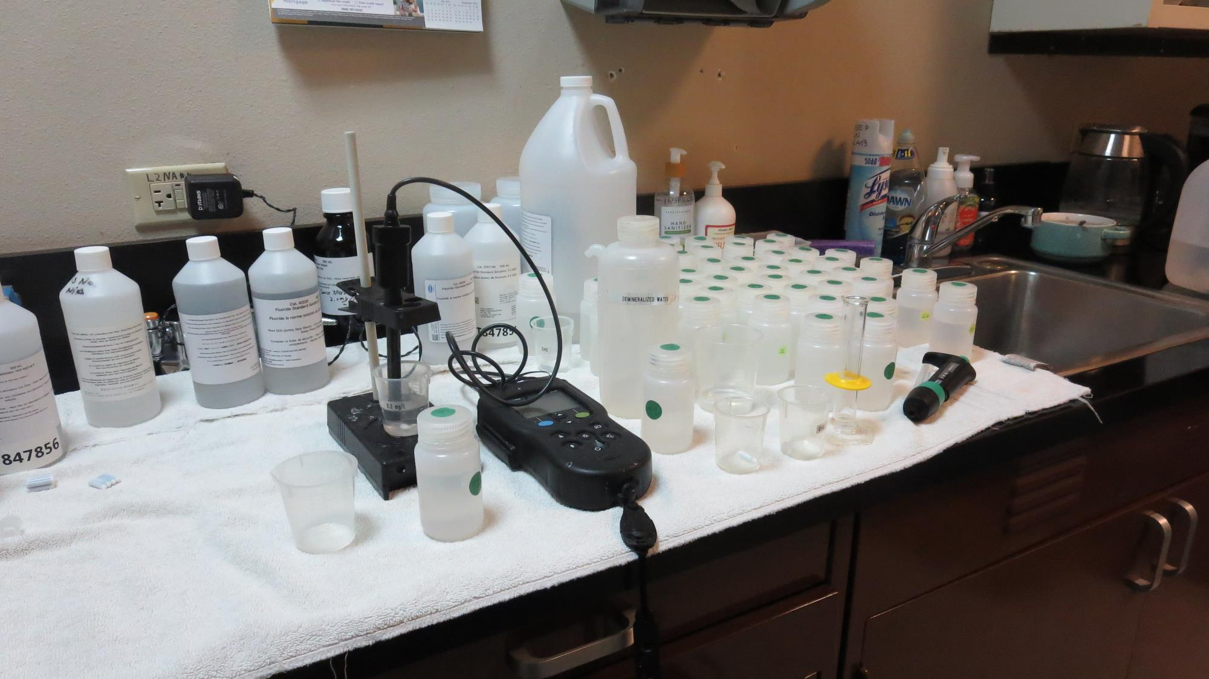
Laboratory
Fluoride Analysis

Slide 12
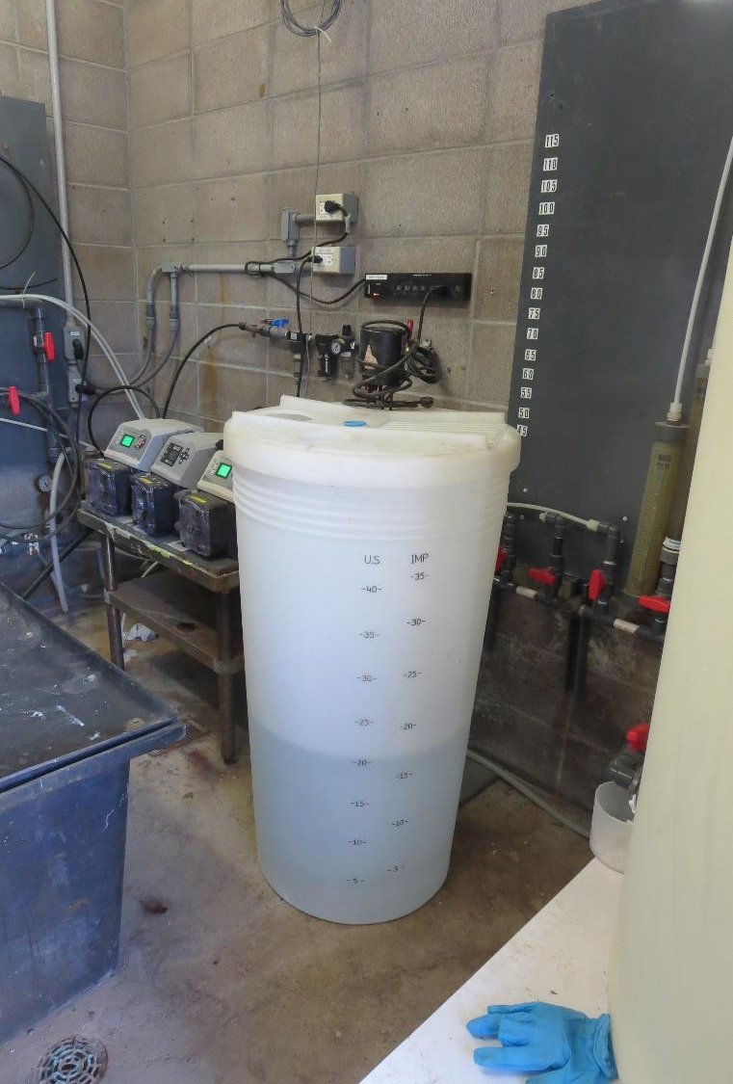
Clearlake Oaks CWS
Tracer and Fluoride injection location
Tracer: H₂SiF₆, Fluoride (F)
Feed pump capacity 17.2 gal/hr set at 50% (8.6 gal/hr) during test
Add 1.4 liters H₂SiF₆ to 10-gal H₂O (~ratio 27/1, H2O/chemical)
Background Fluoride: 0.146 mg/L as F
Measured dose: 1.73 mg/L as F (excluding background fluoride)
Fluoride (tracer) was injected into a vault at chlorine injection point.

Slide 13
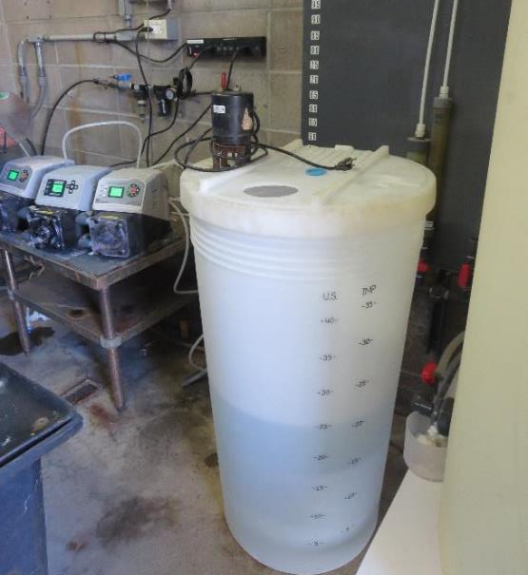
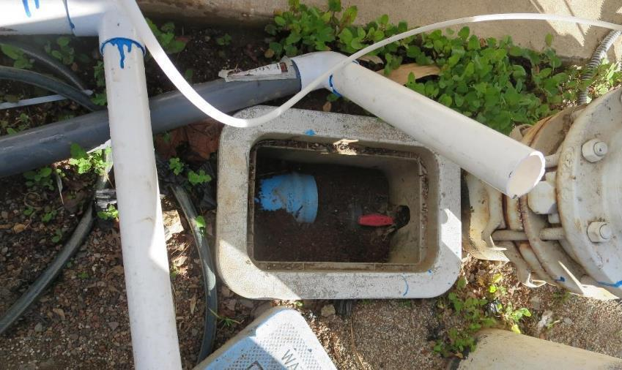
Feed Pump and Tracer Injection
Fluoride chemical crock and pump
Fluoride Injection Point (same location of post NaOCl)

Slide 14
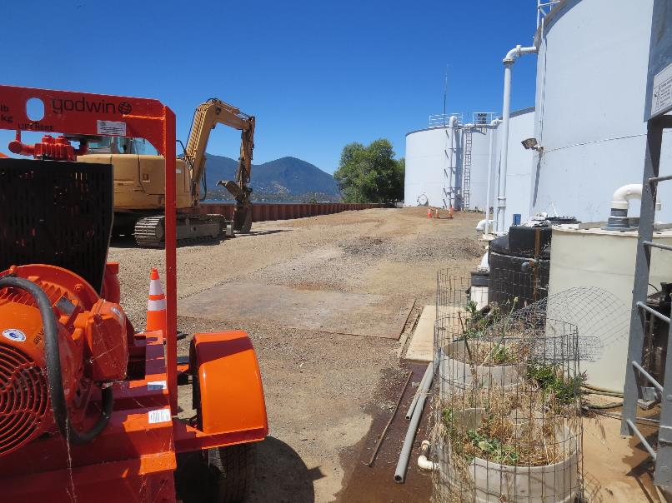
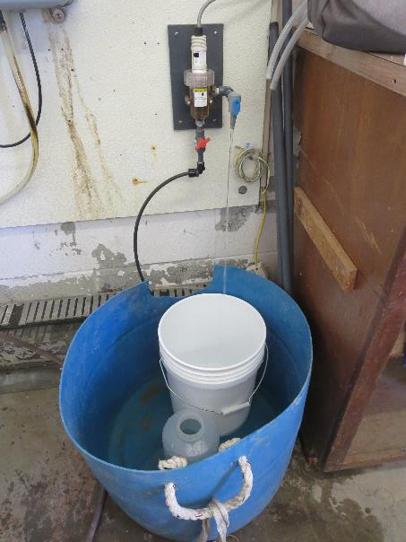
Tracer Sample Point to Clearwell for Determining Fluoride Dose
Vault location of sample point
Sample collection point of tracer

Slide 15
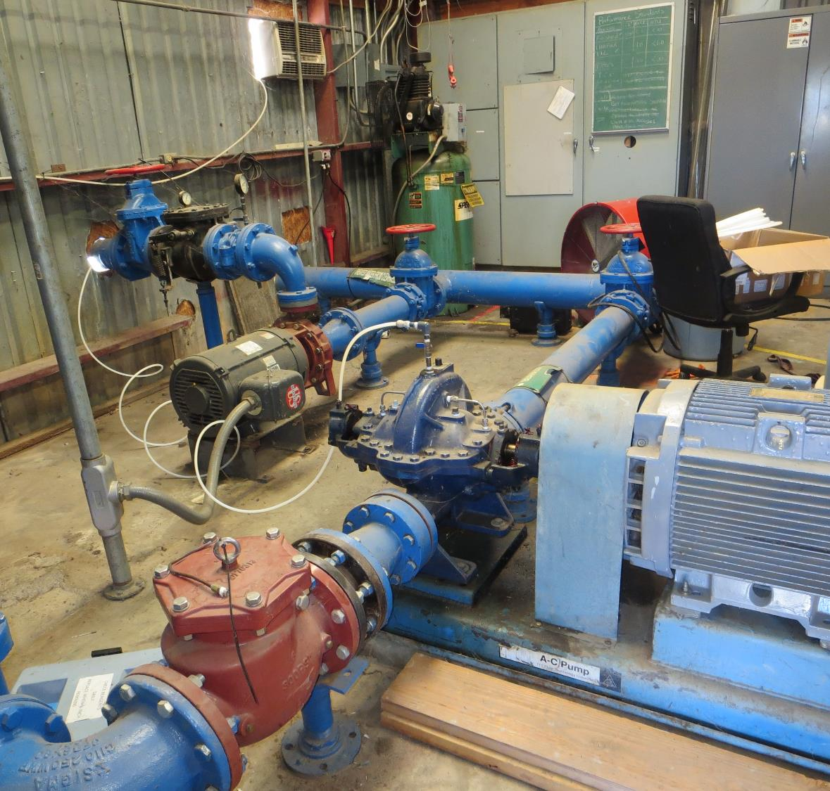
Clearwell Sample Tap off Booster Pump

Slide 16
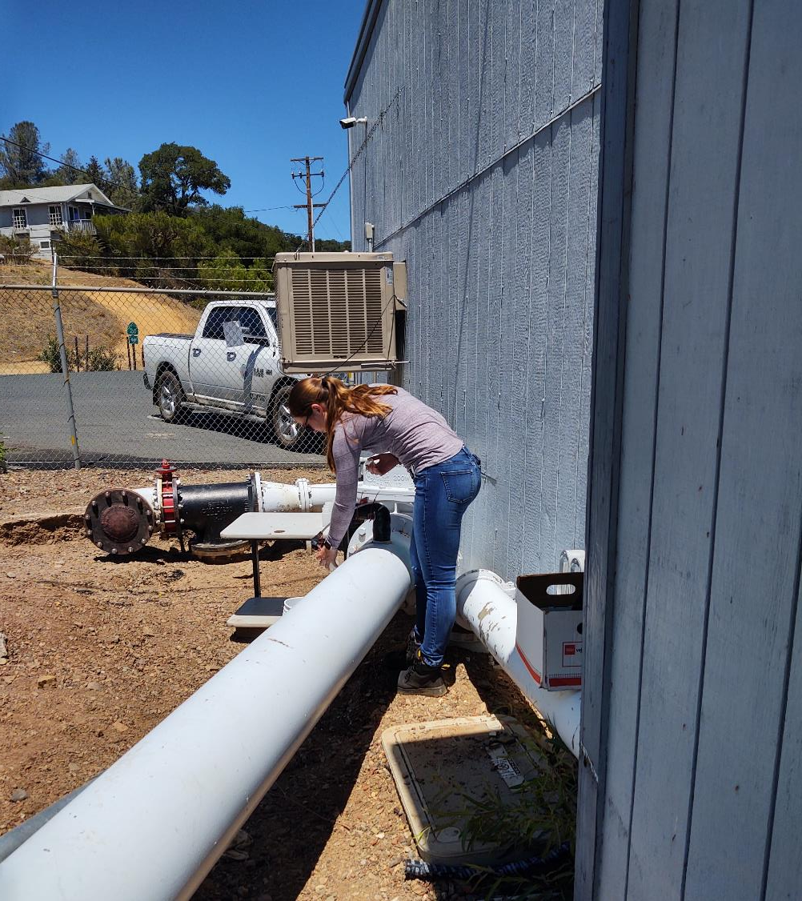
Clearwell Outlet Tracer Sample Line Station from Booster Pump

Slide 17
Tracer Fluoride Dose, Inlet to Clearwell,
Table 1
Elapsed Time minutes | *Tracer Fluoride Dose mg/L
5-9 | 1.70
10-14 | 1.71
15-19 | 1.73
20-24 | 1.74
25-29 | 1.76
30-34 | 1.76
*Excludes background fluoride of 0.146 mg/L

Slide 18
Tracer Dose and Background Residual
Average background fluoride concentration: 0.146 mg/L as F
Average steady-state measured fluoride concentration exiting pipeline and entering the first tank (steel): 1.88 mg/L as F
Fluoride dose: 1.88 – 0.146 = 1.73 mg/L as F
Results are based on tracer dose of 1.73 mg/L as F
10% of tracer dose is 0.173 mg/L as F

Slide 19
Results 2

Slide 20
Step
Dose: 1.73 mg/L
0.173 mg/L at t₁₀
t₁₀: 34.5 min
HRT: 278 min
BF: 0.12 (t₁₀/HRT)

Slide 21
Step Curve tanks 1-5
Baffling Factor (BF) = 0.12

Slide 22
Purpose of a Tracer Study
To determine the hydraulic efficiency or disinfectant exposure time of water through one or more reactors.
The addition of known quantities of a nonreactive chemical (tracer) is added in the form of a pulse (slug) or step-input.
The time of travel or disinfectant exposure time through the reactor is related to:
  Flow rate
  Reactor water volume
  Water Depth
  Reactor configuration
  Hydraulic mixing

Slide 23
Disinfection Exposure Time of Fluid in Vessel for Determining Ct₁₀
C” is the disinfectant residual (mg/L) at the point of inactivation compliance.
The disinfection exposure time of water used for Ct₁₀ calculation is the time (t₁₀) it takes for the first 10 percent of the water entering the reactor to exit the reactor.
To determine this, a marker (nonreactive tracer) is introduced into the water and is monitored leaving the reactor.
Example: 2.7 mg/L of tracer is continuously dose during testing; t₁₀ is that time when 0.27 mg/L of tracer concentration (10% of dose) has exited the reactor.

Slide 24
Ct₁₀ Value
Log inactivation is based on the Delivered Dose, “Ct₁₀”
  “C” is the disinfectant residual (mg/L)
  “t₁₀” is the exposure or contact time (minutes)
  Multiply them:
C • t₁₀ = mg/L • min (delivered dose to pathogens)
The calculated Ct₁₀ value is looked up in EPA Ct tables to determine the log inactivation based on specific monitoring parameters (pH, disinfectant residual and temperature).

Slide 25
Baffling Factor (BF)
Baffling factor or short-circuiting factor:
  Determined from tracer study or estimated
  BF = t₁₀/ HRT from tracer study
  HRT (hydraulic residence time) = reactor volume divided by reactor flow
Once the BF is determined, then it is applied to the operations of the reactor for determining the disinfectant exposure time.
Example:
  Total Clearwell operating volume: 180,000 gallons
  Exit flow: 620 gpm (0.892 MGD)
  BF: 0.12, from tracer study
  Calculated contact or disinfection exposure time:
    180,000 gal ÷ 620 gpm × 0.12 = 35 minutes = t₁₀

Slide 26
Test Method
Modified Step-Dose Method
It is a continue feed of tracer at constant rate and inlet plant flow throughout the duration of the test. The “Step-Dose” test has a duration of 3-4 HRT to achieve reactor outlet steady-state tracer concentration. The time “t₁₀” is determined when 10% of the tracer dose concentration has exist the reactor. The “Modified Step-Dose” test allows the test to be completed in less than 1 HRT by physical measurements of the tracer inlet flow and/or channel basin concentration.

Slide 27
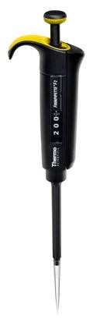
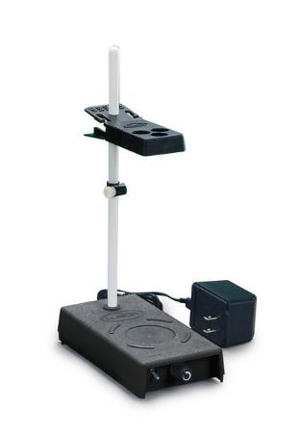
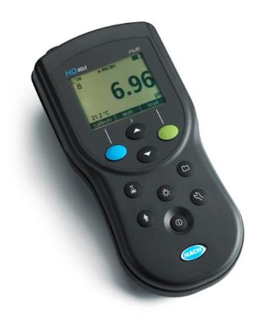
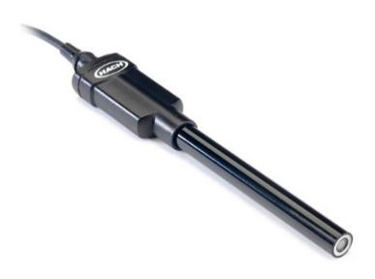
Method of Analysis and Equipment
Intellical™ ISEF121 Fluoride (F⁻) Ion Selective Electrode (ISE)
HQ40d Portable ISE Multi-Parameter Meter
Fluoride Ionic Strength Adjustor (ISA)
Fluoride Standards (0.2 & 2.0 mg/L)
25 mL graduated cylinder
Finnpipette F2 variable volume pipette, capacity 0.5 - 5 mL
Electrode stirrer stand
50 mL beakers
Stir Bar, Magnetic, Polygon

Slide 28

Contact
Guy Schott, P.E.
State Water Resources Control Board
Division of Drinking Water
Santa Rosa, CA
Go to Tracer Test Results for review
www.waterboards.ca.gov/drinking_water/programs/districts/mendocino_district.html
Email: Guy Schott - Guy.Schott@waterboards.ca.gov
Office Number: 707-576-2732

