Slide 1
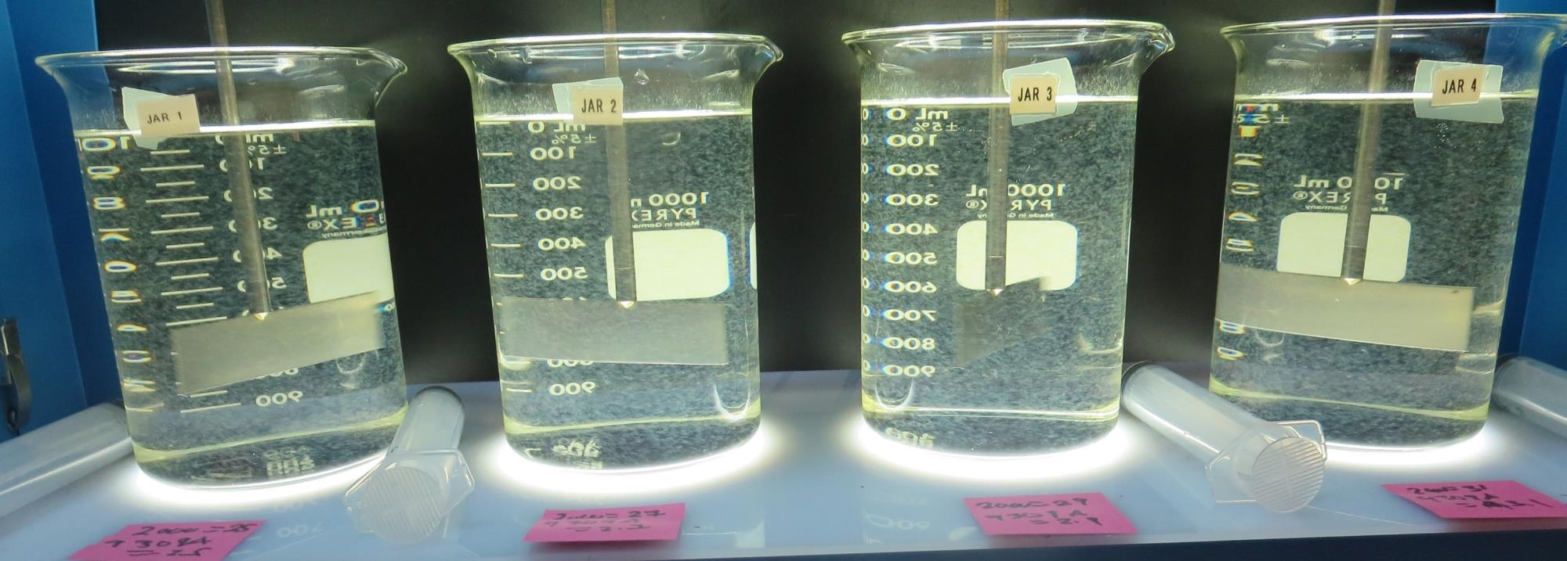
Golden State Water Co., Clearlake System CA1710002 Lake County Jar Test
by Guy Schott, P.E.
December 13, 2019

Slide 2
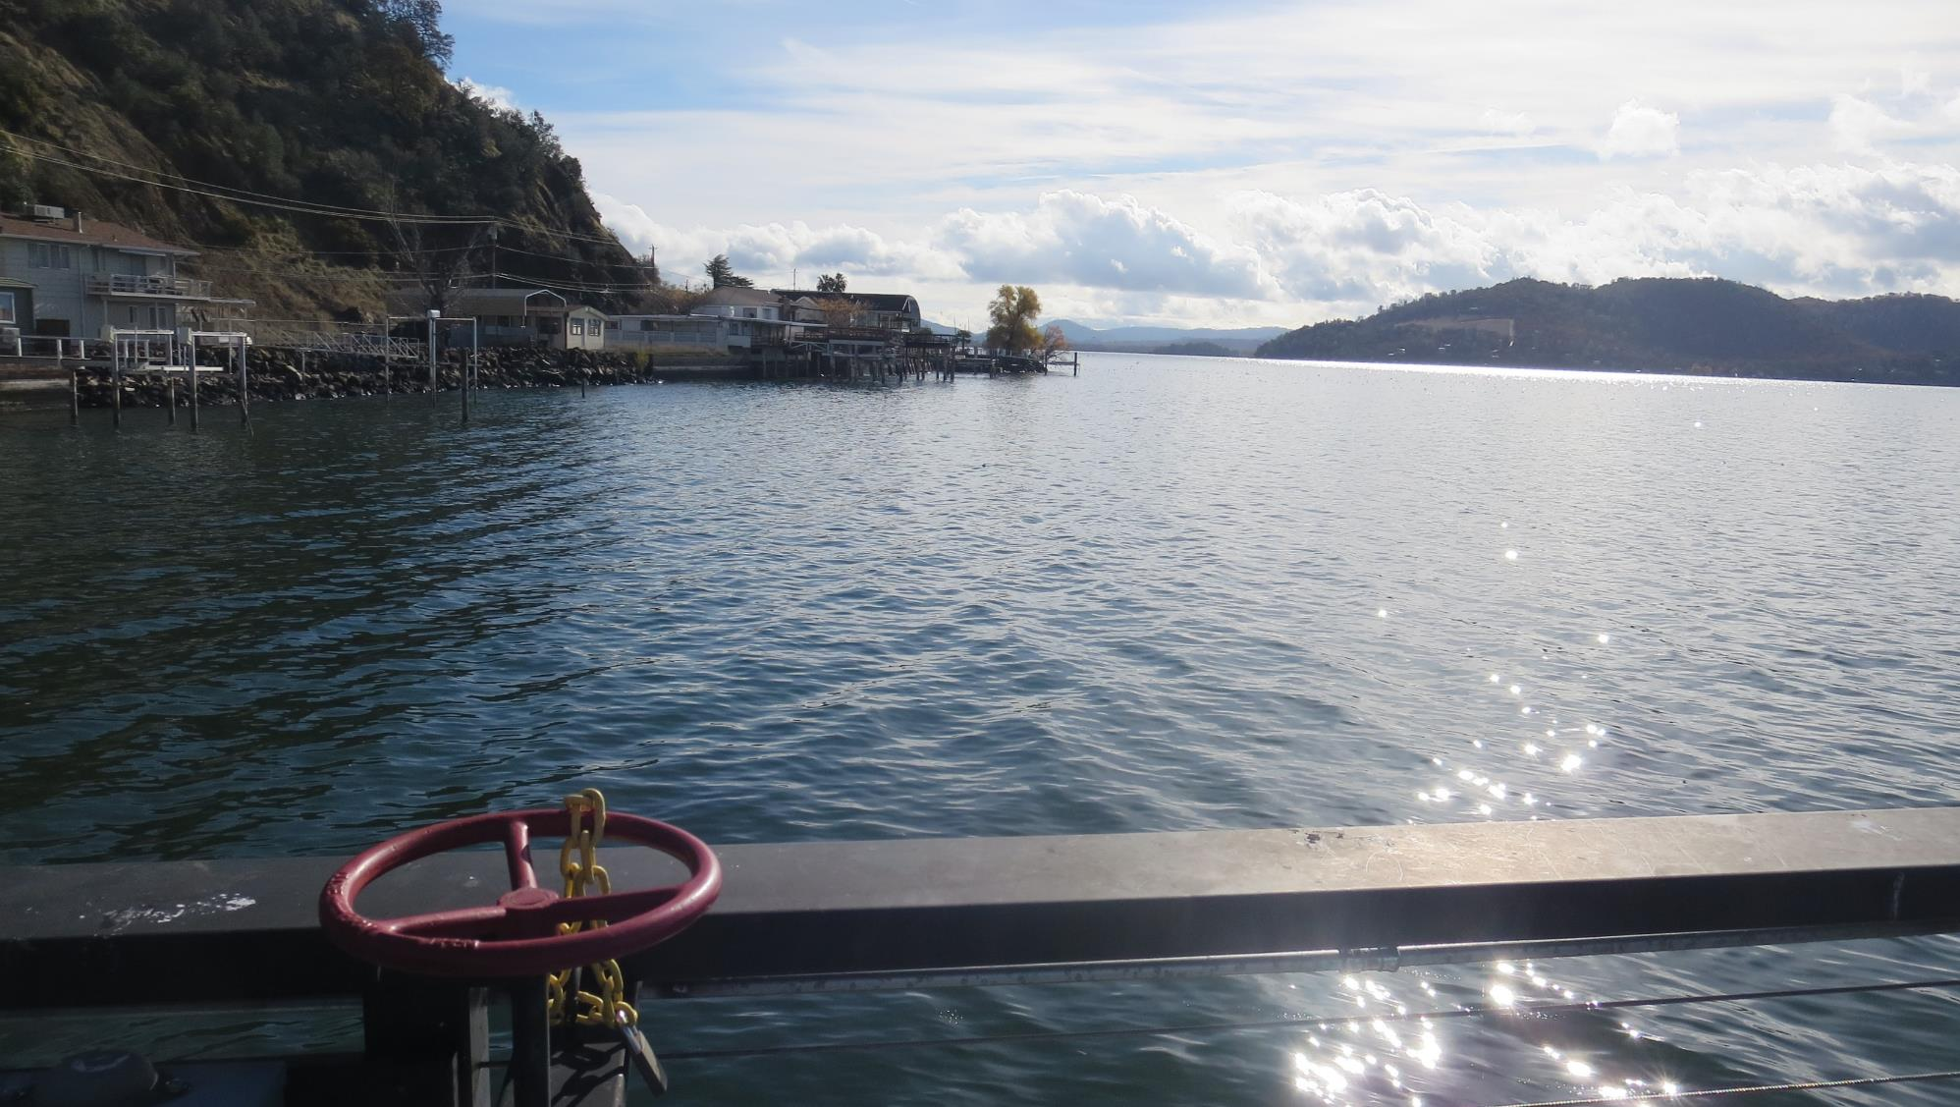
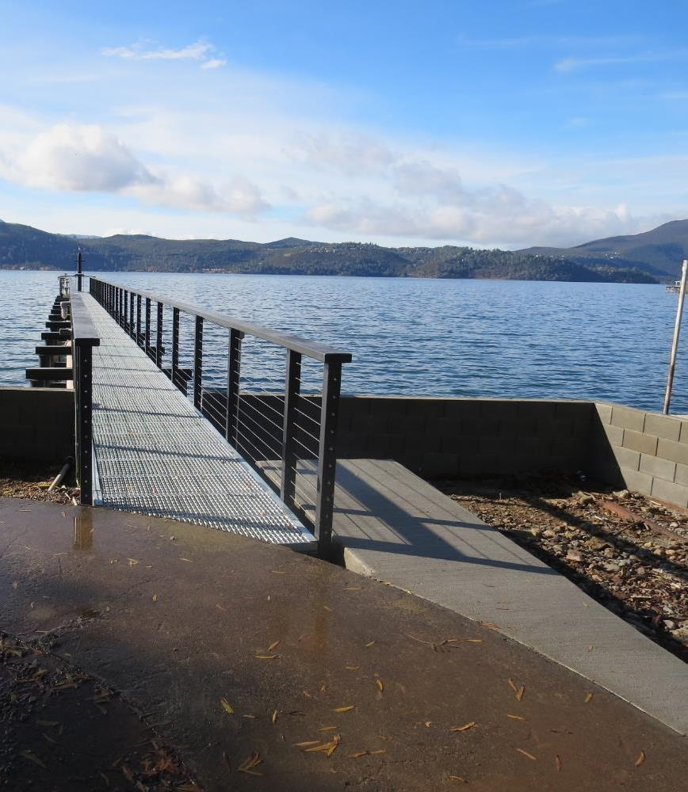
Golden State Water Co. Source Water: Clearlake December 14, 2019

Slide 3
Golden State Water Co., Clearlake December 14, 2019
Source
Turbidity: 2.04 NTU
pH: 7.56
UVT: 83.3%, UVA: 0.079/cm
0.4 um Filtered
UVT: 85.4%, UVA: 0.069/cm
Filter 1: 0.09 NTU
UVT: 91.5%, UVA: 0.039/cm
UVA Reduction: 43.5%
Filter 2: 0.10 NTU
UVT: 91.1%, UVA: 0.040/cm
UVA Reduction: 42.0%
Post GAC: 0.10 NTU
UVT: 93.4%, UVA: 0.030/cm
UVA Reduction: 56.5%
Post Cl2: 0.09 NTU
UVT: 95.1%, UVA: 0.022/cm

Slide 4
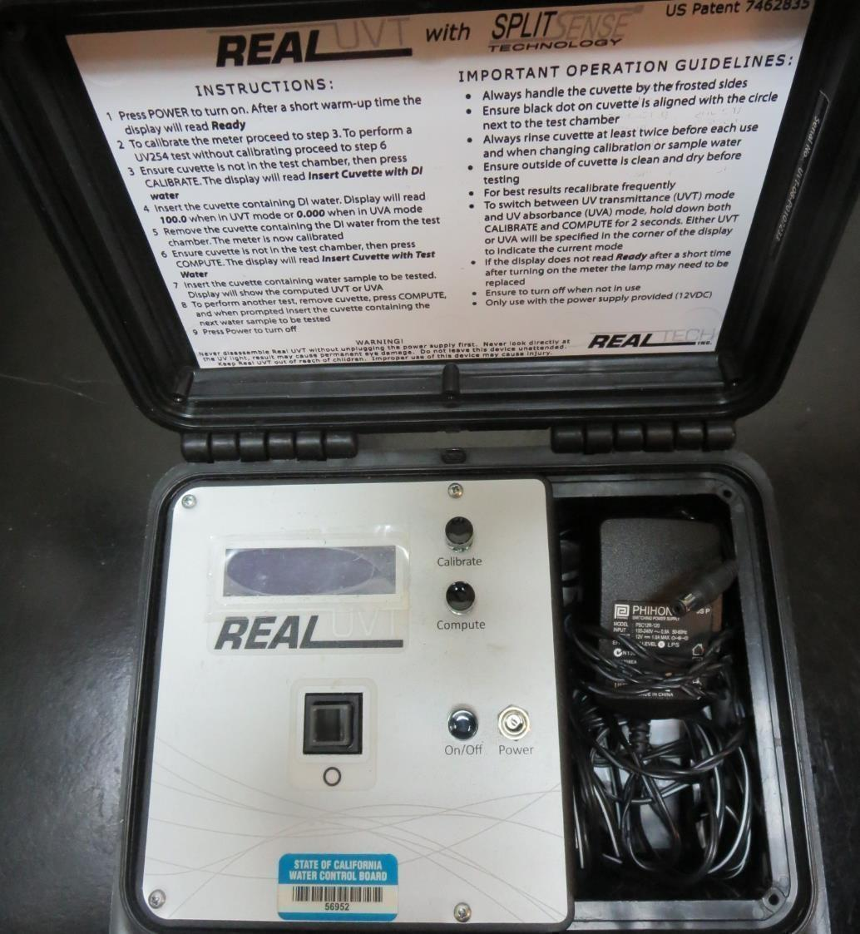
UVT/UVA
UV transmittance (UVT) is a measurement of the amount of ultraviolet light (commonly at 254 nm due to its germicidal effect) that passes through a water sample compared to the amount of light that passes through a pure water sample. The measurement is expressed as a percentage, % UVT.
%UVT = 10^{(-UVA)} x 100%
UV absorbance (UVA) is calculated as a relative measure of the amount of light absorbed by a water sample compared with the amount of light absorbed by a pure water sample.
UVA = -log(%UVT/100)

Slide 5
Coagulant Used for Jar Testing
SWT 2000
(Sterling Water Technologies LLC)
50% Aluminum Chlorohydrate (ACH)
50% Water
SG = 1.338
SWT 9309A
(Sterling Water Technologies LLC)
30-50% Aluminum Chlorohydrate (ACH)
30-40% Polydiallyldimethylammonium
50-60% H₂O
SG = 1.2-1.3

Slide 6
Coagulant Information
Unless stated otherwise, all coagulant doses are reported as Product (100% strength).
Preparation of coagulant stock solutions are generally 1.0 and/or 0.1 percent strength using 100 and/or 200 mL volumetric flasks.
Finnpipette F2 variable volume pipette, capacity 100-1000 micro liters is used for stock solution preparation and coagulant aid jar test dosing.
Finnpipette F2 variable volume pipette, capacity 0.5-5 mL is used for primary coagulant jar test dosing.

Slide 7
Laboratory Charge Analyzer
Source pH: 7.56
LCA #1:
SWT2000: 28 mg/L as product (no pH adj)
Final pH: 7.50

Slide 8
Laboratory Charge Analyzer Continue
Source post KMnO₄ pH: 7.44
LCA #1:
SWT2000: 23 mg/L as product (no pH adj)
Final pH: 7.40
LCA #2:
SWT9309A: 2.0 mg/L
SWT2000: 21.5 mg/L as product (no pH adj)
Final pH: 7.41
LCA #3:
SWT9309A: 36 mg/L as product (no pH adj)
Final pH: 7.45

Slide 9
Golden State Water Co. - Post KMNO₄; Jar Test 1-8 Results Flash Mix (200 RPM, 30 sec); Floc Mix (30 RPM, 5 min)
Jar # | SWT 2000 mg/L | SWT 9309A mg/L | Filtrate NTU | Filtrate %UVT | Filtrate UVA/cm | %UVA Reduction | Settle NTU 15 min | Settle NTU 25 min
J1 | 19 | 1.9 | 0.09 | 91.1 | 0.040 | 42.0 | 1.06 | 0.76
J2 | 21 | 2.1 | 0.09 | 91.0 | 0.041 | 40.6 | 0.52 | 0.75
J3 | 23 | 2.3 | 0.12 | 91.1 | 0.040 | 42.0 | 0.61 | 0.48
J4 | 25 | 2.5 | 0.08 | 91.3 | 0.040 | 42.0 | 0.81 | 0.42
J5 | 25 | 2.5 | 0.10 | 91.5 | 0.039 | 43.5 | 0.52 | 0.40
J6 | 27 | 2.7 | 0.09 | 91.5 | 0.039 | 43.5 | 0.64 | 0.39
J7 | 29 | 2.9 | 0.08 | 91.7 | 0.038 | 44.9 | 0.60 | 0.38
J8 | 31 | 3.1 | 0.08 | 91.7 | 0.038 | 44.9 | 0.49 | 0.45

Slide 10
Golden State Water Co. - Post KMNO₄; Jar Test 9-12 Results Flash Mix (200 RPM, 30 sec); Floc Mix (30 RPM, 10 min)
Jar # | SWT 2000 mg/L | SWT 9309A mg/L | PAC mg/L | Filtrate NTU | Filtrate %UVT | Filtrate UVA/cm | %UVA Reduction | Settle NTU 15 min | Settle NTU 25 min
J9 | 29 | 2.9 | 0 | 0.09 | 91.8 | 0.037 | 46.4 | 0.26 | 0.22
J10 | 29 | 2.9 | 3 | 0.09 | 92.0 | 0.036 | 47.8 | 0.66 | 0.54
J11 | 29 | 2.9 | 6 | 0.12 | 92.1 | 0.036 | 47.8 | 0.95 | 0.79
J12 | 29 | 2.9 | 9 | 0.08 | 91.8 | 0.037 | 46.4 | 0.84 | 0.81

Slide 11
Golden State Water Co. - Post KMNO₄; Jar Test 13-16 Results Flash Mix (200 RPM, 30 sec); Floc Mix (30 RPM, 20 min)
Jar # | SWT 2000 mg/L | SWT 9309A mg/L | PAC mg/L | Filtrate NTU | Filtrate %UVT | Filtrate UVA/cm | %UVA Reduction | Settle NTU 15 min | Settle NTU 25 min
J13 | 29 | 2.9 | 0 | 0.08 | 91.4 | 0.039 | 43.5 | 0.28 | 0.27
J14 | 29 | 2.9 | 3 | 0.09 | 91.7 | 0.038 | 44.9 | 0.80 | 0.69
J15 | 29 | 2.9 | 6 | 0.10 | 92.0 | 0.036 | 47.8 | 0.81 | 0.71
J16 | 29 | 2.9 | 9 | 0.10 | 92.4 | 0.034 | 50.7 | 0.98 | 1.11

Slide 12
Golden State Water Co. - Post KMNO₄; Jar Test 17-20 Results Flash Mix (200 RPM, 30 sec); Floc Mix (30 RPM, 20 min)
Jar # | SWT 2000 mg/L | SWT 9309A mg/L | PAC mg/L | Filtrate NTU | Filtrate %UVT | Filtrate UVA/cm | %UVA Reduction | Settle NTU 15 min | Settle NTU 25 min
J17 | 29 | 2.9 | 0 | 0.08 | 91.8 | 0.037 | 46.4 | 0.67 | 0.30
J18 | 29 | 2.9 | 12 | 0.10 | 92.8 | 0.032 | 53.6 | 1.03 | 1.02
J19 | 29 | 2.9 | 15 | 0.09 | 93.1 | 0.031 | 55.1 | 1.48 | 1.63
J20 | 29 | 2.9 | 18 | 0.12 | 93.2 | 0.031 | 55.1 | 1.83 | 1.70

Slide 13
Golden State Water Co. - Post KMNO₄; Jar Test 21-24 Results Flash Mix (200 RPM, 30 sec)
Jar # | 30 RPM Floc Mix Min | SWT 2000 mg/L | SWT 9309A mg/L | PAC mg/L | Filtrate NTU | Filtrate %UVT | Filtrate UVA/cm | %UVA Reduction | Settle NTU 25 min
J21 | 5 | 29 | 2.9 | 0 | 0.07 | 91.6 | 0.038 | 44.9 | 0.39
J22 | 10 | 29 | 2.9 | 15 | 0.14 | 92.9 | 0.032 | 53.6 | 3.82
J23 | 20 | 29 | 2.9 | 15 | 0.09 | 92.8 | 0.032 | 53.6 | 1.58
J24 | 30 | 29 | 2.9 | 15 | 0.12 | 93.2 | 0.031 | 55.1 | 1.41

Slide 14
Golden State Water Co. - Post KMNO₄; Jar Test 25-28 Results Flash Mix (200 RPM, 30 sec); Floc Mix (30 RPM, 5 min)
Jar # | SWT 2000 mg/L | SWT 9309A mg/L | PAC mg/L | Filtrate NTU | Filtrate %UVT | Filtrate UVA/cm | %UVA Reduction | Settle NTU 15 min | Settle NTU 25 min
J25 | 16 | 2.0 | 0 | 0.10 | 90.4 | 0.044 | 36.2 | 0.80 | 0.43
J26 | 18 | 2.0 | 0 | 0.10 | 90.5 | 0.043 | 37.7 | 0.58 | 0.48
J27 | 29 | 2.9 | 0 | 0.08 | 91.2 | 0.040 | 42.0 | 0.45 | 0.34
J28 | 29 | 2.9 | 15 | 0.12 | 92.2 | 0.035 | 49.3 | 2.4 | 2.21

Slide 15
Golden State Water Co. – Pre-KMNO₄; Jar Test 29-32 Results Flash Mix (200 RPM, 30 sec); Floc Mix (30 RPM, 5 min)
Jar # | SWT 2000 mg/L | SWT 9309A mg/L | PAC mg/L | Filtrate NTU | Filtrate %UVT | Filtrate UVA/cm | %UVA Reduction | Settle NTU 15 min | Settle NTU 25 min
J29 | 24 | 2.4 | 0 | 0.10 | 90.5 | 0.043 | 37.7 | 0.42 | 0.31
J30 | 26 | 2.6 | 0 | 0.08 | 90.6 | 0.043 | 37.7 | 0.41 | 0.40
J31 | 28 | 2.8 | 0 | 0.08 | 90.6 | 0.043 | 37.7 | 0.37 | 0.32
J32 | 30 | 3.0 | 0 | 0.07 | 90.8 | 0.042 | 39.1 | 0.40 | 0.37

Slide 16
Golden State Water Co. – Pre-KMNO₄; Jar Test 33-36 Results Flash Mix (200 RPM, 30 sec); Floc Mix (30 RPM, 10 min)
Jar # | SWT 2000 mg/L | SWT 9309A mg/L | PAC mg/L | Filtrate NTU | Filtrate %UVT | Filtrate UVA/cm | %UVA Reduction | Settle NTU 15 min | Settle NTU 25 min
J33 | 29 | 2.9 | 0 | 0.09 | 90.4 | 0.044 | 36.2 | 0.71 | 0.32
J34 | 29 | 2.9 | 15 | 0.14 | 91.4 | 0.039 | 43.5 | 2.51 | 1.64
J35 | 29 | 2.9 | 15 | 0.19 | 92.0 | 0.036 | 47.8 | 3.79 | 2.79
J36 | 29 | 2.9 | 15 | 0.13 | 92.3 | 0.035 | 49.3 | 3.43 | 3.17

Slide 17
Jars 1-4 Test Source: Post KMNO₄ Flash Mix 30 Sec (200 RPM) Floc Mix 5 min (30 RPM) Applied Coagulants SWT9309A SWT2000

Slide 18
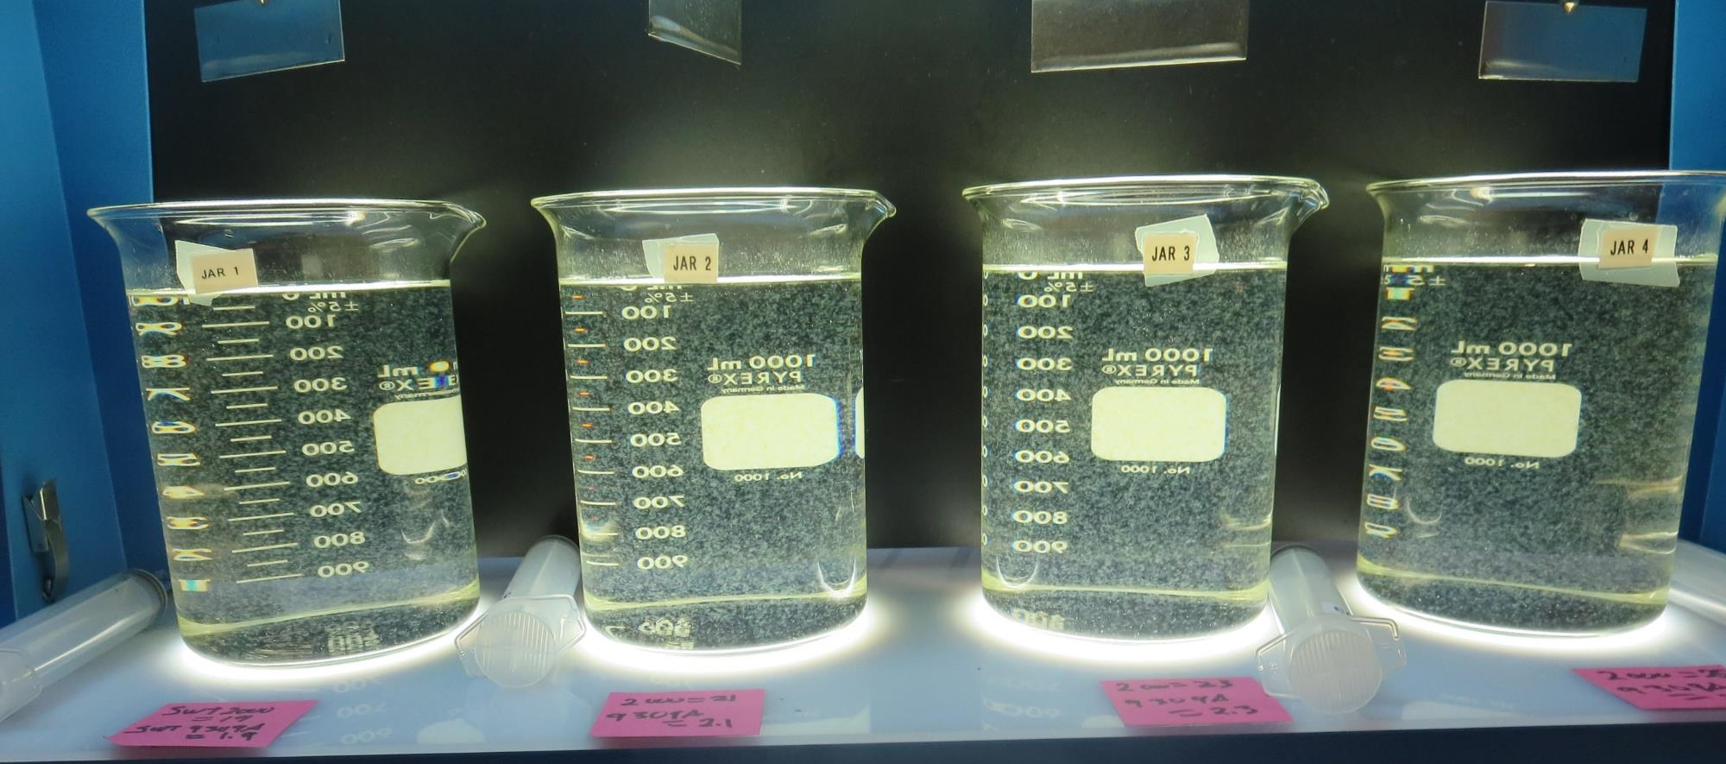
Jars 1-4 Test: End of 5-minute flocculation (30 RPM) duration.
19 mg/L SWT2000
1.9 mg/L SWT9309A
Filtrate 0.09 NTU
UVT: 91.1%
UVA: 0.040/cm
UVA Reduction: 42%
Settled: 0.67 NTU
21 mg/L SWT2000
2.1 mg/L SWT9309A
Filtrate 0.09 NTU
UVT: 91.0%
UVA: 0.041/cm
UVA Reduction: 40.6%
Settled: 0.75 NTU
23 mg/L SWT2000
2.3 mg/L SWT9309A
Filtrate 0.12 NTU
UVT: 91.1%
UVA: 0.040/cm
UVA Reduction: 42%
Settled: 0.48 NTU
25 mg/L SWT2000
2.5 mg/L SWT9309A
Filtrate 0.08 NTU
UVT: 91.3%
UVA: 0.040/cm
UVA Reduction: 42%
Settled: 0.42 NTU

Slide 19
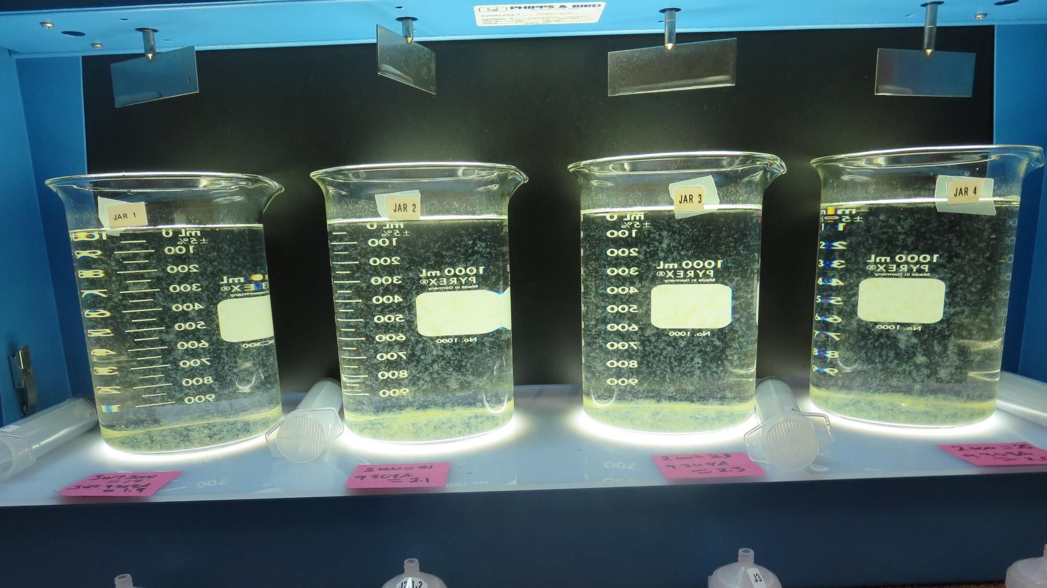
Jars 1-4: After 5 min of settling, 25 mL is syringed for filterability and %UVT/UVA.

Slide 20
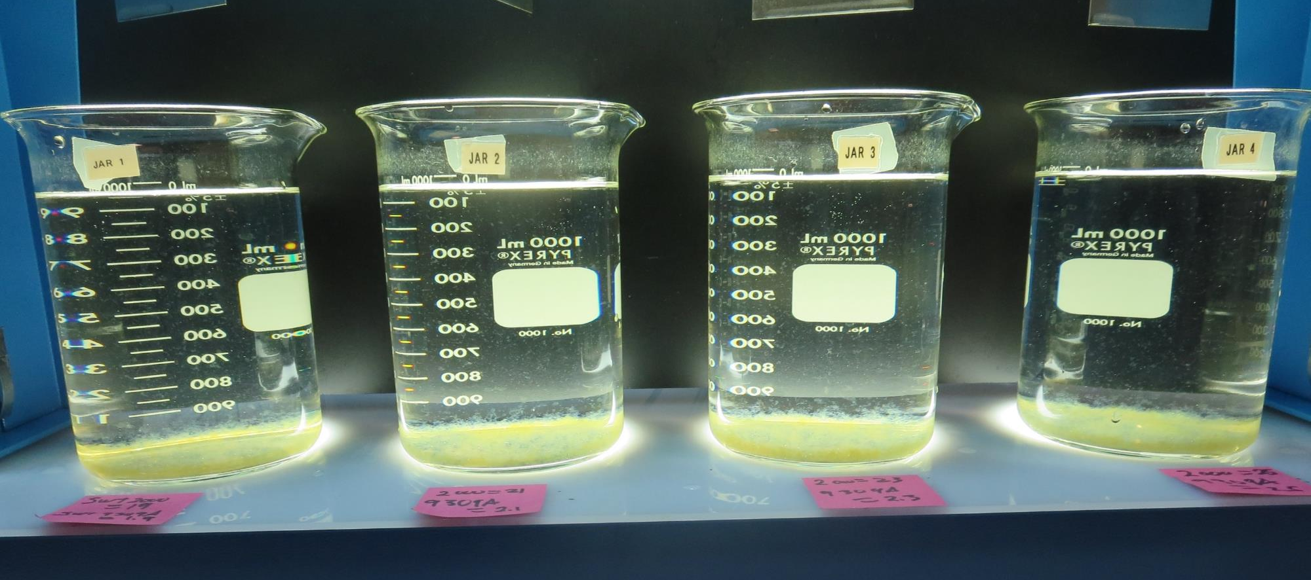
Jars 1-4: After 25-minutes of settling, settled water turbidity is taken.
19 mg/L SWT2000
1.9 mg/L SWT9309A
Filtrate 0.09 NTU
UVT: 91.1%
UVA: 0.040/cm
UVA Reduction: 42%
Settled: 0.67 NTU
21 mg/L SWT2000
2.1 mg/L SWT9309A
Filtrate 0.09 NTU
UVT: 91.0%
UVA: 0.041/cm
UVA Reduction: 40.6%
Settled: 0.75 NTU
23 mg/L SWT2000
2.3 mg/L SWT9309A
Filtrate 0.12 NTU
UVT: 91.1%
UVA: 0.040/cm
UVA Reduction: 42%
Settled: 0.48 NTU
25 mg/L SWT2000
2.5 mg/L SWT9309A
Filtrate 0.08 NTU
UVT: 91.3%
UVA: 0.040/cm
UVA Reduction: 42%
Settled: 0.42 NTU

Slide 21
Jars 5-8 Test Source: Post KMNO₄ Flash Mix 30 Sec (200 RPM) Floc Mix 5 min (30 RPM) Applied Coagulants SWT9309A SWT2000

Slide 22
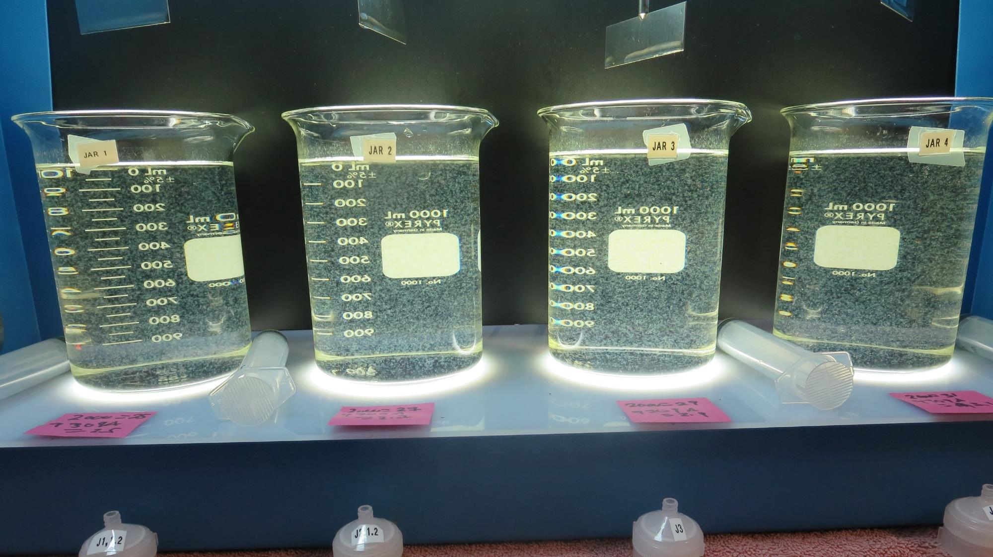
Jars 5-8 Test: End of 5-minute flocculation (30 RPM) duration.
25 mg/L SWT2000
2.5 mg/L SWT9309A
Filtrate 0.10 NTU
UVT: 91.5%
UVA: 0.039/cm
UVA Reduction: 43.5%
Settled: 0.40 NTU
27 mg/L SWT2000
2.7 mg/L SWT9309A
Filtrate 0.09 NTU
UVT: 91.5%
UVA: 0.039/cm
UVA Reduction: 43.5%
Settled: 0.39 NTU
29 mg/L SWT2000
2.9 mg/L SWT9309A
Filtrate 0.08 NTU
UVT: 91.7%
UVA: 0.038/cm
UVA Reduction: 44.9%
Settled: 0.38 NTU
31 mg/L SWT2000
3.1 mg/L SWT9309A
Filtrate 0.08 NTU
UVT: 91.7%
UVA: 0.038/cm
UVA Reduction: 44.9%
Settled: 0.45 NTU

Slide 23
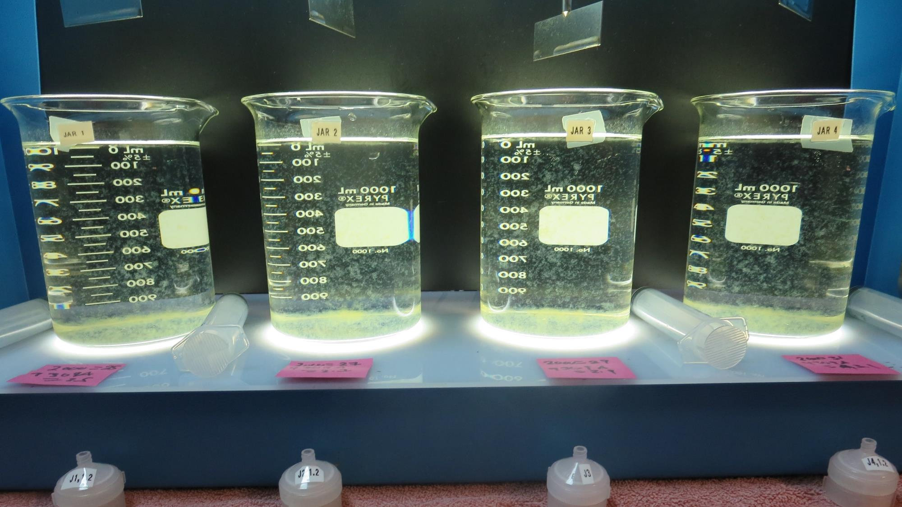
Jars 5-8: After 5 min of settling, 25 mL is syringed for filterability and %UVT/UVA.

Slide 24
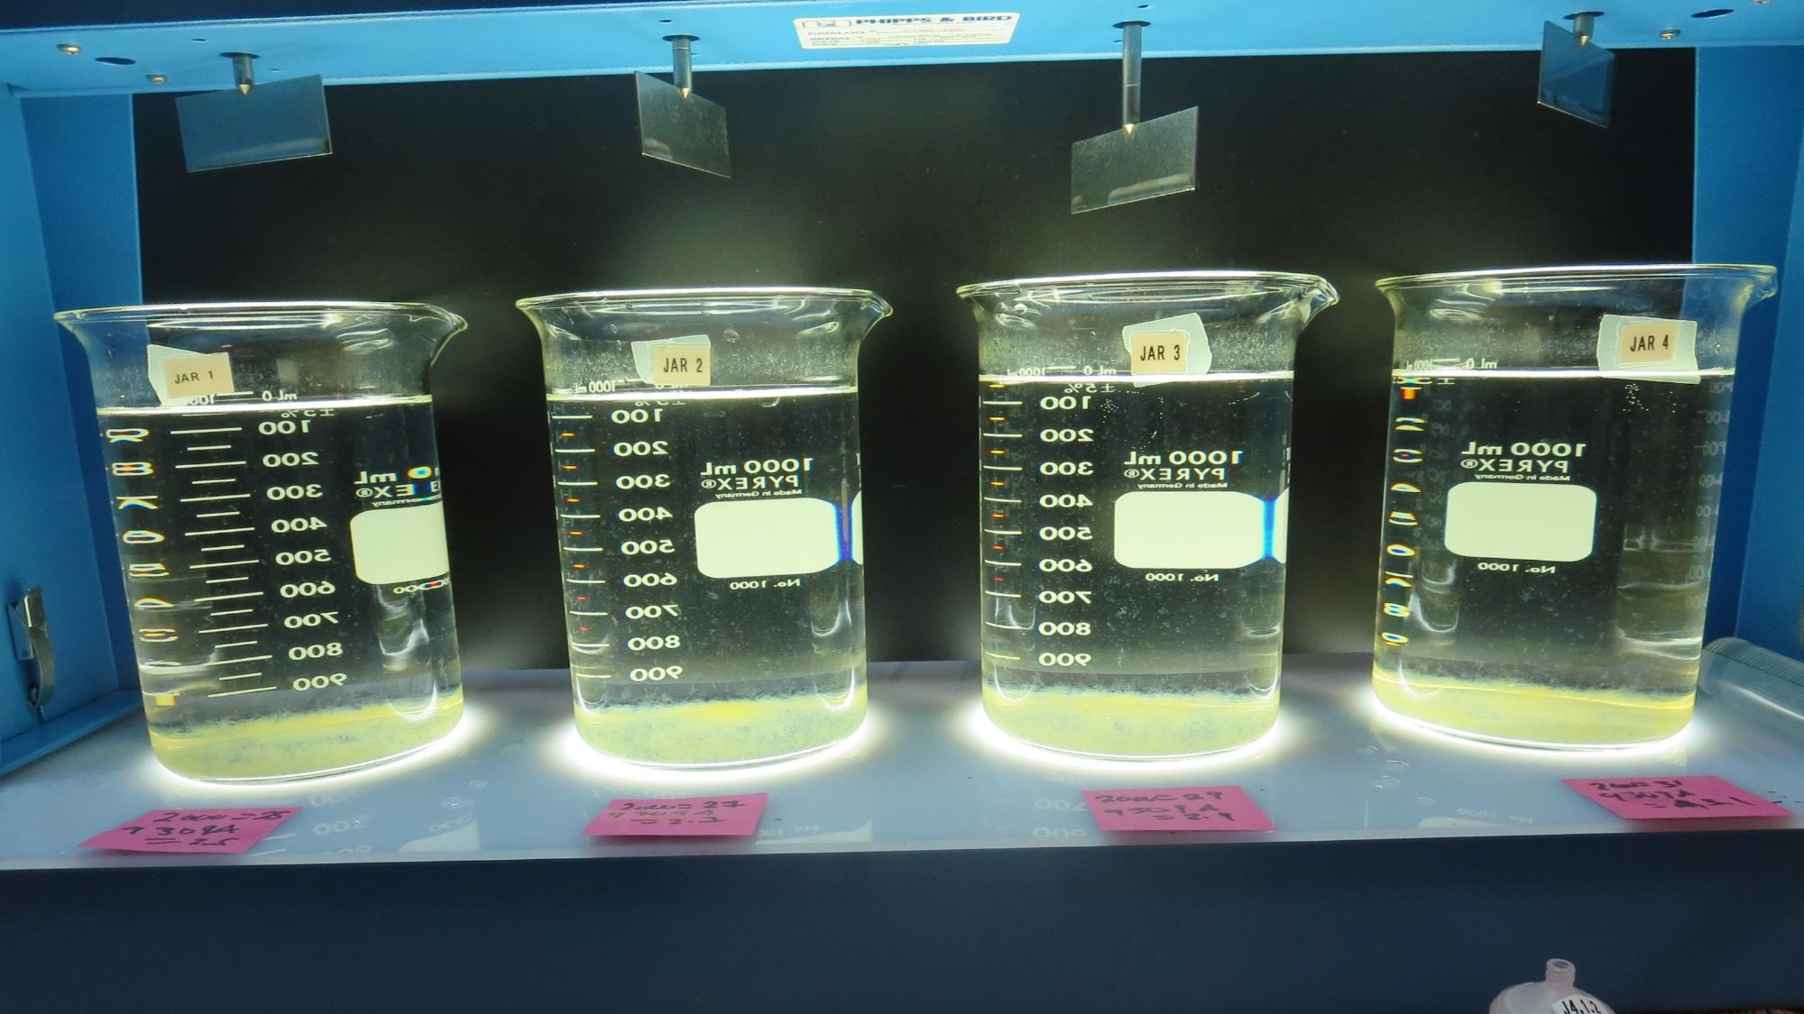
Jars 5-8: After 25-minutes of settling, settled water turbidity is taken.
25 mg/L SWT2000
2.5 mg/L SWT9309A
Filtrate 0.10 NTU
UVT: 91.5%
UVA: 0.039/cm
UVA Reduction: 43.5%
Settled: 0.40 NTU
27 mg/L SWT2000
2.7 mg/L SWT9309A
Filtrate 0.09 NTU
UVT: 91.5%
UVA: 0.039/cm
UVA Reduction: 43.5%
Settled: 0.39 NTU
29 mg/L SWT2000
2.9 mg/L SWT9309A
Filtrate 0.08 NTU
UVT: 91.7%
UVA: 0.038/cm
UVA Reduction: 44.9%
Settled: 0.38 NTU
31 mg/L SWT2000
3.1 mg/L SWT9309A
Filtrate 0.08 NTU
UVT: 91.7%
UVA: 0.038/cm
UVA Reduction: 44.9%
Settled: 0.45 NTU

Slide 25
Jars 9-12 Test Source: Post KMNO₄ Flash Mix 30 Sec (200 RPM) Floc Mix 10 min (30 RPM) Applied Coagulants SWT9309A SWT2000 Powder Activated Carbon (PAC)

Slide 26
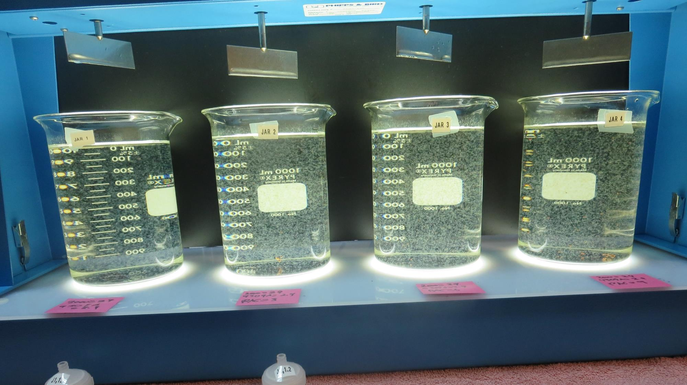
Jars 9-12 Test: End of 10-minute flocculation (30 RPM) duration.
29 mg/L SWT2000
2.9 mg/L SWT9309A
0 mg/L PAC
Filtrate 0.09 NTU
UVT: 91.8%
UVA: 0.037/cm
UVT Reduction: 46.4%
Settled: 0.22 NTU
29 mg/L SWT2000
2.9 mg/L SWT9309A
3 mg/L PAC
Filtrate 0.09 NTU
UVT: 92.0%
UVA: 0.036/cm
UVT Reduction: 47.8%
Settled: 0.54 NTU
29 mg/L SWT2000
2.9 mg/L SWT9309A
6 mg/L PAC
Filtrate 0.10 NTU
UVT: 92.1%
UVA: 0.036/cm
UVT Reduction: 47.8%
Settled: 0.79 NTU
29 mg/L SWT2000
2.9 mg/L SWT9309A
9 mg/L PAC
Filtrate 0.10 NTU
UVT: 91.8%
UVA: 0.037/cm
UVT Reduction: 46.4%
Settled: 0.81 NTU

Slide 27
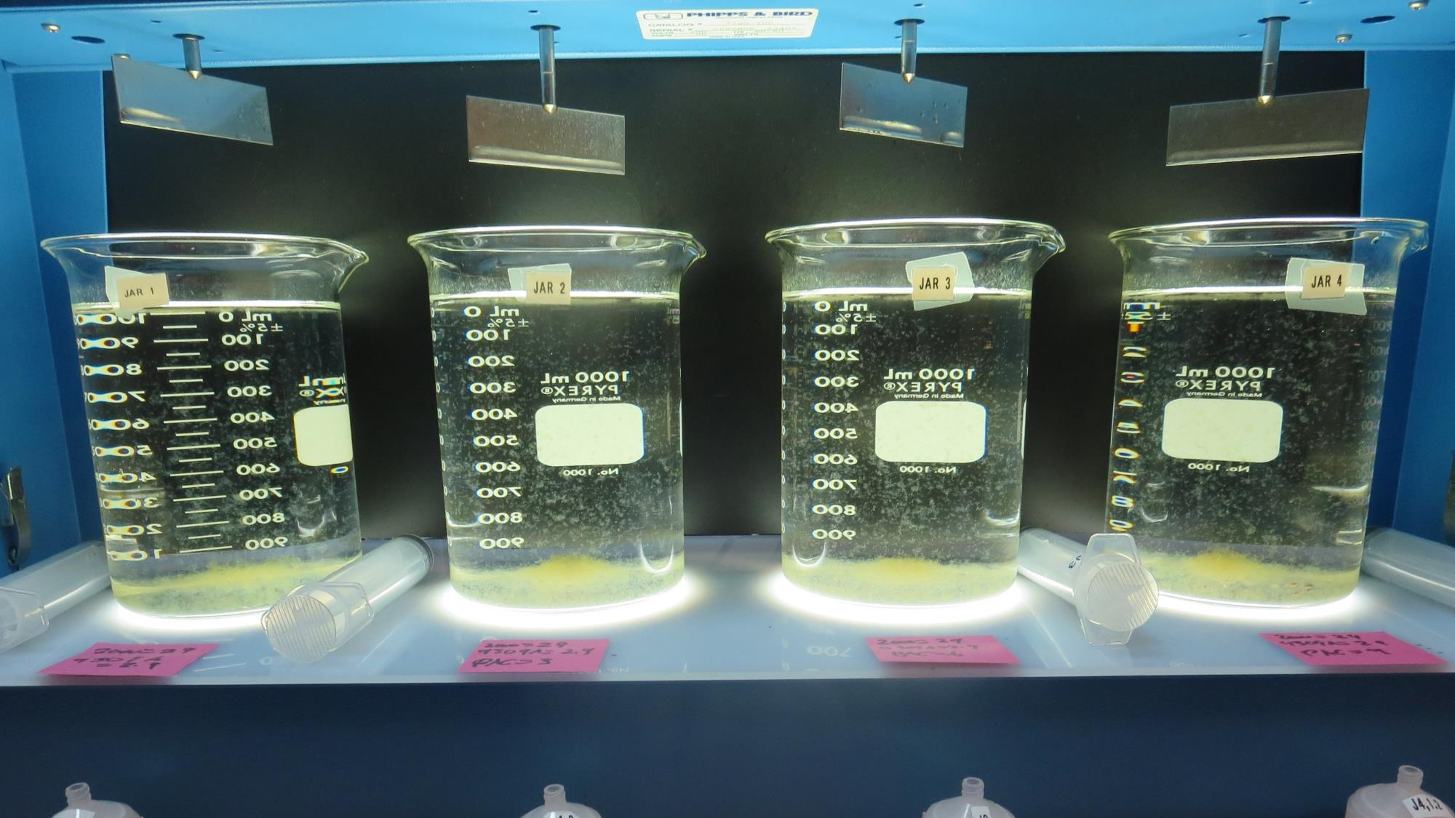
Jars 9-12: After 5 min of settling, 25 mL is syringed for filterability and %UVT/UVA.

Slide 28
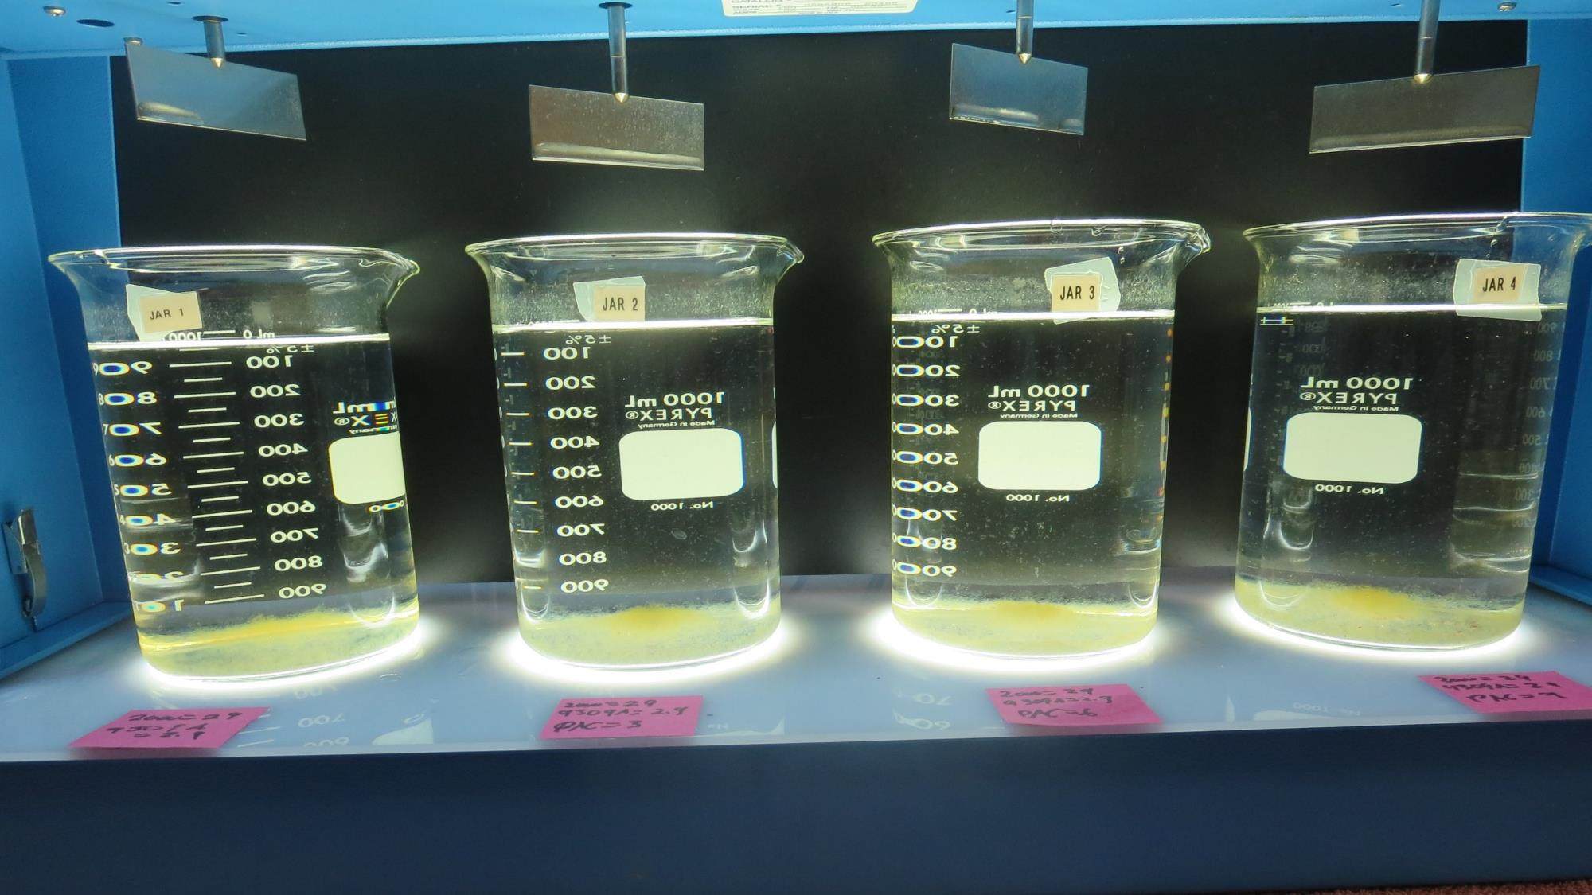
Jars 9-12: After 25-minutes of settling, settled water turbidity is taken.
29 mg/L SWT2000
2.9 mg/L SWT9309A
0 mg/L PAC
Filtrate 0.09 NTU
UVT: 91.8%
UVA: 0.037/cm
UVT Reduction: 46.4%
Settled: 0.22 NTU
29 mg/L SWT2000
2.9 mg/L SWT9309A
3 mg/L PAC
Filtrate 0.09 NTU
UVT: 92.0%
UVA: 0.036/cm
UVT Reduction: 47.8%
Settled: 0.54 NTU
29 mg/L SWT2000
2.9 mg/L SWT9309A
6 mg/L PAC
Filtrate 0.10 NTU
UVT: 92.1%
UVA: 0.036/cm
UVT Reduction: 47.8%
Settled: 0.79 NTU
29 mg/L SWT2000
2.9 mg/L SWT9309A
9 mg/L PAC
Filtrate 0.10 NTU
UVT: 91.8%
UVA: 0.037/cm
UVT Reduction: 46.4%
Settled: 0.81 NTU

Slide 29
Jars 13 -16 Test Source: Post KMNO₄ Flash Mix 30 Sec (200 RPM) Floc Mix 20 min (30 RPM) Applied Coagulants SWT9309A SWT2000 Powder Activated Carbon (PAC)

Slide 30
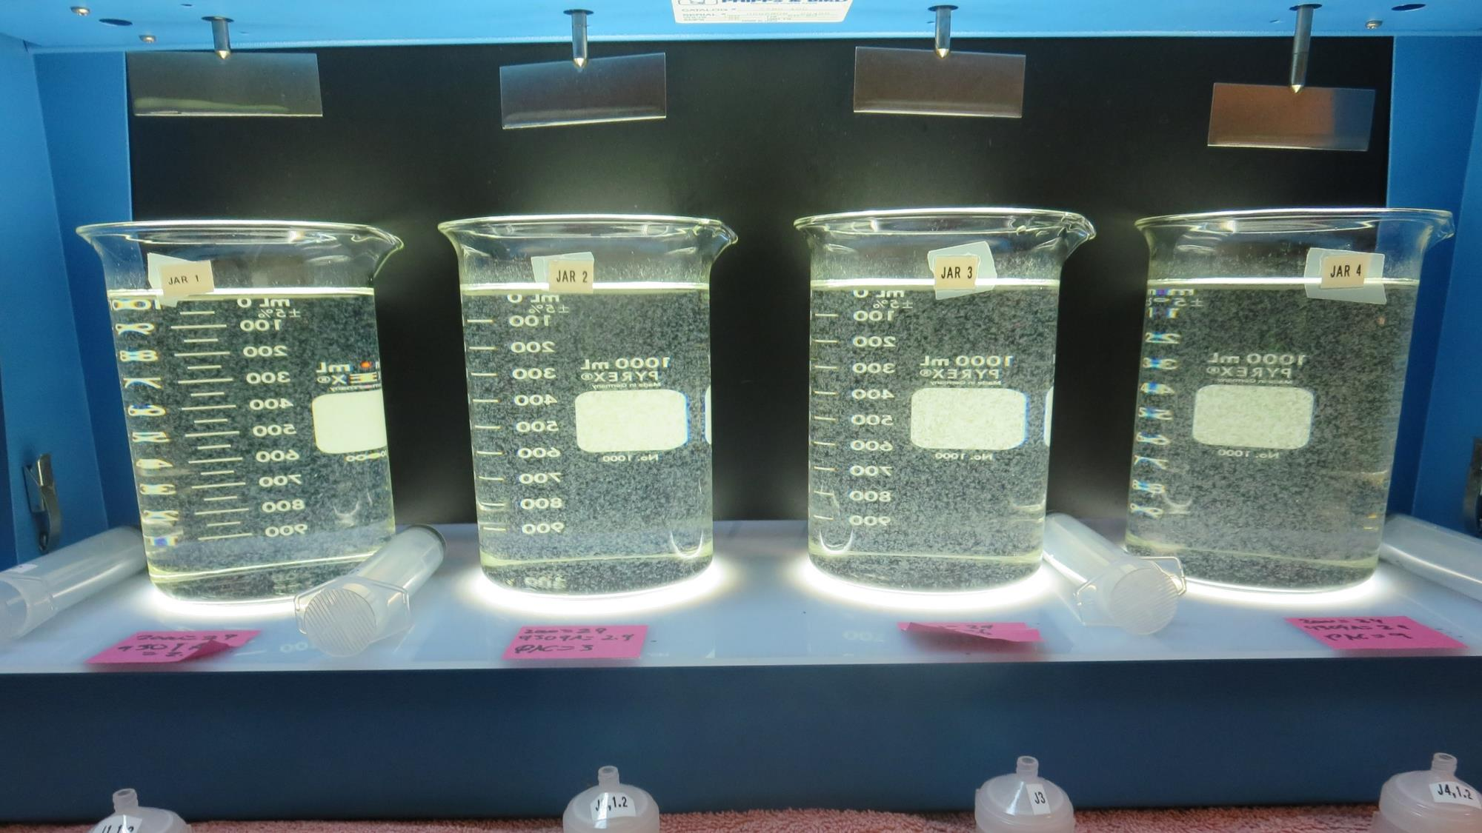
Jars 13-16 Test: End of 20-minute flocculation (30 RPM) duration.
29 mg/L SWT2000
2.9 mg/L SWT9309A
0 mg/L PAC
Filtrate 0.08 NTU
UVT: 91.4%
UVA: 0.039/cm
UVA Reduction: 43.5%
Settled: 0.27 NTU
29 mg/L SWT2000
2.9 mg/L SWT9309A
3 mg/L PAC
Filtrate 0.09 NTU
UVT: 91.7%
UVA: 0.038/cm
UVA Reduction: 44.9%
Settled: 0.69 NTU
29 mg/L SWT2000
2.9 mg/L SWT9309A
6 mg/L PAC
Filtrate 0.10 NTU
UVT: 92.0%
UVA: 0.036/cm
UVA Reduction: 47.8%
Settled: 0.71 NTU
29 mg/L SWT2000
2.9 mg/L SWT9309A
9 mg/L PAC
Filtrate 0.10 NTU
UVT: 92.4%
UVA: 0.034/cm
UVA Reduction: 50.7%
Settled: 0.68 NTU

Slide 31
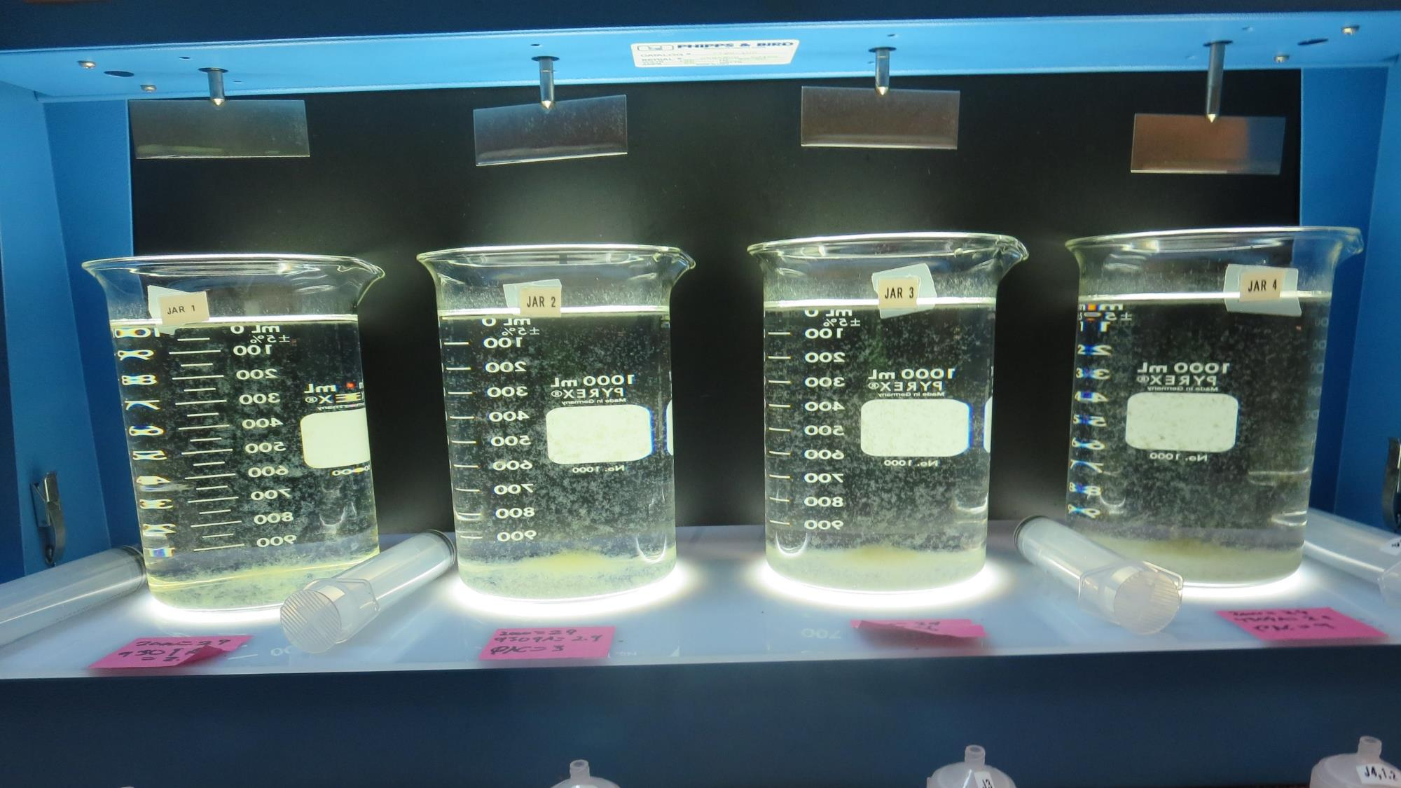
Jars 13-16: After 5 min of settling, 25 mL is syringed for filterability and %UVT/UVA.

Slide 32
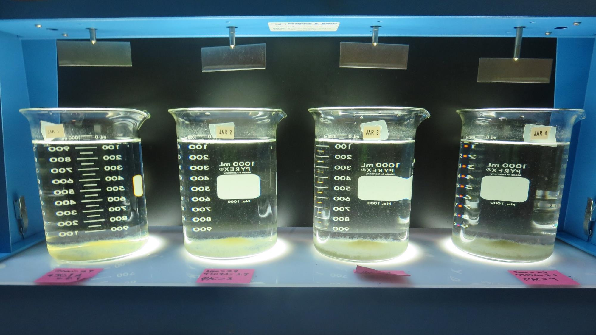
Jars 13-16: After 25-minutes of settling, settled water turbidity is taken.
29 mg/L SWT2000
2.9 mg/L SWT9309A
0 mg/L PAC
Filtrate 0.08 NTU
UVT: 91.4%
UVA: 0.039/cm
UVA Reduction: 43.5%
Settled: 0.27 NTU
29 mg/L SWT2000
2.9 mg/L SWT9309A
3 mg/L PAC
Filtrate 0.09 NTU
UVT: 91.7%
UVA: 0.038/cm
UVA Reduction: 44.9%
Settled: 0.69 NTU
29 mg/L SWT2000
2.9 mg/L SWT9309A
6 mg/L PAC
Filtrate 0.10 NTU
UVT: 92.0%
UVA: 0.036/cm
UVA Reduction: 47.8%
Settled: 0.71 NTU
29 mg/L SWT2000
2.9 mg/L SWT9309A
9 mg/L PAC
Filtrate 0.10 NTU
UVT: 92.4%
UVA: 0.034/cm
UVA Reduction: 50.7%
Settled: 0.68 NTU

Slide 33
Jars 17 -20 Test Source: Post KMNO₄ Flash Mix 30 Sec (200 RPM) Floc Mix 20 min (30 RPM) Applied Coagulants SWT9309A SWT2000 Powder Activated Carbon (PAC)

Slide 34
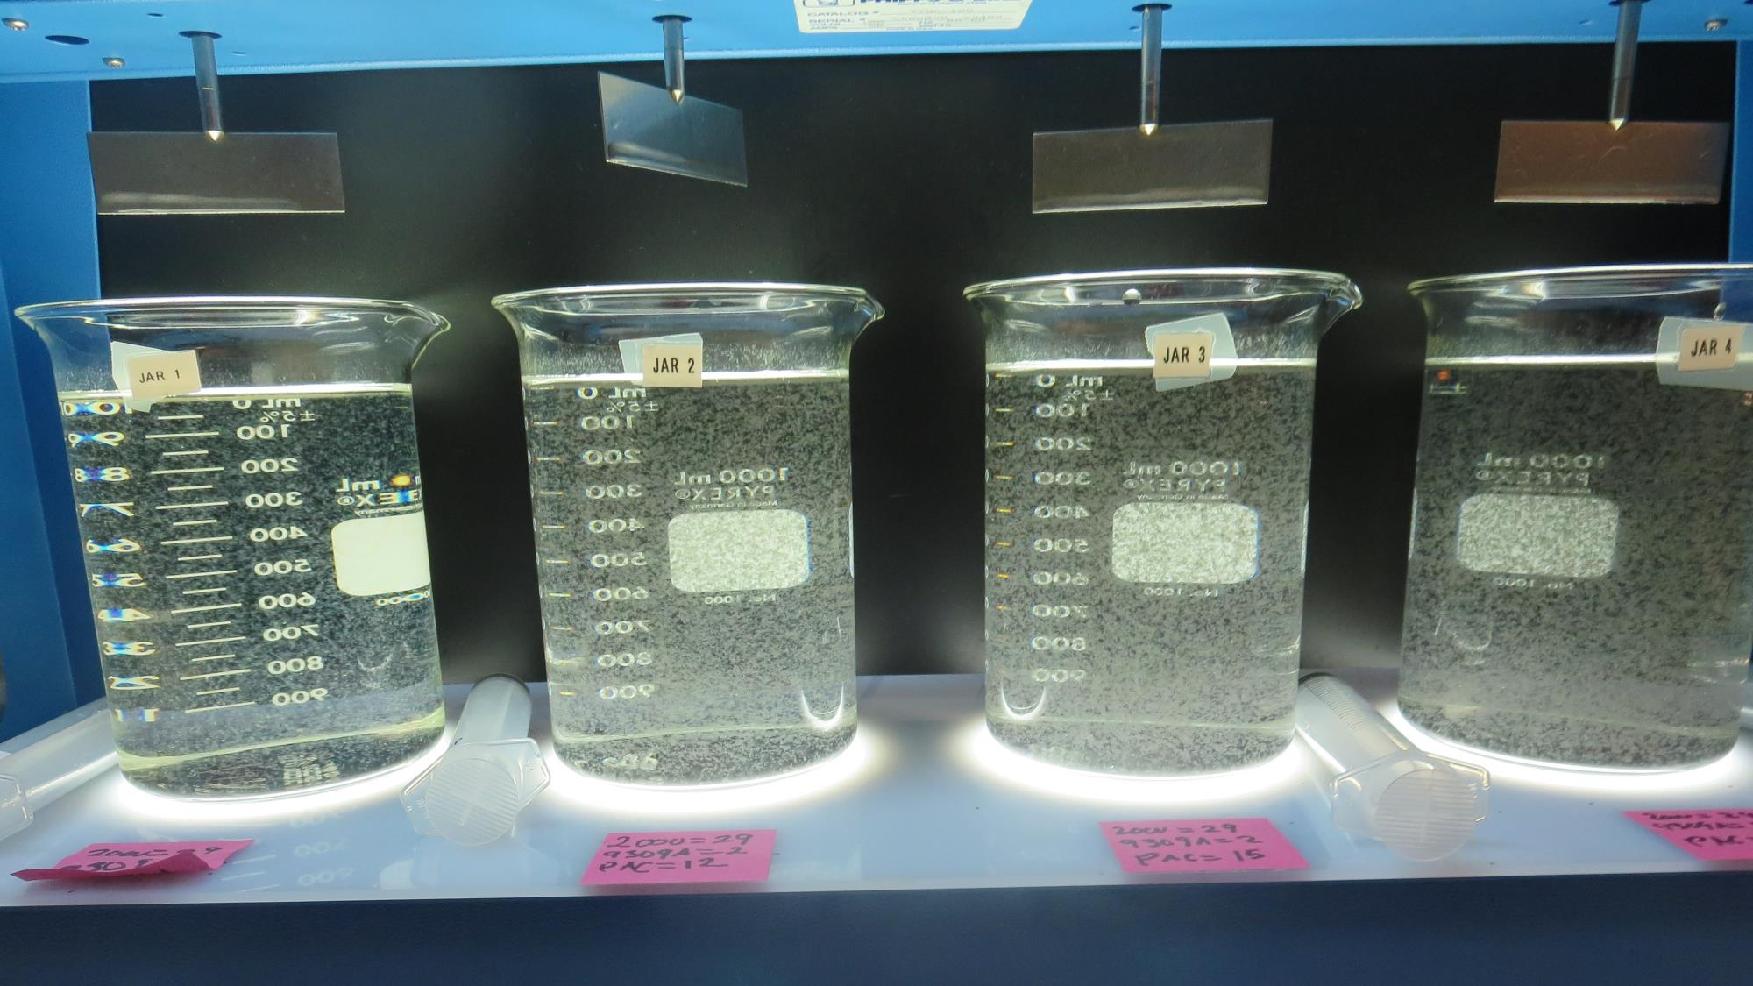
Jars 17-20 Test: End of 20-minute flocculation (30 RPM) duration.
29 mg/L SWT2000
2.9 mg/L SWT9309A
0 mg/L PAC
Filtrate 0.08 NTU
UVT: 91.8%
UVA: 0.037/cm
UVA Reduction: 46.4%
Settled: 0.30 NTU
29 mg/L SWT2000
2.9 mg/L SWT9309A
12 mg/L PAC
Filtrate 0.10 NTU
UVT: 92.8%
UVA: 0.032/cm
UVA Reduction: 53.6%
Settled: 1.02 NTU
29 mg/L SWT2000
2.9 mg/L SWT9309A
15 mg/L PAC
Filtrate 0.09 NTU
UVT: 93.1%
UVA: 0.031/cm
UVA Reduction: 55.1%
Settled: 1.63 NTU
29 mg/L SWT2000
2.9 mg/L SWT9309A
18 mg/L PAC
Filtrate 0.12 NTU
UVT: 93.2%
UVA: 0.031/cm
UVA Reduction: 55.1%
Settled: 1.70 NTU

Slide 35
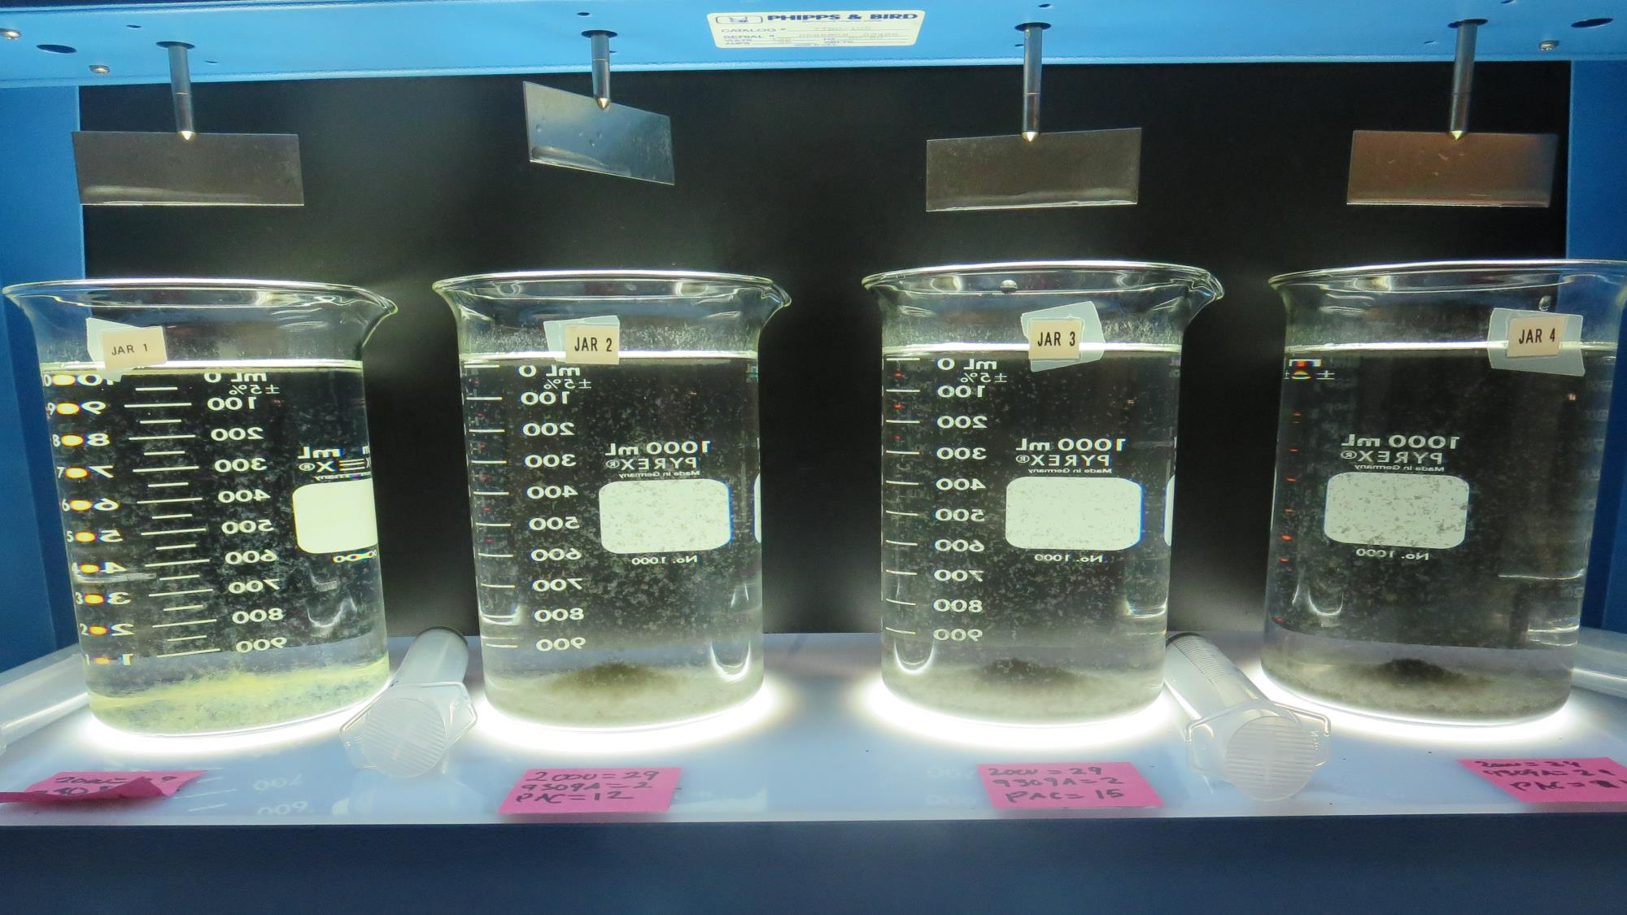
Jars 17-20: After 5 min of settling, 25 mL is syringed for filterability and %UVT/UVA.

Slide 36
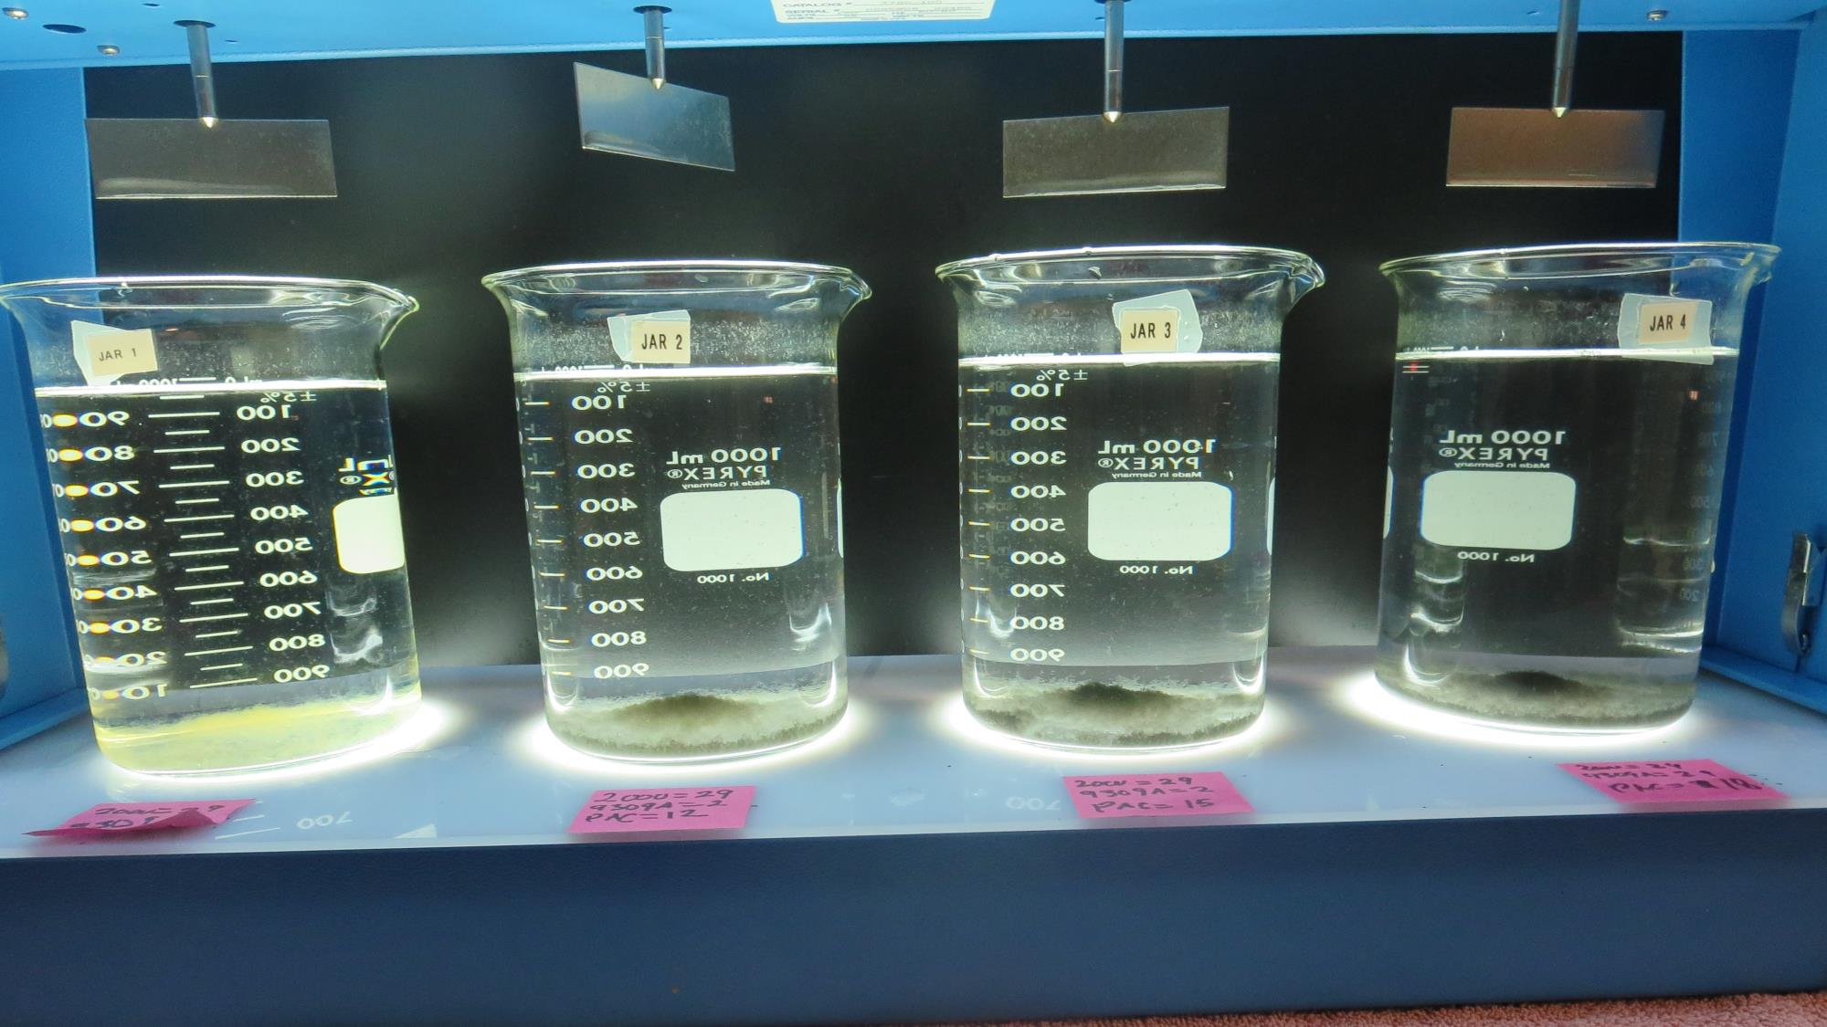
Jars 17-20: After 25-minutes of settling, settled water turbidity is taken.
29 mg/L SWT2000
2.9 mg/L SWT9309A
0 mg/L PAC
Filtrate 0.08 NTU
UVT: 91.8%
UVA: 0.037/cm
UVA Reduction: 46.4%
Settled: 0.30 NTU
29 mg/L SWT2000
2.9 mg/L SWT9309A
12 mg/L PAC
Filtrate 0.10 NTU
UVT: 92.8%
UVA: 0.032/cm
UVA Reduction: 53.6%
Settled: 1.02 NTU
29 mg/L SWT2000
2.9 mg/L SWT9309A
15 mg/L PAC
Filtrate 0.09 NTU
UVT: 93.1%
UVA: 0.031/cm
UVA Reduction: 55.1%
Settled: 1.63 NTU
29 mg/L SWT2000
2.9 mg/L SWT9309A
18 mg/L PAC
Filtrate 0.12 NTU
UVT: 93.2%
UVA: 0.031/cm
UVA Reduction: 55.1%
Settled: 1.70 NTU

Slide 37
Jars 21 -24 Test Source: Post KMNO₄ Flash Mix 30 Sec (200 RPM) Floc Mix 5-30 min (30 RPM) Applied Coagulants SWT9309A SWT2000 Powder Activated Carbon (PAC) No Photos Presented

Slide 38
Jars 25 -28 Test Source: Post KMNO₄ Flash Mix 30 Sec (200 RPM) Floc Mix 5 min (30 RPM) Applied Coagulants SWT9309A SWT2000 Powder Activated Carbon (PAC)

Slide 39
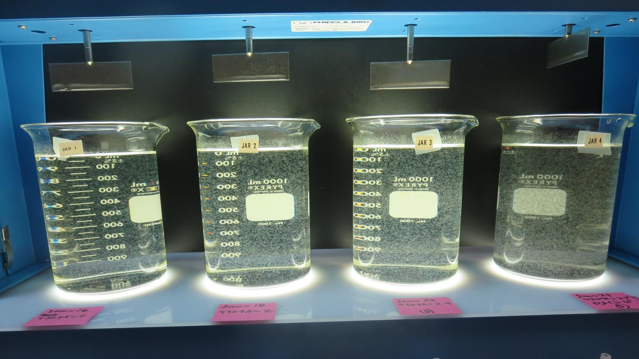
Jars 25-28 Test: End of 5-minute flocculation (30 RPM) duration.
16 mg/L SWT2000
2.0 mg/L SWT9309A
0 mg/L PAC
Filtrate 0.10 NTU
UVT: 90.4%
UVA: 0.044/cm
UVA Reduction: 36.2%
Settled: 0.43 NTU
18 mg/L SWT2000
2.0 mg/L SWT9309A
0 mg/L PAC
Filtrate 0.10 NTU
UVT: 90.5%
UVA: 0.043/cm
UVA Reduction: 37.7%
Settled: 0.48 NTU
29 mg/L SWT2000
2.9 mg/L SWT9309A
0 mg/L PAC
Filtrate 0.10 NTU
UVT: 91.2%
UVA: 0.040/cm
UVA Reduction: 42.0%
Settled: 0.34 NTU
29 mg/L SWT2000
2.9 mg/L SWT9309A
15 mg/L PAC
Filtrate 0.12 NTU
UVT: 92.2%
UVA: 0.035/cm
UVA Reduction: 49.3%
Settled: 2.21 NTU

Slide 40
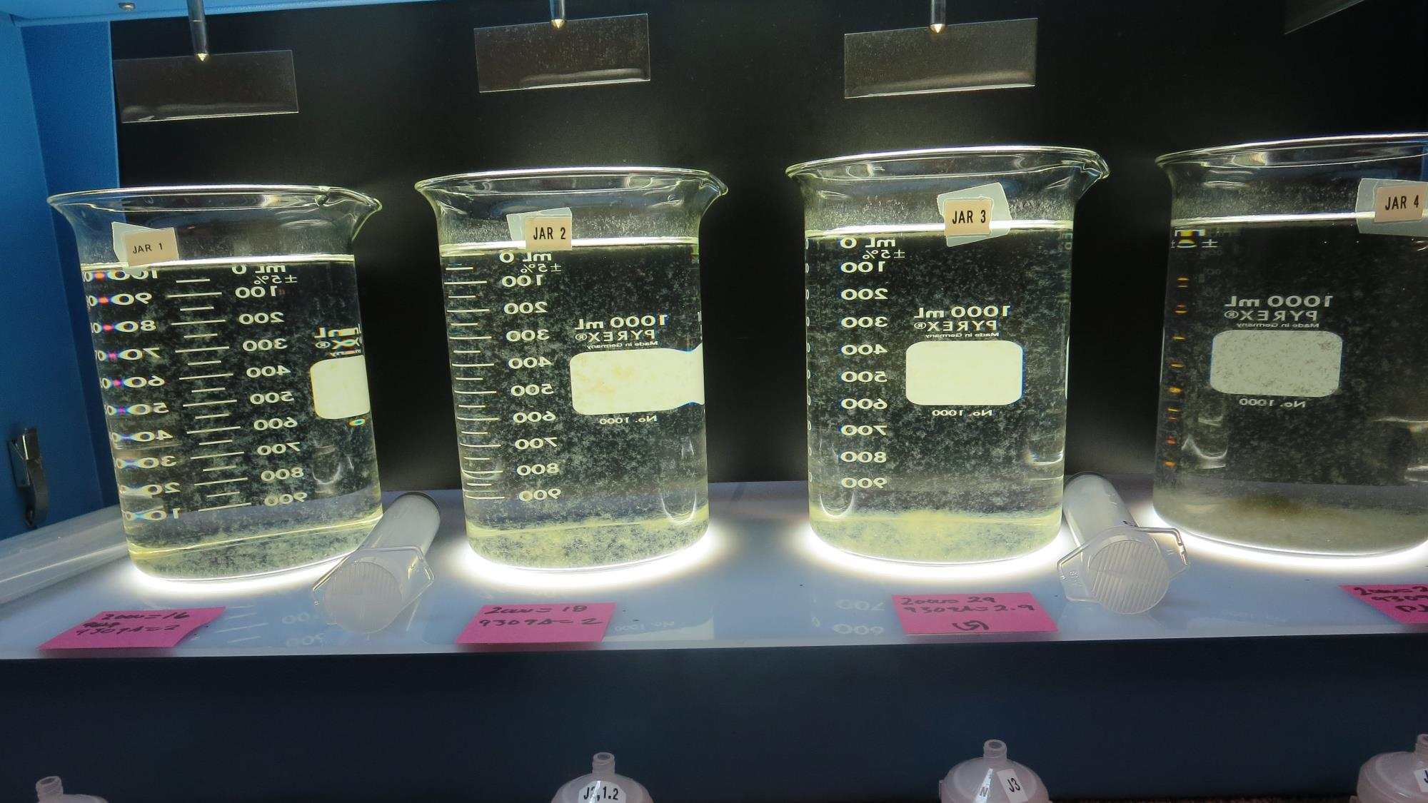
Jars 25-28: After 5 min of settling, 25 mL is syringed for filterability and %UVT/UVA.

Slide 41
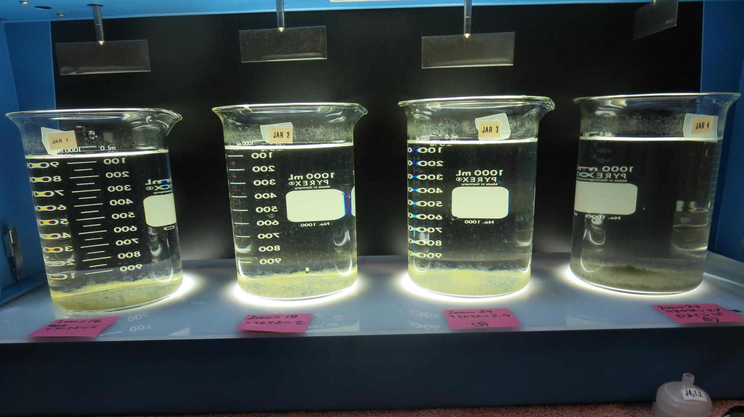
Jars 25-28: After 25-minutes of settling, settled water turbidity is taken.
16 mg/L SWT2000
2.0 mg/L SWT9309A
0 mg/L PAC
Filtrate 0.10 NTU
UVT: 90.4%
UVA: 0.044/cm
UVA Reduction: 36.2%
Settled: 0.43 NTU
18 mg/L SWT2000
2.0 mg/L SWT9309A
0 mg/L PAC
Filtrate 0.10 NTU
UVT: 90.5%
UVA: 0.043/cm
UVA Reduction: 37.7%
Settled: 0.48 NTU
29 mg/L SWT2000
2.9 mg/L SWT9309A
0 mg/L PAC
Filtrate 0.10 NTU
UVT: 91.2%
UVA: 0.040/cm
UVA Reduction: 42.0%
Settled: 0.34 NTU
29 mg/L SWT2000
2.9 mg/L SWT9309A
15 mg/L PAC
Filtrate 0.12 NTU
UVT: 92.2%
UVA: 0.035/cm
UVA Reduction: 49.3%
Settled: 2.21 NTU

Slide 42
Jars 29 -32 Test Source: Pre-KMNO₄ Flash Mix 30 Sec (200 RPM) Floc Mix 5 min (30 RPM) Applied Coagulants SWT9309A SWT2000 Powder Activated Carbon (PAC)

Slide 43
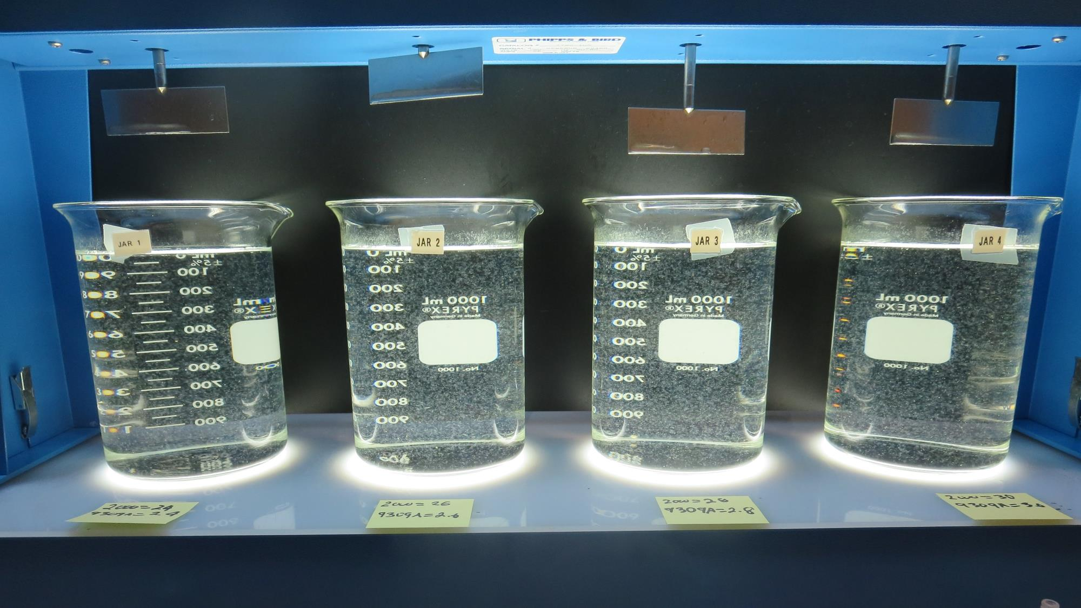
Jars 29-32 Test: End of 5-minute flocculation (30 RPM) duration.
24 mg/L SWT2000
2.4 mg/L SWT9309A
0 mg/L PAC
Filtrate 0.10 NTU
UVT: 90.5%
UVA: 0.043/cm
UVA Reduction: 37.7%
Settled: 0.31 NTU
26 mg/L SWT2000
2.6 mg/L SWT9309A
0 mg/L PAC
Filtrate 0.08 NTU
UVT: 90.6%
UVA: 0.043/cm
UVA Reduction: 37.7%
Settled: 0.28 NTU
28 mg/L SWT2000
2.8 mg/L SWT9309A
0 mg/L PAC
Filtrate 0.08 NTU
UVT: 90.6%
UVA: 0.043/cm
UVA Reduction: 37.7%
Settled: 0.28 NTU
30 mg/L SWT2000
3.0 mg/L SWT9309A
0 mg/L PAC
Filtrate 0.07 NTU
UVT: 90.8%
UVA: 0.042/cm
UVA Reduction: 39.1%
Settled: 0.29 NTU

Slide 44
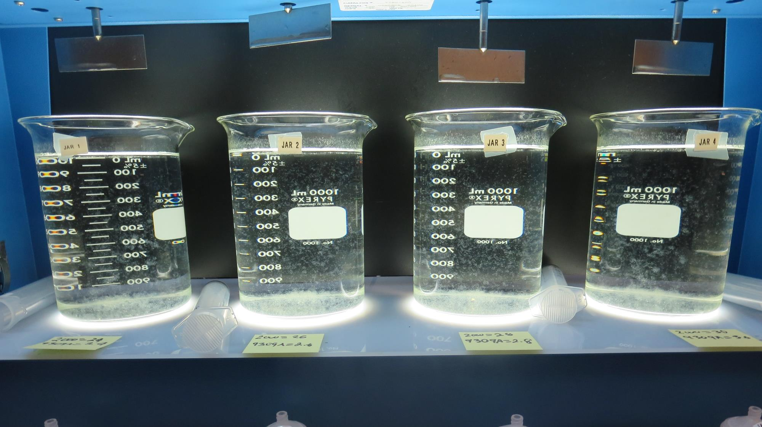
Jars 29-32: After 5 min of settling, 25 mL is syringed for filterability and %UVT/UVA.

Slide 45
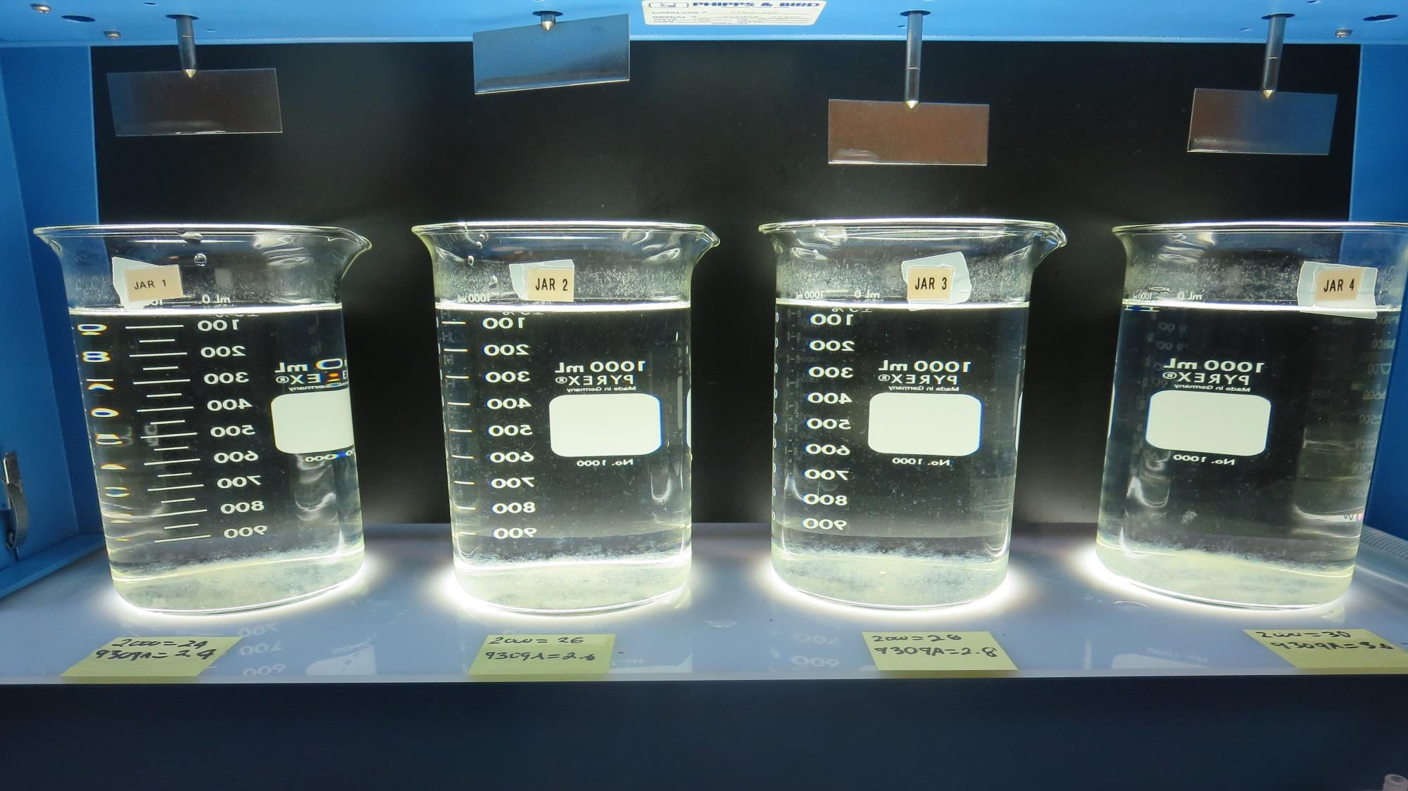
Jars 29-32: After 25-minutes of settling, settled water turbidity is taken.
24 mg/L SWT2000
2.4 mg/L SWT9309A
0 mg/L PAC
Filtrate 0.10 NTU
UVT: 90.5%
UVA: 0.043/cm
UVA Reduction: 37.7%
Settled: 0.31 NTU
26 mg/L SWT2000
2.6 mg/L SWT9309A
0 mg/L PAC
Filtrate 0.08 NTU
UVT: 90.6%
UVA: 0.043/cm
UVA Reduction: 37.7%
Settled: 0.28 NTU
28 mg/L SWT2000
2.8 mg/L SWT9309A
0 mg/L PAC
Filtrate 0.08 NTU
UVT: 90.6%
UVA: 0.043/cm
UVA Reduction: 37.7%
Settled: 0.28 NTU
30 mg/L SWT2000
3.0 mg/L SWT9309A
0 mg/L PAC
Filtrate 0.07 NTU
UVT: 90.8%
UVA: 0.042/cm
UVA Reduction: 39.1%
Settled: 0.29 NTU

Slide 46
Jars 33 -36 Test Source: Pre-KMNO₄ Flash Mix 30 Sec (200 RPM) Floc Mix 10 min (30 RPM) Applied Coagulants SWT9309A SWT2000 Powder Activated Carbon (PAC)

Slide 47
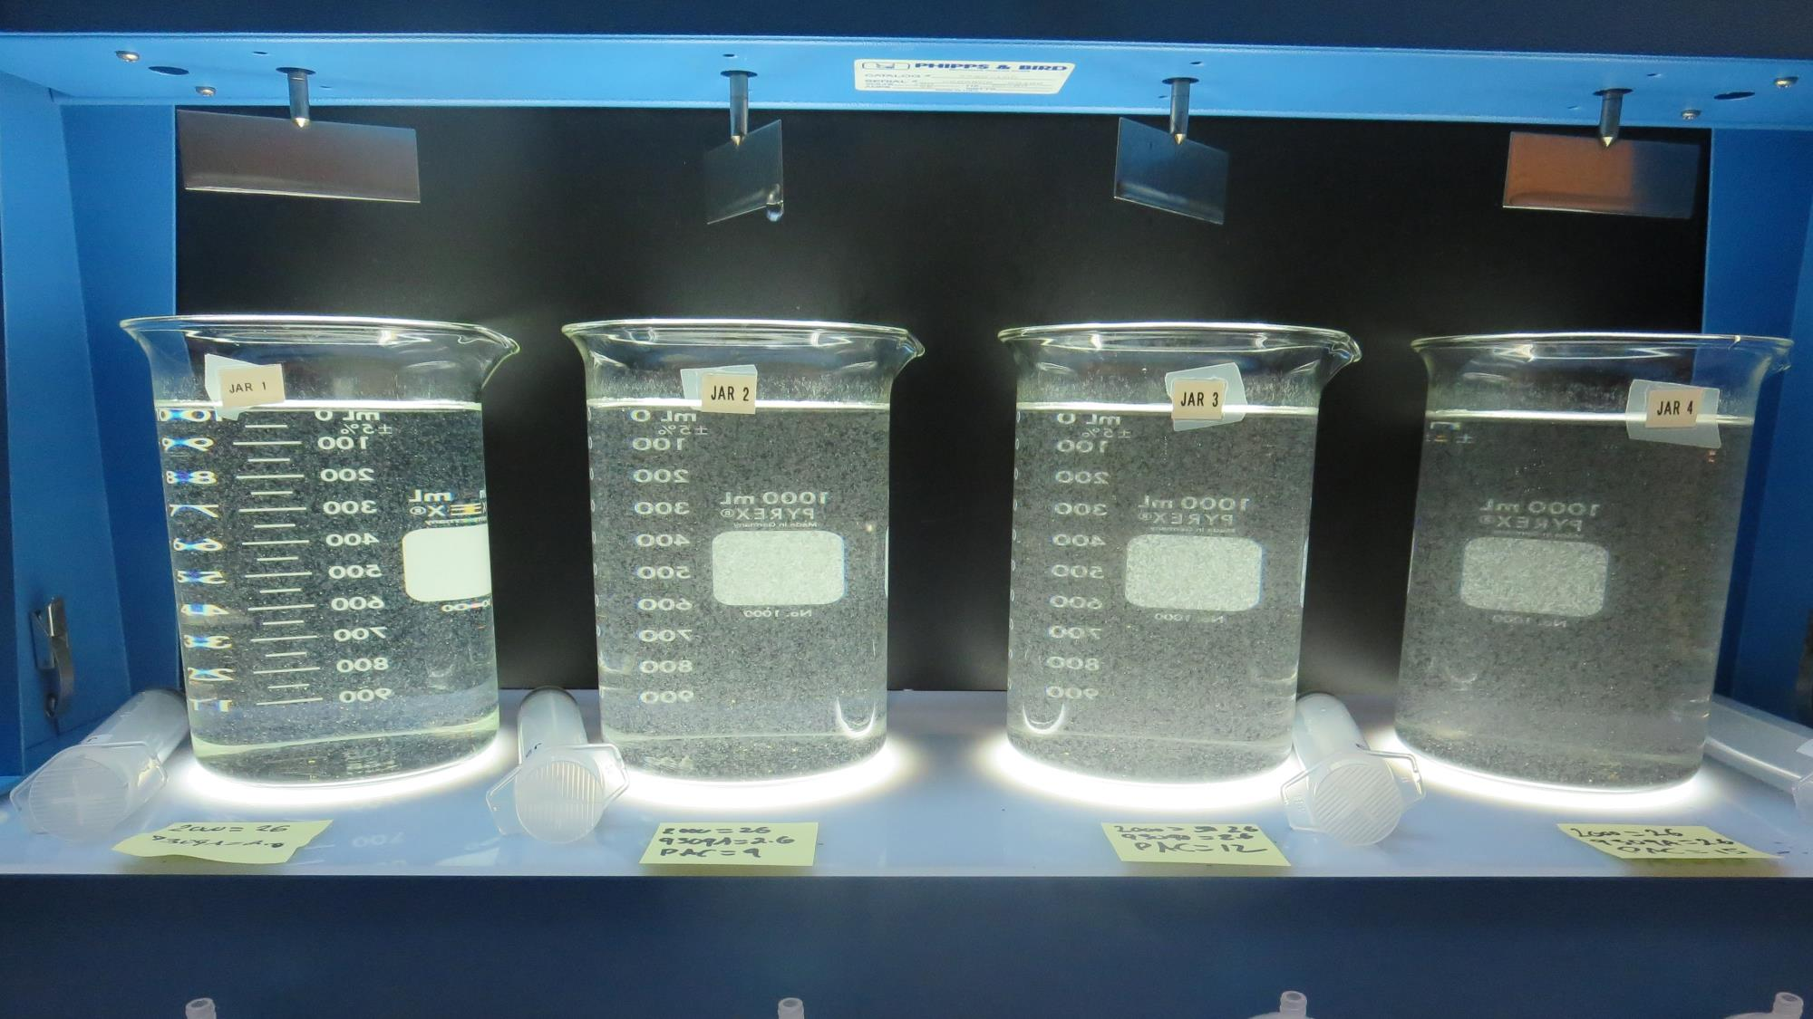
Jars 29-32 Test: End of 10-minute flocculation (30 RPM) duration.
29 mg/L SWT2000
2.9 mg/L SWT9309A
0 mg/L PAC
Filtrate 0.09 NTU
UVT: 90.4%
UVA: 0.044/cm
UVA Reduction: 36.2%
Settled: 0.32 NTU
29 mg/L SWT2000
2.9 mg/L SWT9309A
15 mg/L PAC
Filtrate 0.14 NTU
UVT: 91.4%
UVA: 0.039/cm
UVA Reduction: 43.5%
Settled: 1.64 NTU
29 mg/L SWT2000
2.9 mg/L SWT9309A
15 mg/L PAC
Filtrate 0.19 NTU
UVT: 92.0%
UVA: 0.036/cm
UVA Reduction: 47.8%
Settled: 2.79 NTU
29 mg/L SWT2000
2.9 mg/L SWT9309A
15 mg/L PAC
Filtrate 0.13 NTU
UVT: 92.3%
UVA: 0.035/cm
UVA Reduction: 49.3%
Settled: 3.17 NTU

Slide 48
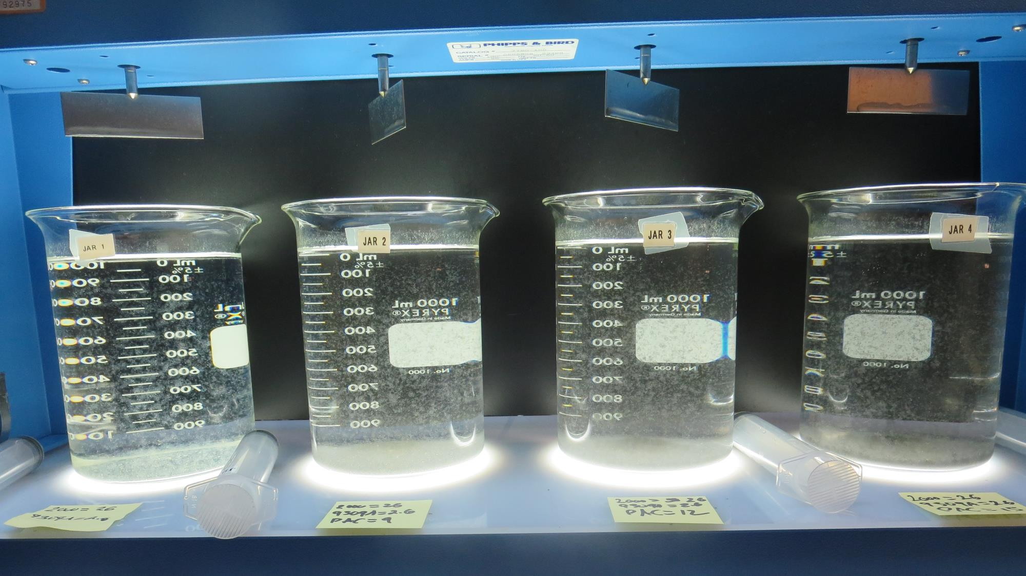
Jars 33-36: After 5 min of settling, 25 mL is syringed for filterability and %UVT/UVA.

Slide 49
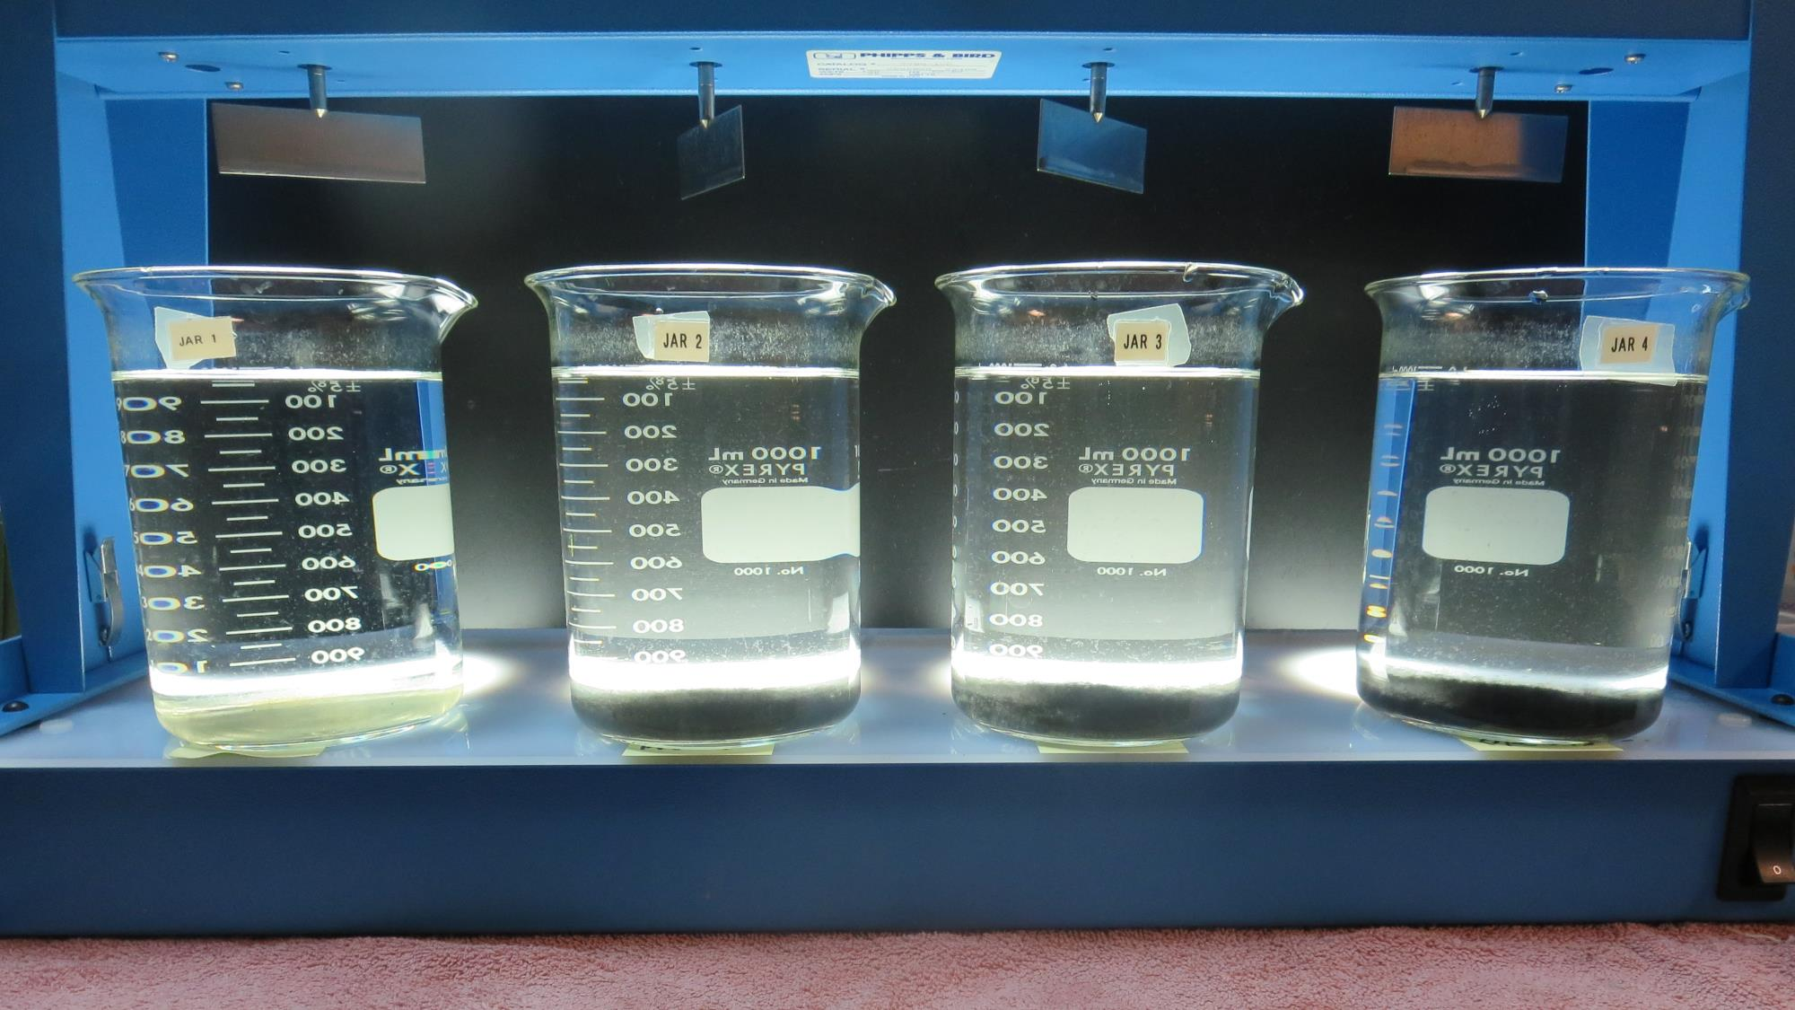
Jars 33-36: After 25-minutes of settling, settled water turbidity is taken.
29 mg/L SWT2000
2.9 mg/L SWT9309A
0 mg/L PAC
Filtrate 0.09 NTU
UVT: 90.4%
UVA: 0.044/cm
UVA Reduction: 36.2%
Settled: 0.32 NTU
29 mg/L SWT2000
2.9 mg/L SWT9309A
15 mg/L PAC
Filtrate 0.14 NTU
UVT: 91.4%
UVA: 0.039/cm
UVA Reduction: 43.5%
Settled: 1.64 NTU
29 mg/L SWT2000
2.9 mg/L SWT9309A
15 mg/L PAC
Filtrate 0.19 NTU
UVT: 92.0%
UVA: 0.036/cm
UVA Reduction: 47.8%
Settled: 2.79 NTU
29 mg/L SWT2000
2.9 mg/L SWT9309A
15 mg/L PAC
Filtrate 0.13 NTU
UVT: 92.3%
UVA: 0.035/cm
UVA Reduction: 49.3%
Settled: 3.17 NTU

Slide 50
Jar Testing for 1-Liter Jars: General Procedures for Most Treatment Plants
Fill jars with source water prior to coagulant injection and set paddle speed at 30 rpm
Add chemicals (i.e., NaOCl, primary coagulant, coagulant aid) to each jar
Flash mix for 15-60 seconds (200 rpm)
Slow mix for 5 minutes (20-30 rpm)
Settled for 5 minutes. Syringe 25 mL from each jar taken 1-inch below surface (25 mL/12 sec rate)
Filtered through 1.2 um isopore membrane into cuvette drip rate, 15 mL/(50-90 sec)
Measure filtrate turbidity, chlorine residual and %UVT/UVA
Measure settled water turbidity after 25 minutes of total setting
Record all data

Slide 51
Jar Test Filterability Test Equipment
Turbidity Instrument
Syringe w/Luer-Lock Tip, 30 cc
(part#: 2225800, by Hach)
Swinnex Filter Holder, 25 mm (part#: SX0002500)
Isopore Membrane Filter, 1.2 um absolute
pore size,
Φ= 25 mm , thickness: 24 um,
hydrophilic polycarbonate membrane
(part #: RTTP02500)
Go to Sigma-Aldrich for laboratory supplies http://www.sigmaaldrich.com/united-states.html

Slide 52
Isopore Membrane Information
Categories | Information
trade name | Isopore
filter color | White
chemistry | Polycarbonate (PC)
water flow rate | Avg. 175 mL/min x cm² (typical results @ 10 psi)
media | Isopore®
wettability | Hydrophilic
porosity | 14.7%
pore size | 1.2 µm
bubble point at 23 °C | 1.0 bar, air with water
thickness | 24 µm
filter diameter (ø) | 25 mm
material size | polycarbonate, Hydrophilic, 1.2 µm, 25 mm, white, plain, 100

Slide 53
Isopore Membrane Background Information
The Isopore membrane is a polycarbonate, track-etched screen filter recommended for all analyses in which the sample is viewed on the surface of the membrane. The Isopore membrane is composed of polycarbonate film, which has a smooth, glass-like surface for clearer sample observation. The unique manufacturing process of the membrane ensures a precise pore diameter and a consistent pore size for accurate separation of samples by size. Matched-weight filters are not usually required because of low, constant tar and ash weights. Features & Benefits: Membrane structure retains particles on the surface, simplifying counting and analysis

Slide 54
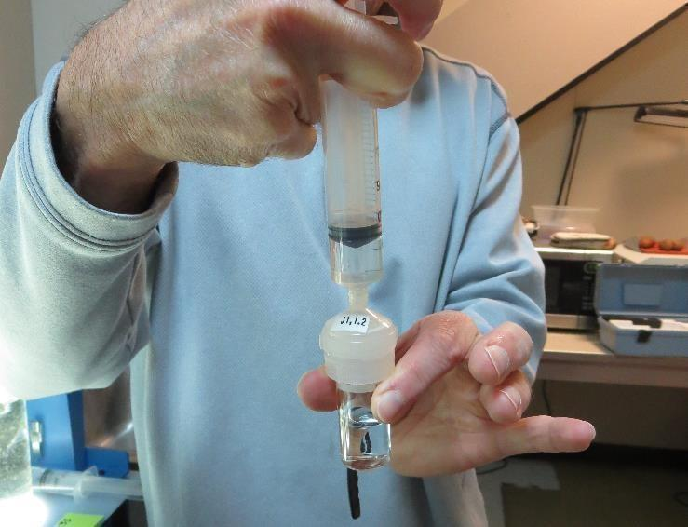
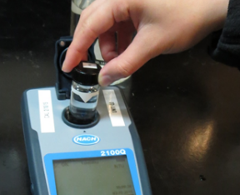
Jar Test - Filterability Test
Syringe ~ 25 mL from jar (after 5-minutes of settling)
Filter-to-waste 3-5 mL
Filter directly into clean cuvette
Measure turbidity
Note: Take several readings before recording final NTU results. Micro bubbles can adhere to glass causing false NTU readings. To remove bubbles, tilt cuvette up to 90 degrees.

Slide 55
Contact
Guy Schott, P.E.
State Water Resources Control Board
Division of Drinking Water
Santa Rosa, CA
Go to Stock Solution/Dose calculations/Jar Test Results for tools to download
www.waterboards.ca.gov/drinking_water/programs/districts/mendocino_district.html
Email: Guy Schott - Guy.Schott@waterboards.ca.gov
Office Number: 707-576-2732

