Slide 1
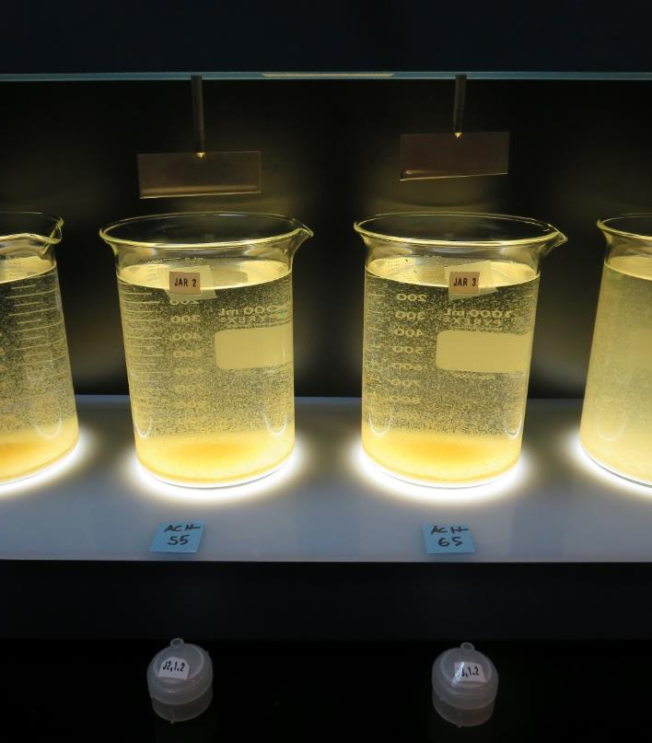
Highlands Mutual Water Company
CA1710003
Lake County
Jar Test
by Guy Schott, P.E.
January 18, 2019

Slide 2
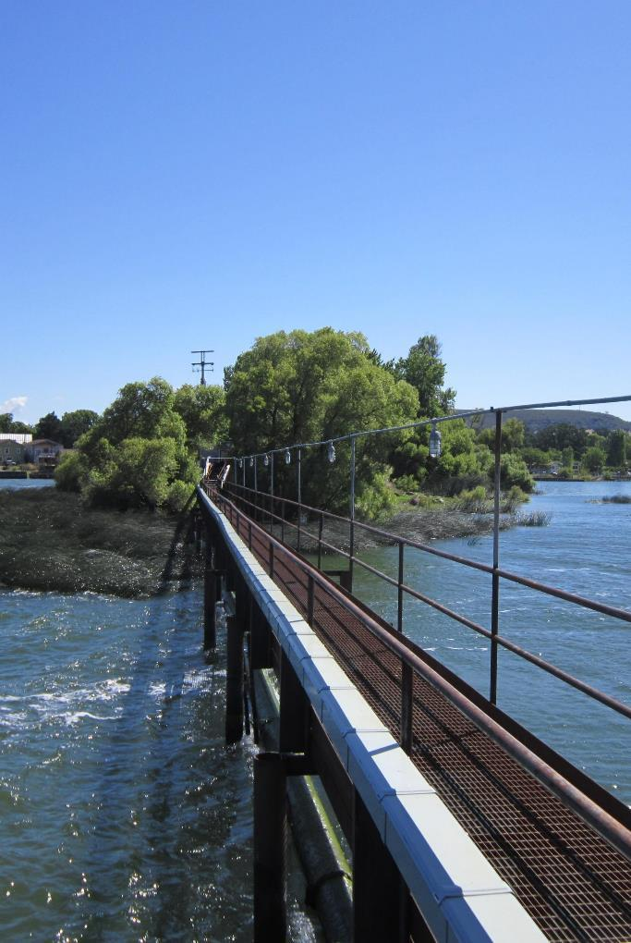
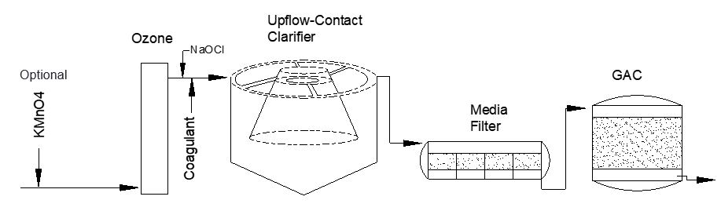
Highlands Mutual Water Company
Source Water: Clear Lake
Conventional Treatment

Slide 3
Highlands Mutual Water Company, January 18, 2019
Clear Lake Source and Treated Water Characteristics
Source Water Charateristics
Turbidity: 115 NTU
pH: 7.7
UVT: 30.8%, UVA: 0.511/cm
Particles > 2.0 um: 25,410/mL
Post Ozone Water Charateristics
Turbidity: 126 NTU
pH: 7.74
UVT: 31.1%, UVA: 0.507/cm
Particles > 2.0 um: 25,062/mL
Media Filter
Turbidity: 0.27 NTU
UVT: 93.2%
UVA: 0.019/cm
Particles > 2.0 um: 21/mL

Slide 4
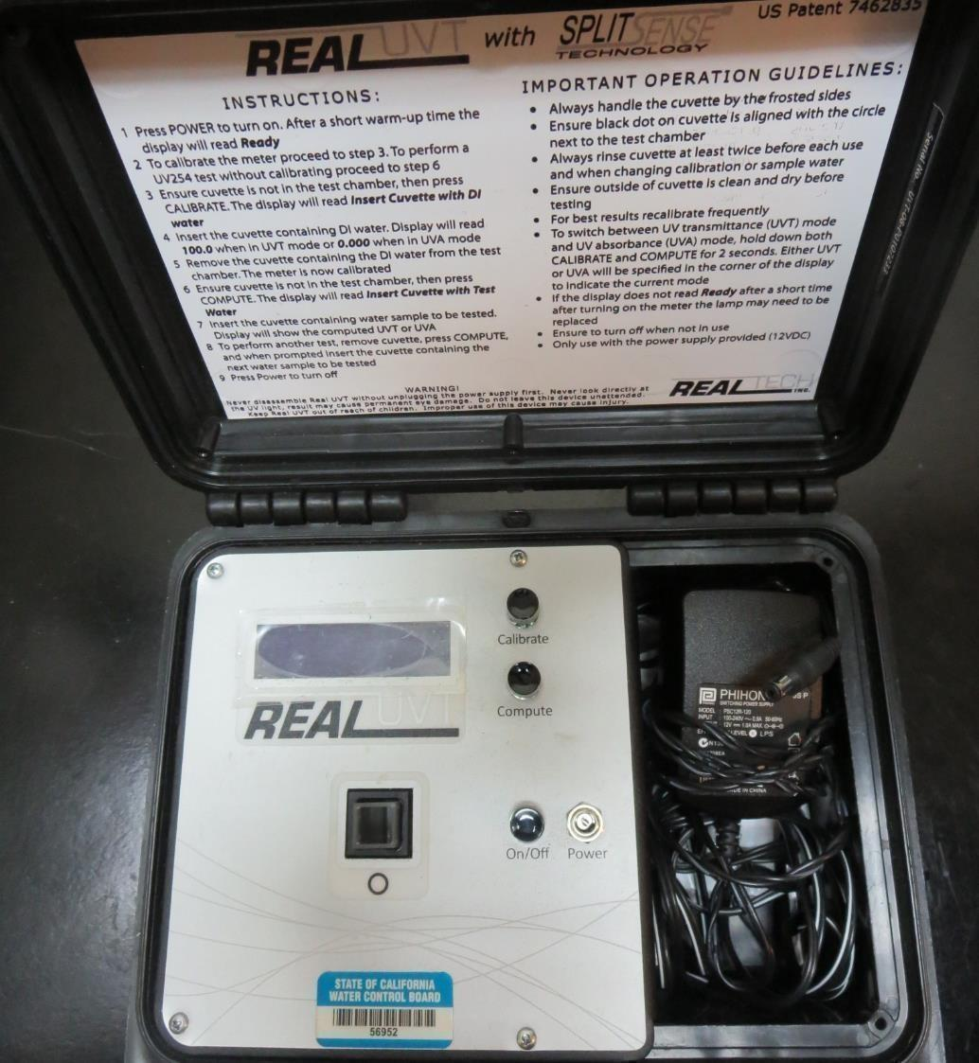
UVT/UVA
UV transmittance (UVT) is a measurement of the amount of ultraviolet light (commonly at 254 nm due to its germicidal effect) that passes through a water sample compared to the amount of light that passes through a pure water sample. The measurement is expressed as a percentage, % UVT.
%UVT = 10^{(-UVA)} x 100%
UV absorbance (UVA) is calculated as a relative measure of the amount of light absorbed by a water sample compared with the amount of light absorbed by a pure water sample.
UVA = -log(%UVT/100)

Slide 5
Coagulants Used for Jar Testing
9800 (NTU Technologies)
50% Aluminum Chlorohydrate
50% Water
SG = 1.34
9890 (NTU Technologies)
35-45% Aluminum Chlorohydrate
35-45% Water
20% Proprietary
SG = 1.25-1.34

Slide 6
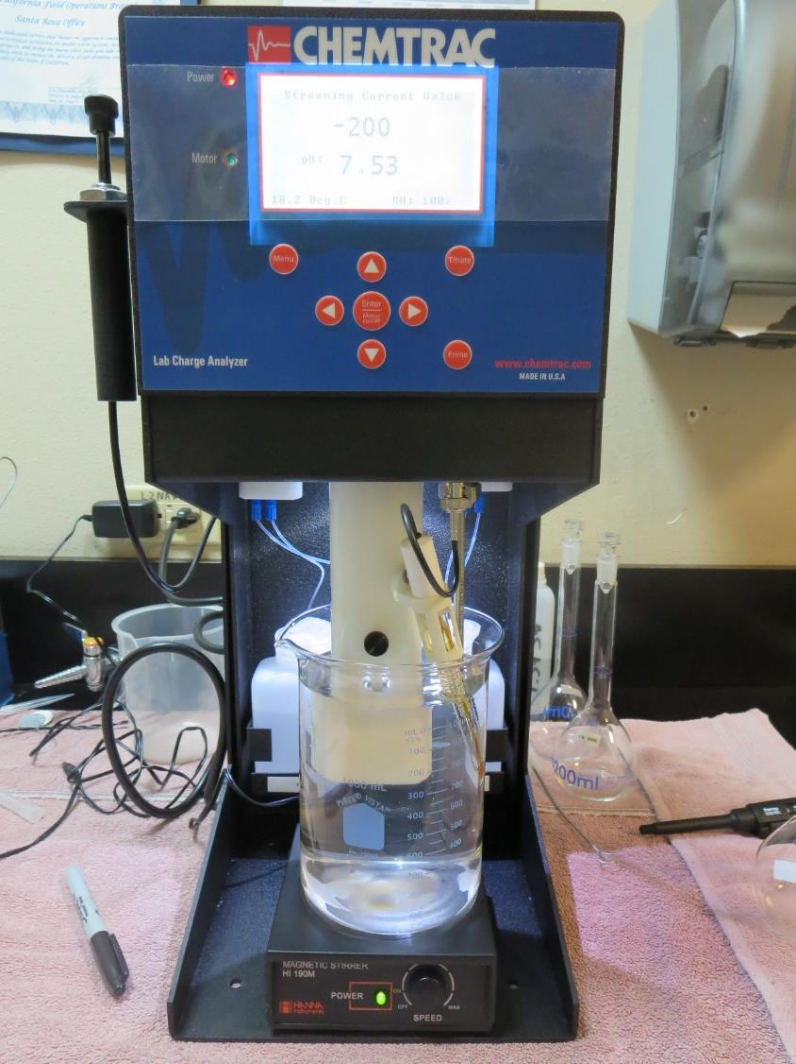
Laboratory Charge Analyzer
LCA: Used to determine coagulant demand of a source water entering the treatment plant.
Source (post ozone), pH: 7.74
pH adjusted to 7.5 w/acetic acid
9800: 44.8mg/L as product
2) Source pH: 7.66
pH adjusted to 7.5 w/acetic acid
9800: 48.1 mg/L as product
3) Source pH: 7.66
KMnO₄: 3 mg/L
pH adjusted to 7.5 w/acetic acid
9800: 48.7 mg/L as product

Slide 7
Coagulant Information
Unless stated otherwise, all coagulant doses are reported as Product (100% strength).
Preparation of coagulant stock solutions are generally 1.0 and/or 0.1 percent strength using 100 and/or 200 mL volumetric flasks.
Finnpipette F2 variable volume pipette, capacity 100-1000 micro liters is used for stock solution preparation and coagulant aid jar test dosing.
Finnpipette F2 variable volume pipette, capacity 0.5-5 mL is used for primary coagulant jar test dosing.

Slide 8
Highlands MWC, Jar Test 1-8 Results
(Post O₃ Treatment)
Jar # | 200 RPM Flash Mix Sec | 30 RPM Floc Mix Minutes | 9890 mg/L | 9800 mg/L | Filtrate NTU | Filtrate %UVT | Filtrate UVA/cm | Settle NTU 25 min
J1 | 60 | 5 | 0 | 45 | 0.50 | 89.3 | 0.049 | 2.2
J2 | 60 | 5 | 0 | 55 | 0.35 | 90.7 | 0.042 | 1.9
J3 | 60 | 5 | 0 | 65 | 0.18 | 91.6 | 0.038 | 2.4
J4 | 60 | 5 | 0 | 110 | 0.20 | 92.6 | 0.033 | 7.0
J5 | 60 | 5 | 0 | 65 | 0.20 | 90.6 | 0.043 | 1.9
J6 | 60 | 5 | 0 | 75 | 0.05 | 91.7 | 0.039 | 2.8
J7 | 60 | 5 | 0 | 85 | 0.14 | 91.4 | 0.039 | 3.2
J8 | 60 | 5 | n/a | n/a | n/a | n/a | n/a | n/a

Slide 9
Highlands MWC, Jar Test 9-12 Results
(Post O₃ Treatment), Flash Mix 60 sec (200 RPM)
Jar # | 30 RPM Floc Mix Minutes | NaOCl mg/L | 9800 mg/L | 9890 mg/L | Filtrate NTU | Filtrate %UVT | Filtrate UVA/cm | Settle NTU 25 min
J9 | 5 | 0 | 60 | 6 | 0.07 | 90.3 | 0.044 | 2.6
J10 | 5 | 2.2 | 60 | 0 | 0.22 | 90.0 | 0.046 | 0.04
J11 | 5 | 2.2 | 65 | 0 | 0.09 | 90.5 | 0.043 | 0.02
J12 | 5 | 2.2 | 75 | 0 | 0.06 | 91.1 | 0.040 | 0.11

Slide 10
Highlands MWC, Jar Test 13-16 Results
(Before O₃ Contactor)
Jar # | 200 RPM Flash Mix Sec | 30 RPM Floc Mix Minutes | KMnO4 mg/L | 9800 mg/L | Filtrate NTU | Filtrate %UVT | Filtrate UVA/cm | Settle NTU 25 min
J13 | 60 | 5 | 3.0 | 50 | 0.10 | 89.1 | 0.050 | 3.0
J14 | 60 | 5 | 2.5 | 55 | 0.16 | 88.2 | 0.055 | 2.3
J15 | 60 | 5 | 2.5 | 65 | 0.24 | 89.8 | 0.047 | 2.4
J16 | 60 | 5 | 0 | 55 | 0.06 | 88.9 | 0.051 | 2.4
J17 | 60 | 5 | 0 | 65 | 0.07 | 89.6 | 0.048 | 3.3

Slide 11
Highlands MWC, Jar Test 18-25 Results
(Before O₃ Contactor)
Jar # | 200 RPM Flash Mix Sec | 30 RPM Floc Mix Minutes | NaOCl mg/L | 9800 mg/L | Filtrate NTU | Filtrate %UVT | Filtrate UVA/cm | Settle NTU 25 min
J18 | 60 | 5 | 3 | 48 | 0.10 | 88.3 | 0.054 | 2.0
J19 | 60 | 5 | 3 | 55 | 0.11 | 89.2 | 0.050 | 2.2
J20 | 60 | 5 | 0 | 48 | 0.08 | 88.8 | 0.052 | 2.9
J21 | 60 | 5 | 0 | 55 | 0.07 | 89.8 | 0.047 | 2.9
J22 | 60 | 5 | 0 | 60 | 0.09 | 89.8 | 0.047 | 2.7
J23 | 60 | 5 | 0 | 65 | 0.05 | 90.3 | 0.044 | 2.6
J24 | 60 | 5 | 0 | 70 | 0.12 | 90.1 | 0.045 | 3.0
J24 | 60 | 5 | 0 | 75 | 0.06 | 90.6 | 0.043 | 5.0

Slide 12
Jars 1-4 Test
Flash Mix 60 Sec (200 RPM)
Floc Mix 5 min (30 RPM)
Post Ozone
Applied Coagulant
9800

Slide 13
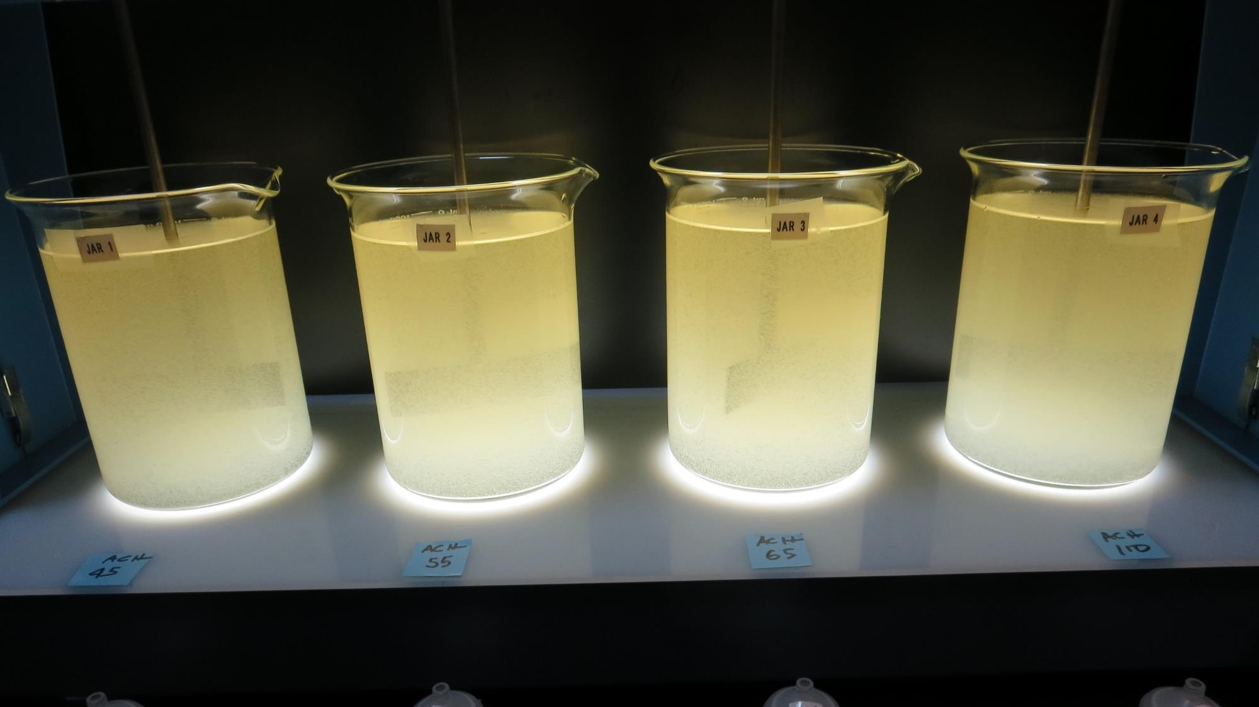
Jars 1-4: End of 5-minute flocculation (30 RPM) duration.
45 mg/L 9800
Filtrate 0.50 NTU
UVT: 89.3%
UVA: 0.049/cm
Settled: 2.2 NTU
55 mg/L 9800
Filtrate 0.35 NTU
UVT: 90.7%
UVA: 0.042/cm
Settled: 1.9 NTU
65 mg/L 9800
Filtrate 0.18 NTU
UVT: 91.6%
UVA: 0.038/cm
Settled: 2.4 NTU
110 mg/L 9800
Filtrate 0.20 NTU
UVT: 92.6%
UVA: 0.033/cm
Settled: 7.0 NTU

Slide 14
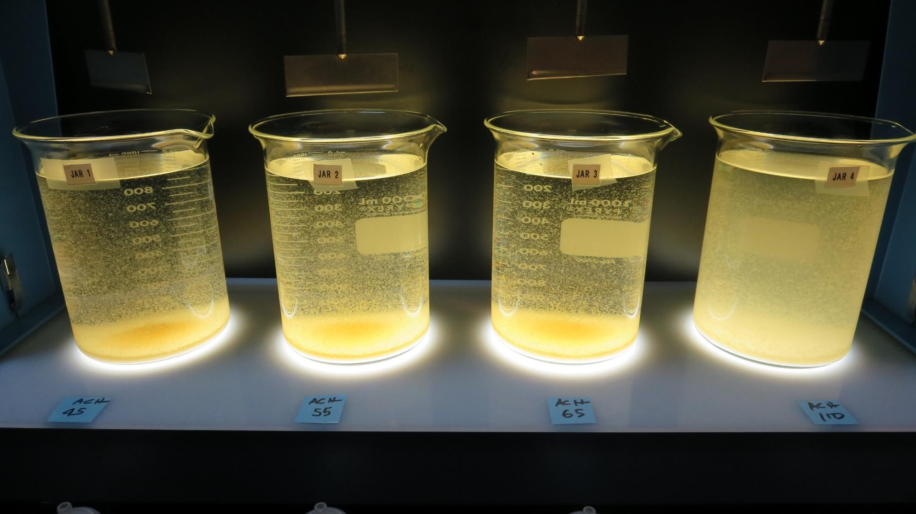
Jars 1-4: After 5 min of settling, 25 mL is decanted for filterability and %UVT/UVA.

Slide 15
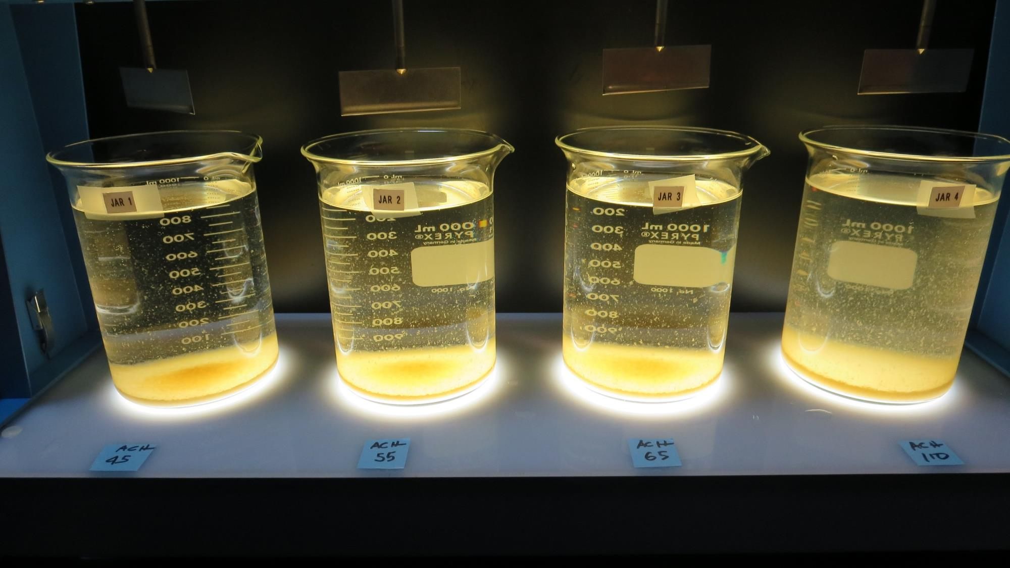
Jars 1-4: After 25-minutes of settling, settled water turbidity is taken.
45 mg/L 9800
Filtrate 0.50 NTU
UVT: 89.3%
UVA: 0.049/cm
Settled: 2.2 NTU
55 mg/L 9800
Filtrate 0.35 NTU
UVT: 90.7%
UVA: 0.042/cm
Settled: 1.9 NTU
65 mg/L 9800
Filtrate 0.18 NTU
UVT: 91.6%
UVA: 0.038/cm
Settled: 2.4 NTU
110 mg/L 9800
Filtrate 0.20 NTU
UVT: 92.6%
UVA: 0.033/cm
Settled: 7.0 NTU

Slide 16
Jars 5-8 Test
Flash Mix 60 Sec (200 RPM)
Floc Mix 5 min (30 RPM)
Post Ozone
Applied Coagulant
9800

Slide 17
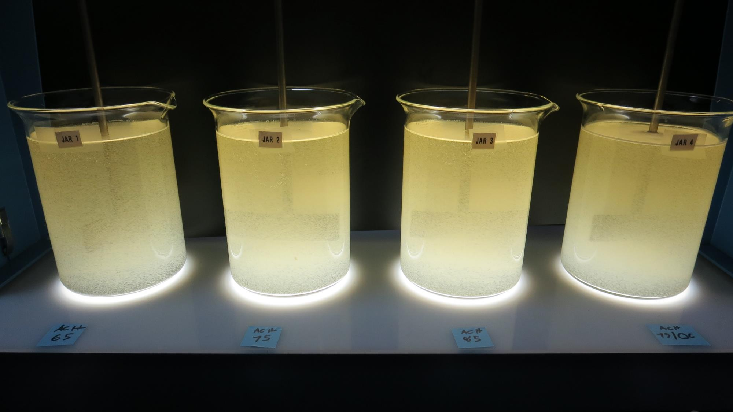
Jars 5-8: End of 5-minute flocculation (30 RPM) duration.
65 mg/L 9800
Filtrate 0.20 NTU
UVT: 90.6%
UVA: 0.043/cm
Settled: 1.9 NTU
75 mg/L 9800
Filtrate 0.05 NTU
UVT: 91.7%
UVA: 0.038/cm
Settled: 2.8 NTU
85 mg/L 9800
Filtrate 0.14 NTU
UVT: 91.4%
UVA: 0.039/cm
Settled: 3.2 NTU

Slide 18
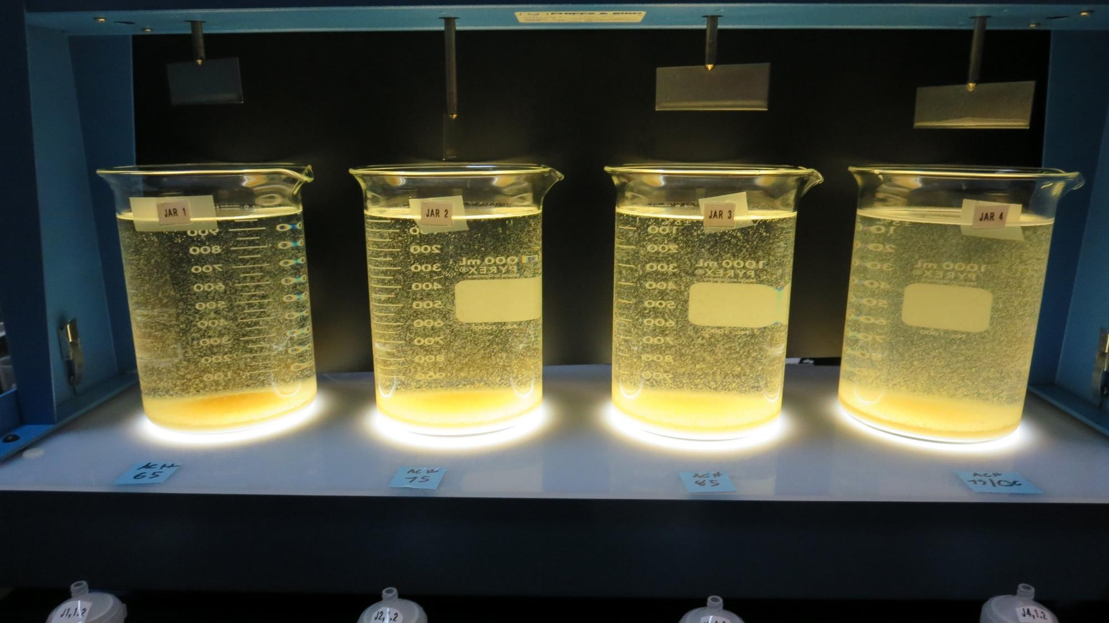
Jars 5-8: After 5 min of settling, 25 mL is decanted for filterability and %UVT/UVA.

Slide 19
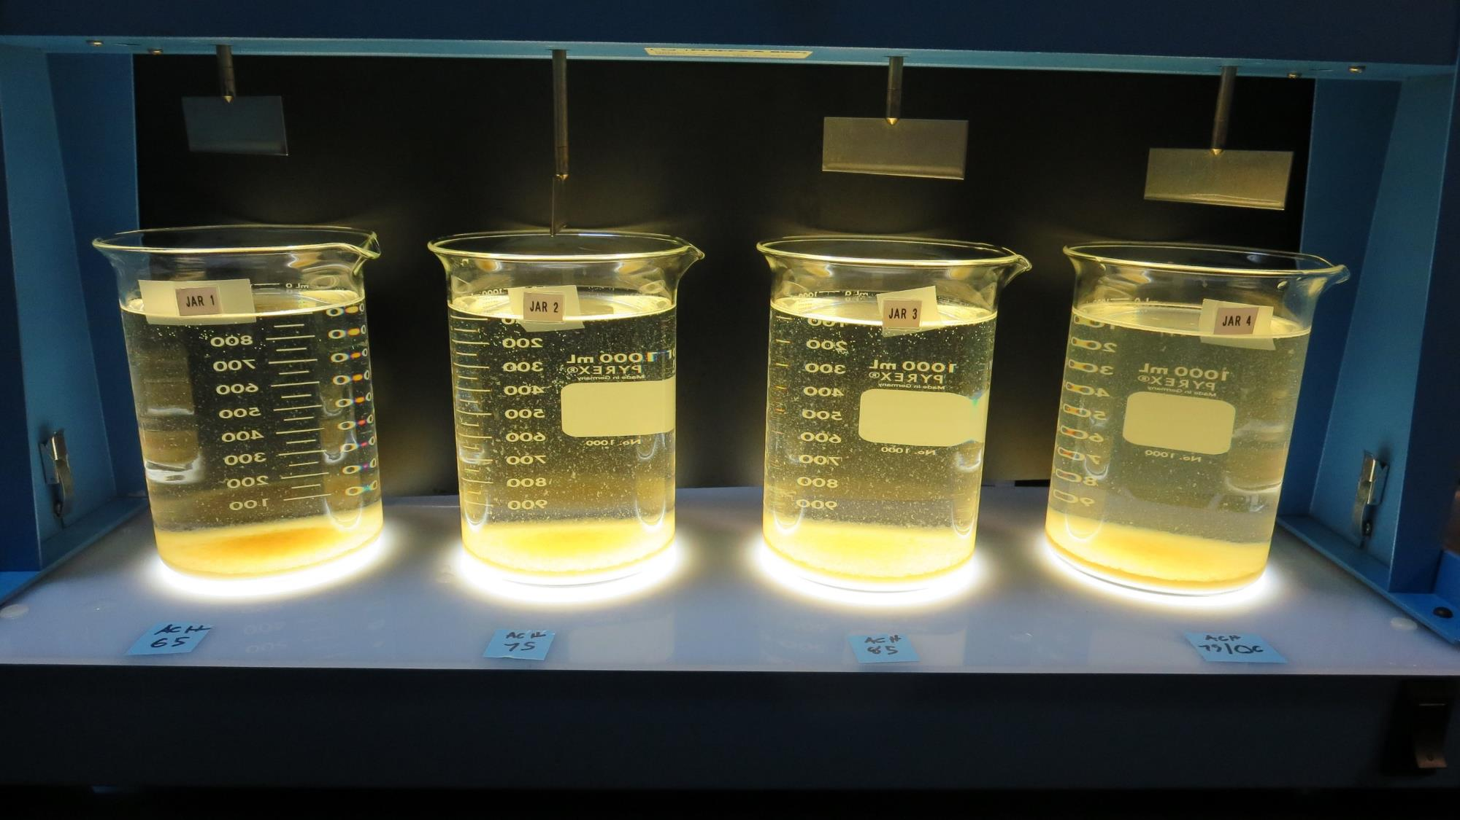
Jars 5-8: After 25-minutes of settling, settled water turbidity is taken.
65 mg/L 9800
Filtrate 0.20 NTU
UVT: 90.6%
UVA: 0.043/cm
Settled: 1.9 NTU
75 mg/L 9800
Filtrate 0.05 NTU
UVT: 91.7%
UVA: 0.038/cm
Settled: 2.8 NTU
85 mg/L 9800
Filtrate 0.14 NTU
UVT: 91.4%
UVA: 0.039/cm
Settled: 3.2 NTU

Slide 20
Jars 9-12 Test
Flash Mix 60 Sec (200 RPM)
Floc Mix 5 min (30 RPM)
Post Ozone
Applied Coagulants
9800/9890 w/NaOCl

Slide 21
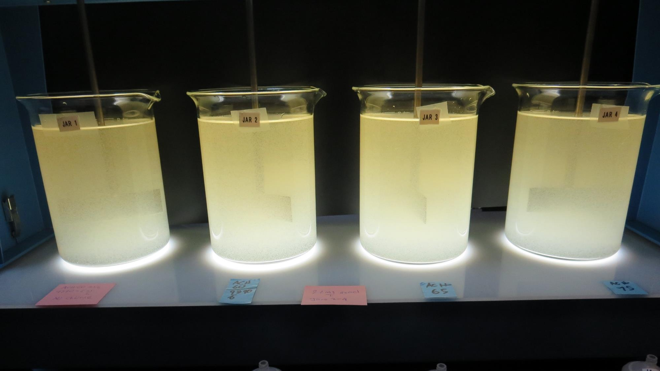
Jars 9-12: End of 5-minute flocculation (30 RPM) duration.
6 mg/L 9890
60 mg/L 9800
Filtrate 0.07 NTU
UVT: 90.3%
UVA: 0.044/cm
Settled: 2.6 NTU
2.2 mg/L NaOCl
60 mg/L 9800
Filtrate 0.22 NTU
UVT: 90%
UVA: 0.046/cm
Settled: 2.6 NTU
2.2 mg/L NaOCl
65 mg/L 9800
Filtrate 0.09 NTU
UVT: 90.5
UVA: 0.043/cm
Settled: 3.5 NTU
2.2 mg/L NaOCl
75 mg/L 9800
Filtrate 0.06 NTU
UVT: 91.1
UVA: 0.040/cm
Settled: 8.3 NTU

Slide 22
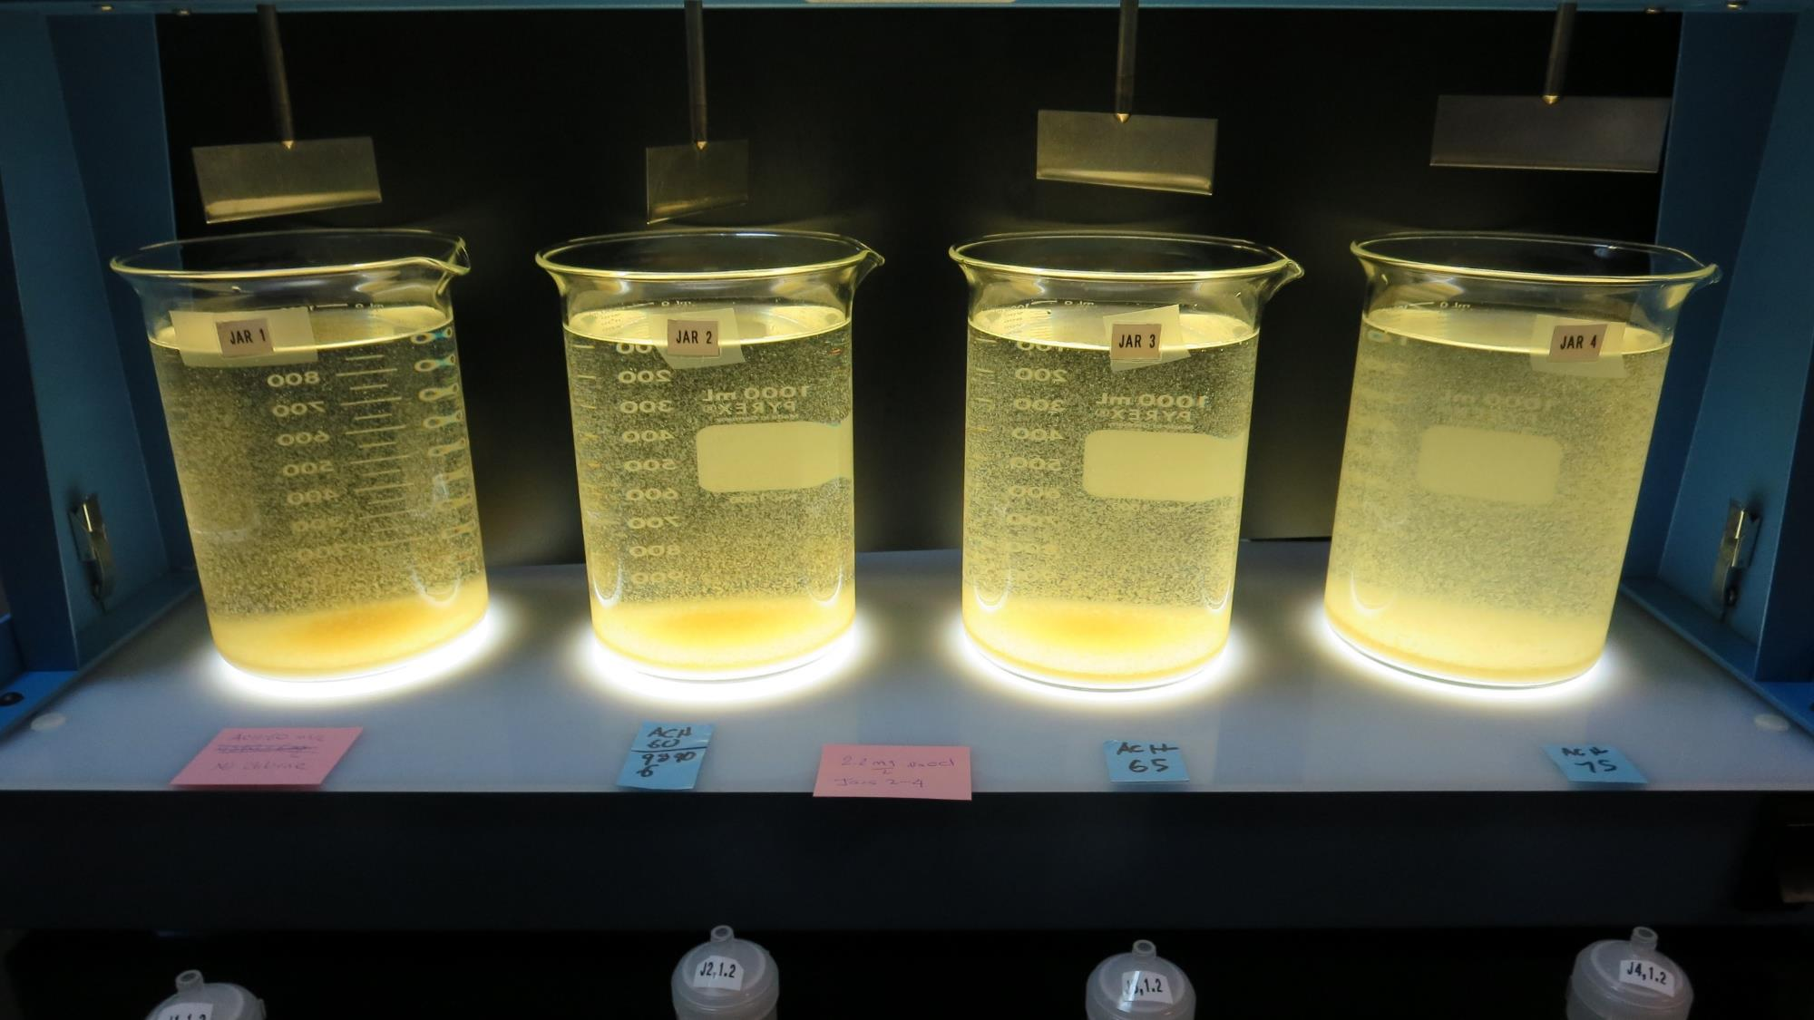
Jars 9-12: After 5 min of settling, 25 mL is decanted for filterability and %UVT/UVA.

Slide 23
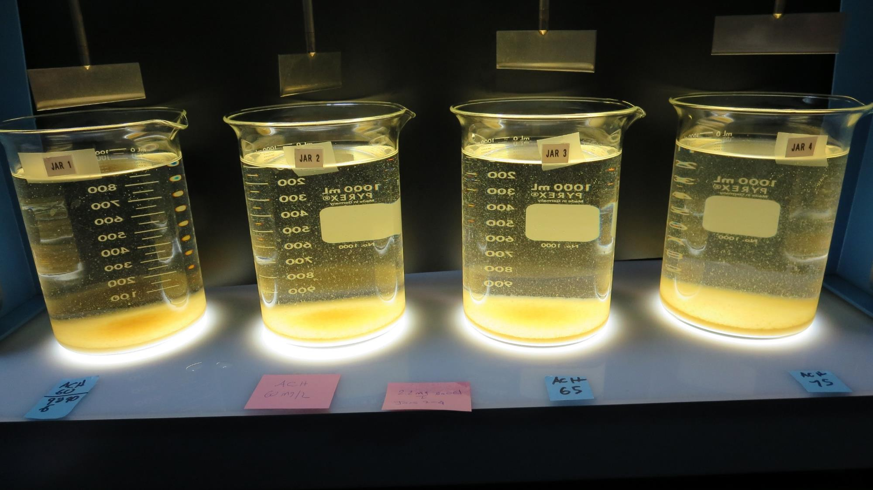
Jars 9-4: After 12-minutes of settling, settled water turbidity is taken.
6 mg/L 9890
60 mg/L 9800
Filtrate 0.07 NTU
UVT: 90.3%
UVA: 0.044/cm
Settled: 2.6 NTU
2.2 mg/L NaOCl
60 mg/L 9800
Filtrate 0.22 NTU
UVT: 90%
UVA: 0.046/cm
Settled: 2.6 NTU
2.2 mg/L NaOCl
65 mg/L 9800
Filtrate 0.09 NTU
UVT: 90.5
UVA: 0.043/cm
Settled: 3.5 NTU
2.2 mg/L NaOCl
75 mg/L 9800
Filtrate 0.06 NTU
UVT: 91.1
UVA: 0.040/cm
Settled: 8.3 NTU

Slide 24
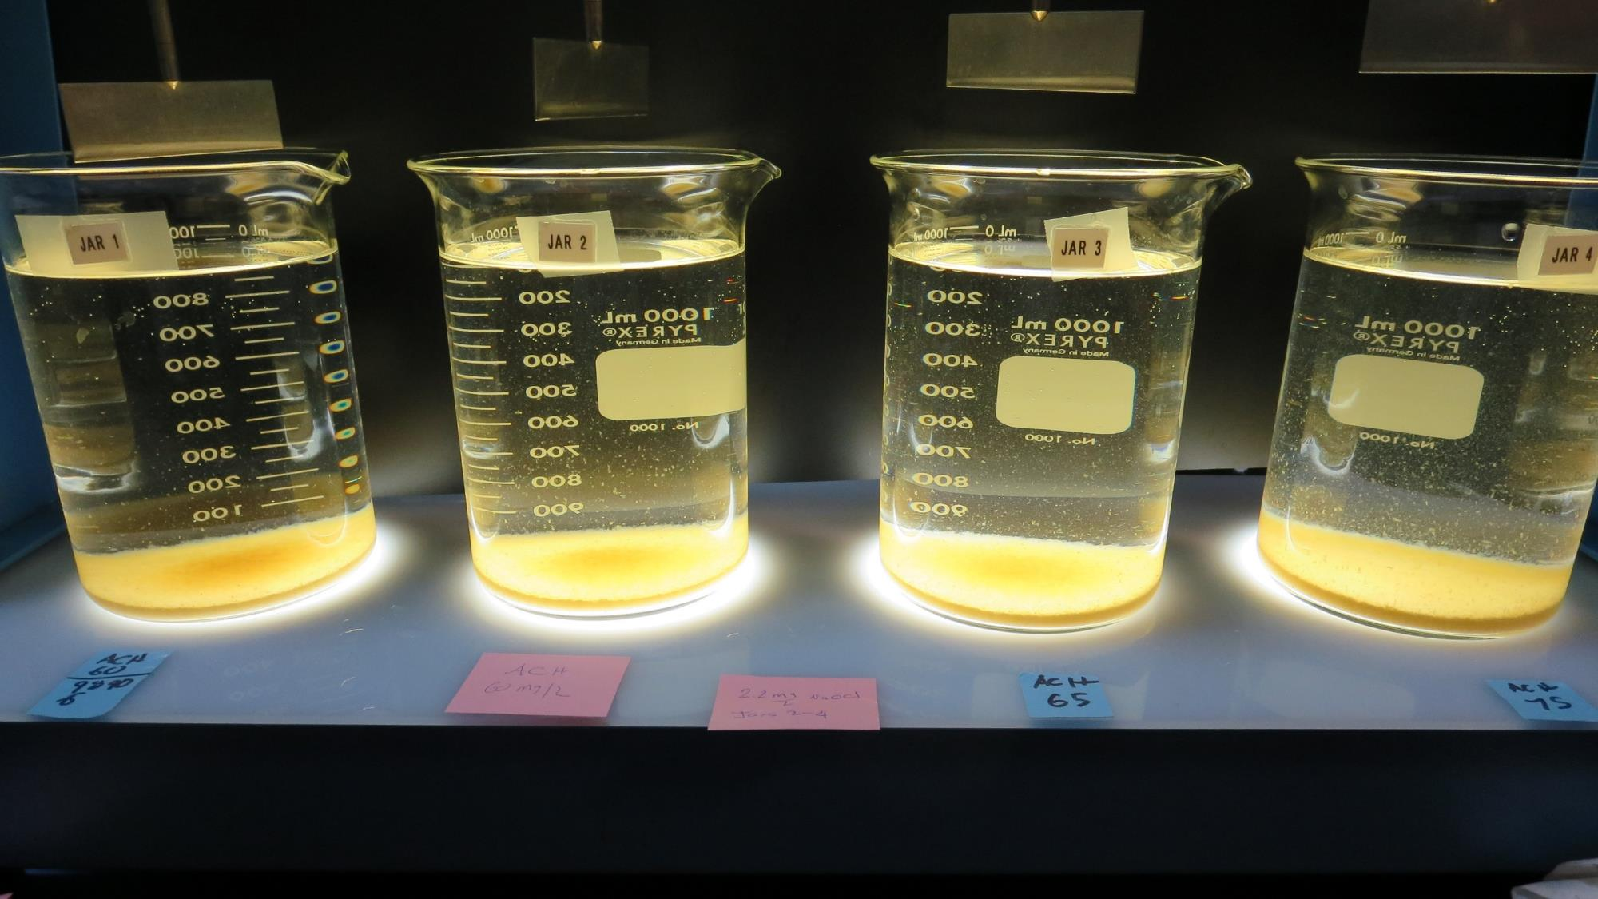
Jars 9-12: After 53-minutes of settling.

Slide 25
Jars 14-17 Test
Flash Mix 60 Sec (200 RPM)
Floc Mix 5 min (30 RPM)
Pre-Ozone
Applied Coagulant
9800 w/KMnO₄

Slide 26
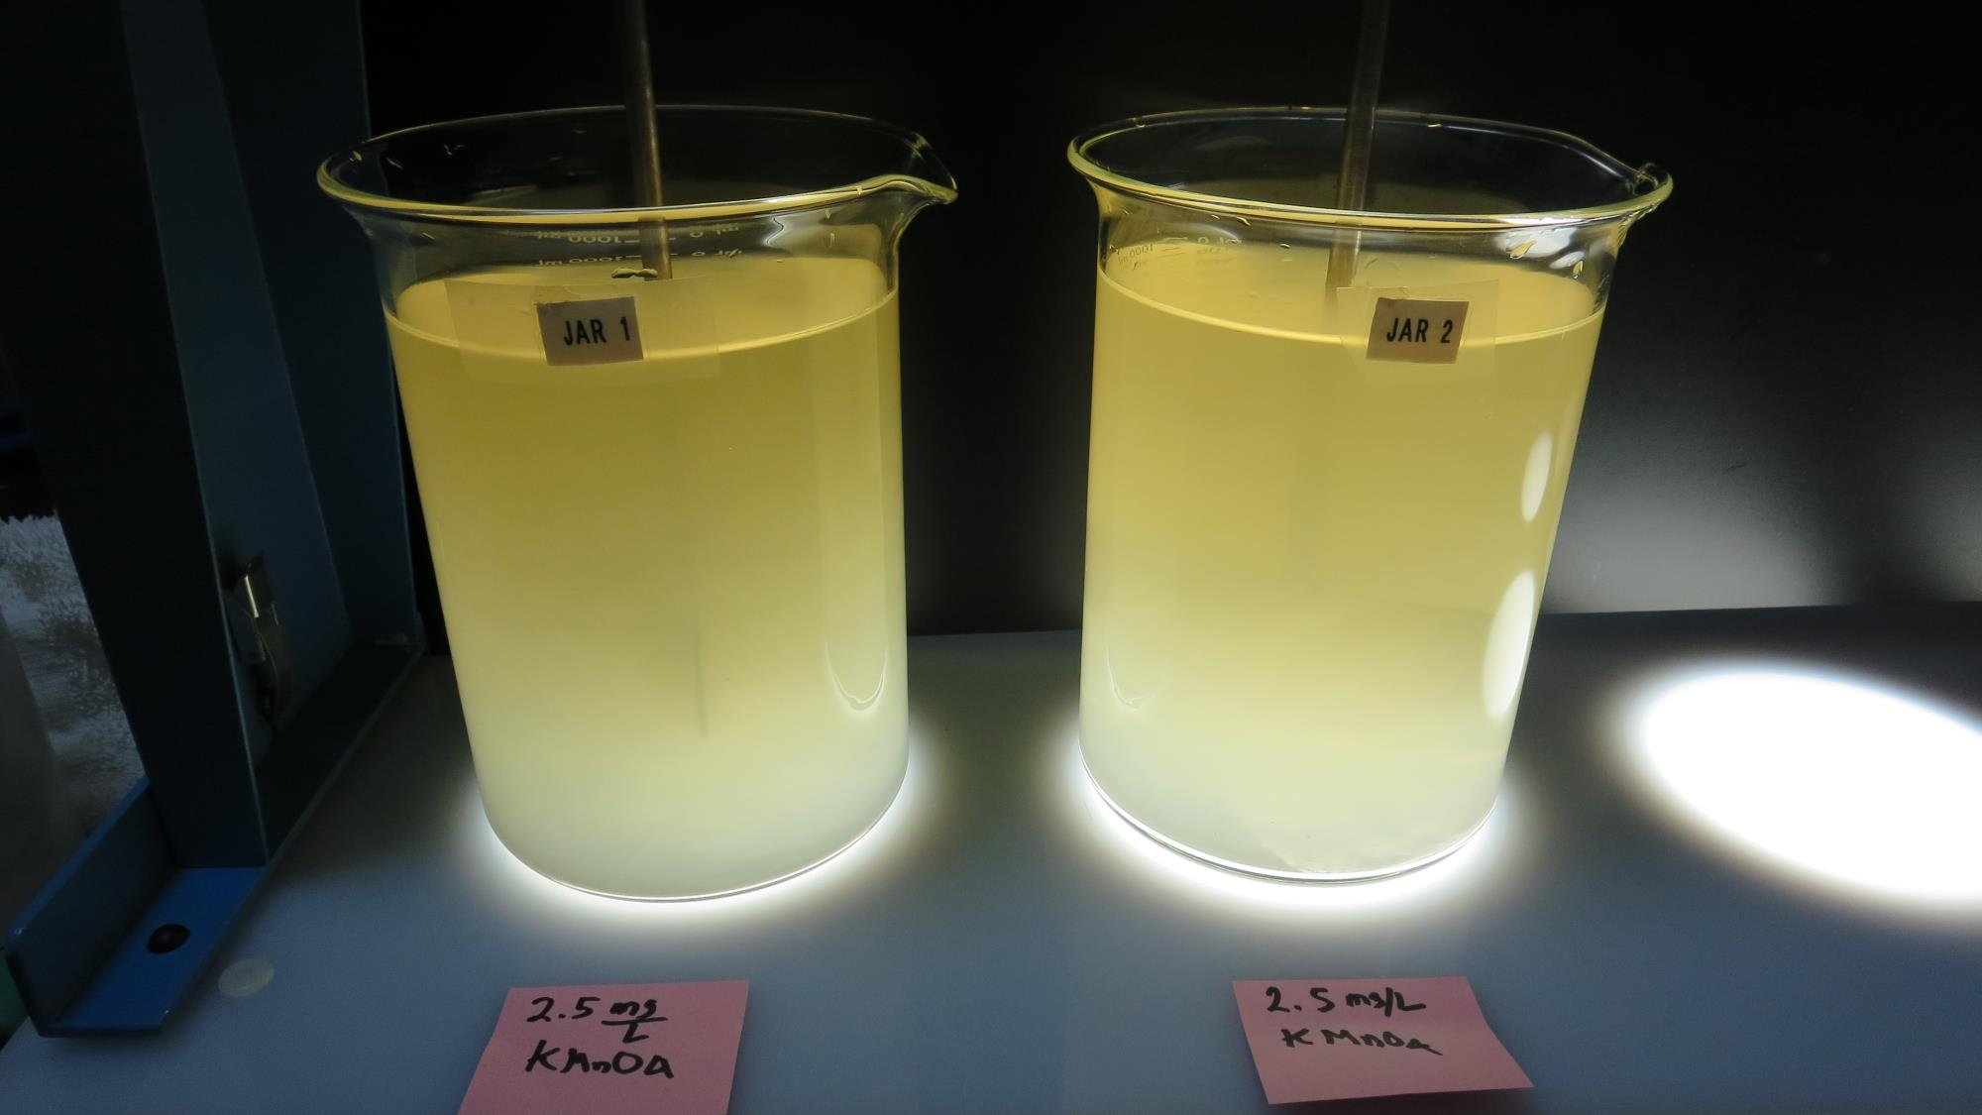
Jars 15 & 15, Before KMnO₄ injection

Slide 27
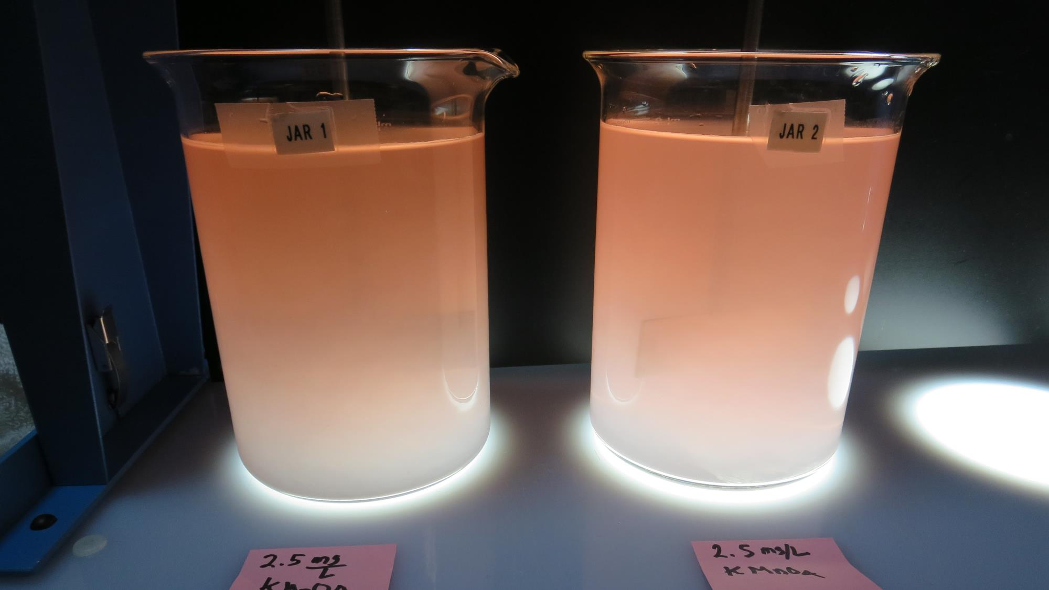
Jars 15 & 15, After MnO₄ injection

Slide 28
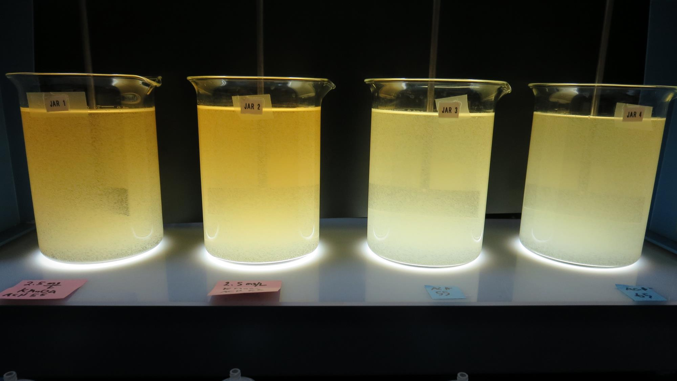
Jars 14-17: End of 5-minute flocculation (30 RPM) duration. Jars 14 & 15 had 38 min of mixing w/KMNO4 before Coagulant Addition
2.5 mg/L KMnO₄
55 mg/L 9800
Filtrate 0.16 NTU
UVT: 88.2%
UVA: 0.055/cm
Settled: 2.3 NTU
2.5 mg/L KMnO₄
65 mg/L 9800
Filtrate 0.08 NTU
UVT: 89.8%
UVA: 0.047/cm
Settled: 2.4 NTU
55 mg/L 9800
Filtrate 0.06 NTU
UVT: 89.9%
UVA: 0.046/cm
Settled: 2.4 NTU
65 mg/L 9800
Filtrate 0.07 NTU
UVT: 89.6%
UVA: 0.048/cm
Settled: 3.3 NTU

Slide 29
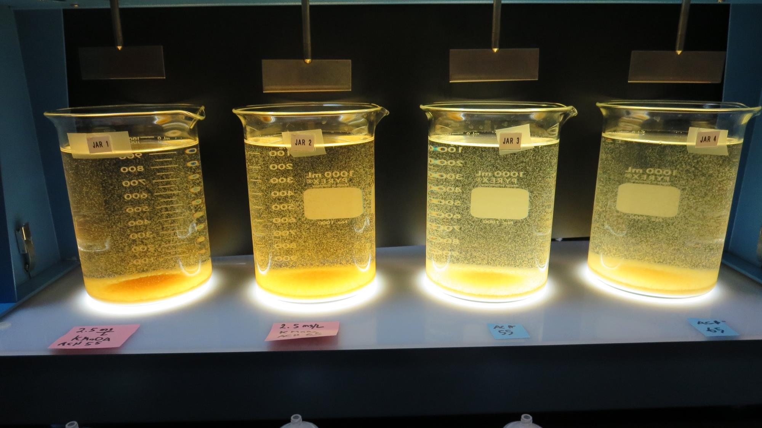
Jars 14-17: After 5 min of settling, 25 mL is decanted for filterability and %UVT/UVA.

Slide 30
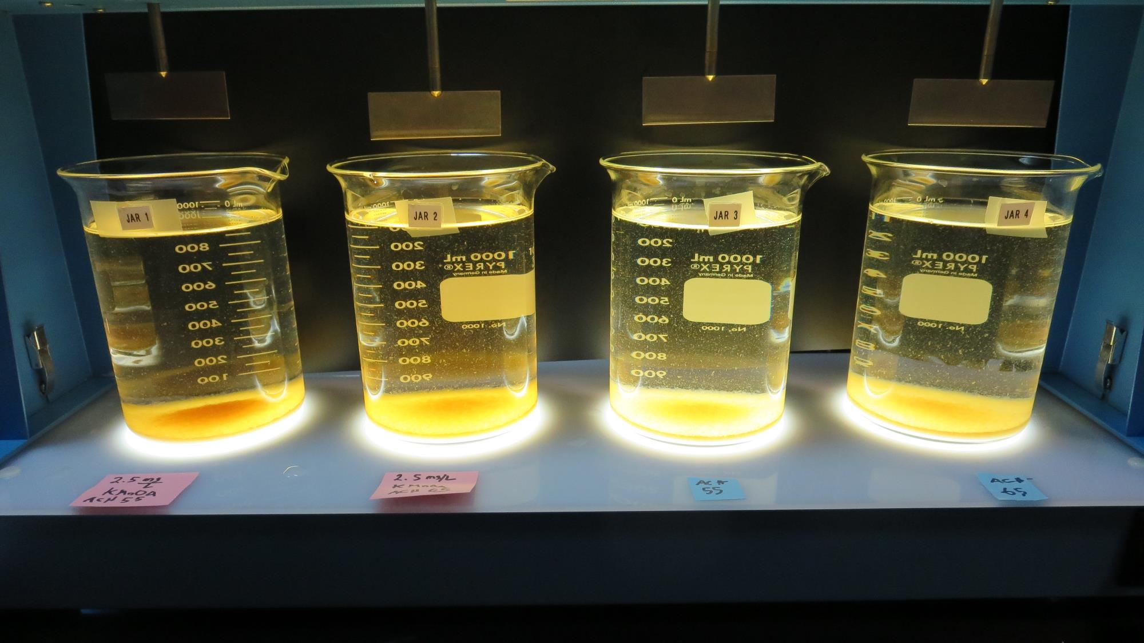
Jars 14-17: After 25-minutes of settling, settled water turbidity is taken.
2.5 mg/L KMnO₄
55 mg/L 9800
Filtrate 0.16 NTU
UVT: 88.2%
UVA: 0.055/cm
Settled: 2.3 NTU
2.5 mg/L KMnO₄
65 mg/L 9800
Filtrate 0.08 NTU
UVT: 89.8%
UVA: 0.047/cm
Settled: 2.4 NTU
55 mg/L 9800
Filtrate 0.06 NTU
UVT: 89.9%
UVA: 0.046/cm
Settled: 2.4 NTU
65 mg/L 9800
Filtrate 0.07 NTU
UVT: 89.6%
UVA: 0.048/cm
Settled: 3.3 NTU
Notes:
le

Slide 31
Jars 18-21 Test
Flash Mix 60 Sec (200 RPM)
Floc Mix 5 min (30 RPM)
Pre-Ozone
Applied Coagulant
9800 w/NaOCl

Slide 32
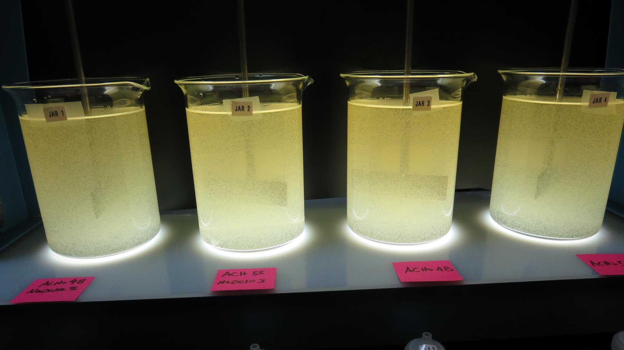
Jars 18-21: End of 5-minute flocculation (30 RPM) duration.
3 mg/L NaOCl
48 mg/L 9800
Filtrate 0.10 NTU
UVT: 89.3%
UVA: 0.049/cm
Settled: 2.0 NTU
3 mg/L NaOCl
55 mg/L 9800
Filtrate 0.11 NTU
UVT: 89.2%
UVA: 0.050/cm
Settled: 2.2 NTU
48 mg/L 9800
Filtrate 0.08 NTU
UVT: 88.8%
UVA: 0.052/cm
Settled: 2.9 NTU
55 mg/L 9800
Filtrate 0.07 NTU
UVT: 89.8%
UVA: 0.050/cm
Settled: 2.9 NTU

Slide 33
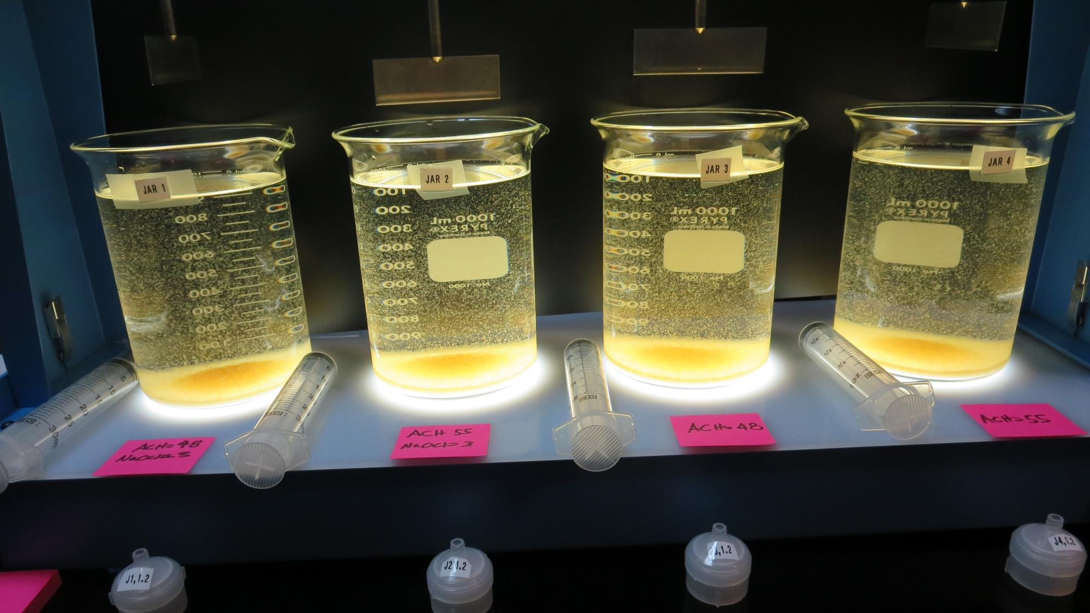
Jars 18-21: After 5 min of settling, 25 mL is decanted for filterability and %UVT/UVA.

Slide 34
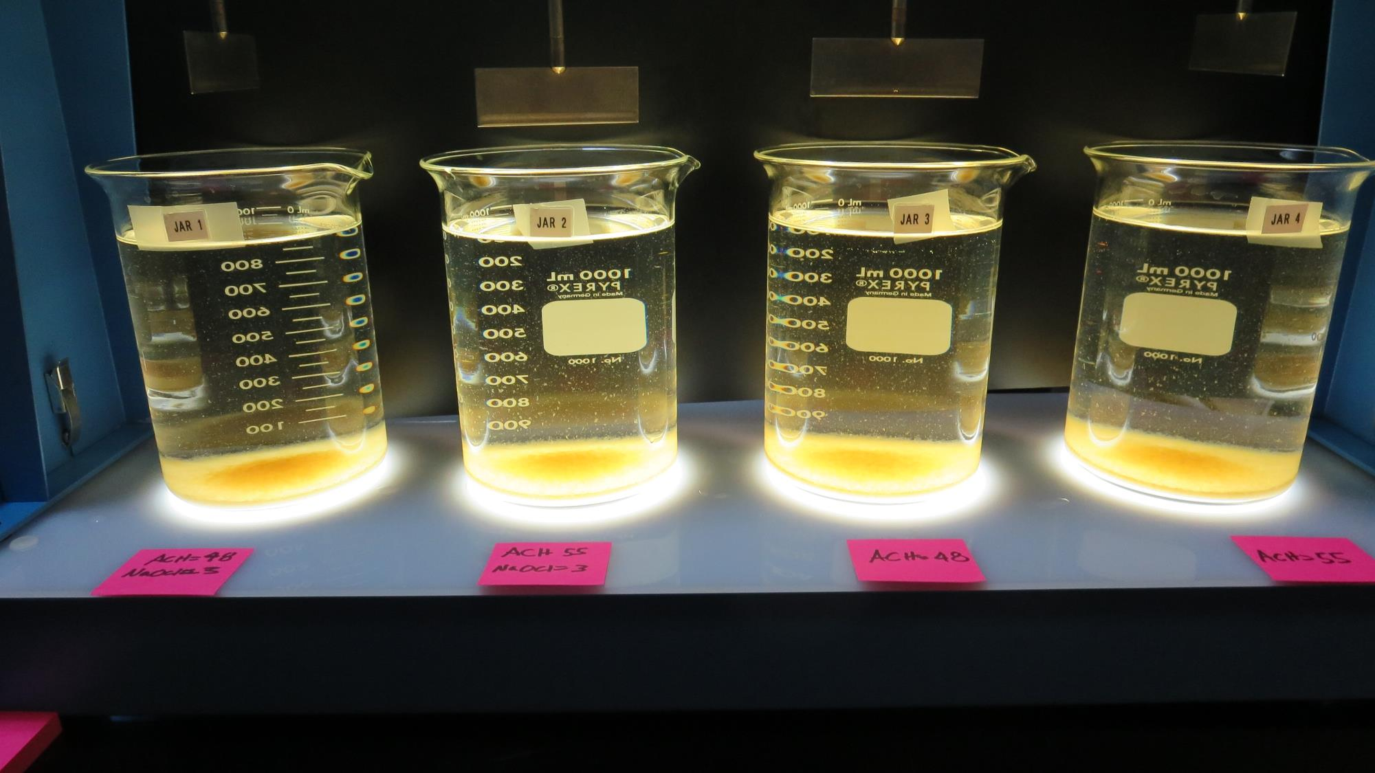
Jars 18-21: After 25-minutes of settling, settled water turbidity is taken.
3 mg/L NaOCl
48 mg/L 9800
Filtrate 0.10 NTU
UVT: 89.3%
UVA: 0.049/cm
Settled: 2.0 NTU
3 mg/L NaOCl
55 mg/L 9800
Filtrate 0.11 NTU
UVT: 89.2%
UVA: 0.050/cm
Settled: 2.2 NTU
48 mg/L 9800
Filtrate 0.08 NTU
UVT: 88.8%
UVA: 0.052/cm
Settled: 2.9 NTU
55 mg/L 9800
Filtrate 0.07 NTU
UVT: 89.8%
UVA: 0.050/cm
Settled: 2.9 NTU

Slide 35
Jars 22-25 Test
Flash Mix 60 Sec (200 RPM)
Floc Mix 5 min (30 RPM)
Pre-Ozone
Applied Coagulant
9800

Slide 36
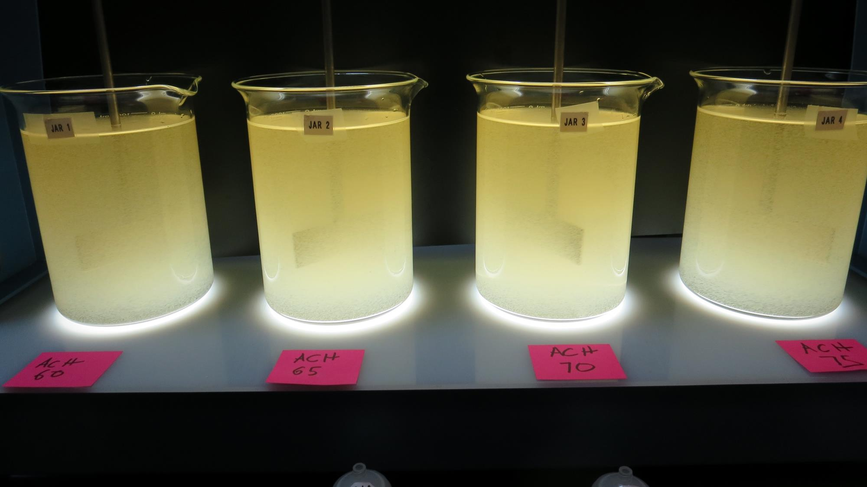
Jars 22-25: End of 5-minute flocculation (30 RPM) duration.
60 mg/L 9800
Filtrate 0.10 NTU
UVT: 88.3%
UVA: 0.054/cm
Settled: 2.0 NTU
65 mg/L 9800
Filtrate 0.11 NTU
UVT: 89.2%
UVA: 0.050/cm
Settled: 2.2 NTU
70 mg/L 9800
Filtrate 0.08 NTU
UVT: 88.8%
UVA: 0.052/cm
Settled: 2.9 NTU
75 mg/L 9800
Filtrate 0.07 NTU
UVT: 89.8%
UVA: 0.047/cm
Settled: 2.9 NTU

Slide 37
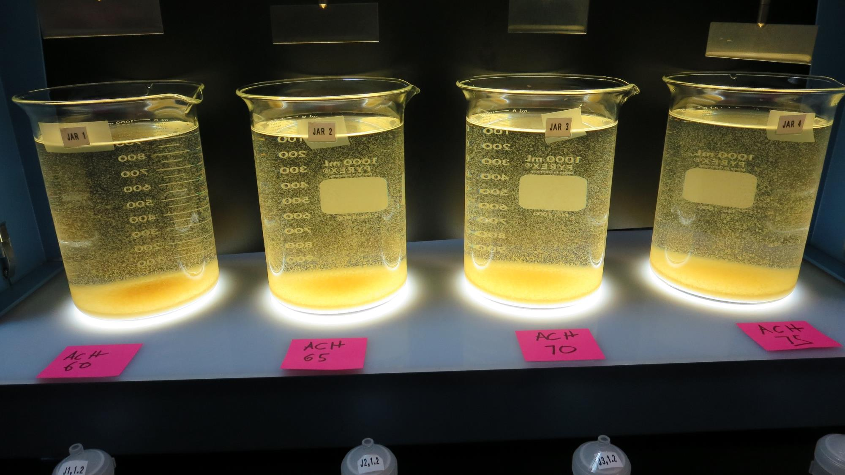
Jars 22-25: After 5 min of settling, 25 mL is decanted for filterability and %UVT/UVA.

Slide 38
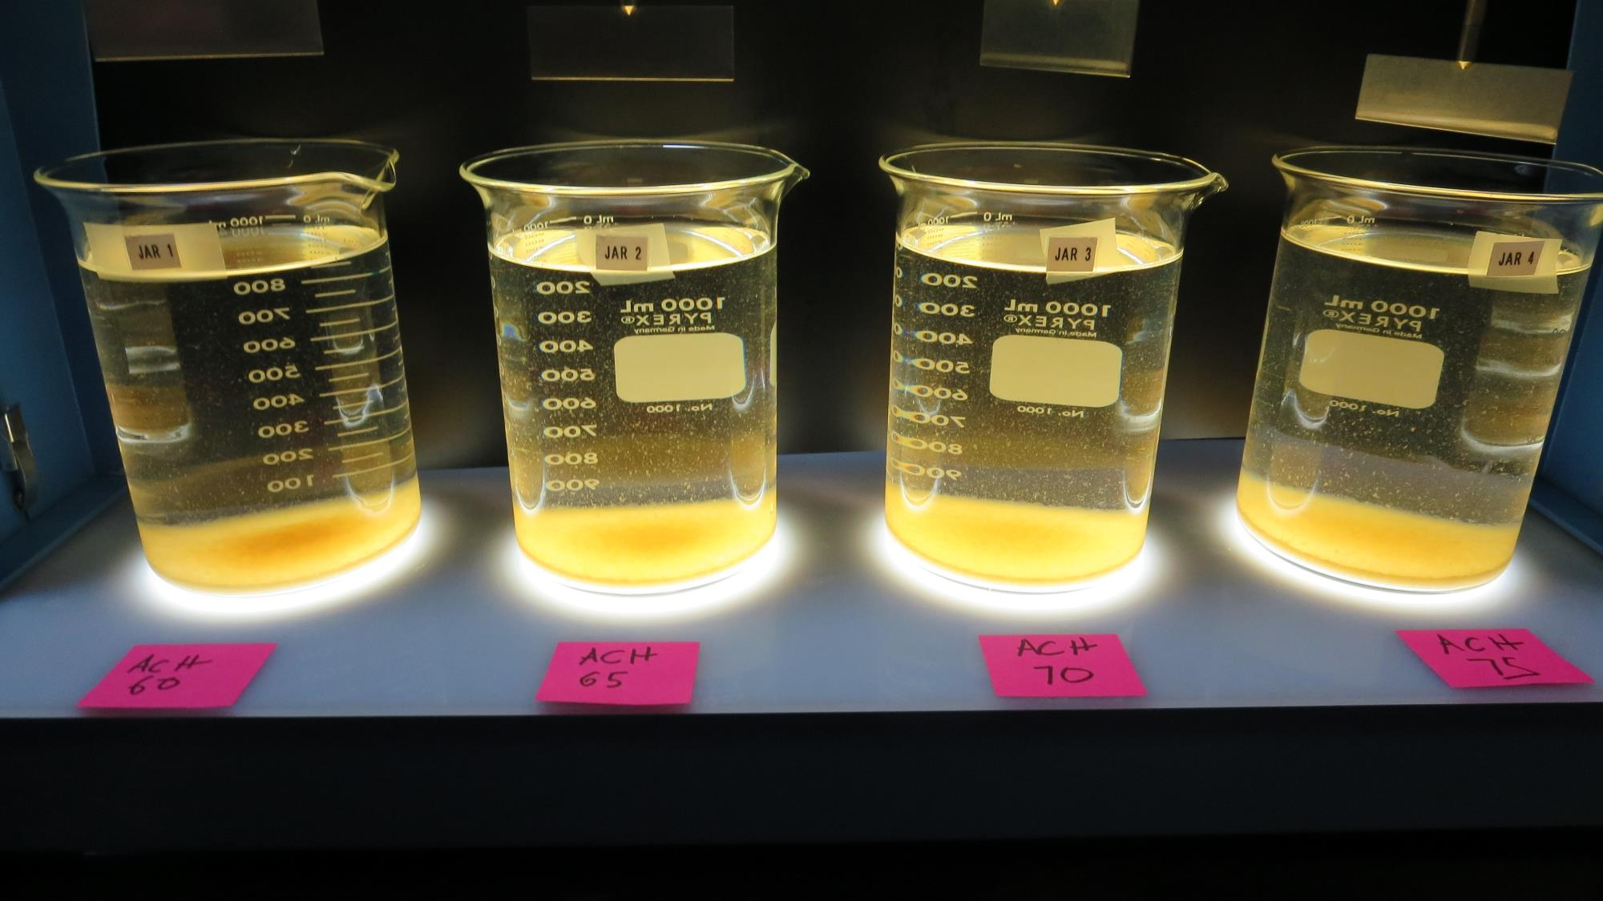
Jars 22-25: After 25-minutes of settling, settled water turbidity is taken.
60 mg/L 9800
Filtrate 0.10 NTU
UVT: 88.3%
UVA: 0.054/cm
Settled: 2.0 NTU
65 mg/L 9800
Filtrate 0.11 NTU
UVT: 89.2%
UVA: 0.050/cm
Settled: 2.2 NTU
70 mg/L 9800
Filtrate 0.08 NTU
UVT: 88.8%
UVA: 0.052/cm
Settled: 2.9 NTU
75 mg/L 9800
Filtrate 0.07 NTU
UVT: 89.8%
UVA: 0.047/cm
Settled: 2.9 NTU

Slide 39
Jar Testing for 1-Liter Jars:
Procedures for Most Treatment Plants
Fill jars with source water prior to coagulant injection and set paddle speed at 30 rpm
Add chemicals (i.e., NaOCl, primary coagulant, coagulant aid) to each jar
Flash mix for 15-60 seconds (200 rpm)
Slow mix for 5 minutes (20-30 rpm)
Settled for 5 minutes. Syringe 25 mL from each jar taken 1-inch below surface (25 mL/12 sec rate)
Filtered through 1.2 um isopore membrane into cuvette drip rate, 15 mL/(50-90 sec)
Measure filtrate turbidity, chlorine residual and %UVT/UVA
Measure settled water turbidity after 25 minutes of total setting
Record all data

Slide 40

Jar Test
Filterability Test Equipment
Turbidity Instrument
Syringe w/Luer-Lock Tip, 30 cc
(part#: 2225800, by Hach)
Swinnex Filter Holder, 25 mm (part#: SX0002500)
Isopore Membrane Filter, 1.2 um absolute
pore size,
Φ= 25 mm , thickness: 24 um,
hydrophilic polycarbonate membrane
(part #: RTTP02500)
Go to Sigma-Aldrich for laboratory supplies http://www.sigmaaldrich.com/united-states.html

Slide 41
Isopore Membrane Information
Categories | Information
trade name | Isopore
filter color | White
chemistry | Polycarbonate (PC)
water flow rate | Avg. 175 mL/min x cm² (typical results @ 10 psi)
media | Isopore®
wettability | Hydrophilic
porosity | 14.7%
pore size | 1.2 µm
bubble point at 23 °C | 1.0 bar, air with water
thickness | 24 µm
filter diameter (ø) | 25 mm
material size | polycarbonate, Hydrophilic, 1.2 µm, 25 mm, white, plain, 100

Slide 42
Isopore Membrane Background Information
The Isopore membrane is a polycarbonate, track-etched screen filter recommended for all analyses in which the sample is viewed on the surface of the membrane. The Isopore membrane is composed of polycarbonate film, which has a smooth, glass-like surface for clearer sample observation. The unique manufacturing process of the membrane ensures a precise pore diameter and a consistent pore size for accurate separation of samples by size. Matched-weight filters are not usually required because of low, constant tar and ash weights.
Features & Benefits:
Membrane structure retains particles on the surface, simplifying counting and analysis

Slide 43
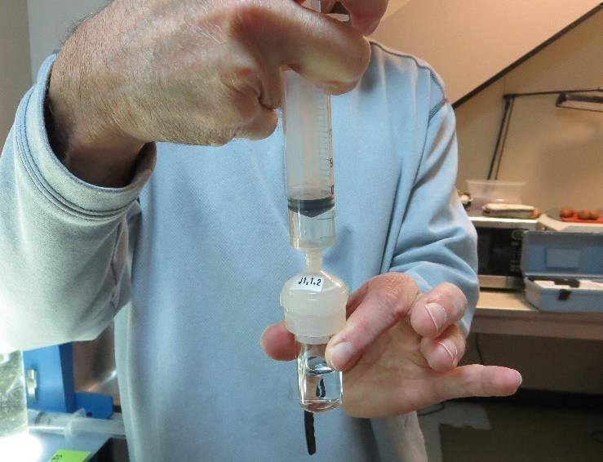

Jar Test - Filterability Test
Syringe ~ 25 mL from jar (after 5-minutes of settling)
Filter-to-waste 3-5 mL
Filter directly into clean cuvette
Measure turbidity
Note: Take several readings before recording final NTU results. Micro bubbles can adhere to glass causing false NTU readings. To remove bubbles, tilt cuvette up to 90 degrees.

Slide 44

Contact
Guy Schott, P.E.
State Water Resources Control Board
Division of Drinking Water
Santa Rosa, CA
Go to Stock Solution/Dose calculations/Jar Test Results for tools to download
www.waterboards.ca.gov/drinking_water/programs/districts/mendocino_district.html
Email: Guy Schott - Guy.Schott@waterboards.ca.gov
Office Number: 707-576-2732

