Slide 1
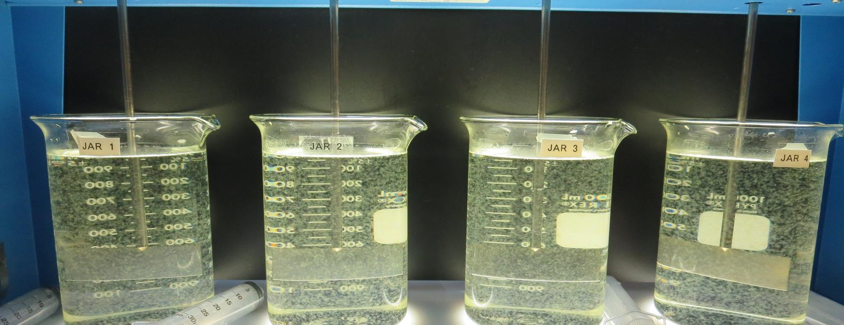
Lucerne Water Co., Cal Water Service CA1710005 Lake County Jar Test
by Guy Schott, P.E.
July 27, 2021

Slide 2
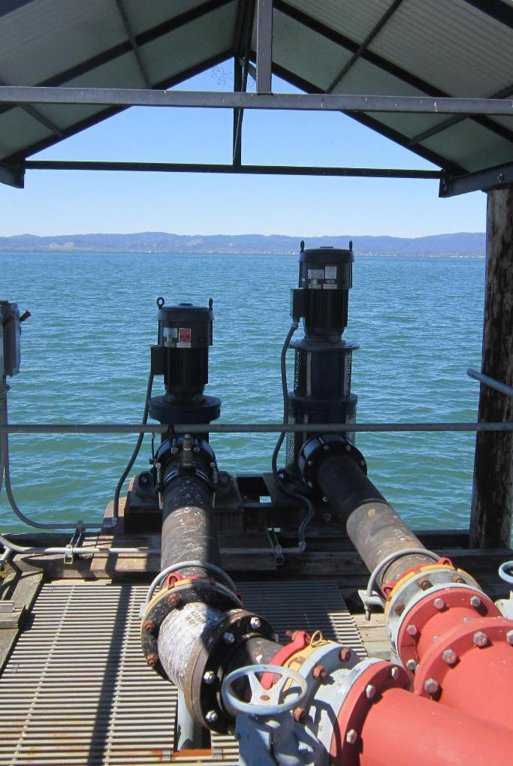
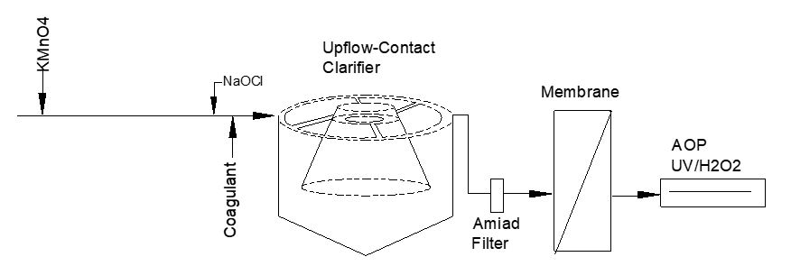
Lucerne Water Co. Source Water: Clear Lake Conventional Treatment

Slide 3
Lucerne Water Co. Characteristics July 27, 2021
Source
pH: 9.10
Turbidity: 4.8 NTU
UVT: 80.3%,
UVA: 0.095/cm
0.4 um Filtered
Turbidity: 0.44 NTU
UVT: 85.2%,
UVA: 0.069/cm

Slide 4
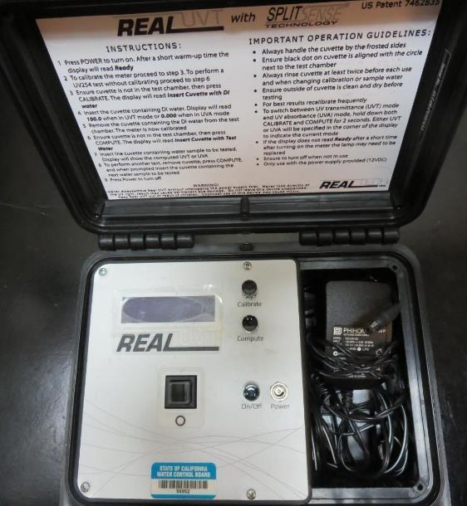
UVT/UVA, pathlength 10 mm
UV transmittance (UVT) is a measurement of the amount of ultraviolet light (commonly at 254 nm due to its germicidal effect) that passes through a water sample compared to the amount of light that passes through a pure water sample. The measurement is expressed as a percentage, % UVT.
%UVT = 10^{(-UVA)} x 100%
UV absorbance (UVA) is calculated as a relative measure of the amount of light absorbed by a water sample compared with the amount of light absorbed by a pure water sample.
UVA = -log(%UVT/100)

Slide 5
Applied Coagulants for Jar Testing
Pro Pac 9800 (NTU Technologies)
50% Aluminum Chlorohydrate
50% Water
23.62% Al₂O₃
12.5% Al
83% Basicity
SG = 1.25-1.34
NSF limit: 250 mg/L as Product
10 mg/L as 9800 = Reduction 1.18 mg/L as CaCO₃

Slide 6
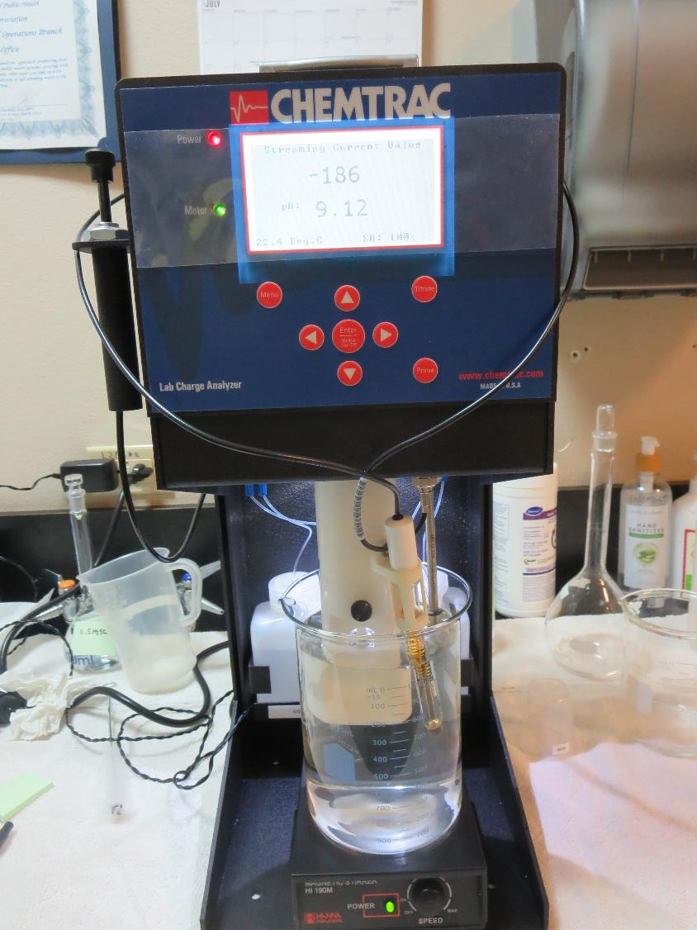
Laboratory Charge Analyzer
LCA: Used to determine coagulant demand of a source water entering the treatment plant.
Source pH: 9.10
LCA #1:
9800: 34.8 mg/L as product
pH adjusted to 7.70 with acetic acid

Slide 7
Coagulant Information
Unless stated otherwise, all coagulant doses are reported as Product (100% strength).
Preparation of coagulant stock solutions are generally 1.0 and/or 0.1 percent strength using 100 and/or 200 mL volumetric flasks.
Finnpipette F2 variable volume pipette, capacity 100-1000 micro liters is used for stock solution preparation and coagulant aid jar test dosing.
Finnpipette F2 variable volume pipette, capacity 0.5-5 mL is used for primary coagulant jar test dosing.

Slide 8
Source Water pH and Alkalinity Changes when H₂SO₄ is Added
Constituents | pH open system (measured) | *Loss of CO₂ open system (calculated) | pH, no loss of CO₂ closed system (calculated) | Alkalinity as CaCO₃, mg/L (calculated
Source pH | 9.10 | - | - | 181
H₂SO₄ = 10 mg/L | 8.81 | 3.7 | 8.43 | 170.8
H₂SO₄ = 20 mg/L | 8.24 | 7.4 | 7.57 | 160.6
H₂SO₄ = 25 mg/L | 7.81 | 8.2 | 7.37 | 155.5
H₂SO₄ = 30 mg/L | 7.56 | 9.1 | 7.23 | 150.4
H₂SO₄ = 40 mg/L | 7.19 | 8.9 | 7.01 | 140.2
H₂SO₄ = 50 mg/L | 6.98 | 8.9 | 6.85 | 130.0 (130 measured)
*This is the calculated amount of CO₂ loss from a closed system pH to calculated the measured open system pH.

Slide 9
Lucerne Water Co., Jar Test 1 - 8 Results Flash Mix 200 RPM (30 sec); Floc Mix 30 RPM (5 min)
Jar# | H₂SO₄ mg/L | 9800 mg/L | Filtrate NTU | Filtrate %UVT | Filtrate UVA/cm | %UVA Reduction | Settle NTU 25 min
J1 | 0 | 35 | 0.22 | 88.9 | 0.050 | 27.5 | 0.81
J2 | 25 | 35 | 0.23 | 89.8 | 0.046 | 33.3 | 0.83
J3 | 0 | 45 | 0.20 | 89.2 | 0.049 | 29.0 | 0.61
J4 | 25 | 45 | 0.11 | 90.4 | 0.043 | 37.7 | 0.33
J5 | 0 | 50 | 0.27 | 89.5 | 0.048 | 30.4 | 0.58
J6 | 25 | 50 | 0.19 | 90.7 | 0.042 | 39.1 | 0.50
J7 | 0 | 60 | 0.15 | 89.7 | 0.047 | 31.9 | 0.44
J8 | 25 | 60 | 0.10 | 91.0 | 0.040 | 42.0 | 0.28

Slide 10
Lucerne Water Co., Jar Test 9 - 16 Results Flash Mix 200 RPM (30 sec); Floc Mix 30 RPM (5 min)
Jar # | H₂SO₄ mg/L | 9800 mg/L | Filtrate NTU | Filtrate %UVT | Filtrate UVA/cm | %UVA Reduction | Settle NTU 25 min
J9 | 0 | 60 | 0.17 | 89.1 | 0.050 | 27.5 | 0.43
J10 | 25 | 60 | 0.14 | 90.3 | 0.044 | 36.2 | 0.40
J11 | 0 | 70 | 0.14 | 89.2 | 0.049 | 29.0 | 0.41
J12 | 25 | 70 | 0.09 | 90.7 | 0.042 | 39.1 | 0.35
J13 | 0 | 70 | 0.20 | 89.3 | 0.049 | 29.0 | 0.51
J14 | 25 | 70 | 0.15 | 91.3 | 0.039 | 43.5 | 0.36
J15 | 0 | 80 | 0.19 | 89.5 | 0.048 | 30.4 | 0.46
J16 | 25 | 80 | 0.07 | 91.7 | 0.037 | 46.4 | 0.24

Slide 11
Lucerne Water Co., Jar Test 17 - 24 Results Flash Mix 200 RPM (30 sec); Floc Mix 30 RPM (5 min)
Jar # | H₂SO₄ mg/L | 9800 mg/L | Filtrate NTU | Filtrate %UVT | Filtrate UVA/cm | %UVA Reduction | Settle NTU 25 min
J17 | 0 | 80 | 0.16 | 89.7 | 0.046 | 33.3 | 0.37
J18 | 15 | 80 | 0.11 | 90.7 | 0.042 | 39.1 | 0.31
J19 | 25 | 80 | 0.09 | 91.4 | 0.038 | 44.9 | 0.30
J20 | 35 | 80 | 0.07 | 91.7 | 0.037 | 46.4 | 0.26
J21 | 0 | 60 | 0.19 | 89.0 | 0.050 | 19.0 | 0.52
J22 | 25 | 60 | 0.11 | 90.6 | 0.042 | 39.1 | 0.42
J23 | 35 | 60 | 0.14 | 90.8 | 0.041 | 40.6 | 0.43
J24 | 45 | 60 | 0.08 | 91.1 | 0.040 | 42.0 | 0.37

Slide 12
Jars 1-4 Test Post KMnO₄ Flash Mix 30 Sec (200 RPM) Floc Mix 5 min (30 RPM) Applied Acid (H₂SO₄) + Applied Coagulant 9800

Slide 13
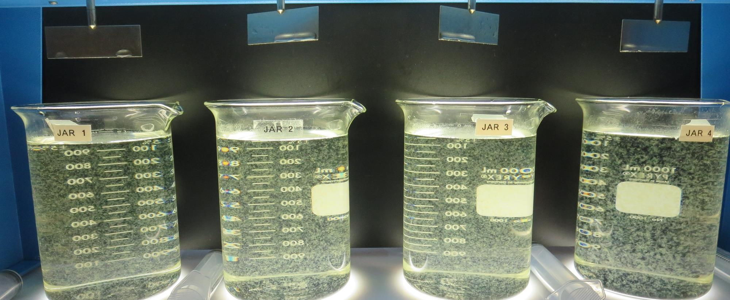
Jars 1-4: End of 5-minute flocculation (30 RPM) duration.
0 mg/L H₂SO₄
35 mg/L 9800
Filtrate 0.22 NTU
UVT: 88.9%
UVA: 0.050/cm
UVA Reduction 27.5%
Settled: 0.81 NTU
25 mg/L H₂SO₄
35 mg/L 9800
Filtrate 0.23 NTU
UVT: 89.8%
UVA: 0.046/cm
UVA Reduction 33.3%
Settled: 0.83 NTU
0 mg/L H₂SO₄
45 mg/L 9800
Filtrate 0.20 NTU
UVT: 89.2%
UVA: 0.049/cm
UVA Reduction 29.0%
Settled: 0.61 NTU
25 mg/L H₂SO₄
45 mg/L 9800
Filtrate 0.11 NTU
UVT: 90.4%
UVA: 0.043/cm
UVA Reduction 37.7%
Settled: 0.33 NTU

Slide 14
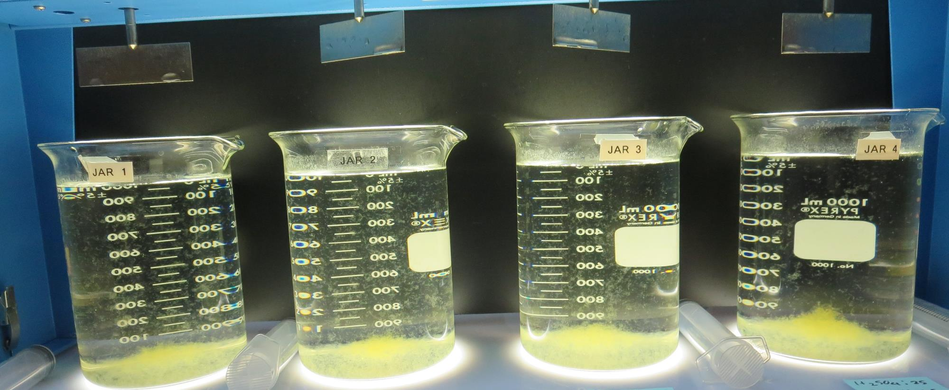
Jars 1-4: After 5 min of settling, 25 mL is syringed for filterability and %UVT/UVA.

Slide 15
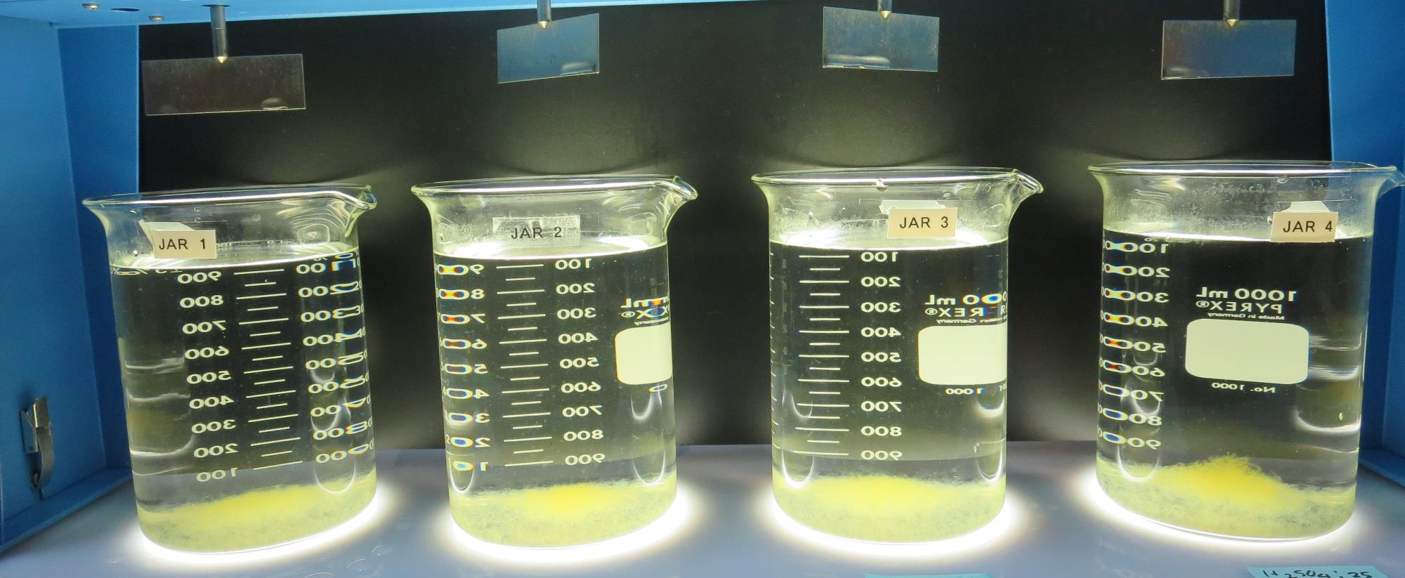
Jars 1-4: After 25-minutes of settling, settled water turbidity is taken.
0 mg/L H₂SO₄
35 mg/L 9800
Filtrate 0.22 NTU
UVT: 88.9%
UVA: 0.050/cm
UVA Reduction 27.5%
Settled: 0.81 NTU
25 mg/L H₂SO₄
35 mg/L 9800
Filtrate 0.23 NTU
UVT: 89.8%
UVA: 0.046/cm
UVA Reduction 33.3%
Settled: 0.83 NTU
0 mg/L H₂SO₄
45 mg/L 9800
Filtrate 0.20 NTU
UVT: 89.2%
UVA: 0.049/cm
UVA Reduction 29.0%
Settled: 0.61 NTU
25 mg/L H₂SO₄
45 mg/L 9800
Filtrate 0.11 NTU
UVT: 90.4%
UVA: 0.043/cm
UVA Reduction 37.7%
Settled: 0.33 NTU

Slide 16
Jars 5-8 Test Post KMnO₄ Flash Mix 30 Sec (200 RPM) Floc Mix 5 min (30 RPM) Applied Acid (H₂SO₄) + Applied Coagulant 9800

Slide 17
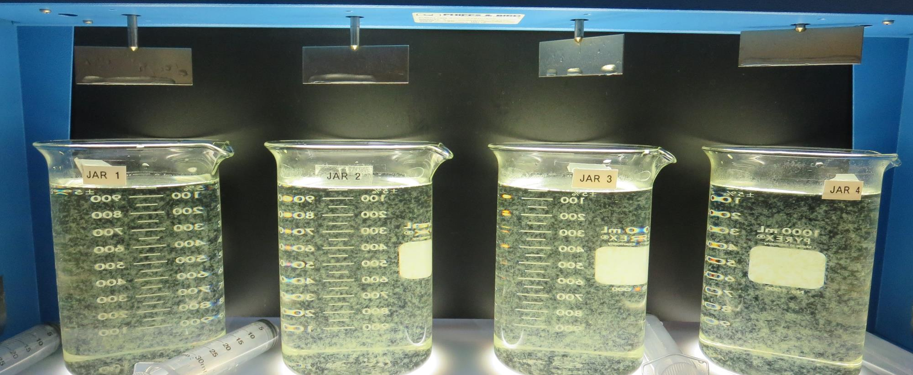
Jars 5-8: End of 5-minute flocculation (30 RPM) duration.
0 mg/L H₂SO₄
50 mg/L 9800
Filtrate 0.27 NTU
UVT: 89.5%
UVA: 0.048/cm
UVA Reduction 30.4%
Settled: 0.58 NTU
25 mg/L H₂SO₄
50 mg/L 9800
Filtrate 0.19 NTU
UVT: 90.7%
UVA: 0.042/cm
UVA Reduction 39.1%
Settled: 0.50 NTU
0 mg/L H₂SO₄
60 mg/L 9800
Filtrate 0.15 NTU
UVT: 89.7%
UVA: 0.047/cm
UVA Reduction 31.9%
Settled: 0.44 NTU
25 mg/L H₂SO₄
60 mg/L 9800
Filtrate 0.10 NTU
UVT: 91.0%
UVA: 0.040/cm
UVA Reduction 42.0%
Settled: 0.28 NTU

Slide 18
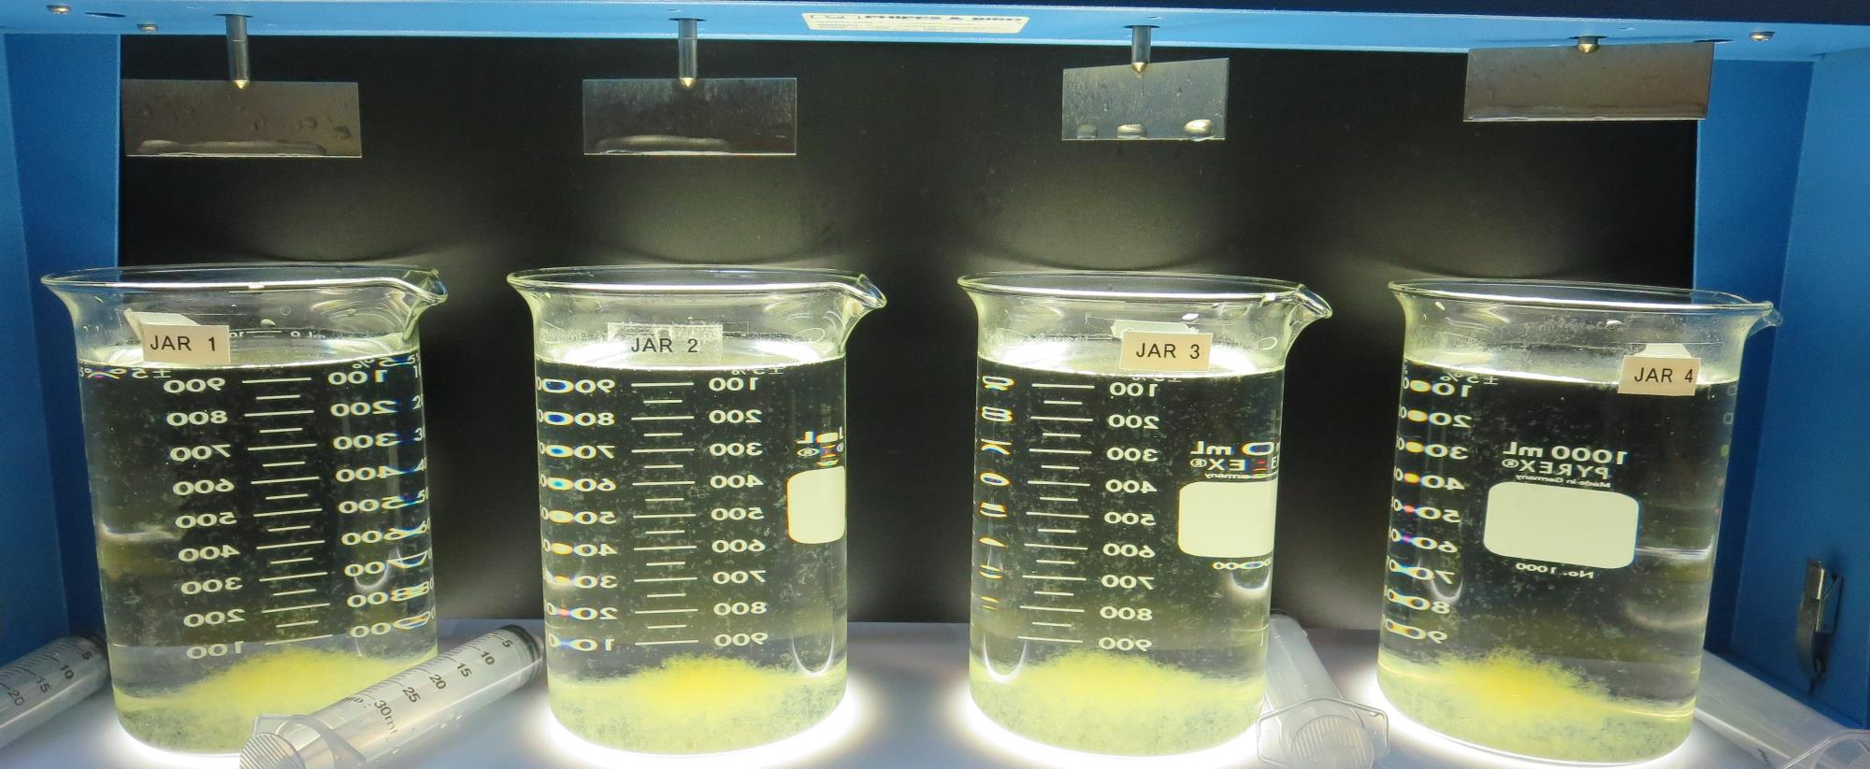
Jars 5-8: After 5 min of settling, 25 mL is syringed for filterability and %UVT/UVA.

Slide 19
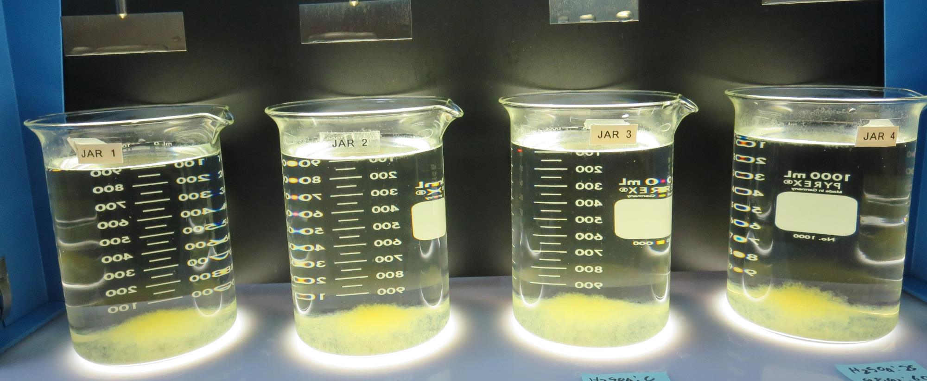
Jars 5-8: After 25-minutes of settling, settled water turbidity is taken.
0 mg/L H₂SO₄
50 mg/L 9800
Filtrate 0.27 NTU
UVT: 89.5%
UVA: 0.048/cm
UVA Reduction 30.4%
Settled: 0.58 NTU
25 mg/L H₂SO₄
50 mg/L 9800
Filtrate 0.19 NTU
UVT: 90.7%
UVA: 0.042/cm
UVA Reduction 39.1%
Settled: 0.50 NTU
0 mg/L H₂SO₄
60 mg/L 9800
Filtrate 0.15 NTU
UVT: 89.7%
UVA: 0.047/cm
UVA Reduction 31.9%
Settled: 0.44 NTU
25 mg/L H₂SO₄
60 mg/L 9800
Filtrate 0.10 NTU
UVT: 91.0%
UVA: 0.040/cm
UVA Reduction 42.0%
Settled: 0.28 NTU

Slide 20
Jars 9-12 Test Post KMnO₄ Flash Mix 30 Sec (200 RPM) Floc Mix 5 min (30 RPM) Applied Acid (H₂SO₄) + Applied Coagulant 9800

Slide 21
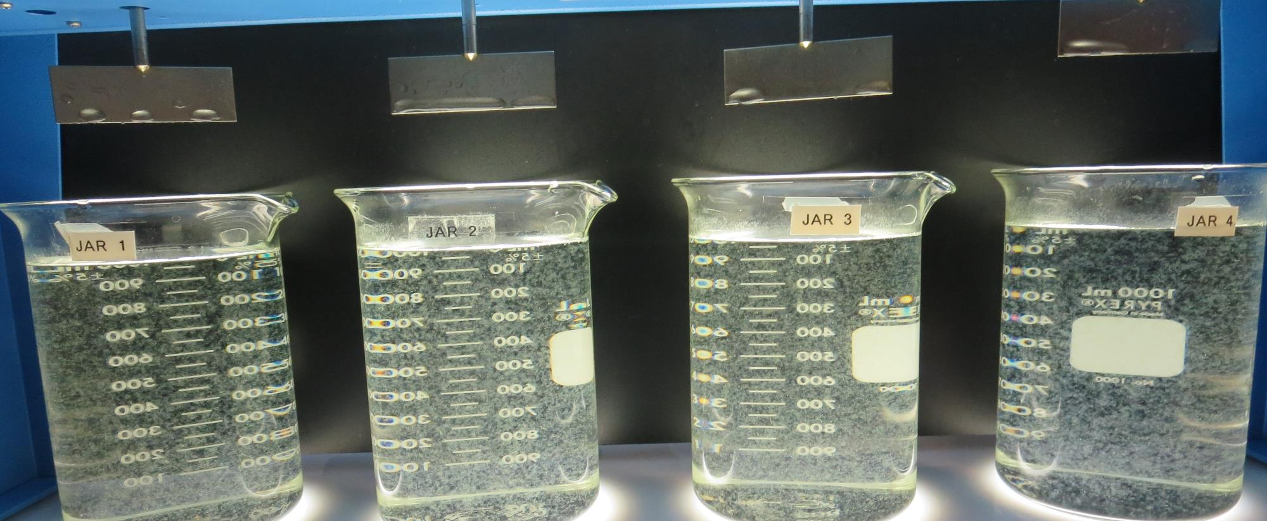
Jars 9-12: End of 5-minute flocculation (30 RPM) duration.
0 mg/L H₂SO₄
60 mg/L 9800
Filtrate 0.17 NTU
UVT: 89.1%
UVA: 0.050/cm
UVA Reduction 27.5%
Settled: 0.43 NTU
25 mg/L H₂SO₄
60 mg/L 9800
Filtrate 0.14 NTU
UVT: 90.3%
UVA: 0.044/cm
UVA Reduction 36.2%
Settled: 0.40 NTU
0 mg/L H₂SO₄
70 mg/L 9800
Filtrate 0.14 NTU
UVT: 89.2%
UVA: 0.049/cm
UVA Reduction 29.0%
Settled: 0.41 NTU
25 mg/L H₂SO₄
70 mg/L 9800
Filtrate 0.09 NTU
UVT: 90.7%
UVA: 0.042/cm
UVA Reduction 39.1%
Settled: 0.35 NTU

Slide 22
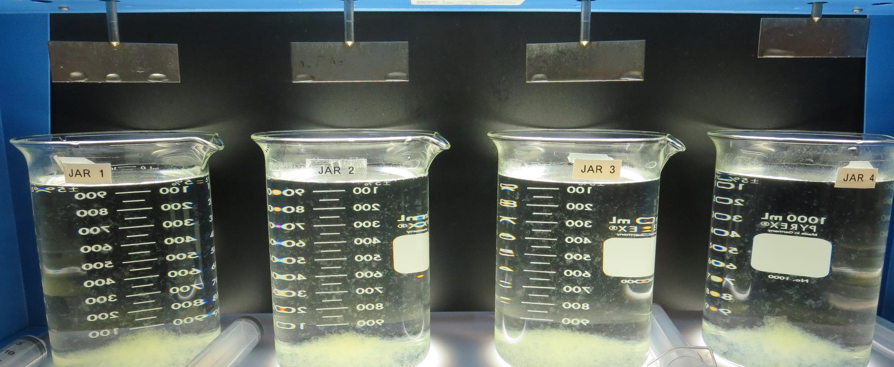
Jars 9-12: After 5 min of settling, 25 mL is syringed for filterability and %UVT/UVA.

Slide 23
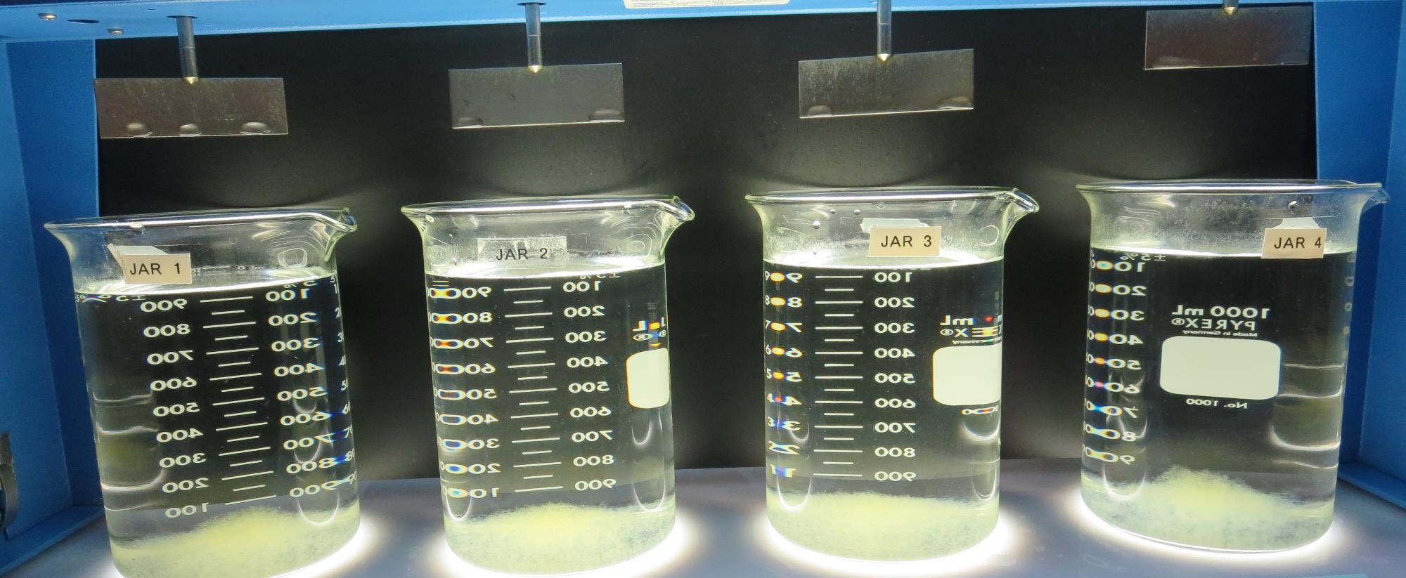
Jars 9-12: After 25-minutes of settling, settled water turbidity is taken.
0 mg/L H₂SO₄
60 mg/L 9800
Filtrate 0.17 NTU
UVT: 89.1%
UVA: 0.050/cm
UVA Reduction 27.5%
Settled: 0.43 NTU
25 mg/L H₂SO₄
60 mg/L 9800
Filtrate 0.14 NTU
UVT: 90.3%
UVA: 0.044/cm
UVA Reduction 36.2%
Settled: 0.40 NTU
0 mg/L H₂SO₄
70 mg/L 9800
Filtrate 0.14 NTU
UVT: 89.2%
UVA: 0.049/cm
UVA Reduction 29.0%
Settled: 0.41 NTU
25 mg/L H₂SO₄
70 mg/L 9800
Filtrate 0.09 NTU
UVT: 90.7%
UVA: 0.042/cm
UVA Reduction 39.1%
Settled: 0.35 NTU

Slide 24
Jars 13-16 Test Post KMnO₄ Flash Mix 30 Sec (200 RPM) Floc Mix 5 min (30 RPM) Applied Acid (H₂SO₄) + Applied Coagulant 9800

Slide 25
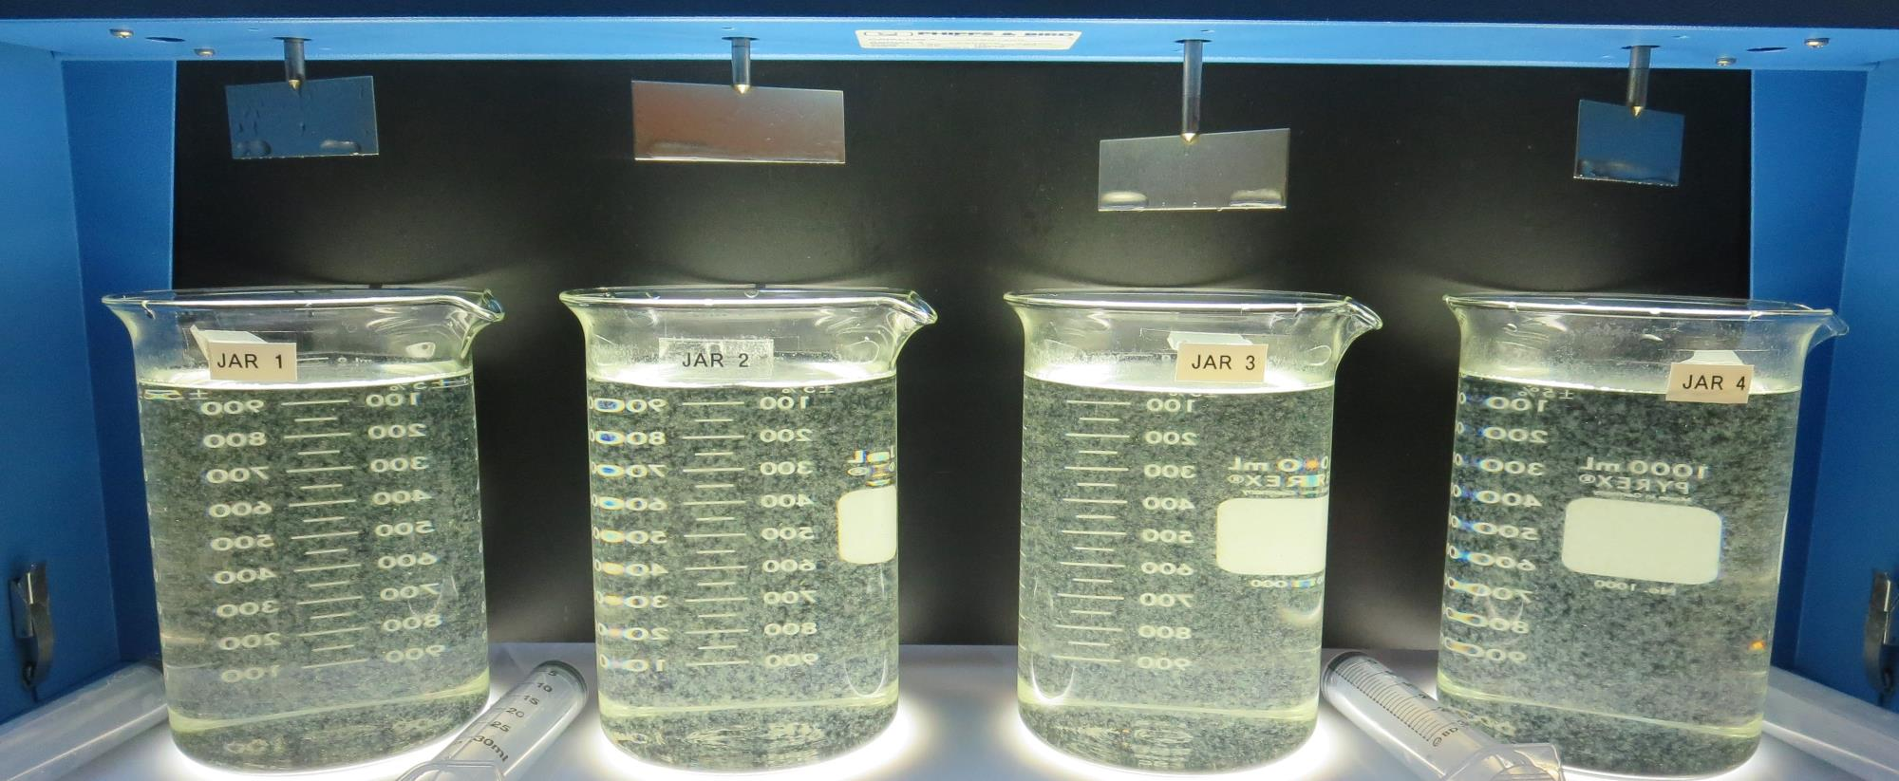
Jars 13-16: End of 5-minute flocculation (30 RPM) duration.
0 mg/L H₂SO₄
70 mg/L 9800
Filtrate 0.20 NTU
UVT: 89.3%
UVA: 0.049/cm
UVA Reduction 29.0%
Settled: 0.43 NTU
25 mg/L H₂SO₄
70 mg/L 9800
Filtrate 0.15 NTU
UVT: 90.3%
UVA: 0.039/cm
UVA Reduction 43.5%
Settled: 0.40 NTU
0 mg/L H₂SO₄
80 mg/L 9800
Filtrate 0.19 NTU
UVT: 89.2%
UVA: 0.048/cm
UVA Reduction 30.4%
Settled: 0.41 NTU
25 mg/L H₂SO₄
80 mg/L 9800
Filtrate 0.07 NTU
UVT: 90.7%
UVA: 0.037/cm
UVA Reduction 46.4%
Settled: 0.35 NTU

Slide 26
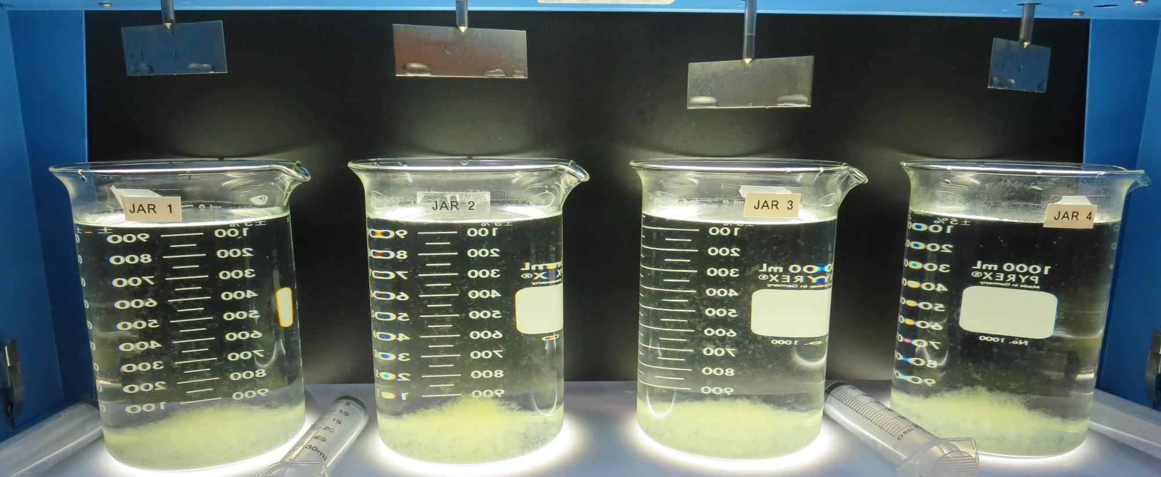
Jars 13-16: After 5 min of settling, 25 mL is syringed for filterability and %UVT/UVA.

Slide 27
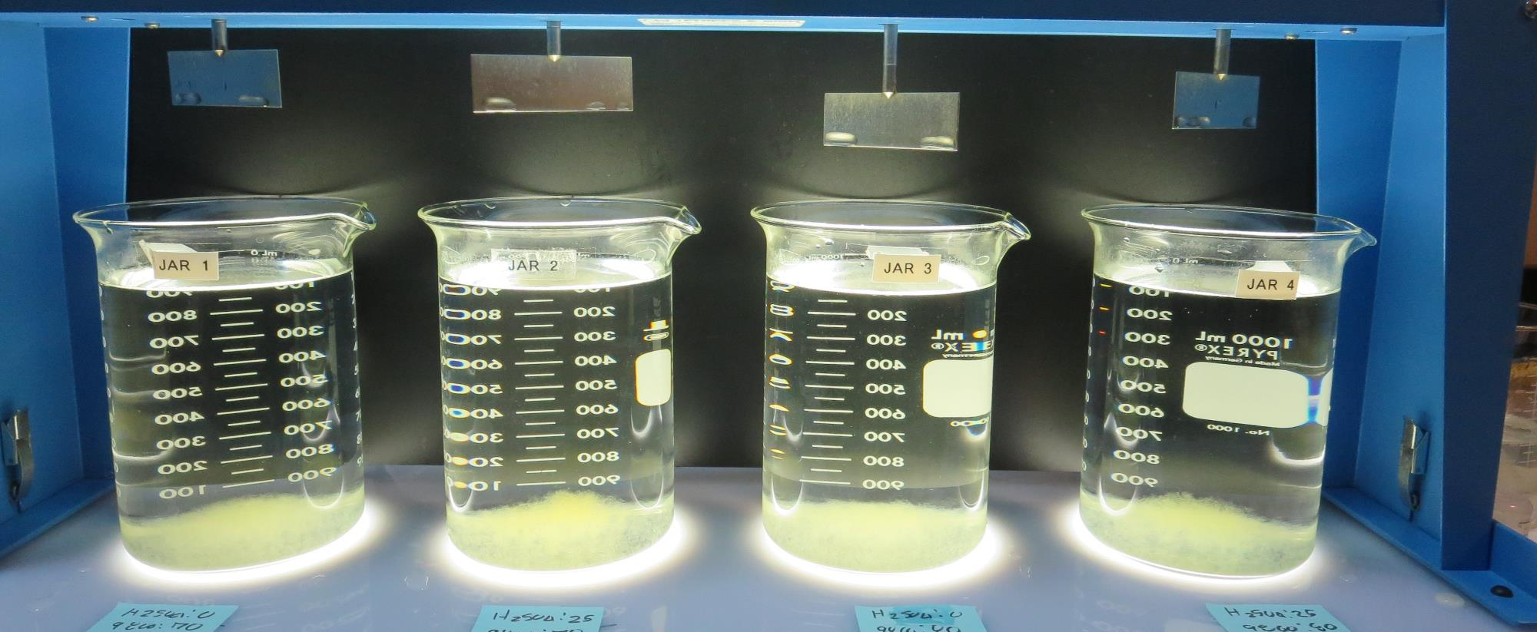
Jars 13-16: After 25-minutes of settling, settled water turbidity is taken.
0 mg/L H₂SO₄
70 mg/L 9800
Filtrate 0.20 NTU
UVT: 89.3%
UVA: 0.049/cm
UVA Reduction 29.0%
Settled: 0.43 NTU
25 mg/L H₂SO₄
70 mg/L 9800
Filtrate 0.15 NTU
UVT: 90.3%
UVA: 0.039/cm
UVA Reduction 43.5%
Settled: 0.40 NTU
0 mg/L H₂SO₄
80 mg/L 9800
Filtrate 0.19 NTU
UVT: 89.2%
UVA: 0.048/cm
UVA Reduction 30.4%
Settled: 0.41 NTU
25 mg/L H₂SO₄
80 mg/L 9800
Filtrate 0.07 NTU
UVT: 90.7%
UVA: 0.037/cm
UVA Reduction 46.4%
Settled: 0.35 NTU

Slide 28
Jars 17-20 Test Post KMnO₄ Flash Mix 30 Sec (200 RPM) Floc Mix 5 min (30 RPM) Applied Acid (H₂SO₄) + Applied Coagulant 9800

Slide 29
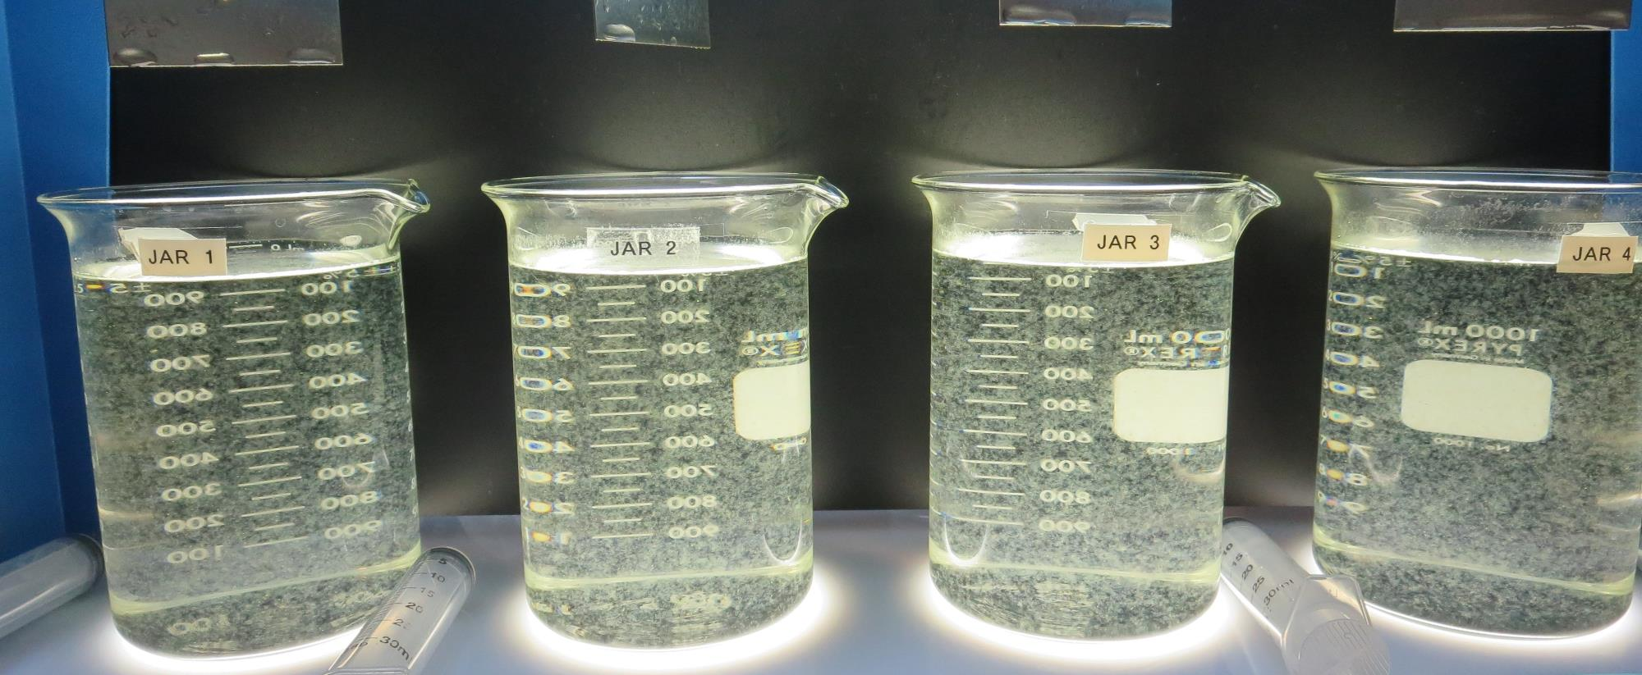
Jars 17-20: End of 5-minute flocculation (30 RPM) duration.
0 mg/L H₂SO₄
80 mg/L 9800
Filtrate 0.16 NTU
UVT: 89.7%
UVA: 0.046/cm
UVA Reduction 33.3%
Settled: 0.37 NTU
15 mg/L H₂SO₄
80 mg/L 9800
Filtrate 0.11 NTU
UVT: 90.7%
UVA: 0.042/cm
UVA Reduction 39.1%
Settled: 0.31 NTU
25 mg/L H₂SO₄
80 mg/L 9800
Filtrate 0.09 NTU
UVT: 91.4%
UVA: 0.038/cm
UVA Reduction 44.9%
Settled: 0.30 NTU
35 mg/L H₂SO₄
80 mg/L 9800
Filtrate 0.07 NTU
UVT: 91.7%
UVA: 0.037/cm
UVA Reduction 46.4%
Settled: 0.26 NTU

Slide 30
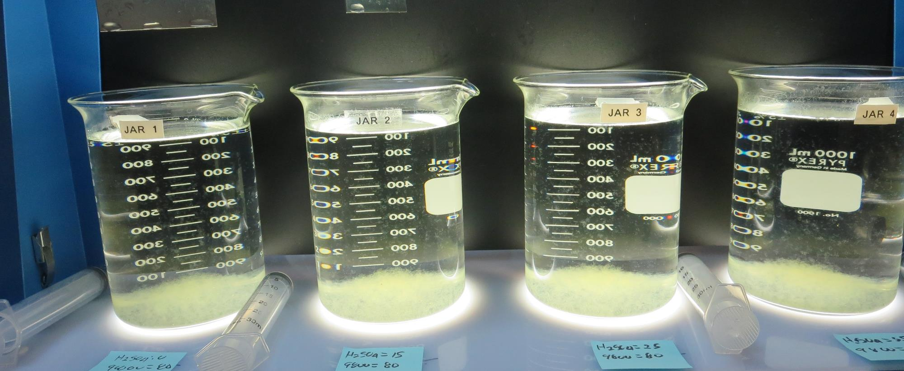
Jars 17-20: After 5 min of settling, 25 mL is syringed for filterability and %UVT/UVA.

Slide 31
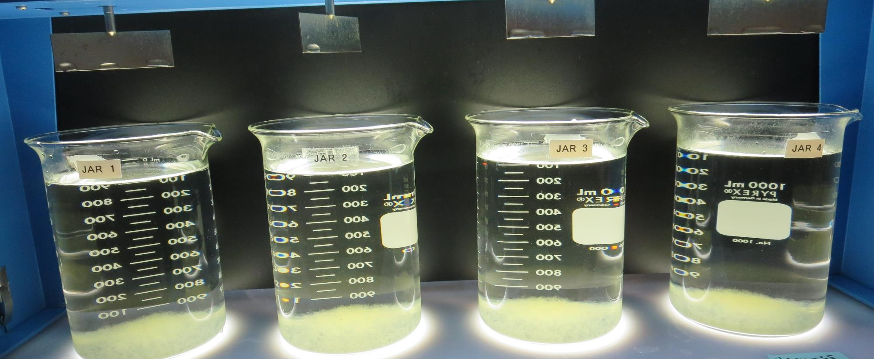
Jars 17-20: After 25-minutes of settling, settled water turbidity is taken.
0 mg/L H₂SO₄
80 mg/L 9800
Filtrate 0.16 NTU
UVT: 89.7%
UVA: 0.046/cm
UVA Reduction 33.3%
Settled: 0.37 NTU
15 mg/L H₂SO₄
80 mg/L 9800
Filtrate 0.11 NTU
UVT: 90.7%
UVA: 0.042/cm
UVA Reduction 39.1%
Settled: 0.31 NTU
25 mg/L H₂SO₄
80 mg/L 9800
Filtrate 0.09 NTU
UVT: 91.4%
UVA: 0.038/cm
UVA Reduction 44.9%
Settled: 0.30 NTU
35 mg/L H₂SO₄
80 mg/L 9800
Filtrate 0.07 NTU
UVT: 91.7%
UVA: 0.037/cm
UVA Reduction 46.4%
Settled: 0.26 NTU

Slide 32
Jars 21-24 Test Post KMnO₄ Flash Mix 30 Sec (200 RPM) Floc Mix 5 min (30 RPM) Applied Acid (H₂SO₄) + Applied Coagulant 9800

Slide 33
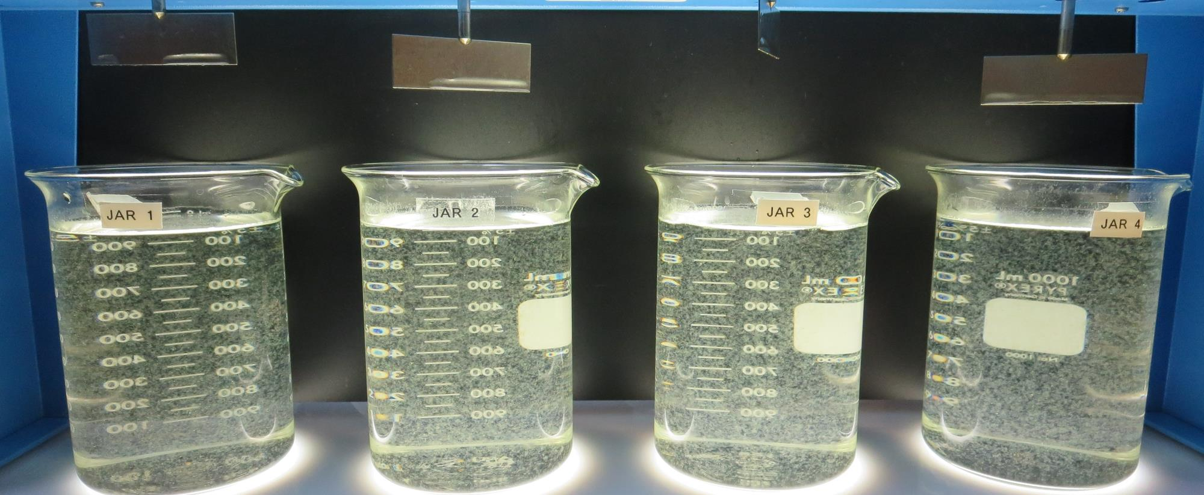
Jars 21-24: End of 5-minute flocculation (30 RPM) duration.
0 mg/L H₂SO₄
60 mg/L 9800
Filtrate 0.19 NTU
UVT: 89.0%
UVA: 0.050/cm
UVA Reduction 19.0%
Settled: 0.52 NTU
25 mg/L H₂SO₄
60 mg/L 9800
Filtrate 0.11 NTU
UVT: 90.6%
UVA: 0.042/cm
UVA Reduction 39.1%
Settled: 0.42 NTU
35 mg/L H₂SO₄
60 mg/L 9800
Filtrate 0.14 NTU
UVT: 90.8%
UVA: 0.041/cm
UVA Reduction 40.6%
Settled: 0.43 NTU
45 mg/L H₂SO₄
60 mg/L 9800
Filtrate 0.08 NTU
UVT: 91.1%
UVA: 0.040/cm
UVA Reduction 42.0%
Settled: 0.37 NTU

Slide 34
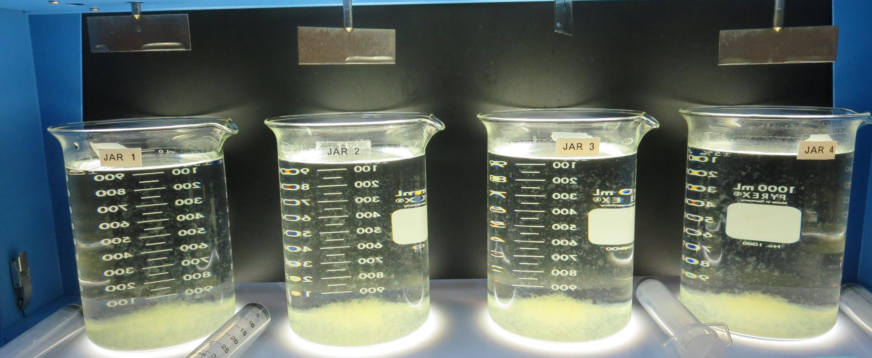
Jars 21-24: After 5 min of settling, 25 mL is syringed for filterability and %UVT/UVA.

Slide 35
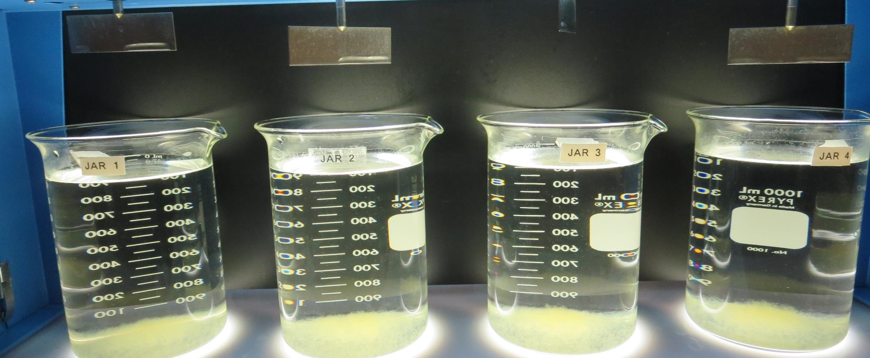
Jars 21-24: After 25-minutes of settling, settled water turbidity is taken.
0 mg/L H₂SO₄
60 mg/L 9800
Filtrate 0.19 NTU
UVT: 89.0%
UVA: 0.050/cm
UVA Reduction 19.0%
Settled: 0.52 NTU
25 mg/L H₂SO₄
60 mg/L 9800
Filtrate 0.11 NTU
UVT: 90.6%
UVA: 0.042/cm
UVA Reduction 39.1%
Settled: 0.42 NTU
35 mg/L H₂SO₄
60 mg/L 9800
Filtrate 0.14 NTU
UVT: 90.8%
UVA: 0.041/cm
UVA Reduction 40.6%
Settled: 0.43 NTU
45 mg/L H₂SO₄
60 mg/L 9800
Filtrate 0.08 NTU
UVT: 91.1%
UVA: 0.040/cm
UVA Reduction 42.0%
Settled: 0.37 NTU

Slide 36
Jar Testing for 1-Liter Jars: Procedures for Most Treatment Plants
Fill jars with source water prior to coagulant injection and set paddle speed at 30 rpm
Add chemicals (i.e., NaOCl, primary coagulant, coagulant aid) to each jar
Flash mix for 15-30 seconds (200 rpm)
Slow mix for 5 minutes (20-30 rpm)
Settled for 5 minutes. Syringe 25 mL from each jar taken 1-inch below surface (25 mL/12 sec rate)
Filtered through 1.2 um isopore membrane into cuvette drip rate, 15 mL/(50-90 sec)
Measure filtrate turbidity, chlorine residual and %UVT/UVA
Measure settled water turbidity after 25 minutes of total setting
Record all data

Slide 37
Jar Test Filterability Test Equipment
Turbidity Instrument
Syringe w/Luer-Lock Tip, 30 cc
(part#: 2225800, by Hach)
Swinnex Filter Holder, 25 mm (part#: SX0002500)
Isopore Membrane Filter, 1.2 um absolute
pore size,
Φ= 25 mm , thickness: 24 um,
hydrophilic polycarbonate membrane
(part #: RTTP02500)
Go to Sigma-Aldrich for laboratory supplies http://www.sigmaaldrich.com/united-states.html

Slide 38
Isopore Membrane Information
Categories | Information
trade name | Isopore
filter color | White
chemistry | Polycarbonate (PC)
water flow rate | Avg. 175 mL/min x cm² (typical results @ 10 psi)
media | Isopore®
wettability | Hydrophilic
porosity | 14.7%
pore size | 1.2 µm
bubble point at 23 °C | 1.0 bar, air with water
thickness | 24 µm
filter diameter (ø) | 25 mm
material size | polycarbonate, Hydrophilic, 1.2 µm, 25 mm, white, plain, 100

Slide 39
Isopore Membrane Background Information
The Isopore membrane is a polycarbonate, track-etched screen filter recommended for all analyses in which the sample is viewed on the surface of the membrane. The Isopore membrane is composed of polycarbonate film, which has a smooth, glass-like surface for clearer sample observation. The unique manufacturing process of the membrane ensures a precise pore diameter and a consistent pore size for accurate separation of samples by size. Matched-weight filters are not usually required because of low, constant tar and ash weights. Features & Benefits: Membrane structure retains particles on the surface, simplifying counting and analysis

Slide 40
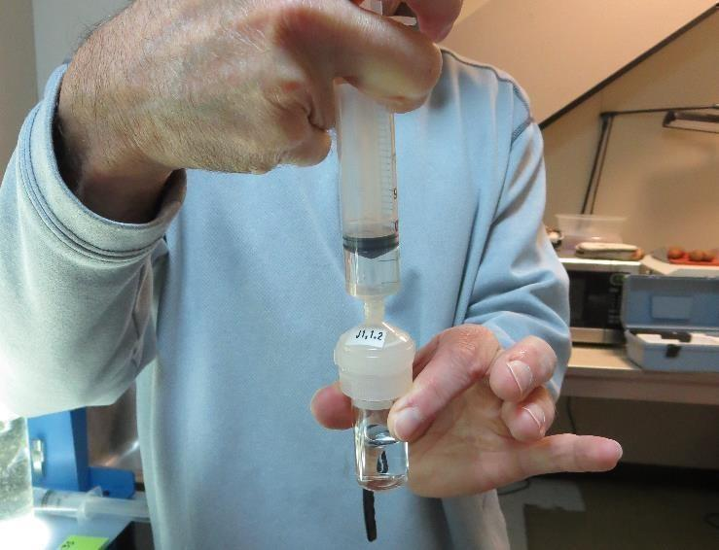
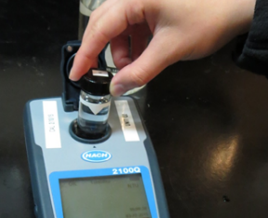
Jar Test - Filterability Test
Syringe ~ 25 mL from jar (after 5-minutes of settling)
Filter-to-waste 3-5 mL
Filter directly into clean cuvette
Measure turbidity
Note: Take several readings before recording final NTU results. Micro bubbles can adhere to glass causing false NTU readings. To remove bubbles, tilt cuvette up to 90 degrees.

Slide 41
Contact
Guy Schott, P.E.
State Water Resources Control Board
Division of Drinking Water
Santa Rosa, CA
Go to Stock Solution/Dose calculations/Jar Test Results for tools to download
www.waterboards.ca.gov/drinking_water/programs/districts/mendocino_district.html
Email: Guy Schott - Guy.Schott@waterboards.ca.gov
Office Number: 707-576-2732

