Slide 1
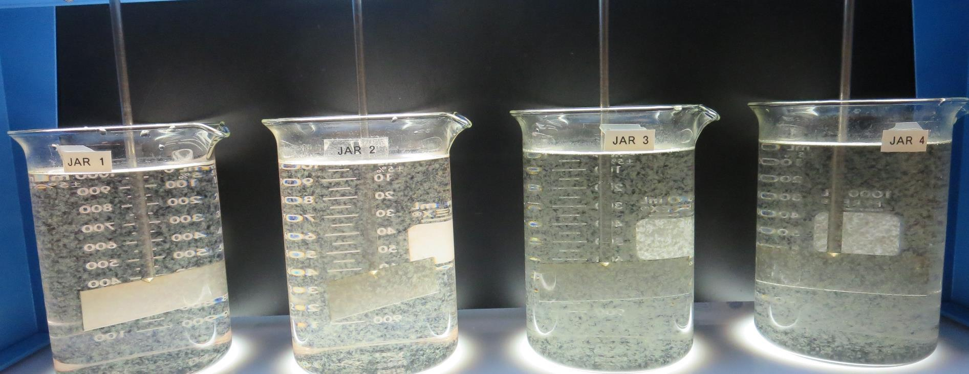
Lucerne Water Co., Cal Water Service
CA1710005
Lake County
Jar Test
by Guy Schott, P.E.
July 30, 2021

Slide 2
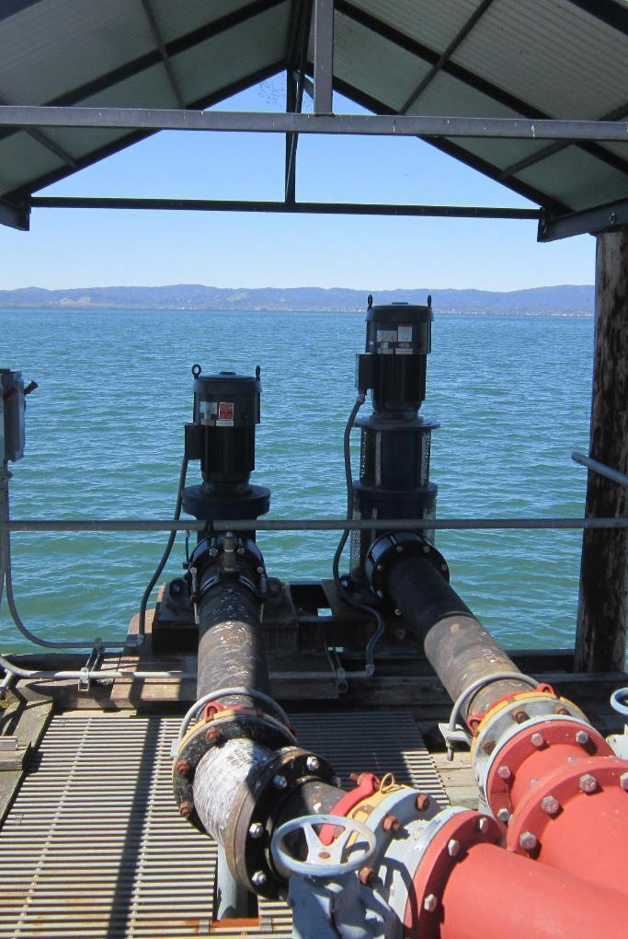
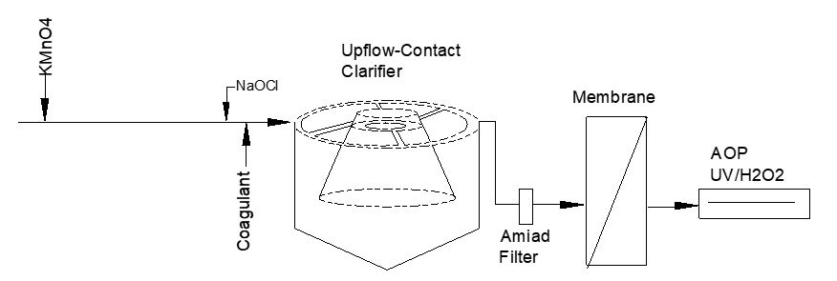
Lucerne Water Co.
Source Water: Clear Lake
Conventional Treatment

Slide 3
Lucerne
Water Co. Characteristics
July 30, 2021
Source
Turbidity: 7.9 NTU
UVT: 79.7%,
UVA: 0.098/cm
0.4 um Filtered
Turbidity: 0.5 NTU
UVT: 85.4%,
UVA: 0.068/cm

Slide 4
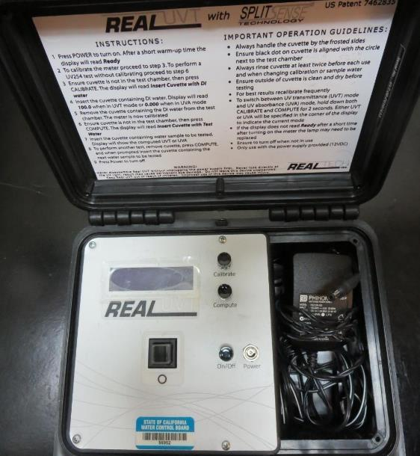
UVT/UVA, pathlength 10 mm
UV transmittance (UVT) is a measurement of the amount of ultraviolet light (commonly at 254 nm due to its germicidal effect) that passes through a water sample compared to the amount of light that passes through a pure water sample. The measurement is expressed as a percentage, % UVT.
%UVT = 10^{(-UVA)} x 100%
UV absorbance (UVA) is calculated as a relative measure of the amount of light absorbed by a water sample compared with the amount of light absorbed by a pure water sample.
UVA = -log(%UVT/100)

Slide 5
Applied Coagulants for Jar Testing
Pro Pac 9800 (NTU Technologies)
50% Aluminum Chlorohydrate
50% Water
23.62% Al₂O₃
12.5% Al
83% Basicity
SG = 1.25-1.34
NSF limit: 250 mg/L as Product
10 mg/L as 9800 = Reduction 1.18 mg/L as CaCO₃

Slide 6
Coagulant Information
Unless stated otherwise, all coagulant doses are reported as Product (100% strength).
Preparation of coagulant stock solutions are generally 1.0 and/or 0.1 percent strength using 100 and/or 200 mL volumetric flasks.
Finnpipette F2 variable volume pipette, capacity 100-1000 micro liters is used for stock solution preparation and coagulant aid jar test dosing.
Finnpipette F2 variable volume pipette, capacity 0.5-5 mL is used for primary coagulant jar test dosing.

Slide 7
Lucerne Water Co., Source: Clear Lake
Summary Highlights
Jar# | KMnO₄ mg/L | H₂SO₄ mg/L | PAC mg/L | 9800 mg/L | Filtrate NTU | Filtrate %UVT | Filtrate UVA/cm | %UVA Reduction | Settle NTU 25 min
1 | 0 | 0 | 0 | 80 | 0.09 | 89.3 | 0.048 | 29.4 | 0.26
2 | 0.8 | 0 | 0 | 80 | 0.09 | 89.5 | 0.047 | 30.9 | 0.34
3 | 0.8 | 0 | 0 | 80 | 0.09 | 89.8 | 0.046 | 32.4 | 0.37
4 | 0.8 | 25 | 0 | 80 | 0.08 | 90.6 | 0.042 | 38.2 | 0.37
5 | 0.8 | 25 | 0 | 80 | 0.07 | 90.8 | 0.041 | 39.7 | 0.36
6 | 0.8 | 25 | 0 | 80 | 0.06 | 91.6 | 0.037 | 45.6 | 0.32
7 | 0.8 | 0 | 20 | 80 | 0.06 | 91.7 | 0.037 | 45.6 | 0.22
8 | 0.8 | 25 | 20 | 80 | 0.07 | 92.7 | 0.032 | 52.9 | 0.31
9 | 0.8 | 25 | 20 | 80 | 0.06 | 92.7 | 0.032 | 52.9 | 0.31
10 | 0.8 | 25 | 20 | 80 | 0.06 | 93.2 | 0.030 | 55.9 | 0.39

Slide 8
Lucerne Water Co., Jar Test 1 - 4 Results
Flash Mix 200 RPM (30 sec); Floc Mix 20 RPM (15 min)
Jar# | KMnO₄ mg/L | *PAC mg/L | H₂SO₄ mg/L | 9800 mg/L | Filtrate NTU | Filtrate %UVT | Filtrate UVA/cm | %UVA Reduction | Settle NTU 25 min
J1 | 0 | 0 | 0 | 80 | 0.16 | 88.8 | 0.051 | 25.0 | 0.70
J2 | 0 | 10 | 0 | 80 | 0.32 | 89.1 | 0.049 | 27.9 | 0.90
J3 | 0 | 15 | 0 | 80 | 0.31 | 89.8 | 0.046 | 32.4 | 0.97
J4 | 0 | 20 | 0 | 80 | 0.28 | 89.7 | 0.046 | 32.4 | 0.72
*It is suspected that PAC was not well mixed when added resulting in poor removal of DOC
Notes:
PAC added first and then floc for 2 minutes at 20 RPM
Coagulants were added then flash mix for 30 seconds at 200 RPM
Flocculation for 15 minutes at 20 RPM

Slide 9
Lucerne Water Co., Jar Test 5 - 8 Results
Flash Mix 200 RPM (30 sec); Floc Mix 20 RPM (15 min)
Jar# | KMnO₄ mg/L | H₂SO₄ mg/L | *PAC mg/L | 9800 mg/L | Filtrate NTU | Filtrate %UVT | Filtrate UVA/cm | %UVA Reduction | Settle NTU 25 min
J5 | 0 | 25 | 0 | 80 | 0.12 | 90.3 | 0.044 | 35.3 | 0.40
J6 | 0 | 25 | 10 | 80 | 0.19 | 91.2 | 0.039 | 42.6 | 0.58
J7 | 0 | 25 | 15 | 80 | 0.20 | 91.0 | 0.040 | 41.2 | 0.61
J8 | 0 | 20 | 20 | 80 | 0.18 | 90.4 | 0.043 | 36.8 | 0.52
*It is suspected that PAC was not well mixed when added resulting poor removal of DOC
Notes:
H₂SO₄ followed by PAC were added first and then floc for 2 minutes at 20 RPM
Coagulants were added then flash mix for 30 seconds at 200 RPM
Flocculation for 15 minutes at 20 RPM

Slide 10
Lucerne Water Co., Jar Test 9 - 12 Results
Flash Mix 200 RPM (30 sec); Floc Mix 20 RPM (15 min)
Jar# | KMnO₄ mg/L | H₂SO₄ mg/L | *PAC mg/L | 9800 mg/L | Filtrate NTU | Filtrate %UVT | Filtrate UVA/cm | %UVA Reduction | Settle NTU 25 min
J9 | 0 | 25 | 0 | 80 | 0.13 | 90.2 | 0.044 | 35.3 | 0.38
J10 | 0 | 25 | 10 | 80 | 0.13 | 91.2 | 0.039 | 42.6 | 0.71
J11 | 0 | 25 | 15 | 80 | 0.12 | 91.7 | 0.037 | 45.6 | 0.59
J12 | 0 | 20 | 20 | 80 | 0.09 | 92.1 | 0.035 | 48.5 | 0.42
*PAC was well mixed when added compared to previous results resulting in good reduction of indirect DOC
Notes:
H₂SO₄ followed by PAC were added first and then floc for 2 minutes at 20 RPM
Coagulants were added then flash mix for 30 seconds at 200 RPM
Flocculation for 15 minutes at 20 RPM

Slide 11
Lucerne Water Co., Jar Test 13 - 16 Results
Flash Mix 200 RPM (30 sec); Floc Mix 20 RPM (15 min)
Jar# | KMnO₄ mg/L | H₂SO₄ mg/L | 9800 mg/L | PAC mg/L | Filtrate NTU | Filtrate %UVT | Filtrate UVA/cm | %UVA Reduction | Settle NTU 25 min
J13 | 0 | 25 | 80 | 0 | 0.19 | 90.4 | 0.043 | 36.8 | 0.39
J14 | 0 | 25 | 80 | 10 | 0.12 | 91.4 | 0.039 | 42.6 | 0.90
J15 | 0 | 25 | 80 | 15 | 0.18 | 91.9 | 0.036 | 47.1 | 1.28
J16 | 0 | 20 | 80 | 20 | 0.17 | 92.0 | 0.036 | 47.1 | 1.87
Notes:
H₂SO₄ added first followed by coagulants then PAC
Flash mix for 30 seconds at 200 RPM
Flocculation for 15 minutes at 20 RPM

Slide 12
Lucerne Water Co., Jar Test 17 - 20 Results
Flash Mix 200 RPM (30 sec); Floc Mix 20 RPM (15 min)
Jar# | KMnO₄ mg/L | H₂SO₄ mg/L | PAC mg/L | 9800 mg/L | Filtrate NTU | Filtrate %UVT | Filtrate UVA/cm | %UVA Reduction | Settle NTU 25 min
J17 | 0.8 | 25 | 0 | 80 | 0.06 | 91.2 | 0.039 | 42.6 | 0.40
J18 | 0.8 | 25 | 10 | 80 | 0.07 | 92.2 | 0.035 | 48.5 | 0.33
J19 | 0.8 | 25 | 15 | 80 | 0.06 | 92.8 | 0.032 | 52.9 | 0.41
J20 | 0.8 | 20 | 20 | 80 | 0.06 | 93.2 | 0.030 | 55.9 | 0.37
Notes:
KMnO₄ added first followed by flocculation for 2 minutes at 20 RPM
Added: H₂SO₄ followed by PAC and then coagulants
Flash mix for 30 seconds at 200 RPM
Flocculation for 15 minutes at 20 RPM

Slide 13
Lucerne Water Co., Jar Test 21 - 24 Results
Flash Mix 200 RPM (30 sec); Floc Mix 20 RPM (15 min)
Jar# | KMnO₄ mg/L | H₂SO₄ mg/L | PAC mg/L | 9800 mg/L | Filtrate NTU | Filtrate %UVT | Filtrate UVA/cm | %UVA Reduction | Settle NTU 25 min
J21 | 0.8 | 0 | 0 | 80 | 0.09 | 89.8 | 0.046 | 32.4 | 0.37
J22 | 0.8 | 25 | 0 | 80 | 0.06 | 91.6 | 0.037 | 45.6 | 0.32
J23 | 0.8 | 25 | 20 | 80 | 0.06 | 93.2 | 0.030 | 55.9 | 0.39
J24 | 0.8 | 20 | 20 | 80 | 0.07 | 93.1 | 0.030 | 55.9 | 0.99
Jar 24 – 9800 was added first followed by PAC. Settled water increased significantly.
Notes:
KMnO₄ added first followed by flocculation for 2 minutes at 20 RPM
Added: H₂SO₄ to Jars 2-3, followed by PAC to Jar 3 only.
Add coagulants to Jars 1 – 4, followed by PAC to Jar 4.
Flash mix for 30 seconds at 200 RPM
Flocculation for 15 minutes at 20 RPM

Slide 14
Lucerne Water Co., Jar Test 25 - 28 Results
Flash Mix 200 RPM (30 sec); Floc Mix 20 RPM (15 min)
Jar# | KMnO₄ mg/L | H₂SO₄ mg/L | PAC mg/L | 9800 mg/L | Filtrate NTU | Filtrate %UVT | Filtrate UVA/cm | %UVA Reduction | Settle NTU 25 min
J25 | 0 | 0 | 0 | 80 | 0.09 | 89.3 | 0.048 | 29.4 | 0.26
J26 | 0.8 | 0 | 0 | 80 | 0.09 | 89.5 | 0.047 | 30.9 | 0.34
J27 | 0.8 | 25 | 0 | 80 | 0.08 | 90.6 | 0.042 | 38.2 | 0.37
J28 | 0.8 | 25 | 20 | 80 | 0.07 | 92.7 | 0.032 | 52.9 | 0.31
Notes:
KMnO₄ added first followed by flocculation for 2 minutes at 20 RPM
Added: H₂SO₄ followed by PAC and then coagulants
Flash mix for 30 seconds at 200 RPM
Flocculation for 15 minutes at 20 RPM

Slide 15
Lucerne Water Co., Jar Test 29 - 32 Results
Flash Mix 200 RPM (30 sec); Floc Mix 20 RPM (15 min)
Jar# | KMnO₄ mg/L | H₂SO₄ mg/L | PAC mg/L | 9800 mg/L | Filtrate NTU | Filtrate %UVT | Filtrate UVA/cm | %UVA Reduction | Settle NTU 25 min
J29 | 0.8 | 25 | 0 | 80 | 0.07 | 90.8 | 0.041 | 39.7 | 0.36
J30 | 0.8 | 25 | 0 | 80 | 0.06 | 90.7 | 0.041 | 39.7 | 0.29
J31 | 0.8 | 25 | 20 | 80 | 0.06 | 92.7 | 0.032 | 52.9 | 0.31
J32 | 0.8 | 0 | 20 | 80 | 0.06 | 91.7 | 0.037 | 45.6 | 0.22
Notes:
KMnO₄ added first followed by flocculation for 2 minutes at 20 RPM
Add H₂SO₄ to Jars 1 and 3; Add PAC to Jars 3 and 4
Add coagulant to Jars 1-4
Add H₂SO₄ to Jars 1
Flash mix for 30 seconds at 200 RPM; Flocculation for 15 minutes at 20 RPM

Slide 16
Jars 1-4 Test
Flash Mix 30 Sec (200 RPM)
Floc Mix 15 min (20 RPM)
Applied PAC +
Applied Coagulant
9800

Slide 17
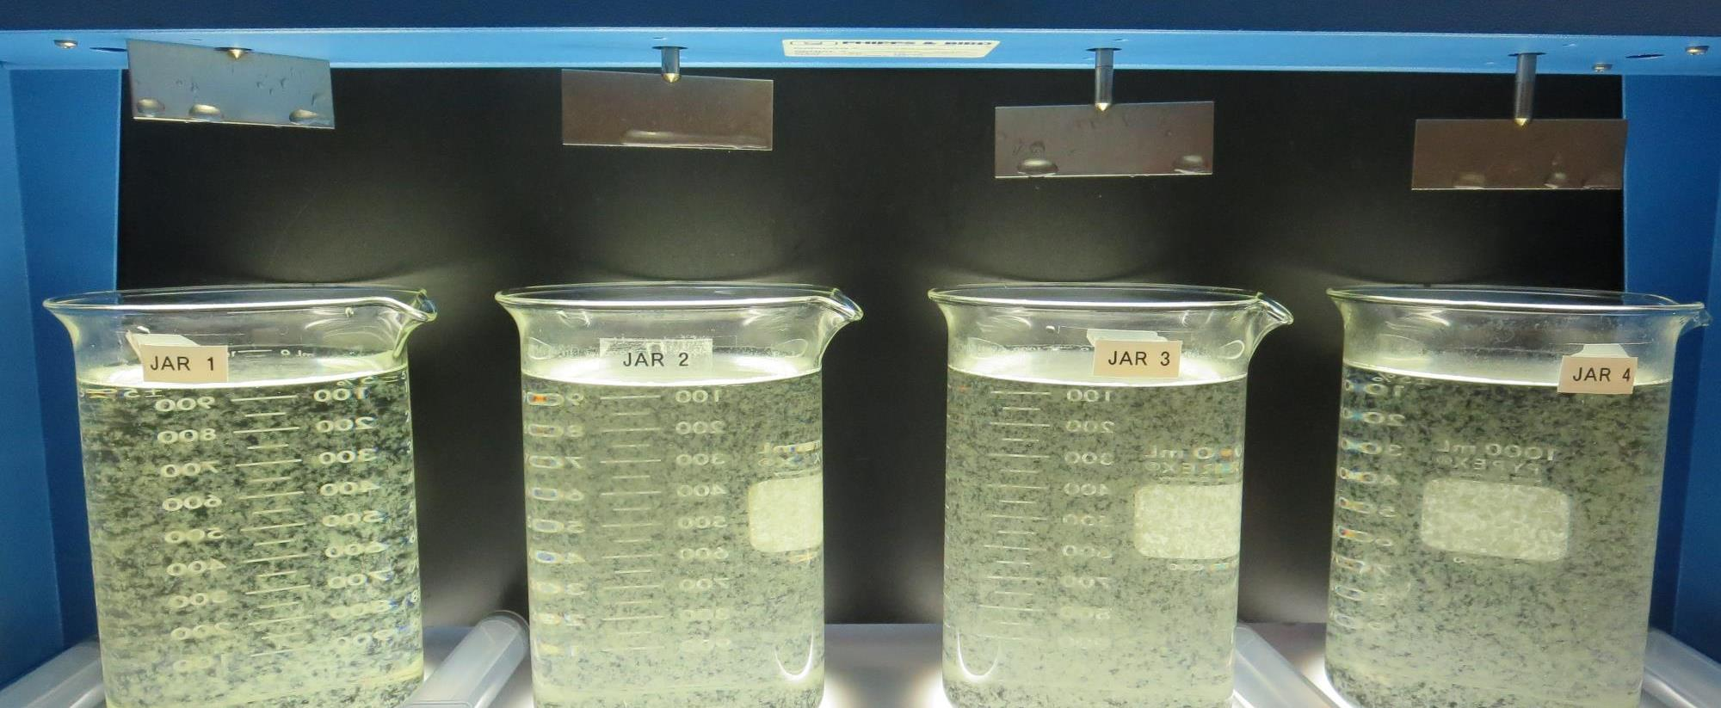
Jars 1-4: End of 15-minute flocculation (20 RPM) duration.
0 mg/L KMnO₄
0 mg/L H₂SO₄
0 mg/L PAC
80 mg/L 9800
Filtrate 0.16 NTU
UVT: 89.0%
UVA: 0.051/cm
UVA Reduction 25.0%
Settled: 0.70 NTU
0 mg/L KMnO₄
0 mg/L H₂SO₄
10 mg/L PAC
80 mg/L 9800
Filtrate 0.32 NTU
UVT: 89.1%
UVA: 0.049/cm
UVA Reduction 27.9%
Settled: 0.90 NTU
0 mg/L KMnO₄
0 mg/L H₂SO₄
15 mg/L PAC
80 mg/L 9800
Filtrate 0.31 NTU
UVT: 89.8%
UVA: 0.046/cm
UVA Reduction 32.4%
Settled: 0.97 NTU
0 mg/L KMnO₄
0 mg/L H₂SO₄
20 mg/L PAC
80 mg/L 9800
Filtrate 0.28 NTU
UVT: 89.7%
UVA: 0.046/cm
UVA Reduction 32.4%
Settled: 0.72 NTU

Slide 18
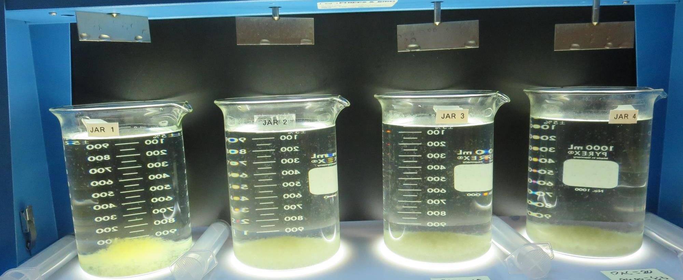
Jars 1-4: After 5 min of settling, 25 mL is syringed for filterability and %UVT/UVA.

Slide 19
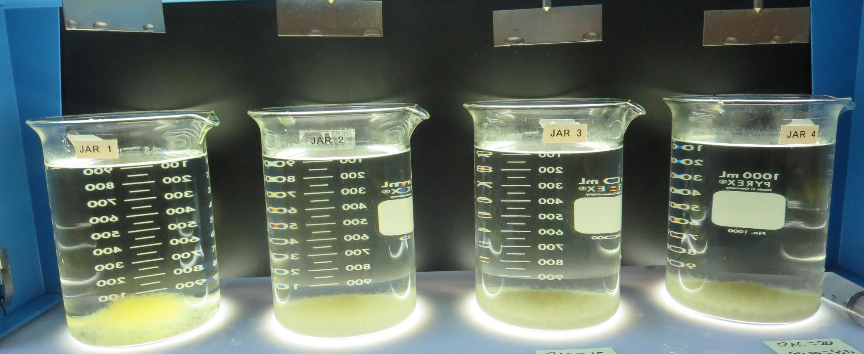
Jars 1-4: After 25-minutes of settling, settled water turbidity is taken.
0 mg/L KMnO₄
0 mg/L H₂SO₄
0 mg/L PAC
80 mg/L 9800
Filtrate 0.16 NTU
UVT: 89.0%
UVA: 0.051/cm
UVA Reduction 25.0%
Settled: 0.70 NTU
0 mg/L KMnO₄
0 mg/L H₂SO₄
10 mg/L PAC
80 mg/L 9800
Filtrate 0.32 NTU
UVT: 89.1%
UVA: 0.049/cm
UVA Reduction 27.9%
Settled: 0.90 NTU
0 mg/L KMnO₄
0 mg/L H₂SO₄
15 mg/L PAC
80 mg/L 9800
Filtrate 0.31 NTU
UVT: 89.8%
UVA: 0.046/cm
UVA Reduction 32.4%
Settled: 0.97 NTU
0 mg/L KMnO₄
0 mg/L H₂SO₄
20 mg/L PAC
80 mg/L 9800
Filtrate 0.28 NTU
UVT: 89.7%
UVA: 0.046/cm
UVA Reduction 32.4%
Settled: 0.72 NTU

Slide 20
Jars 5-8 Test
Flash Mix 30 Sec (200 RPM)
Floc Mix 15 min (20 RPM)
Applied PAC + Acid (H₂SO₄) +
Applied Coagulant
9800

Slide 21
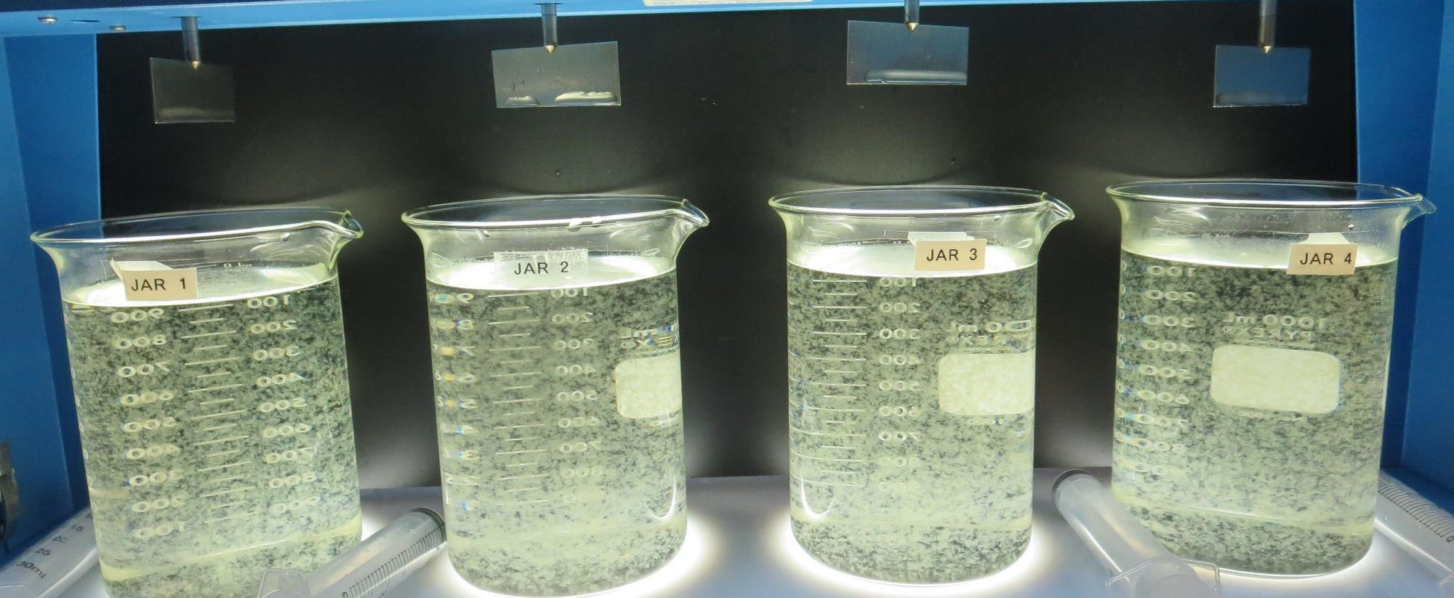
Jars 5-8: End of 15-minute flocculation (20 RPM) duration.
0 mg/L KMnO₄
25 mg/L H₂SO₄
0 mg/L PAC
80 mg/L 9800
Filtrate 0.12 NTU
UVT: 90.3%
UVA: 0.044/cm
UVA Reduction 35.3%
Settled: 0.40 NTU
0 mg/L KMnO₄
25 mg/L H₂SO₄
10 mg/L PAC
80 mg/L 9800
Filtrate 0.19 NTU
UVT: 91.2%
UVA: 0.039/cm
UVA Reduction 42.6%
Settled: 0.58 NTU
0 mg/L KMnO₄
25 mg/L H₂SO₄
15 mg/L PAC
80 mg/L 9800
Filtrate 0.20 NTU
UVT: 91.0%
UVA: 0.040/cm
UVA Reduction 41.2%
Settled: 0.61 NTU
0 mg/L KMnO₄
25 mg/L H₂SO₄
20 mg/L PAC
80 mg/L 9800
Filtrate 0.18 NTU
UVT: 90.4%
UVA: 0.043/cm
UVA Reduction 36.8%
Settled: 0.52 NTU

Slide 22
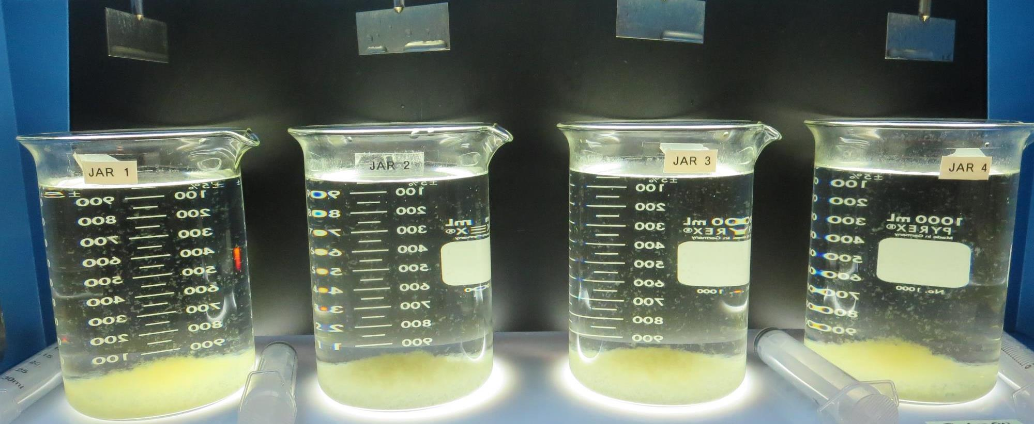
Jars 5-8: After 5 min of settling, 25 mL is syringed for filterability and %UVT/UVA.

Slide 23
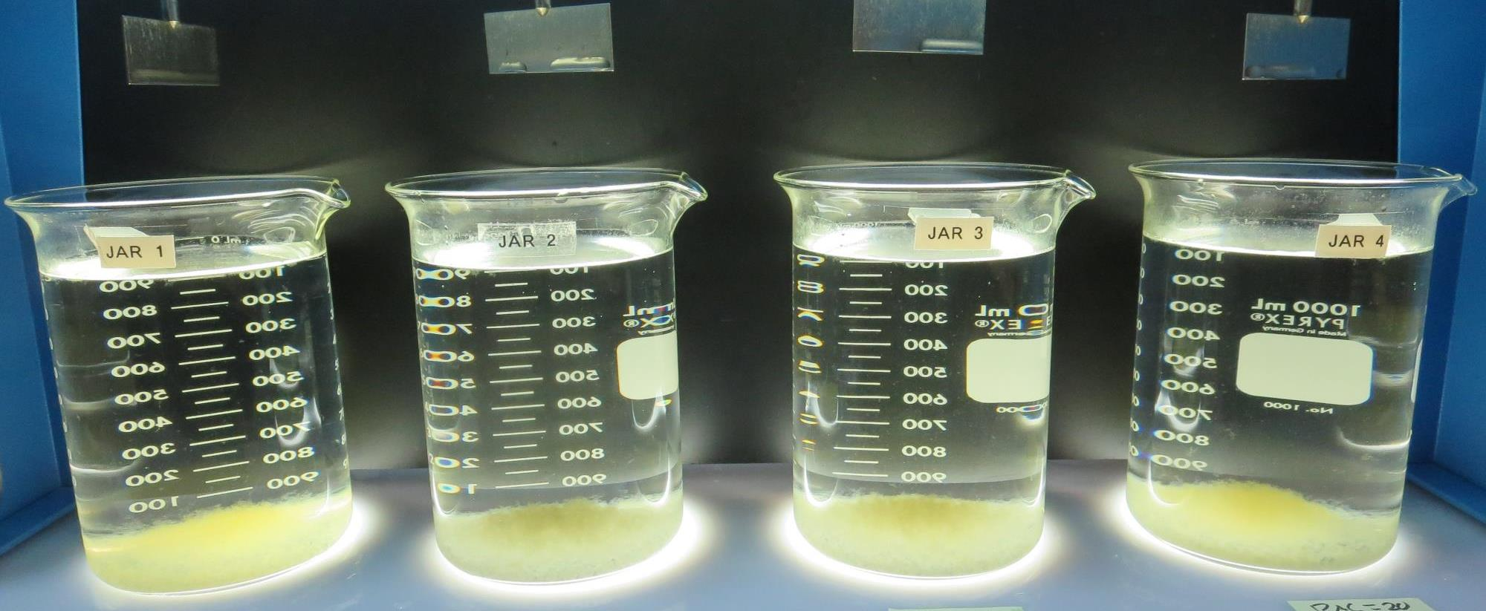
Jars 5-8: After 25-minutes of settling, settled water turbidity is taken.
0 mg/L KMnO₄
25 mg/L H₂SO₄
0 mg/L PAC
80 mg/L 9800
Filtrate 0.12 NTU
UVT: 90.3%
UVA: 0.044/cm
UVA Reduction 35.3%
Settled: 0.40 NTU
0 mg/L KMnO₄
25 mg/L H₂SO₄
10 mg/L PAC
80 mg/L 9800
Filtrate 0.19 NTU
UVT: 91.2%
UVA: 0.039/cm
UVA Reduction 42.6%
Settled: 0.58 NTU
0 mg/L KMnO₄
25 mg/L H₂SO₄
15 mg/L PAC
80 mg/L 9800
Filtrate 0.20 NTU
UVT: 91.0%
UVA: 0.040/cm
UVA Reduction 41.2%
Settled: 0.61 NTU
0 mg/L KMnO₄
25 mg/L H₂SO₄
20 mg/L PAC
80 mg/L 9800
Filtrate 0.18 NTU
UVT: 90.4%
UVA: 0.043/cm
UVA Reduction 36.8%
Settled: 0.52 NTU

Slide 24
Jars 9-12 Test
Flash Mix 30 Sec (200 RPM)
Floc Mix 15 min (20 RPM)
Applied PAC + Acid (H₂SO₄) +
Applied Coagulant
9800

Slide 25
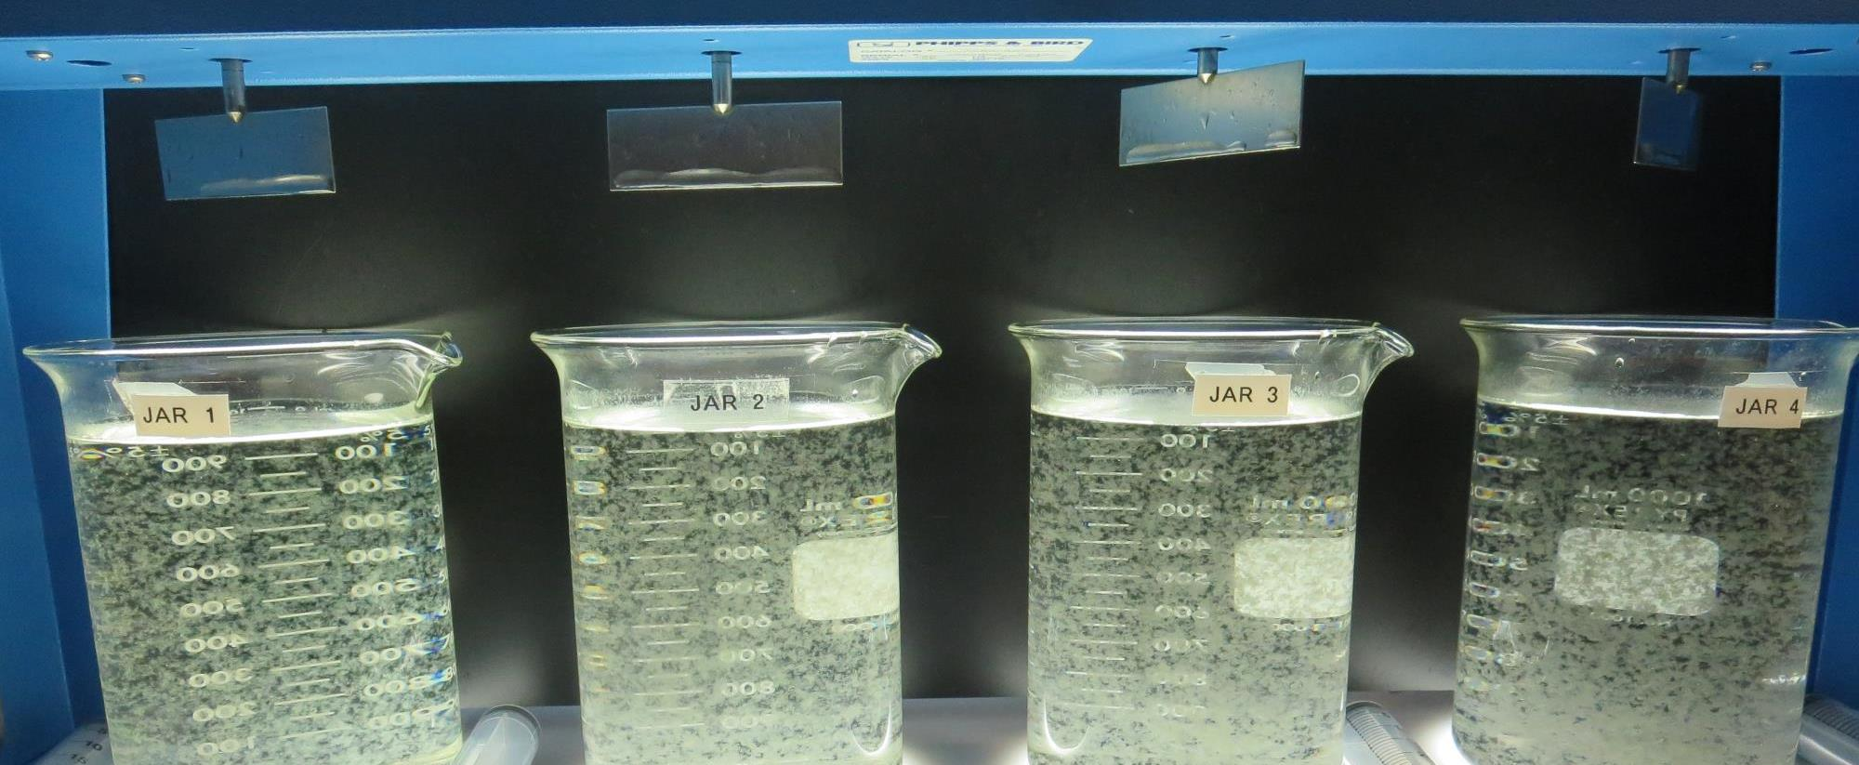
Jars 9-12: End of 15-minute flocculation (20 RPM) duration.
0 mg/L KMnO₄
25 mg/L H₂SO₄
0 mg/L PAC
80 mg/L 9800
Filtrate 0.13 NTU
UVT: 90.2%
UVA: 0.044/cm
UVA Reduction 35.3%
Settled: 0.38 NTU
0 mg/L KMnO₄
25 mg/L H₂SO₄
10 mg/L PAC
80 mg/L 9800
Filtrate 0.13 NTU
UVT: 91.2%
UVA: 0.039/cm
UVA Reduction 42.6%
Settled: 0.71 NTU
0 mg/L KMnO₄
25 mg/L H₂SO₄
15 mg/L PAC
80 mg/L 9800
Filtrate 0.12 NTU
UVT: 91.7%
UVA: 0.037/cm
UVA Reduction 45.6%
Settled: 0.59 NTU
0 mg/L KMnO₄
25 mg/L H₂SO₄
20 mg/L PAC
80 mg/L 9800
Filtrate 0.09 NTU
UVT: 92.1%
UVA: 0.035/cm
UVA Reduction 48.5%
Settled: 0.42 NTU

Slide 26
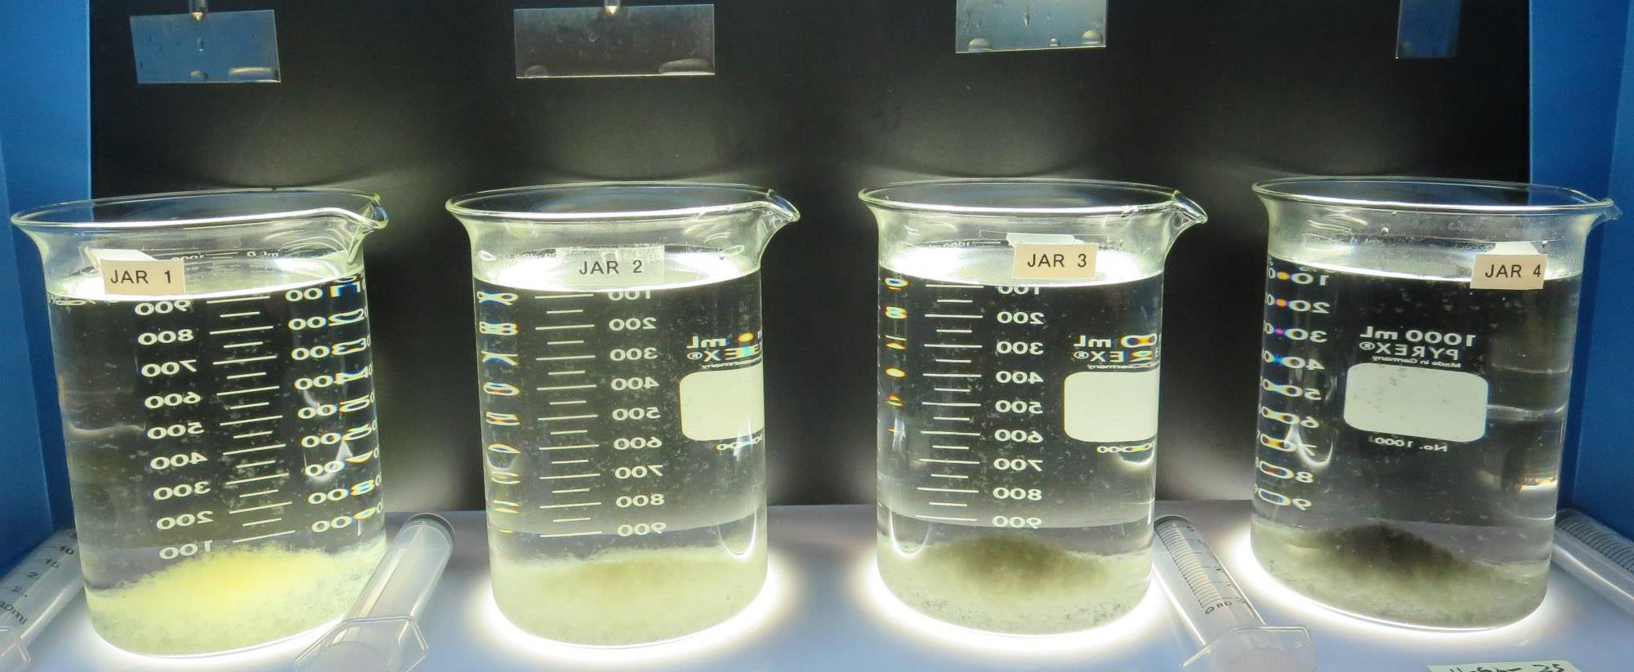
Jars 9-12: After 5 min of settling, 25 mL is syringed for filterability and %UVT/UVA.

Slide 27
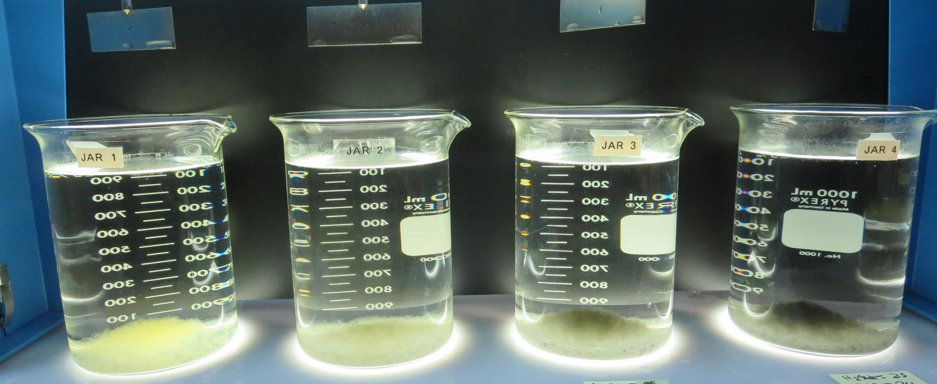
Jars 9-12: After 25-minutes of settling, settled water turbidity is taken.
0 mg/L KMnO₄
25 mg/L H₂SO₄
0 mg/L PAC
80 mg/L 9800
Filtrate 0.13 NTU
UVT: 90.2%
UVA: 0.044/cm
UVA Reduction 35.3%
Settled: 0.38 NTU
0 mg/L KMnO₄
25 mg/L H₂SO₄
10 mg/L PAC
80 mg/L 9800
Filtrate 0.13 NTU
UVT: 91.2%
UVA: 0.039/cm
UVA Reduction 42.6%
Settled: 0.71 NTU
0 mg/L KMnO₄
25 mg/L H₂SO₄
15 mg/L PAC
80 mg/L 9800
Filtrate 0.12 NTU
UVT: 91.7%
UVA: 0.037/cm
UVA Reduction 45.6%
Settled: 0.59 NTU
0 mg/L KMnO₄
25 mg/L H₂SO₄
20 mg/L PAC
80 mg/L 9800
Filtrate 0.09 NTU
UVT: 92.1%
UVA: 0.035/cm
UVA Reduction 48.5%
Settled: 0.42 NTU

Slide 28
Jars 13-16 Test
Flash Mix 30 Sec (200 RPM)
Floc Mix 15 min (20 RPM)
Applied PAC + Acid (H₂SO₄) +
Applied Coagulant
9800

Slide 29
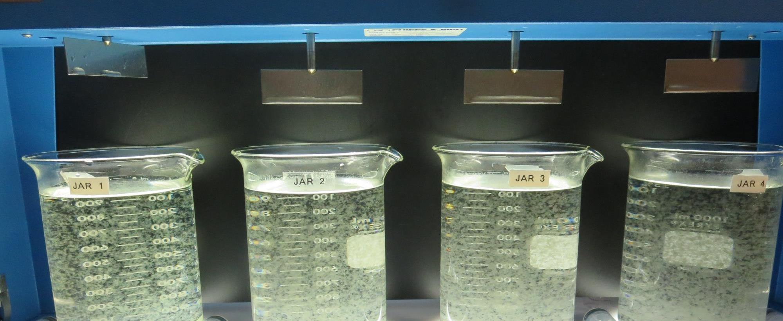
Jars 13-16: End of 15-minute flocculation (20 RPM) duration.
0 mg/L KMnO₄
25 mg/L H₂SO₄
80 mg/L 9800
0 mg/L PAC
Filtrate 0.19 NTU
UVT: 90.4%
UVA: 0.043/cm
UVA Reduction 36.8%
Settled: 0.39 NTU
0 mg/L KMnO₄
25 mg/L H₂SO₄
80 mg/L 9800
10 mg/L PAC
Filtrate 0.12 NTU
UVT: 91.4%
UVA: 0.039/cm
UVA Reduction 42.6%
Settled: 0.90 NTU
0 mg/L KMnO₄
25 mg/L H₂SO₄
80 mg/L 9800
15 mg/L PAC
Filtrate 0.18 NTU
UVT: 91.8%
UVA: 0.036/cm
UVA Reduction 47.1%
Settled: 1.28 NTU
0 mg/L KMnO₄
25 mg/L H₂SO₄
80 mg/L 9800
20 mg/L PAC
Filtrate 0.17 NTU
UVT: 92.0%
UVA: 0.035/cm
UVA Reduction 47.1%
Settled: 1.87 NTU

Slide 30
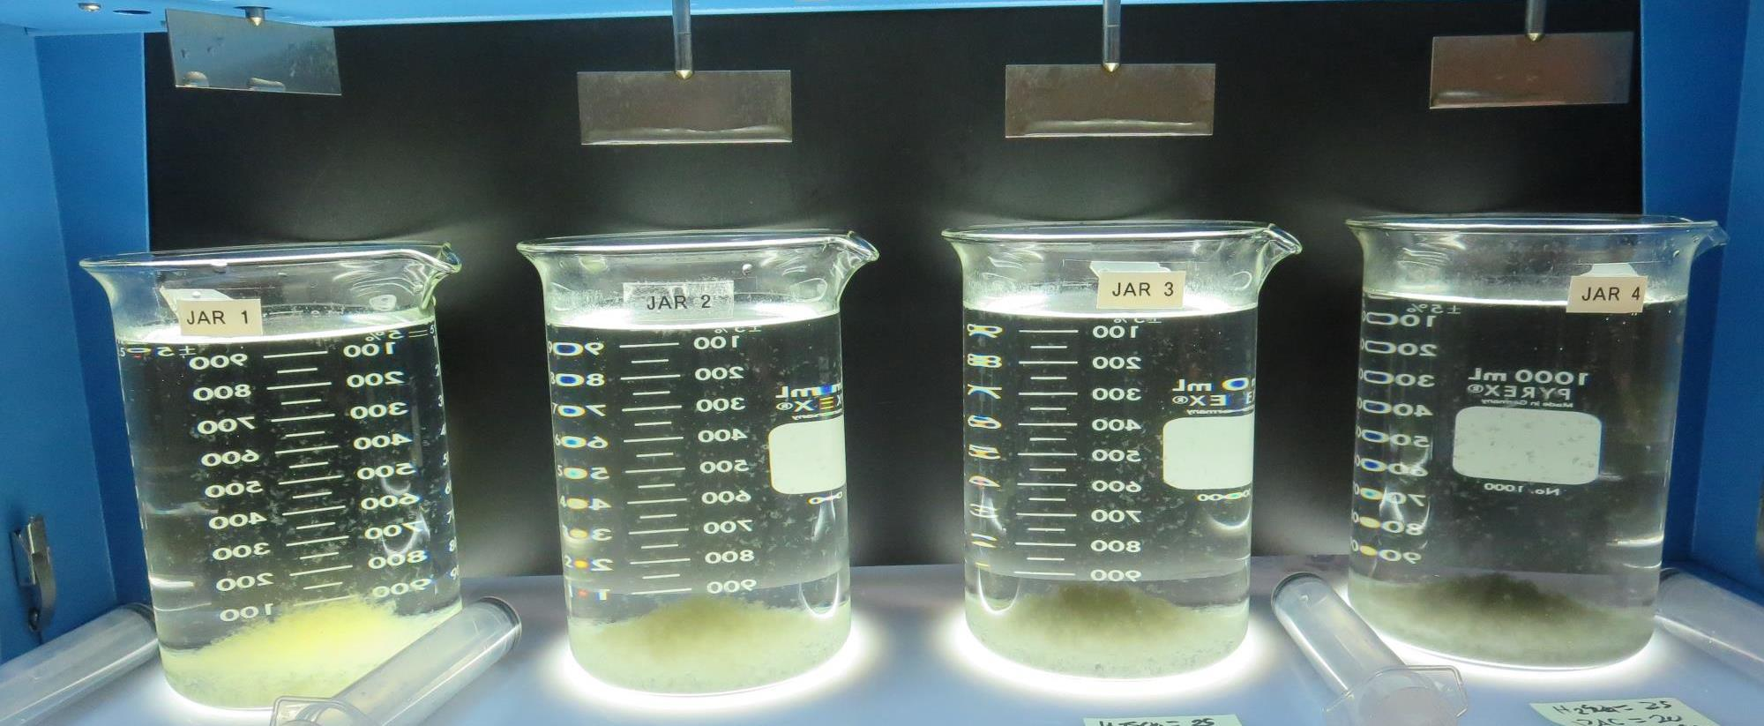
Jars 13-16: After 5 min of settling, 25 mL is syringed for filterability and %UVT/UVA.

Slide 31
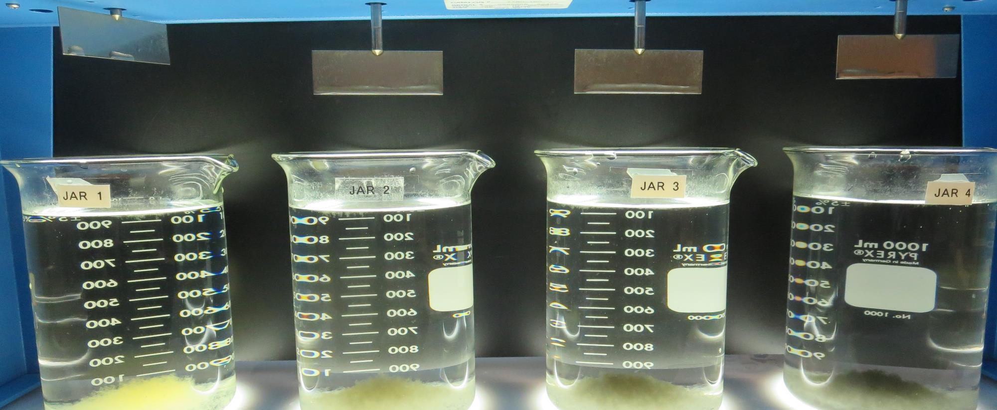
Jars 13-16: After 25-minutes of settling, settled water turbidity is taken.
0 mg/L KMnO₄
25 mg/L H₂SO₄
80 mg/L 9800
0 mg/L PAC
Filtrate 0.19 NTU
UVT: 90.4%
UVA: 0.043/cm
UVA Reduction 36.8%
Settled: 0.39 NTU
0 mg/L KMnO₄
25 mg/L H₂SO₄
80 mg/L 9800
10 mg/L PAC
Filtrate 0.12 NTU
UVT: 91.4%
UVA: 0.039/cm
UVA Reduction 42.6%
Settled: 0.90 NTU
0 mg/L KMnO₄
25 mg/L H₂SO₄
80 mg/L 9800
15 mg/L PAC
Filtrate 0.18 NTU
UVT: 91.8%
UVA: 0.036/cm
UVA Reduction 47.1%
Settled: 1.28 NTU
0 mg/L KMnO₄
25 mg/L H₂SO₄
80 mg/L 9800
20 mg/L PAC
Filtrate 0.17 NTU
UVT: 92.0%
UVA: 0.035/cm
UVA Reduction 47.1%
Settled: 1.87 NTU

Slide 32
Jars 17-20 Test
Flash Mix 30 Sec (200 RPM)
Floc Mix 15 min (20 RPM)
Applied KMnO₄ +
Applied PAC + Acid (H₂SO₄) +
Applied Coagulant
9800

Slide 33
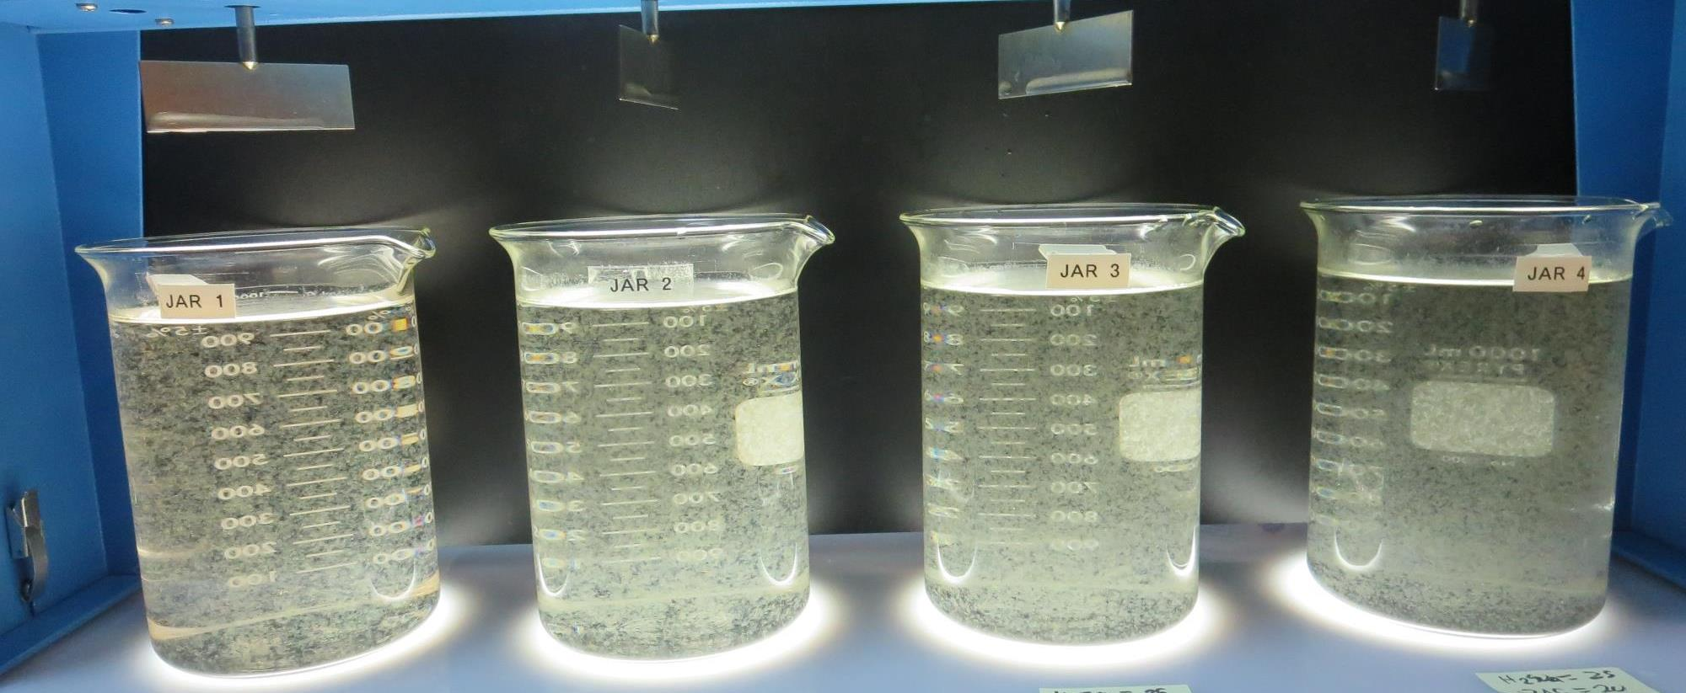
Jars 17-20: End of 15-minute flocculation (20 RPM) duration.
0.8 mg/L KMnO₄
25 mg/L H₂SO₄
0 mg/L PAC
80 mg/L 9800
Filtrate 0.06 NTU
UVT: 91.2%
UVA: 0.039/cm
UVA Reduction 42.6%
Settled: 0.40 NTU
0.8 mg/L KMnO₄
25 mg/L H₂SO₄
10 mg/L PAC
80 mg/L 9800
Filtrate 0.07 NTU
UVT: 92.2%
UVA: 0.035/cm
UVA Reduction 48.5%
Settled: 0.33 NTU
0.8 mg/L KMnO₄
25 mg/L H₂SO₄
15 mg/L PAC
80 mg/L 9800
Filtrate 0.06 NTU
UVT: 92.8%
UVA: 0.032/cm
UVA Reduction 52.9%
Settled: 0.41 NTU
0.8 mg/L KMnO₄
25 mg/L H₂SO₄
20 mg/L PAC
80 mg/L 9800
Filtrate 0.06 NTU
UVT: 93.2%
UVA: 0.030/cm
UVA Reduction 55.9%
Settled: 0.37 NTU

Slide 34
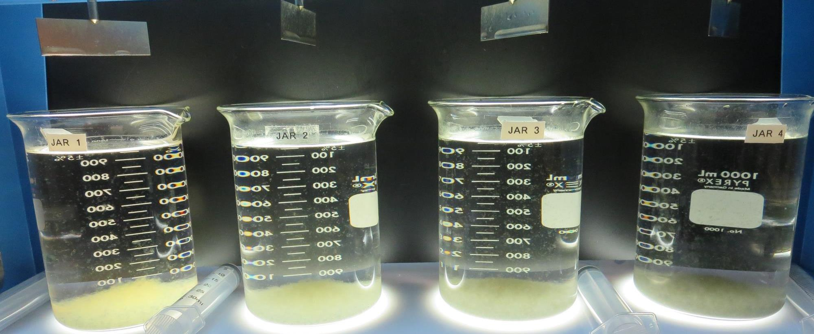
Jars 17-20: After 5 min of settling, 25 mL is syringed for filterability and %UVT/UVA.

Slide 35
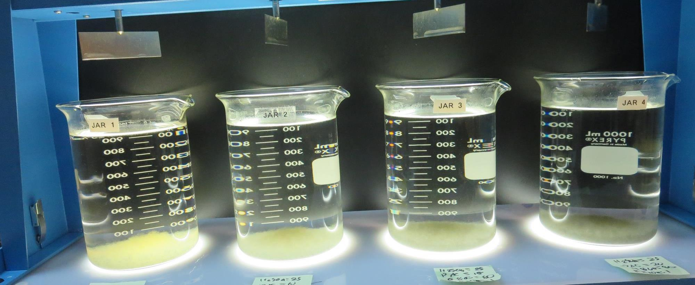
Jars 17-20: After 25-minutes of settling, settled water turbidity is taken.
0.8 mg/L KMnO₄
25 mg/L H₂SO₄
0 mg/L PAC
80 mg/L 9800
Filtrate 0.06 NTU
UVT: 91.2%
UVA: 0.039/cm
UVA Reduction 42.6%
Settled: 0.40 NTU
0.8 mg/L KMnO₄
25 mg/L H₂SO₄
10 mg/L PAC
80 mg/L 9800
Filtrate 0.07 NTU
UVT: 92.2%
UVA: 0.035/cm
UVA Reduction 48.5%
Settled: 0.33 NTU
0.8 mg/L KMnO₄
25 mg/L H₂SO₄
15 mg/L PAC
80 mg/L 9800
Filtrate 0.06 NTU
UVT: 92.8%
UVA: 0.032/cm
UVA Reduction 52.9%
Settled: 0.41 NTU
0.8 mg/L KMnO₄
25 mg/L H₂SO₄
20 mg/L PAC
80 mg/L 9800
Filtrate 0.06 NTU
UVT: 93.2%
UVA: 0.030/cm
UVA Reduction 55.9%
Settled: 0.37 NTU

Slide 36
Jars 21-24 Test
Flash Mix 30 Sec (200 RPM)
Floc Mix 15 min (20 RPM)
Applied KMnO₄ +
Applied PAC + Acid (H₂SO₄) +
Applied Coagulant
9800

Slide 37
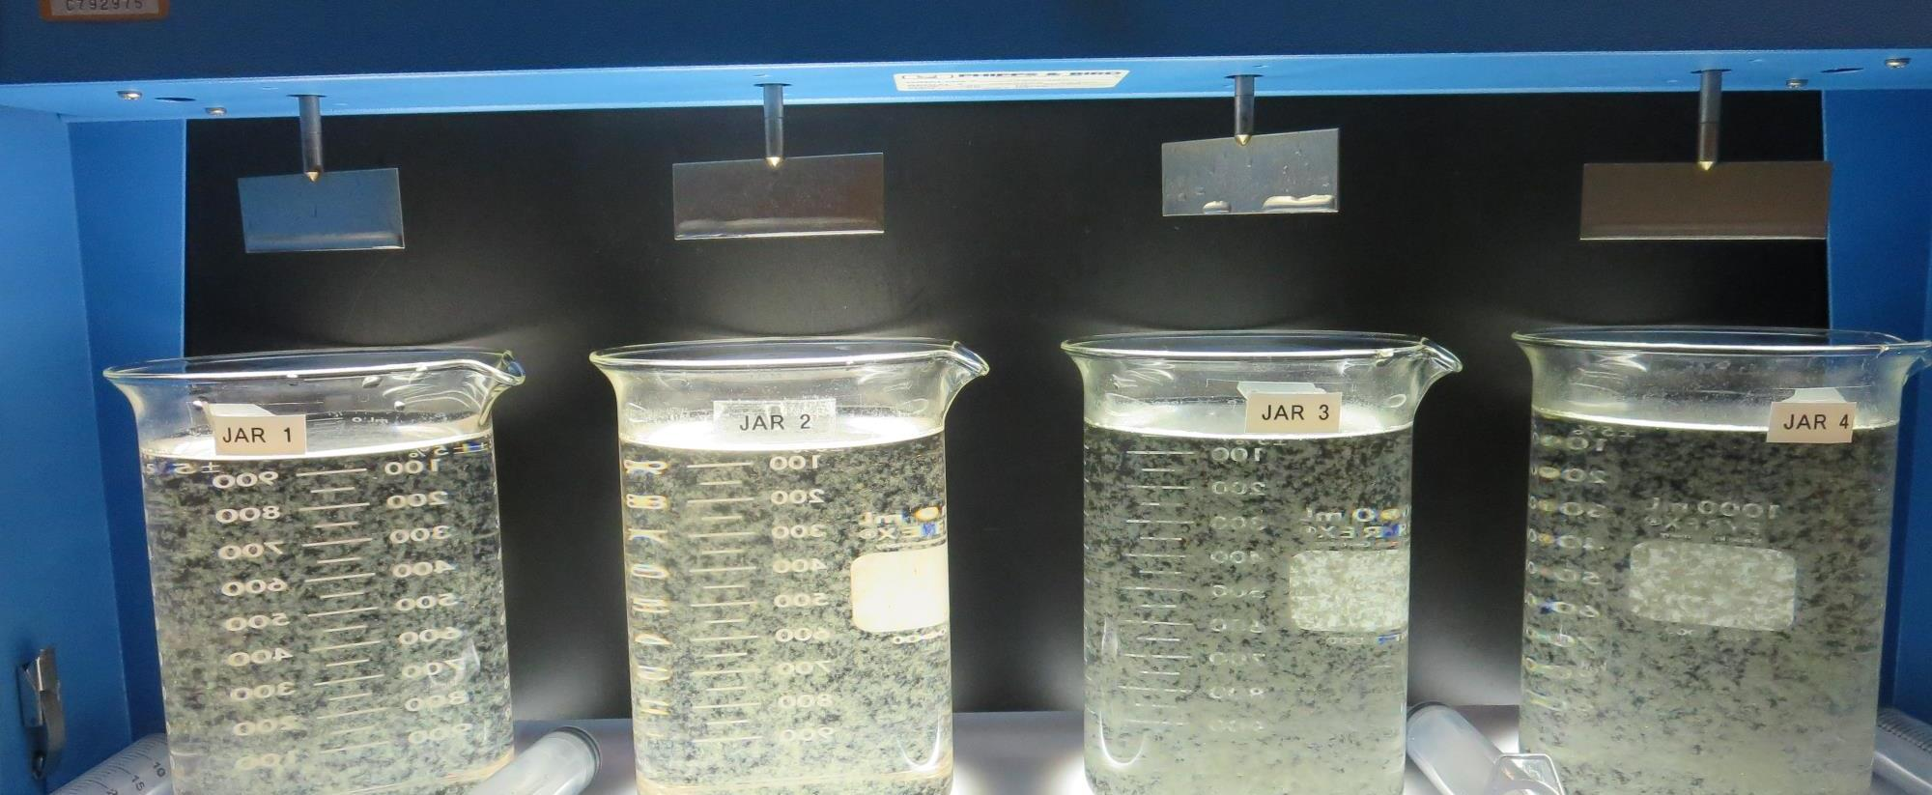
Jars 21-24: End of 15-minute flocculation (20 RPM) duration.
0.8 mg/L KMnO₄
0 mg/L H₂SO₄
0 mg/L PAC
80 mg/L 9800
Filtrate 0.09 NTU
UVT: 89.8%
UVA: 0.046/cm
UVA Reduction 32.4%
Settled: 0.37 NTU
0.8 mg/L KMnO₄
25 mg/L H₂SO₄
0 mg/L PAC
80 mg/L 9800
Filtrate 0.06 NTU
UVT: 91.6%
UVA: 0.037/cm
UVA Reduction 45.6%
Settled: 0.32 NTU
0.8 mg/L KMnO₄
25 mg/L H₂SO₄
20 mg/L PAC
80 mg/L 9800
Filtrate 0.06 NTU
UVT: 93.2%
UVA: 0.030/cm
UVA Reduction 55.9%
Settled: 0.39 NTU
0.8 mg/L KMnO₄
25 mg/L H₂SO₄
80 mg/L 9800
20 mg/L PAC
Filtrate 0.07 NTU
UVT: 93.1%
UVA: 0.030/cm
UVA Reduction 55.9%
Settled: 0.99 NTU

Slide 38
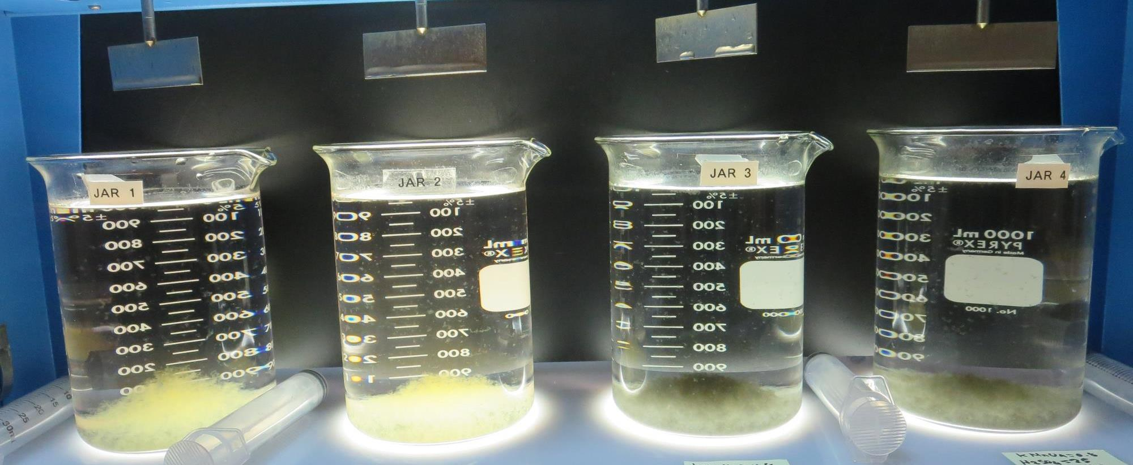
Jars 21-24: After 5 min of settling, 25 mL is syringed for filterability and %UVT/UVA.

Slide 39
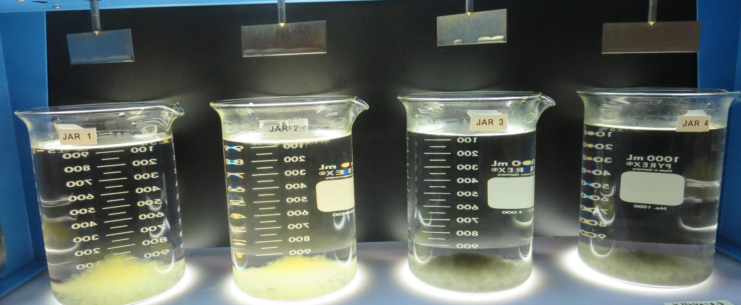
Jars 21-24: After 25-minutes of settling, settled water turbidity is taken.
0.8 mg/L KMnO₄
0 mg/L H₂SO₄
0 mg/L PAC
80 mg/L 9800
Filtrate 0.09 NTU
UVT: 89.8%
UVA: 0.046/cm
UVA Reduction 32.4%
Settled: 0.37 NTU
0.8 mg/L KMnO₄
25 mg/L H₂SO₄
0 mg/L PAC
80 mg/L 9800
Filtrate 0.06 NTU
UVT: 91.6%
UVA: 0.037/cm
UVA Reduction 45.6%
Settled: 0.32 NTU
0.8 mg/L KMnO₄
25 mg/L H₂SO₄
20 mg/L PAC
80 mg/L 9800
Filtrate 0.06 NTU
UVT: 93.2%
UVA: 0.030/cm
UVA Reduction 55.9%
Settled: 0.39 NTU
0.8 mg/L KMnO₄
25 mg/L H₂SO₄
80 mg/L 9800
20 mg/L PAC
Filtrate 0.07 NTU
UVT: 93.1%
UVA: 0.030/cm
UVA Reduction 55.9%
Settled: 0.99 NTU

Slide 40
Jars 25-28 Test
Flash Mix 30 Sec (200 RPM)
Floc Mix 15 min (20 RPM)
Applied KMnO₄ +
Applied PAC + Acid (H₂SO₄) +
Applied Coagulant
9800

Slide 41
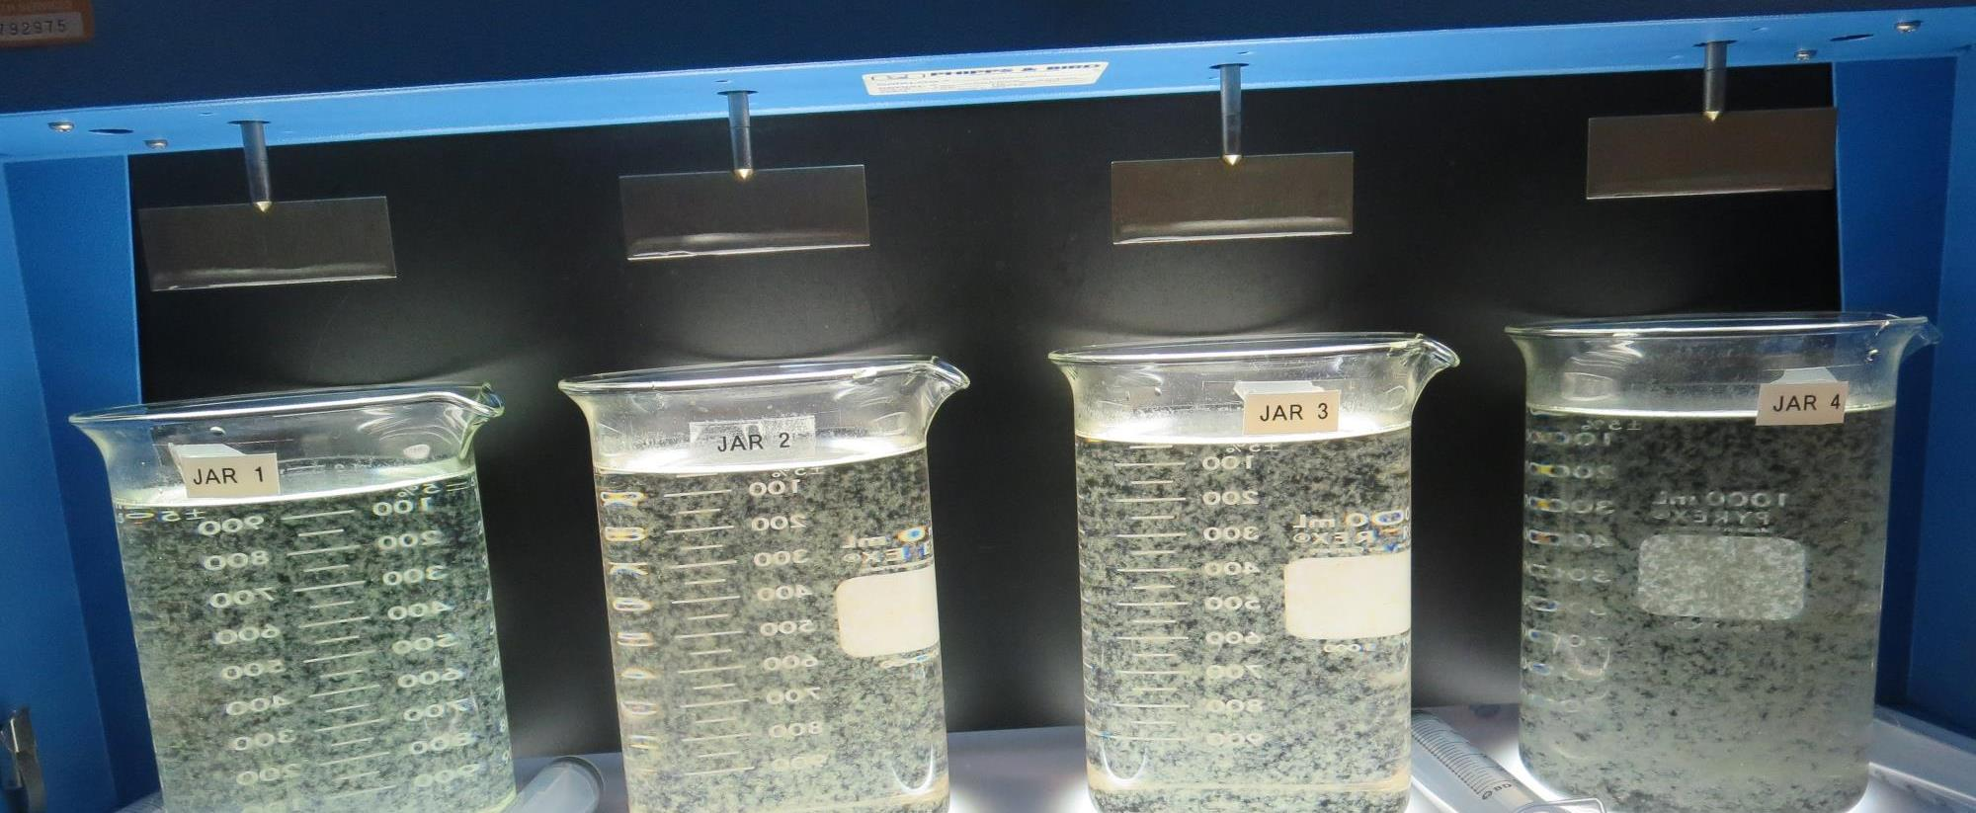
Jars 25-28: End of 15-minute flocculation (20 RPM) duration.
0 mg/L KMnO₄
0 mg/L H₂SO₄
0 mg/L PAC
80 mg/L 9800
Filtrate 0.09 NTU
UVT: 89.3%
UVA: 0.048/cm
UVA Reduction 29.4%
Settled: 0.26 NTU
0.8 mg/L KMnO₄
0 mg/L H₂SO₄
0 mg/L PAC
80 mg/L 9800
Filtrate 0.09 NTU
UVT: 89.5%
UVA: 0.047/cm
UVA Reduction 30.9%
Settled: 0.34 NTU
0.8 mg/L KMnO₄
25 mg/L H₂SO₄
0 mg/L PAC
80 mg/L 9800
Filtrate 0.08 NTU
UVT: 90.6%
UVA: 0.042/cm
UVA Reduction 38.2%
Settled: 0.37 NTU
0.8 mg/L KMnO₄
25 mg/L H₂SO₄
20 mg/L PAC
80 mg/L 9800
Filtrate 0.07 NTU
UVT: 92.7%
UVA: 0.032/cm
UVA Reduction 52.9%
Settled: 0.31 NTU

Slide 42
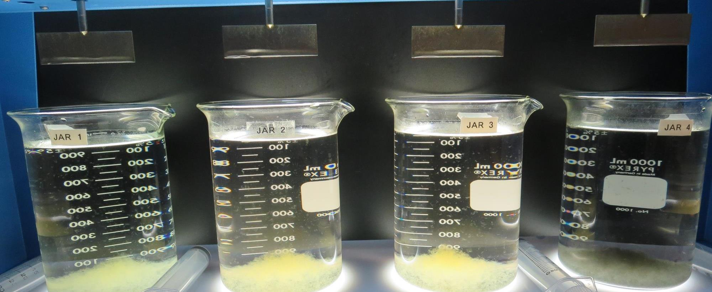
Jars 25-28: After 5 min of settling, 25 mL is syringed for filterability and %UVT/UVA.

Slide 43
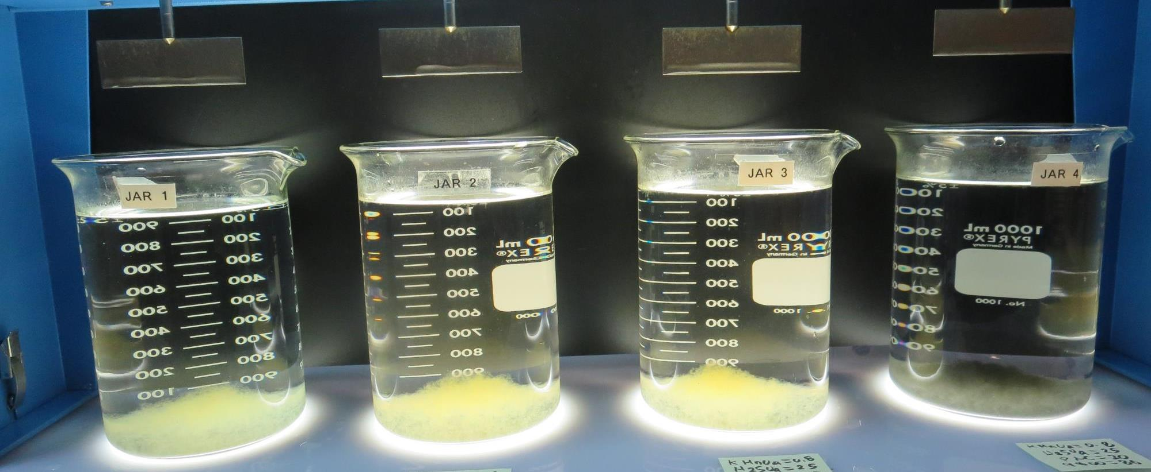
Jars 25-28: After 25-minutes of settling, settled water turbidity is taken.
0 mg/L KMnO₄
0 mg/L H₂SO₄
0 mg/L PAC
80 mg/L 9800
Filtrate 0.09 NTU
UVT: 89.3%
UVA: 0.048/cm
UVA Reduction 29.4%
Settled: 0.26 NTU
0.8 mg/L KMnO₄
0 mg/L H₂SO₄
0 mg/L PAC
80 mg/L 9800
Filtrate 0.09 NTU
UVT: 89.5%
UVA: 0.047/cm
UVA Reduction 30.9%
Settled: 0.34 NTU
0.8 mg/L KMnO₄
25 mg/L H₂SO₄
0 mg/L PAC
80 mg/L 9800
Filtrate 0.08 NTU
UVT: 90.6%
UVA: 0.042/cm
UVA Reduction 38.2%
Settled: 0.37 NTU
0.8 mg/L KMnO₄
25 mg/L H₂SO₄
20 mg/L PAC
80 mg/L 9800
Filtrate 0.07 NTU
UVT: 92.7%
UVA: 0.032/cm
UVA Reduction 52.9%
Settled: 0.31 NTU

Slide 44
Jars 29-32 Test
Flash Mix 30 Sec (200 RPM)
Floc Mix 15 min (20 RPM)
Applied KMnO₄ +
Applied PAC + Acid (H₂SO₄) +
Applied Coagulant
9800

Slide 45
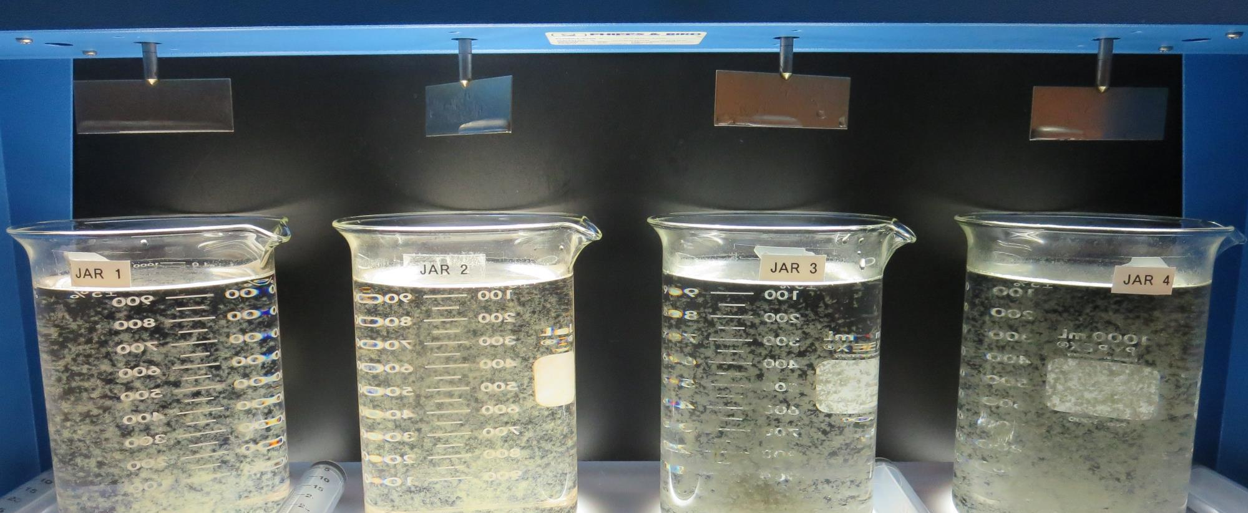
Jars 29-32: End of 15-minute flocculation (20 RPM) duration.
0.8 mg/L KMnO₄
25 mg/L H₂SO₄
0 mg/L PAC
80 mg/L 9800
Filtrate 0.07 NTU
UVT: 90.8%
UVA: 0.041/cm
UVA Reduction 39.7%
Settled: 0.36 NTU
0.8 mg/L KMnO₄
0 mg/L PAC
80 mg/L 9800
25 mg/L H₂SO₄
Filtrate 0.06 NTU
UVT: 90.8%
UVA: 0.041/cm
UVA Reduction 39.7%
Settled: 0.29 NTU
0.8 mg/L KMnO₄
25 mg/L H₂SO₄
20 mg/L PAC
80 mg/L 9800
Filtrate 0.06 NTU
UVT: 92.7%
UVA: 0.032/cm
UVA Reduction 52.9%
Settled: 0.31 NTU
0.8 mg/L KMnO₄
0 mg/L H₂SO₄
20 mg/L PAC
80 mg/L 9800
Filtrate 0.06 NTU
UVT: 91.7%
UVA: 0.037/cm
UVA Reduction 45.6%
Settled: 0.22 NTU

Slide 46
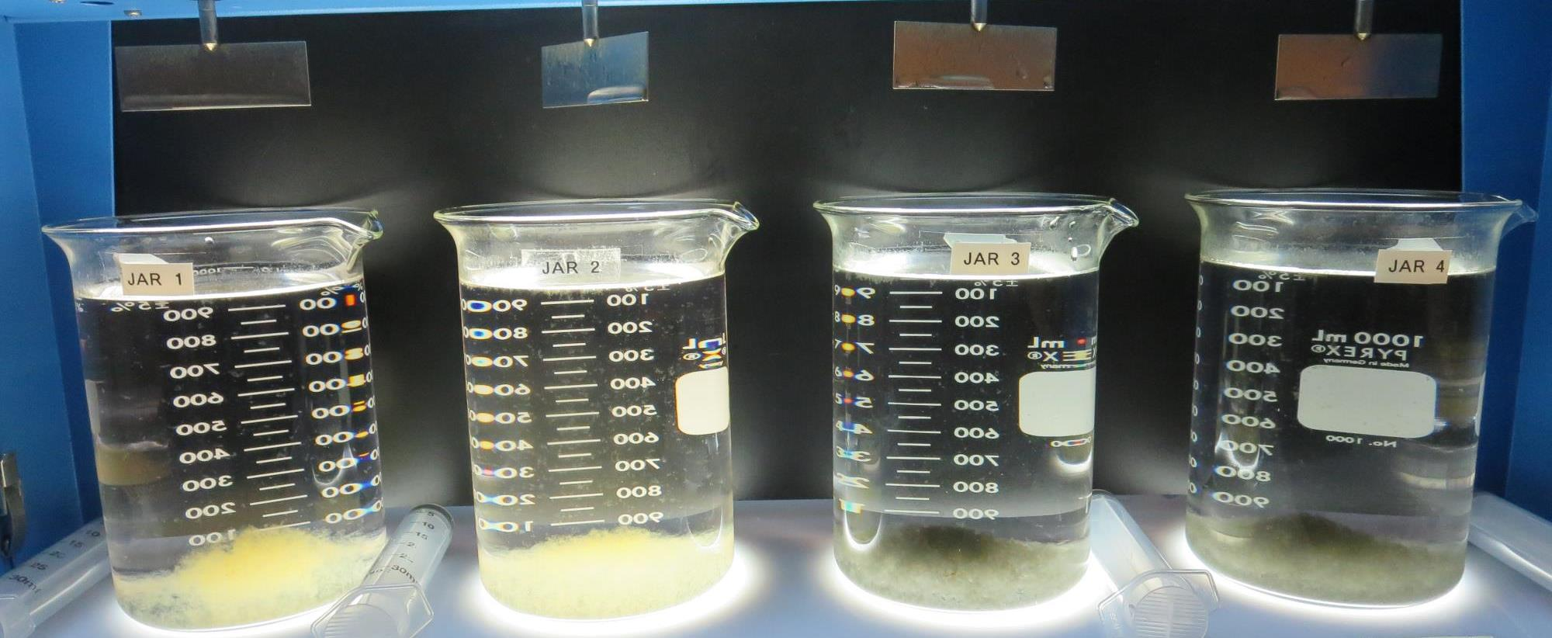
Jars 29-32: After 5 min of settling, 25 mL is syringed for filterability and %UVT/UVA.

Slide 47
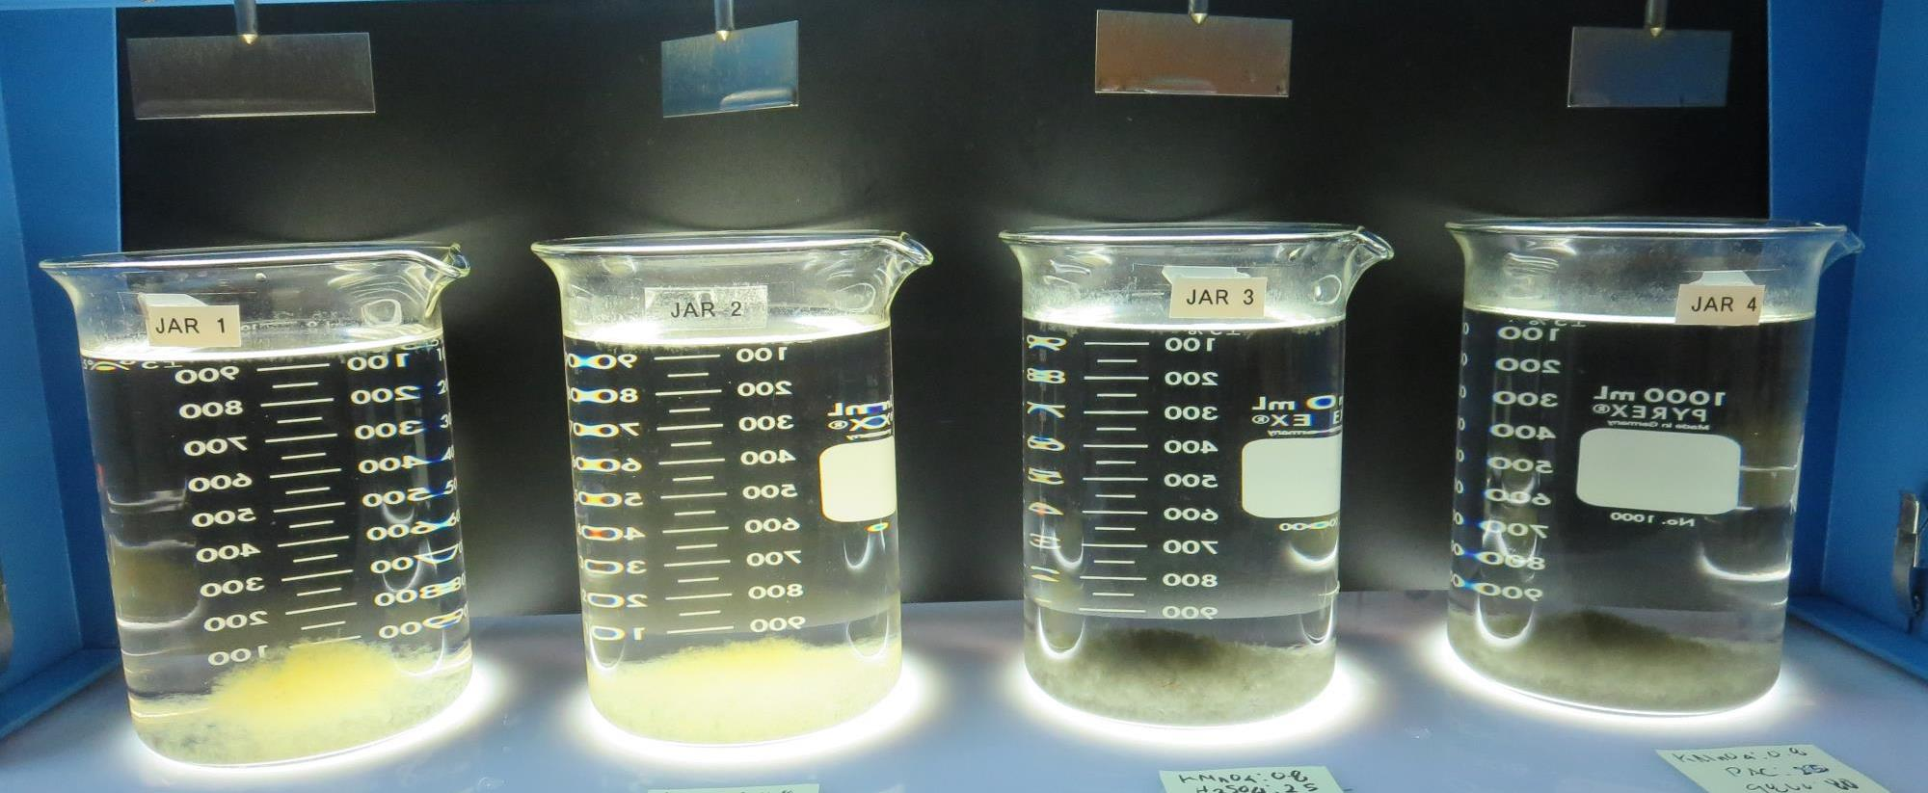
Jars 29-32: After 25-minutes of settling, settled water turbidity is taken.
0.8 mg/L KMnO₄
25 mg/L H₂SO₄
0 mg/L PAC
80 mg/L 9800
Filtrate 0.07 NTU
UVT: 90.8%
UVA: 0.041/cm
UVA Reduction 39.7%
Settled: 0.36 NTU
0.8 mg/L KMnO₄
0 mg/L PAC
80 mg/L 9800
25 mg/L H₂SO₄
Filtrate 0.06 NTU
UVT: 90.8%
UVA: 0.041/cm
UVA Reduction 39.7%
Settled: 0.29 NTU
0.8 mg/L KMnO₄
25 mg/L H₂SO₄
20 mg/L PAC
80 mg/L 9800
Filtrate 0.06 NTU
UVT: 92.7%
UVA: 0.032/cm
UVA Reduction 52.9%
Settled: 0.31 NTU
0.8 mg/L KMnO₄
0 mg/L H₂SO₄
20 mg/L PAC
80 mg/L 9800
Filtrate 0.06 NTU
UVT: 91.7%
UVA: 0.037/cm
UVA Reduction 45.6%
Settled: 0.22 NTU

Slide 48
Jar Testing for 1-Liter Jars:
Procedures for Most Treatment Plants
Fill jars with source water prior to coagulant injection and set paddle speed at 30 rpm
Add chemicals (i.e., NaOCl, primary coagulant, coagulant aid) to each jar
Flash mix for 15-30 seconds (200 rpm)
Slow mix for 5 minutes (20-30 rpm)
Settled for 5 minutes. Syringe 25 mL from each jar taken 1-inch below surface (25 mL/12 sec rate)
Filtered through 1.2 um isopore membrane into cuvette drip rate, 15 mL/(50-90 sec)
Measure filtrate turbidity, chlorine residual and %UVT/UVA
Measure settled water turbidity after 25 minutes of total setting
Record all data

Slide 49

Jar Test
Filterability Test Equipment
Turbidity Instrument
Syringe w/Luer-Lock Tip, 30 cc
(part#: 2225800, by Hach)
Swinnex Filter Holder, 25 mm (part#: SX0002500)
Isopore Membrane Filter, 1.2 um absolute
pore size,
Φ= 25 mm , thickness: 24 um,
hydrophilic polycarbonate membrane
(part #: RTTP02500)
Go to Sigma-Aldrich for laboratory supplies http://www.sigmaaldrich.com/united-states.html

Slide 50
Isopore Membrane Information
Categories | Information
trade name | Isopore
filter color | White
chemistry | Polycarbonate (PC)
water flow rate | Avg. 175 mL/min x cm² (typical results @ 10 psi)
media | Isopore®
wettability | Hydrophilic
porosity | 14.7%
pore size | 1.2 µm
bubble point at 23 °C | 1.0 bar, air with water
thickness | 24 µm
filter diameter (ø) | 25 mm
material size | polycarbonate, Hydrophilic, 1.2 µm, 25 mm, white, plain, 100

Slide 51
Isopore Membrane Background Information
The Isopore membrane is a polycarbonate, track-etched screen filter recommended for all analyses in which the sample is viewed on the surface of the membrane. The Isopore membrane is composed of polycarbonate film, which has a smooth, glass-like surface for clearer sample observation. The unique manufacturing process of the membrane ensures a precise pore diameter and a consistent pore size for accurate separation of samples by size. Matched-weight filters are not usually required because of low, constant tar and ash weights.
Features & Benefits:
Membrane structure retains particles on the surface, simplifying counting and analysis

Slide 52
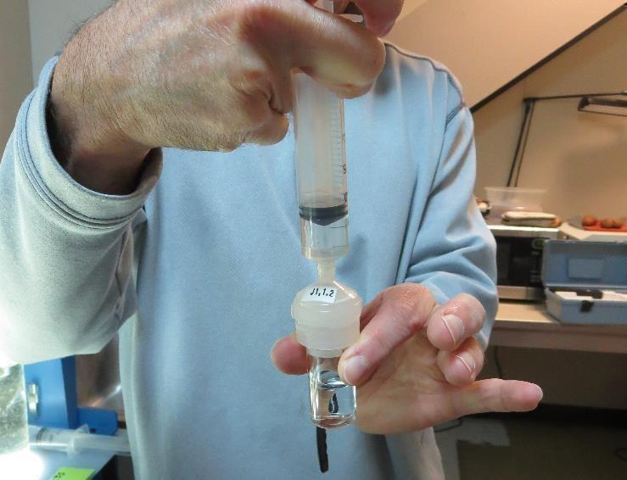

Jar Test - Filterability Test
Syringe ~ 25 mL from jar (after 5-minutes of settling)
Filter-to-waste 3-5 mL
Filter directly into clean cuvette
Measure turbidity
Note: Take several readings before recording final NTU results. Micro bubbles can adhere to glass causing false NTU readings. To remove bubbles, tilt cuvette up to 90 degrees.

Slide 53

Contact
Guy Schott, P.E.
State Water Resources Control Board
Division of Drinking Water
Santa Rosa, CA
Go to Stock Solution/Dose calculations/Jar Test Results for tools to download
www.waterboards.ca.gov/drinking_water/programs/districts/mendocino_district.html
Email: Guy Schott - Guy.Schott@waterboards.ca.gov
Office Number: 707-576-2732

