Slide 1
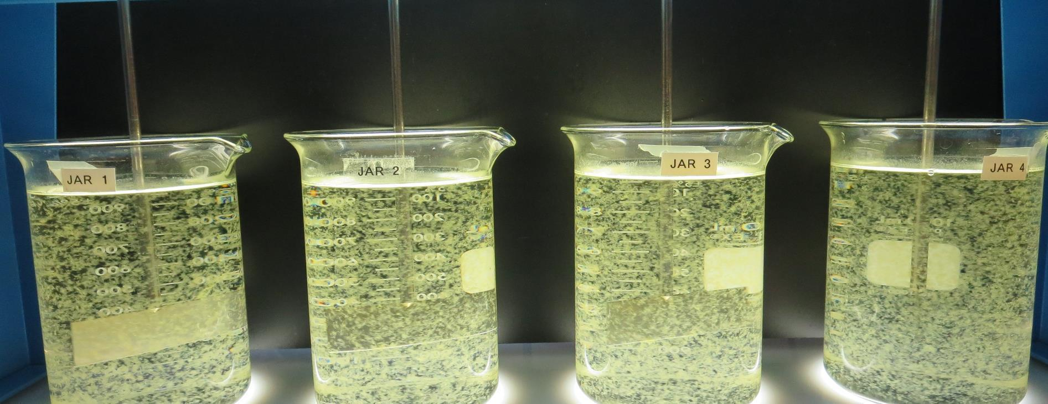
Konocti County Water District CA1710006, Lake County, Jar Test
by Guy Schott, P.E. April 30, 2021

Slide 2
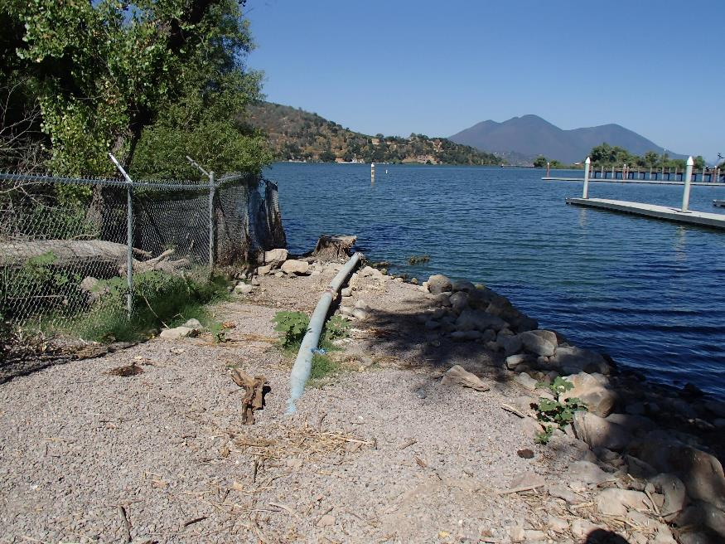
Konocti County Water District Source Water: Clear Lake Conventional Treatment

Slide 3
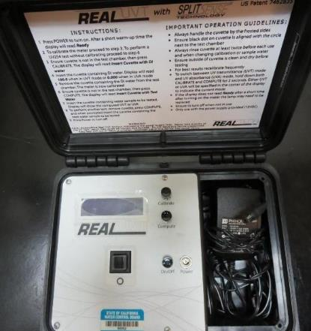
UVT/UVA, pathlength 10 mm
UV transmittance (UVT) is a measurement of the amount of ultraviolet light (254 nm) that passes through a water sample compared to the amount of light that passes through a pure water sample. The measurement is expressed as % UVT.
%UVT = 10^{(-UVA)} x 100%
UV absorbance (UVA) is calculated as a relative measure of the amount of light absorbed by a water sample compared with the amount of light absorbed by a pure water sample.
UVA = -log(%UVT/100)

Slide 4
Konocti CWD Source & Treated Water Characteristics, April 30, 2021
Source (post KMnO4 & O3)
pH: 8.56
Alkalinity: 153 mg/L as CaCO3
Turbidity: 20.1 NTU
UVT: 74.9%,
UVA: 0.125/cm
0.4 um Filtered
Turbidity: 0.83 NTU
D-UVT: 84.6%,
UVA: 0.072/cm
Plant Filtrate Water
pH: 8.01
Alkalinity: 145 mg/L as CaCO3
Turbidity: 0.12 NTU
UVT: 92.2%,
UVA: 0.035/cm

Slide 5
Applied Coagulants for Jar Testing (1)
Pro Pac 9800 (NTU Technologies)
50% Aluminum Chlorohydrate
50% Water
23.62% Al₂O₃
12.5% Al
83% Basicity
SG = 1.25-1.34
NSF limit: 250 mg/L as Product
Pro Pac 9890 (NTU Technologies)
35-45% Aluminum Chlorohydrate
20% polyamine (50% water, 50% active polyamines)
35-45% Water
~18.9% Al₂O₃
~10.5% Al
83% Basicity
SG = 1.25-1.34
NSF limit: 50 mg/L as Product;
Product dose 10 mg/L = 1 mg/L polyamines active

Slide 6
Applied Coagulants for Jar Testing (2)
Polydyne Incorporated
Clarifloc C-308P
SG = 1.0 – 1.2
Viscosity: 80-180 centipoise
pDADMAC (20% active, 80% H₂O)
NSF limit: 50 mg/L (product)
Product dose 5 mg/L = 1 mg/L pDADMAC active
Polydyne Incorporated
Clarifloc C-378
SG = 1.0 – 1.2
Viscosity: 800-1000 centipoise
pDADMAC (20% active, 80% H₂O)
NSF limit: 50 mg/L (product)
Product dose 5 mg/L = 1 mg/L pDADMAC active

Slide 7
Applied Coagulants for Jar Testing (3)
Pro Pac 9810 (NTU Technologies)
45-50% Aluminum Chlorohydrate
45-50% Water
~22.4% Al₂O₃
~11.9% Al
83% Basicity
5% polyamines (50% water, 50% active polyamines)
SG = 1.25-1.34
NSF limit: 200 mg/L as Product;
Product dose 40 mg/L = 1 mg/L polyamines active
BWS, Inc.
AdvFloc-CTC-00025
Polyamines
SG = 1.12 – 1.16
Viscosity: 650-1000 centipoise
(50% water, 50% active polyamines)
NSF limit: 10 mg/L as Product

Slide 8
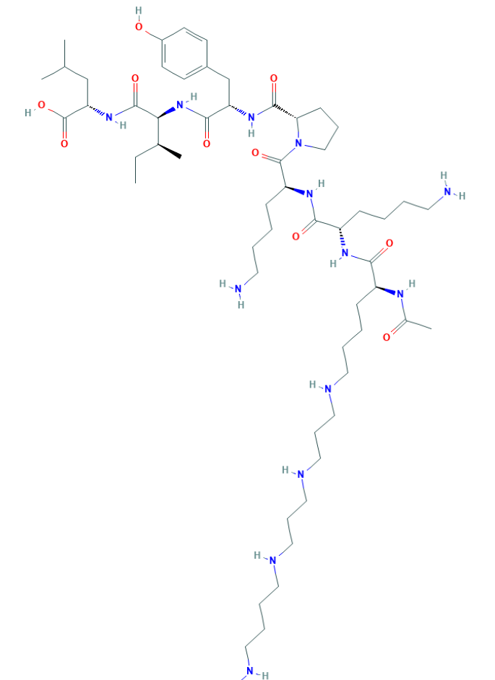
Polyamine C₅₉H₁₀₈N₁₄O₁₀ MW: 1,173.6 g/mol

Slide 9
Diallyldimethylammonium chloride or N-allyl-N,N-dimethylprop-2-en-1-aminium chloride pDADMAC C₈H₁₆ClN MW: 161.67 g/mol
CH₃
CH₂
CH₂
CH
N
+
CH
CH₂
CH₂
CH₃
Cl⁻

Slide 10
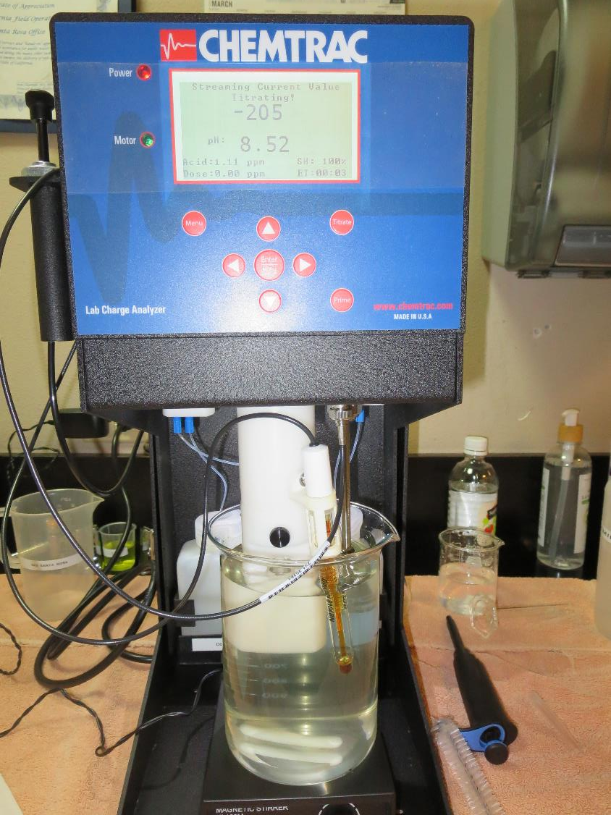
Laboratory Charge Analyzer
LCA: Used to determine coagulant demand of a source water entering the treatment plant.
Source pH: 8.52 (post oxidation)
LCA #1: 9800: 41 mg/L
pH adjusted to 7.7 with acetic acid

Slide 11
Coagulant Information
Unless stated otherwise, all coagulant doses are reported as Product (100% strength).
Aluminum Sulfate doses are reported as hydrated Al₂(SO₄)₃*14.3H₂0.
Preparation of coagulant stock solutions are generally 1.0 and/or 0.1 percent strength using 100 and/or 200 mL volumetric flasks.
Finnpipette F2 variable volume pipette, capacity 100-1000 micro liters is used for stock solution preparation and coagulant aid jar test dosing.
Finnpipette F2 variable volume pipette, capacity 0.5-5 mL is used for primary coagulant jar test dosing.

Slide 12
Konocti CWD; Jar Test 1 - 8 Results Flash Mix 200 RPM (30 sec); Floc Mix 30 RPM (5 min)
Jar# | 9800 mg/L | Filtrate NTU | Filtrate %UVT | Filtrate UVA/cm | %UVA Reduction | Settle NTU 25 min
J1 | 40 | 0.36 | 89.4 | 0.048 | 33.3 | 1.36
J2 | 45 | 0.29 | 89.9 | 0.046 | 36.1 | 1.39
J3 | 50 | 0.28 | 90.1 | 0.045 | 37.5 | 1.05
J4 | 55 | 0.08 | 90.9 | 0.045 | 43.1 | 0.29
J5 | 55 | 0.22 | 90.7 | 0.045 | 41.7 | 0.83
J6 | 60 | 0.21 | 90.8 | 0.044 | 43.1 | 0.75
J7 | 65 | 0.17 | 91.0 | 0.044 | 44.4 | 0.68
J8 | 70 | 0.07 | 91.6 | 0.043 | 48.6 | 0.24

Slide 13
Konocti CWD; Jar Test 9 - 12 Results Flash Mix 200 RPM (30 sec); Floc Mix 30 RPM (5 min)
Jar# | 9800 mg/L | Clarifloc 308P mg/L | Filtrate NTU | Filtrate %UVT | Filtrate UVA/cm | %UVA Reduction | Settle NTU 25 min
J9 | 50 | 0.0 | 0.28 | 90.0 | 0.045 | 36.1 | 1.18
J10 | 50 | 2.0 | 0.23 | 90.3 | 0.044 | 38.9 | 0.98
J11 | 50 | 4.0 | 0.24 | 90.3 | 0.044 | 38.9 | 1.02
J12 | 50 | 6.0 | 0.21 | 90.4 | 0.043 | 40.3 | 0.85

Slide 14
Konocti CWD; Jar Test 13 - 20 Results Flash Mix 200 RPM (30 sec); Floc Mix 30 RPM (5 min)
Jar# | 9810 mg/L | 9800 mg/L | 9890 mg/L | Filtrate NTU | Filtrate %UVT | Filtrate UVA/cm | %UVA Reduction | Settle NTU 25 min
J13 | 50 | 0.0 | 0.0 | 0.10 | 91.2 | 0.040 | 44.4 | 0.78
J14 | 55 | 0.0 | 0.0 | 0.10 | 91.3 | 0.039 | 45.8 | 0.65
J15 | 60 | 0.0 | 0.0 | 0.08 | 91.4 | 0.038 | 47.2 | 0.50
J16 | 65 | 0.0 | 0.0 | 0.06 | 91.6 | 0.037 | 48.6 | 0.20
J17 | 60 | 0.0 | 0.0 | 0.07 | 91.7 | 0.037 | 48.6 | 0.29
J18 | 0.0 | 45 | 15 | 0.04 | 92.3 | 0.034 | 52.8 | 0.31
J19 | 65 | 0.0 | 0.0 | 0.05 | 91.7 | 0.037 | 48.6 | 0.30
J20 | 0.0 | 48.8 | 16.2 | 0.05 | 92.4 | 0.034 | 52.8 | 0.41

Slide 15
Konocti CWD; Jar Test 21 - 28 Results Flash Mix 200 RPM (30 sec); Floc Mix 30 RPM (5 min)
Jar# | 9800 mg/L | Clarifloc C-378 mg/L | Filtrate NTU | Filtrate %UVT | Filtrate UVA/cm | %UVA Reduction | Settle NTU 25 min
J21 | 50 | 0.0 | 0.23 | 90.3 | 0.044 | 38.9 | 0.94
J22 | 50 | 2.0 | 0.05 | 91.2 | 0.040 | 44.4 | 0.58
J23 | 50 | 4.0 | 0.04 | 91.5 | 0.038 | 47.2 | 0.81
J24 | 50 | 6.0 | 0.07 | 91.4 | 0.038 | 47.2 | 0.86
J25 | 50 | 4.0 | 0.05 | 91.7 | 0.037 | 48.6 | 0.69
J26 | 55 | 4.0 | 0.05 | 91.7 | 0.037 | 48.6 | 0.76
J27 | 60 | 4.0 | 0.05 | 91.7 | 0.037 | 48.6 | 0.64
J28 | 65 | 4.0 | 0.05 | 91.7 | 0.037 | 48.6 | 0.57

Slide 16
Konocti CWD; Jar Test 29 - 36 Results Flash Mix 200 RPM (30 sec); Floc Mix 30 RPM (5 min)
Jar# | 9800 mg/L | 9890 mg/L | Filtrate NTU | Filtrate %UVT | Filtrate UVA/cm | %UVA Reduction | Settle NTU 25 min
J29 | 37.5 | 12.5 | 0.04 | 92.3 | 0.034 | 52.8 | 0.36
J30 | 41.3 | 13.8 | 0.05 | 92.4 | 0.034 | 52.8 | 0.36
J31 | 45.0 | 15.0 | 0.05 | 92.4 | 0.034 | 52.8 | 0.41
J32 | 48.8 | 16.2 | 0.04 | 92.4 | 0.034 | 52.8 | 0.44
J33 | 26.2 | 8.9 | 0.05 | 91.8 | 0.036 | 50.0 | 0.33
J34 | 30.0 | 10.0 | 0.05 | 92.0 | 0.036 | 50.0 | 0.33
J35 | 33.8 | 11.2 | 0.06 | 92.0 | 0.036 | 50.0 | 0.38
J36 | 37.5 | 12.5 | 0.06 | 92.1 | 0.035 | 51.4 | 0.36

Slide 17
Konocti CWD; Jar Test 37 - 40 Results Flash Mix 200 RPM (30 sec); Floc Mix 30 RPM (5 min)
Jar# | 9800 mg/L | CTC-00025 mg/L | Filtrate NTU | Filtrate %UVT | Filtrate UVA/cm | %UVA Reduction | Settle NTU 25 min
J37 | 33.2 | 1.8 | 0.06 | 91.7 | 0.037 | 48.6 | 0.52
J38 | 38.0 | 2.0 | 0.05 | 91.6 | 0.038 | 47.2 | 0.46
J39 | 42.8 | 2.2 | 0.06 | 91.8 | 0.037 | 48.6 | 0.44
J40 | 47.5 | 2.5 | 0.05 | 91.9 | 0.036 | 50.0 | 0.37

Slide 18
Jars 1-4 Test Flash Mix 30 Sec (200 RPM) Floc Mix 5 min (30 RPM) Post-Oxidation KMnO₄/O₃ Applied Coagulant 9800

Slide 19
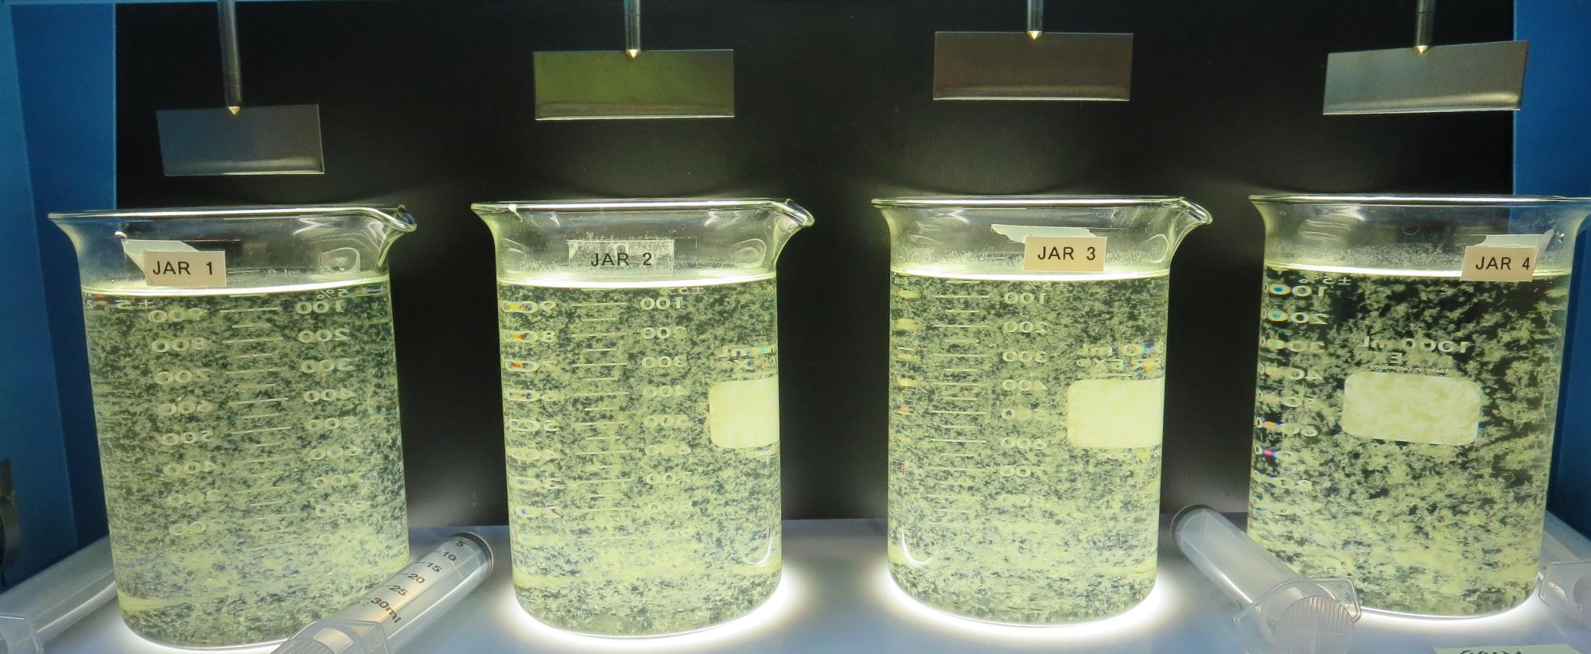
Jars 1-4: End of 5-minute flocculation (30 RPM) duration.
40 mg/L 9800
Filtrate 0.36 NTU
UVT: 89.4%
UVA: 0.048/cm
UVA Reduction 33.3%
Settled: 1.36 NTU
45 mg/L 9800
Filtrate 0.29 NTU
UVT: 89.9%
UVA: 0.046/cm
UVA Reduction 36.1%
Settled: 1.39 NTU
50 mg/L 9800
Filtrate 0.28 NTU
UVT: 90.1%
UVA: 0.045/cm
UVA Reduction 37.5%
Settled: 1.05 NTU
55 mg/L 9800
Filtrate 0.08 NTU
UVT: 90.9%
UVA: 0.041/cm
UVA Reduction 43.1%
Settled: 0.29 NTU

Slide 20
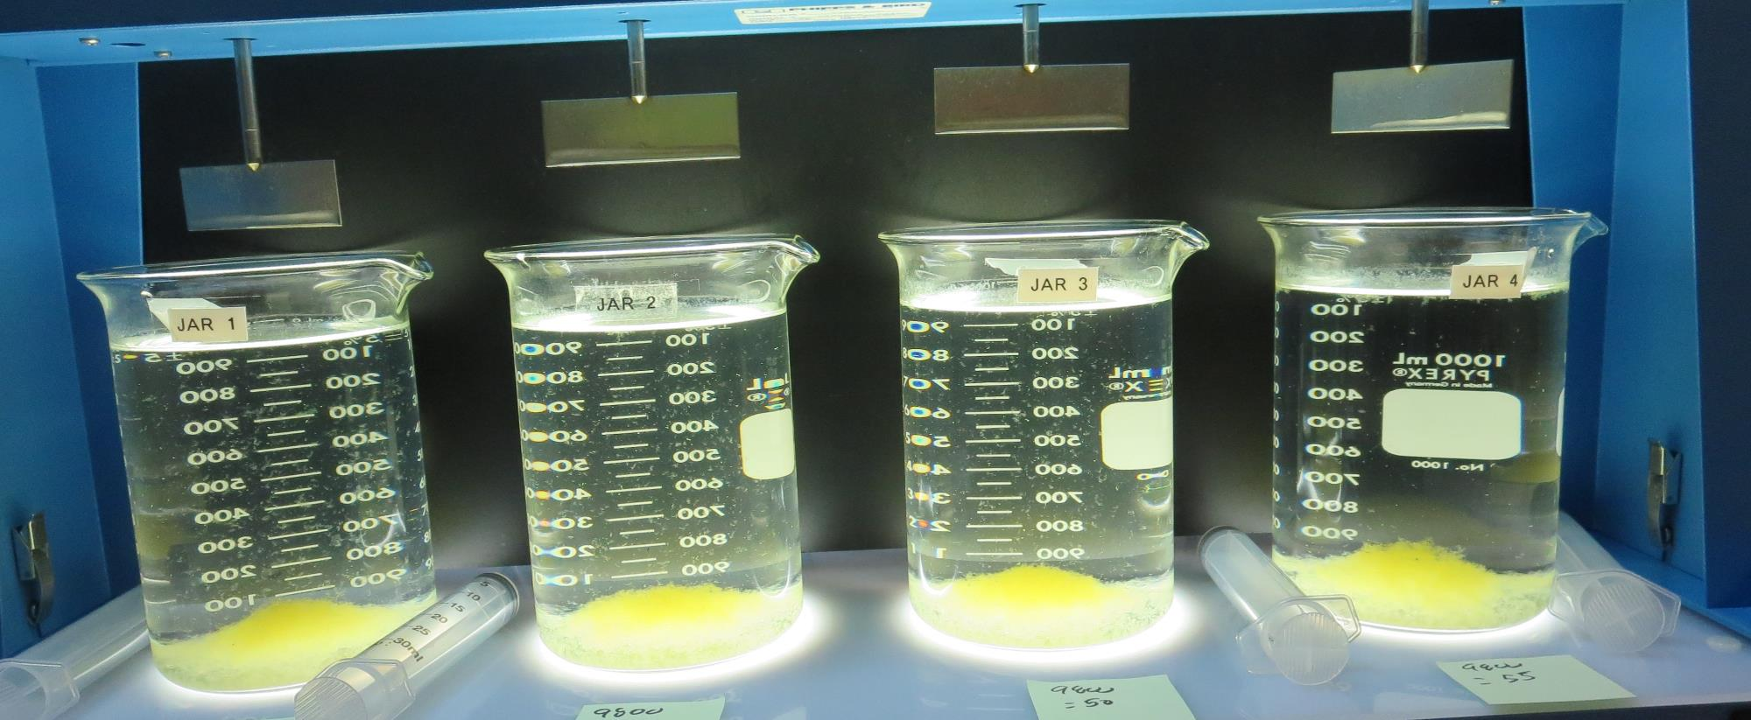
Jars 1-4: After 5 min of settling, 25 mL is syringed for filterability and %UVT/UVA.

Slide 21
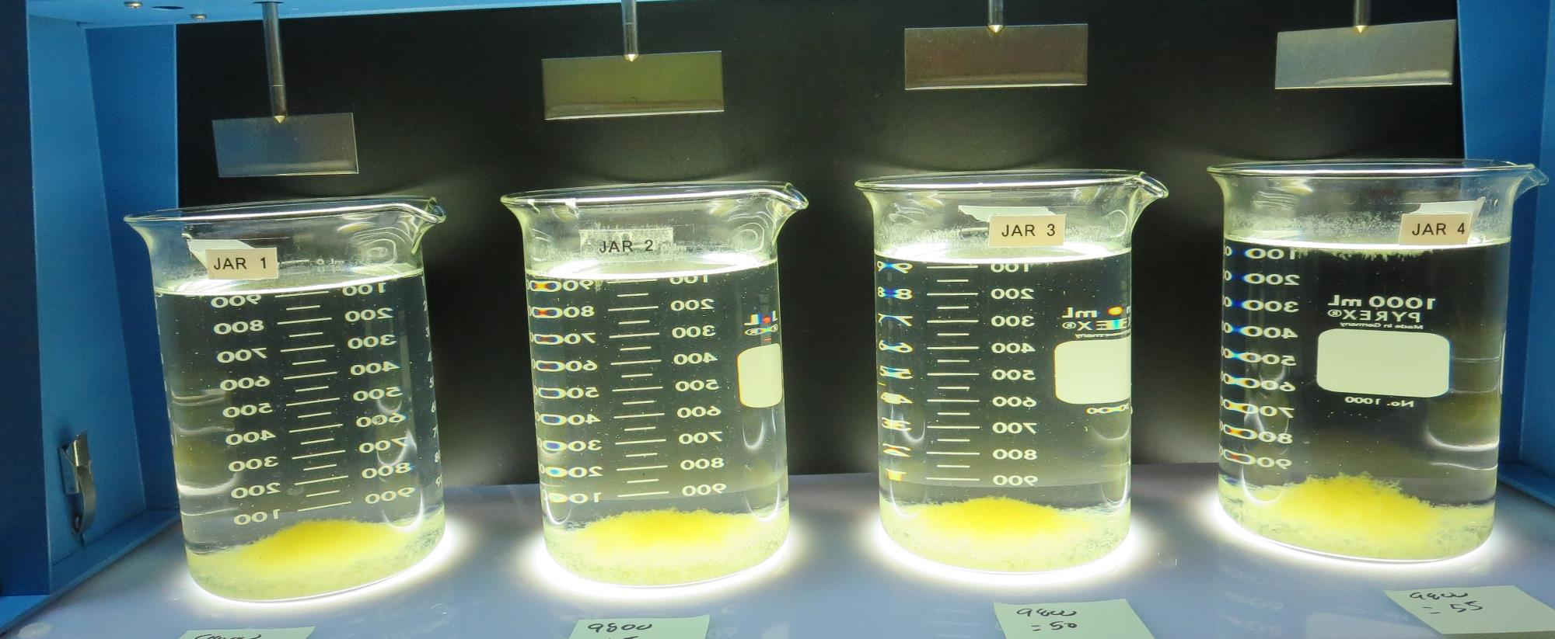
Jars 1-4: After 25-minutes of settling, settled water turbidity is taken.
40 mg/L 9800
Filtrate 0.36 NTU
UVT: 89.4%
UVA: 0.048/cm
UVA Reduction 33.3%
Settled: 1.36 NTU
45 mg/L 9800
Filtrate 0.29 NTU
UVT: 89.9%
UVA: 0.046/cm
UVA Reduction 36.1%
Settled: 1.39 NTU
50 mg/L 9800
Filtrate 0.28 NTU
UVT: 90.1%
UVA: 0.045/cm
UVA Reduction 37.5%
Settled: 1.05 NTU
55 mg/L 9800
Filtrate 0.08 NTU
UVT: 90.9%
UVA: 0.041/cm
UVA Reduction 43.1%
Settled: 0.29 NTU

Slide 22
Jars 5-8 Test Flash Mix 30 Sec (200 RPM) Floc Mix 5 min (30 RPM) Post-Oxidation KMnO₄/O₃ Applied Coagulant 9800

Slide 23
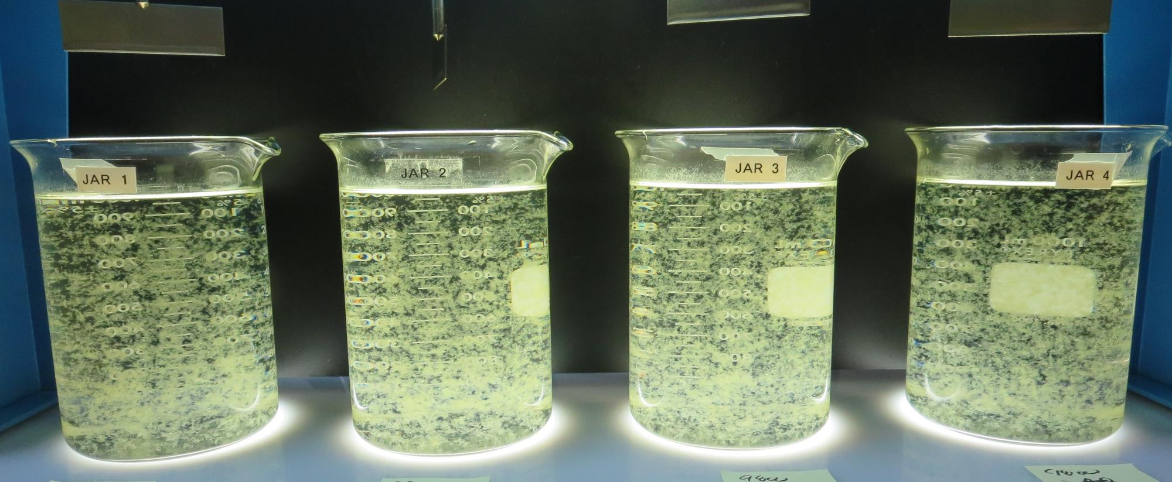
Jars 5-8: End of 5-minute flocculation (30 RPM) duration.
55 mg/L 9800
Filtrate 0.22 NTU
UVT: 90.7%
UVA: 0.042/cm
UVA Reduction 41.7%
Settled: 0.83 NTU
60 mg/L 9800
Filtrate 0.21 NTU
UVT: 90.8%
UVA: 0.041/cm
UVA Reduction 43.1%
Settled: 0.75 NTU
65 mg/L 9800
Filtrate 0.17 NTU
UVT: 91.0%
UVA: 0.040/cm
UVA Reduction 44.4%
Settled: 0.68 NTU
70 mg/L 9800
Filtrate 0.07 NTU
UVT: 91.6%
UVA: 0.037/cm
UVA Reduction 48.6%
Settled: 0.24 NTU

Slide 24
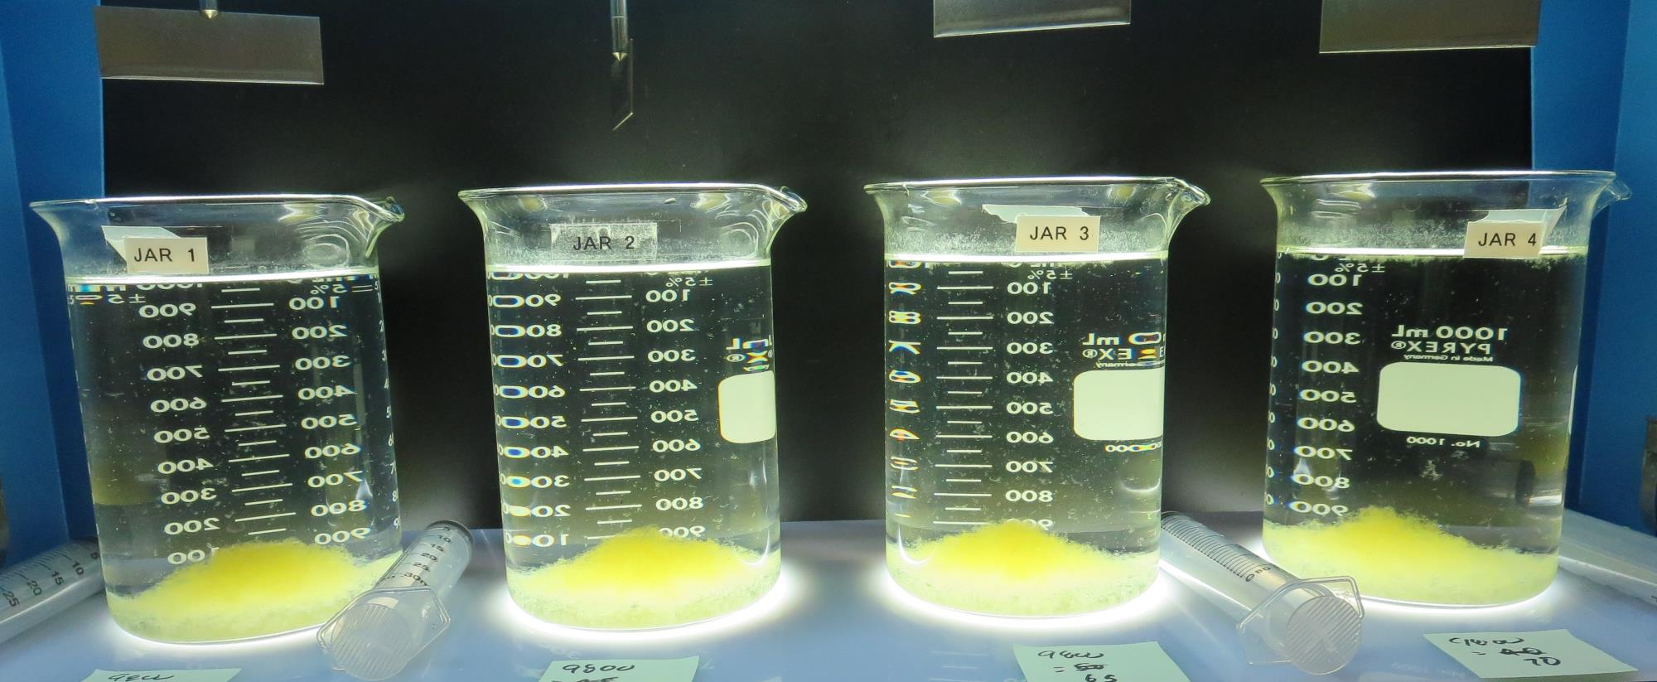
Jars 5-8: After 5 min of settling, 25 mL is syringed for filterability and %UVT/UVA.

Slide 25
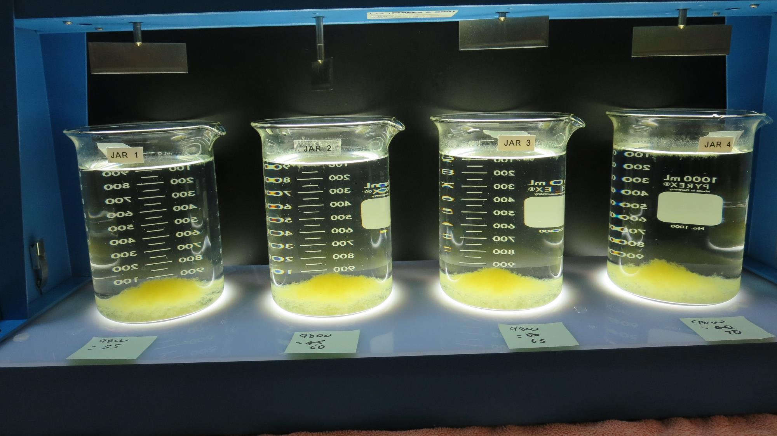
Jars 5-8: After 25-minutes of settling, settled water turbidity is taken.
55 mg/L 9800
Filtrate 0.22 NTU
UVT: 90.7%
UVA: 0.042/cm
UVA Reduction 41.7%
Settled: 0.83 NTU
60 mg/L 9800
Filtrate 0.21 NTU
UVT: 90.8%
UVA: 0.041/cm
UVA Reduction 43.1%
Settled: 0.75 NTU
65 mg/L 9800
Filtrate 0.17 NTU
UVT: 91.0%
UVA: 0.040/cm
UVA Reduction 44.4%
Settled: 0.68 NTU
70 mg/L 9800
Filtrate 0.07 NTU
UVT: 91.6%
UVA: 0.037/cm
UVA Reduction 48.6%
Settled: 0.24 NTU

Slide 26
Jars 9-12 Test Flash Mix 30 Sec (200 RPM) Floc Mix 5 min (30 RPM) Post-Oxidation KMnO₄/O₃ Applied Coagulants 9800 Clarifloc C-308P

Slide 27
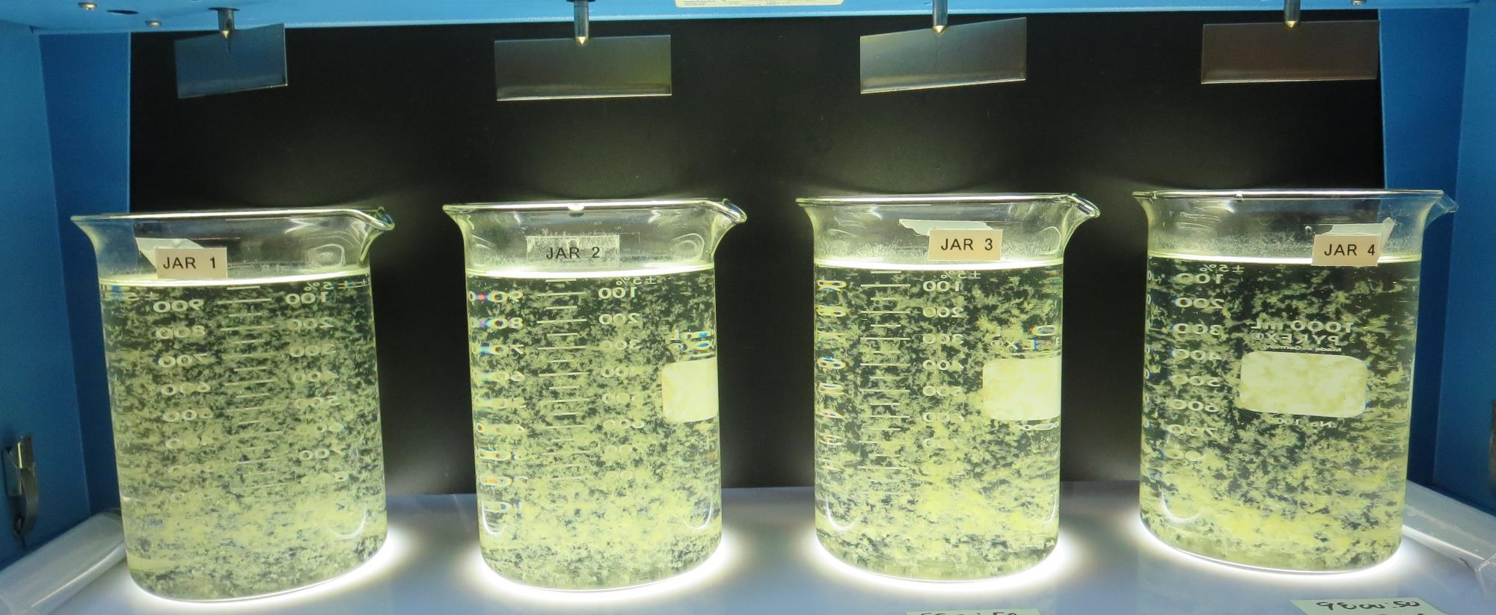
Jars 9-12: End of 5-minute flocculation (30 RPM) duration.
50 mg/L 9800
0.0 mg/L C-308P
Filtrate 0.28 NTU
UVT: 90.0%
UVA: 0.045/cm
UVA Reduction 37.5%
Settled: 1.18 NTU
50 mg/L 9800
2.0 mg/L C-308P
Filtrate 0.23 NTU
UVT: 90.3%
UVA: 0.044/cm
UVA Reduction 38.9%
Settled: 0.98 NTU
50 mg/L 9800
4.0 mg/L C-308P
Filtrate 0.24 NTU
UVT: 90.3%
UVA: 0.044/cm
UVA Reduction 38.9%
Settled: 1.02 NTU
50 mg/L 9800
6.0 mg/L C-308P
Filtrate 0.21 NTU
UVT: 90.1%
UVA: 0.043/cm
UVA Reduction 40.3%
Settled: 0.85 NTU

Slide 28
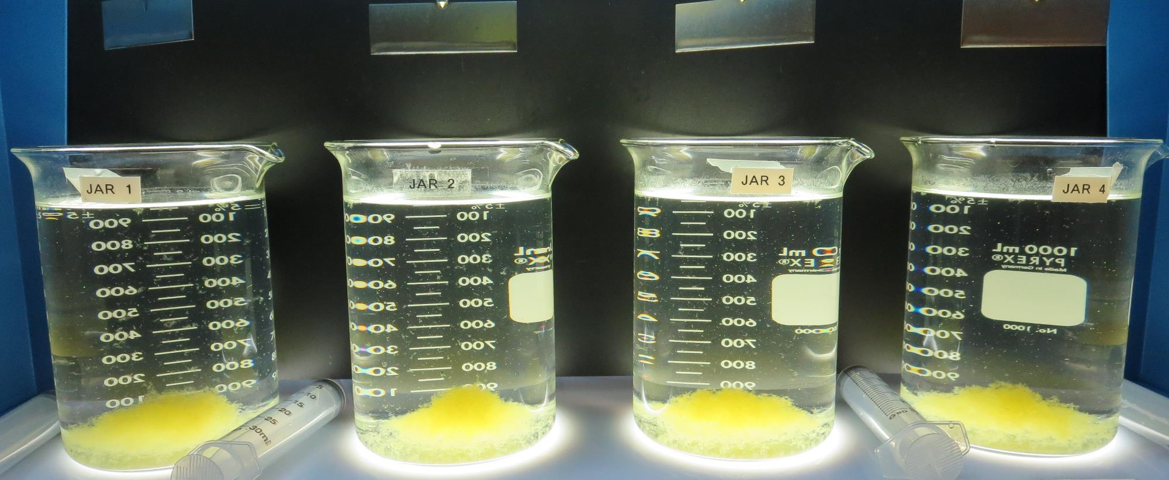
Jars 9-12: After 5 min of settling, 25 mL is syringed for filterability and %UVT/UVA.

Slide 29
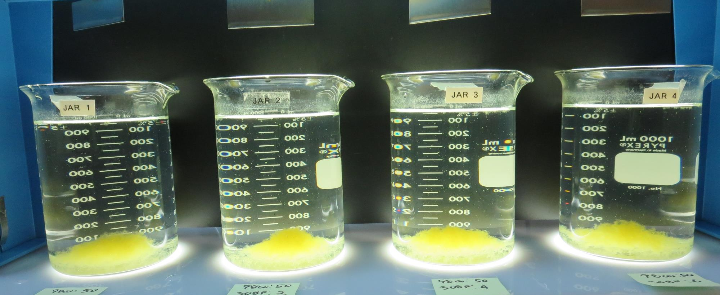
Jars 9-12: After 25-minutes of settling, settled water turbidity is taken.
50 mg/L 9800
0.0 mg/L C-308P
Filtrate 0.28 NTU
UVT: 90.0%
UVA: 0.045/cm
UVA Reduction 37.5%
Settled: 1.18 NTU
50 mg/L 9800
2.0 mg/L C-308P
Filtrate 0.23 NTU
UVT: 90.3%
UVA: 0.044/cm
UVA Reduction 38.9%
Settled: 0.98 NTU
50 mg/L 9800
4.0 mg/L C-308P
Filtrate 0.24 NTU
UVT: 90.3%
UVA: 0.044/cm
UVA Reduction 38.9%
Settled: 1.02 NTU
50 mg/L 9800
6.0 mg/L C-308P
Filtrate 0.21 NTU
UVT: 90.1%
UVA: 0.043/cm
UVA Reduction 40.3%
Settled: 0.85 NTU

Slide 30
Jars 13-16 Test Flash Mix 30 Sec (200 RPM) Floc Mix 5 min (30 RPM) Post-Oxidation KMnO₄/O₃ Applied Coagulant 9810

Slide 31
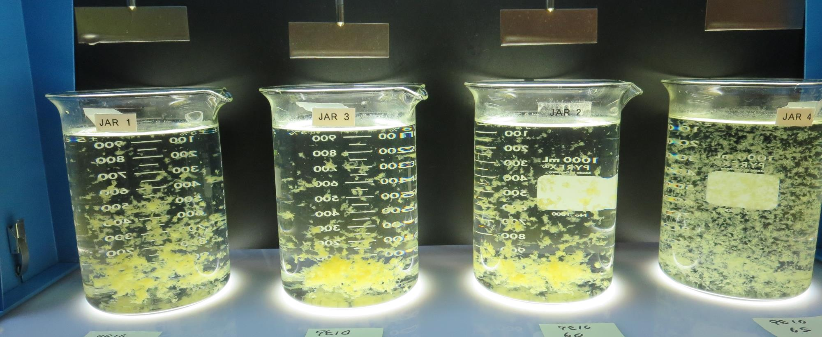
Jars 13-16: End of 5-minute flocculation (30 RPM) duration.
50 mg/L 9810
Filtrate 0.10 NTU
UVT: 91.2%
UVA: 0.040/cm
UVA Reduction 44.4%
Settled: 0.78 NTU
55 mg/L 9810
Filtrate 0.10 NTU
UVT: 91.3%
UVA: 0.039/cm
UVA Reduction 45.8%
Settled: 0.65 NTU
60 mg/L 9810
Filtrate 0.08 NTU
UVT: 91.4%
UVA: 0.038/cm
UVA Reduction 47.2%
Settled: 0.50 NTU
65 mg/L 9810
Filtrate 0.06 NTU
UVT: 91.6%
UVA: 0.037/cm
UVA Reduction 48.6%
Settled: 0.20 NTU

Slide 32
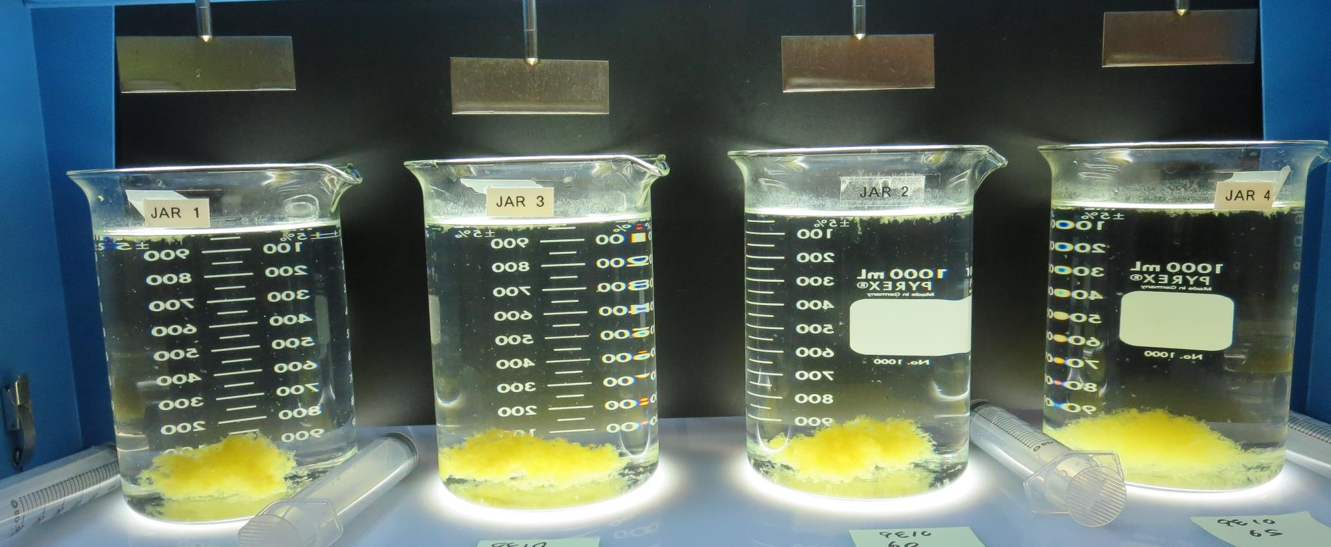
Jars 13-16: After 5 min of settling, 25 mL is syringed for filterability and %UVT/UVA

Slide 33
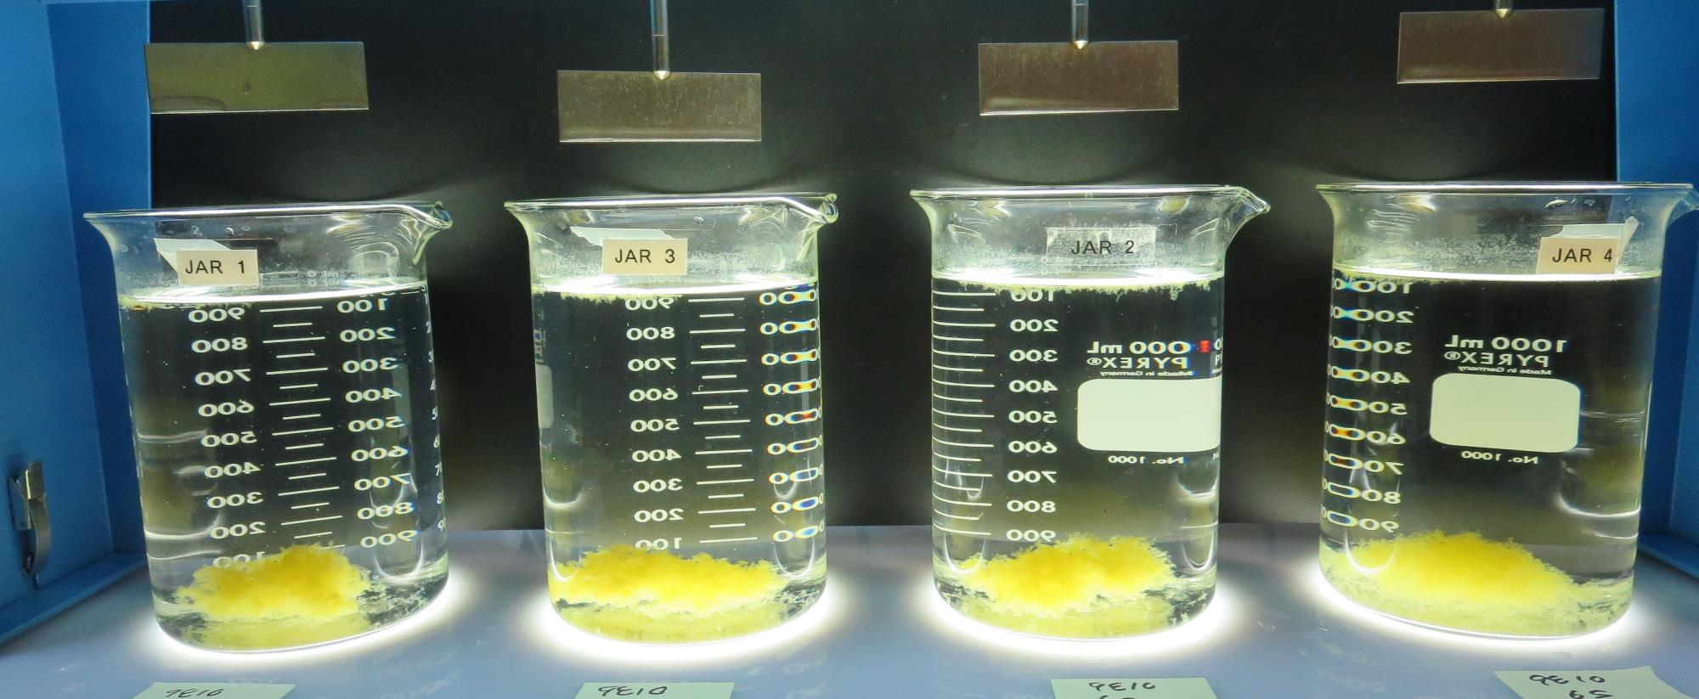
Jars 13-16: After 25-minutes of settling, settled water turbidity is taken.
50 mg/L 9810
Filtrate 0.10 NTU
UVT: 91.2%
UVA: 0.040/cm
UVA Reduction 44.4%
Settled: 0.78 NTU
55 mg/L 9810
Filtrate 0.10 NTU
UVT: 91.3%
UVA: 0.039/cm
UVA Reduction 45.8%
Settled: 0.65 NTU
60 mg/L 9810
Filtrate 0.08 NTU
UVT: 91.4%
UVA: 0.038/cm
UVA Reduction 47.2%
Settled: 0.50 NTU
65 mg/L 9810
Filtrate 0.06 NTU
UVT: 91.6%
UVA: 0.037/cm
UVA Reduction 48.6%
Settled: 0.20 NTU

Slide 34
Jars 17-20 Test Flash Mix 30 Sec (200 RPM) Floc Mix 5 min (30 RPM) Post-Oxidation KMnO₄/O₃ Applied Coagulant 9810/9800

Slide 35
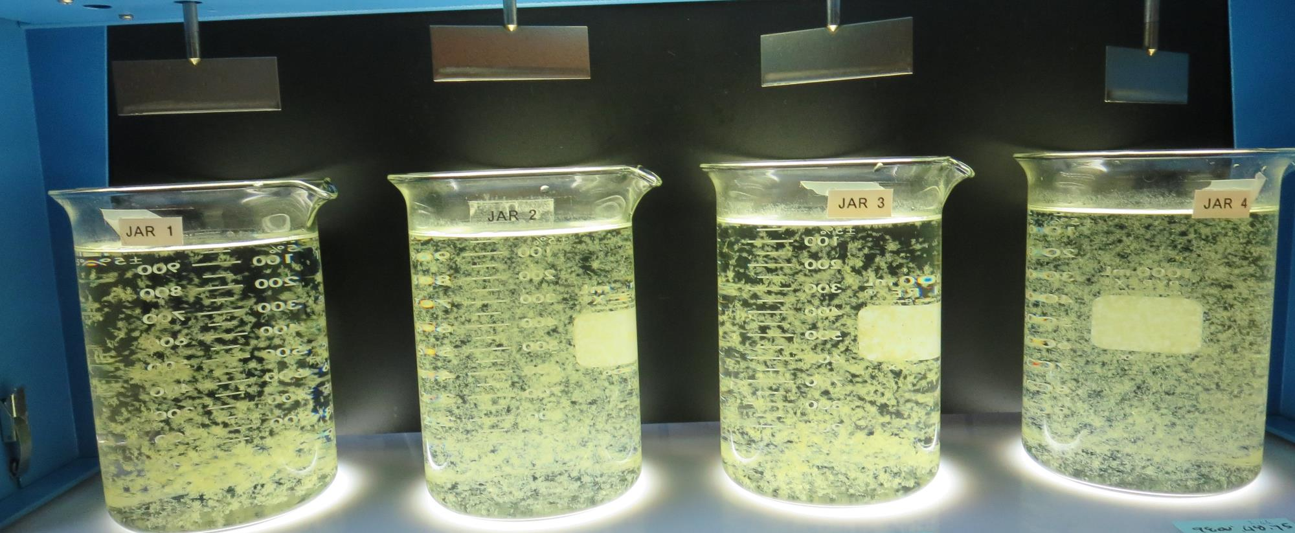
Jars 17-20: End of 5-minute flocculation (30 RPM) duration.
60 mg/L 9810
Filtrate 0.07 NTU
UVT: 91.7%
UVA: 0.037/cm
UVA Reduction 48.6%
Settled: 0.29 NTU
45 mg/L 9800
15 mg/L 9890
Filtrate 0.04 NTU
UVT: 92.3%
UVA: 0.034/cm
UVA Reduction 52.8%
Settled: 0.31 NTU
65 mg/L 9810
Filtrate 0.05 NTU
UVT: 91.7%
UVA: 0.037/cm
UVA Reduction 48.6%
Settled: 0.30 NTU
48.8 mg/L 9800
16.2 mg/L 9890
Filtrate 0.05 NTU
UVT: 92.4%
UVA: 0.034/cm
UVA Reduction 52.8%
Settled: 0.41 NTU

Slide 36
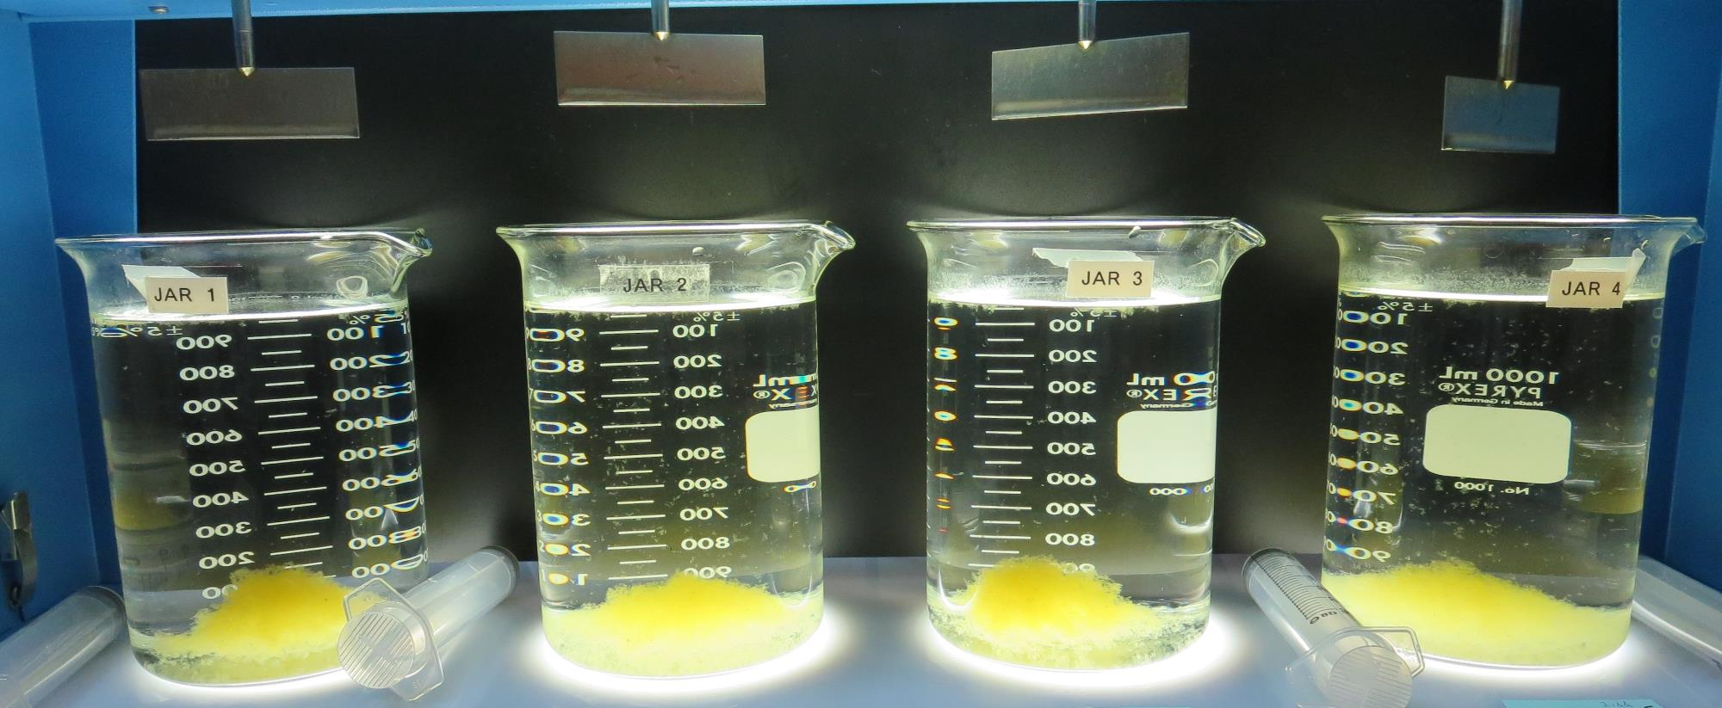
Jars 17-20: After 5 min of settling, 25 mL is syringed for filterability and %UVT/UVA.

Slide 37
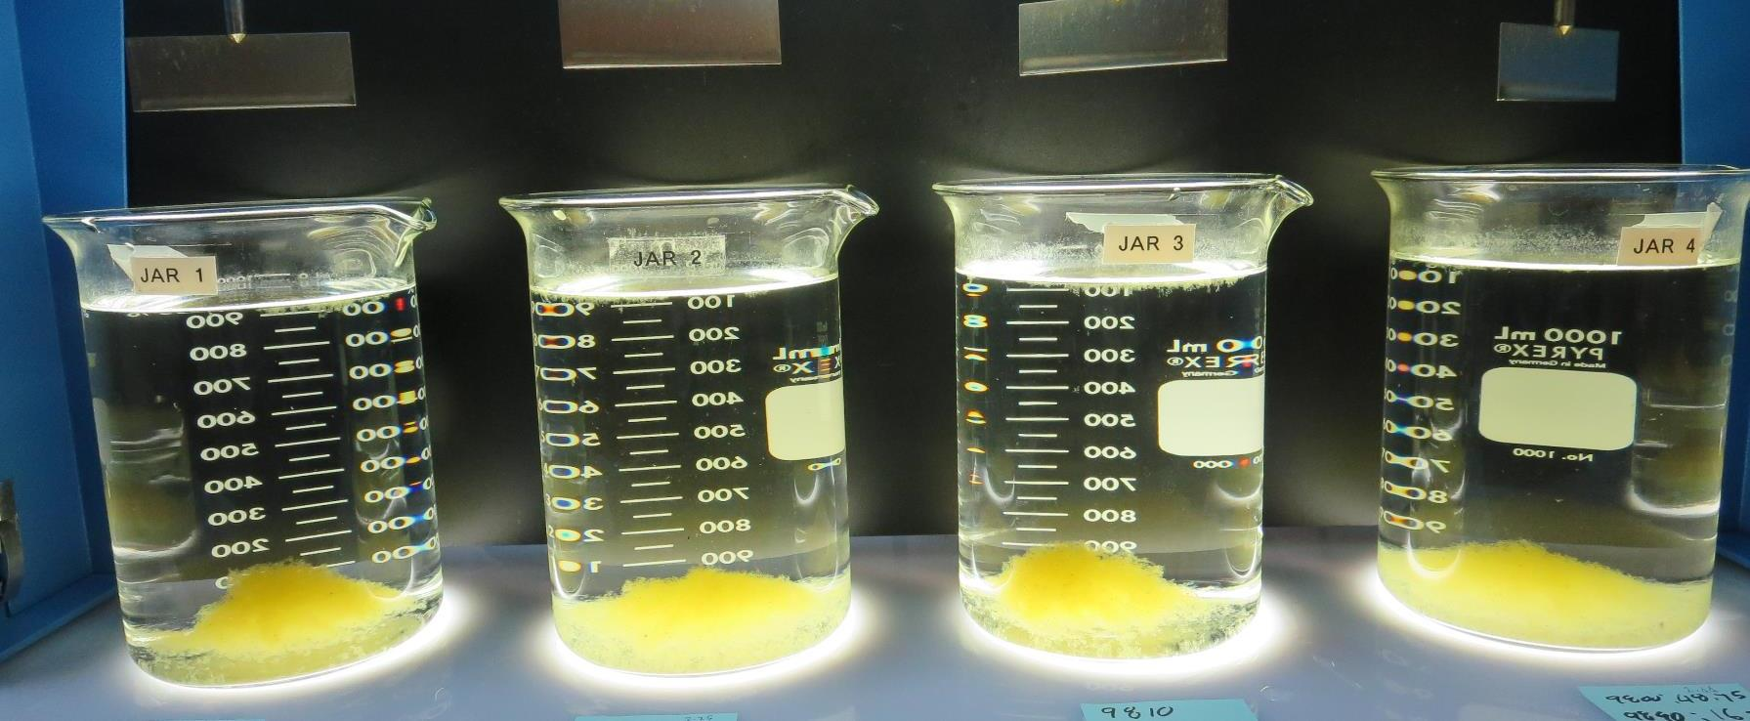
Jars 17-20: After 25-minutes of settling, settled water turbidity is taken.
60 mg/L 9810
Filtrate 0.07 NTU
UVT: 91.7%
UVA: 0.037/cm
UVA Reduction 48.6%
Settled: 0.29 NTU
45 mg/L 9800
15 mg/L 9890
Filtrate 0.04 NTU
UVT: 92.3%
UVA: 0.034/cm
UVA Reduction 52.8%
Settled: 0.31 NTU
65 mg/L 9810
Filtrate 0.05 NTU
UVT: 91.7%
UVA: 0.037/cm
UVA Reduction 48.6%
Settled: 0.30 NTU
48.8 mg/L 9800
16.2 mg/L 9890
Filtrate 0.05 NTU
UVT: 92.4%
UVA: 0.034/cm
UVA Reduction 52.8%
Settled: 0.41 NTU

Slide 38
Jars 21-24 Test Flash Mix 30 Sec (200 RPM) Floc Mix 5 min (30 RPM) Post-Oxidation KMnO₄/O₃ Applied Coagulant 9800 Clarifloc C-378

Slide 39
Jars 21-24: End of 5-minute flocculation (30 RPM) duration.
50 mg/L 9800
0 mg/L C-378
Filtrate 0.23 NTU
UVT: 90.3%
UVA: 0.044/cm
UVA Reduction 38.9%
Settled: 0.94 NTU
50 mg/L 9800
2 mg/L C-378
Filtrate 0.05 NTU
UVT: 91.2%
UVA: 0.040/cm
UVA Reduction 44.4%
Settled: 0.58 NTU
50 mg/L 9800
4 mg/L C-378
Filtrate 0.04 NTU
UVT: 91.5%
UVA: 0.038/cm
UVA Reduction 47.2%
Settled: 0.81 NTU
50 mg/L 9800
6 mg/L C-378
Filtrate 0.07 NTU
UVT: 91.4%
UVA: 0.038/cm
UVA Reduction 47.2%
Settled: 0.86 NTU

Slide 40
Jars 21-24: After 5 min of settling, 25 mL is syringed for filterability and %UVT/UVA.

Slide 41
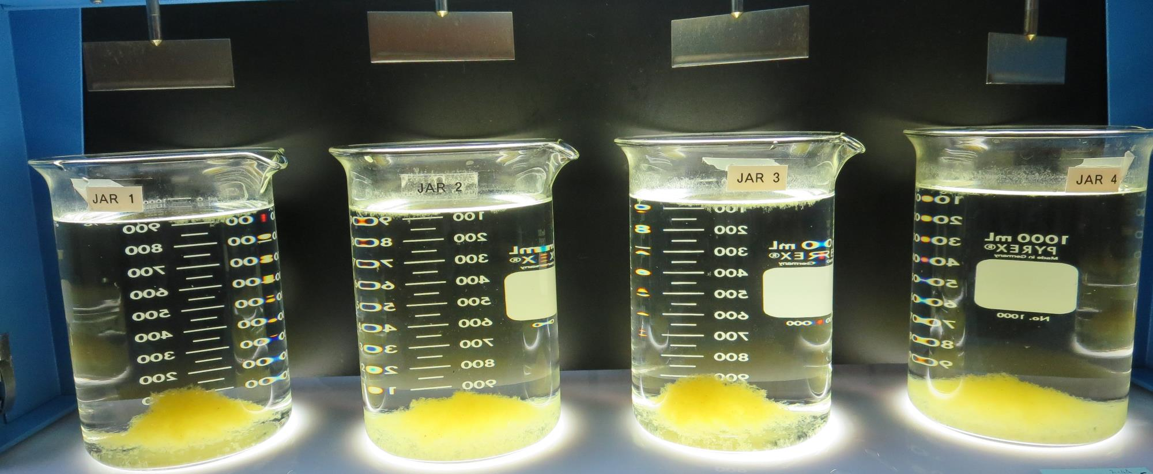
Jars 21-24: After 25-minutes of settling, settled water turbidity is taken.
50 mg/L 9800
0 mg/L C-378
Filtrate 0.23 NTU
UVT: 90.3%
UVA: 0.044/cm
UVA Reduction 38.9%
Settled: 0.94 NTU
50 mg/L 9800
2 mg/L C-378
Filtrate 0.05 NTU
UVT: 91.2%
UVA: 0.040/cm
UVA Reduction 44.4%
Settled: 0.58 NTU
50 mg/L 9800
4 mg/L C-378
Filtrate 0.04 NTU
UVT: 91.5%
UVA: 0.038/cm
UVA Reduction 47.2%
Settled: 0.81 NTU
50 mg/L 9800
6 mg/L C-378
Filtrate 0.07 NTU
UVT: 91.4%
UVA: 0.038/cm
UVA Reduction 47.2%
Settled: 0.86 NTU

Slide 42
Jars 25-28 Test Flash Mix 30 Sec (200 RPM) Floc Mix 5 min (30 RPM) Post-Oxidation KMnO₄/O₃ Applied Coagulant 9800 Clarifloc C-378

Slide 43
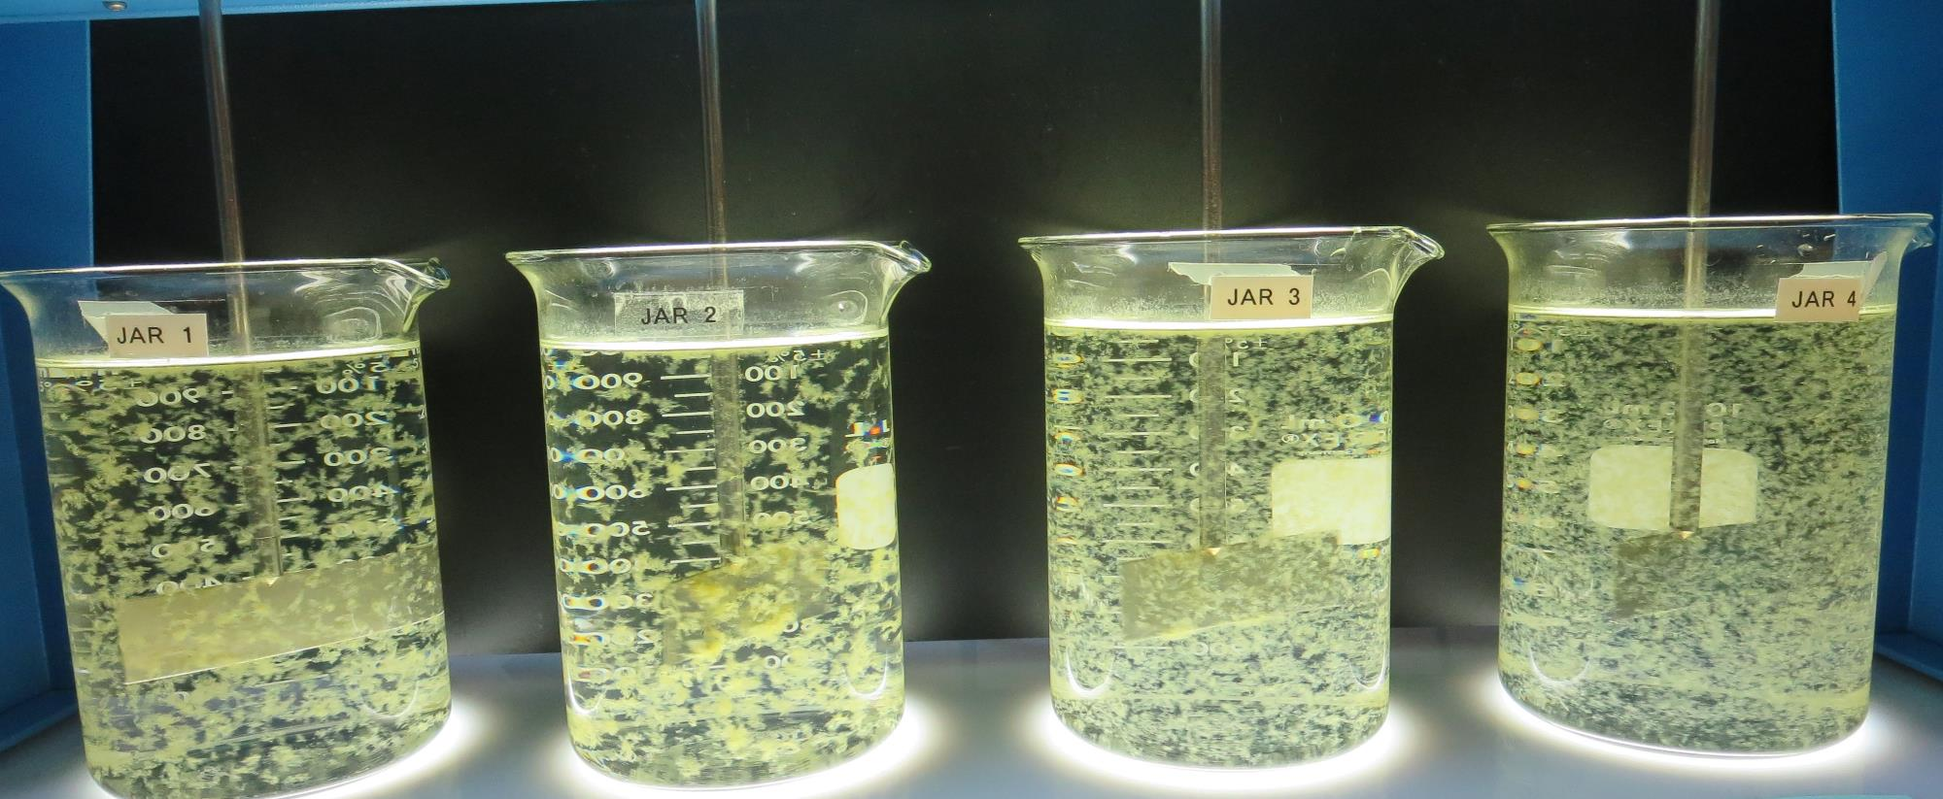
Jars 25-28: End of 5-minute flocculation (30 RPM) duration.
50 mg/L 9800
4 mg/L C-378
Filtrate 0.05 NTU
UVT: 91.7%
UVA: 0.037/cm
UVA Reduction 48.6%
Settled: 0.69 NTU
55 mg/L 9800
4 mg/L C-378
Filtrate 0.05 NTU
UVT: 91.7%
UVA: 0.037/cm
UVA Reduction 48.6%
Settled: 0.76 NTU
60 mg/L 9800
4 mg/L C-378
Filtrate 0.05 NTU
UVT: 91.7%
UVA: 0.037/cm
UVA Reduction 48.6%
Settled: 0.64 NTU
65 mg/L 9800
4 mg/L C-378
Filtrate 0.05 NTU
UVT: 91.7%
UVA: 0.037/cm
UVA Reduction 48.6%
Settled: 0.57 NTU

Slide 44
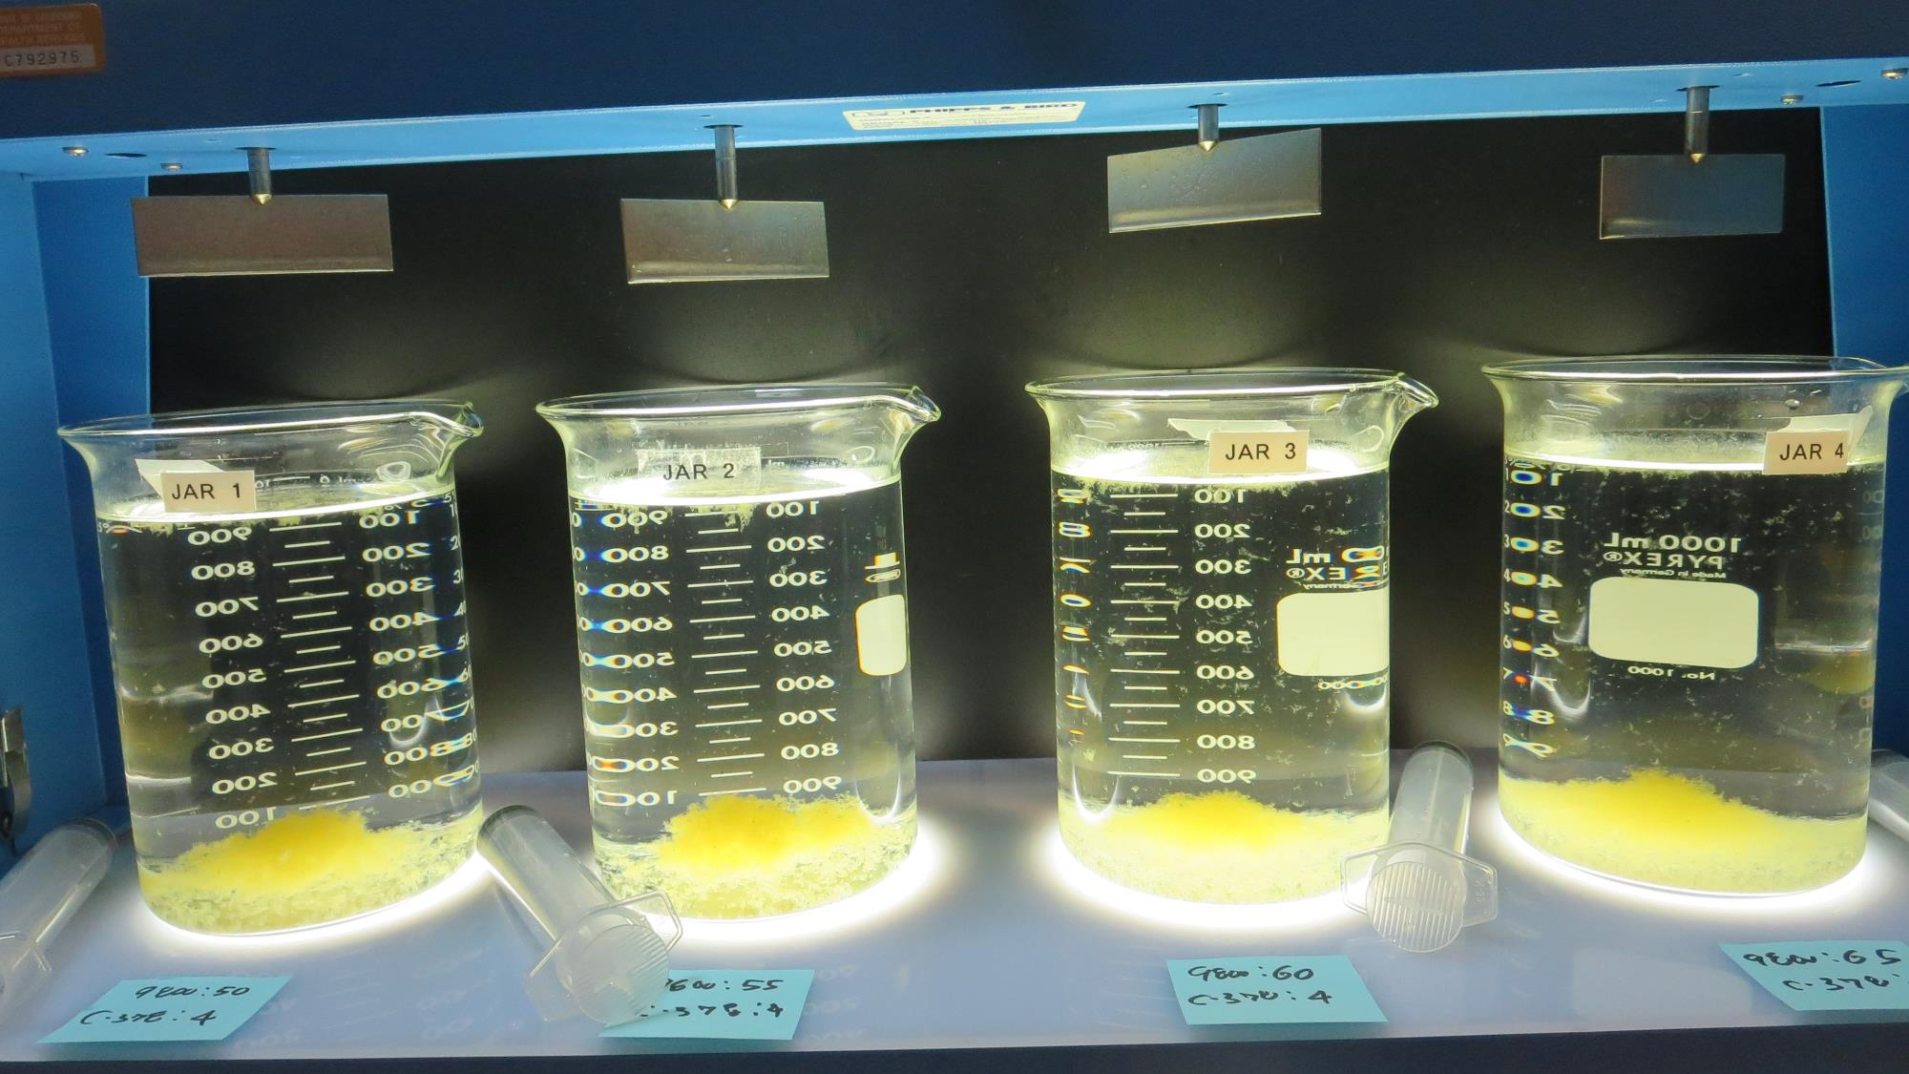
Jars 25-28: After 5 min of settling, 25 mL is syringed for filterability and %UVT/UVA.

Slide 45
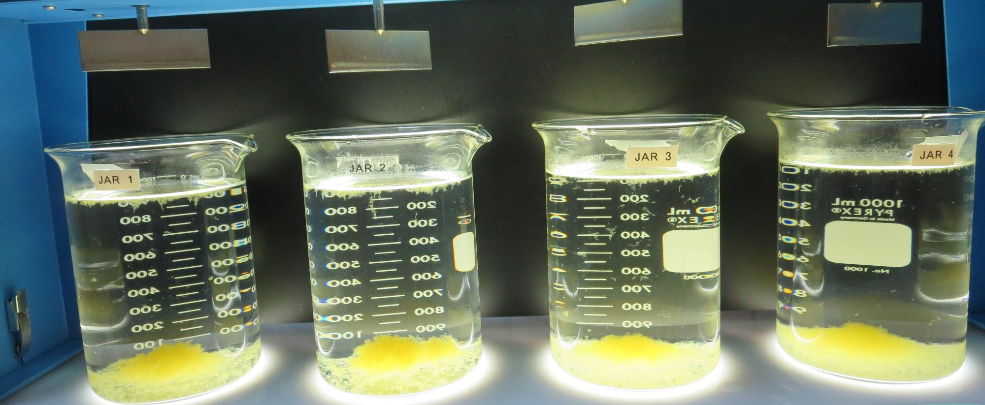
Jars 25-28: After 25-minutes of settling, settled water turbidity is taken.
50 mg/L 9800
4 mg/L C-378
Filtrate 0.05 NTU
UVT: 91.7%
UVA: 0.037/cm
UVA Reduction 48.6%
Settled: 0.69 NTU
55 mg/L 9800
4 mg/L C-378
Filtrate 0.05 NTU
UVT: 91.7%
UVA: 0.037/cm
UVA Reduction 48.6%
Settled: 0.76 NTU
60 mg/L 9800
4 mg/L C-378
Filtrate 0.05 NTU
UVT: 91.7%
UVA: 0.037/cm
UVA Reduction 48.6%
Settled: 0.64 NTU
65 mg/L 9800
4 mg/L C-378
Filtrate 0.05 NTU
UVT: 91.7%
UVA: 0.037/cm
UVA Reduction 48.6%
Settled: 0.57 NTU

Slide 46
Jars 29-32 Test Flash Mix 30 Sec (200 RPM) Floc Mix 5 min (30 RPM) Post-Oxidation KMnO₄/O₃ Applied Coagulant 9800/9890

Slide 47
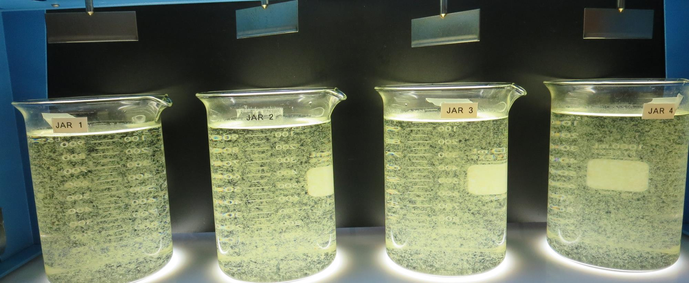
Jars 29-32: End of 5-minute flocculation (30 RPM) duration.
37.5 mg/L 9800
12.5 mg/L 9890
Filtrate 0.04 NTU
UVT: 92.3%
UVA: 0.034/cm
UVA Reduction 52.8%
Settled: 0.36 NTU
41.25 mg/L 9800
13.75 mg/L 9890
Filtrate 0.05 NTU
UVT: 92.4%
UVA: 0.034/cm
UVA Reduction 52.8%
Settled: 0.36 NTU
45 mg/L 9800
15 mg/L 9890
Filtrate 0.05 NTU
UVT: 92.4%
UVA: 0.034/cm
UVA Reduction 52.8%
Settled: 0.41 NTU
48.75 mg/L 9800
16.25 mg/L 9890
Filtrate 0.04 NTU
UVT: 92.4%
UVA: 0.034/cm
UVA Reduction 52.8%
Settled: 0.44 NTU

Slide 48
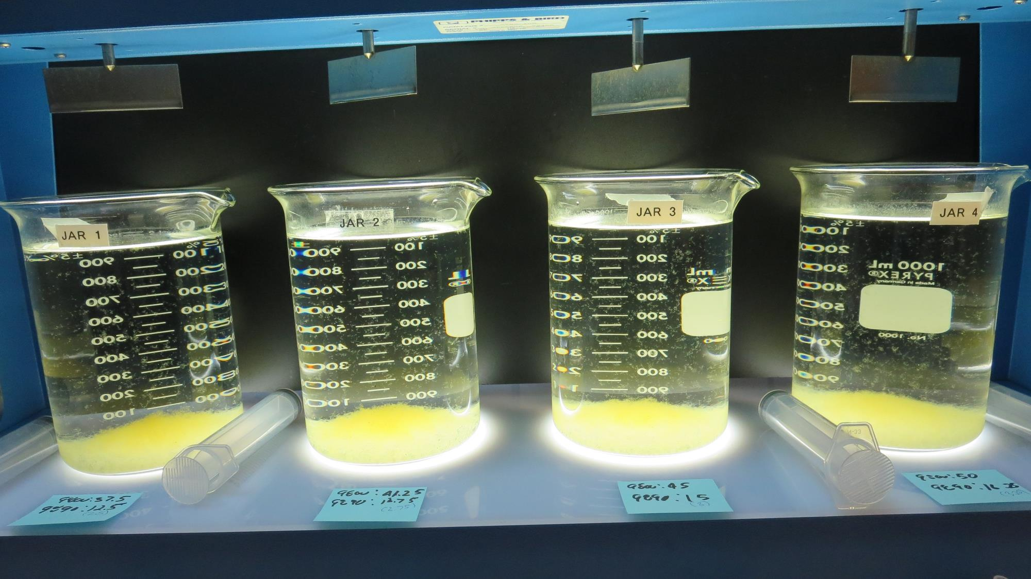
Jars 29-32: After 5 min of settling, 25 mL is syringed for filterability and %UVT/UVA.

Slide 49
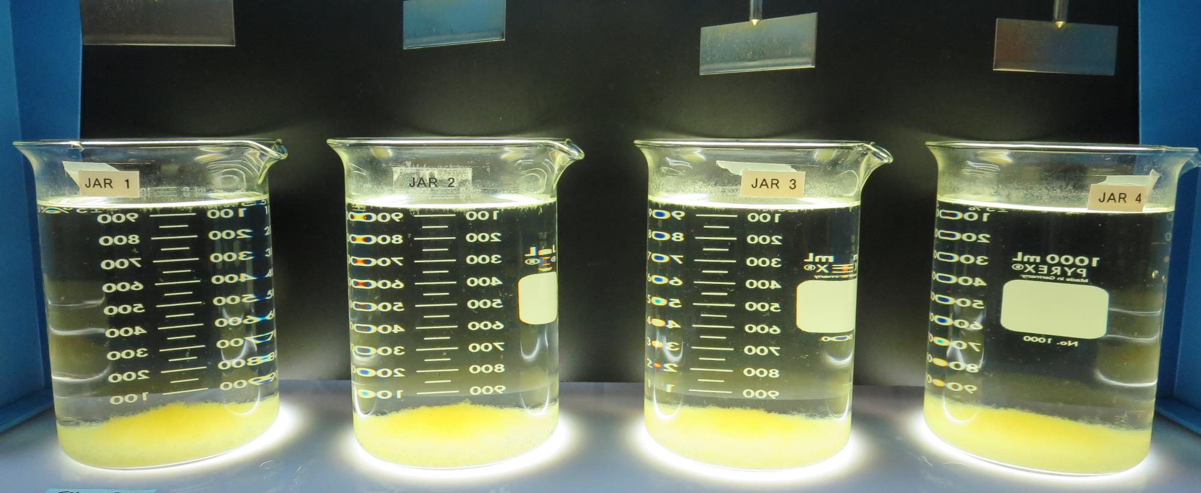
Jars 29-32: After 25-minutes of settling, settled water turbidity is taken.
37.5 mg/L 9800
12.5 mg/L 9890
Filtrate 0.04 NTU
UVT: 92.3%
UVA: 0.034/cm
UVA Reduction 52.8%
Settled: 0.36 NTU
41.25 mg/L 9800
13.75 mg/L 9890
Filtrate 0.05 NTU
UVT: 92.4%
UVA: 0.034/cm
UVA Reduction 52.8%
Settled: 0.36 NTU
45 mg/L 9800
15 mg/L 9890
Filtrate 0.05 NTU
UVT: 92.4%
UVA: 0.034/cm
UVA Reduction 52.8%
Settled: 0.41 NTU
48.75 mg/L 9800
16.25 mg/L 9890
Filtrate 0.04 NTU
UVT: 92.4%
UVA: 0.034/cm
UVA Reduction 52.8%
Settled: 0.44 NTU

Slide 50
Jars 33-36 Test Flash Mix 30 Sec (200 RPM) Floc Mix 5 min (30 RPM) Post-Oxidation KMnO₄/O₃ Applied Coagulant 9800/9890

Slide 51
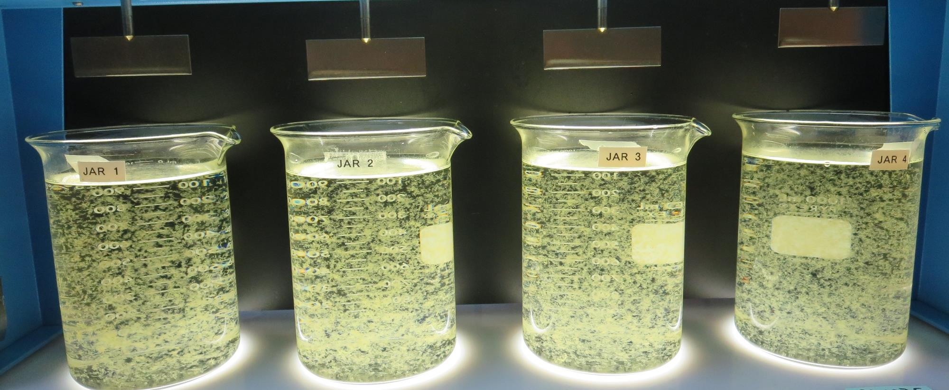
Jars 33-36: End of 5-minute flocculation (30 RPM) duration.
26.25 mg/L 9800
8.75 mg/L 9890
Filtrate 0.05 NTU
UVT: 91.8%
UVA: 0.036/cm
UVA Reduction 50.0%
Settled: 0.33 NTU
30 mg/L 9800
10 mg/L 9890
Filtrate 0.05 NTU
UVT: 92.0%
UVA: 0.036/cm
UVA Reduction 50.0%
Settled: 0.33 NTU
33.75 mg/L 9800
11.25 mg/L 9890
Filtrate 0.06 NTU
UVT: 92.0%
UVA: 0.036/cm
UVA Reduction 50.0%
Settled: 0.38 NTU
37.5 mg/L 9800
12.5 mg/L 9890
Filtrate 0.06 NTU
UVT: 92.1%
UVA: 0.035/cm
UVA Reduction 51.4%
Settled: 0.36 NTU

Slide 52
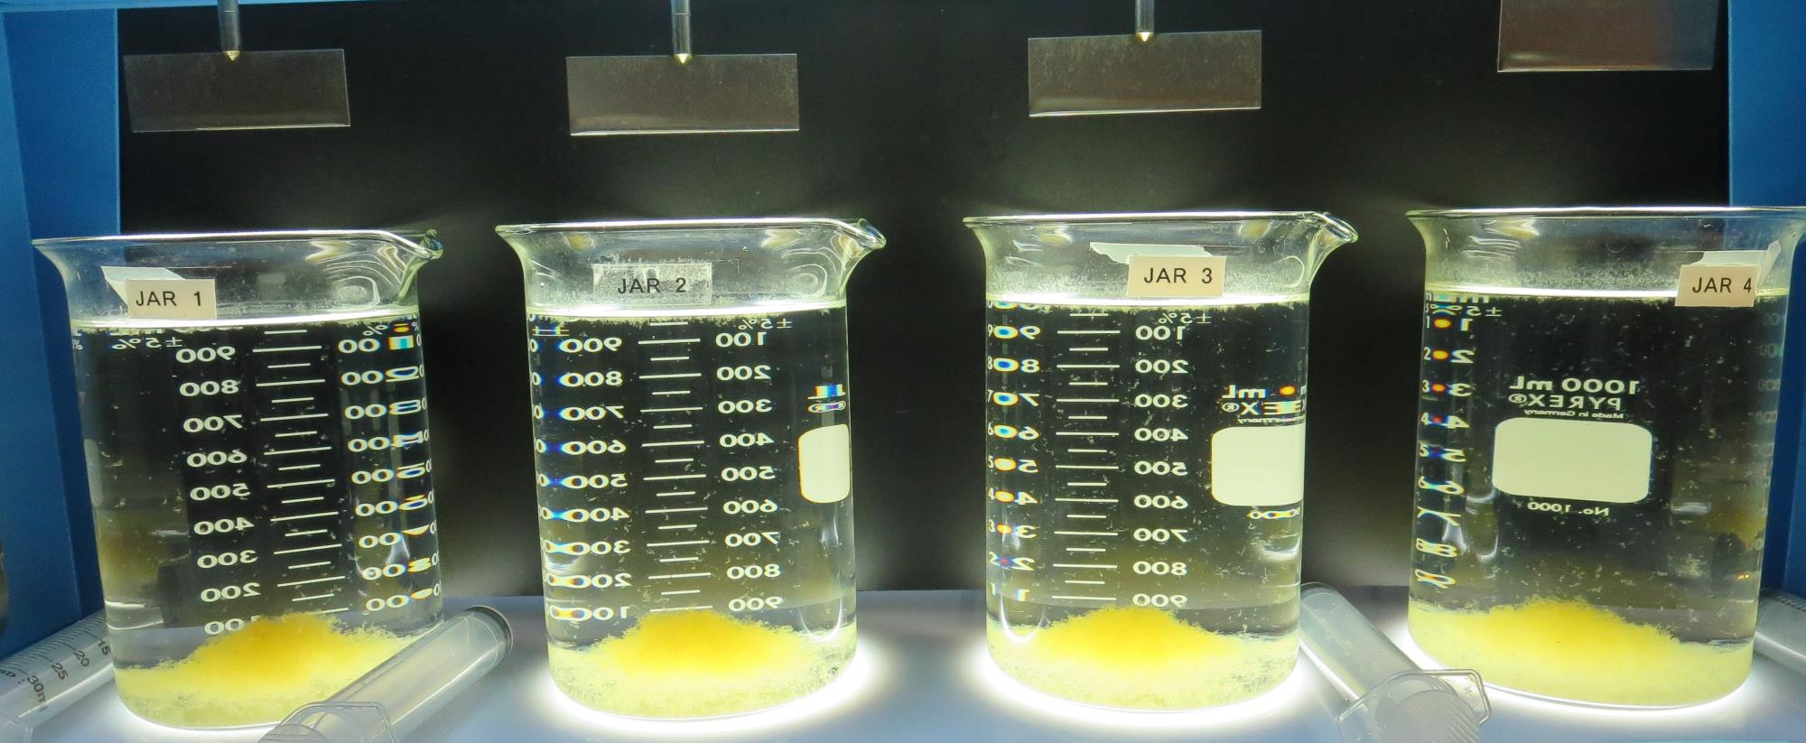
Jars 33-36: After 5 min of settling, 25 mL is syringed for filterability and %UVT/UVA.

Slide 53
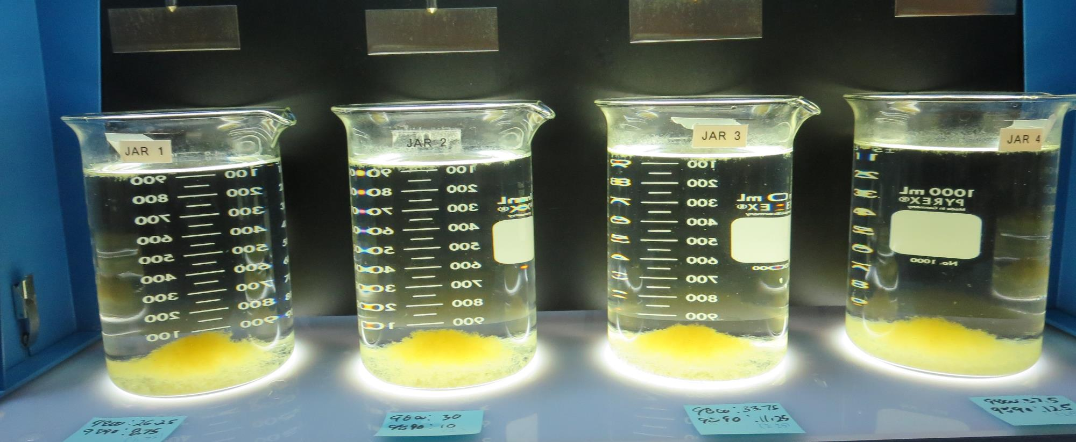
Jars 33-36: After 25-minutes of settling, settled water turbidity is taken.
26.25 mg/L 9800
8.75 mg/L 9890
Filtrate 0.05 NTU
UVT: 91.8%
UVA: 0.036/cm
UVA Reduction 50.0%
Settled: 0.33 NTU
30 mg/L 9800
10 mg/L 9890
Filtrate 0.05 NTU
UVT: 92.0%
UVA: 0.036/cm
UVA Reduction 50.0%
Settled: 0.33 NTU
33.75 mg/L 9800
11.25 mg/L 9890
Filtrate 0.06 NTU
UVT: 92.0%
UVA: 0.036/cm
UVA Reduction 50.0%
Settled: 0.38 NTU
37.5 mg/L 9800
12.5 mg/L 9890
Filtrate 0.06 NTU
UVT: 92.1%
UVA: 0.035/cm
UVA Reduction 51.4%
Settled: 0.36 NTU

Slide 54
Jars 37-40 Test Flash Mix 30 Sec (200 RPM) Floc Mix 5 min (30 RPM) Post-Oxidation KMnO₄/O₃ Applied Coagulant 9800/CTC-00025

Slide 55
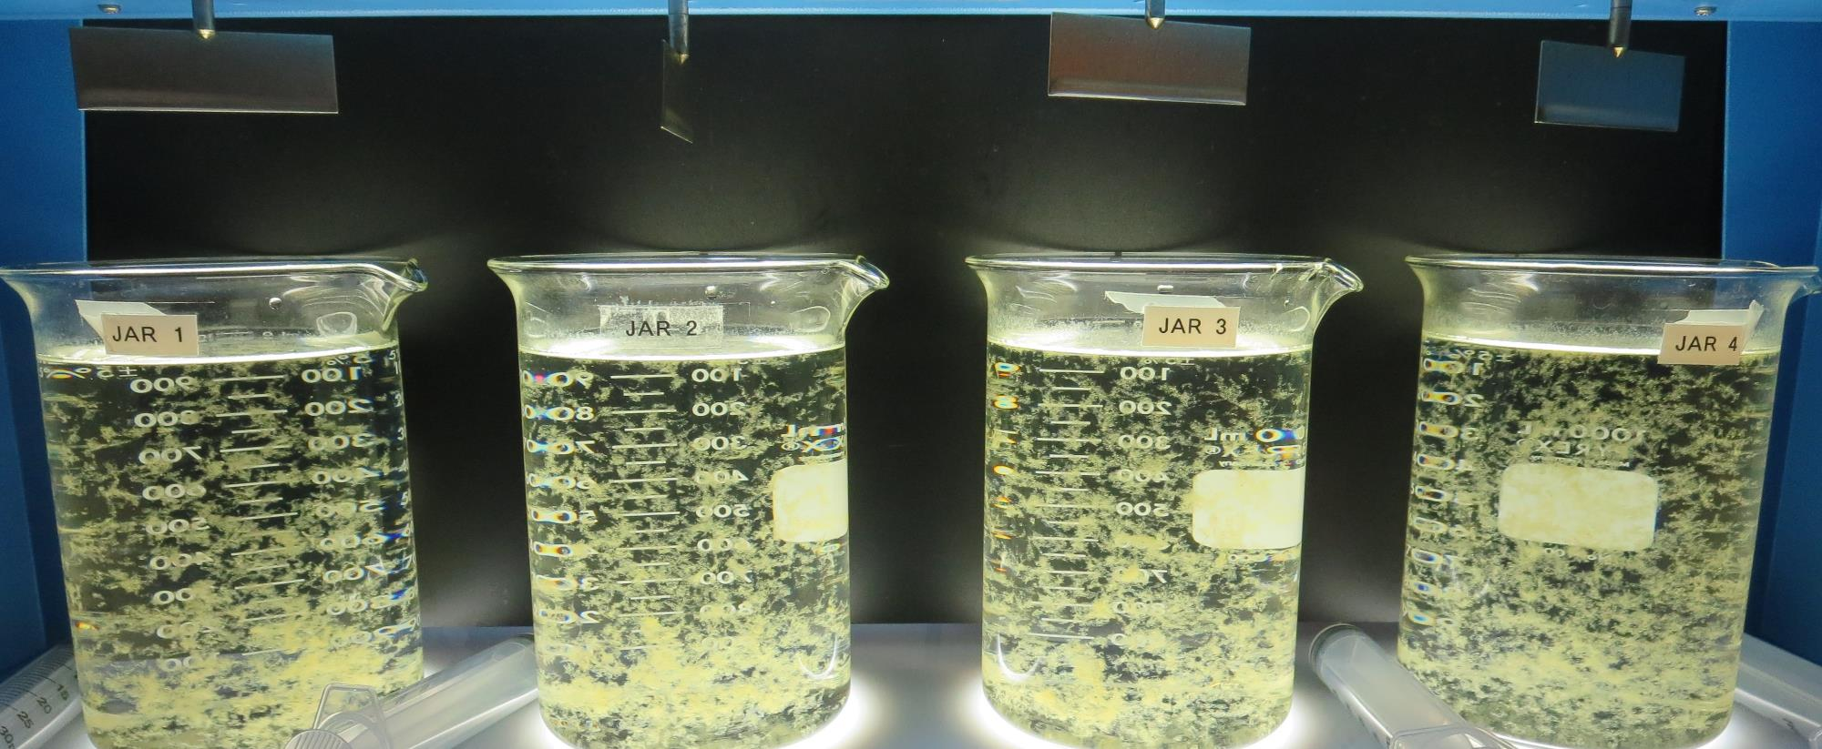
Jars 37-40: End of 5-minute flocculation (30 RPM) duration.
33.25 mg/L 9800
1.75 mg/L CTC-00025
Filtrate 0.06 NTU
UVT: 91.7%
UVA: 0.037/cm
UVA Reduction 48.6%
Settled: 0.52 NTU
38 mg/L 9800
2 mg/L CTC-00025
Filtrate 0.05 NTU
UVT: 91.6%
UVA: 0.038/cm
UVA Reduction 47.2%
Settled: 0.46 NTU
42.75 mg/L 9800
2.25 mg/L CTC-00025
Filtrate 0.06 NTU
UVT: 91.8%
UVA: 0.037/cm
UVA Reduction 48.6%
Settled: 0.44 NTU
47.75 mg/L 9800
2.5 mg/L CTC-00025
Filtrate 0.05 NTU
UVT: 91.9%
UVA: 0.036/cm
UVA Reduction 50.0%
Settled: 0.37 NTU

Slide 56
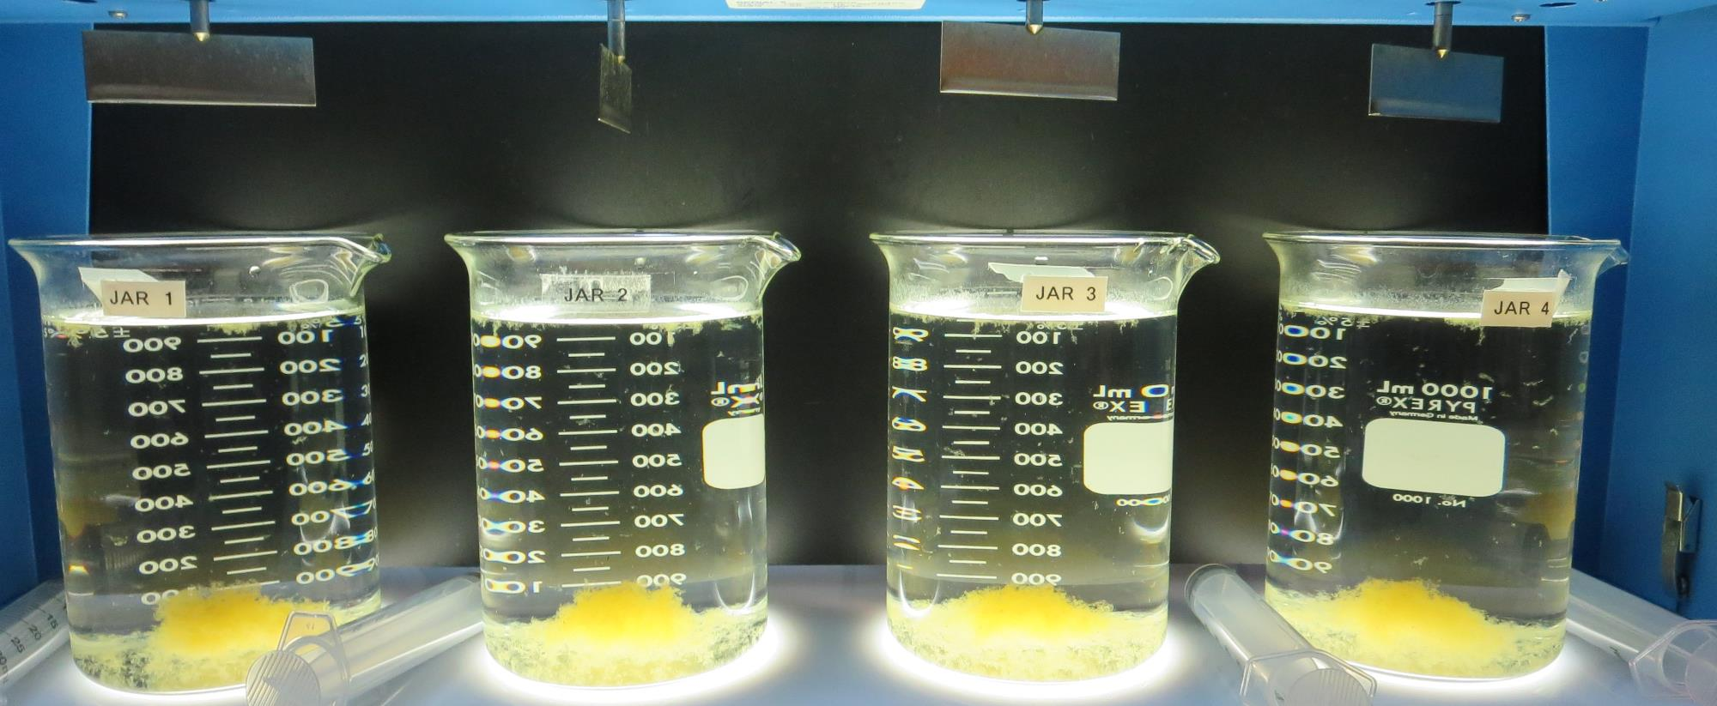
Jars 37-40: After 5 min of settling, 25 mL is syringed for filterability and %UVT/UVA.

Slide 57
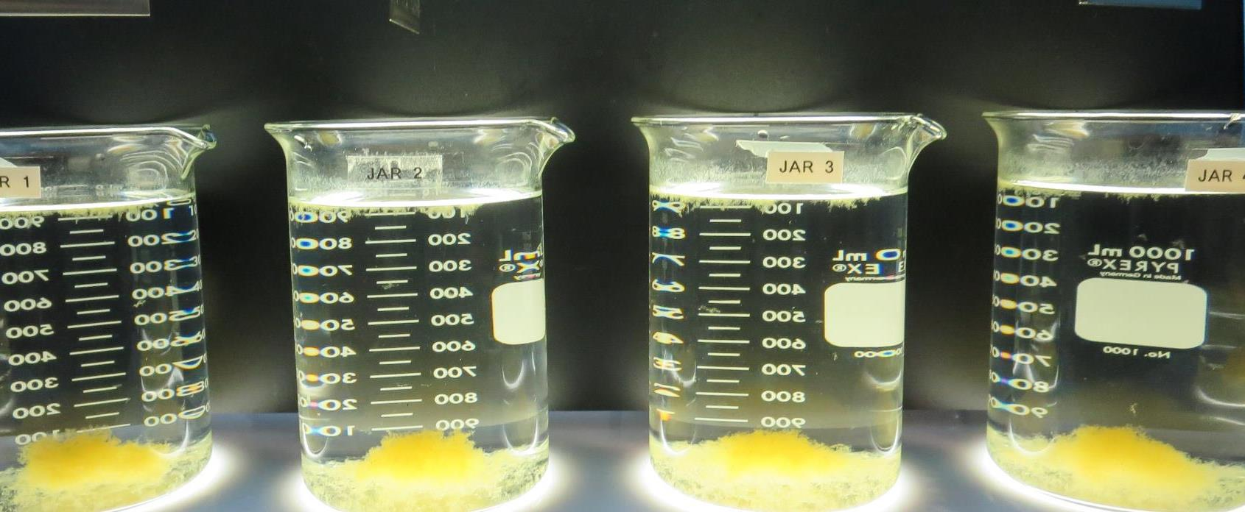
Jars 37-40: After 25-minutes of settling, settled water turbidity is taken.
33.25 mg/L 9800
1.75 mg/L CTC-00025
Filtrate 0.06 NTU
UVT: 91.7%
UVA: 0.037/cm
UVA Reduction 48.6%
Settled: 0.52 NTU
38 mg/L 9800
2 mg/L CTC-00025
Filtrate 0.05 NTU
UVT: 91.6%
UVA: 0.038/cm
UVA Reduction 47.2%
Settled: 0.46 NTU
42.75 mg/L 9800
2.25 mg/L CTC-00025
Filtrate 0.06 NTU
UVT: 91.8%
UVA: 0.037/cm
UVA Reduction 48.6%
Settled: 0.44 NTU
47.75 mg/L 9800
2.5 mg/L CTC-00025
Filtrate 0.05 NTU
UVT: 91.9%
UVA: 0.036/cm
UVA Reduction 50.0%
Settled: 0.37 NTU

Slide 58
Jar Testing for 1-Liter Jars: Procedures for Most Treatment Plants
Fill jars with source water prior to coagulant injection and set paddle speed at 30 rpm
Add chemicals (i.e., NaOCl, primary coagulant, coagulant aid) to each jar
Flash mix for 15-30 seconds (200 rpm)
Slow mix for 5 minutes (20-30 rpm)
Settled for 5 minutes. Syringe 25 mL from each jar taken 1-inch below surface (25 mL/12 sec rate)
Filtered through 1.2 um isopore membrane into cuvette drip rate, 15 mL/(50-90 sec)
Measure filtrate turbidity, chlorine residual and %UVT/UVA
Measure settled water turbidity after 25 minutes of total setting
Record all data

Slide 59
Jar Test Filterability Test Equipment
Turbidity Instrument
Syringe w/Luer-Lock Tip, 30 cc
(part#: 2225800, by Hach)
Swinnex Filter Holder, 25 mm (part#: SX0002500)
Isopore Membrane Filter, 1.2 um absolute
pore size,
Φ= 25 mm , thickness: 24 um,
hydrophilic polycarbonate membrane
(part #: RTTP02500)
Go to Sigma-Aldrich for laboratory supplies http://www.sigmaaldrich.com/united-states.html

Slide 60
Isopore Membrane Information
Categories | Information
trade name | Isopore
filter color | White
chemistry | Polycarbonate (PC)
water flow rate | Avg. 175 mL/min x cm² (typical results @ 10 psi)
media | Isopore®
wettability | Hydrophilic
porosity | 14.7%
pore size | 1.2 µm
bubble point at 23 °C | 1.0 bar, air with water
thickness | 24 µm
filter diameter (ø) | 25 mm
material size | polycarbonate, Hydrophilic, 1.2 µm, 25 mm, white, plain, 100

Slide 61
Isopore Membrane Background Information
The Isopore membrane is a polycarbonate, track-etched screen filter recommended for all analyses in which the sample is viewed on the surface of the membrane. The Isopore membrane is composed of polycarbonate film, which has a smooth, glass-like surface for clearer sample observation. The unique manufacturing process of the membrane ensures a precise pore diameter and a consistent pore size for accurate separation of samples by size. Matched-weight filters are not usually required because of low, constant tar and ash weights. Features & Benefits: Membrane structure retains particles on the surface, simplifying counting and analysis

Slide 62
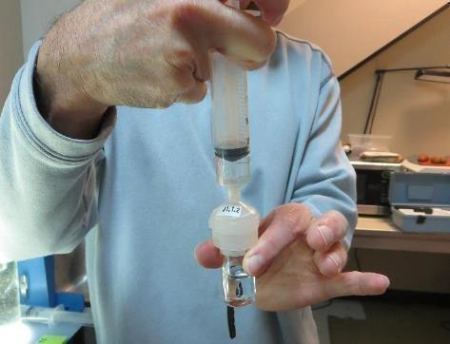
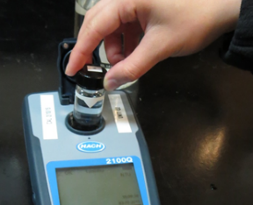
Jar Test - Filterability Test
Syringe ~ 25 mL from jar (after 5-minutes of settling)
Filter-to-waste 3-5 mL
Filter directly into clean cuvette
Measure turbidity
Note: Take several readings before recording final NTU results. Micro bubbles can adhere to glass causing false NTU readings. To remove bubbles, tilt cuvette up to 90 degrees.

Slide 63
Contact
Guy Schott, P.E.
State Water Resources Control Board
Division of Drinking Water
Santa Rosa, CA
Go to Stock Solution/Dose calculations/Jar Test Results for tools to download
www.waterboards.ca.gov/drinking_water/programs/districts/mendocino_district.html
Email: Guy Schott - Guy.Schott@waterboards.ca.gov
Office Number: 707-576-2732

