Slide 1
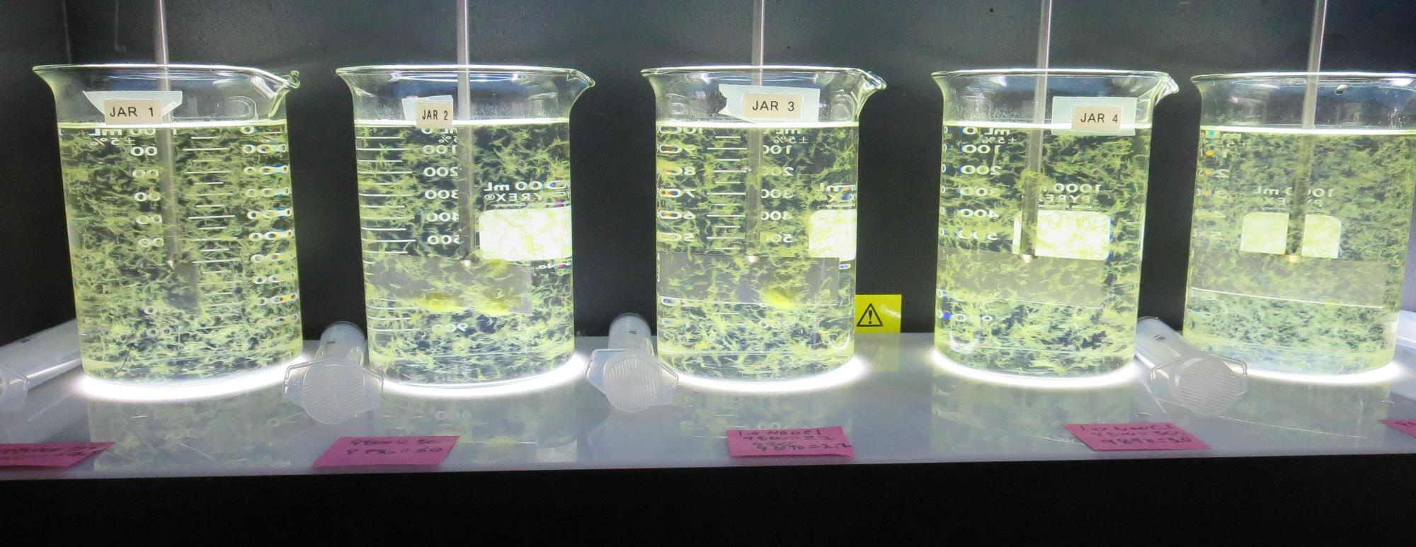
Konocti County Water District CA1710006, Lake County, Jar Test
by Guy Schott, P.E. August 11, 2020

Slide 2
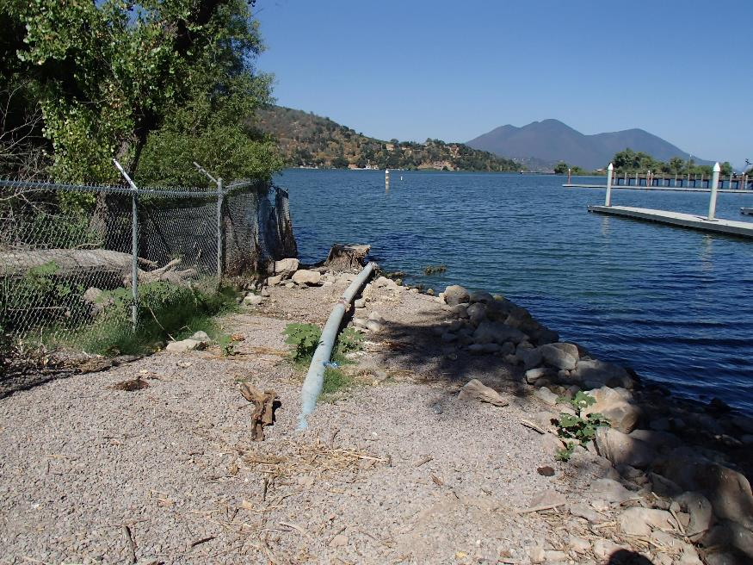
Konocti County Water District Source Water: Clear Lake Conventional Treatment

Slide 3
Fish Collected on Screen before Filters. “Luca Brasi sleeps with the fishes.”

Slide 4
Konocti CWD, August 11, 2020 Source Water Characteristics
Source (morning)
pH: 9.10
Turbidity: 8.15 NTU
UVT: 74%
UVA: 0.130/cm
0.4 um Filtered
Turbidity: 0.49 NTU
UVT: 85.4%
UVA: 0.068/cm
Source (afternoon)
Turbidity: 15.8 NTU
UVT: 71.1%
UVA: 0.148/cm
0.4 um Filtered
Turbidity: 0.47 NTU
UVT: 85.9%
UVA: 0.066/cm
Plant Coagulant
9800 dose: 60 mg/L
Filter aid 9890 dose: 1.5 mg/L
Plant CFE (afternoon)
Turbidity: 0.10 NTU
UVT: 94.2%
UVA: 0.025/cm
UVA Reduction: 62.1%
Plant post GAC #1
Turbidity: 0.08 NTU
UVT: 95.0%
UVA: 0.022/cm
UVA Reduction: 66.7%

Slide 5
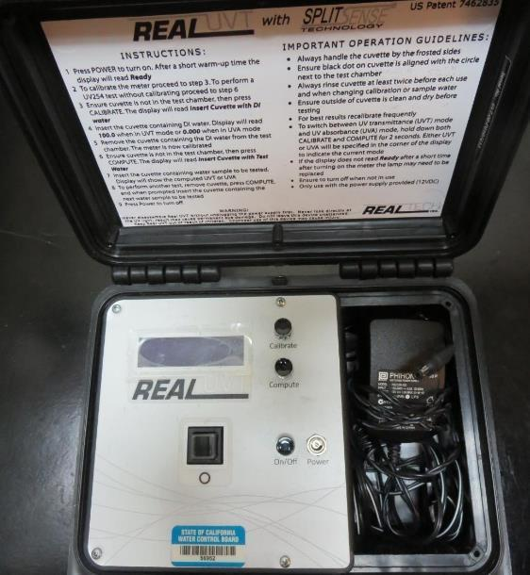
UVT/UVA, pathlength 10 mm
UV transmittance (UVT) is a measurement of the amount of ultraviolet light (commonly at 254 nm due to its germicidal effect) that passes through a water sample compared to the amount of light that passes through a pure water sample. The measurement is expressed as a percentage, % UVT.
%UVT = 10^{(-UVA)} x 100%
UV absorbance (UVA) is calculated as a relative measure of the amount of light absorbed by a water sample compared with the amount of light absorbed by a pure water sample.
UVA = -log(%UVT/100)

Slide 6
Applied Coagulants for Jar Testing
Pro Pac 9800 (NTU Technologies)
50% Aluminum Chlorohydrate
50% Water
83% Basicity
SG = 1.34
Pro Pac 9890 (NTU Technologies)
35-45% Aluminum Chlorohydrate
20% Trade Secret
35-45% Water
SG = 1.25-1.34
Advanced Coagulant
12.55% Al₂O₃
64.9% Basicity
SG = 1.299

Slide 7
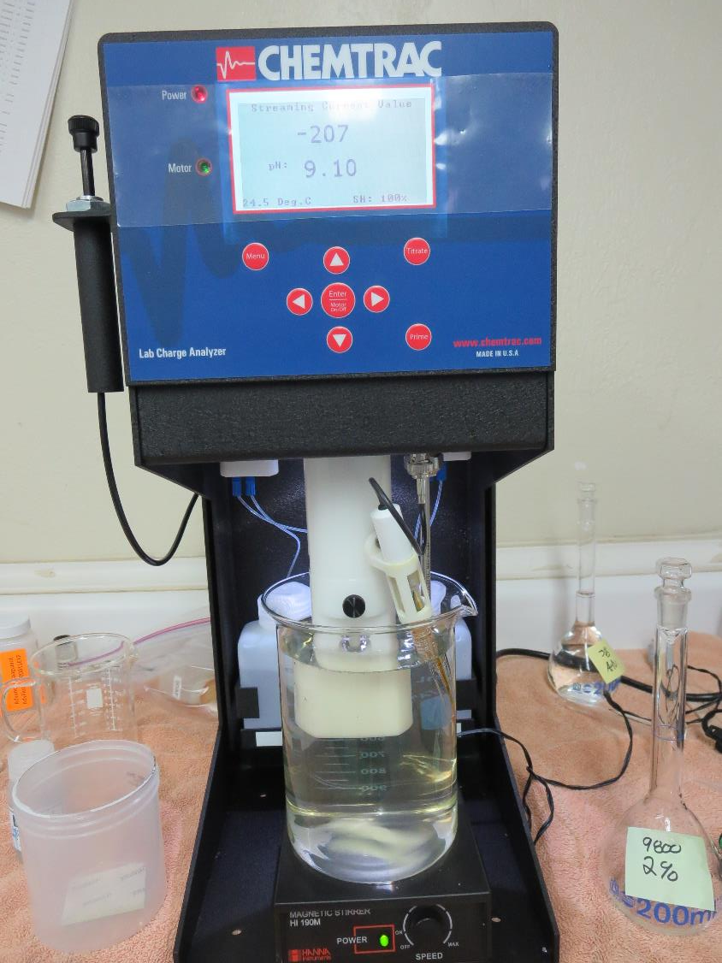
Laboratory Charge Analyzer
LCA: Used to determine coagulant demand of a source water entering the treatment plant.
Source pH: 9.10
LCA #1:
9800: 30 mg/L as product
pH adjusted to 7.5 w/acetic acid solution
LCA #2:
9800: 31 mg/L as product
With 1 mg/L NaOCl
pH adjusted to 7.5 w/acetic acid solution
LCA #3:
Advance Coagulant: 100 mg/L as product
pH adjusted to 7.5 w/acetic acid solution

Slide 8
Coagulant Information
Unless stated otherwise, all coagulant doses are reported as Product (100% strength).
Preparation of coagulant stock solutions are generally 1.0 and/or 0.1 percent strength using 100 and/or 200 mL volumetric flasks.
Finnpipette F2 variable volume pipette, capacity 100-1000 micro liters is used for stock solution preparation and coagulant aid jar test dosing.
Finnpipette F2 variable volume pipette, capacity 0.5-5 mL is used for primary coagulant jar test dosing.

Slide 9
Konocti CWD: Jar Test 1-5 Results Clear Lake Source Water Flash Mix 200 RPM (30 sec); Floc Mix 30 RPM (5 minutes)
Jar # | 9800 mg/L | Adv Coag. mg/L | Filtrate NTU | Filtrate %UVT | Filtrate UVA/cm | %UVA Reduction | Settle NTU 25 min
J1 | 30 | 0 | 0.14 | 91.9 | 0.036 | 47.1 | 0.93
J2 | 33 | 0 | 0.18 | 91.4 | 0.038 | 44.1 | 0.80
J3 | 36 | 0 | 0.20 | 91.3 | 0.039 | 42.6 | 0.73
J4 | 60 | 0 | 0.07 | 93.0 | 0.031 | 54.4 | 0.21
J5 | 0 | 100 | 0.08 | 91.9 | 0.036 | 47.1 | 0.38

Slide 10
Konocti CWD: Jar Test 6-10 Results Clear Lake Source Water Flash Mix 200 RPM (30 sec); Floc Mix 30 RPM (5 minutes)
Jar # | 9800 mg/L | 9890 mg/L | Adv Coag. mg/L | Filtrate NTU | Filtrate %UVT | Filtrate UVA/cm | %UVA Reduction | Settle NTU 25 min
J6 | 30 | 3.0 | 0 | 0.07 | 91.7 | 0.037 | 45.6 | 0.35
J7 | 33 | 3.3 | 0 | 0.10 | 91.7 | 0.037 | 45.6 | 0.47
J8 | 60 | 1.5 | 0 | 0.09 | 92.1 | 0.035 | 48.5 | 0.35
J9 | 60 | 0 | 0 | 0.11 | 92.0 | 0.036 | 47.1 | 0.38
J10 | 0 | 0 | 150 | 0.09 | 92.2 | 0.035 | 48.5 | 0.43

Slide 11
Konocti CWD: Jar Test 11-15 Results Clear Lake Source Water Flash Mix 200 RPM (30 sec); Floc Mix 30 RPM (5 minutes)
Jar # | NaOCl mg/L | 9800 mg/L | 9890 mg/L | Filtrate NTU | Filtrate %UVT | Filtrate UVA/cm | %UVA Reduction | Settle NTU 25 min
J11 | 0 | 27 | 2.7 | 0.14 | 91.9 | 0.036 | 45.5 | 0.39
J12 | 0 | 30 | 3.0 | 0.10 | 92.2 | 0.035 | 47.0 | 0.62
J13 | 1.0 | 27 | 2.7 | 0.11 | 91.8 | 0.037 | 43.9 | 0.81
J14 | 1.0 | 30 | 3.0 | 0.10 | 91.8 | 0.037 | 43.9 | 0.67
J15 | 1.0 | 60 | 1.5 | 0.12 | 92.5 | 0.033 | 50.0 | 0.42

Slide 12
Jars 1-5 Test Flash Mix 30 Sec (200 RPM) Floc Mix 5 min (30 RPM) Applied Coagulants 9800/9890 Advanced Coagulant

Slide 13
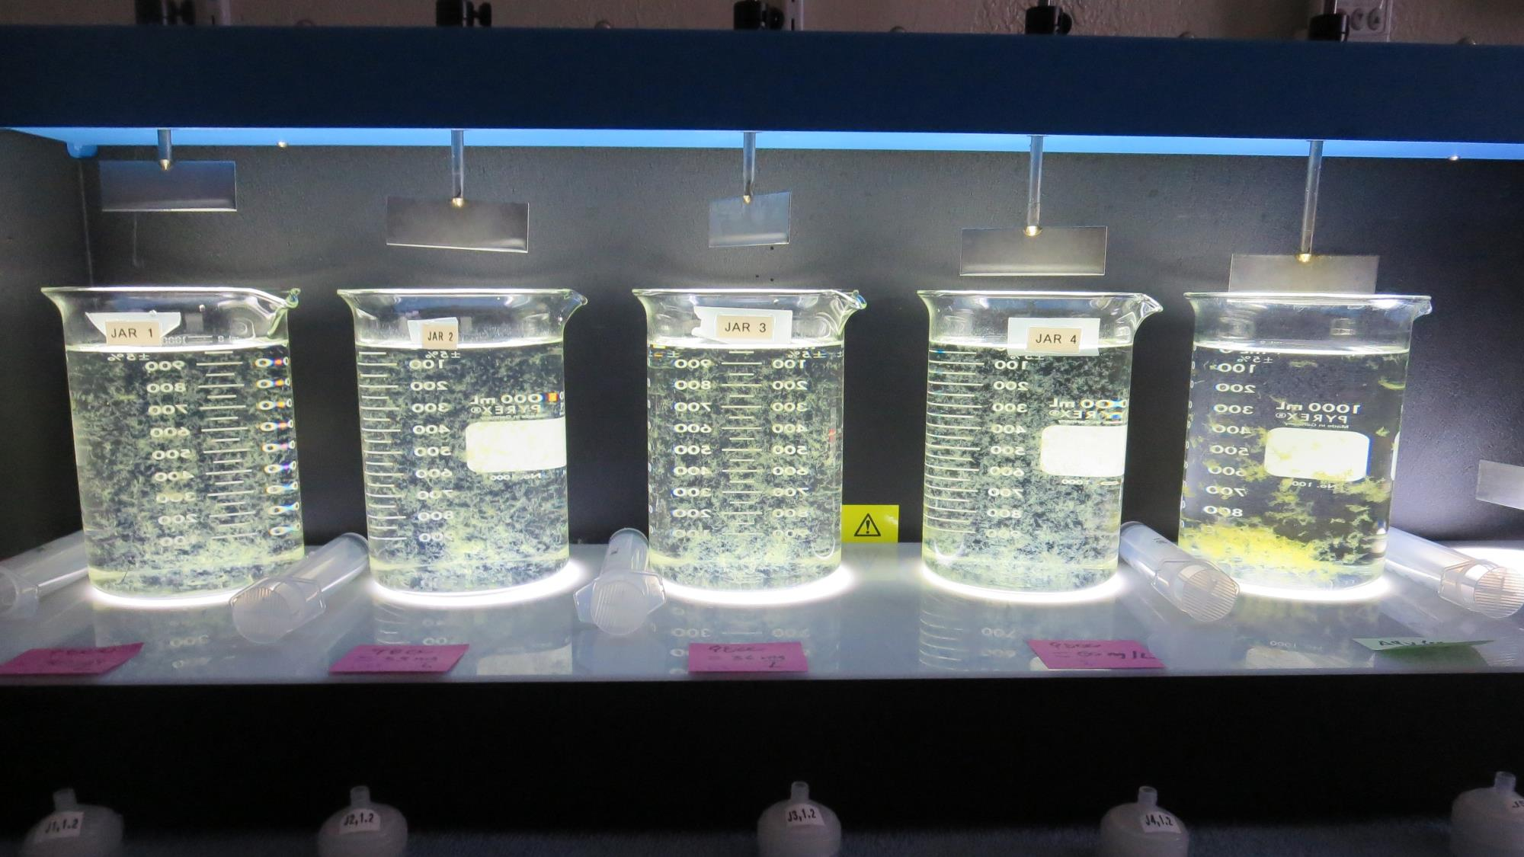
Jars 1-5: End of 5-minute flocculation (30 RPM) duration.
30 mg/L 9800
Filtrate 0.14 NTU
UVT: 91.9%
UVA: 0.036/cm
UVA Reduction: 47.1%
Settled: 0.93 NTU
33 mg/L 9800
Filtrate 0.18 NTU
UVT: 91.4%
UVA: 0.038/cm
UVA Reduction : 44.1%
Settled: 0.80 NTU
36 mg/L 9800
Filtrate 0.20 NTU
UVT: 91.3%
UVA: 0.039/cm
UVA Reduction : 42.6%
Settled: 0.73 NTU
60 mg/L 9800
Filtrate 0.07 NTU
UVT: 93.0%
UVA: 0.031/cm
UVA Reduction: 54.4%
Settled: 0.21 NTU
100 mg/L Adv Coag.
Filtrate 0.08 NTU
UVT: 91.9%
UVA: 0.036/cm
UVA Reduction: 47.1%
Settled: 0.38 NTU

Slide 14
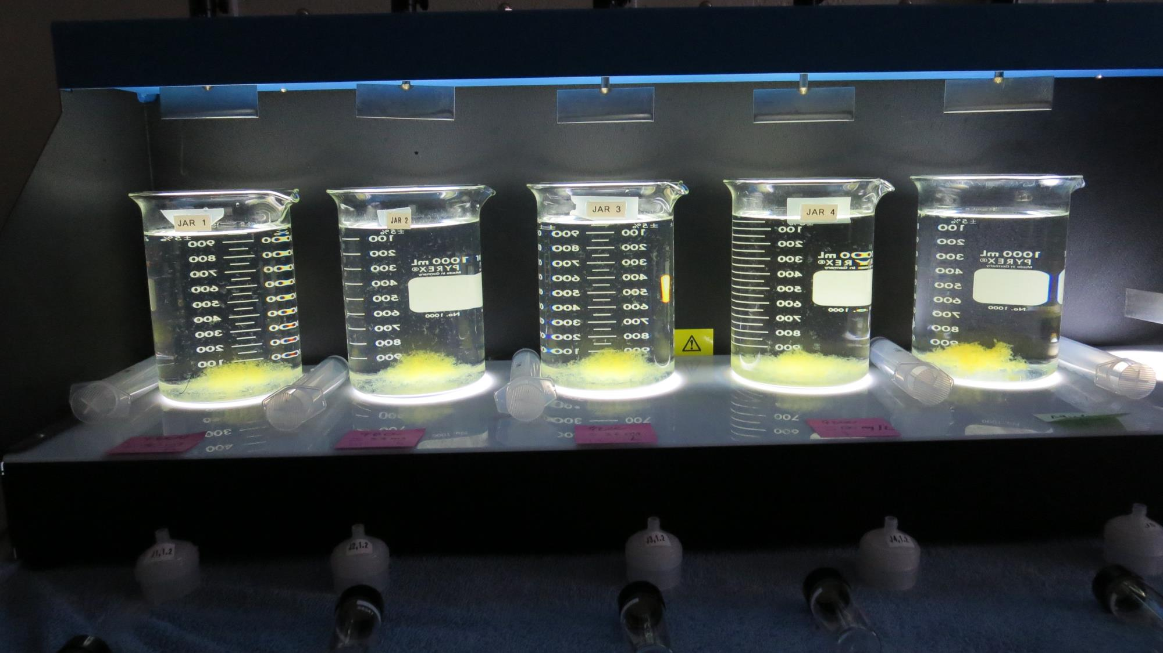
Jars 1-5: After 5 min of settling, 25 mL is syringed for filterability and %UVT/UVA.

Slide 15
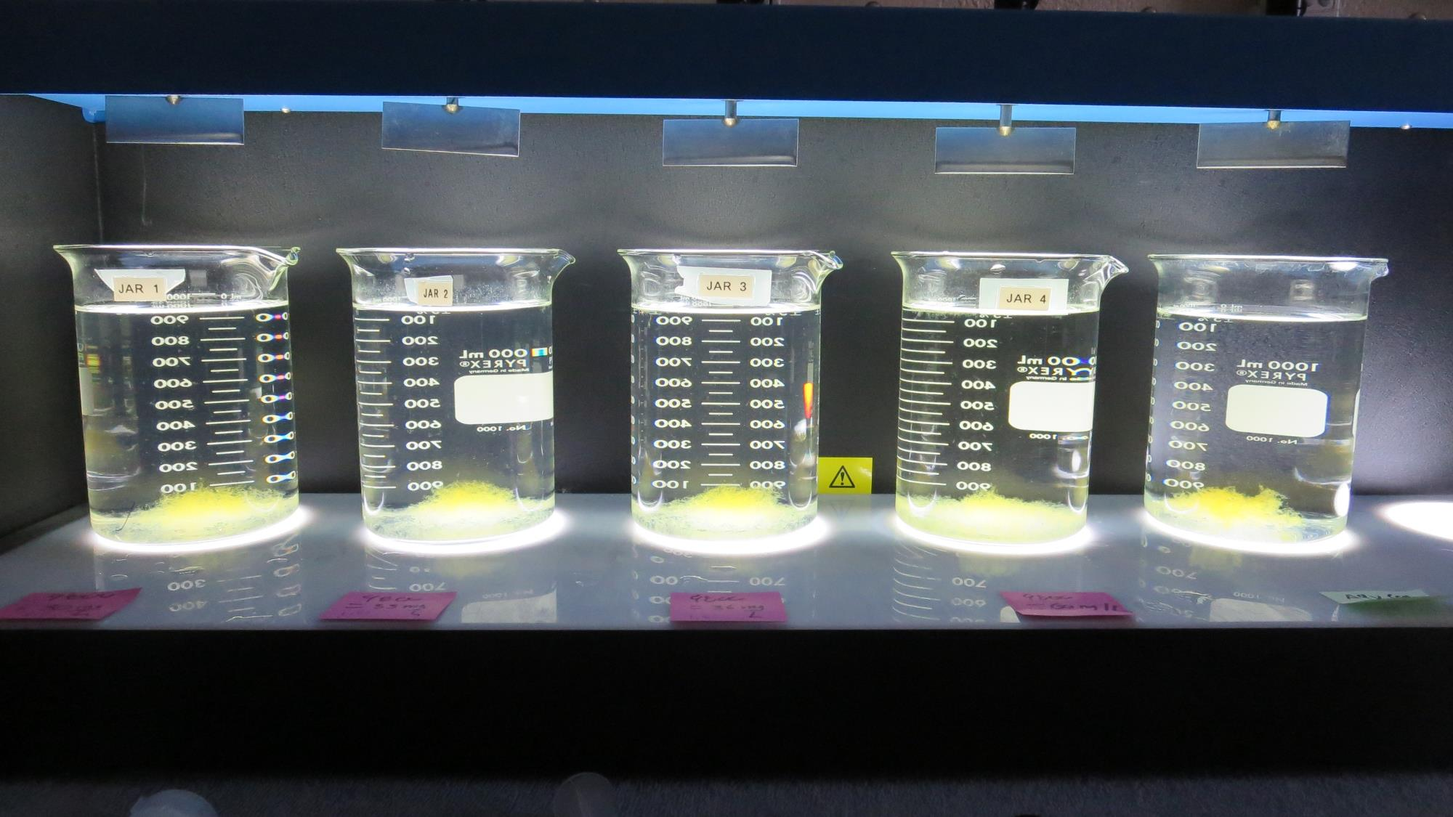
Jars 1-5: After 25-minutes of settling, settled water turbidity is taken.
30 mg/L 9800
Filtrate 0.14 NTU
UVT: 91.9%
UVA: 0.036/cm
UVA Reduction: 47.1%
Settled: 0.93 NTU
33 mg/L 9800
Filtrate 0.18 NTU
UVT: 91.4%
UVA: 0.038/cm
UVA Reduction: 44.1%
Settled: 0.80 NTU
36 mg/L 9800
Filtrate 0.20 NTU
UVT: 91.3%
UVA: 0.039/cm
UVA Reduction: 42.6%
Settled: 0.73 NTU
60 mg/L 9800
Filtrate 0.07 NTU
UVT: 93.0%
UVA: 0.031/cm
UVA Reduction: 54.4%
Settled: 0.21 NTU
100 mg/L Adv Coag.
Filtrate 0.08 NTU
UVT: 91.9%
UVA: 0.036/cm
UVA Reduction: 47.1%
Settled: 0.38 NTU

Slide 16
Jars 6-10 Test Flash Mix 30 Sec (200 RPM) Floc Mix 5 min (30 RPM) Applied Coagulants 9800/9890 Advanced Coagulant

Slide 17
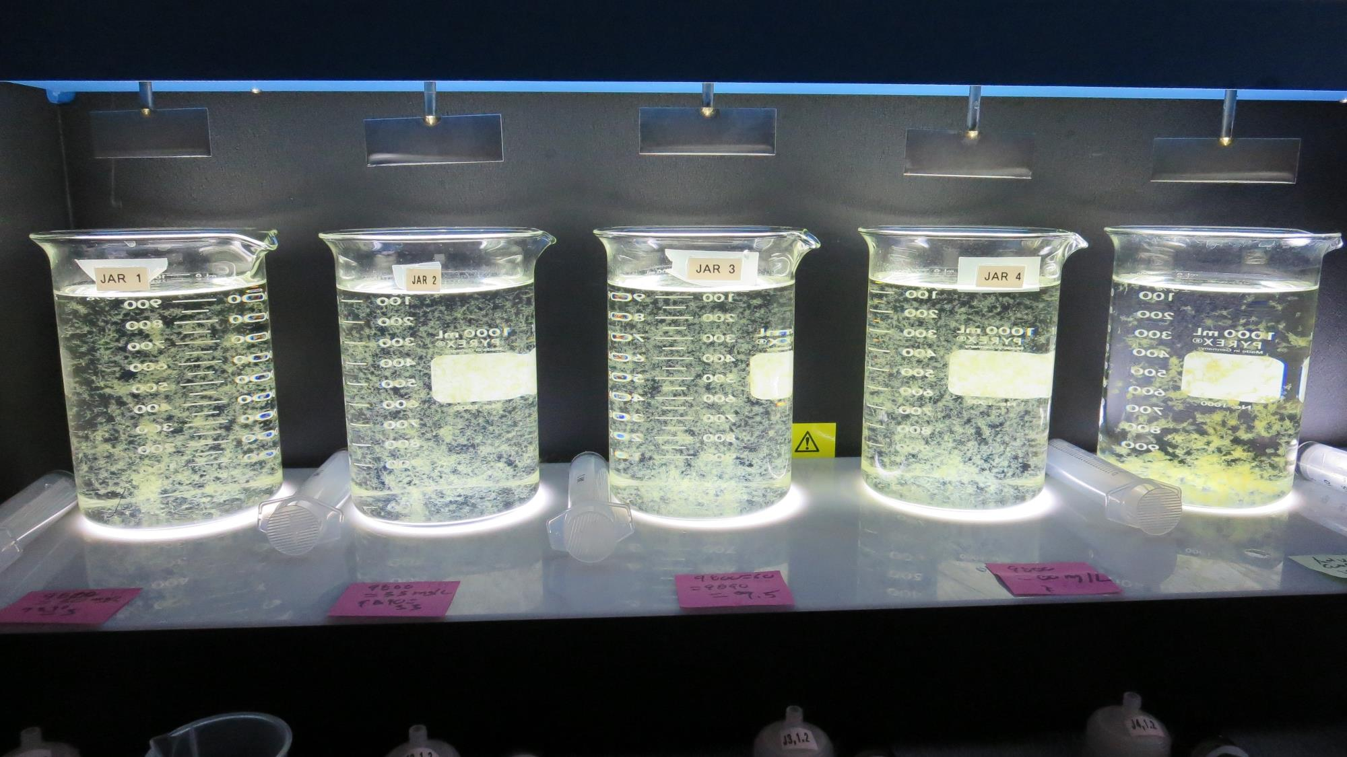
Jars 6-10: End of 5-minute flocculation (30 RPM) duration.
30 mg/L 9800
3.0 mg/L 9890
Filtrate 0.07 NTU
UVT: 91.7%
UVA: 0.037/cm
UVA Reduction: 45.6%
Settled: 0.35 NTU
33 mg/L 9800
3.3 mg/L 9890
Filtrate 0.10 NTU
UVT: 91.7%
UVA: 0.037/cm
UVA Reduction: 45.6%
Settled: 0.47 NTU
60 mg/L 9800
1.5 mg/L 9890
Filtrate 0.09 NTU
UVT: 92.1%
UVA: 0.035/cm
UVA Reduction: 48.5%
Settled: 0.35 NTU
60 mg/L 9800
0 mg/L 9890
Filtrate 0.11 NTU
UVT: 92.0%
UVA: 0.036/cm
UVA Reduction: 47.1%
Settled: 0.38 NTU
150 mg/L Adv Coag.
Filtrate 0.09 NTU
UVT: 92.2%
UVA: 0.035/cm
UVA Reduction: 48.5%
Settled: 0.43 NTU

Slide 18
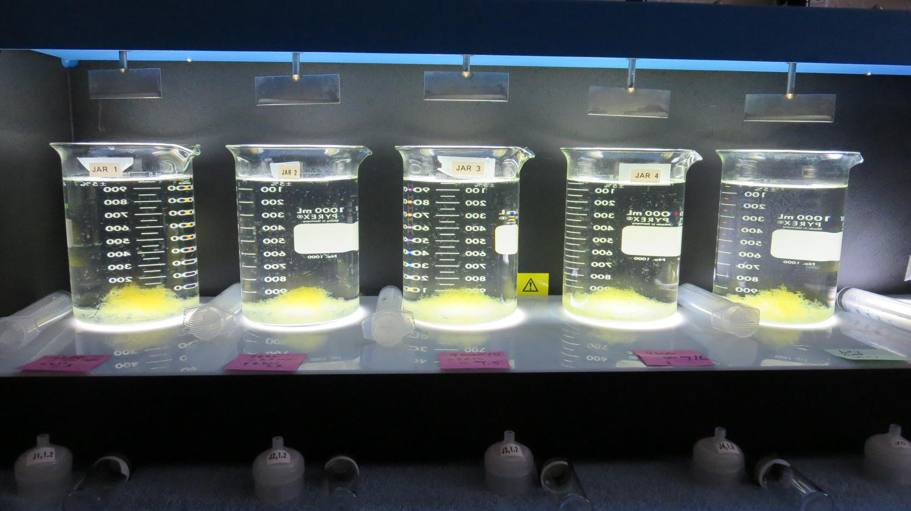
Jars 6-10: After 5 min of settling, 25 mL is syringed for filterability and %UVT/UVA.

Slide 19
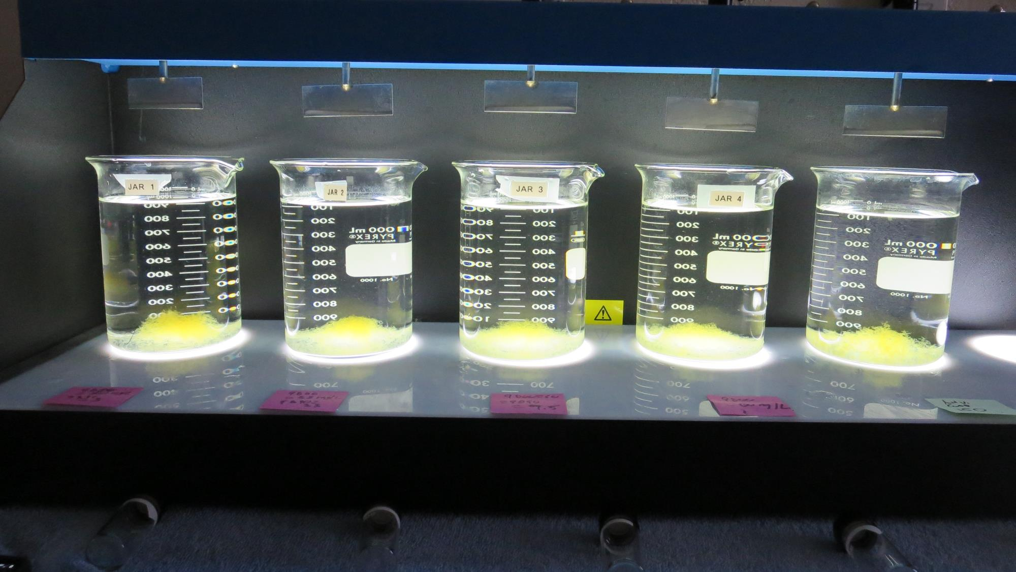
Jars 6-10: After 25-minutes of settling, settled water turbidity is taken.
30 mg/L 9800
3.0 mg/L 9890
Filtrate 0.07 NTU
UVT: 91.7%
UVA: 0.037/cm
UVA Reduction: 45.6%
Settled: 0.35 NTU
33 mg/L 9800
3.3 mg/L 9890
Filtrate 0.10 NTU
UVT: 91.7%
UVA: 0.037/cm
UVA Reduction: 45.6%
Settled: 0.47 NTU
60 mg/L 9800
1.5 mg/L 9890
Filtrate 0.09 NTU
UVT: 92.1%
UVA: 0.035/cm
UVA Reduction: 48.5%
Settled: 0.35 NTU
60 mg/L 9800
0 mg/L 9890
Filtrate 0.11 NTU
UVT: 92.0%
UVA: 0.036/cm
UVA Reduction: 47.1%
Settled: 0.38 NTU
150 mg/L Adv Coag.
Filtrate 0.09 NTU
UVT: 92.2%
UVA: 0.035/cm
UVA Reduction: 48.5%
Settled: 0.43 NTU

Slide 20
Jars 11-15 Test Flash Mix 30 Sec (200 RPM) Floc Mix 5 min (30 RPM) w/NaOCl Applied Coagulants 9800/9890

Slide 21
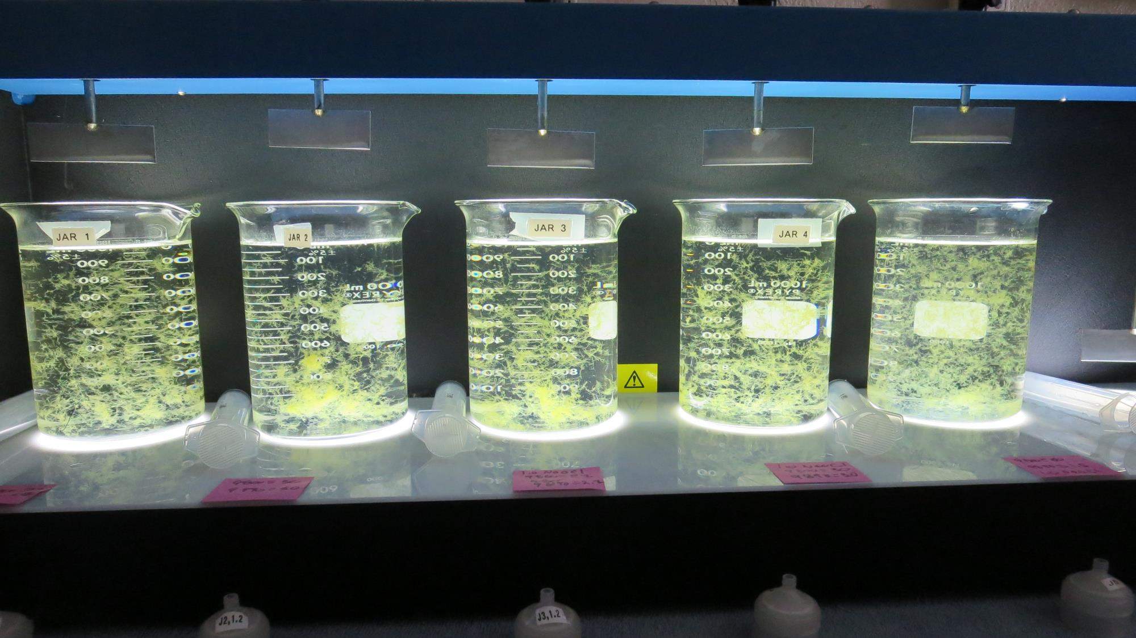
Jars 11-15: End of 5-minute flocculation (30 RPM) duration.
0 mg/L NaOCl
27 mg/L 9800
2.7 mg/L 9890
Filtrate 0.14 NTU
UVT: 91.9%
UVA: 0.036/cm
UVA Reduction: 45.5%
Settled: 0.39 NTU
0 mg/L NaOCl
30 mg/L 9800
3.0 mg/L 9890
Filtrate 0.10 NTU
UVT: 92.2%
UVA: 0.035/cm
UVA Reduction: 47.0%
Settled: 0.62 NTU
1.0 mg/L NaOCl
27 mg/L 9800
2.7 mg/L 9890
Filtrate 0.11 NTU
UVT: 91.8%
UVA: 0.037/cm
UVA Reduction: 43.9%
Settled: 0.81 NTU
1.0 mg/L NaOCl
30 mg/L 9800
3.0 mg/L 9890
Filtrate 0.10 NTU
UVT: 91.8%
UVA: 0.037/cm
UVA Reduction: 43.9%
Settled: 0.67 NTU
1.0 mg/L NaOCl
60 mg/L 9800
1.5 mg/L 9890
Filtrate 0.12 NTU
UVT: 92.5%
UVA: 0.033/cm
UVA Reduction: 50.0%
Settled: 0.42 NTU

Slide 22
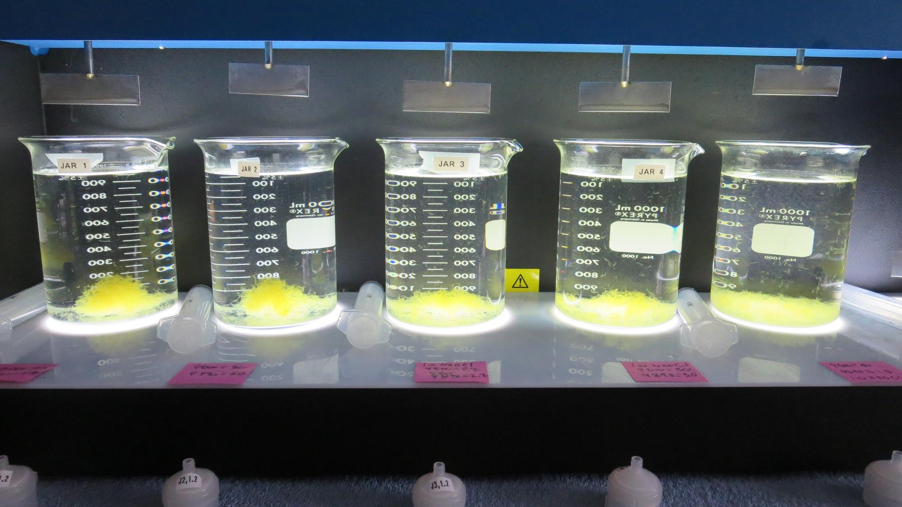
Jars 11-15: After 5 min of settling, 25 mL is syringed for filterability and %UVT/UVA.

Slide 23
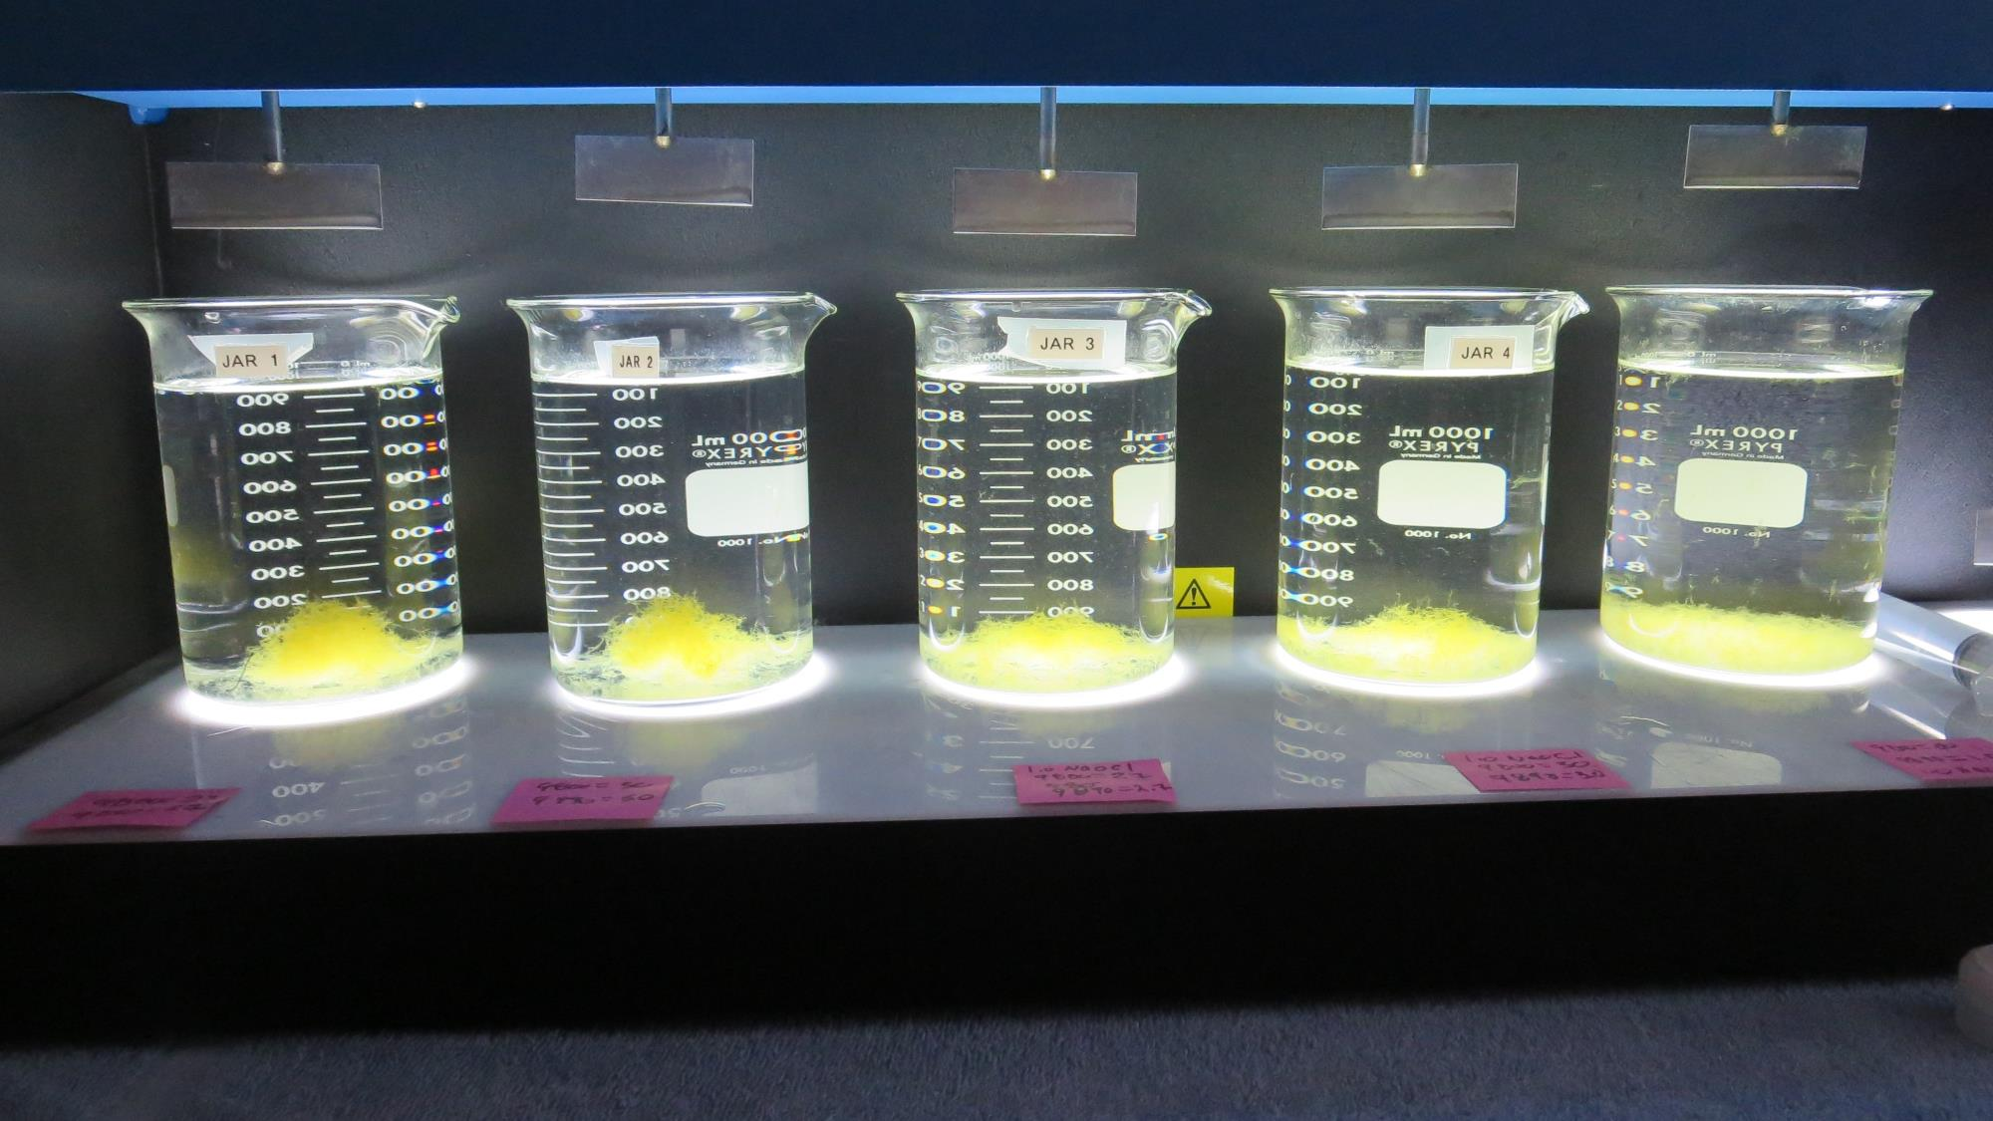
Jars 11-15: After 25-minutes of settling, settled water turbidity is taken.
0 mg/L NaOCl
27 mg/L 9800
2.7 mg/L 9890
Filtrate 0.14 NTU
UVT: 91.9%
UVA: 0.036/cm
UVA Reduction: 45.5%
Settled: 0.39 NTU
0 mg/L NaOCl
30 mg/L 9800
3.0 mg/L 9890
Filtrate 0.10 NTU
UVT: 92.2%
UVA: 0.035/cm
UVA Reduction: 47.0%
Settled: 0.62 NTU
1.0 mg/L NaOCl
27 mg/L 9800
2.7 mg/L 9890
Filtrate 0.11 NTU
UVT: 91.8%
UVA: 0.037/cm
UVA Reduction: 43.9%
Settled: 0.81 NTU
1.0 mg/L NaOCl
30 mg/L 9800
3.0 mg/L 9890
Filtrate 0.10 NTU
UVT: 91.8%
UVA: 0.037/cm
UVA Reduction: 43.9%
Settled: 0.67 NTU
1.0 mg/L NaOCl
60 mg/L 9800
1.5 mg/L 9890
Filtrate 0.12 NTU
UVT: 92.5%
UVA: 0.033/cm
UVA Reduction: 50.0%
Settled: 0.42 NTU

Slide 24
Jar Testing for 1-Liter Jars: Procedures for Most Treatment Plants
Fill jars with source water prior to coagulant injection and set paddle speed at 30 rpm
Add chemicals (i.e., NaOCl, primary coagulant, coagulant aid) to each jar
Flash mix for 15-30 seconds (200 rpm)
Slow mix for 5 minutes (20-30 rpm)
Settled for 5 minutes. Syringe 25 mL from each jar taken 1-inch below surface (25 mL/12 sec rate).
Filtered through 1.2 um isopore membrane into cuvette drip rate, 15 mL/(50-90 sec)
Measure filtrate turbidity, chlorine residual and %UVT/UVA
Measure settled water turbidity after 25 minutes of total setting
Record all data

Slide 25
Jar Test Filterability Test Equipment
Turbidity Instrument
Syringe w/Luer-Lock Tip, 30 cc
(part#: 2225800, by Hach)
Swinnex Filter Holder, 25 mm (part#: SX0002500)
Isopore Membrane Filter, 1.2 um absolute
pore size,
Φ= 25 mm , thickness: 24 um,
hydrophilic polycarbonate membrane
(part #: RTTP02500)
Go to Sigma-Aldrich for laboratory supplies http://www.sigmaaldrich.com/united-states.html

Slide 26
Isopore Membrane Information
Categories | Information
trade name | Isopore
filter color | White
chemistry | Polycarbonate (PC)
water flow rate | Avg. 175 mL/min x cm² (typical results @ 10 psi)
media | Isopore®
wettability | Hydrophilic
porosity | 14.7%
pore size | 1.2 µm
bubble point at 23 °C | 1.0 bar, air with water
thickness | 24 µm
filter diameter (ø) | 25 mm
material size | polycarbonate, Hydrophilic, 1.2 µm, 25 mm, white, plain, 100

Slide 27
Isopore Membrane Background Information
The Isopore membrane is a polycarbonate, track-etched screen filter recommended for all analyses in which the sample is viewed on the surface of the membrane. The Isopore membrane is composed of polycarbonate film, which has a smooth, glass-like surface for clearer sample observation. The unique manufacturing process of the membrane ensures a precise pore diameter and a consistent pore size for accurate separation of samples by size. Matched-weight filters are not usually required because of low, constant tar and ash weights. Features & Benefits: Membrane structure retains particles on the surface, simplifying counting and analysis

Slide 28
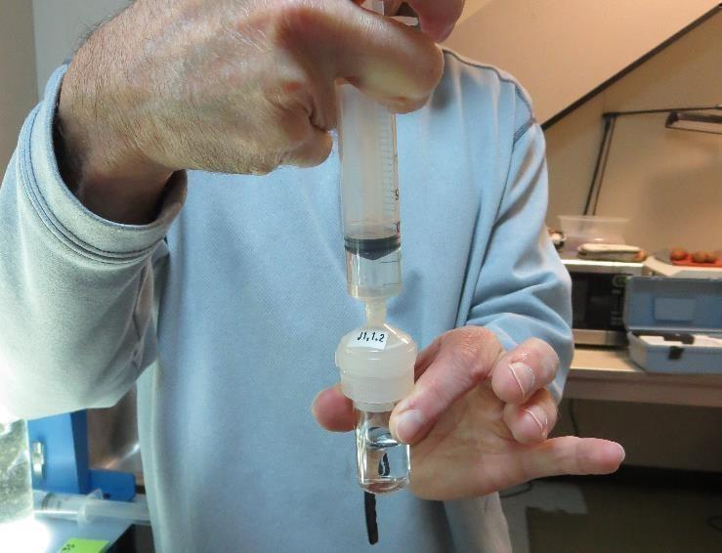
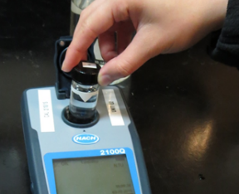
Jar Test - Filterability Test
Syringe ~ 25 mL from jar (after 5-minutes of settling)
Filter-to-waste 3-5 mL
Filter directly into clean cuvette
Measure turbidity
Note: Take several readings before recording final NTU results. Micro bubbles can adhere to glass causing false NTU readings. To remove bubbles, tilt cuvette up to 90 degrees.

Slide 29
Contact
Guy Schott, P.E.
State Water Resources Control Board
Division of Drinking Water
Santa Rosa, CA
Go to Stock Solution/Dose calculations/Jar Test Results for tools to download
www.waterboards.ca.gov/drinking_water/programs/districts/mendocino_district.html
Email: Guy Schott - Guy.Schott@waterboards.ca.gov
Office Number: 707-576-2732

