Slide 1
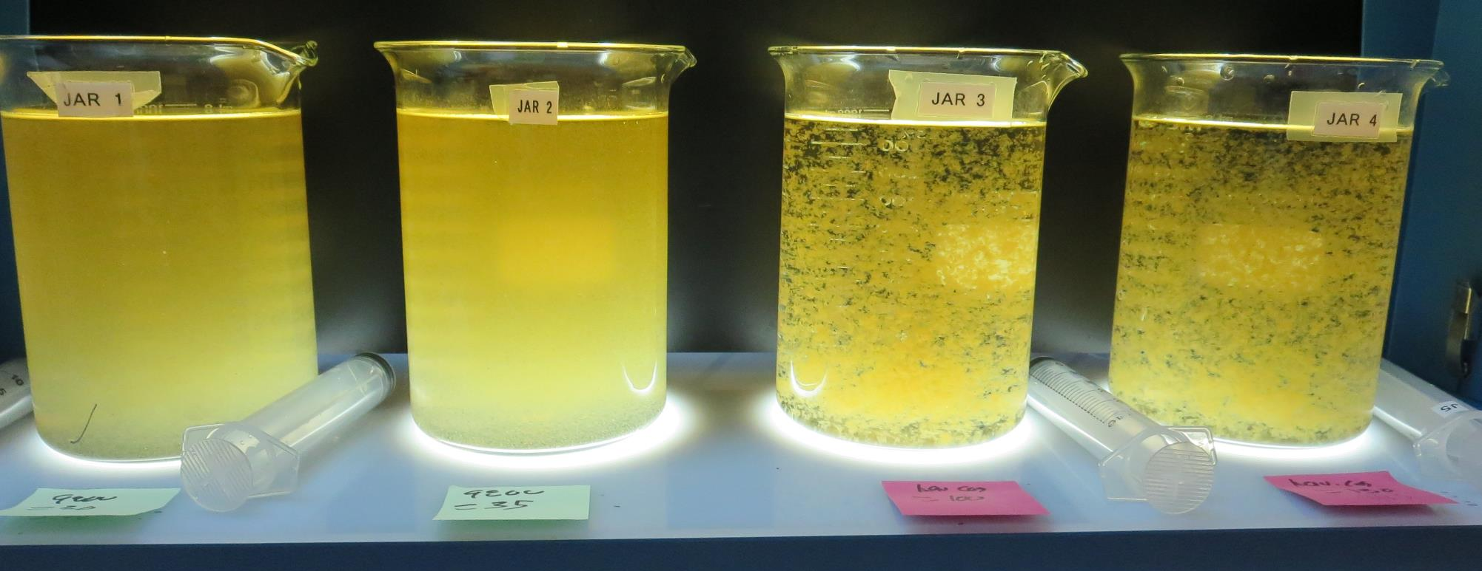
Konocti County Water District
CA1710006
Lake County
Jar Test
by Guy Schott, P.E.
July 15, 2020

Slide 2
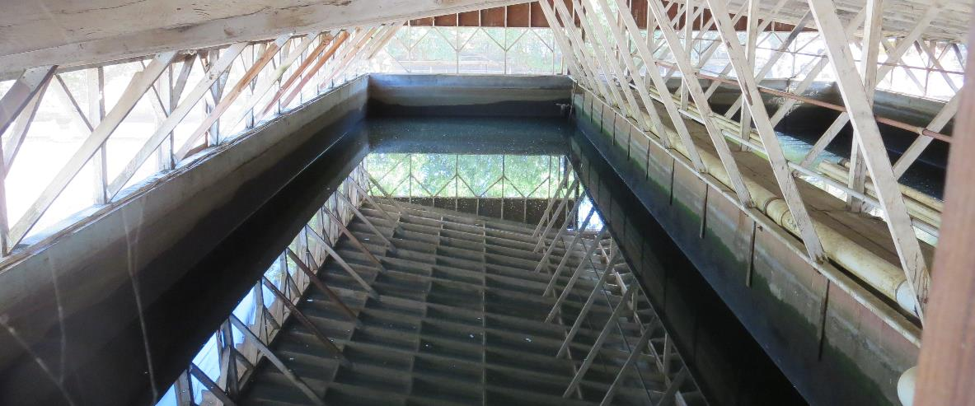
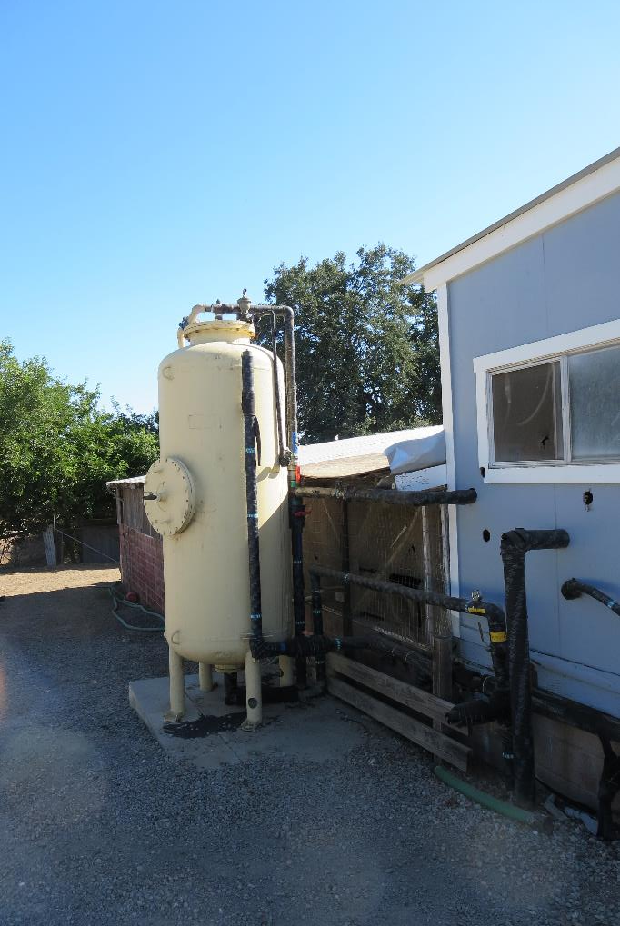
Konocti County Water District
Filter Backwash Water
Basin and Filter

Slide 3
Konocti CWD, July 15, 2020
Settled Backwash Water Characteristics
Settled Backwash Water
pH: 7.57
Turbidity: 3.87 NTU
UVT: 86.2%
UVA: 0.064/cm
Laboratory Filter (0.4 um)
Turbidity: 0.17 NTU
UVT: 91.3%
UVA: 0.039/cm
Laboratory Filter (1.2 um)
Turbidity: 0.29 NTU
UVT: 90.9%
UVA: 0.041/cm
Plant post media filter
Turbidity: 0.65 NTU
UVT: 90.8%
UVA: 0.041/cm

Slide 4
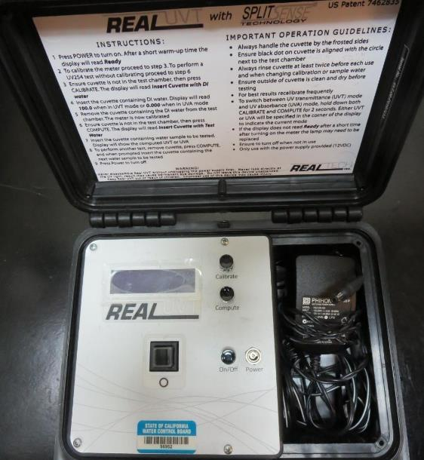
UVT/UVA
UV transmittance (UVT) is a measurement of the amount of ultraviolet light (commonly at 254 nm due to its germicidal effect) that passes through a water sample compared to the amount of light that passes through a pure water sample. The measurement is expressed as a percentage, % UVT.
%UVT = 10^{(-UVA)} x 100%
UV absorbance (UVA) is calculated as a relative measure of the amount of light absorbed by a water sample compared with the amount of light absorbed by a pure water sample.
UVA = -log(%UVT/100)

Slide 5
Applied Coagulants for Jar Testing
Pro Pac 9800 (NTU Technologies)
50% Aluminum Chlorohydrate
50% Water
83% Basicity
SG = 1.34
Advanced Coagulant
12.55% Al₂O₃
64.9% Basicity
SG = 1.299
Polydine C-300P
SG = 1.0-1.2

Slide 6
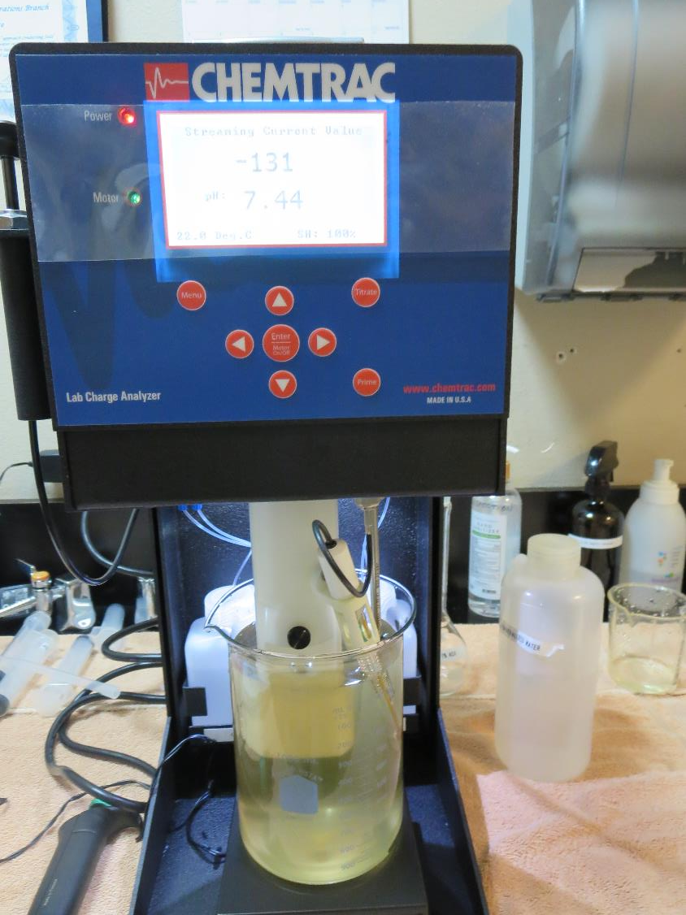
Laboratory Charge Analyzer
LCA: Used to determine coagulant demand of a source water entering the treatment plant.
LCA #1: Backwash Water, pH= 7.45
9800: 9.8 mg/L as product
LCA #2: Settled Backwash Water
pH = 7.57
9800: 40 mg/L as product
pH adjusted to 7.5 w/acetic acid solution

Slide 7
Coagulant Information
Unless stated otherwise, all coagulant doses are reported as Product (100% strength).
Preparation of coagulant stock solutions are generally 1.0 and/or 0.1 percent strength using 100 and/or 200 mL volumetric flasks.
Finnpipette F2 variable volume pipette, capacity 100-1000 micro liters is used for stock solution preparation and coagulant aid jar test dosing.
Finnpipette F2 variable volume pipette, capacity 0.5-5 mL is used for primary coagulant jar test dosing.

Slide 8
Konocti CWD: Jar Test 1-8 Results
Settled Backwash Water
Jar | 200 RPM Flash Mix Seconds | 20 RPM Floc Duration Seconds | 9800 mg/L | Filtrate NTU | Filtrate %UVT | Filtrate UVA/cm
J1 | 15 | 60 | 30 | 0.08 | 91.7 | 0.037
J2 | 15 | 60 | 35 | 0.08 | 91.6 | 0.038
J3 | 15 | 60 | 40 | 0.12 | 91.6 | 0.037
J4 | 15 | 60 | 45 | 0.12 | 91.5 | 0.038
J5 | 15 | 60 | 10 | 0.12 | 91.2 | 0.039
J6 | 15 | 60 | 15 | 0.24 | 90.9 | 0.041
J7 | 15 | 60 | 20 | 0.16 | 91.2 | 0.039
J8 | 15 | 60 | 25 | 0.23 | 91.1 | 0.040

Slide 9
Konocti CWD: Jar Test 9-15 Results
Settled Backwash Water
Jar | 200 RPM Flash Mix Seconds | 20 RPM Floc Duration Seconds | Polydine C-308P mg/L | 9800 mg/L | Filtrate NTU | Filtrate %UVT | Filtrate UVA/cm
J9 | 15 | 60 | 0.5 | 0 | 0.23 | 90.5 | 0.043
J10 | 15 | 60 | 1.0 | 0 | 0.24 | 90.8 | 0.041
J11 | 15 | 60 | 1.5 | 0 | 0.19 | 91.0 | 0.040
J12 | 15 | 60 | 2.0 | 0 | 0.31 | 90.8 | 0.041
J13 | 15 | 60 | 0 | 30 | 0.16 | 91.1 | 0.040
J14 | 15 | 60 | 0 | 35 | 0.07 | 91.4 | 0.038
J15 | 15 | 60 | 0 | 40 | 0.14 | 90.8 | 0.041

Slide 10
Konocti CWD: Jar Test 1-4 Results; Backwash Water
Jars 1 &2, settled bucket BW; Jars 3 & 4, well mixed BW
Jar | 200 RPM Flash Mix Seconds | 30 RPM Floc Duration minutes | 9800 mg/L | Filtrate NTU | Filtrate %UVT | Filtrate UVA/cm | Settle NTU 25 min
J1 | 15 | 5 | 6.0 | 0.29 | 92.5 | 0.033 | No Data
J2 | 15 | 5 | 9.0 | 0.33 | 92.4 | 0.034 | No Data
J3 | 15 | 5 | 6.0 | 0.13 | 92.7 | 0.032 | No Data
J4 | 15 | 5 | 9.0 | 0.20 | 92.5 | 0.033 | No Data

Slide 11
Konocti CWD: Jar Test 5-12 Results
Backwash Water; Flash 15 sec (200 RPM)
Jar | 20 RPM Floc Duration Seconds | 9800 mg/L | Adv Coag. mg/L | Filtrate NTU | Filtrate %UVT | Filtrate UVA/cm | Settle NTU 25 min
J5 | 60 | 6.0 | 0 | 0.18 | 92.6 | 0.033 | 1.98
J6 | 60 | 20 | 0 | 0.19 | 92.7 | 0.032 | 1.57
J7 | 60 | 25 | 0 | 0.23 | 92.8 | 0.032 | 1.80
J8 | 60 | 30 | 0 | 0.10 | 93.3 | 0.030 | 1.54
J9 | 60 | 30 | 0 | 0.09 | 93.1 | 0.030 | 1.25
J10 | 60 | 35 | 0 | 0.15 | 93.0 | 0.031 | 1.41
J11 | 60 | 0 | 100 | 0.07 | 93.2 | 0.030 | 0.34
J12 | 60 | 0 | 130 | 0.09 | 93.4 | 0.029 | 0.22

Slide 12
Jars 1-15 Test
Flash Mix 15 Sec (200 RPM)
Floc Mix 60 Sec (20 RPM)
Settled Backwash Water
Applied Coagulant
9800

Slide 13
Jars 1-15 – Backwash Settled Water
Source water tested for Jars 1-15 is backwash settled water taken just before the vertical multi-media filter.

Slide 14
Jars 1-4 Test
Flash Mix 15 Sec (200 RPM)
Floc Mix 60 Sec (20 RPM)
Settled Backwash Water
Applied Coagulant
9800

Slide 15
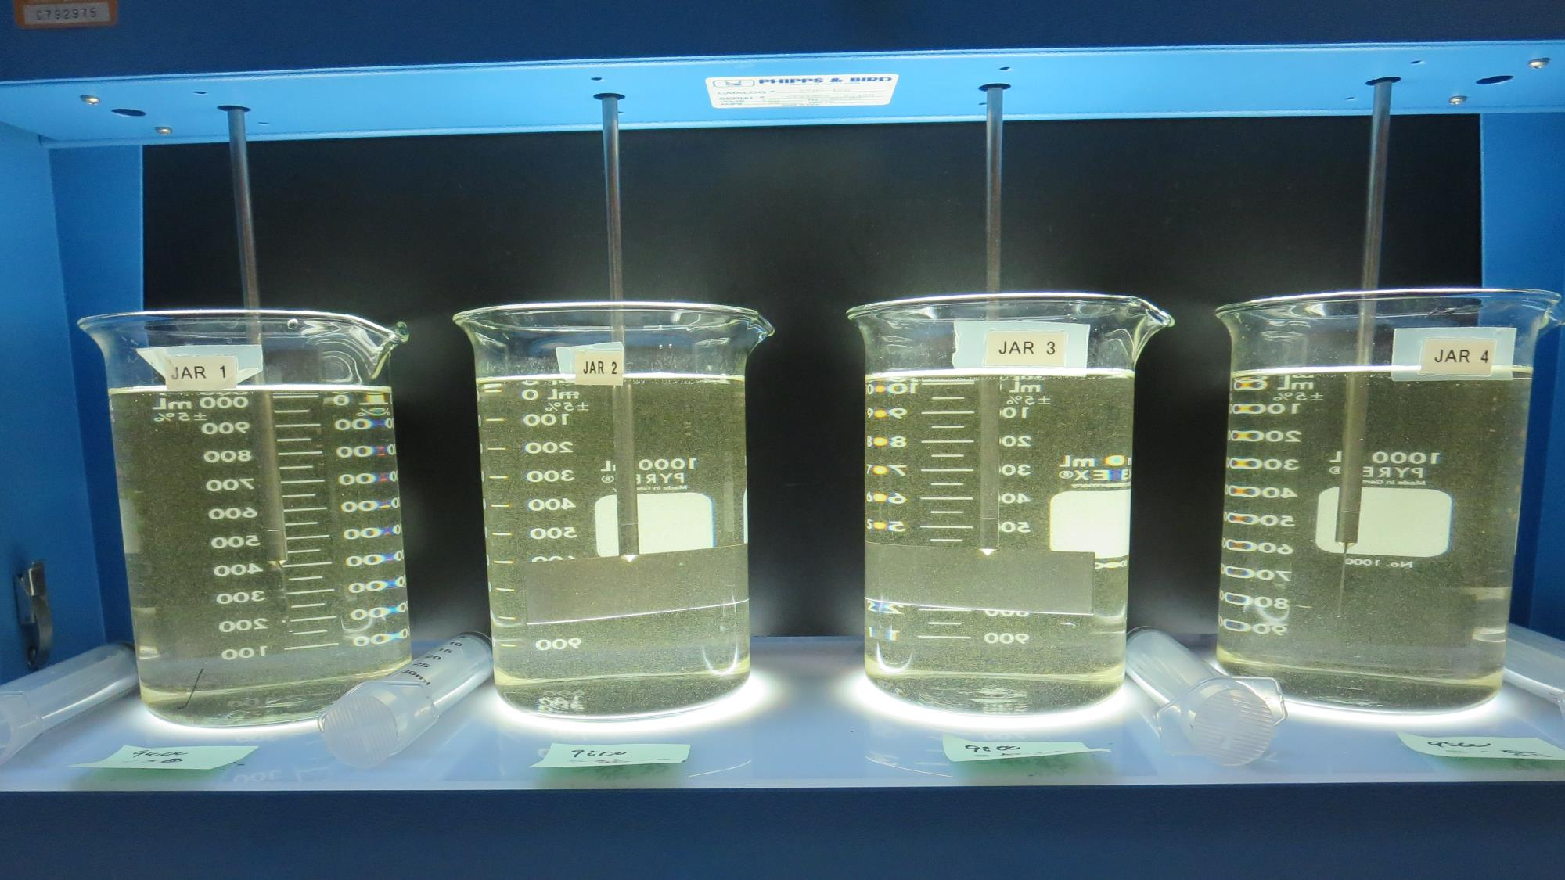
Jars 1-4: End of 1-minute flocculation (20 RPM) duration – Settled BW water.
30 mg/L 9800
Filtrate 0.08 NTU
UVT: 91.7%
UVA: 0.037/cm
35 mg/L 9800
Filtrate 0.08 NTU
UVT: 91.6%
UVA: 0.038/cm
40 mg/L 9800
Filtrate 0.12 NTU
UVT: 91.6%
UVA: 0.037/cm
45 mg/L 9800
Filtrate 0.12 NTU
UVT: 91.5%
UVA: 0.038/cm

Slide 16
Jars 5-8 Test
Flash Mix 15 Sec (200 RPM)
Floc Mix 60 Sec (20 RPM)
Settled Backwash Water
Applied Coagulant
9800

Slide 17
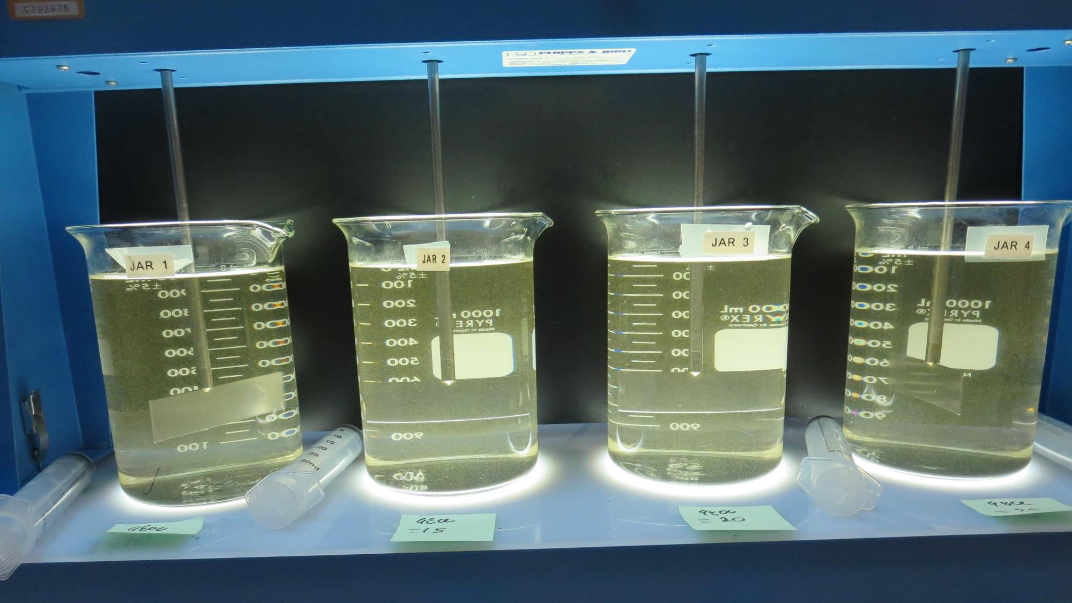
Jars 5-8: End of 1-minute flocculation (20 RPM) duration – Settled BW water.
10 mg/L 9800
Filtrate 0.12 NTU
UVT: 91.2%
UVA: 0.039/cm
15 mg/L 9800
Filtrate 0.24 NTU
UVT: 90.9%
UVA: 0.041/cm
20 mg/L 9800
Filtrate 0.16 NTU
UVT: 91.2%
UVA: 0.039/cm
25 mg/L 9800
Filtrate 0.16 NTU
UVT: 91.1%
UVA: 0.040/cm

Slide 18
Jars 9-12 Test
Flash Mix 15 Sec (200 RPM)
Floc Mix 60 Sec (20 RPM)
Settled Backwash Water
Applied Coagulant
Polydine C-308P

Slide 19
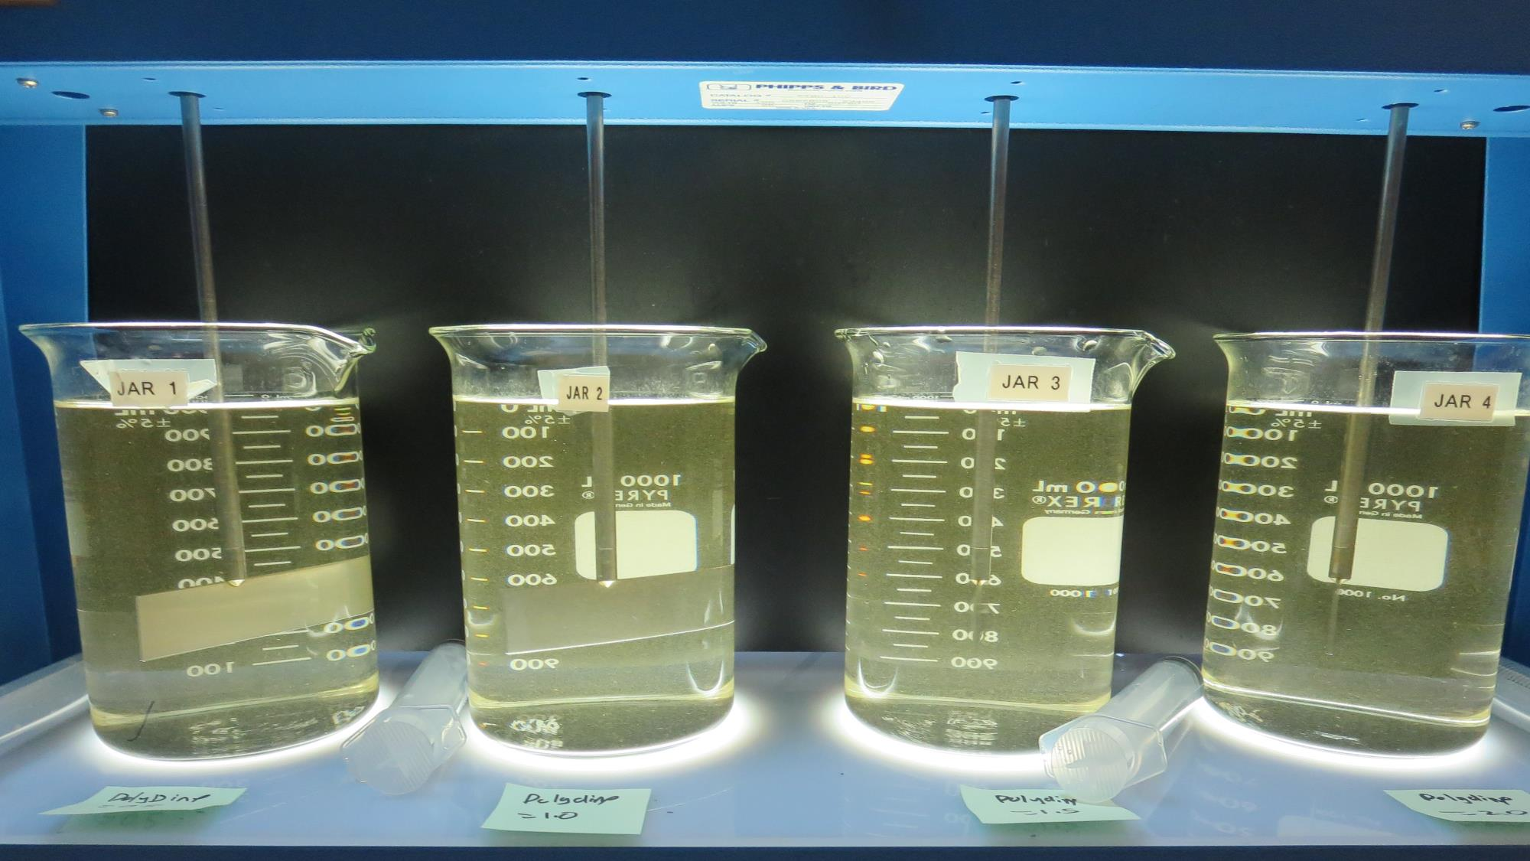
Jars 9-12: End of 1-minute flocculation (20 RPM) duration – Settled BW water.
0.5 mg/L Polydine C-308P
Filtrate 0.23 NTU
UVT: 90.5%
UVA: 0.043/cm
1.0 mg/L Polydine C-308P
Filtrate 0.24 NTU
UVT: 90.8%
UVA: 0.041/cm
1.5 mg/L Polydine C-308P
Filtrate 0.19 NTU
UVT: 91.0%
UVA: 0.040/cm
2.0 mg/L Polydine C-308P
Filtrate 0.31 NTU
UVT: 90.8%
UVA: 0.041/cm

Slide 20
Jars 13-15 Test
Flash Mix 15 Sec (200 RPM)
Floc Mix 60 Sec (20 RPM)
Settled Backwash Water
Applied Coagulants
9800
Advanced Coagulant

Slide 21
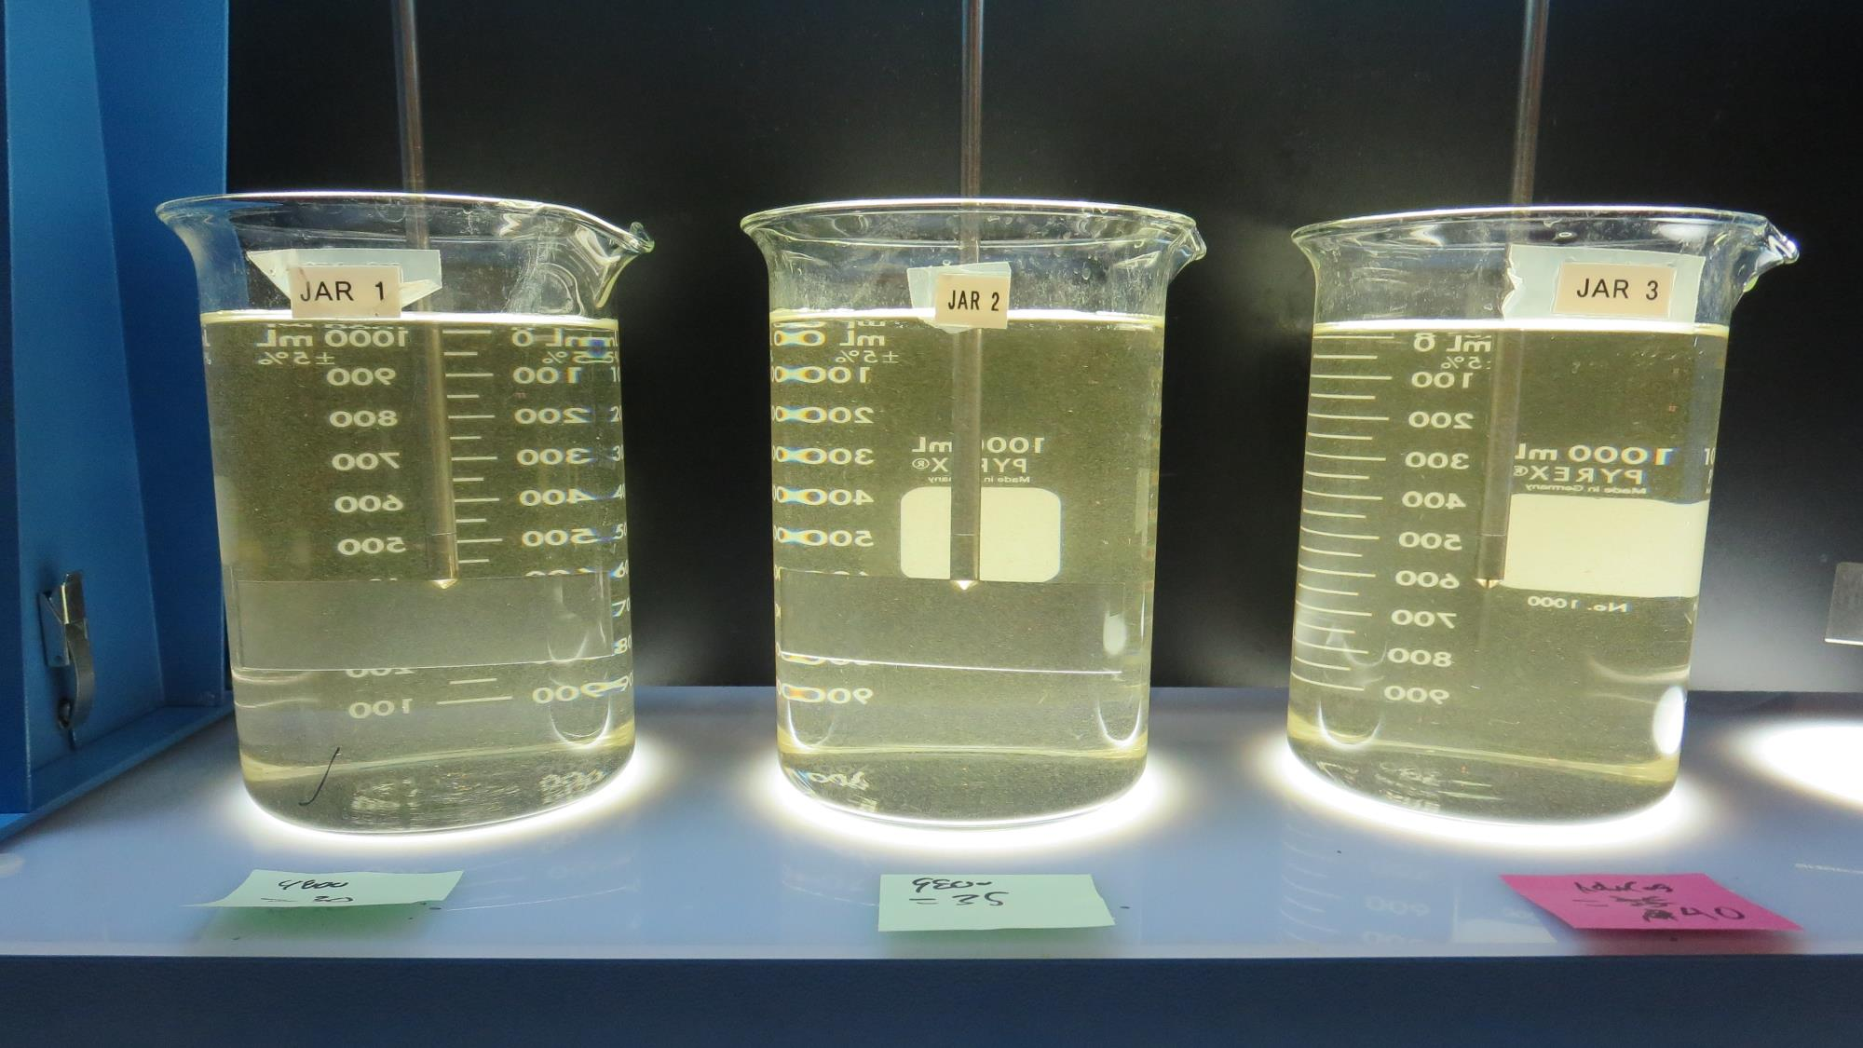
Jars 13-15: End of 1-minute flocculation (20 RPM) duration – Settled BW water.
30 mg/L 9800
Filtrate 0.16 NTU
UVT: 91.1%
UVA: 0.040/cm
35 mg/L 9800
Filtrate 0.07 NTU
UVT: 91.4%
UVA: 0.038/cm
40 mg/L 9800
Filtrate 0.14 NTU
UVT: 90.8%
UVA: 0.041/cm

Slide 22
Jars 1-15 – Backwash Water
Source water tested for Jars 1-12 is backwash water.
Jars 1-2 is settled water from travel bucket. For the rest of the jars, the water in the bucket was mixed.

Slide 23
Jars 1-4 Test
Flash Mix 15 Sec (200 RPM)
Floc Mix 5 Min (30 RPM)
Backwash Water
Applied Coagulant
9800

Slide 24
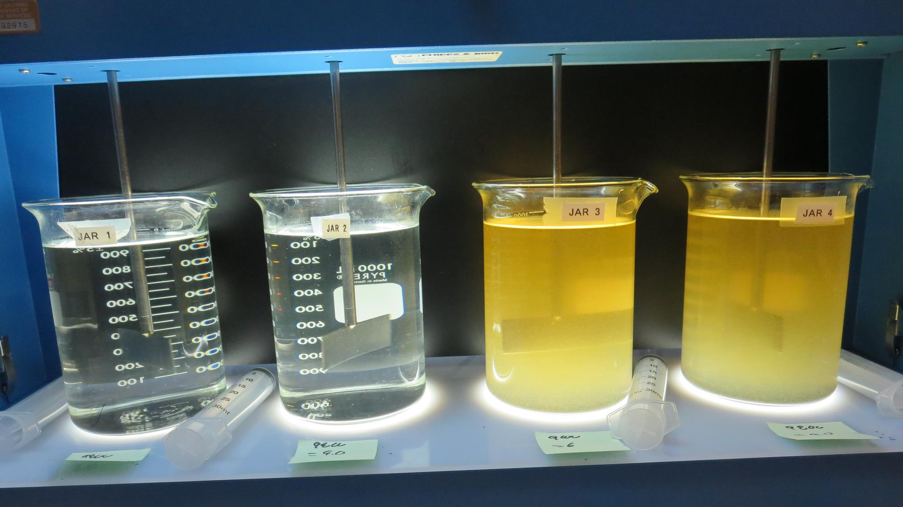
Jars 1-4: End of 5-minute flocculation (30 RPM) duration – Backwash Water.
6.0 mg/L 9800
Filtrate 0.29 NTU
UVT: 92.5%
UVA: 0.033/cm
Settled: N/A NTU
9.0 mg/L 9800
Filtrate 0.33 NTU
UVT: 92.4%
UVA: 0.034/cm
Settled: N/A NTU
6.0 mg/L 9800
Filtrate 0.13 NTU
UVT: 92.7%
UVA: 0.032/cm
Settled: N/A NTU
9.0 mg/L 9800
Filtrate 0.20 NTU
UVT: 92.5%
UVA: 0.033/cm
Settled: N/A NTU

Slide 25
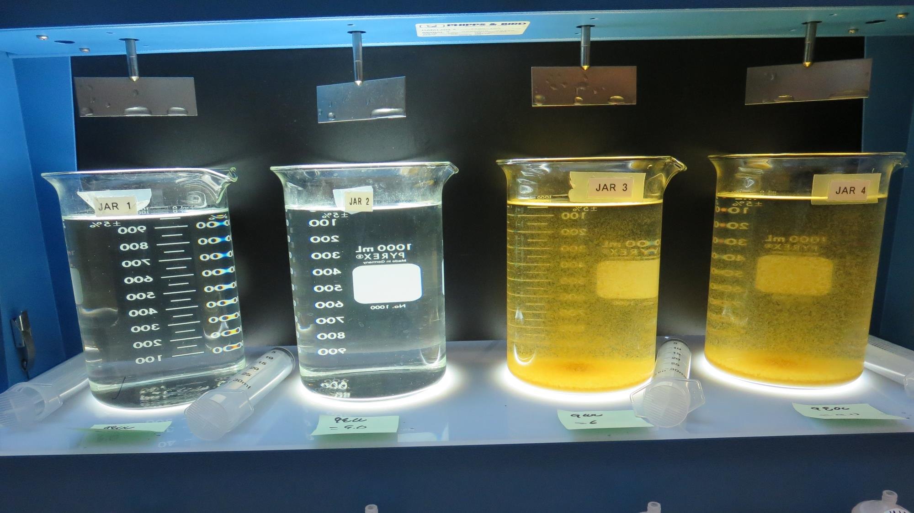
Jars 1-4: After 5 min of settling, 25 mL is syringed for filterability and %UVT/UVA.
6.0 mg/L 9800
Filtrate 0.29 NTU
UVT: 92.5%
UVA: 0.033/cm
Settled: N/A NTU
9.0 mg/L 9800
Filtrate 0.33 NTU
UVT: 92.4%
UVA: 0.034/cm
Settled: N/A NTU
6.0 mg/L 9800
Filtrate 0.13 NTU
UVT: 92.7%
UVA: 0.032/cm
Settled: N/A NTU
9.0 mg/L 9800
Filtrate 0.20 NTU
UVT: 92.5%
UVA: 0.033/cm
Settled: N/A NTU

Slide 26
Jars 5-8 Test
Flash Mix 15 Sec (200 RPM)
Floc Mix 5 Min (30 RPM)
Backwash Water
Applied Coagulant
9800

Slide 27
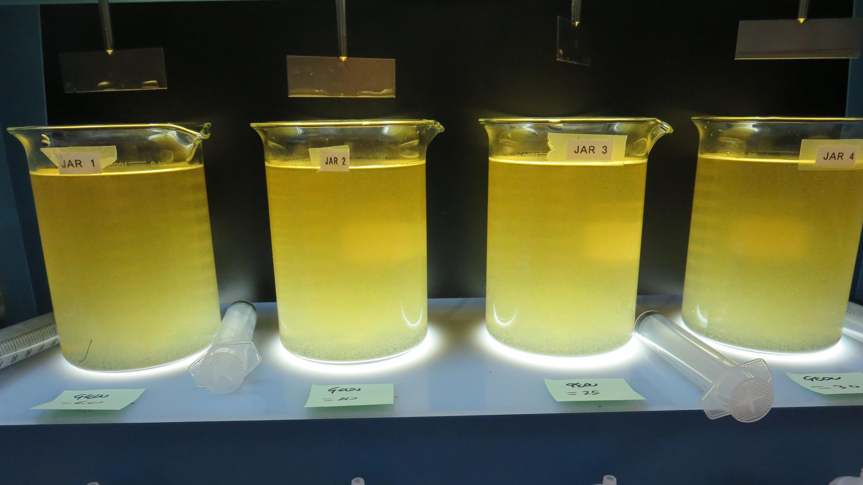
Jars 5-8: End of 5-minute flocculation (30 RPM) duration – Backwash Water.
6.0 mg/L 9800
Filtrate 0.18 NTU
UVT: 92.6%
UVA: 0.033/cm
Settled: 1.98 NTU
20 mg/L 9800
Filtrate 0.19 NTU
UVT: 91.7%
UVA: 0.032/cm
Settled: 1.57 NTU
25 mg/L 9800
Filtrate 0.23 NTU
UVT: 92.8%
UVA: 0.032/cm
Settled: 1.80 NTU
30 mg/L 9800
Filtrate 0.10 NTU
UVT: 93.3%
UVA: 0.030/cm
Settled: 1.54 NTU

Slide 28
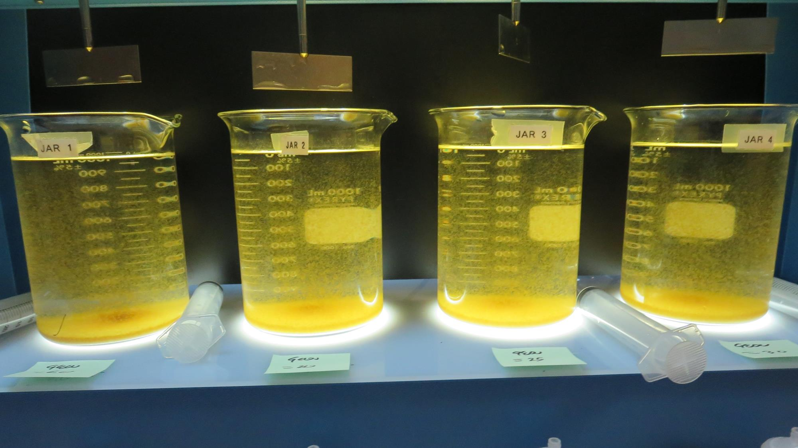
Jars 5-8: After 5 min of settling, 25 mL is syringed for filterability and %UVT/UVA.

Slide 29
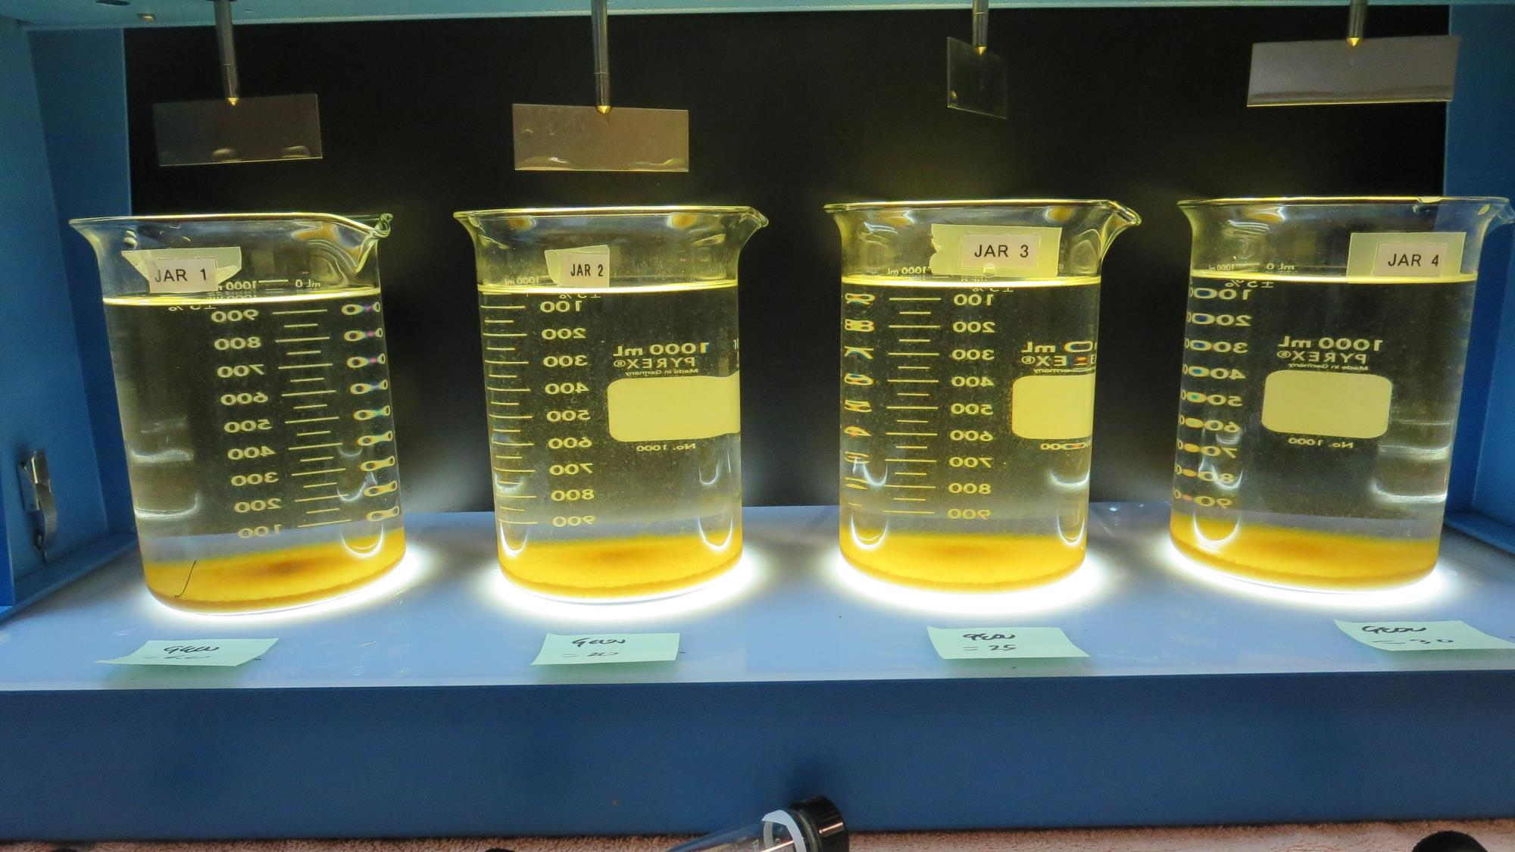
Jars 5-8: After 25-minutes of settling, settled water turbidity is taken.
6.0 mg/L 9800
Filtrate 0.18 NTU
UVT: 92.6%
UVA: 0.033/cm
Settled: 1.98 NTU
20 mg/L 9800
Filtrate 0.19 NTU
UVT: 91.7%
UVA: 0.032/cm
Settled: 1.57 NTU
25 mg/L 9800
Filtrate 0.23 NTU
UVT: 92.8%
UVA: 0.032/cm
Settled: 1.80 NTU
30 mg/L 9800
Filtrate 0.10 NTU
UVT: 93.3%
UVA: 0.030/cm
Settled: 1.54 NTU

Slide 30
Jars 9-12 Test
Flash Mix 15 Sec (200 RPM)
Floc Mix 5 Min (30 RPM)
Backwash Water
Applied Coagulants
9800
Advanced Coagulant

Slide 31
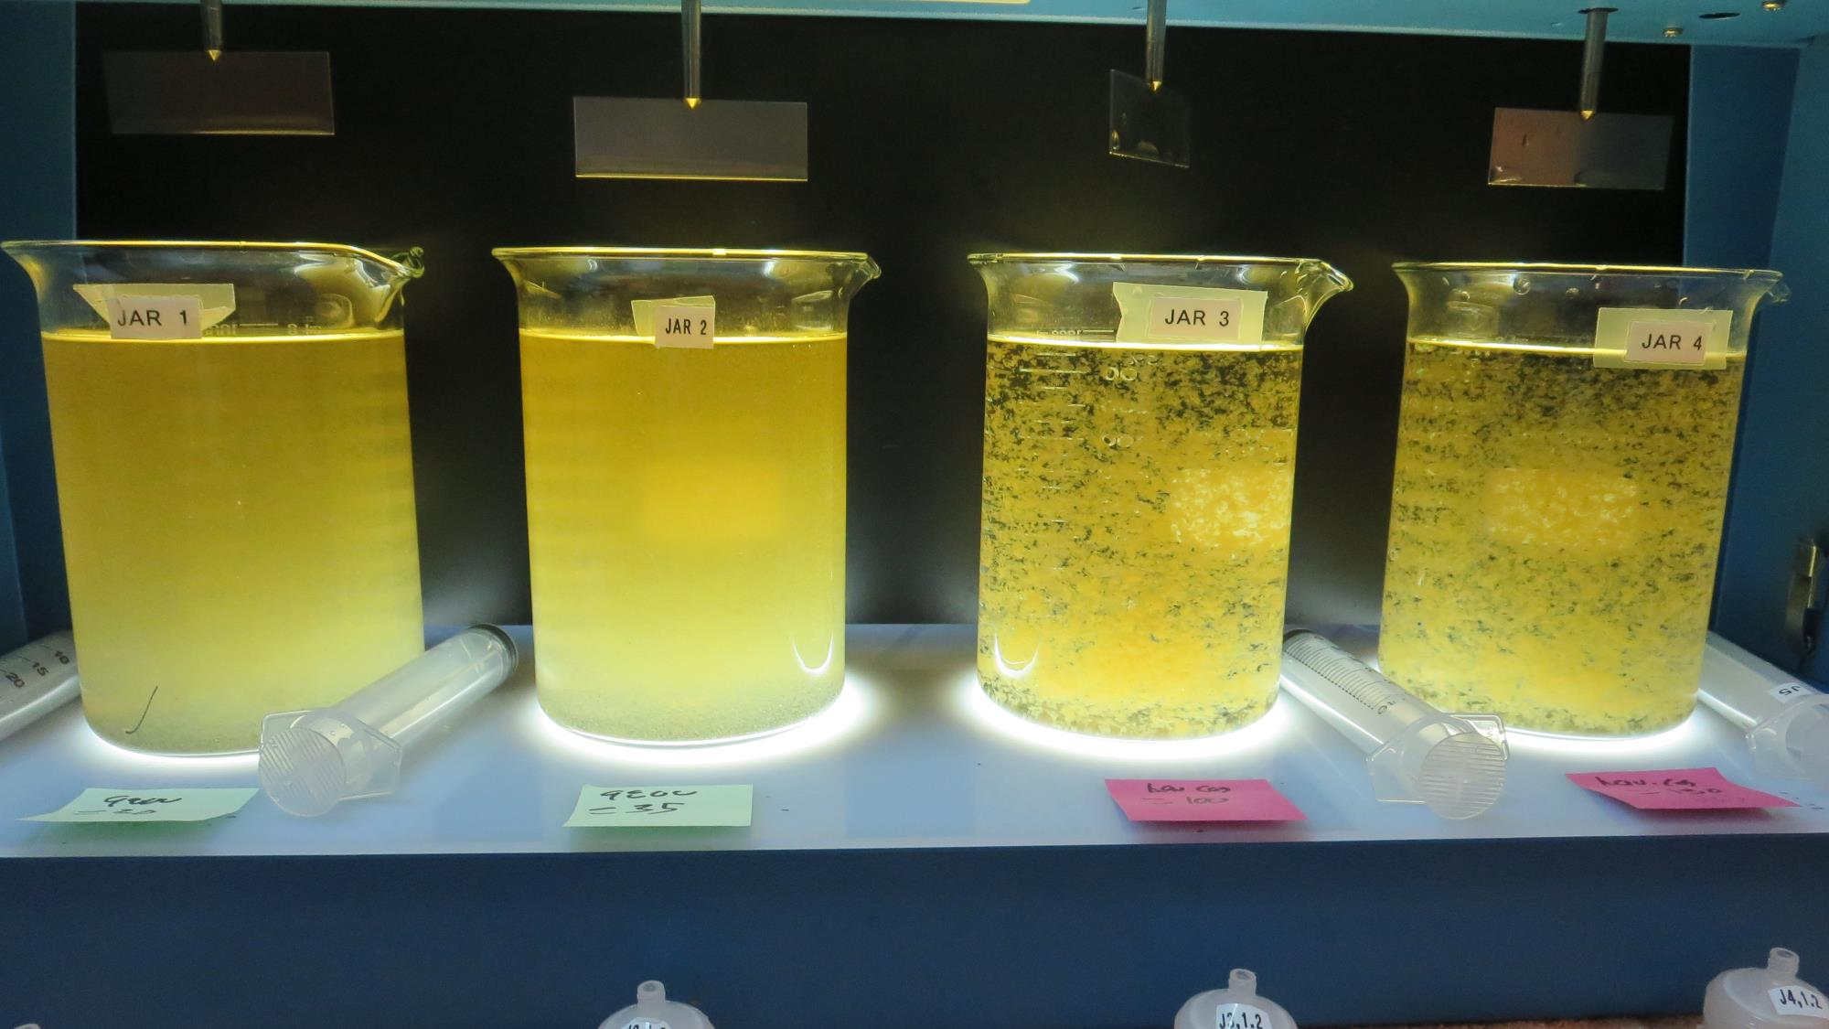
Jars 9-12: End of 5-minute flocculation (30 RPM) duration – Backwash Water.
30 mg/L 9800
Filtrate 0.09 NTU
UVT: 93.1%
UVA: 0.030/cm
Settled: 1.25 NTU
35 mg/L 9800
Filtrate 0.15 NTU
UVT: 93.0%
UVA: 0.031/cm
Settled: 1.41 NTU
100 mg/L Adv Coag.
Filtrate 0.07 NTU
UVT: 93.2%
UVA: 0.030/cm
Settled: 0.34 NTU
130 mg/L Adv Coag.
Filtrate 0.09 NTU
UVT: 93.4%
UVA: 0.029/cm
Settled: 0.22 NTU

Slide 32
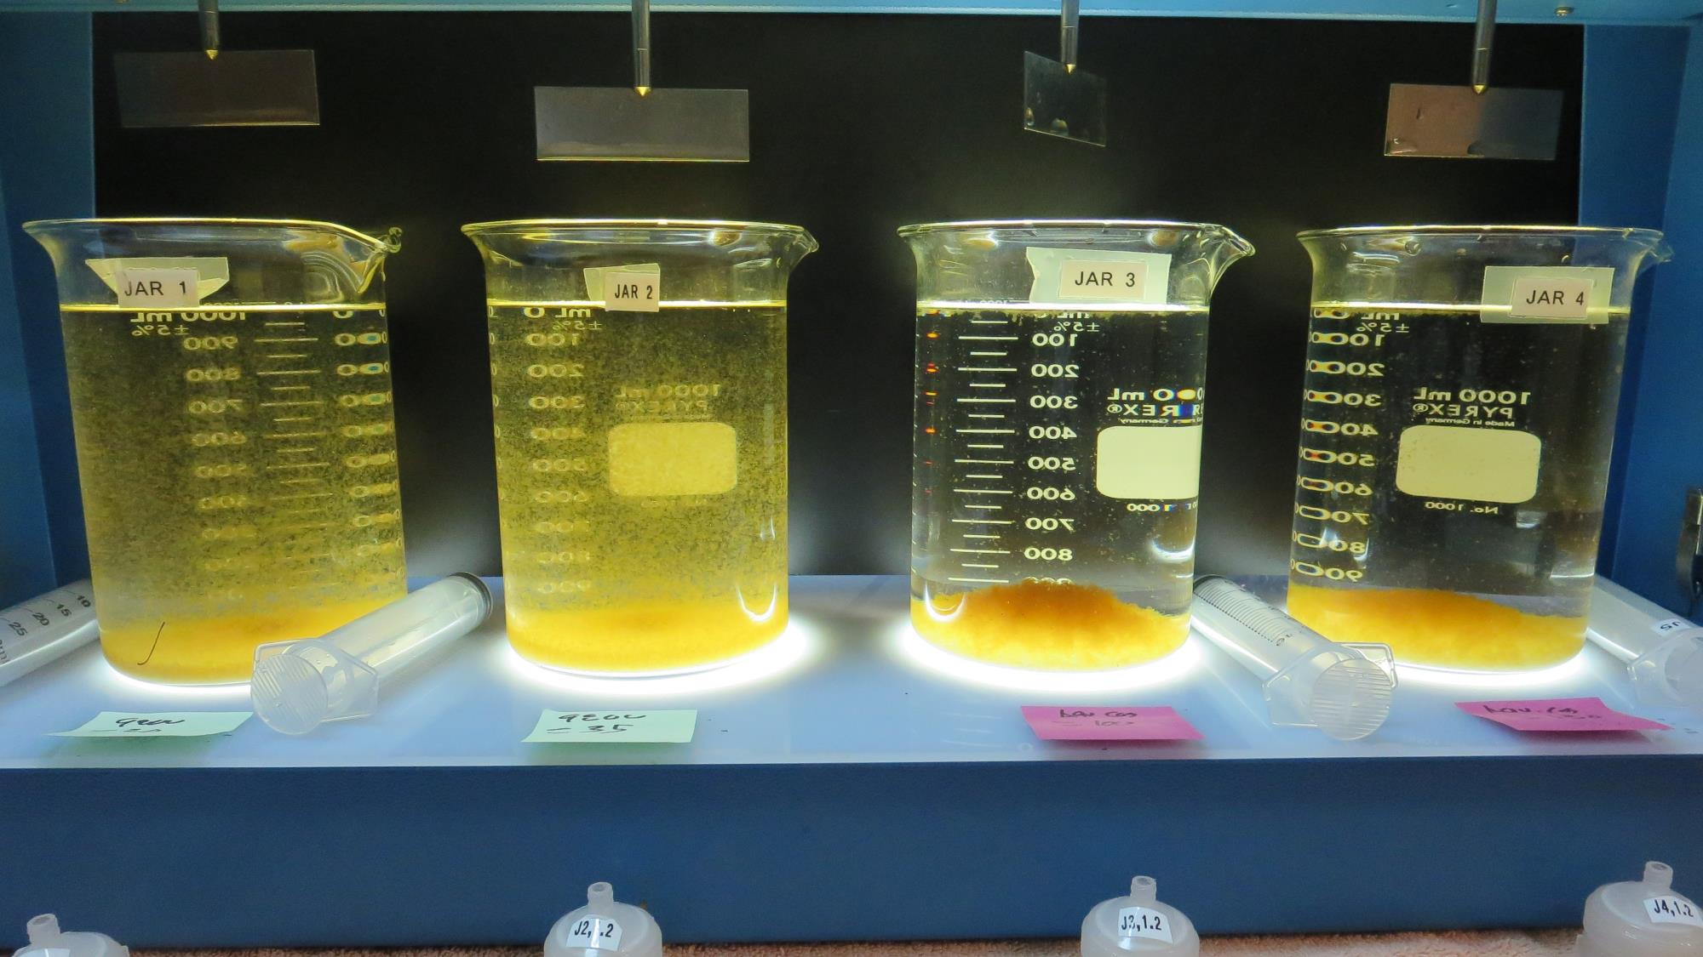
Jars 9-12: After 5 min of settling, 25 mL is syringed for filterability and %UVT/UVA.

Slide 33
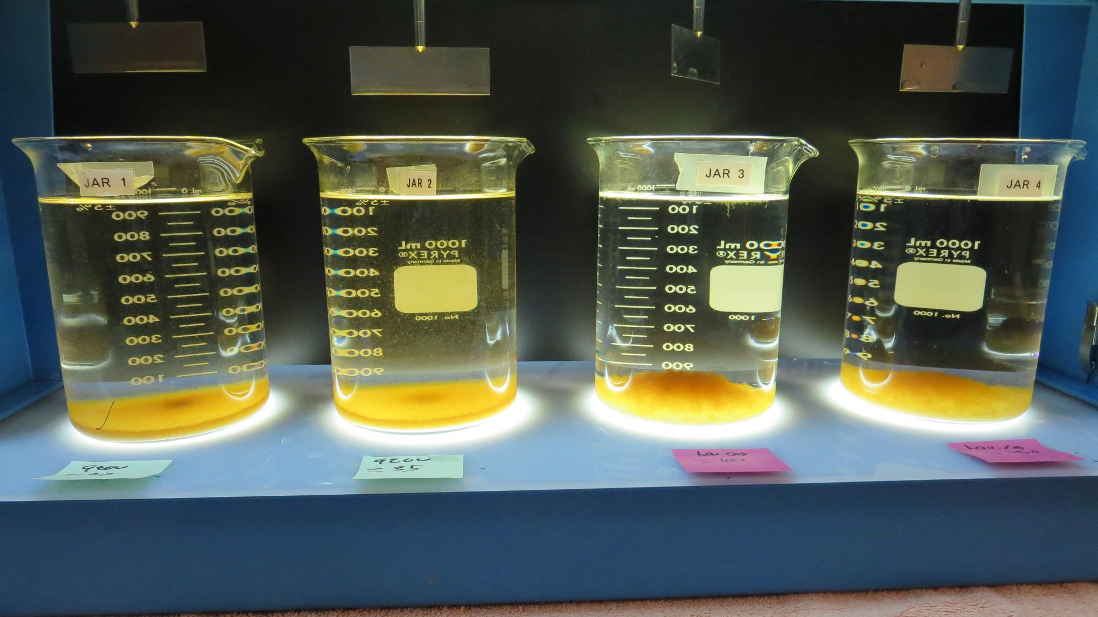
Jars 9-12: After 25-minutes of settling, settled water turbidity is taken.
30 mg/L 9800
Filtrate 0.09 NTU
UVT: 93.1%
UVA: 0.030/cm
Settled: 1.25 NTU
35 mg/L 9800
Filtrate 0.15 NTU
UVT: 93.0%
UVA: 0.031/cm
Settled: 1.41 NTU
100 mg/L Adv Coag.
Filtrate 0.07 NTU
UVT: 93.2%
UVA: 0.030/cm
Settled: 0.34 NTU
130 mg/L Adv Coag.
Filtrate 0.09 NTU
UVT: 93.4%
UVA: 0.029/cm
Settled: 0.22 NTU

Slide 34
Jar Testing for 1-Liter Jars:
Procedures for Most Treatment Plants
Fill jars with source water prior to coagulant injection and set paddle speed at 30 rpm
Add chemicals (i.e., NaOCl, primary coagulant, coagulant aid) to each jar
Flash mix for 15-30 seconds (200 rpm)
Slow mix for 5 minutes (20-30 rpm)
Settled for 5 minutes. Syringe 25 mL from each jar taken 1-inch below surface (25 mL/12 sec rate).
Filtered through 1.2 um isopore membrane into cuvette drip rate, 15 mL/(50-90 sec)
Measure filtrate turbidity, chlorine residual and %UVT/UVA
Measure settled water turbidity after 25 minutes of total setting
Record all data

Slide 35

Jar Test
Filterability Test Equipment
Turbidity Instrument
Syringe w/Luer-Lock Tip, 30 cc
(part#: 2225800, by Hach)
Swinnex Filter Holder, 25 mm (part#: SX0002500)
Isopore Membrane Filter, 1.2 um absolute
pore size,
Φ= 25 mm , thickness: 24 um,
hydrophilic polycarbonate membrane
(part #: RTTP02500)
Go to Sigma-Aldrich for laboratory supplies http://www.sigmaaldrich.com/united-states.html

Slide 36
Isopore Membrane Information
Categories | Information
trade name | Isopore
filter color | White
chemistry | Polycarbonate (PC)
water flow rate | Avg. 175 mL/min x cm² (typical results @ 10 psi)
media | Isopore®
wettability | Hydrophilic
porosity | 14.7%
pore size | 1.2 µm
bubble point at 23 °C | 1.0 bar, air with water
thickness | 24 µm
filter diameter (ø) | 25 mm
material size | polycarbonate, Hydrophilic, 1.2 µm, 25 mm, white, plain, 100

Slide 37
Isopore Membrane Background Information
The Isopore membrane is a polycarbonate, track-etched screen filter recommended for all analyses in which the sample is viewed on the surface of the membrane. The Isopore membrane is composed of polycarbonate film, which has a smooth, glass-like surface for clearer sample observation. The unique manufacturing process of the membrane ensures a precise pore diameter and a consistent pore size for accurate separation of samples by size. Matched-weight filters are not usually required because of low, constant tar and ash weights.
Features & Benefits:
Membrane structure retains particles on the surface, simplifying counting and analysis

Slide 38
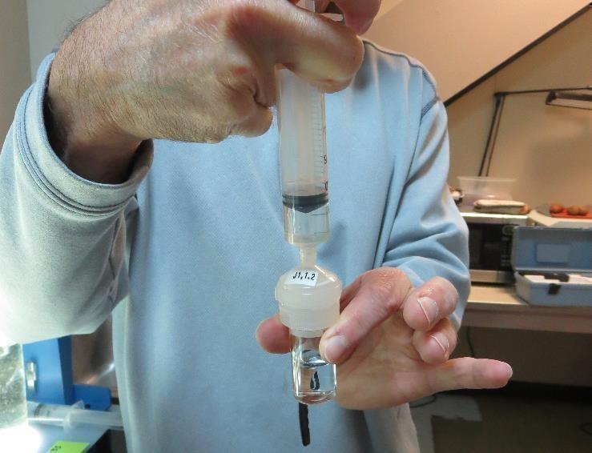

Jar Test - Filterability Test
Syringe ~ 25 mL from jar (after 5-minutes of settling)
Filter-to-waste 3-5 mL
Filter directly into clean cuvette
Measure turbidity
Note: Take several readings before recording final NTU results. Micro bubbles can adhere to glass causing false NTU readings. To remove bubbles, tilt cuvette up to 90 degrees.

Slide 39

Contact
Guy Schott, P.E.
State Water Resources Control Board
Division of Drinking Water
Santa Rosa, CA
Go to Stock Solution/Dose calculations/Jar Test Results for tools to download
www.waterboards.ca.gov/drinking_water/programs/districts/mendocino_district.html
Email: Guy Schott - Guy.Schott@waterboards.ca.gov
Office Number: 707-576-2732

