Slide 1
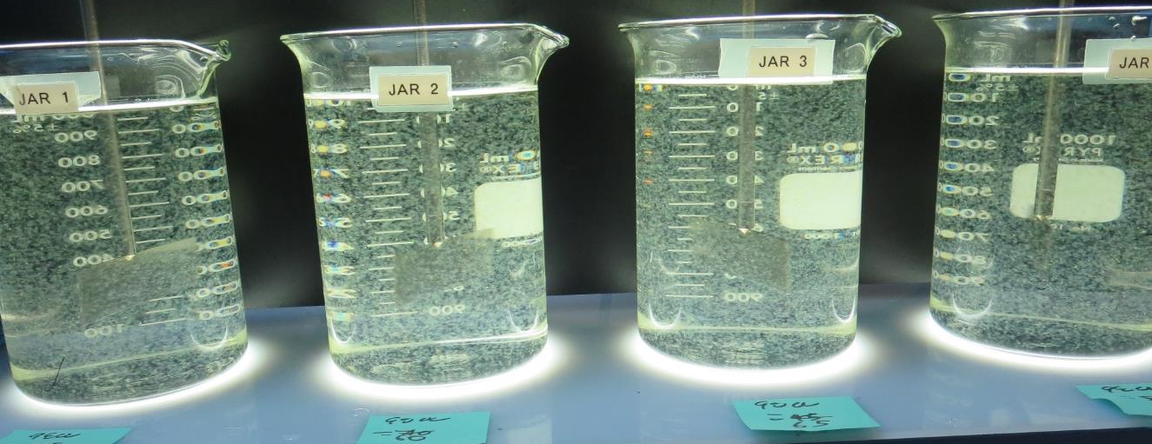
Konocti County Water District
CA1710006
Lake County
Jar Test
by Guy Schott, P.E.
July 15, 2020

Slide 2
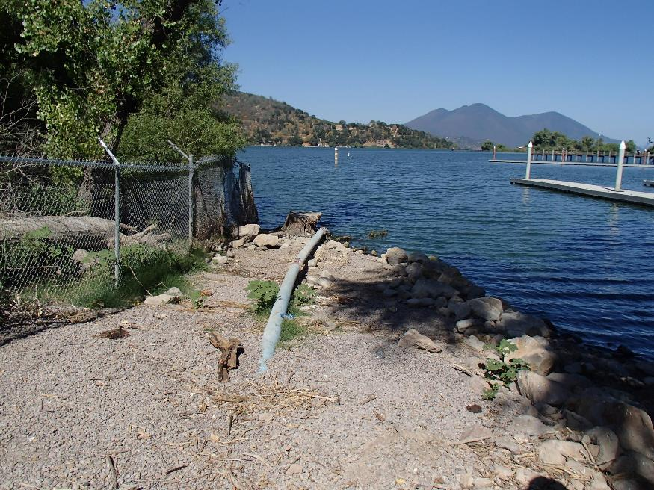
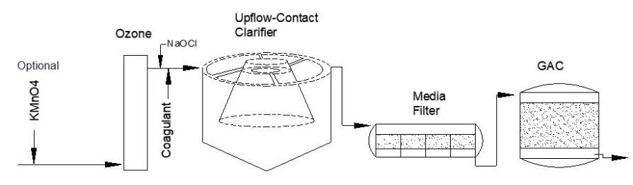
Konocti County Water District
Source Water: Clear Lake
Conventional Treatment

Slide 3
Konocti CWD, July 15, 2020
Source Water Characteristics
Source
pH: 8.02
Turbidity: 7.59 NTU
UVT: 79%
UVA: 0.102/cm
0.4 um Filtered
Turbidity: 0.55 NTU
UVT: 84.3%
UVA: 0.073/cm
Plant CFE
Turbidity: 0.10 NTU
UVT: 92.4%
UVA: 0.034/cm
UVA Reduction: 53.4%
Plant post GAC
Turbidity: 0.08 NTU
UVT: 94.8%
UVA: 0.023/cm
UVA Reduction: 68.5%

Slide 4
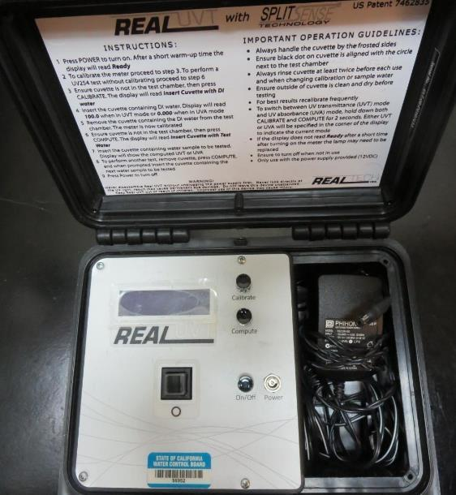
UVT/UVA, pathlength 10 mm
UV transmittance (UVT) is a measurement of the amount of ultraviolet light (commonly at 254 nm due to its germicidal effect) that passes through a water sample compared to the amount of light that passes through a pure water sample. The measurement is expressed as a percentage, % UVT.
%UVT = 10^{(-UVA)} x 100%
UV absorbance (UVA) is calculated as a relative measure of the amount of light absorbed by a water sample compared with the amount of light absorbed by a pure water sample.
UVA = -log(%UVT/100)

Slide 5
Applied Coagulants for Jar Testing
Pro Pac 9800 (NTU Technologies)
50% Aluminum Chlorohydrate
50% Water
83% Basicity
SG = 1.34
Advanced Coagulant
12.55% Al₂O₃
64.9% Basicity
SG = 1.299

Slide 6
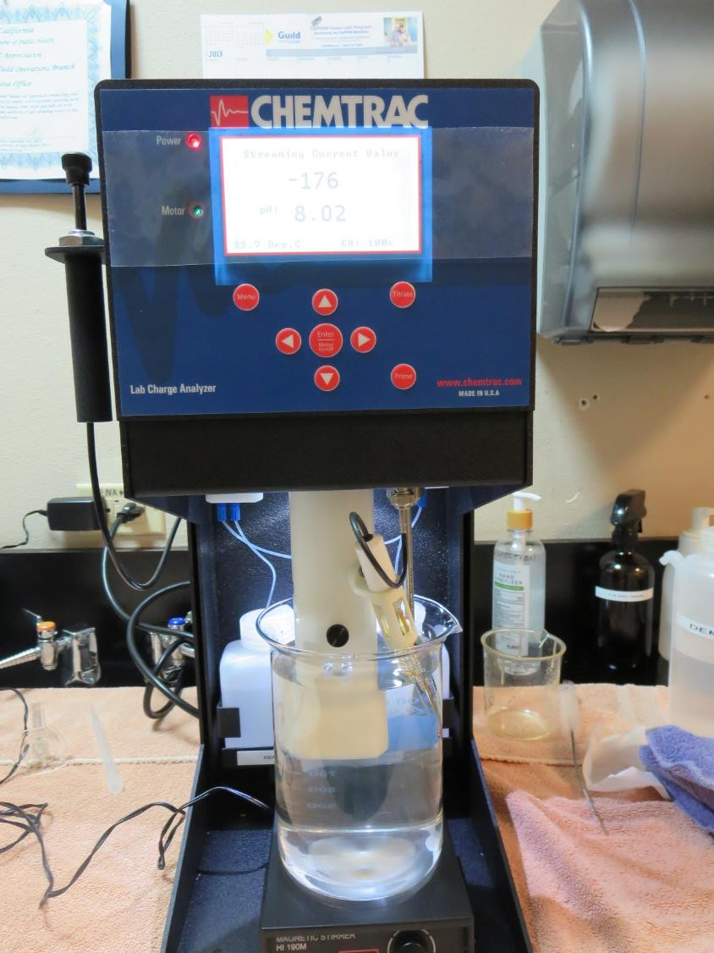
Laboratory Charge Analyzer
LCA: Used to determine coagulant demand of a source water entering the treatment plant.
Source pH: 8.02
LCA #1:
Advance Coagulant: 160 mg/L as product
pH adjusted to 7.5 w/acetic acid solution
LCA #2:
Advance Coagulant: 131 mg/L as product
pH adjusted to 7.3 w/acetic acid solution
LCA #3:
9800: 37 mg/L as product
pH adjusted to 7.5 w/acetic acid solution

Slide 7
Coagulant Information
Unless stated otherwise, all coagulant doses are reported as Product (100% strength).
Preparation of coagulant stock solutions are generally 1.0 and/or 0.1 percent strength using 100 and/or 200 mL volumetric flasks.
Finnpipette F2 variable volume pipette, capacity 100-1000 micro liters is used for stock solution preparation and coagulant aid jar test dosing.
Finnpipette F2 variable volume pipette, capacity 0.5-5 mL is used for primary coagulant jar test dosing.

Slide 8
Konocti CWD: Jar Test 1-8 Results
Clear Lake Source Water; Flash Mix 200 RPM (30 sec)
Jar # | 30 RPM Floc Duration minutes | Adv Coag. mg/L | Filtrate NTU | Filtrate %UVT | Filtrate UVA/cm | %UVA Reduction | Settle NTU 25 min
J1 | 5 | 60 | 0.18 | 88.8 | 0.051 | 30.1 | 0.99
J2 | 5 | 80 | 0.15 | 89.3 | 0.048 | 34.2 | 0.68
J3 | 5 | 100 | 0.17 | 89.8 | 0.046 | 37.0 | 0.30
J4 | 5 | 120 | 0.10 | 90.6 | 0.042 | 42.5 | 0.72
J5 | 5 | 140 | 0.13 | 90.6 | 0.042 | 42.5 | 0.40
J6 | 5 | 160 | 0.11 | 91.0 | 0.040 | 45.2 | 0.42
J7 | 5 | 180 | 0.09 | 91.3 | 0.039 | 46.6 | 0.35
J8 | 5 | 200 | 0.09 | 91.9 | 0.036 | 50.7 | 0.21

Slide 9
Konocti CWD: Jar Test 9-16 Results
Clear Lake Source Water; Flash Mix 200 RPM (30 sec)
Jar # | 30 RPM Floc Duration minutes | Adv Coag. mg/L | Filtrate NTU | Filtrate %UVT | Filtrate UVA/cm | %UVA Reduction | Settle NTU 25 min
J9 | 5 | 200 | 0.08 | 91.8 | 0.036 | 50.7 | 0.28
J10 | 5 | 220 | 0.08 | 91.9 | 0.036 | 50.7 | 0.21
J11 | 5 | 240 | 0.10 | 92.0 | 0.035 | 52.1 | 0.23
J12 | 5 | 260 | 0.06 | 92.3 | 0.034 | 53.4 | 0.22
J13 | 5 | 200 | 0.08 | 91.7 | 0.037 | 49.3 | 0.21
J14 | 5 | 260 | 0.09 | 92.2 | 0.035 | 52.1 | 0.27
J15 | 5 | 270 | 0.08 | 92.1 | 0.035 | 52.1 | 0.21
J16 | 5 | 280 | 0.08 | 92.4 | 0.034 | 53.4 | 0.16

Slide 10
Konocti CWD: Jar Test 17-24 Results
Clear Lake Source Water; Flash Mix 200 RPM (30 sec)
Jar # | 30 RPM Floc Duration minutes | 9800 mg/L | Filtrate NTU | Filtrate %UVT | Filtrate UVA/cm | %UVA Reduction | Settle NTU 25 min
J17 | 5 | 35 | 0.12 | 90.5 | 0.043 | 41.1 | 0.35
J18 | 5 | 40 | 0.12 | 90.5 | 0.043 | 41.1 | 0.48
J19 | 5 | 45 | 0.10 | 90.7 | 0.042 | 42.5 | 0.35
J20 | 5 | 50 | 0.08 | 90.8 | 0.041 | 43.8 | 0.33
J21 | 5 | 55 | 0.08 | 91.1 | 0.040 | 45.2 | 0.27
J22 | 5 | 60 | 0.08 | 91.1 | 0.040 | 45.2 | 0.26
J23 | 5 | 65 | 0.08 | 91.3 | 0.039 | 46.6 | 0.28
J24 | 5 | 70 | 0.08 | 91.4 | 0.039 | 46.6 | 0.26

Slide 11
Konocti CWD: Jar Test 25-28 Results
Clear Lake Source Water; Flash Mix 200 RPM (30 sec)
Jar # | 30 RPM Floc Duration minutes | Adv Coag. mg/L | Filtrate NTU | Filtrate %UVT | Filtrate UVA/cm | %UVA Reduction | Settle NTU 25 min
J25 | 5 | 130 | 0.13 | 90.4 | 0.043 | 41.1 | 0.30
J26 | 5 | 140 | 0.10 | 91.0 | 0.040 | 45.2 | 0.30
J27 | 5 | 150 | 0.09 | 91.2 | 0.039 | 46.6 | 0.27
J28 | 5 | 160 | 0.07 | 91.5 | 0.038 | 47.9 | 0.22

Slide 12
Jars 1-4 Test
Flash Mix 30 Sec (200 RPM)
Floc Mix 5 min (30 RPM)
Applied Coagulant
Advanced Coagulant

Slide 13
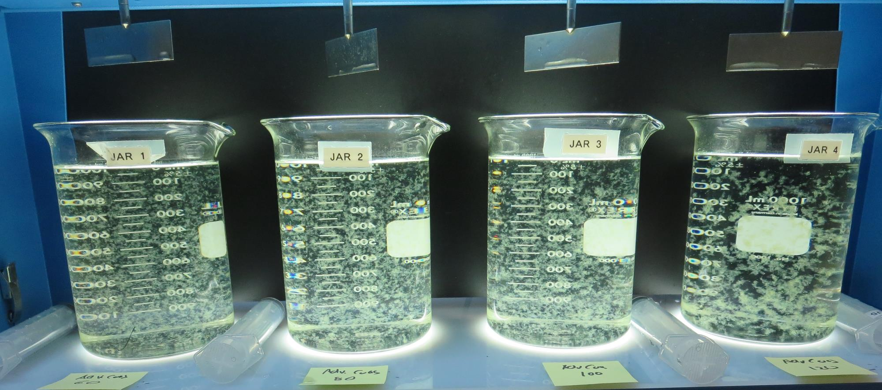
Jars 1-4: End of 5-minute flocculation (30 RPM) duration.
60 mg/L Adv Coag.
Filtrate 0.18 NTU
UVT: 88.8%
UVA: 0.051/cm
UVA Reduction: 30.1%
Settled: 0.99 NTU
80 mg/L Adv Coag.
Filtrate 0.15 NTU
UVT: 89.3%
UVA: 0.048/cm
UVA Reduction: 34.2%
Settled: 0.68 NTU
100 mg/L Adv Coag.
Filtrate 0.17 NTU
UVT: 89.8%
UVA: 0.046/cm
UVA Reduction: 37.0%
Settled: 0.30 NTU
120 mg/L Adv Coag.
Filtrate 0.10 NTU
UVT: 90.6%
UVA: 0.042/cm
UVA Reduction: 42.5%
Settled: 0.72 NTU

Slide 14
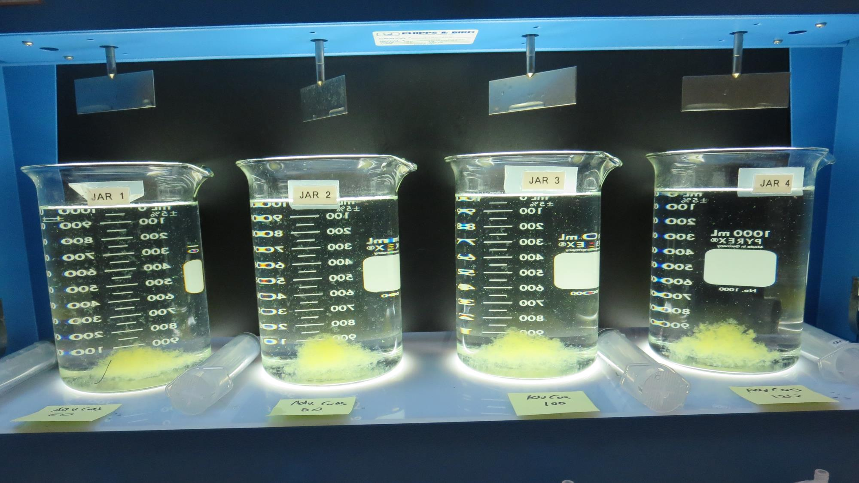
Jars 1-4: After 5 min of settling, 25 mL is syringed for filterability and %UVT/UVA.

Slide 15
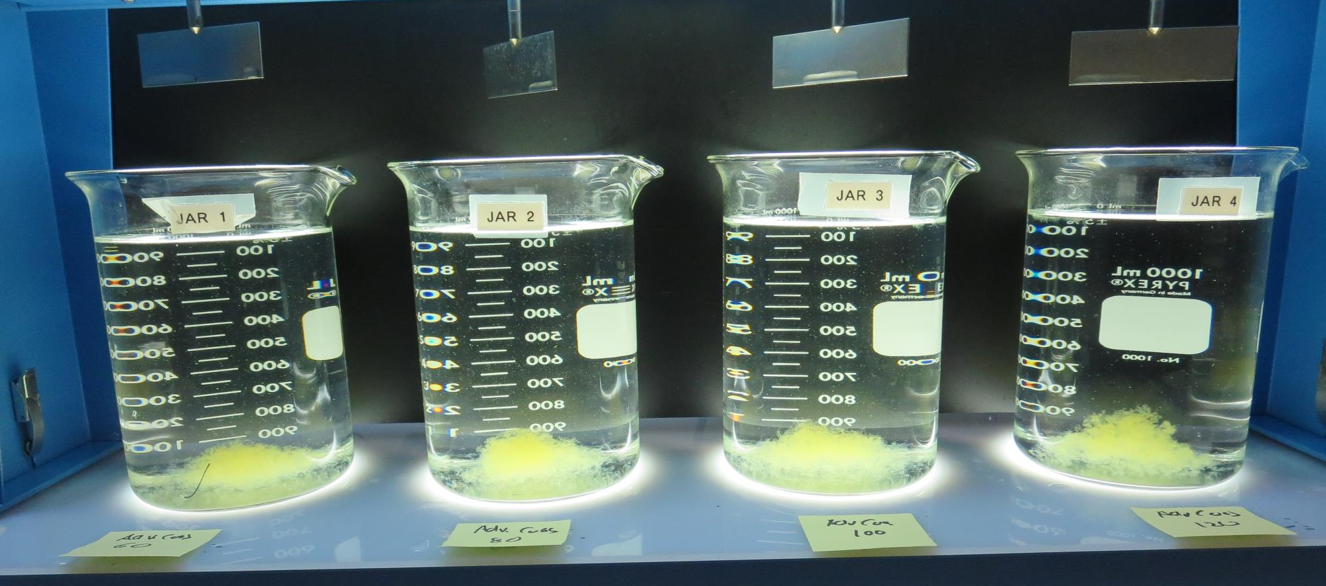
Jars 1-4: After 25-minutes of settling, settled water turbidity is taken.
60 mg/L Adv Coag.
Filtrate 0.18 NTU
UVT: 88.8%
UVA: 0.051/cm
UVA Reduction: 30.1%
Settled: 0.99 NTU
80 mg/L Adv Coag.
Filtrate 0.15 NTU
UVT: 89.3%
UVA: 0.048/cm
UVA Reduction: 34.2%
Settled: 0.68 NTU
100 mg/L Adv Coag.
Filtrate 0.17 NTU
UVT: 89.8%
UVA: 0.046/cm
UVA Reduction: 37.0%
Settled: 0.30 NTU
120 mg/L Adv Coag.
Filtrate 0.10 NTU
UVT: 90.6%
UVA: 0.042/cm
UVA Reduction: 42.5%
Settled: 0.72 NTU

Slide 16
Jars 5-8 Test
Flash Mix 30 Sec (200 RPM)
Floc Mix 5 min (30 RPM)
Applied Coagulant
Advanced Coagulant

Slide 17
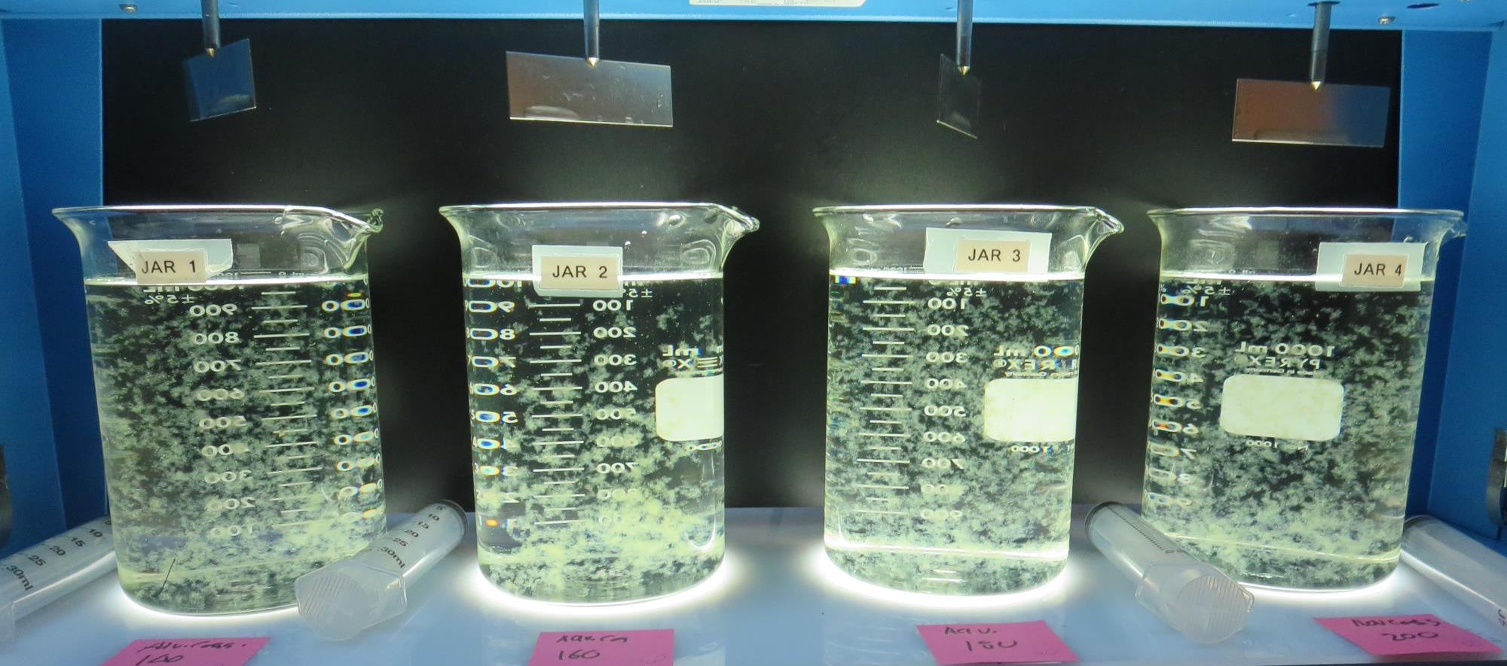
Jars 5-8: End of 5-minute flocculation (30 RPM) duration.
140 mg/L Adv Coag.
Filtrate 0.13 NTU
UVT: 90.6%
UVA: 0.042/cm
UVA Reduction: 42.5%
Settled: 0.40 NTU
160 mg/L Adv Coag.
Filtrate 0.11 NTU
UVT: 91.0%
UVA: 0.040/cm
UVA Reduction: 45.2%
Settled: 0.42 NTU
180 mg/L Adv Coag.
Filtrate 0.09 NTU
UVT: 91.3%
UVA: 0.039/cm
UVA Reduction: 46.6%
Settled: 0.35 NTU
200 mg/L Adv Coag.
Filtrate 0.09 NTU
UVT: 91.9%
UVA: 0.036/cm
UVA Reduction: 50.7%
Settled: 0.21 NTU

Slide 18
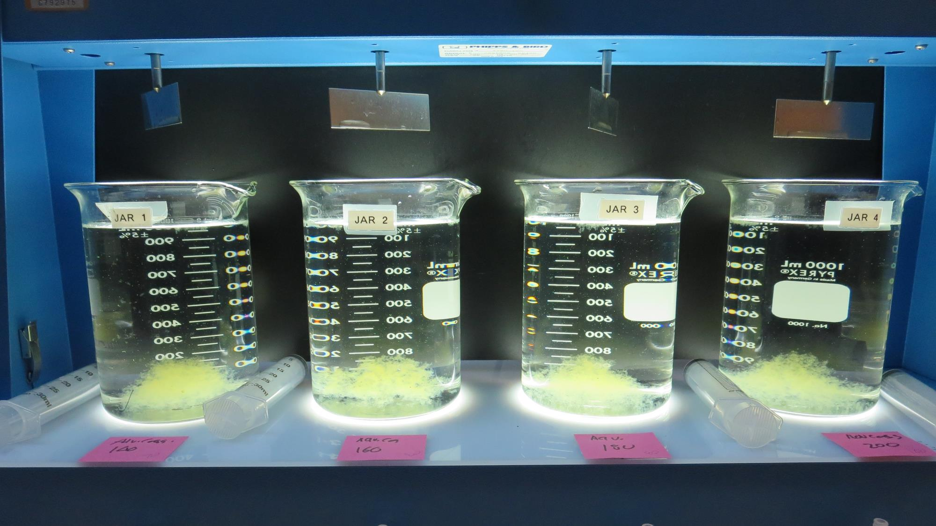
Jars 5-8: After 5 min of settling, 25 mL is syringed for filterability and %UVT/UVA.

Slide 19
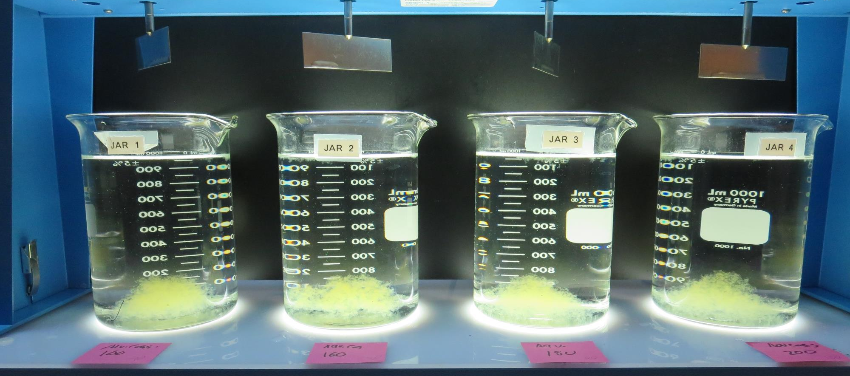
Jars 5-8: After 25-minutes of settling, settled water turbidity is taken.
140 mg/L Adv Coag.
Filtrate 0.13 NTU
UVT: 90.6%
UVA: 0.042/cm
UVA Reduction: 42.5%
Settled: 0.40 NTU
160 mg/L Adv Coag.
Filtrate 0.11 NTU
UVT: 91.0%
UVA: 0.040/cm
UVA Reduction: 45.2%
Settled: 0.42 NTU
180 mg/L Adv Coag.
Filtrate 0.09 NTU
UVT: 91.3%
UVA: 0.039/cm
UVA Reduction: 46.6%
Settled: 0.35 NTU
200 mg/L Adv Coag.
Filtrate 0.09 NTU
UVT: 91.9%
UVA: 0.036/cm
UVA Reduction: 50.7%
Settled: 0.21 NTU

Slide 20
Jars 9-12 Test
Flash Mix 30 Sec (200 RPM)
Floc Mix 5 min (30 RPM)
Applied Coagulant
Advanced Coagulant

Slide 21
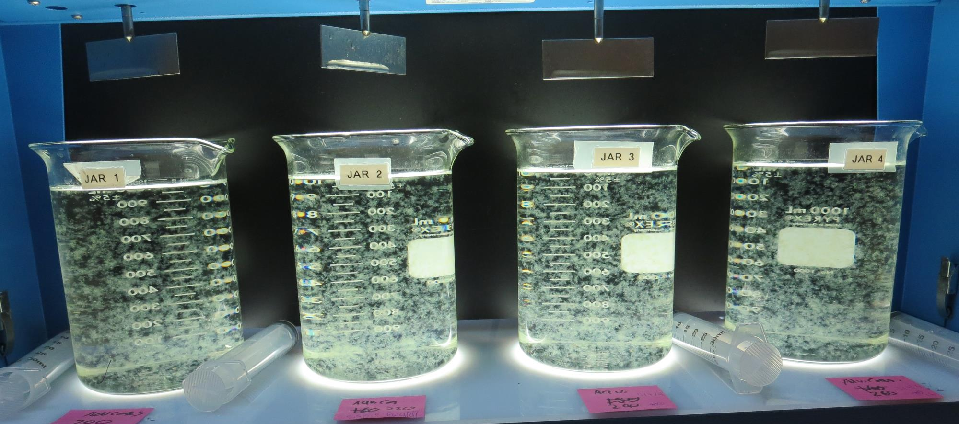
Jars 9-12: End of 5-minute flocculation (30 RPM) duration.
200 mg/L Adv Coag.
Filtrate 0.08 NTU
UVT: 91.8%
UVA: 0.036/cm
UVA Reduction: 50.7%
Settled: 0.28 NTU
220 mg/L Adv Coag.
Filtrate 0.08 NTU
UVT: 91.9%
UVA: 0.036/cm
UVA Reduction: 50.7%
Settled: 0.21 NTU
240 mg/L Adv Coag.
Filtrate 0.10 NTU
UVT: 92.0%
UVA: 0.035/cm
UVA Reduction: 52.1%
Settled: 0.23 NTU
260 mg/L Adv Coag.
Filtrate 0.06 NTU
UVT: 92.3%
UVA: 0.034/cm
UVA Reduction: 53.4%
Settled: 0.22 NTU

Slide 22
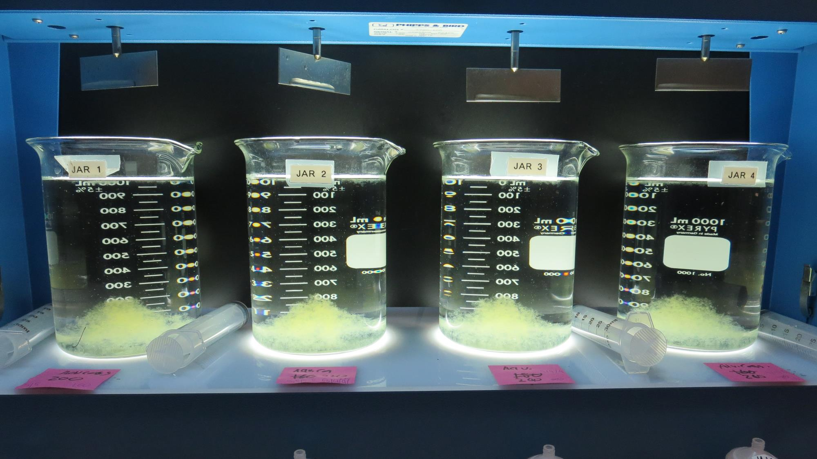
Jars 9-12: After 5 min of settling, 25 mL is syringed for filterability and %UVT/UVA.

Slide 23
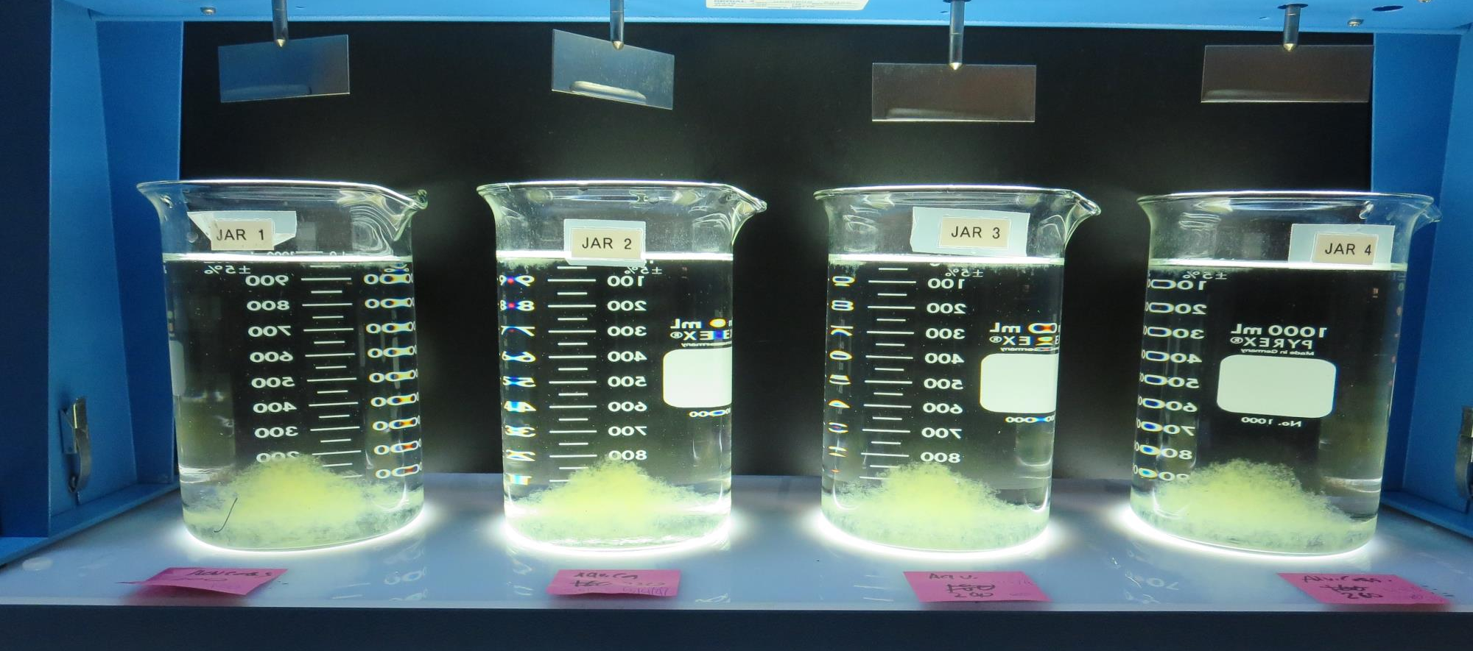
Jars 9-12: After 25-minutes of settling, settled water turbidity is taken.
200 mg/L Adv Coag.
Filtrate 0.08 NTU
UVT: 91.8%
UVA: 0.036/cm
UVA Reduction: 50.7%
Settled: 0.28 NTU
220 mg/L Adv Coag.
Filtrate 0.08 NTU
UVT: 91.9%
UVA: 0.036/cm
UVA Reduction: 50.7%
Settled: 0.21 NTU
240 mg/L Adv Coag.
Filtrate 0.10 NTU
UVT: 92.0%
UVA: 0.035/cm
UVA Reduction: 52.1%
Settled: 0.23 NTU
260 mg/L Adv Coag.
Filtrate 0.06 NTU
UVT: 92.3%
UVA: 0.034/cm
UVA Reduction: 53.4%
Settled: 0.22 NTU

Slide 24
Jars 13-16 Test
Flash Mix 30 Sec (200 RPM)
Floc Mix 5 min (30 RPM)
Applied Coagulant
Advanced Coagulant

Slide 25
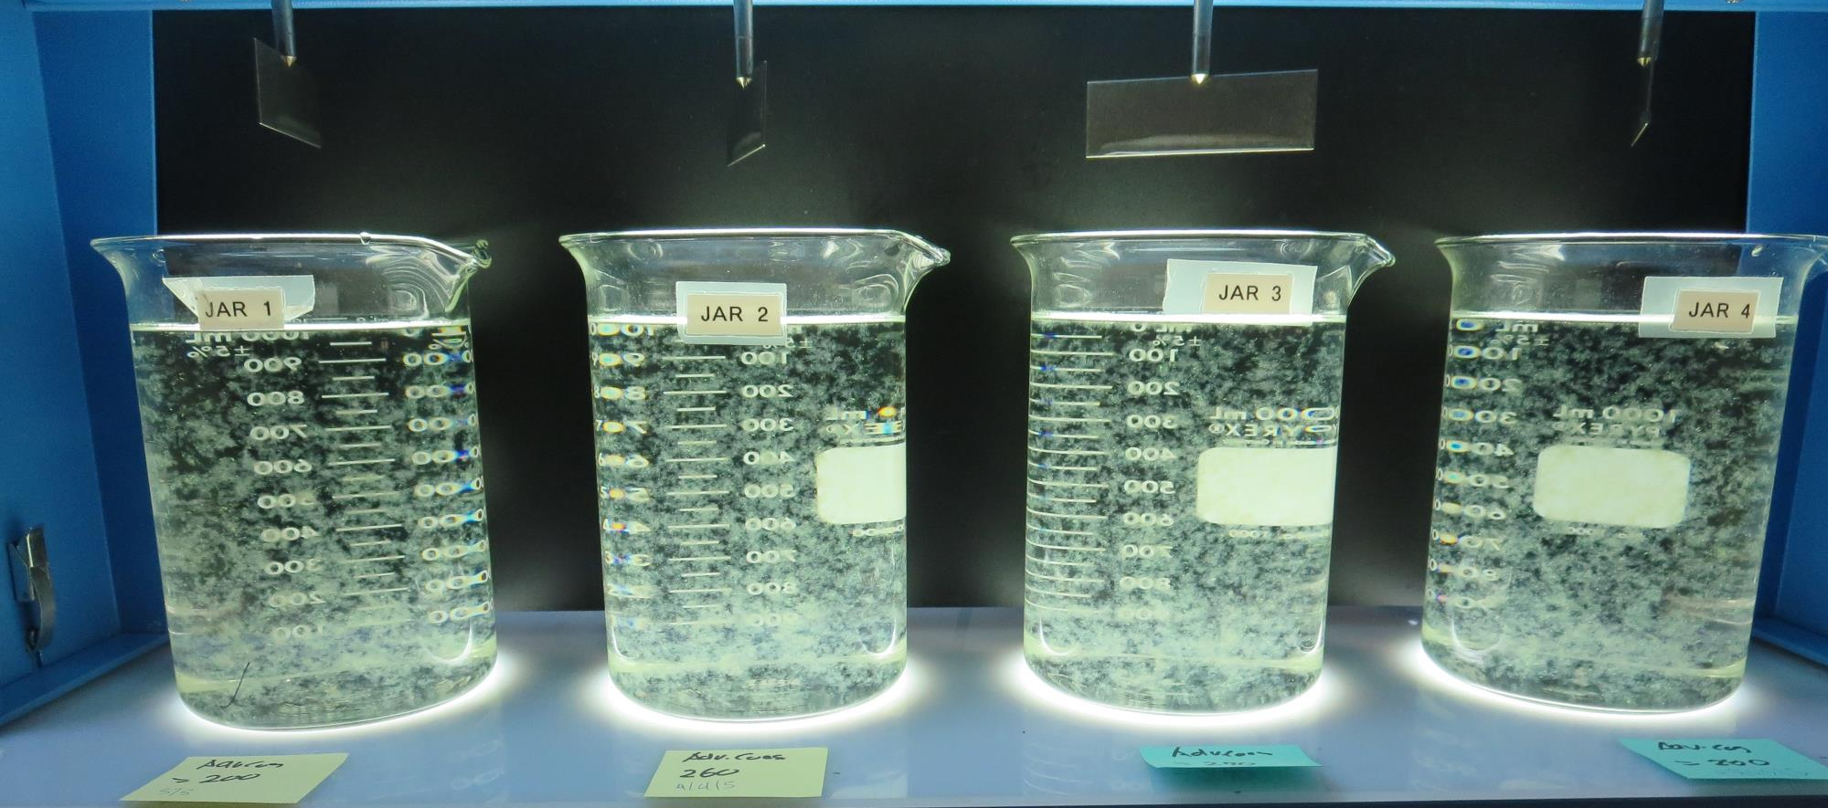
Jars 13-16: End of 5-minute flocculation (30 RPM) duration.
200 mg/L Adv Coag.
Filtrate 0.08 NTU
UVT: 91.7%
UVA: 0.037/cm
UVA Reduction: 49.3%
Settled: 0.21 NTU
260 mg/L Adv Coag.
Filtrate 0.09 NTU
UVT: 92.8%
UVA: 0.035/cm
UVA Reduction: 52.1%
Settled: 0.27 NTU
270 mg/L Adv Coag.
Filtrate 0.08 NTU
UVT: 92.1%
UVA: 0.035/cm
UVA Reduction: 52.1%
Settled: 0.21 NTU
280 mg/L Adv Coag.
Filtrate 0.08 NTU
UVT: 92.4%
UVA: 0.034/cm
UVA Reduction: 53.4%
Settled: 0.16 NTU

Slide 26
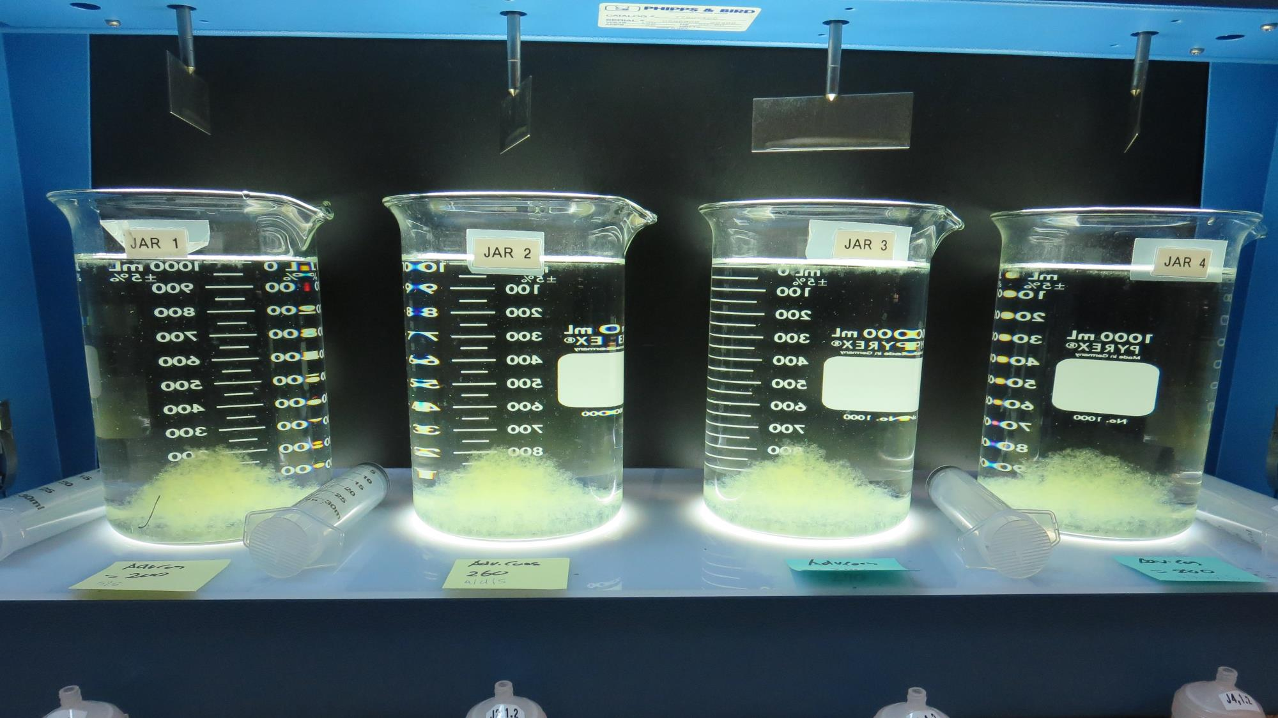
Jars 13-16: After 5 min of settling, 25 mL is syringed for filterability and %UVT/UVA.

Slide 27
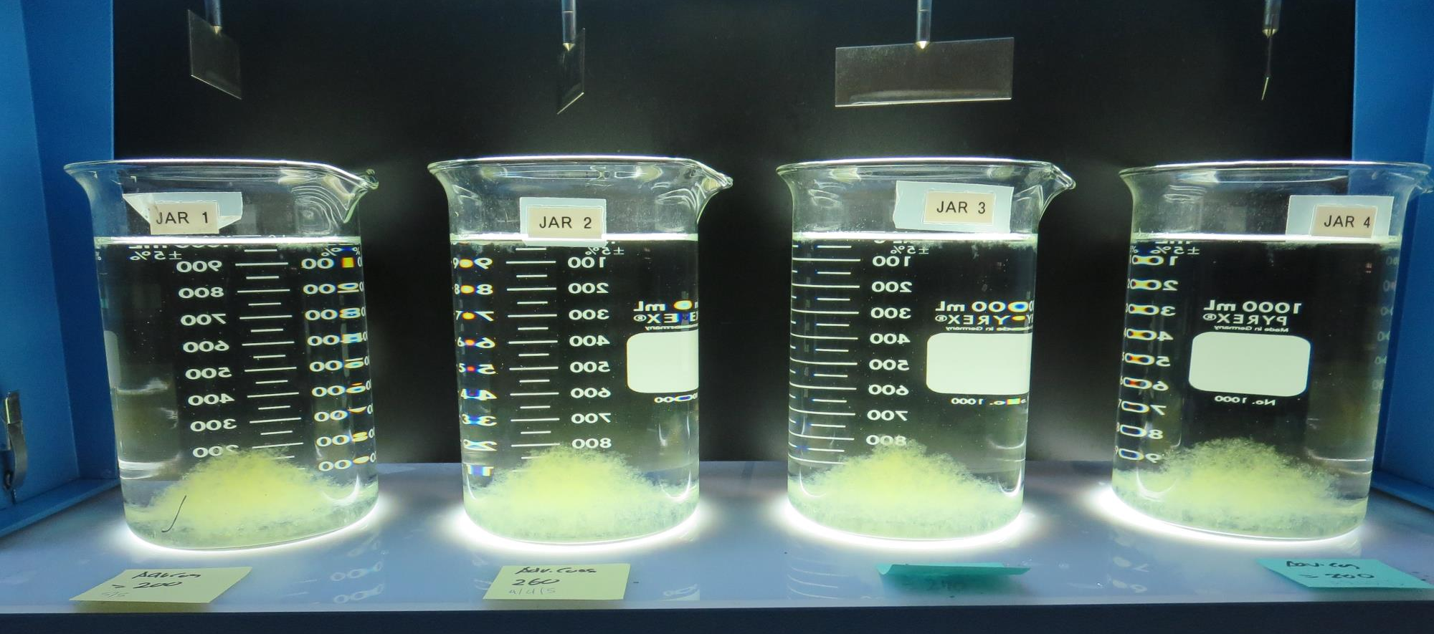
Jars 13-16: After 25-minutes of settling, settled water turbidity is taken.
200 mg/L Adv Coag.
Filtrate 0.08 NTU
UVT: 91.7%
UVA: 0.037/cm
UVA Reduction: 49.3%
Settled: 0.21 NTU
260 mg/L Adv Coag.
Filtrate 0.09 NTU
UVT: 92.8%
UVA: 0.035/cm
UVA Reduction: 52.1%
Settled: 0.27 NTU
270 mg/L Adv Coag.
Filtrate 0.08 NTU
UVT: 92.1%
UVA: 0.035/cm
UVA Reduction: 52.1%
Settled: 0.21 NTU
280 mg/L Adv Coag.
Filtrate 0.08 NTU
UVT: 92.4%
UVA: 0.034/cm
UVA Reduction: 53.4%
Settled: 0.16 NTU

Slide 28
Jars 17-20 Test
Flash Mix 30 Sec (200 RPM)
Floc Mix 5 min (30 RPM)
Applied Coagulant
9800

Slide 29
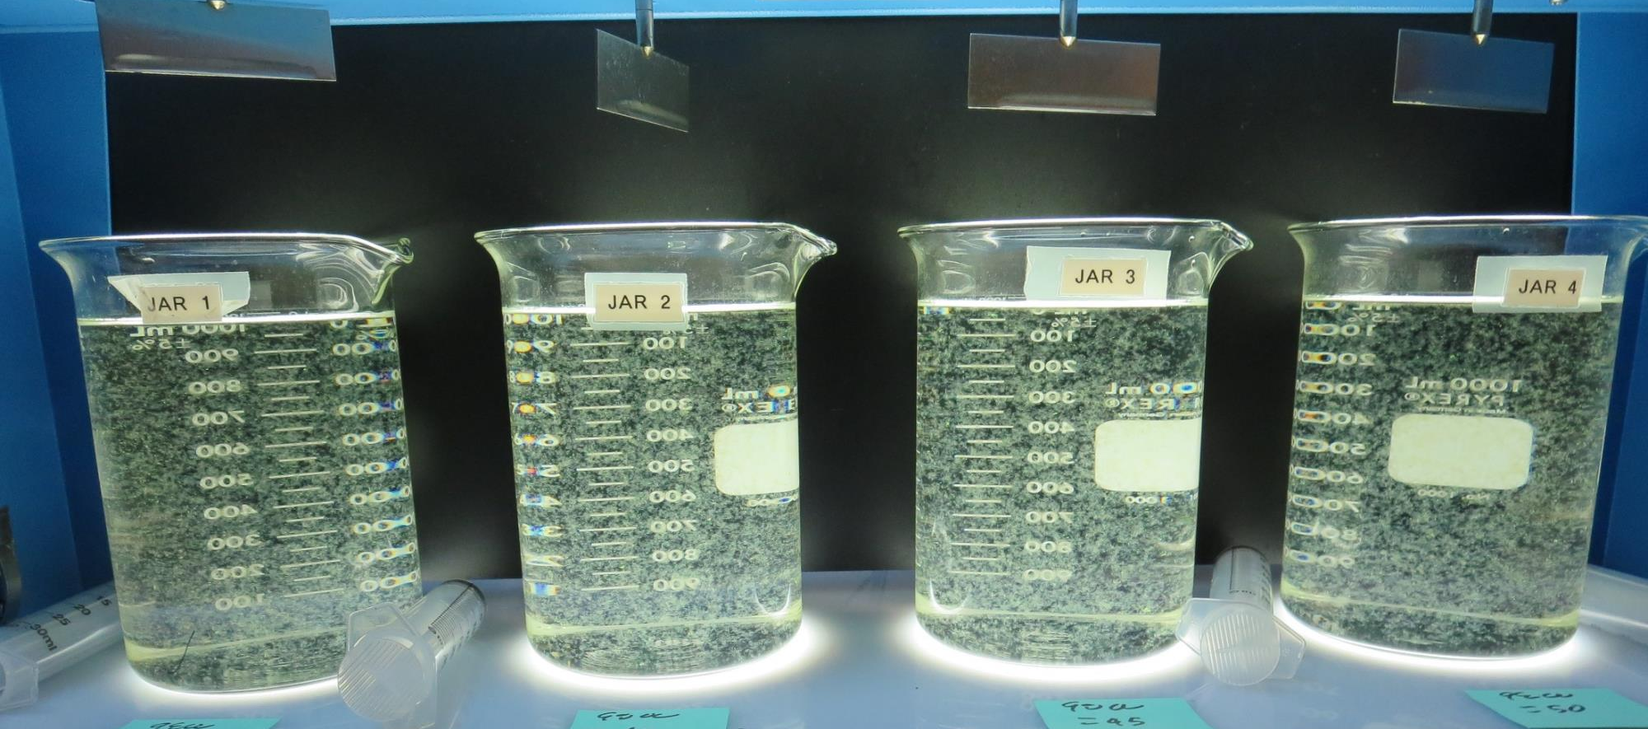
Jars 17-20: End of 5-minute flocculation (30 RPM) duration.
35 mg/L 9800
Filtrate 0.12 NTU
UVT: 90.5%
UVA: 0.043/cm
UVA Reduction: 41.1%
Settled: 0.35 NTU
40 mg/L 9800
Filtrate 0.12 NTU
UVT: 90.5%
UVA: 0.043/cm
UVA Reduction: 41.1%
Settled: 0.48 NTU
45 mg/L 9800
Filtrate 0.10 NTU
UVT: 90.7%
UVA: 0.042/cm
UVA Reduction: 42.5%
Settled: 0.35 NTU
50 mg/L 9800
Filtrate 0.08 NTU
UVT: 90.8%
UVA: 0.041/cm
UVA Reduction: 43.8%
Settled: 0.33 NTU

Slide 30
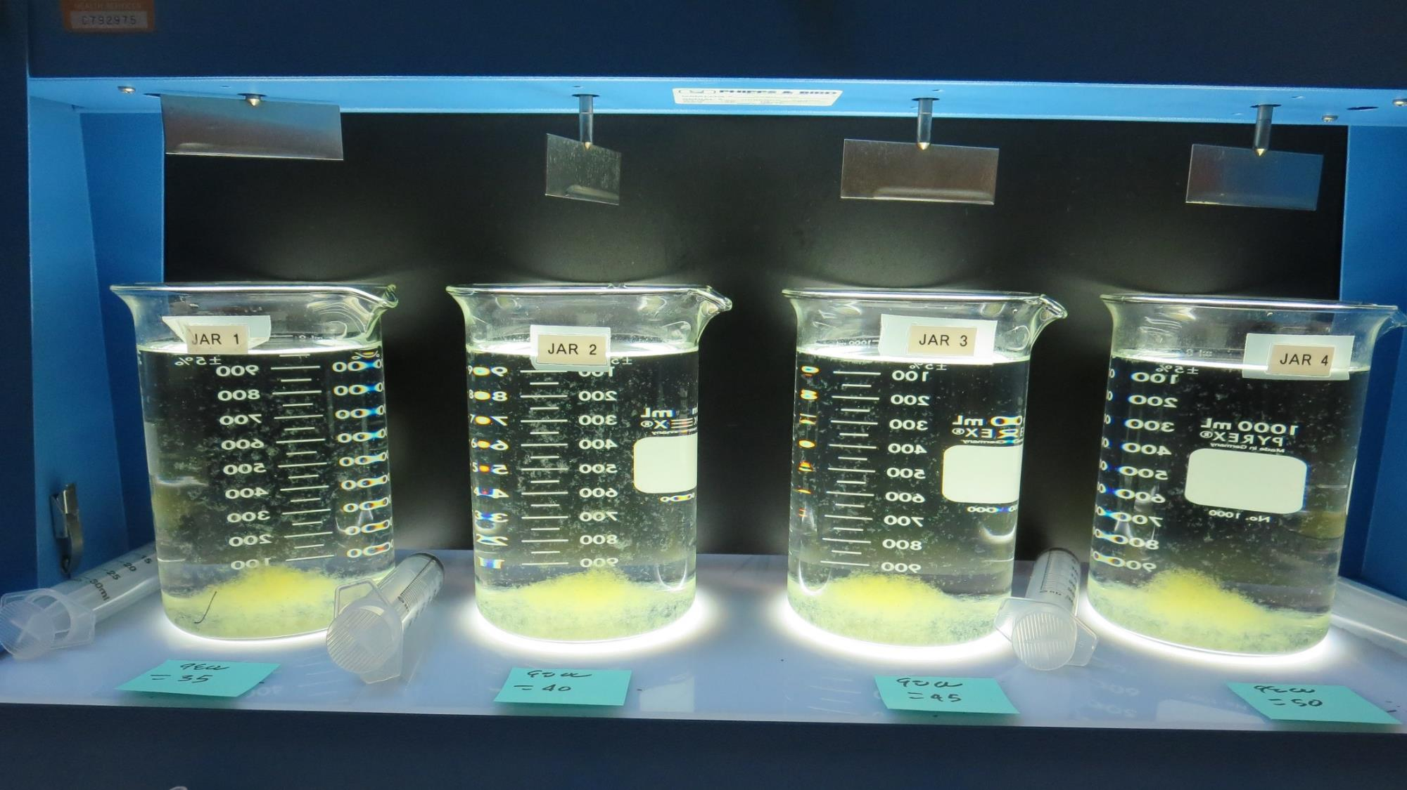
Jars 16-20: After 5 min of settling, 25 mL is syringed for filterability and %UVT/UVA.

Slide 31
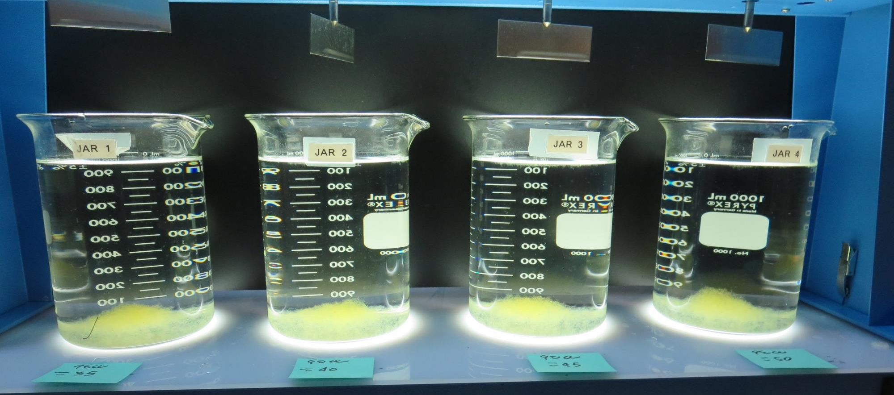
Jars 17-20: After 25-minutes of settling, settled water turbidity is taken.
35 mg/L 9800
Filtrate 0.12 NTU
UVT: 90.5%
UVA: 0.043/cm
UVA Reduction: 41.1%
Settled: 0.35 NTU
40 mg/L 9800
Filtrate 0.12 NTU
UVT: 90.5%
UVA: 0.043/cm
UVA Reduction: 41.1%
Settled: 0.48 NTU
45 mg/L 9800
Filtrate 0.10 NTU
UVT: 90.7%
UVA: 0.042/cm
UVA Reduction: 42.5%
Settled: 0.35 NTU
50 mg/L 9800
Filtrate 0.08 NTU
UVT: 90.8%
UVA: 0.041/cm
UVA Reduction: 43.8%
Settled: 0.33 NTU

Slide 32
Jars 21-24 Test
Flash Mix 30 Sec (200 RPM)
Floc Mix 5 min (30 RPM)
Applied Coagulant
9800

Slide 33
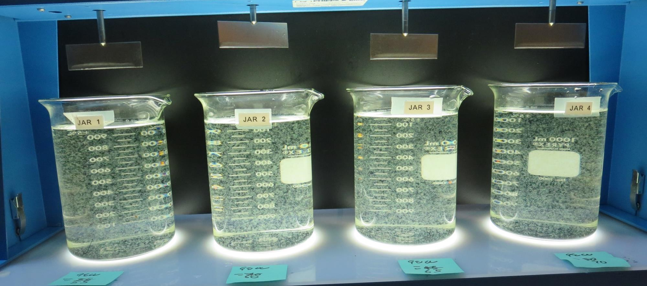
Jars 21-24: End of 5-minute flocculation (30 RPM) duration.
55 mg/L 9800
Filtrate 0.08 NTU
UVT: 91.1%
UVA: 0.040/cm
UVA Reduction: 45.2%
Settled: 0.27 NTU
60 mg/L 9800
Filtrate 0.08 NTU
UVT: 91.1%
UVA: 0.040/cm
UVA Reduction: 45.2%
Settled: 0.26 NTU
65 mg/L 9800
Filtrate 0.08 NTU
UVT: 91.3%
UVA: 0.039/cm
UVA Reduction: 46.6%
Settled: 0.28 NTU
70 mg/L 9800
Filtrate 0.08 NTU
UVT: 91.4%
UVA: 0.039/cm
UVA Reduction: 46.6%
Settled: 0.26 NTU

Slide 34
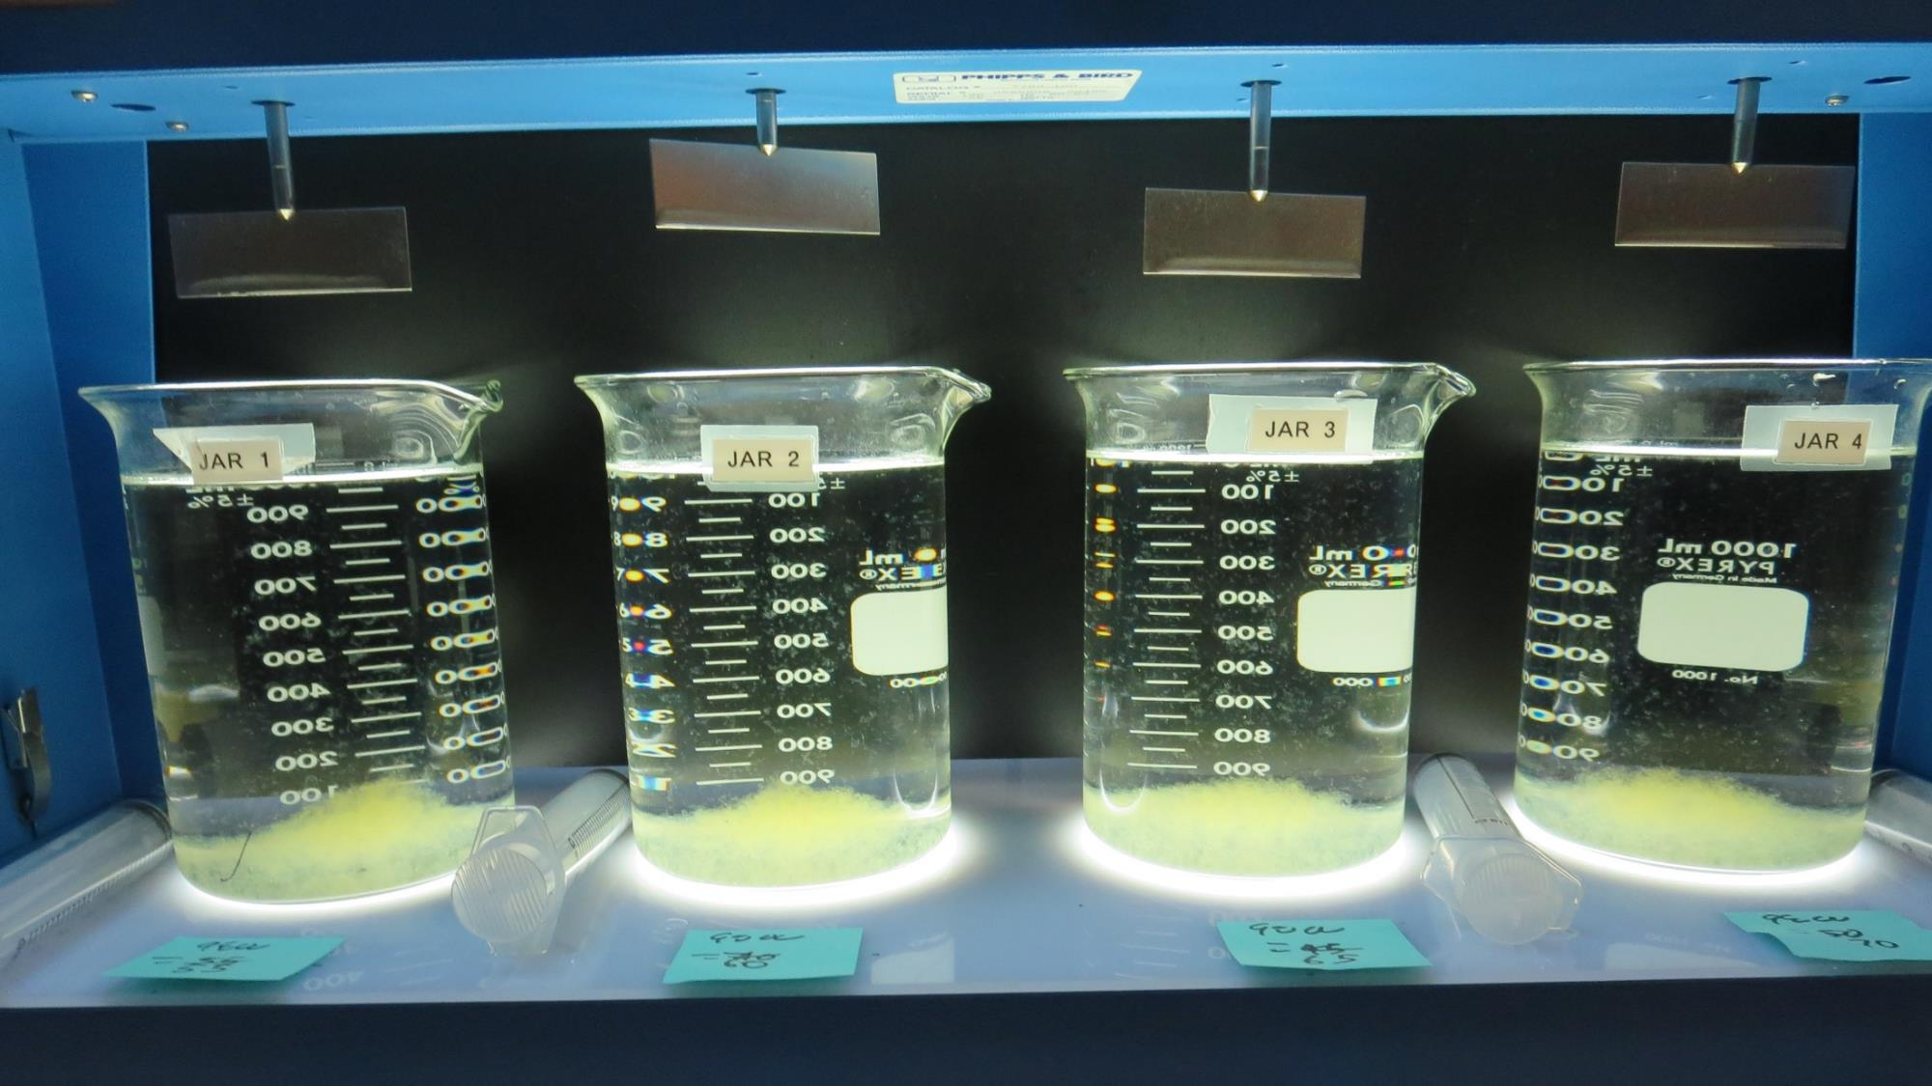
Jars 21-24: After 5 min of settling, 25 mL is syringed for filterability and %UVT/UVA.

Slide 35
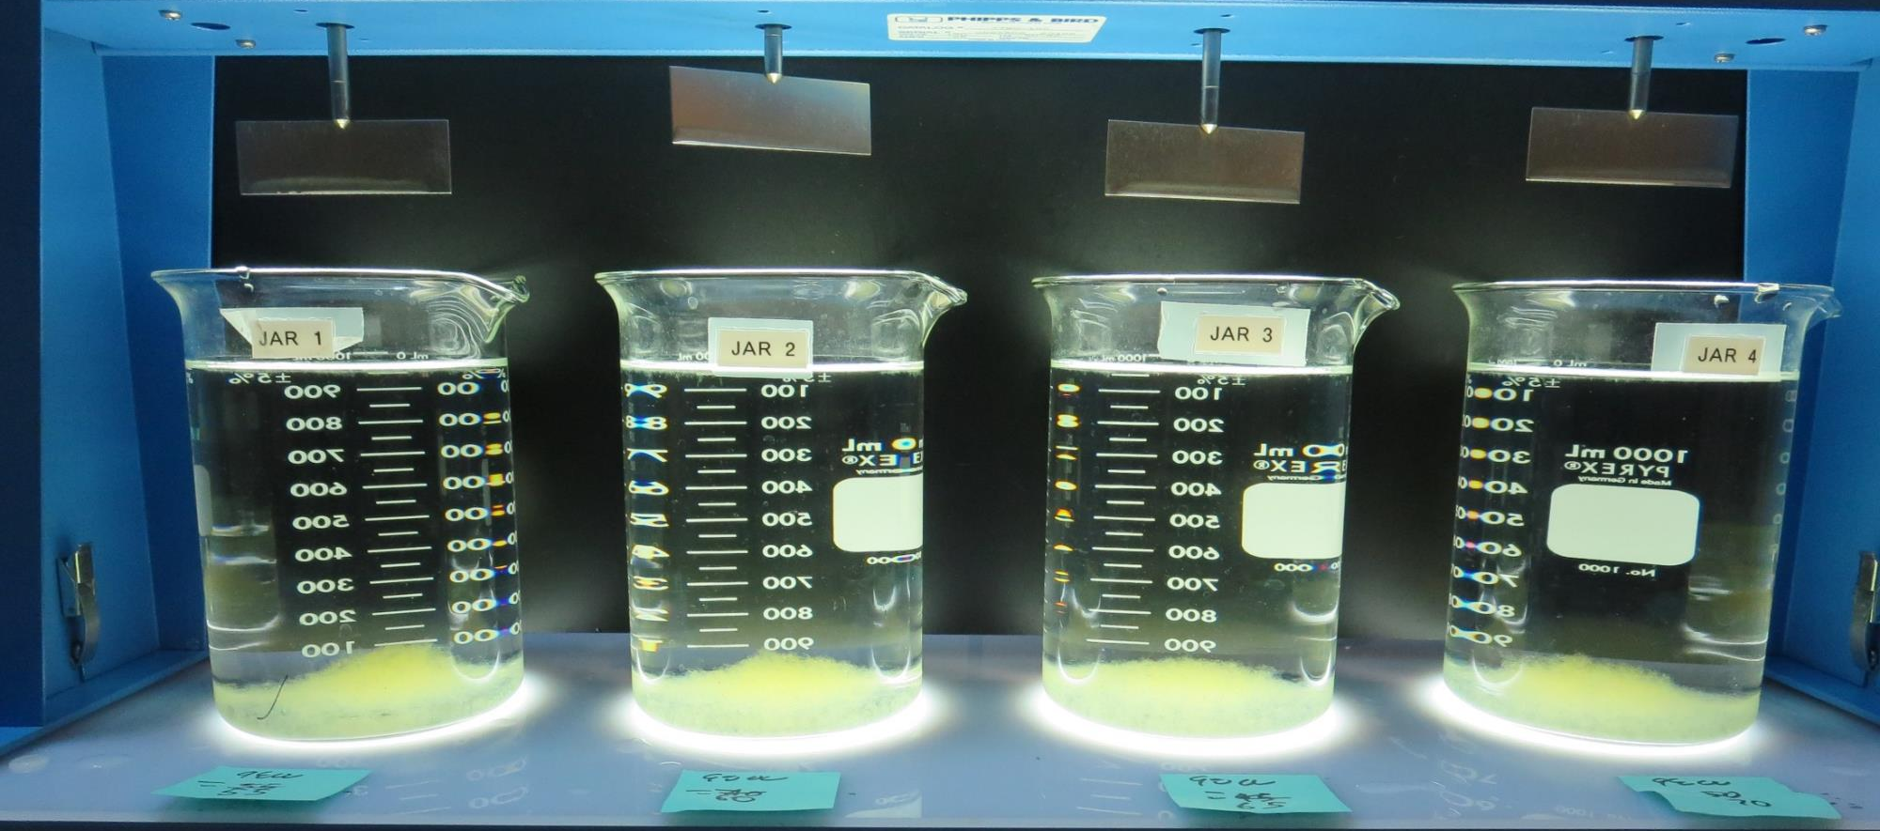
Jars 21-24: After 25-minutes of settling, settled water turbidity is taken.
55 mg/L 9800
Filtrate 0.08 NTU
UVT: 91.1%
UVA: 0.040/cm
UVA Reduction: 45.2%
Settled: 0.27 NTU
60 mg/L 9800
Filtrate 0.08 NTU
UVT: 91.1%
UVA: 0.040/cm
UVA Reduction: 45.2%
Settled: 0.26 NTU
65 mg/L 9800
Filtrate 0.08 NTU
UVT: 91.3%
UVA: 0.039/cm
UVA Reduction: 46.6%
Settled: 0.28 NTU
70 mg/L 9800
Filtrate 0.08 NTU
UVT: 91.4%
UVA: 0.039/cm
UVA Reduction: 46.6%
Settled: 0.26 NTU

Slide 36
Jars 25-28 Test
Flash Mix 30 Sec (200 RPM)
Floc Mix 5 min (30 RPM)
Applied Coagulant
Advanced Coagulant

Slide 37
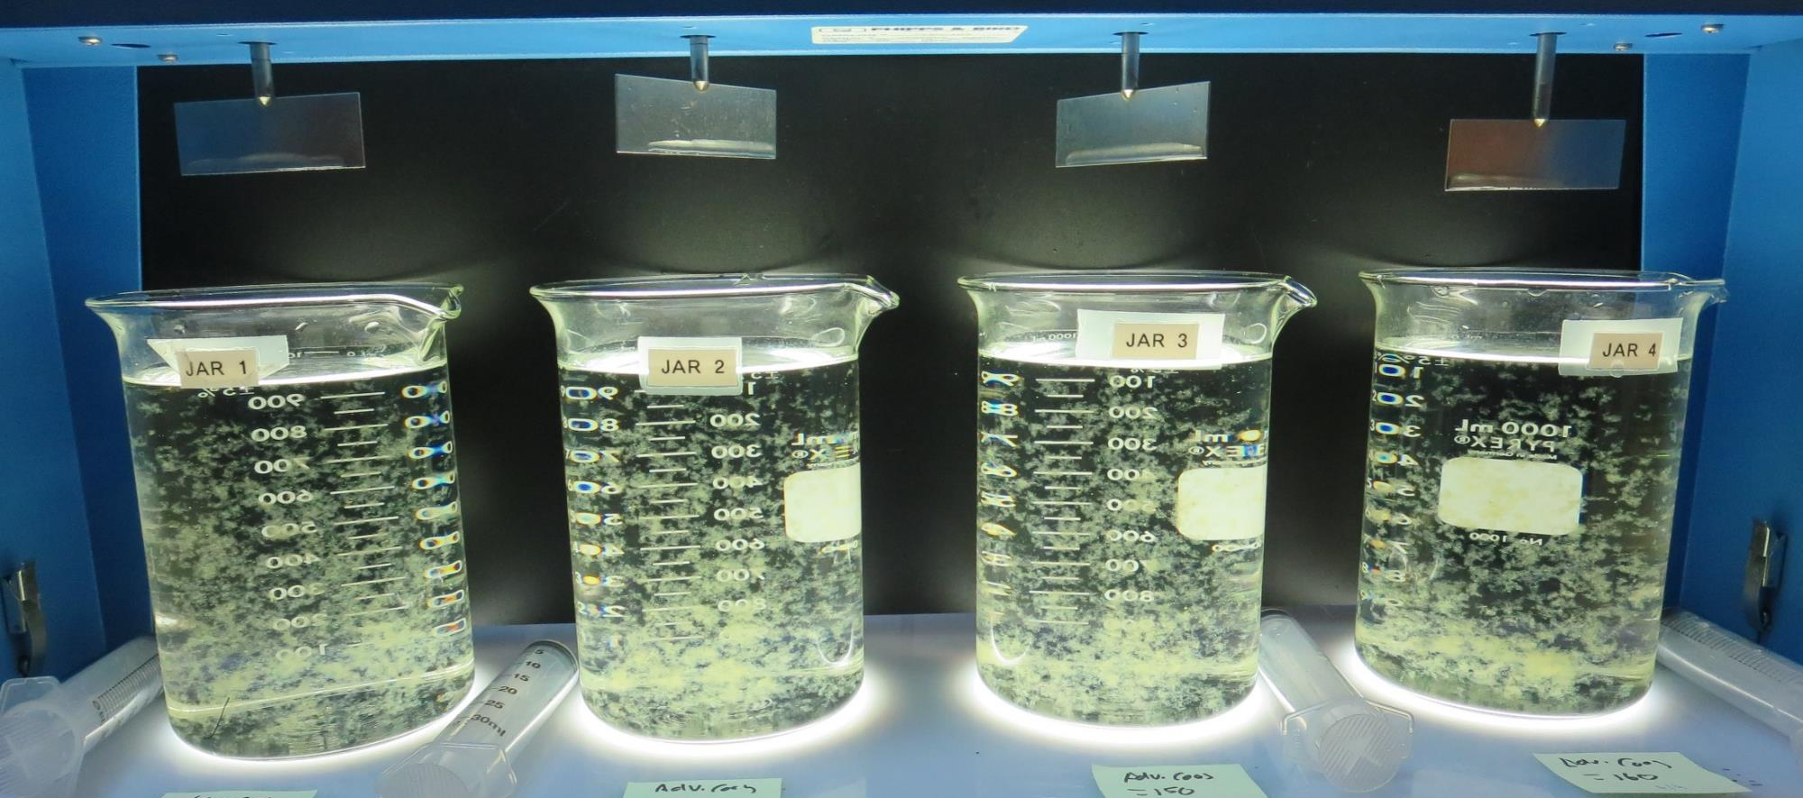
Jars 25-28: End of 5-minute flocculation (30 RPM) duration.
130 mg/L Adv Coag.
Filtrate 0.13 NTU
UVT: 90.4%
UVA: 0.043/cm
UVA Reduction: 41.1%
Settled: 0.30 NTU
140 mg/L Adv Coag.
Filtrate 0.10 NTU
UVT: 91.0%
UVA: 0.040/cm
UVA Reduction: 45.2%
Settled: 0.30 NTU
150 mg/L Adv Coag.
Filtrate 0.09 NTU
UVT: 91.2%
UVA: 0.039/cm
UVA Reduction: 46.6%
Settled: 0.27 NTU
160 mg/L Adv Coag.
Filtrate 0.07 NTU
UVT: 91.5%
UVA: 0.038/cm
UVA Reduction: 47.9%
Settled: 0.22 NTU

Slide 38
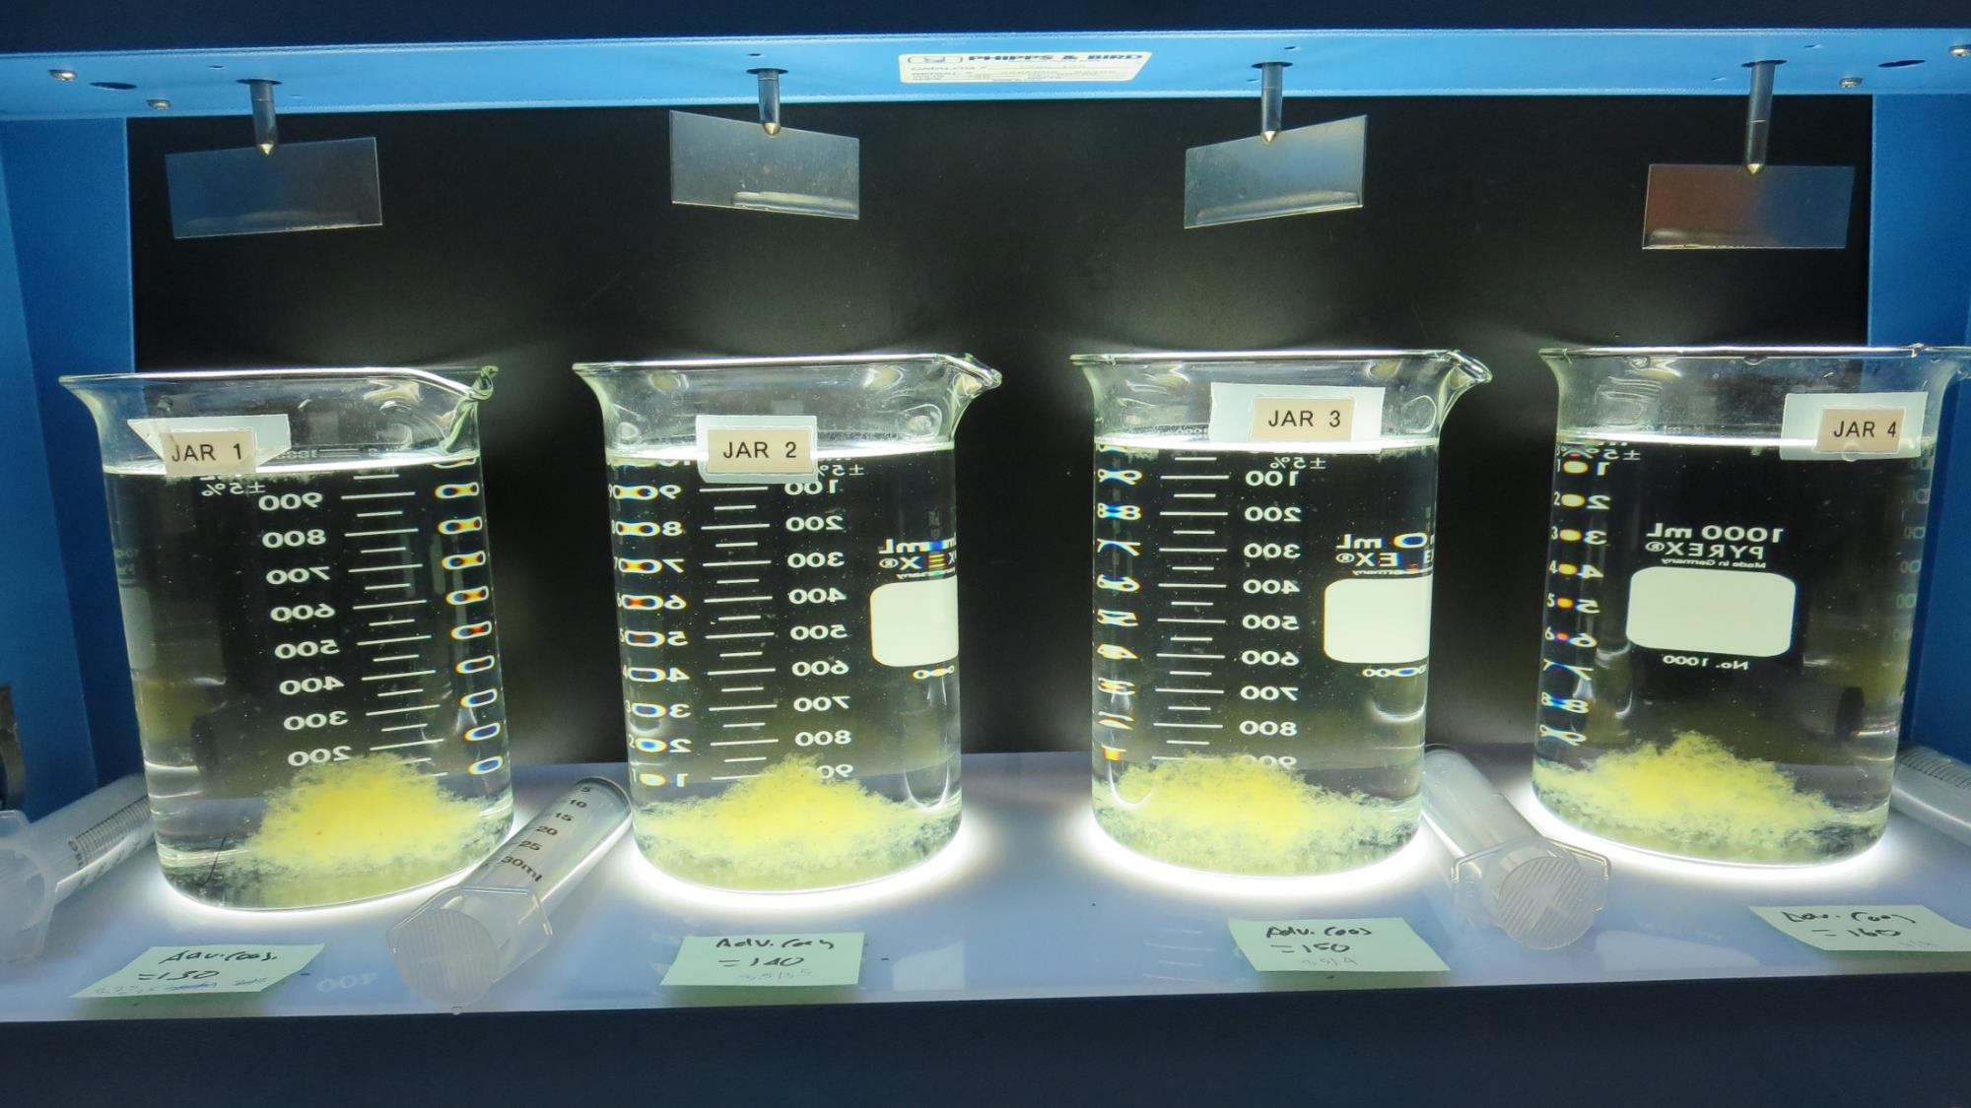
Jars 25-28: After 5 min of settling, 25 mL is syringed for filterability and %UVT/UVA.

Slide 39
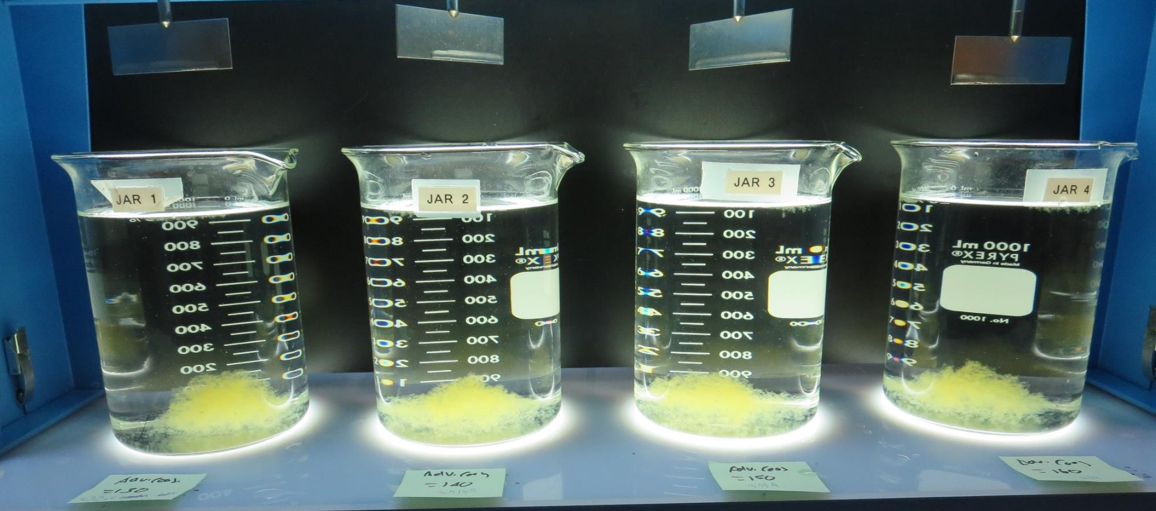
Jars 25-28: After 25-minutes of settling, settled water turbidity is taken.
130 mg/L Adv Coag.
Filtrate 0.13 NTU
UVT: 90.4%
UVA: 0.043/cm
UVA Reduction: 41.1%
Settled: 0.30 NTU
140 mg/L Adv Coag.
Filtrate 0.10 NTU
UVT: 91.0%
UVA: 0.040/cm
UVA Reduction: 45.2%
Settled: 0.30 NTU
150 mg/L Adv Coag.
Filtrate 0.09 NTU
UVT: 91.2%
UVA: 0.039/cm
UVA Reduction: 46.6%
Settled: 0.27 NTU
160 mg/L Adv Coag.
Filtrate 0.07 NTU
UVT: 91.5%
UVA: 0.038/cm
UVA Reduction: 47.9%
Settled: 0.22 NTU

Slide 40
Jar Testing for 1-Liter Jars:
Procedures for Most Treatment Plants
Fill jars with source water prior to coagulant injection and set paddle speed at 30 rpm
Add chemicals (i.e., NaOCl, primary coagulant, coagulant aid) to each jar
Flash mix for 15-30 seconds (200 rpm)
Slow mix for 5 minutes (20-30 rpm)
Settled for 5 minutes. Syringe 25 mL from each jar taken 1-inch below surface (25 mL/12 sec rate).
Filtered through 1.2 um isopore membrane into cuvette drip rate, 15 mL/(50-90 sec)
Measure filtrate turbidity, chlorine residual and %UVT/UVA
Measure settled water turbidity after 25 minutes of total setting
Record all data

Slide 41

Jar Test
Filterability Test Equipment
Turbidity Instrument
Syringe w/Luer-Lock Tip, 30 cc
(part#: 2225800, by Hach)
Swinnex Filter Holder, 25 mm (part#: SX0002500)
Isopore Membrane Filter, 1.2 um absolute
pore size,
Φ= 25 mm , thickness: 24 um,
hydrophilic polycarbonate membrane
(part #: RTTP02500)
Go to Sigma-Aldrich for laboratory supplies http://www.sigmaaldrich.com/united-states.html

Slide 42
Isopore Membrane Information
Categories | Information
trade name | Isopore
filter color | White
chemistry | Polycarbonate (PC)
water flow rate | Avg. 175 mL/min x cm² (typical results @ 10 psi)
media | Isopore®
wettability | Hydrophilic
porosity | 14.7%
pore size | 1.2 µm
bubble point at 23 °C | 1.0 bar, air with water
thickness | 24 µm
filter diameter (ø) | 25 mm
material size | polycarbonate, Hydrophilic, 1.2 µm, 25 mm, white, plain, 100

Slide 43
Isopore Membrane Background Information
The Isopore membrane is a polycarbonate, track-etched screen filter recommended for all analyses in which the sample is viewed on the surface of the membrane. The Isopore membrane is composed of polycarbonate film, which has a smooth, glass-like surface for clearer sample observation. The unique manufacturing process of the membrane ensures a precise pore diameter and a consistent pore size for accurate separation of samples by size. Matched-weight filters are not usually required because of low, constant tar and ash weights.
Features & Benefits:
Membrane structure retains particles on the surface, simplifying counting and analysis

Slide 44
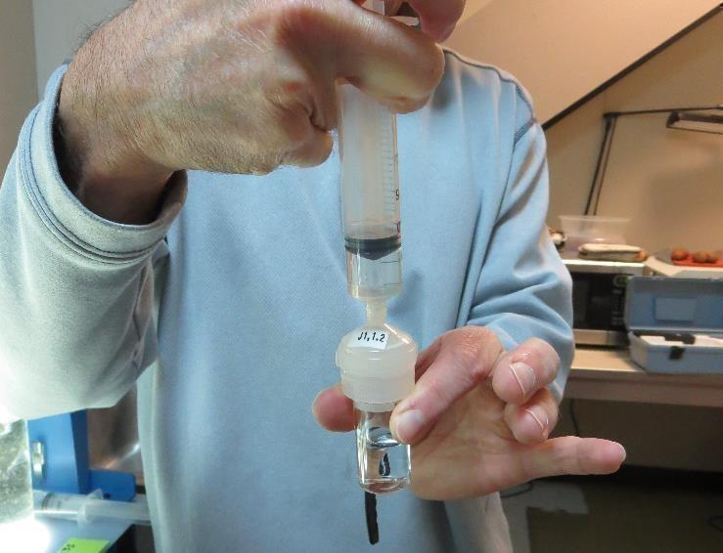

Jar Test - Filterability Test
Syringe ~ 25 mL from jar (after 5-minutes of settling)
Filter-to-waste 3-5 mL
Filter directly into clean cuvette
Measure turbidity
Note: Take several readings before recording final NTU results. Micro bubbles can adhere to glass causing false NTU readings. To remove bubbles, tilt cuvette up to 90 degrees.

Slide 45

Contact
Guy Schott, P.E.
State Water Resources Control Board
Division of Drinking Water
Santa Rosa, CA
Go to Stock Solution/Dose calculations/Jar Test Results for tools to download
www.waterboards.ca.gov/drinking_water/programs/districts/mendocino_district.html
Email: Guy Schott - Guy.Schott@waterboards.ca.gov
Office Number: 707-576-2732

