Slide 1
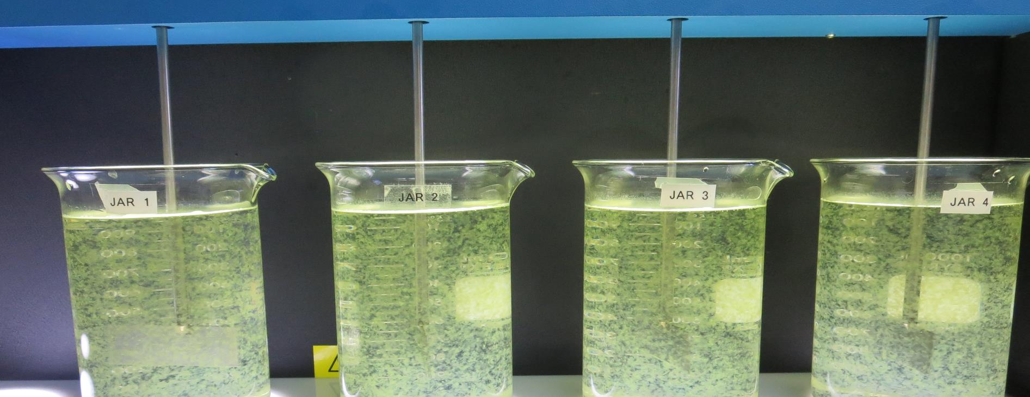
Konocti County Water District
CA1710006, Lake County, Jar Test
by Guy Schott, P.E. July 20, 2021

Slide 2
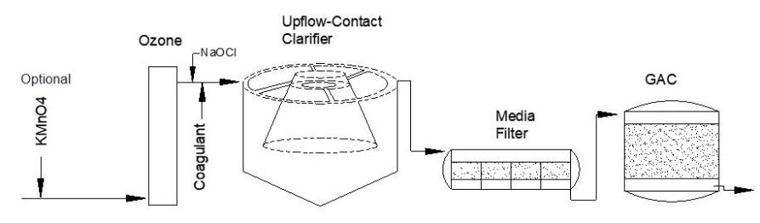
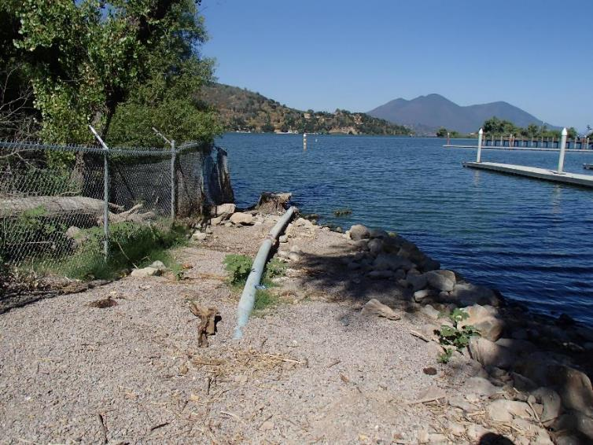
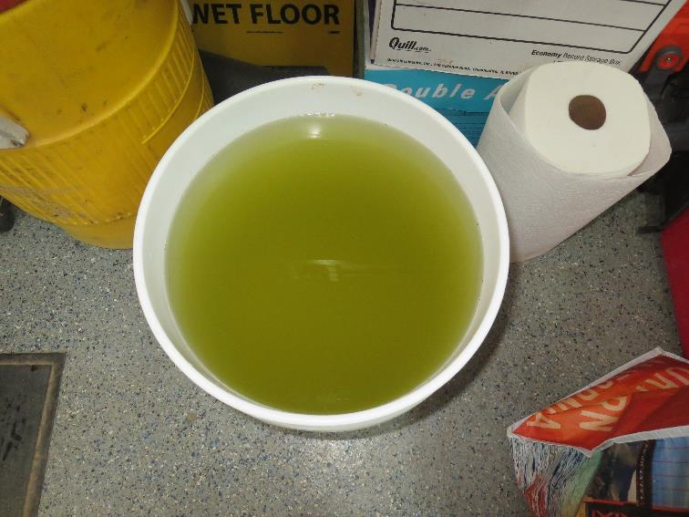
Konocti County Water District
Source Water: Clear Lake
Conventional Treatment

Slide 3
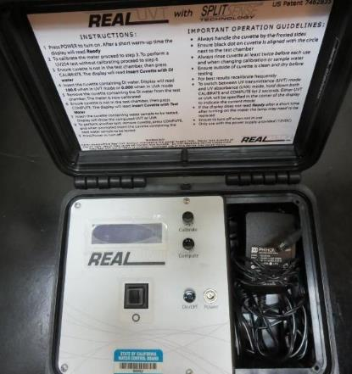
UVT/UVA, pathlength 10 mm
UV transmittance (UVT) is a measurement of the amount of ultraviolet light (254 nm) that passes through a water sample compared to the amount of light that passes through a pure water sample. The measurement is expressed as % UVT.
%UVT = 10^{(-UVA)} x 100%
UV absorbance (UVA) is calculated as a relative measure of the amount of light absorbed by a water sample compared with the amount of light absorbed by a pure water sample.
UVA = -log(%UVT/100)

Slide 4
Konocti CWD Source & Treated Water Characteristics, June 3, 2021
Source (post KMnO4 & O3)
pH: 8.48
Turbidity: 10 NTU
UVT: 69.4%,
UVA: 0.158/cm
0.4 um Filtered
Turbidity: 0.84 NTU
D-UVT: 81.5%,
UVA: 0.088/cm
Plant Filtrate Water
Not available

Slide 5
Applied Coagulants for Jar Testing (1)
Pro Pac 9800 (NTU Technologies)
50% Aluminum Chlorohydrate
50% Water
23.62% Al₂O₃
12.5% Al
83% Basicity
SG = 1.25-1.34
NSF limit: 250 mg/L as Product
10 mg/L as 9800 = Reduction 1.18 mg/L as CaCO₃
Pro Pac 9890 (NTU Technologies)
35-45% Aluminum Chlorohydrate
20% polyamine (50% water, 50% active polyamines)
35-45% Water
~18.9% Al₂O₃
~10.5% Al
83% Basicity
SG = 1.25-1.34
NSF limit: 50 mg/L as Product;
Product dose 10 mg/L = 1 mg/L polyamines active

Slide 6
Applied Coagulants for Jar Testing (2)
BWS, Inc.
AdvFloc-CTC-00011
Polyaluminum Hydroxy Chlorosulfate
12.55% Al₂O₃
6.64% Al
64.9% Basicity
SG = 1.299
NSF limit: 250 mg/L as Product
BWS, Inc.
Greg Nieckarz, Ph.D.
Greg.niekarz@bws.works
541-953-5112

Slide 7
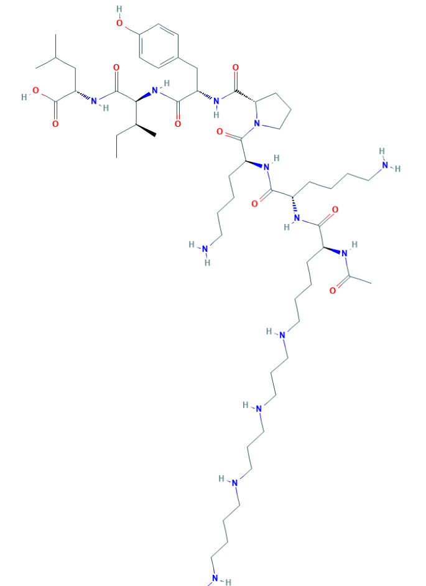
Polyamine
C₅₉H₁₀₈N₁₄O₁₀
MW: 1,173.6 g/mol

Slide 8
Coagulant Information
Unless stated otherwise, all coagulant doses are reported as Product (100% strength).
Aluminum Sulfate doses are reported as hydrated Al₂(SO₄)₃*14.3H₂0.
Preparation of coagulant stock solutions are generally 1.0 and/or 0.1 percent strength using 100 and/or 200 mL volumetric flasks.
Finnpipette F2 variable volume pipette, capacity 100-1000 micro liters is used for stock solution preparation and coagulant aid jar test dosing.
Finnpipette F2 variable volume pipette, capacity 0.5-5 mL is used for primary coagulant jar test dosing.

Slide 9
Konocti CWD; Jar Test 1 - 4 Results
Sample: Settled Water
Floc Mix 20 RPM (2 min)
Jar# | CTC-00011 mg/L | Filtrate NTU | Filtrate %UVT | Filtrate UVA/cm
J1 | 2 | 0.21 | 87.8 | 0.057
J2 | 4 | 0.22 | 87.8 | 0.057
J3 | 6 | 0.21 | 87.8 | 0.057
J4 | 8 | 0.20 | 87.8 | 0.056
J5 | 10 | 0.20 | 87.8 | 0.056

Slide 10
Konocti CWD; Jar Test 5 - 12 Results
Flash Mix 200 RPM (30 sec); Floc Mix 30 RPM (5 min)
Jar# | 9800 mg/L | 9890 mg/L | Filtrate NTU | Filtrate %UVT | Filtrate UVA/cm | %UVA Reduction | Settle NTU 25 min
J5 | 30 | 15 | 0.19 | 89.4 | 0.049 | 67.4 | 0.86
J6 | 35 | 15 | 0.23 | - | - | - | 1.11
J7 | 40 | 15 | 0.19 | 89.2 | 0.050 | 66.6 | 0.88
J8 | 45 | 15 | 0.14 | 89.4 | 0.049 | 67.2 | 0.68
J9 | 45 | 15 | 0.10 | 89.4 | 0.049 | 67.3 | 0.56
J10 | 50 | 15 | 0.08 | 89.7 | 0.047 | 68.3 | 0.59
J11 | 55 | 15 | 0.08 | 89.8 | 0.047 | 68.6 | 0.51
J12 | 60 | 15 | 0.08 | 90.1 | 0.045 | 69.6 | 0.41

Slide 11
Konocti CWD; Jar Test 13 - 16 Results
Flash Mix 200 RPM (30 sec); Floc Mix 30 RPM (5 min)
Jar# | NaOCl mg/L | 9800 mg/L | 9890 mg/L | Filtrate NTU | Filtrate %UVT | Filtrate UVA/cm | %UVA Reduction | Settle NTU 25 min
J13 | 0 | 55 | 15 | 0.07 | 89.7 | 0.047 | 68.3 | -
J14 | 0 | 60 | 15 | 0.11 | 89.7 | 0.047 | 68.4 | -
J15 | 3 | 55 | 15 | 0.09 | 89.1 | 0.050 | 66.4 | -
J16 | 3 | 60 | 15 | 0.07 | 89.3 | 0.049 | 67.1 | -

Slide 12
Jars 1-4 Test
Floc Mix 2 min (20 RPM)
Settled Water
Applied Coagulant
CTC-00011
No photos available

Slide 13
Jars 5-8 Test
Flash Mix 30 Sec (200 RPM)
Floc Mix 5 min (30 RPM)
Post-Oxidation
KMnO₄/O₃
Applied Coagulants
9800/9890

Slide 14
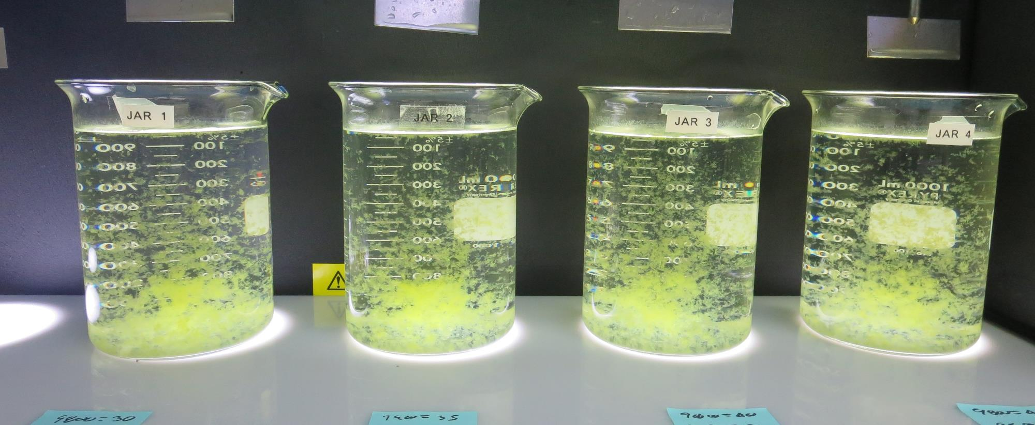
Jars 5-8: End of 5-minute flocculation (30 RPM) duration.
30 mg/L 9800
15 mg/L 9890
Filtrate 0.19 NTU
UVT: 89.38%
UVA: 0.0488/cm
UVA Reduction: 67.4%
Settled: 0.86 NTU
35 mg/L 9800
15 mg/L 9890
Filtrate 0.23 NTU
UVT: -%
UVA: -/cm
UVA Reduction-%
Settled: 1.11 NTU
40 mg/L 9800
15 mg/L 9890
Filtrate 0.19 NTU
UVT: 89.15%
UVA: 0.0499/cm
UVA Reduction: 66.6%
Settled: 0.88 NTU
45 mg/L 9800
15 mg/L 9890
Filtrate 0.14 NTU
UVT: 89.35%
UVA: 0.0490/cm
UVA Reduction: 67.2%
Settled: 0.68 NTU

Slide 15
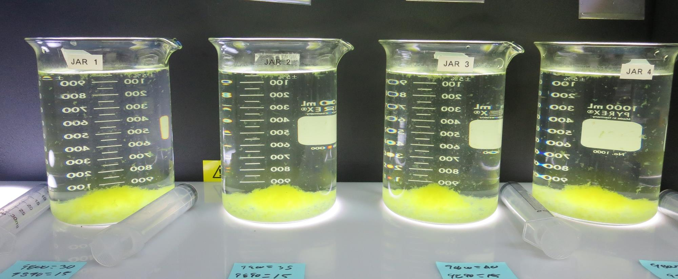
Jars 5-8: After 5 min of settling, 25 mL is syringed for filterability and %UVT/UVA.

Slide 16
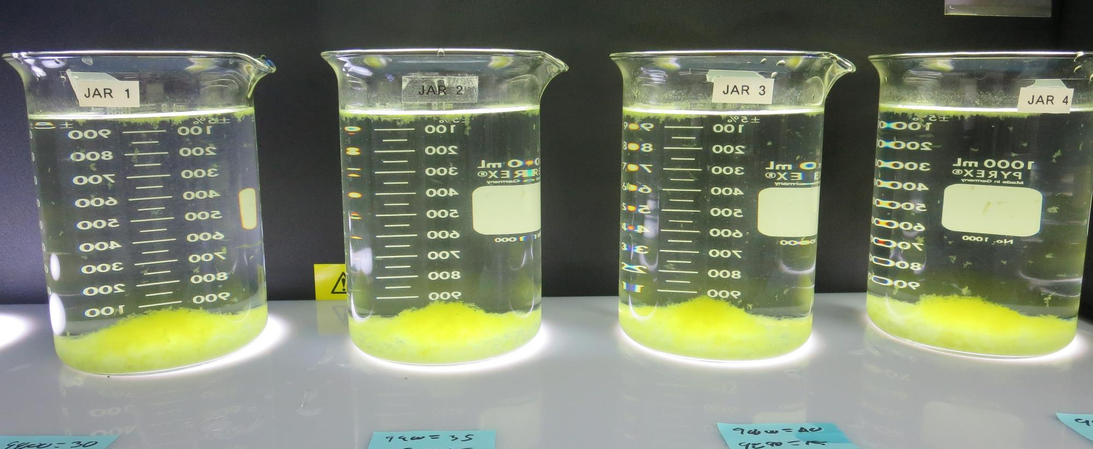
Jars 5-8: After 25-minutes of settling, settled water turbidity is taken.
30 mg/L 9800
15 mg/L 9890
Filtrate 0.19 NTU
UVT: 89.38%
UVA: 0.0488/cm
UVA Reduction: 67.4%
Settled: 0.86 NTU
35 mg/L 9800
15 mg/L 9890
Filtrate 0.23 NTU
UVT: -%
UVA: -/cm
UVA Reduction-%
Settled: 1.11 NTU
40 mg/L 9800
15 mg/L 9890
Filtrate 0.19 NTU
UVT: 89.15%
UVA: 0.0499/cm
UVA Reduction: 66.6%
Settled: 0.88 NTU
45 mg/L 9800
15 mg/L 9890
Filtrate 0.14 NTU
UVT: 89.35%
UVA: 0.0490/cm
UVA Reduction: 67.2%
Settled: 0.68 NTU

Slide 17
Jars 9-12 Test
Flash Mix 30 Sec (200 RPM)
Floc Mix 5 min (30 RPM)
Post-Oxidation
KMnO₄/O₃
Applied Coagulants
9800/9890

Slide 18
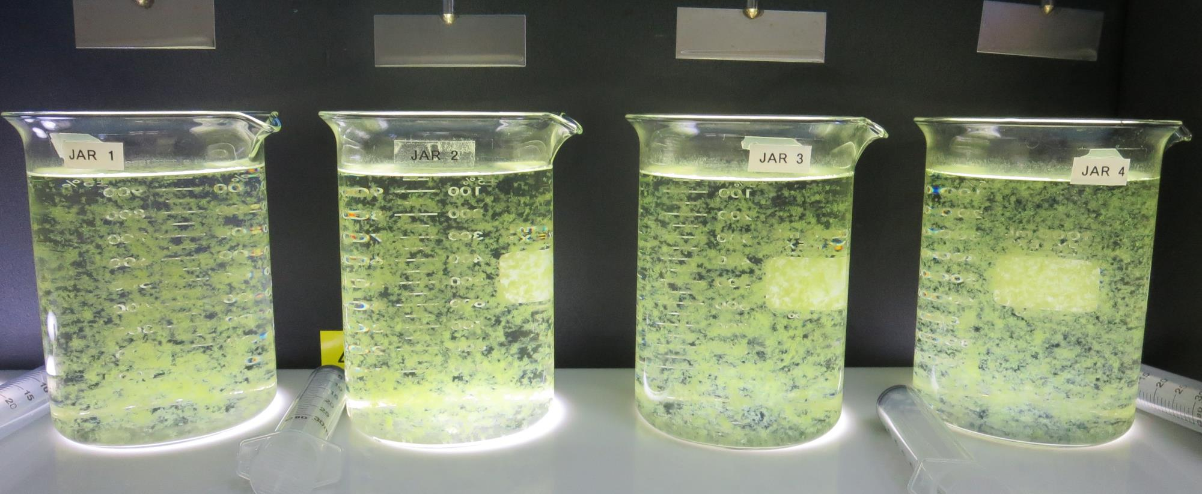
Jars 9-12: End of 5-minute flocculation (30 RPM) duration.
45 mg/L 9800
15 mg/L 9890
Filtrate 0.10 NTU
UVT: 89.37%
UVA: 0.0489/cm
UVA Reduction: 67.3%
Settled: 0.56 NTU
50 mg/L 9800
15 mg/L 9890
Filtrate 0.08 NTU
UVT: 89.67%
UVA: 0.0474/cm
UVA Reduction: 68.3%
Settled: 0.59 NTU
55 mg/L 9800
15 mg/L 9890
Filtrate 0.08 NTU
UVT: 89.75%
UVA: 0.0470/cm
UVA Reduction: 68.6%
Settled: 0.51 NTU
60 mg/L 9800
15 mg/L 9890
Filtrate 0.08 NTU
UVT: 90.07%
UVA: 0.0454/cm
UVA Reduction: 68.6%
Settled: 0.41 NTU

Slide 19
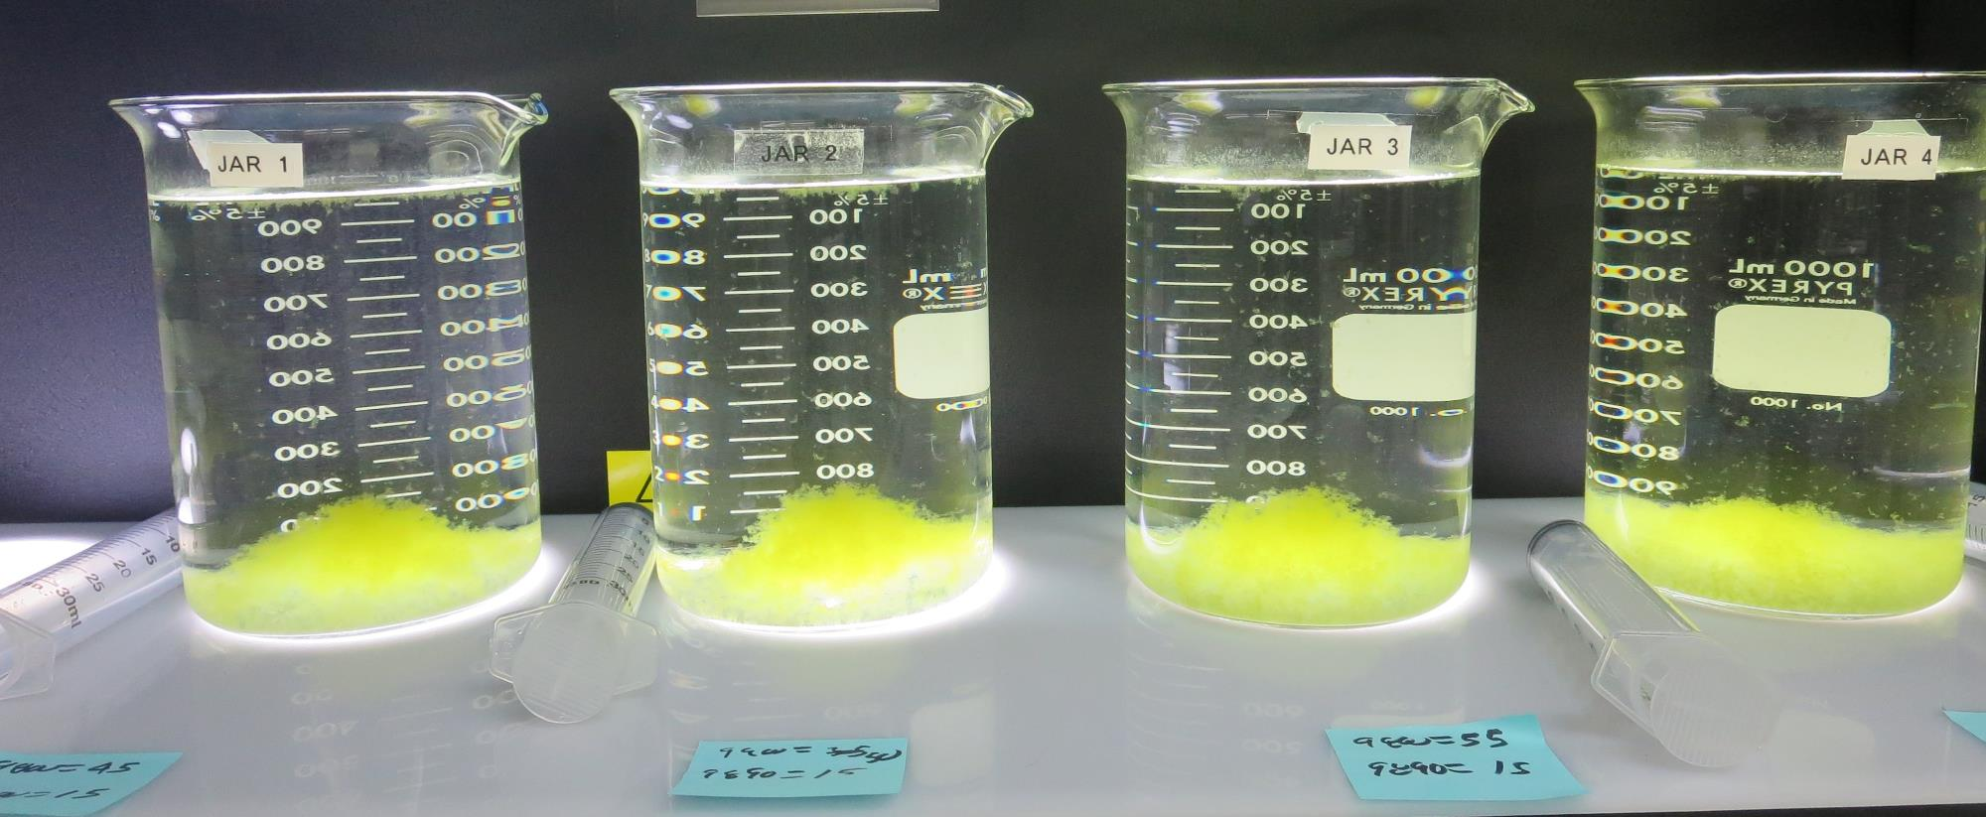
Jars 9-12: After 5 min of settling, 25 mL is syringed for filterability and %UVT/UVA.

Slide 20
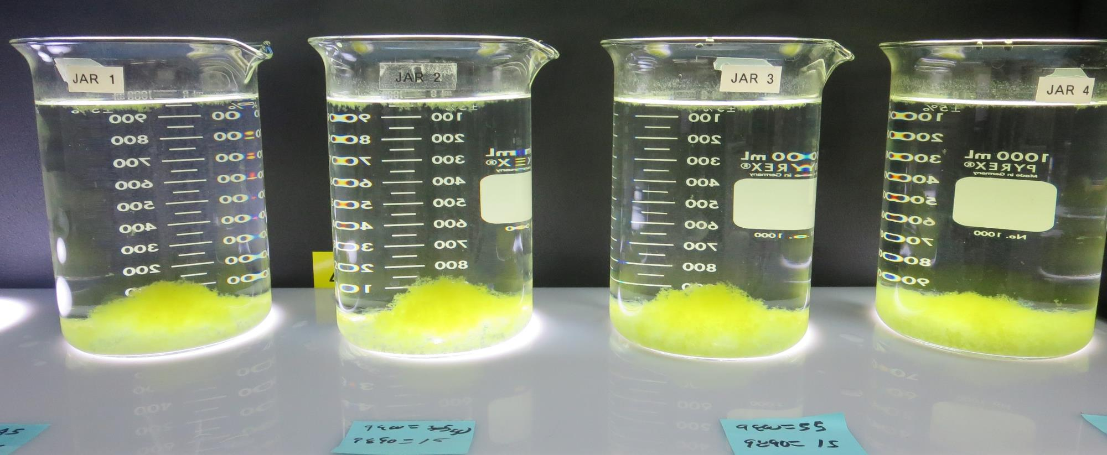
Jars 9-12: After 25-minutes of settling, settled water turbidity is taken.
45 mg/L 9800
15 mg/L 9890
Filtrate 0.10 NTU
UVT: 89.37%
UVA: 0.0489/cm
UVA Reduction: 67.3%
Settled: 0.56 NTU
50 mg/L 9800
15 mg/L 9890
Filtrate 0.08 NTU
UVT: 89.67%
UVA: 0.0474/cm
UVA Reduction: 68.3%
Settled: 0.59 NTU
55 mg/L 9800
15 mg/L 9890
Filtrate 0.08 NTU
UVT: 89.75%
UVA: 0.0470/cm
UVA Reduction: 68.6%
Settled: 0.51 NTU
60 mg/L 9800
15 mg/L 9890
Filtrate 0.08 NTU
UVT: 90.07%
UVA: 0.0454/cm
UVA Reduction: 68.6%
Settled: 0.41 NTU

Slide 21
Jars 13-16 Test
Flash Mix 30 Sec (200 RPM)
Floc Mix 5 min (30 RPM)
Post-Oxidation
KMnO₄/O₃
Applied Coagulants
9800/9890

Slide 22
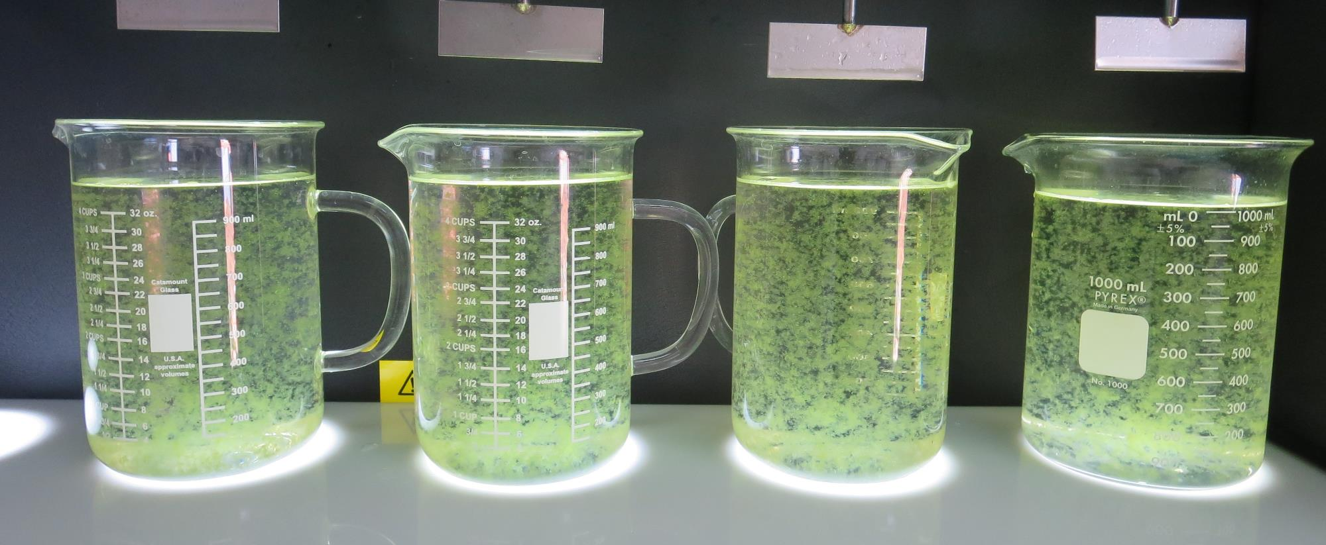
Jars 13-16: End of 5-minute flocculation (30 RPM) duration.
0 mg/L NaOCl
55 mg/L 9800
15 mg/L 9890
Filtrate 0.07 NTU
UVT: 89.66%
UVA: 0.0474/cm
UVA Reduction: 68.3%
0 mg/L NaOCl
60 mg/L 9800
15 mg/L 9890
Filtrate 0.11 NTU
UVT: 89.70%
UVA: 0.0472/cm
UVA Reduction: 68.4%
3 mg/L NaOCl
55 mg/L 9800
15 mg/L 9890
Filtrate 0.09 NTU
UVT: 89.06%
UVA: 0.0503/cm
UVA Reduction: 66.4%
3 mg/L NaOCl
60 mg/L 9800
15 mg/L 9890
Filtrate 0.07 NTU
UVT: 89.28%
UVA: 0.0492/cm
UVA Reduction: 67.1%

Slide 23
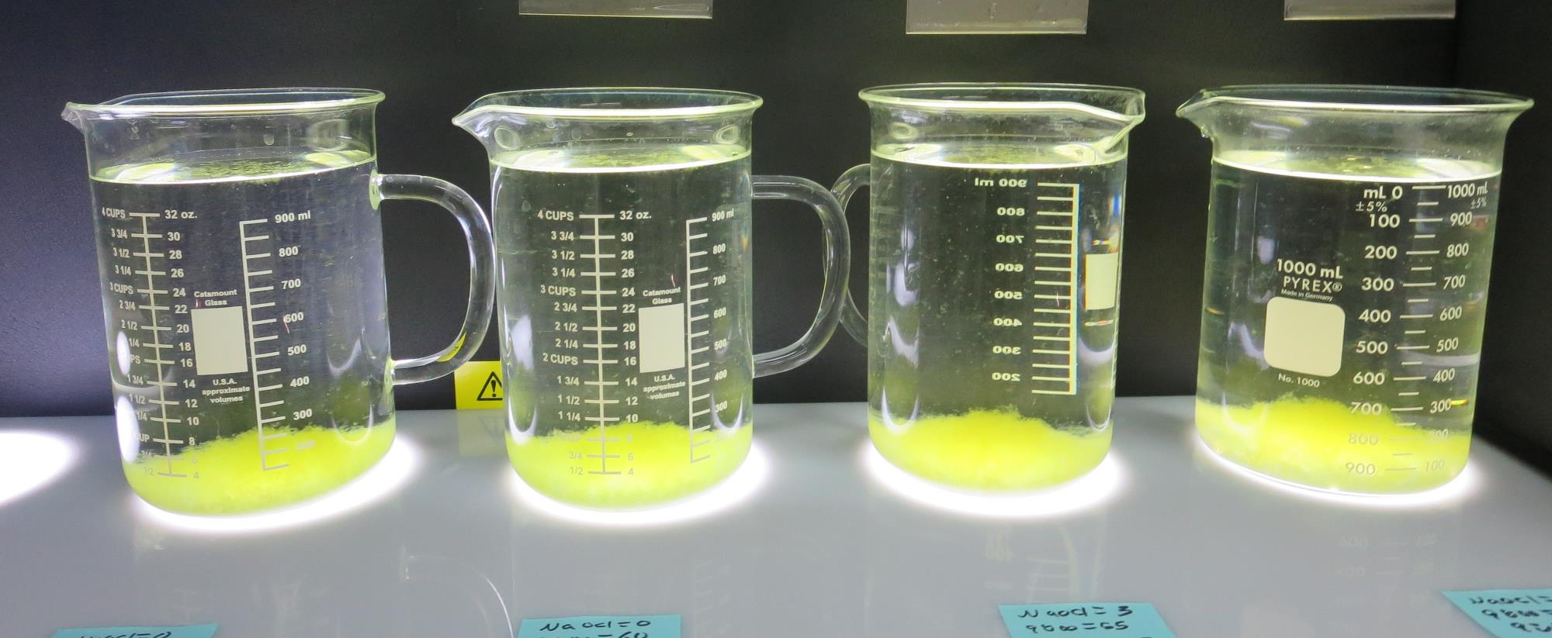
Jars 13-16: After 5 min of settling, 25 mL is syringed for filterability and %UVT/UVA

Slide 24
Jar Testing for 1-Liter Jars:
Procedures for Most Treatment Plants
Fill jars with source water prior to coagulant injection and set paddle speed at 30 rpm
Add chemicals (i.e., NaOCl, primary coagulant, coagulant aid) to each jar
Flash mix for 15-30 seconds (200 rpm)
Slow mix for 5 minutes (20-30 rpm)
Settled for 5 minutes. Syringe 25 mL from each jar taken 1-inch below surface (25 mL/12 sec rate)
Filtered through 1.2 um isopore membrane into cuvette drip rate, 15 mL/(50-90 sec)
Measure filtrate turbidity, chlorine residual and %UVT/UVA
Measure settled water turbidity after 25 minutes of total setting
Record all data

Slide 25

Jar Test
Filterability Test Equipment
Turbidity Instrument
Syringe w/Luer-Lock Tip, 30 cc
(part#: 2225800, by Hach)
Swinnex Filter Holder, 25 mm (part#: SX0002500)
Isopore Membrane Filter, 1.2 um absolute
pore size,
Φ= 25 mm , thickness: 24 um,
hydrophilic polycarbonate membrane
(part #: RTTP02500)
Go to Sigma-Aldrich for laboratory supplies http://www.sigmaaldrich.com/united-states.html

Slide 26
Isopore Membrane Information
Categories | Information
trade name | Isopore
filter color | White
chemistry | Polycarbonate (PC)
water flow rate | Avg. 175 mL/min x cm² (typical results @ 10 psi)
media | Isopore®
wettability | Hydrophilic
porosity | 14.7%
pore size | 1.2 µm
bubble point at 23 °C | 1.0 bar, air with water
thickness | 24 µm
filter diameter (ø) | 25 mm
material size | polycarbonate, Hydrophilic, 1.2 µm, 25 mm, white, plain, 100

Slide 27
Isopore Membrane Background Information
The Isopore membrane is a polycarbonate, track-etched screen filter recommended for all analyses in which the sample is viewed on the surface of the membrane. The Isopore membrane is composed of polycarbonate film, which has a smooth, glass-like surface for clearer sample observation. The unique manufacturing process of the membrane ensures a precise pore diameter and a consistent pore size for accurate separation of samples by size. Matched-weight filters are not usually required because of low, constant tar and ash weights.
Features & Benefits:
Membrane structure retains particles on the surface, simplifying counting and analysis

Slide 28
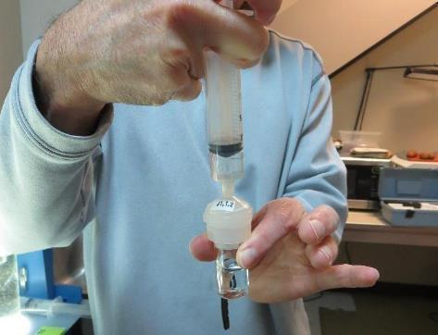

Jar Test - Filterability Test
Syringe ~ 25 mL from jar (after 5-minutes of settling)
Filter-to-waste 3-5 mL
Filter directly into clean cuvette
Measure turbidity
Note: Take several readings before recording final NTU results. Micro bubbles can adhere to glass causing false NTU readings. To remove bubbles, tilt cuvette up to 90 degrees.

Slide 29

Contact
Guy Schott, P.E.
State Water Resources Control Board
Division of Drinking Water
Santa Rosa, CA
Go to Stock Solution/Dose calculations/Jar Test Results for tools to download
www.waterboards.ca.gov/drinking_water/programs/districts/mendocino_district.html
Email: Guy Schott - Guy.Schott@waterboards.ca.gov
Office Number: 707-576-2732

