Slide 1
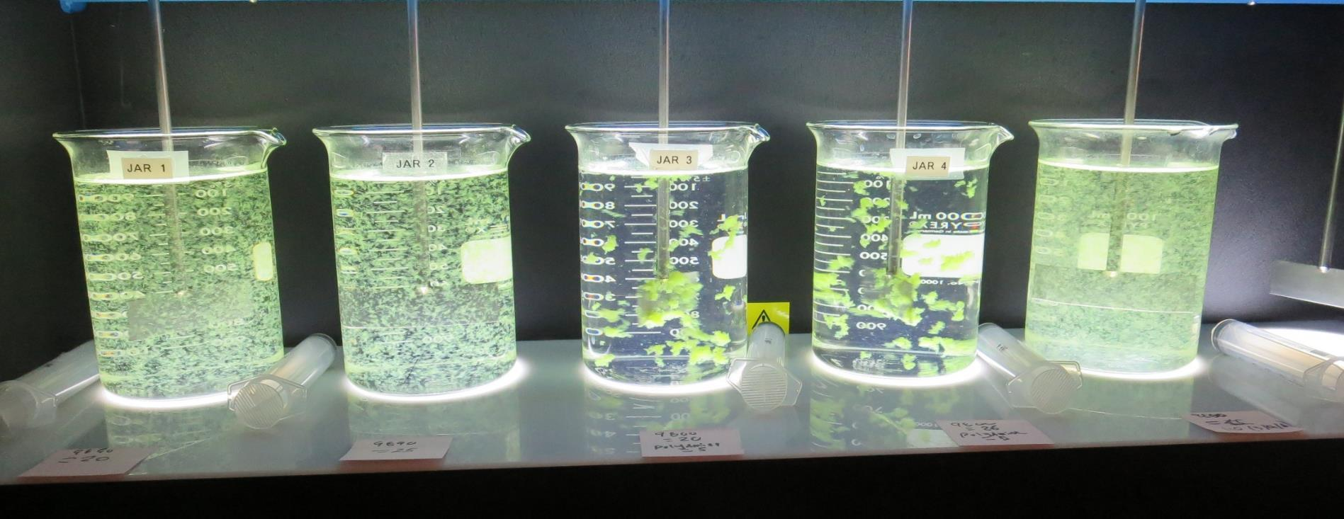
Konocti County Water District
CA1710006, Lake County, Jar Test
by Guy Schott, P.E. October 1-2, 2020

Slide 2
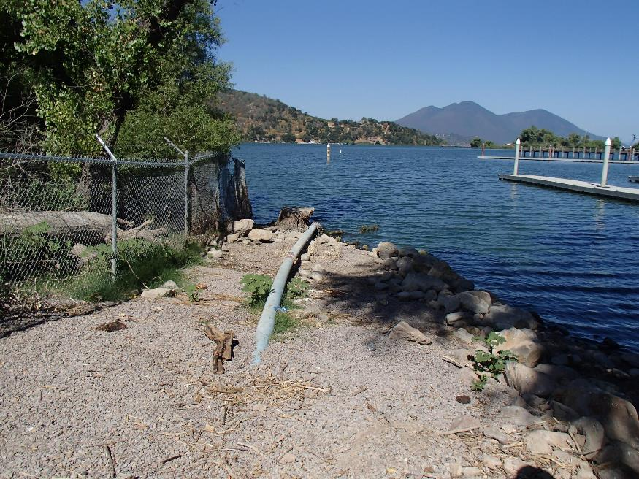
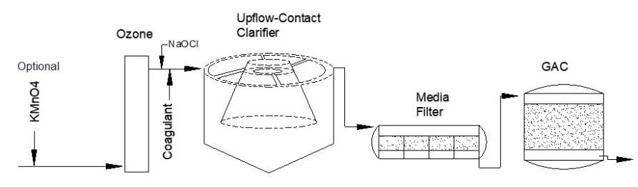
Konocti County Water District
Source Water: Clear Lake
Conventional Treatment

Slide 3
Konocti CWD, October 1, 2020
Source Water Characteristics
Source (morning), Post Oxidation
pH: 8.95
Turbidity: 26 NTU
UVT: 68.86%
UVA: 0.1411/cm
0.4 um Filtered
Turbidity: 1.45 NTU
UVT: 84.79%
UVA: 0.0717/cm
Using the P300 UVT/UVA analyzer; calibrated with DI water.
Source (afternoon), Post Oxidation
Turbidity: 14.4 NTU
UVT: 72.27%
UVA: 0.1411/cm
0.4 um Filtered
Turbidity: 1.61 NTU
UVT: 85.18%
UVA: 0.0697/cm
Using the P300 UVT/UVA analyzer; calibrated with DI water.

Slide 4
Konocti CWD, October 2, 2020
Source Water Characteristics
Source (morning), Post Oxidation
pH: 8.94
Turbidity: 15.9 NTU
UVT: 69.58%
UVA: 0.1575/cm
0.4 um Filtered
Turbidity: 1.55 NTU
UVT: 79.82%
UVA: 0.0979/cm
Using the P300 UVT/UVA analyzer; calibrated with DI water.
Source (afternoon), Pre-Oxidation
Turbidity: 21.5 NTU
UVT: 76.75%
UVA: 0.1149/cm
0.4 um Filtered
Turbidity: 0.63 NTU
UVT: 83.51%
UVA: 0.0783/cm
Using the P300 UVT/UVA analyzer; calibrated with DI water.

Slide 5
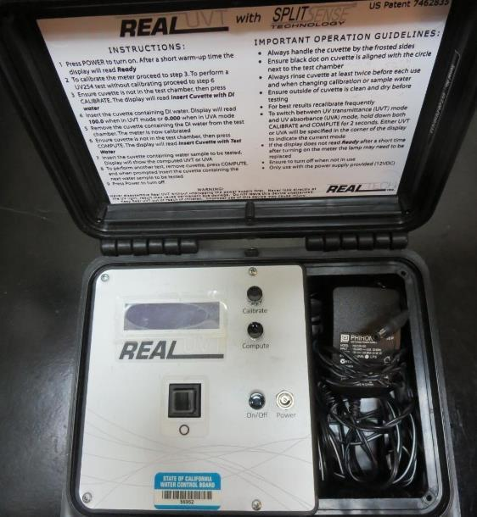
UVT/UVA, pathlength 40 mm
UV transmittance (UVT) is a measurement of the amount of ultraviolet light (commonly at 254 nm due to its germicidal effect) that passes through a water sample compared to the amount of light that passes through a pure water sample. The measurement is expressed as a percentage, % UVT.
%UVT = 10^{(-UVA)} x 100%
UV absorbance (UVA) is calculated as a relative measure of the amount of light absorbed by a water sample compared with the amount of light absorbed by a pure water sample.
UVA = -log(%UVT/100)

Slide 6
Applied Coagulants for Jar Testing
Pro Pac 9800 (NTU Technologies)
50% Aluminum Chlorohydrate
50% Water
23.62% Al₂O₃
83% Basicity
SG = 1.34
Pro Pac 9890 (NTU Technologies)
35-45% Aluminum Chlorohydrate
20% Trade Secret
35-45% Water
SG = 1.25-1.34
poly-Amine
Average bulk viscosity: 750cps
Average bulk specific gravity: 1.15 (~9.6lb./gal.
Bulk average solution concentration: 50%
NSF limit: 10mg/L (product)
Clarifloc C-308P (Liquid Cationic Polymer)
PolyDADMAC
SG = 1.0-1.2
20% active
NSF limit: 50 mg/L (product)

Slide 7
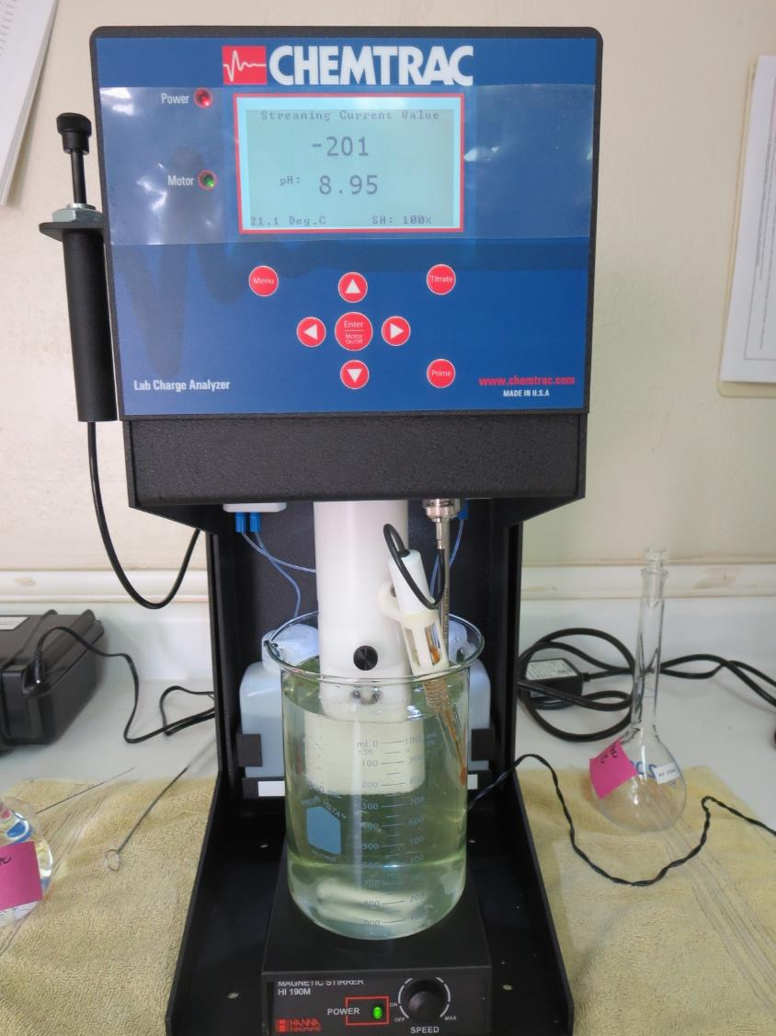
Laboratory Charge Analyzer
LCA: Used to determine coagulant demand of a source water entering the treatment plant.
Source pH: 8.95
LCA #1:
pH adjusted to 7.5 w/acetic acid solution
9800: 80 mg/L as product
LCA #2:
pH adjusted to 7.5 w/acetic acid solution
9890: 5 mgL as product (manually added)
9800: 72 mg/L as product
LCA #2:
pH adjusted to 7.5 w/acetic acid solution
9890: 24 mgL as product

Slide 8
Coagulant Information
Unless stated otherwise, all coagulant doses are reported as Product (100% strength).
Preparation of coagulant stock solutions are generally 1.0 and/or 0.1 percent strength using 100 and/or 200 mL volumetric flasks.
Finnpipette F2 variable volume pipette, capacity 100-1000 micro liters is used for stock solution preparation and coagulant aid jar test dosing.
Finnpipette F2 variable volume pipette, capacity 0.5-5 mL is used for primary coagulant jar test dosing.

Slide 9
Water Source – Post Oxidation
Unless stated otherwise, all water jar testing is post oxidation (KMnO₄ and O₃).

Slide 10
Konocti CWD: Jar Test 1-8 Results
Clear Lake Source Water (10/1/20, morning)
Flash Mix 200 RPM (30 sec); Floc Mix 30 RPM (5 minutes)
Jar # | 9800 mg/L | 9890 mg/L | Poly-DADMAC mg/L | Filtrate NTU | Filtrate %UVT | Filtrate UVA/cm | %UVA Reduc | Settle NTU 25 min
J1 | 80 | 5 | 0 | 0.12 | 91.28 | 0.0397 | 44.6 | 15.5
J2 | 90 | 5 | 0 | 0.12 | 91.34 | 0.0394 | 45.0 | 29.0
J3 | 0 | 26 | 0 | 0.11 | 90.94 | 0.0413 | 42.4 | 0.66
J4 | 25 | 0 | 0.5 | 0.34 | 89.91 | 0.0462 | 35.6 | 9.0
J5 | 0 | 30 | 0 | 0.12 | 90.53 | 0.0432 | 39.7 | 2.3
J6 | 0 | 35 | 0 | 0.12 | 90.77 | 0.0421 | 41.3 | 0.67
J7 | 0 | 40 | 0 | 0.12 | 90.86 | 0.0416 | 42.0 | 0.57
J8 | 30 | 0 | 5 | 0.17 | 90.37 | 0.0440 | 38.6 | 3.3

Slide 11
Konocti CWD: Jar Test 9-13 Results
Clear Lake Source Water (10/1/20, afternoon)
Flash Mix 200 RPM (30 sec); Floc Mix 30 RPM (5 minutes)
Jar # | 9890 mg/L | Filtrate NTU | Filtrate %UVT | Filtrate UVA/cm | %UVA Reduction | Settle NTU 25 min
J9 | 25 | 0.08 | 92.91 | 0.0319 | 54.2 | 4.85
J10 | 30 | 0.09 | 92.98 | 0.0316 | 54.7 | 13
J11 | 35 | 0.12 | 93.03 | 0.0314 | 54.9 | 10.7
J12 | 40 | 0.12 | 93.13 | 0.0310 | 55.5 | 3.64
J13 | 45 | 0.09 | 93.01 | 0.0316 | 54.8 | 9.4

Slide 12
Konocti CWD: Jar Test 14-18 Results
Clear Lake Source Water (10/2/20, morning)
Flash Mix 200 RPM (30 sec); Floc Mix 30 RPM (5 minutes)
Jar # | 9890 mg/L | 9800 mg/L | Poly-amine mg/L | Filtrate NTU | Filtrate %UVT | Filtrate UVA/cm | %UVA Reduction | Settle NTU 25 min
J14 | 20 | 0 | 0 | 0.20 | 90.24 | 0.0446 | 54.4 | 1.75
J15 | 25 | 0 | 0 | 0.16 | 90.39 | 0.0439 | 55.2 | 0.45
J16 | 0 | 20 | 5 | 0.08 | 90.48 | 0.0435 | 55.6 | 1.80
J17 | 0 | 26 | 5 | 0.10 | 90.67 | 0.0426 | 56.5 | 1.52
J18 | 0 | 110 | 0 | 0.12 | 91.0 | 0.0410 | 58.1 | 25.5

Slide 13
Konocti CWD: Jar Test 19-23 Results
Clear Lake Source Water (10/2/20, morning)
Flash Mix 200 RPM (30 sec); Floc Mix 30 RPM (5 minutes)
Jar # | 9890 mg/L | 9800 mg/L | Poly-amine mg/L | Filtrate NTU | Filtrate %UVT | Filtrate UVA/cm | %UVA Reduction | Settle NTU 25 min
J19 | 25 | 0 | 0 | 0.14 | 90.40 | 0.0438 | 55.3 | 0.43
J20 | 30 | 0 | 0 | 0.14 | 90.46 | 0.0436 | 55.5 | 0.39
J21 | 35 | 0 | 0 | 0.65 | 90.55 | 0.0431 | 56.0 | 0.52
J22 | 0 | 20 | 5 | 0.10 | 90.35 | 0.0441 | 55.0 | 0.79
J23 | 0 | 30 | 5 | 0.09 | 90.41 | 0.0438 | 55.3 | 0.70

Slide 14
Konocti CWD: Jar Test 24-27 Results
Clear Lake Source Water (10/2/20, morning)
Flash Mix 200 RPM (30 sec); Floc Mix 30 RPM (5 minutes)
Jars 24-25 (post oxidation); Jars 26-27 (pre-oxidation)
Jar # | 9890 mg/L | 9800 mg/L | Poly-amine mg/L | Filtrate NTU | Filtrate %UVT | Filtrate UVA/cm | %UVA Reduction | Settle NTU 25 min
J24 | 25 | 0 | 0 | 0.19 | 89.96 | 0.0460 | 53.0 | 0.41
J25 | 0 | 20 | 5 | 0.13 | 90.47 | 0.0435 | 55.6 | 1.29
J26 | 25 | 0 | 0 | 0.12 | 88.60 | 0.0526 | 32.8 | 0.43
J27 | 0 | 20 | 5 | 0.11 | 88.58 | 0.0527 | 32.7 | 0.84

Slide 15
Jars 1-4 Test
Flash Mix 30 Sec (200 RPM)
Floc Mix 5 min (30 RPM)
10/1/20 (morning source)
Applied Coagulants
9800/9890/Polyamine

Slide 16
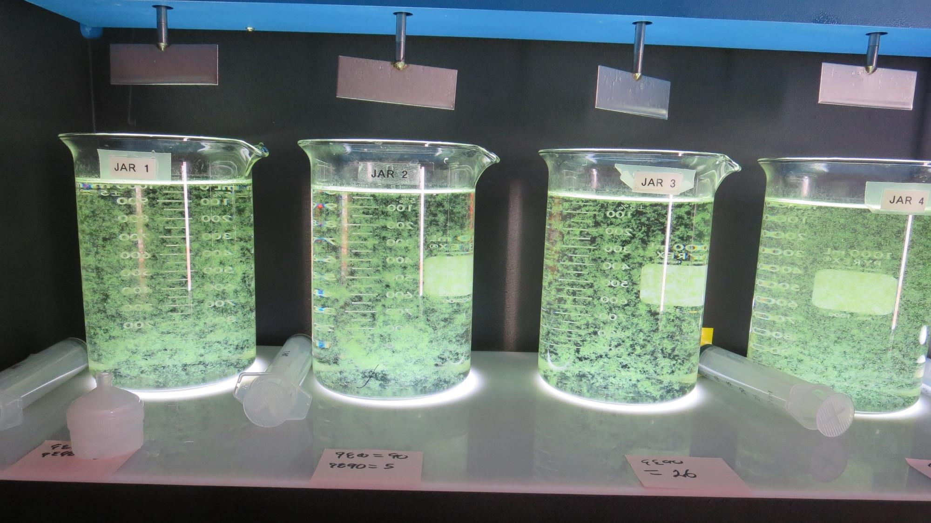
Jars 1-4: End of 5-minute flocculation (30 RPM) duration.
80 mg/L 9800
5 mg/L 9800
Filtrate 0.12 NTU
UVT: 91.28%
UVA: 0.0397/cm
UVA Reduction: 44.6%
Settled: 15.5 NTU
90 mg/L 9800
5 mg/L 9800
Filtrate 0.12 NTU
UVT: 91.34%
UVA: 0.0394/cm
UVA Reduction: 45.6%
Settled: 29 NTU
0 mg/L 9800
26 mg/L 9800
Filtrate 0.11 NTU
UVT: 90.94%
UVA: 0.0413/cm
UVA Reduction: 42.4%
Settled: 0.66 NTU
25 mg/L 9800
0.5 mg/L Polyamine
Filtrate 0.34 NTU
UVT: 89.91%
UVA: 0.0462/cm
UVA Reduction: 35.6%
Settled: 9.0 NTU

Slide 17
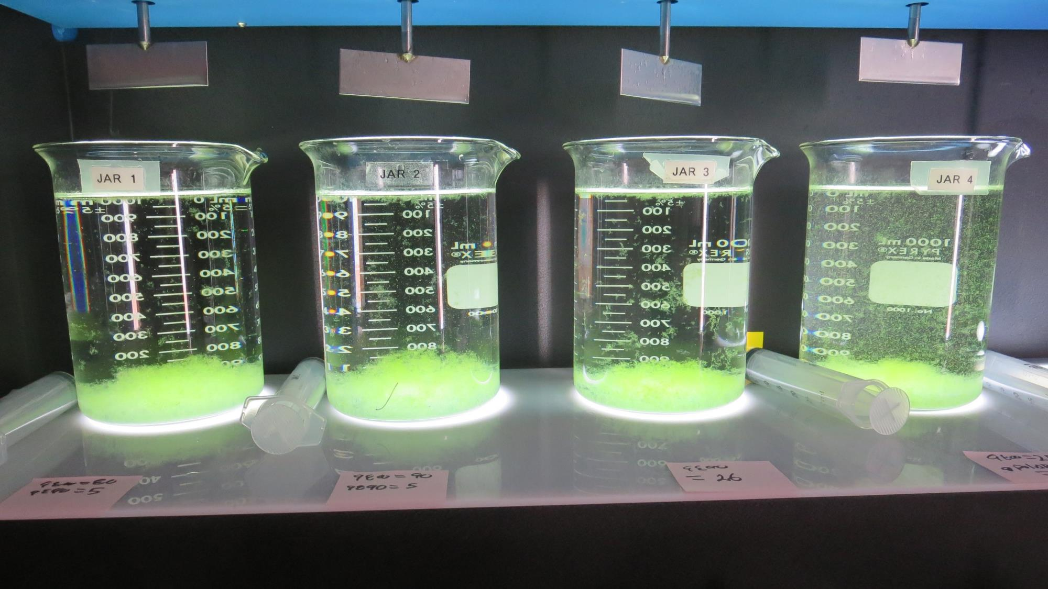
Jars 1-4: After 5 min of settling, 25 mL is syringed for filterability and %UVT/UVA.

Slide 18
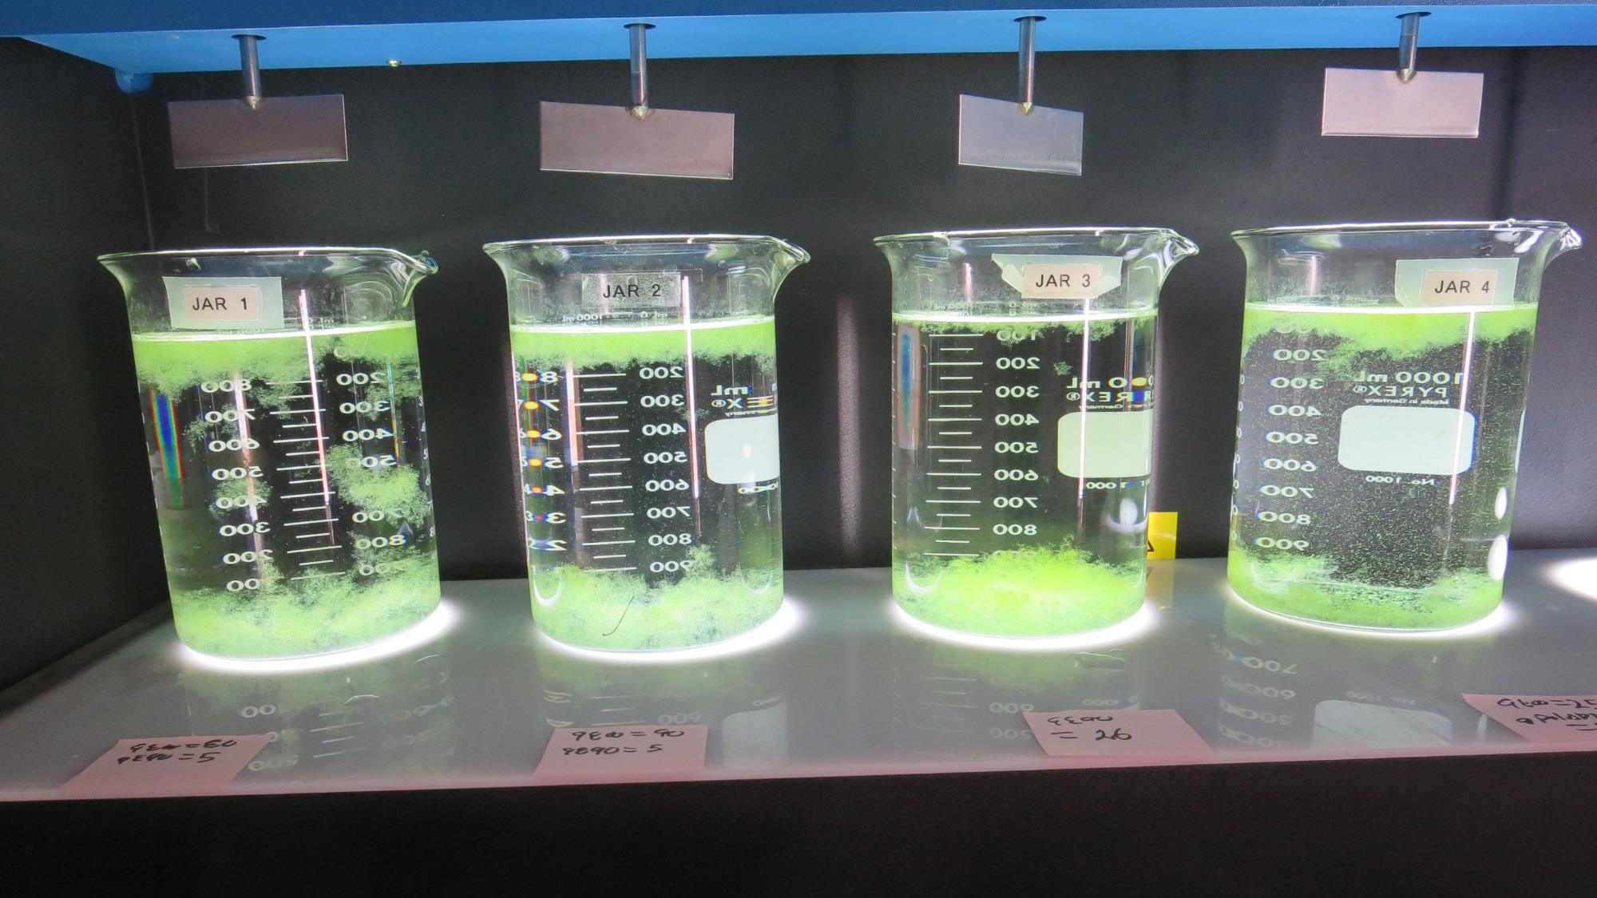
Jars 1-4: After 25-minutes of settling, settled water turbidity is taken.
80 mg/L 9800
5 mg/L 9800
Filtrate 0.12 NTU
UVT: 91.28%
UVA: 0.0397/cm
UVA Reduction: 44.6%
Settled: 15.5 NTU
90 mg/L 9800
5 mg/L 9800
Filtrate 0.12 NTU
UVT: 91.34%
UVA: 0.0394/cm
UVA Reduction: 45.6%
Settled: 29 NTU
0 mg/L 9800
26 mg/L 9800
Filtrate 0.11 NTU
UVT: 90.94%
UVA: 0.0413/cm
UVA Reduction: 42.4%
Settled: 0.66 NTU
25 mg/L 9800
0.5 mg/L Polyamine
Filtrate 0.34 NTU
UVT: 89.91%
UVA: 0.0462/cm
UVA Reduction: 35.6%
Settled: 9.0 NTU

Slide 19
Jars 5-8 Test
Flash Mix 30 Sec (200 RPM)
Floc Mix 5 min (30 RPM)
10/1/20 (morning source)
Applied Coagulants
9800/9890
Advanced Coagulant

Slide 20
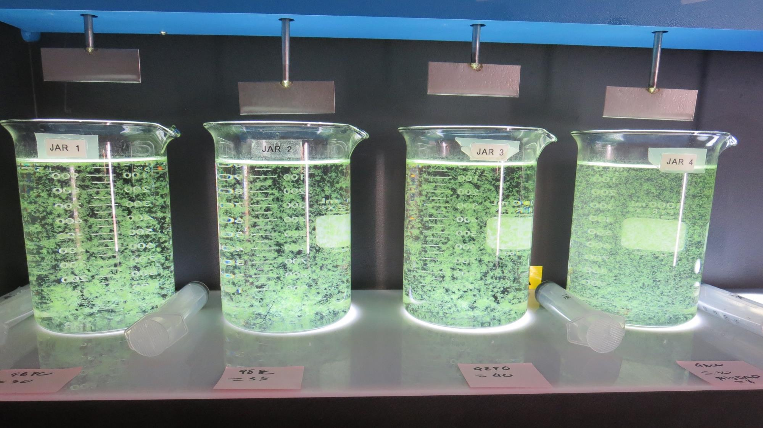
Jars 5-8: End of 5-minute flocculation (30 RPM) duration.
30 mg/L 9890
Filtrate 0.12 NTU
UVT: 90.53%
UVA: 0.0432/cm
UVA Reduction: 39.7%
Settled: 2.29 NTU
35 mg/L 9890
Filtrate 0.12 NTU
UVT: 90.77%
UVA: 0.0421/cm
UVA Reduction: 41.3%
Settled: 0.67 NTU
40 mg/L 9890
Filtrate 0.12 NTU
UVT: 90.86%
UVA: 0.0416/cm
UVA Reduction: 42.0%
Settled: 0.57 NTU
30 mg/L 9890
5 mg/L PolyDADMAC
Filtrate 0.17 NTU
UVT: 90.37%
UVA: 0.0440/cm
UVA Reduction: 38.6%
Settled: 3.3 NTU

Slide 21
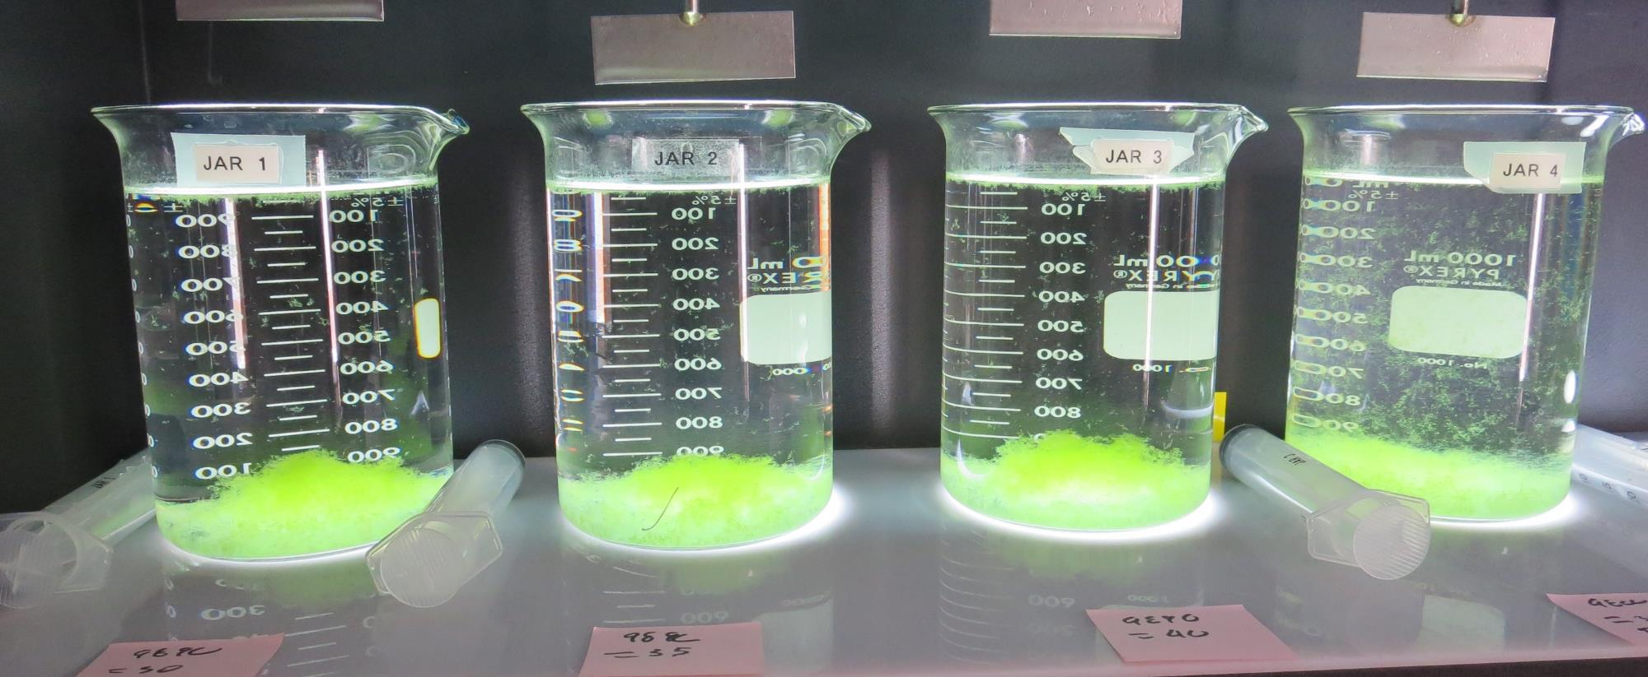
Jars 5-8: After 5 min of settling, 25 mL is syringed for filterability and %UVT/UVA.

Slide 22
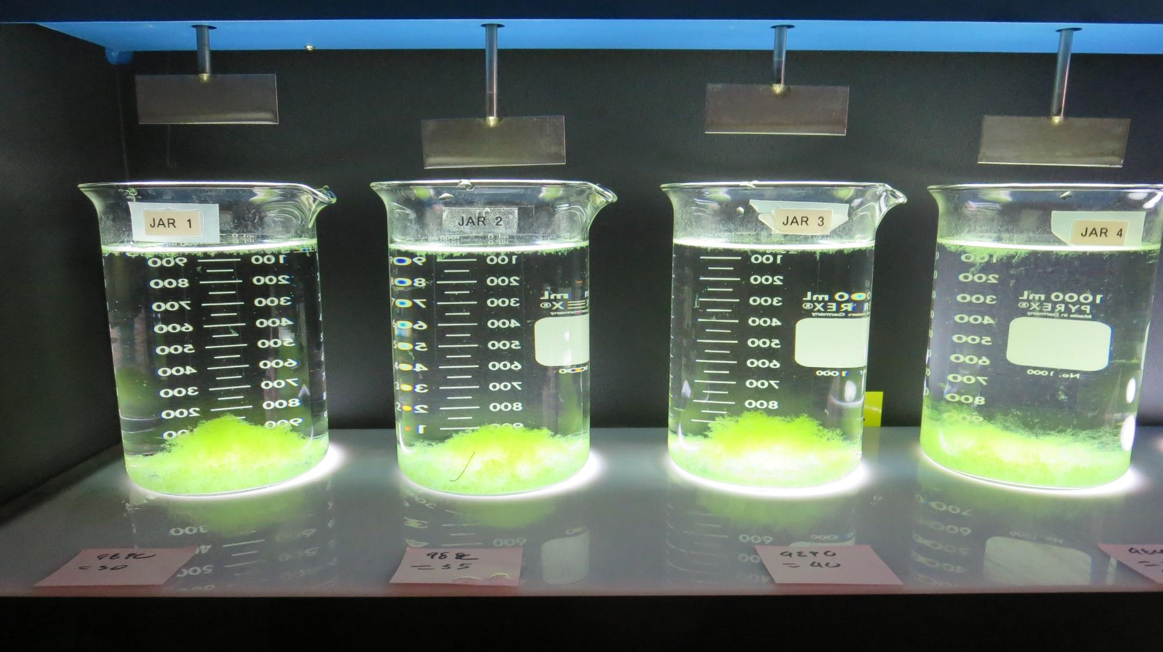
Jars 5-8: After 25-minutes of settling, settled water turbidity is taken.
30 mg/L 9890
Filtrate 0.12 NTU
UVT: 90.53%
UVA: 0.0432/cm
UVA Reduction: 39.7%
Settled: 2.29 NTU
35 mg/L 9890
Filtrate 0.12 NTU
UVT: 90.77%
UVA: 0.0421/cm
UVA Reduction: 41.3%
Settled: 0.67 NTU
40 mg/L 9890
Filtrate 0.12 NTU
UVT: 90.86%
UVA: 0.0416/cm
UVA Reduction: 42.0%
Settled: 0.57 NTU
30 mg/L 9890
5 mg/L PolyDADMAC
Filtrate 0.17 NTU
UVT: 90.37%
UVA: 0.0440/cm
UVA Reduction: 38.6%
Settled: 3.3 NTU

Slide 23
Jars 9-13 Test
Flash Mix 30 Sec (200 RPM)
Floc Mix 5 min (30 RPM)
10/1/20 (afternoon source)
Applied Coagulant
9890

Slide 24
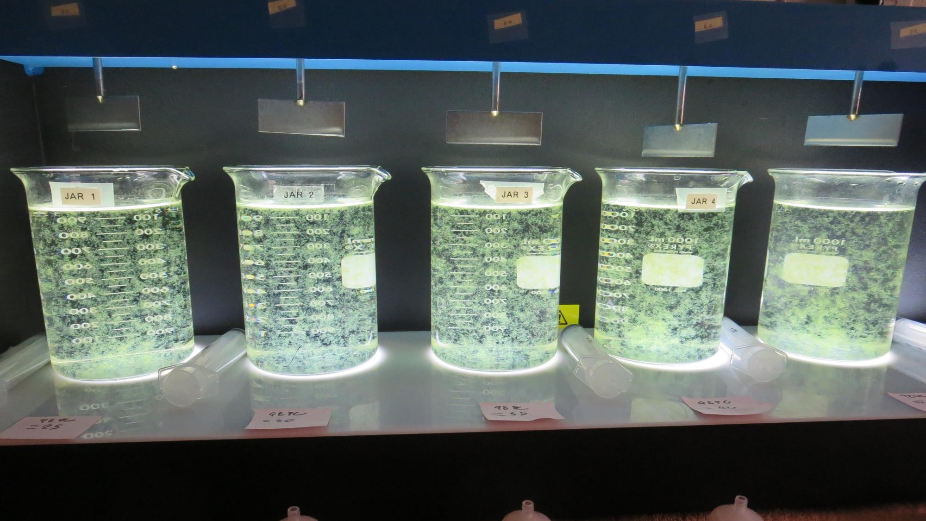
Jars 9-13: End of 5-minute flocculation (30 RPM) duration.
25 mg/L 9890
Filtrate 0.08 NTU
UVT: 92.91%
UVA: 0.0319/cm
UVA Reduction: 54.2%
Settled: 4.85 NTU
30 mg/L 9890
Filtrate 0.09 NTU
UVT: 92.98%
UVA: 0.0316/cm
UVA Reduction: 54.7%
Settled: 13 NTU
35 mg/L 9890
Filtrate 0.12 NTU
UVT: 93.03%
UVA: 0.0314/cm
UVA Reduction: 54.9%
Settled: 10.7 NTU
40 mg/L 9890
Filtrate 0.12 NTU
UVT: 93.13%
UVA: 0.0310/cm
UVA Reduction: 55.5%
Settled: 3.64 NTU
45 mg/L 9890
Filtrate 0.09 NTU
UVT: 93.01%
UVA: 0.0315/cm
UVA Reduction: 54.8%
Settled: 9.4 NTU

Slide 25
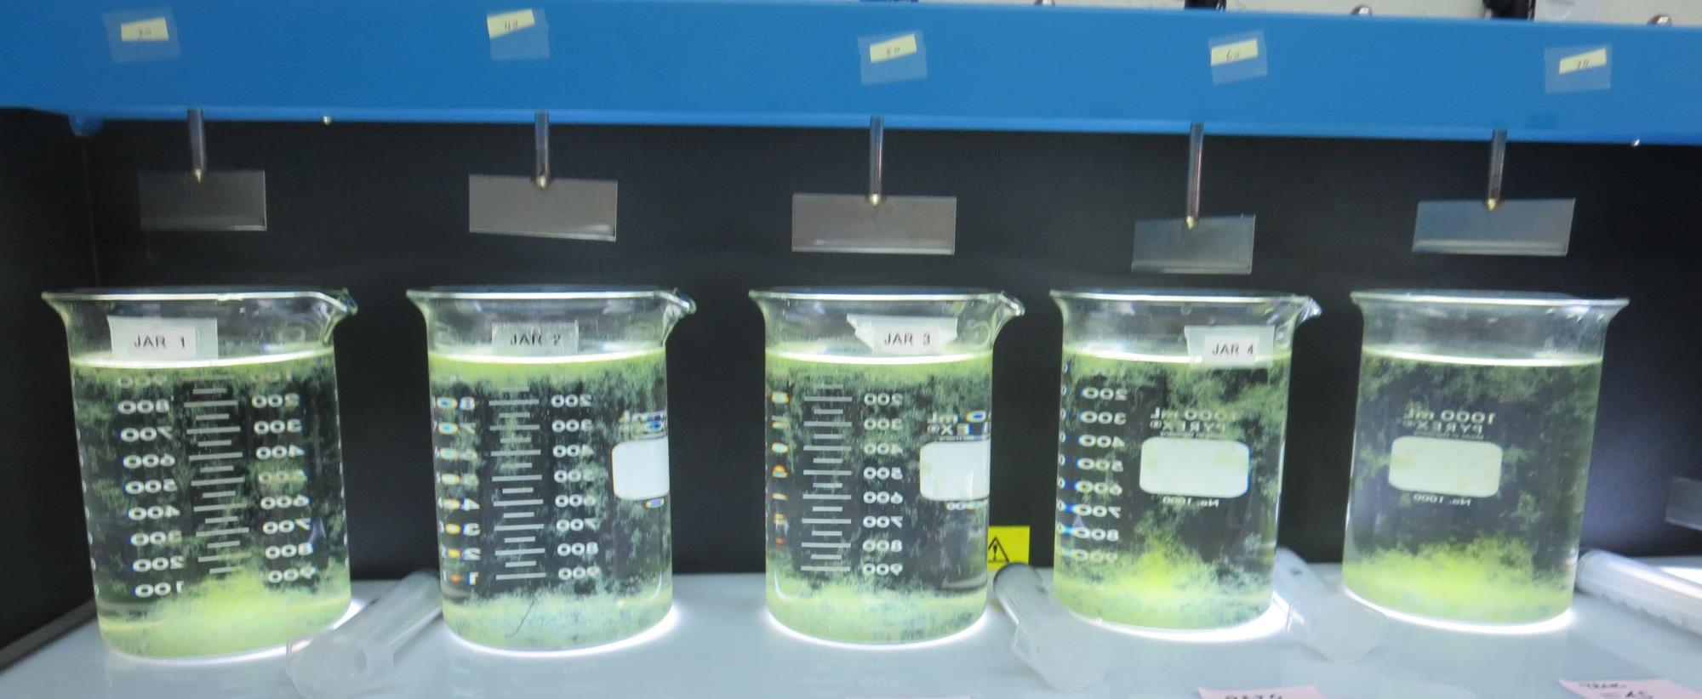
Jars 9-13: After 5 min of settling, 25 mL is syringed for filterability and %UVT/UVA.

Slide 26
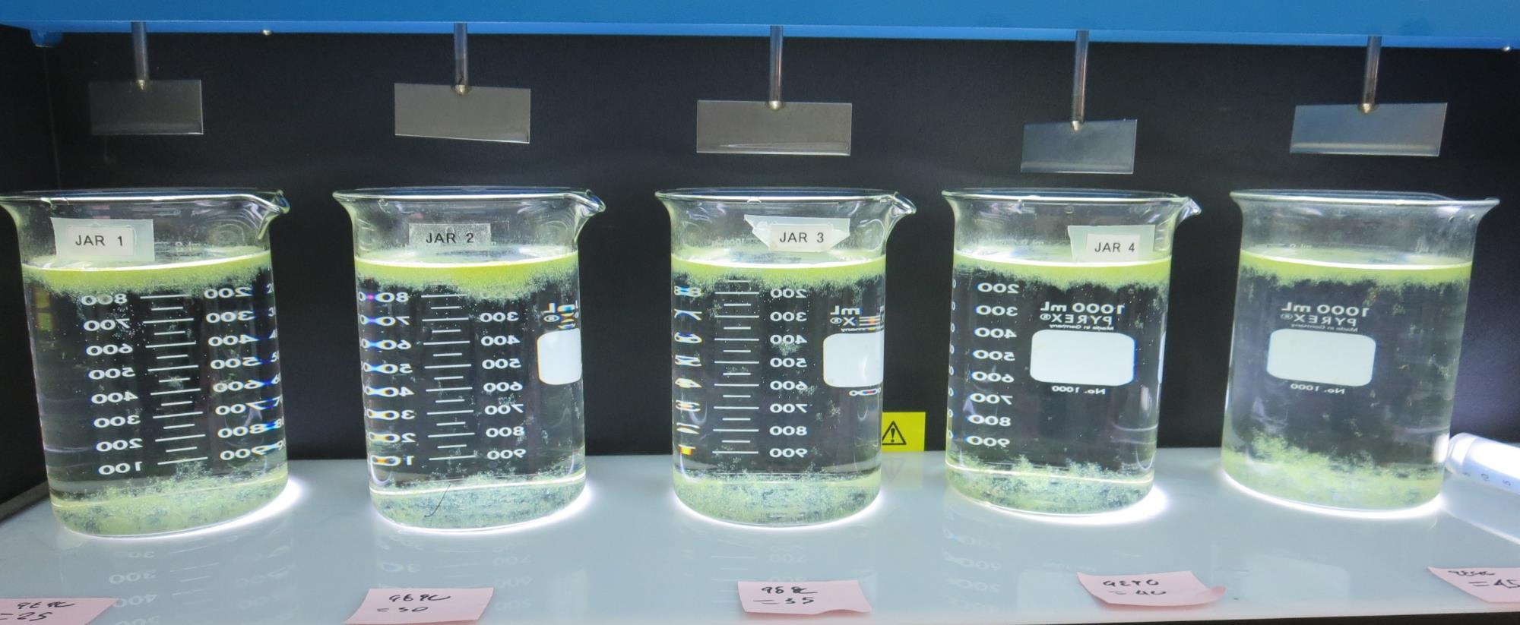
Jars 9-13: After 25-minutes of settling, settled water turbidity is taken.
25 mg/L 9890
Filtrate 0.08 NTU
UVT: 92.91%
UVA: 0.0319/cm
UVA Reduction: 54.2%
Settled: 4.85 NTU
30 mg/L 9890
Filtrate 0.09 NTU
UVT: 92.98%
UVA: 0.0316/cm
UVA Reduction: 54.7%
Settled: 13 NTU
35 mg/L 9890
Filtrate 0.12 NTU
UVT: 93.03%
UVA: 0.0314/cm
UVA Reduction: 54.9%
Settled: 10.7 NTU
40 mg/L 9890
Filtrate 0.12 NTU
UVT: 93.13%
UVA: 0.0310/cm
UVA Reduction: 55.5%
Settled: 3.64 NTU
45 mg/L 9890
Filtrate 0.09 NTU
UVT: 93.01%
UVA: 0.0315/cm
UVA Reduction: 54.8%
Settled: 9.4 NTU

Slide 27
Jars 14-18 Test
Flash Mix 30 Sec (200 RPM)
Floc Mix 5 min (30 RPM)
10/2/20 (morning source)
Applied Coagulants
9800/9890/Polyamine

Slide 28
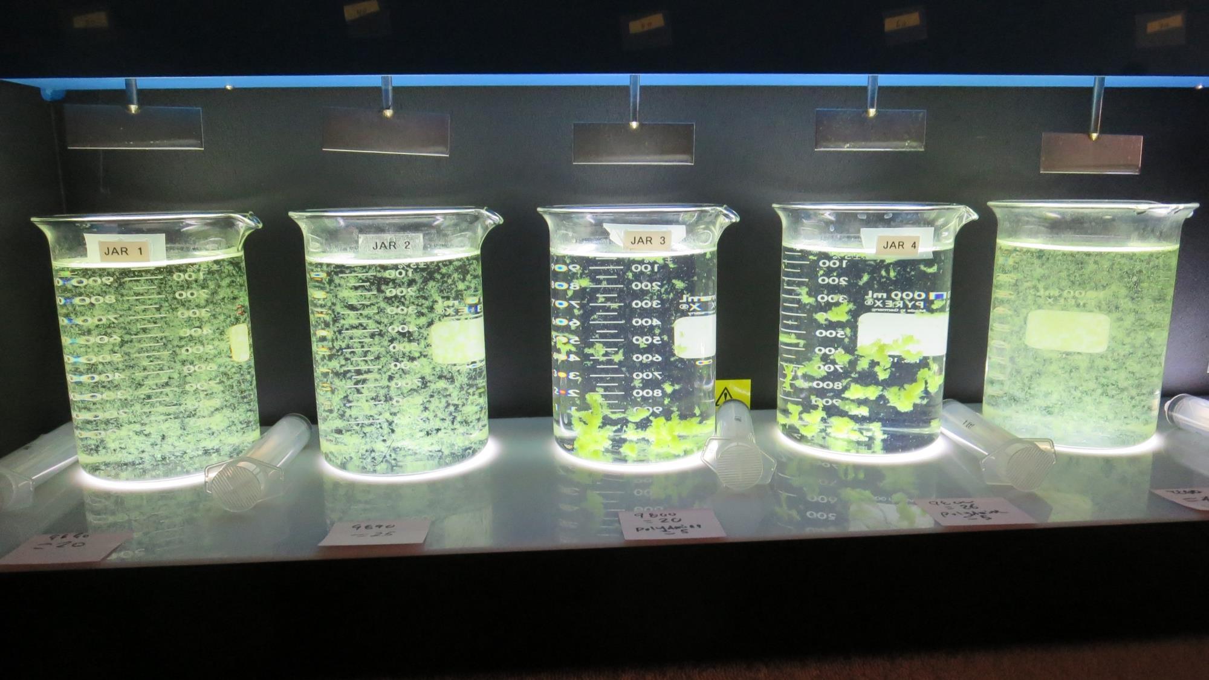
Jars 14-18 End of 5-minute flocculation (30 RPM) duration.
20 mg/L 9890
Filtrate 0.20 NTU
UVT: 90.24%
UVA: 0.0446/cm
UVA Reduction: 54.4%
Settled: 1.75 NTU
25 mg/L 9890
Filtrate 0.16 NTU
UVT: 90.39%
UVA: 0.0439/cm
UVA Reduction: 55.2%
Settled: 0.45 NTU
20 mg/L 9800
5 mg/L Polyamine
Filtrate 0.08 NTU
UVT: 90.48%
UVA: 0.0435/cm
UVA Reduction: 55.6%
Settled: 1.80 NTU
26 mg/L 9800
5 mg/L Polyamine
Filtrate 0.10 NTU
UVT: 90.67%
UVA: 0.0426/cm
UVA Reduction: 56.5%
Settled: 1.52 NTU
110 mg/L 9800
Filtrate 0.12 NTU
UVT: 91.0%
UVA: 0.0410/cm
UVA Reduction: 58.1%
Settled: 25.5 NTU

Slide 29
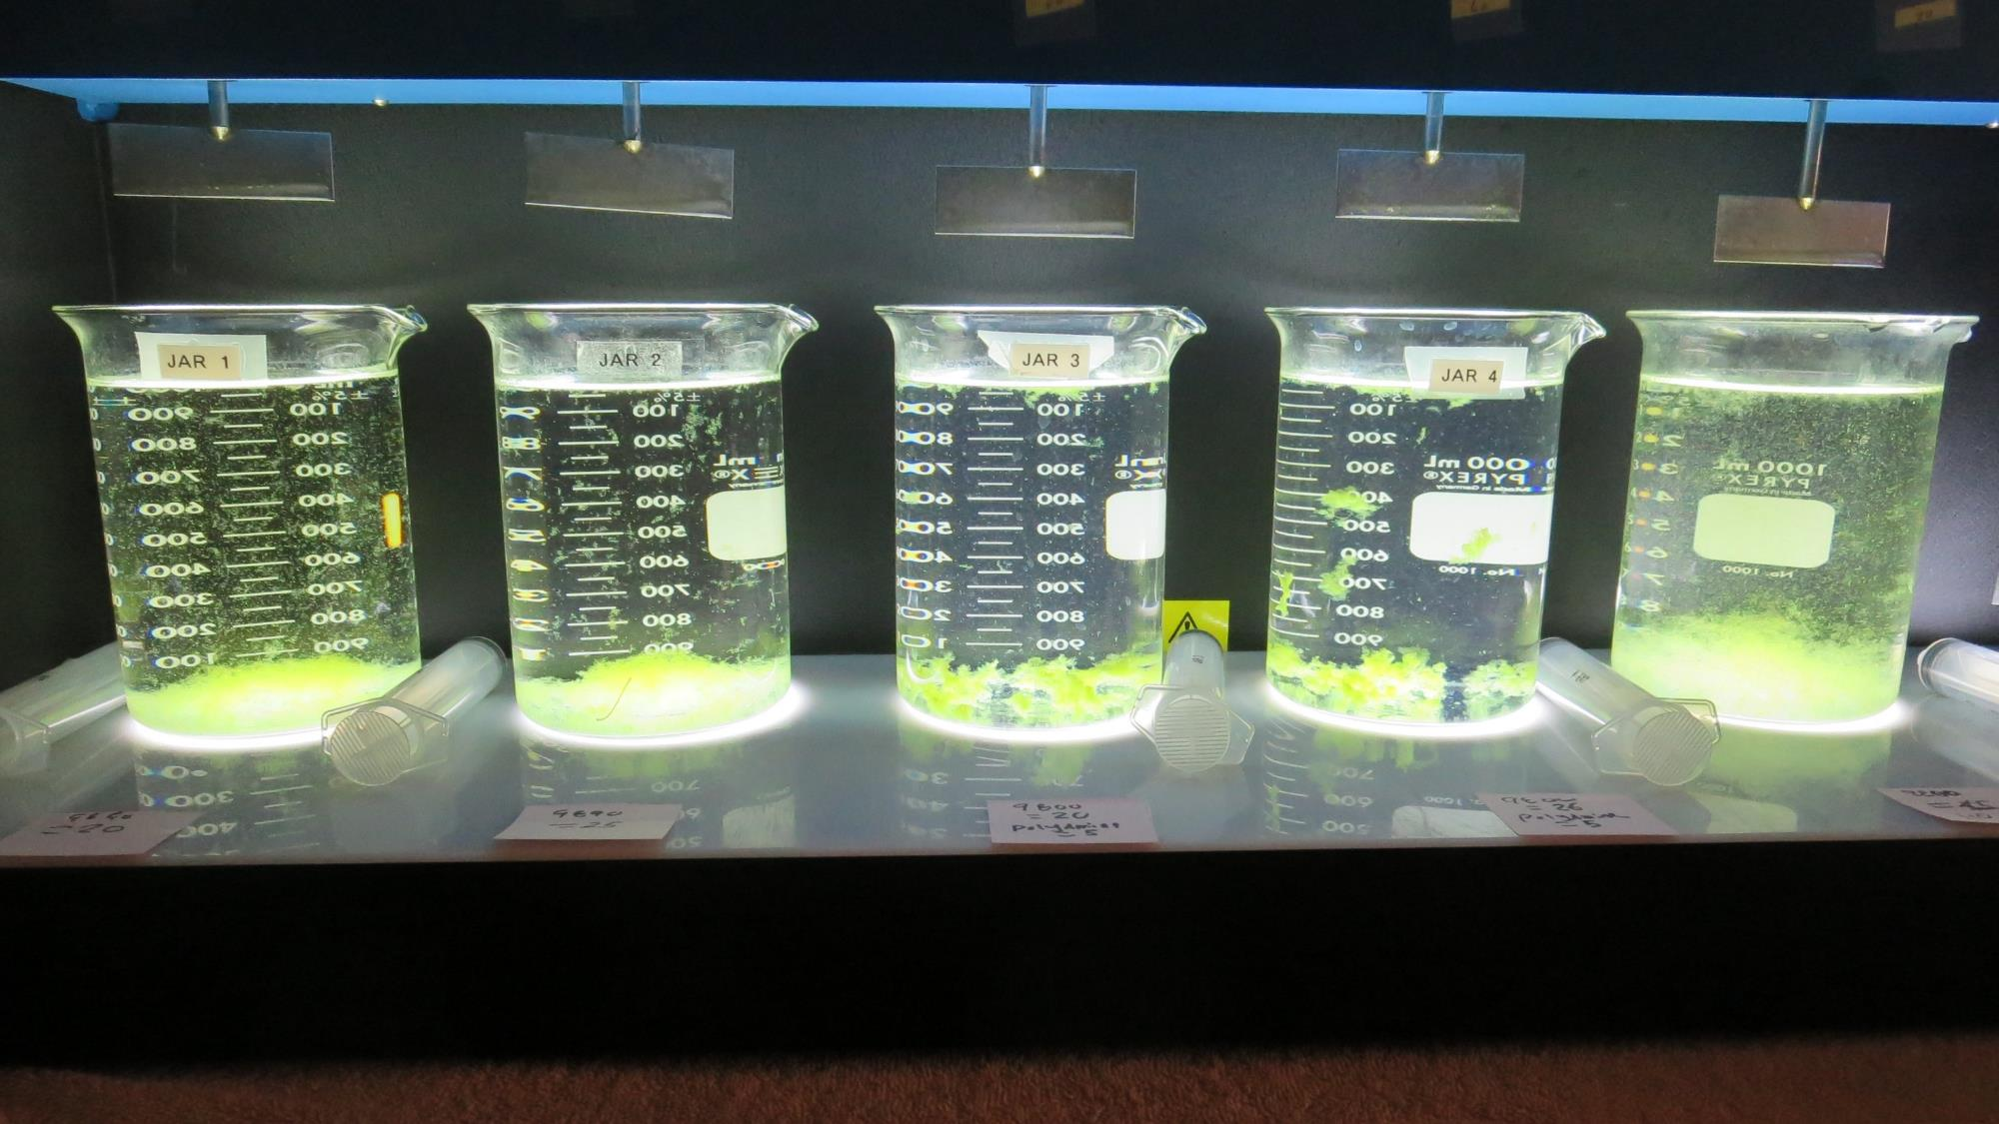
Jars 16-18: After 5 min of settling, 25 mL is syringed for filterability and %UVT/UVA.

Slide 30
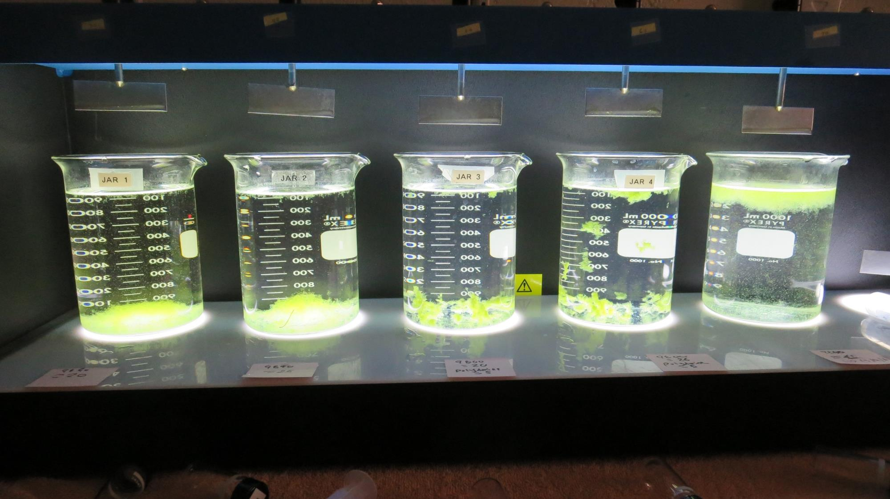
Jars 16-18: After 25-minutes of settling, settled water turbidity is taken.
20 mg/L 9890
Filtrate 0.20 NTU
UVT: 90.24%
UVA: 0.0446/cm
UVA Reduction: 54.4%
Settled: 1.75 NTU
25 mg/L 9890
Filtrate 0.16 NTU
UVT: 90.39%
UVA: 0.0439/cm
UVA Reduction: 55.2%
Settled: 0.45 NTU
20 mg/L 9800
5 mg/L Polyamine
Filtrate 0.08 NTU
UVT: 90.48%
UVA: 0.0435/cm
UVA Reduction: 55.6%
Settled: 1.80 NTU
26 mg/L 9800
5 mg/L Polyamine
Filtrate 0.10 NTU
UVT: 90.67%
UVA: 0.0426/cm
UVA Reduction: 56.5%
Settled: 1.52 NTU
110 mg/L 9800
Filtrate 0.12 NTU
UVT: 91.0%
UVA: 0.0410/cm
UVA Reduction: 58.1%
Settled: 25.5 NTU

Slide 31
Jars 19-23 Test
Flash Mix 30 Sec (200 RPM)
Floc Mix 5 min (30 RPM)
10/2/20 (morning source)
Applied Coagulants
9800/9890/Polyamine

Slide 32
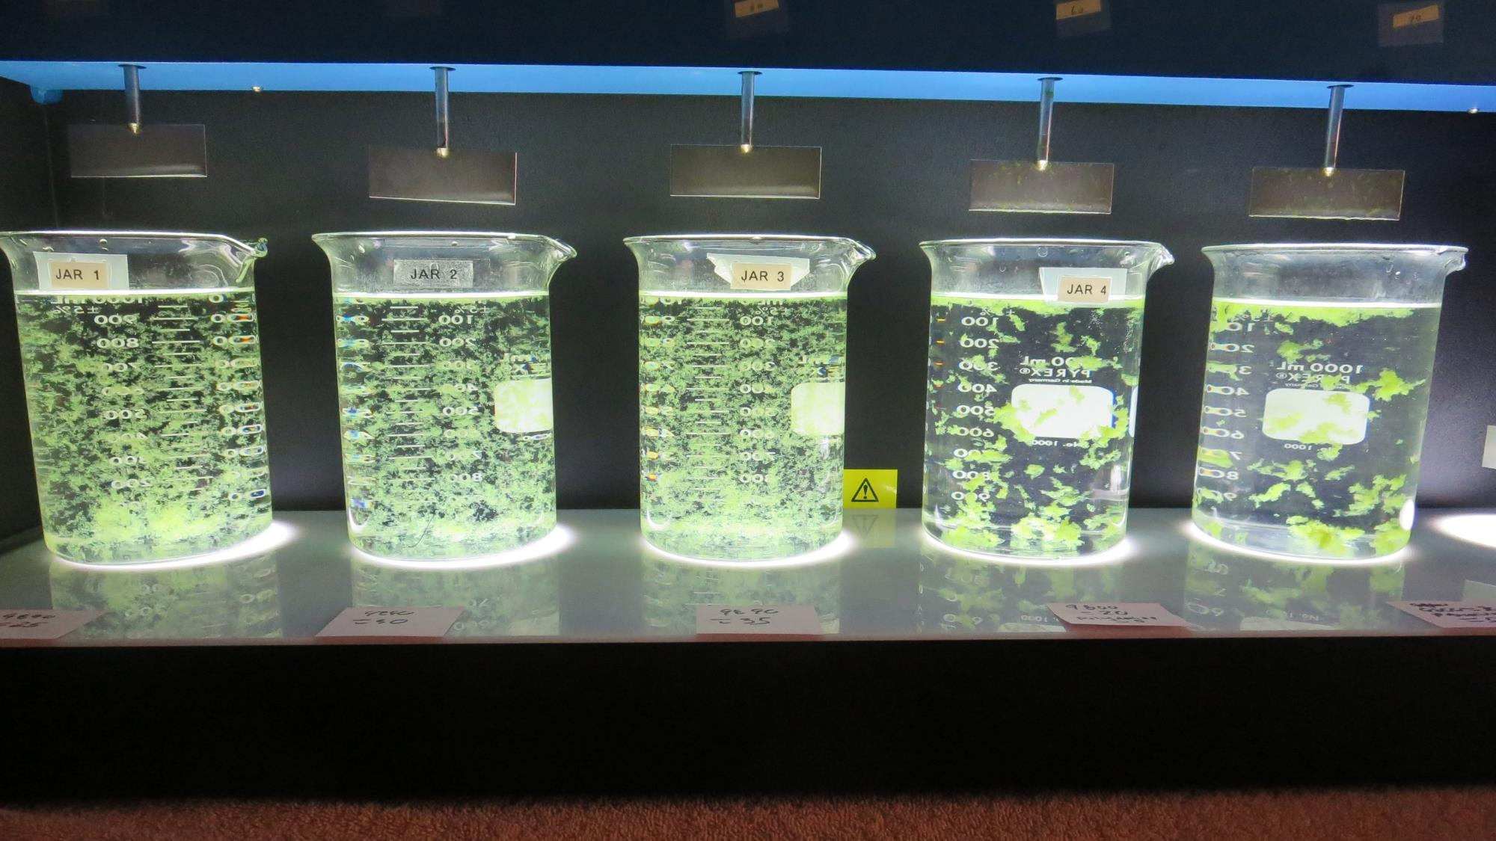
Jars 19-23: End of 5-minute flocculation (30 RPM) duration.
25 mg/L 9890
Filtrate 0.14 NTU
UVT: 90.40%
UVA: 0.0438/cm
UVA Reduction: 55.3%
Settled: 0.43 NTU
30 mg/L 9890
Filtrate 0.14 NTU
UVT: 90.46%
UVA: 0.0436/cm
UVA Reduction: 55.5%
Settled: 0.39 NTU
35 mg/L 9890
Filtrate 0.65 NTU
UVT: 90.55%
UVA: 0.0431/cm
UVA Reduction: 56.0%
Settled: 0.52 NTU
20 mg/L 9800
5 mg/L Polyamine
Filtrate 0.10 NTU
UVT: 90.35%
UVA: 0.0441/cm
UVA Reduction: 55.0%
Settled: 0.79 NTU
30 mg/L 9800
5 mg/L Polyamine
Filtrate 0.09 NTU
UVT: 90.41%
UVA: 0.0438/cm
UVA Reduction: 55.3%
Settled: 0.70 NTU

Slide 33
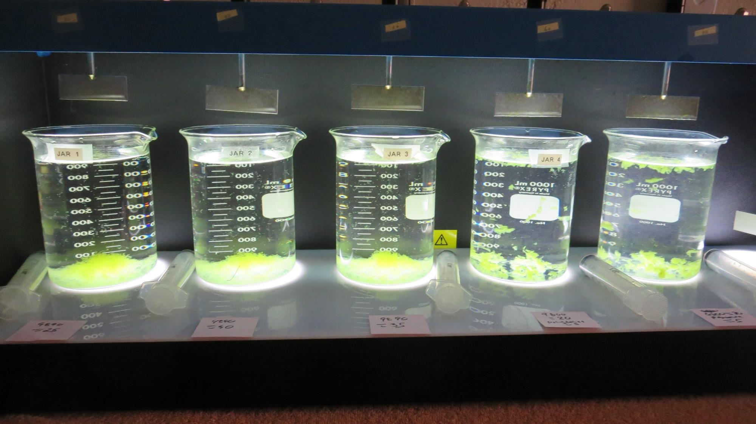
Jars 19-23: After 5 min of settling, 25 mL is syringed for filterability and %UVT/UVA.

Slide 34
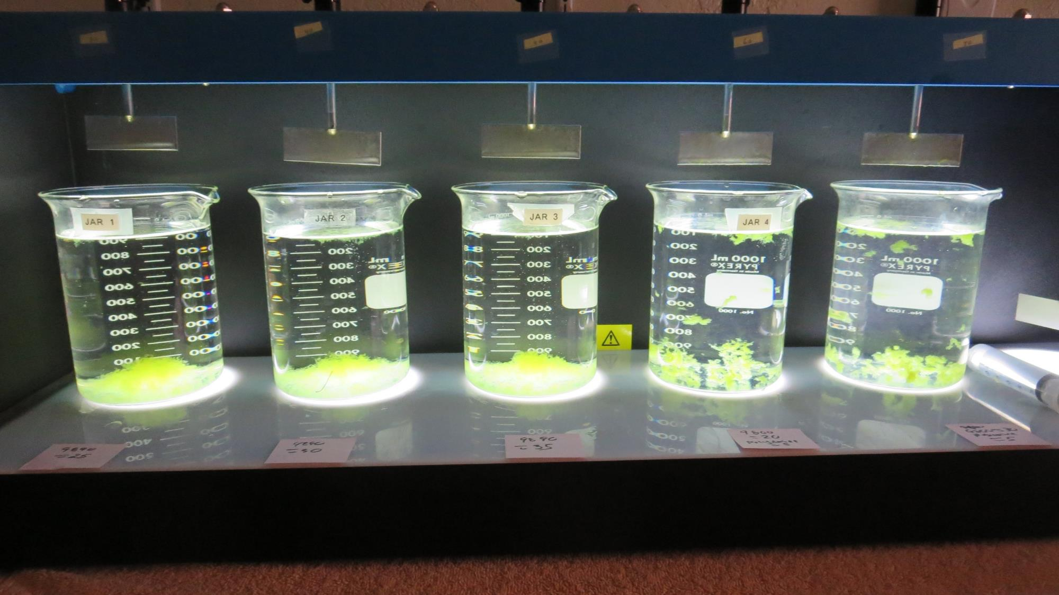
Jars 19-23: After 25-minutes of settling, settled water turbidity is taken.
25 mg/L 9890
Filtrate 0.14 NTU
UVT: 90.40%
UVA: 0.0438/cm
UVA Reduction: 55.3%
Settled: 0.43 NTU
30 mg/L 9890
Filtrate 0.14 NTU
UVT: 90.46%
UVA: 0.0436/cm
UVA Reduction: 55.5%
Settled: 0.39 NTU
35 mg/L 9890
Filtrate 0.65 NTU
UVT: 90.55%
UVA: 0.0431/cm
UVA Reduction: 56.0%
Settled: 0.52 NTU
20 mg/L 9800
5 mg/L Polyamine
Filtrate 0.10 NTU
UVT: 90.35%
UVA: 0.0441/cm
UVA Reduction: 55.0%
Settled: 0.79 NTU
30 mg/L 9800
5 mg/L Polyamine
Filtrate 0.09 NTU
UVT: 90.41%
UVA: 0.0438/cm
UVA Reduction: 55.3%
Settled: 0.70 NTU

Slide 35
Jars 24-27 Test
Flash Mix 30 Sec (200 RPM)
Floc Mix 5 min (30 RPM)
10/2/20
Applied Coagulants
9800/9890/Polyamine

Slide 36
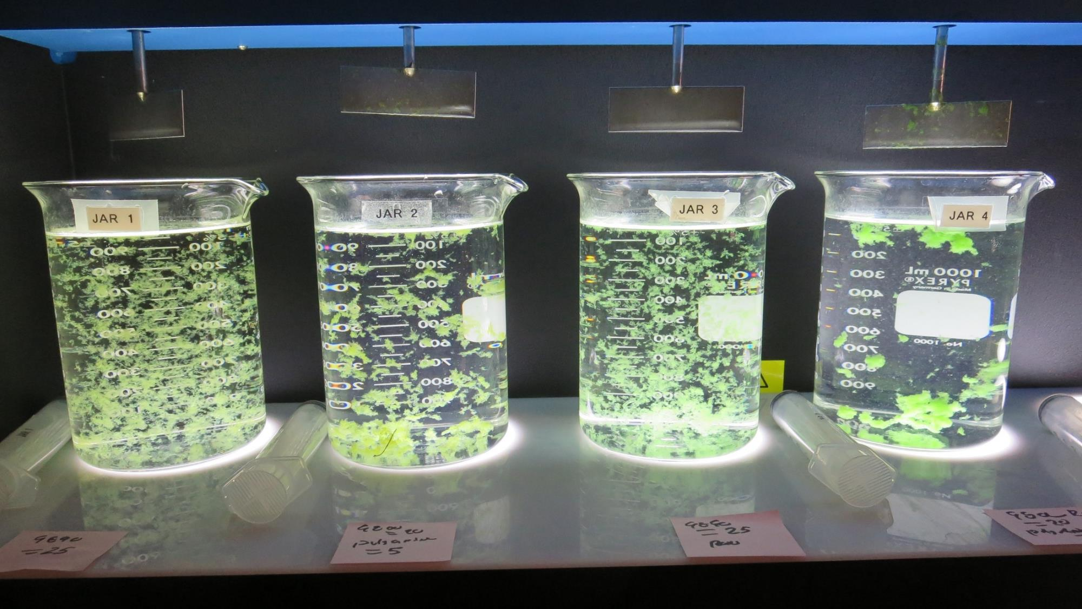
Jars 24-27: End of 5-minute flocculation (30 RPM) duration.
25 mg/L 9890
Filtrate 0.19 NTU
UVT: 89.96%
UVA: 0.0460/cm
UVA Reduction: 53.0%
Settled: 0.41 NTU
20 mg/L 9890
5 mg/L Polyamine
Filtrate 0.13 NTU
UVT: 90.47%
UVA: 0.0435/cm
UVA Reduction: 55.6%
Settled: 1.29 NTU
25 mg/L 9890
Filtrate 0.12 NTU
UVT: 89.60%
UVA: 0.0526/cm
UVA Reduction: 32.8%
Settled: 0.43 NTU
20 mg/L 9890
5 mg/L Polyamine
Filtrate 0.11 NTU
UVT: 88.58%
UVA: 0.0527/cm
UVA Reduction: 32.7%
Settled: 0.84 NTU

Slide 37
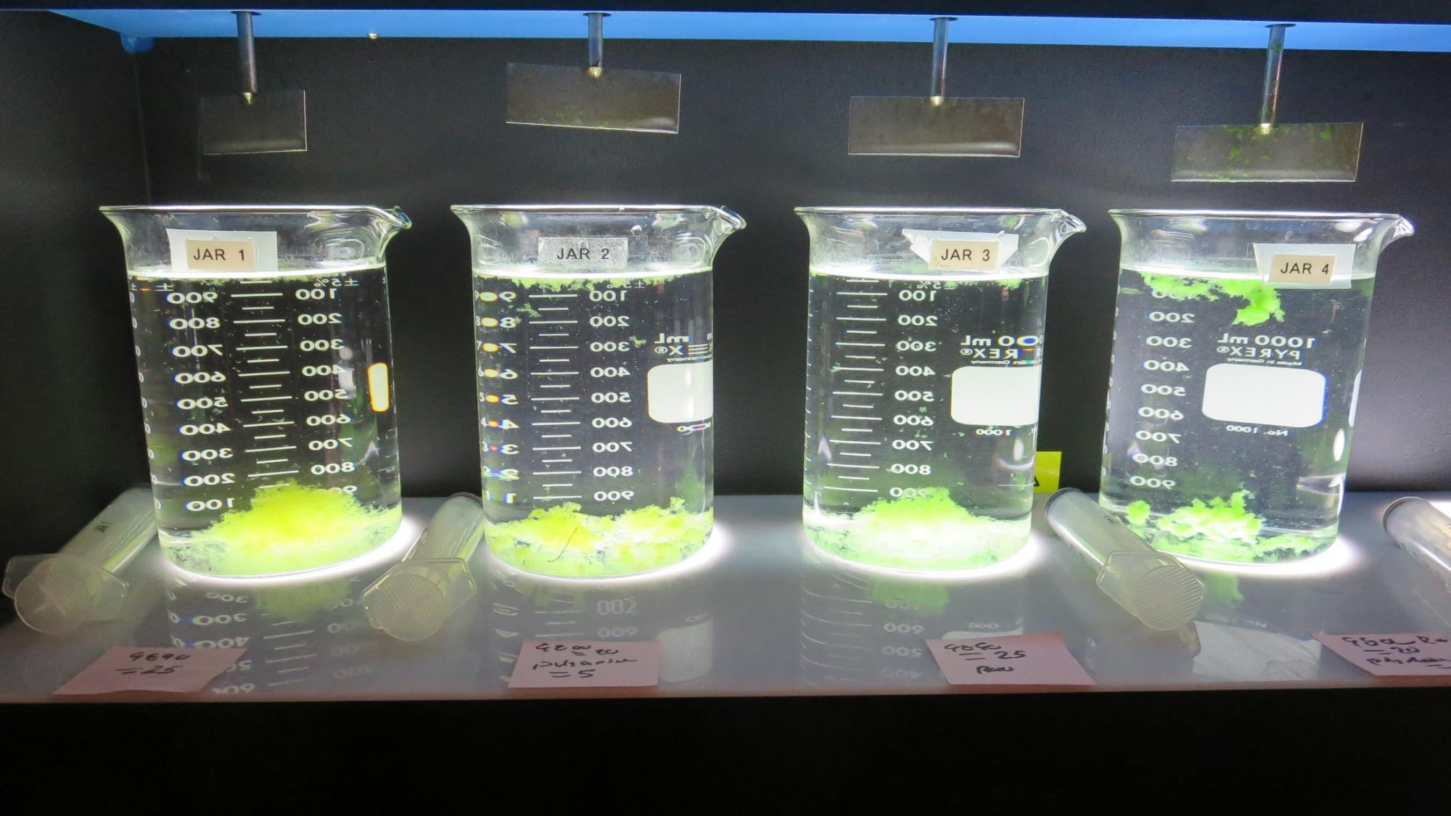
Jars 24-27: After 5 min of settling, 25 mL is syringed for filterability and %UVT/UVA.

Slide 38
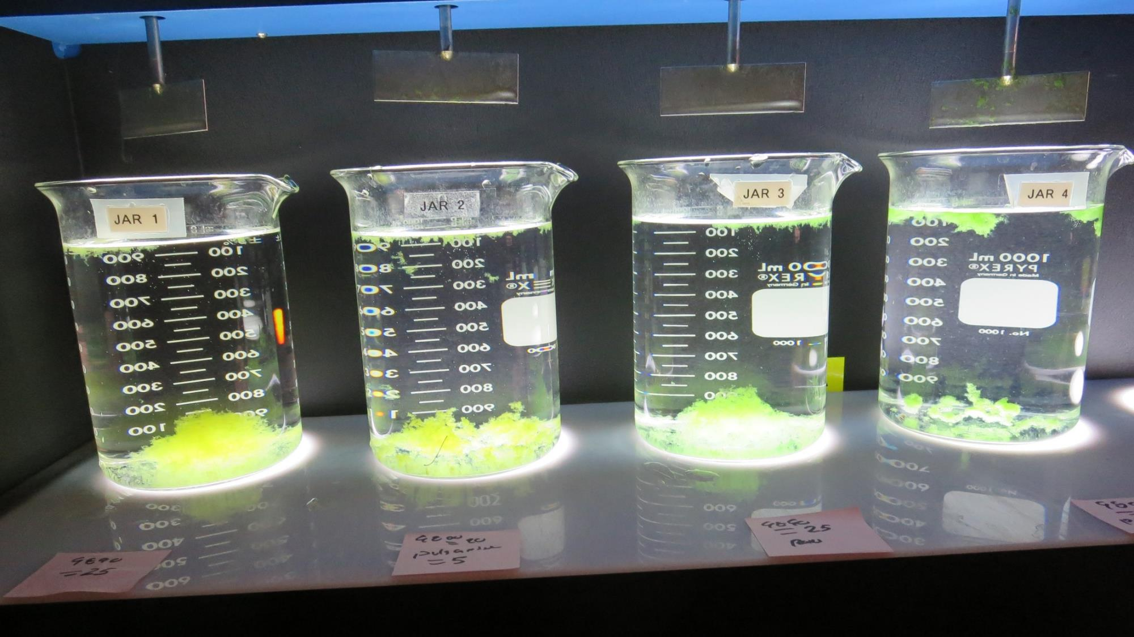
Jars 24-27: After 25-minutes of settling, settled water turbidity is taken.
25 mg/L 9890
Filtrate 0.19 NTU
UVT: 89.96%
UVA: 0.0460/cm
UVA Reduction: 53.0%
Settled: 0.41 NTU
20 mg/L 9890
5 mg/L Polyamine
Filtrate 0.13 NTU
UVT: 90.47%
UVA: 0.0435/cm
UVA Reduction: 55.6%
Settled: 1.29 NTU
25 mg/L 9890
Filtrate 0.12 NTU
UVT: 89.60%
UVA: 0.0526/cm
UVA Reduction: 32.8%
Settled: 0.43 NTU
20 mg/L 9890
5 mg/L Polyamine
Filtrate 0.11 NTU
UVT: 88.58%
UVA: 0.0527/cm
UVA Reduction: 32.7%
Settled: 0.84 NTU

Slide 39
Jar Testing for 1-Liter Jars:
Procedures for Most Treatment Plants
Fill jars with source water prior to coagulant injection and set paddle speed at 30 rpm
Add chemicals (i.e., NaOCl, primary coagulant, coagulant aid) to each jar
Flash mix for 15-30 seconds (200 rpm)
Slow mix for 5 minutes (20-30 rpm)
Settled for 5 minutes. Syringe 25 mL from each jar taken 1-inch below surface (25 mL/12 sec rate).
Filtered through 1.2 um isopore membrane into cuvette drip rate, 15 mL/(50-90 sec)
Measure filtrate turbidity, chlorine residual and %UVT/UVA
Measure settled water turbidity after 25 minutes of total setting
Record all data

Slide 40

Jar Test
Filterability Test Equipment
Turbidity Instrument
Syringe w/Luer-Lock Tip, 30 cc
(part#: 2225800, by Hach)
Swinnex Filter Holder, 25 mm (part#: SX0002500)
Isopore Membrane Filter, 1.2 um absolute
pore size,
Φ= 25 mm , thickness: 24 um,
hydrophilic polycarbonate membrane
(part #: RTTP02500)
Go to Sigma-Aldrich for laboratory supplies http://www.sigmaaldrich.com/united-states.html

Slide 41
Isopore Membrane Information
Categories | Information
trade name | Isopore
filter color | White
chemistry | Polycarbonate (PC)
water flow rate | Avg. 175 mL/min x cm² (typical results @ 10 psi)
media | Isopore®
wettability | Hydrophilic
porosity | 14.7%
pore size | 1.2 µm
bubble point at 23 °C | 1.0 bar, air with water
thickness | 24 µm
filter diameter (ø) | 25 mm
material size | polycarbonate, Hydrophilic, 1.2 µm, 25 mm, white, plain, 100

Slide 42
Isopore Membrane Background Information
The Isopore membrane is a polycarbonate, track-etched screen filter recommended for all analyses in which the sample is viewed on the surface of the membrane. The Isopore membrane is composed of polycarbonate film, which has a smooth, glass-like surface for clearer sample observation. The unique manufacturing process of the membrane ensures a precise pore diameter and a consistent pore size for accurate separation of samples by size. Matched-weight filters are not usually required because of low, constant tar and ash weights.
Features & Benefits:
Membrane structure retains particles on the surface, simplifying counting and analysis

Slide 43
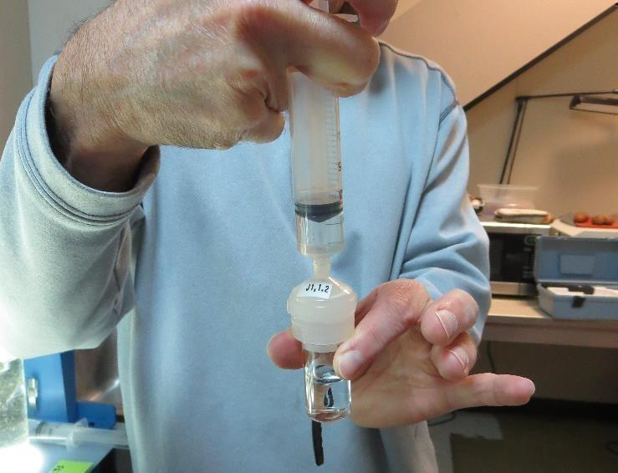

Jar Test - Filterability Test
Syringe ~ 25 mL from jar (after 5-minutes of settling)
Filter-to-waste 3-5 mL
Filter directly into clean cuvette
Measure turbidity
Note: Take several readings before recording final NTU results. Micro bubbles can adhere to glass causing false NTU readings. To remove bubbles, tilt cuvette up to 90 degrees.

Slide 44

Contact
Guy Schott, P.E.
State Water Resources Control Board
Division of Drinking Water
Santa Rosa, CA
Go to Stock Solution/Dose calculations/Jar Test Results for tools to download
www.waterboards.ca.gov/drinking_water/programs/districts/mendocino_district.html
Email: Guy Schott - Guy.Schott@waterboards.ca.gov
Office Number: 707-576-2732

