Slide 1
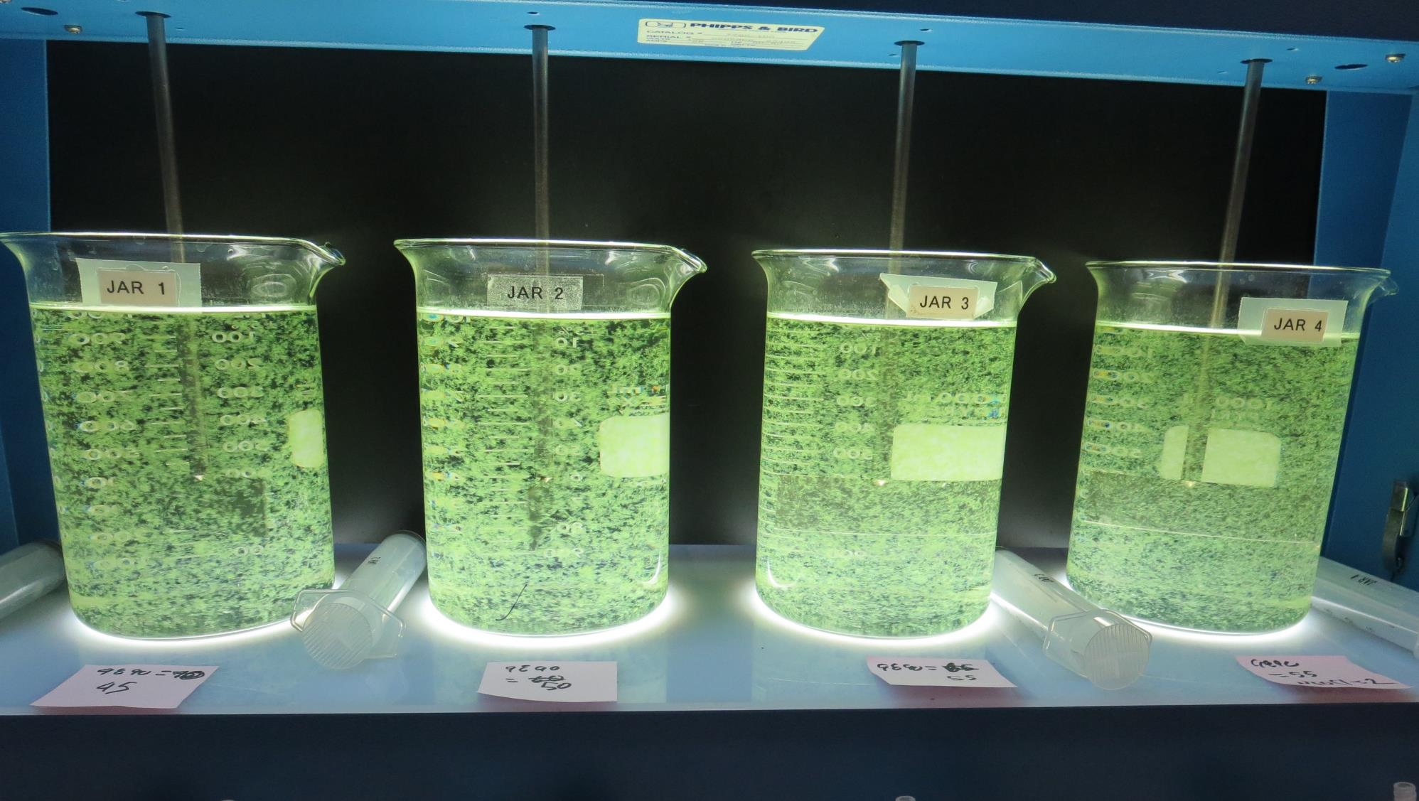
Konocti County Water District
CA1710006, Lake County, Jar Test
by Guy Schott, P.E. September 22, 2020

Slide 2
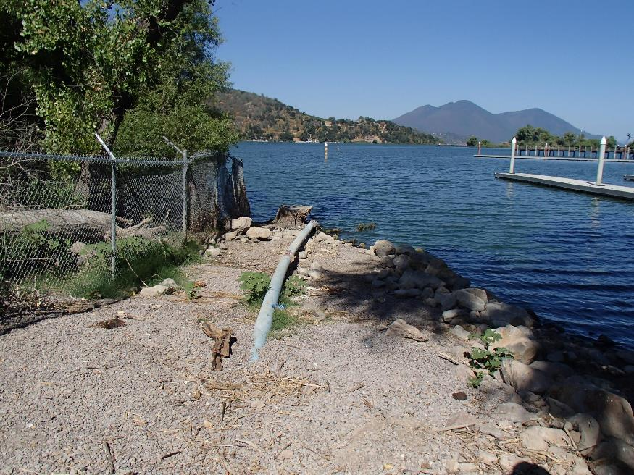
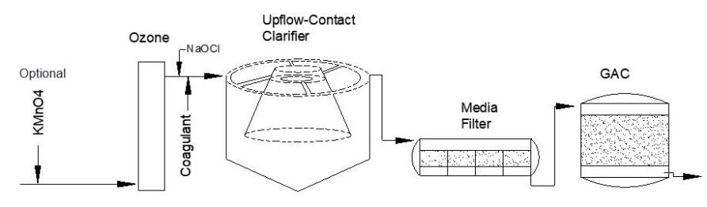
Konocti County Water District
Source Water: Clear Lake
Conventional Treatment

Slide 3
Konocti CWD, September 21, 2020
Source Water Characteristics
Source (evening)
pH: 8.62
Turbidity: 25.5 NTU
UVT: 70.68%
UVA: 0.1507/cm
0.4 um Filtered
Turbidity: 1.31 NTU
UVT: 82.378%
UVA: 0.0843/cm
Using the P300 UVT/UVA analyzer; calibrated with DI water.
0.4 um Filtered
Turbidity: 1.44 NTU
UVT: 80.9%
UVA: 0.091/cm
Using the P200 UVT/UVA analyzer; calibrated with Organic free water.

Slide 4
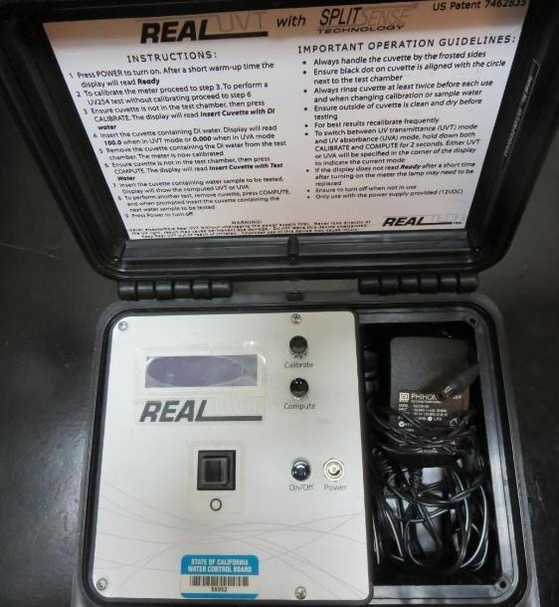
UVT/UVA, pathlength 10 mm
UV transmittance (UVT) is a measurement of the amount of ultraviolet light (commonly at 254 nm due to its germicidal effect) that passes through a water sample compared to the amount of light that passes through a pure water sample. The measurement is expressed as a percentage, % UVT.
%UVT = 10^{(-UVA)} x 100%
UV absorbance (UVA) is calculated as a relative measure of the amount of light absorbed by a water sample compared with the amount of light absorbed by a pure water sample.
UVA = -log(%UVT/100)

Slide 5
Applied Coagulants for Jar Testing
Pro Pac 9800 (NTU Technologies)
50% Aluminum Chlorohydrate
50% Water
23.62% Al₂O₃
83% Basicity
SG = 1.34
Pro Pac 9890 (NTU Technologies)
35-45% Aluminum Chlorohydrate
20% Trade Secret
35-45% Water
SG = 1.25-1.34
BWS, Inc.
Advanced Coagulant
AdvFloc-CTC-00011
12.55% Al₂O₃
64.9% Basicity
SG = 1.299

Slide 6
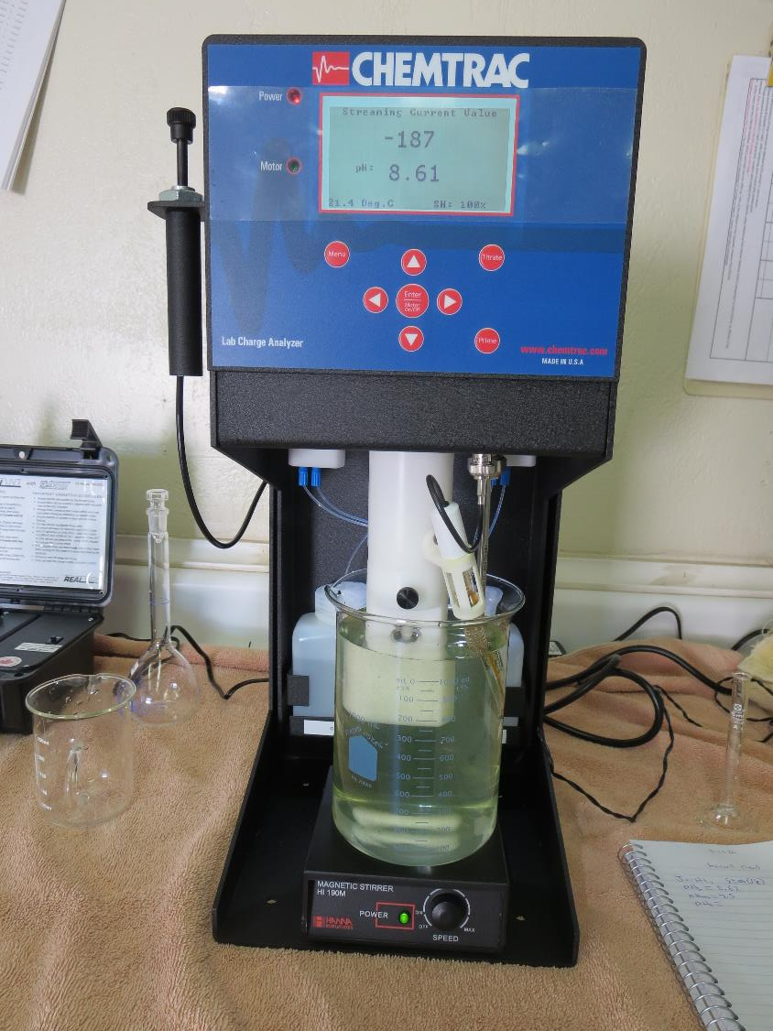
Laboratory Charge Analyzer
LCA: Used to determine coagulant demand of a source water entering the treatment plant.
Source pH: 8.62
LCA #1:
9800: 68.5 mg/L as product
pH adjusted to 7.5 w/acetic acid solution

Slide 7
Coagulant Information
Unless stated otherwise, all coagulant doses are reported as Product (100% strength).
Preparation of coagulant stock solutions are generally 1.0 and/or 0.1 percent strength using 100 and/or 200 mL volumetric flasks.
Finnpipette F2 variable volume pipette, capacity 100-1000 micro liters is used for stock solution preparation and coagulant aid jar test dosing.
Finnpipette F2 variable volume pipette, capacity 0.5-5 mL is used for primary coagulant jar test dosing.

Slide 8
Konocti CWD: Jar Test 1-4 Results
Clear Lake Source Water
Flash Mix 200 RPM (30 sec); Floc Mix 30 RPM (5 minutes)
Jar # | H₂SO₄ mg/L | 9800 mg/L | Filtrate NTU | Filtrate %UVT | Filtrate UVA/cm | %UVA Reduction | Settle NTU 25 min
J1 | 0 | 69 | 0.20 | 91.86 | 0.0369 | 56.2 | 4.0
J2 | 25 | 69 | 0.12 | 92.52 | 0.0338 | 59.9 | 2.44
J3 | 0 | 75 | 0.12 | 92.47 | 0.0340 | 59.7 | 2.76
J4 | 25 | 75 | 0.13 | 92.96 | 0.0317 | 62.4 | 0.64

Slide 9
Konocti CWD: Jar Test 5-8 Results
Clear Lake Source Water
Flash Mix 200 RPM (30 sec); Floc Mix 30 RPM (5 minutes)
Jar # | 9890 mg/L | 9800 mg/L | Adv. Coag. mg/L | Filtrate NTU | Filtrate %UVT | Filtrate UVA/cm | %UVA Reduction | Settle NTU 25 min
J5 | 70 | 3.5 | 0 | 0.08 | 92.24 | 0.0351 | 58.6 | 1.25
J6 | 75 | 3.75 | 0 | 0.08 | 92.20 | 0.0353 | 58.1 | 0.39
J7 | 80 | 4.0 | 0 | 0.10 | 92.32 | 0.0347 | 58.8 | 0.70
J8 | 0 | 0 | 220 | 0.18 | 92.27 | 0.0350 | 58.5 | 6.8

Slide 10
Konocti CWD: Jar Test 9-12 Results
Clear Lake Source Water
Flash Mix 200 RPM (30 sec); Floc Mix 30 RPM (5 minutes)
Jar # | NaOCl mg/L | 9890 mg/L | 9800 mg/L | Filtrate NTU | Filtrate %UVT | Filtrate UVA/cm | %UVA Reduction | Settle NTU 25 min
J9 | 0 | 3.5 | 70 | 0.13 | 92.13 | 0.0356 | 57.8 | 2.95
J10 | 0 | 3.75 | 75 | 0.12 | 92.01 | 0.0362 | 57.1 | 3.2
J11 | 2.0 | 3.5 | 70 | 0.12 | 90.97 | 0.0411 | 51.2 | 5.3
J12 | 2.0 | 3.75 | 75 | 0.15 | 90.99 | 0.0410 | 51.4 | 7.0

Slide 11
Konocti CWD: Jar Test 13-15 Results
Clear Lake Source Water
Flash Mix 200 RPM (30 sec); Floc Mix 30 RPM (5 minutes)
Jar 15: NaOCl = 5.0 mg/L
Jar # | Adv Coag. mg/L | 9800 mg/L | 9890 mg/L | Filtrate NTU | Filtrate %UVT | Filtrate UVA/cm | %UVA Reduction | Settle NTU 25 min
J13 | 140 | 0 | 0 | 0.13 | 91.87 | 0.0368 | 56.3 | 4.4
J14 | 150 | 0 | 0 | 0.20 | 92.13 | 0.0356 | 57.8 | 1.5
J15 | 0 | 70 | 3.5 | 0.15 | 90.99 | 0.0410 | 51.7 | 7.0

Slide 12
Konocti CWD: Jar Test 16-23 Results
Clear Lake Source Water
Flash Mix 200 RPM (30 sec); Floc Mix 30 RPM (5 minutes)
Jar # | 9890 mg/L | 9800 mg/L | Filtrate NTU | Filtrate %UVT | Filtrate UVA/cm | %UVA Reduction | Settle NTU 25 min
J16 | 70 | 3.5 | 0.10 | 92.5 | 0.033 | 63.7 | 0.87
J17 | 75 | 3.75 | 0.10 | 92.4 | 0.034 | 62.6 | 0.43
J18 | 70 | 0 | 0.09 | 92.3 | 0.034 | 62.6 | 0.33
J19 | 75 | 0 | 0.09 | 92.2 | 0.034 | 62.6 | 0.31
J20 | 55 | 0 | 0.08 | 92.2 | 0.035 | 61.5 | 0.31
J21 | 60 | 0 | 0.08 | 92.1 | 0.035 | 61.5 | 0.34
J22 | 65 | 0 | 0.07 | 92.1 | 0.035 | 61.5 | 0.54
J23 | 70 | 0 | 0.08 | 92.0 | 0.036 | 60.4 | 0.66

Slide 13
Konocti CWD: Jar Test 24-27 Results
Clear Lake Source Water
Flash Mix 200 RPM (30 sec); Floc Mix 30 RPM (5 minutes)
Jar # | NaOCl mg/L | 9890 mg/L | Filtrate NTU | Filtrate %UVT | Filtrate UVA/cm | %UVA Reduction | Settle NTU 25 min
J24 | 0 | 45 | 0.09 | 91.9 | 0.036 | 60.4 | 0.55
J25 | 0 | 50 | 0.08 | 91.9 | 0.036 | 60.4 | 0.33
J26 | 0 | 55 | 0.08 | 92.0 | 0.035 | 61.5 | 0.39
J27 | 2.0 | 55 | 0.08 | 91.7 | 0.037 | 59.3 | 0.29

Slide 14
No Photos Available
Jars 1-4 Test
Flash Mix 30 Sec (200 RPM)
Floc Mix 5 min (30 RPM)
Applied Coagulant
9800

Slide 15
Jars 5-8 Test
Flash Mix 30 Sec (200 RPM)
Floc Mix 5 min (30 RPM)
Applied Coagulants
9800/9890
Advanced Coagulant

Slide 16
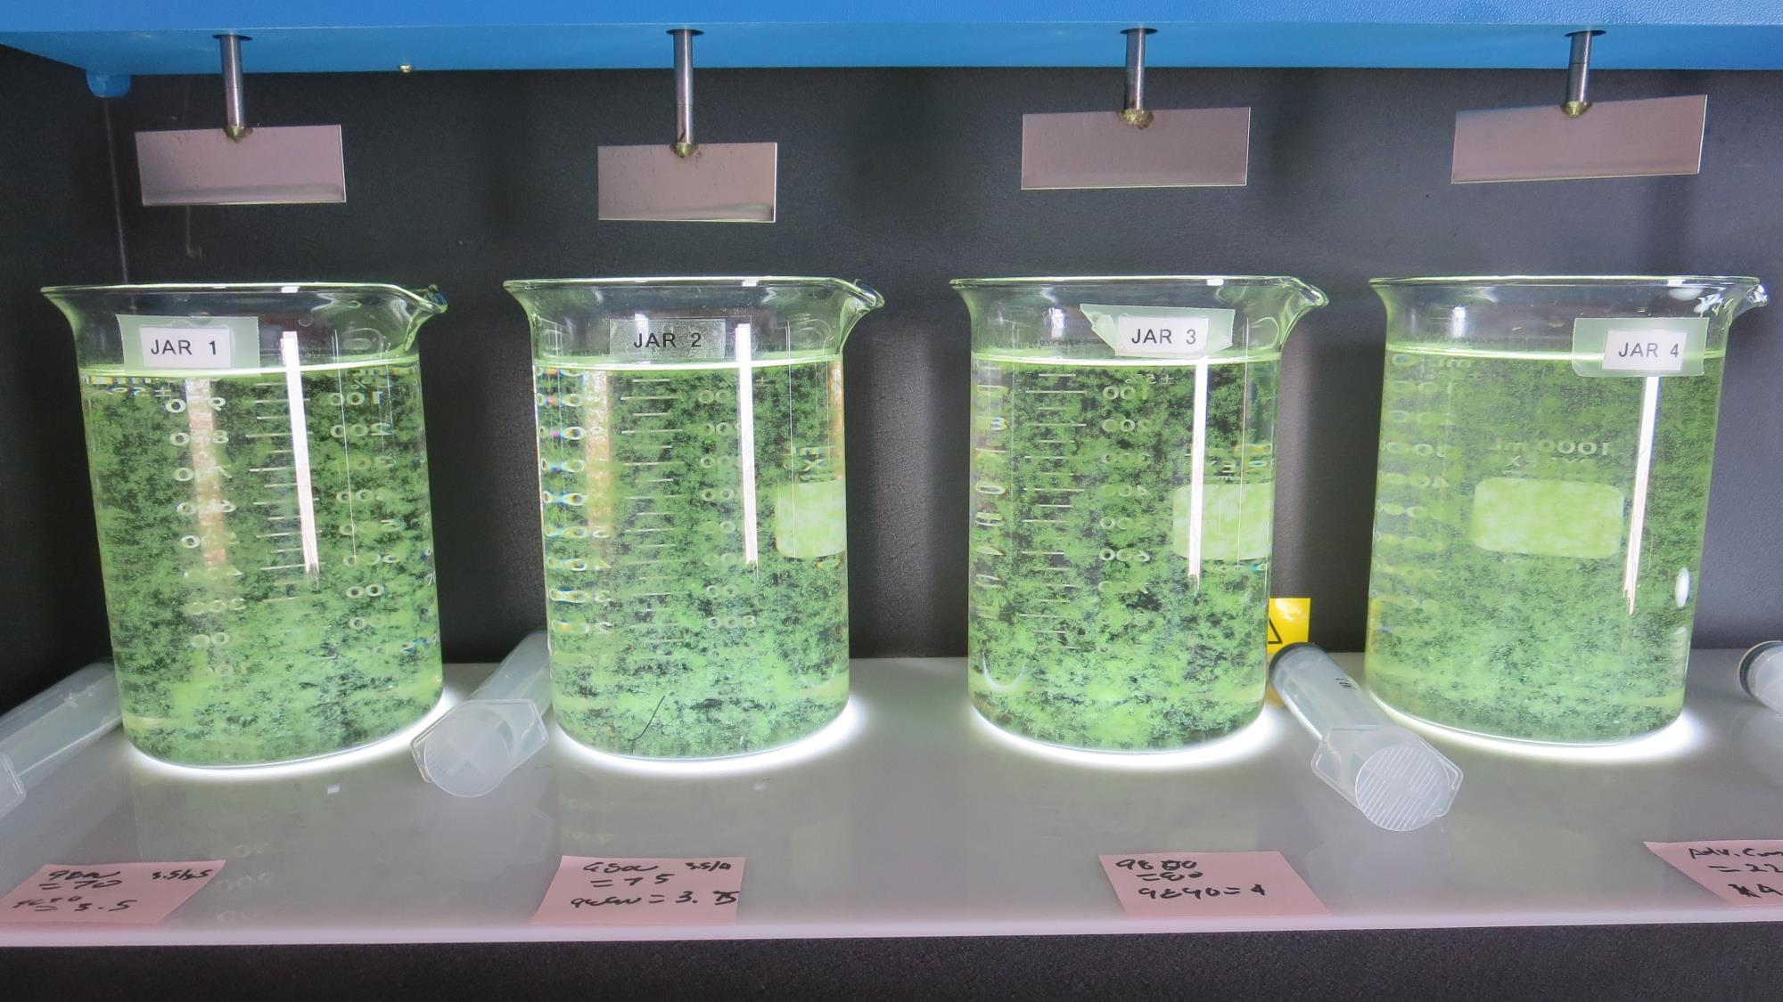
Jars 5-8: End of 5-minute flocculation (30 RPM) duration.
70 mg/L 9890
3.5 mg/L 9800
Filtrate 0.08 NTU
UVT: 92.24%
UVA: 0.0351/cm
UVA Reduction: 58.6%
Settled: 1.25 NTU
75 mg/L 9890
3.75 mg/L 9800
Filtrate 0.08 NTU
UVT: 92.20%
UVA: 0.0353/cm
UVA Reduction: 58.1%
Settled: 0.39 NTU
80 mg/L 9890
4.0 mg/L 9800
Filtrate 0.10 NTU
UVT: 92.32%
UVA: 0.0347/cm
UVA Reduction: 58.8%
Settled: 0.70 NTU
220 mg/L Adv. Coag.
Filtrate 0.18 NTU
UVT: 92.27%
UVA: 0.0350/cm
UVA Reduction: 58.5%
Settled: 6.8 NTU

Slide 17
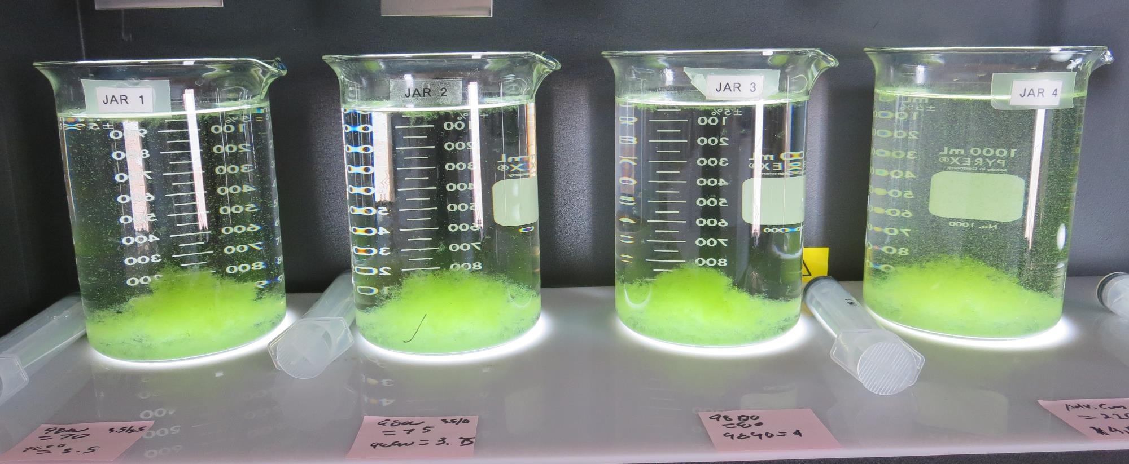
Jars 6-10: After 5 min of settling, 25 mL is syringed for filterability and %UVT/UVA.

Slide 18
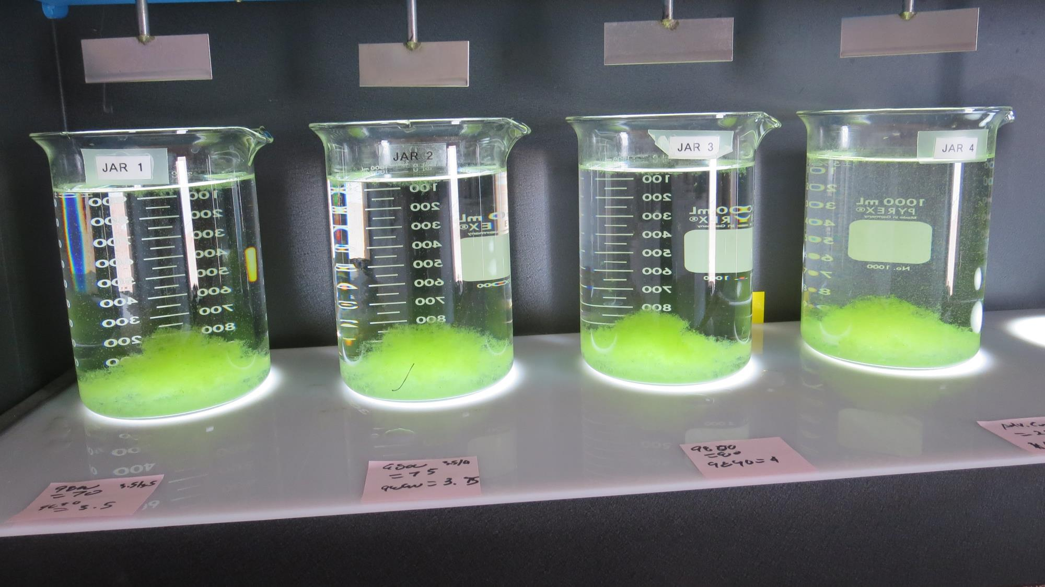
Jars 6-10: After 25-minutes of settling, settled water turbidity is taken.
70 mg/L 9890
3.5 mg/L 9800
Filtrate 0.08 NTU
UVT: 92.24%
UVA: 0.0351/cm
UVA Reduction: 58.6%
Settled: 1.25 NTU
75 mg/L 9890
3.75 mg/L 9800
Filtrate 0.08 NTU
UVT: 92.20%
UVA: 0.0353/cm
UVA Reduction: 58.1%
Settled: 0.39 NTU
80 mg/L 9890
4.0 mg/L 9800
Filtrate 0.10 NTU
UVT: 92.32%
UVA: 0.0347/cm
UVA Reduction: 58.8%
Settled: 0.70 NTU
220 mg/L Adv. Coag.
Filtrate 0.18 NTU
UVT: 92.27%
UVA: 0.0350/cm
UVA Reduction: 58.5%
Settled: 6.8 NTU

Slide 19
Jars 9-12 Test
Flash Mix 30 Sec (200 RPM)
Floc Mix 5 min (30 RPM) w/NaOCl
Applied Coagulants
9800/9890

Slide 20
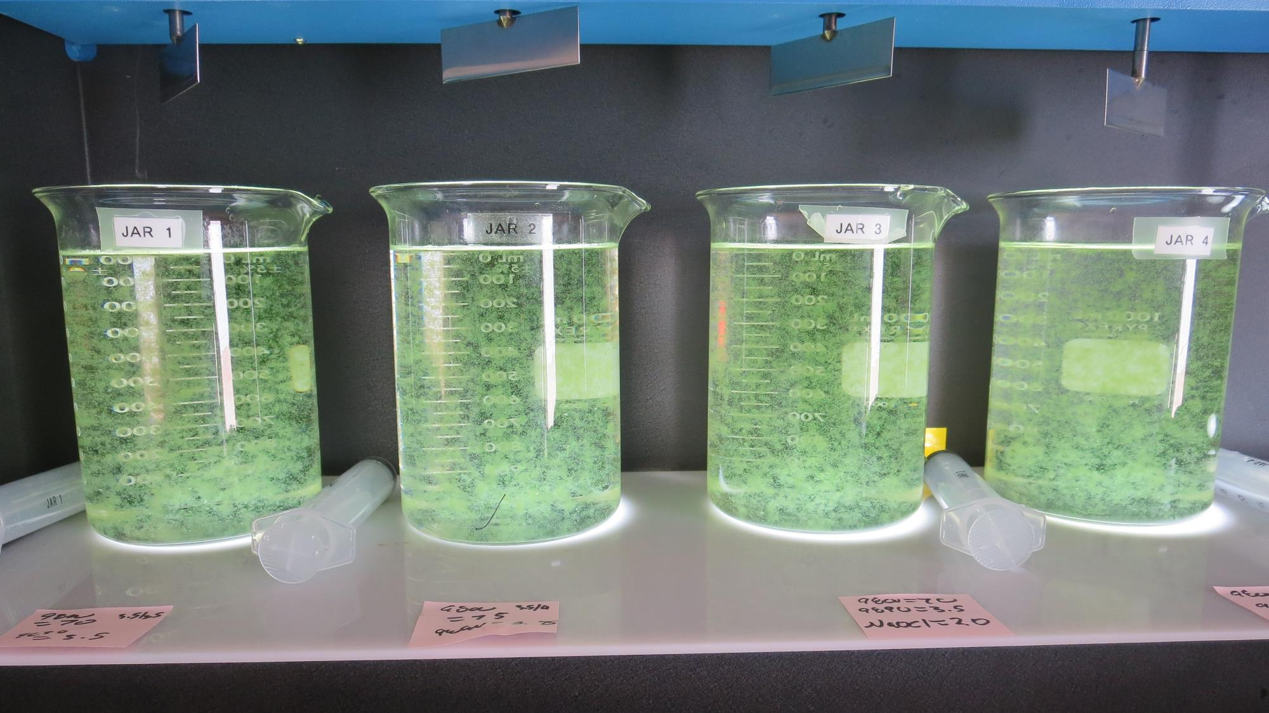
Jars 9-12: End of 5-minute flocculation (30 RPM) duration.
0 mg/L NaOCl
70 mg/L 9800
3.5 mg/L 9890
Filtrate 0.13 NTU
UVT: 92.13%
UVA: 0.0356/cm
UVA Reduction: 57.8%
Settled: 2.95 NTU
0 mg/L NaOCl
75 mg/L 9800
3.75 mg/L 9890
Filtrate 0.12 NTU
UVT: 92.01%
UVA: 0.0362/cm
UVA Reduction: 57.1%
Settled: 3.2 NTU
2.0 mg/L NaOCl
70 mg/L 9800
3.5 mg/L 9890
Filtrate 0.12 NTU
UVT: 90.97%
UVA: 0.0411/cm
UVA Reduction: 51.2%
Settled: 5.3 NTU
2.0 mg/L NaOCl
75 mg/L 9800
3.75 mg/L 9890
Filtrate 0.15 NTU
UVT: 90.97%
UVA: 0.0410/cm
UVA Reduction: 51.4%
Settled: 7.0 NTU

Slide 21
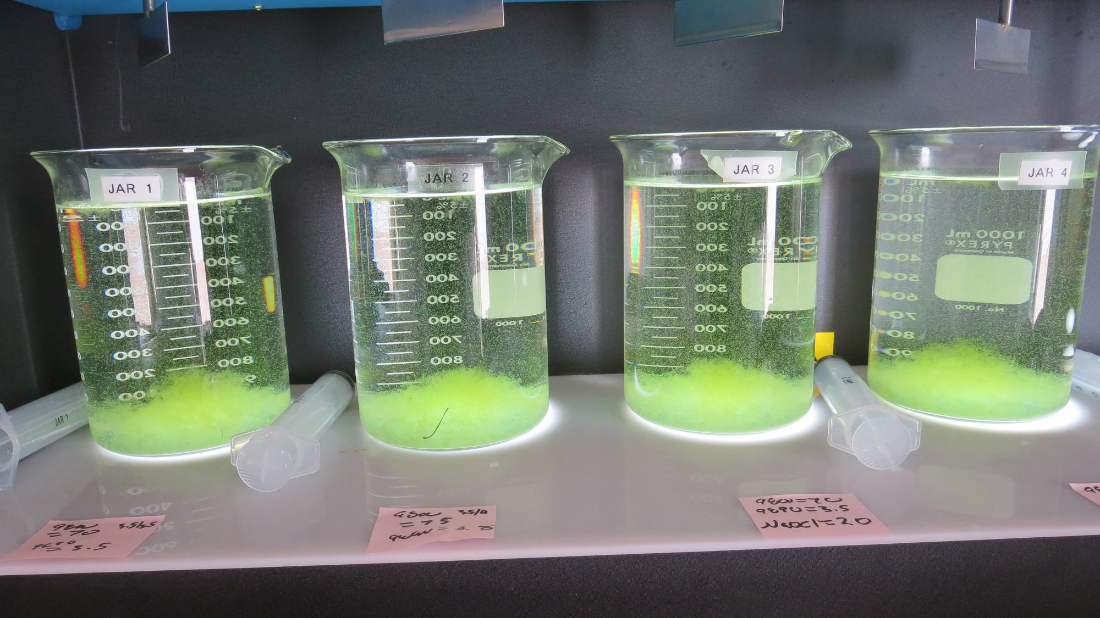
Jars 9-12: After 5 min of settling, 25 mL is syringed for filterability and %UVT/UVA.

Slide 22
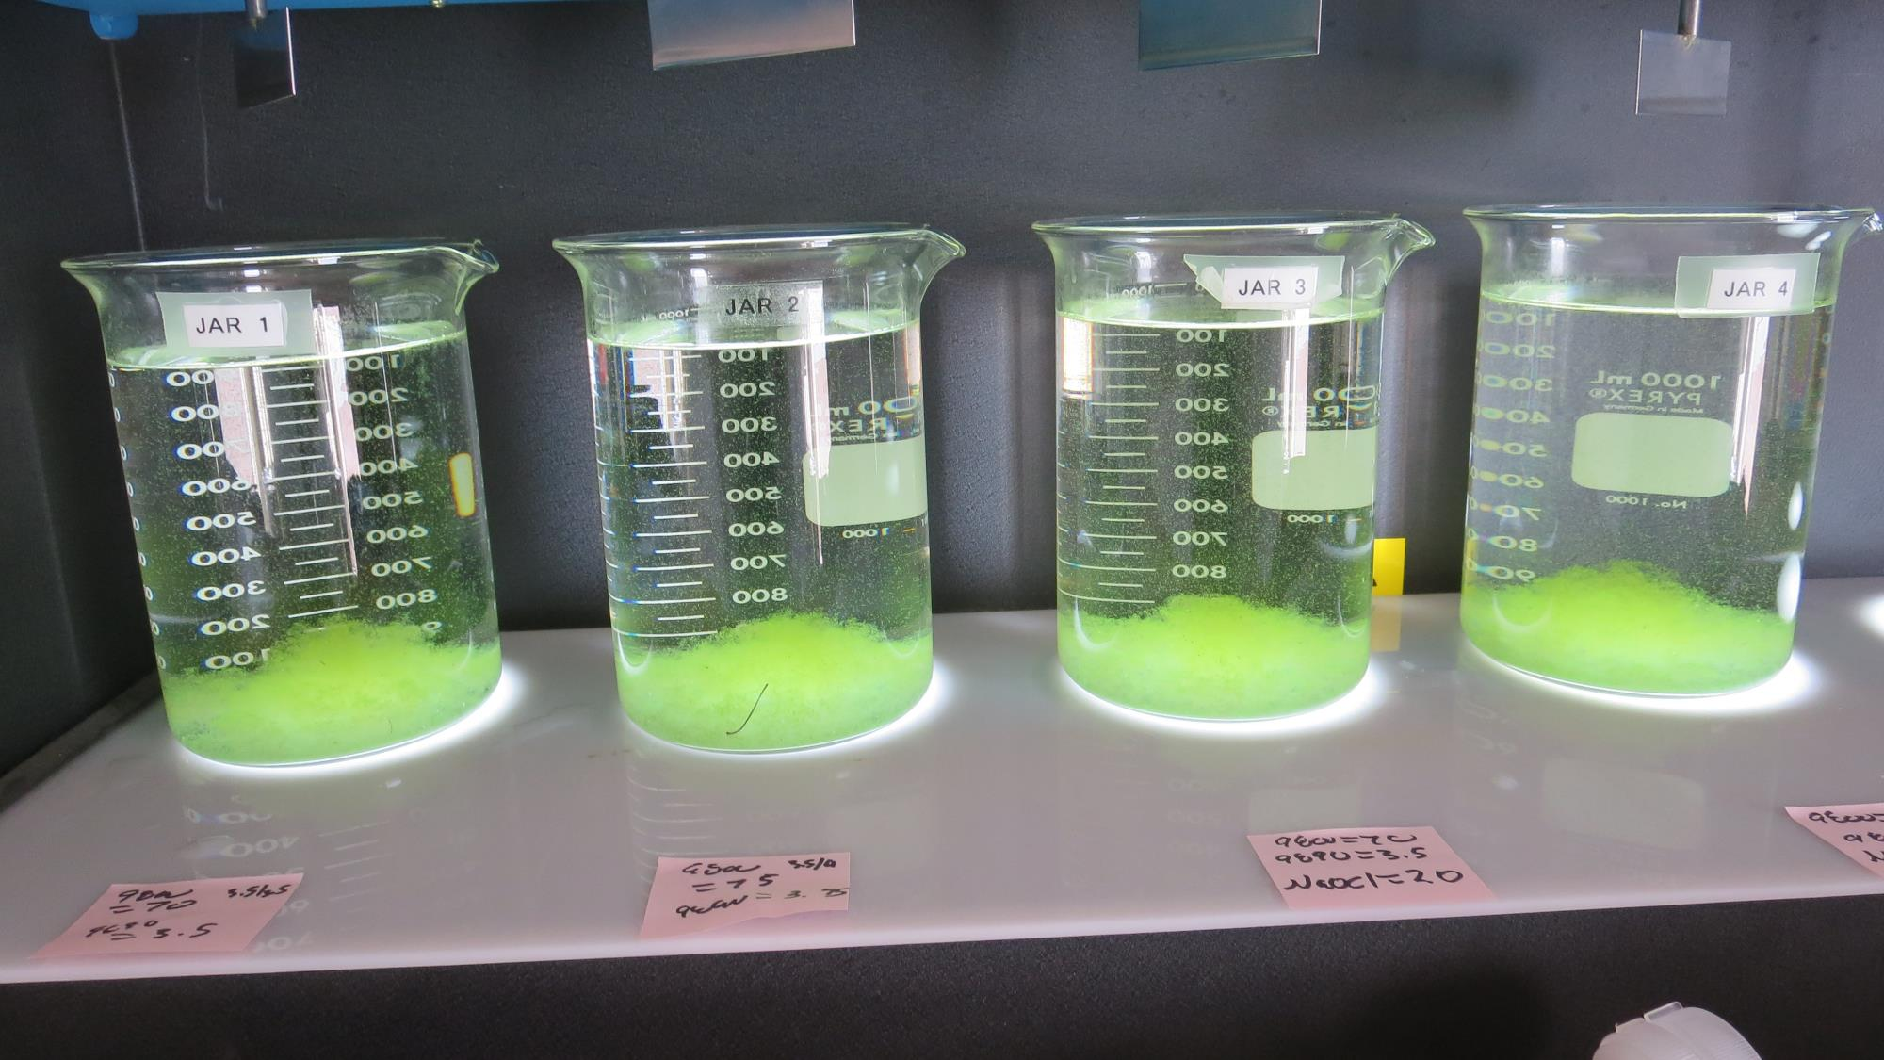
Jars 9-12: After 25-minutes of settling, settled water turbidity is taken.
0 mg/L NaOCl
70 mg/L 9800
3.5 mg/L 9890
Filtrate 0.13 NTU
UVT: 92.13%
UVA: 0.0356/cm
UVA Reduction: 57.8%
Settled: 2.95 NTU
0 mg/L NaOCl
75 mg/L 9800
3.75 mg/L 9890
Filtrate 0.12 NTU
UVT: 92.01%
UVA: 0.0362/cm
UVA Reduction: 57.1%
Settled: 3.2 NTU
2.0 mg/L NaOCl
70 mg/L 9800
3.5 mg/L 9890
Filtrate 0.12 NTU
UVT: 90.97%
UVA: 0.0411/cm
UVA Reduction: 51.2%
Settled: 5.3 NTU
2.0 mg/L NaOCl
75 mg/L 9800
3.75 mg/L 9890
Filtrate 0.15 NTU
UVT: 90.97%
UVA: 0.0410/cm
UVA Reduction: 51.4%
Settled: 7.0 NTU

Slide 23
Jars 13-15 Test
Flash Mix 30 Sec (200 RPM)
Floc Mix 5 min (30 RPM) w/NaOCl
Applied Coagulants
Adv Coag./9800/9890

Slide 24
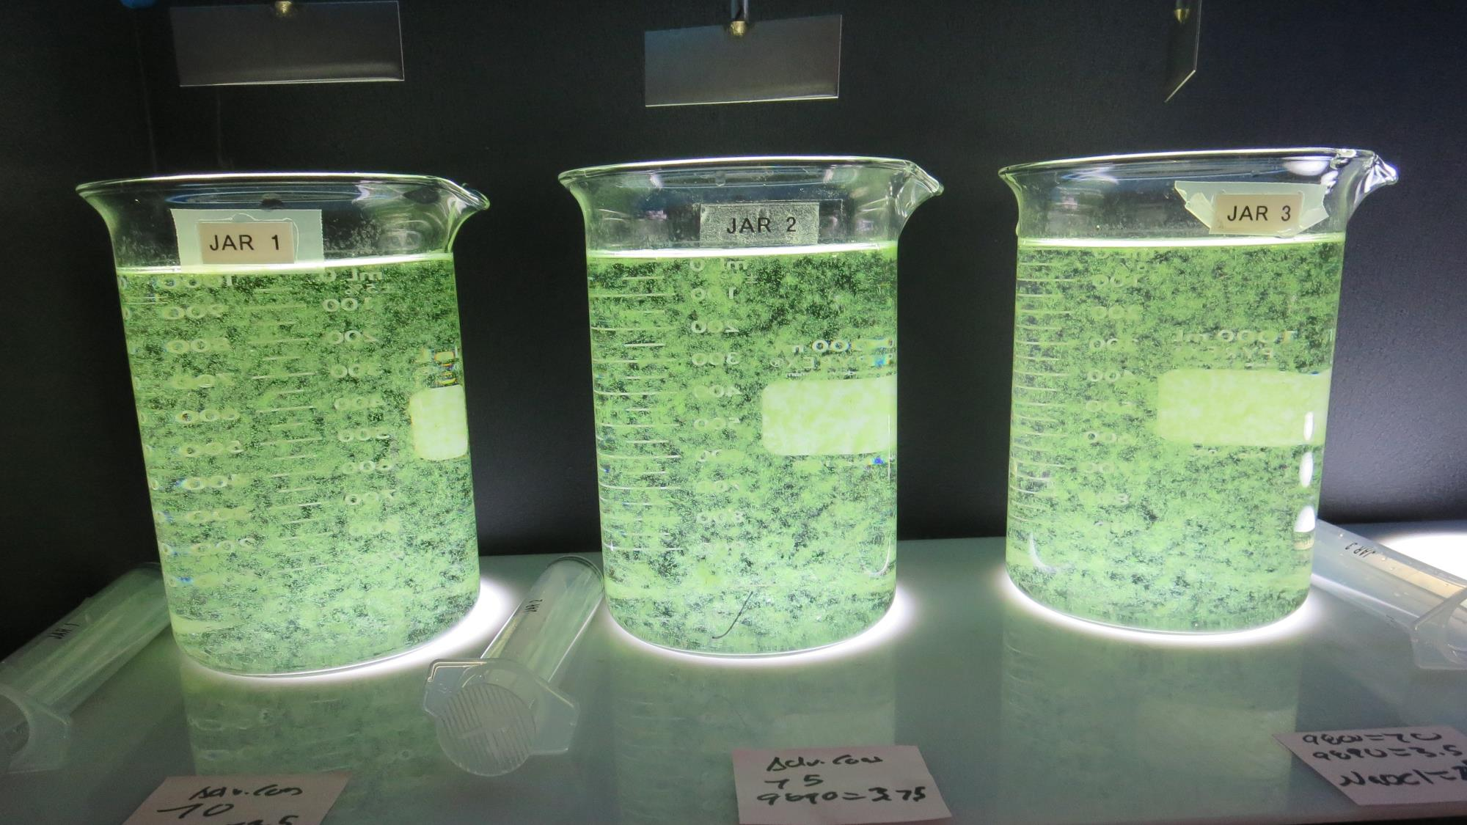
Jars 13-15: End of 5-minute flocculation (30 RPM) duration.
0 mg/L NaOCl
140 mg/L Adv Coag.
Filtrate 0.13 NTU
UVT: 91.87%
UVA: 0.0368/cm
UVA Reduction: 56.3%
Settled: 4.4 NTU
0 mg/L NaOCl
150 mg/L Adv Coag.
Filtrate 0.20 NTU
UVT: 92.13%
UVA: 0.0356/cm
UVA Reduction: 57.8%
Settled: 1.5 NTU
5.0 mg/L NaOCl
70 mg/L 9800
3.5 mg/L 9890
Filtrate 0.10 NTU
UVT: 91.07%
UVA: 0.0407/cm
UVA Reduction: 51.7%
Settled: 1.48 NTU

Slide 25
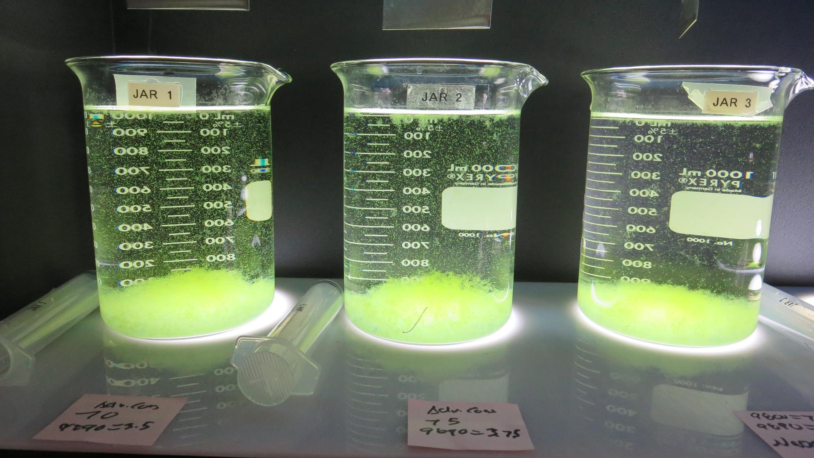
Jars 13-15: After 5 min of settling, 25 mL is syringed for filterability and %UVT/UVA.

Slide 26
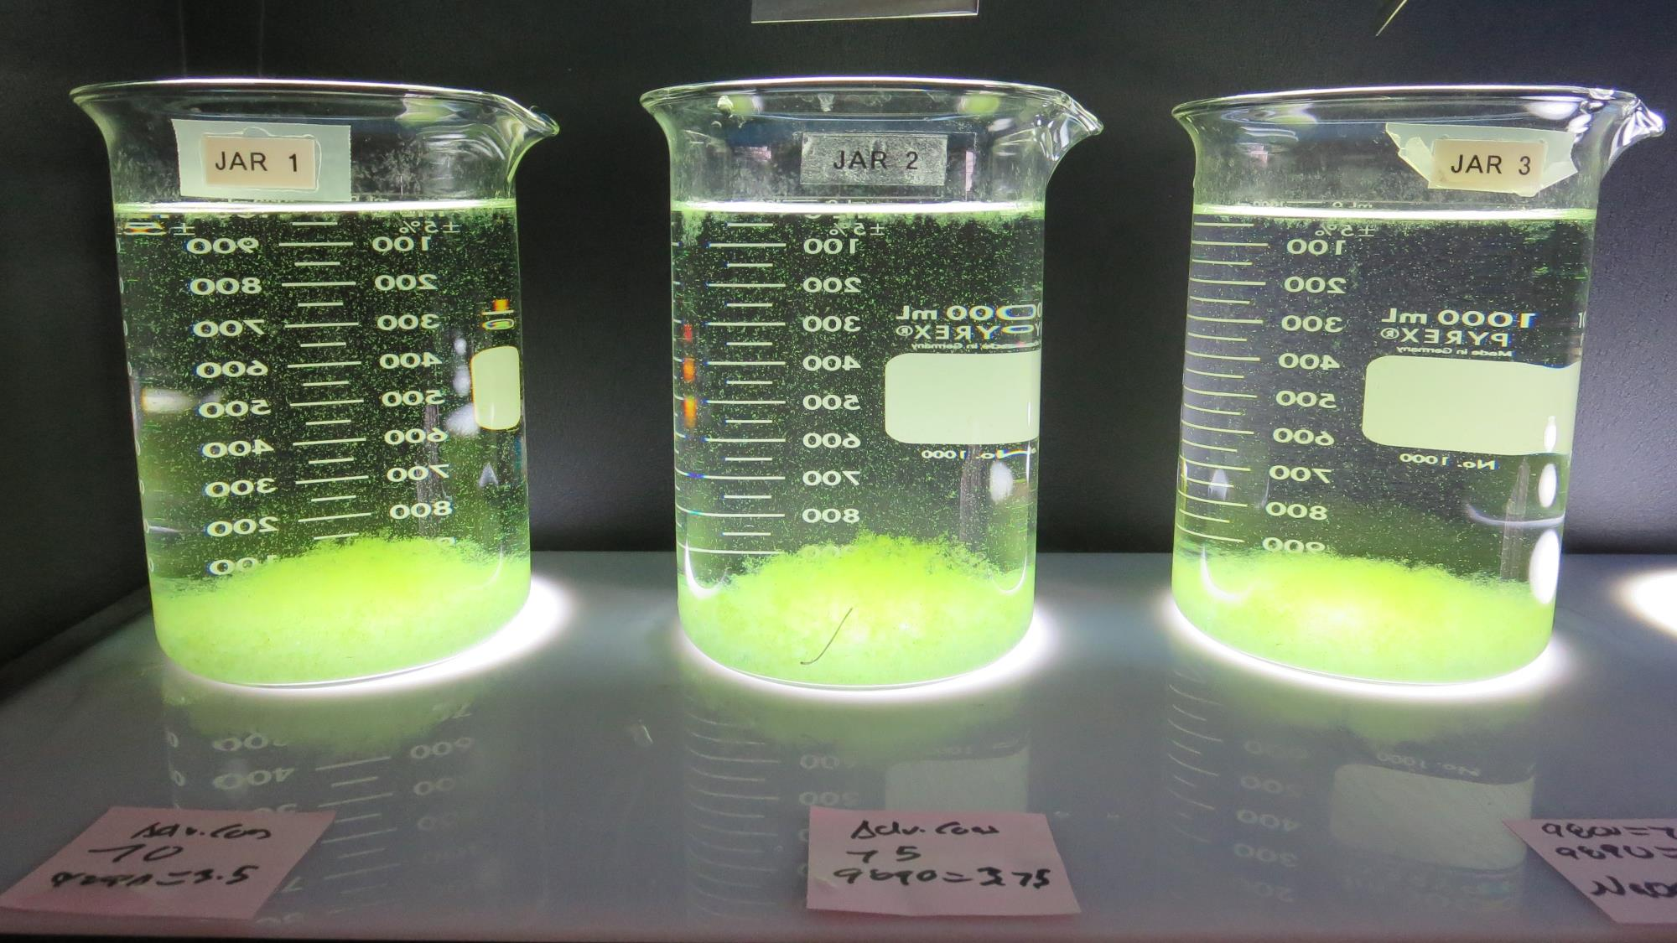
Jars 13-15: After 25-minutes of settling, settled water turbidity is taken.

Slide 27
Jars 16-19 Test
Flash Mix 30 Sec (200 RPM)
Floc Mix 5 min (30 RPM)
Applied Coagulants
9800/9890

Slide 28
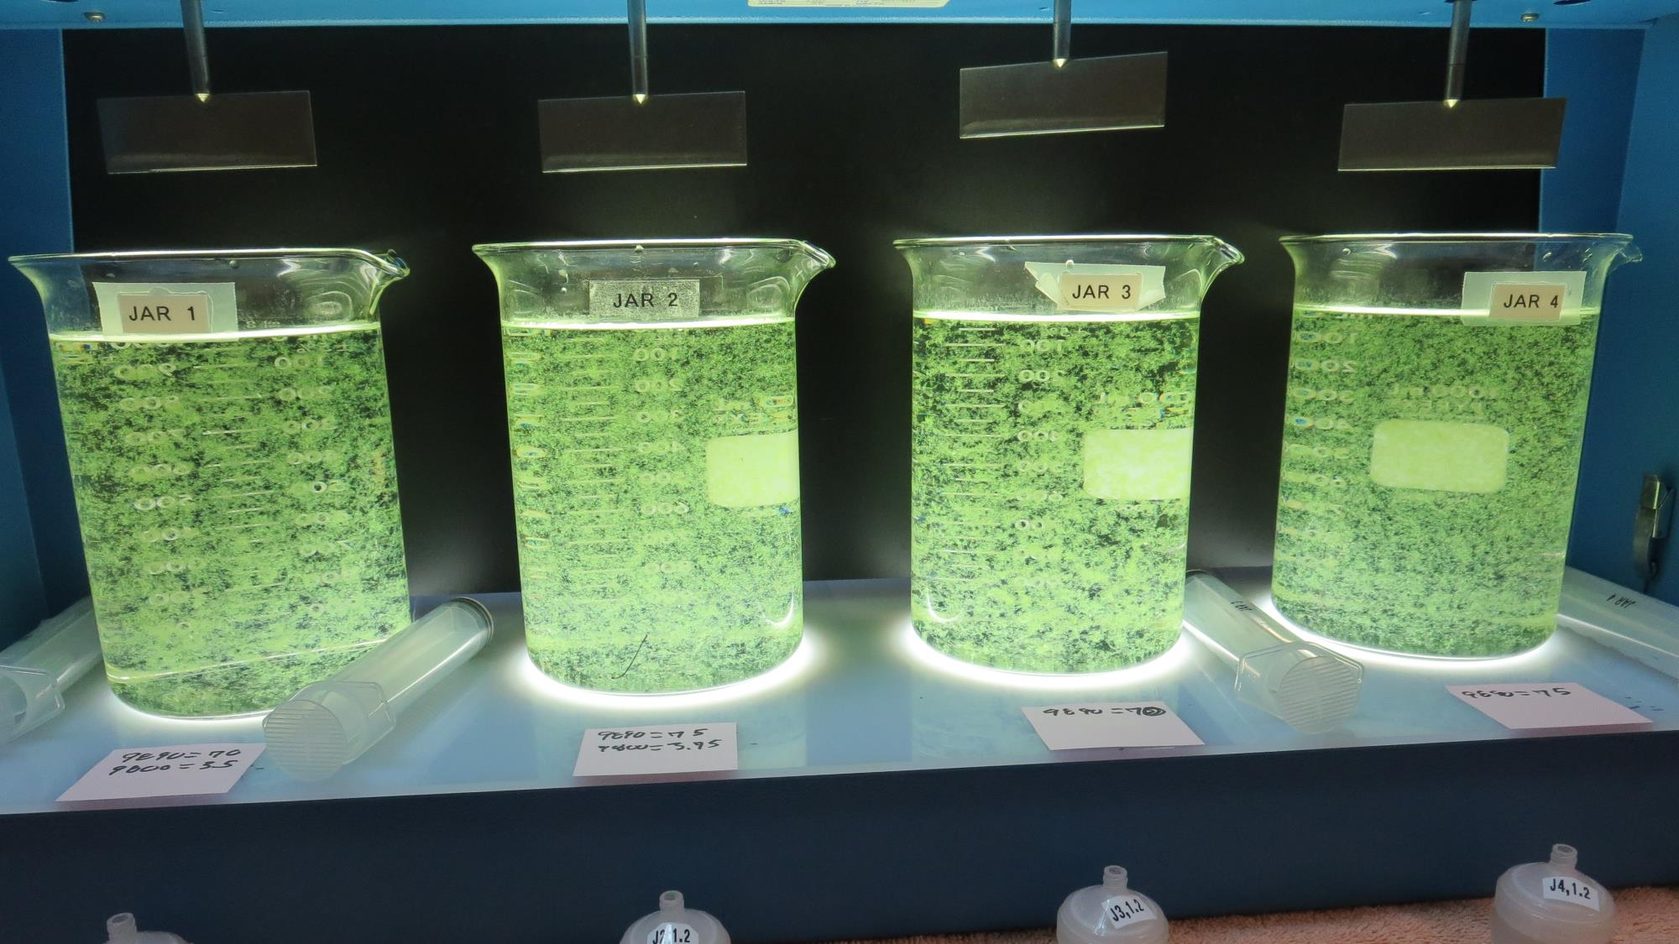
Jars 16-19: End of 5-minute flocculation (30 RPM) duration.
70 mg/L 9890
3.5 mg/L 9800
Filtrate 0.10 NTU
UVT: 92.5%
UVA: 0.033/cm
UVA Reduction: 63.7%
Settled: 0.87 NTU
75 mg/L 9890
3.5 mg/L 9800
Filtrate 0.10 NTU
UVT: 92.4%
UVA: 0.034/cm
UVA Reduction: 62.6%
Settled: 0.43 NTU
70 mg/L 9890
0 mg/L 9800
Filtrate 0.09 NTU
UVT: 92.3%
UVA: 0.034/cm
UVA Reduction: 62.6%
Settled: 0.33 NTU
75 mg/L 9890
0 mg/L 9800
Filtrate 0.09 NTU
UVT: 92.2%
UVA: 0.034/cm
UVA Reduction: 62.6%
Settled: 0.31 NTU

Slide 29
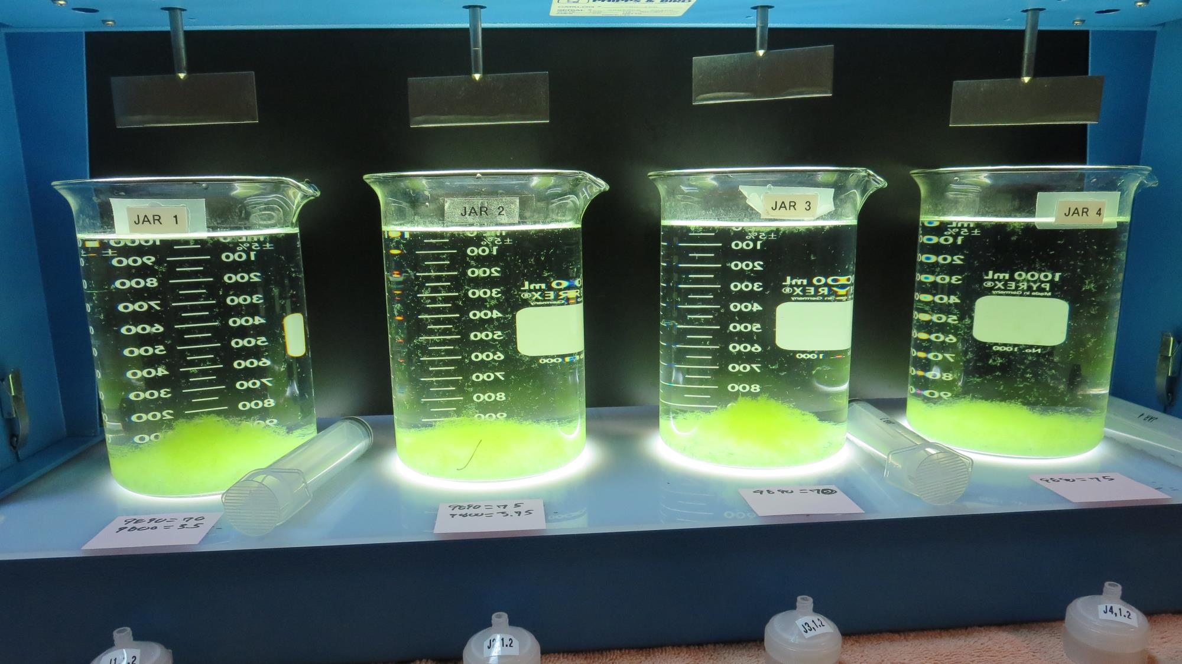
Jars 16-19: After 5 min of settling, 25 mL is syringed for filterability and %UVT/UVA.

Slide 30
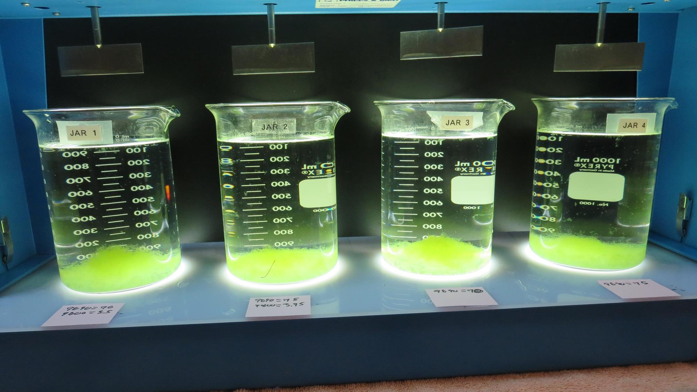
Jars 16-19: After 25-minutes of settling, settled water turbidity is taken.
70 mg/L 9890
3.5 mg/L 9800
Filtrate 0.10 NTU
UVT: 92.5%
UVA: 0.033/cm
UVA Reduction: 63.7%
Settled: 0.87 NTU
75 mg/L 9890
3.5 mg/L 9800
Filtrate 0.10 NTU
UVT: 92.4%
UVA: 0.034/cm
UVA Reduction: 62.6%
Settled: 0.43 NTU
70 mg/L 9890
0 mg/L 9800
Filtrate 0.09 NTU
UVT: 92.3%
UVA: 0.034/cm
UVA Reduction: 62.6%
Settled: 0.33 NTU
75 mg/L 9890
0 mg/L 9800
Filtrate 0.09 NTU
UVT: 92.2%
UVA: 0.034/cm
UVA Reduction: 62.6%
Settled: 0.31 NTU

Slide 31
Jars 20-23 Test
Flash Mix 30 Sec (200 RPM)
Floc Mix 5 min (30 RPM)
Applied Coagulant
9890

Slide 32
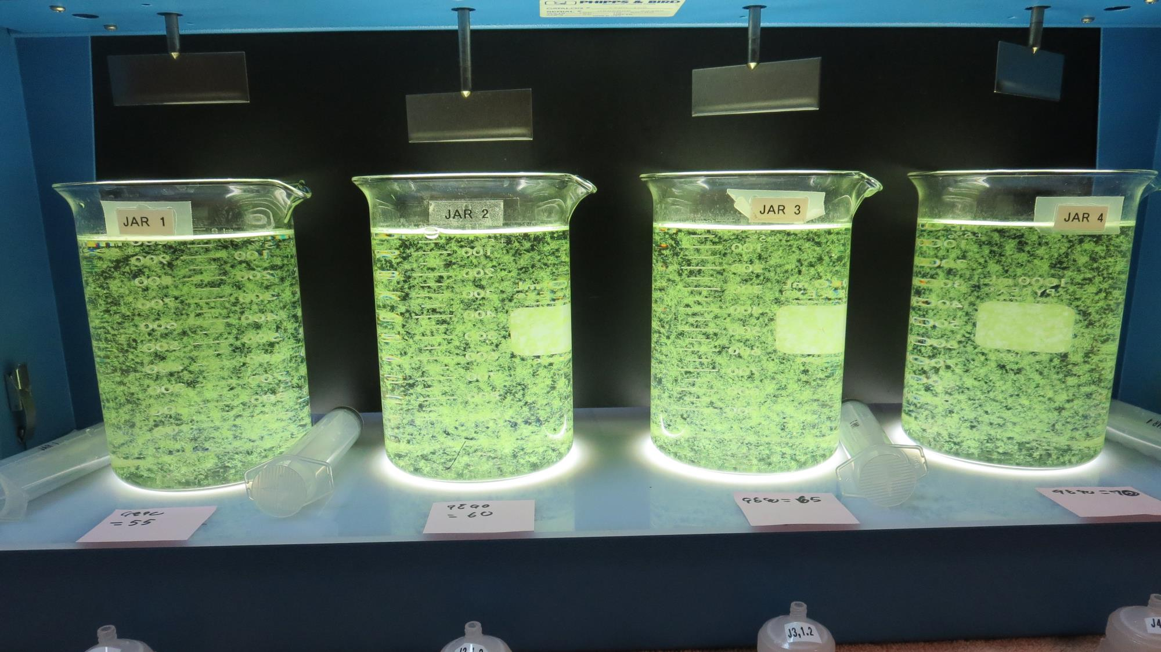
Jars 20-23: End of 5-minute flocculation (30 RPM) duration.
55 mg/L 9890
Filtrate 0.08 NTU
UVT: 92.2%
UVA: 0.035/cm
UVA Reduction: 61.5%
Settled: 0.31 NTU
60 mg/L 9890
Filtrate 0.08 NTU
UVT: 92.1%
UVA: 0.035/cm
UVA Reduction: 61.5%
Settled: 0.34 NTU
65 mg/L 9890
Filtrate 0.07 NTU
UVT: 92.1%
UVA: 0.035/cm
UVA Reduction: 61.5%
Settled: 0.54 NTU
70 mg/L 9890
Filtrate 0.08 NTU
UVT: 92.0%
UVA: 0.036/cm
UVA Reduction: 60.4%
Settled: 0.66 NTU

Slide 33
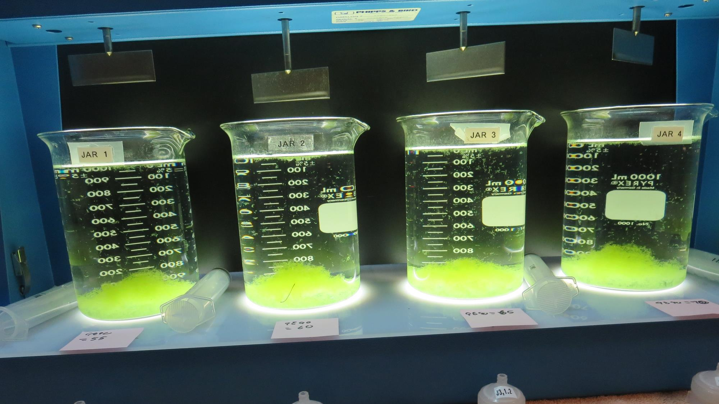
Jars 20-23: After 5 min of settling, 25 mL is syringed for filterability and %UVT/UVA.

Slide 34
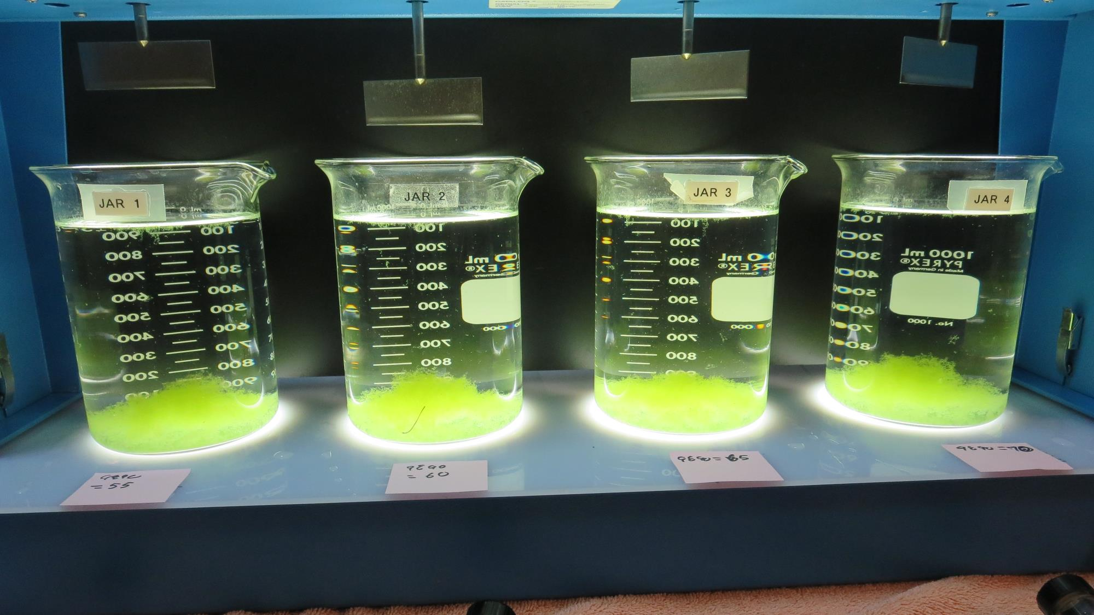
Jars 20-23: After 25-minutes of settling, settled water turbidity is taken.
55 mg/L 9890
Filtrate 0.08 NTU
UVT: 92.2%
UVA: 0.035/cm
UVA Reduction: 61.5%
Settled: 0.31 NTU
60 mg/L 9890
Filtrate 0.08 NTU
UVT: 92.1%
UVA: 0.035/cm
UVA Reduction: 61.5%
Settled: 0.34 NTU
65 mg/L 9890
Filtrate 0.07 NTU
UVT: 92.1%
UVA: 0.035/cm
UVA Reduction: 61.5%
Settled: 0.54 NTU
70 mg/L 9890
Filtrate 0.08 NTU
UVT: 92.0%
UVA: 0.036/cm
UVA Reduction: 60.4%
Settled: 0.66 NTU

Slide 35
Jars 24-27 Test
Flash Mix 30 Sec (200 RPM)
Floc Mix 5 min (30 RPM) w/NaOCl
Applied Coagulant
9890

Slide 36
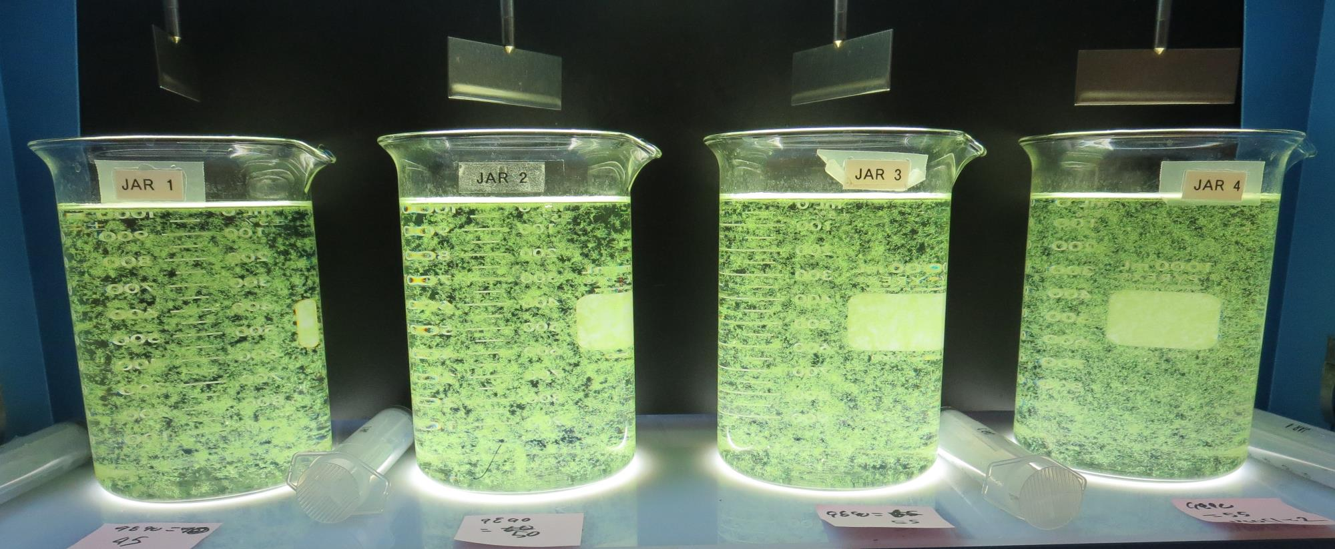
Jars 24-27: End of 5-minute flocculation (30 RPM) duration.
45 mg/L 9890
Filtrate 0.09 NTU
UVT: 91.9%
UVA: 0.036/cm
UVA Reduction: 60.4%
Settled: 0.55 NTU
50 mg/L 9890
Filtrate 0.08 NTU
UVT: 91.9%
UVA: 0.036/cm
UVA Reduction: 60.4%
Settled: 0.33 NTU
55 mg/L 9890
Filtrate 0.08 NTU
UVT: 92.0%
UVA: 0.035/cm
UVA Reduction: 61.5%
Settled: 0.39 NTU
2.0 mg/L NaOCl
55 mg/L 9890
Filtrate 0.08 NTU
UVT: 92.0%
UVA: 0.035/cm
UVA Reduction: 61.5%
Settled: 0.39 NTU

Slide 37
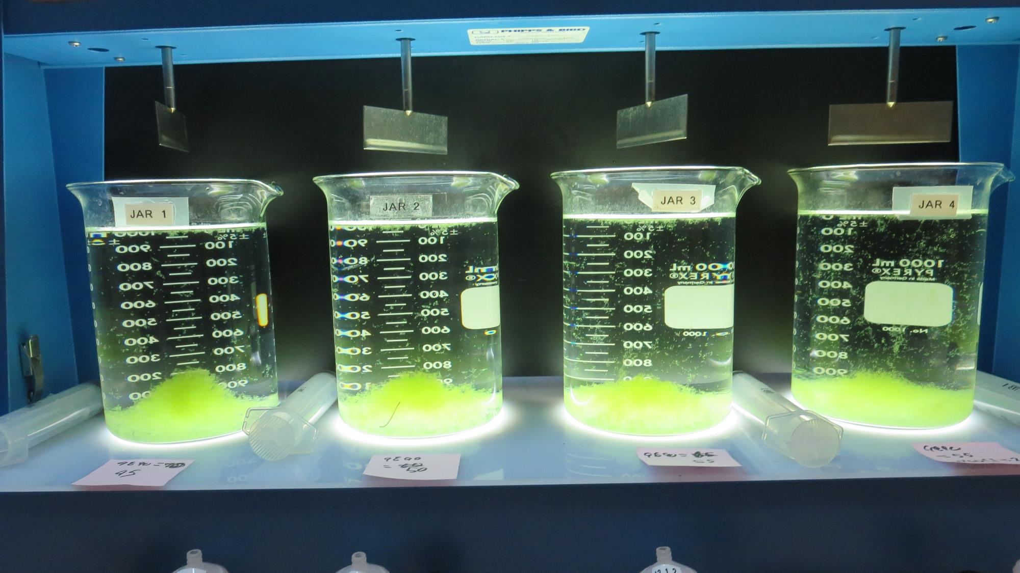
Jars 24-27: After 5 min of settling, 25 mL is syringed for filterability and %UVT/UVA.

Slide 38
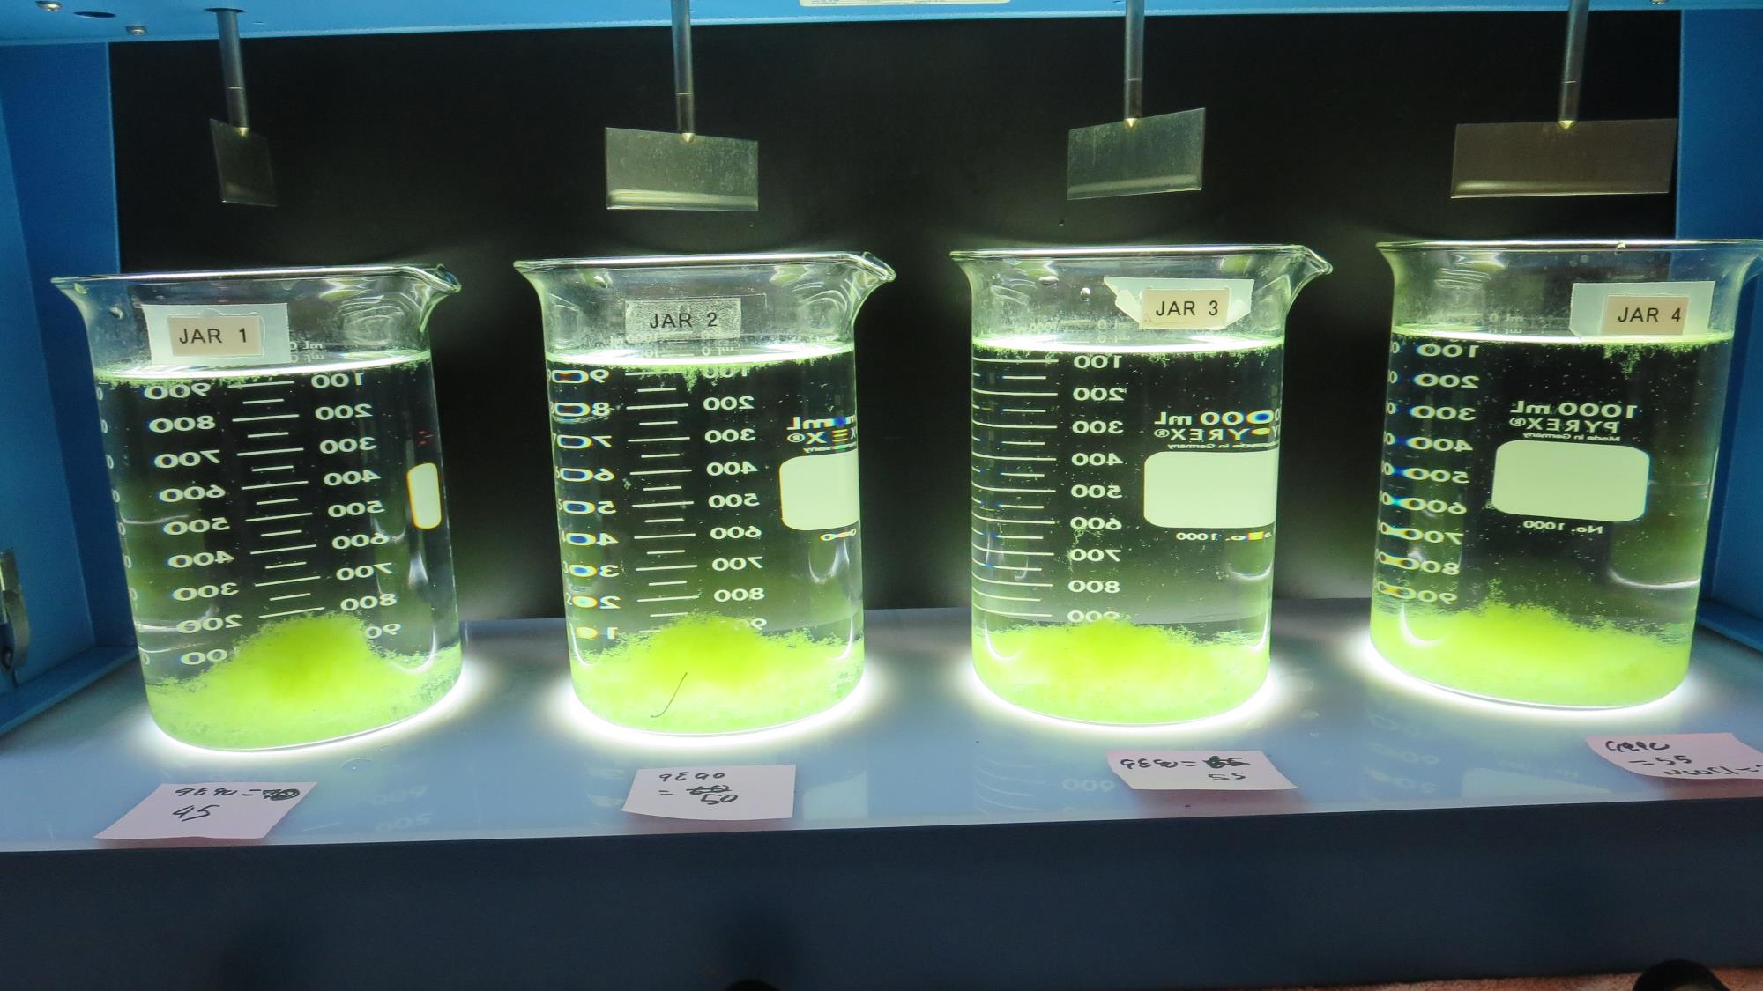
Jars 24-27: After 25-minutes of settling, settled water turbidity is taken.
45 mg/L 9890
Filtrate 0.09 NTU
UVT: 91.9%
UVA: 0.036/cm
UVA Reduction: 60.4%
Settled: 0.55 NTU
50 mg/L 9890
Filtrate 0.08 NTU
UVT: 91.9%
UVA: 0.036/cm
UVA Reduction: 60.4%
Settled: 0.33 NTU
55 mg/L 9890
Filtrate 0.08 NTU
UVT: 92.0%
UVA: 0.035/cm
UVA Reduction: 61.5%
Settled: 0.39 NTU
2.0 mg/L NaOCl
55 mg/L 9890
Filtrate 0.08 NTU
UVT: 92.0%
UVA: 0.035/cm
UVA Reduction: 61.5%
Settled: 0.39 NTU

Slide 39
Jar Testing for 1-Liter Jars:
Procedures for Most Treatment Plants
Fill jars with source water prior to coagulant injection and set paddle speed at 30 rpm
Add chemicals (i.e., NaOCl, primary coagulant, coagulant aid) to each jar
Flash mix for 15-30 seconds (200 rpm)
Slow mix for 5 minutes (20-30 rpm)
Settled for 5 minutes. Syringe 25 mL from each jar taken 1-inch below surface (25 mL/12 sec rate).
Filtered through 1.2 um isopore membrane into cuvette drip rate, 15 mL/(50-90 sec)
Measure filtrate turbidity, chlorine residual and %UVT/UVA
Measure settled water turbidity after 25 minutes of total setting
Record all data

Slide 40

Jar Test
Filterability Test Equipment
Turbidity Instrument
Syringe w/Luer-Lock Tip, 30 cc
(part#: 2225800, by Hach)
Swinnex Filter Holder, 25 mm (part#: SX0002500)
Isopore Membrane Filter, 1.2 um absolute
pore size,
Φ= 25 mm , thickness: 24 um,
hydrophilic polycarbonate membrane
(part #: RTTP02500)
Go to Sigma-Aldrich for laboratory supplies http://www.sigmaaldrich.com/united-states.html

Slide 41
Isopore Membrane Information
Categories | Information
trade name | Isopore
filter color | White
chemistry | Polycarbonate (PC)
water flow rate | Avg. 175 mL/min x cm² (typical results @ 10 psi)
media | Isopore®
wettability | Hydrophilic
porosity | 14.7%
pore size | 1.2 µm
bubble point at 23 °C | 1.0 bar, air with water
thickness | 24 µm
filter diameter (ø) | 25 mm
material size | polycarbonate, Hydrophilic, 1.2 µm, 25 mm, white, plain, 100

Slide 42
Isopore Membrane Background Information
The Isopore membrane is a polycarbonate, track-etched screen filter recommended for all analyses in which the sample is viewed on the surface of the membrane. The Isopore membrane is composed of polycarbonate film, which has a smooth, glass-like surface for clearer sample observation. The unique manufacturing process of the membrane ensures a precise pore diameter and a consistent pore size for accurate separation of samples by size. Matched-weight filters are not usually required because of low, constant tar and ash weights.
Features & Benefits:
Membrane structure retains particles on the surface, simplifying counting and analysis

Slide 43
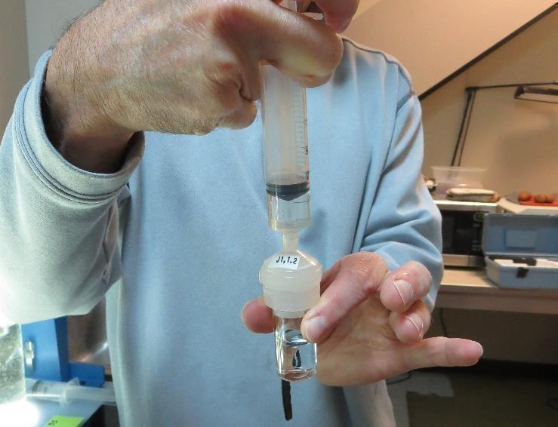

Jar Test - Filterability Test
Syringe ~ 25 mL from jar (after 5-minutes of settling)
Filter-to-waste 3-5 mL
Filter directly into clean cuvette
Measure turbidity
Note: Take several readings before recording final NTU results. Micro bubbles can adhere to glass causing false NTU readings. To remove bubbles, tilt cuvette up to 90 degrees.

Slide 44

Contact
Guy Schott, P.E.
State Water Resources Control Board
Division of Drinking Water
Santa Rosa, CA
Go to Stock Solution/Dose calculations/Jar Test Results for tools to download
www.waterboards.ca.gov/drinking_water/programs/districts/mendocino_district.html
Email: Guy Schott - Guy.Schott@waterboards.ca.gov
Office Number: 707-576-2732

