Slide 1
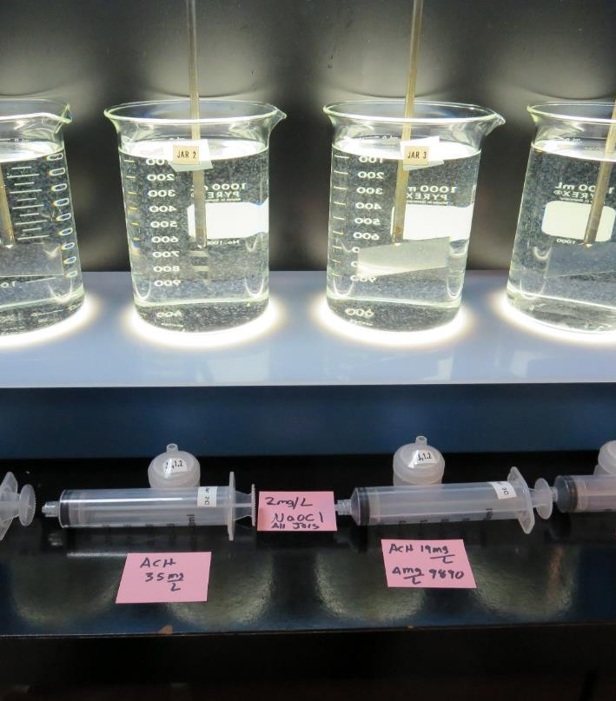
Mt Konocti Mutual Water Company CA1710014 Lake County Jar Test
by Guy Schott, P.E.
December 2, 2018

Slide 2
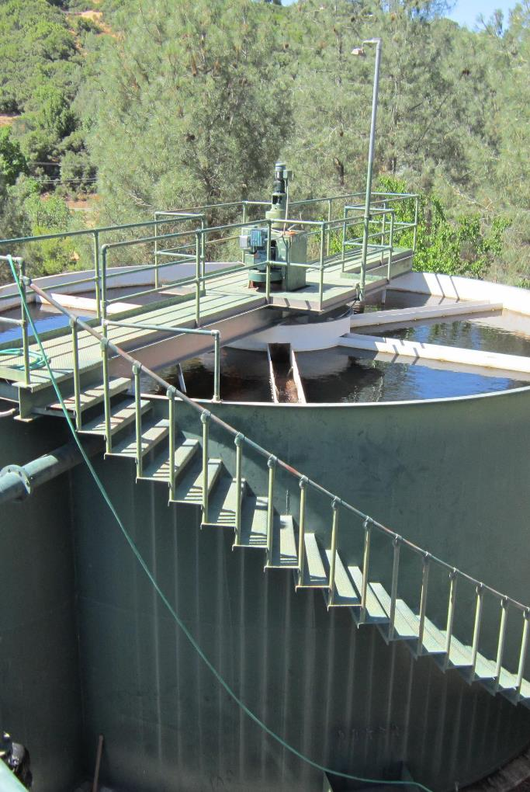
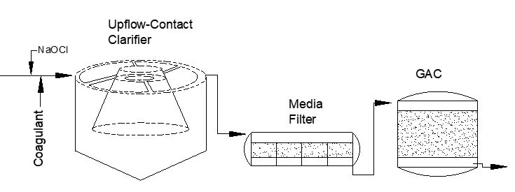
Mt Konocti Mutual Water Company Source Water: Clear Lake Conventional Treatment

Slide 3
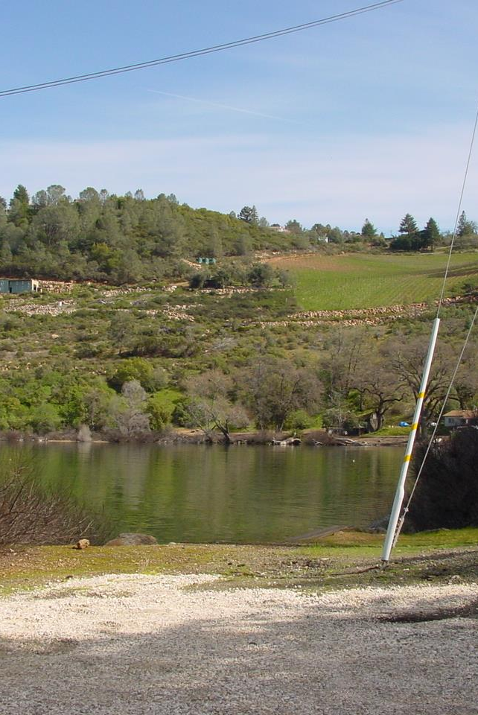
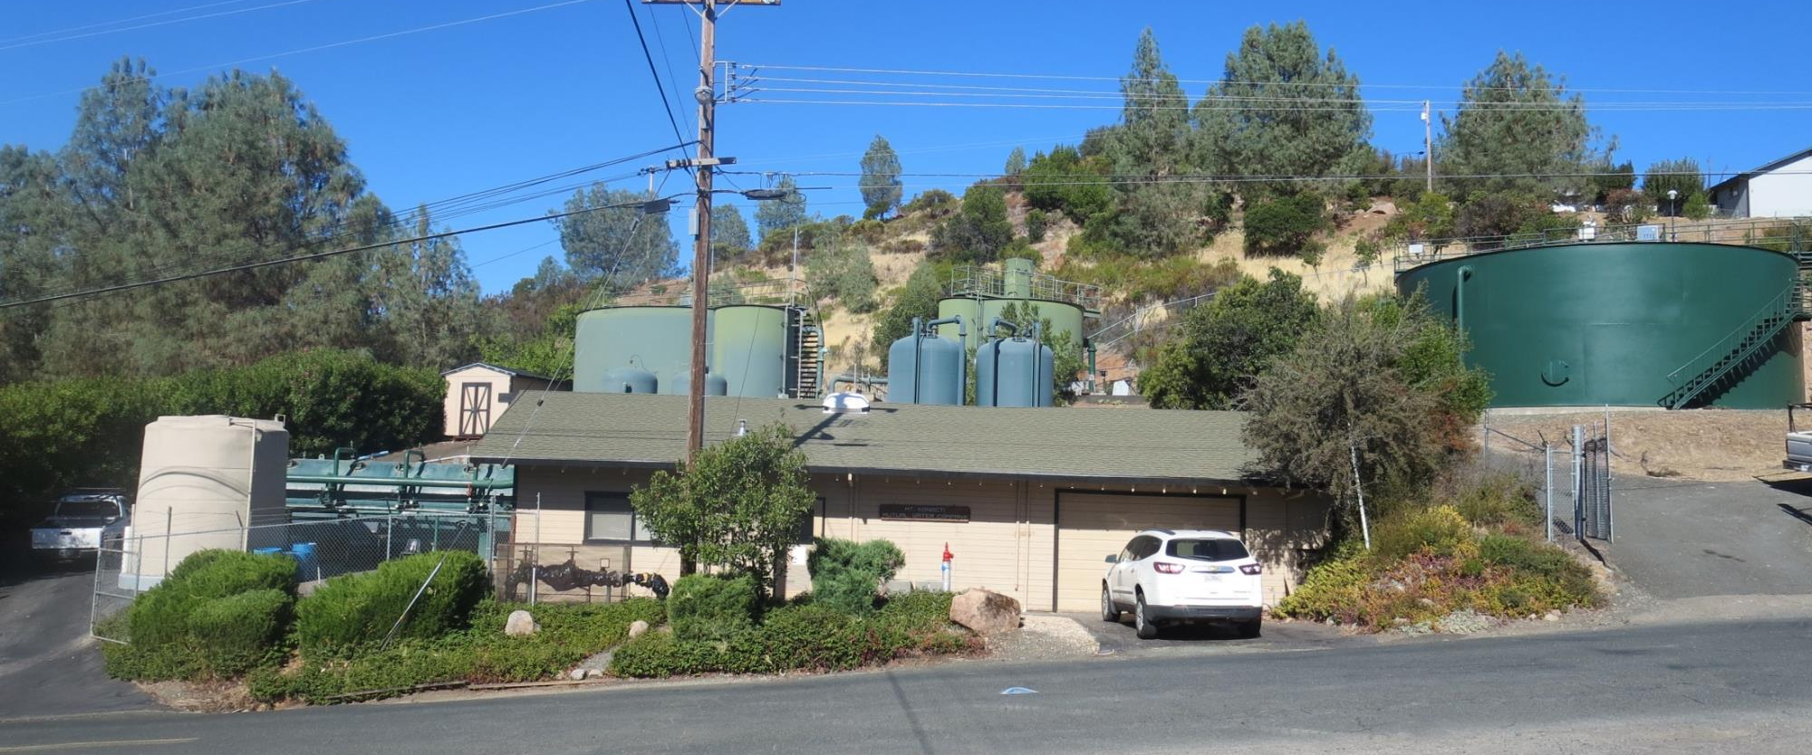
Mt Konocti Mutual Water Company

Slide 4
Mt Konocti Mutual Water Company, December 2, 2018 Clear Lake Source Water Characteristics
Source Water Charateristics
Turbidity: 2.2 NTU
Particles > 2.0 um: 10,137/mL
pH: 7.8
UVT: 82.7%
UVA: 0.082/cm

Slide 5
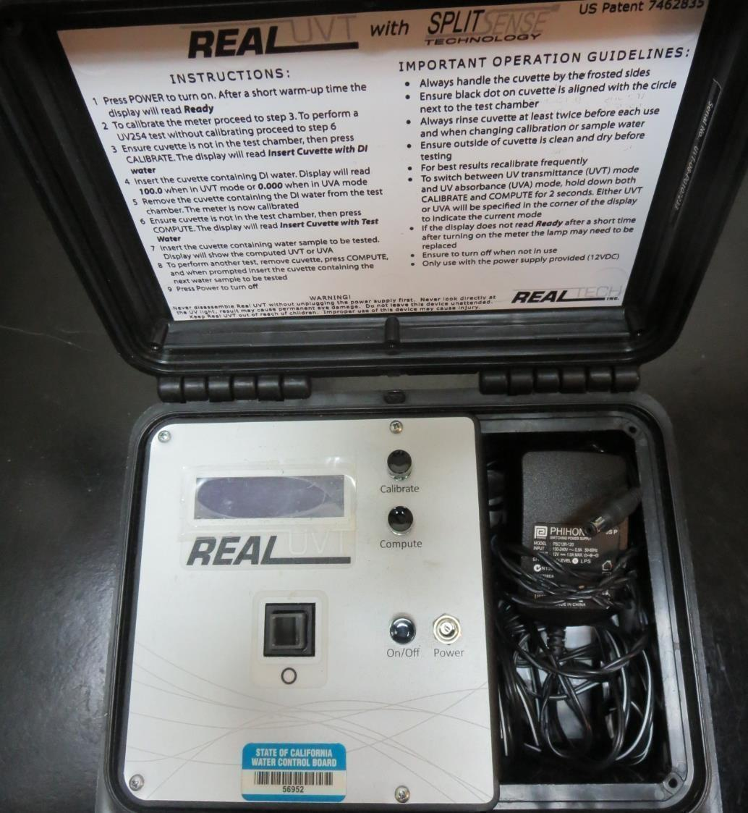
UVT/UVA
UV transmittance (UVT) is a measurement of the amount of ultraviolet light (commonly at 254 nm due to its germicidal effect) that passes through a water sample compared to the amount of light that passes through a pure water sample. The measurement is expressed as a percentage, % UVT.
%UVT = 10^{(-UVA)} x 100%
UV absorbance (UVA) is calculated as a relative measure of the amount of light absorbed by a water sample compared with the amount of light absorbed by a pure water sample.
UVA = -log(%UVT/100)

Slide 6
Coagulants Used for Jar Testing
9800 (NTU Technologies)
50% Aluminum Chlorohydrate
50% Water
SG = 1.34
Aluminum Sulfate
% Active 48.2%
SG = 1.34
9890 (NTU Technologies)
35-45% Aluminum Chlorohydrate
35-45% Water
20% Proprietary
SG = 1.25-1.34

Slide 7
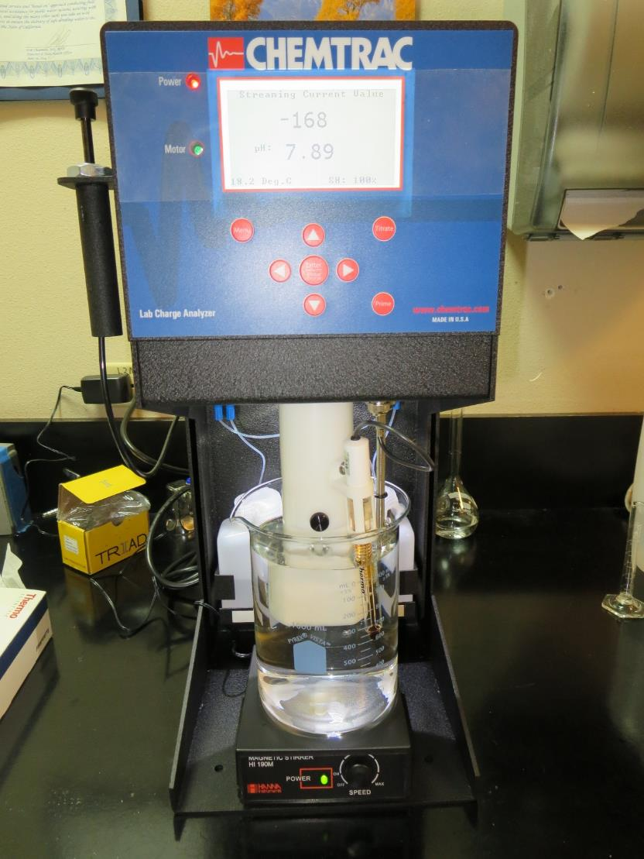
Laboratory Charge Analyzer
LCA: Used to determine coagulant demand of a source water entering the treatment plant.
Source pH: 7.89
pH adjusted to 7.5 w/acetic acid
9800: 27 mg/L as product
2) Source pH: 7.89
Added 4 mg/L of 9890 as product
pH adjusted to 7.5 w/acetic acid
9800: 11 mg/L as product
3) Source pH: 7.89
Added 50 mg/L H₂SO₄ to reduce pH to 6.58
Alum: 50 mg/L

Slide 8
Coagulant Information
Unless stated otherwise, all coagulant doses are reported as Product (100% strength). Aluminum Sulfate is reported as Alum.
Preparation of coagulant stock solutions are generally 1.0 and/or 0.1 percent strength using 100 and/or 200 mL volumetric flasks.
Finnpipette F2 variable volume pipette, capacity 100-1000 micro liters is used for stock solution preparation and coagulant aid jar test dosing.
Finnpipette F2 variable volume pipette, capacity 0.5-5 mL is used for primary coagulant jar test dosing.

Slide 9
Mt Konocti MWC, Jar Test 1-8 Results
Jar # | 200 RPM Flash Mix Sec | 30 RPM Floc Mix Minutes | 9800 mg/L | Filtrate NTU | Filtrate %UVT | Filtrate UVA/cm | Settle NTU 25 min
J1 | 60 | 5 | 23 | 0.08 | 88.2 | 0.055 | 0.28
J2 | 60 | 5 | 27 | 0.06 | 88.7 | 0.052 | 0.28
J3 | 60 | 5 | 31 | 0.06 | 88.8 | 0.052 | 0.24
J4 | 60 | 5 | 35 | 0.05 | 89.3 | 0.049 | 0.30
J5 | 60 | 5 | 39 | 0.16 | 88.6 | 0.053 | 0.32
J6 | 60 | 5 | 43 | 0.06 | 89.6 | 0.048 | 0.23
J7 | 60 | 5 | 47 | 0.11 | 89.3 | 0.049 | 0.24
J8 | 60 | 5 | 51 | 0.06 | 89.7 | 0.049 | 0.37

Slide 10
Mt Konocti MWC, Jar Test 9-12 Results
Jar # | 200 RPM Flash Mix Sec | 30 RPM Floc Mix Minutes | 9800 mg/L | 9890 mg/L | Filtrate NTU | Filtrate %UVT | Filtrate UVA/cm | Settle NTU 25 min
J9 | 60 | 5 | 11 | 4 | 0.09 | 87.9 | 0.056 | 0.38
J10 | 60 | 5 | 15 | 4 | 0.11 | 87.9 | 0.056 | 0.56
J11 | 60 | 5 | 19 | 4 | 0.06 | 88.4 | 0.054 | 0.39
J12 | 60 | 5 | 23 | 4 | 0.05 | 88.7 | 0.052 | 0.50

Slide 11
Mt Konocti MWC, Jar Test 13-16 Results
Jar # | 200 RPM Flash Mix Sec | 30 RPM Floc Mix Minutes | H₂SO₄ mg/L | Alum mg/L | Filtrate NTU | Filtrate %UVT | Filtrate UVA/cm | Settle NTU 25 min
J13 | 60 | 5 | 50 | 50 | 0.09 | 88.9 | 0.052 | 0.38
J14 | 60 | 5 | 50 | 60 | 0.06 | 89.3 | 0.049 | 0.63
J15 | 60 | 5 | 50 | 70 | 0.05 | 89.4 | 0.049 | 0.90
J16 | 60 | 5 | 50 | 80 | 0.05 | 89.7 | 0.047 | 0.65

Slide 12
Mt Konocti MWC, Jar Test 17-20 Results Flash Mix 60 sec (200 RPM)
Jar # | 30 RPM Floc Mix Minutes | NaOCl mg/L | 9800 mg/L | 9890 mg/L | Filtrate NTU | Filtrate %UVT | Filtrate UVA/cm | Settle NTU 25 min
J17 | 5 | 2 | 31 | 0 | 0.05 | 90.3 | 0.044 | 0.14
J18 | 5 | 2 | 35 | 0 | 0.04 | 90.2 | 0.045 | 0.18
J19 | 5 | 2 | 19 | 4 | 0.04 | 89.6 | 0.048 | 0.24
J20 | 5 | 2 | 23 | 4 | 0.04 | 89.9 | 0.046 | 0.23

Slide 13
Jars 1-4 Test Flash Mix 60 Sec (200 RPM) Floc Mix 5 min (30 RPM) Applied Coagulant 9800

Slide 14
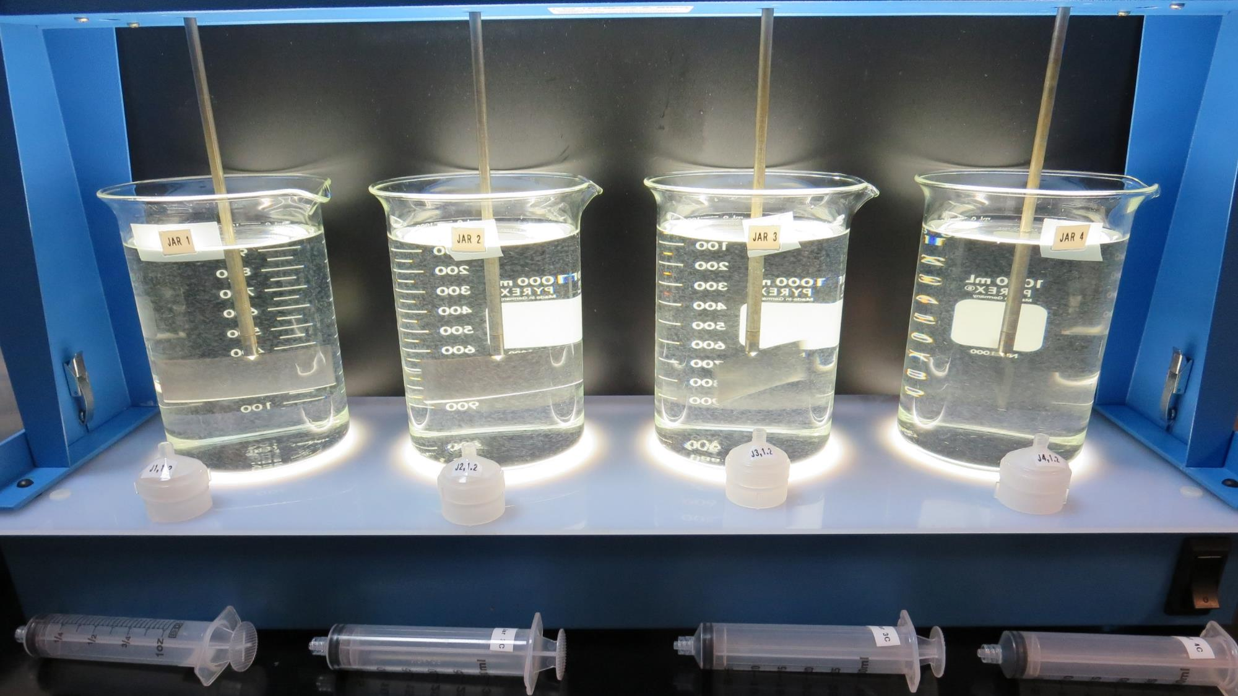
Jars 1-4: End of 5-minute flocculation (30 RPM) duration. After 5 min of settling, 25 mL is decanted for filterability and %UVT/UVA.
23 mg/L 9800
Filtrate 0.08 NTU
UVT: 88.2%
UVA: 0.055/cm
Settled: 0.28 NTU
27 mg/L 9800
Filtrate 0.06 NTU
UVT: 88.7%
UVA: 0.052/cm
Settled: 0.28 NTU
31 mg/L 9800
Filtrate 0.06 NTU
UVT: 88.8%
UVA: 0.052/cm
Settled: 0.24 NTU
35 mg/L 9800
Filtrate 0.05 NTU
UVT: 89.3%
UVA: 0.049/cm
Settled: 0.30 NTU

Slide 15
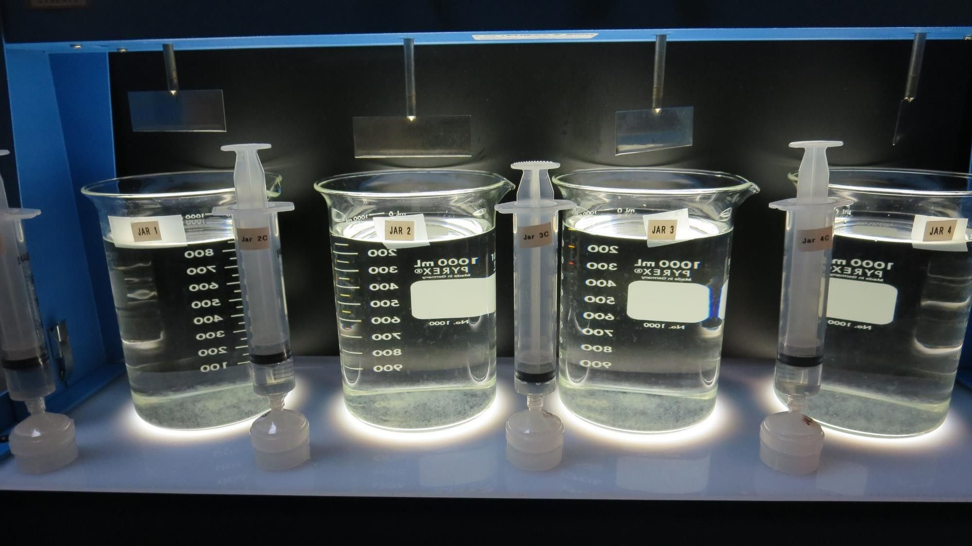
Jars 1-4: After 25-minutes of settling, settled water turbidity is taken.
23 mg/L 9800
Filtrate 0.08 NTU
UVT: 88.2%
UVA: 0.055/cm
Settled: 0.28 NTU
27 mg/L 9800
Filtrate 0.06 NTU
UVT: 88.7%
UVA: 0.052/cm
Settled: 0.28 NTU
31 mg/L 9800
Filtrate 0.06 NTU
UVT: 88.8%
UVA: 0.052/cm
Settled: 0.24 NTU
35 mg/L 9800
Filtrate 0.05 NTU
UVT: 89.3%
UVA: 0.049/cm
Settled: 0.30 NTU

Slide 16
Jars 5-8 Test Flash Mix 60 Sec (200 RPM) Floc Mix 5 min (30 RPM) Applied Coagulant 9800

Slide 17
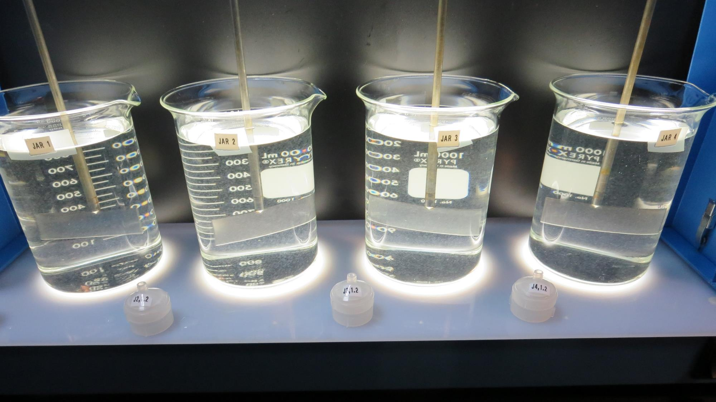
Jars 5-8: End of 5-minute flocculation (30 RPM) duration. After 5 min of settling, 25 mL is decanted for filterability and %UVT/UVA.
39 mg/L 9800
Filtrate 0.16 NTU
UVT: 88.6%
UVA: 0.053/cm
Settled: 0.32 NTU
43 mg/L 9800
Filtrate 0.06 NTU
UVT: 89.6%
UVA: 0.048/cm
Settled: 0.23 NTU
47 mg/L 9800
Filtrate 0.11 NTU
UVT: 89.3%
UVA: 0.049/cm
Settled: 0.24 NTU
51 mg/L 9800
Filtrate 0.06 NTU
UVT: 89.7%
UVA: 0.049/cm
Settled: 0.37 NTU

Slide 18
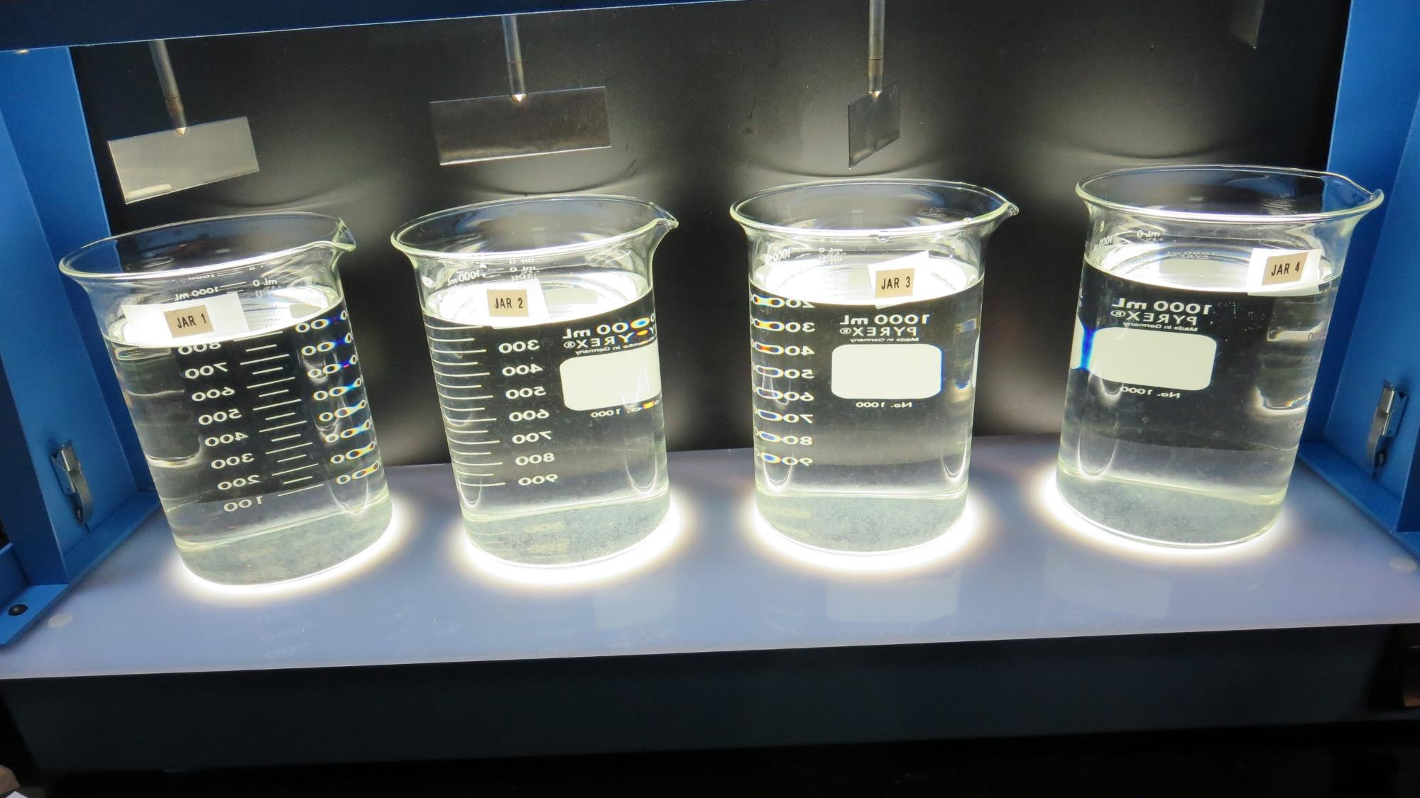
Jars 5-8: After 25-minutes of settling, settled water turbidity is taken.
39 mg/L 9800
Filtrate 0.16 NTU
UVT: 88.6%
UVA: 0.053/cm
Settled: 0.32 NTU
43 mg/L 9800
Filtrate 0.06 NTU
UVT: 89.6%
UVA: 0.048/cm
Settled: 0.23 NTU
47 mg/L 9800
Filtrate 0.11 NTU
UVT: 89.3%
UVA: 0.049/cm
Settled: 0.24 NTU
51 mg/L 9800
Filtrate 0.06 NTU
UVT: 89.7%
UVA: 0.049/cm
Settled: 0.37 NTU

Slide 19
Jars 9-12 Test Flash Mix 60 Sec (200 RPM) Floc Mix 5 min (30 RPM) Applied Coagulants 9800/9890

Slide 20
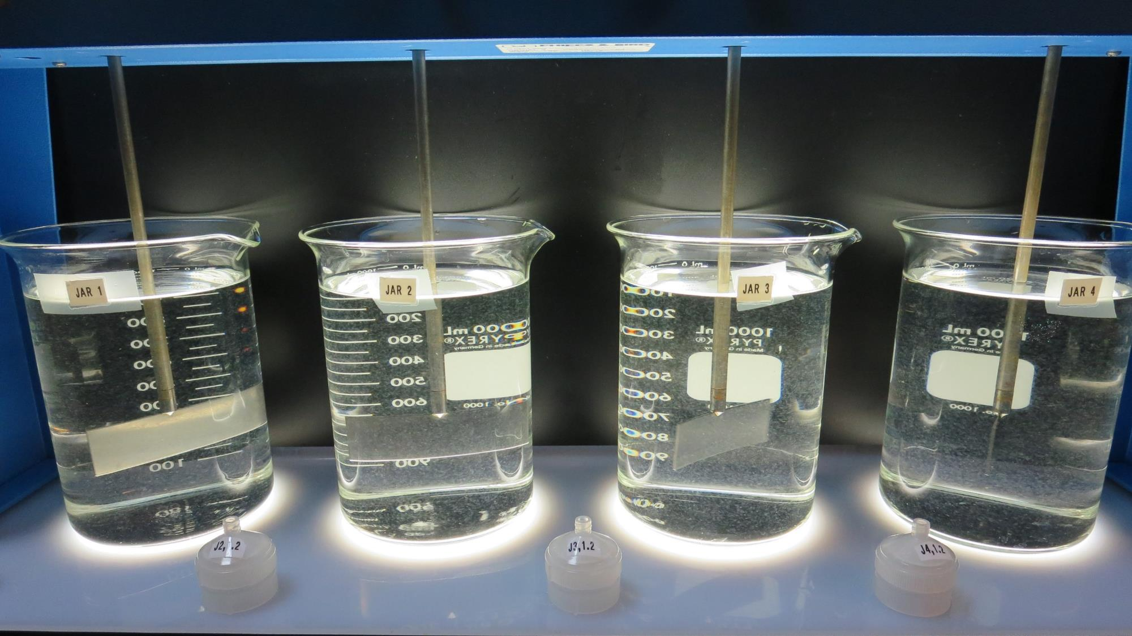
Jars 9-12: End of 5-minute flocculation (30 RPM) duration. After 5 min of settling, 25 mL is decanted for filterability and %UVT/UVA.
11 mg/L 9800
4 mg/L 9890
Filtrate 0.09 NTU
UVT: 87.9%
UVA: 0.056/cm
Settled: 0.38 NTU
15 mg/L 9800
4 mg/L 9890
Filtrate 0.11 NTU
UVT: 87.9%
UVA: 0.056/cm
Settled: 0.56 NTU
19 mg/L 9800
4 mg/L 9890
Filtrate 0.06 NTU
UVT: 88.4%
UVA: 0.054/cm
Settled: 0.39 NTU
23 mg/L 9800
4 mg/L 9890
Filtrate 0.05 NTU
UVT: 88.7%
UVA: 0.052/cm
Settled: 0.50 NTU

Slide 21
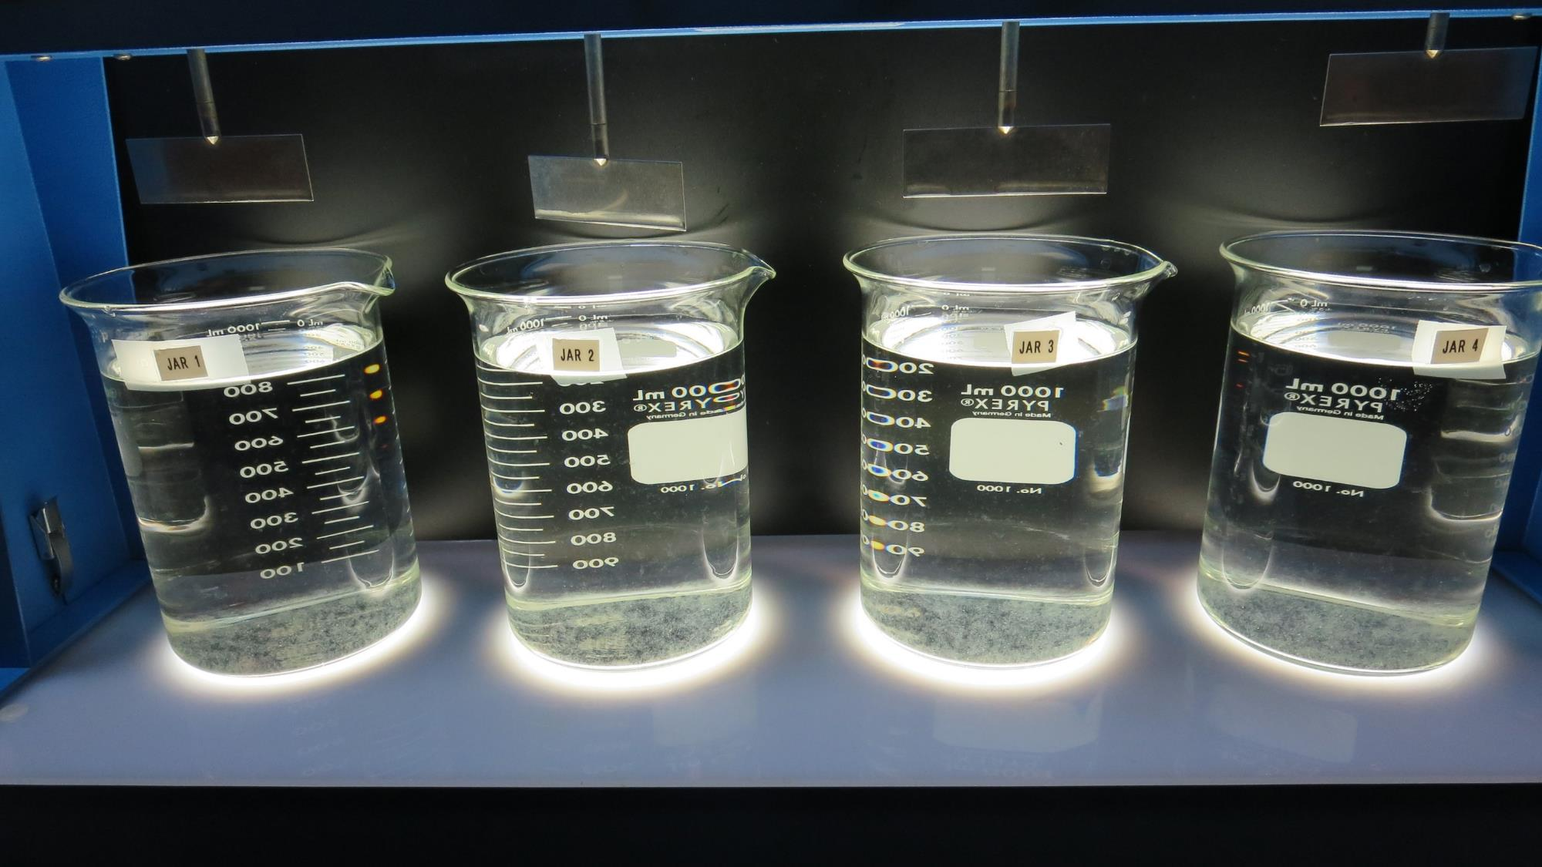
Jars 9-12: After 25-minutes of settling, settled water turbidity is taken.
11 mg/L 9800
4 mg/L 9890
Filtrate 0.09 NTU
UVT: 87.9%
UVA: 0.056/cm
Settled: 0.38 NTU
15 mg/L 9800
4 mg/L 9890
Filtrate 0.11 NTU
UVT: 87.9%
UVA: 0.056/cm
Settled: 0.56 NTU
19 mg/L 9800
4 mg/L 9890
Filtrate 0.06 NTU
UVT: 88.4%
UVA: 0.054/cm
Settled: 0.39 NTU
23 mg/L 9800
4 mg/L 9890
Filtrate 0.05 NTU
UVT: 88.7%
UVA: 0.052/cm
Settled: 0.50 NTU

Slide 22
Jars 13-16 Test Flash Mix 60 Sec (200 RPM) Floc Mix 5 min (30 RPM) Applied Coagulant Alum w/H₂SO₄

Slide 23
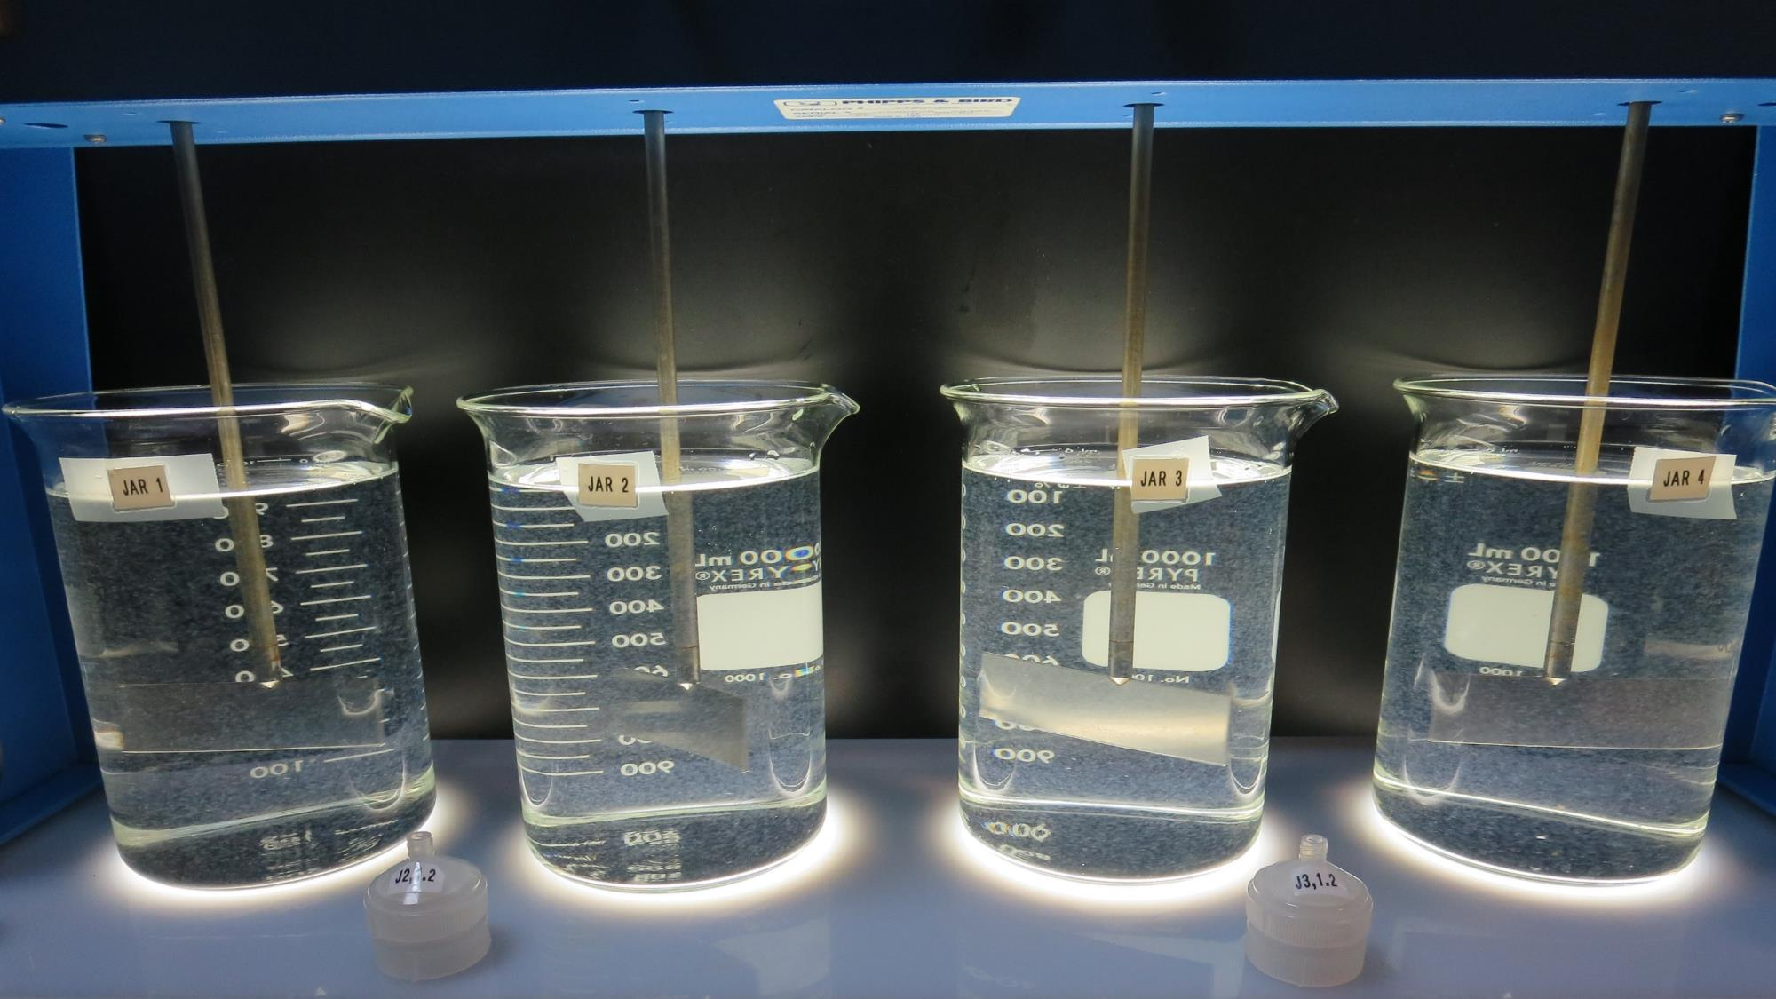
Jars 13-16: End of 5-minute flocculation (30 RPM) duration. After 5 min of settling, 25 mL is decanted for filterability and %UVT/UVA.
50 mg/L H₂SO₄
50 mg/L Alum
Filtrate 0.09 NTU
UVT: 88.9%
UVA: 0.052/cm
Settled: 0.38 NTU
50 mg/L H₂SO₄
60 mg/L Alum
Filtrate 0.06 NTU
UVT: 89.3%
UVA: 0.049/cm
Settled: 0.63 NTU
50 mg/L H₂SO₄
70 mg/L Alum
Filtrate 0.05 NTU
UVT: 89.4%
UVA: 0.049/cm
Settled: 0.90 NTU
50 mg/L H₂SO₄
80 mg/L Alum
Filtrate 0.05 NTU
UVT: 89.7%
UVA: 0.047/cm
Settled: 0.65 NTU

Slide 24
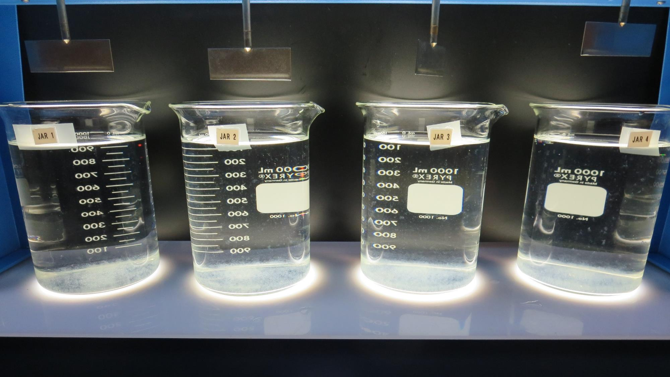
Jars 13-16: After 25-minutes of settling, settled water turbidity is taken.
50 mg/L H₂SO₄
50 mg/L Alum
Filtrate 0.09 NTU
UVT: 88.9%
UVA: 0.052/cm
Settled: 0.38 NTU
50 mg/L H₂SO₄
60 mg/L Alum
Filtrate 0.06 NTU
UVT: 89.3%
UVA: 0.049/cm
Settled: 0.63 NTU
50 mg/L H₂SO₄
70 mg/L Alum
Filtrate 0.05 NTU
UVT: 89.4%
UVA: 0.049/cm
Settled: 0.90 NTU
50 mg/L H₂SO₄
80 mg/L Alum
Filtrate 0.05 NTU
UVT: 89.7%
UVA: 0.047/cm
Settled: 0.65 NTU

Slide 25
Jars 17-20 Test Flash Mix 60 Sec (200 RPM) Floc Mix 5 min (30 RPM) Applied Coagulants 9800/9890 w/NaOCl

Slide 26
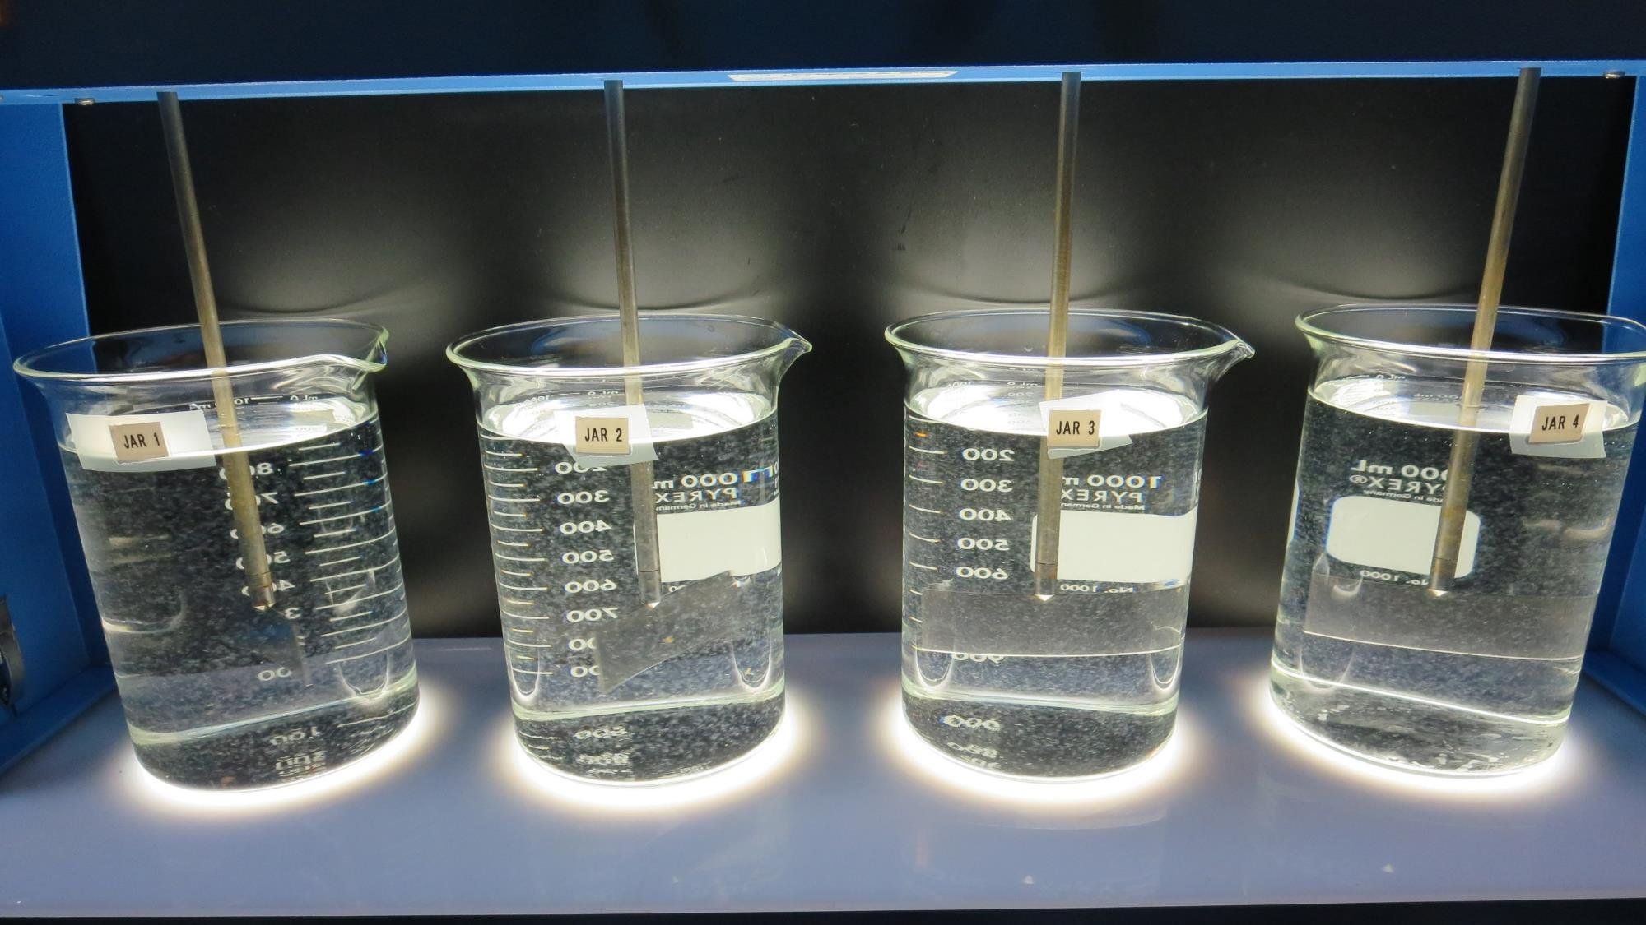
Jars 17-20: End of 5-minute flocculation (30 RPM) duration. After 5 min of settling, 25 mL is decanted for filterability and %UVT/UVA.
2 mg/L NaOCl
19 mg/L 9800
4 mg/L 9890
Filtrate 0.04 NTU
UVT: 89.6%
UVA: 0.048/cm
Settled: 0.24 NTU
2 mg/L NaOCl
23 mg/L 9800
4 mg/L 9890
Filtrate 0.04 NTU
UVT: 89.9%
UVA: 0.046/cm
Settled: 0.23 NTU
2 mg/L NaOCl
31 mg/L 9800
Filtrate 0.05 NTU
UVT: 90.3%
UVA: 0.044/cm
Settled: 0.14 NTU
2 mg/L NaOCl
35 mg/L 9800
Filtrate 0.04 NTU
UVT: 90.2%
UVA: 0.045/cm
Settled: 0.18 NTU

Slide 27
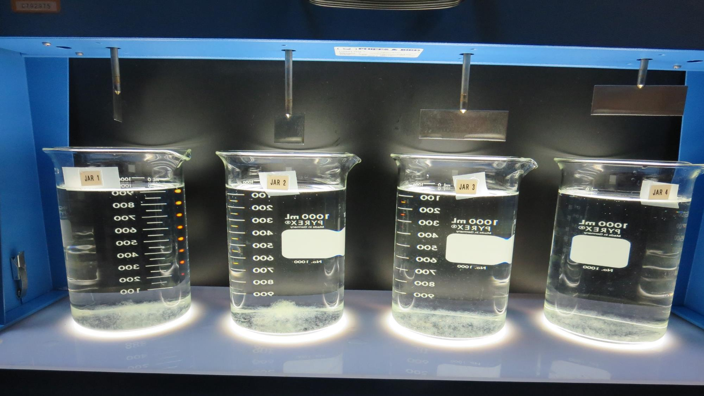
Jars 17-20: After 25-minutes of settling, settled water turbidity is taken.
2 mg/L NaOCl
31 mg/L 9800
Filtrate 0.05 NTU
UVT: 90.3%
UVA: 0.044/cm
Settled: 0.14 NTU
2 mg/L NaOCl
35 mg/L 9800
Filtrate 0.04 NTU
UVT: 90.2%
UVA: 0.045/cm
Settled: 0.18 NTU
2 mg/L NaOCl
19 mg/L 9800
4 mg/L 9890
Filtrate 0.04 NTU
UVT: 89.6%
UVA: 0.048/cm
Settled: 0.24 NTU
2 mg/L NaOCl
23 mg/L 9800
4 mg/L 9890
Filtrate 0.04 NTU
UVT: 89.9%
UVA: 0.046/cm
Settled: 0.23 NTU

Slide 28
Jar Testing for 1-Liter Jars: Procedures for Most Treatment Plants
Fill jars with source water prior to coagulant injection and set paddle speed at 30 rpm
Add chemicals (i.e., NaOCl, primary coagulant, coagulant aid) to each jar
Flash mix for 15-60 seconds (200 rpm)
Slow mix for 5 minutes (20-30 rpm)
Settled for 5 minutes. Syringe 25 mL from each jar taken 1-inch below surface (25 mL/12 sec rate)
Filtered through 1.2 um isopore membrane into cuvette drip rate, 15 mL/(50-90 sec)
Measure filtrate turbidity, chlorine residual and %UVT/UVA
Measure settled water turbidity after 25 minutes of total setting
Record all data

Slide 29
Jar Test Filterability Test Equipment
Turbidity Instrument
Syringe w/Luer-Lock Tip, 30 cc
(part#: 2225800, by Hach)
Swinnex Filter Holder, 25 mm (part#: SX0002500)
Isopore Membrane Filter, 1.2 um absolute
pore size,
Φ= 25 mm , thickness: 24 um,
hydrophilic polycarbonate membrane
(part #: RTTP02500)
Go to Sigma-Aldrich for laboratory supplies http://www.sigmaaldrich.com/united-states.html

Slide 30
Isopore Membrane Information
Categories | Information
trade name | Isopore
filter color | White
chemistry | Polycarbonate (PC)
water flow rate | Avg. 175 mL/min x cm² (typical results @ 10 psi)
media | Isopore®
wettability | Hydrophilic
porosity | 14.7%
pore size | 1.2 µm
bubble point at 23 °C | 1.0 bar, air with water
thickness | 24 µm
filter diameter (ø) | 25 mm
material size | polycarbonate, Hydrophilic, 1.2 µm, 25 mm, white, plain, 100

Slide 31
Isopore Membrane Background Information
The Isopore membrane is a polycarbonate, track-etched screen filter recommended for all analyses in which the sample is viewed on the surface of the membrane. The Isopore membrane is composed of polycarbonate film, which has a smooth, glass-like surface for clearer sample observation. The unique manufacturing process of the membrane ensures a precise pore diameter and a consistent pore size for accurate separation of samples by size. Matched-weight filters are not usually required because of low, constant tar and ash weights. Features & Benefits: Membrane structure retains particles on the surface, simplifying counting and analysis

Slide 32
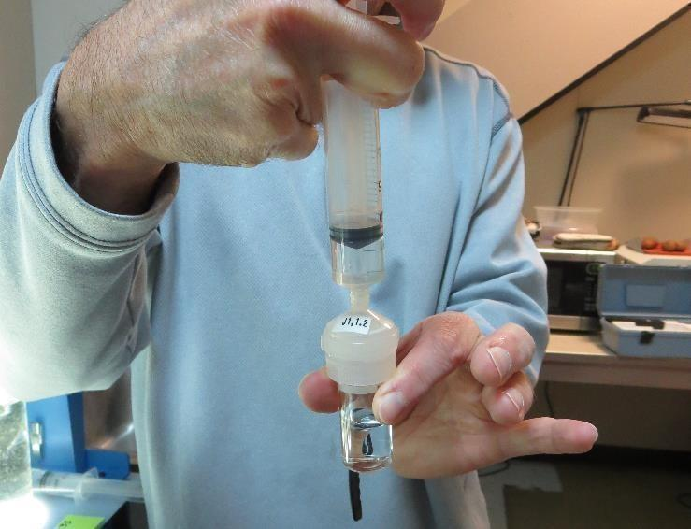
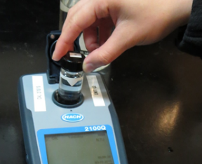
Jar Test - Filterability Test
Syringe ~ 25 mL from jar (after 5-minutes of settling)
Filter-to-waste 3-5 mL
Filter directly into clean cuvette
Measure turbidity
Note: Take several readings before recording final NTU results. Micro bubbles can adhere to glass causing false NTU readings. To remove bubbles, tilt cuvette up to 90 degrees.

Slide 33
Contact
Guy Schott, P.E.
State Water Resources Control Board
Division of Drinking Water
Santa Rosa, CA
Go to Stock Solution/Dose calculations/Jar Test Results for tools to download
www.waterboards.ca.gov/drinking_water/programs/districts/mendocino_district.html
Email: Guy Schott - Guy.Schott@waterboards.ca.gov
Office Number: 707-576-2732

