Slide 1
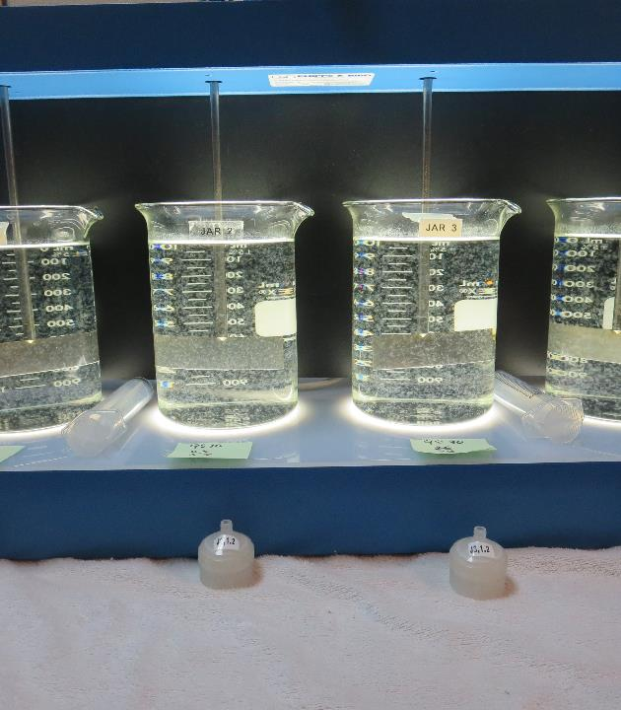
Konocti Harbor Resort
CA1710016
Lake County
Jar Test
by Guy Schott, P.E.
April 23, 2021

Slide 2
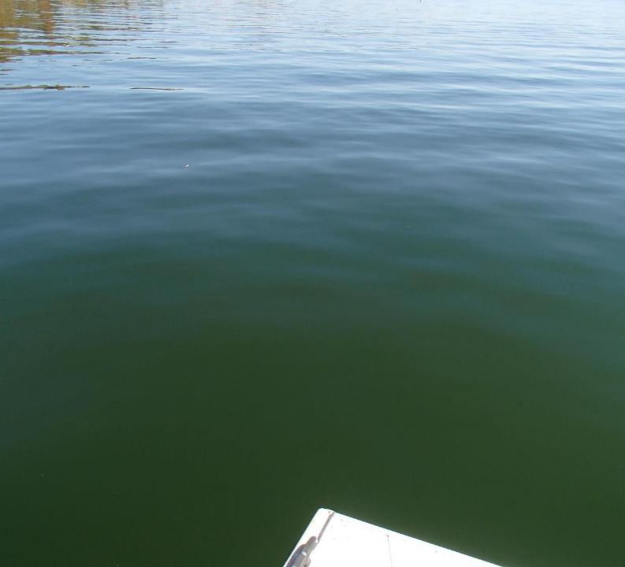
Konocti Harbor Resort Water Characteristics
April 23, 2021
Source
pH: 7.98
Turbidity: 2.56 NTU
UVT: 85.3%,
UVA: 0.068/cm
0.4 um Filtered
Turbidity: 0.20 NTU
D-UVT: 87.7%,
UVA: 0.057/cm

Slide 3
Schematice
CA1710016
Konocti Harbor & Resort
Conventional Treatment

Slide 4
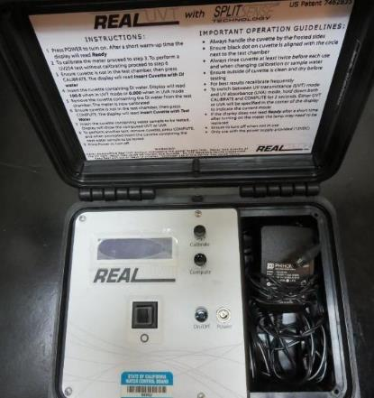
UVT/UVA, pathlength 10 mm
UV transmittance (UVT) is a measurement of the amount of ultraviolet light (254 nm) that passes through a water sample compared to the amount of light that passes through a pure water sample. The measurement is expressed as % UVT.
%UVT = 10^{(-UVA)} x 100%
UV absorbance (UVA) is calculated as a relative measure of the amount of light absorbed by a water sample compared with the amount of light absorbed by a pure water sample.
UVA = -log(%UVT/100)

Slide 5
Konocti Harbor Resort Source & Treated Water Characteristics, April 23, 2021
Source
pH: 7.98
Turbidity: 2.56 NTU
UVT: 85.3%,
UVA: 0.068/cm
0.4 um Filtered
Turbidity: 0.20 NTU
D-UVT: 87.7%,
UVA: 0.057/cm
Plant Filtrate Water (pre-NaOCl added)
Turbidity: 0.05 NTU
UVT: 93.2%,
UVA: 0.030/cm
GAC Filtrate Water
Turbidity: 0.09 NTU
UVT: 93.4%,
UVA: 0.029/cm
Clearwell (post-chlorine)
Turbidity: 0.06 NTU
UVT: 93.8%,
D-UVA: 0.027/cm

Slide 6
Applied Coagulants for Jar Testing (1)
Pro Pac 9810 (NTU Technologies)
45-50% Aluminum Chlorohydrate
45-50% Water
~22.4% Al₂O₃
~11.9% Al
83% Basicity
5% polyamine (50% water, 50% active polyamines)
SG = 1.25-1.34
NSF limit: 200 mg/L as Product;
Product dose 40 mg/L = 1 mg/L polyamines active
Polydyne Incorporated
Clarifloc C-378
SG = 1.0 – 1.2
Viscosity: 800-1000 centipoise
pDADMAC (20% active, 80% H₂O)
NSF limit: 50 mg/L (product)
Product dose 5 mg/L = 1 mg/L pDADMAC active

Slide 7
Applied Coagulants for Jar Testing (2)
BWS, Inc.
AdvFloc-CTC-00011
Polyaluminum Hydroxy Chlorosulfate
12.55% Al₂O₃
6.64% Al
64.9% Basicity
SG = 1.299
NSF limit: 250 mg/L as Product
Gregory F. Nieckarz, Ph.D.
Principal Consultant
SWS Consulting, LLC.
+1.541.953.5112
gregn.swsc@gmail.com

Slide 8
Diallyldimethylammonium chloride or
N-allyl-N,N-dimethylprop-2-en-1-aminium chloride pDADMAC
C₈H₁₆ClN
MW: 161.67 g/mol
CH₃
CH₂
CH₂
CH
N
+
CH
CH₂
CH₂
CH₃
Cl⁻

Slide 9
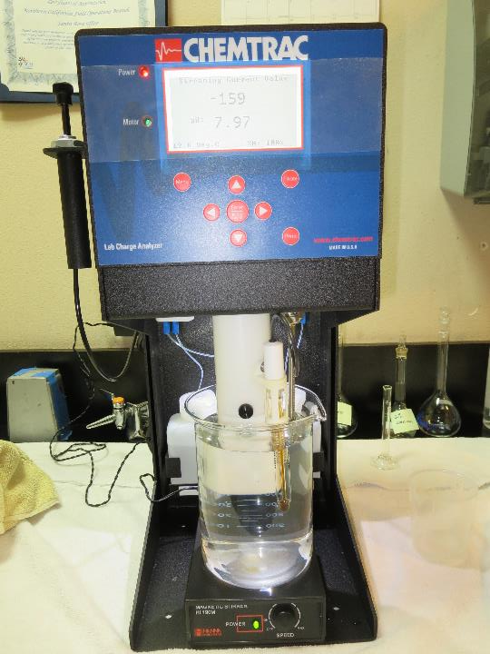
Laboratory Charge Analyzer
LCA: Used to determine coagulant demand of a source water entering the treatment plant.
Source pH: 7.98
LCA #1: 9810: 19.2 mg/L
pH adjusted to 7.7 with acetic acid
LCA #2: AdvFloc CTC-00011: 126 mg/L
pH adjusted to 7.7 with acetic acid

Slide 10
Coagulant Information
Unless stated otherwise, all coagulant doses are reported as Product (100% strength).
Aluminum Sulfate doses are reported as hydrated Al₂(SO₄)₃*14.3H₂0.
Preparation of coagulant stock solutions are generally 1.0 and/or 0.1 percent strength using 100 and/or 200 mL volumetric flasks.
Finnpipette F2 variable volume pipette, capacity 100-1000 micro liters is used for stock solution preparation and coagulant aid jar test dosing.
Finnpipette F2 variable volume pipette, capacity 0.5-5 mL is used for primary coagulant jar test dosing.

Slide 11
Konocti Harbor Resort; Jar Test 1 - 8 Results
Flash Mix 200 RPM (20 sec); Floc Mix 20 RPM (5 min)
Jar# | 9810 mg/L | Filtrate NTU | Filtrate %UVT | Filtrate UVA/cm | %UVA Reduction | Settle NTU 25 min
J1 | 20 | 0.06 | 90.8 | 0.041 | 28.1 | 0.30
J2 | 23 | 0.05 | 91.0 | 0.040 | 29.8 | 0.35
J3 | 26 | 0.04 | 91.2 | 0.039 | 31.6 | 0.24
J4 | 29 | 0.04 | 91.8 | 0.037 | 35.1 | 0.21
J5 | 32 | 0.05 | 91.6 | 0.037 | 35.1 | 0.26
J6 | 35 | 0.05 | 91.9 | 0.036 | 36.8 | 0.25
J7 | 38 | 0.05 | 92.1 | 0.035 | 38.6 | 0.26
J8 | 41 | 0.05 | 92.2 | 0.035 | 38.6 | 0.24

Slide 12
Konocti Harbor Resort; Jar Test 9 - 12 Results
Flash Mix 200 RPM (20 sec); Floc Mix 20 RPM (5 min)
Jar# | AdvFloc CTC-0011 mg/L | Filtrate NTU | Filtrate %UVT | Filtrate UVA/cm | %UVA Reduction | Settle NTU 25 min
J9 | 130 | 0.06 | 92.2 | 0.035 | 38.6 | 0.24
J10 | 140 | 0.06 | 92.5 | 0.033 | 42.1 | 0.32
J11 | 150 | 0.06 | 91.8 | 0.036 | 36.8 | 0.23
J12 | 160 | 0.06 | 92.0 | 0.036 | 36.8 | 0.16

Slide 13
Konocti Harbor Resort; Jar Test 13 - 16 Results
Flash Mix 200 RPM (20 sec); Floc Mix 20 RPM (5 min)
Jar# | KMnO₄ mg/L | 9810 mg/L | Filtrate NTU | Filtrate %UVT | Filtrate UVA/cm | %UVA Reduction | Settle NTU 25 min
J13 | 0 | 32 | 0.06 | 91.6 | 0.037 | 35.1 | 0.19
J14 | 1.0 | 32 | 0.04 | 92.0 | 0.036 | 36.8 | 0.24
J15 | 2.0 | 32 | 0.05 | 91.5 | 0.038 | 33.3 | 0.27
J16 | 3.0 | 32 | 0.05 | 91.1 | 0.040 | 29.8 | 0.19
Note: KMnO₄ was added and floc at 20 RPM for 75 minutes. At the end of the
floc period, coagulant was then added, flash and floc at 20 RPM for 5 minutes.

Slide 14
Konocti Harbor Resort; Jar Test 17 - 20 Results
Flash Mix 200 RPM (20 sec); Floc Mix 20 RPM (5 min)
Jar# | KMnO₄ mg/L | 9810 mg/L | Filtrate NTU | Filtrate %UVT | Filtrate UVA/cm | %UVA Reduction | Settle NTU 25 min
J17 | 0 | 32 | 0.05 | 91.4 | 0.038 | 33.3 | 0.13
J18 | 1.0 | 32 | 0.05 | 91.6 | 0.037 | 35.1 | 0.15
J19 | 2.0 | 32 | 0.05 | 91.5 | 0.038 | 33.3 | 0.29
J20 | 3.0 | 32 | 0.07 | 90.9 | 0.041 | 28.1 | 0.36
Note: KMnO₄ and coagulant were added at the same time and
floc at 20 RPM for 5 minutes.

Slide 15
Konocti Harbor Resort; Jar Test 21 - 24 Results
Flash Mix 200 RPM (20 sec); Floc Mix 20 RPM (5 min)
Jar# | 9810 mg/L | C-378 mg/L | Filtrate NTU | Filtrate %UVT | Filtrate UVA/cm | %UVA Reduction | Settle NTU 25 min
J21 | 32 | 0.0 | 0.06 | 91.7 | 0.037 | 35.1 | 0.16
J22 | 32 | 5.0 | 0.05 | 91.7 | 0.037 | 35.1 | 0.25
J23 | 50 | 0.0 | 0.04 | 92.0 | 0.036 | 36.8 | 0.22
J24 | 50 | 5.0 | 0.07 | 91.6 | 0.037 | 35.1 | 0.32

Slide 16
Jars 1-4 Test
Flash Mix 20 Sec (200 RPM)
Floc Mix 5 min (20 RPM)
No Pre-Oxidation
Applied Coagulant
9810

Slide 17
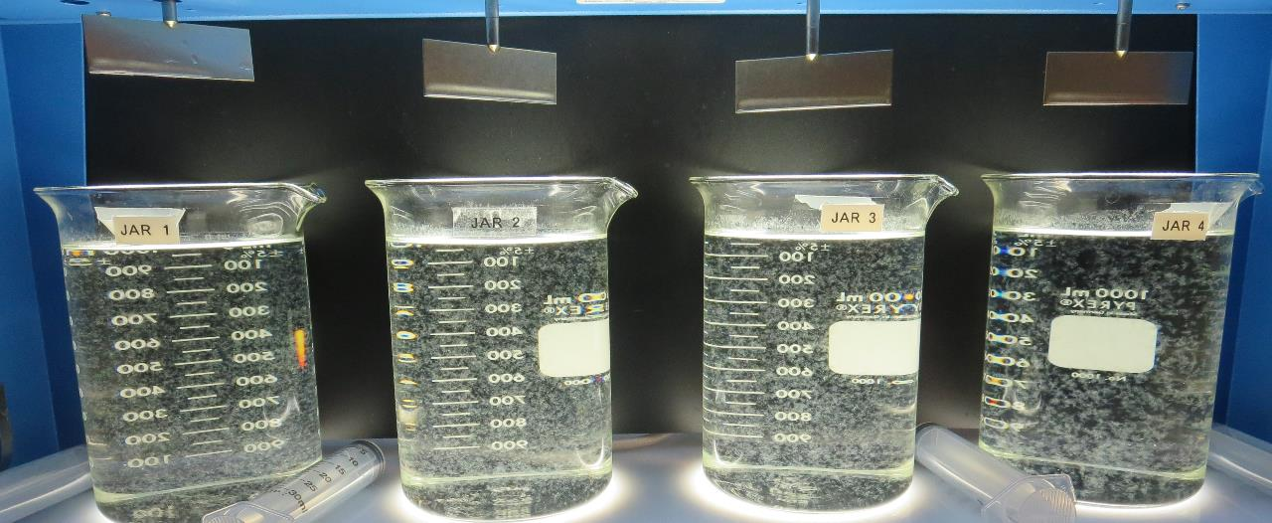
Jars 1-4: End of 5-minute flocculation (20 RPM) duration.
20 mg/L 9810
Filtrate 0.06 NTU
UVT: 90.8%
UVA: 0.041/cm
UVA Reduction 28.1%
Settled: 0.30 NTU
23 mg/L 9810
Filtrate 0.05 NTU
UVT: 91.0%
UVA: 0.040/cm
UVA Reduction 29.8%
Settled: 0.35 NTU
26 mg/L 9810
Filtrate 0.04 NTU
UVT: 91.2%
UVA: 0.039/cm
UVA Reduction 31.6%
Settled: 0.24 NTU
29 mg/L 9810
Filtrate 0.04 NTU
UVT: 91.8%
UVA: 0.037/cm
UVA Reduction 35.1%
Settled: 0.21 NTU

Slide 18
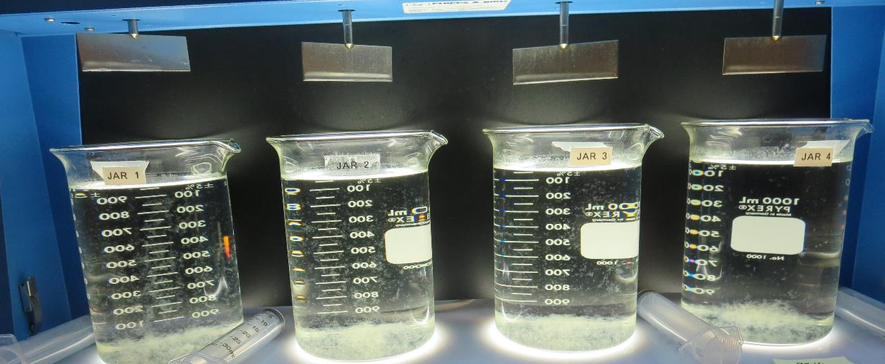
Jars 1-4: After 5 min of settling, 25 mL is syringed for filterability and %UVT/UVA.

Slide 19
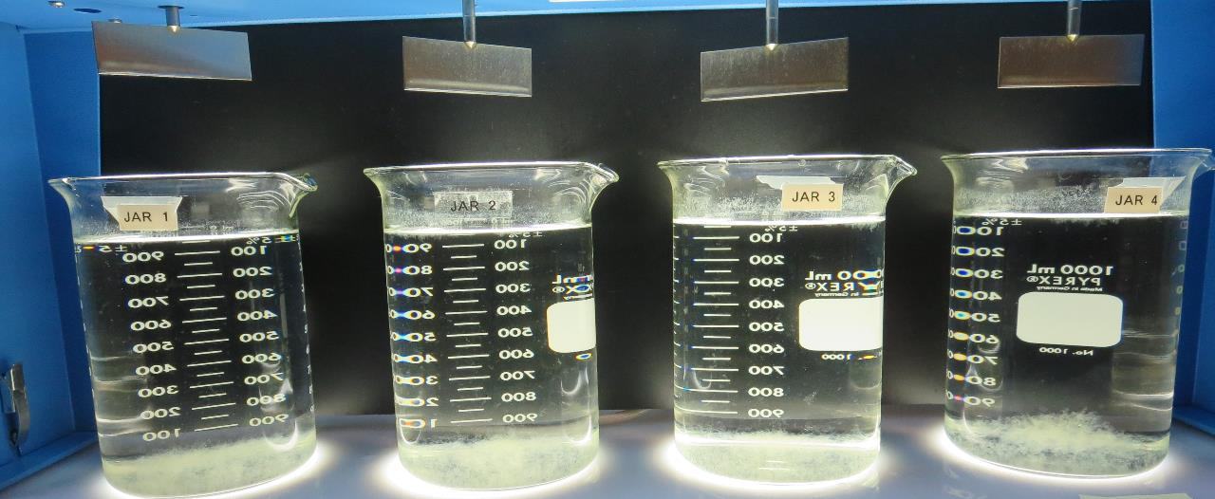
Jars 1-4: After 25-minutes of settling, settled water turbidity is taken.
20 mg/L 9810
Filtrate 0.06 NTU
UVT: 90.8%
UVA: 0.041/cm
UVA Reduction 28.1%
Settled: 0.30 NTU
23 mg/L 9810
Filtrate 0.05 NTU
UVT: 91.0%
UVA: 0.040/cm
UVA Reduction 29.8%
Settled: 0.35 NTU
26 mg/L 9810
Filtrate 0.04 NTU
UVT: 91.2%
UVA: 0.039/cm
UVA Reduction 31.6%
Settled: 0.24 NTU
29 mg/L 9810
Filtrate 0.04 NTU
UVT: 91.8%
UVA: 0.037/cm
UVA Reduction 35.1%
Settled: 0.21 NTU

Slide 20
Jars 5-8 Test
Flash Mix 20 Sec (200 RPM)
Floc Mix 5 min (20 RPM)
No Pre-Oxidation
Applied Coagulant
9810

Slide 21
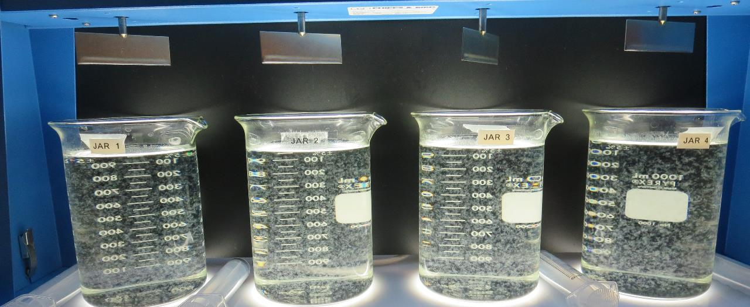
Jars 5-8: End of 5-minute flocculation (20 RPM) duration.
32 mg/L 9810
Filtrate 0.05 NTU
UVT: 91.6%
UVA: 0.037/cm
UVA Reduction 35.1%
Settled: 0.26 NTU
35 mg/L 9810
Filtrate 0.05 NTU
UVT: 91.9%
UVA: 0.036/cm
UVA Reduction 36.8%
Settled: 0.25 NTU
38 mg/L 9810
Filtrate 0.05 NTU
UVT: 92.1%
UVA: 0.035/cm
UVA Reduction 38.6%
Settled: 0.26 NTU
41 mg/L 9810
Filtrate 0.05 NTU
UVT: 92.2%
UVA: 0.035/cm
UVA Reduction 38.6%
Settled: 0.24 NTU

Slide 22
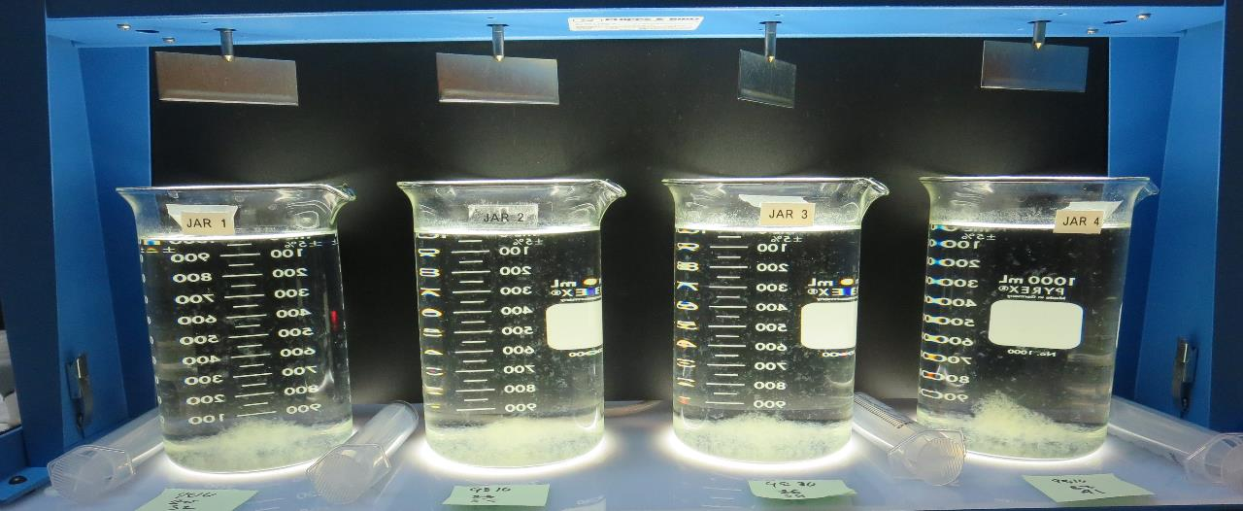
Jars 5-8: After 5 min of settling, 25 mL is syringed for filterability and %UVT/UVA.

Slide 23
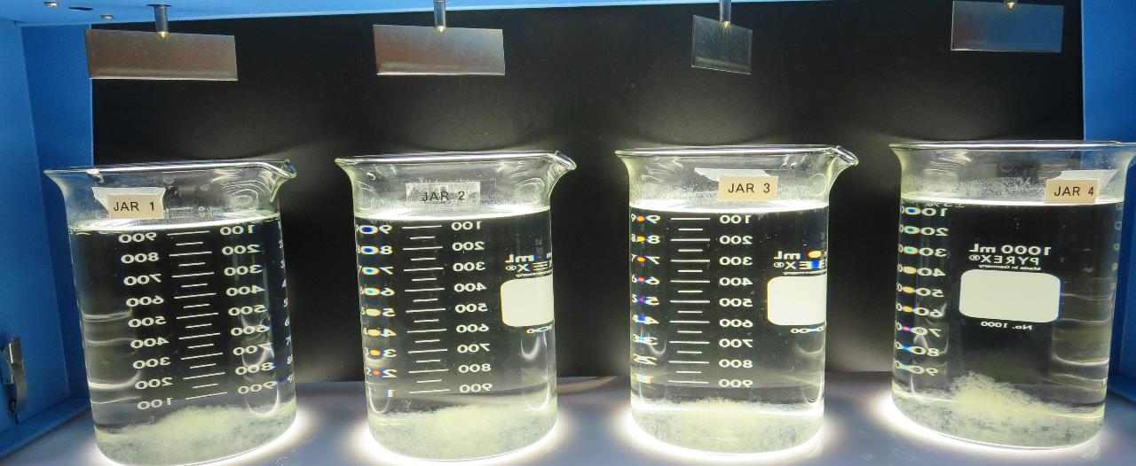
Jars 5-8: After 25-minutes of settling, settled water turbidity is taken.
32 mg/L 9810
Filtrate 0.05 NTU
UVT: 91.6%
UVA: 0.037/cm
UVA Reduction 35.1%
Settled: 0.26 NTU
35 mg/L 9810
Filtrate 0.05 NTU
UVT: 91.9%
UVA: 0.036/cm
UVA Reduction 36.8%
Settled: 0.25 NTU
38 mg/L 9810
Filtrate 0.05 NTU
UVT: 92.1%
UVA: 0.035/cm
UVA Reduction 38.6%
Settled: 0.26 NTU
41 mg/L 9810
Filtrate 0.05 NTU
UVT: 92.2%
UVA: 0.035/cm
UVA Reduction 38.6%
Settled: 0.24 NTU

Slide 24
Jars 9-12 Test
Flash Mix 20 Sec (200 RPM)
Floc Mix 5 min (20 RPM)
No Pre-Oxidation
Applied Coagulant
AdvFloc CTC-00011

Slide 25
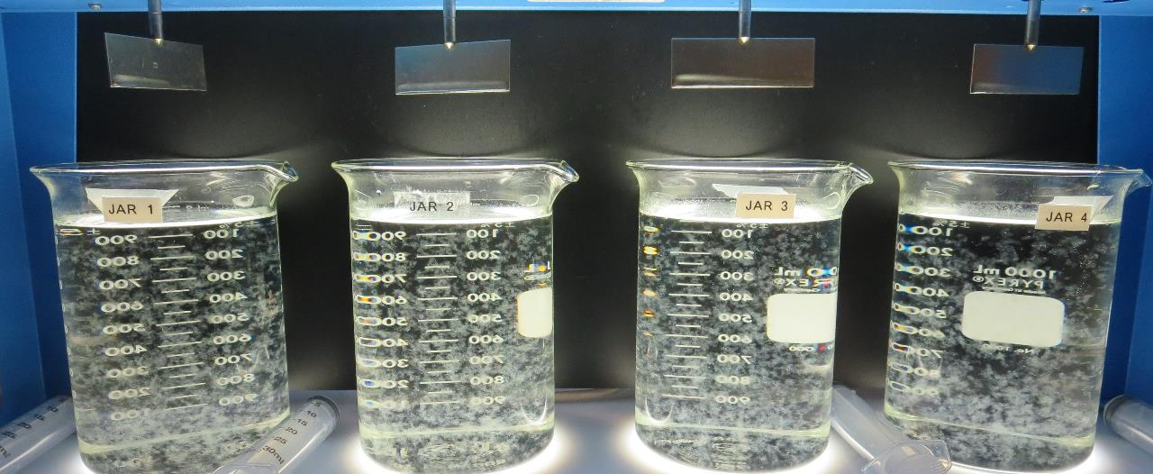
Jars 9-12: End of 5-minute flocculation (20 RPM) duration.
130 mg/L CTC-0011
Filtrate 0.06 NTU
UVT: 92.2%
UVA: 0.035/cm
UVA Reduction: 38.6%
Settled: 0.24 NTU
140 mg/L CTC-0011
Filtrate 0.06 NTU
UVT: 92.5%
UVA: 0.033/cm
UVA Reduction: 42.1%
Settled: 0.32NTU
150 mg/L CTC-0011
Filtrate 0.06 NTU
UVT: 91.8%
UVA: 0.036/cm
UVA Reduction: 36.8%
Settled: 0.23 NTU
160 mg/L CTC-0011
Filtrate 0.06 NTU
UVT: 92.0%
UVA: 0.036/cm
UVA Reduction: 36.8%
Settled: 0.16 NTU

Slide 26
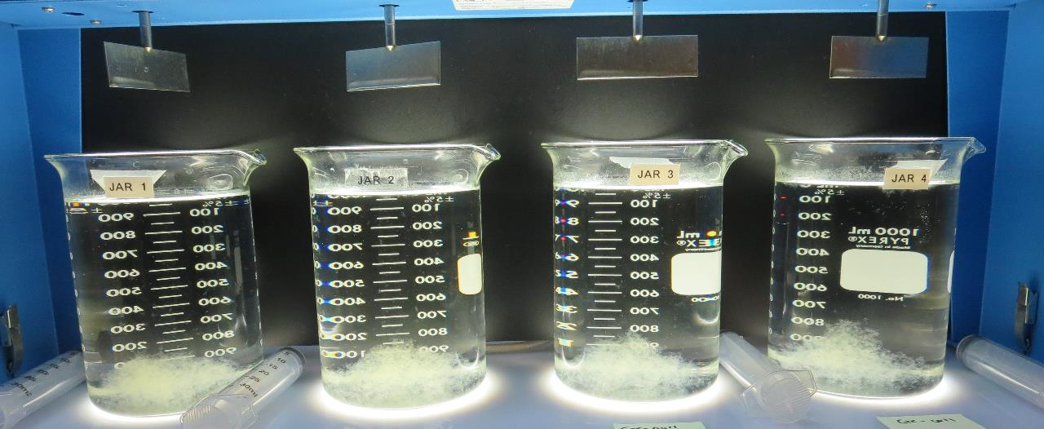
Jars 9-12: After 5 min of settling, 25 mL is syringed for filterability and %UVT/UVA.

Slide 27
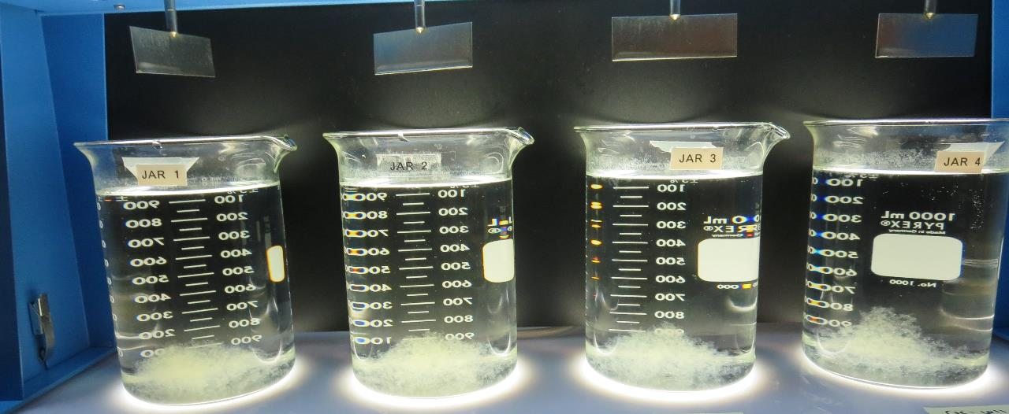
Jars 9-12: After 25-minutes of settling, settled water turbidity is taken.
130 mg/L CTC-0011
Filtrate 0.06 NTU
UVT: 92.2%
UVA: 0.035/cm
UVA Reduction: 38.6%
Settled: 0.24 NTU
140 mg/L CTC-0011
Filtrate 0.06 NTU
UVT: 92.5%
UVA: 0.033/cm
UVA Reduction: 42.1%
Settled: 0.32NTU
150 mg/L CTC-0011
Filtrate 0.06 NTU
UVT: 91.8%
UVA: 0.036/cm
UVA Reduction: 36.8%
Settled: 0.23 NTU
160 mg/L CTC-0011
Filtrate 0.06 NTU
UVT: 92.0%
UVA: 0.036/cm
UVA Reduction: 36.8%
Settled: 0.16 NTU

Slide 28
Jars 13-16 Test
Flash Mix 20 Sec (200 RPM)
Floc Mix 5 min (20 RPM)
Pre-Oxidation KMnO₄ (75 min)
Applied Coagulant
9810

Slide 29
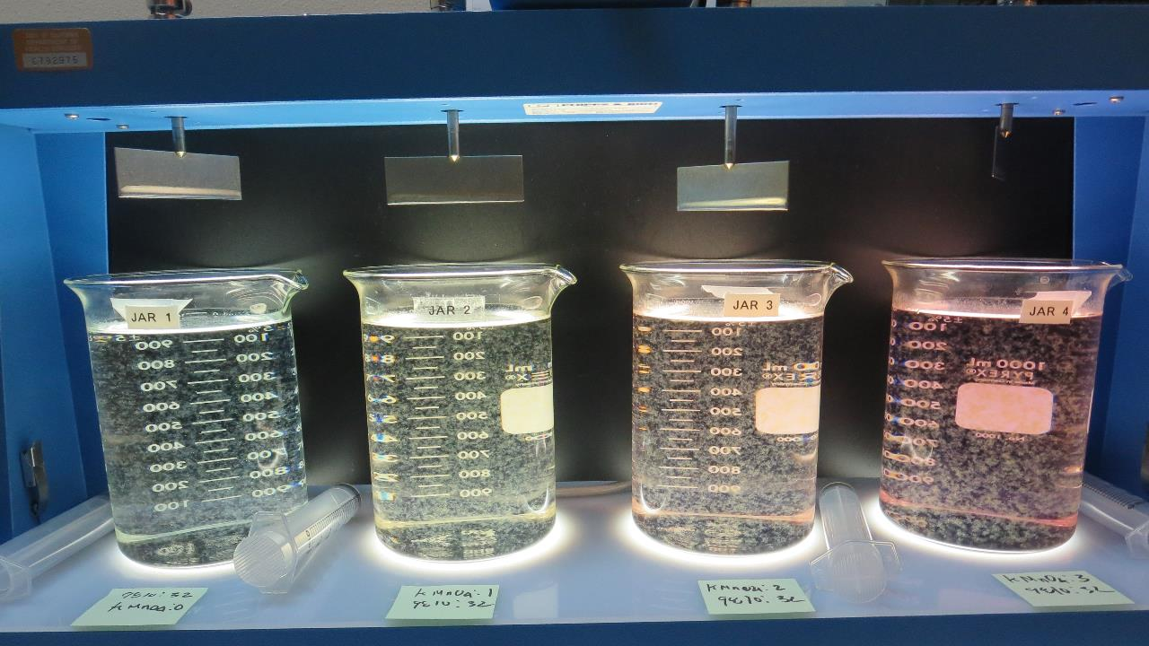
Jars 13-16: End of 5-minute flocculation (20 RPM) duration.
0 mg/L KMnO₄
32 mg/L 9810
Filtrate 0.06 NTU
UVT: 91.6%
UVA: 0.037/cm
UVA Reduction 35.1%
Settled: 0.19 NTU
1.0 mg/L KMnO₄
32 mg/L 9810
Filtrate 0.04 NTU
UVT: 92.0%
UVA: 0.036/cm
UVA Reduction 36.8%
Settled: 0.24 NTU
2.0 mg/L KMnO₄
32 mg/L 9810
Filtrate 0.05 NTU
UVT: 91.5%
UVA: 0.038/cm
UVA Reduction 33.3%
Settled: 0.27 NTU
2.0 mg/L KMnO₄
32 mg/L 9810
Filtrate 0.05 NTU
UVT: 91.1%
UVA: 0.040/cm
UVA Reduction 29.8%
Settled: 0.19 NTU

Slide 30
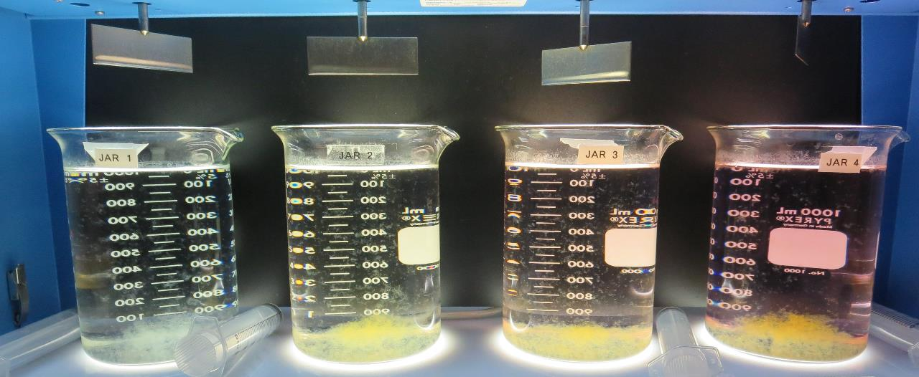
Jars 13-16: After 5 min of settling, 25 mL is syringed for filterability and %UVT/UVA

Slide 31
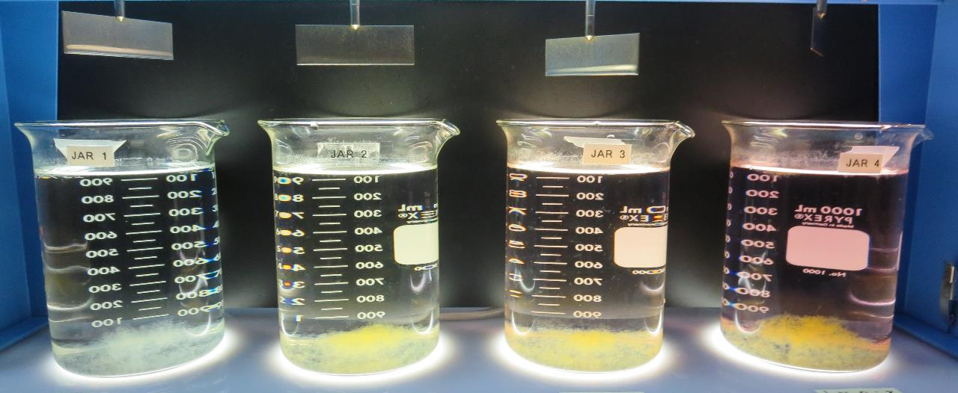
Jars 13-16: After 25-minutes of settling, settled water turbidity is taken.
0 mg/L KMnO₄
32 mg/L 9810
Filtrate 0.06 NTU
UVT: 91.6%
UVA: 0.037/cm
UVA Reduction 35.1%
Settled: 0.19 NTU
1.0 mg/L KMnO₄
32 mg/L 9810
Filtrate 0.04 NTU
UVT: 92.0%
UVA: 0.036/cm
UVA Reduction 36.8%
Settled: 0.24 NTU
2.0 mg/L KMnO₄
32 mg/L 9810
Filtrate 0.05 NTU
UVT: 91.5%
UVA: 0.038/cm
UVA Reduction 33.3%
Settled: 0.27 NTU
2.0 mg/L KMnO₄
32 mg/L 9810
Filtrate 0.05 NTU
UVT: 91.1%
UVA: 0.040/cm
UVA Reduction 29.8%
Settled: 0.19 NTU

Slide 32
Jars 17-20 Test
Flash Mix 20 Sec (200 RPM)
Floc Mix 5 min (20 RPM)
Pre-Oxidation KMnO₄
(75 min with coagulant)
Applied Coagulant
9810

Slide 33
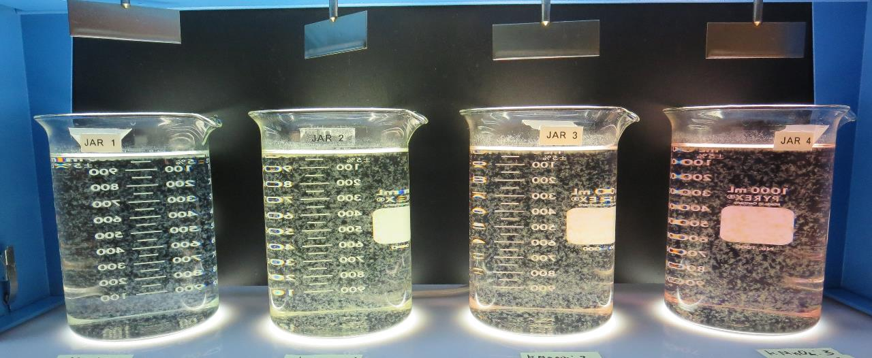
Jars 17-20: End of 5-minute flocculation (20 RPM) duration.
0 mg/L KMnO₄
32 mg/L 9810
Filtrate 0.05 NTU
UVT: 91.4%
UVA: 0.038/cm
UVA Reduction 33.3%
Settled: 0.13 NTU
1.0 mg/L KMnO₄
32 mg/L 9810
Filtrate 0.05 NTU
UVT: 91.6%
UVA: 0.036/cm
UVA Reduction 35.1%
Settled: 0.15 NTU
2.0 mg/L KMnO₄
32 mg/L 9810
Filtrate 0.05 NTU
UVT: 91.5%
UVA: 0.038/cm
UVA Reduction 33.3%
Settled: 0.29 NTU
2.0 mg/L KMnO₄
32 mg/L 9810
Filtrate 0.07 NTU
UVT: 90.9%
UVA: 0.041/cm
UVA Reduction 28.1%
Settled: 0.36 NTU

Slide 34
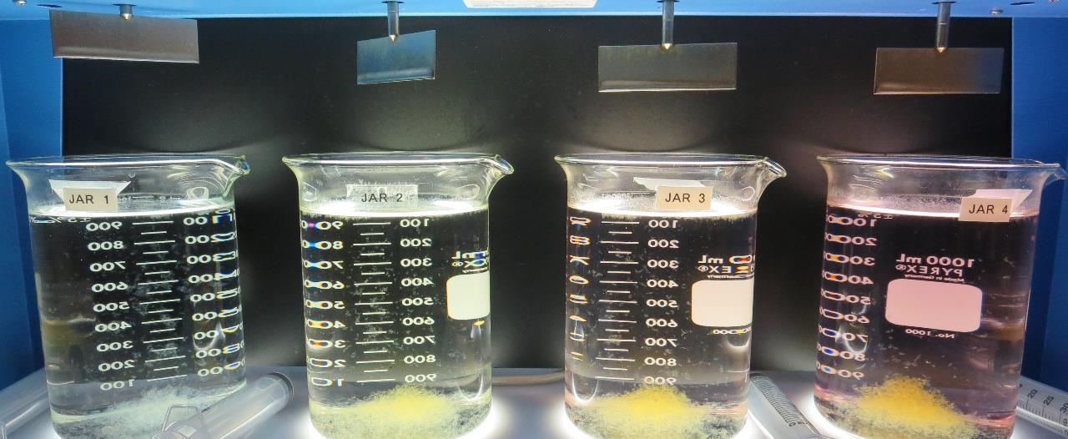
Jars 17-20: After 5 min of settling, 25 mL is syringed for filterability and %UVT/UVA.

Slide 35
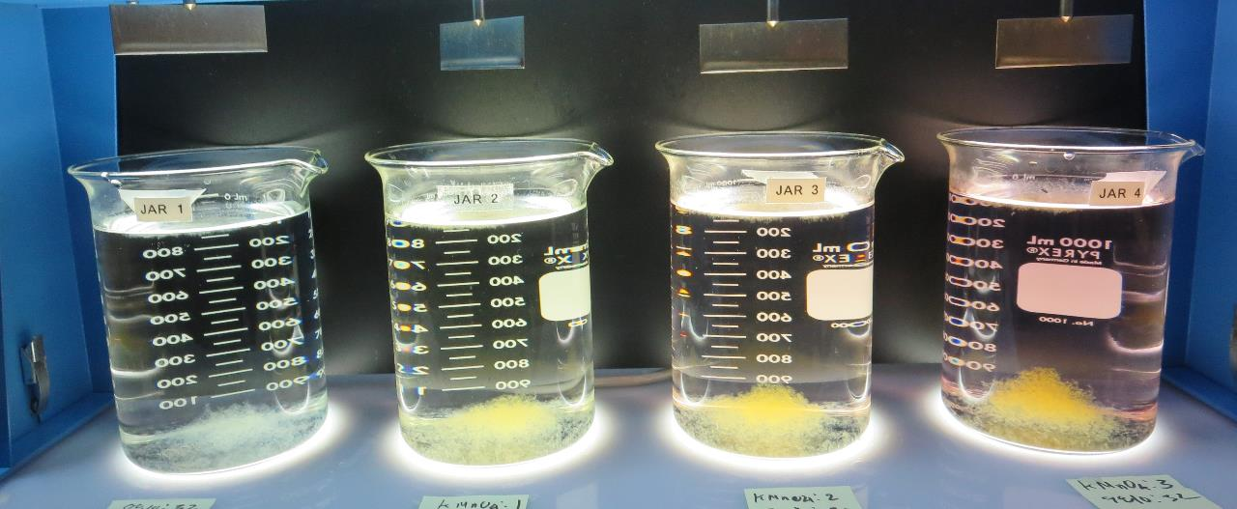
Jars 17-20: After 25-minutes of settling, settled water turbidity is taken.
0 mg/L KMnO₄
32 mg/L 9810
Filtrate 0.05 NTU
UVT: 91.4%
UVA: 0.038/cm
UVA Reduction 33.3%
Settled: 0.13 NTU
1.0 mg/L KMnO₄
32 mg/L 9810
Filtrate 0.05 NTU
UVT: 91.6%
UVA: 0.036/cm
UVA Reduction 35.1%
Settled: 0.15 NTU
2.0 mg/L KMnO₄
32 mg/L 9810
Filtrate 0.05 NTU
UVT: 91.5%
UVA: 0.038/cm
UVA Reduction 33.3%
Settled: 0.29 NTU
2.0 mg/L KMnO₄
32 mg/L 9810
Filtrate 0.07 NTU
UVT: 90.9%
UVA: 0.041/cm
UVA Reduction 28.1%
Settled: 0.36 NTU

Slide 36
Jars 21-24 Test
Flash Mix 20 Sec (200 RPM)
Floc Mix 5 min (20 RPM)
No Pre-Oxidation
Applied Coagulant
9810
Clarifloc C-378

Slide 37
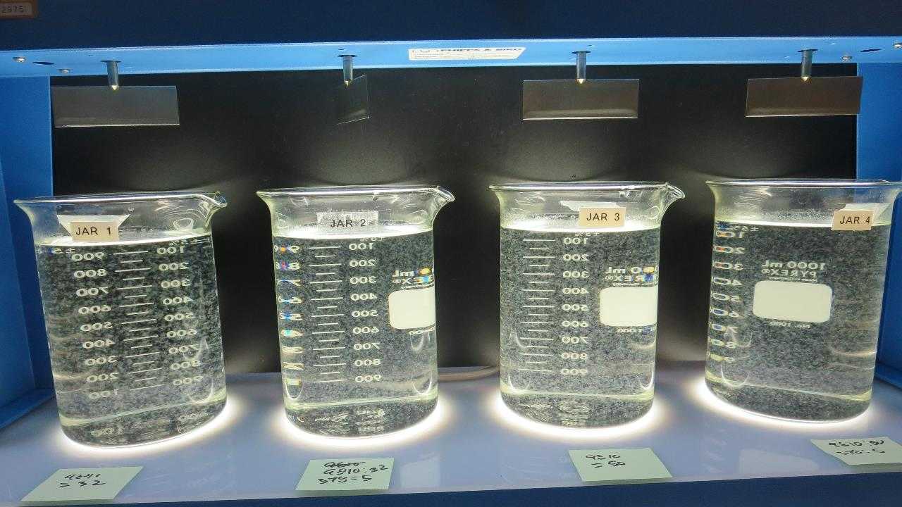
Jars 21-24: End of 5-minute flocculation (30 RPM) duration.
32 mg/L 9810
Clarifloc C-378: 0 mg/L
Filtrate 0.06 NTU
UVT: 91.7%
UVA: 0.037/cm
UVA Reduction 35.1%
Settled: 0.16 NTU
32 mg/L 9810
Clarifloc C-378: 5 mg/L
Filtrate 0.06 NTU
UVT: 91.7%
UVA: 0.037/cm
UVA Reduction 35.1%
Settled: 0.25 NTU
50 mg/L 9810
Clarifloc C-378: 0 mg/L
Filtrate 0.04 NTU
UVT: 92.0%
UVA: 0.036/cm
UVA Reduction 36.8%
Settled: 0.22 NTU
50 mg/L 9810
Clarifloc C-378: 5 mg/L
Filtrate 0.07 NTU
UVT: 91.6%
UVA: 0.037/cm
UVA Reduction 35.1%
Settled: 0.32 NTU

Slide 38
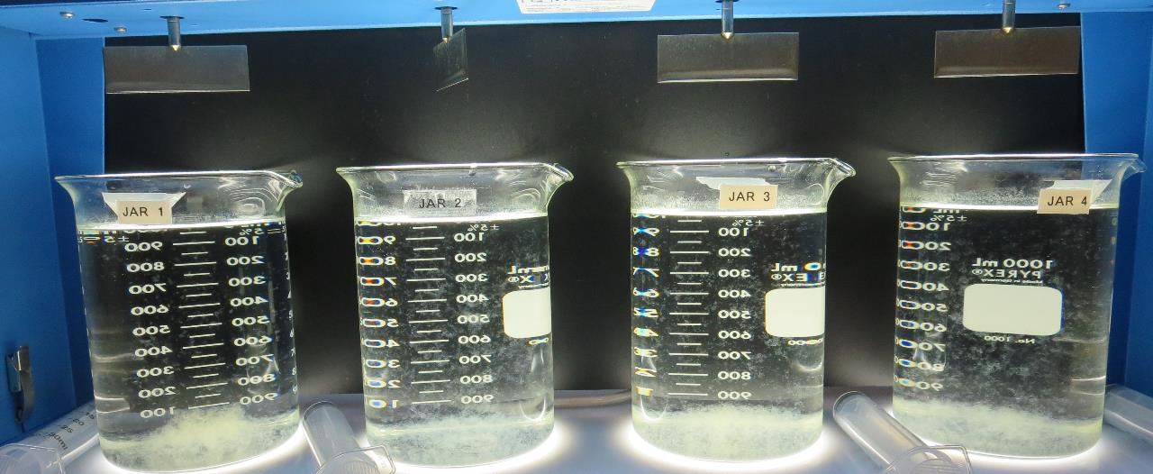
Jars 21-24: After 5 min of settling, 25 mL is syringed for filterability and %UVT/UVA.

Slide 39
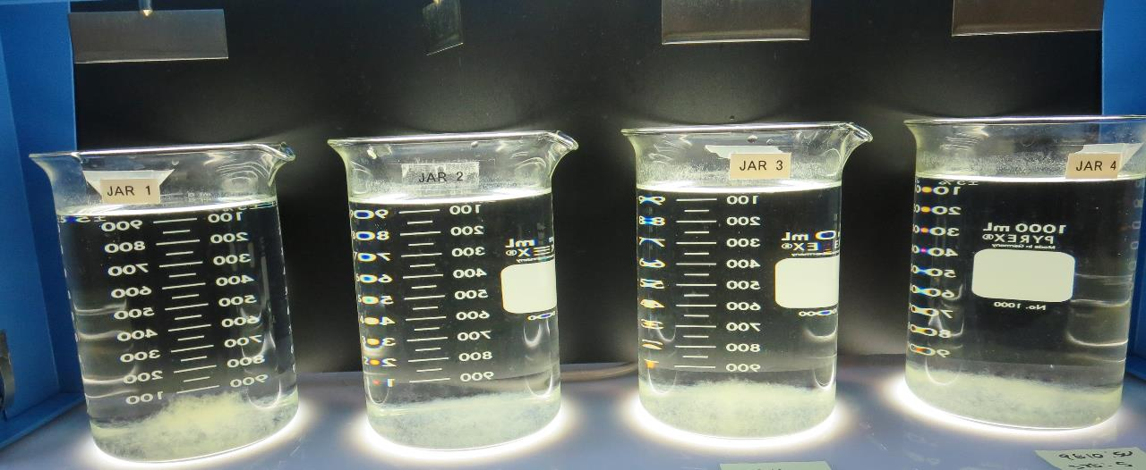
Jars 21-24: After 25-minutes of settling, settled water turbidity is taken.
32 mg/L 9810
Clarifloc C-378: 0 mg/L
Filtrate 0.06 NTU
UVT: 91.7%
UVA: 0.037/cm
UVA Reduction 35.1%
Settled: 0.16 NTU
32 mg/L 9810
Clarifloc C-378: 5 mg/L
Filtrate 0.06 NTU
UVT: 91.7%
UVA: 0.037/cm
UVA Reduction 35.1%
Settled: 0.25 NTU
50 mg/L 9810
Clarifloc C-378: 0 mg/L
Filtrate 0.04 NTU
UVT: 92.0%
UVA: 0.036/cm
UVA Reduction 36.8%
Settled: 0.22 NTU
50 mg/L 9810
Clarifloc C-378: 5 mg/L
Filtrate 0.07 NTU
UVT: 91.6%
UVA: 0.037/cm
UVA Reduction 35.1%
Settled: 0.32 NTU

Slide 40
Jar Testing for 1-Liter Jars:
Procedures for Most Treatment Plants
Fill jars with source water prior to coagulant injection and set paddle speed at 30 rpm
Add chemicals (i.e., NaOCl, primary coagulant, coagulant aid) to each jar
Flash mix for 15-30 seconds (200 rpm)
Slow mix for 5 minutes (20-30 rpm)
Settled for 5 minutes. Syringe 25 mL from each jar taken 1-inch below surface (25 mL/12 sec rate)
Filtered through 1.2 um isopore membrane into cuvette drip rate, 15 mL/(50-90 sec)
Measure filtrate turbidity, chlorine residual and %UVT/UVA
Measure settled water turbidity after 25 minutes of total setting
Record all data

Slide 41

Jar Test
Filterability Test Equipment
Turbidity Instrument
Syringe w/Luer-Lock Tip, 30 cc
(part#: 2225800, by Hach)
Swinnex Filter Holder, 25 mm (part#: SX0002500)
Isopore Membrane Filter, 1.2 um absolute
pore size,
Φ= 25 mm , thickness: 24 um,
hydrophilic polycarbonate membrane
(part #: RTTP02500)
Go to Sigma-Aldrich for laboratory supplies http://www.sigmaaldrich.com/united-states.html

Slide 42
Isopore Membrane Information
Categories | Information
trade name | Isopore
filter color | White
chemistry | Polycarbonate (PC)
water flow rate | Avg. 175 mL/min x cm² (typical results @ 10 psi)
media | Isopore®
wettability | Hydrophilic
porosity | 14.7%
pore size | 1.2 µm
bubble point at 23 °C | 1.0 bar, air with water
thickness | 24 µm
filter diameter (ø) | 25 mm
material size | polycarbonate, Hydrophilic, 1.2 µm, 25 mm, white, plain, 100

Slide 43
Isopore Membrane Background Information
The Isopore membrane is a polycarbonate, track-etched screen filter recommended for all analyses in which the sample is viewed on the surface of the membrane. The Isopore membrane is composed of polycarbonate film, which has a smooth, glass-like surface for clearer sample observation. The unique manufacturing process of the membrane ensures a precise pore diameter and a consistent pore size for accurate separation of samples by size. Matched-weight filters are not usually required because of low, constant tar and ash weights.
Features & Benefits:
Membrane structure retains particles on the surface, simplifying counting and analysis

Slide 44
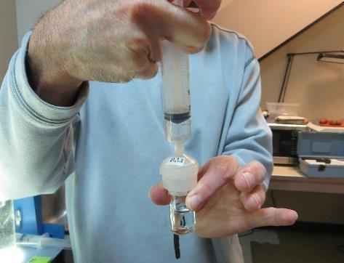

Jar Test - Filterability Test
Syringe ~ 25 mL from jar (after 5-minutes of settling)
Filter-to-waste 3-5 mL
Filter directly into clean cuvette
Measure turbidity
Note: Take several readings before recording final NTU results. Micro bubbles can adhere to glass causing false NTU readings. To remove bubbles, tilt cuvette up to 90 degrees.

Slide 45

Contact
Guy Schott, P.E.
State Water Resources Control Board
Division of Drinking Water
Santa Rosa, CA
Go to Stock Solution/Dose calculations/Jar Test Results for tools to download
www.waterboards.ca.gov/drinking_water/programs/districts/mendocino_district.html
Email: Guy Schott - Guy.Schott@waterboards.ca.gov
Office Number: 707-576-2732

